Slide 1

COVID-19 Strategies for OB & Neonatal Units
March 5, 2021
12:00 – 1:15pm

Slide 2

Welcome
Please be certain you are on “mute” when not speaking to avoid background noise.
Whether you have joined by phone or computer audio, you can mute and unmute yourself by clicking on the microphone icon.
The following shortcuts can also be used
For PC: Alt + A : Mute or Unmute
For Mac: Shift + Command + A: Mute or Unmute
For telephone: *6 : Mute or Unmute

Slide 3
Housekeeping:
We Are Recording Now

Slide 4
ILPQC Covid 19 webinars
The strategies shared today are examples from individual institutions not IDPH or ILPQC recommendations.
This is our 19th COVID-19 strategies for OB/Neonatal Units webinar in coordination with IDPH, since April 3rd. Please see https://ilpqc.org/covid-19-information/ for future webinar registration, prior recorded webinars and written out Q/A’s from those webinars.
The next webinar will be Friday, April 2, noon to 1:15pm. We are continuing monthly webinars for now.
Please let us know if your hospital would like to share on an upcoming webinar, please put questions/comments into the chatbox or email directly to info@ilpqc.org

Slide 5
Overview
Introduction
Discussion of OB Unit Strategies
  Beth A. Plunkett, MD, MPH – Maternal-Fetal Medicine, NorthShore University HealthSystem, Evanston Hospital
  Rita Allen Brennan, DNP, RNC-NIC, APRN - Outcomes Manager, Women’s & Children’s Services Northwestern Medicine Central DuPage Hospital
  Michael Hussey, MD – Maternal-Fetal Medicine, Northwestern Medicine Central DuPage Hospital, Winfield
  Jean Goodman, MD MBA – Division Director, Maternal-Fetal Medicine, Obstetrics Safety & Quality, Loyola University Medical Center, Maywood
  Laura Meints, MD, MBA – OSF Perinatal Associates, Maternal-Fetal Medicine, OSF HealthCare Network, Peoria
Discussion of Neonatal Unit Strategies
  Justin Josephsen, MD – Medical Director, St. Mary’s Hospital NICU, Neonatologist Cardinal Glennon Children’s Hospital, St. Louis
  Leslie Caldarelli, MD – NICU Director, Prentice Women's Hospital, Chicago

Slide 6
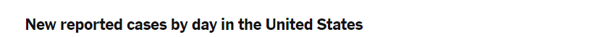
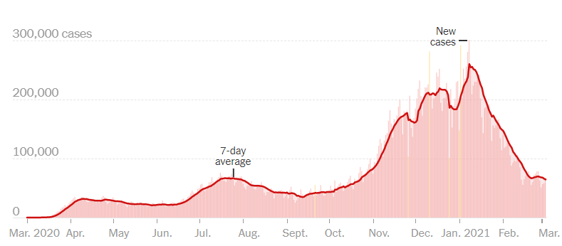
US COVID case trend
Notes:
Updated 3/4/2021
https://www.nytimes.com/interactive/2020/us/coronavirus-us-cases.html

Slide 7
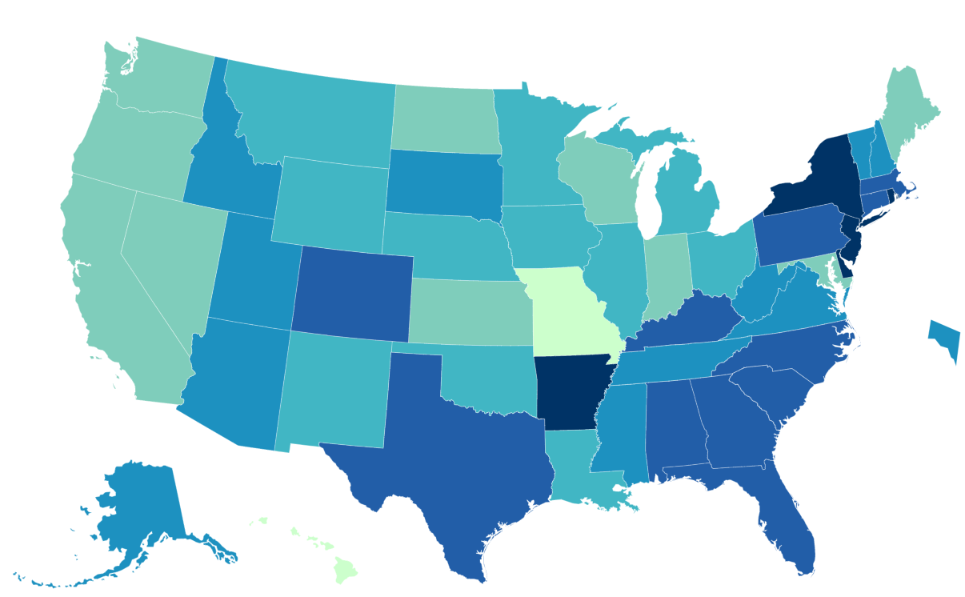
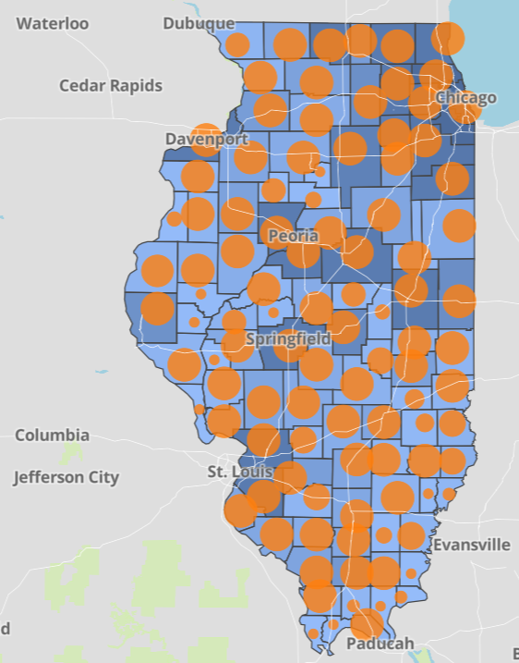
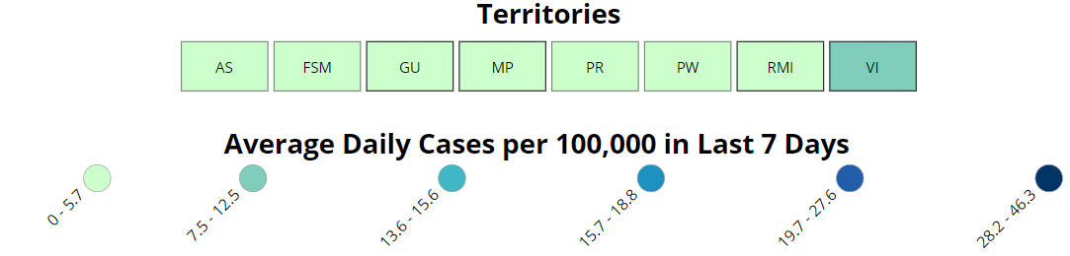
Data Update March 4, 2021
CDC/IDPH: COVID-19 Outbreak
CDC https://www.cdc.gov/coronavirus/2019-ncov/cases-updates/cases-in-us.html | IDPH https://www.dph.illinois.gov/covid19
Total cases: 28,580,198 confirmed Total deaths: 517,224 confirmed | 1,193,260 Confirmed Positive Cases 20,668 Deaths
Notes:
Updated 3/4/2021

Slide 8
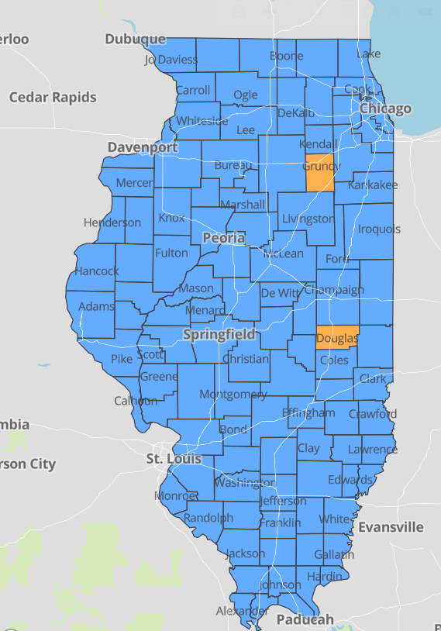
IDPH County Level COVID-19 Risk Metrics
Week 7: 2/14/2021 Through 2/20/2021
Blue indicates that the county is experiencing overall stable COVID-19 metrics.
Orange indicates there are warning signs of increased COVID-19 risk in the county.
Notes:
Updated 3/4/2021
https://www.dph.illinois.gov/countymetrics?county=Cook

Slide 9
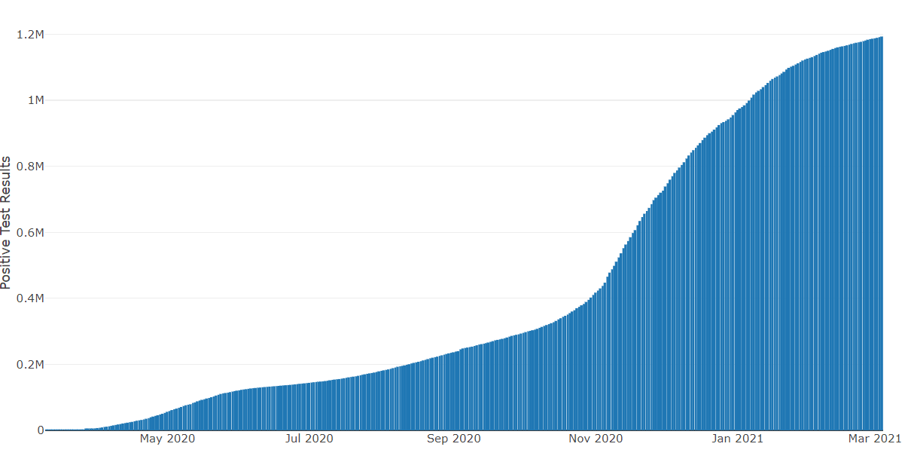
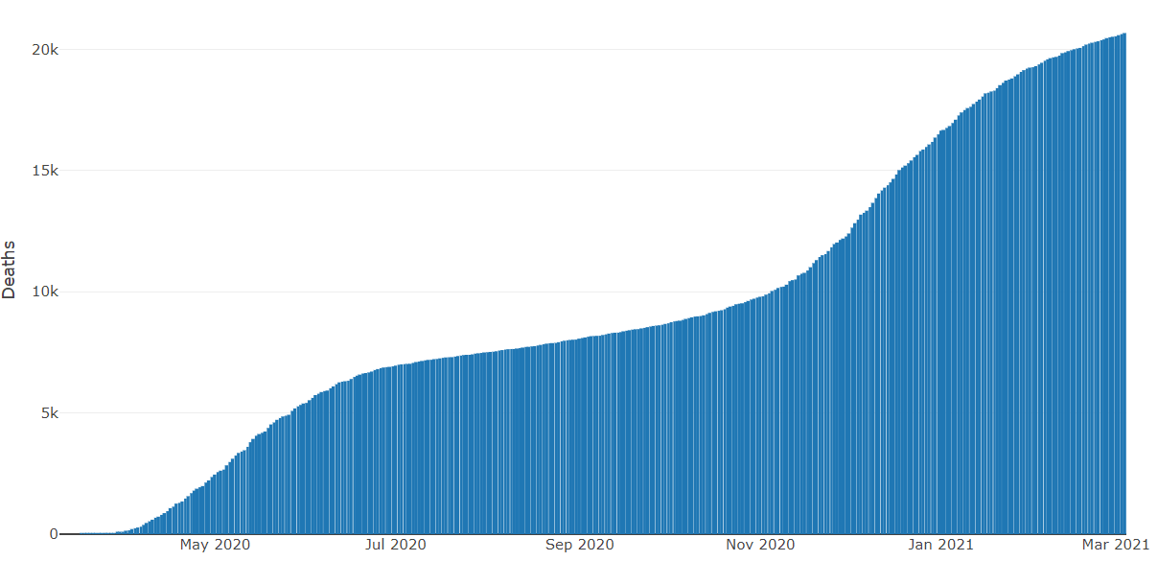
Data Update March 4, 2021
IDPH: COVID-19 Outbreak
https://www.dph.illinois.gov/covid19
IL Positive Cases Over Time
IL Deaths Over Time
Total: 1,193,260 Confirmed Positive Cases
Total: 20,668 Deaths
Notes:
Update 3/4/2021
http://www.dph.illinois.gov/covid19/covid19-statistics

Slide 10
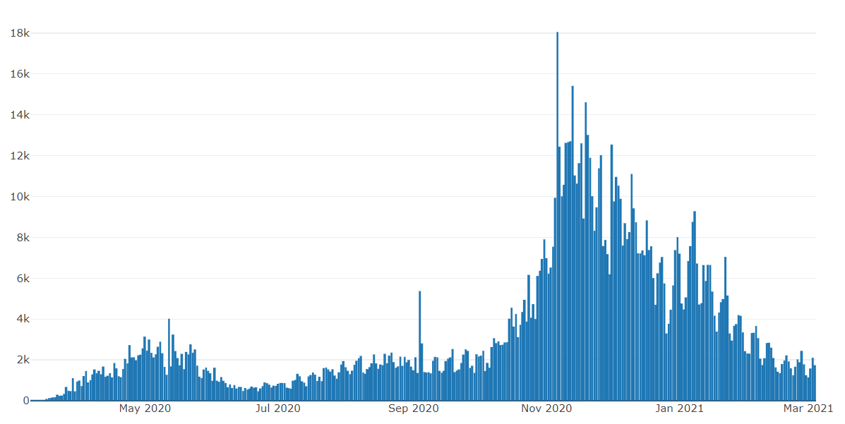
Illinois Daily Incidence
IDPH daily data summary
Notes:
Updated 3/4/2021
https://www.dph.illinois.gov/covid19/covid19-statistics

Slide 11
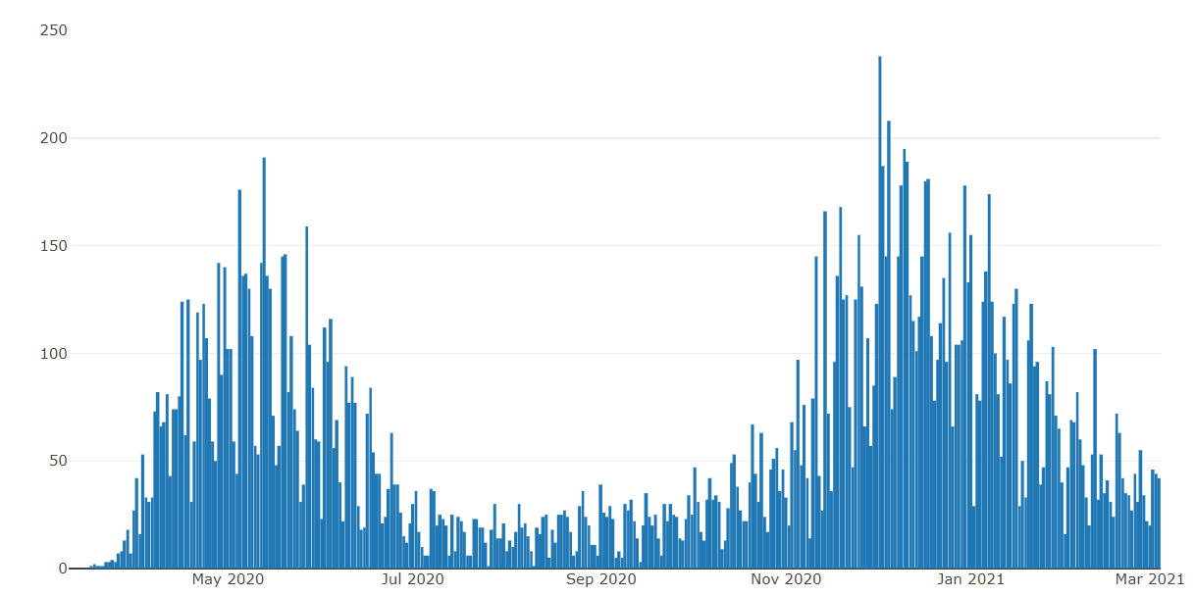
Illinois Covid Deaths
IDPH daily data summary
Notes:
Updated 3/4/2021
https://www.dph.illinois.gov/covid19/covid19-statistics

Slide 12
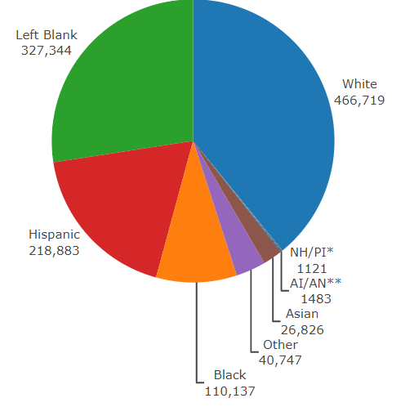
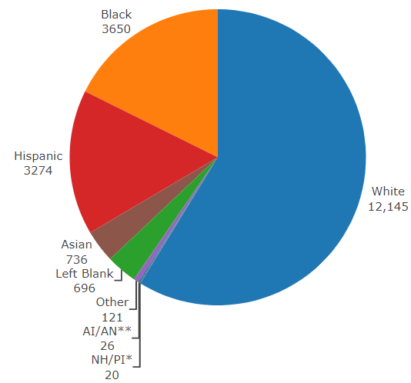
Data Update March 4, 2021
IDPH: COVID-19 Outbreak
Race Demographics
https://www.dph.illinois.gov/covid19
Confirmed Cases
Deaths
Notes:
Updated 3/4/2021
http://www.dph.illinois.gov/covid19/covid19-statistics

Slide 13
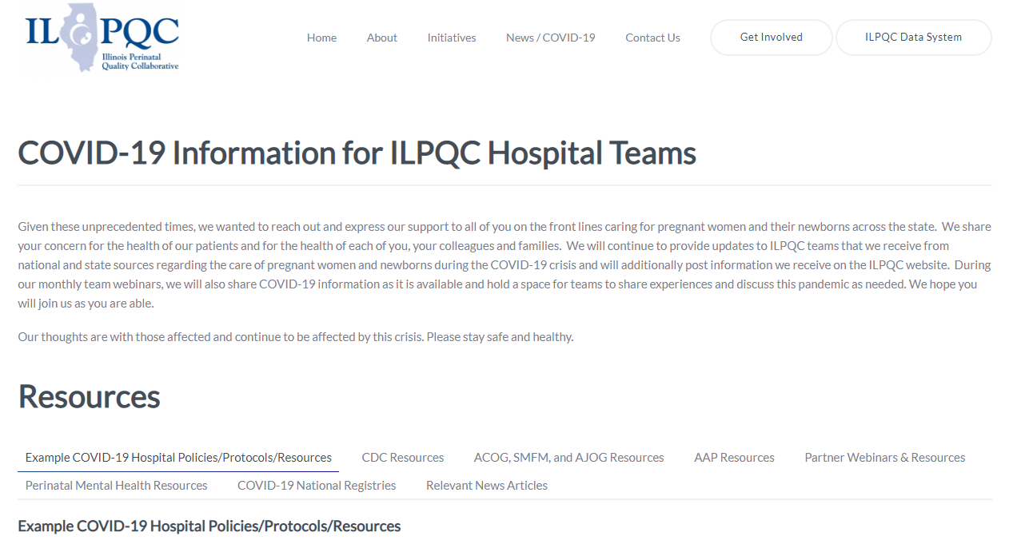
ILPQC COVID-19 Webpage www.ilpqc.org
ILPQC posts national guidelines and OB & Neonatal COVID-19 example hospital protocols & resources
please note dates as guidelines are changing rapidly
https://ilpqc.org/covid-19-information/

Slide 14
Updated OB (ACOG/SMFM) Resources
ACOG Pt Educ: COVID-19 and Pregnancy: 3 Steps to Stay Safe. (Nov 2020)
SMFM: Coronavirus (COVID-19) and Pregnancy: What Maternal-Fetal Medicine Subspecialists Need to Know (11.23.20)
ACOG: COVID-19: The Role of Obstetrician-Gynecologists in Building Vaccine Confidence. (1.6.21)
ACOG: Maternal Immunization Task Force and Partners Urge That COVID-19 Vaccine be Available to Pregnant Individuals( 2.3.21)
ACOG: Vaccinating Pregnant Individuals: Eight Key Recommendations for COVID-19 Vaccination Sites. (2.3.21)
SMFM: Management Considerations for Pregnant Patients With COVID-19 (2.2.21)
ACOG: COVID-19 Vaccines and Pregnancy - Conversation Guide for Clinicians. (3.2021)
SMFM Provider Considerations for Engaging in COVID-19 Vaccine Counseling With Pregnant and Lactating Patients (Updated 3.3, 2021)
SMFM Patient Education (English/Spanish): COVID-19 Vaccines and Pregnancy. (3.4.21)
ACOG: Practice Advisory: Vaccinating Pregnant and Lactating Patients Against COVID-19. (3.4.21)
Notes:
ACOG: Vaccinating Pregnant and Lactating Patients Against COVID-19, Practice Advisory. (12.21.20)
ACOG: COVID-19 Vaccines and Pregnancy: Conversation Guide for Clinicians. (12.20.20)
SMFM: Management Considerations for Pregnant Patients with COVID-19 (Updated 1.7.21)
SMFM: Provider Considerations for Engaging in COVID-19 Vaccine Counseling With Pregnant and Lactating Patients. (Updated 12.21.20)

Slide 15
Updated Neonatal /AAP Resources
COVID-19 Testing Guidance: Guidance developed to help pediatric practices determine when to test for severe acute respiratory syndrome-coronavirus 2 (SARS-CoV-2) infection in their patient population. (Updated 12/30/2020)
Family Presence Policies for Pediatric Inpatient Settings During the COVID-19 Pandemic: (1/25/21)
Breastfeeding Guidance Post Hospital Discharge for Mothers or Infants with Suspected or Confirmed SARS-Co V-2 Infection: Guidance developed to support pediatricians providing direct care for breastfeeding families after discharge from the newborn hospital stay. (2/11/2021)
FAQs: Management of Infants Born to Mothers with Suspected or Confirmed COVID-19: Includes precautions for birth attendants, rooming-in, breastfeeding, testing, neonatal intensive care, visitation and hospital discharge. (2/11/2021)
Multisystem Inflammatory Syndrome in Children (MIS-C) Interim Guidance: Clinical guidance for pediatricians including signs, symptoms, diagnosis and management of this rare but serious complication associated with COVID-19. (Updated 2/10/2021)
AAP: Interim Guidance for COVID-19 Vaccination in Children and Adolescents. (2.2.21)
Notes:
AAP: Multisystem Inflammatory Syndrome in Children (MIS-C) Interim Guidance (Updated 11.17.2020)
AAP: FAQs: Management of Infants Born to Mothers with Suspected or Confirmed COVID-19 (11.19.2020)
AAP: Breastfeeding Guidance Post Hospital Discharge for Mothers or Infants (12.2.2020)

Slide 16
Updated OB/Neo Covid Publications
NEOBGYN: Prone Positioning for Pregnant Women With Hypoxemia Due to Coronavirus Disease 2019 (COVID-19) (6.9.2020)
JAHA: Extracorporeal Life Support in Pregnancy: A Systematic Review. (9.2020)
JAMA: Association of SARS-CoV-2 Test Status and Pregnancy Outcomes. (9.23.2020)
JAMA: Outcomes of Neonates Born to Mothers With Severe Acute Respiratory. (10.16.2020)
PRIORITY Study Published: Pregnancy Coronavirus Outcomes Registry. (10.9.2020)
JAMA: COVID-19 Poses Pregnancy Risks (11.10.2020)
JAMA: Pregnancy Outcomes Among Women With and Without Severe Acute Respiratory Syndrome Coronavirus 2 Infection. (11.19.2020)​
NEJM: Safety and Efficacy of the BNT162b2 mRNA Covid-19 Vaccine. (12.31.20)
JAMA: Protecting Pregnant Women and Their Infants From COVID-19: Clues From Maternal Viral Loads, Antibody Responses, and Placentas. (12.22.20)
JAMA: Assessment of Maternal and Neonatal SARS-CoV-2 Viral Load, Transplacental Antibody Transfer, and Placental Pathology in Pregnancies During the COVID-19 Pandemic. (12.22.20)
AJOG: Disease Severity, Pregnancy Outcomes and Maternal Deaths among Pregnant Patients with SARS-CoV-2 Infection (12.30.20)
Neo Reviews: Perinatal SARS-CoV-2 Infection and Neonatal COVID-19: A 2021 Update (2.4.21)
ACOG: Disease Severity and Perinatal Outcomes of Pregnant Patients With Coronavirus Disease 2019 (COVID-19) (2.21.21)
​

Slide 17
IDPH / HFS / CDC
HFS: Provider Notice Issued Blood Pressure Monitoring Kit (7.2.2020)​ - Medicaid now covers home BP cuffs for all pregnant / postpartum patients
CDC: Birth and Infant Outcomes Following Laboratory-Confirmed SARS-CoV-2 Infection in Pregnancy. (MMWR 11.6.2020)
​CDC: Allergic Reactions After Receipt of the First Dose of Pfizer-BioNTech COVID-19 Vaccine. (MMWR 1.6.21)
CDC: Interim Clinical Considerations for Use of mRNA COVID-19 Vaccines Currently Authorized in the United States. (MMWR 1.6.21)
Racial and Ethnic Disparities in the Prevalence of Stress and Worry, Mental Health Conditions, and Increased Substance Use Among Adults During the COVID-19 Pandemic (MMWR Feb 5, 2021)
CDC: The Advisory Committee on Immunization Practices’ Interim Recommendation for Use of Janssen COVID-19 Vaccine (MMWR 3.5.21)
CDC: Toolkit for Pregnant People and New Parents. (2.2621)

Slide 18
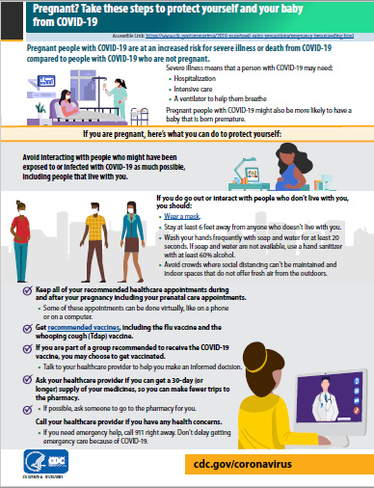
CDC: Pregnancy Factsheet
CDC Patient Education: Pregnant? Take these steps to protect yourself and your baby from COVID-19. (Jan. 2021)

Slide 19
Covid-19 Vaccines
Currently three vaccines are approved with an FDA Emergency Use Authorization
  Pfizer
  Moderna
  Jansen (Johnson and Johnson)
Pfizer and Moderna vaccines are mRNA vaccines Jansen vaccine is an adenovirus vaccine
Both Pfizer and Moderna vaccines require two doses Pfizer doses are 21 days apart Moderna doses are 28 days apart Jansen vaccine is a single IM injection

Slide 20
What do we know about the Jansen Vaccine?
About 40,000 study participants
Follow-up time frame was 2 months after vaccine administration
Vaccine Efficacy was 66.9% across all geographic areas; 72% in the US Vaccine
Efficacy for severe/critical COVID infection 76.7 % (after 14 days) and 85.4% (after 28 days)
Vaccine efficacy for death from COVID -- 100%
All individuals 18 and older eligible for vaccine
Vaccine can be stored at 36-46 degrees F; room temp for 2 hours

Slide 21
COVID-19 Vaccine Reactions
Overall risk of anaphylaxis to the COVID vaccine is 4.5 per 1 million
Overall risk of DYING from COVID at LEAST 1 in 100
Risk of being struck by lightning is 1 in 500,000 in your lifetime
Risk of allergy to penicillin is 1 in 2000-5000.

Slide 22
ACOG Practice Advisory:
Vaccinating Pregnant and Lactating Patients against Covid-19 (03/04/21)
ACOG recommends that COVID-19 vaccines should not be withheld from pregnant individuals who meet criteria for vaccination based on ACIP-recommended priority groups.
COVID-19 vaccines should be offered to lactating individuals similar to non-lactating individuals when they meet criteria for receipt of the vaccine based on prioritization groups outlined by the ACIP.
Individuals considering a COVID-19 vaccine should have access to available information about the safety and efficacy of the vaccine, including information about data that are not available. A conversation between the patient and their clinical team may assist with decisions regarding the use of vaccines approved under EUA for the prevention of COVID-19 by pregnant patients. Important considerations include:
  the level of activity of the virus in the community
  the potential efficacy of the vaccine
  the risk and potential severity of maternal disease, including the effects of disease on the fetus and newborn
  the safety of the vaccine for the pregnant patient and the fetus.

Slide 23
What do we know about Vaccination for Pregnant Women in IL?
IDPH SARS-CoV-2/Covid-19 Mass Vaccination Planning Guide https://www.dph.illinois.gov/covid19/vaccination-plan
Phase 1A
  Health care Personnel, Hospital Settings, Non-hospital health care
  Other Congregate Care, Long-Term Care Facility residents and staff
Phase 1B – started January 25
  Persons aged 65 years and older, Frontline essential workers, Inmates
Phase 1B+: - Started February 25 (not all counties have moved to 1B+)
Persons aged 16 to 64 years old with medical conditions that increase the risk for severe COVID-19.
Conditions include: Obesity, Diabetes, Pulmonary Diseases, Smoking
Heart Conditions, Chronic Kidney Disease, Cancer, Solid Organ Transplant,
Sickle Cell Disease, Pregnancy, Persons with a Disability
Notes:
Obesity
Diabetes
Pulmonary Diseases
Smoking
Heart Conditions
Chronic Kidney Disease
Cancer
Solid Organ Transplant
Sickle Cell Disease
Pregnancy
Persons with a Disability1 (Not otherwise covered in previous categories.)

Slide 24
V-SAFE vaccine monitoring
– what data is being gathered pregnant patients?
As of February 16, 2021, there have been over 30,400 pregnancies reported in CDC’s V-SAFE post-vaccination health checker and CDC is currently enrolling pregnant individuals in a pregnancy registry. Evidence gathered through these systems will provide clinicians with critically needed data to inform future recommendations related to COVID-19 vaccination during pregnancy
https://www.cdc.gov/coronavirus/2019-ncov/vaccines/safety/vsafe.html

Slide 25
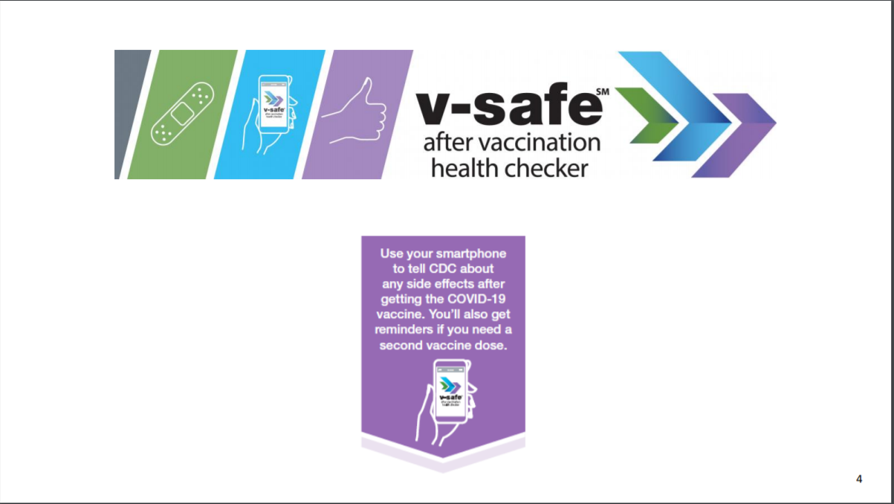

Slide 26
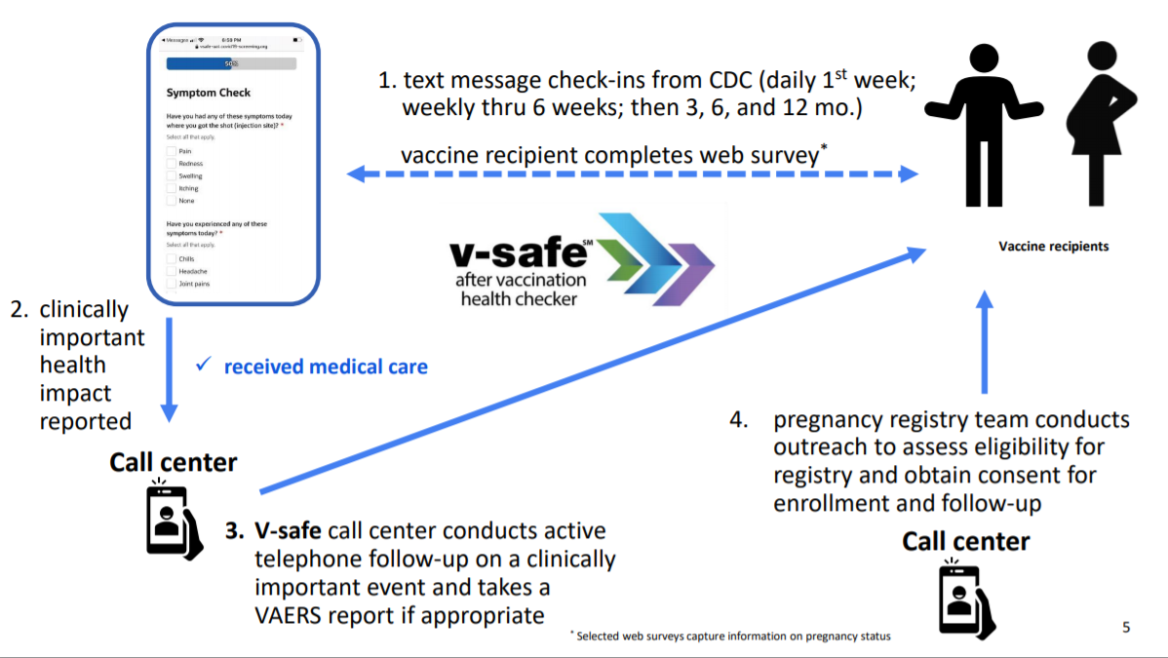

Slide 27
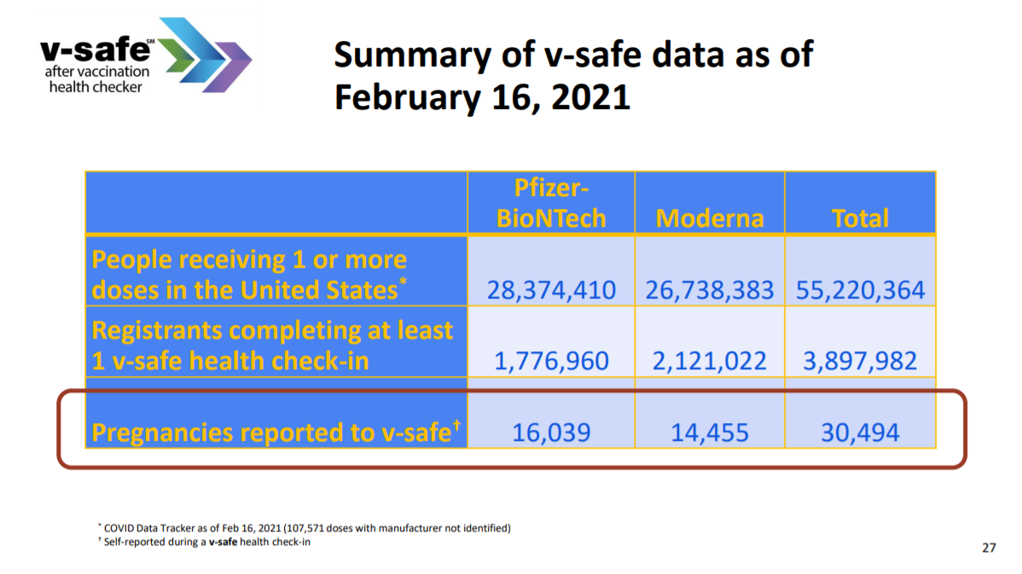

Slide 28
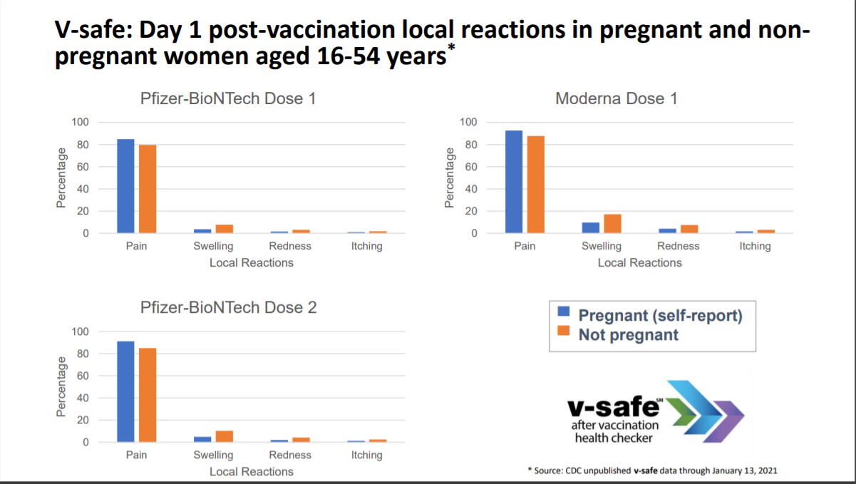

Slide 29
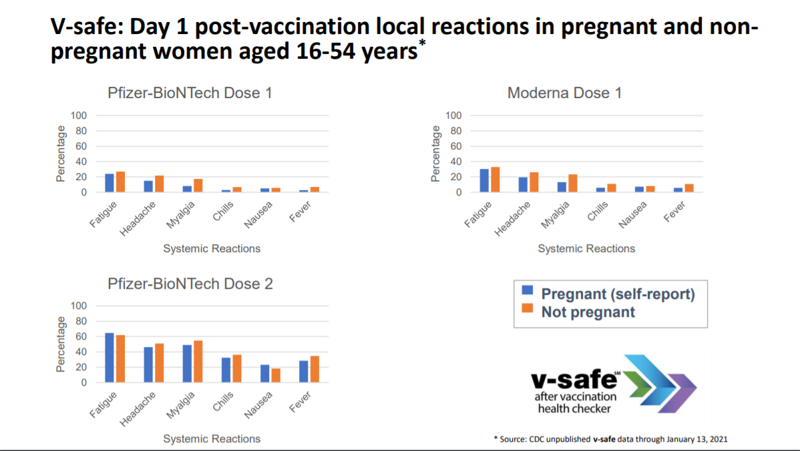

Slide 30
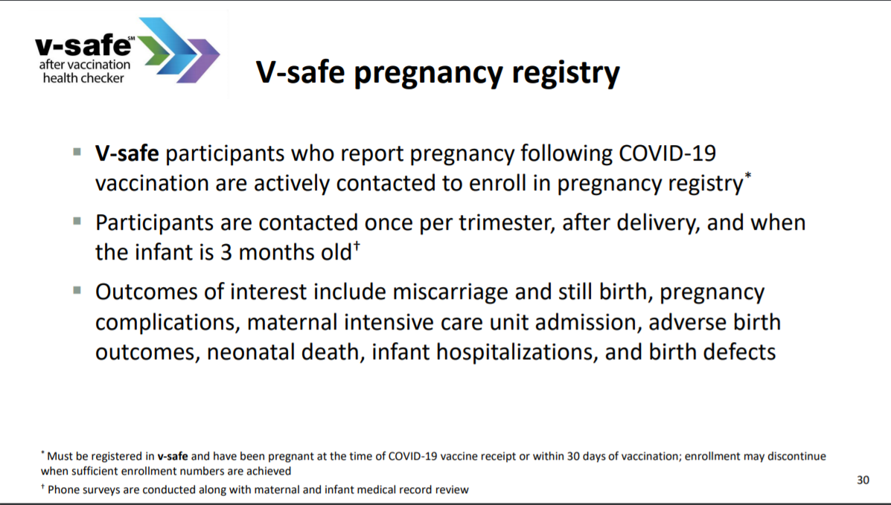

Slide 31
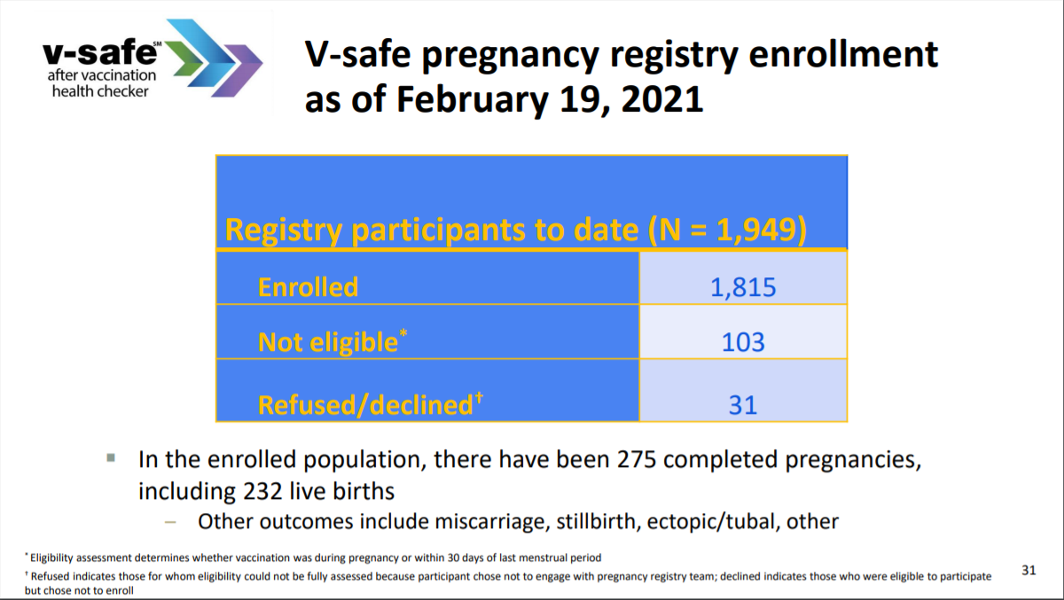

Slide 32
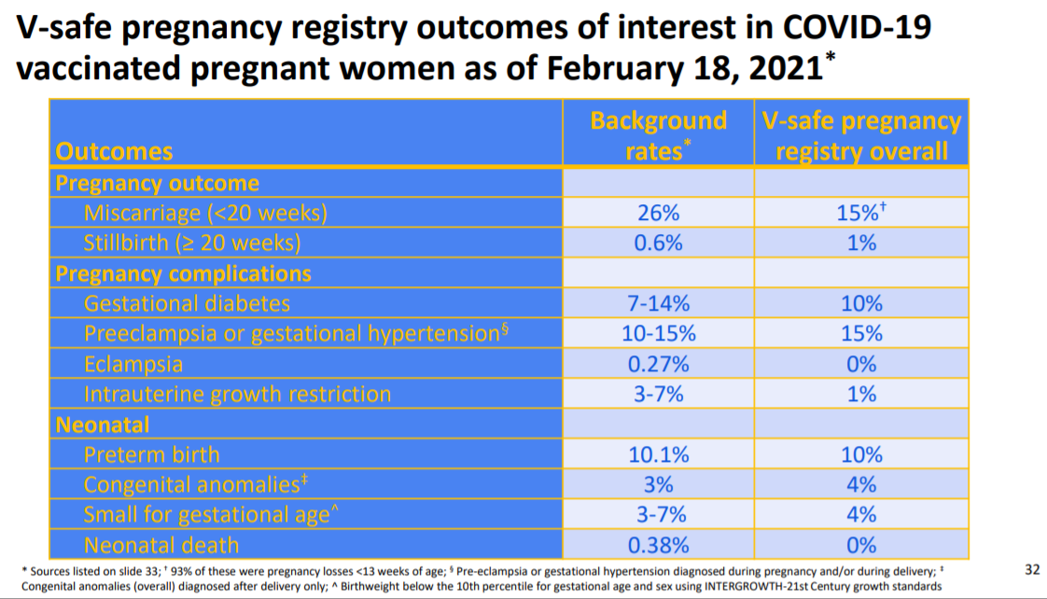

Slide 33
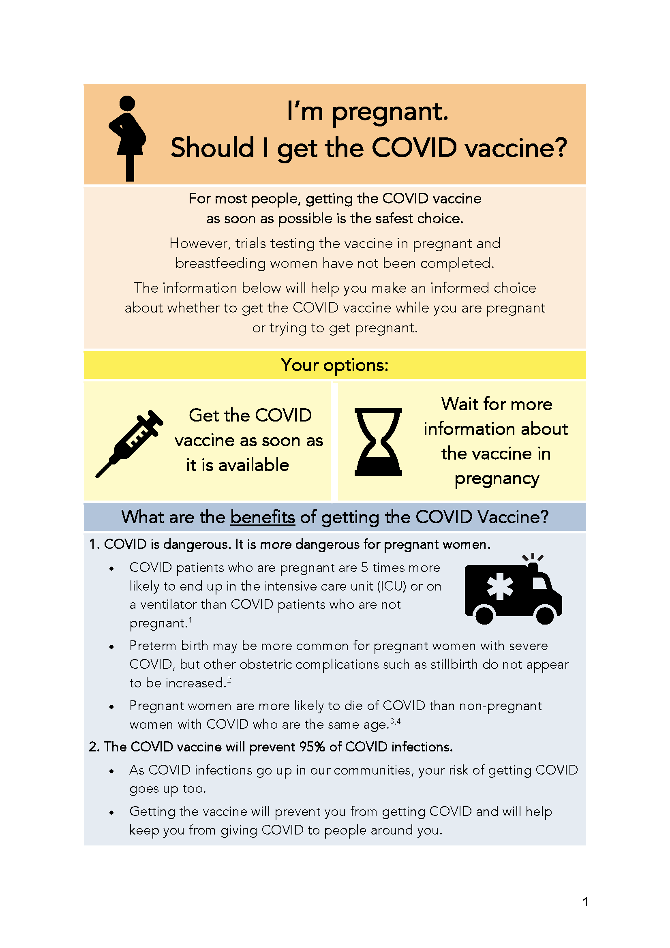
COVID Vaccine
Patient Education Examples
Baystate Health, MA: Covid Vaccine Info for Pregnant/ Breastfeeding Patients. (12.14.20)
English, Spanish, Arabic, Chinese, HaitianCreole, Nepali, Portuguese, Russian, Somali, Turkish, and Vietnamese.
SMFM Patient Education (English/Spanish): COVID-19 Vaccines and Pregnancy. (3.4.21)

Slide 34

Q&A: African Americans and the Covid-19 Vaccines
﻿
 | WBEZ: YouTube recording of WBEZ Q&A: African Americans and the COVID 19 vaccine. (3.3.21)
https://www.wbez.org/events/african-americans-and-the-covid-19-vaccine/48

Slide 35
Help Finding Vaccines
State of Illinois Coronavirus Response: Find IL Vaccine Distribution Locations by Zipcode or City
NPR: How to Sign Up for a COVID-19 Vaccine in Your State

Slide 36
  IDPH Updates
  Amanda Bennett, PhD, MPH
  CDC Field Assignee in Maternal and Child Health Epidemiology, Illinois Department of Public Health

Slide 37
IDPH Updates
IDPH is sending out an updated COVID-19 Birthing Hospital Survey the week of March 8th
OB nurse managers should watch for an email with the link
Very important for ALL BIRTHING HOSPITALS to complete the survey

Slide 38
IDPH Updates
The data collection period for Labor & Delivery sentinel surveillance has ended
  THANK YOU to every hospital that submitted data
  Data analysis results will be shared soon
CDC Toolkit for Pregnant and Postpartum Patients and their families – graphics and one-pagers
Misinformation circulating about COVID vaccine and fertility - CDC has added to their FAQ page to specifically address this issue to the public: https://www.cdc.gov/coronavirus/2019-ncov/vaccines/facts.html
https://www.cdc.gov/coronavirus/2019-ncov/communication/toolkits/pregnant-people-and-new-parents.html

Slide 39
OB Discussion Panel
  Beth A. Plunkett, MD, MPH – Maternal-Fetal Medicine, NorthShore University HealthSystem, Evanston Hospital
  Rita Allen Brennan, DNP, RNC-NIC, APRN - Outcomes Manager, Women’s & Children’s Services Northwestern Medicine Central DuPage Hospital
  Michael Hussey, MD – Maternal-Fetal Medicine, Northwestern Medicine Central DuPage Hospital, Winfield
  Jean Goodman, MD MBA – Division Director, Maternal-Fetal Medicine, Obstetrics Safety & Quality, Loyola University Medical Center, Maywood
  Laura Meints, MD, MBA – OSF Perinatal Associates, Maternal-Fetal Medicine, OSF HealthCare Network, Peoria

Slide 40
COVID-19 in Pregnancy Update
Beth A. Plunkett, MD, MPH
March 5, 2021
ILPQC Covid-19 Webinar

Slide 41
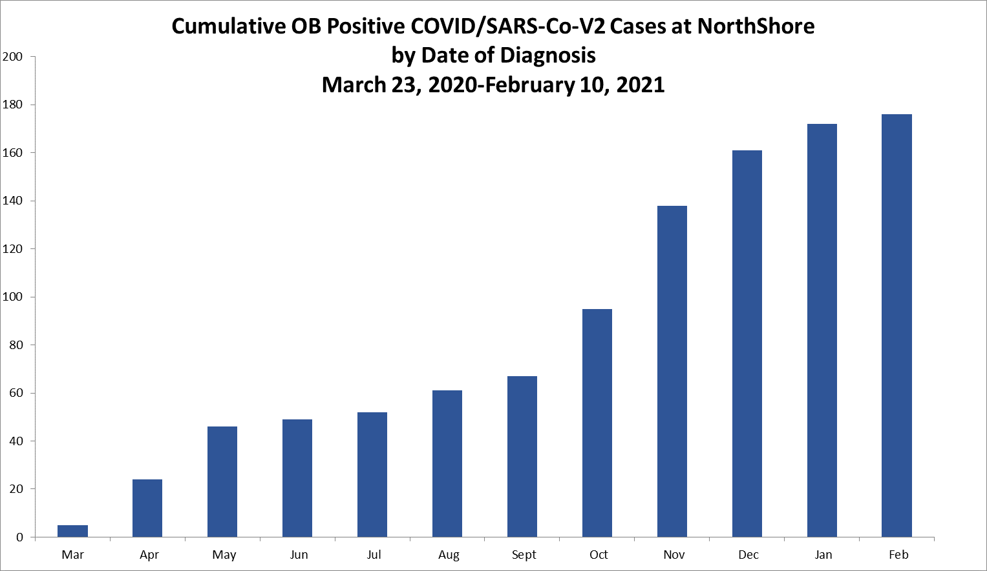
COVID -19/SARS-CoV-2 at NorthShore

Slide 42
Testing SARS-Co-V2
Universal testing at EH/HP
May, 2020- Feb, 2021
2,892 tests performed, 89% eligible patient tested
1.5% positive, 74% asymptomatic
IDPH Sentinel Surveillance Program
25 Chicago and suburban hospitals
June, 2020– January, 2021
26,633 deliveries, 97% tested
2.4% positive, 78% asymptomatic
Positivity rate more stable than population rates over time
Did not serve as early signal to detect changes in population health

Slide 43
NICHD Maternal-Fetal Medicine Units Network
12 centers
33 sites
14 states
Notes:
The NICHD MFMU consists of 12 centers denoted here as main sites in red and a number of subsites denoted in yellow. All together 33 sites in 14 states were included in this analysis including both academic and community-based hospitals. MFMU sites have access to a patient population with demographic, socioeconomic and racial-ethnic diversity. All of these sites participated in this project.

Slide 45
Objective
To describe COVID-19 severity in a multistate cohort of pregnant patients and evaluate the association between disease severity and perinatal outcomes

Slide 49
Pre-existing comorbidities such as immunocompromise, asthma, pregestational diabetes,
hypertension were associated with increased disease severity

Slide 50
6 maternal deaths overall, 4 attributable to COVID-19 (0.3%, 95% CI 0.1-0.8%)
300 / 100,000 live births
US maternal mortality ratio 2018
17.4 / 100,000 live births

Slide 51
Perinatal transmission is rare –1% regardless of disease severity

Slide 53
Pregnancy and COVID-19
COVID-19 is more dangerous for pregnant than non-pregnant people
  Patients with severe disease are 5 x more likely to require ICU care or ventilation
  Preterm birth may be more common
  Pregnant people are more likely to die of COVID-19
    DeBolt,AJOG 2020; Adhikari, JAMA Open Network 2020; DiMascio, Ultra Obstet Gynecol 2020; CDC Nov 2020
Pregnancy identified as high risk condition
Class 1b as of Feb 25 in IL

Slide 54
COVID-19 Vaccine in Pregnant and Lactating People
No data
Current FDA approved vaccines have met strict safety criteria
We do know risks of COVID-19 in pregnancy
  15% of people who get sick more likely to get very ill or not survive
mRNA vaccines are new
  Machinery, taken up by the muscle cells
  Stays within the cell for about 10 days—cannot get to the baby
  Produces proteins—unlikely to get to the baby
  Trigger an immune response and generate antibodies
  Some of those antibodies may get to the baby
    We don’t know/no data
    Passive immunity, would expect it to happen
    Tdap, lactation as passive immunity

Slide 55
COVID-19 Vaccine in Pregnant and Lactating People
Side effects of concern?
  Fever – recommend acetaminophen
Personal choice – risk of exposure, vaccine availability
RECOMMEND

Slide 56
COVID-19 Vaccine in Pregnancy Resources
Patient Decision Tool (UMass Baystate)
https://foamcast.org/covidvacpregnancy/
CDC Vaccine Site
https://www.cdc.gov/vaccines/covid-19/index.html
CDC Vaccine Tracker V-Safe
https://vsafe.cdc.gov

Slide 57
Pregnancy & COVID 19
Care in ICU- Acute Respiratory Failure
Central DuPage Hospital
Presented by: Michael Hussey MD
Presented to: ILPQC COVID call
Date presented: March 5, 2021
Central DuPage Hospital is designated as a Level III perinatal hospital, part of Northwestern Perinatal Center.
Number of births annually- approximately 2800

Slide 58
Pregnancy & COVID 19
Care in ICU- Acute Respiratory Failure
Presentation and course of illness
34 y.o. Multigravida, White, Hispanic with PMH:
    28 wks. Gestation; DM type II; HTN; DX with fungal blastomycosis in late fall of 2020.
    Presented to ED with cough, dyspnea and rash to arm (had TDaP day before). Malaise since shot. Denies fever and chills. N/V/D. No known contact with COVID+ individuals. Family asymptomatic. O2 90% in RA; placed on 2L O2. COVID +. ID, OB, Pulmonology consult.
Worsening hospital course – COVID 19 infection/viral pneumonia/acute respiratory failure.
    Acute deterioration led to ICU admission requiring intubation day after admission and emergent C/S. Critical course throughout ICU stay. 22 day stay in ICU.
    Treated with Remdesivir, steroids, and empiric antibiotics. Labile course. Required prone positioning.
    Tracheostomy, PEG placed. Decannulated approximately 1 month after initial intubation. PEG removed prior to transfer.
Problem list: C/S, fever (resolved), DM with hyperglycemia (glucose labile with steroid administration), anemia, LUE superficial thrombus, Left TVC paresis
D/C from hospital after 5 weeks to acute care rehabilitation facility. LOS- 36 day

Slide 59
Pregnancy & COVID 19
Care in ICU- Acute Respiratory Failure
Presentation and course of illness
Decision Points
  Bed placement
  When to deliver
  Where to deliver
  Transfer to higher level of care
Challenges:
  Coordination of care, timing of delivery with multiple providers
  Language barrier/communication with patient & family
  Husband/father COVID + so could not visit
Learnings from case:
  Communication and collaborations between providers is essential. MFM consult on day of admission
  Coordination and plan of care for pregnant patient in a non-perinatal area is essential

Slide 60
Pregnancy & COVID 19
Care in ICU- Acute Respiratory Failure
Presentation and course of illness
Neonatal course:
  Delivered via emergency C/S at 29 wks. gestation for maternal increased O2 needs
  Mother received betamethasone x2
  APGARS 3, 6, 8
  Admitted to Level III NICU
  Intubated and placed on ventilator.
  Neonate COVID-19 negative
  Cultures negative
  Currently on room air via nasal cannula
  Mother was able to come to NICU and hold her baby prior to her transfer to rehab.

Slide 61
Neonatal Discussion Panel
Justin Josephsen, MD – Medical Director, St. Mary’s Hospital NICU, Neonatologist Cardinal Glennon Children’s Hospital, St. Louis
Leslie Caldarelli MD – Medical Director Prentice NICU, Northwestern University
Rebecca Reed, MSW – Social Worker, Prentice NICU

Slide 62
Thank You
We continue to give thanks to the nurses, doctors, health care workers, public health teams and others across our state at work confronting the COVID-19 pandemic.
Please send questions, comments and recommendations, cases / willingness to share for future COVID-19 OB/Neo discussion webinars to info@ilpqc.org
Recording of this webinar, Q/A and registration for the next webinar on Friday, 4/2/21 will be available at www.ilpqc.org

Slide 63










THANKS TO OUR
FUNDERS
In Kind Support

