Slide 1
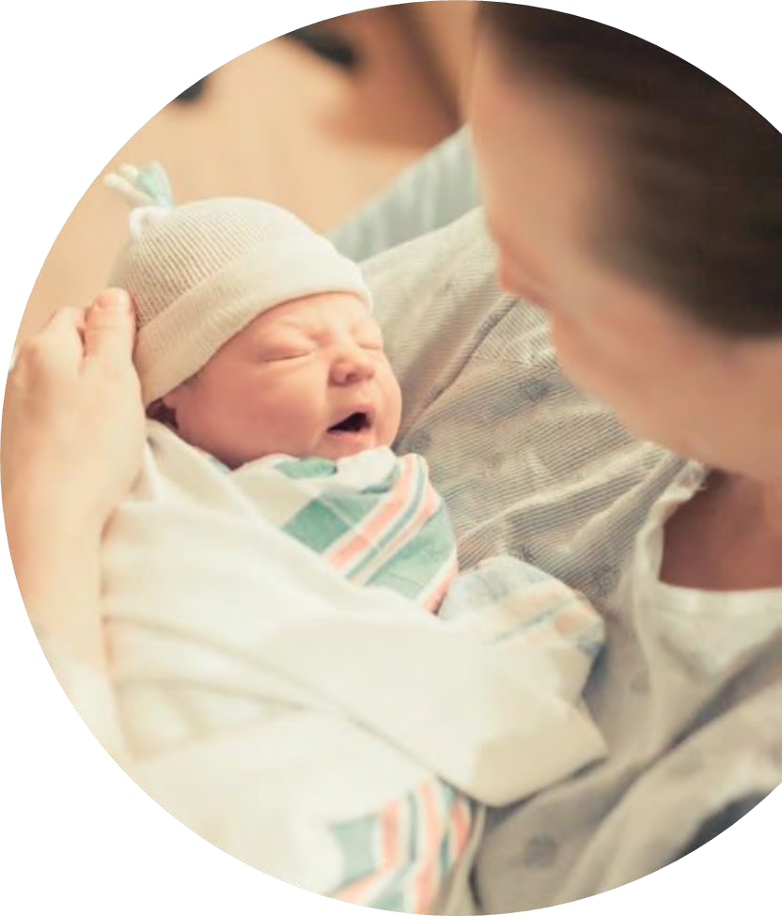


COVID-19 Strategies for OB & Neonatal Units
March 11, 2022
12:00 – 1:15pm

Slide 2

Welcome
Please be certain you are on “mute” when not speaking to avoid background noise.
Whether you have joined by phone or computer audio, you can mute and unmute yourself by clicking on the microphone icon.
The following shortcuts can also be used
For PC: Alt + A : Mute or Unmute
For Mac: Shift + Command + A: Mute or Unmute
For telephone: *6 : Mute or Unmute
2

Slide 3
Housekeeping:
We Are Recording Now
3

Slide 4

ILPQC Covid 19 webinars
The strategies shared today are examples from individual institutions not IDPH or ILPQC recommendations.
This is our 30th COVID-19 strategies for OB/Neonatal Units webinar in coordination with IDPH, since April 2020. Please see https://ilpqc.org/covid-19-information/ for
future webinar registration, prior recorded webinars and written out Q/A’s from those webinars.
The next webinar will be Friday, April 8, noon to 1:15pm. We are continuing monthly for now, but determining the needed frequency going forward
Please let us know if your hospital would like to share on an upcoming webinar, please put questions/comments into the chatbox or email directly to info@ilpqc.org
4

Slide 5
Overview
Introduction
Overview of updated data and recommendations
IDPH Update on Covid Therapeutics in Pregnancy/Postpartum
  Arti Barnes, MD, MPH -- Medical Director / Chief Medical Officer, IL Department of Public Health
Everthrive Vaccination Program Update
  Andie Baker-- Deputy Director of Strategy and Programs, EverThrive Illinois
ICAAP Vaccination Program
  Helen Plavik, MD -- Ob/Gyn Advocate Lutheran General Hospital, sharing example of providing COVID vaccines in OB/GYN office
Discussion of OB Unit Strategies
  Ann McCormick, DO -- Maternal Fetal Medicine, Rush University Medical Center
5

Slide 6

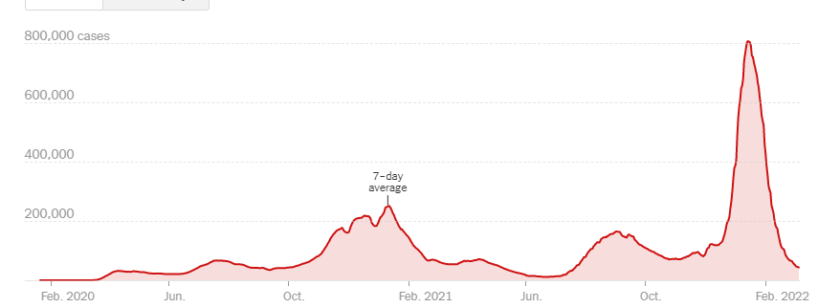
US COVID case trend
6

Slide 7
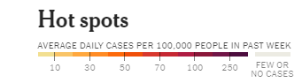
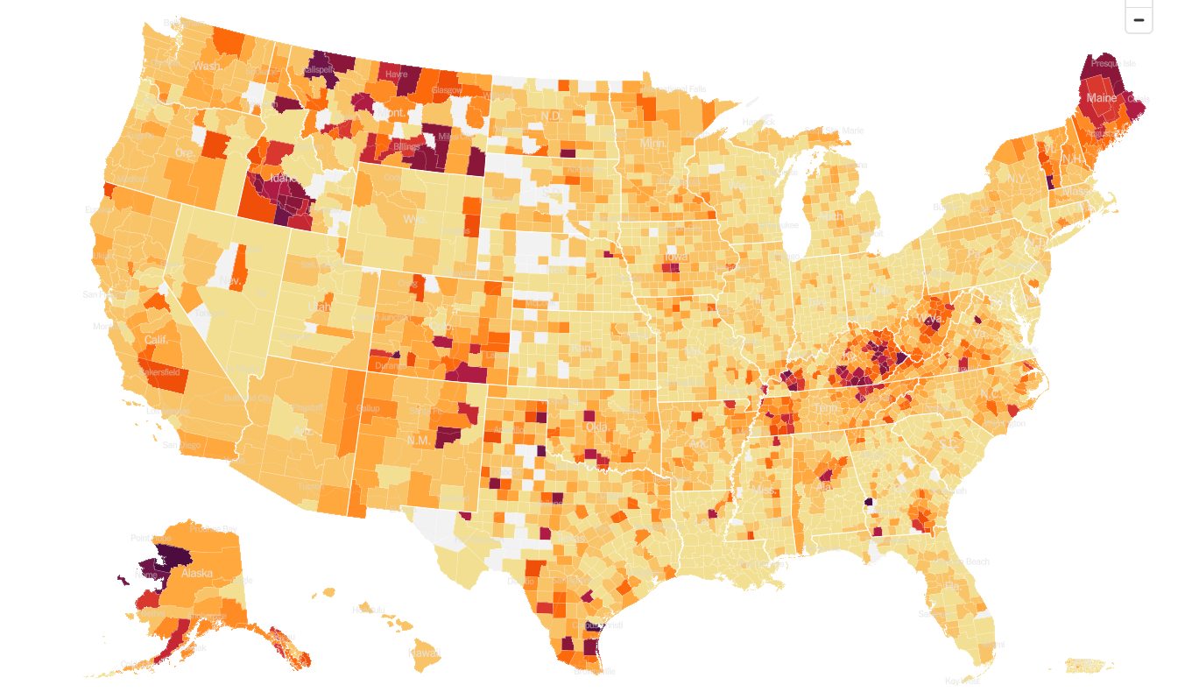
United States Hot Spots 3/8/22

Slide 8
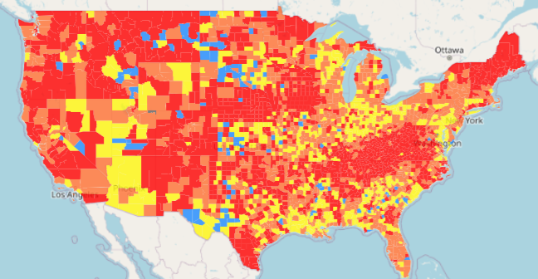
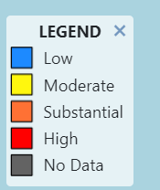
COVID
transmission across the Country
Updated 3/8/22

Slide 9
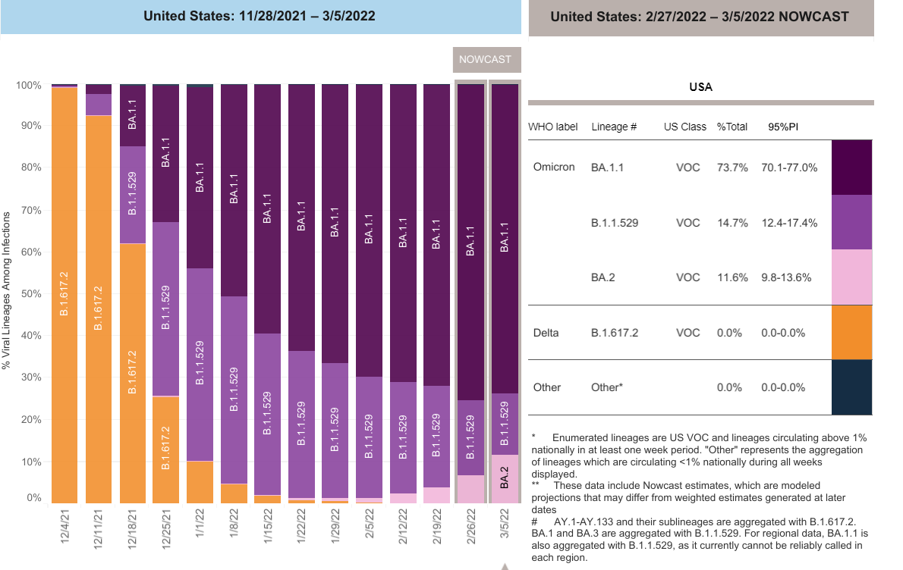
Increasing Omicron Cases
Updated 3/8/2022

Slide 10


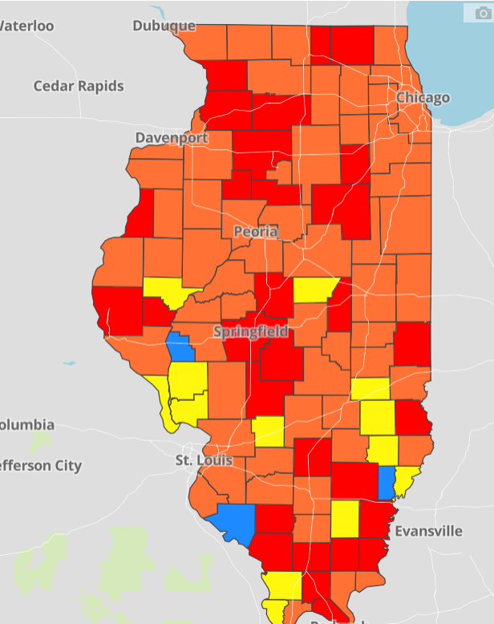
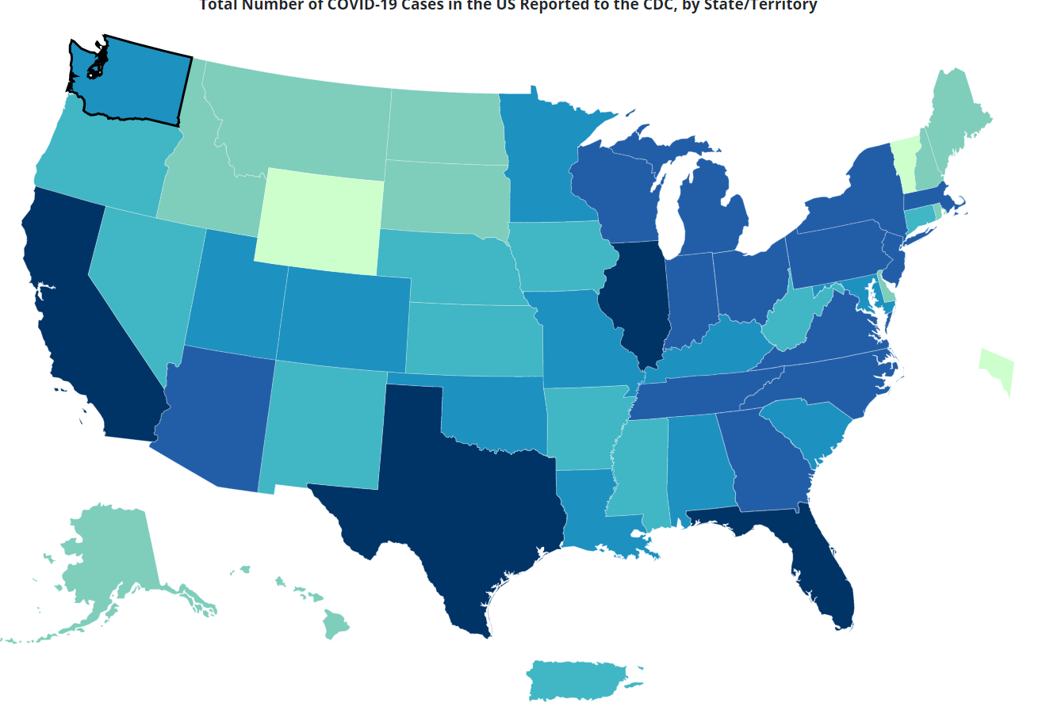
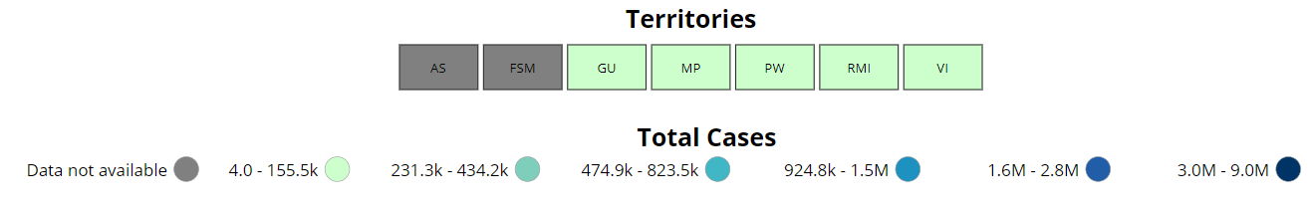
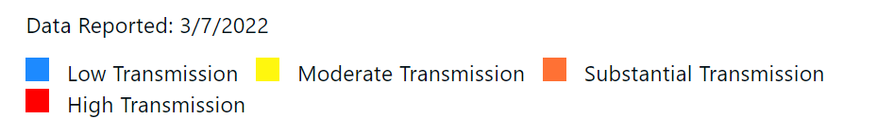
Data Update: March 8, 2022
CDC/IDPH: COVID-19 Outbreak
CDC
https://covid.cdc.gov/covid-data-tracker/#cases_totalcases
IDPH
https://www.dph.illinois.gov/covid19
Total cases: 79,165,308 confirmed
Total deaths: 957,752 confirmed
3,039,806 Confirmed Positive Cases
32,956 Deaths
8

Slide 11
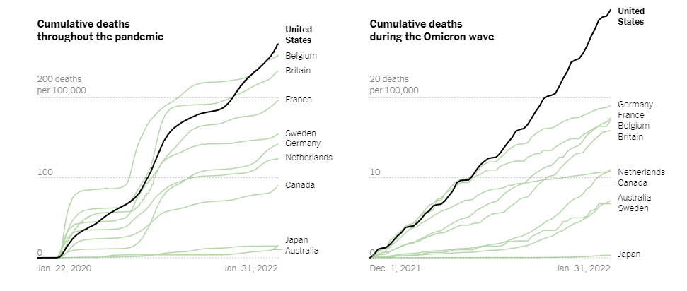
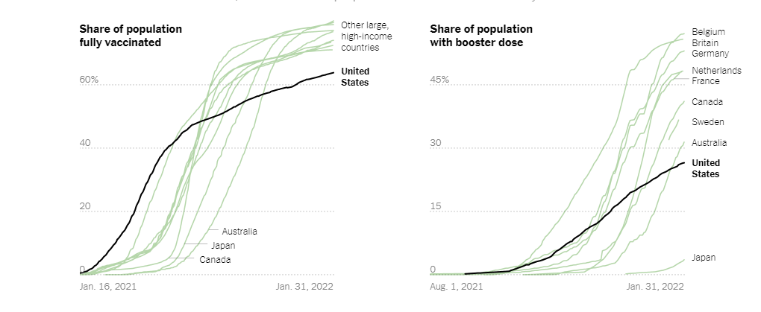
U.S. Has Far Higher Covid Death Rate Than Other Wealthy Countries
NY Times, 2.1.2022
https://www.nytimes.com/interactive/2022/02/01/science/covid-deaths-united-states.html

Slide 12
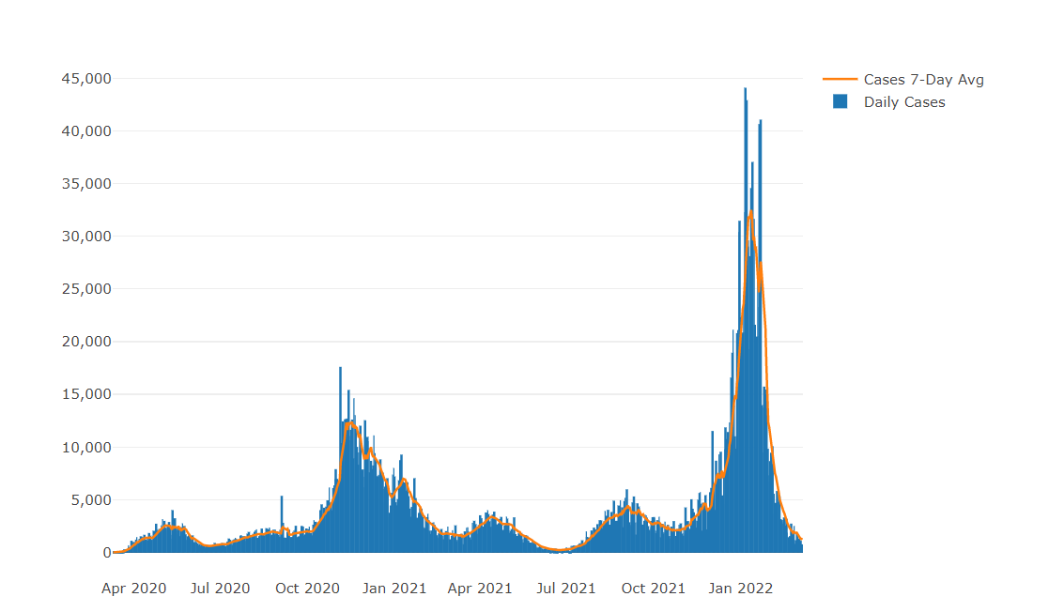

Illinois Daily Incidence
IDPH daily data summary
12

Slide 13
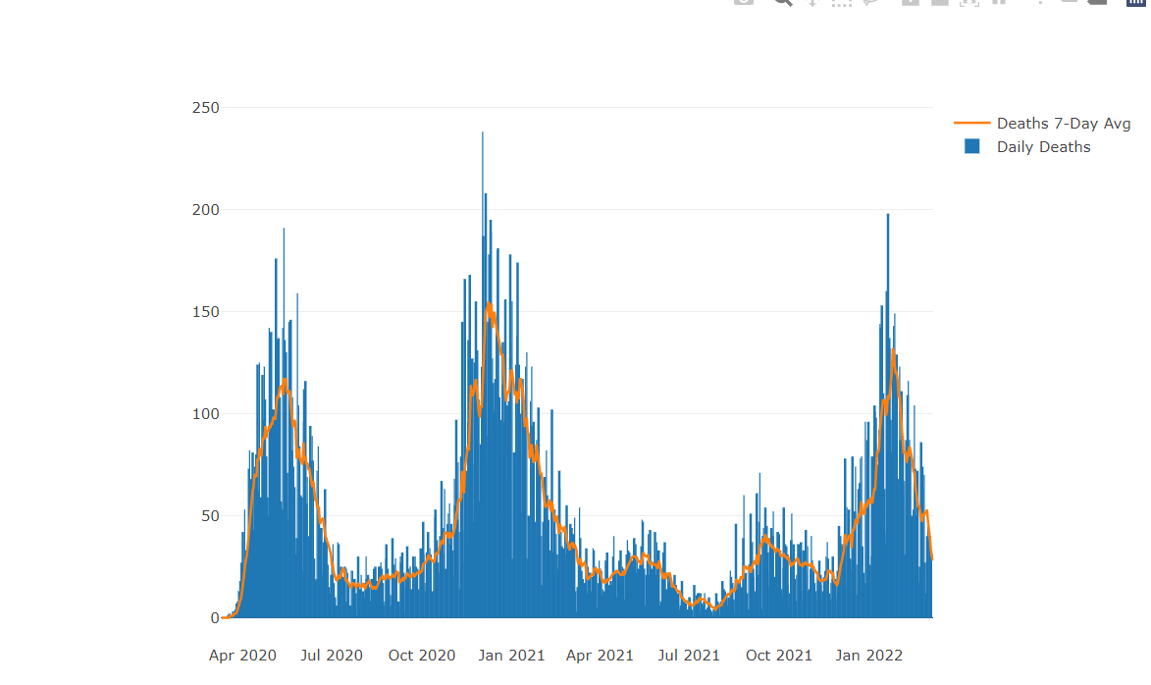
Illinois Covid Deaths
IDPH daily data summary
13

Slide 14
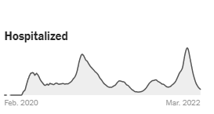
Illinois Hospitalizations By Time through 3/8/2022
Sources: U.S. Department of Health and Human Services (daily confirmed and suspected Covid-19 hospital admissions); Census Bureau (population data). Data prior to October 2020 was unreliable. Data reported in the most recent seven days may be incomplete.

Slide 15
Illinois Covid Transmission
by County
Updated 3/7/2022
Based on:
Cases/100,000 (>100 red)
Test Positivity Avg (>10% red)

Slide 16
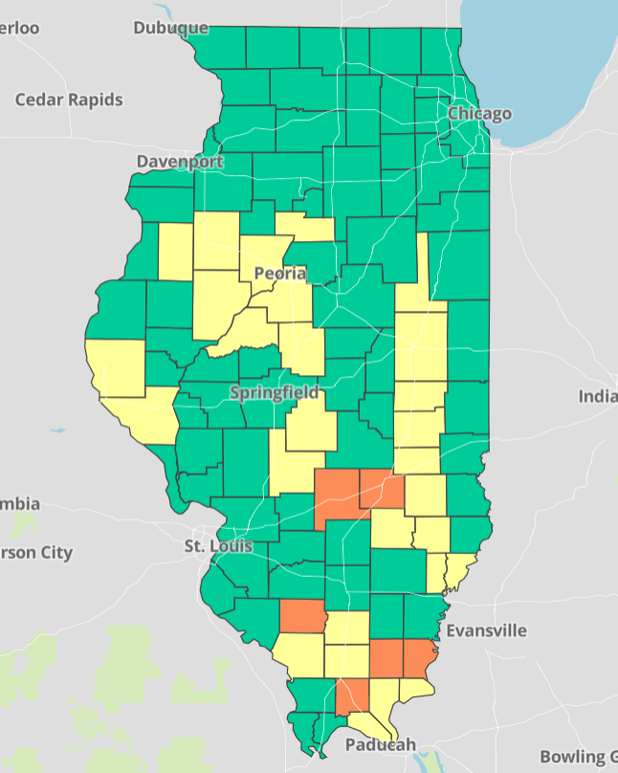

COVID-19 Community Levels Map Updated 3/8/2022
New CDC Guidance (3/4/2022):
Levels can be low, medium, or high and are determined by looking at % of hospital beds being used by pts with Covid, new Covid hospital admissions, and the total number of new COVID-19 cases in an area.
Notes:
determined by looking at hospital beds being used by patients with COVID-19, new hospital admissions among people with COVID-19, and the total number of new COVID-19 cases in your area.

Slide 17
CDC’s COVID-19 Community Levels and Indicators
New Cases (per 100,000 population in the last 7 days) | Indicators | Low | Medium | High
Fewer than 200 | New COVID-19 admissions per 100,000 population (7-day total) | <10.0 | 10.0-19.9 | ≥20.0
 | Percent of staffed inpatient beds occupied by COVID-19 patients (7-day average) | <10.0% | 10.0-14.9% | ≥15.0%
200 or more | New COVID-19 admissions per 100,000 population (7-day total) | NA | <10.0 | ≥10.0
 | Percent of staffed inpatient beds occupied by COVID-19 patients (7-day average) | NA | <10.0% | ≥10.0%
The COVID-19 community level is determined by the higher of the inpatient beds and new admissions indicators, based on the current level of new cases per 100,000 population in the past 7 days Check your county’s COVID-19 Community Level.

Slide 18
Low | Medium | High
Stay up to date with COVID-19 vaccines Get tested if you have symptoms | If you are at high risk for severe illness, talk to your healthcare provider about whether you need to wear a mask and take other precautions Stay up to date with COVID-19 vaccines Get tested if you have symptoms | Wear a mask indoors in public Stay up to date with COVID-19 vaccines Get tested if you have symptoms Additional precautions may be needed for people at high risk for severe illness
People may choose to mask at any time. People with symptoms, a positive test, or exposure to someone with COVID-19 should wear a mask.
The whole community can be safe only when we all take steps to protect each other, even when the COVID-19 Community Level is low or medium. No matter what your COVID-19 Community Level, layered prevention strategies can help limit severe disease and reduce the potential for strain on the healthcare system. Proven prevention steps include staying up to date on vaccines, getting tested if you have symptoms, and wearing a mask when you’re around someone at increased risk. – CDC 3/4/2022
New
Covid-19 Community Levels
3/4/2022
Does not apply to health care facilities

Slide 19
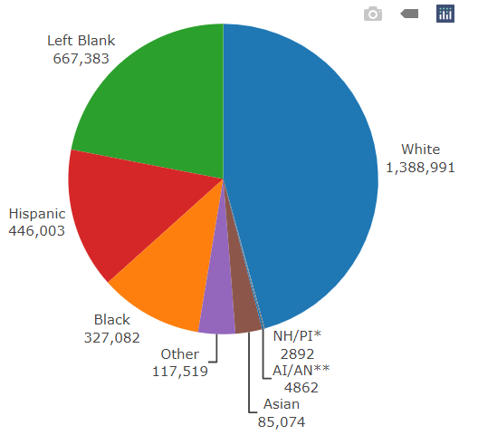
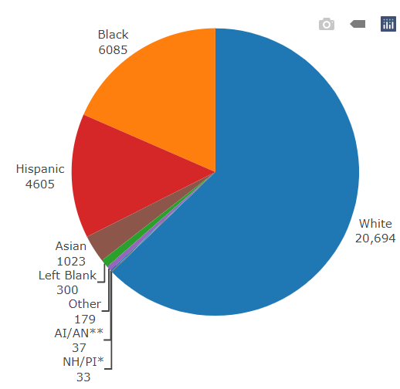
Data Update March 8, 2022 IDPH: COVID-19 Outbreak Race Demographics
https://www.dph.illinois.gov/covid19
Confirmed Cases
Deaths
13

Slide 20

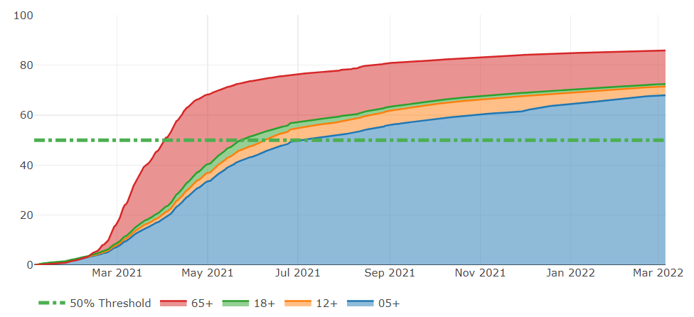
Illinois Population Vaccinated Fully
13

Slide 21
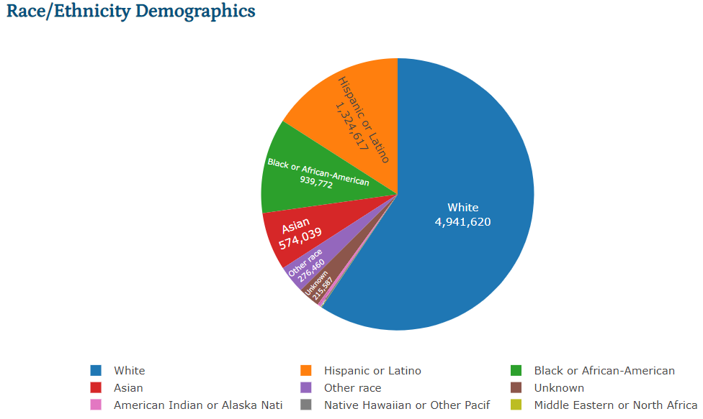
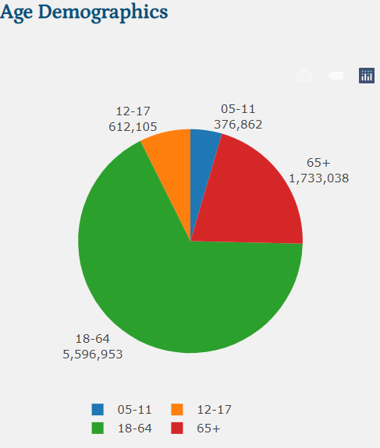
Illinois Population Administered Booster Doses
13

Slide 22
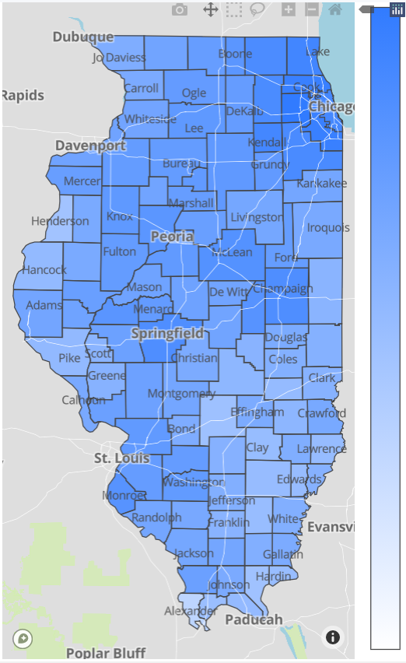

Illinois Daily Reported Administered Vaccine Doses
Last updated 3/8/2022
21,187,726
Administered Vaccine Doses
Illinois Perinatal Quality Collaborative
14

Slide 23
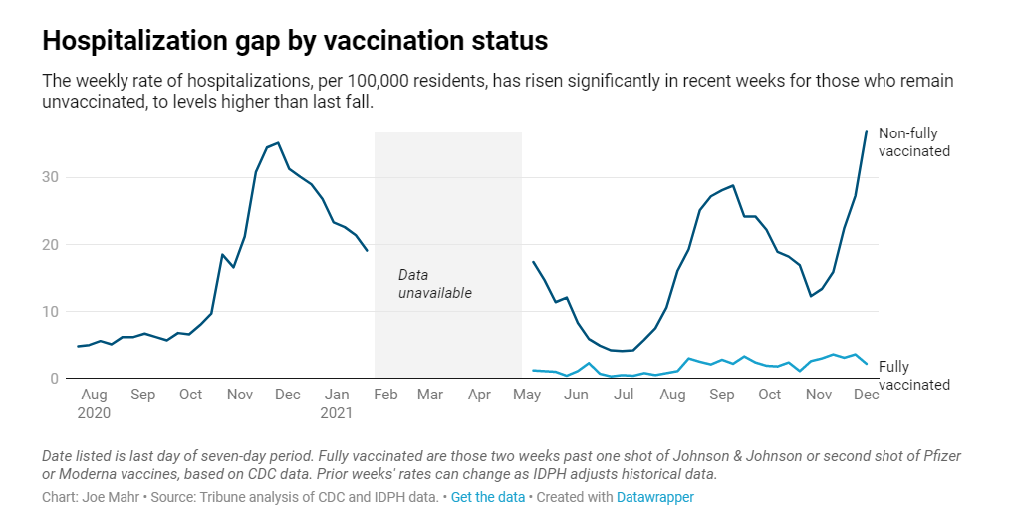
Notes:
Do you have the updated link for this graph?

Slide 24
In January, compared to fully vaccinated persons in each group shown below, the monthly rates of COVID-19-associated hospitalizations were:
7X Higher in Unvaccinated Adults Ages 18 Years and Older
3x Higher in Unvaccinated Adolescents
Ages 12-17 Years
5x Higher in Unvaccinated Adults
Ages 18-49 years
7x Higher in Unvaccinated Adults
Ages 50-64 years
8x Higher in Unvaccinated Adults
Ages 65 Years and Older

Slide 25
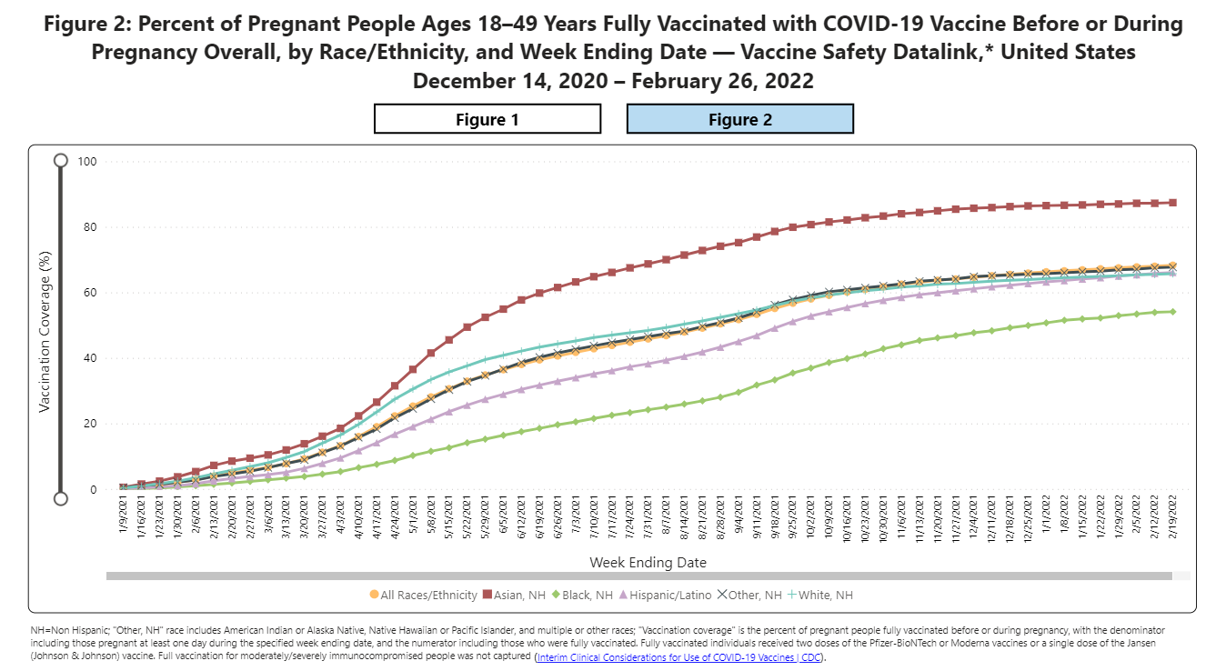
Notes:
https://urldefense.com/v3/__https://covid.cdc.gov/covid-data-tracker/*vaccinations-pregnant-women__;Iw!!Dq0X2DkFhyF93HkjWTBQKhk!BRT8JkbGHSHMqUvlHo57UsXRx3oQL6Au0KIaOe8oN7qp9yWGe1oyTAFdCw-PzSyj1gqEUOSiCw$

Slide 26
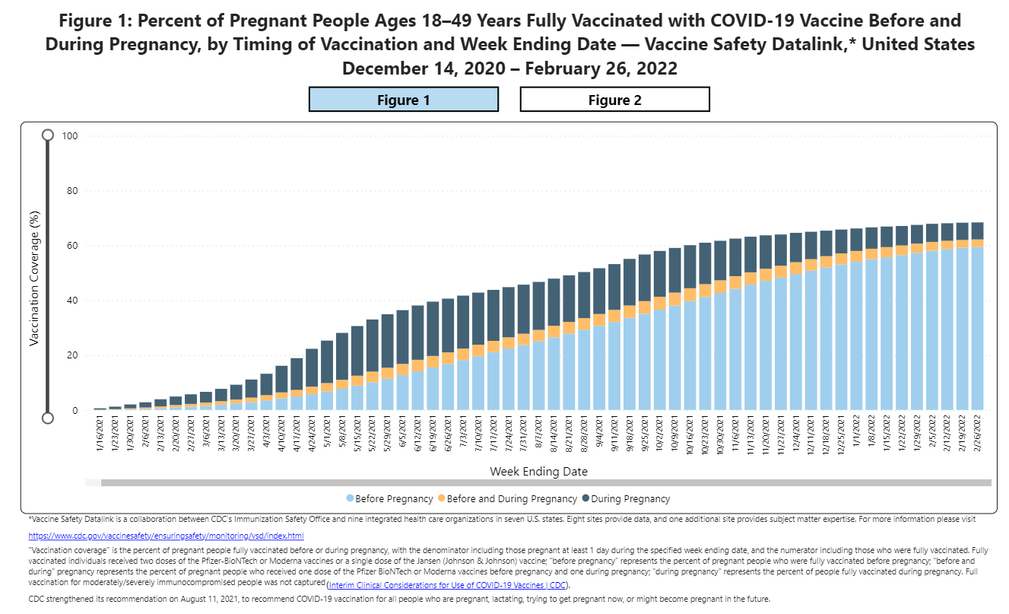
Notes:
https://urldefense.com/v3/__https://covid.cdc.gov/covid-data-tracker/*vaccinations-pregnant-women__;Iw!!Dq0X2DkFhyF93HkjWTBQKhk!AZLmkCzjPqbpDlw3HSvzpeV2yHLjASTwFArm1NOsQ1zqBmsgYQCTjWJcfL5ZsjyF2-lUxyxYPA$

Slide 27
Covid-19 and Pregnancy
Pregnant women with COVID-19, United States, January 22, 2020 - March 7, 2022
  187,751 cases
  30,327 hospitalizations
  293 deaths

Slide 28
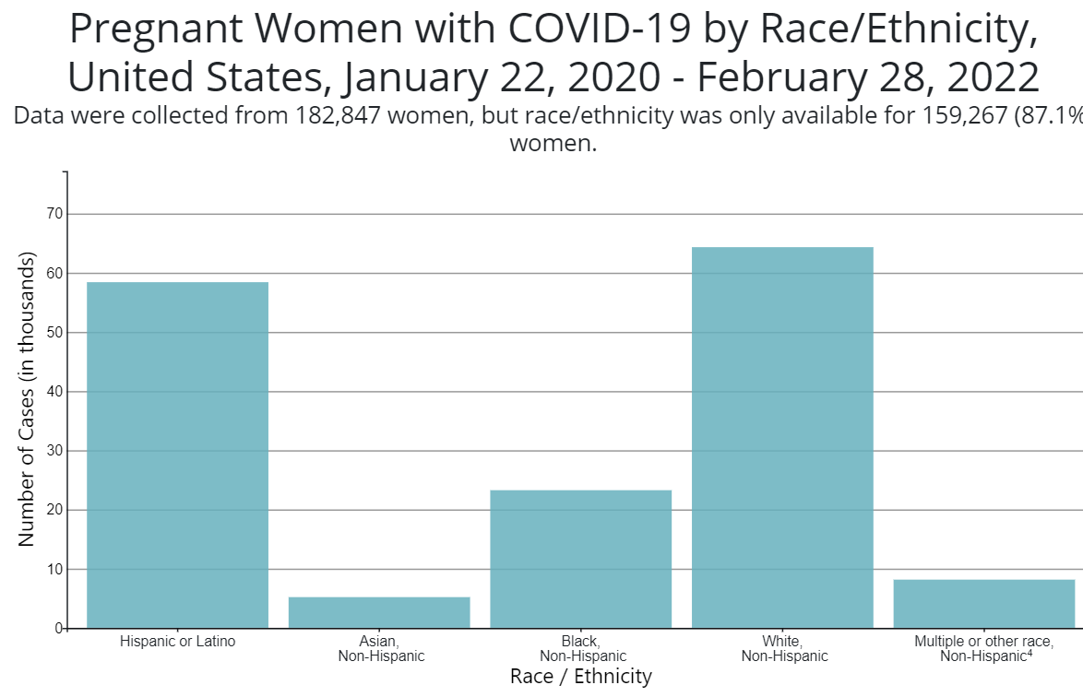

Slide 29
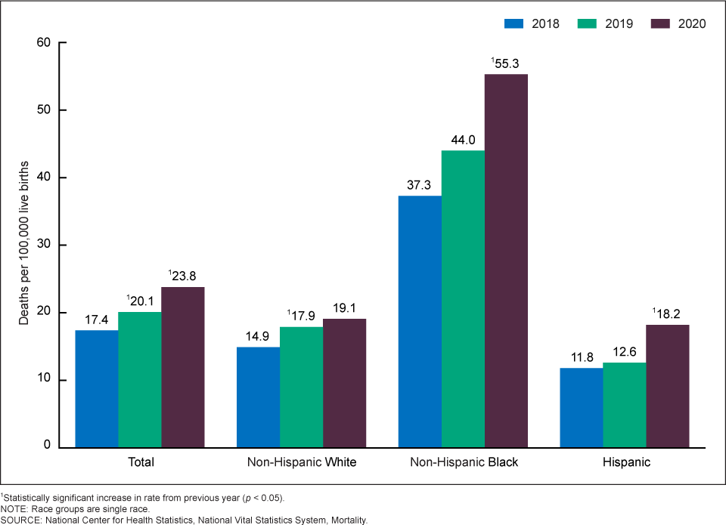
Figure 1. Maternal mortality rates, by race and Hispanic origin: United States, 2018–2020
MMWR, National Center for Health Statistics, Hoyert, February 2022
CDC MMWR: Maternal Mortality Rates in the United States, 2018-2020

Slide 30
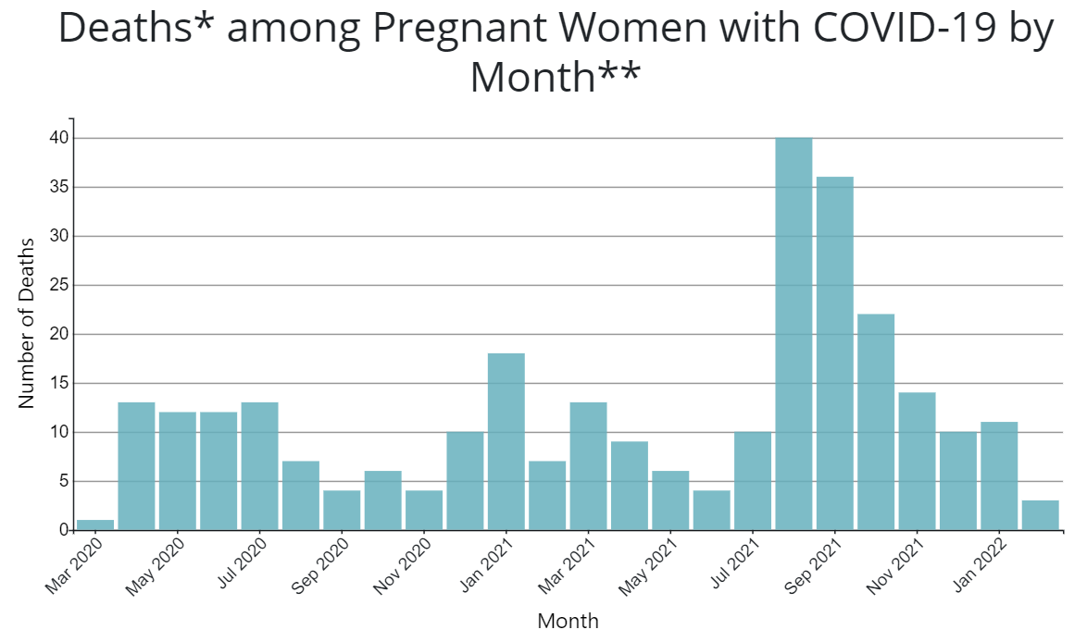

Slide 31
JAMA: Association of SARS-CoV-2 Infection With Serious Maternal Morbidity and Mortality From Obstetric Complications. (2.7.2022)
In this retrospective cohort study that included 14 104 patients, a composite outcome of maternal death or serious morbidity related to hypertensive disorders of pregnancy, postpartum hemorrhage, or infection other than SARS-CoV-2 occurred significantly more frequently in individuals with SARS-CoV-2 infection compared with individuals without SARS-CoV-2 infection (13.4% vs 9.2%, respectively).
Compared with those without a positive SARS-CoV-2 test result, moderate or higher COVID-19 severity (n = 586) was significantly associated with the primary outcome (26.1% vs 9.2%; difference, 16.9% [95% CI, 13.3%-20.4%]; aRR, 2.06 [95% CI, 1.73-2.46]) and the major secondary outcome of cesarean birth (45.4% vs 32.4%; difference, 12.8% [95% CI, 8.7%-16.8%]; aRR, 1.17 [95% CI, 1.07-1.28])

Slide 32
MDPI: Stillbirth after COVID-19 in Unvaccinated Mothers Can Result from SARS-CoV-2 Placentitis, Placental Insufficiency, and Hypoxic. (2.15.2022)
Arch Pathol Lab Med: Placental Tissue Destruction and Insufficiency from COVID-19 Causes Stillbirth and Neonatal Death. (2.10.2022)
Stillbirth after COVID-19 in Unvaccinated Mothers Can Result from SARS-CoV-2 Placentitis, Placental Insufficiency, and Hypoxic Ischemic Fetal Demise, Not Direct Fetal Infection: Potential Role of Maternal Vaccination in Pregnancy
An MMWR released on September 16, 2020, reported an increased stillbirth rate of 3.2% among pregnant patients with symptomatic and asymptomatic SARS-CoV-2 infection.
An MMWR released on November 19, 2021, found that the adjusted risk of stillbirth in patients with a COVID-19 diagnosis documented at delivery hospitalization was 4 times higher than the risk in patients without COVID-19 infection.
In addition, case series of patients with COVID-19 who experienced stillbirth had evidence of fibrin deposition and trophoblast necrosis on placental pathology.

Slide 33

CDC: COVID-19 Vaccination for Pregnant People to Prevent Serious Illness, Deaths, and Adverse Pregnancy Outcomes from COVID-19. (9.29.21)
CDC recommends urgent action to help protect pregnant people and their fetuses/infants.
Healthcare providers should communicate the risks of COVID-19, the benefits of vaccination, and information on the safety and effectiveness of COVID-19 vaccination in pregnancy.
Compared with non-pregnant symptomatic people, symptomatic pregnant people have more than a two-fold increased risk of requiring ICU admission, invasive ventilation, and ECMO, and a 70% increased risk of death.⁶
Healthcare providers should strongly recommend that people who are pregnant, recently pregnant (including those who are lactating), who are trying to become pregnant now, or who might become pregnant in the future receive one of the authorized or approved COVID-19 vaccines as soon as possible.

Slide 34
VACCINE SAFETY DATA

Slide 35
V-SAFE vaccine monitoring
– what data is being gathered pregnant patients
As of March 7, 2022, there have been over 207,726 pregnancies reported in CDC’s V-SAFE post-vaccination health checker
CDC is also enrolling pregnant individuals in a pregnancy registry for additional follow up with over 18,707 enrolled.
Evidence gathered through these system has provide clinicians with critically needed safety data on COVID-19 vaccination during pregnancy
No adverse pregnancy outcomes associated with Covid-19 vaccine and pregnancy
https://www.cdc.gov/coronavirus/2019-ncov/vaccines/safety/vsafe.html

Slide 36
Association of BNT162b2 COVID-19 Vaccination During Pregnancy With Neonatal and Early Infant Outcomes,
JAMA Pediatrics, February 10, 2022
Cohort of 24 288 eligible newborns (16 697 were exposed in the first and second trimesters) to maternal vaccination
Median follow-up after birth was 126 days
No substantial differences were observed in preterm birth rates between exposed and unexposed newborns or SGA
No significant differences were observed in the incidence of all-cause neonatal hospitalizations, postneonatal hospitalizations after birth, congenital anomalies, or infant mortality over the study period

Slide 37
Durability of Antibodies in Infants After Maternal COVID-19 Vaccination or Natural Infection (2/7/2022)
A JAMA study suggests that vaccinating women against SARS-CoV-2 in mid to late pregnancy could provide their infants some protection against COVID-19 through six months of age.
Compared to infants born to mothers who had COVID-19 during pregnancy, infants born to vaccinated mothers were much more likely to have antibodies against the virus.
Read the full NIH Science Update at https://bit.ly/33fsSPr
The JAMA article is open access and can be found here: Durability of Anti-Spike Antibodies in Infants After Maternal COVID-19 Vaccination or Natural Infection

Slide 38
CDC MMWR: Effectiveness of Maternal Vaccination with mRNA COVID-19 Vaccine During Pregnancy Against COVID-19–Associated Hospitalization in Infants Aged <6 Months — 17 States. (2.18.2022)
Completion of a 2-dose primary mRNA COVID-19 vaccination series during pregnancy was associated with reduced risk for COVID-19–associated hospitalization among infants aged <6 months, and protection was higher among infants whose mothers were vaccinated later in pregnancy
Among 176 infants aged <6 months hospitalized with COVID-19, 148 (84%) were born to mothers who were not vaccinated during pregnancy. Overall, these findings indicate that maternal vaccination during pregnancy might help protect against COVID-19 hospitalization among infants aged <6 months.

Slide 39
CDC Vaccine and Pregnancy Summary: what you need to know
People who are pregnant or recently pregnant are more likely to get severely ill with COVID-19 compared with people who are not pregnant.
Getting a COVID-19 vaccine can help protect you from severe illness from COVID-19.
COVID-19 vaccination is recommended for people who are pregnant, breastfeeding, trying to get pregnant now, or might become pregnant in the future.
People who are pregnant should receive a COVID-19 vaccine booster shot.
Evidence about the safety and effectiveness of COVID-19 vaccination during pregnancy has been significant and continues to grow. These data suggest that the benefits of receiving a COVID-19 vaccine outweigh any known or potential risks of vaccination during pregnancy.
There is currently no evidence that any vaccines, including COVID-19 vaccines, cause fertility problems in women or men.

Slide 40
SMFM: Provider Considerations for Engaging in COVID-19 Vaccine Counseling With Pregnant and Lactating Patients (1.11.2022)
SMFM and ACOG recommend that pregnant people, including health care workers, receive a COVID-19 booster shot at least 5 months after their primary series. As with the primary series, the booster dose should be given at any stage during pregnancy and postpartum.
Everyone 12 and over is eligible for booster at least 5 months from primary series.

Slide 41
Boosters needed to fight Omicron
Data from South Africa and the United Kingdom demonstrate that vaccine effectiveness against infection for two doses of an mRNA vaccine is approximately 35%.
A COVID-19 vaccine booster dose restores vaccine effectiveness against infection to 75%.
COVID-19 vaccination decreases the risk of severe disease, hospitalization, and death from COVID-19. CDC strongly encourages COVID-19 vaccination for everyone 5 and older and boosters for everyone 12 and older.

Slide 42

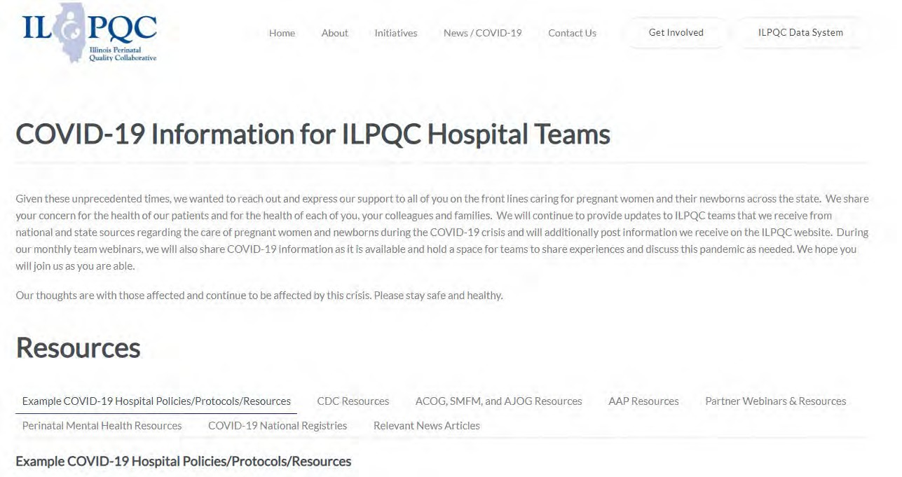
ILPQC COVID-19 Webpage www.ilpqc.org
ILPQC posts national guidelines and OB & Neonatal COVID-19 example hospital protocols & resources
please note dates as guidelines are changing rapidly
https://ilpqc.org/covid-19- information/

Slide 43
Updated OB (ACOG/SMFM) Resources
ACOG: Statement on the CDC’s Health Advisory on COVID-19 Vaccination. (9.29.21)
ACOG: COVID-19 Vaccination During Pregnancy Is Key to Saving Lives, Medical Experts Urge. (12.6.21)
SMFM: SMFM Supports the Use of Paxlovid in Pregnant Patients. (12.22.21)
ACOG: COVID-19 FAQs for Obstetrician-Gynecologists, Obstetric. (12.28.21)
SMFM: Provider Considerations for Engaging in COVID-19 Vaccine Counseling With Pregnant and Lactating Patients(1.11.2022)
ACOG new PSA: COVID-19 Vaccines in Pregnancy: Safe, Proven, Effective. (2.8.2022)
ACOG: COVID-19 Vaccines: Tools for Your Practice and Your Patients. (2.8.2022)
ACOG: COVID-19 FAQs for Obstetrician-Gynecologists, Obstetric. (2.8.22)
SMFM: Coronavirus (COVID-19) and Pregnancy: What Maternal-Fetal Medicine Subspecialists Need to Know (03.2.2022)
ACOG: COVID-19 Vaccination Considerations for Obstetric–Gynecologic Care. (3.2.2022)
Notes:
SMFM: Coronavirus (COVID-19) and Pregnancy: What Maternal-Fetal Medicine Subspecialists Need to Know (03.2.2022)

Slide 44
SMFM: Coronavirus (COVID-19) and Pregnancy: What Maternal-Fetal Medicine Subspecialists Need to Know (March 2, 2022)
The following pertains to outpatient treatment for pregnant patients:
• Paxlovid (nirmatrelvir [PF-07321332] tablets and ritonavir tablets) is an antiviral medication. There are no human pregnancy data available on nirmetrelvir, but ritonavir is used extensively in pregnancy with documented safety. Practitioners should consider drug-drug interactions.
• Sotrovimab is a monoclonal antibody. It is available as a single infusion and is effective against the Omicron variant. May be limited supply and may only be available to patients at the highest risk of progression to severe disease. No need to delay vaccination after receipt of monoclonal antibody Rx.
• Remdesivir (3-day outpatient regimen) is an antiviral medication. There has been documented use of remdesivir throughout the pandemic. This regimen requires multiple IV infusions, which can be logistically difficult. All of the above have similar efficacy at preventing hospitalization and death; however, no trials have specifically evaluated efficacy in a pregnant population.
• Molnupiravir is an antiviral medication with a reported 30% efficacy. Although the EUA recommends against its use in pregnancy due to mutagenicity concerns, this drug may be reasonably considered for use in pregnancy if there are no other therapies available and with documented counseling that the patient understands the risks and benefits.

Slide 45
COVID Therapeutics
For use in HIGH RISK individuals early in symptoms
  Oral therapies (Paxlovid) to be given within 5 days
  IV monoclonal antibody (Sotrovimab) to be given within (updated 2/22/22) reduced from 10 to 7 days
HIGH RISK generally refers to those > 65 years, immunocompromised, high-risk comorbid conditions (obesity, DM), pregnancy or under vaccinated
  NIH Therapy Tier: https://www.covid19treatmentguidelines.nih.gov/therapies/statement-on-patient-prioritization-for-outpatient-therapies/

Slide 46
Outpatient Therapeutic Preferences
https://www.covid19treatmentguidelines.nih.gov/therapies/statement-on-therapies-for-high-risk-nonhospitalized-patients/
Paxlovid (nirmatrelvir/ritonavir) – first line
  PROS: oral and highly effective
  CONS: needs to be given within 5 days of symptom onset, renal adjustment (can’t be given for GFR <30) and many drug-drug interactions (DDIs)
Sotrovimab - first line
  PROS: highly effective, can be given up to (updated 2/22/22) reduced from 10 to 7 days of symptom onset
  CONS: intravenous, limited access – need pathway for pregnant patients
Remdesivir – second line – typically used INPATIENT
  PROS: highly effective in early illness, readily available, can be given outpatient up to 7 days of symptom onset
  CONS: three consecutive days of IV therapy is extremely difficult in the outpatient world
    Good use is for inpatients who are COVID+ but actually hospitalized for another reason
Molnupiravir – only if above therapies unavailable NOT TO USE IN PREGNANCY
  PROS: oral and more readily available than Paxlovid, no significant DDIs
  CONS: less effective, concerns about mutagenesis, not recommended in pregnancy, requires contraception for patients of childbearing potential, only for age > 18

Slide 47
Updated SMFM Patient Education Resources (on ILPQC Covid webpage)
SMFM: COVID-19 Vaccination if You Are
Pregnant or Breastfeeding English. (11.3.2021)
SMFM: COVID-19 Vaccination if You Are
Pregnant or Breastfeeding Spanish. (11.3.2021)
SMFM: Top 5 Reasons to Get the COVID-19 Vaccine (English and Spanish). (11.23.21)

Slide 48
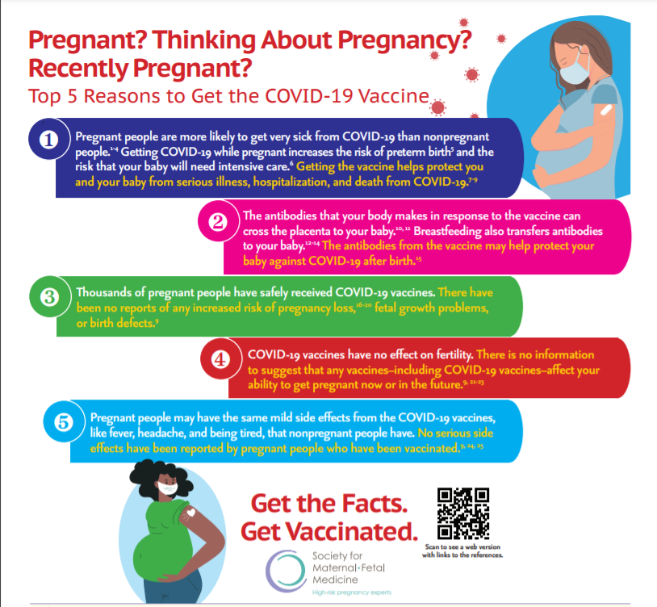
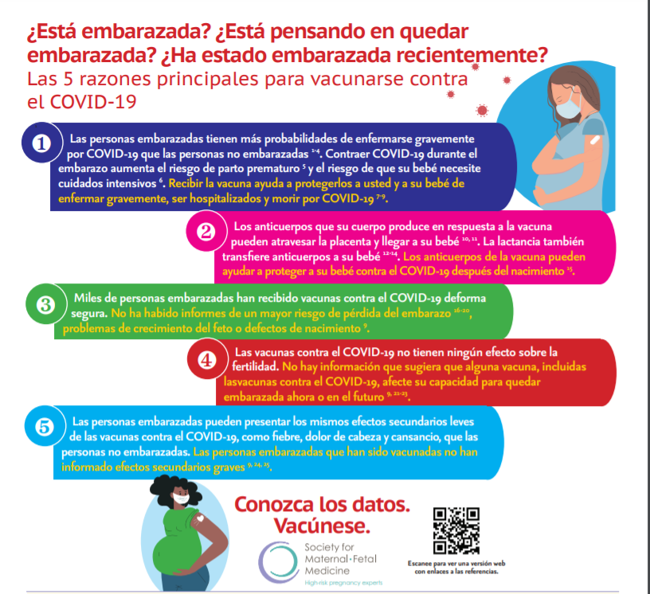
SMFM: NEW INFOGRAPHIC Top 5 Reasons to Get the COVID-19 Vaccine (English and Spanish)

Slide 49
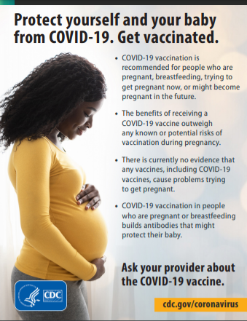
CDC

Slide 50
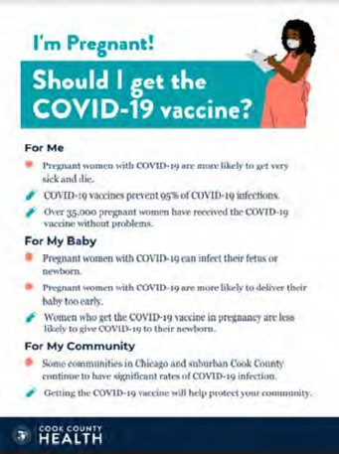
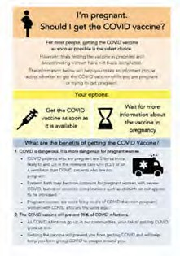

COVID Vaccine
Patient Education Examples
University of Massachusetts Medical School – Baystate: Covid Vaccine Info for Pregnant/Breastfeeding Patients English.
Available in:
Spanish, Nepali, Portuguese, Arabic, Turkish, Somali, Chinese, Vietnamese, Russian (3.17.21)
SMFM Patient Education (English/Spanish): COVID-19 Vaccines and Pregnancy. (3.4.21)
CDC: Safety of COVID-19 Vaccines. Video link. (Updated 6.8. 2021)
Cook County Health: Should I get the COVID-19 vaccine?
Flyer English and Spanish (6.11.21)
CDC: Information about COVID-19 Vaccines for People who Are Pregnant or Breastfeeding. (3.18.21)

Slide 51
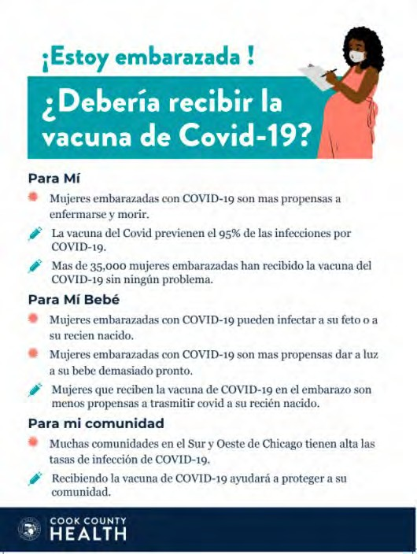

POSTERS

Slide 52
New ACOG / CDC PSA
Covid Vaccination in Pregnancy
Please Share This Important PSA
In partnership with the CDC, ACOG has released our first-ever PSA! Please help us spread this important, life-saving message to get vaccinated during pregnancy by sharing: https://vimeo.com/674866776 https://vimeo.com/672469139
We know that a trusted obstetrician-gynecologist can play a large role in a patient’s decision about whether to get vaccinated, so use this PSA as a tool to share with your communities and spread the message.

Slide 53
Updated OB/Neo Covid Publications
Plos Medicine: Incidence, co-occurrence, and evolution of long-COVID features: A 6-month retrospective cohort study of 273,618 survivors of COVID-19. (09.28.2021)
JAMA: Short-term and Long-term Rates of Postacute Sequelae of SARS-CoV-2 Infection. (10.13.21)
NyTimes: U.S. Has Far Higher Covid Death Rate Than Other Wealthy Countries. (1.2.2022)
AJOG: COVID-19 vaccination during pregnancy: coverage and safety. (2.1.2022)
JAMA: Association of BNT162b2 COVID-19 Vaccination During Pregnancy With Neonatal and Early Infant Outcomes. (2.10.2022)
Arch Pathol Lab Med: Placental Tissue Destruction and Insufficiency from COVID-19 Causes Stillbirth and Neonatal Death. (2.10.2022)
Nature: SARS-CoV-2 is associated with changes in brain structure in UK Biobank. (08.19.21)
NyTimes: Covid May Cause Changes in the Brain, New Study Finds. (03.7.2022)
MDPI: Stillbirth after COVID-19 in Unvaccinated Mothers Can Result from SARS-CoV-2 Placentitis, Placental Insufficiency, and Hypoxic. (2.15.2022)
34

Slide 54
Arti Barnes, MD, MPH
Medical Director / Chief Medical Officer, IL Department of Public Health

Slide 55
COVID-19 Therapies in Pregnancy: Monoclonal Antibodies and Oral Therapeutics
Arti Barnes MD, MPH
Medical Director/Chief Medical Officer
Notes:
tagline to reflect the value of public health

Slide 56
Covid 19 and pregnancy
  Pregant women more likely to need ICU care (ARR 3.0), ventilation (aRR 2.9), ECMO (aRR 2.4) and die from Covid-19 (aRR 1.7)
    Pre-vaccine
    Pre-Omicron
  In the vaccine era and Delta variant (Sept 2021)
    Higher risk of stillbirths with Delta (aRR 4.04)
Risks of still birth:
  chronic hypertension
  multiple-gestation
  adverse cardiac event
  placental abruption
  sepsis, shock
  acute respiratory distress syndrome
  mechanical ventilation
  ICU admission
Zambreno et al, MMWR Nov 2020
Desisto et al, MMWR Nov 2021
Notes:
After adjusting for age, race/ethnicity, and underlying medical conditions, pregnant women were significantly more likely than were nonpregnant women to be admitted to an intensive care unit (ICU) (10.5 versus 3.9 per 1,000 cases; adjusted risk ratio [aRR] = 3.0; 95% confidence interval [CI] = 2.6–3.4), receive invasive ventilation (2.9 versus 1.1 per 1,000 cases; aRR = 2.9; 95% CI = 2.2–3.8), receive extracorporeal membrane oxygenation (ECMO) (0.7 versus 0.3 per 1,000 cases; aRR = 2.4; 95% CI = 1.5–4.0), and die (1.5 versus 1.2 per 1,000 cases; aRR = 1.7; 95% CI = 1.2–2.4).
During the pre-Delta period (March 2020–June 2021), 6,983 stillbirths were documented, involving 0.98% of deliveries with COVID-19 compared with 0.64% of deliveries without COVID-19 (aRR = 1.47; 95% CI = 1.27–1.71). During the Delta period (July–September 2021), 1,171 stillbirths were documented, involving 2.70% of deliveries with COVID-19 compared with 0.63% of deliveries without COVID-19 (aRR = 4.04; 95% CI = 3.28–4.97).

Slide 57
IDPH-NIH Clinical Decision Tree
Notes:
90 days use 2 forms of protection

Slide 58
ACOG Vs NIH/EUA
NIH
  Pregnancy itself is a risk factor that warrants treatment
ACOG
  Pregnancy PLUS one additional risk factor should warrant treatment

Slide 59
RISK: Criteria for use of monoclonal antibodies to treat SARS-CoV-2
Obesity or being overweight (eg, adults with BMI >25 kg/m2, or, if age 12 to 17, have BMI ≥85th percentile for age and sex)
Pregnancy
Chronic kidney or liver disease
Diabetes mellitus
Immunosuppression, HIV
Cancer
Cardiovascular disease (including congenital heart disease) or hypertension
Sickle cell disease
Chronic lung diseases
Disabilities (even intellectual)
Dependence on a medical-related technology (eg, gastrostomy)
Mental health conditions (depressions, schizophrenia)
Physical inactivity
Smoking (current or former)
Substance use disorder
TB
Age > 65
Not an exhaustive list- clinician judgement is paramount
CDC People with Underlying Medical Conditions
Notes:
Substance use disorder, mental health

Slide 60
O!Micron
Bam/ete does not work against Omicron variant ¹
Regencov does not work against Omicron²
Sotrovimab retains activity in pre-clinical studies ³
  ⁻-EUA was updated for use within 7 days of symptom onset (previously 10 days) and shorter infusion time
Gruel et al preprint, open access
Wilhelm et al, preprint MedRxIV
Cathart et al, preprint, biorxIV
Notes:
https://drive.google.com/file/d/13iHMR6rk3MKRFhDZmNuH3AAjR1uT8mEU/view

Slide 61
BA.2
First detected in IL mid Jan 2022
  Only 1.5% prevalence in IL as of 2 weeks ago
Sotrovimab with 27 fold reduction in activity
Bebtelovimab retains activity Mixed data about Evusheld
Oral antivirals expected to retain activity
VACCINES RETAIN activity
Zhou et al, BioRxIV Pre-print Jan 2022
Iketani et al BioRxIV Pre-print Jan 2022
U.K. Health Security Agency Report Jan 2022
Notes:
Vaccines 70% efficacy symptomatic disease UK

Slide 62
Attachment inhibitors:
Bebtelovimab (anti-Spike mAb)
EUA just issued 2/11/22
Now available for ordering through IDPH
mAb indicated for treatment of outpatients with COVID-19 in patients at risk for development of moderate to severe disease
For adults and children > 12 who weigh > 40kg
Given as single IV push injection of 175mg over 30 seconds with 1 hour of post-dose observation
Given within 7 days of symptom onset
Only use if no adequate/available/approved alternative given limited data
In vitro, no reduction in activity against Omicron (BA1.1 or BA.2 variants)
  Slight reduction against Mu variant
Efficacy: BLAZE-4 study
Looked at lower risk patients
A higher proportion in the placebo arm vs. Tx arm had persistently high viral load at 7 days
    21% vs. 14%, RRR of 34%
Symptoms resolved more quickly:
    6 days vs. 8 days for Tx vs. placebo
Studied in higher risk patients but no placebo group makes comparison difficult
Safety: BLAZE-4 study, N = 602 patients
  Nausea 0.8%
  Infusion-related reactions 0.3% (N=2)
  Pruritus 0.3%
  Rash 0.8%
https://www.fda.gov/media/156152/download
Slide courtesy : Dr. Lubelchek

Slide 63
Getting ahead of the curve
Pre-exposure prophylaxis mAB Evusheld approved by the FDA
Restricted to those who are
  Immunocompromised and will not mount a good response to the vaccine
  Have a vaccine contraindication
Only be used during pregnancy if the potential benefit outweighs the potential risk for the mother and the fetus.
  No fetal tissue binding was observed
  Can cross placental barrier
FDA EUA FACT SHEETS
Notes:
In a tissue cross-reactivity study assessing off-target binding of tixagevimab and cilgavimab to human fetal tissues no binding of clinical concern was observed.

Slide 64
REMDESIVIR (ANTIVIRAL)
Remdesivir 200 mg IV on Day 1, followed by 100 mg IV daily on Days 2 and 3
  initiated as soon as possible
  within 7 days of symptom onset
  aged ≥12 years or 40 kg
  Pediatric use >=3.5 kg
  Off label use for non hospitalized patients
Notes:
In settings where anaphylaxis can be managed.

Slide 65
WHO? WHEN?
For post exposure prophylaxis (casiri/imde subQ or IV OR bamla/ete IV, NOT sotrovimab or Bebetlovimab)
  Close contact OR institutional setting exposure (high risk)
  Not been fully vaccinated OR who are expected to have inadequate response to vaccination (anyone considered immunosuppressed)
  Within 7 days of exposure
    Studies used 96 hours from exposure to measure efficacy
FDA EUA FACT SHEETS
Notes:
Not PRE- exposure prophy

Slide 66
mAB and COVID-19 vaccine/booster
Limited data on how they may interact with each other
If vaccine is administered first, no delay in mAB
If mAB if administered first, CDC suggests a 90 day delay till vaccine administered considering that re-infection in 90 days from receipt of such therapies is rare.
NO DELAY if mAB given before vaccine
HHS clinical implementation guide for Monoclonal Antibodies, Dec 2021
Notes:
Based on the estimated half-life of such therapies and evidence suggesting that reinfection is uncommon within the 90 days after initial infection, vaccination should be deferred for at least 90 days after receiving monoclonal antibodies or convalescent plasma. This is a precautionary measure until additional information becomes available, to avoid potential interference of the antibody therapy with vaccine-induced immune responses. This recommendation applies to people who receive passive antibody therapy before receiving any vaccine dose; any vaccine dose after the initial vaccine dose should be deferred for at least 90 days following receipt of the antibody therapy. Receipt of passive antibody therapy in the past 90 days is not a contraindication to receipt of COVID-19 vaccine. COVID-19 vaccine doses received within 90 days after receipt of passive antibody therapy do not need to be repeated.
https://www.phe.gov/emergency/events/COVID19/investigation-MCM/Documents/USG-COVID19-Tx-Playbook.pdf

Slide 67
ORAL AGENTS
Oral pills for outpatient treatments-
Molnupiravir authorized by the FDA (~30% effective in reducing hospital admissions)
  800 mg twice a day for 5 days
  Given within 5 days of symptom onset
  Safety concerns- mutagenesis
Paxlovid also authorized by the FDA (~89% effective in reducing hospital admissions)
  Twice a day for 5 days
  Combined with a boosting agent ritonavir (significant drug interactions)
Notes:
Impact on bone and cartilage – not in children

Slide 68
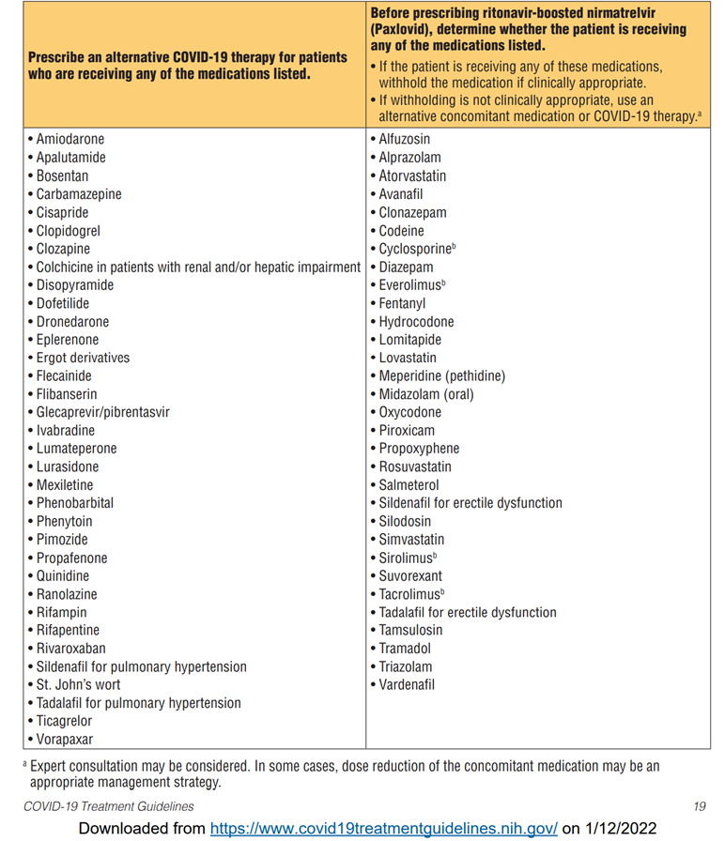
Paxlovid Drug interactions

Slide 69
Paxlovid (Drug Interactions)
Use another Covid-19 agent if the patient is on
  Clopidogrel, rivaroxaban
  Sildenafil or tadalafil (for pulm HTN)
  Phenytoin
  Colchicine
  Amiodarone
  12 other agents
Hold these agents while on Paxlovid
  Atorvastatin, simvastatin, rosuvastatin
  Tacrolimus, sirolimus
  Clonazepam, midazolam
  Tramadol, hydrocodone, oxycodone
  Vardenaphil, sildenafil (for ED)
NIH Statement on Paxlovid Drug-Drug interactions
Notes:
https://www.covid19treatmentguidelines.nih.gov/therapies/statement-on-therapies-for-high-risk-nonhospitalized-patients/
https://www.covid19treatmentguidelines.nih.gov/therapies/statement-on-paxlovid-drug-drug-interactions/
17 contraindications

Slide 70
Paxlovid
Renal impairment
Reduce to 150 mg of nirmatrelvir if GFR is 30-60 ml/min
Avoid if GFR <30 ml/min
Hepatic Impairment
Avoid if Child Pugh C

Slide 71
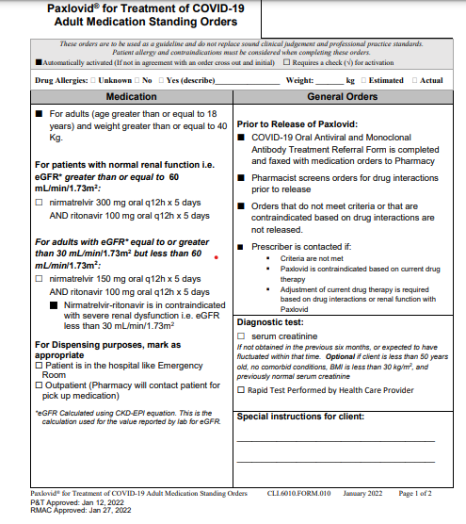
PAXLOVID AND HIV
Ritonavir has an antiviral effect
  Do not use in women with unsuppressed HIV
    Could result in HIV antiviral resistance

Slide 72
Molnupiravir
ONLY use when other agents not available in a timely manner
Can cause DNA mutations in humans (theoretical risk)
Equivocal data in rodents
Avoid in
Pregnancy (especially under 10 weeks gestation)
Age under 18 years (damage to bone and cartilage)
Notes:
Contraception
Females of childbearing potential: Use a reliable method of contraception correctly and consistently, as applicable during treatment and for 4 days after final dose
Males with partners of childbearing potential: Use a reliable method of contraception correctly and consistently during treatment and for at least 3 months after final dose; risk beyond 3 months after last dose is unknown; studies on the risks >3 months are ongoing
Animal data
Oral administration to pregnant rats during organogenesis resulted in embryofetal lethality and teratogenicity at 8x the human NHC exposures at the recommended human dose (RHD) and reduced fetal growth at ≥3x the human NHC exposure at the RHD
Oral administration to pregnant rabbits during organogenesis resulted in reduced fetal body weights at 18x the human NHC exposure at the RHD

Slide 73
Molnupiravir
Contraception
  Natal females should use contraception during and for 4 days after completing last dose
  Natal males should use contraception for THREE MONTHS after completing last dose
Breastfeeding
  Unknown- advised to avoid for up to 4 days after last dose

Slide 74
Access to medications
There are
  639 therapeutics locations across the state
  325 Drive-through Walgreens
  136 Walmarts and 23 Sam’s Clubs
  Coverate 99.4% of state population
  14 LTC pharmacies are involved in distributing therapy
Notes:
CIMPAR ( we are not a pharmacy but we survive LTC with vaccines and mABs ) BANDYS LONG TERM CARE PHARMACY
CARE ONE PHARMACY SERVICES
Forum Extended Care Services
GREEN TREE PHARMACY
HEALTHDIRECT PHARMACY #128
HEALTHDIRECT PHARMACY #129 MAC RX LLC MEDICATION MANAGEMENT PARTNERS MEDWIZ PHARMACY OF ILLINOIS OREGON HEALTHCARE PHARMACY SERVICES PHARMSCRIPT OF ILLINOIS SYMBRIA RX SERVICES THE MEDICINE SHOPPE #503

Slide 75
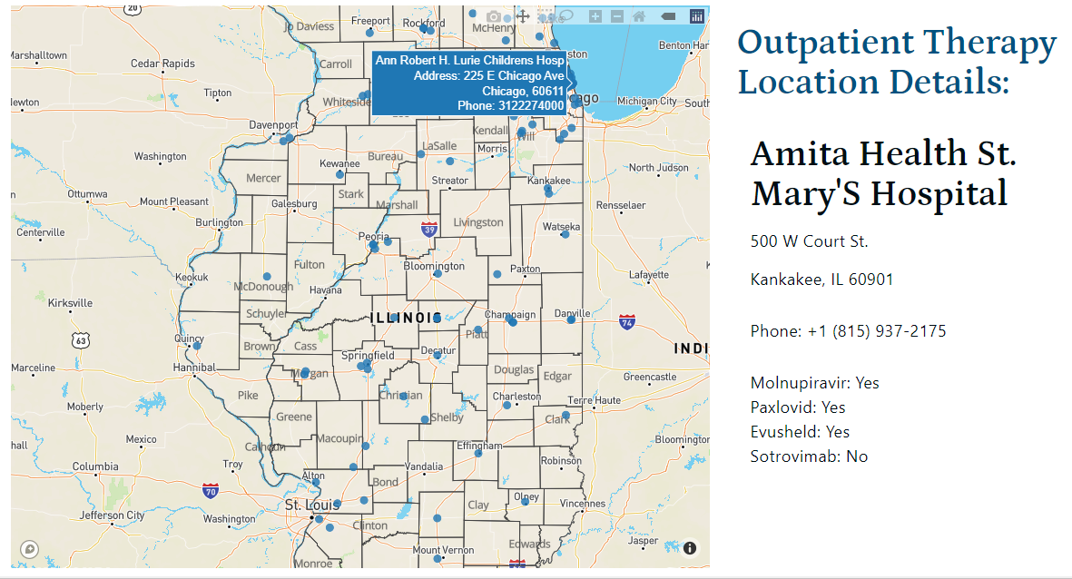
IDPH Covid Outpatient Therapy locator

Slide 76
In Summary
Therapeutics can prevent hospitalizations and deaths (maternal and child) in pregnant with Covid
Oral agents are widely accessible and work against variants
The Need-to-Use gap should decrease especially in high risk pregnant women

Slide 77
THANK YOU
  ​
  Ashley Thoele, ashley.thoele@illinois.gov
  Kristin Rzeczkowski, kristin.rzeczkowski@illinois.gov ​
  Aaron Eisfelder: DPH.mabtherapy@illinois.gov
  IEM team, OPR team

Slide 78

Increasing Vaccine Confidence Among Pregnant People and Caregivers
ILPQC COVID-19 Strategies for OB and Neonatal Units
Andie Baker, Deputy Director of Strategy and Programs
EverThrive Illinois

Slide 79

About EverThrive Illinois
EverThrive Illinois’ mission is to achieve reproductive justice in the health care ecosystem through community-driven partnership, policy action and systems change.
OUR VISION
A just and affirming health care ecosystem where individuals, families and communities can thrive
OUR VALUES
Reproductive Justice
Anti-Racism
Centering the Most Impacted
Bold Action and Transformation
Notes:
Update new messaging

Slide 80
Background
Educating Pregnant People and Caregivers about COVID-19 Vaccination
According to a recent Kaiser Family Foundation survey, Black women often serve as healthcare decision-makers for their families.
In the same survey, the majority interviewed said they did not have the information they needed about many aspects of COVID-19, including vaccination.
Only 33% of pregnant people ages 18-49 are fully vaccinated for COVID-19 with Black birthing people with the lowest rates at just 17%
Continue to see significant disparities in vaccination among Black/African American Chicagoans compared to their counterparts
CDC. COVID Data Tracker. Centers for Disease Control and Prevention
Guo, T, Fan Y, Chen M. Cardiovascular Implications of Fatal Outcomes of Patients with Coronavirus Disease 2019
2021. Attitudes Towards COVID-19 Vaccination Among Black Women and Men.
Notes:
Question about COVID19 or flu vaccination

Slide 81
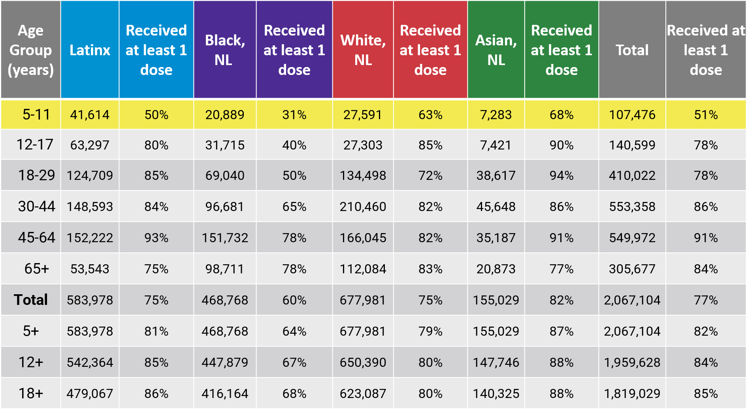
Percentage of population with at least one dose by race/ethnicity and age
Chicago Department of Public Health
Chicago COVID Update
March 8, 2022

Slide 82
Campaign Goals
Address hyper local concerns regarding COVID-19 Vaccination
Connect community members to Vaccine Providers
Reach 100,000 people through social media and canvassing
Increase Community Level Vaccine Confidence
Increase COVID-19 Vaccination Rates
Short Term
Long Term
Notes:
Question about COVID19 or flu vaccination

Slide 83
Outreach Strategy
Virtual Engagement
Neighborhood Canvassing
Training Health and Social Service Providers
English and Spanish Language Websites providing up to date vaccine information
Facebook and Instagram ads aimed at reaching 100,000 people
  Parents and Caregivers
  Pregnant and Recently Pregnant People
Distribute Door Hangers and Palm cards with QR codes connecting recipients to landing page
Outreach to community-based organizations and businesses in Roseland, Englewood and Woodlawn neighborhoods (e.g. homeless shelters, WIC offices, food pantries, FQHCs, currency exchanges, and churches)
Train staff at nine community-based organizations on increasing vaccine confidence

Slide 84
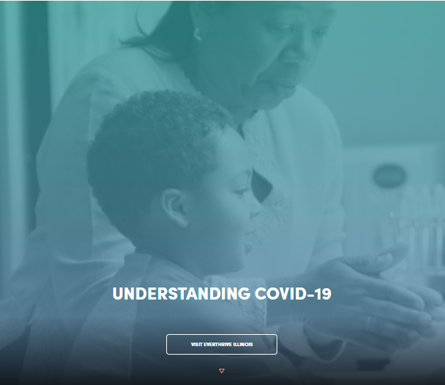
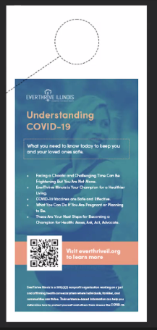
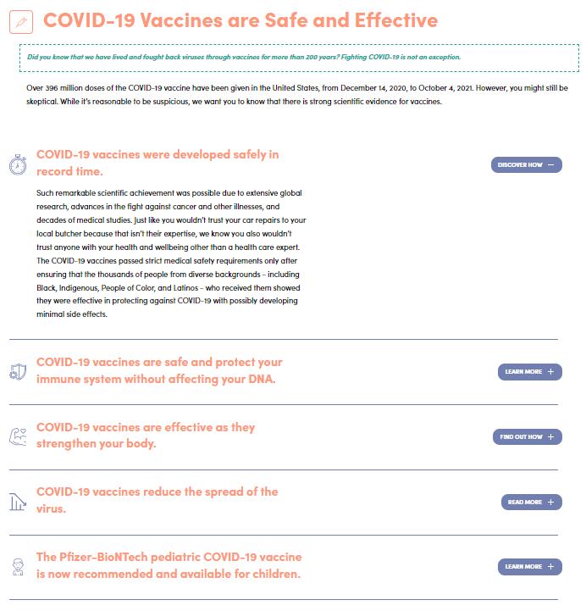
Campaign Resources

Slide 85
Campaign Resources
Websites in English and Spanish
https://understand.everthriveil.org/
https://understand.everthriveil.org/es/
Fact Sheets on our websites for:
Parents and Caregivers
Pregnant and lactating people
Faith leaders (coming soon!)
Train the Trainer Series
Aimed at healthcare and social service professionals who work with pregnant people and caregivers
Address topics such as:
  Information about COVID-19 Vaccines
  Talking to pregnant people, recently pregnant people and caregivers about vaccination
  Key messages
Notes:
Add additional trainings. Update coming soon

Slide 86
What we have accomplished
Since December 2021, the virtual campaign reach is 141,889 (unique individuals who have seen the campaign) with a .42% click through rate.
We have counseled 1,975 community members through street-based outreach in Roseland, Englewood and Woodlawn communities about the importance of vaccination

Slide 87
What we are learning
Community concerns include:
  Speed with which vaccinations have been developed
  If we can create vaccines for COVID-19, why can’t we address hypertension, diabetes or cancer
  COVID-19 vaccinations cause infertility
  Too many different conflicting information sources
  Will get first or second dose, but booster is too much
What’s working:
  Hire members of the community
  Peer to peer conversations where health educator shares personal experience with vaccines and side effects for themselves and their children
  Directly address myths in vaccine campaigns
  Create opportunities where people feel comfortable ask those they trust questions about the vaccination

Slide 88
Contact Us
  Andie Baker, Deputy Director of Strategy and Programs
abaker@everthriveil.org
  Join our Mailing List
https://everthriveil.org/contact-us/

Slide 89
Helen Plavnick, MD
OB/GYN Advocate Lutheran General Hospital, Skokie IL

Slide 90
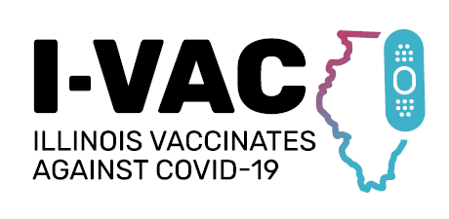




Foundational Training
Learning Collaboratives
Implementation Support
Toolkit & Outreach Materials
Notes:
The goal is to ensure Illinoisans are being immunized at every opportunity and trusted healthcare providers are prepared to immunize additional age-groups and special at-risk populations.
FREE PROGRAM FOR PROVDERS AND PROVIDER ORGANIZATIONS
data will be used to support I-VAC activities and prioritizations

Slide 91
Foundational Training
“Vaccine Bootcamps”
  Foundational knowledge and skills related to COVID-19 vaccine administration and distribution:
    Operational issues (I-CARE, VFC, etc.)
    Handling, storage and preparation
    Clinical resources for adult and pediatric populations
    Strategies for overcoming vaccine hesitancy
Held weekly for four weeks – multiple cohorts – web-based – Free CME

Slide 92

Implementation Support
Local providers in primary care and hospital networks to serve as coaches
From each of the 11 COVID-19 regions in the state
Support throughout the process
Seeking OBGYNs to serve as advisors

Slide 93
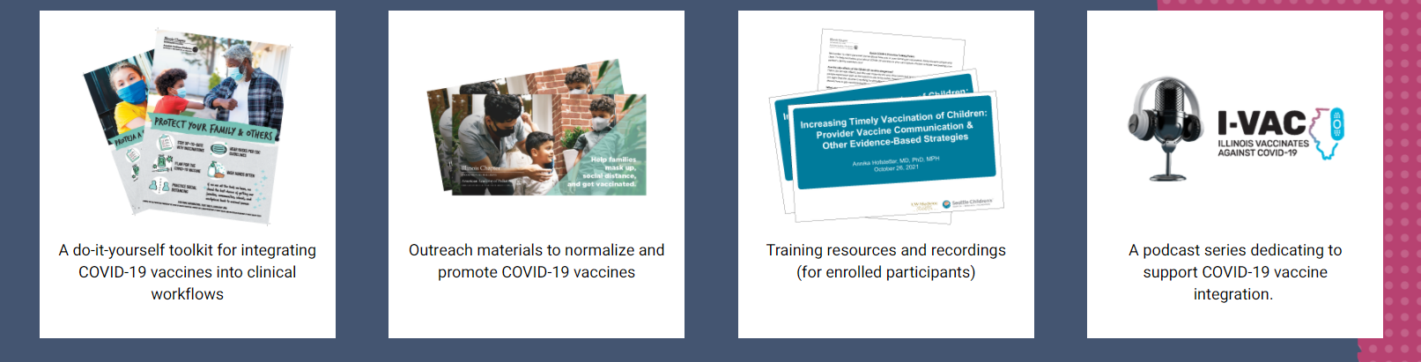
Toolkit & Outreach Materials
Website: illinoisvaccinates.com
Notes:
Supplemental materials, materials to support project

Slide 94
OB Discussion Panel
IDPH Update on Covid Therapeutics in Pregnancy/Postpartum
  Arti Barnes, MD, MPH -- Medical Director / Chief Medical Officer, IL Department of Public Health
Everthrive Vaccination Program Update
  Andie Baker-- Deputy Director of Strategy and Programs, EverThrive Illinois
ICAAP Vaccination Program
  Helen Plavik, MD -- Ob/Gyn Advocate Lutheran General Hospital, sharing example of providing COVID vaccines in OB/GYN office
Discussion of OB Unit Strategies
  Ann McCormick, DO -- Maternal Fetal Medicine, Rush University Medical Center
Notes:
Executive Medical Director, Family Birth Center
Chief of Obstetric Quality

Slide 95
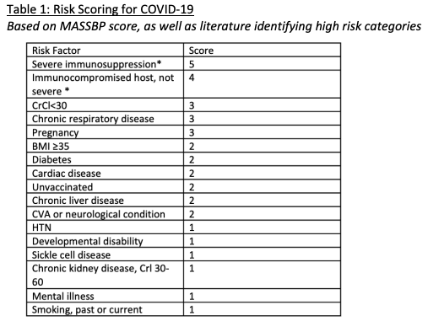
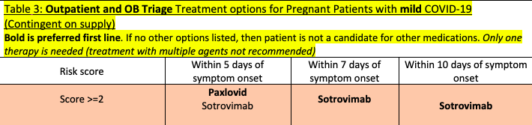
Therapeutics for pregnant patients with mild COVID-19
Sotrovimab
  infusion via home health
Paxlovid
  oral antiviral pill
  First line
  Several drug interactions
  Contraindicated if eGFR <30
Remdesivir – infusion over 3 days
  Reserved for inpatients only secondary to dosing
  *Any patient with >2 points are candidates for therapeutics
This document is privileged and confidential under the Illinois Medical Studies Act and should not be shared or distributed other than through the Rush University Medical Center quality improvement committee structure.

Slide 96
Thank You
We continue to give thanks to the nurses, doctors, health care workers, public health teams and others across our state at work confronting the COVID-19 pandemic.
Please send questions, comments and recommendations, cases / willingness to share for future COVID-19 OB/Neo discussion webinars to info@ilpqc.org
Recording of this webinar, Q/A and registration for the next webinar on Friday, April 1, 12-1:15pm, will be available at www.ilpqc.org

Slide 97












Thanks to our Funders
In kind support:

