Slide 1

COVID-19 Strategies for OB & Neonatal Units
June 12, 2020
12:00 – 1:15pm

Slide 2

Welcome
Please be certain you are on “mute” when not speaking to avoid background noise.
Whether you have joined by phone or computer audio, you can mute and unmute yourself by clicking on the microphone icon.
The following shortcuts can also be used
For PC: Alt + A : Mute or Unmute
For Mac: Shift + Command + A: Mute or Unmute
For telephone: *6 : Mute or Unmute

Slide 3
Housekeeping:
We Are Recording Now

Slide 4
Before we begin…
In this time when the country and our communities are in crisis and shaken by the effects of racism and bias we are stricken by the impact on our communities, families, patients and colleagues. As we move forward together as the community of ILPQC, we consider the impact of institutional racism and implicit and explicit bias on maternal and newborn health outcomes.
We remain focused on promoting equity and reducing maternal and newborn disparities in everything we do together as a collaborative, from Covid-19 impact, through our upcoming Birth Equity Initiative and in each of our ongoing and upcoming initiatives.
Together as a collaborative we can listen, learn from each other, take responsibility for change and do better. Please send thoughts or comments to info@ilpqc.org.

Slide 5
Birth Equity Links
Please see the following links and publications for information that may help your organization consider next steps to take action to address birth equity and reduction of perinatal racial and ethnic disparities.
AIM: Reduction of Peripartum Racial/Ethnic Disparities Patient Safety Bundle (May 2018)
ACOG: Reduction of Peripartum Racial and Ethnic Disparities: a conceptual framework and maternal safety consensus bundle (May 2018)
ACOG Committee Opinion No. 729: Importance of Social Determinants of Health and Cultural Awareness in the Delivery of Reproductive Health Care (January 2018)
SMFM: Strategies to overcome racism's impact on pregnancy outcomes (May 2020)
SMFM: Strategies to provide equitable care during COVID-19 (May 2020)
ACOG: Addressing Health Equity During the COVID-19 Pandemic (May 2020)
AAP: Racial and Ethnic Disparities in the Health and Health Care of Children (May 2013)
AAP Policy Statement: The impact of racism on child and adolescent health (August 2019)

Slide 6
ILPQC Covid 19 webinars
The strategies shared today are examples from individual institutions not IDPH or ILPQC recommendations.
This is our 9th COVID-19 strategies for OB/Neonatal Units webinars, Friday’s at noon since April 3rd. Please see https://ilpqc.org/covid-19-information/ for future webinar registration, prior recorded webinars and written out Q/A’s from those webinars.
We have moved to every other week webinars, the next call will be Friday, June 26.
Please let us know if your hospital would like to share on an upcoming webinar, please put questions/comments into the chatbox or email directly to info@ilpqc.org

Slide 7
Overview
Introduction
Discussion of Neonatal Unit Strategies
  Aarti Raghaven, MD, Neonatologist, University of Illinois Hospital, Chicago
  Amanda Bennett NNP, Neonatal Nurse Practitioner, Swedish American Hospital, Rockford
  Shaaista Budhani, MD Neonatologist, Swedish American Hospital, Rockford
  Leslie Caldarelli, MD, NICU Director, Prentice Women's Hospital, Chicago
  Justin Josephsen, MD, Medical Director – St. Mary’s Hospital NICU, Neonatologist Cardinal Glennon Children’s Hospital, St. Louis
Discussion of OB Unit Strategies
  Jen Pacheco, MSN, RNC-OB, Women & Children’s Education Coordinator, Swedish American Hospital, Rockford
  Jean Goodman, MD, Maternal-Fetal Medicine, Loyola Medical Center, Maywood
  Jeannie Kelly, MD, MS, Maternal-Fetal Medicine, Barnes Jewish Hospital, St. Louis
IDPH Hospital Survey Covid-19
  Amanda Bennett, PhD, MPH, CDC Field Assignee in Maternal and Child Health Epidemiology, Illinois Department of Public Health

Slide 8
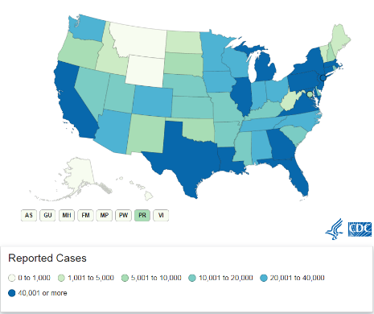
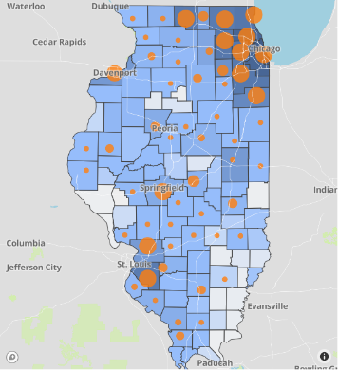
Data Update June 11, 2020
CDC/IDPH: COVID-19 Outbreak
CDC (5.14.2020) https://www.cdc.gov/coronavirus/2019-ncov/cases-updates/cases-in-us.html | IDPH https://www.dph.illinois.gov/covid19
Total cases: 1,994,283 confirmed Total deaths: 112,967 confirmed | 130,608 Confirmed Positive Cases 6,185 Deaths
Notes:
Dan to update

Slide 9
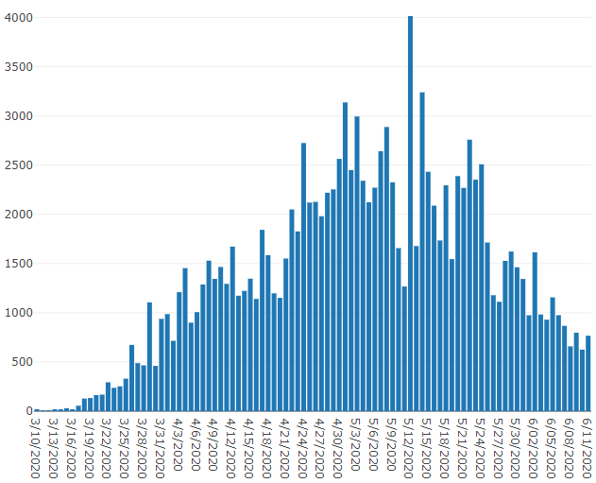
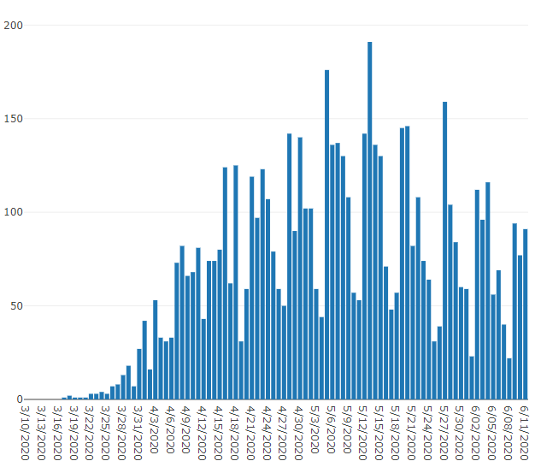
Data Update June 11, 2020
IDPH: COVID-19 Outbreak
https://www.dph.illinois.gov/covid19
IL Positive Cases Over Time
IL Deaths Over Time
Total: 130,608 Confirmed Positive Cases
Total: 6,185 Deaths
Notes:
http://www.dph.illinois.gov/covid19/covid19-statistics
Dan to update

Slide 10
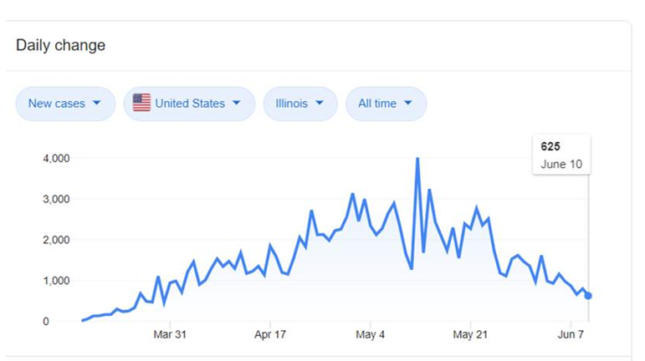
Illinois Daily Incidence
IDPH daily data summary

Slide 11
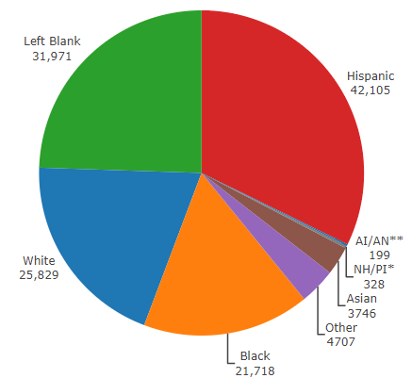
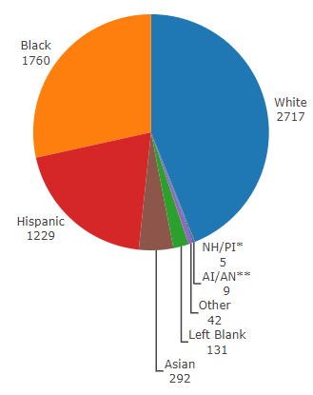
Data Update June 11, 2020
IDPH: COVID-19 Outbreak
Race Demographics
https://www.dph.illinois.gov/covid19
Confirmed Cases
Deaths
Notes:
http://www.dph.illinois.gov/covid19/covid19-statistics
Dan to update

Slide 12
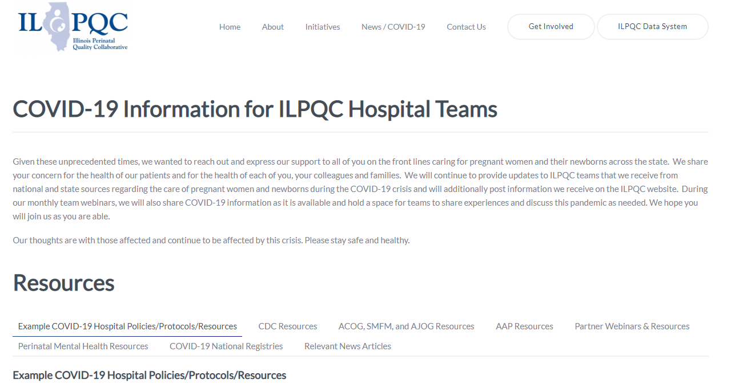
ILPQC COVID-19 Webpage www.ilpqc.org
ILPQC posts national guidelines and OB & Neonatal COVID-19 example hospital protocols & resources
please note dates as guidelines are changing rapidly
https://ilpqc.org/covid-19-information/

Slide 13
IDPH Communications
IDPH - Coronavirus Disease 2019 (COVID-19)
IDPH - Coronavirus Disease 2019 (COVID-19): Press Releases / Briefings
IDPH - Coronavirus Disease 2019 (COVID-19): Frequently Asked Questions
Coronavirus COVID-19 Global Cases by Johns Hopkins CSSE
CDC Homepage for Coronavirus Disease 2019 (COVID-19)
IDPH: COVID-19 Elective Surgeries & Procedures (4.24.2020)
IDPH: COVID-19 Considerations for Healthcare Providers in ANY Healthcare Setting (4.26.2020)
CDC: Symptom-Based Strategy to Discontinue Isolation for Persons with COVID-19 (5.3.2020)
IDPH: Changes to Isolation Period for COVID-19 Cases (5.7.2020)
IDPH PAC: Obstetrical & neonatal care during the COVID-19 pandemic (5.14.2020)
CDC: Protect yourself and your family from COVID-19 (6.9.2020)

Slide 14
Updated OB Resources
ACOG & SMFM: COVID-19 Algorithm (Shared 4.23.2020)
SMFM: Management Considerations for Pregnant Patients With COVID-19 (4.29.2020)
ACOG: Early Acute Respiratory Support for Pregnant Patients With Coronavirus Disease 2019 (COVID-19) Infection (4.29.2020)
ACOG: reopening women’s health (5.06.20)
ACOG: Health Equity in Covid 19 (5.11.20)
AJOG MFM: Coronovirus Guidance
ACOG: Step-by-Step Guide: How Ob-Gyn Practices Can Access HHS Federal Relief Funds (5.19.20)
ACOG: Practice Advisory: Novel Coronavirus 2019 (COVID-19) (updated 5.19.2020)
ACOG: COVID-19 FAQs for Obstetrician-Gynecologists, Obstetrics (updated 5.20.2020)
SMFM: Practical Guidance for Treating Pregnant Persons with COVID-19 in Resource Limited Settings: Early Lessons from the US Epidemic (5.20.20)
ACOG: FAQs for Practices: Financial Relief Provisions in the Coronavirus Aid, Relief and Economics Security (CARES) Act (updated 5.27.20)
ACOG Ob-Gyn Practices Financial Relief Information (6.2020)
  Step-by-Step Guide: How Ob-gyn Practices Can Access HHS Federal Relief Funds
  Advanced and Accelerated Insurance Payment Programs Available During COVID-19
  Update: ACOG Continues to Work to Secure Financial Relief for Obstetrician-Gynecologists
  Telehealth Policy Changes and A New Loan Program for Practices (5.29.2020)

Slide 15
Updated AAP Neonatal Guidance
AAP FAQs: Management of Infants Born to Mothers with Suspected or Confirmed COVID-19 (5.21.2020)
Newborn Care (5/21/20): Guidance for the care of infants whose mothers have suspected or confirmed COVID-19. Includes precautions for birth attendants, rooming-in, breastfeeding, testing, neonatal intensive care, visitation and hospital discharge.
  https://services.aap.org/en/pages/2019-novel-coronavirus-covid-19-infections/faqs-management-of-infants-born-to-covid-19-mothers/
  Newborn Screening During the COVID-19 Pandemic (4/15/20): Guidance recommending that pediatricians continue to follow federal and state guidelines on newborn bloodspot screening, newborn hearing screening, and critical congenital heart disease screening.
    https://services.aap.org/en/pages/2019-novel-coronavirus-covid-19-infections/guidance-on-newborn-screening-during-covid-19/
Breastfeeding Guidance Post Hospital Discharge for Mothers or Infants with Suspected or Confirmed SARS-Co V-2 Infection (4/23/20): Guidance developed to support pediatricians providing direct care for breastfeeding families after discharge from the newborn hospital stay.
  https://services.aap.org/en/pages/2019-novel-coronavirus-covid-19-infections/breastfeeding-guidance-post-hospital-discharge/

Slide 16
Updated OB/Neo Covid Publications
OBGYN: Pregnancy hypertension diagnosis and care in COVID ‐19 era and beyond (6.7.2020)
NEJM: False Negative Tests for SARS-CoV-2 Infection — Challenges and Implications (6.5.2020)
Lancet: Physical distancing, face masks, and eye protection to prevent person-to-person transmission of SARS-CoV-2 and COVID-19: a systematic review and meta-analysis (6.1.2020)
OBGYN: Prone Positioning for Pregnant Women With Hypoxemia Due to Coronavirus Disease 2019 (COVID-19) (5.29.2020)
OBGYN: Prevention of thrombosis in pregnant women with suspected SARS‐CoV ‐2 infection: clinical management algorithm (5.25.2020)
AJOG: Universal testing of patients and their support persons for COVID-19 when presenting for admission to Labor and Delivery within the Mount Sinai Health System (5.22.20)
AJCP: Placental pathology in COVID-19 (5.22.20)
AJOG MFM: Preeclampsia Treatment in SARS-CoV-2 (5.20.20)
OBGYN: Clinical Findings and Disease Severity in Hospitalized Pregnant Women With Coronavirus Disease 2019 (COVID-19) (5.19.2020)
OBGYN: Testing of Patients and Support Persons for Coronavirus Disease 2019 (COVID-19) Infection Before Scheduled Deliveries (5.19.2020)
AJOG MFM: Vertical transmission of COVID-19 SARS-CoV-2 RNA on the fetal side of the placenta in pregnancies with COVID-19 positive mothers and neonates at birth (5.18.20)
OBGYN: A Postpartum Death Due to Coronavirus Disease 2019 (COVID-19) in the United States (5.8.2020)
AJOG MFM: Detection of SARS-COV-2 in placental and fetal membrane samples (5.8.20)
AJOG MFM: Clinical course of severe and critical COVID-19 in hospitalized pregnancies: a US cohort study (5.8.20)
Support for Pregnant Patients With Coronavirus Disease 2019 (COVID-19) Infection (4.29.2020)
AJOG: False-Negative COVID-19 Testing: Considerations in Obstetrical Care (4.28.2020)

Slide 17
Mental Health/Wellness
ACOG: Wellness in the Time of COVID-19 (6.2020)
MCPAP for Moms: Mental Health Care Package for Pregnant and Postpartum Women and Families (5.20.2020)
MCPAP for Moms: Promoting Optimal Mental Health for Pregnant and Postpartum Women during COVID-19 (5.20.2020)
MCPAP for Moms: Taking Care of Yourself During COVID-19 (5.20.2020)

Slide 18
Updated “Recovered” Definition
CDC and IDPH have aligned to the following recommendations for both healthcare and non-healthcare workers
For asymptomatic individuals: Isolation should be maintained for 10 days from the positive COVID-19 diagnostic test as long as the patient remains asymptomatic during that period of time
For symptomatic individuals: Isolation should be maintained for at least 10 days after illness onset and at least 72 hours after recovery
  Illness onset: date symptoms began
  Recovery: resolution of fever without the use of fever-reducing medications with progressive improvement or resolution of other symptoms
Exposed family members / contacts should quarantine for 14 days
These time periods may be adjusted for individuals who are immunocompromised, work in high risk environments or other special populations

Slide 19
Managing “Recovered” Patients
Considerations of how to manage isolation requirements for “recovered” patients
Example of strategy from NorthShore University HealthSystem
All hospitalized COVID-19 patients will remain in isolation until discharged from the hospital. The EPIC COVID-19 banner will be removed 14 days after discharge from hospital and they will be noted to be “COVID recovered”.
  If a patient is re-admitted 14 days after discharge, they are considered recovered and do not need to be admitted to the COVID unit or re-tested.
  If a patient is re-admitted within 14 days of discharge, they should be placed in isolation and admitted to the COVID unit.
  If an ambulatory patient (never hospitalized) needs hospitalization for any reason 14 days after symptom onset, they are considered COVID recovered and do not need to be admitted to the COVID unit or re-tested.
  If an ambulatory patient (never hospitalized) needs hospitalization for any reason within 14 days of symptom onset, they should be placed in isolation and in general will be admitted to a COVID unit unless they fall into a special population such as an obstetric patient.

Slide 20
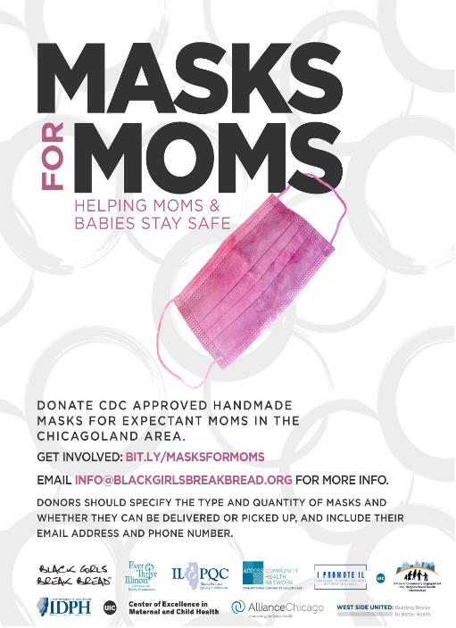
Masks for MOMs wants to get reusable cloth face masks to the moms and moms-to-be who need them in the Chicago-land area.
The aim is to ensure that pregnant moms from vulnerable communities have access to face masks at their prenatal visits and when they arrive at hospitals for delivery.
Find out more & sign-up to volunteer at https://bit.ly/masksforMOMs.

Slide 21
Discussion of Neonatal Unit Strategies

Slide 22
Visitation at University of Illinois Hospital and Health Sciences Systems
Neonatal Intensive Care Unit during the Covid-19 Pandemic
Aarti Raghavan, MD,FAAP, MS (Patient Safety Leadership)
Medical Director, NICU
Director of Quality and Safety, Department of Pediatrics
Program Director, Graduate Programs in Patient Safety
University of Illinois Hospital/ University of Illinois at at Chicago

Slide 23
UIH NICU
Childrens hospital (Childrens Hospital University of Illinois) within a 500 bed general hospital.
Located in the Illinois Medical District on the West side of Chicago.
Delivery volume 2500/ year
Approximately 700 NICU admissions/ year
44 bed Level III NICU, 30 ICU beds
Open bay unit – Unit design original from 1970s
In house 24/7 Neonatology coverage including Attendings and Fellows, active transport team.
Supported by all pediatric subspecialty services except ECMO and Pediatric ENT

Slide 24
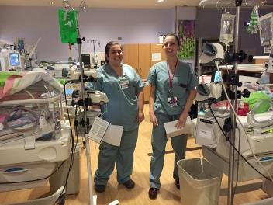
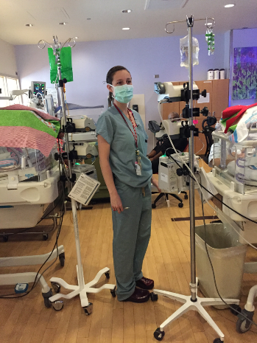
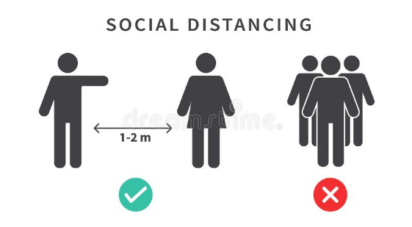
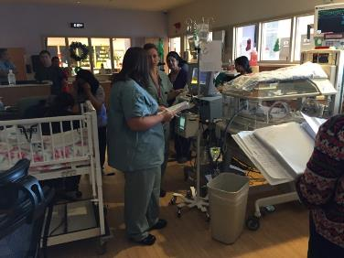
Normal Operations in the UIH NICU

Slide 25
UIH NICU Covid Strategy and Plans
Multidisciplinary NICU Covid 19 Leadership team
Daily meetings with review of city, state, hospital numbers
Review of new literature.
Address new needs:
  Accommodate term PUI newborns
  Increase social distancing
  Incorporate new hospital, state and national recommendations
Visitation restrictions implemented in a collaborative, step-wise manner approved by Incident Command as follows:
  Only parents to visit
  Only one parent to visit only once per day

Slide 26
The Trigger Point – Late March, 2020
Prior to universal screening and availability of POCT
Baby C born at 31 weeks gestational age to an asymptomatic mother by SVD.
Suspected anal atresia on admission.
Supported with CPAP from birth.
Initially placed NPO , central lines placed and started on TPN.
Both parents initially allowed to visit the NICU during hospitalization.
In second week of life, visitation restricted to mother.
At post menstrual age 33 weeks (2 weeks into admission), mother developed influenza like illness (ILI) symptoms and became a PUI.
Last visit to NICU – few hours prior to symptom onset.
She was tested by her PCP using PCR – 72 hour turn around time.
Issues that came up:
  Contact tracing
    Exposure to patient
    Exposure to other patients – neighbors, patients who had shared nurses
    Exposure to other families – Other parents who were visiting?
    Exposure to staff – (Unit clerk, Nurses, respiratory therapists, residents, fellows, attendings)
  Exposure to equipment / surfaces
  How far back to we trace ? 14 days at the time based on CDC recommendations.

Slide 27
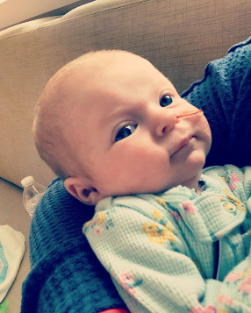


Slide 29
UIH Approach to Safety
Change in visitation policy followed mother who had been routinely visiting and became PUI
  NICU closed to visitors – Trigger point in March
  Recognition that there is no ability to adequately screen visitors for COVID risk
  Can't adequately screen visitors since they could potentially be infectious prior to the onset of COVID symptoms
  Guidance from IDPH that Covid negative status not reliable and care should continue with assumption of positive
Exceptions were made for:
  Parents of infants who are being discharged have scheduled times with infant, physician, nurse or pharmacist for discharge teaching in the NICU Brightspace Room. Room cleaned between discharges.
  Parents of critically unstable infants are being accommodated
  Parents are allowed a brief visit just prior to and right after an infant undergoes surgery
Enhanced parent communication
  Child Life specialist set up video conferences for families with infant and nurses
  Using tablets to videoconference with parents
  Daily touchbase by medical team via phone with each family
  New social worker and family support specialist assisting with family needs – “Drop off day”

Slide 30
Other Safety Measures at UIH
Social distancing of medical team
  Ceased bedside rounds in the NICU
  OWL and laptops to facilitate remote rounders
  NICU Hospitalists, Nutrition, Pharmacy, Pediatric Sub-Specialty Consultants – all are remote rounders
  Nurses call-in
  Only one physician doing exam per patient – Attending

Slide 31
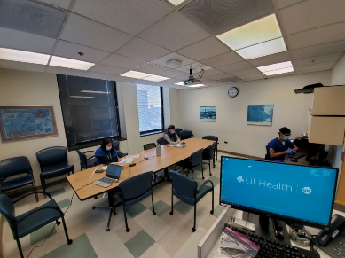
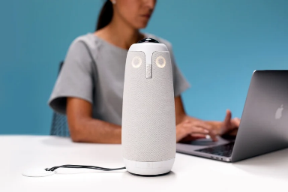
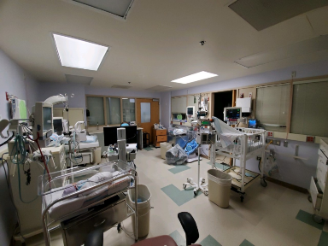
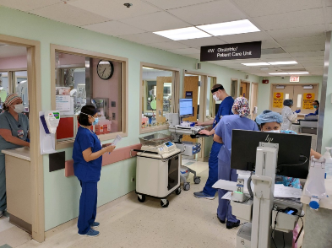
The Current Normal

Slide 32
Qualitative Outcomes
No Covid positive staff in NICU
Significant increase in emotional support needs for family and staff
Need for quick procurement, adaptation, and creative use of technology

Slide 33
Reopening the NICU

Slide 34
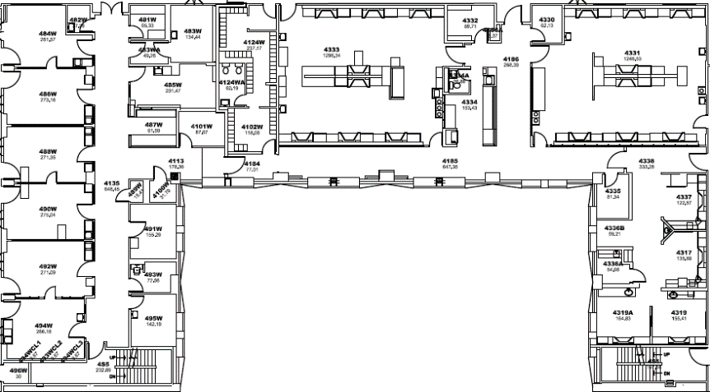
NICU Floor Plan

Slide 35
ROOM # | Type of Patient | Space Required by IDPH current building code | Actual Sq Feet | # Patients in Room | Sq ft per patient
4331 | Level II, III | 80-100 sq ft Level III 4-6 ft between beds | 1254 sq ft 4-6 ft between beds with vent/equipment | 8 | 156.75
4333 | Level II, III | 80-100 sq ft Level III | 1320 sq ft 4-6 ft between beds with vent/equipment | 8 | 165
4337 | Level II, III | 100 sq ft Level III (New code-rooms opened in 2010 | For each room/bay | 4 | 122.75
483 | Level II, Level III | Level II Level III | 135 sq ft | 1 | 135
484 | Level II | 4 to 6 feet between beds | 224 sq ft with 4-6 feet between beds | 3 ICN beds | 74.6 if 3 ICN babies
485 | Level II, III | 4 to 6 feet between beds | 200 sq ft with 4-6 feet between beds | 2 NICU/ICN patients | 100
486 | Level II, III | 4 to 6 feet between beds | 240 sq ft with 4-6 feet between beds | 4 (3 NICU; 1 ICN) | 60
488 | Level II, III | 4 to 6 feet between beds | 275 sq ft with 4-6 feet between beds | 3 (2 NICU; 1 ICN | 91.66
490 | Level II, III | 4 to 6 feet between beds | 275 sq ft with 4-6 feet between beds | 3 (2 NICU; 1 ICN | 91.66
492 | Level II | 4 to 6 feet between beds | 275 sq ft with 4-6 feet between beds | 4 | 68.75
494 | Level II | 4 to 6 feet between beds | 266 sq ft with 4-6 feet between beds | 4 | 66.5

Slide 36
Acknowledgments
Families and friends of our NICU babies
NICU staff
Peds Infectious Disease Specialist – Covid 19 consultant
Family support specialists
Incident Command

Slide 37
Resources
www.Perinatalcovid19.com
AAP
ILPQC
Pediatrics:
  Ethics Rounds: Benefits and Risks of Visitor Restrictions for Hospitalized Children During the COVID Pandemic Alice K. Virani, PhD, Henry T. Puls, MD, Rebecca Mitsos, CCLS, Holly Longstaff, PhD, Ran D. Goldman, MD, John D. Lantos, MD

Slide 38
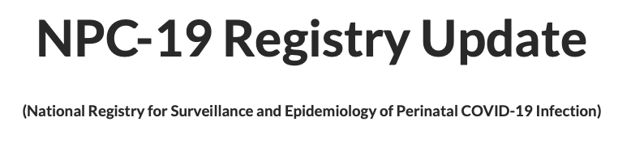

Slide 39


Slide 40
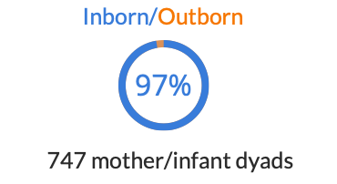

Slide 41
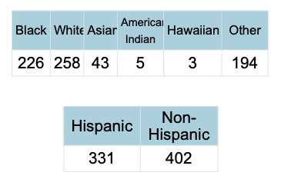

Slide 42
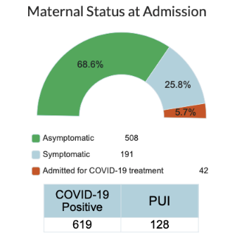

Slide 43
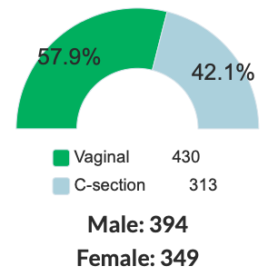

Slide 44
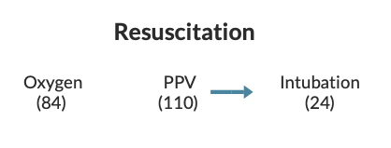

Slide 45
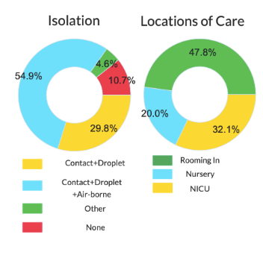
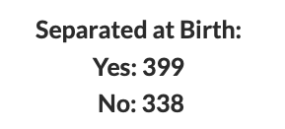

Slide 46
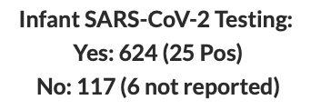

Slide 47
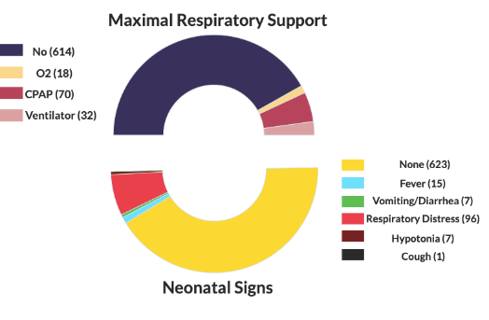

Slide 48
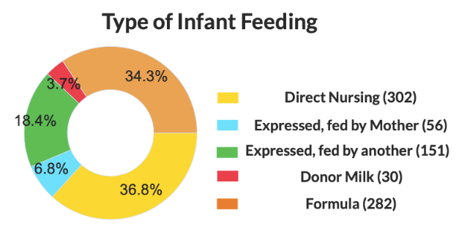

Slide 49
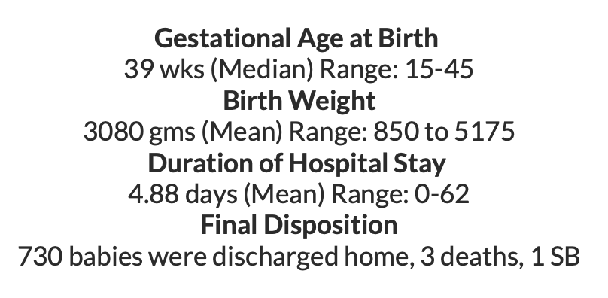

Slide 50
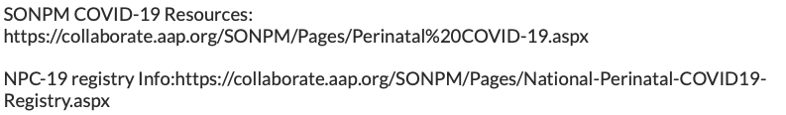

Slide 51
Discussion Panel
Aarti Raghaven, MD, Medical Director NICU, University of Illinois Hospital, Chicago
Amanda Bennett NNP, Swedish American Hospital, Rockford
Shaaista Budhani, MD neonatologist, Swedish American Hospital, Rockford
Leslie Caldarelli, MD, NICU Director, Prentice Women's Hospital, Chicago
Justin Josephsen, MD, Medical Director – St. Mary’s Hospital NICU, Neonatologist Cardinal Glennon Children’s Hospital, St. Louis
Notes:
UPDATE

Slide 52
Neonatal Questions/Discussion
Questions from chat box
Questions from meeting registration
XXX from 5.29.20 webinar
Neonatal Q&A from 5.15.20 webinar
Q/A from 5.8.2020
Q/A from 5.01.2020 – questions answered webcast
Q/A from 4.24.2020 webinar (Neonatal Answers)
Q/A from 4.17.2020 webinar
Q/A from 4.10.2020 webinar
Q/A from 4.3.2020 webinar

Slide 53
Discussion of OB Unit Strategies

Slide 54



Perinatal Center: Northwest Illinois
Location: Rockford, IL
Perinatal Level 3 hospital with 10-bed NICU and 14-bed Special Care Nursery
1,600 deliveries annually

Slide 55
Case
Patient: 17 y.o. G1P0 @ 21.4 weeks of gestation, H/O decreased cervical length, measured at 1.9 cm, using progesterone intravaginally
Presented to L&D with report of PPROM, vaginal bleeding, and cramping; sterile speculum exam revealed pooling and bleeding with closed cervix, amnisure positive, ferning negative, reports positive fetal movement
Ultrasound performed by MFM: anhydramnios noted with fetal feet in the cervix
Patient counseled about the poor prognosis and given options including expectant management and evacuation by induction
Patient was managed expectantly throughout the day but began having severe cramping around 21:30.
Delivered male at 22:26, apgars 0 at 5 and 10 minutes
The placenta showed gross inflammation. It was swabbed in multiple areas and sent for COVID PCR testing.
Placenta pathology showed Acute chorioamnionitis with acute chorionic vasculitis, chronic deciduitis, negative for COVID-19
Patient’s nasopharangeal swab was positive for COVID-19 and she remained asymptomatic
Discharge on postpartum day 2

Slide 56
Lessons Learned
Most patients present without symptoms
We are swabbing every inpatient for COVID-19
Staff have become more comfortable and less fearful of caring for COVID+ patients.

Slide 57
OB Discussion Panel
Jen Pacheco, MSN, RNC-OB, Women & Children’s Education Coordinator, Swedish American Hospital, Rockford
Jean Goodman, MD, Maternal-Fetal Medicine, Loyola Medical Center, Maywood
Jeannie Kelly, MD, MS, Maternal-Fetal Medicine, Barnes Jewish Hospital, St. Louis

Slide 58
OB Questions/Discussion
Questions from chat box
Questions from registration
XXX from 5.29.20 webinar
OB Q&A from 5.15.20 webinar
Q/A from 5.8.2020 webinar (OB answers)
Q/A from 5.01.2020 – questions answered webcast
Q/A from 4.24.2020 webinar (OB answers)
Q/A from 4.17.2020 webinar
Q/A from 4.10.2020 webinar
Q/A from 4.3.2020 webinar

Slide 59
Illinois Perinatal Hospital
COVID-19 Survey Results
Amanda Bennett, PhD, MPH
IDPH Office of Women’s Health and Family Services
June 11, 2020

Slide 60
Perinatal Hospital COVID-19 Survey Overview
Goals
  Understand landscape of COVID-19-related practices and policies in Illinois birthing hospitals
  Inform Illinois Project Restore sentinel surveillance efforts
Development
  Input from Illinois Perinatal Advisory Committee and Illinois Perinatal Quality Collaborative
  Administered via SurveyMonkey
  Available 5/18/20 – 5/31/20
Response rate = 95%
  95 / 99 hospitals currently open for obstetric services
  Includes two hospitals in St. Louis

Slide 61
COVID-19 Perinatal Hospital Survey Response Rates
Perinatal Level
Illinois Restore Region

Slide 62
Survey Results:
Universal Testing
Notes:
For purposes of this section, the non-responding hospitals are included in denominator to give us a sense of the % of hospitals that we know FOR SURE are doing universal testing

Slide 63
Percent of Hospitals Implementing
Universal Testing among Pregnant Women
About half of hospitals implementing universal testing at admission for L&D
  Covers 65% of the delivery volume of the state

Slide 64
Percent of Hospitals Implementing
Universal Testing at Labor and Delivery Admission
Perinatal Level
Illinois Restore Region

Slide 65
Percent of Hospitals Implementing Universal Testing at L&D Admission and Using Rapid Tests for ALL Women Tested
Perinatal Level
Illinois Restore Region

Slide 66
Percent of Hospitals Implementing
Universal Testing for Scheduled Deliveries
Perinatal Level
Illinois Restore Region

Slide 67
Percent of Hospitals Implementing
Universal Testing for Scheduled Deliveries
Perinatal Level
Illinois Restore Region

Slide 68
Percent of Hospitals Implementing Universal Testing for Pregnant Women Admitted for Non-Delivery Reasons
Perinatal Level
Illinois Restore Region

Slide 69
COVID-19 Positivity Rate
Among Hospitals Universally Testing at Labor & Delivery
5,891 patients tested through L&D universal testing so far
240 COVID+
Illinois Restore Region

Slide 70
Asymptomatic Rate Among COVID+ Pregnant Women at Hospitals Universally Testing at Labor and Delivery
5,891 patients tested through L&D universal testing so far
240 COVID+
130 asymptomatic
Illinois Restore Region

Slide 71
Barriers to Universal Testing
Among those not currently conducting universal testing, common barriers were:
  Lack of availability of rapid test supplies
  Rationing of supplies within facility
  Limited in-house lab capacity to process tests
A small number of facilities concerns with poor validity of rapid tests as reason for not conducting universal testing

Slide 72
Percent of Hospitals NOT Implementing Universal Testing at Labor and Delivery that are Interested in Doing So if Testing Supplies were Made Available
Perinatal Level
Illinois Restore Region

Slide 73
Survey Results: policies and practices
Related to COVID-19

Slide 74
COVID-19 Related Practices
Most hospitals are using universal PPE for providers during labor and delivery
Only about 1/3 of hospitals are using prophylactic anti-coagulation for COVID+ patients

Slide 75
Early Discharge
Few hospitals are allowing early maternal or neonatal discharge for COVID- patients
Of those allowing early discharge:
  None reported seeing increased readmissions
  All reported being able to do neonatal screenings

Slide 76
Support Persons and Visitation
All hospitals are limiting support persons and visitors during L&D and on postpartum unit
  All hospitals have set limit of 1 support person
  6 hospitals allowing doula as additional support
All hospitals with NICU are limiting visitors

Slide 77
Mother-Newborn Contact
Majority of hospitals are routinely separating COVID+ mothers and their infants
Majority of hospitals are limiting direct breastfeeding when mother is COVID+

Slide 78
Outpatient Care
About half of hospitals are seeing COVID-19 impact on prenatal care
Fewer report impact on postpartum visits

Slide 79
Comments about How Prenatal and Postpartum Outpatient Care Has Been Affected
Decreased frequency of visits
  Provider suspending services
  Patient cancellations/rescheduling due to fear
Decreased assessments (e.g., fewer ultrasounds)
Increased use of telemedicine
Limits on visitors or support persons during prenatal care

Slide 80
ILPQC Weekly Webinars
Overwhelmingly, hospitals are participating in ILPQC webinars and find them to be helpful!

Slide 81
Suggested Topics for Future ILPQC Webinars
Care of COVID+ patients
  Examples: care before delivery, care during cesarean, care for recovered patients
Testing
  Examples: antibody tests, retesting for recovered COVID+ patients
Prophylactic anti-coagulation for COVID+ pregnant patients
Discharge planning for COVID+ women
Mother-infant separation policies (what is best?)
Pediatric multi-inflammatory syndrome
Continue case studies and hospital sharing!
Information specific for low-resource and/or rural hospitals

Slide 82
Comments & Concerns Related to Obstetric Care
Universal testing
  Testing capacity & supplies
Anti-coagulation
Support persons policies (e.g., allow doula as “extra”?)
Separation of mother and infant
PPE guidelines
Isolation & lack of negative-pressure rooms
Pre-eclampsia and COVID-19

Slide 83
Comments & Concerns Related to Neonatal Care
Separation of mother and infant
Discharge planning when mom is COVID+
Breastfeeding
Well Baby Care

Slide 84
Questions?
Amanda Bennett
Amanda.C.Bennett@illinois.gov

Slide 85
Thank You
We continue to give thanks to the nurses, doctors, health care workers, public health teams and others across our state at work confronting the COVID-19 pandemic.
Please send questions, comments and recommendations, cases / willingness to share for future COVID-19 OB/Neo discussion webinars to info@ilpqc.org
Recording of this webinar, Q/A and registration for the next webinar on 6/26/20 will be available at www.ilpqc.org

Slide 86



THANKS TO OUR
FUNDERS
Email info@ilpqc.org or visit us at www.ilpqc.org
Notes:
Updated 10/22/19

