Slide 1
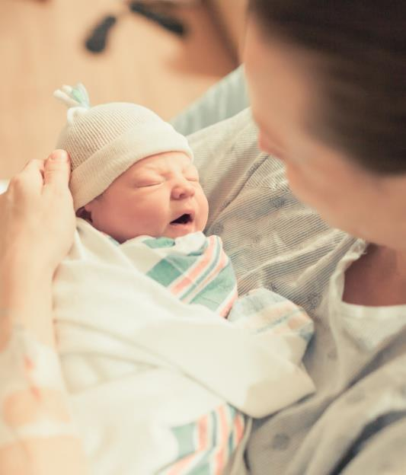
COVID-19 Strategies for OB & Neonatal Units
June 11, 2021
12:00 – 1:15pm

Slide 2

Welcome
Please be certain you are on “mute” when not speaking to avoid background noise.
Whether you have joined by phone or computer audio, you can mute and unmute yourself by clicking on the microphone icon.
The following shortcuts can also be used
For PC: Alt + A : Mute or Unmute
For Mac: Shift + Command + A: Mute or Unmute
For telephone: *6 : Mute or Unmute

Slide 3
Housekeeping:
We Are Recording Now

Slide 4
ILPQC Covid 19 webinars
The strategies shared today are examples from individual institutions not IDPH or ILPQC recommendations.
This is our 22nd COVID-19 strategies for OB/Neonatal Units webinar in coordination with IDPH, since April 2020. Please see https://ilpqc.org/covid-19-information/ for future webinar registration, prior recorded webinars and written out Q/A’s from those webinars.
The next webinar will be Friday, August 6, noon to 1:15pm. We are moving to every other month and determining the needed frequency going forward
Please let us know if your hospital would like to share on an upcoming webinar, please put questions/comments into the chatbox or email directly to info@ilpqc.org
Notes:
Ann, when we will have next covid-19 webinar

Slide 5
Overview
Introduction
Discussion of OB Unit Strategies
  Rob Abrams, MD, Executive Director - SIU Center for Maternal - Fetal Medicine, HSHS St. John's Hospital, Springfield
  Emily S Miller, MD MPH – Assistant Professor, Dept of Obstetrics & Gynecology, Division of Maternal Fetal Medicine, Northwestern University
  Ashish Premkumar, MD – Assistant Professor, Department of Obstetrics and Gynecology Feinberg School of Medicine, Northwestern University, Department of Obstetrics and Gynecology, John H. Stroger, Jr. Hospital of Cook County
  Helen E. Cejtin, MD, MPH – Associate Professor, Department of Obstetrics and Gynecology Feinberg School of Medicine, Northwestern University, Department of Obstetrics and Gynecology, John H. Stroger, Jr. Hospital of Cook County
  Emma James, MD – Obstetrics & Gynecology Resident, Southern Illinois University School of Medicine
Discussion of NEO Unit Strategies
  Leena K. Mithal, MD, MSCI – Assistant Professor of Pediatrics, Northwestern University Feinberg School of Medicine, Attending Physician, Division of Infectious Diseases, Ann & Robert H. Lurie Children’s Hospital
  Justin Josephsen, MD – Medical Director, St. Mary’s Hospital NICU, Neonatologist Cardinal Glennon Children’s Hospital, St. Louis
  Leslie Caldarelli, MD – NICU Director, Prentice Women's Hospital, Chicago
Notes:
Ann, please make sure the information is correct

Slide 6
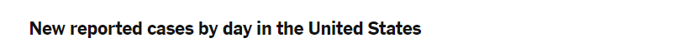
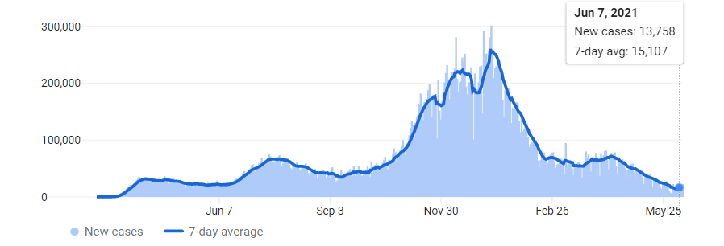
US COVID case trend
Notes:
Updated 6/10/2021
https://www.nytimes.com/interactive/2020/us/coronavirus-us-cases.html

Slide 7
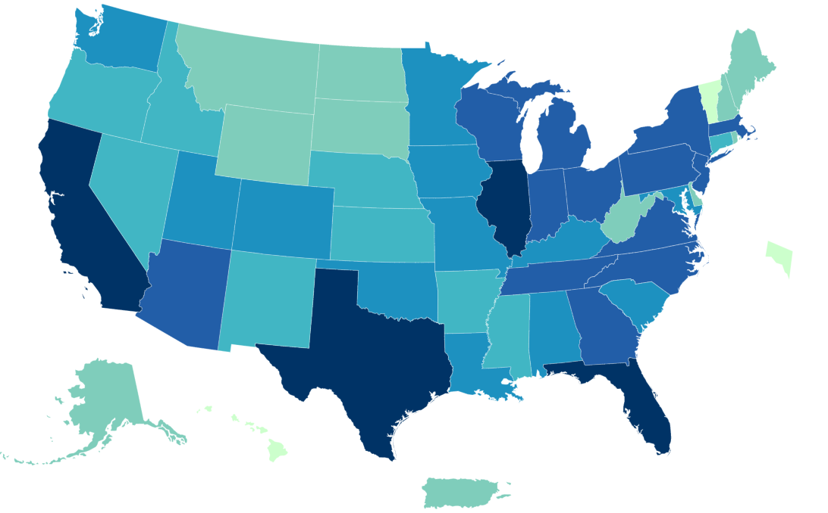
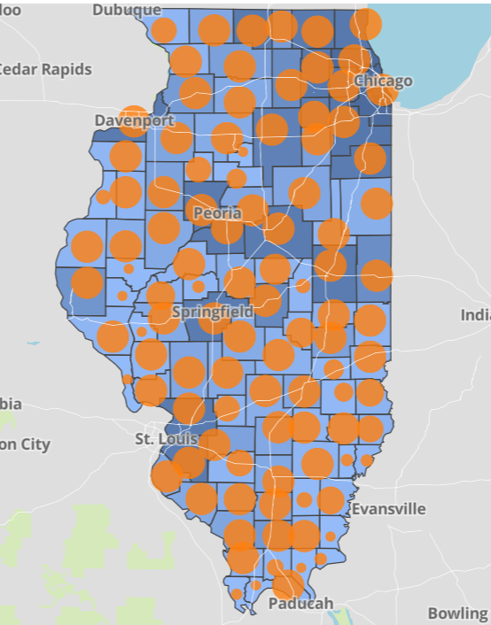
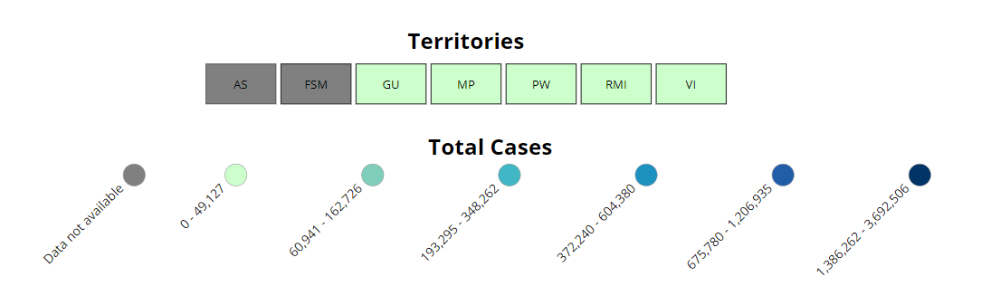
Data Update: June 10, 2021
CDC/IDPH: COVID-19 Outbreak
CDC https://covid.cdc.gov/covid-data-tracker/#cases_totalcases | IDPH https://www.dph.illinois.gov/covid19
Total cases: 33,246,578 confirmed Total deaths: 596,059 confirmed | 1,386,628 Confirmed Positive Cases 23,014 Deaths
Notes:
Updated 6/10/2021

Slide 8
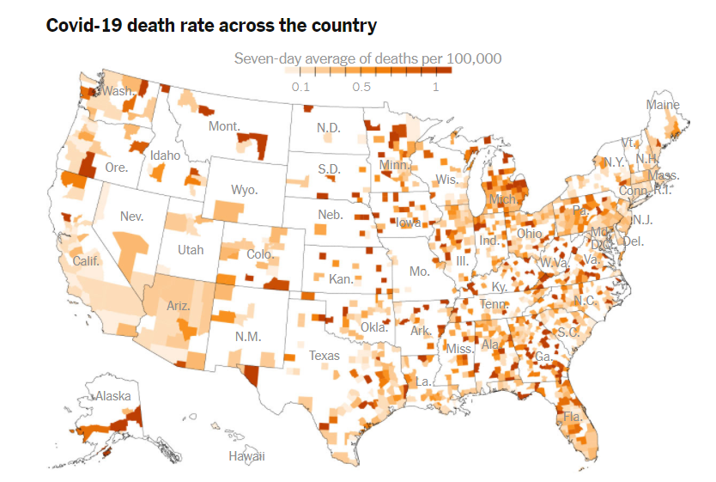
Source: New York Times database of reports from state and local health agencies and hospitals | Note: Deaths include both confirmed and probable deaths from Covid-19. Data are as of May 22.
Notes:
New York Times: Which Groups Are Still Dying of Covid in the U.S.?

Slide 9
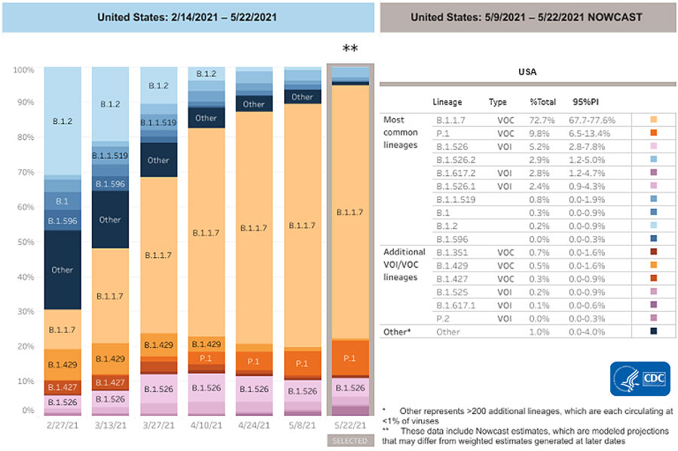
SARS-CoV-2 Variants Circulating in the United States
CDC, through May 22, 2021

Slide 10
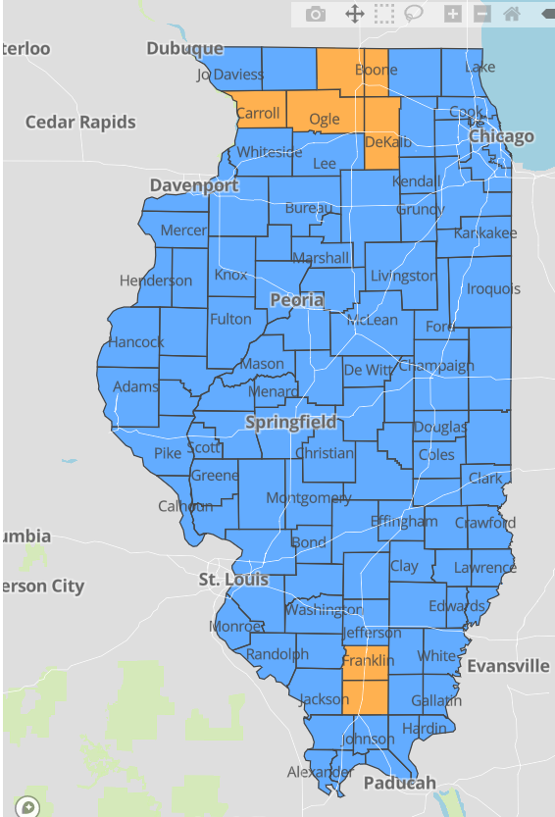
IDPH County Level COVID-19
Risk Metrics
Week 21: 5/23/2021 Through 5/29/2021
Blue indicates that the county is experiencing overall stable COVID-19 metrics.
Orange indicates there are warning signs of increased COVID-19 risk in the county.
Notes:
Updated 6/10/2021
https://www.dph.illinois.gov/countymetrics?county=Cook

Slide 11
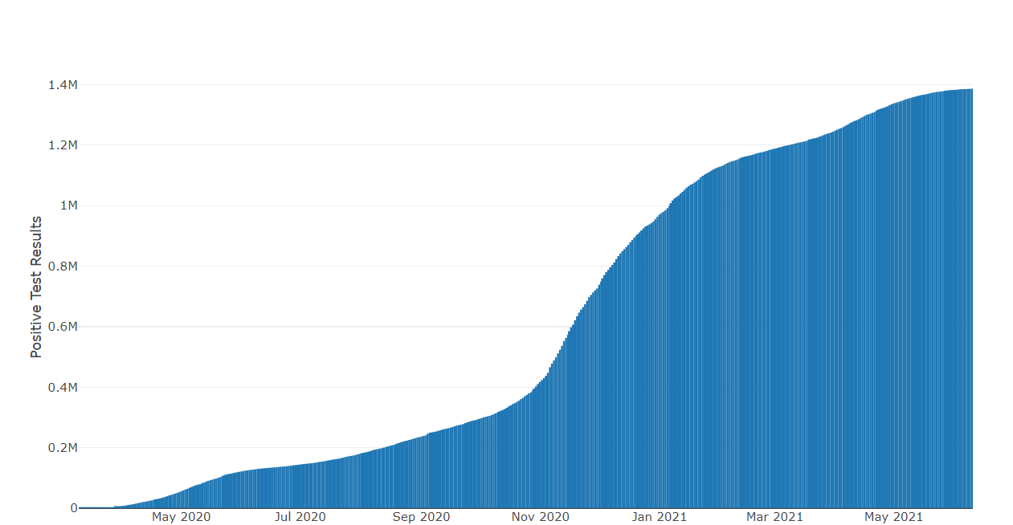
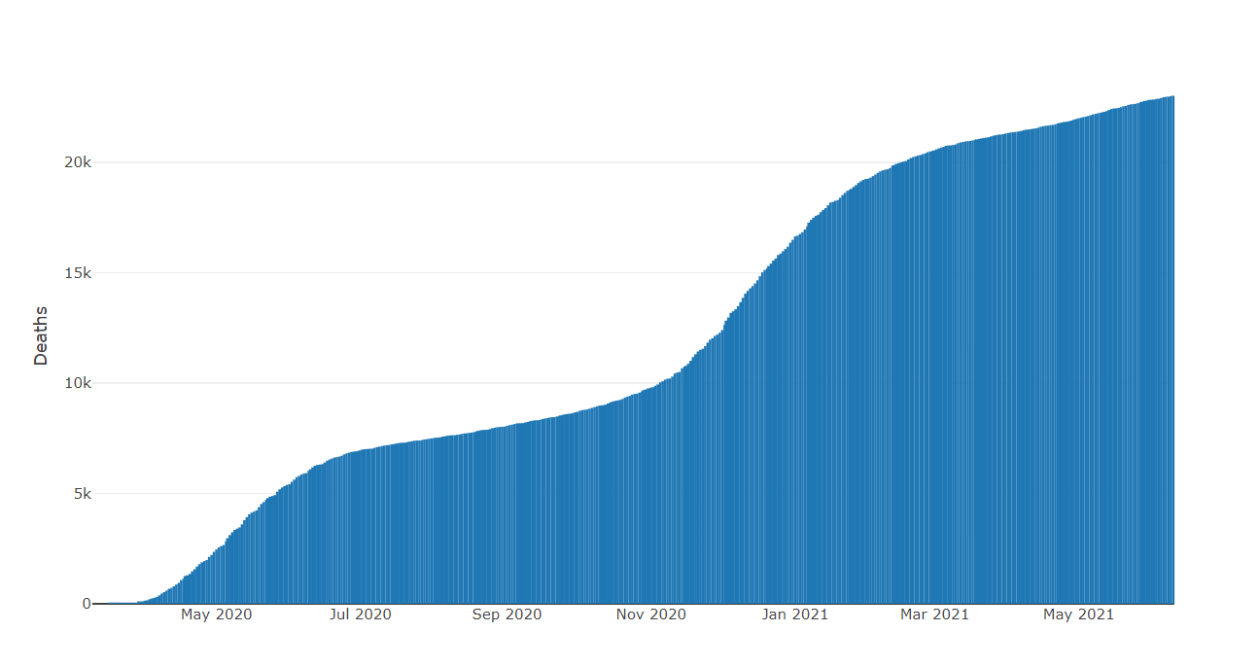
Data Update June 10, 2021
IDPH: COVID-19 Outbreak
https://www.dph.illinois.gov/covid19
IL Positive Cases Over Time
IL Deaths Over Time
Total: 1,386,628 Confirmed Positive Cases
Total: 23,014 Deaths
Notes:
Update 6/10/2021
http://www.dph.illinois.gov/covid19/covid19-statistics

Slide 12
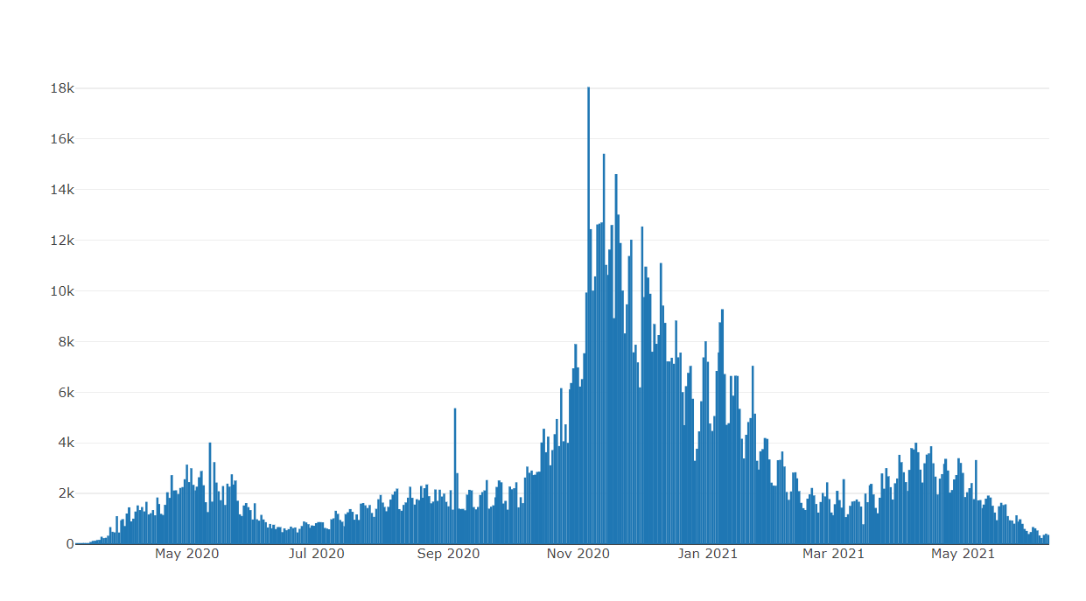
Illinois Daily Incidence
IDPH daily data summary
Notes:
Updated 6/10/2021
https://www.dph.illinois.gov/covid19/covid19-statistics

Slide 13
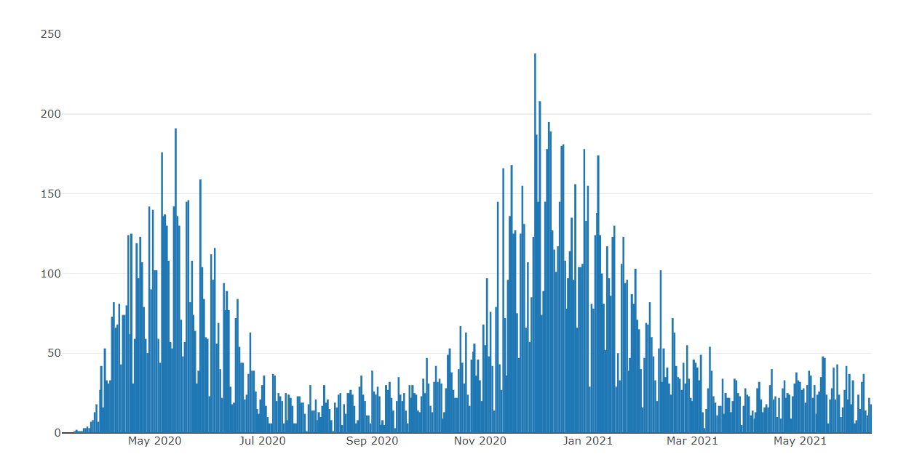
Illinois Covid Deaths
IDPH daily data summary
Notes:
Updated 6/10/2021
https://www.dph.illinois.gov/covid19/covid19-statistics

Slide 14
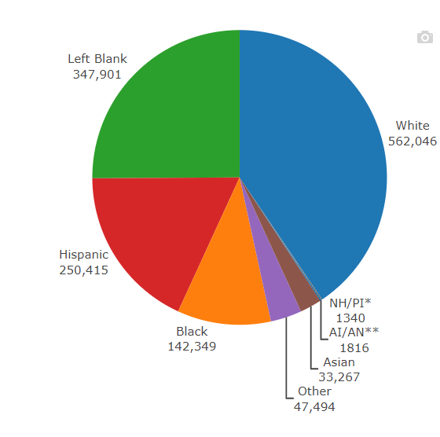
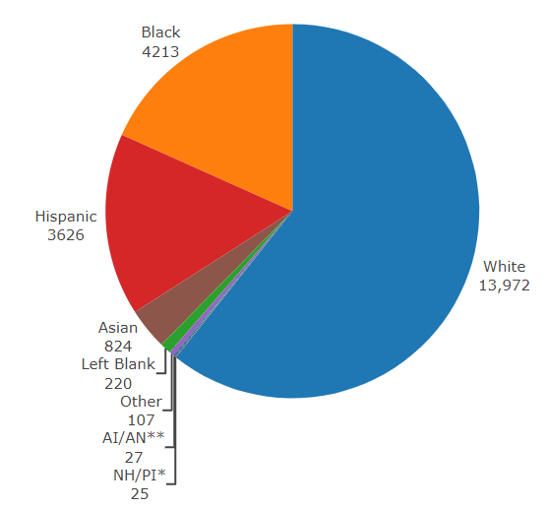
Data Update June 10, 2021
IDPH: COVID-19 Outbreak
Race Demographics
https://www.dph.illinois.gov/covid19
Confirmed Cases
Deaths
Notes:
Updated 6/10/2021
http://www.dph.illinois.gov/covid19/covid19-statistics

Slide 15
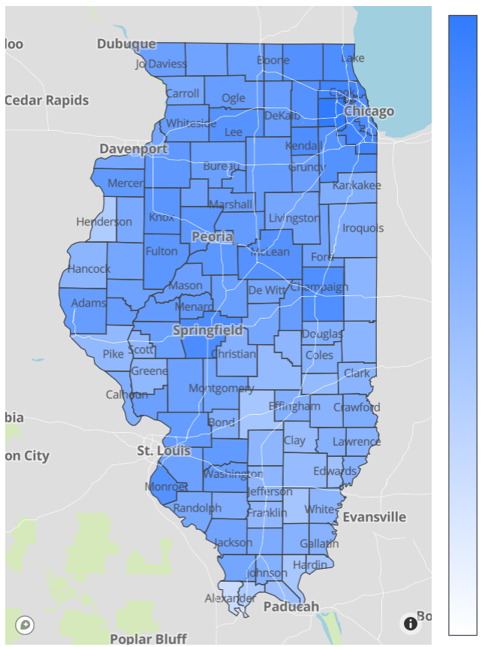
Illinois Daily Reported Administered Vaccine Doses
Last updated 6.9.2021
Notes:
https://www.dph.illinois.gov/covid19/vaccinedata?county=Illinois

Slide 16
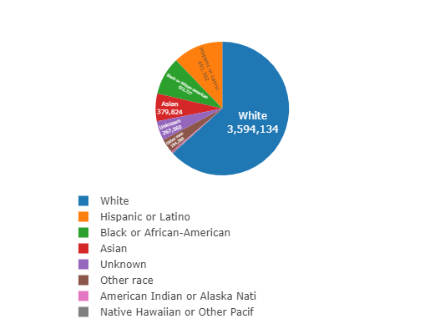
Vaccine by Race/Ethnicity Demographics
Updated
6/9/2021
Notes:
https://www.dph.illinois.gov/covid19/vaccinedata?county=Illinois

Slide 17
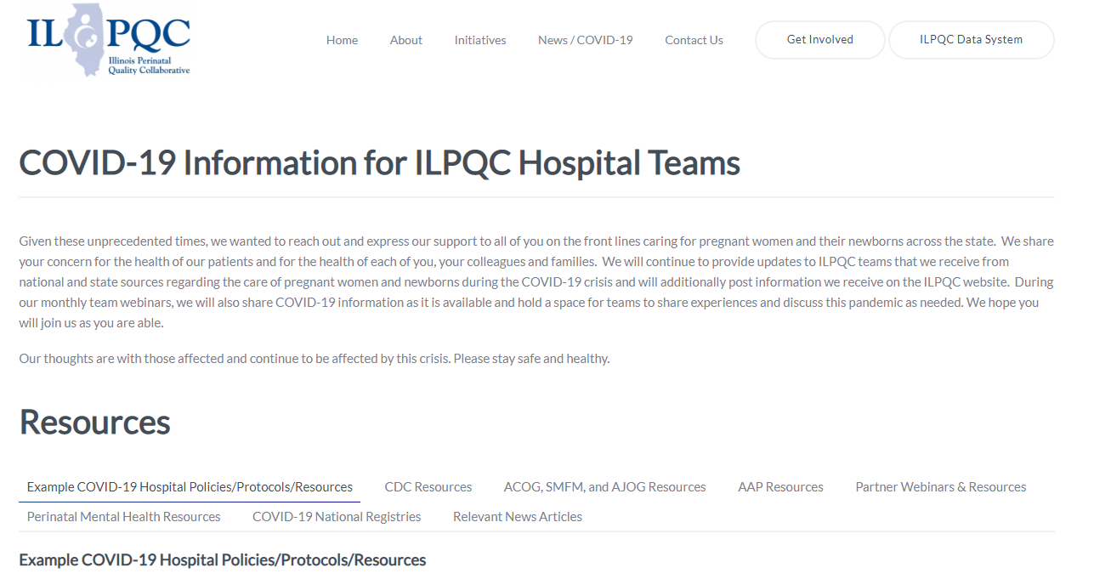
ILPQC COVID-19 Webpage www.ilpqc.org
ILPQC posts national guidelines and OB & Neonatal COVID-19 example hospital protocols & resources
please note dates as guidelines are changing rapidly
https://ilpqc.org/covid-19-information/

Slide 18
Updated OB (ACOG/SMFM) Resources
ACOG: Vaccinating Pregnant Individuals: Eight Key Recommendations for COVID-19 Vaccination Sites. (2.3.21)
SMFM: Management Considerations for Pregnant Patients With COVID-19 (2.2.21)
ACOG: COVID-19 Vaccines Pregnancy - Conversation Guide for Clinicians. (3.5.21)
SMFM Pt Education (English/Spanish): COVID-19 Vaccines and Pregnancy. (3.4.21)
AGOG: My Vaccine Choice: A Pregnant Ob-Gyn Shares Why She Got a COVID-19 Vaccine (March 2021)
ACOG:COVID-19 FAQs for Obstetrician-Gynecologists, Obstetrics (Updated 3.30.2021)
ACOG: Statement on the Johnson & Johnson COVID-19 Vaccine. (4.13.21)
SMFM - Provider Considerations for Engaging in COVID-19 Vaccine Counseling With Pregnant and Lactating Patients (April 30, 2021)
ACOG: Practice Advisory: Vaccinating Pregnant and Lactating Patients Against COVID-19. (Updated 6.9.21)

Slide 19
Updated Neonatal /AAP Resources
Family Presence Policies for Pediatric Inpatient Settings During the COVID-19 Pandemic: (1/25/21)
Multisystem Inflammatory Syndrome in Children (MIS-C) Interim Guidance: Clinical guidance for pediatricians including signs, symptoms, diagnosis and management of this rare but serious complication associated with COVID-19. (Updated 2/10/2021)
AAP: Interim Guidance for COVID-19 Vaccination in Children and Adolescents. (2.2.21)
FAQs: Management of Infants Born to Mothers with Suspected or Confirmed COVID-19: Includes precautions for birth attendants, rooming-in, breastfeeding, testing, neonatal intensive care, visitation and hospital discharge. (2/11/2021)
Breastfeeding Guidance Post Hospital Discharge for Mothers or Infants with Suspected or Confirmed SARS-Co V-2 Infection: Guidance developed to support pediatricians providing direct care for breastfeeding families after discharge from the newborn hospital stay. (2/11/2021)
AAP: COVID-19 Testing Guidance - Guidance developed to help pediatric practices determine when to test for severe acute respiratory syndrome-coronavirus 2 (SARS-CoV-2) infection in their patient population. (Updated 3.5.21)

Slide 20
Updated OB/Neo Covid Publications
JAMA: Assessment of Maternal and Neonatal SARS-CoV-2 Viral Load, Transplacental Antibody Transfer, and Placental Pathology in Pregnancies During the COVID-19 Pandemic. (12.22.20)
AJOG: Disease Severity, Pregnancy Outcomes and Maternal Deaths among Pregnant Patients with SARS-CoV-2 Infection (12.30.20)
Neo Reviews: Perinatal SARS-CoV-2 Infection and Neonatal COVID-19: A 2021 Update (2.4.21)
ACOG: Disease Severity and Perinatal Outcomes of Pregnant Patients With Coronavirus Disease 2019 (COVID-19) (2.21.21)
MedRxiv: SARS-CoV-2 antibodies detected in human breast milk post-vaccination. (3.02.21)
AJOG: COVID-19 vaccine response in pregnant and lactating women: a cohort study. (3.21.21)
BMC Pediatrics: Newborn antibodies to SARS-CoV-2 detected in cord blood after maternal vaccination – a case report. (3.22.21)
U.S. News: Promising News for Pregnant People Who Want a COVID-19 Vaccine. (4.6.21)
NEJM: Preliminary Findings of mRNA Covid-19Vaccine Safety in Pregnant Persons. (4.21.21)
AJOG: Professionally responsible coronavirus disease 2019 vaccination counseling of obstetrical and gynecologic patients. (5.2021)
Obstetrics & Gynecology: Severe Acute Respiratory Syndrome Coronavirus 2 (SARS-CoV-2) Vaccination in Pregnancy: Measures of Immunity and Placental Histopathology. (5.11.21)
Obstetrics & Gynecology: Cord blood antibodies following maternal coronavirus disease 2019 vaccination during pregnancy (4.1.2021)
​

Slide 21
IDPH / HFS / CDC
HFS: Provider Notice Issued Blood Pressure Monitoring Kit (7.2.2020)​ - Medicaid now covers home BP cuffs for all pregnant / postpartum patients
CDC: Birth and Infant Outcomes Following Laboratory-Confirmed SARS-CoV-2 Infection in Pregnancy. (MMWR 11.6.2020)
CDC: Interim Clinical Considerations for Use of mRNA COVID-19 Vaccines Currently Authorized in the United States. (MMWR 1.6.21)
Racial and Ethnic Disparities in the Prevalence of Stress and Worry, Mental Health Conditions, and Increased Substance Use Among Adults During the COVID-19 Pandemic (MMWR Feb 5, 2021)
CDC: The Advisory Committee on Immunization Practices’ Interim Recommendation for Use of Janssen COVID-19 Vaccine (MMWR 3.5.21)
CDC: Toolkit for Pregnant People and New Parents. (2.26.21)
CDC: Information about COVID-19 Vaccines for People who Are Pregnant or Breastfeeding. (4.28.21)
CDC: Joint CDC and FDA Statement on Johnson & Johnson COVID-19 Vaccine. (4.13.21)
CDC: Covid Data Tracker: Health Equity Data (June 2021)
CDC MMRC: Patterns in COVID-19 Vaccination Coverage, by Social Vulnerability and Urbanicity — United States. (6.4.21)
CDC: Safety of COVID-19 Vaccines. Video link. (Updated 6.8. 2021)

Slide 22
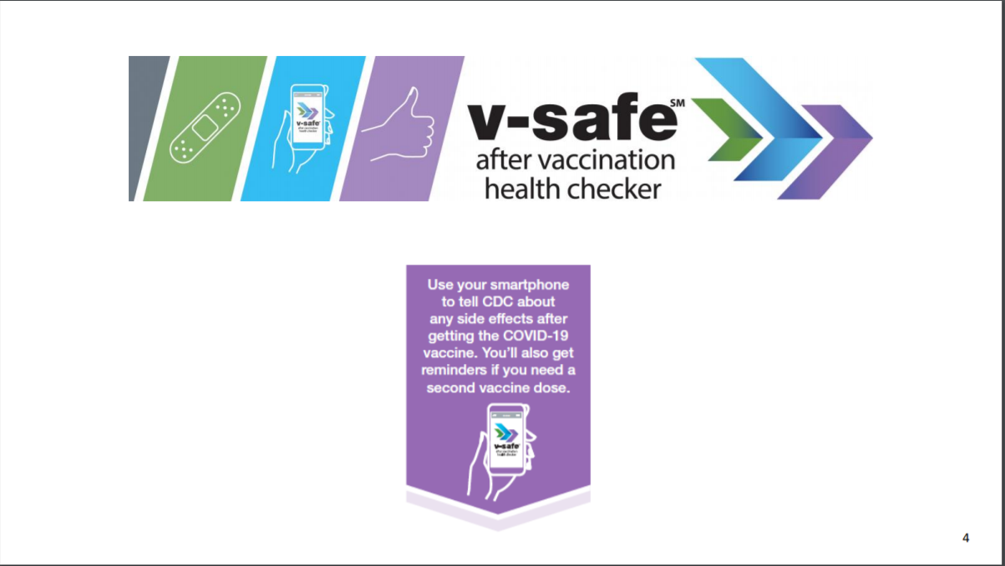

Slide 23
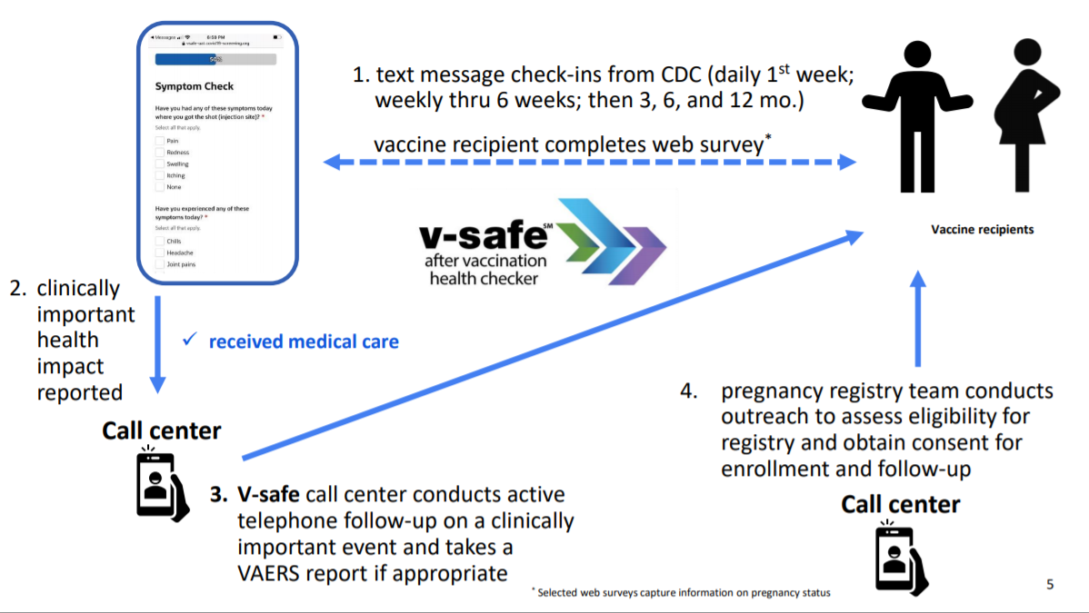

Slide 24
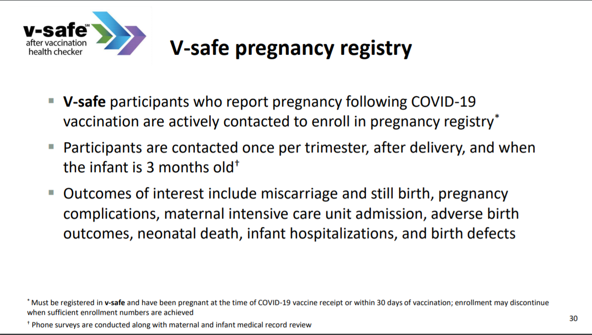

Slide 25
V-SAFE vaccine monitoring
– what data is being gathered pregnant patients
As of May 3, 2021, there have been over 106,241 pregnancies reported in CDC’s V-SAFE post-vaccination health checker
CDC is currently enrolling pregnant individuals in a pregnancy registry with over 4,077 enrolled.
Evidence gathered through these system provide clinicians with critically needed data to inform future recommendations related to COVID-19 vaccination during pregnancy
https://www.cdc.gov/coronavirus/2019-ncov/vaccines/safety/vsafe.html
Notes:
v-safe COVID-19 Vaccine Pregnancy Registry
Pregnant people enrolled, United States, as of April 5, 2021
4,218*

Slide 26
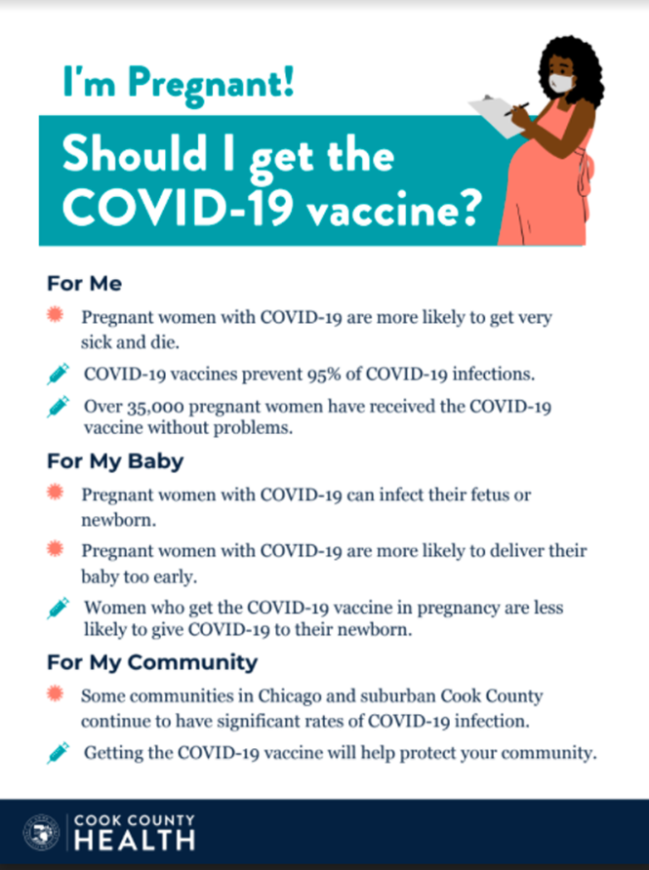
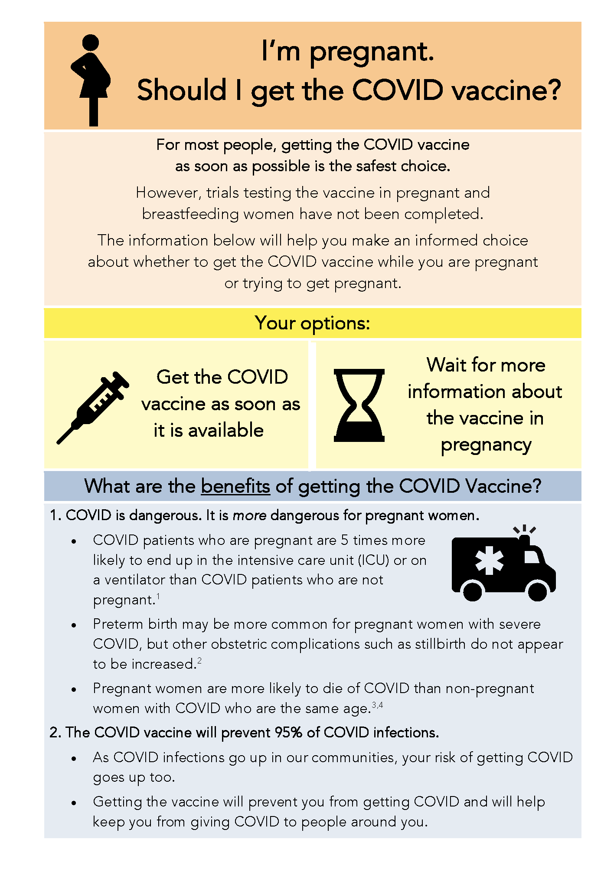

COVID Vaccine
Patient Education Examples
University of Massachusetts Medical School – Baystate: Covid Vaccine Info for Pregnant/Breastfeeding Patients English.
Available in:
Spanish, Nepali, Portuguese, Arabic,
Turkish, Somali, Chinese, Vietnamese,
Russian (3.17.21)
SMFM Patient Education (English/Spanish): COVID-19 Vaccines and Pregnancy. (3.4.21)
CDC: Information about COVID-19 Vaccines for People who Are Pregnant or Breastfeeding. (3.18.21)
CDC: Safety of COVID-19 Vaccines. Video link. (Updated 6.8. 2021)
Cook County Health: Should I get the COVID-19 vaccine? Flyer English and Spanish (6.11.21)

Slide 27
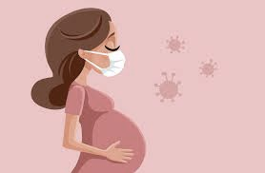
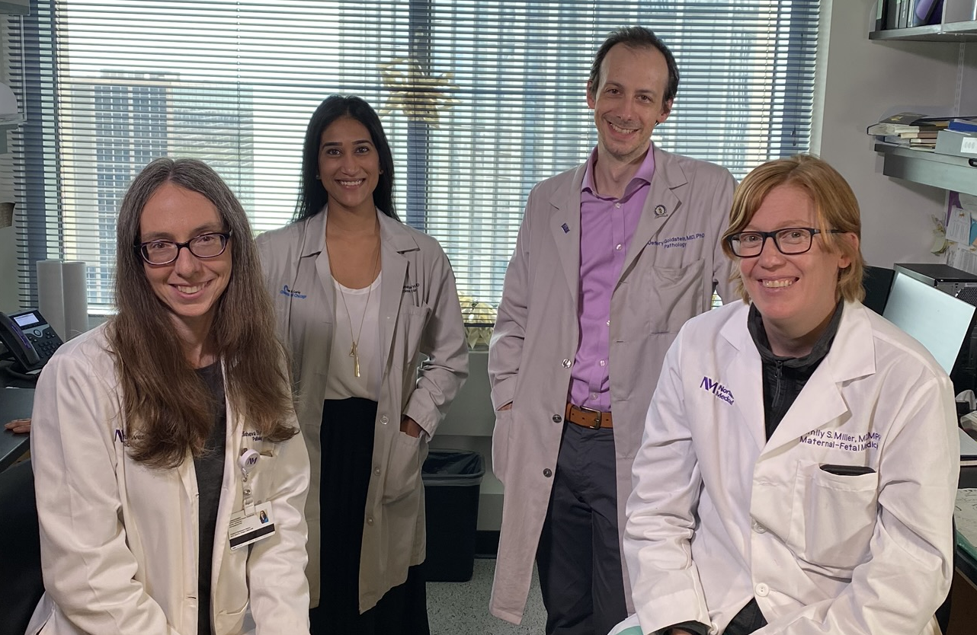
COVID-19 Vaccination during Pregnancy
Leena B. Mithal, MD MSCI
Assistant Professor of Pediatrics, Infectious Diseases
Ann & Robert H. Lurie Children’s Hospital
Northwestern University Feinberg School of Medicine
Studying Novel Infectious Pathogens in Pregnancy (SNIPP)
Impact of COVID-19 on Pregnancy, the Placenta, & Fetal Health
Jeffery A. Goldstein, MD PhD - Perinatal Pathology
Elisheva D. Shanes, MD - Perinatal Pathology
Emily S. Miller, MD MPH - Maternal Fetal Medicine
Support from Lurie Children’s/Stanley Manne Children’s Research Institute and Friends of Prentice

Slide 28


Placental histopathology in patients who received SARS-CoV-2 vaccination during pregnancy
Shanes ED, Otero S, Mithal LB, Mupanomunda CA, Miller ES, Goldstein JA. SARS-CoV-2 vaccination in pregnancy: measures of immunity and placental histopathology. Obstet Gynecol. 2021 May 11. doi: 10.1097. PMID: 33975329.

Slide 29
Why look at this?
Urgent need for research regarding the safety of SARS-CoV-2 mRNA vaccines in pregnancy.
Placental findings can indicate potential clinical risk/early safety signal.
Associations between SARS-CoV-2 infection and abnormal placental histopathologic lesions:
  Decidual arteriopathy
  Fetal vascular malperfusion
  Chronic histiocytic intervillositis
mRNA vaccines induce an immune response through TLR3, which has been linked in mouse models to placental abnormalities, growth restriction, preterm delivery, and fetal loss.

Slide 30
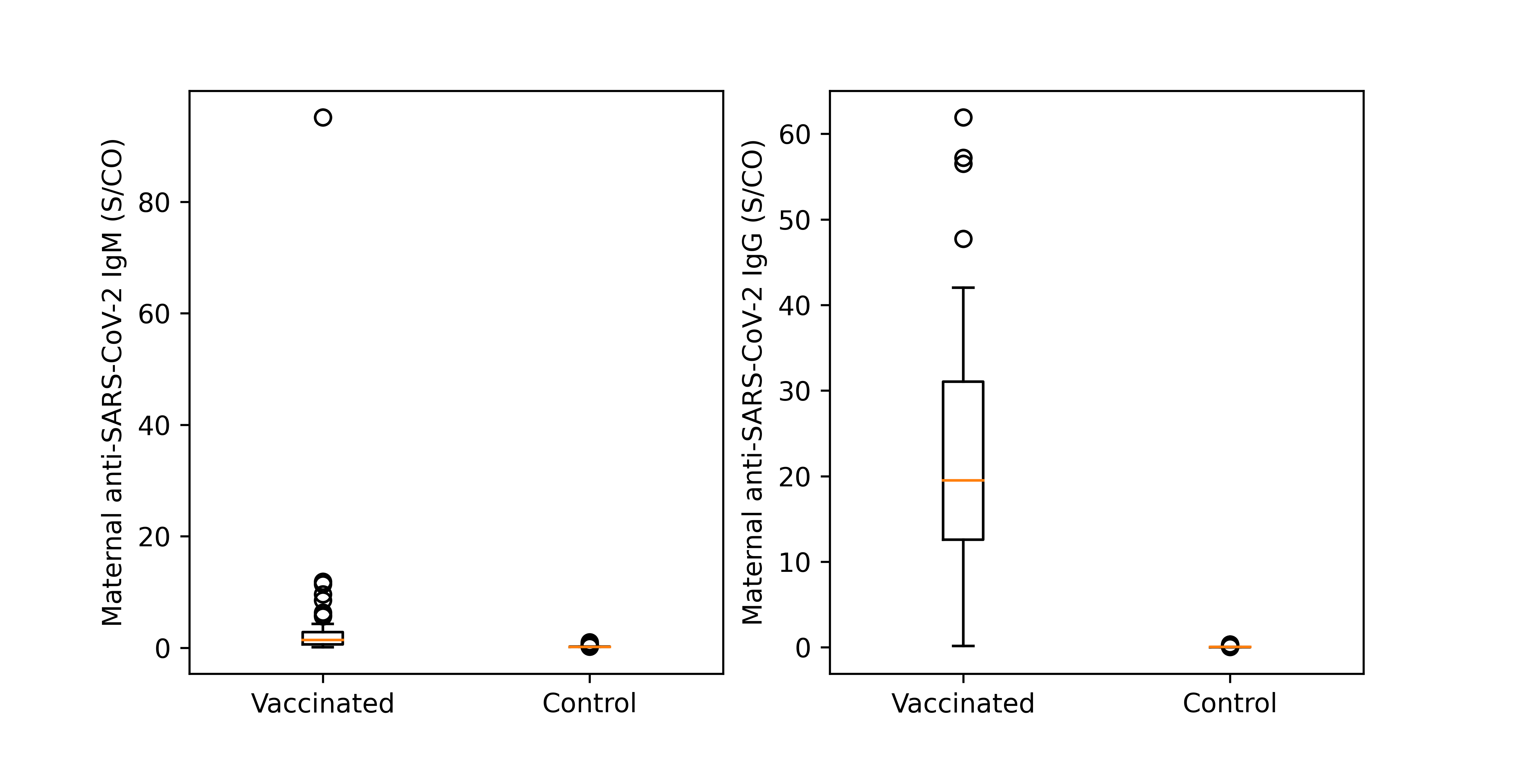
Pregnant patients have robust antibody response to immunization
Cohort
Vaccinated pregnant patients, n=84
  The first dose was 46 +/- 24 days before delivery for the 75 patients with known vaccination timing.
  January - April 2021
Controls, n=116
  SARS-CoV-2 PCR negative at delivery, IgG/IgM negative, no vaccine
  April 2020 - 2021
IgM
IgG
Data
Antibodies (IgG IgM) to anti-SARS-CoV-2 spike protein RBD (n=52)
Placental histopathology

Slide 31
No increased incidence of key placental lesions in vaccinated patients compared to controls

Slide 32
Conclusions
No observed increase in placental lesions characteristic of SARS-CoV-2 infection in pregnancy.
No evidence of vaccine-triggered breakdown in maternal immunologic tolerance of fetus.
These findings add to growing literature supporting safety of SARS-CoV-2 vaccination in pregnancy.

Slide 33
Cord blood antibodies following SARS-CoV-2 vaccination in pregnancy
Mithal LB, Otero S, Shanes ED, Goldstein JA, Miller ES. Cord Blood Antibodies following Maternal COVID-19 Vaccination During Pregnancy. Am J Obstet Gynecol. 2021 Apr 1:S0002-9378(21)00215-5.
Notes:
To investigate transfer of SARS-CoV-2 IgG to infants following maternal COVID-19 vaccination in pregnancy and factors associated with increased efficiency of transfer

Slide 34
Why look at this?
Vaccination of pregnant women can be an important strategy to confer protection to neonates and young infants.
Concerns about antibody transfer in setting of SARS-CoV-2 infection in third trimester.
Limited data on the immunologic response of pregnant women to mRNA COVID-19 vaccination and the kinetics of transplacental antibody transfer.

Slide 35
Cohort
Pregnant patients who received mRNA COVID-19 vaccine and delivered January-March 2021
  n=27 mothers, 28 infants (1 twin)
  22 (74%) women received two vaccine doses prior to delivery
  Mean latency from first vaccine to delivery was 6 ± 3 weeks (range 1.6-12.4)
Data
Matched maternal blood and cord blood (infant)
SARS-CoV-2 IgG and IgM antibody test
Antibody transfer ratio = infant IgG/maternal IgG
Linear regressions to identify factors associated with antibody transfer

Slide 36
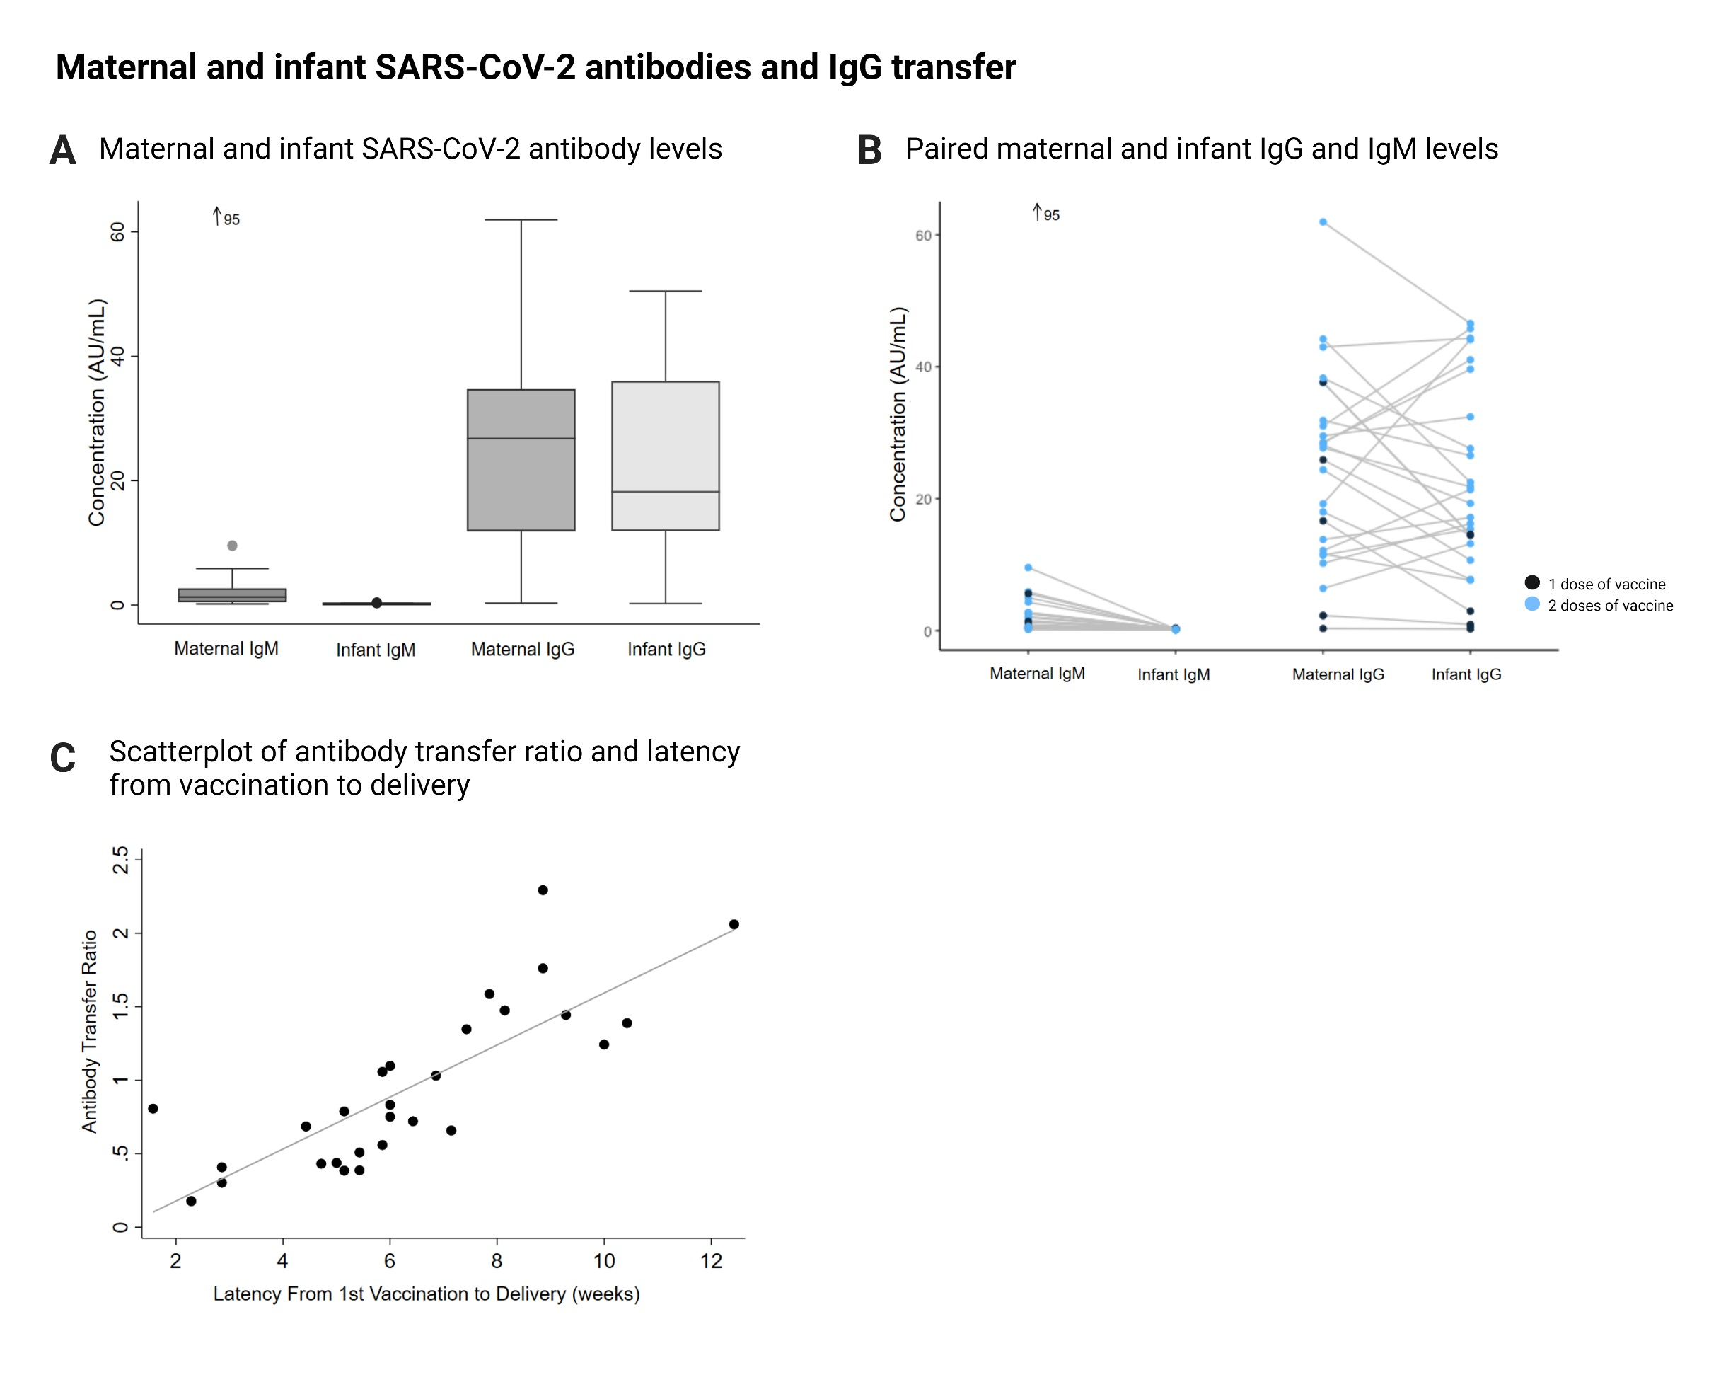
Positive maternal and infant antibodies following SARS-CoV-2 vaccination in third trimester
Most women (26/27) and infants (25/28) had SARS-CoV-2 IgG at time of delivery.
For 3 infants without IgG, mothers had received first vaccine less than 3 weeks prior to delivery.

Slide 37
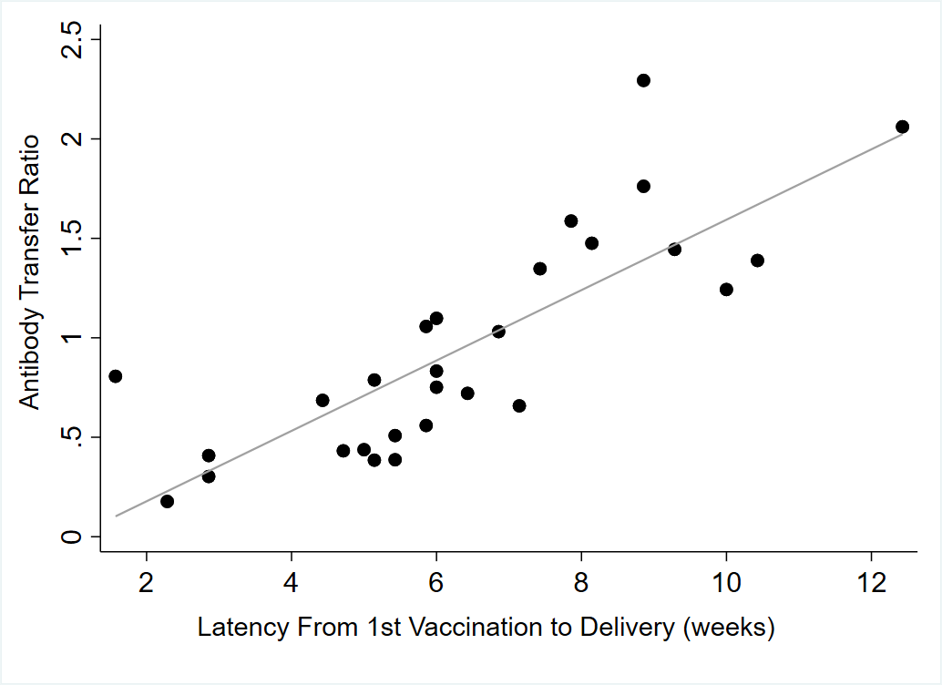
Two doses and increased latency from vaccination until delivery were associated with increased infant IgG and transfer ratio
Mean IgG transfer ratio was 1.0 ± 0.6
Two vaccine doses associated with higher infant IgG level (β=19.0, 95% CI 7.1-30.8)
β=0.2, 95% CI 0.1-0.2

Slide 38
Conclusions
There is passive immunity against SARS-CoV-2 in newborns after maternal receipt of SARS-CoV-2 mRNA vaccine.
Mean IgG transfer ratio demonstrates about equal infant antibody level to maternal level.
Earlier vaccination may produce greater infant immunity (our data from across third trimester).
*Goal of vaccination in pregnancy is protection of pregnant person with added benefit of antibody transfer to infant.

Slide 39
Thank you
Questions or comments?

Slide 40
OB Discussion Panel
  Rob Abrams, MD, Executive Director - SIU Center for Maternal - Fetal Medicine, HSHS St. John's Hospital, Springfield
  Emily S Miller, MD MPH – Assistant Professor, Dept of Obstetrics & Gynecology, Division of Maternal Fetal Medicine, Northwestern University
  Ashish Premkumar, MD – Assistant Professor, Department of Obstetrics and Gynecology Feinberg School of Medicine, Northwestern University, Department of Obstetrics and Gynecology, John H. Stroger, Jr. Hospital of Cook County
  Helen E. Cejtin, MD, MPH – Associate Professor, Department of Obstetrics and Gynecology Feinberg School of Medicine, Northwestern University, Department of Obstetrics and Gynecology, John H. Stroger, Jr. Hospital of Cook County
  Emma James, MD – Obstetrics & Gynecology resident, Southern Illinois University School of Medicine

Slide 41


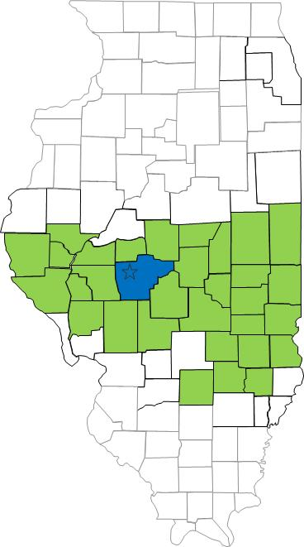
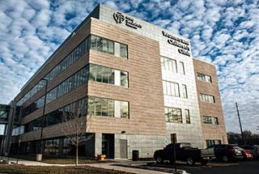
South Central Illinois Perinatal Center, Level III
2100 annual births
40 bed NICU

Slide 42
LW, 29 year old G3P2002 at 34w5d
Chronic hypertension, BMI 67, history of 2 CS
Admitted for SOB, fever, chills after COVID exposure at work
  Tested positive one day prior to admission
Admitted to COVID unit (IMC status)
  TID fetal monitoring for one hour
  Requiring 10 L O2 on admit > reduced to 3 L > weaned off O2
  Dexamethasone, hospitalist team rec holding Remdesivir
  Lovenox

Slide 43
LW, 29 year old G3P2002 at 34w6d
HD#1 tachypneic on 6 L O2, worsening respiratory status
  CS planned 12 hours after most recent Lovenox (2 PM)
  Anesthesia not able to establish spinal anesthesia safely
Intubated, repeat LTCS under general anesthesia
ICU post op
  ID consult: Azithromycin and ceftriaxone
  Dexamethasone x10 d, Remdesirvir, tocilizumab
Extubated POD #15
  COVID encephalopathy vs. delirium
  On 3 L O2 NC
Notes:
QBL 889, APGARS 8/9

Slide 44
Lessons Learned
Importance of delivery for maternal benefit
Communication regarding postpartum blood pressure parameters
Postpartum incision checks

Slide 45
COVID IN PREGNANCY
JOHN H. STROGER/COOK COUNTY EXPERIENCE
Helen E. Cejtin, MD, MPH

Slide 46
COVID NUMBERS
TEST ALL ADMISSIONS TO L&D/ANTEPARTUM
TEST ALL SYMPTOMATIC PATIENTS DURING PREGNANCY-CLINIC, ED
PATIENTS TESTED ELSEWHERE/READMITS

Slide 47
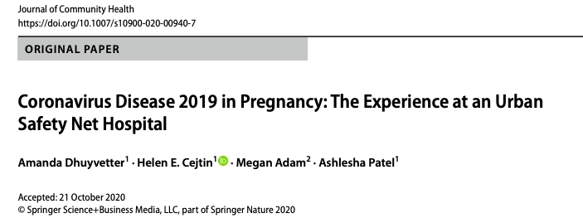
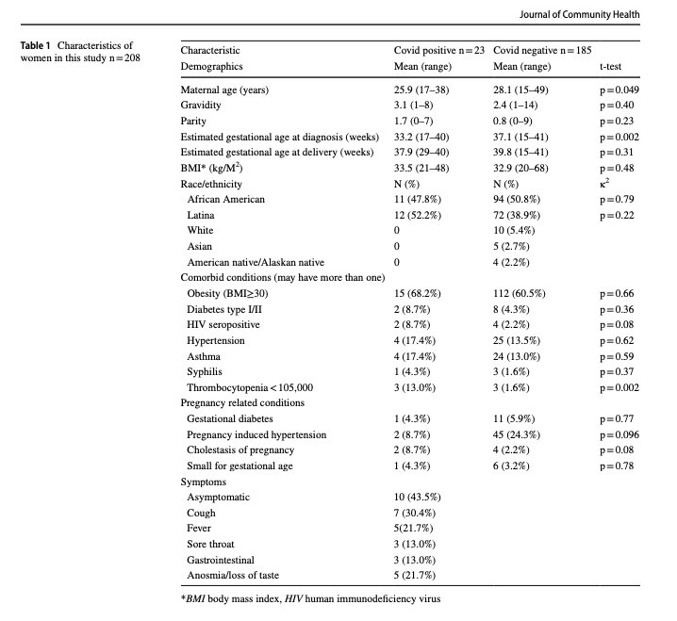
11.1% +COVID
MEAN AGE 25.9 yr
100% AA/LA
68.2% OBESE
43.5% OTHER COMORBIDITY
43% ASYMPTOMATIC
COUGH/FEVER/ANOSMIA
NO MODERATE/SEVERE CASES

Slide 48
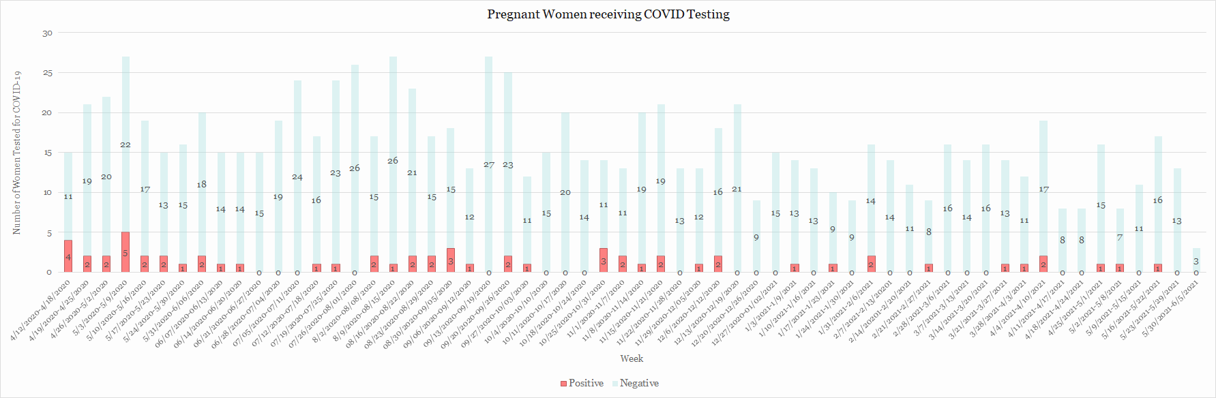
COVID NUMBERS

Slide 49
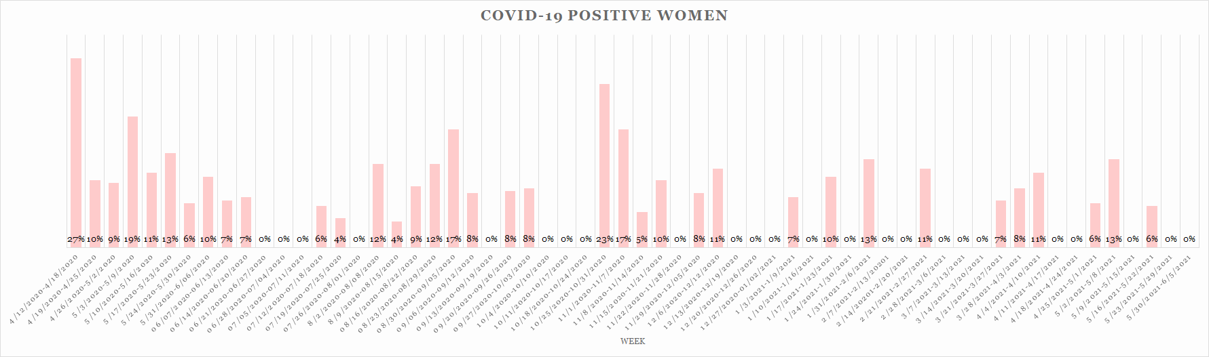
COVID NUMBERS
OVERALL COVID+ RATE=6%/ALL ASYMPTOMATIC OR MILD

Slide 50
COVID VACCINATION IN PREGNANCY
RECOMMENDATIONS-FOR ALL PREGNANT PEOPLE
ASK ALL PATIENTS AT EVERY VISIT
HESITANCY/MISTRUST-UNDERSTAND PATIENTS REASONS
BARRIERS-TIMING AROUND COVID INFECTION (2 WKS)
TIMING AROUND OTHER VACCINES (NO LONGER)
OTHER

Slide 51
COVID VACCINATION/STROGER
OUTPATIENT:
STARTED 4/14/21
SAME DAY VACCINATION (PFIZER)
NAVIGATOR ACCOMPANIES patient
F/U APPOINTMENT COORDINATED WITH OB VISIT
42 VACCINATED
9 MISSED 2ND DOSE
INPATIENT:
STARTED 5/7/21
INPATIENT JOHNSON & JOHNSON
PFIZER FOR PREGNANT PATIENTS
OFFERED AT ALL AP ADMISSION/L&D
F/U APPOINTMENT AT STROGER
13 VACCINATED/20 ORDERED
2ND DOSE?

Slide 52
OUTPATIENT VACCINE FOLLOW-UP
9 NO SHOWS FOR 2ND VACCINE
PHONE ISSUES-2
LEFT VOICE MAIL-1
TRANSPORTATION ISSUES-2
DOCUMENTED INCORRECTLY-1
WORK-2
ILLNESS-1

Slide 53
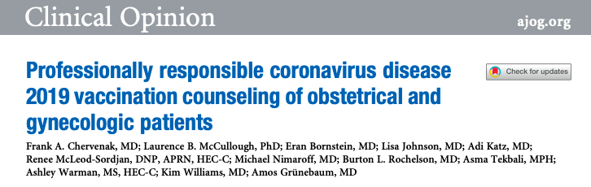
AM J OB GYN ARTICLE
MAY 2021
DO NOT TAKE REFUSALS PERSONALLY
LISTEN TO PATIENT
USE AVAILABLE DATA/NOT THEORETICAL RISKS
ALL PREGNANT PATIENTS SHOULD RECEIVE VACCINE
DISCUSS “FREE RIDERS”
“SHARED DECISION-MAKING”=MAKING A RECOMMENDATION TO VACCINATE

Slide 54
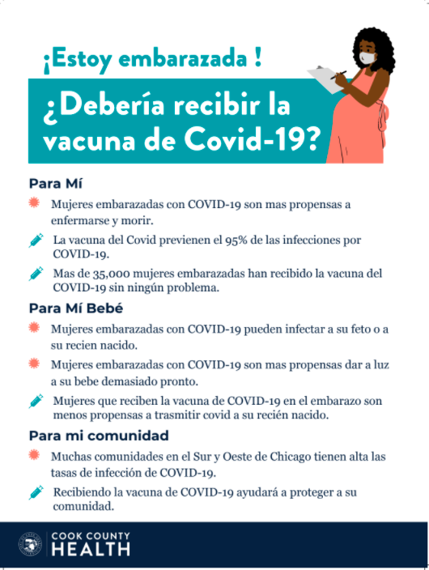
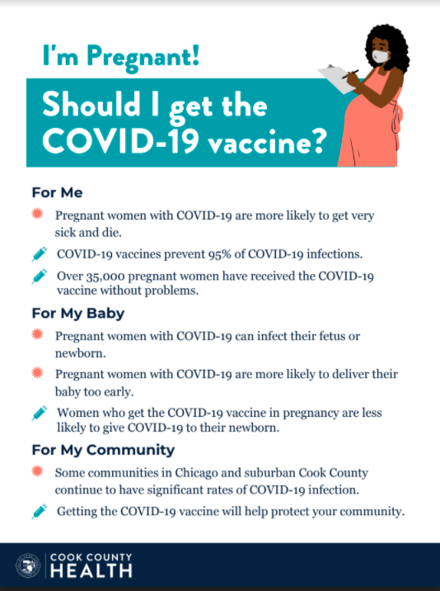
POSTERS

Slide 55
OB Discussion Panel
  Rob Abrams, MD, Executive Director - SIU Center for Maternal - Fetal Medicine, HSHS St. John's Hospital, Springfield
  Emily S Miller, MD MPH – Assistant Professor, Dept of Obstetrics & Gynecology, Division of Maternal Fetal Medicine, Northwestern University
  Ashish Premkumar, MD – Assistant Professor, Department of Obstetrics and Gynecology Feinberg School of Medicine, Northwestern University, Department of Obstetrics and Gynecology, John H. Stroger, Jr. Hospital of Cook County
  Helen E. Cejtin, MD, MPH – Associate Professor, Department of Obstetrics and Gynecology Feinberg School of Medicine, Northwestern University, Department of Obstetrics and Gynecology, John H. Stroger, Jr. Hospital of Cook County
  Emma James, MD – Obstetrics & Gynecology resident, Southern Illinois University School of Medicine

Slide 56
Neonatal Discussion Panel
  Leena K. Mithal, MD – Attending Physician, Infectious Diseases, Assistant Professor of Pediatrics (Infectious Disease), Northwestern University Feinberg School of Medicine
  Justin Josephsen, MD – Medical Director, St. Mary’s Hospital NICU, Neonatologist Cardinal Glennon Children’s Hospital, St. Louis
  Leslie Caldarelli, MD – NICU Director, Prentice Women's Hospital, Chicago

Slide 57
Thank You
We continue to give thanks to the nurses, doctors, health care workers, public health teams and others across our state at work confronting the COVID-19 pandemic.
Please send questions, comments and recommendations, cases / willingness to share for future COVID-19 OB/Neo discussion webinars to info@ilpqc.org
Recording of this webinar, Q/A and registration for the next webinar on Friday August 6, 12-1pm, will be available at www.ilpqc.org
Notes:
Ann, when we will have next covid-19 webinar

Slide 58
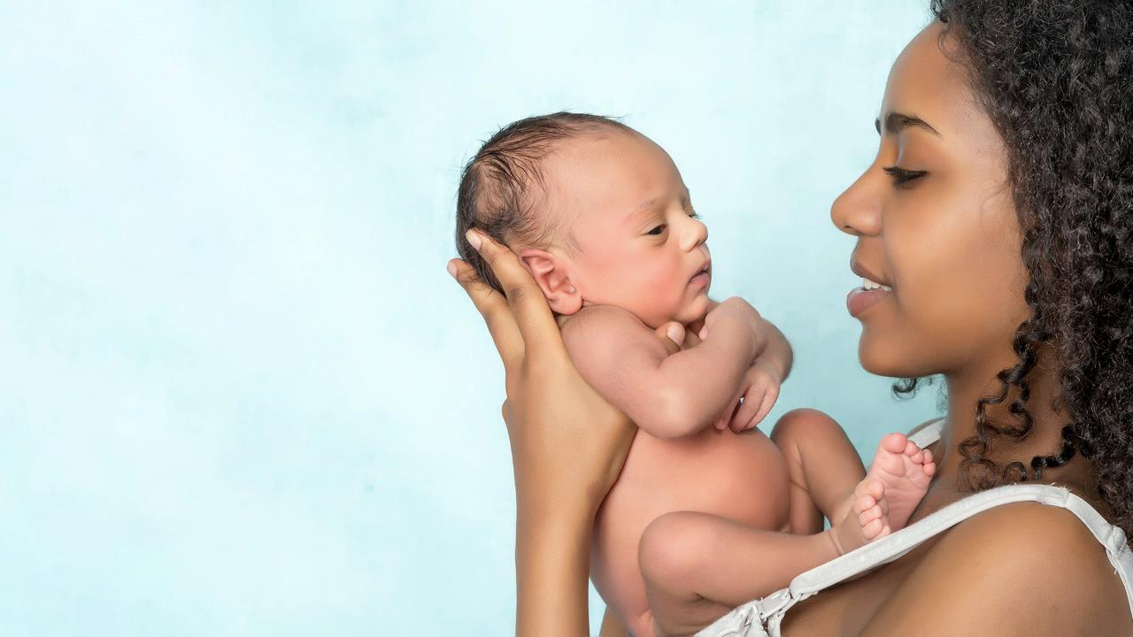









Thanks to our Funders
In kind support:

