Slide 1

COVID-19 Strategies for OB & Neonatal Units
July 10, 2020
12:00 – 1:15pm

Slide 2

Welcome
Please be certain you are on “mute” when not speaking to avoid background noise.
Whether you have joined by phone or computer audio, you can mute and unmute yourself by clicking on the microphone icon.
The following shortcuts can also be used
For PC: Alt + A : Mute or Unmute
For Mac: Shift + Command + A: Mute or Unmute
For telephone: *6 : Mute or Unmute

Slide 3
Housekeeping:
We Are Recording Now

Slide 4
ILPQC Covid 19 webinars
The strategies shared today are examples from individual institutions not IDPH or ILPQC recommendations.
This is our 10th COVID-19 strategies for OB/Neonatal Units webinars in coordination with IDPH, Friday’s at noon since April 3rd. Please see https://ilpqc.org/covid-19-information/ for future webinar registration, prior recorded webinars and written out Q/A’s from those webinars.
The next webinar will be Friday, August 7. We are moving to monthly webinars for now.
Please let us know if your hospital would like to share on an upcoming webinar, please put questions/comments into the chatbox or email directly to info@ilpqc.org

Slide 5
Overview
Introduction
Discussion of OB Unit Strategies
  Steven Ambrose, MD - Maternal-Fetal Medicine, Unity Point Health Methodist Hospital, Peoria
  Jean Goodman, MD, Maternal Fetal Medicine, Loyola University Medical Center, Maywood
  Abbe Kordik, MD, OB/GYN, University of Chicago Medical Center, Chicago
  Catalin S. Buhimschi, MD, MMS, MBA- Director, Division of MFM, Director OB Service & Patient Safety, UI Health
Discussion of Neonatal Unit Strategies
  Nour Akhras, MD - Pediatric Infectious Diseases, AMITA Alexian Brother’s Women and Children’s Hospital, Hoffman Estates
  Maliha Shareef, MD, MS, MBA, FAAP - Medical Director, Neonatal Intensive Care Unit, Amita Health St Alexius Medical Center, Hoffman Estates
  Beau Batton, MD – Chief of Neonatology, SIU School of Medicine, HSHS St. John's Hospital, Springfield
  Justin Josephsen, MD, Medical Director – St. Mary’s Hospital NICU, Neonatologist Cardinal Glennon Children’s Hospital, St. Louis

Slide 6
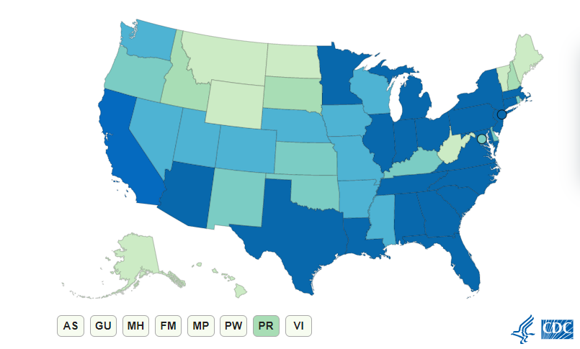
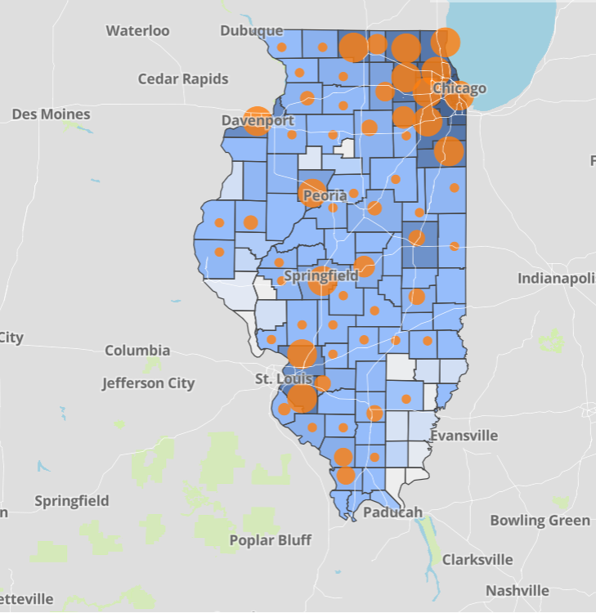
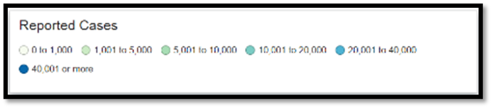
Data Update July 9, 2020
CDC/IDPH: COVID-19 Outbreak
CDC https://www.cdc.gov/coronavirus/2019-ncov/cases-updates/cases-in-us.html | IDPH https://www.dph.illinois.gov/covid19
Total cases: 3,047,671 confirmed Total deaths: 132,056 confirmed | 150,450 Confirmed Positive Cases 7,119 Deaths
Notes:
Ieshia updated 7/9/2020

Slide 7
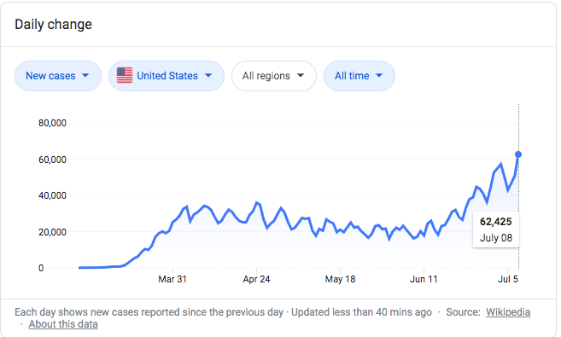
US Daily New Cases Surpass 60K

Slide 8
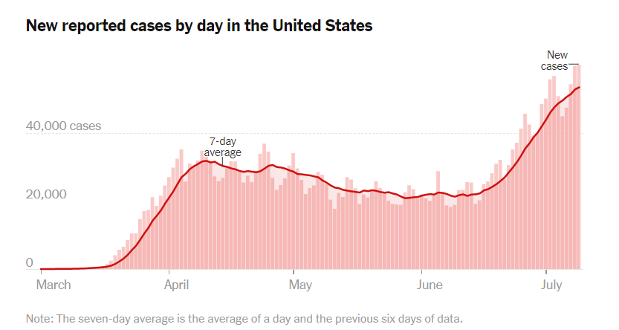
US COVID case trend
Notes:
Ieshia updated 7/10/2020

Slide 9
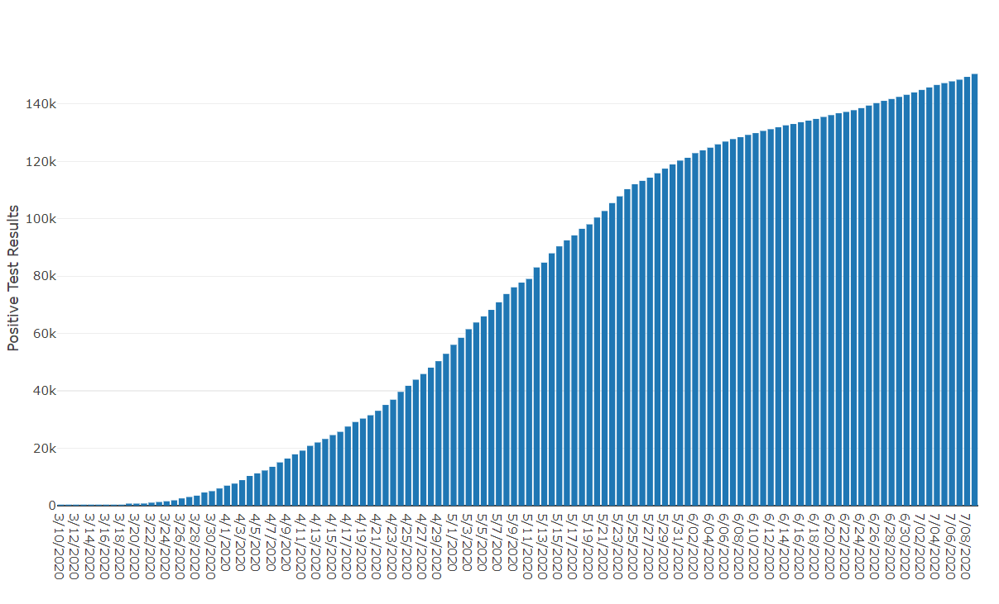
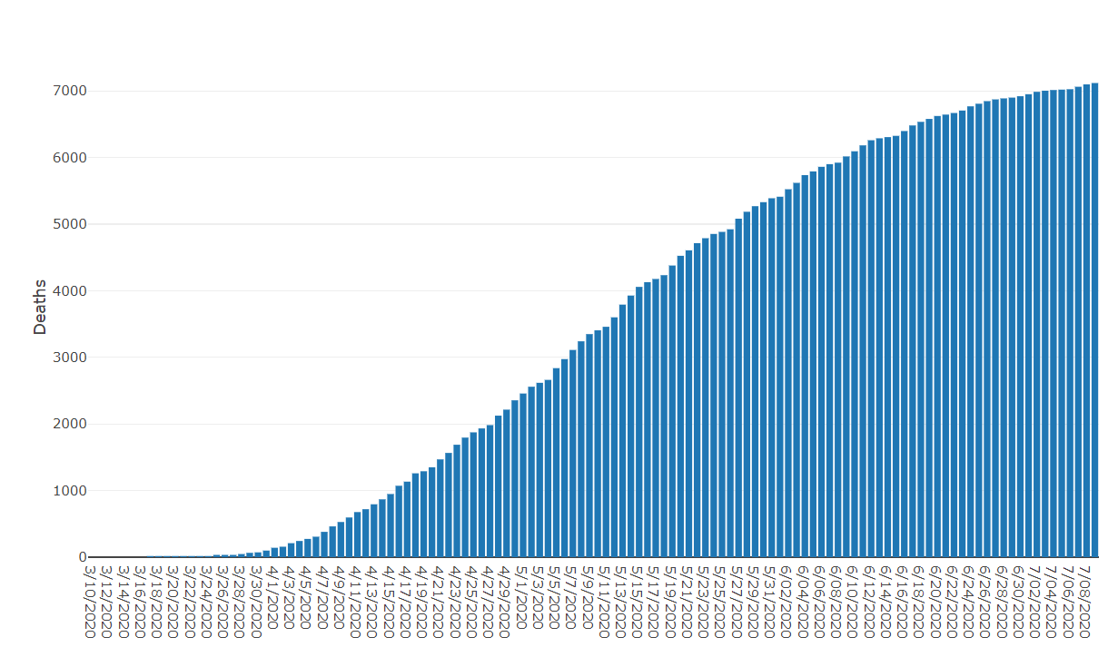
Data Update July 9, 2020
IDPH: COVID-19 Outbreak
https://www.dph.illinois.gov/covid19
IL Positive Cases Over Time
IL Deaths Over Time
Total: 150,450 Confirmed Positive Cases
Total: 7,119 Deaths
Notes:
http://www.dph.illinois.gov/covid19/covid19-statistics
Ieshia update 7/9/2020

Slide 10
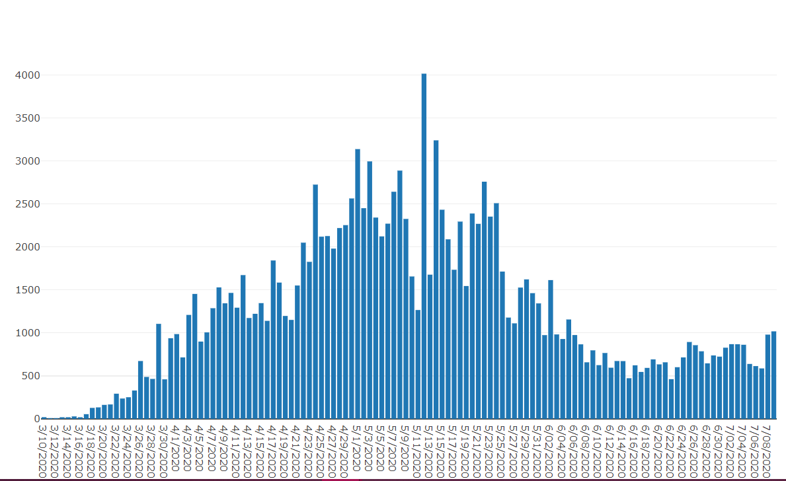
Illinois Daily Incidence
IDPH daily data summary
Notes:
Ieshia updated 7/10/2020

Slide 11
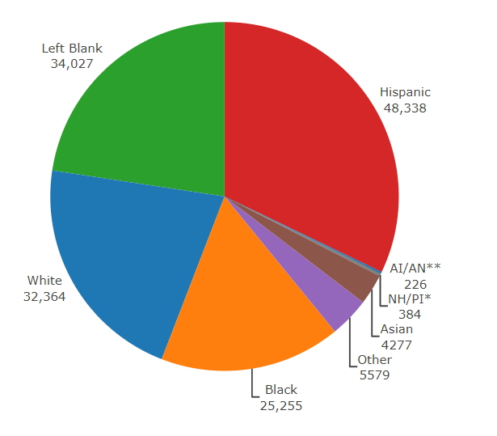
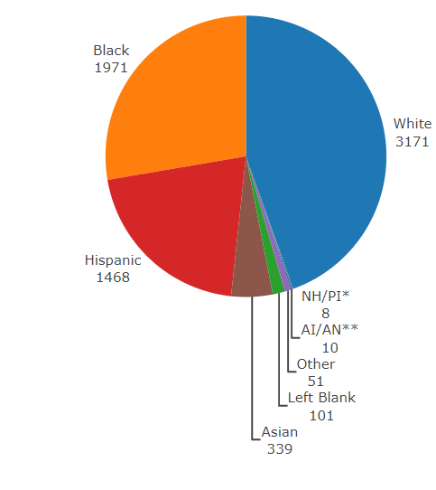
Data Update July 9, 2020
IDPH: COVID-19 Outbreak
Race Demographics
https://www.dph.illinois.gov/covid19
Confirmed Cases
Deaths
Notes:
http://www.dph.illinois.gov/covid19/covid19-statistics
Ieshia updated 7/9/2020

Slide 12
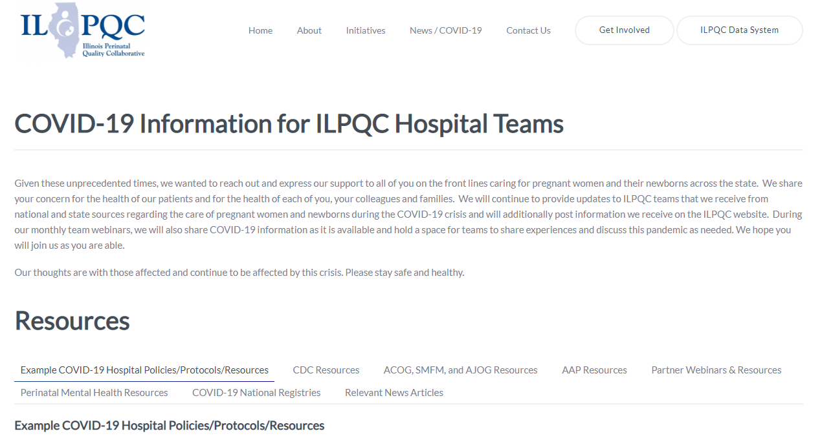
ILPQC COVID-19 Webpage www.ilpqc.org
ILPQC posts national guidelines and OB & Neonatal COVID-19 example hospital protocols & resources
please note dates as guidelines are changing rapidly
https://ilpqc.org/covid-19-information/

Slide 13
IDPH / HFS / CDC Communications
CDC: Symptom-Based Strategy to Discontinue Isolation for Persons with COVID-19 (5.3.2020)
IDPH: Changes to Isolation Period for COVID-19 Cases (5.7.2020)
IDPH PAC: Obstetrical & neonatal care during the COVID-19 pandemic (5.14.2020)
CDC: Protect yourself and your family from COVID-19 (6.9.2020)
CDC: Characteristics of Women of Reproductive Age with Lab-Confirmed SARS-CoV-2 Infection by Pregnancy Status (6.26.2020)
CDC: Pregnancy Data on COVID-19 (7.9.2020)
HFS: Provider Notice Issued Blood Pressure Monitoring Kit (7.2.2020)​ - Medicaid now covers home BP cuffs for all pregnant / postpartum patients

Slide 14
New Pregnancy Data from CDC
During January 22–June 7, CDC received reports of 326,335 women of reproductive age (15–44 years) who had Covid positive tests. Data on pregnancy status were available for 91,412 (28.0%) women; among these, 8,207 (9.0%) were pregnant.
Among women with COVID-19, approximately one third (31.5%) of pregnant women were reported to have been hospitalized compared with 5.8% of nonpregnant women.
After adjusting for age, presence of underlying medical conditions, and race/ethnicity, pregnant women were significantly more likely to be admitted to the intensive care unit (ICU) (aRR = 1.5) and receive mechanical ventilation (aRR = 1.7). Sixteen (0.2%) COVID-19–related deaths were reported among pregnant women aged 15–44 years, and 208 (0.2%) such deaths were reported among nonpregnant women.
Among women of reproductive age with COVID-19, pregnant women are more likely to be hospitalized and at increased risk for ICU admission and receipt of mechanical ventilation compared with nonpregnant women, but their risk for death is similar.
To reduce occurrence of severe illness from COVID-19, pregnant women should be counseled about the potential risk for severe illness from COVID-19, and measures to prevent infection with SARS-CoV-2 should be emphasized for pregnant women and their families.

Slide 15
Updated OB Resources
AJOG MFM: Coronovirus Guidance
ACOG: COVID-19 FAQs for Obstetrician-Gynecologists, Obstetrics (updated 5.20.2020)
SMFM: Practical Guidance for Treating Pregnant Persons with COVID-19 in Resource Limited Settings: Early Lessons from the US Epidemic (5.20.20)
ACOG Ob-Gyn Practices Financial Relief Information (6.2020)
  Step-by-Step Guide: How Ob-gyn Practices Can Access HHS Federal Relief Funds
  Advanced and Accelerated Insurance Payment Programs Available During COVID-19
  Update: ACOG Continues to Work to Secure Financial Relief for Obstetrician-Gynecologists
  Telehealth Policy Changes and A New Loan Program for Practices (5.29.2020)
SMFM & SOAP: L&D COVID-19 Considerations (6.16.2020)
ACOG: Statement on new CDC data COVID-19 and Pregnancy (6.24.2020)
Preeclampsia Foundation: How To Take Your Blood Pressure. (7.8.2020)
SMFM: Management Considerations for Pregnant Patients with COVID-19 (7.2.2020) updated
SMFM: COVID-19 and Pregnancy: What MFM Subspecialists need to Know (6.29.2020)​ updated
ACOG Practice Advisory (7.1.20202) updated

Slide 16
AAP Neonatal Guidance
AAP FAQs: Management of Infants Born to Mothers with Suspected or Confirmed COVID-19 (5.21.2020)
Newborn Care (5/21/20): Guidance for the care of infants whose mothers have suspected or confirmed COVID-19. Includes precautions for birth attendants, rooming-in, breastfeeding, testing, neonatal intensive care, visitation and hospital discharge.
  https://services.aap.org/en/pages/2019-novel-coronavirus-covid-19-infections/faqs-management-of-infants-born-to-covid-19-mothers/
  Newborn Screening During the COVID-19 Pandemic (4/15/20): Guidance recommending that pediatricians continue to follow federal and state guidelines on newborn bloodspot screening, newborn hearing screening, and critical congenital heart disease screening.
    https://services.aap.org/en/pages/2019-novel-coronavirus-covid-19-infections/guidance-on-newborn-screening-during-covid-19/
Breastfeeding Guidance Post Hospital Discharge for Mothers or Infants with Suspected or Confirmed SARS-Co V-2 Infection (4/23/20): Guidance developed to support pediatricians providing direct care for breastfeeding families after discharge from the newborn hospital stay.
  https://services.aap.org/en/pages/2019-novel-coronavirus-covid-19-infections/breastfeeding-guidance-post-hospital-discharge/

Slide 17
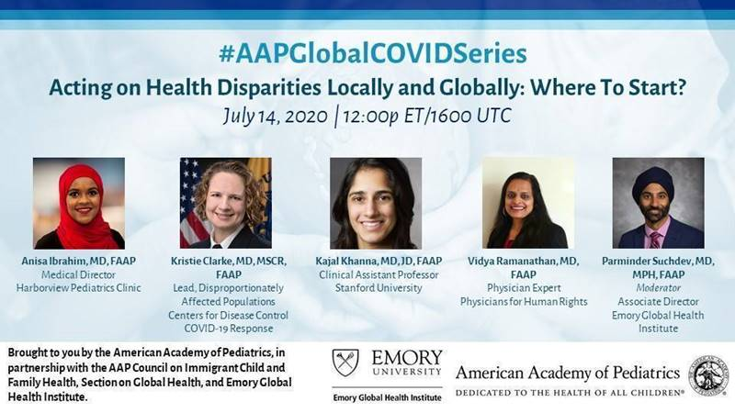
Next AAP’s webinar series
Acting on Health Disparities Locally and Globally: Where to Start?
Tuesday, July 14, 2020 (12:00p ET/ 1600 UTC)
This session will feature a panel of pediatric professionals who will discuss health disparities in local and global settings that have widened during the COVID-19 pandemic, the parallels and differences in both types of settings, and address local and global solutions to those disparities in different populations.
This session is co-sponsored by the American Academy of Pediatrics, the AAP Council on Immigrant Child and Family Health, Section on Global Health and Emory Global Health Institute.
Speakers:
Anisa Ibrahim, MD, FAAP
Medical Director
Harborview Pediatric Clinics
Executive Committee Member – Council on Immigrant Child and Family Health
Kristie Clarke, MD, MSCR, FAAP
Lead, Disproportionately Affected Populations
Centers for Disease Control COVID-19 Response
Kajal Khanna, MD, JD, FAAP
Clinical Assistant Professor
Stanford University
Vidya Ramanathan, MD, FAAP
Physician Expert
Physicians for Human Rights
Moderator:
Parminder Suchdev, MD, MPH, FAAP
Associate Director
Emory Global Health Institute
Immediate Past Chair – Section on Global Health
REGISTER HERE!
  Join the conversation online using the hashtag #AAPGlobalCOVIDSeries.
  Questions ? E-mail : sgh@aap.org.
Notes:
Ieshia add the AAP information

Slide 18
Updated OB/Neo Covid Publications
CDC MMWR: Characteristics of Women of Reproductive Age with Lab-Confirmed SARS-CoV-2 Infection by Pregnancy Status (6.26.2020)
OBGYN: Prone Positioning for Pregnant Women With Hypoxemia Due to Coronavirus Disease 2019 (COVID-19) (6.9.2020)
OBGYN: Pregnancy hypertension diagnosis and care in COVID ‐19 era and beyond (6.7.2020)
NEJM: False Negative Tests for SARS-CoV-2 Infection — Challenges and Implications (6.5.2020)
Lancet: Physical distancing, face masks, and eye protection to prevent person-to-person transmission of SARS-CoV-2 and COVID-19: a systematic review and meta-analysis (6.1.2020)
AJOG MFM: Outcome of coronavirus spectrum infections during pregnancy. (5.2020)
OBGYN: Prevention of thrombosis in pregnant women with suspected SARS‐CoV ‐2 infection: clinical management algorithm (5.25.2020)
AJOG: Universal testing of patients and their support persons for COVID-19 when presenting for admission to Labor and Delivery within the Mount Sinai Health System (5.22.20)
AJCP: Placental pathology in COVID-19 (5.22.20)
AJOG MFM: Preeclampsia Treatment in SARS-CoV-2 (5.20.20)
OBGYN: Clinical Findings and Disease Severity in Hospitalized Pregnant Women With Coronavirus Disease 2019 (COVID-19) (5.19.2020)
OBGYN: Testing of Patients and Support Persons for Coronavirus Disease 2019 (COVID-19) Infection Before Scheduled Deliveries (5.19.2020)
AJOG MFM: Vertical transmission of COVID-19 SARS-CoV-2 RNA on the fetal side of the placenta in pregnancies with COVID-19 positive mothers and neonates at birth (5.18.20)
AJOG: False-Negative COVID-19 Testing: Considerations in Obstetrical Care (4.28.2020)

Slide 19
Birth Equity Links
Please see the following links and publications for information that may help your organization consider next steps to take action to address birth equity and reduction of perinatal racial and ethnic disparities.
AIM: Reduction of Peripartum Racial/Ethnic Disparities Patient Safety Bundle (May 2018)
ACOG: Reduction of Peripartum Racial and Ethnic Disparities: a conceptual framework and maternal safety consensus bundle (May 2018)
ACOG Committee Opinion No. 729: Importance of Social Determinants of Health and Cultural Awareness in the Delivery of Reproductive Health Care (January 2018)
SMFM: Strategies to overcome racism's impact on pregnancy outcomes (May 2020)
SMFM: Strategies to provide equitable care during COVID-19 (May 2020)
ACOG: Addressing Health Equity During the COVID-19 Pandemic (May 2020)
AAP: Racial and Ethnic Disparities in the Health and Health Care of Children (May 2013)
AAP Policy Statement: The impact of racism on child and adolescent health (August 2019)
Today: Black. Pregnant. And COVID-19 positive. (7.8.2020)

Slide 20
Discussion of OB Unit Strategies

Slide 21


Unity Point Health Methodist
Dr. Steven Ambrose, MFM
Level IIE
1700 Deliveries per year
OSF Perinatal Network

Slide 22
Case
20 year old G3P2002
35 weeks gestation
Severe iron deficiency anemia
6/28/2020 vaginal spotting and pelvic pain

Slide 23
ER 7/02/2020
Presents with complaint of worsening chest pain
Two day duration
Subjective fever
Ongoing pelvic pain
Upon questioning possible dyspnea and loss of taste

Slide 24
findings
Negative physical exam
Fever 101F
CT-right middle lobe infiltrate
Tachycardia 115bpm sinus tach
Prolonged QT
Pulse ox 97 to 100% RA

Slide 25
What We Did
Admit
Hydrate
Transfuse
Out patient after 48 hours observation

Slide 26
What We Did Not Do
Antenatal steroids
Low molecular weight heparin

Slide 27
Protocols
Transfusion protocol
Sepsis protocol
Thromboembolic prophylaxis protocol
Obstetric protocols
COVID protocol

Slide 28
discussion
Lmwh
Betamethasone/dexamethasone
In patient observation
Cytokine storm
Cardiac involvement
Timing and route of delivery
Antenatal surveillance

Slide 29
Background
Peoria prevalence 2%?
Screening delivering patients since April 27th

Slide 30
TEAMWORK
Family medicine OB
Womens health fellow
MFM
Hospitalist
ER
Infectious disease
Radiology
Pathologist/lab medicine

Slide 31
OB Discussion Panel
Steven Ambrose, MD - Maternal-Fetal Medicine, Unity Point Health Methodist Hospital, Peoria
Jean Goodman, MD, Maternal Fetal Medicine, Loyola University Medical Center, Maywood
Abbe Kordik, MD, OB/GYN, University of Chicago Medical Center, Chicago
Catalin S. Buhimschi, MD, MMS, MBA- Director, Division of MFM, Director OB Service & Patient Safety, UI Health

Slide 32
The severity scale for COVID-19
● Asymptomatic or presymptomatic disease or presumptive infection is defined as a positive COVID-19 test result with no symptoms.
● Mild disease is defined as flu-like symptoms, such as fever, cough, myalgias, and anosmia without dyspnea, shortness of breath, or abnormal chest imaging.
● Moderate disease is defined by evidence of lower respiratory tract disease with clinical assessment (dyspnea, pneumonia on imaging, abnormal blood gas results, refractory fever of 39.0 °C /102.2 °F or greater, while maintaining an oxygen saturation of greater than 93% on room air at sea level.
● Severe disease is defined by a respiratory rate greater than 30 breaths per minute (bpm), hypoxia with oxygen saturation less than or equal to 93%, a ratio of arterial partial pressure of oxygen to fraction of inspired oxygen of less than 300, or greater than 50% lung involvement on imaging.
● Critical disease is defined as multi-organ failure or dysfunction, shock, or respiratory failure requiring mechanical ventilation or high-flow nasal cannula.
SMFM: Management Considerations for Pregnant Patients with COVID-19 (7.2.2020) updated

Slide 33
Many COVID-19 patients, including pregnant patients, have mild or no symptoms.
● Outpatient monitoring with a 14-day self-quarantine can be considered for pregnant patients with COVID-19 who have mild symptoms or are asymptomatic. Recommendations for outpatient monitoring is outlined below.
SMFM: Management Considerations for Pregnant Patients with COVID-19 (7.2.2020) updated

Slide 34
Inpatient monitoring may be needed for the following categories of patients:
○ Pregnant COVID-19 patients with moderate to severe signs and symptoms or oxygen saturation less than 95%. (incudes dyspnea)
○ Pregnant COVID-19 patients with comorbid conditions, eg, uncontrolled hypertension, inadequately controlled gestational or pregestational diabetes, chronic renal disease, chronic cardiopulmonary disease, or immunosuppressive states (intrinsic or medication-related)
○ Pregnant COVID-19 patients with fevers greater than 39 °C despite acetaminophen, raising concern for secondary hemophagocytic lymphohistiocytosis (sHLH) or "cytokine storm syndrome." sHLH is a fulminant and often fatal hypercytokinemia associated with multi-organ failure. The disease is defined by unremitting fever, cytopenia, and high ferritin levels. If a patient has an Hscore (see Table 1) indicating a high probability for sHLH, inpatient observation is warranted.
SMFM: Management Considerations for Pregnant Patients with COVID-19 (7.2.2020) updated

Slide 35
Remdesivir and Pregnancy
The Adaptive COVID-19 Treatment Trial (ACTT-1) investigated the use of the antiviral agent remdesivir among patients requiring oxygen therapy due to COVID-19 infection and demonstrated a decreased duration of disease in treated patients. Because of these promising results, the National Institutes of Health (NIH) COVID-19 Treatment Guidelines Panel (the Panel) recommends remdesivir for treatment of COVID-19 in hospitalized patients with SpO2 ≤94% on ambient air (at sea level) or those who require supplemental oxygen (AI). The Panel recommends remdesivir for treatment of COVID-19 in patients who are on mechanical ventilation or extracorporeal membrane oxygenation (ECMO) (BI). There is no known fetal toxicity associated with remdesivir. SMFM recommends that remdesivir be offered to pregnant patients with COVID-19 meeting criteria for compassionate use. (https://www.gilead.com/purpose/advancing-global-health/covid19/emergency-access-to-remdesivir-outside-of-clinical-trials).
SMFM: Management Considerations for Pregnant Patients with COVID-19 (7.2.2020) updated

Slide 36
Dexamethasone and Pregnancy
A recent pre-print report of the RECOVERY trial demonstrated that dexamethasone was associated with a decreased risk of mortality among people requiring mechanical ventilation and also demonstrated a small but statistically significant decrease in mortality risk among those requiring oxygen for COVID19. Because of these promising preliminary results, the NIH COVID-19 Treatment Guidelines Panel (the Panel) recommends using dexamethasone (at a dose of 6 mg PO or IV per day for up to 10 days) in patients with COVID-19 who are mechanically ventilated (AI) and in patients with COVID-19 who require supplemental oxygen but who are not mechanically ventilated (BI). The Panel recommends against using dexamethasone in patients with COVID-19 who do not require supplemental oxygen (AI). These recommendations are not specific to pregnant patients. Since the benefit of mortality reduction outweighs the risk of fetal steroid exposure for this short course of treatment, SMFM recommends that this treatment should also be offered to pregnant patients with COVID-19.
SMFM: Management Considerations for Pregnant Patients with COVID-19 (7.2.2020) updated

Slide 37
Timing of Delivery: mild symptoms
In an asymptomatic or mildly symptomatic woman positive for COVID-19 at 37 to 38 6/7 weeks of gestation without other indications for delivery, expectant management can be considered until 14 days after the polymerase chain reaction (PCR) result was noted to be positive OR until 7 days after onset of symptoms and 3 days after resolution of symptoms. This option allows for decreased exposure of health care workers and the neonate to SARS-CoV-2.
In an asymptomatic or mildly symptomatic woman positive for COVID-19 at 39 weeks of gestation or later, delivery can be considered to decrease the risk of worsening maternal status.
SMFM: Management Considerations for Pregnant Patients with COVID-19 (7.2.2020) updated

Slide 38
Timing of Delivery: critical illness
The timing of delivery requires carefully weighing the benefits and risks for the patient and fetus, and the decision to deliver requires close communication between the maternal-fetal medicine and critical care teams. Improvement in lung mechanics gained by early delivery is theoretical. In the third trimester, the pressure of the uterus can decrease expiratory reserve volume, inspiratory reserve volume, and functional residual capacity, which can increase the risk of severe hypoxemia in pregnant patients, especially those who are critically ill.
Although data regarding delivery timing and acute respiratory distress syndrome are limited, it is reasonable to consider delivery in the setting of worsening critical illness.
SMFM: Management Considerations for Pregnant Patients with COVID-19 (7.2.2020) updated

Slide 39
OB Questions/Discussion
Questions from chat box and registration
OB Q&A from 5.15.20 webinar
Q/A from 5.8.2020 webinar (OB answers)
Q/A from 5.01.2020 – questions answered webcast
Q/A from 4.24.2020 webinar (OB answers)
Q/A from 4.17.2020 webinar
Q/A from 4.10.2020 webinar
Q/A from 4.3.2020 webinar
Notes:
Update?

Slide 40
Discussion of Neonatal Unit Strategies

Slide 41
Multisystem Inflammatory syndrome-Children
(MIS-C)
Nour Akhras, MD
Pediatric Infectious Diseases
AMITA Alexian Brother’s Women and Children’s Hospital
July 10, 2020

Slide 42

AMITA Women and Children’s Hospital
Level III NICU
30 beds
Loyola University Medical Center
2019 => 3269 deliveries
24 pediatric beds/ 8 Peds ICU
Subspecialist: neuro, ID, heme, cards, GI

Slide 43

Case Presentation
CC: vomiting
HPI: 6 y male, no sig PMH; 5 d PTA fever, LAD -> Augmentin by PCP
2 d PTA rash; ABX stopped; thought to be EBV
1 d PTA emesis, diarrhea, inability to tolerate PO. intermittent fevers; cough with blood-tinged sputum.

Slide 44
ER Course
T 101.5 P 154 RR 21 BP 88/51 P ox 95 on RA
ED exam indicates non-toxic appearance, dry lips, cries with tears
Diffusely tender abdomen with no peritoneal signs
LABS; 22> 10.8 < 393 S 26 B57 L 4
Na 129 K 5.9 Cl 98 CO2 20 Cr 2.4 Alb 2.4 CRP 32.7 AST 117 ALT 146
Rapid strep/Flu A/B neg
UA 40 WBCs. - blood; trace LE
CXR: neg
KUB: neg
App US: no evidence of appy but appendix not visualized.

Slide 45
Hospital Course
admitted to ICU for refractory hypotension requiring epi drip
Echo: mild-mod depressed biventricular function with mild dilatation of RCA
DDx: TSS; bacterial/viral sepsis; COVID; KD; other vasculitides; MAS
Triple ABX until negative cultures and continued fever and high inflammatory markers
IVIG x 2, then high dose steroids and ASA; d/c 48 h after steroids

Slide 46
CDC Guidelines
Case definition:
  Pt < 21 y.o with fever,
  lab evidence of inflammation AND
  evidence of clinically severe illness requiring hospitalization with 2+ organ involvement AND
  no alternative plausible dx AND
  + SARS-CoV2 by RT-PCR, serology, Ag test or COVID19 exposure w/i 4 weeks of onset
Temp > 38 x at least 24 h or subjective x 24 h
. Labs => elevated CRP; ESR; fibrinogen; PCT; D-dimer; ferritin; LDH; IL 6; neutrophilia; lymphopenia; hypoalbuminemia

Slide 47
Lesson Learned
MIS-C is a rare complication in children (200 cases in NY vs 400,000 adult cases)
Many met criteria for complete or incomplete KD
Older children and adolescents
Likely disproportionately affects Hispanic and AA
Average age 9 (age range 1-17)
MIS-C cases peak a couple of weeks after COVID19 cases peak in community
Most kids are PCR neg but Ab + suggesting a post-infectious process
Labs and presenting may suggest that this is different entity than KD

Slide 48
Lesson Learned
Presenting s/s
  Fever, rash, conjunctivitis, LAD, hand/feet changes, oral mucosa changes
  GI symptoms: vomiting and diarrhea
  Neurocognitive complaints
  Resp symptoms
  Sore throat
. Labs => elevated CRP; ESR; fibrinogen; PCT; D-dimer; ferritin; LDH; IL 6; neutrophilia; lymphopenia; hypoalbuminemia

Slide 49
Imaging
Echo: depressed LV function; CA abnormalities
CXR: mostly normal but some with pleural effusions, patchy or focal consolidation; atelectasis
CT chest: same as above
Abdominal imaging: free fluid, ascites, bowel and mesenteric inflammation; pericholecystic edema.

Slide 50
Spectrum of Disease
Most children: asymptomatic or mild disease
Covid19 associated febrile inflammatory state: persistent fevers. ,mild symptoms (HA, fatigue) elevated inflammatory markers, but no evidence of multi system involvement
Covid19 associated KD – no shock or multi system involvement
MIS-C

Slide 51
Lesson Learned
Most children have survived
Treated with IVIG; steroids; other immunomodulators
Follow up unclear
Rapidly and continually evolving situation

Slide 52
Questions/Discussion?

Slide 53
References
https://www.rcpch.ac.uk/sites/default/files/2020-05/COVID-19-Paediatric-multisystem-%20inflammatory%20syndrome-20200501.pdf?fbclid=IwAR02fqx5OBag0OxeUoZstb3cujlE717qaccuL3Poo4exh7E_ywHZ6GC0E9k
https://www.thelancet.com/journals/lancet/article/PIIS0140-6736(20)31094-1/fulltext
https://hosppeds.aappublications.org/content/hosppeds/early/2020/04/06/hpeds.2020-0123.full.pdf
https://www.thelancet.com/journals/lancet/article/PIIS0140-6736(20)31103-X/fulltext
https://www.aappublications.org/news/2020/05/14/covid19inflammatory051420
https://pubmed.ncbi.nlm.nih.gov/32418446/
https://www.clinicalkey.com/service/content/pdf/watermarked/1-s2.0-S0016508520347533.pdf?locale=en_US&searchIndex=
https://jamanetwork.com/journals/jama/fullarticle/2767209

Slide 54
Neonatal Discussion Panel
Nour Akhras, MD - Pediatric Infectious Diseases, AMITA Alexian Brother’s Women and Children’s Hospital, Hoffman Estates
Maliha Shareef, MD, MS, MBA, FAAP - Medical Director, Neonatal Intensive Care Unit, Amita Health St Alexius Medical Center, Hoffman Estates
Beau Batton, MD – Chief of Neonatology, SIU School of Medicine, HSHS St. John's Hospital, Springfield
Justin Josephsen, MD, Medical Director – St. Mary’s Hospital NICU, Neonatologist Cardinal Glennon Children’s Hospital, St. Louis
Notes:
UPDATE

Slide 55
Neonatal Questions/Discussion
Questions from chat box and meeting registration
Slides from 6.12.20 webinar
Slides from 5.29.20 webinar
Neonatal Q&A from 5.15.20 webinar
Q/A from 5.8.2020
Q/A from 5.01.2020 – questions answered webcast
Q/A from 4.24.2020 webinar (Neonatal Answers)
Q/A from 4.17.2020 webinar
Q/A from 4.10.2020 webinar
Q/A from 4.3.2020 webinar

Slide 56
Thank You
We continue to give thanks to the nurses, doctors, health care workers, public health teams and others across our state at work confronting the COVID-19 pandemic.
Please send questions, comments and recommendations, cases / willingness to share for future COVID-19 OB/Neo discussion webinars to info@ilpqc.org
Recording of this webinar, Q/A and registration for the next webinar on Friday, 7/10/20 will be available at www.ilpqc.org

Slide 57



THANKS TO OUR
FUNDERS
Email info@ilpqc.org or visit us at www.ilpqc.org
Notes:
Updated 10/22/19

