Slide 1
COVID-19 Strategies for OB & Neonatal Units
February 11, 2022
12:00 – 1:15pm

Slide 2
Welcome
Please be certain you are on “mute” when not speaking to avoid background noise.
Whether you have joined by phone or computer audio, you can mute and unmute yourself by clicking on the microphone icon.
The following shortcuts can also be used
For PC: Alt + A : Mute or Unmute
For Mac: Shift + Command + A: Mute or Unmute
For telephone: *6 : Mute or Unmute
2

Slide 3
Housekeeping:
We Are Recording Now
3

Slide 4
ILPQC Covid 19 webinars
The strategies shared today are examples from individual institutions not IDPH or ILPQC recommendations.
This is our 29th COVID-19 strategies for OB/Neonatal Units webinar in coordination with IDPH, since April 2020. Please see https://ilpqc.org/covid-19-information/ for
future webinar registration, prior recorded webinars and written out Q/A’s from those webinars.
The next webinar will be Friday, March 4, noon to 1:15pm. We are continuing monthly for now, but determining the needed frequency going forward
Please let us know if your hospital would like to share on an upcoming webinar, please put questions/comments into the chatbox or email directly to info@ilpqc.org
4

Slide 5
Overview
Introduction
Overview of updated data and recommendations
Discussion of OB Unit Strategies
Stephanie Atella, MPH, CHES - Project Director Immunizations, Illinois Chapter, American Academy of Pediatrics
Sarah Bradley, MD – OB Hospitalist, Swedish American Hospital, Rockford
Maggie Sevrin, – OB/GYN 3rd year Resident, Southern Illinois University School of Medicine, Springfield
Emma Jones, – OB/GYN 3rd year Resident, Southern Illinois University School of Medicine, Springfield
Rob Abrams, MD – Professor and Executive Director – SIU Center for Maternal-Fetal Medicine, Southern Illinois University School of Medicine, Director of Obstetrics – South Central Illinois Perinatal Center
Discussion of NEO Unit Strategies
Justin Josephsen, MD – Medical Director, St. Mary’s Hospital NICU, Neonatologist Cardinal Glennon Children’s Hospital, St. Louis
5

Slide 6
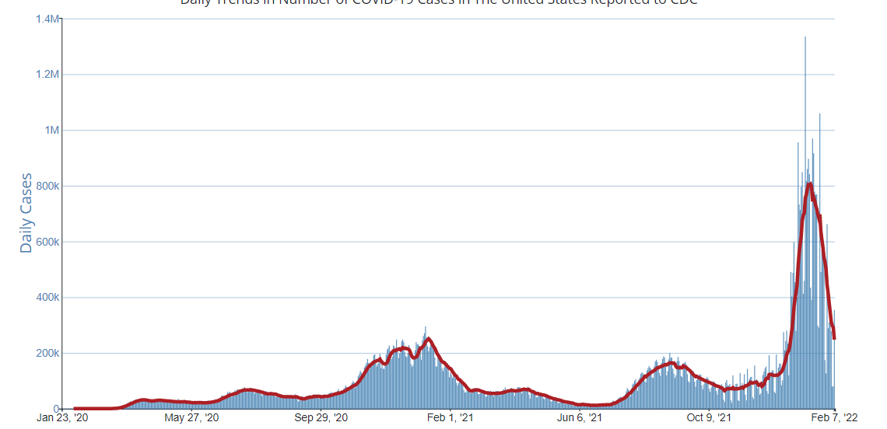
US COVID case trend
6

Slide 7
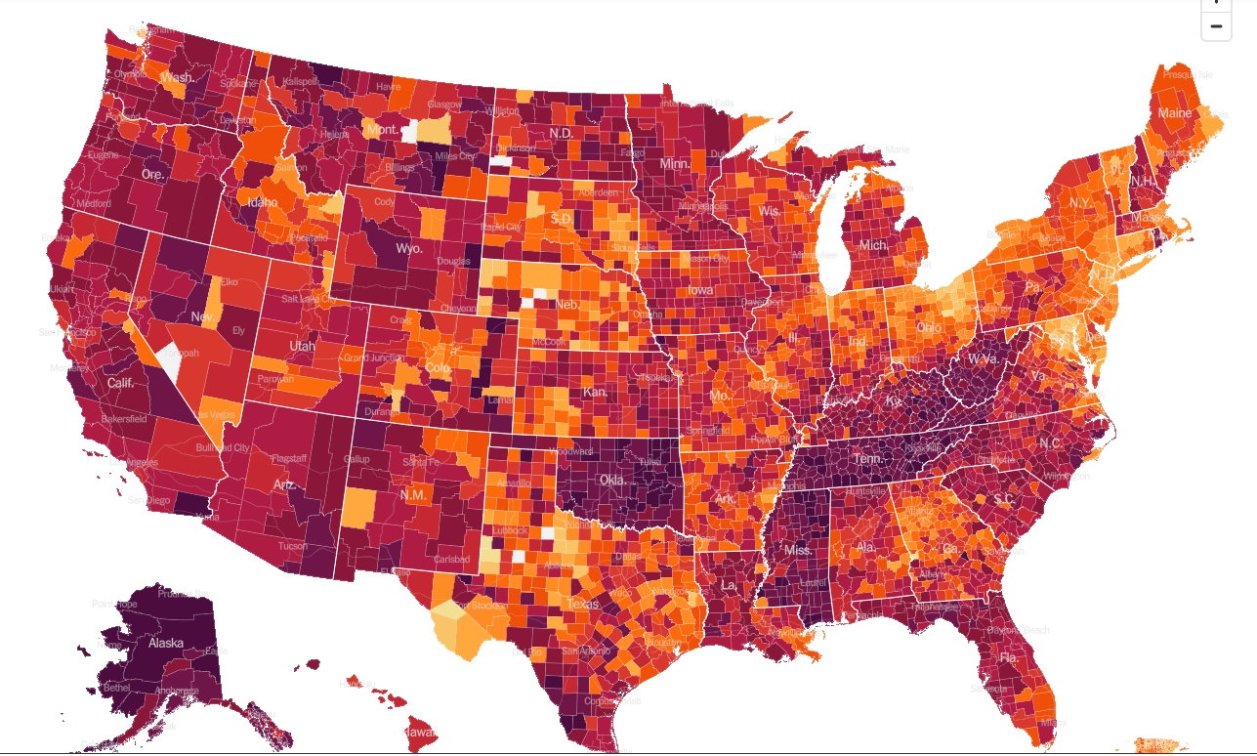
United States Hot Spots 2/9/22

Slide 8
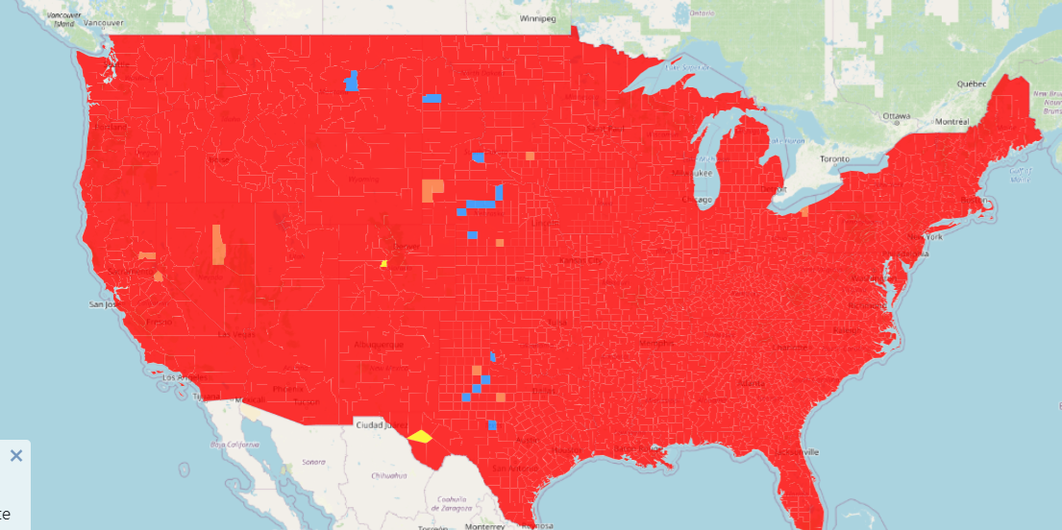
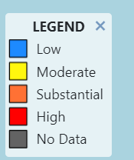
COVID
High transmission across the Country
Updated 2/9/22

Slide 9
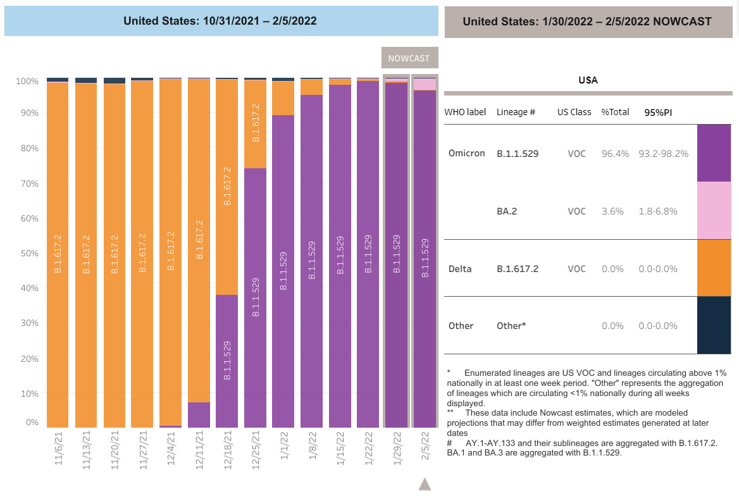
Increasing Omicron Cases
Updated 2/9/2022

Slide 10
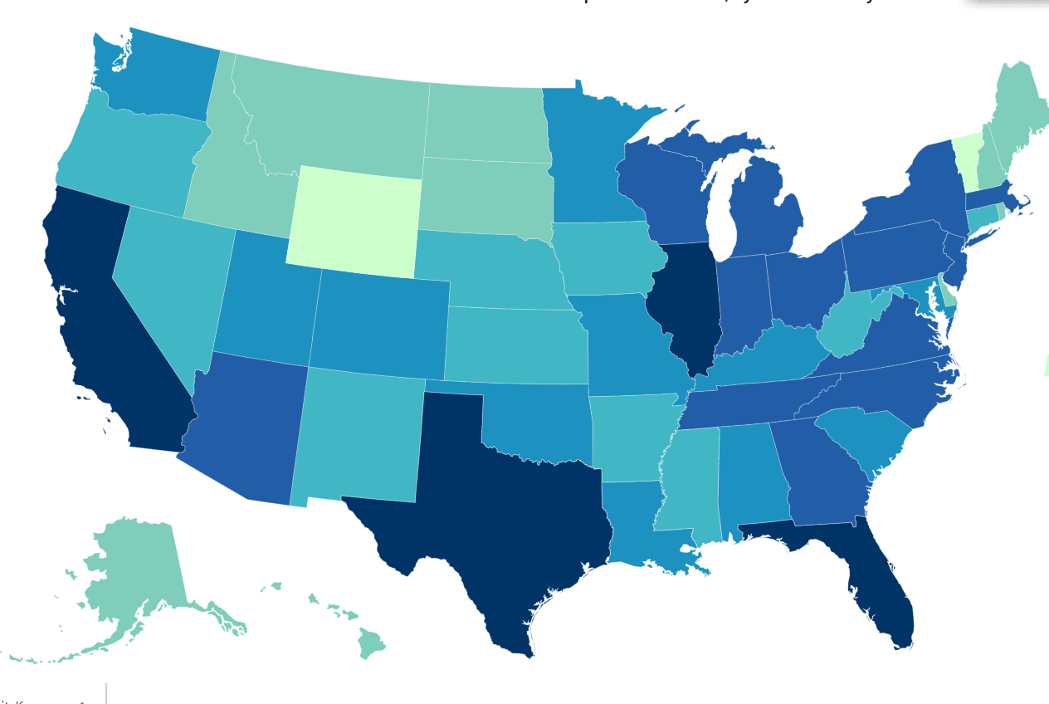
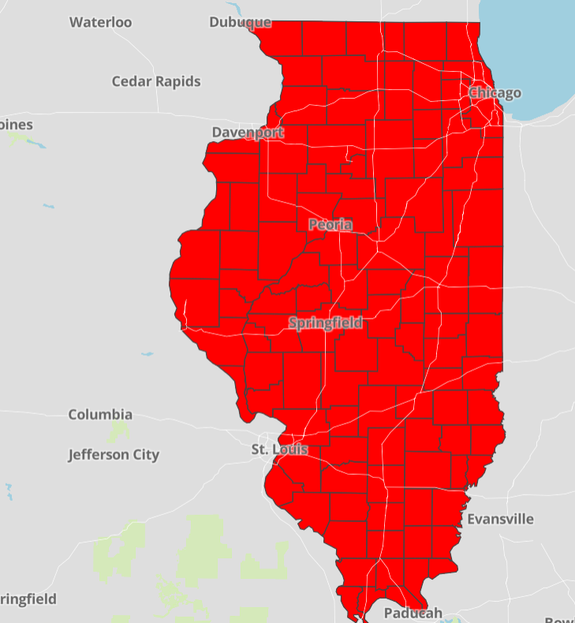
Data Update: February 9, 2022
CDC/IDPH: COVID-19 Outbreak
CDC
https://covid.cdc.gov/covid-data-tracker/#cases_totalcases
IDPH
https://www.dph.illinois.gov/covid19
Total cases: 76,782,002 confirmed
Total deaths: 903,038 confirmed
2,982,083 Confirmed Positive Cases
31,679 Deaths
8

Slide 11
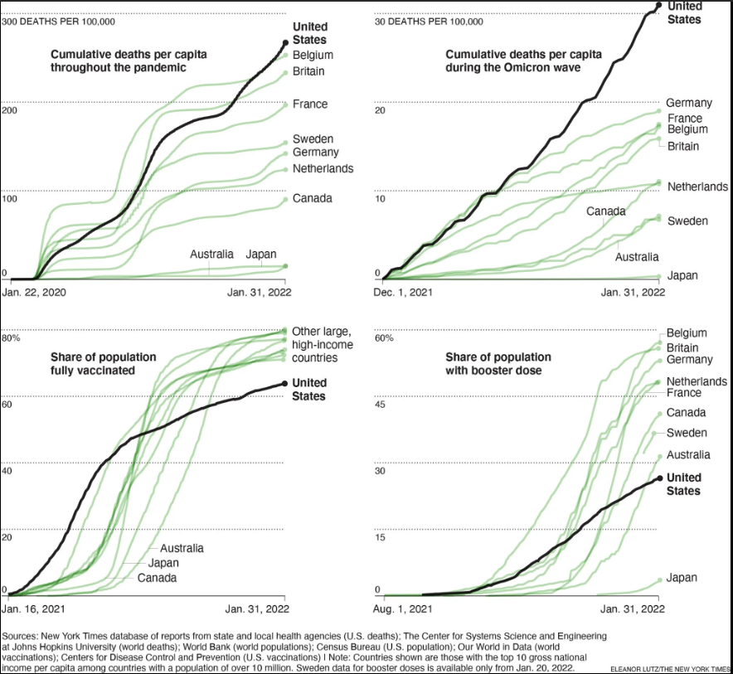
U.S. Has Far Higher Covid Death Rate Than Other Wealthy Countries

Slide 12
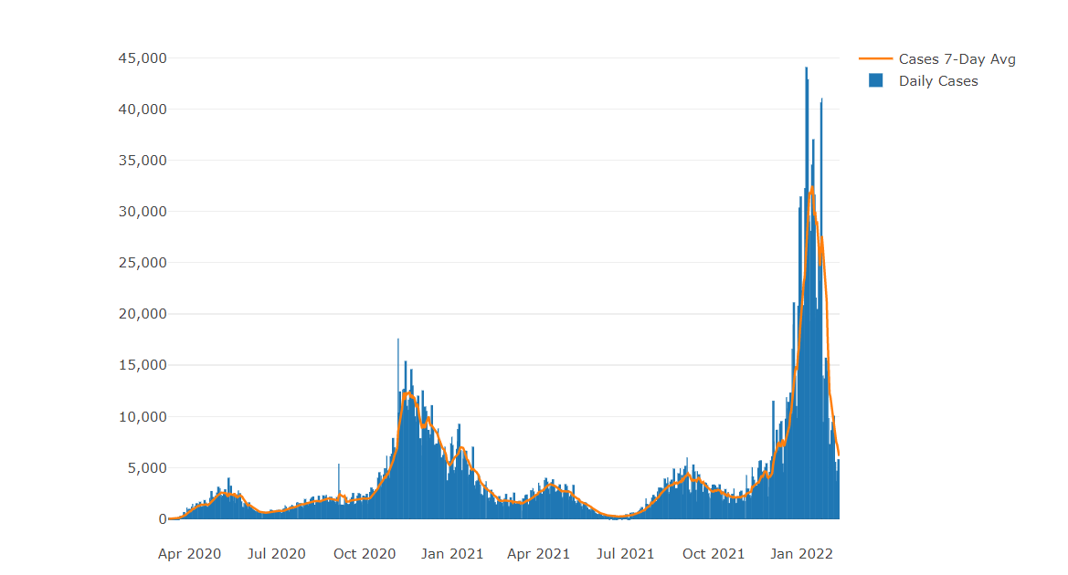
Illinois Daily Incidence
IDPH daily data summary
12

Slide 13
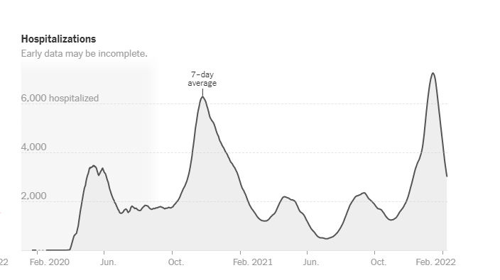
Illinois Hospitalizations By Time through 2/9/2022
Sources: U.S. Department of Health and Human Services (daily confirmed and suspected Covid-19 hospital admissions); Census Bureau (population data). Data prior to October 2020 was unreliable. Data reported in the most recent seven days may be incomplete.

Slide 14
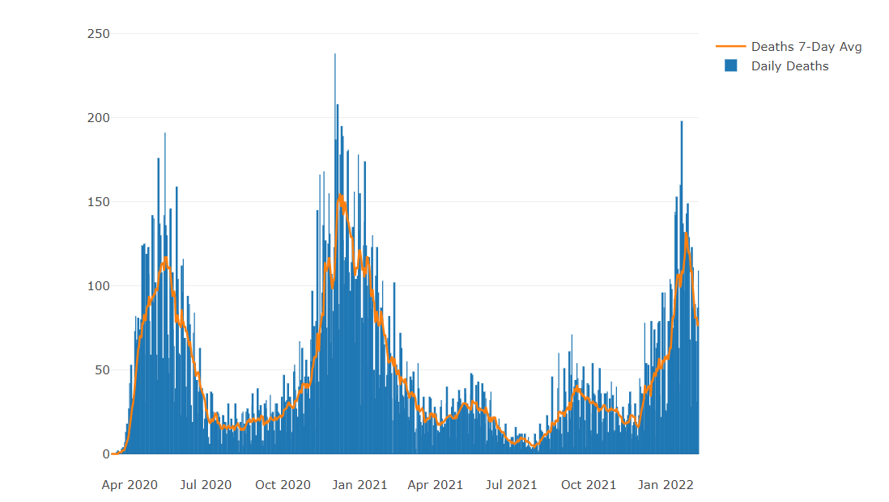
Illinois Covid Deaths
IDPH daily data summary
14

Slide 15
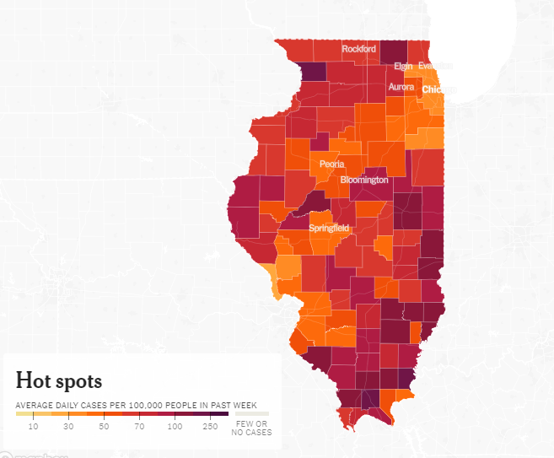
Illinois Hot Spots
2/9/2022

Slide 16
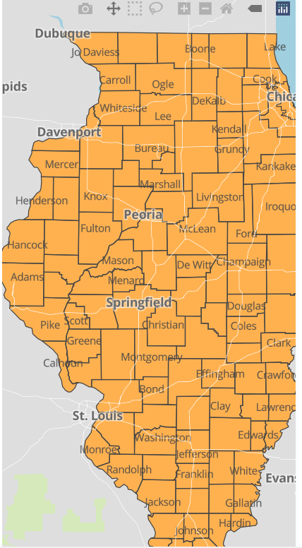
IDPH County Level COVID-19 Risk Metrics
Week 51: 1/23/2022 Through 1/29/2022
Blue indicates that the county is experiencing overall stable COVID-19 metrics.
Orange indicates there are warning signs of increased COVID-19 risk in the county.
11

Slide 17
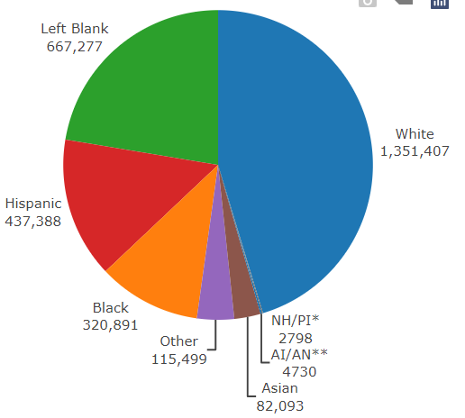
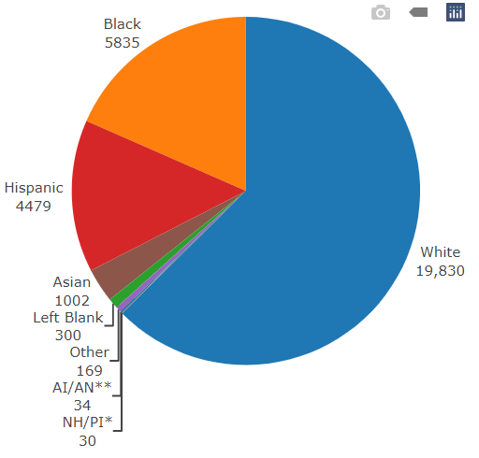
Data Update February 9, 2022 IDPH: COVID-19 Outbreak Race Demographics
https://www.dph.illinois.gov/covid19
Confirmed Cases
Deaths
13

Slide 18
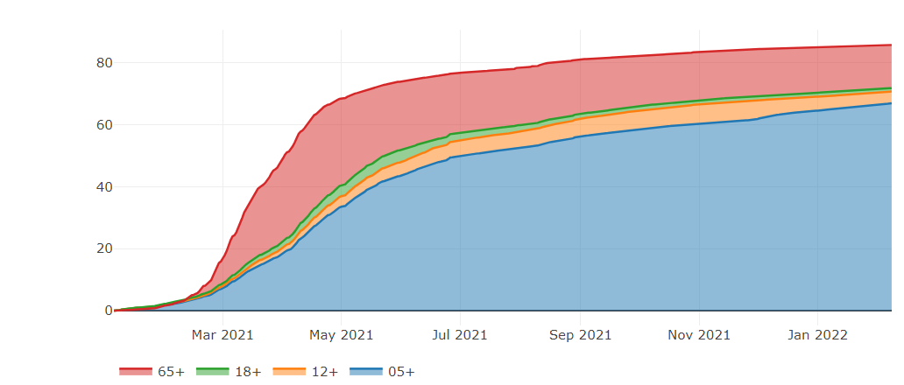
Illinois Population Vaccinated Fully
13

Slide 19
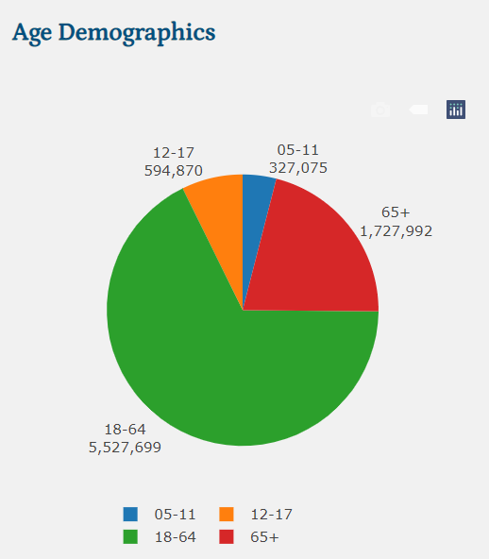
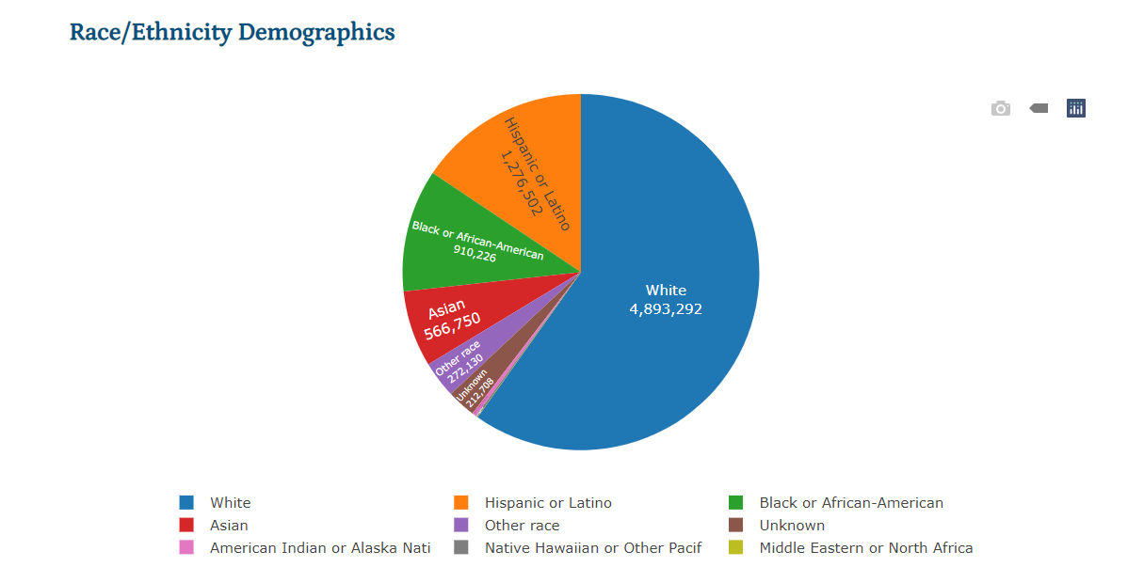
Illinois Population Administered Booster Doses
13

Slide 20
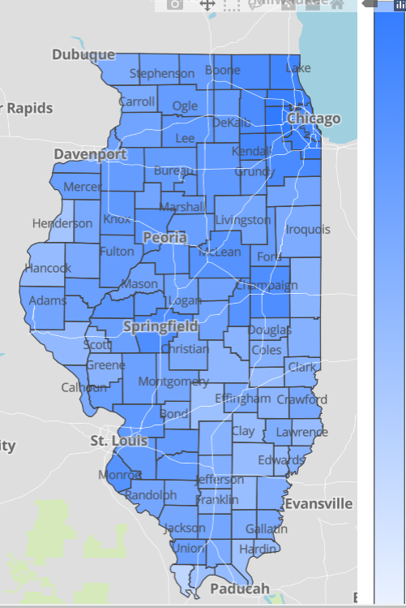
Illinois Daily Reported Administered Vaccine Doses
Last updated 2/9/2022
20,775,048
Administered Vaccine Doses
Illinois Perinatal Quality Collaborative
14

Slide 21
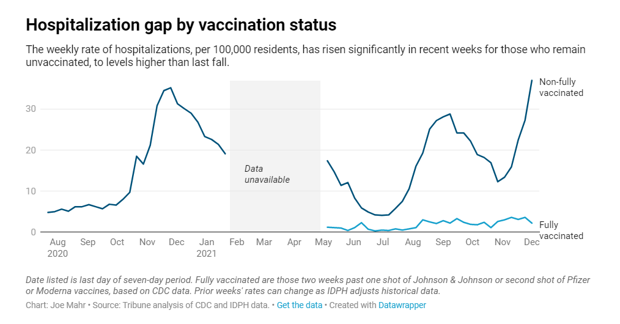
Notes:
Do you have the updated link for this graph?

Slide 22
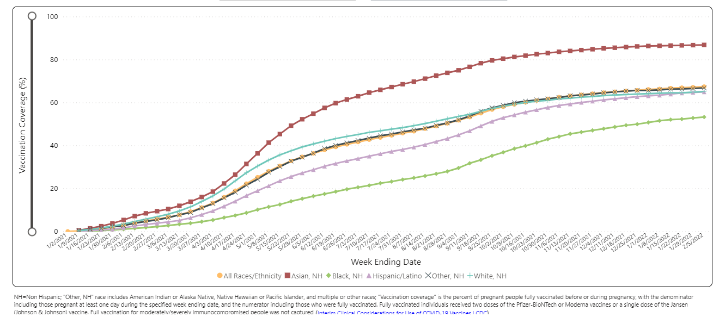
Notes:
https://urldefense.com/v3/__https://covid.cdc.gov/covid-data-tracker/*vaccinations-pregnant-women__;Iw!!Dq0X2DkFhyF93HkjWTBQKhk!BRT8JkbGHSHMqUvlHo57UsXRx3oQL6Au0KIaOe8oN7qp9yWGe1oyTAFdCw-PzSyj1gqEUOSiCw$

Slide 23
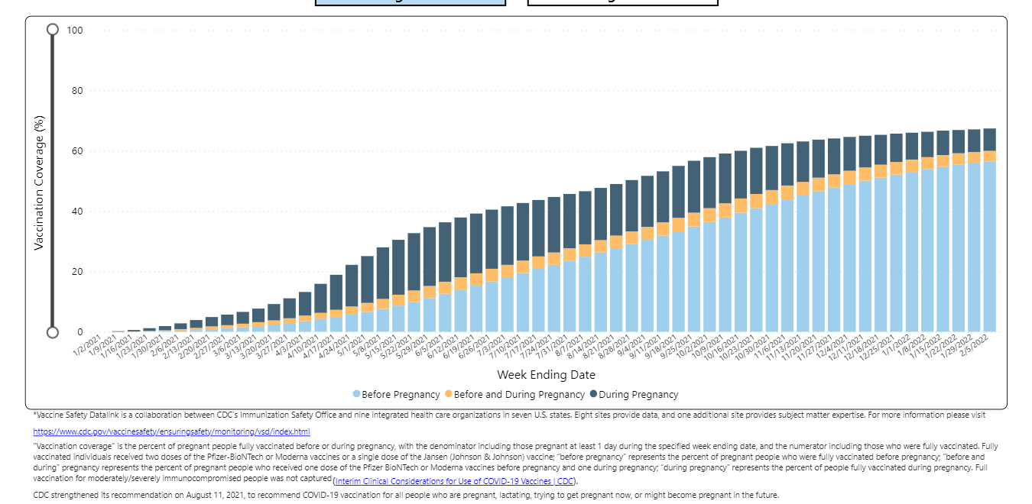
Notes:
https://urldefense.com/v3/__https://covid.cdc.gov/covid-data-tracker/*vaccinations-pregnant-women__;Iw!!Dq0X2DkFhyF93HkjWTBQKhk!AZLmkCzjPqbpDlw3HSvzpeV2yHLjASTwFArm1NOsQ1zqBmsgYQCTjWJcfL5ZsjyF2-lUxyxYPA$

Slide 24
Covid-19 and Pregnancy
Pregnant women with COVID-19, United States, January 22, 2020 - February 7, 2022
171,428 cases
29,008 hospitalizations
273 deaths

Slide 25
CDC: COVID-19 Vaccination for Pregnant People to Prevent Serious Illness, Deaths, and Adverse Pregnancy Outcomes from COVID-19. (9.29.21)
CDC recommends urgent action to help protect pregnant people and their fetuses/infants.
Healthcare providers should communicate the risks of COVID-19, the benefits of vaccination, and information on the safety and effectiveness of COVID-19 vaccination in pregnancy.
Compared with non-pregnant symptomatic people, symptomatic pregnant people have more than a two-fold increased risk of requiring ICU admission, invasive ventilation, and ECMO, and a 70% increased risk of death.⁶
Healthcare providers should strongly recommend that people who are pregnant, recently pregnant (including those who are lactating), who are trying to become pregnant now, or who might become pregnant in the future receive one of the authorized or approved COVID-19 vaccines as soon as possible.

Slide 26
CDC: MotherToBaby help line for Covid and pregnancy questions for patients
If you are pregnant and have questions about COVID-19 vaccine
If you would like to speak to someone about COVID-19 vaccination during pregnancy, you can contact MotherToBaby.
MotherToBaby experts are available to answer questions in English or Spanish by phone or chat.
The free and confidential service is available Monday–Friday 8am–5pm (local time).
To reach MotherToBaby: Call 1-866-626-6847
Chat live or send an email MotherToBabyexternal iconexternal icon

Slide 27
VACCINE SAFETY DATA

Slide 28
Association of BNT162b2 COVID-19 Vaccination During Pregnancy With Neonatal and Early Infant Outcomes, JAMA Pediatrics, February 10, 2022
Cohort of 24 288 eligible newborns (16 697 were exposed in the first and second trimesters) to maternal vaccination
Median follow-up after birth was 126 days
No substantial differences were observed in preterm birth rates between exposed and unexposed newborns or SGA
No significant differences were observed in the incidence of all-cause neonatal hospitalizations, postneonatal hospitalizations after birth, congenital anomalies, or infant mortality over the study period

Slide 29
V-SAFE vaccine monitoring
– what data is being gathered pregnant patients
As of February 7, 2022, there have been over 198,028 pregnancies reported in CDC’s V-SAFE post-vaccination health checker
CDC is also enrolling pregnant individuals in a pregnancy registry for additional follow up with over 15,793 enrolled.
Evidence gathered through these system has provide clinicians with critically needed safety data on COVID-19 vaccination during pregnancy
No adverse pregnancy outcomes associated with Covid-19 vaccine and pregnancy
https://www.cdc.gov/coronavirus/2019-ncov/vaccines/safety/vsafe.html

Slide 30
CDC MMWR: Receipt of COVID-19 Vaccine During Pregnancy and Preterm or Small-for-Gestational-Age at Birth — December 15, 2020–July 22, 2021. (1.4.21)
Pregnant women with COVID-19 are at increased risk for severe illness and adverse birth outcomes, yet many remain reluctant to be vaccinated.
What is added by this report?
In a retrospective cohort of >40,000 pregnant women, COVID-19 vaccination during pregnancy was not associated with preterm birth or small-for-gestational-age at birth overall, stratified by trimester of vaccination, or number of vaccine doses received during pregnancy, compared with unvaccinated pregnant women.
What are the implications for public health practice?
These data support the safety of COVID-19 vaccination during pregnancy. CDC recommends COVID-19 vaccination for women who are pregnant, recently pregnant, who are trying to become pregnant now, or who might become pregnant in the future.

Slide 31
CDC Vaccine and Pregnancy Summary: what you need to know
People who are pregnant or recently pregnant are more likely to get severely ill with COVID-19 compared with people who are not pregnant.
Getting a COVID-19 vaccine can help protect you from severe illness from COVID-19.
COVID-19 vaccination is recommended for people who are pregnant, breastfeeding, trying to get pregnant now, or might become pregnant in the future.
People who are pregnant should receive a COVID-19 vaccine booster shot.
Evidence about the safety and effectiveness of COVID-19 vaccination during pregnancy has been significant and continues to grow. These data suggest that the benefits of receiving a COVID-19 vaccine outweigh any known or potential risks of vaccination during pregnancy.
There is currently no evidence that any vaccines, including COVID-19 vaccines, cause fertility problems in women or men.

Slide 32
ACOG: COVID-19 Vaccination During Pregnancy Is Key to Saving Lives, Medical Experts Urge. (12.6.21)
The following is a joint statement from the American College of Obstetricians and Gynecologists | American Academy of Family Physicians | American College of Nurse-Midwives | American Society for Reproductive Medicine | Association of Women’s Health, Obstetric and Neonatal Nurses | National Hispanic Medical Association | National Medical Association | National Rural Health Association | Nurse Practitioners in Women’s Health | Society for Maternal-Fetal Medicine.
“As the leading organizations representing experts in maternal care, we continue to strongly urge all eligible individuals—especially those who are considering pregnancy, pregnant, recently pregnant, and lactating—to be vaccinated against COVID-19.
“Pregnant individuals are at increased risk of severe COVID-19 infection, ICU admission, and death, as well as adverse pregnancy outcomes. If an individual is pregnant, the best way to protect themselves and their pregnancy against the potential harm from COVID-19 infection is to be vaccinated

Slide 33
SMFM: Provider Considerations for Engaging in COVID-19 Vaccine Counseling With Pregnant and Lactating Patients (Updated 10.26.21)
SMFM and ACOG recommend that pregnant people, including health care workers, receive a COVID-19 booster shot at least 5 months after their primary series. As with the primary series, the booster dose should be given at any stage during pregnancy and postpartum.

Slide 34
New ACOG / CDC PSA Covid Vaccination in Pregnancy
Please Share This Important PSA
In partnership with the CDC, ACOG has released our first-ever PSA! Please help us spread this important, life-saving message to get vaccinated during pregnancy by sharing: https://vimeo.com/674866776
We know that a trusted obstetrician-gynecologist can play a large role in a patient’s decision about whether to get vaccinated, so use this PSA as a tool to share with your communities and spread the message.

Slide 35
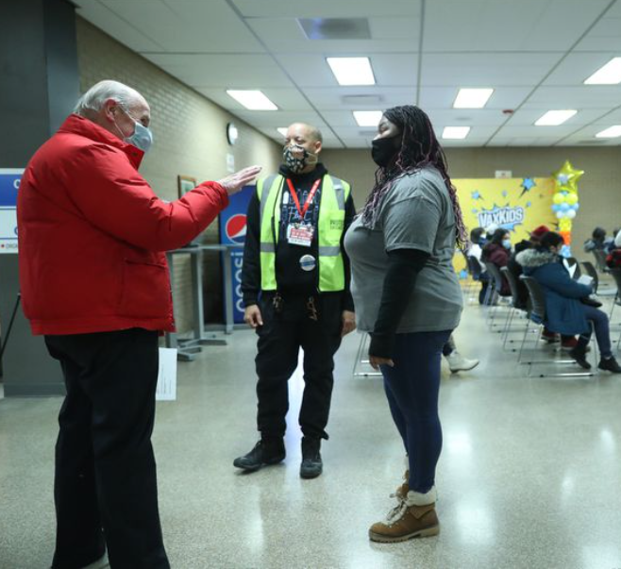
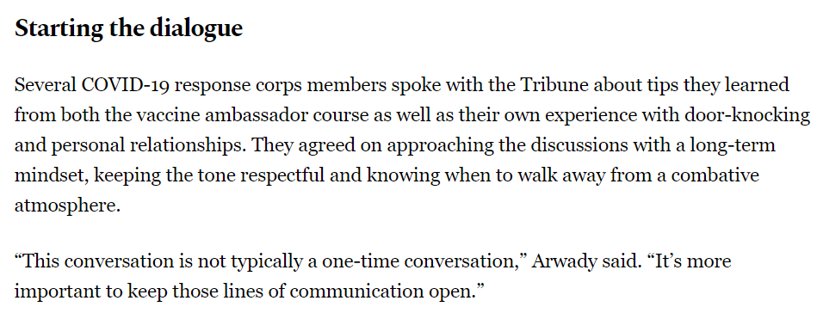
A vaccine recipient, left, talks with "vaccine ambassadors" Caesar Thompson and Armani Nightengale at an inoculation site at Richard J. Daley College in Chicago on Jan. 22. (John J. Kim / Chicago Tribune)

Slide 36
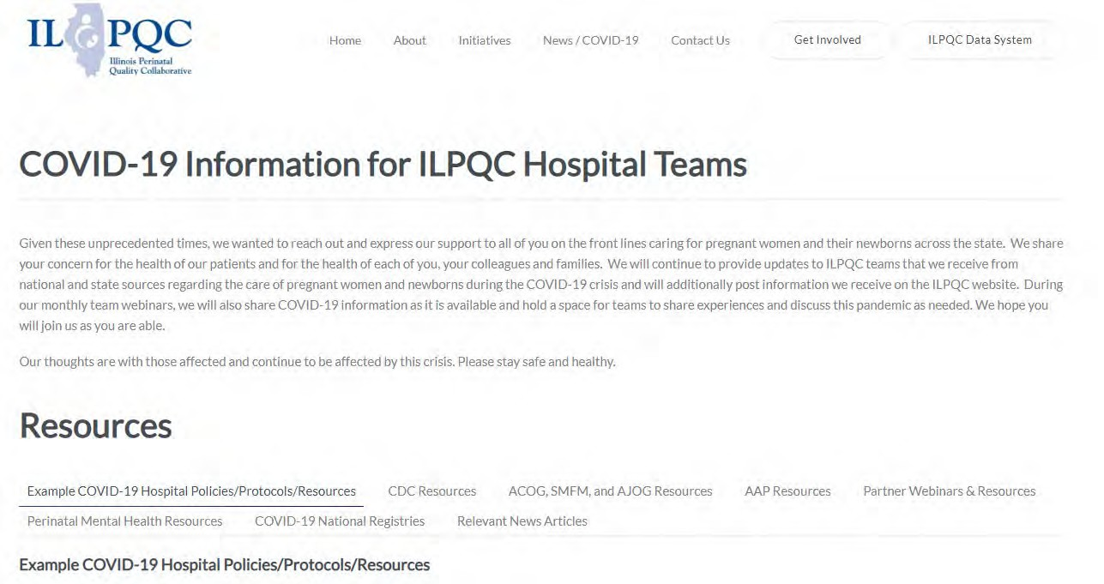
ILPQC COVID-19 Webpage www.ilpqc.org
ILPQC posts national guidelines and OB & Neonatal COVID-19 example hospital protocols & resources
please note dates as guidelines are changing rapidly
https://ilpqc.org/covid-19- information/

Slide 37
Updated OB (ACOG/SMFM) Resources
ACOG: Statement of Strong Medical Consensus for Vaccination of Pregnant Individuals Against COVID-19. (Updated 9.14.21)
ACOG: Statement on the CDC’s Health Advisory on COVID-19 Vaccination. (9.29.21)
ACOG: COVID-19 Vaccination Considerations for Obstetric–Gynecologic Care. (12.3.21)
ACOG: COVID-19 Vaccination During Pregnancy Is Key to Saving Lives, Medical Experts Urge. (12.6.21)
SMFM: COVID-19 and Pregnancy: What Maternal-Fetal Medicine Subspecialists Need to Know(12.3.21)
SMFM: SMFM Supports the Use of Paxlovid in Pregnant Patients. (12.22.21)
ACOG: COVID-19 FAQs for Obstetrician-Gynecologists, Obstetric. (12.28.21)
SMFM: Provider Considerations for Engaging in COVID-19 Vaccine Counseling With Pregnant and Lactating Patients(1.11.2022)
ACOG new PSA: COVID-19 Vaccines in Pregnancy: Safe, Proven, Effective. (2.8.2022)
Notes:
SMFM supports the NIH COVID-19 treatment guidelines and suggests that shared decision-making and acknowledgment of the limitations of the existing data should occur when considering monoclonal antibody treatment for pregnant patients. However, therapies that would otherwise be given should not be withheld specifically due to pregnancy or lactation. Therapies including monoclonal antibodies, remdesivir, dexamethasone, baricitinib, and tocilizumab, can and should be provided to pregnant patients with COVID-19 who meet clinical qualifications. The NIH guidelines also recommend that monoclonal antibody therapy be offered as a treatment for infected individuals and that postexposure prophylaxis should be considered for inadequately vaccinated individuals exposed to SARS-CoV-2; this should also include pregnant individuals.
: Statement of Strong Medical Consensus for Vaccination of Pregnant Individuals Against COVID-19. (Updated 9.14.21)
ACOG’s Practice Advisory: COVID-19 Vaccination Considerations for Obstetric-Gynecologic Care
ACOG’s Vaccinating Pregnant Individuals: Eight Key Recommendations for COVID-19 Vaccination Sites
ACOG’s COVID-19 Vaccines and Pregnancy: Conversation Guide for Clinicians
SMFM’s Provider Considerations for Engaging in COVID-19 Vaccine Counseling With Pregnant and Lactating Patients
SMFM’s Covid Vaccination if you are Pregnant or Breastfeeding
TopicsCOVID-19Coronavirus

Slide 38
Polling:
We will launch the polling questions now.
Please take a brief moment to answer the few questions!
38

Slide 39
VOC Compared to Original Strain
https://www.who.int/publications/m/item/weekly-epidemiological-update-on-covid-19---8-february-2022
Variant | Spread | Severity | Vaccine | Reinfection | mAB
Alpha (B.1.1.7) | Faster | Possibly increased | Protection retained against all outcomes | Similar to original | Effective
Beta (B.1.351) | Faster | Possibly increased | Protection retained against severe disease | Potentially more reinfection risk | Some less effective
Gamma (P.1) | Faster | Possibly increased | Unclear, limited evidence | Potentially more reinfection risk | Some less effective
Delta (B.1.617.2) | Much faster | Possibly increased | Protection retained against severe disease | Potentially more reinfection risk | Some less effective
Omicron (BA.1.1.529)* *most data based on BA.1 | Fastest | Decreased risk of hospitalization and death | Diminished protection though protection (especially for severe disease) restored with booster | Increased reinfection risk | Most not effective (sotrovimab remains effective)

Slide 40
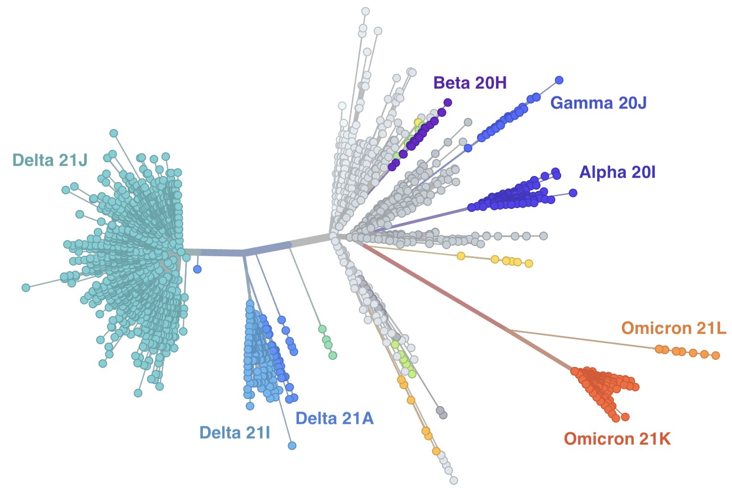
Tell me more about BA.2
Omicron (BA.1.1.529) has multiple lineages
BA.1 = ‘original’ Omicron = 21K
BA.2 = ‘subvariant’, ‘stealth variant’ = 21L
Also BA.1.1 and BA.3
BA.2 dominant in several countries (Denmark, Philippines, Nepal)
BA.2 rising globally (now found at low levels throughout the US)
BA.2 appears more transmissible
Severity is suspected to be the same as BA.1
Overall clinical significance, impact on vaccinations, monoclonal antibodies and reinfections after BA.1 unknown
https://www.who.int/publications/m/item/weekly-epidemiological-update-on-covid-19---8-february-2022

Slide 41
COVID Therapeutics
For use in HIGH RISK individuals early in symptoms
Oral therapies (Paxlovid) to be given within 5 days
IV monoclonal antibody (Sotrovimab) to be given within 10 days
HIGH RISK generally refers to those > 65 years, immunocompromised, high-risk comorbid conditions (obesity, DM), pregnancy or under vaccinated
NIH Therapy Tier: https://www.covid19treatmentguidelines.nih.gov/therapies/statement-on-patient-prioritization-for-outpatient-therapies/

Slide 42
Outpatient Therapeutic Preferences
https://www.covid19treatmentguidelines.nih.gov/therapies/statement-on-therapies-for-high-risk-nonhospitalized-patients/
Paxlovid (nirmatrelvir/ritonavir) – first line
PROS: oral and highly effective
CONS: needs to be given within 5 days of symptom onset, renal adjustment (can’t be given for GFR <30) and many drug-drug interactions (DDIs)
Sotrovimab - first line
PROS: highly effective, can be given up to 10 days of symptom onset
CONS: intravenous, limited access – need pathway for pregnant patients
Remdesivir – second line – typically used INPATIENT
PROS: highly effective in early illness, readily available, can be given outpatient up to 7 days of symptom onset
CONS: three consecutive days of IV therapy is extremely difficult in the outpatient world
Good use is for inpatients who are COVID+ but actually hospitalized for another reason
Molnupiravir – only if above therapies unavailable NOT TO USE IN PREGNANCY
PROS: oral and more readily available than Paxlovid, no significant DDIs
CONS: less effective, concerns about mutagenesis, not recommended in pregnancy, requires contraception for patients of childbearing potential, only for age > 18

Slide 43
FDA Issues EUA for the Treatment of Mild-to-Moderate COVID-19 Maternal-Fetal Medicine Subspecialists Support Use in Pregnant Patients
December 22, 2021 –the U.S. Food and Drug Administration issued an Emergency Use Authorization (EUA) for Paxlovid for the treatment of mild-to-moderate COVID-19 in adults and some pediatric patients.
In response, the Society for Maternal-Fetal Medicine (SMFM) issued the following statement. “SMFM supports the use of Paxlovid (nirmatrelvir [PF-07321332] tablets and ritonavir tablets) for treatment of pregnant patients with COVID-19 who meet clinical qualifications. Any therapy that would otherwise be given should not be withheld specifically due to pregnancy or lactation.”

Slide 44
Anti-Viral Medication and Pregnancy
ACOG: COVID-19 FAQs for Obstetrician-Gynecologists, Obstetric. (12.28.21)
ACOG FAQ Obstetrics: Should oral SARS-CoV-2 protease inhibitor therapy be used as a treatment option for pregnant patients?
An oral SARS-CoV-2 protease inhibitor, PAXLOVID (which includes nirmatrelvir, a SARS-CoV-2 main protease inhibitor, and ritonavir, an HIV-1 protease inhibitor and CYP3A inhibitor) is now available under emergency use authorization. It is recommended for the treatment of outpatients with mild to moderate COVID-19 infection who are at high risk of clinical progression
Pregnancy is included among the conditions that put individuals at high risk for clinical progression. This makes pregnant patients, including those with pregnancy as their only risk factor, eligible to receive outpatient oral SARS-CoV-2 protease inhibitor therapy, according to the EUA.
May consider for the treatment of non-hospitalized COVID-19 positive pregnant individuals with mild to moderate symptoms, particularly if one or more additional risk factors are present (eg body mass index >25, chronic kidney disease, diabetes mellitus, cardiovascular disease). Clinicians should weigh the available data against the individual risks of COVID-19 in pregnancy in each situation.

Slide 45
Anti-Viral Medication and Pregnancy
If utilizing protease inhibitor (PAXLOVID) treatment, this treatment should be initiated orally as soon as possible after diagnosis of COVID-19 and within 5 days of symptom onset.
Obstetric care clinicians should be aware that the concomitant use of PAXLOVID and certain other drugs (including medications used in obstetric settings such as nifedipine, methylergonovine, fentanyl, midazolam, or betamethasone) may result in potentially significant drug interactions. (EUA Fact Sheet).
Lactation is not a contraindication for the use of this oral SARS-CoV-2 protease inhibitor (EUA Fact Sheet). Lactating individuals with one or more risk factors for severe COVID-19 illness may receive SARS-CoV-2 protease inhibitor for treatment

Slide 46
ACOG: COVID-19 FAQs for Obstetrics (Monoclonal Antibody Recommendation) (updated 10.18. 2021)
Monoclonal antibody treatments recommended for the treatment of outpatients with mild to moderate COVID-19 infection who are at high risk of clinical progression as defined by the EUA criteria.
Pregnancy is included among the conditions that put individuals at high risk for clinical progression. This makes patients with pregnancy as their only risk factor eligible to receive outpatient monoclonal antibodies, according to the EUA (NIH).
Obstetric care clinicians may consider the use of monoclonal antibodies for the treatment of non-hospitalized COVID-19 positive pregnant individuals with mild to moderate symptoms, particularly if one or more additional risk factors are present (eg BMI >25, chronic kidney disease, diabetes mellitus, cardiovascular disease).
Post-exposure prophylaxis should be considered for inadequately vaccinated individuals who have been exposed to SARS-CoV-2 (NIH). These individuals include those who have had a recent exposure to an individual with SARS-CoV-2 for a cumulative total of 15 minutes or more over a 24-hour period or there is a recent occurrence of SARS-CoV-2 infection in other individuals in the same institutional setting AND are 1) not fully vaccinated or 2) fully vaccinated but may not mount an adequate immune response.

Slide 47
Updated SMFM Patient Education Resources (on ILPQC Covid webpage)
SMFM: COVID-19 Vaccination if You Are Pregnant or Breastfeeding English. (11.3.2021)
SMFM: COVID-19 Vaccination if You Are Pregnant or Breastfeeding Spanish. (11.3.2021)
SMFM: Top 5 Reasons to Get the COVID-19 Vaccine (English and Spanish). (11.23.21)

Slide 48
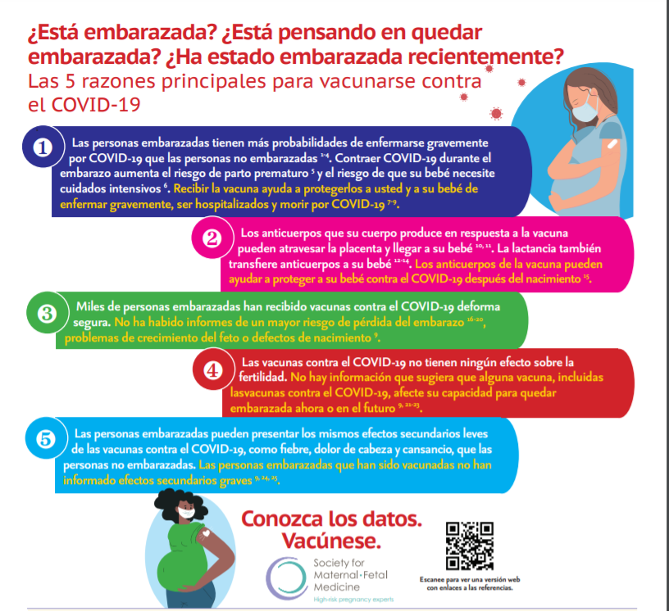
SMFM: NEW INFOGRAPHIC Top 5 Reasons to Get the COVID-19 Vaccine (English and Spanish)

Slide 49
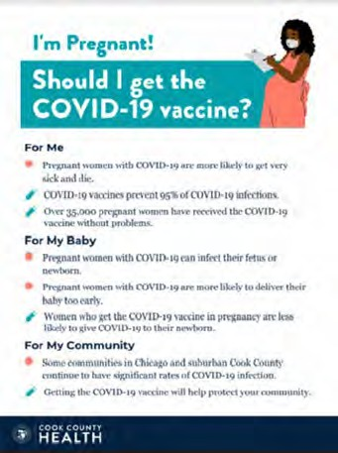
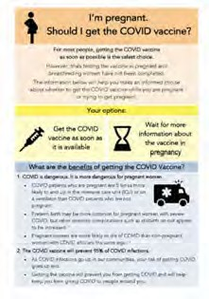
COVID Vaccine
Patient Education Examples
University of Massachusetts Medical School – Baystate: Covid Vaccine Info for Pregnant/Breastfeeding Patients English.
Available in:
Spanish, Nepali, Portuguese, Arabic, Turkish, Somali, Chinese, Vietnamese, Russian (3.17.21)
SMFM Patient Education (English/Spanish): COVID-19 Vaccines and Pregnancy. (3.4.21)
CDC: Safety of COVID-19 Vaccines. Video link. (Updated 6.8. 2021)
Cook County Health: Should I get the COVID-19 vaccine?
Flyer English and Spanish (6.11.21)
CDC: Information about COVID-19 Vaccines for People who Are Pregnant or Breastfeeding. (3.18.21)

Slide 50
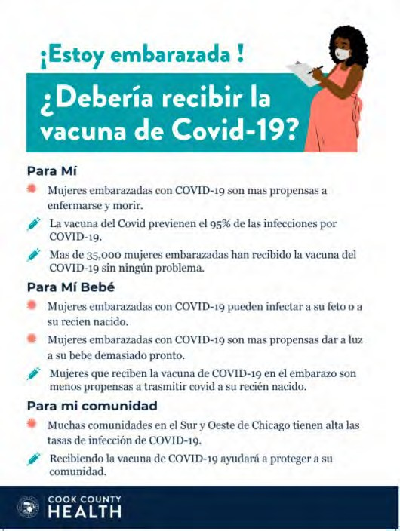
POSTERS

Slide 51
Everthrive COVID-19 Vaccination Education Campaign
EverThrive IL has launched a COVID-19 Vaccination Education campaign aimed at increasing vaccine confidence and vaccination rates on Chicago’s southside.
198,883 people have viewed the campaign materials online so far!
Pregnancy Fact Sheet is coming soon.
Care providers/parents Fact Sheet
English
Spanish
Links to education resources on the campaign website (English and Spanish language) https://understand.everthriveil.org/
https://understand.everthriveil.org/es/
Free virtual trainings for healthcare and social service providers in Roseland, Englewood, and Woodlawn on how to talk to patients about COVID-19 vaccination to reduce vaccine hesitancy.
Trainings available outside those communities for a fee.

Slide 52
New ACOG / CDC PSA Covid Vaccination in Pregnancy
Please Share This Important PSA
In partnership with the CDC, ACOG has released our first-ever PSA! Please help us spread this important, life-saving message to get vaccinated during pregnancy by sharing: https://vimeo.com/674866776
We know that a trusted obstetrician-gynecologist can play a large role in a patient’s decision about whether to get vaccinated, so use this PSA as a tool to share with your communities and spread the message.

Slide 53
IDPH / HFS / CDC
CDC Official Health Advisory : COVID-19 Vaccination for Pregnant People to Prevent Serious Illness, Deaths, and Adverse Pregnancy Outcomes from COVID-19. (9.29.21)
CDC: Recommends Pediatric COVID-19 Vaccine for Children 5 to 11 Years. (11.02.21)
CDC: Expands guidance for Covid-19 Booster shots for all over 18. (11.29.21)
CDC: Updates and Shortens Recommended Isolation and Quarantine Period for General Population. (12.27.21)
CDC: Pregnant and Recently Pregnant People At Increased Risk for Severe Illness from COVID-19. (1.22.2022)
CDC: V-safe COVID-19 Vaccine Pregnancy Registry. (2.8.2022)
ACOG: COVID-19 Vaccines: Tools for Your Practice and Your Patients. (2.8.2022)
ACOG: COVID-19 Vaccination Considerations for Obstetric–Gynecologic Care. (2.8.22
ACOG: COVID-19 FAQs for Obstetrician-Gynecologists, Obstetric. (2.8.22)
37

Slide 54
CDC Updated Quarantine
If you test positive for Covid-19:
Highest risk of infection first 5 days, 1/3 (30%) remain positive up to 10 days
Stay home for 5 days. If you have no symptoms or your symptoms are resolving after 5 days, you can leave your house.
If you leave the house day 5-10:
Avoid immunocompromised or high risk people,
continue to wear a mask at all times around other people,
do not eat or drink around other people.
CDC: Updates and Shortens Recommended Isolation and Quarantine Period for General Population. (12.27.21)

Slide 55
Boosters needed to fight Omicron
Data from South Africa and the United Kingdom demonstrate that vaccine effectiveness against infection for two doses of an mRNA vaccine is approximately 35%.
A COVID-19 vaccine booster dose restores vaccine effectiveness against infection to 75%.
COVID-19 vaccination decreases the risk of severe disease, hospitalization, and death from COVID-19. CDC strongly encourages COVID-19 vaccination for everyone 5 and older and boosters for everyone 16 and older.

Slide 56
CDC: Expands guidance for Covid-19 Booster shots for all over 18. (11.29.21)
For individuals who received a Pfizer-BioNTech or Moderna COVID-19 vaccine
Everyone over age 12 is eligible for a booster shot at 5 months or more after their initial vaccine series
If you got the Johnson & Johnson COVID-19 vaccine
Everyone over age 18 and older is eligible for a booster shot who were vaccinated two or more months ago.
Pregnant women should receive the booster
Individuals may choose which vaccine they receive as a booster. Some people may have a preference for the vaccine type that they originally received, and others may prefer to get a different booster.

Slide 57
Updated OB/Neo Covid Publications
AJOG: Monoclonal antibody treatment of symptomatic COVID-19 in pregnancy: initial report. (8.25.21)
NEJM: Resurgence of SARS-CoV-2 Infection in a Highly Vaccinated Health System Workforce. (9.9.21)
NEJM: Receipt of mRNA COVID-19 vaccines preconception and during pregnancy and risk of self-reported spontaneous abortions. (09.8.21)
Plos Medicine: Incidence, co-occurrence, and evolution of long-COVID features: A 6-month retrospective cohort study of 273,618 survivors of COVID-19. (09.28.2021)
JAMA: Short-term and Long-term Rates of Postacute Sequelae of SARS-CoV-2 Infection. (10.13.21)
NyTimes: U.S. Has Far Higher Covid Death Rate Than Other Wealthy Countries. (1.2.2022)
AJOG: COVID-19 vaccination during pregnancy: coverage and safety. (2.1.2022)
JAMA: Association of BNT162b2 COVID-19 Vaccination During Pregnancy With Neonatal and Early Infant Outcomes. (2.10.2022)
Arch Pathol Lab Med: Placental Tissue Destruction and Insufficiency from COVID-19 Causes Stillbirth and Neonatal Death. (2.10.2022)
34

Slide 58
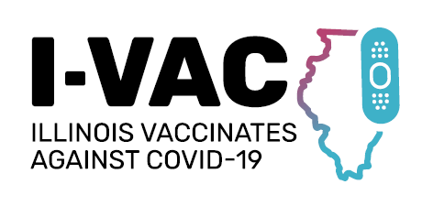
February 11, 2022
Jennie Pinkwater, MNM - Executive Director ICAAP
Stephanie Atella, MPH, CHES – Project Director ICAAP
Notes:
Sub-grantees
The Extension for Community Health Outcomes (ECHO)-Chicago at the University of Chicago
The Illinois Academy of Family Physicians (IAFP)

Slide 59
Foundational Training
Learning Collaboratives
Implementation Support
Toolkit & Outreach Materials
Notes:
The goal is to ensure Illinoisans are being immunized at every opportunity and trusted healthcare providers are prepared to immunize additional age-groups and special at-risk populations.
FREE PROGRAM FOR PROVDERS AND PROVIDER ORGANIZATIONS
data will be used to support I-VAC activities and prioritizations

Slide 60
Foundational Training
“Vaccine Bootcamps”
Foundational knowledge and skills related to COVID-19 vaccine administration and distribution:
Operational issues (I-CARE, VFC, etc.)
Handling, storage and preparation
Clinical resources for adult and pediatric populations
Strategies for overcoming vaccine hesitancy
Held weekly for four weeks – multiple cohorts – web-based – Free CME

Slide 61
Learning Collaboratives
Children and adolescents, adults, and pregnant women tracks
Forum for providers to engage with their peers around solving real-world barriers to COVID-19 vaccine implementation
Available to any provider or provider organization in the state who is interested, regardless of phase one participation
Held bi-weekly – drop in as needed – web-based – Free CME
Notes:
each tailored to providers serving different patient populations, i.e.,

Slide 62
Implementation Support
Local providers in primary care and hospital networks to serve as coaches
From each of the 11 COVID-19 regions in the state
Support throughout the process
Seeking OBGYNs to serve as advisors

Slide 63
Toolkit & Outreach Materials
Website: illinoisvaccinates.com
Notes:
Supplemental materials, materials to support project

Slide 64
Next Steps
Reminders:
Leading organizations overwhelmingly agree that the COVID-19 vaccine is vital in reducing COVID-19 cases and deaths.
Reimbursement for COVID-19 vaccine administration is $42.14 per dose*.
You do not need an ultra cold freezer to store vaccines.
Asks:
Participate in I-VAC in any way that you can!
Become an I-VAC advisor.
Vaccinate your patients and their families.
*Per the IL Medicaid Rate
Notes:
Supplemental materials, materials to support project

Slide 65
Thank You
Jennie Pinkwater jpinkwater@illinoisaap.com
Stephanie Atella satella@illinoisaap.com
Funding for I-VAC is provided by the Office of Disease Control, through the Illinois Department of Public Health.

Slide 66
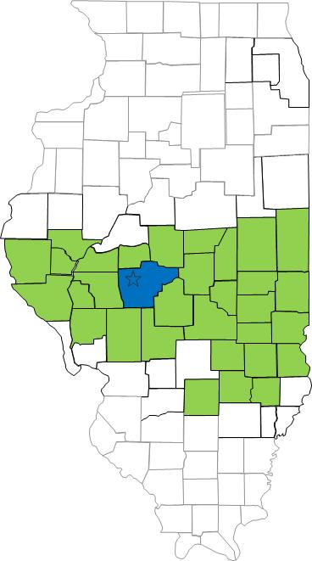
South Central Illinois Perinatal Center, Level III
2100 annual births
40 bed NICU

Slide 67
AC, 23 year old G4P1021 at 22w0d
Shock
Pancytopenia
Thrombocytopenia
Transaminitis
COVID 19
Differential diagnosis: Urosepsis, TTP, Acute fatty liver of pregnancy, HELLP, COVID-19 infection itself
 | Baseline | Admission
WBC | 6.8 | 1.5
PLT | 193 | 25
Cr | 0.63 | 3.11
AST | 15 | 1119
ALT | 12 | 857
Notes:
Presented to primary OB due to CVA tenderness and abdominal pain. She had proteinuria with subsequent preeclampsia work up. Pain worsened and she presented to SMD L&D.
Transported from St. Mary’s Decatur to SJH due to shock, pancytopenia, thrombocytopenia, and transaminitis
COVID+, on 2L NC
PT 22.0
INR 1.9
BNP 12,517
Glucose 55
CT chest/abd/pelvis- mild diffuse right hydroureter, diffuse hepatic steatosis
IV vancomycin and zosyn
Hypotensive to normotensive, Headache, hypoglycemic
Ucx positive for e coli
Blood culture no growth
TTP- peripheral smear does not indicate TTP
HELLP unlikely due to hypotension and low WBC
AFLP low likelihood due to gestational age
Counseled her that given her extremely early gestational age as well as critical maternal status, would not recommend continuous fetal monitoring or intervention on fetal behalf.
Initiated dexamethasone

Slide 68
AC, 23 year old G4P1021 at 22w0d
Admitted to ICU
IV Vancomycin and Zosyn
COVID 19 management
Transported to Barnes Jewish Hospital
Improved quickly after transfer
Final diagnosis: Urosepsis with superimposed COVID 19
Notes:
Presented to primary OB due to CVA tenderness and abdominal pain. She had proteinuria with subsequent preeclampsia work up. Pain worsened and she presented to SMD L&D.
Transported from St. Mary’s Decatur to SJH due to shock, pancytopenia, thrombocytopenia, and transaminitis
COVID+, on 2L NC
PT 22.0
INR 1.9
BNP 12,517
Glucose 55
CT chest/abd/pelvis- mild diffuse right hydroureter, diffuse hepatic steatosis
IV vancomycin and zosyn
Hypotensive to normotensive, Headache, hypoglycemic
Ucx positive for e coli
Blood culture no growth
TTP- peripheral smear does not indicate TTP
HELLP unlikely due to hypotension and low WBC
AFLP low likelihood due to gestational age
Counseled her that given her extremely early gestational age as well as critical maternal status, would not recommend continuous fetal monitoring or intervention on fetal behalf.
Initiated dexamethasone

Slide 69
Lessons Learned
COVID 19 can be superimposed with other diagnoses
Increases difficulty in narrowing differential
May exacerbate other conditions

Slide 70
OB Discussion Panel
Stephanie Atella, MPH, CHES - Project Director Immunizations, Illinois Chapter, American Academy of Pediatrics
Sarah Bradley, MD – OB Hospitalist, Swedish American Hospital, Rockford
Maggie Sevrin, – OB/GYN 3rd year Resident, Southern Illinois University School of Medicine, Springfield
Emma Jones, – OB/GYN 3rd year Resident, Southern Illinois University School of Medicine, Springfield
Rob Abrams, MD – Professor and Executive Director – SIU Center for Maternal-Fetal Medicine, Southern Illinois University School of Medicine, Director of Obstetrics – South Central Illinois Perinatal Center
Notes:
Executive Medical Director, Family Birth Center
Chief of Obstetric Quality

Slide 71
Thank You
We continue to give thanks to the nurses, doctors, health care workers, public health teams and others across our state at work confronting the COVID-19 pandemic.
Please send questions, comments and recommendations, cases / willingness to share for future COVID-19 OB/Neo discussion webinars to info@ilpqc.org
Recording of this webinar, Q/A and registration for the next webinar on Friday, March 4, 12-1:15pm, will be available at www.ilpqc.org

Slide 72
Thanks to our Funders
In kind support:

