Slide 1

COVID-19 Strategies for OB & Neonatal Units
February 5, 2021
12:00 – 1:15pm

Slide 2

Welcome
Please be certain you are on “mute” when not speaking to avoid background noise.
Whether you have joined by phone or computer audio, you can mute and unmute yourself by clicking on the microphone icon.
The following shortcuts can also be used
For PC: Alt + A : Mute or Unmute
For Mac: Shift + Command + A: Mute or Unmute
For telephone: *6 : Mute or Unmute

Slide 3
Housekeeping:
We Are Recording Now

Slide 4
ILPQC Covid 19 webinars
The strategies shared today are examples from individual institutions not IDPH or ILPQC recommendations.
This is our 18th COVID-19 strategies for OB/Neonatal Units webinar in coordination with IDPH, since April 3rd. Please see https://ilpqc.org/covid-19-information/ for future webinar registration, prior recorded webinars and written out Q/A’s from those webinars.
The next webinar will be Friday, March 5, noon to 1:15pm. We are continuing monthly webinars for now.
Please let us know if your hospital would like to share on an upcoming webinar, please put questions/comments into the chatbox or email directly to info@ilpqc.org

Slide 5
Overview
Introduction
IDPH Updates
  Amanda Bennett, PhD, MPH – CDC Field Assignee in Maternal and Child Health Epidemiology, Illinois Department of Public Health
Discussion of OB Unit Strategies
  Emily Stinnett Miller, MD - Maternal-Fetal Medicine, Northwestern University
  Ashish Premkumar, MD - Maternal Fetal Medicine, John H. Stroger, Jr. Hospital of Cook County, Chicago
  Sarah L Bradley, MD – OB Hospitalist, Swedish American Hospital, Rockford
  Kandi Ogden-Moles, DO, PGY-1 Family Medicine, Swedish American Hospital, Rockford
  Rob Abrams, MD - SIU Center for Maternal - Fetal Medicine, HSHS St. John's Hospital
Discussion of Neonatal Unit Strategies
  Justin Josephsen, MD – Medical Director, St. Mary’s Hospital NICU, Neonatologist Cardinal Glennon Children’s Hospital, St. Louis
  Leslie Caldarelli, MD – NICU Director, Prentice Women's Hospital, Chicago
Notes:
Updated 2/4

Slide 6
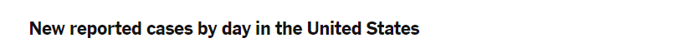
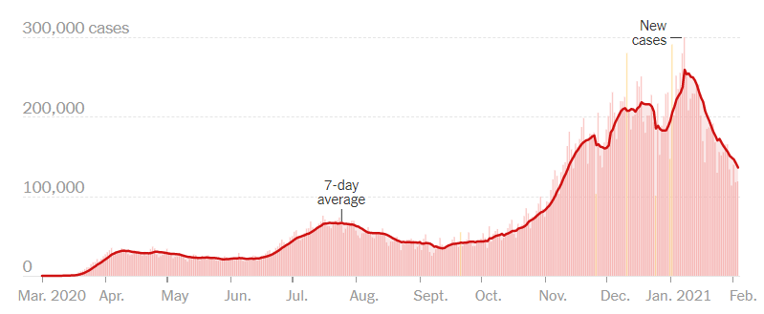
US COVID case trend
Notes:
Ieshia updated 2/4/2021
https://www.nytimes.com/interactive/2020/us/coronavirus-us-cases.html

Slide 7
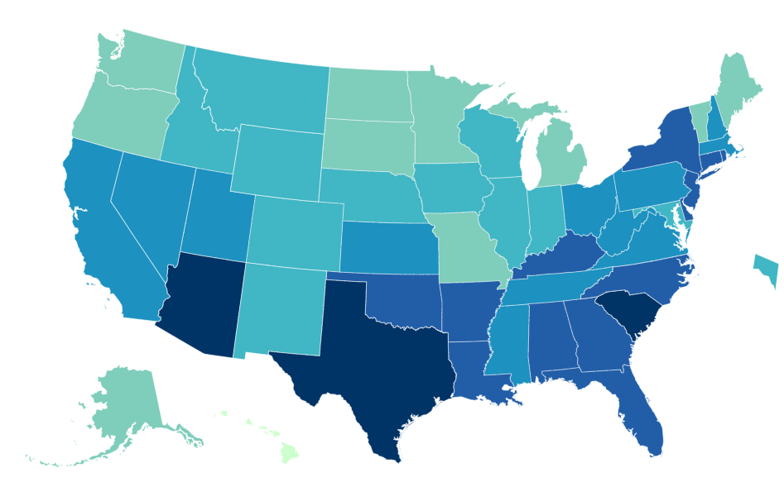
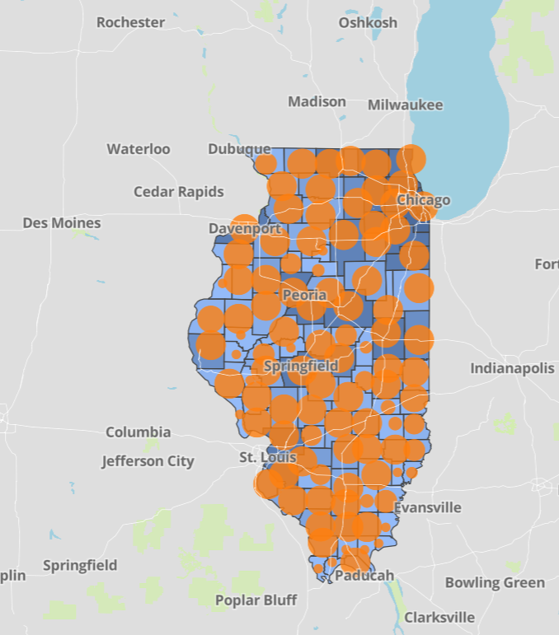
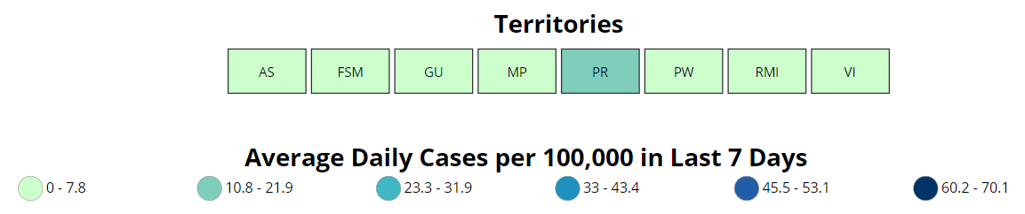
Data Update February 4, 2021
CDC/IDPH: COVID-19 Outbreak
CDC https://www.cdc.gov/coronavirus/2019-ncov/cases-updates/cases-in-us.html | IDPH https://www.dph.illinois.gov/covid19
Total cases: 26,277,125 confirmed Total deaths: 445,264 confirmed | 1,134,231 Confirmed Positive Cases 19,375 Deaths
Notes:
Ieshia updated 2/4/2021

Slide 8
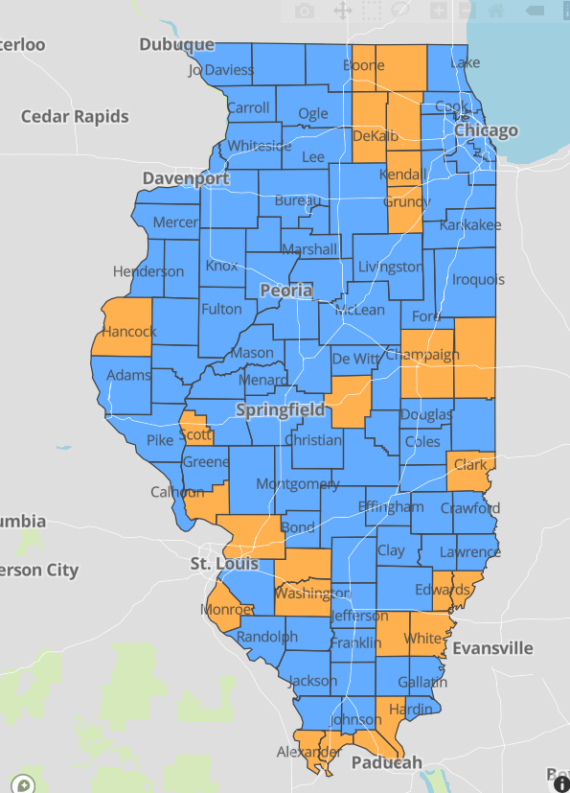
IDPH County Level COVID-19 Risk Metrics
Week 3: 1/17/2021 Through 1/23/2021
Blue indicates that the county is experiencing overall stable COVID-19 metrics.
Orange indicates there are warning signs of increased COVID-19 risk in the county.
Notes:
Ieshia updated 2/4/2021
https://www.dph.illinois.gov/countymetrics?county=Cook

Slide 9
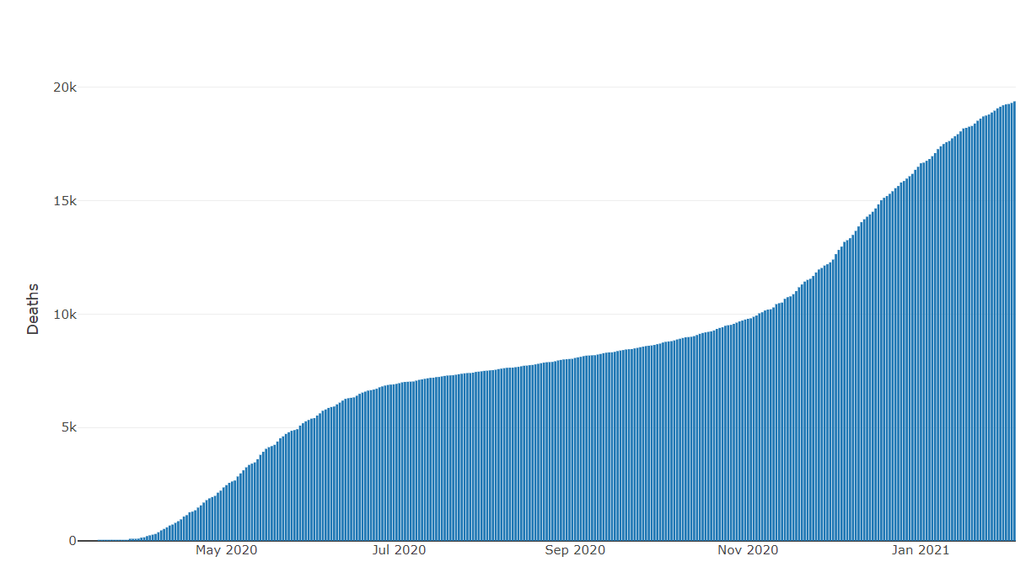
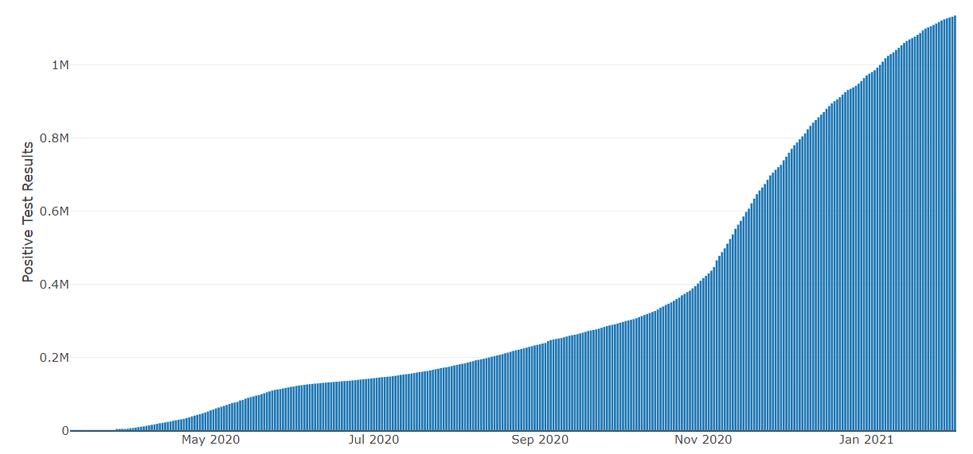
Data Update February 4, 2021
IDPH: COVID-19 Outbreak
https://www.dph.illinois.gov/covid19
IL Positive Cases Over Time
IL Deaths Over Time
Total: 1,134,231 Confirmed Positive Cases
Total: 19,375 Deaths
Notes:
Ieshia update 2/4/2021
http://www.dph.illinois.gov/covid19/covid19-statistics

Slide 10
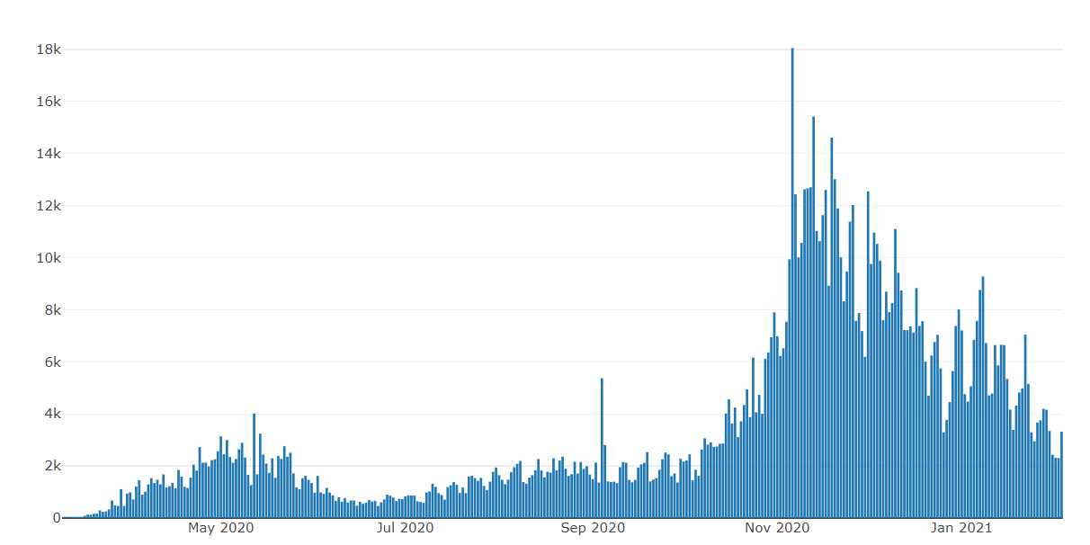
Illinois Daily Incidence
IDPH daily data summary
Notes:
Updated 2/4/2021
https://www.dph.illinois.gov/covid19/covid19-statistics

Slide 11
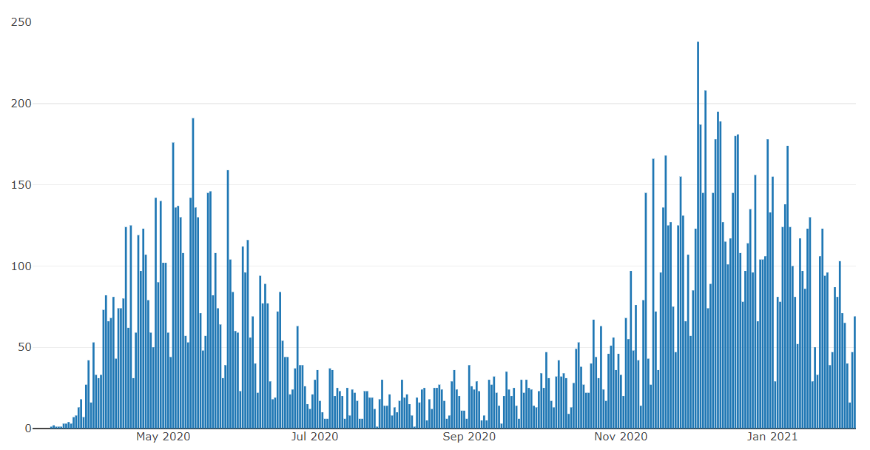
Illinois Covid Deaths
IDPH daily data summary
Notes:
Ieshia updated 2/4/2021
https://www.dph.illinois.gov/covid19/covid19-statistics

Slide 12
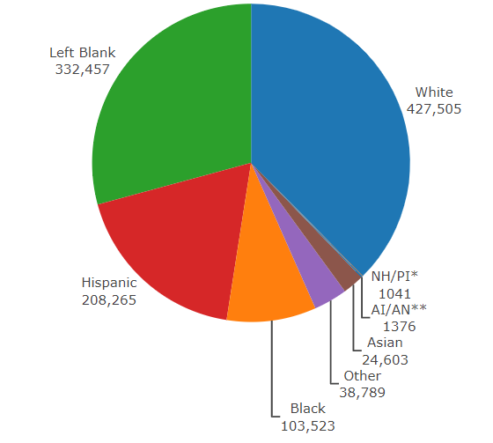
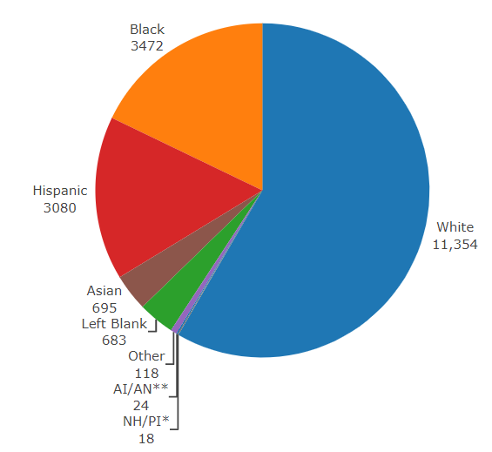
Data Update February 4, 2021
IDPH: COVID-19 Outbreak
Race Demographics
https://www.dph.illinois.gov/covid19
Confirmed Cases
Deaths
Notes:
Ieshia updated 2/4/2021
http://www.dph.illinois.gov/covid19/covid19-statistics

Slide 13
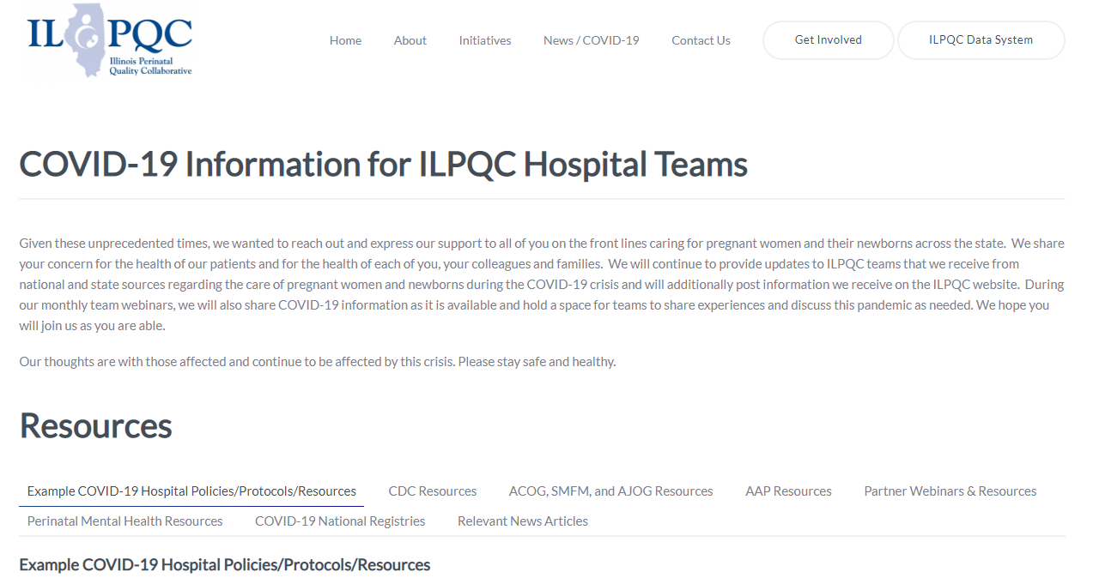
ILPQC COVID-19 Webpage www.ilpqc.org
ILPQC posts national guidelines and OB & Neonatal COVID-19 example hospital protocols & resources
please note dates as guidelines are changing rapidly
https://ilpqc.org/covid-19-information/

Slide 14
Updated OB (ACOG/SMFM) Resources
ACOG Practice Advisory: Novel Coronavirus 2019 (COVID-19) (11.9.20)
ACOG: COVID-19 FAQs for Obstetrician-Gynecologists, Obstetrics (11.9.20)
ACOG Pt Educ: COVID-19 and Pregnancy: 3 Steps to Stay Safe. (Nov 2020)
ACOG: COVID-19 Vaccines and Pregnancy: Conversation Guide for Clinicians (12.20.20)
ACOG: Vaccinating Pregnant Individuals: Eight Key Recommendations for COVID-19 Vaccination Sites. (2.3.21)
ACOG: Practice Advisory: Vaccinating Pregnant and Lactating Patients Against COVID-19. (1.27.21)
ACOG: COVID-19: The Role of Obstetrician-Gynecologists in Building Vaccine Confidence. (1.6.21)
ACOG: Maternal Immunization Task Force and Partners Urge That COVID-19 Vaccine be Available to Pregnant Individuals( 2.3.21)
SMFM: Coronavirus (COVID-19) and Pregnancy: What Maternal-Fetal Medicine Subspecialists Need to Know (11.23.20)
SMFM: Provider Considerations for Engaging in COVID-19 Vaccine Counseling With Pregnant and Lactating Patients (Updated 12.21.20)
SMFM: Management Considerations for Pregnant Patients With COVID-19 (2.2.21)
Notes:
ACOG: Vaccinating Pregnant and Lactating Patients Against COVID-19, Practice Advisory. (12.21.20)
ACOG: COVID-19 Vaccines and Pregnancy: Conversation Guide for Clinicians. (12.20.20)
SMFM: Management Considerations for Pregnant Patients with COVID-19 (Updated 1.7.21)
SMFM: Provider Considerations for Engaging in COVID-19 Vaccine Counseling With Pregnant and Lactating Patients. (Updated 12.21.20)

Slide 15
SMFM has updated Management Considerations for Pregnant Pts and Covid
NEW SMFM: Management Considerations for Pregnant Patients With COVID-19 (February 2, 2021
Very helpful guidance – example: Reasons to call a health care provider (or emergency medical services) for COVID19 patients or caregivers for COVID-19 patients include the following:
○ Worsening shortness of breath ○ Tachypnea ○ Unremitting fever (greater than 39 °C) despite appropriate use of acetaminophen ○ Inability to tolerate oral hydration or needed medications ○ Oxygen saturation less than 95% either at rest or on exertion (if home pulse oximetry available) ○ Persistent pleuritic chest pain ○ New-onset confusion or lethargy ○ Cyanotic lips, face, or fingertips ○ Obstetrical complaints, such as preterm contractions, vaginal bleeding, or decreased fetal movement

Slide 16
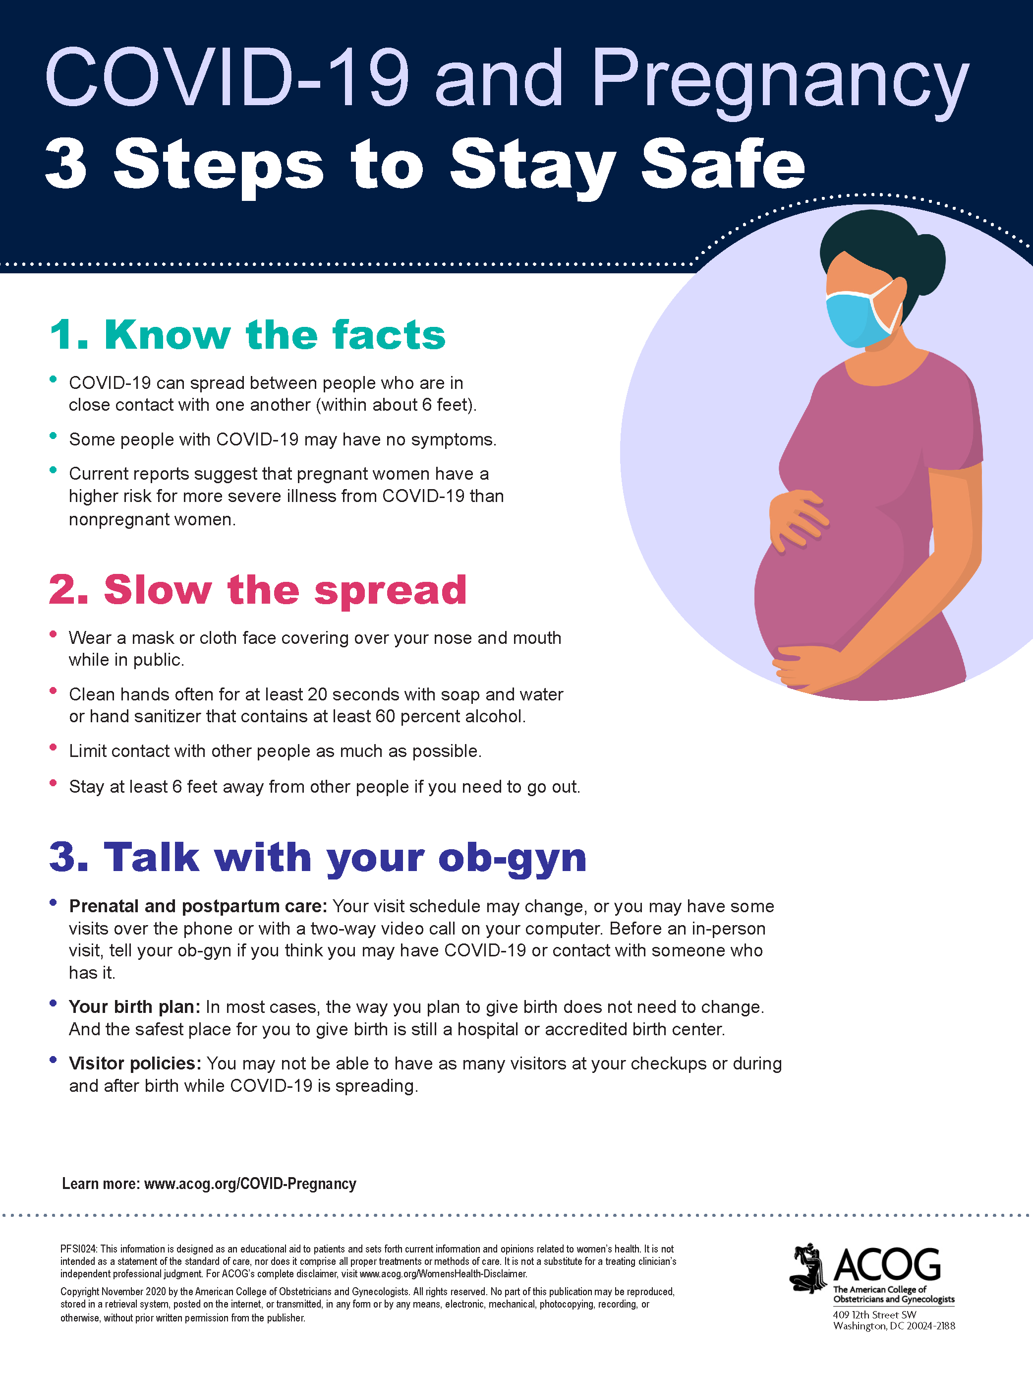
ACOG patient education
ACOG Patient Education: COVID-19 and Pregnancy: 3 Steps to Stay Safe. (Nov 2020)

Slide 17
Updated Neonatal /AAP Resources
Interim Guidance for Covid-19 Vaccination in Children and Adolescents:
ervices.aap.org/en/pages/2019-novel-coronavirus-covid-19-infections/clinical-guidance/interim-guidance-for-covid-19-vaccination-in-children-and-adolescents/ (2.4.21)
COVID-19 Testing Guidance: Guidance developed to help pediatric practices determine when to test for severe acute respiratory syndrome-coronavirus 2 (SARS-CoV-2) infection in their patient population. (Updated 12/30/2020)
Breastfeeding Guidance Post Hospital Discharge for Mothers or Infants with Suspected or Confirmed SARS-Co V-2 Infection: Guidance developed to support pediatricians providing direct care for breastfeeding families after discharge from the newborn hospital stay. (12/2/2020)
FAQs: Management of Infants Born to Mothers with Suspected or Confirmed COVID-19: Includes precautions for birth attendants, rooming-in, breastfeeding, testing, neonatal intensive care, visitation and hospital discharge. (11/19/2020)
Multisystem Inflammatory Syndrome in Children (MIS-C) Interim Guidance: Clinical guidance for pediatricians including signs, symptoms, diagnosis and management of this rare but serious complication associated with COVID-19. (Updated 11/17/2020)
Family Presence Policies for Pediatric Inpatient Settings During the COVID-19 Pandemic: (10/12/2020)
Frequently Asked Questions: Interfacility Transport of the Critically Ill Neonatal or Pediatric Patient with Suspected or Confirmed COVID-19: (10/06/2020)
Notes:
AAP: Multisystem Inflammatory Syndrome in Children (MIS-C) Interim Guidance (Updated 11.17.2020)
AAP: FAQs: Management of Infants Born to Mothers with Suspected or Confirmed COVID-19 (11.19.2020)
AAP: Breastfeeding Guidance Post Hospital Discharge for Mothers or Infants (12.2.2020)

Slide 18
Updated OB/Neo Covid Publications
NEOBGYN: Prone Positioning for Pregnant Women With Hypoxemia Due to Coronavirus Disease 2019 (COVID-19) (6.9.2020)
JAHA: Extracorporeal Life Support in Pregnancy: A Systematic Review. (9.2020)
AJOG: Epidemiology of COVID-19 in Pregnancy: Risk Factors and Associations with Adverse Maternal and Neonatal Outcomes. (9.24.2020)​
AJOG: Risk factors for severe acute respiratory syndrome coronavirus 2 infection in pregnant women. (9.2020)​
ACOG: Clinical Implications of Universal Severe Acute Respiratory Syndrome Coronavirus. (8.2020)​
JAMA: Association of SARS-CoV-2 Test Status and Pregnancy Outcomes. (9.23.2020)
JAMA: Outcomes of Neonates Born to Mothers With Severe Acute Respiratory. (10.16.2020)
Archives of Women's Mental Health: Risk for probable post-partum depression among women during the COVID-19 pandemic. (10.12.2020)
PRIORITY Study Published: Pregnancy Coronavirus Outcomes Registry. (10.9.2020)
JAMA: COVID-19 Poses Pregnancy Risks (11.10.2020)
JAMA: Pregnancy Outcomes Among Women With and Without Severe Acute Respiratory Syndrome Coronavirus 2 Infection. (11.19.2020)​
NEJM: Safety and Efficacy of the BNT162b2 mRNA Covid-19 Vaccine. (12.31.20)
JAMA: Protecting Pregnant Women and Their Infants From COVID-19: Clues From Maternal Viral Loads, Antibody Responses, and Placentas. (12.22.20)
JAMA: Assessment of Maternal and Neonatal SARS-CoV-2 Viral Load, Transplacental Antibody Transfer, and Placental Pathology in Pregnancies During the COVID-19 Pandemic. (12.22.20)
AJOG: Disease Severity, Pregnancy Outcomes and Maternal Deaths among Pregnant Patients with SARS-CoV-2 Infection (12.30.20)
Neo Reviews: Perinatal SARS-CoV-2 Infection and Neonatal COVID-19: A 2021 Update (2.4.21)
​

Slide 19
Birth Equity Links
Please see the following links and publications for information that may help your organization consider next steps to take action to address birth equity and reduction of perinatal racial and ethnic disparities.
AIM: Reduction of Peripartum Racial/Ethnic Disparities Patient Safety Bundle (2018)
ACOG: Reduction of Peripartum Racial and Ethnic Disparities: a conceptual framework and maternal safety consensus bundle (May 2018)
ACOG Committee Opinion No. 729: Importance of Social Determinants of Health and Cultural Awareness in the Delivery of Reproductive Health Care (January 2018)
SMFM: Strategies to overcome racism's impact on pregnancy outcomes (May 2020)
SMFM: Strategies to provide equitable care during COVID-19 (May 2020)
ACOG: Addressing Health Equity During the COVID-19 Pandemic (May 2020)
AAP Policy Statement: The impact of racism on child and adolescent health (Aug 2019)
Today: Black. Pregnant. And COVID-19 positive. (7.8.2020)
CDC: COVID-19 Response Promising Practices in Health Equity II (7.31.2020)
CDC: HEAR HER Campaign (8.4.2020)strategies promote birth equity and reduce preventable maternal mortality
The NY Times: Protecting your Birth: a Guide for Black Mothers. (10.22.2020) How racism can impact your pre- and postnatal care — and advice for speaking to your OB.
NeoReviews: Advancing Health Equity by Translating Lessons Learned from NICU Family Visitations during the COVID-19 Pandemic (8.31.2020)

Slide 20
IDPH / HFS / CDC
HFS: Provider Notice Issued Blood Pressure Monitoring Kit (7.2.2020)​ - Medicaid now covers home BP cuffs for all pregnant / postpartum patients
CDC: Birth and Infant Outcomes Following Laboratory-Confirmed SARS-CoV-2 Infection in Pregnancy. (11.6.2020)
​CDC: Considerations for Inpatient Obstetric Healthcare Settings (12.1.20)
CDC: Guidance on Care for Breastfeeding Women. (12.3.20)
CDC patient education: Pregnancy, Breastfeeding, and Caring for Newborns. (12.28.20)
CDC: Allergic Reactions After Receipt of the First Dose of Pfizer-BioNTech COVID-19 Vaccine. (1.6.21)
CDC: Interim Clinical Considerations for Use of mRNA COVID-19 Vaccines Currently Authorized in the United States. (1.6.21)
CDC: Toolkit for Pregnant People and New Parents. (1.28.21)

Slide 21
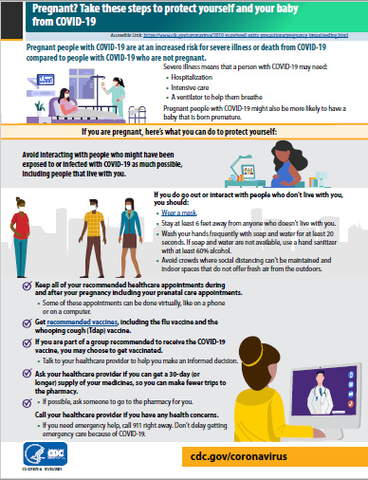
CDC: Pregnancy Factsheet
CDC Patient Education: Pregnant? Take these steps to protect yourself and your baby from COVID-19. (Jan. 2021)

Slide 22
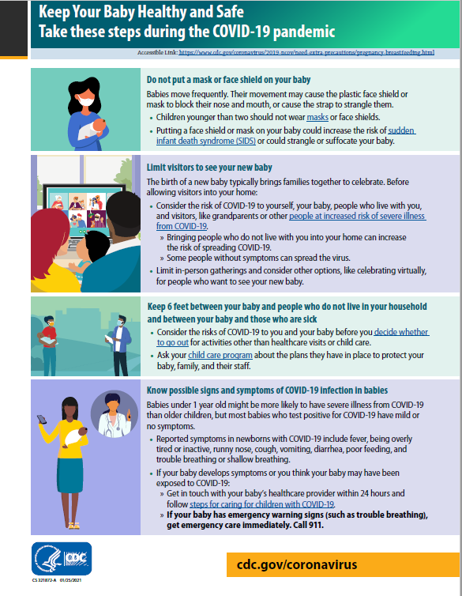
CDC: Patient Education
CDC Patient Education: Keep Your Baby Healthy and Safe. (Jan. 2021)

Slide 23
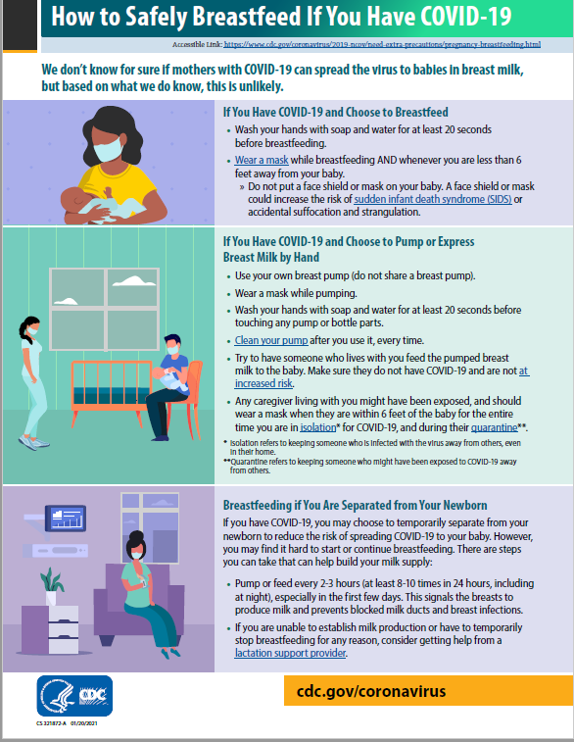
CDC: Breastfeeding Factsheet
CDC Patient Education: How to Safely Breastfeed If You Have COVID-19. (Jan. 2021)

Slide 24
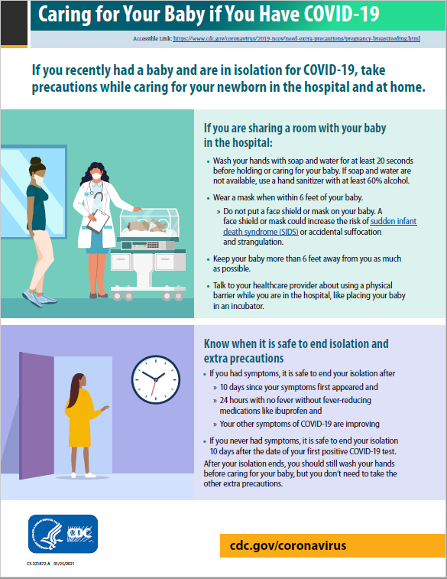
CDC: Infant Care Factsheet
CDC Patient Education: Caring for Your Baby if You Have COVID-19. (Jan. 2021)

Slide 25
CDC MMWRs
Racial and Ethnic Disparities in the Prevalence of Stress and Worry, Mental Health Conditions, and Increased Substance Use Among Adults During the COVID-19 Pandemic — United States, April and May 2020 (Feb 5, 2021)
Demographic Characteristics of Persons Vaccinated During the First Month of the COVID-19 Vaccination Program — United States, December 14, 2020–January 14, 2021 (Feb 5, 2021)
The Advisory Committee on Immunization Practices’ Updated Interim Recommendation for Allocation of COVID-19 Vaccine — United States, December 2020 (Jan 01, 20221)

Slide 26
ACIP recommendations for prioritization of COVID-19 vaccine:
Phase 1a: Health care workers and long-term care facility residents (CDC 2020)
Phase 1b: Persons aged ≥75 years and frontline essential workers (ACIP Slides 2020)
Phase 1c: Persons aged 65-75 years, persons aged 16-64 years with high-risk* medical conditions (including pregnancy), and other essential workers (ACIP Slides 2020)
*High-risk medical conditions outlined by the CDC include:
Pregnancy
Cancer
Chronic kidney disease
COPD (chronic obstructive pulmonary disease)
Heart conditions, such as heart failure, coronary artery disease, or cardiomyopathies
Immunocompromised state (weakened immune system) from solid organ transplant
Obesity (body mass index [BMI] of 30 kg/m2 or higher but < 40 kg/m2)
Severe Obesity (BMI ≥ 40 kg/m2)
Sickle cell disease
Smoking (current or history)
Type 2 diabetes mellitus

Slide 27
ACOG Practice Advisory:
Vaccinating Pregnant and Lactating Patients against Covid-19 (02/04/21)
ACOG recommends that COVID-19 vaccines should not be withheld from pregnant individuals who meet criteria for vaccination based on ACIP-recommended priority groups.
COVID-19 vaccines should be offered to lactating individuals similar to non-lactating individuals when they meet criteria for receipt of the vaccine based on prioritization groups outlined by the ACIP.
Individuals considering a COVID-19 vaccine should have access to available information about the safety and efficacy of the vaccine, including information about data that are not available. A conversation between the patient and their clinical team may assist with decisions regarding the use of vaccines approved under EUA for the prevention of COVID-19 by pregnant patients. Important considerations include:
  the level of activity of the virus in the community
  the potential efficacy of the vaccine
  the risk and potential severity of maternal disease, including the effects of disease on the fetus and newborn
  the safety of the vaccine for the pregnant patient and the fetus.

Slide 28
ACOG Practice Advisory:
Vaccinating Pregnant and Lactating Patients against Covid-19 (02/04/21)
While a conversation with a clinician may be helpful, it should not be required prior to vaccination, as this may cause unnecessary barriers to access.
Vaccines currently available under EUA have not been tested in pregnant women. Therefore, there are no safety data specific to use in pregnancy. See details about the Food and Drug Administration’s (FDA) EUA process below.
Pregnancy testing should not be a requirement prior to receiving any EUA-approved COVID-19 vaccine.
Pregnant patients who decline vaccination should be supported in their decision. Regardless of their decision to receive or not receive the vaccine, these conversations provide an opportunity to remind patients about the importance of other prevention measures such as hand washing, physical distancing, and wearing a mask.
Expected side effects should be explained as part of counseling patients, including that they are a normal part of the body’s reaction to the vaccine and developing antibodies to protect against COVID-19 illness.
The mRNA vaccines are not live virus vaccines, nor do they use an adjuvant to enhance vaccine efficacy. These vaccines do not enter the nucleus and do not alter human DNA in vaccine recipients. As a result, mRNA vaccines cannot cause any genetic changes.

Slide 29
What do we know about Vaccination for Pregnant Women in IL?
IDPH SARS-CoV-2/Covid-19 Mass Vaccination Planning Guide https://www.dph.illinois.gov/covid19/vaccination-plan
Phase 1A
  Health care Personnel, Hospital Settings, Non-hospital health care
  Other Congregate Care, Long-Term Care Facility residents and staff
Phase 1B – CURRENT PHASE
  Persons aged 65 years and older, Frontline essential workers, Inmates
Phase 1C: (Is still in draft form based on ACIP recommendations. Further updates to be released for Phase 1C for the context of Illinois)
  Persons aged 16 to 64 years old with medical conditions that increase the risk for severe COVID-19.
  Conditions include obesity, diabetes, pulmonary disease, heart condition including hypertension, kidney disease, cancer, immunocompromised, sickle cell and pregnancy.

Slide 30
What if sites are denying pregnant women access to the Vaccine?
Kane County has been reported to be denying access for pregnant patients
http://www.chicagotribune.com/coronavirus/ct-life-covid-life-health-lactating-breastfeeding-women-vaccines-tt-20210204-dhutalfaqfgqxk5chpw25i4njm-story.html
If you hear of sites denying Covid vaccine access to pregnant/lactating patients that may need information from CDC/ACIP/ WHO/ACOG/SMFM we can help link to appropriate information

Slide 31
V-SAFE vaccine monitoring
– what data is being gathered pregnant patients?
As of January 20, 2021, there have been over 15,000 pregnancies reported in CDC’s V-SAFE post-vaccination health checker and CDC is currently enrolling pregnant individuals in a pregnancy registry. Evidence gathered through these systems will provide clinicians with critically needed data to inform future recommendations related to COVID-19 vaccination during pregnancy
https://www.cdc.gov/coronavirus/2019-ncov/vaccines/safety/vsafe.html

Slide 32
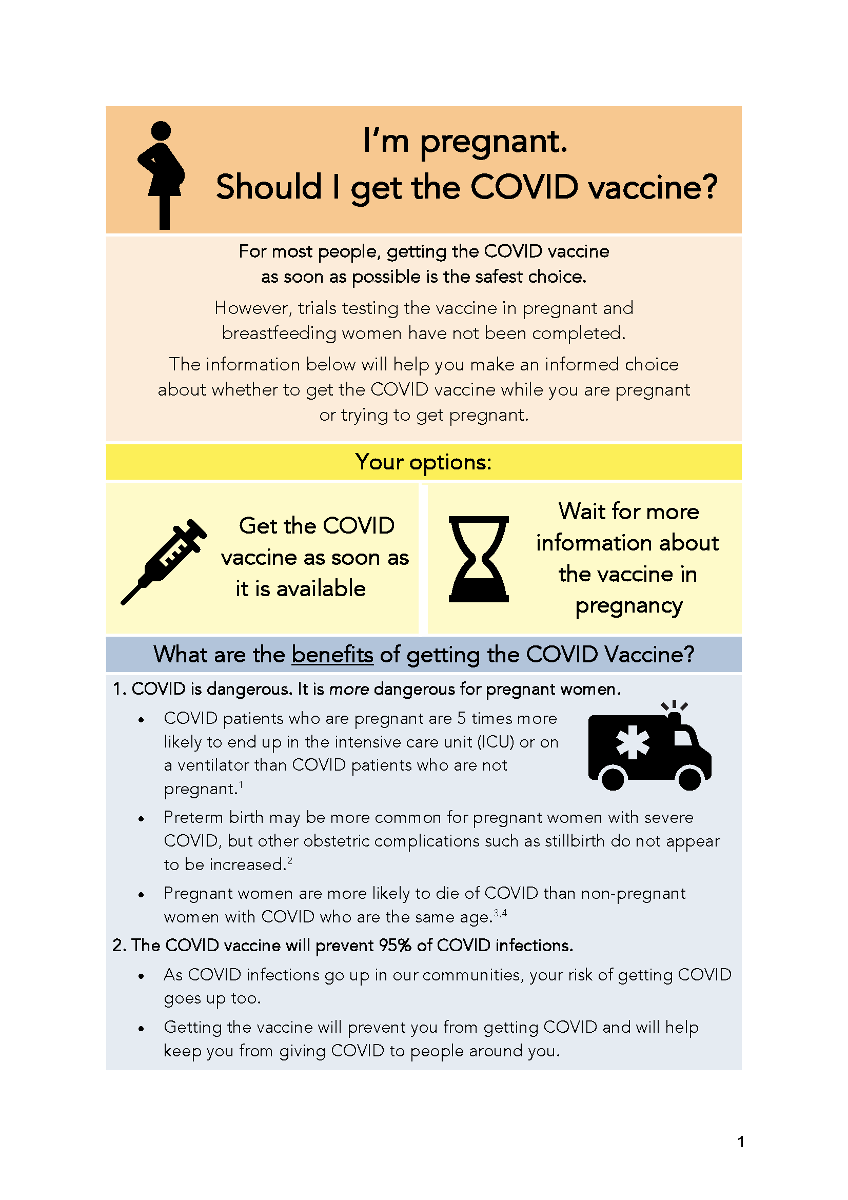
COVID Vaccine
Patient Education Examples
Baystate Health, MA: Covid Vaccine Info for Pregnant/ Breastfeeding Patients. (12.14.20)
Washington University: Pregnancy, Breastfeeding, and the Covid-19 Vaccine. (12.20.20)

Slide 33
Emerging Information
Janssen vaccine (Johnson & Johnson)
  Applied to US-FDA for an EUA, meeting scheduled for 2.26.21
  Adenovirus vaccine
  Single dose and Can be stored in refrigerator
  57% (SA) 72% (US) protection against end points of moderate and severe disease
  85% effective in preventing critical disease, 100% effective in preventing death
Astra-Zeneca vaccine impact on transmissibility (to be published in Lancet)
  After people received two doses of vaccine they were 54 percent less likely to have an infection confirmed by nasal swab (no infection= no transmissibility)
  Single dose 76 percent effective against symptomatic virus infection for up to three months
  Small study (n=256) not yet published showed 75% effective against B117 (UK) variant, 84% effective against original variant

Slide 34
COVID Mental Health Support Resources for Physicians & Healthcare Workers
Project Parachute: offers pro-bono teletherapy (video or phone) to frontline workers
  https://project-parachute.org/
Physician Support Line
  staffed by volunteer psychiatrists
  offers free and confidential peer support to physicians in the U.S.
  available daily by calling 1 (888) 409-0141 from 8 a.m. to 3 a.m. EST.
For the Frontlines: 24/7 help line provides free crisis counseling for frontline workers. Text FRONTLINE to 741741

Slide 35
  IDPH Updates
  Amanda Bennett, PhD, MPH
  CDC Field Assignee in Maternal and Child Health Epidemiology, Illinois Department of Public Health

Slide 36
IDPH Updates
The data collection period for Labor & Delivery sentinel surveillance has ended
  THANK YOU to every hospital that submitted data
  Data analysis results will be shared soon
CDC Toolkit for Pregnant and Postpartum Patients and their families – graphics and one-pagers
Misinformation circulating about COVID vaccine and fertility - CDC has added to their FAQ page to specifically address this issue to the public: https://www.cdc.gov/coronavirus/2019-ncov/vaccines/facts.html
https://www.cdc.gov/coronavirus/2019-ncov/communication/toolkits/pregnant-people-and-new-parents.html

Slide 37
OB Discussion Panel
  Sarah L Bradley, MD – OB Hospitalist, Swedish American Hospital, Rockford
  Kandi Ogden-Moles, DO, PGY-1 Family Medicine, Swedish American Hospital, Rockford
  Emily Stinnett Miller, MD - Maternal-Fetal Medicine, Northwestern University
  Ashish Premkumar, MD - Maternal Fetal Medicine, John H. Stroger, Jr. Hospital of Cook County, Chicago
  Rob Abrams, MD - SIU Center for Maternal - Fetal Medicine, HSHS St. John's Hospital

Slide 38
Adolescent pregnancy complicated by COVID-19
ILPQC Webinar
February 5, 2021
Sarah Bradley, MD, Lead OB Hospitalist
Kandi Ogden-Moles, DO, PGY-1 Family Medicine

Slide 39
Case Presentation
16 yo G1 at 32w3d
Pregnancy history:
  Unplanned but desired pregnancy
  Lives with mom, FOB involved
  PMH: Depression, obesity BMI 36
  Pregnancy complicated by
    Kidney stones first trimester
    GBS bacteriuria
    Chlamydia, negative test of cure
  Regular prenatal care in Rochelle IL with family medicine
Notes:
Rural town of 10K, 35 minutes south of Rockford

Slide 40
Case presentation, continued
COVID diagnosis
  Mild URI symptoms → Positive test 12/28
ED visits
  OB ED 12/31 for decreased fetal movement
    Maternal tachycardia 110s-120s, afebrile, O2 92-100% RA
    IV hydration, NST reactive
    Left AMA because boyfriend not allowed in (also COVID+)
  SAH ED 1/3 for fevers and dyspnea
    Tachycardic to 120s, afebrile, O2 99% RA
    Again left AMA

Slide 41
Case presentation, continued
Hospital Admission 1/5 at 32w2d
  Presented to Rochelle ED with fevers and worsening dyspnea
  CT negative for PE, CXR with COVID PNA
  Transferred to Swedish American
  Admission vitals:
    Afebrile, tachy 100s, RR mid-upper-30s, O2 96% RA
  Started on Clindamycin and Aztreonam, BMZ course
  Concern for decompensation –
    Transfer for PICU availability investigated but not pursued
Notes:
Also congestion, diarhea

Slide 42
Case presentation, continued
Hospital course days 2-3
  Multidisciplinary care team
    FM, MFM, OB Hospitalist, NICU
  Remained on the OB floor –
    concern re need for emergent delivery
  Required 1-4 L O2 to maintain sats >95%
    Intermittently refused oxygen and pulse ox monitoring
  Fetal monitoring reassuring
  Started on remdesivir and dexamethasone
  Prophylactic Lovenox

Slide 43
Case presentation, continued
Hospital day #4
  Began refusing all therapies
    Oxygen, Lovenox, vitals, etc
  Left AMA
  Had completed 2/5 days of remdesivir, 3/10 days dexamethasone
  Given Rx to complete clindamycin course for PNA
Follow up
  Has attended regular prenatal visits
  Antenatal surveillance reassuring
  Now 36 weeks, growth scan pending

Slide 44
Lessons learned
Challenges in obtaining combination of obstetric and pediatric intensive care
  Hospital facility
  Providers
Consent for treatment in minors
  Consent By Minors to Medical Procedures Act, 410 ILCS 210/0.01
  Minors who are pregnant, married, or are parents may give consent for any medical treatment
Notes:
Challenges re teenager – noncompliance, leaving AMA, etc. Consent – she wanted mom to give consent, difficulty in contacting her mom, needing Spanish interpreter

Slide 45


Intersectionality in COVID-19
Emily S Miller, MD MPH
Maternal Fetal Medicine
Northwestern University

Slide 46
Northwestern’s Prentice Women’s Hospital
Opened OB-C unit 3/2020
  Initially 9 beds and closed unit
  Currently 4 beds and open unit
Pregnant individuals within 10d/10d/24h deliver on OB-C
Notes:
12000 deliveries per year – 32 LDRs, 8 prep/hold/recovery rooms, 16 triage rooms, 4 ORs
652 pregnant individuals tested positive

Slide 47
Case
Patient Information
Optimal Hospital Setting
26yo G3P2002 @ 27w3d admitted to ED due to mental status changes
  History of schizoaffective disorder, not currently on medical management
  Experiencing homelessness
  No obstetric concerns
Universal SARS-CoV-2 test positive
Psychiatry inpatient: not permitted to accept patients with SARS-CoV-2
  Requires test-based clearance for admission
OB-C: no obstetric concerns
  Staff less equipped to manage psychiatric instability
  Requires 1:1 sitter in the room

Slide 48
Inpatient Challenges
Multiple episodes of agitation, requiring PRN Haldol
  Discontinuity of mental health providers
  Developed EPS that required multiple evaluations by psychiatry CL service
No structured mental health programming
Auditory hallucinations re: 1:1 sitter
  Multiple episodes of leaving room and ambulating in hallway

Slide 49
Lessons Learned
Preparedness of intersectionality is challenging
  Insufficient resources for inpatient psychiatric care during pregnancy → COVID-19 compounds this risk
Test-based clearance protocols compound access issues to inpatient mental health care
Limited nursing availability challenges cross-disciplinary education or staffing

Slide 50
OB Discussion Panel
  Sarah L Bradley, MD – OB Hospitalist, Swedish American Hospital, Rockford
  Kandi Ogden-Moles, DO, PGY-1 Family Medicine, Swedish American Hospital, Rockford
  Emily Stinnett Miller, MD - Maternal-Fetal Medicine, Northwestern University
  Ashish Premkumar, MD - Maternal Fetal Medicine, John H. Stroger, Jr. Hospital of Cook County, Chicago
  Rob Abrams, MD - SIU Center for Maternal - Fetal Medicine, HSHS St. John's Hospital

Slide 51
Neonatal Discussion Panel
Justin Josephsen, MD – Medical Director, St. Mary’s Hospital NICU, Neonatologist Cardinal Glennon Children’s Hospital, St. Louis
Leslie Caldarelli MD – Medical Director Prentice NICU, Northwestern University

Slide 52
Thank You
We continue to give thanks to the nurses, doctors, health care workers, public health teams and others across our state at work confronting the COVID-19 pandemic.
Please send questions, comments and recommendations, cases / willingness to share for future COVID-19 OB/Neo discussion webinars to info@ilpqc.org
Recording of this webinar, Q/A and registration for the next webinar on Friday, 3/5/21 will be available at www.ilpqc.org

Slide 53










THANKS TO OUR
FUNDERS
In Kind Support

