Slide 1
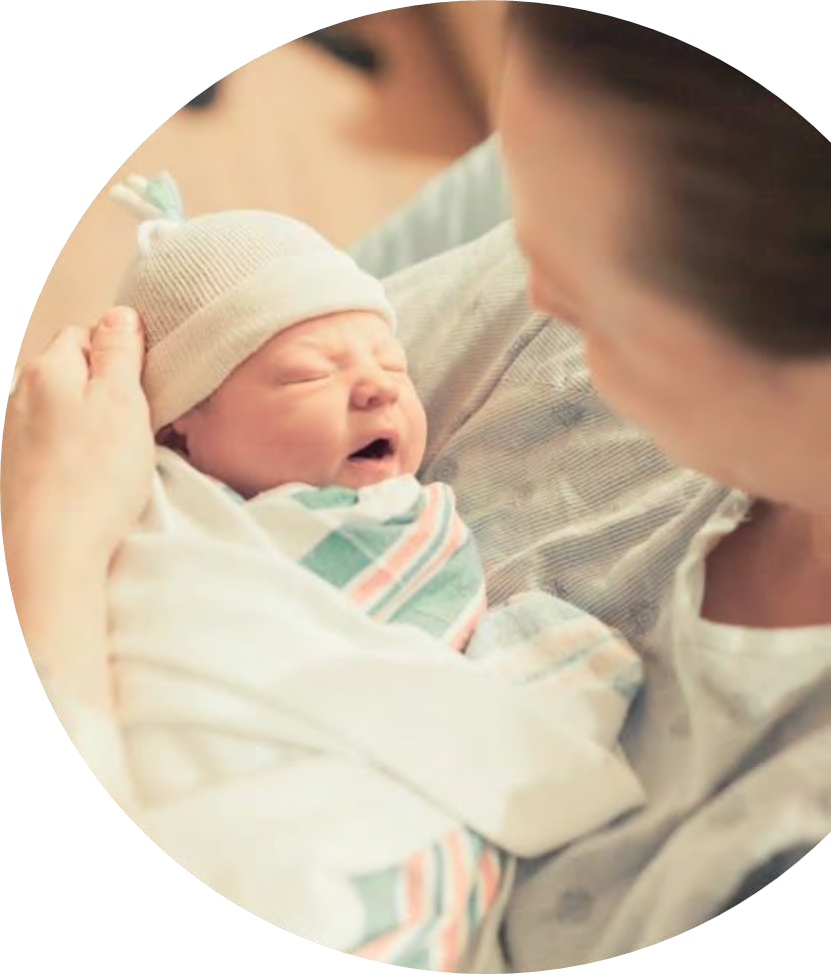


COVID-19 Strategies for OB & Neonatal Units
December 9, 2022
12:00 – 1:15pm

Slide 2

Welcome
Please be certain you are on “mute” when not speaking to avoid background noise.
Whether you have joined by phone or computer audio, you can mute and unmute yourself by clicking on the microphone icon.
The following shortcuts can also be used
For PC: Alt + A : Mute or Unmute
For Mac: Shift + Command + A: Mute or Unmute
For telephone: *6 : Mute or Unmute
2

Slide 3
Housekeeping:
We Are Recording Now
3

Slide 4
ILPQC Covid 19 webinars
We will review a combination of national guidelines, national / state data, community stakeholder work, may include examples of strategies from individual institutions that are not specific IDPH or ILPQC recommendations.
This is our 35th COVID-19 strategies for OB/Neonatal Units webinar in coordination with IDPH, since April 2020. Please see https://ilpqc.org/covid-19-information/ for
future webinar registration, and prior recorded webinars.
The webinar schedule in 2023 is TO BE DETERMINED based on coming need for calls based on updated guidelines / strategies to share.
Please let us know if your hospital would like to share on an upcoming webinar, please put questions/comments into the chatbox or email directly to info@ilpqc.org
4

Slide 5
Overview
Introduction
Overview of updated Covid / flu data and recommendations
IDPH updates on COVID/Flu/RSV
  Arti Barnes, MD, MPH – Illinois Department of Public Health
  Cara Bergo, PhD – Illinois Department of Public Health
EverThrive IL updates on community resources
  Tamela Milan-Alexander, MPPA- EverThrive IL
Discussion of Strategies & Resources:
  Stephanie Fisher, MD - Northwestern Maternal-Fetal Medicine
  ICAAP upcoming trainings / resources
5

Slide 6
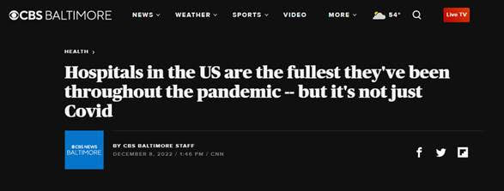
Triple Pandemic: COVID19, Flu, RSV
80% of hospital beds are full nationwide
Highest % hospital bed usage since January 2022 (Omicron Surge)
Combination of Flu, COVID-19, RSV
HHS Secretary Becerra letter to all Governors this week, he was asked by AAP to declare RSV / Flu a public health emergency, described how the public health emergency for COVID-19 can be applied to challenges related to RSV/Flu and COVID19
1 in 10 deaths nationwide are currently due to pneumonia, Flu, or Covid-19
300 deaths per day COVID-19
75 deaths per day Influenza
The Washington Post: Three viruses are waging an attack. But you don’t have to surrender. (12.7.2022)

Slide 7
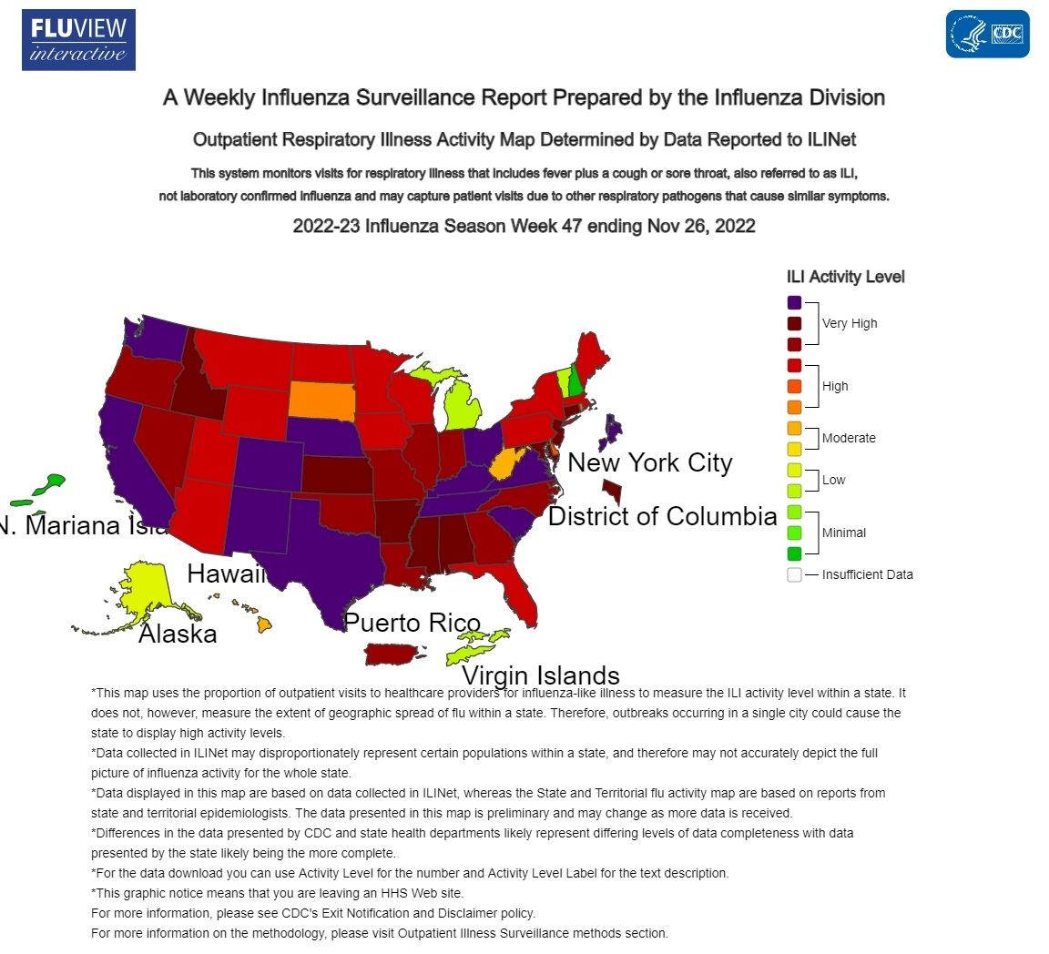

Slide 8
Influenza National Flu Surveillance
Seasonal influenza activity is high and continues to increase across the country with rapid rise post Thanksgiving
Of influenza A viruses detected, 79% have been influenza A (H3N2) and 21% have been influenza A (H1N1)
Two influenza reported pediatric deaths reported this week for a total of 14 this season – 1 in Illinois
Largest portions of hospitalized with flu include children < 17 and elderly 65+
CDC estimates that, so far this season, have been at least 8.7 million flu illnesses, 78,000 hospitalizations and 4,500 deaths
The number of flu hospital admissions reported during week 47 doubled compared to the week prior
Significant increase in flu incidence and earlier in the season than prior 5 years.

Slide 9
Flu Treatment
Who is at risk?
  Children < 17 (particularly < 2)
  Adults > 65
  Pregnant / postpartum
  Nursing facility / long term care
  Black, Latinx, Native American
  Medical Conditions:
    Asthma / chronic lung disease
    Neuro/neurodevelopmental dz
    Heart dz
    Blood disorders
    Liver / kidney disease
    Immune suppression
    BMI > 40
Rx:
  Oseltamivir (Tamiflu) first line and best option for pregnant pts
Who to treat?
  Hospitalized
  Outpatients with complicated illness or high risk of severe illness
  Consider Rx for anyone else within 48 hrs

Slide 10
Flu Treatment
Oseltamivir (Tamiflu)
  Oral BID x 5 days
  All ages
  For inpatient / outpatient, pregnant, immunocompromised, high risk groups
  Available, though regional shortages due to high demand
Remaining Rx
  Zanamivir inhaled BID x 5 days for outpatient uncomplicated limited availability
  Peramivir IV single infusion only use when can’t take oral very limited
  Baloxavir oral single dose, not for pregnant or immuncompromised, very limited availability

Slide 11
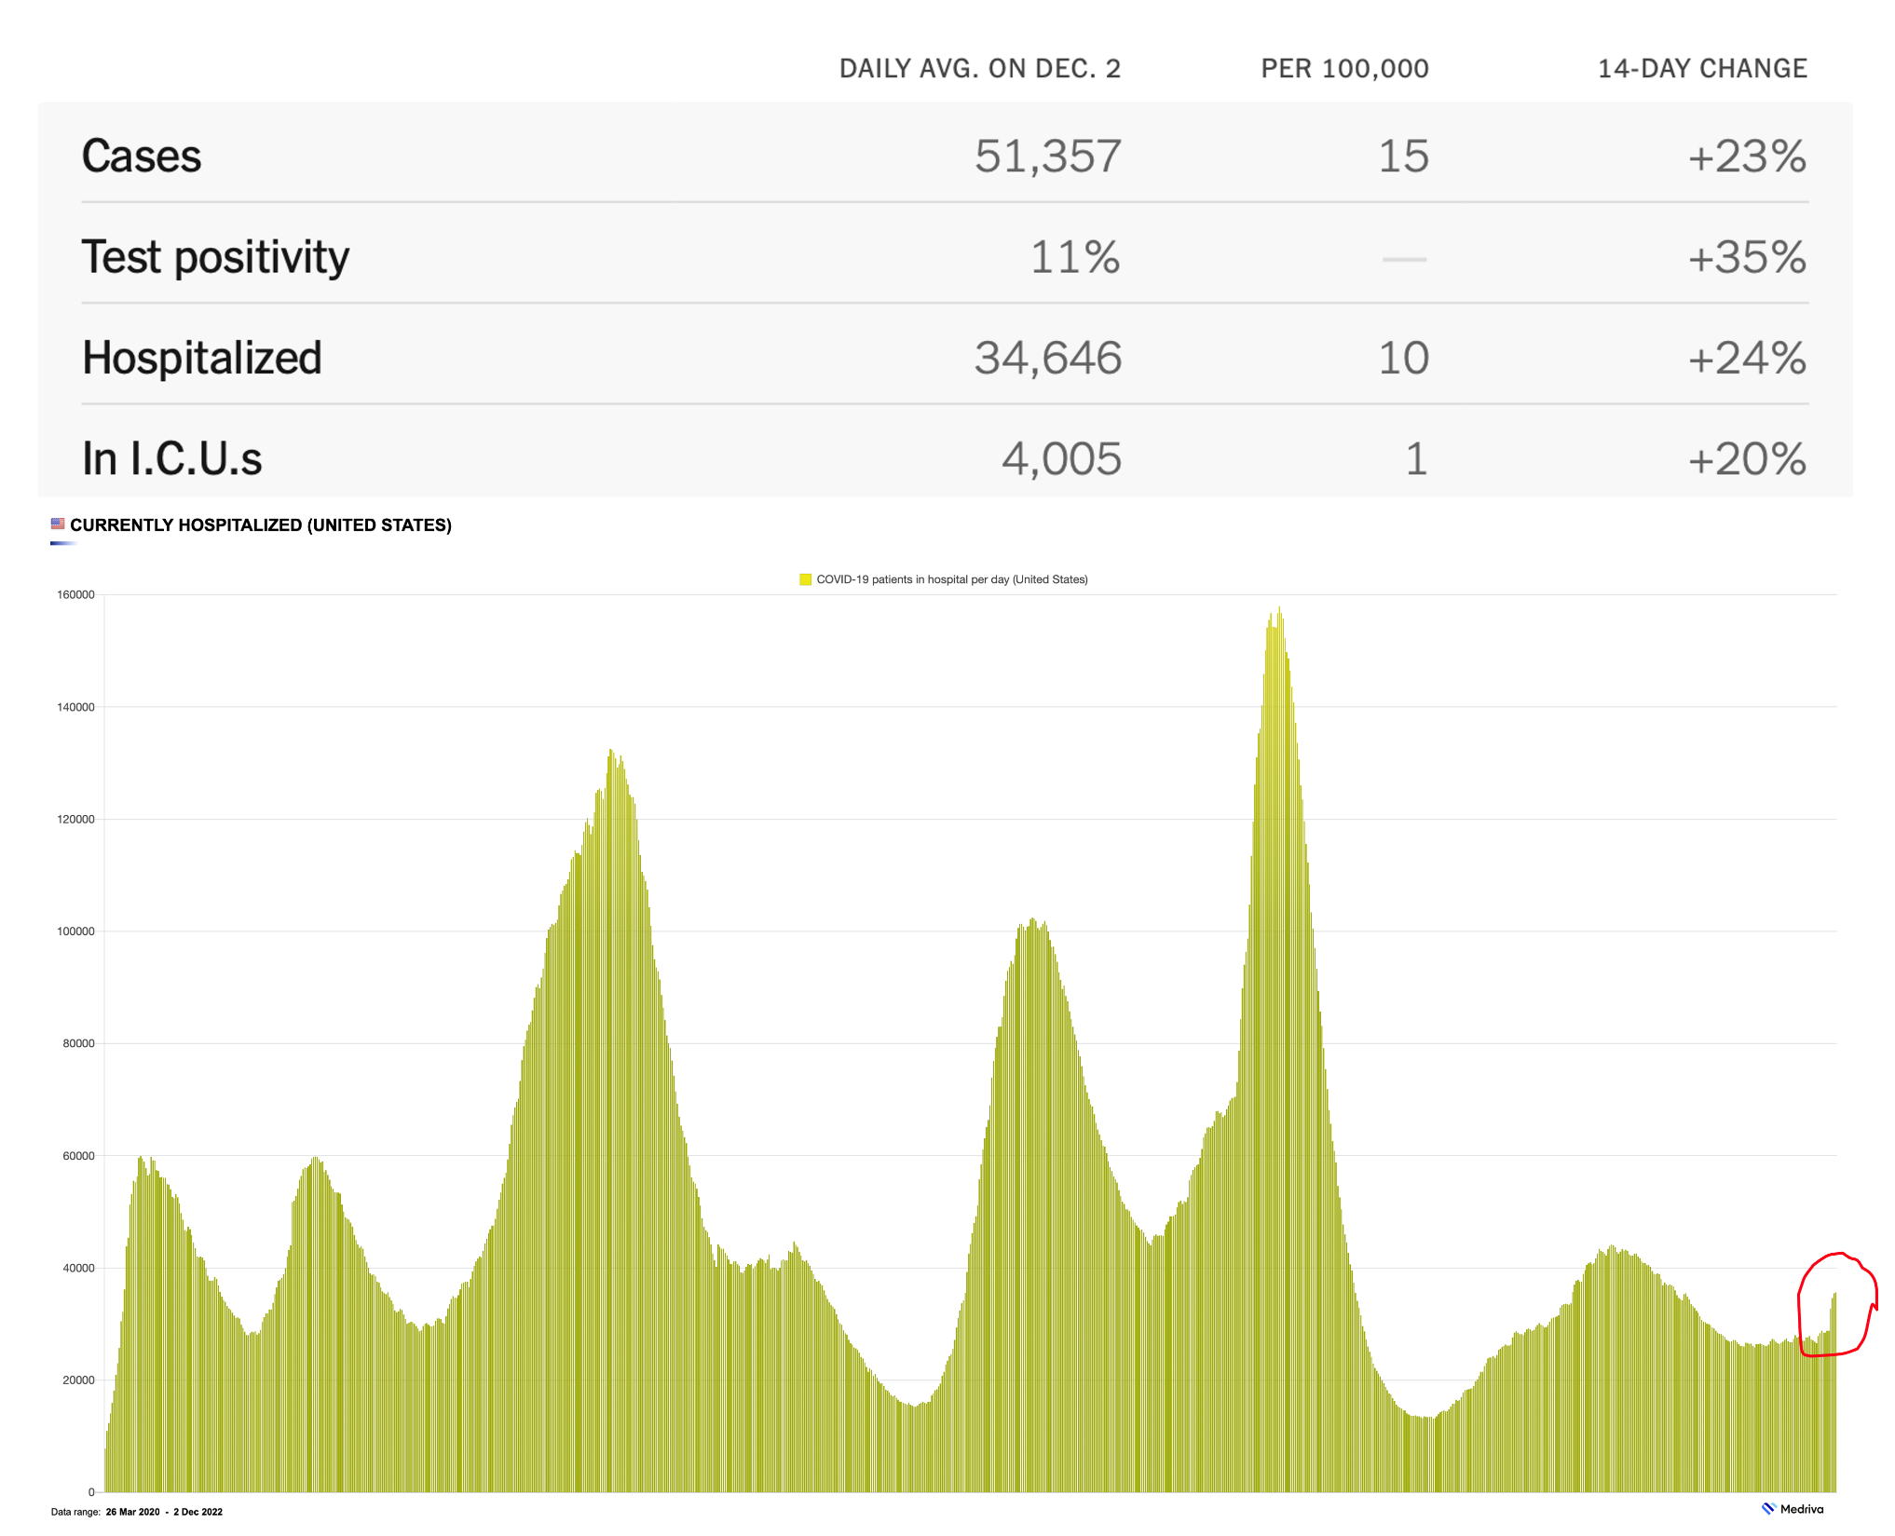
COVID-19 U.S. trends

Slide 12
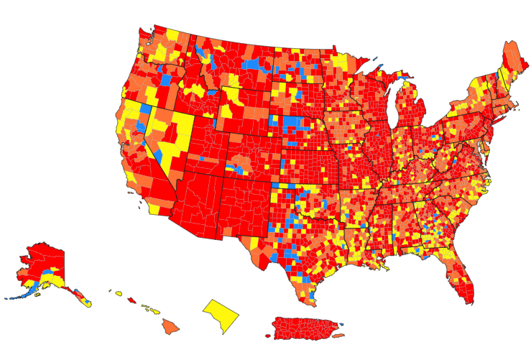
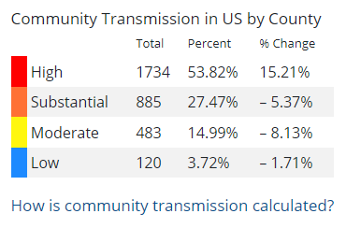
U.S. COVID-19 Community Transmission
CDC community transmission levels are provided to guide healthcare facilities and healthcare safety practices
https://covid.cdc.gov/covid-data-tracker/#county-view?list_select_state=all_states&list_select_county=all_counties&data-type=Risk&null=Risk

Slide 13
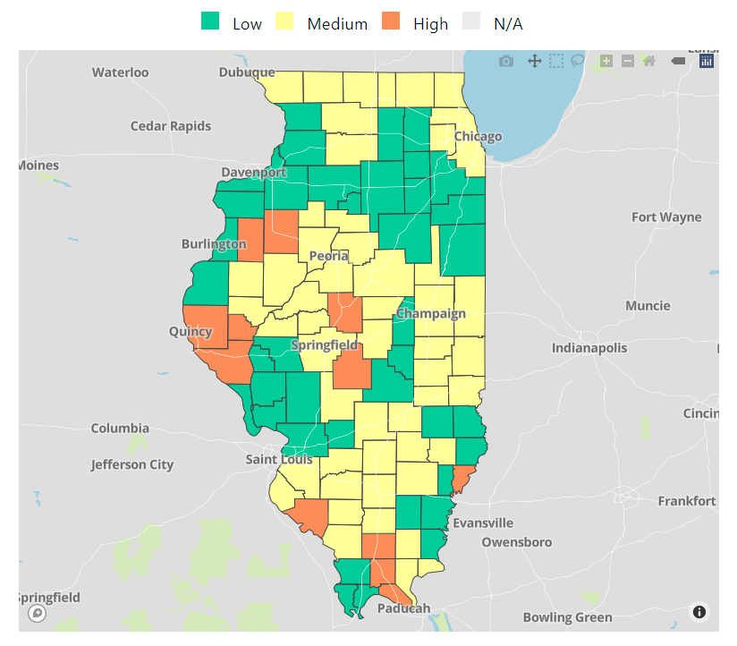
COVID-19 Community Levels Map Updated 12/6/2022
Levels can be low, medium, or high and are determined by looking at % of hospital beds being used by pts with Covid, new Covid hospital admissions, and the total number of new COVID-19 cases in an area.
Use to determine community masking: recommended when high, optional medium/low
Notes:
determined by looking at hospital beds being used by patients with COVID-19, new hospital admissions among people with COVID-19, and the total number of new COVID-19 cases in your area.

Slide 14
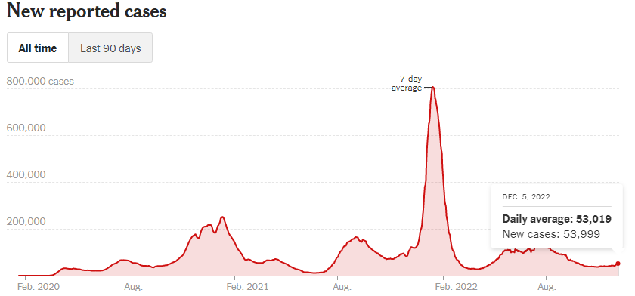
US Trends – COVID19
Source: NYT COVID Tracker
Notes:
The World Health Organization has reported that BA.2, the highly contagious Omicron subvariant, is now driving most coronavirus cases around the world.
Hong Kong officials said that the city was running low on coffins amid its deadliest Covid wave.
A staggered lockdown in Shanghai is testing China’s “Covid zero” policy and the patience of the city’s 26 million residents.
Scientists said they were still searching for explanations for why African countries have reported low rates of Covid infections and deaths, despite earlier predictions that the virus would devastate the continent.
More than 11.2 billion vaccine doses have been administered worldwide, including over 1.6 billion boosters or additional doses. Track each country’s vaccination progress here.

Slide 15


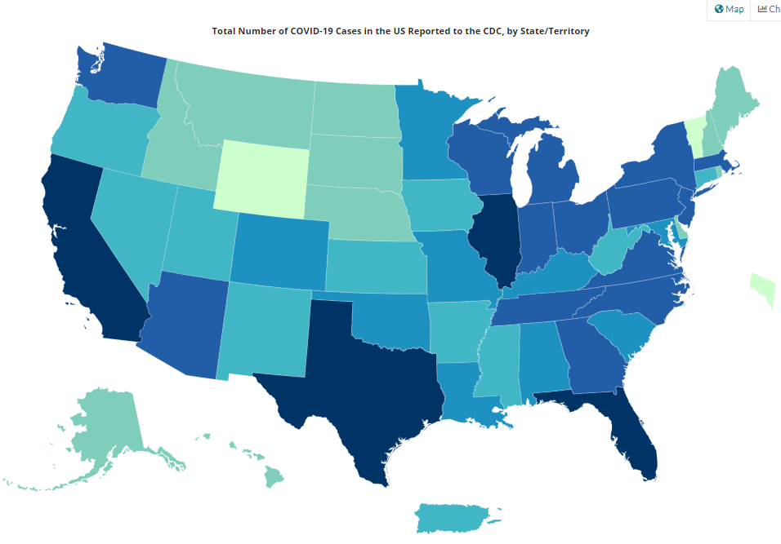
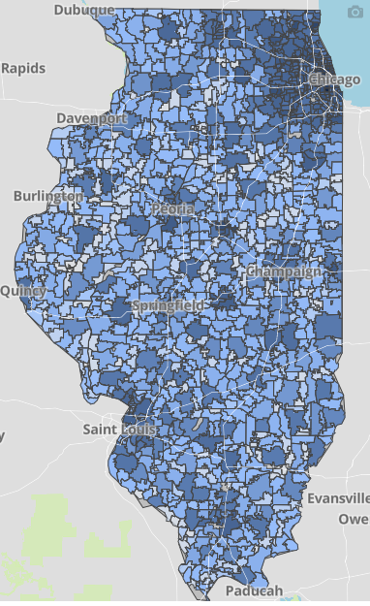
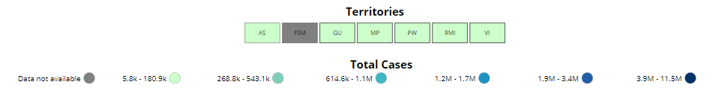
Data Update
CDC/IDPH: COVID-19 Outbreak
CDC (11.30.2022 Data)
https://covid.cdc.gov/covid-data-tracker/#cases_totalcases
IDPH (12.5.2022 Data)
https://www.dph.illinois.gov/covid19
Total cases: 98,777,220 confirmed
Total deaths: 1,077,303 confirmed
3,892,893 Confirmed Positive Cases
35,506 Deaths
8

Slide 16

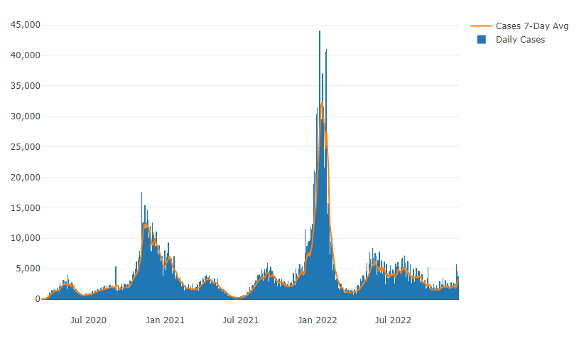

Illinois Daily Incidence – Covid19
IDPH daily data summary
16

Slide 17
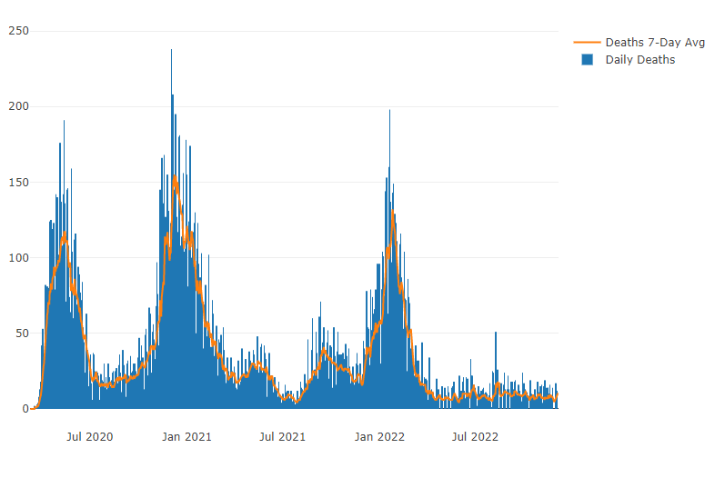
Illinois Covid Deaths
IDPH daily data summary
17

Slide 18
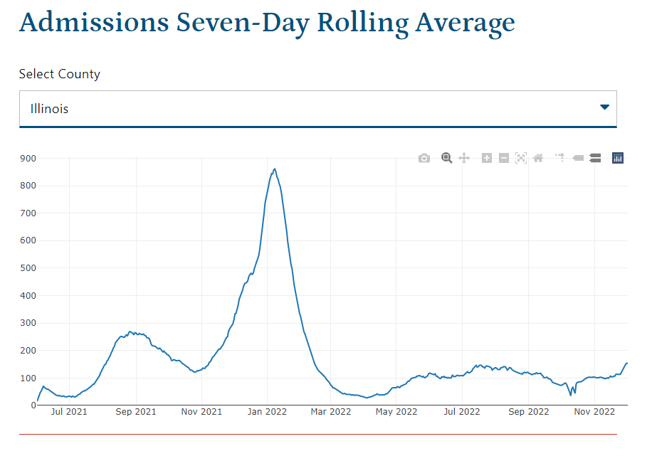
Illinois Hospitalizations By Time through 12/6/2022
https://dph.illinois.gov/covid19/data/surveillance.html

Slide 19
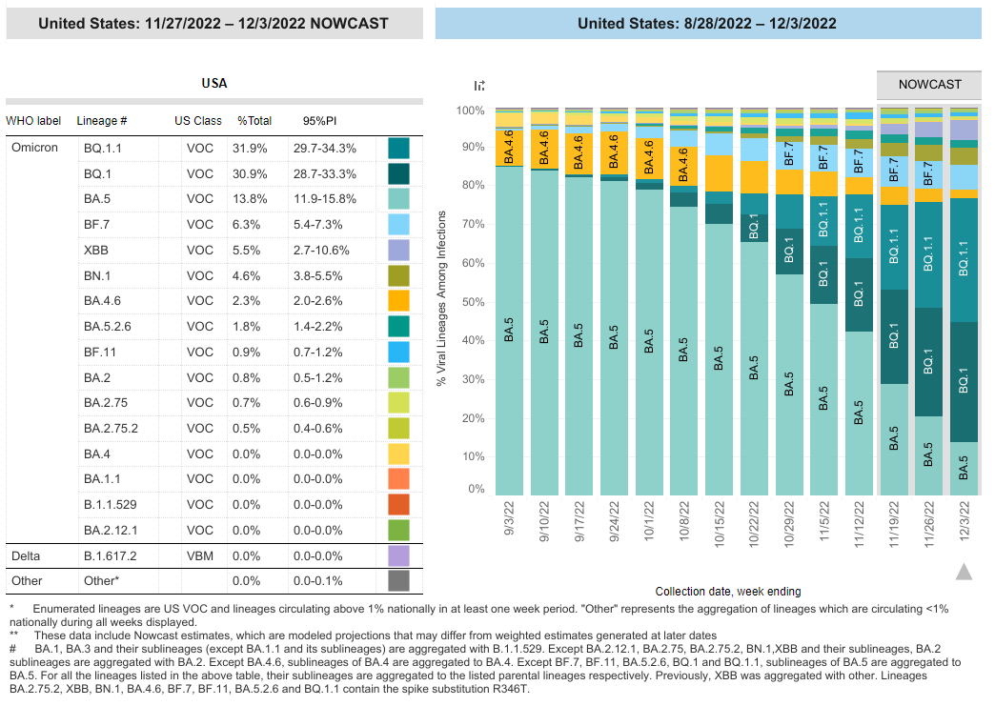
COVID-19 Variants
Omicron subvariants:
BA.5 is no longer the most frequently sampled Omicron subvariant
Seeing an increase of BN.1, BF.7, BQ.1 and BQ.1.1
Current therapy recommendations:
  Paxlovid – remains effective
  Bebtelovimab (monoclonal antibody) – No longer using as of 11/30/22
  Molnupiravir – not recommended for pregnant pts unless only option (per SMFM)
  Remdesivir (inpatients) – remains effective
  * Evusheld decreased effectiveness for prophylaxis

Slide 20
SMFM: SARS-CoV-2 Bivalent Vaccination in Pregnancy (9.22.2022)
SMFM endorses current CDC recommendations that all pregnant, recently pregnant, or lactating people receive the updated bivalent booster, to mitigate increased risk of adverse maternal, fetal, and obstetric outcomes of COVID-19 disease.
Updated Bivalent Booster:
  at least two months after completion of the primary series (for people who have not received any booster), or after the last monovalent booster dose.
  Recommend approximately 3 months after last COVID infection given will have some protection, but can safely receive as early as 2 weeks after infection.
  should be given at any point in pregnancy.

Slide 21
ACOG Practice Advisory
COVID-19 Vaccination Considerations for Obstetric–Gynecologic Care (updated 11/16/22)
ACOG recommends that all people, including pregnant people receive a bivalent mRNA COVID-19 vaccine booster dose following the completion of their last COVID-19 primary vaccine dose or monovalent booster.
Bivalent mRNA COVID-19 vaccines are the default for booster vaccination.
  Novavax’s monovalent COVID-19 vaccine is allowable for use as a booster when a person has not yet received any booster dose and is unable to get a bivalent mRNA COVID-19 vaccine

Slide 22
CDC MMWR: Effectiveness of Bivalent mRNA Vaccines in Preventing Symptomatic SARS-CoV-2 Infection — Increasing Community Access to Testing Program, United States, September–November 2022. (12.2.2022)
In this study of vaccine effectiveness of the U.S.-authorized bivalent mRNA booster formulations, bivalent boosters provided significant additional protection against symptomatic SARS-CoV-2 infection in persons who had previously received 2, 3, or 4 monovalent vaccine doses.
121,687 adults COVID + vs 238,939 adults tested COVID neg
Due to waning immunity of monovalent doses, the benefit of the bivalent booster increased with time since receipt of the most recent monovalent vaccine dose.

Slide 23
CDC Covid Data Tracker
People aged 12 and older vaccinated with updated Booster (Bivalent)
  14.9x lower risk of dying from COVID (Sept 2022)
  3.2x lower risk of testing + with COVID (October 2022)
  Compared to unvaccinated
13.5% of people 5 and older have received the updated booster

Slide 24
Pregnancy and infant outcomes by trimester of SARS-CoV-2 infection in pregnancy–SET-NET, 22 jurisdictions, January 25, 2020–December 31, 2020 (9.6.2022)
35,200 people included in this analysis
  50.8% of pregnant people had infection in the third trimester, 30.8% in the second, and 18.3% in the first.
Third trimester infection was associated with a higher frequency of preterm birth compared to first or second trimester infection combined (17.8% vs. 11.8%; aPR 1.44 95% CI: 1.35–1.54).
Preterm birth in people with SARS-CoV-2 infection in pregnancy was higher than national baseline data (10.0–10.2%), particularly among people with third trimester infection.

Slide 25
Outpatient Therapeutic Preferences
https://www.covid19treatmentguidelines.nih.gov/therapies/statement-on-therapies-for-high-risk-nonhospitalized-patients/
Paxlovid (nirmatrelvir/ritonavir) – remains effective against new variants
  PROS: oral and highly effective
  CONS: needs to be given within 5 days of symptom onset, renal adjustment (can’t be given for GFR <30) and many drug-drug interactions (DDIs)
Bebtelovimab (monoclonal antibody) - NO LONGER USING as of 11/30/22 per FDA not effective against new variants
  PROS: highly effective, can be given up to 7 days of symptom onset
  CONS: intravenous, limited access – need pathway for pregnant patients
Remdesivir – second line – typically used INPATIENT
  PROS: highly effective in early illness, readily available, can be given outpatient up to 7 days of symptom onset
  CONS: three consecutive days of IV therapy is extremely difficult in the outpatient world
    Good use is for inpatients who are COVID+ but actually hospitalized for another reason

Slide 26
Make it easier for OB providers / pregnant patients to access Therapeutics
Therapeutics can prevent hospitalizations and deaths (maternal and child) in pregnant with Covid
Paxlovid is accessible and works against variants
Counsel all pregnant patients to call with symptoms and get tested so can start treatment with in 5 days of symptoms start.

Slide 27
ILPQC Resources

Slide 28
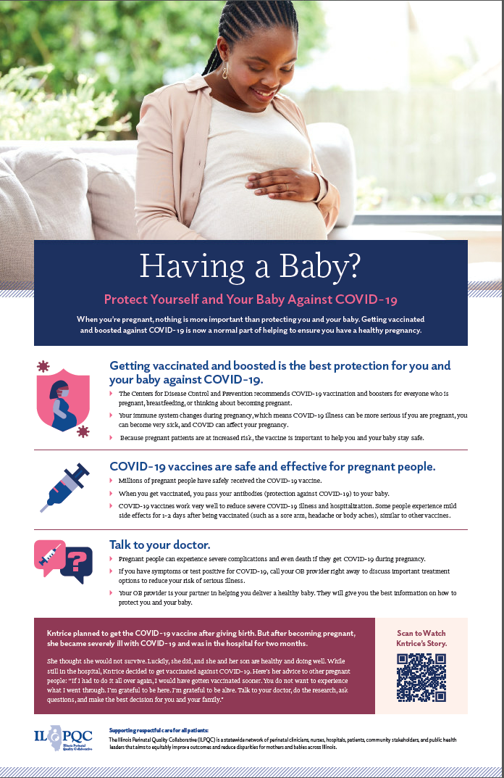
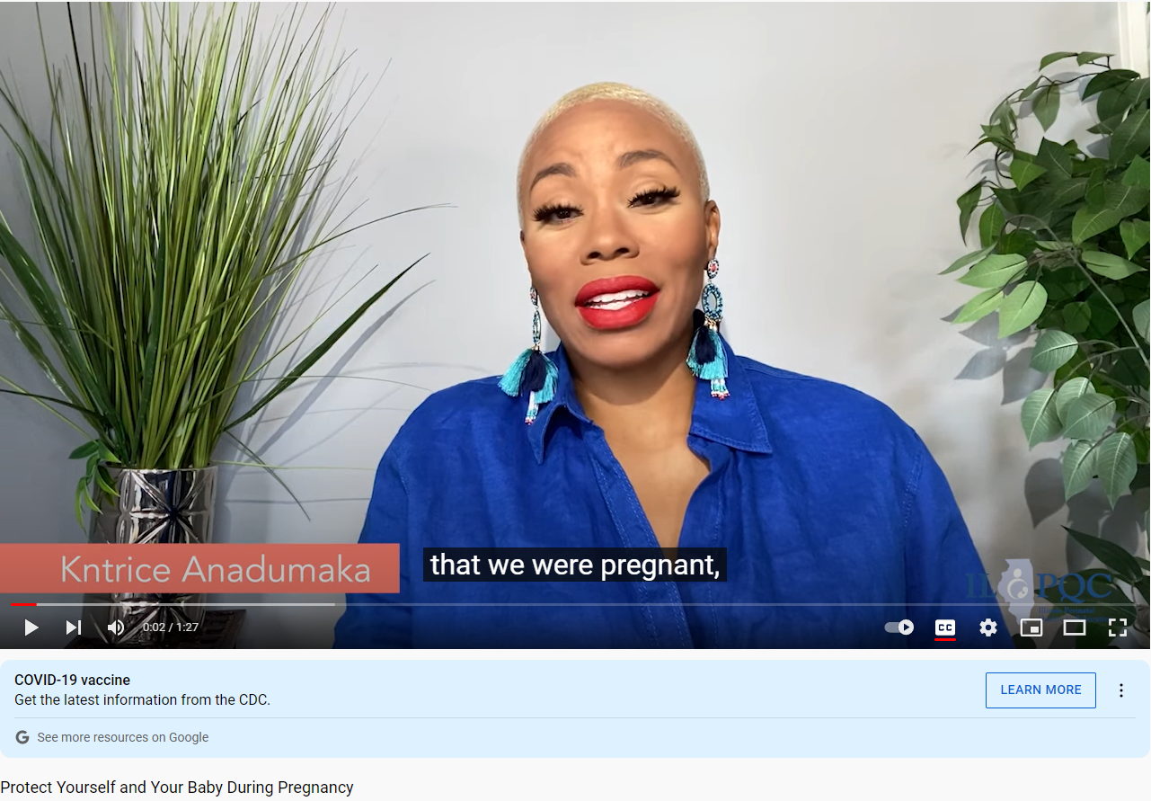
Patient Materials
https://www.youtube.com/watch?v=fVOQR56zVok&t=1s

Slide 29
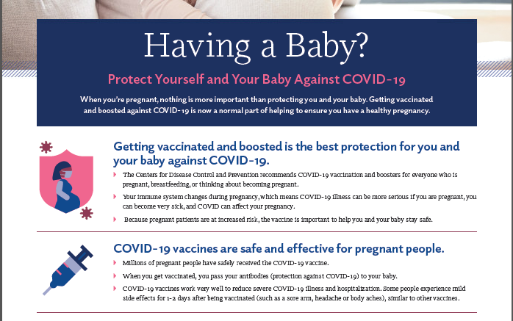
Patient Materials

Slide 30
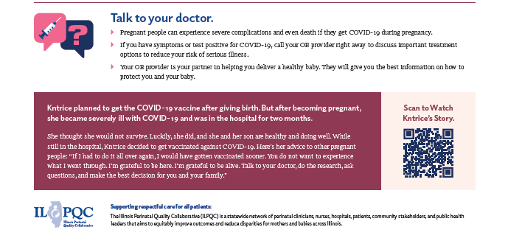
Patient Materials

Slide 31
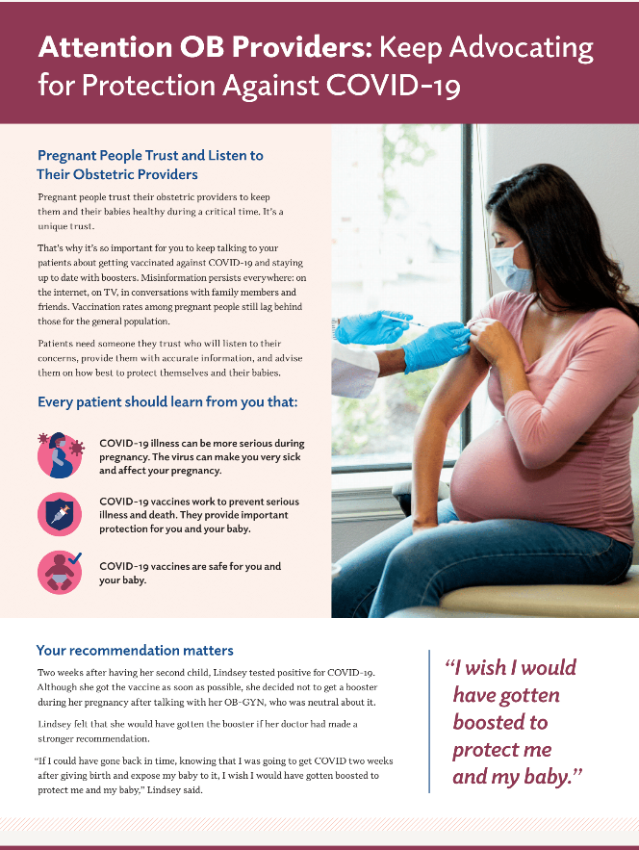
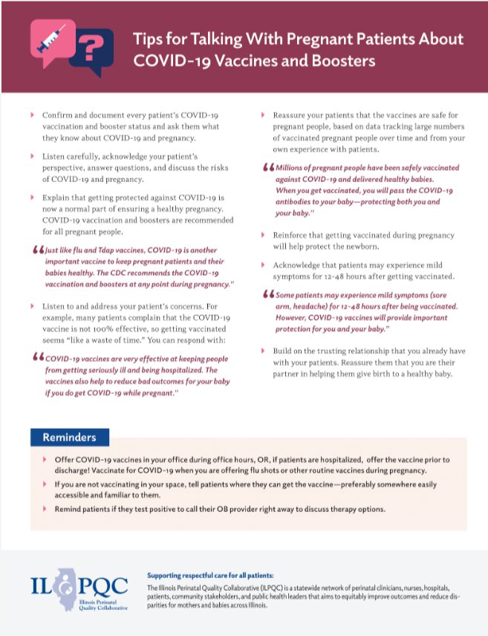
Provider Materials

Slide 32
IDPH Updates
Cara Bergo, PhD – Maternal Mortality Epidemiologist, Illinois Department of Public Health
Arti Barnes, MD, MPH – Chief Medical Officer, Illinois Department of Public Health

Slide 33
2020 Illinois Deaths during pregnancy or within one year of pregnancy reviewed due to COVID-19
Process Additions to Maternal Mortality Review
6 Deaths during pregnancy or within one year of pregnancy
Factors that contributed to preventable, pregnancy-related deaths
Recommendations
Notes:
Processes
Additional Members
COVID-19 Timeline
CDC resources for pregnancy relatedness
Reviewed in the lens of the resources they had at the time
6 Deaths during pregnancy or within one year of pregnancy
All occurred in late spring of 2020
Timing: 1 during pregnancy, 3 within 1 month, 1 within about 2 months, 1 more than 4 months
Pregnancy related: 5/6 were found to be related to pregnancy
1 over four months pp, not
Preventability: 4/5 were found to be preventable, 1 not preventable had no underlying known risk factors
Obesity: 4/5
Factors
-Patient Chronic Disease & Delay- Obesity
-Provider & Facility- Quality of care
-Systems Delay, Assessment, access, care coordination- response to pandemic
-Patient- social support- isolation caused stress
Recommendations
-Providers need to refer patients with obesity to a dietician who can provide culturally-sensitive and comprehensive nutrition counseling services to promote healthier weight.
-Facilities should provide educational materials at delivery discharge on warning signs of postpartum complications.
-Payers, including Illinois Medicaid, should reimburse for group prenatal care visits, in person and through telemedicine.
-Congress should increase funding for federal public health agencies to provide necessary resources for future public health preparedness.
-The state should develop a mechanism for retired nurses and physicians to return to healthcare practice during public health emergencies.

Slide 34
Respiratory Illness Update
12/9/22

Slide 35
Respiratory Illness Rates Are Higher Than Usual for This Time of Year, Especially Among Children.
Pediatric clinic visits for respiratory illnesses are occurring at the highest frequency since 2018, but visits have now been declining for several weeks. Respiratory illness visits usually peak in December or January, but current levels already exceed peaks from the last several years.
Weekly Visits for Influenza-Like-Illness, Ages 0-4¹
Weekly Visits for Influenza-Like-Illness, Ages 5-24¹
2022
2022
2021
Visits
2019
Visits
2019
2021
2018
2018
2020
2020
Week
Week
*Note: most recent week of data is dropped due to reporting delays
Sources:
¹ ILINet: https://gis.cdc.gov/grasp/fluview/fluportaldashboard.html
FOUO​
Notes:
ILINet: https://gis.cdc.gov/grasp/fluview/fluportaldashboard.html

Slide 36
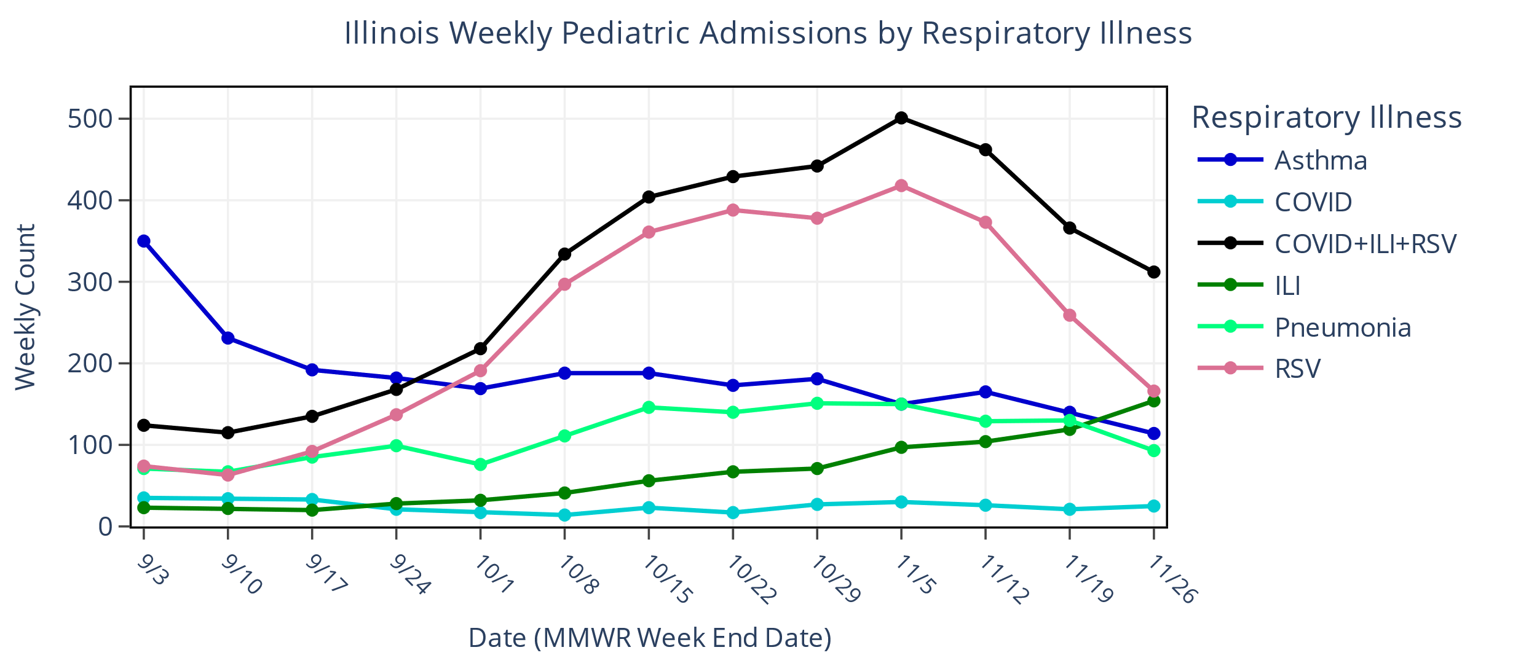
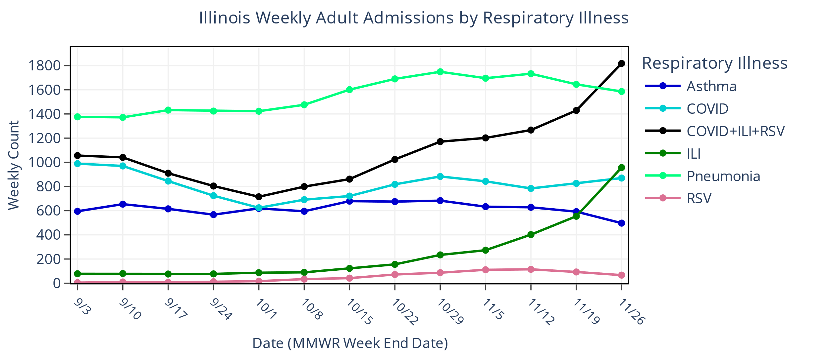
Select Respiratory Admission Trends through Nov 26, 2022
Pediatric Admissions:
ILI increasing
COVID+ILI+RSV decreasing
RSV decreasing
Adult Admissions:
ILI increasing
COVID+ILI+RSV increasing
Illinois data: IDPH: Preliminary draft not for sharing
Slide updated 11/30/22
Notes:
Notes 11/30/2022: Swapped Influenza for ILI. ILI definition is slightly more broad.
I added a line for COVID+ILI+RSV to count admissions where a patient has COVID or ILI or RSV and does not overcount when a patient has multiple.
Here are the ESSENCE CCDD Definitions used for selected respiratory illnesses
'Asthma’:'CDC Asthma CCDD v1'
'COVID’:'CDC COVID-Specific DD v1’
'ILI’:'ILI CCDD v1'
'Pneumonia’:'CDC Pneumonia CCDD v1'
'RSV’:'CDC Respiratory Syncytial Virus v1'

Slide 37
ED Boarders (7 day rolling average)
Illinois data: IDPH: Preliminary draft not for sharing
Notes:
Climbing since March 2022

Slide 38
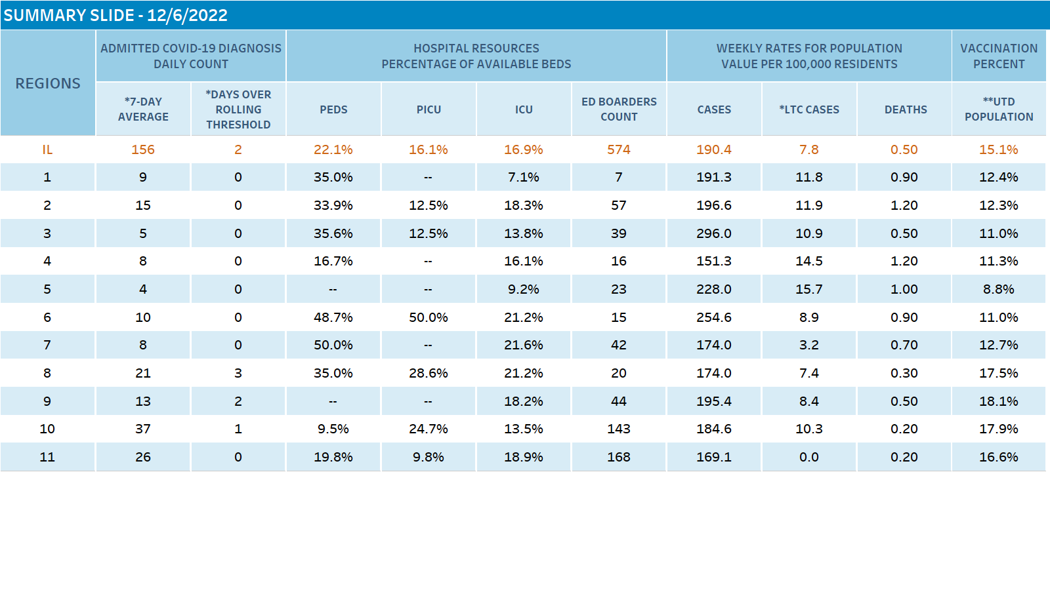

Slide 39
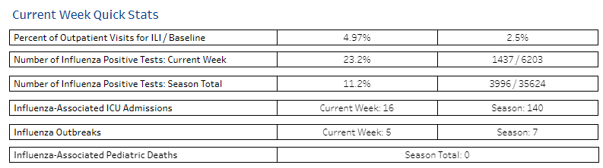
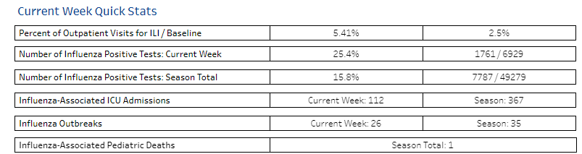
Influenza in IL
Illinois data: IDPH
Notes:
12 pediatric deaths in the nation from Flu-1 in IL. 2100 deaths total.> 6 million infections and >50K hospital admissions.
2900 deaths. laboratory-confirmed influenza-associated hospitalizations were reported by FluSurv-NET sites between October 1, 2022, and November 12, 2022; 95.6% were associated with influenza A virus, 2.4% were associated with influenza B virus, 0.3% with influenza A virus and influenza B virus co-infection, and 1.6% with influenza virus for which the type was not determined. Among 317 hospitalizations with influenza A subtype information, 23.3% were A(H1N1)pdm09 virus and 76.7% were A(H3N2).
The overall cumulative hospitalization rate per 100,000 population was 8.1. This cumulative hospitalization rate is higher than the cumulative in-season hospitalization rate observed in week 45 during previous seasons going back to 2010-2011, which ranged from 0.1 to 0.9. The highest hospitalization rates per 100,000 population were among adults aged ≥ 65 years (18.6), followed by children aged 0-4 years (13.6), adults aged 50-64 (8.0), children aged 5-17 years (7.3), and adults aged 18-49 years (4.2).
Cumulative hospitalization rates for each age group were higher than cumulative in-season hospitalization rates previously observed during week 45; since 2010-11 in-season rates ranged from 0 to 1.6 among children 0-4 years, 0 to 0.5 among children 5-17 years, 0 to 0.4 among adults 18-49 years, 0.1 to 0.9 among adults 50-64 years, and 0.3 to 2.7 among adults ≥ 65 years.

Slide 40
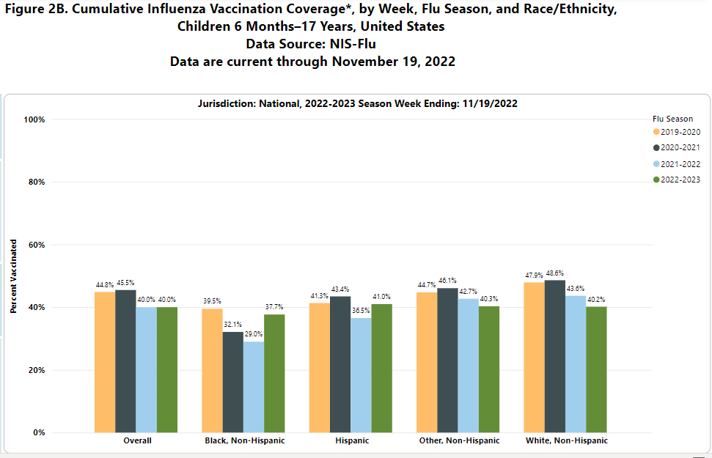
CDC: National data

Slide 41
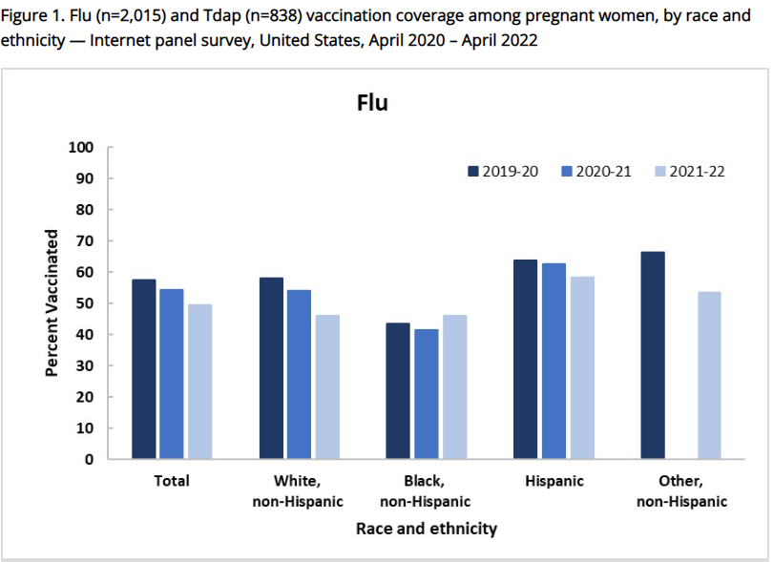
CDC: FluVaxView data

Slide 42
And what about covid?

Slide 43
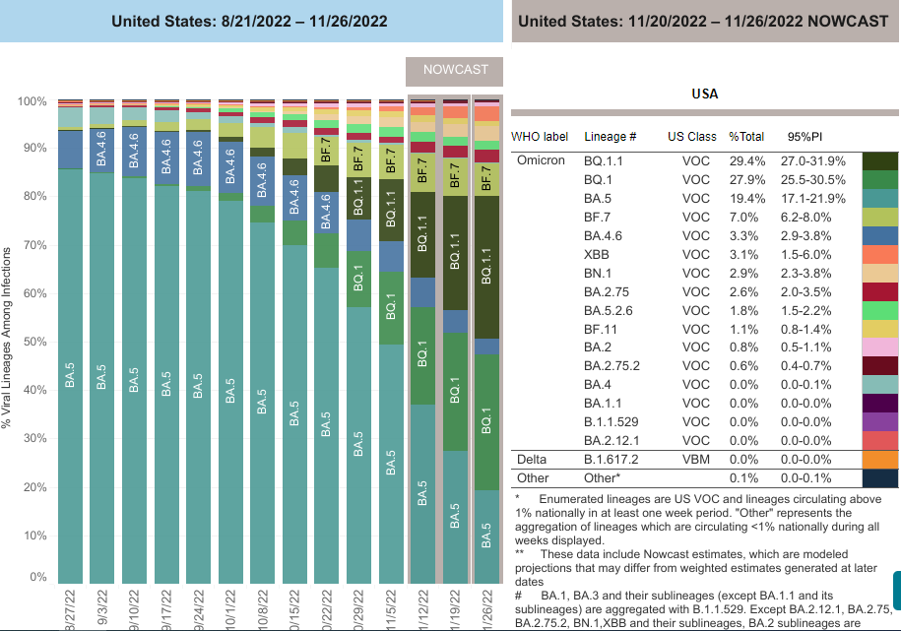
SARS-CoV2 Variants in HHS Regions 5 as Reported by CDC
Omicron continues to be the dominant variant sampled in Region 5
BA.5 is no longer the most frequently sampled Omicron subvariant
CDC is predicting an increase of BN.1, BF.7, BQ.1 and BQ.1.1
Updated 11/22/22
Notes:
Data Source: https://covid.cdc.gov/covid-data-tracker/#variant-proportions
Dates: 8/14/22 to 11/19/22
Percent Viral Lineages Among Infections
10/22/2022 10/29/2022 11/5/2022 11/12/2022 11/19/2022 % change
BQ.1.1 4.8 6.7 11.2 16.6 22.8 375
BQ.1 4.9 8.5 12.2 16.5 20.7 322
BF.7 5.7 9.5 9.1 9.6 9.4 64
BN.1 1.4 1.5 2.4 3.5 4.9 250
BA.5 68.3 61 50.1 39.2 28.7 -57
“Other” represents the aggregation of lineages which are circulating <1% during all weeks displayed
Variants and sublineages aggregated to correspond to CDC COVID variant tracker (https://covid.cdc.gov/covid-data-tracker/#variant-proportions)

Slide 44
What should we know about BQ 1.1?
It is a descendant of BA.5
More transmissible than Omicron but not more virulent
Decreased response to Bebtelovimab for treatment
Decreased response to Evusheld for prophylaxis
Paxlovid, Lagevrio and Remdesivir expected to work
Vaccines expected to work but no confirmatory data yet
Children over 12 yrs can get Paxlovid or remdesivir

Slide 45
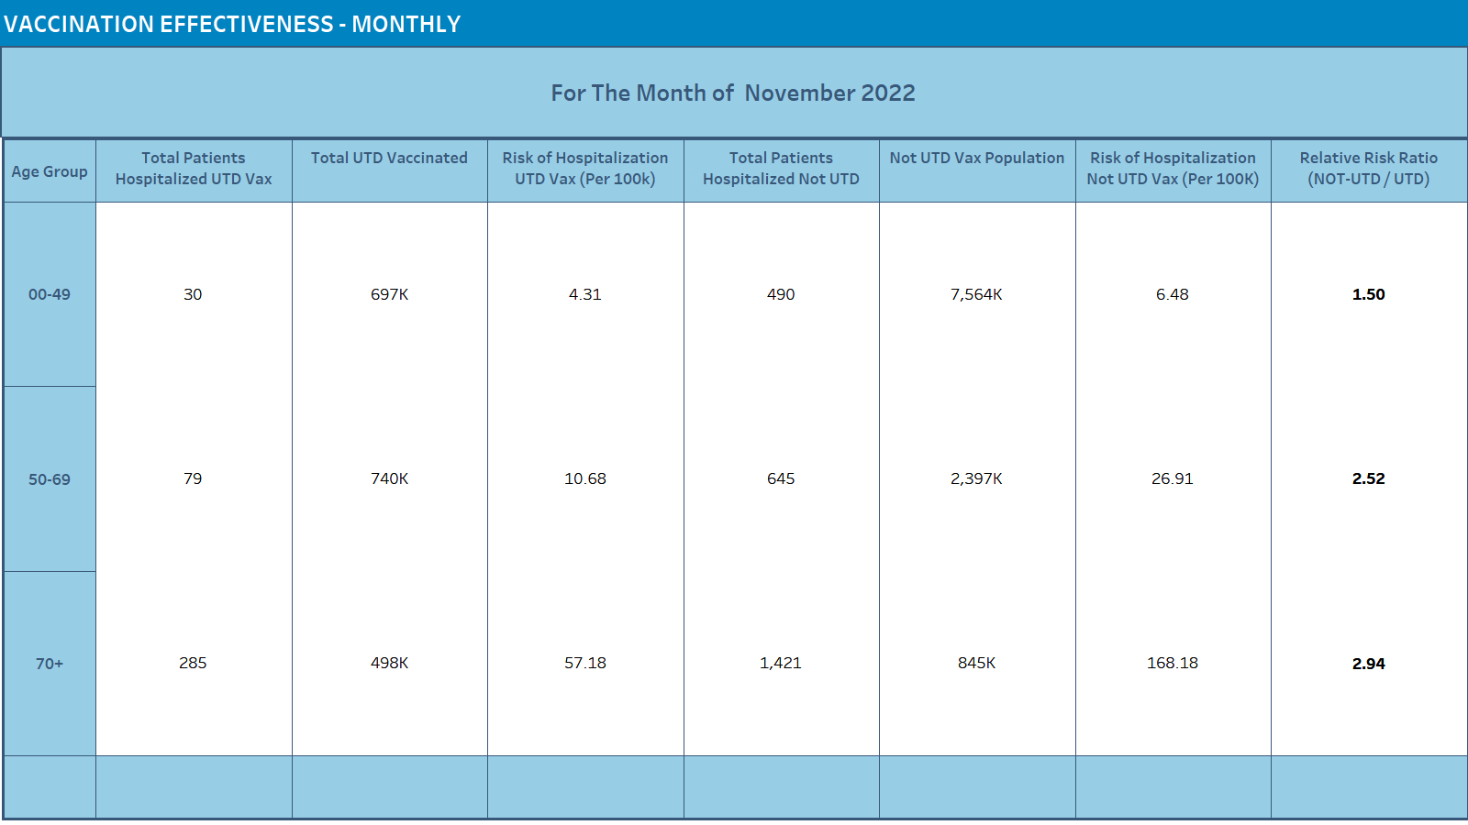
Preliminary draft: Not for wide distribution

Slide 46
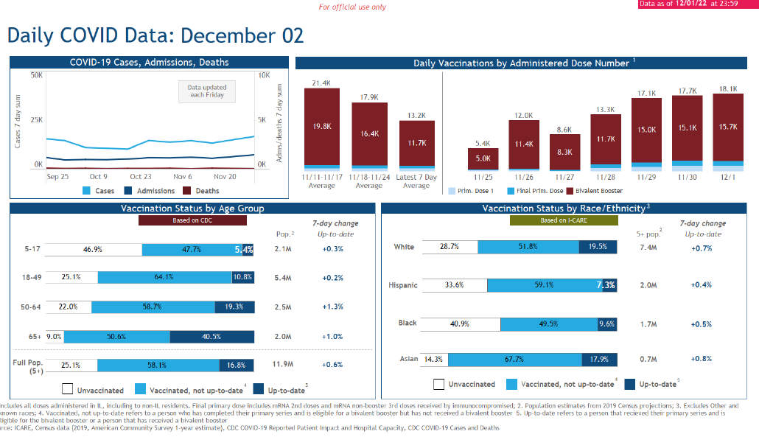
Preliminary draft: Not for wide distribution

Slide 47
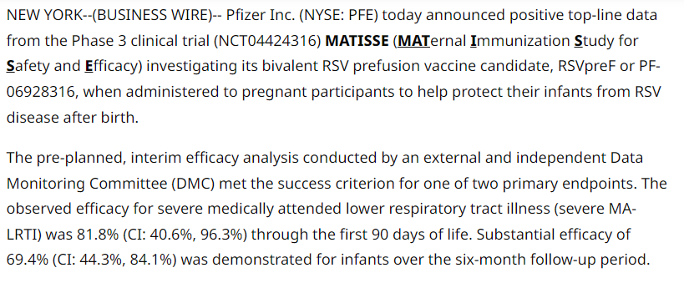
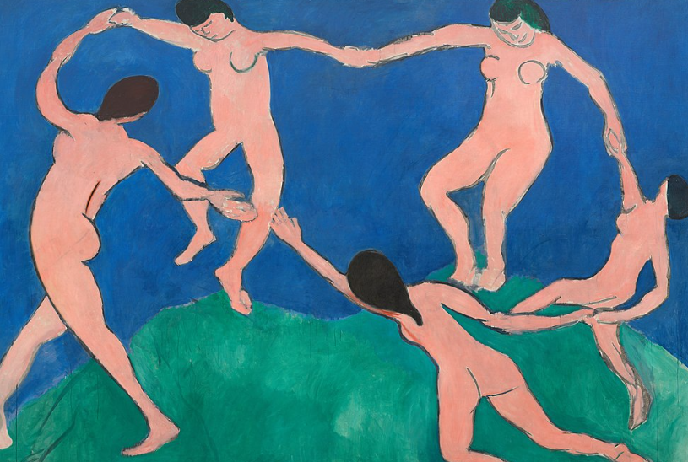
A RAY OF HOPE FOR RSV!
Source: Pfizer Inc.
Notes:
In 2013, researchers at the National Institutes of Health studied a protein from the virus called the F protein, which attaches to human cells and infects people.
They found a way to freeze the protein in the form it takes before it's ready to attach to cells, known as prefusion form.
The Pfizer vaccine contains this prefusion form of the protein. It also is bivalent, meaning it helps protect against both the A and B strains, which are the two most common strains of the virus. https://abcnews.go.com/Health/pfizers-rsv-vaccine-older-adults-fda-prepares-review/story?id=94685096
MATISSE and RENOIR trials
MATISSE is an ongoing randomized, double-blinded, placebo-controlled Phase 3 study designed to evaluate the efficacy, safety, and immunogenicity of RSVpreF against medically attended lower respiratory tract illness (MA-LRTI) and severe MA-LRTI in infants born to healthy women vaccinated during pregnancy. The study enrolled approximately 7,400 pregnant individuals. Maternal participants ≤ 49 years of age were randomized in a 1:1 ratio to receive a single dose of either 120 µg of Pfizer’s RSVpreF or placebo during the late second to third trimester of their pregnancy. The trial also assessed safety throughout the study and immunogenicity of the vaccine in pregnant individuals and their infants. Maternal participants were followed for safety through vaccination and for six months after delivery. Infants were followed for at least one year for safety and efficacy, with over half of the infants followed for two years. This was a global study in 18 countries and started in June 2020, so it spanned multiple RSV seasons in both the northern and southern hemisphere.

Slide 48
Thank You!

Slide 49
Everthrive
Flu and COVID19 Community Education Campaign
Tamela Milan-Alexander, MPPA- EverThrive IL

Slide 50


Flu and Covid19
Community Education Campaign
Tamela Milan Alexander
Director of Community Engagement

Slide 51
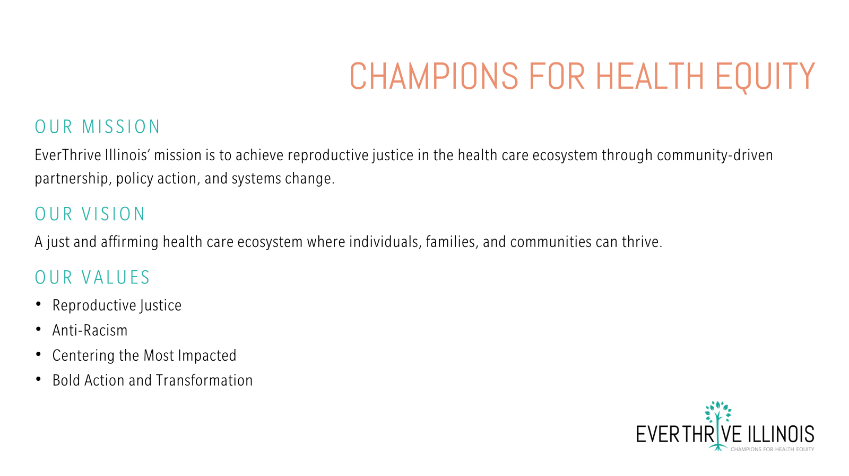

CHAMPIONS FOR HEALTH EQUITY
OUR MISSION
EverThrive Illinois’ mission is to achieve reproductive justice in the health care ecosystem through community-driven partnership, policy action, and systems change.
OUR VISION
A just and affirming health care ecosystem where individuals, families, and communities can thrive.
OUR VALUES
Reproductive Justice
Anti-Racism
Centering the Most Impacted
Bold Action and Transformation

Slide 52
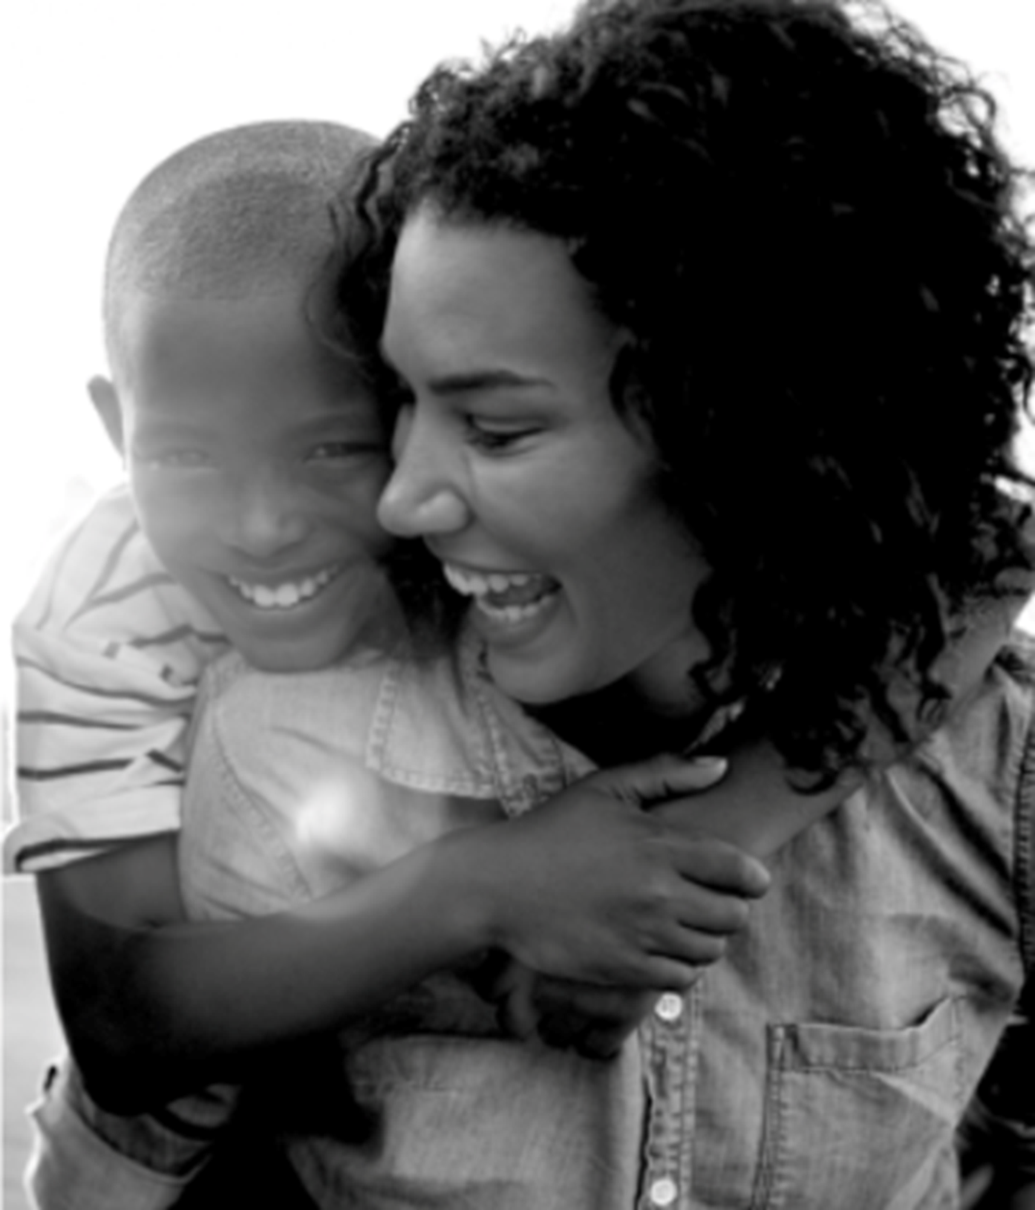
Background
Going into winter months, many Chicagoans (20.3%) have not received one dose of Covid19 vaccinations with higher percentage among Black/African American Chicagoans (35.8%)
Even greater opportunity with Covid19 booster with 70.1% of Black Chicagoans not receiving the booster
Seasonal flu activity is elevated across the country + RSV activity
Covid19 contributed to 25% of maternal deaths between 2020-2021
https://www.chicago.gov/city/en/sites/covid19-vaccine/home/covid-19-vaccine-coverage.html
https://www.cdc.gov/flu/weekly/index.htm
https://www.nbcnews.com/health/health-news/covid-contributing-factor-maternal-deaths-rcna53300

Slide 53
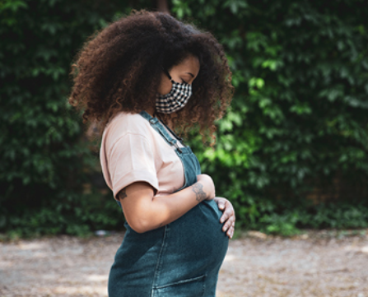

Outreach Strategy
Reaching 10,000 Chicagoans this flu season to promote Chicago Department of Public Health flu and Covid19 clinics through
  Street-based outreach
  Tabling at fall health fairs
  Disseminating materials to community-based organizations
Focusing outreach on communities with particularly low vaccination rates, including Roseland, Englewood, Woodlawn, Greater Grand Crossing and South Shore neighborhoods

Slide 54
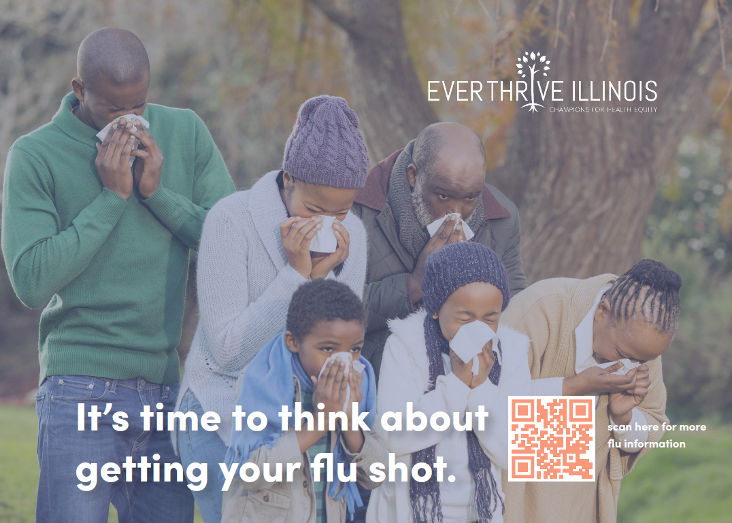
Outreach Strategy
Developed flu landing page: https://flushot.everthriveil.org
Palm cards in English and Spanish for community dissemination debunking key myths with QR codes linking to landing page
Partnering with Chicago Department of Public Health to disseminate their clinic promotional materials

Slide 55
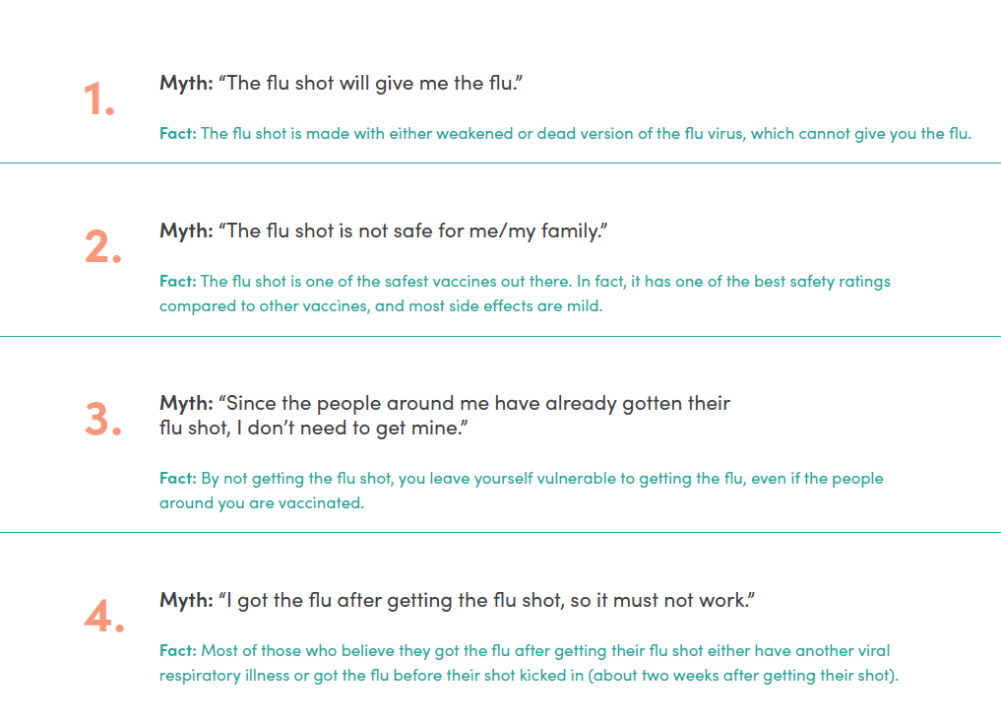
What we are hearing

Slide 56

Our Progress
Trained and onboarded eight health educators who live and work in our five communities of focus with particularly low vaccination rates to provide peer-peer evidence-based education on the importance of flu and Covid19 vaccines
Surpassed our goal reaching 12,043 through November 15th with one more month to go!
Additionally disseminated literature to community-based organizations, potentially reaching up to 18,182 additional people
Participated in 11 community events

Slide 57
Community Concerns

Slide 58


Q&A Discussion
For more information:
Tamela Milan-Alexander
Director of Community Engagement
tmilan-alexander@everthriveil.org

Slide 59
ICAAP Resources

Slide 60
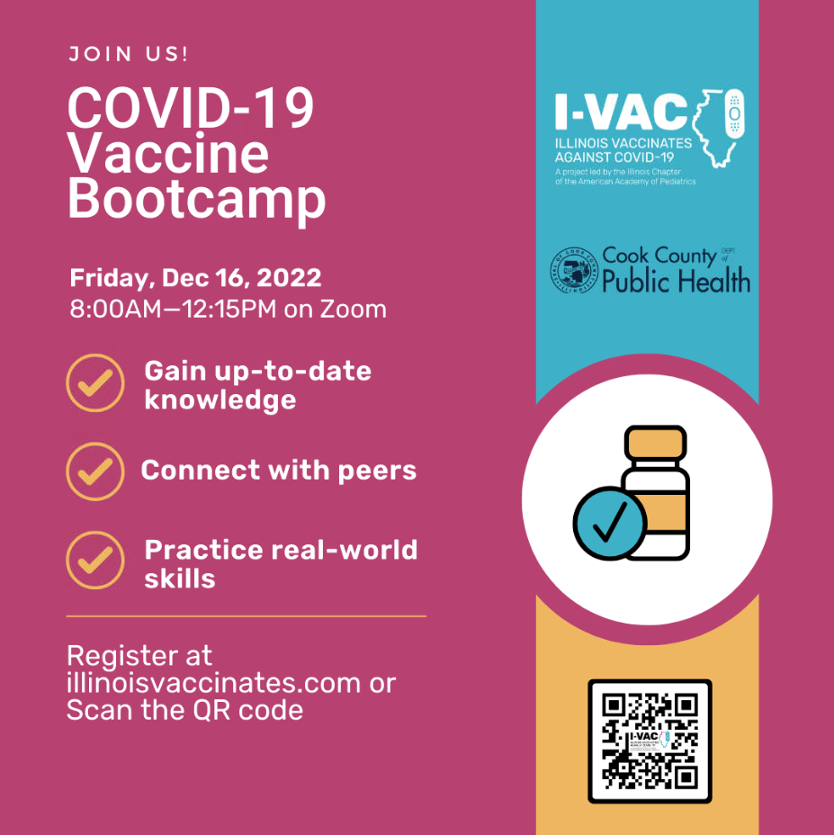
I-VAC COVID-19 Vaccine
Bootcamps

Slide 61
I-VAC Resources for providers:
COVID-19 Dosing and Scheduling Charts
(updated October 12, 2022)
COVID-19 Dosing and Scheduling Charts (updated October 12, 2022) :
  Pfizer: Non-Immunocompromised and Moderately to Severely Immunocompromised
  Moderna: Non-Immunocompromised and Moderately to Severely Immunocompromised
  Janssen & Novavax
Poster (infographic) on COVID-19 Vaccines in Pregnant & Breastfeeding Peoples – English, Spanish

Slide 62
RSV
Here is a link to slides and recording from a webinar on RSV/Flu in Illinois ICAAP, CDPH and IDPH hosted on November 7, 2022.
Patient-facing handouts in English and Spanish with tips to reduce the spread of respiratory illnesses.
ICAAP RSV Webinar recording (11/7/2022): https://us06web.zoom.us/rec/share/o6tmk7JKusPCoDP-F8Ed6woWezpW95LDS4uSxL4BGY9hcG47ZZ7i_Ekh_UjWSWC5.SAGpmrleyMnuX30v
  Slides: https://illinoisaap.org/wp-content/uploads/2022/11/FLU-RSV-11-7-22.pdf

Slide 63

Upcoming Trainings and Support
Illinois Vaccinates Against COVID-19 (I-VAC Office Hours)
  Follow this link to join on Zoom
Notes:
Goal: Educate providers and immunization staff personnel on the proper use of the Pfizer-BioNTech COVID-19 Vaccine
To access dates and links for upcoming training sessions, please visit*: https://www.pfizermedicalinformation.com/en-us/medical-updates
Sessions will be updated to reflect the latest information.

Slide 64
Upcoming Webinars
I-VAC Learning Collaboratives – Adult Populations
Register here
December 14th, 5:30pm, CME available
I-VAC Vaccine Bootcamp (virtual)
December 16th, 8:00am – 12:15pm, CME available
Register here
I-VAC Vaccine Bootcamp (in person)
U of I Hotel and Conference Center (1900 S 1st St, Champaign, IL 61820)
Target Audience: Physicians, PAs, Advanced Practice Nurses, RNs, Pharmacists, MAs, Vaccine Administrators. Register here
January 20th, 8:30am – 2pm, CME available

Slide 65
Additional Resources
Standing orders
COVID-19 Moderna vaccine - 6 months through 5 years of age (dark blue vial cap with magenta [pink] bordered label)
COVID-19 Moderna vaccine - 6 years through 11 years of age (dark blue vial cap with purple bordered label)
COVID-19 Moderna vaccine - adults (12 years of age and older)
COVID-19 Novavax vaccine - adults (12 years of age and older)
COVID-19 Pfizer-BioNTech - 6 months through 4 years of age (maroon vial cap)
COVID-19 Pfizer-BioNTech - 5 through 11 years of age (orange cap)
COVID-19 Pfizer-BioNTech - 12 years and older (gray cap)
CDC Fall Planning Guide
Illinois Vaccinates Against COVID-19 (I-VAC)
  Bivalent social media images available
Provider FAQs here
Patient-Facing COVID-19 Vaccine FAQs
  Pediatrics COVID-19 Vaccines – English, Spanish
  Updated COVID-19 Boosters – English, Spanish
  Pediatric updated COVID-19 Boosters – English, Spanish
AAP dosing guide for when a child has birthdays in between doses here
Pfizer trainings here
Moderna
  Trainings link
  Training for new products available after EUA
  Office hours and regional contacts link

Slide 66
Contact Information
IDPH
To enroll in I-CARE: dph.immunizations@illinois.gov
For questions about vaccine orders: dph.vaccines@illinois.gov
CDPH
Kevin Hansen: Kevin.Hansen@cityofchicago.org
COVID19vaccine@cityofchicago.org
Provider resources: https://www.chicagohan.org/covid-19-vaccine/provider
ICAAP/I-VAC
Illinois Vaccinates Against COVID-19
Stephanie Atella: satella@illinoisaap.com
Facts@ilvaccinates.com
Pfizer
Customer Service: Call 1-800-879-3477
General Product Inquiries: Call 1-877-829-2619
Pfizer Medical Information: Call 1-800-438-1985 or Visit PfizerMedicalInformation.com
Controlant Customer Support: 1-701-540-4039
Pfizer US Shipment Support: Call 1-800-666-7248
Moderna
Customer Service: Call 1‑866‑MODERNA (1‑866‑663‑3762) or Email ModernaPV@modernatx.com
Chatbot here

Slide 67
Thank You
We continue to give thanks to the nurses, doctors, health care workers, public health teams and others across our state at work confronting the COVID-19 (Flu / RSV) pandemic.
Please send questions, comments and recommendations, cases / willingness to share for future COVID-19 OB/Neo discussion webinars to info@ilpqc.org
Recording of this webinar will be available at www.ilpqc.org

Slide 68
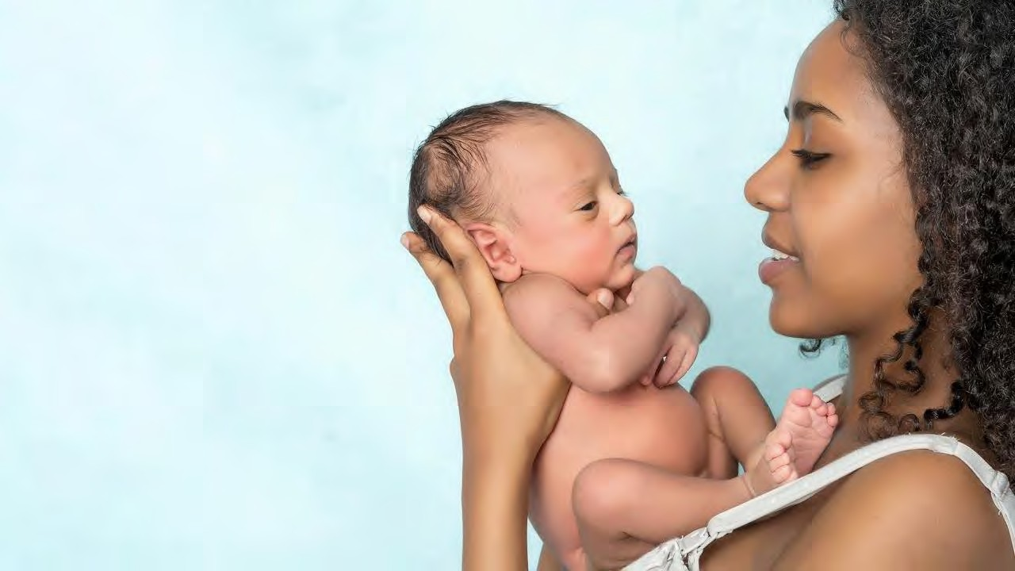











Thanks to our Funders
In kind support:

