Slide 1



COVID-19 Strategies for OB & Neonatal Units
December 3, 2021
12:00 – 1:15pm

Slide 2

Welcome
Please be certain you are on “mute” when not speaking to avoid background noise.
Whether you have joined by phone or computer audio, you can mute and unmute yourself by clicking on the microphone icon.
The following shortcuts can also be used
For PC: Alt + A : Mute or Unmute
For Mac: Shift + Command + A: Mute or Unmute
For telephone: *6 : Mute or Unmute
2

Slide 3
Housekeeping:
We Are Recording Now
3

Slide 4
ILPQC Covid 19 webinars
The strategies shared today are examples from individual institutions not IDPH or ILPQC recommendations.
This is our 27th COVID-19 strategies for OB/Neonatal Units webinar in coordination with IDPH, since April 2020. Please see https://ilpqc.org/covid-19-information/ for
future webinar registration, prior recorded webinars and written out Q/A’s from those webinars.
The next webinar will be Friday, January 7, noon to 1:15pm. We are continuing monthly for now, but determining the needed frequency going forward
Please let us know if your hospital would like to share on an upcoming webinar, please put questions/comments into the chatbox or email directly to info@ilpqc.org
4

Slide 5
Overview
Introduction
Overview of updated data and recommendations
Discussion of OB Unit Strategies
  Emily Miller, MD, MPH – Maternal Fetal Medicine, Northwestern University
  Angela Puric, MSN, APRN-FPA, CNM – Clinical Manager, Labor and Delivery/High Risk OB
  Advocate Lutheran General Hospital, Park Ridge
  Diana Kolettis, MD – Maternal Fetal Medicine, Advocate Lutheran General Hospital, Park Ridge
Discussion of NEO Unit Strategies
  Leslie Caldarelli, MD – NICU Director, Prentice Women's Hospital, Chicago
5

Slide 6

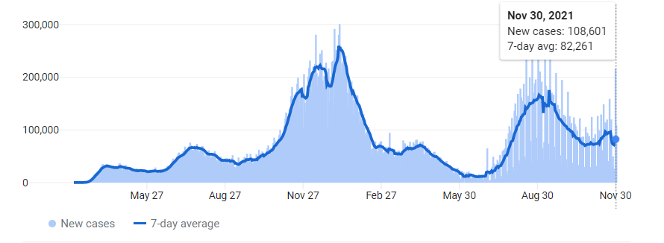
US COVID case trend
6

Slide 7
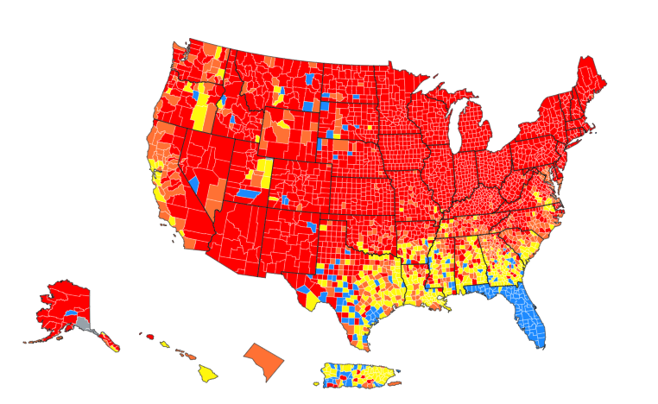
COVID
spreads across the Country
Updated 12/1/21

Slide 8
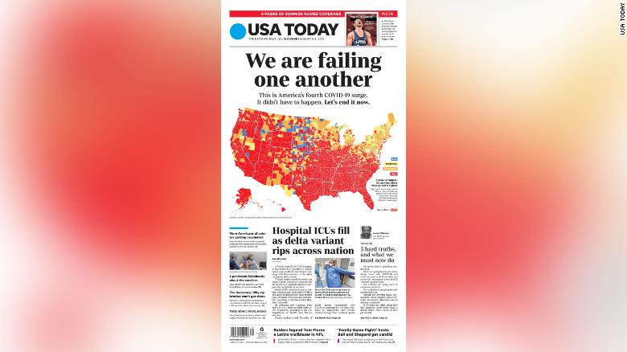
August 6, 2021

Slide 9


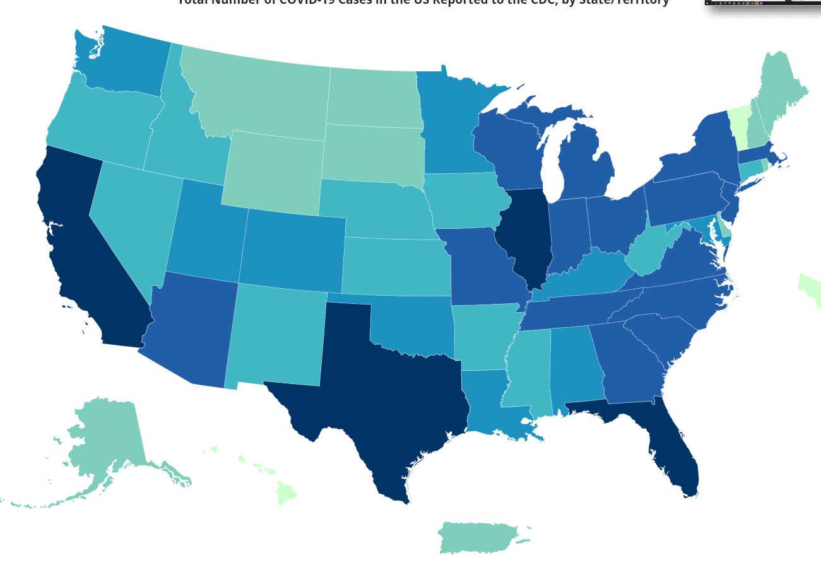
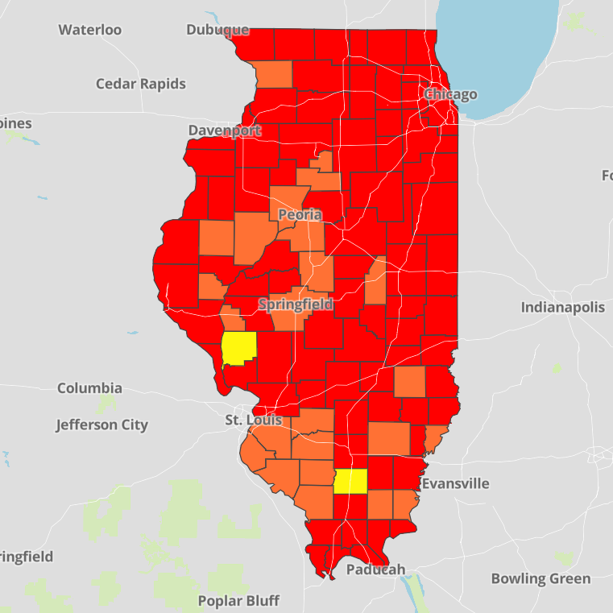
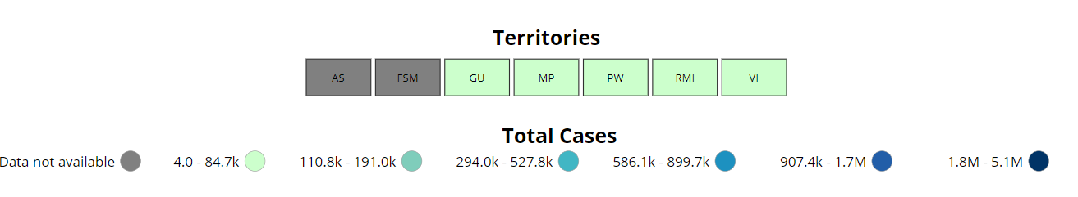
Data Update: December 1, 2021
CDC/IDPH: COVID-19 Outbreak
CDC
https://covid.cdc.gov/covid-data-tracker/#cases_totalcases
IDPH
https://www.dph.illinois.gov/covid19
Total cases: 48,377,531 confirmed
Total deaths: 778,489 confirmed
1, 778,489 Confirmed Positive Cases
26,414 Deaths
8

Slide 10
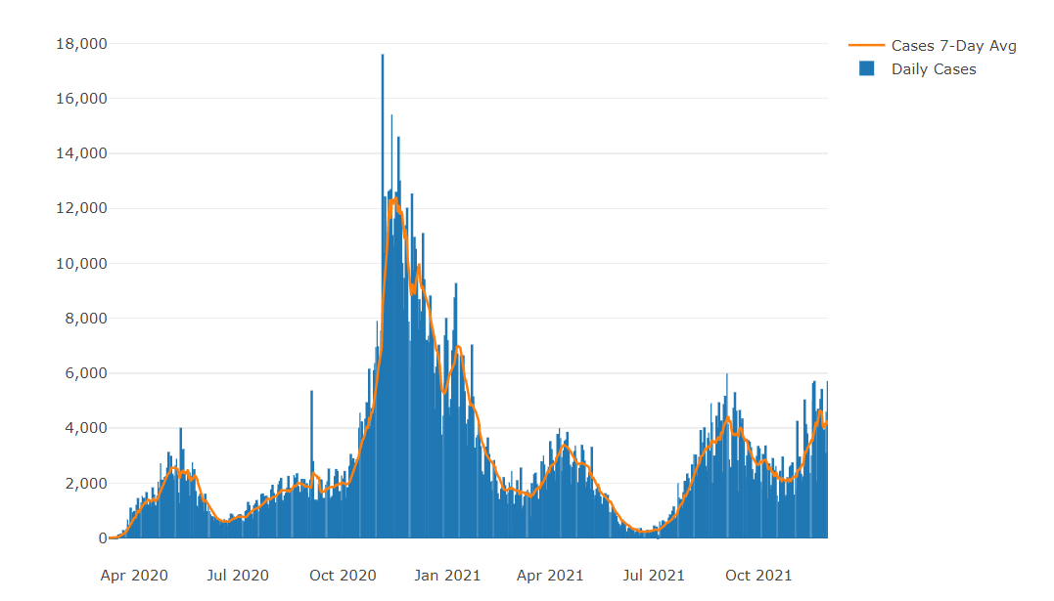

Illinois Daily Incidence
IDPH daily data summary
10

Slide 11
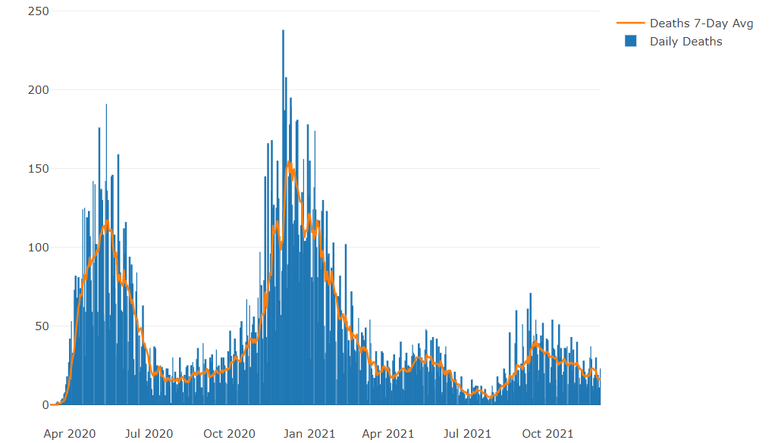
Illinois Covid Deaths
IDPH daily data summary
11

Slide 12
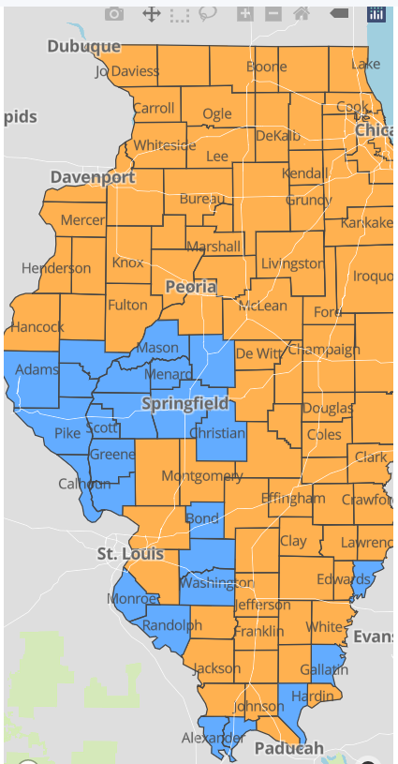
IDPH County Level COVID -19
Risk Metrics
Week 46: 11/14/2021 Through 11/20/2021
Blue indicates that the county is experiencing overall stable COVID-19 metrics.
Orange indicates there are warning signs of increased COVID-19 risk in the county.
11

Slide 13
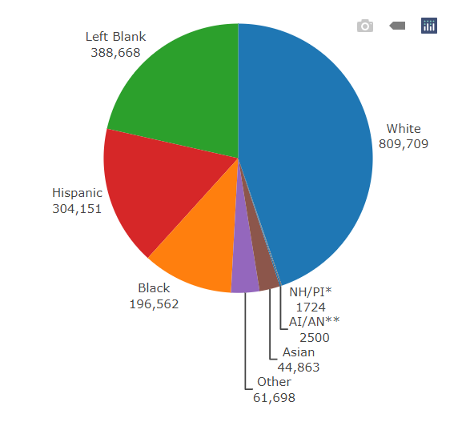
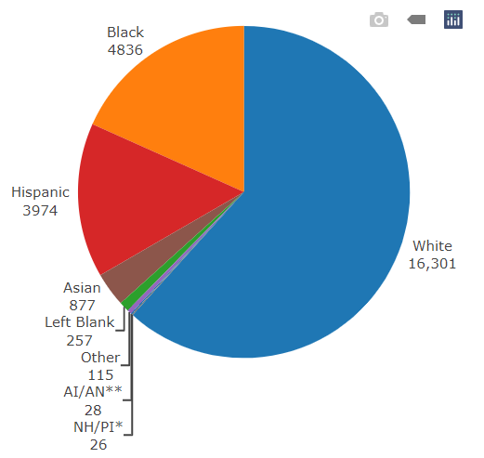
Data Update December 1, 2021 IDPH: COVID-19 Outbreak Race Demographics
https://www.dph.illinois.gov/covid19
Confirmed Cases
Deaths
13

Slide 14

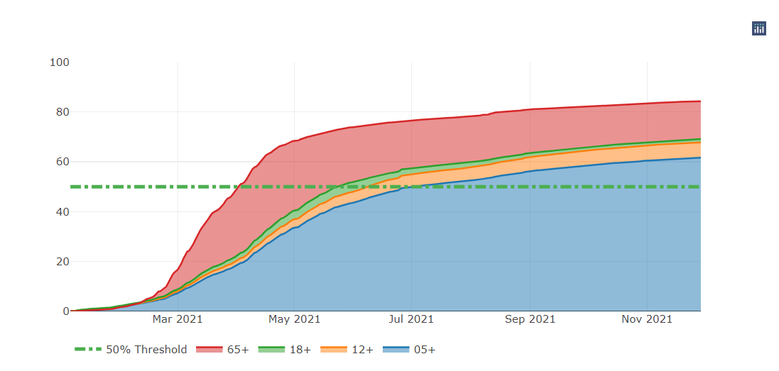
Illinois Population Vaccinated Fully
13

Slide 15
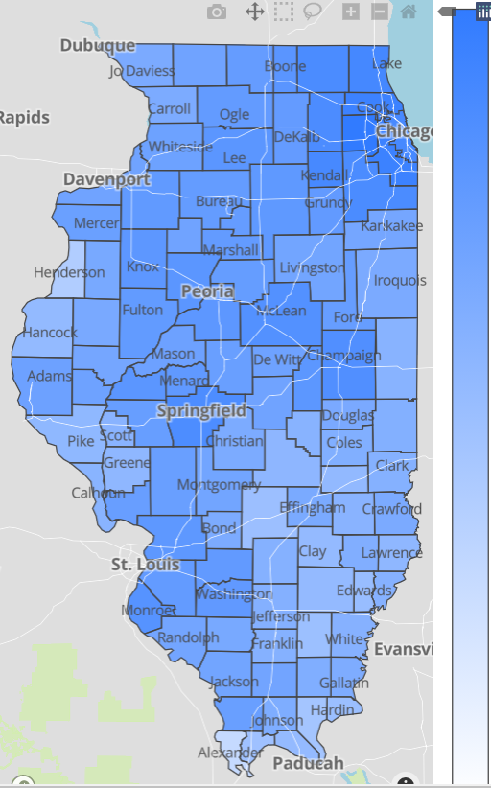

Illinois Daily Reported Administered Vaccine Doses
Last updated 12/1/2021
17,288,192
Administered Vaccine Doses
Illinois Perinatal Quality Collaborative
14

Slide 16
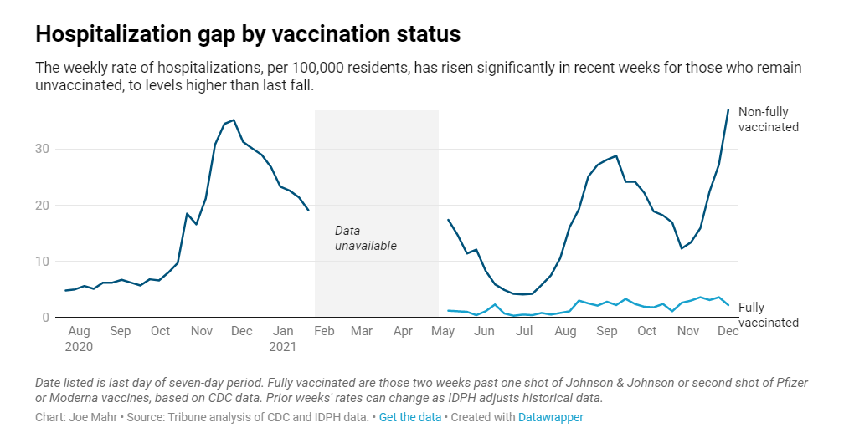

Slide 17
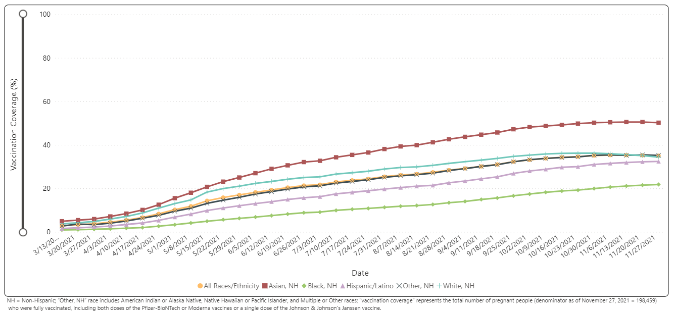
Notes:
https://urldefense.com/v3/__https://covid.cdc.gov/covid-data-tracker/*vaccinations-pregnant-women__;Iw!!Dq0X2DkFhyF93HkjWTBQKhk!BRT8JkbGHSHMqUvlHo57UsXRx3oQL6Au0KIaOe8oN7qp9yWGe1oyTAFdCw-PzSyj1gqEUOSiCw$

Slide 18
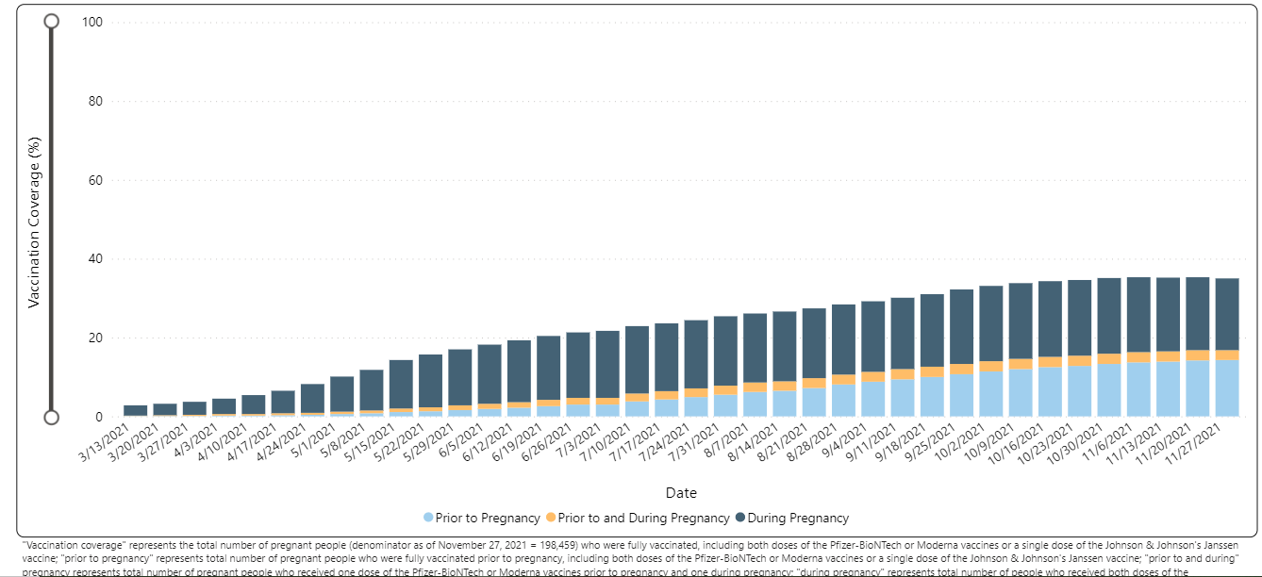
Notes:
https://urldefense.com/v3/__https://covid.cdc.gov/covid-data-tracker/*vaccinations-pregnant-women__;Iw!!Dq0X2DkFhyF93HkjWTBQKhk!AZLmkCzjPqbpDlw3HSvzpeV2yHLjASTwFArm1NOsQ1zqBmsgYQCTjWJcfL5ZsjyF2-lUxyxYPA$

Slide 19
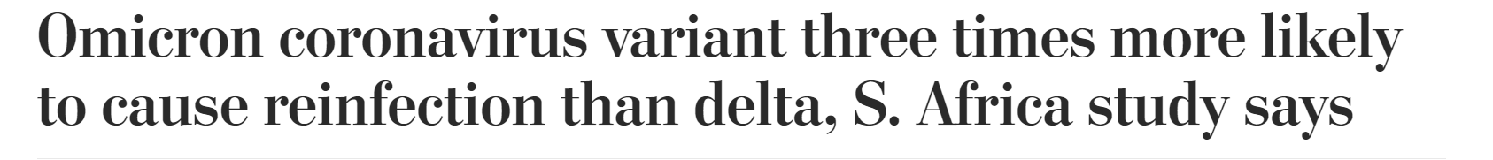
Washington Post, 12.3.21
The Omicron variant of SARS-CoV-2 is the latest strain of the coronavirus to be designated a "variant of concern" by the World Health Organization: more and more countries are reporting cases, in the US has been reported in New York, Minnesota, CA, Colorado, Hawaii.
It has an unusual combination of mutations / larger number of mutations that are thought to be immune evasive that may enable it to spread faster
Early data from South Africa shows 3 x’s higher risk of reinfection after previous Covid infection than Delta and increase spread (S. Africa 349 cases per day early Nov to 3,800 cases per day Dec 1)
Waiting on additional data: vaccine efficacy, virulence, transmissibility (R0)
MedRxiv: Increased risk of SARS-CoV-2 reinfection associated with emergence of the Omicron variant in South Africa. (12.2.2021)

Slide 20
Molnupiravir: Covid antiviral pill (11.29.21)
Merck announced updated results from its molnupiravir study that showed a smaller benefit than first thought: Among more than 1,400 adults in a company study, the drug reduced the combined risk of hospitalization and death by 30 percent, less than the 50 percent first reported.
Nearly 7 percent of patients who received Merck’s drug within five days of COVID-19 symptoms ended up in the hospital and one died. That compared to 10 percent of patients hospitalized who were taking a placebo and nine deaths.
Merck's experimental COVID-19 antiviral pill appears effective, but may pose risks for pregnant women, including birth defects and toxicity to developing fetuses, according to the U.S. Food and Drug Administration.
Based on its findings, the FDA will ask its expert panel whether the pill should never be given during pregnancy or if it could be used in certain situations where the benefits outweigh the risks.

Slide 21
Risks of covid-19 in pregnancy

Slide 22
Covid-19 and Pregnancy
Pregnant women with COVID-19, United States, January 22, 2020 - November 29, 2021
  148,327 cases
  25,178 hospitalizations
  241 deaths

Slide 23
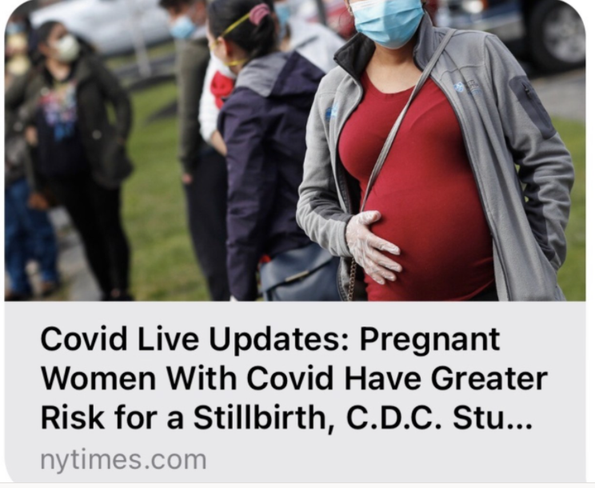
CDC MMWR: Risk for Stillbirth Among Women With and Without COVID-19 at Delivery Hospitalization — United States, March 2020–September 2021. (11.19.21)
Among 1,249,634 delivery hospitalizations during March 2020–September 2021, U.S. women with COVID-19 were at increased risk for stillbirth compared with women without COVID-19 (adjusted relative risk [aRR] = 1.90; 95% CI = 1.69–2.15). The magnitude of association was higher during the period of SARS-CoV-2 B.1.617.2 (Delta) variant predominance than during the pre-Delta period.
53.7% of women were non-Hispanic White, and 50.6% had private insurance as the primary payor
Overall, 15.4% had obesity, 11.2% had diabetes, 17.2% had a hypertensive disorder, 1.8% had a multiple-gestation pregnancy, and 4.9% had smoking (tobacco) documented on the delivery hospitalization record.
Illinois Perinatal Quality Collaborative
14

Slide 24
CDC MMWR: COVID-19–Associated Deaths After SARS-CoV-2 Infection During Pregnancy — Mississippi, March 1, 2020–October 6, 2021. MMWR: November 26, 2021
This report describes 15 COVID-19–associated deaths after infection with SARS-CoV-2 (the virus that causes COVID-19) during pregnancy in Mississippi during March 1, 2020–October 6, 2021.
The median age of the 15 decedents was 30 years. Nine were non-Hispanic Black women, three were non-Hispanic White women, and three were Hispanic women.
The median interval from symptom onset to death before and during Delta predominance was 18 days (pre-Delta range = 1–87 days; Delta range = 9–45 days).
Seven underwent emergency cesarean delivery (including two at the bedside). Three died during pregnancy, resulting in one spontaneous abortion at 9 weeks and two stillbirths at 22 and 23 weeks’ gestation, and 12 died after a live birth (median = 5 days postpartum, range = 1–87 days).
Underlying medical conditions were present in 14 decedents. None of the 15 decedents had been fully vaccinated against COVID-19

Slide 25
CDC MMWR: COVID-19–Associated Deaths After SARS-CoV-2 Infection During Pregnancy — Mississippi, March 1, 2020–October 6, 2021. MMWR: November 26, 2021
increase in the ratio of COVID-19–associated deaths per 1,000 cases among pregnant women as the Delta variant became predominant
(pre-Delta period: five deaths per 1,000 SARS-CoV-2 infections during pregnancy; Delta predominance period: 25 deaths per 1,000 SARS-CoV-2 infections during pregnancy).

Slide 26
















COVID-19 cases, ICU admission and death among pregnant people
(National COVID-19 Case Surveillance Data; Jan 22, 2020 – Sep 13, 2021)
16000
100
14000
90
ICU admission (n)
Death (n)
Total pregnant people
80
Total laboratory-confirmed cases
12000
70
Total ICU admission or deaths
10000
women
60
8000
50
6000
40
30
4000
20
2000
10
0
0

Slide 27
Severe illness and death for symptomatic pregnant women with COVID-19 compared to symptomatic nonpregnant women
No. (%)*
Outcomes of Interest | Symptomatic Pregnant women with COVID-19 | Symptomatic Nonpregnant women with COVID-19 | Crude RR (95% CI) | aRR (95% CI) †
 | (N = 23,434) | (N = 386,028)
ICU Admission | 245 (1.1) | 1,492 (0.4) | 2.7 (2.4-3.1) | 3.0 (2.6-3.4)
Mechanical Ventilation | 67 (0.3) | 412 (0.1) | 2.7 (2.1-3.5) | 2.9 (2.2-3.8)
ECMO§ | 17 (0.1) | 120 (0.0) | 2.3 (1.4-3.9) | 2.4 (1.5-4.0)
Death | 34 (0.2) | 447 (0.1) | 1.3 (0.9-1.8) | 1.7 (1.2-2.4)
* Percentages calculated among total in pregnancy status group; those with missing data on outcomes were counted as not having the outcome
† Adjusted for age, race/ethnicity, and presence of underlying conditions. Nonpregnant women are the referent group.
§ Extracorporeal membrane oxygenation
Zambrano LD, Ellington S, Strid P, et al. Update: Characteristics of Symptomatic Women of Reproductive Age with Laboratory-Confirmed SARS-CoV-2 Infection by Pregnancy Status — United States, January 22–October 3, 2020. MMWR Morb Mortal Wkly Rep. ePub: 2 November 2020.
DOI: http://dx.doi.org/10.15585/mmwr.mm6944e3external icon.

Slide 28

CDC: COVID-19 Vaccination for Pregnant People to Prevent Serious Illness, Deaths, and Adverse Pregnancy Outcomes from COVID-19. (9.29.21)
As of September 27, 2021, more than 125,000 laboratory-confirmed COVID-19 cases have been reported in pregnant people, including more than 22,000 hospitalized cases and 161 deaths.¹
The highest number of COVID-19-related deaths in pregnant people (n=22) in a single month of the pandemic was reported in August 2021.
Data from the COVID-19-Associated Hospitalization Surveillance Network (COVID-NET) in 2021 indicate that approximately 97% of pregnant people hospitalized (either for illness or for labor and delivery) with confirmed SARS-CoV-2 infection were unvaccinated.²
In addition to the risks of severe illness and death for pregnant and recently pregnant people, there is an increased risk for adverse pregnancy and neonatal outcomes, including preterm birth and admission of their neonate(s) to an intensive care unit (ICU).

Slide 29
CDC: COVID-19 Vaccination for Pregnant People to Prevent Serious Illness, Deaths, and Adverse Pregnancy Outcomes from COVID-19. (9.29.21)
Healthcare providers should communicate the risks of COVID-19, the benefits of vaccination, and information on the safety and effectiveness of COVID-19 vaccination in pregnancy.
Compared with non-pregnant symptomatic people, symptomatic pregnant people have more than a two-fold increased risk of requiring ICU admission, invasive ventilation, and ECMO, and a 70% increased risk of death.⁶
Healthcare providers should strongly recommend that people who are pregnant, recently pregnant (including those who are lactating), who are trying to become pregnant now, or who might become pregnant in the future receive one of the authorized or approved COVID-19 vaccines as soon as possible.

Slide 30
CDC: COVID-19 Vaccination for Pregnant People to Prevent Serious Illness, Deaths, and Adverse Pregnancy Outcomes from COVID-19. (9.29.21)
CDC recommends urgent action to help protect pregnant people and their fetuses/infants.
CDC recommends urgent action to accelerate primary vaccination for people who are pregnant, recently pregnant (including those who are lactating), who are trying to get pregnant now, or who might become pregnant in the future. Efforts should specifically address populations with lower vaccination coverage and use approaches to reduce racial and ethnic disparities.
In addition, pregnant people should continue to follow all recommended prevention measures and should seek care immediately for any symptoms of COVID-19. Healthcare providers should have a low threshold for increased monitoring during pregnancy due to the risk of severe illness.

Slide 31
CDC: MotherToBaby help line for Covid and pregnancy questions for patients
If you are pregnant and have questions about COVID-19 vaccine
If you would like to speak to someone about COVID-19 vaccination during pregnancy, you can contact MotherToBaby.
MotherToBaby experts are available to answer questions in English or Spanish by phone or chat.
The free and confidential service is available Monday–Friday 8am–5pm (local time).
To reach MotherToBaby: Call 1-866-626-6847
Chat live or send an email MotherToBabyexternal iconexternal icon

Slide 32
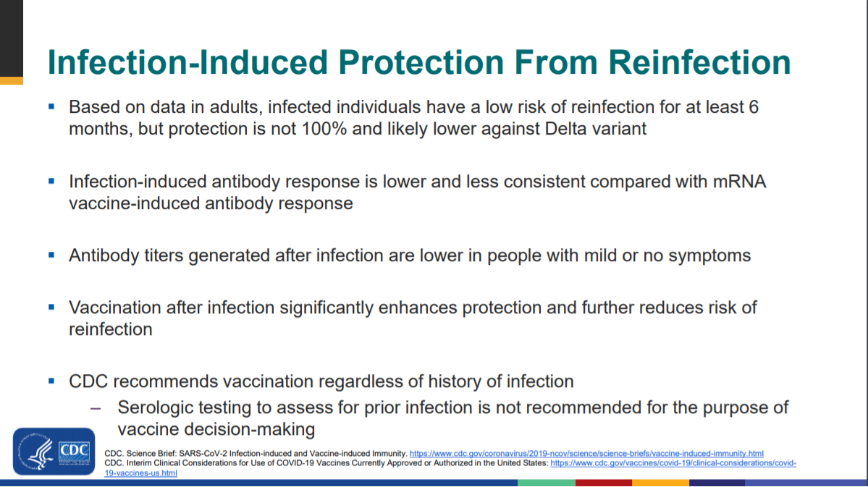

Slide 33
VACCINE SAFETY DATA

Slide 34
CDC Vaccine Safety and Pregnancy
COVID-19 vaccines do not cause COVID-19 infection, including in people who are pregnant or their babies. None of the COVID-19 vaccines contain live virus and cannot make anyone sick with COVID-19, including people who are pregnant or their babies.
Data on the safety of receiving an mRNA COVID-19 vaccine (Moderna or Pfizer-BioNTech) during pregnancy are reassuring.
  Data from three safety monitoring systems did not find any safety concerns for people who received an mRNA COVID-19 vaccine late in pregnancy or for their babies.¹
  Scientists have not found an increased risk for miscarriage among people who received an mRNA COVID-19 vaccine just before and during early pregnancy (before 20 weeks of pregnancy).^{2,3}
Vaccination during pregnancy builds antibodies that might protect the baby. When people receive an mRNA COVID-19 vaccine during pregnancy, their bodies build antibodies against COVID-19, similar to people who are not pregnant. Antibodies made after a pregnant person received an mRNA COVID-19 vaccine were found in umbilical cord blood. This means COVID-19 vaccination during pregnancy might help protect babies against COVID-19. More data are needed to determine how these antibodies, similar to those produced with other vaccines, may provide protection to the baby.⁶

Slide 35
CDC Vaccine Safety and Pregnancy
No safety concerns were found in animal studies. Studies in animals receiving a Moderna, Pfizer-BioNTech, or Johnson & Johnson’s Janssen(J&J/Janssen) COVID-19 vaccine before or during pregnancy found no safety concerns in pregnant animals or their babies.
No adverse pregnancy-related outcomes occurred in previous clinical trials that used the same vaccine platform as the J&J/Janssen COVID-19 vaccine. Vaccines that use the same viral vector as the J&J/Janssen COVID-19 vaccine have been given to people in all trimesters of pregnancy, including in a large-scale Ebola vaccination trial. No adverse pregnancy-related outcomes, including adverse outcomes affecting the baby, were associated with vaccination in these trials.

Slide 36
Maternal Vaccination Protects Baby
A prospective cohort study from two academic centers found that vaccinated pregnant and lactating women produced comparable immune responses to non-pregnant controls, and generated higher antibody titers than those observed following SARS-CoV-2 infection in pregnancy.
Further, vaccine-generated antibodies were present in umbilical cord blood and breastmilk after maternal vaccination (Gray 2021, Prabhu 2021, Juncker 2021). Providing protection to the newborn receiving maternal antibodies

Slide 37
V-SAFE vaccine monitoring
– what data is being gathered pregnant patients
As of November 29, 2021, there have been over 177,736 pregnancies reported in CDC’s V-SAFE post-vaccination health checker
CDC is also enrolling pregnant individuals in a pregnancy registry for additional follow up with over 6,685 enrolled.
Evidence gathered through these system has provide clinicians with critically needed safety data on COVID-19 vaccination during pregnancy
No adverse pregnancy outcomes associated with Covid-19 vaccine and pregnancy
https://www.cdc.gov/coronavirus/2019-ncov/vaccines/safety/vsafe.html

Slide 38
Pregnancy vaccine safety data
ACOG
CDC is currently enrolling pregnant individuals in a v-safe pregnancy registry.
Data collected from the v-safe pregnancy registry did not indicate any safety concerns based on the reactogenicity profile and adverse events observed among pregnant individuals.
Additionally, side effects were similar in pregnant and non-pregnant populations.
Further, no differences have been seen when comparing pregnant individuals participating in the v-safe pregnancy registry with the background rates of adverse pregnancy outcomes.
On-line conspiracy theories linking COVID-19 vaccines to infertility are unfounded and have no scientific evidence supporting them. ACOG recommends vaccination for all eligible people who may consider future pregnancy.

Slide 39
Zauche LH, Wallace B, Smoots AN, et al. Receipt of mRNA COVID-19 vaccines and risk of spontaneous abortions. New Engl J Med Published online September 8, 2021
Among 2,456 pregnant persons who received an mRNA COVID-19 vaccine preconception or prior to 20 weeks' gestation, the cumulative risk of SAB from 6-19 weeks' gestation was 14.1%.
Among recognized pregnancies in high-income countries, 11-16% end in spontaneous abortion (SAB).
Conclusions When compared to the expected range of SABs in recognized pregnancies, these data suggest receipt of an mRNA COVID-19 vaccine preconception or during pregnancy is not associated with an increased risk of SAB. These findings add to accumulating evidence that mRNA COVID-19 vaccines during pregnancy are safe.
NEJM: Receipt of mRNA COVID-19 vaccines preconception and during pregnancy and risk of self-reported spontaneous abortions. (09.8.21)

Slide 40
CDC Vaccine and Pregnancy Summary: what you need to know
People who are pregnant or recently pregnant are more likely to get severely ill with COVID-19 compared with people who are not pregnant.
Getting a COVID-19 vaccine can help protect you from severe illness from COVID-19.
COVID-19 vaccination is recommended for people who are pregnant, breastfeeding, trying to get pregnant now, or might become pregnant in the future.
People who are pregnant should receive a COVID-19 vaccine booster shot.
Evidence about the safety and effectiveness of COVID-19 vaccination during pregnancy has been growing. These data suggest that the benefits of receiving a COVID-19 vaccine outweigh any known or potential risks of vaccination during pregnancy.
There is currently no evidence that any vaccines, including COVID-19 vaccines, cause fertility problems in women or men.

Slide 41

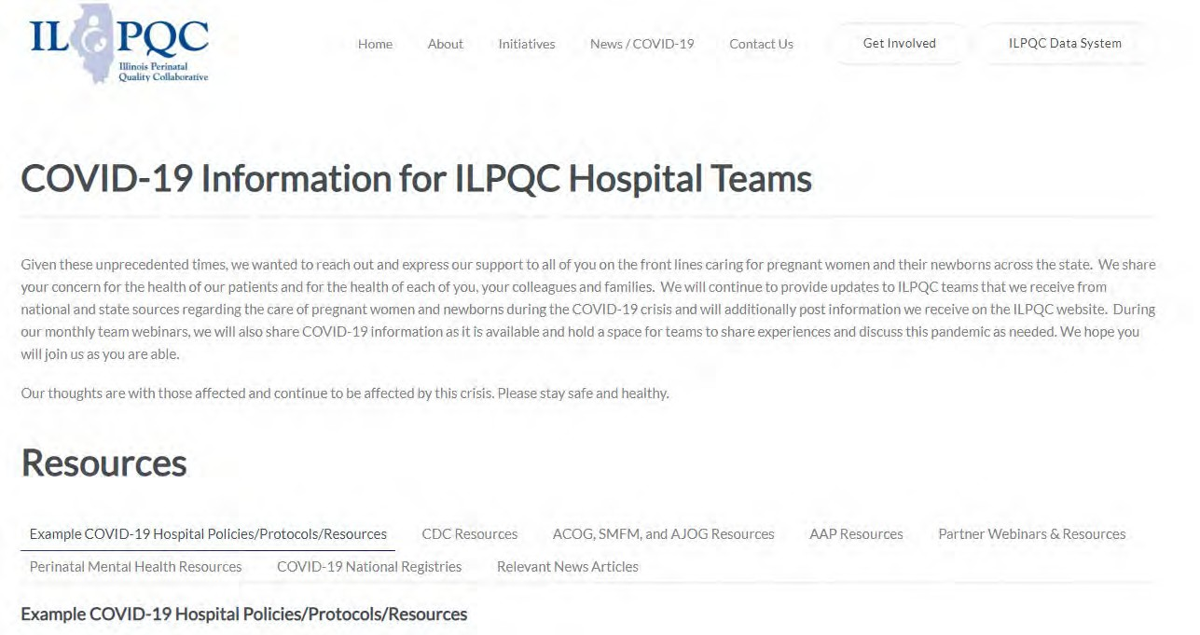
ILPQC COVID-19 Webpage www.ilpqc.org
ILPQC posts national guidelines and OB & Neonatal COVID-19 example hospital protocols & resources
please note dates as guidelines are changing rapidly
https://ilpqc.org/covid-19- information/

Slide 42
Updated OB (ACOG/SMFM) Resources
ACOG’s COVID-19 Vaccines and Pregnancy: Conversation Guide for Clinicians
SMFM: SMFM Learning: Myth-Busting COVID-19 Vaccines in Pregnancy. (09.10.21)
ACOG: Statement of Strong Medical Consensus for Vaccination of Pregnant Individuals Against COVID-19. (Updated 9.14.21)
ABOG: Statement Regarding Dissemination of COVID-19 Misinformation (9/27/21)
ACOG: Statement on the CDC’s Health Advisory on COVID-19 Vaccination. (9.29.21)
SMFM: Provider Considerations for Engaging in COVID-19 Vaccine Counseling With Pregnant and Lactating Patients. (Updated 10.26.21)
ACOG: COVID-19 FAQs for Obstetricians-Gynecologists, Obstetrics (Monoclonal Antibody Recommendation) (updated 10.18. 2021)
Notes:
ACOG: Statement of Strong Medical Consensus for Vaccination of Pregnant Individuals Against COVID-19. (Updated 9.14.21)
ACOG’s Practice Advisory: COVID-19 Vaccination Considerations for Obstetric-Gynecologic Care
ACOG’s Vaccinating Pregnant Individuals: Eight Key Recommendations for COVID-19 Vaccination Sites
ACOG’s COVID-19 Vaccines and Pregnancy: Conversation Guide for Clinicians
SMFM’s Provider Considerations for Engaging in COVID-19 Vaccine Counseling With Pregnant and Lactating Patients
SMFM’s Covid Vaccination if you are Pregnant or Breastfeeding
TopicsCOVID-19Coronavirus

Slide 43
ACOG: COVID-19 FAQs for Obstetrics (Monoclonal Antibody Recommendation) (updated 10.18. 2021)
Monoclonal antibody treatments recommended for the treatment of outpatients with mild to moderate COVID-19 infection who are at high risk of clinical progression as defined by the EUA criteria.
Pregnancy is included among the conditions that put individuals at high risk for clinical progression. This makes patients with pregnancy as their only risk factor eligible to receive outpatient monoclonal antibodies, according to the EUA (NIH).
Obstetric care clinicians may consider the use of monoclonal antibodies for the treatment of non-hospitalized COVID-19 positive pregnant individuals with mild to moderate symptoms, particularly if one or more additional risk factors are present (eg BMI >25, chronic kidney disease, diabetes mellitus, cardiovascular disease).
Post-exposure prophylaxis should be considered for inadequately vaccinated individuals who have been exposed to SARS-CoV-2 (NIH). These individuals include those who have had a recent exposure to an individual with SARS-CoV-2 for a cumulative total of 15 minutes or more over a 24-hour period or there is a recent occurrence of SARS-CoV-2 infection in other individuals in the same institutional setting AND are 1) not fully vaccinated or 2) fully vaccinated but may not mount an adequate immune response.

Slide 44
ACOG: Monoclonal Antibody for Pregnant Patients (updated October 18, 2021)
Lactation is not a contraindication for the use of monoclonal antibodies. Lactating individuals with one or more risk factors for severe COVID-19 illness may receive monoclonal antibodies for treatment or post-exposure prophylaxis. There is no need to temporarily discontinue breastfeeding when receiving monoclonal antibodies.
The CDC currently recommends waiting 90 days to get the vaccine after receipt of monoclonal antibodies (CDC).
Efforts should be made to ensure that communities most affected by SARS-CoV-2 have equitable access to these treatments

Slide 45
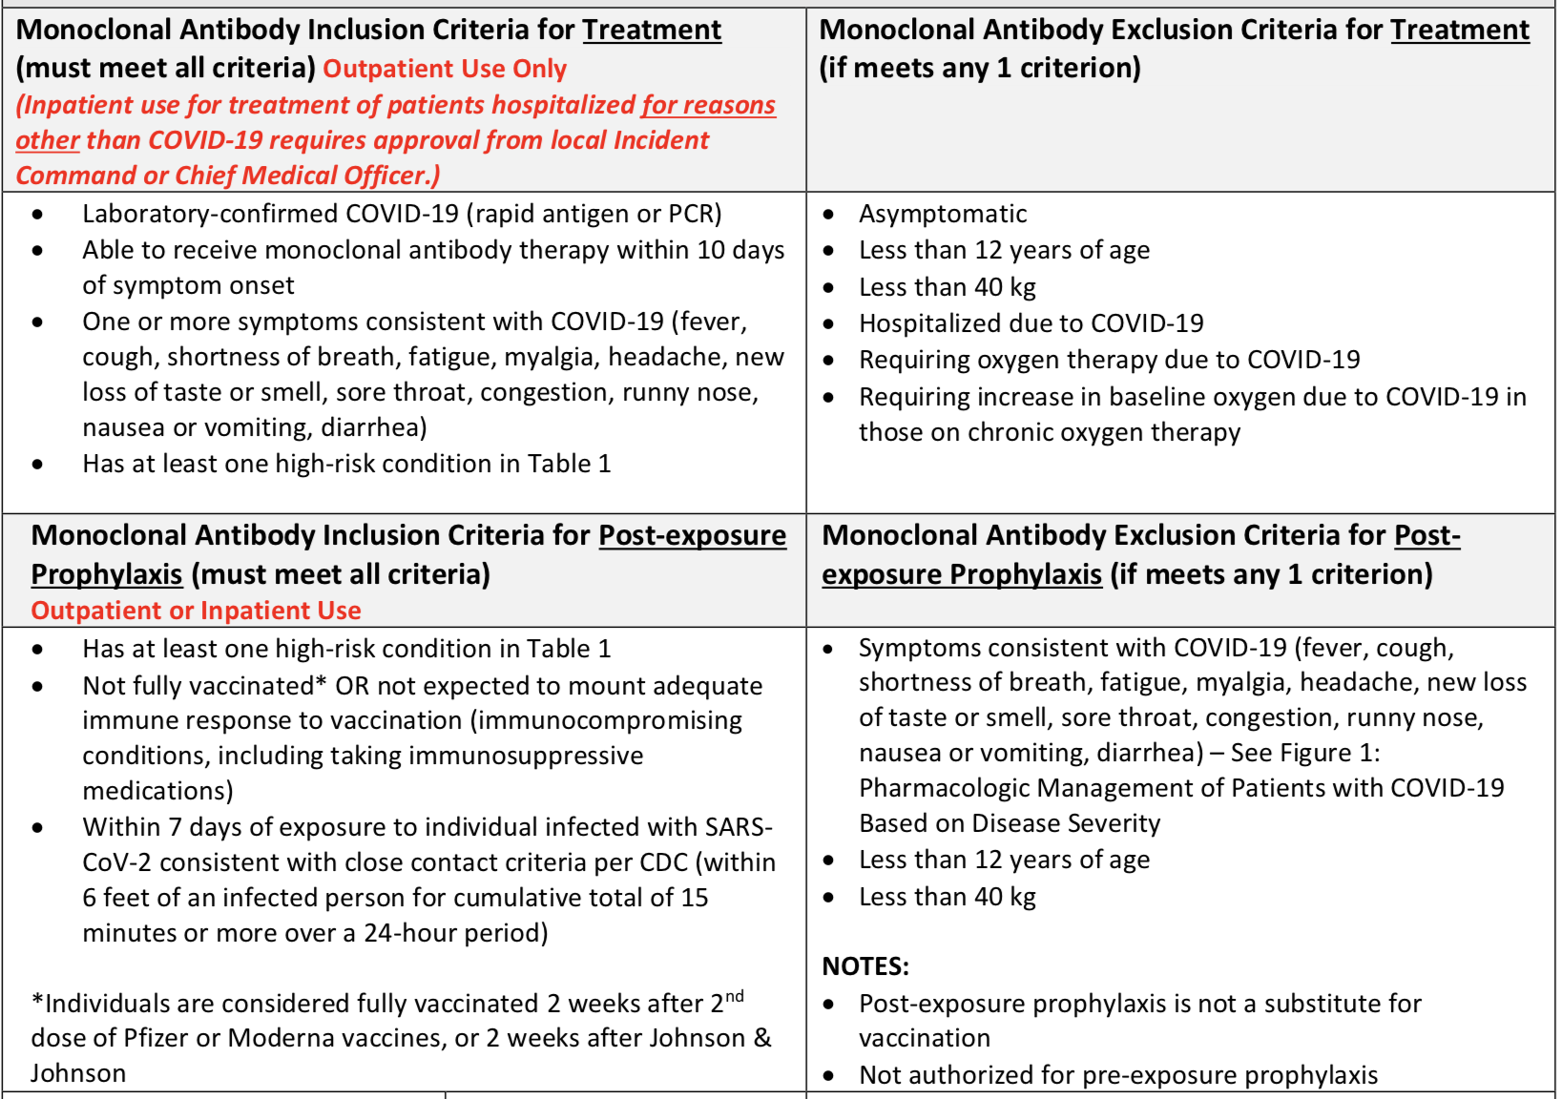
Barnes Jewish BJC monoclonal antibodies protocol
AJOG: Monoclonal antibody treatment of symptomatic COVID-19 in pregnancy: initial report. (8.25.21)

Slide 46
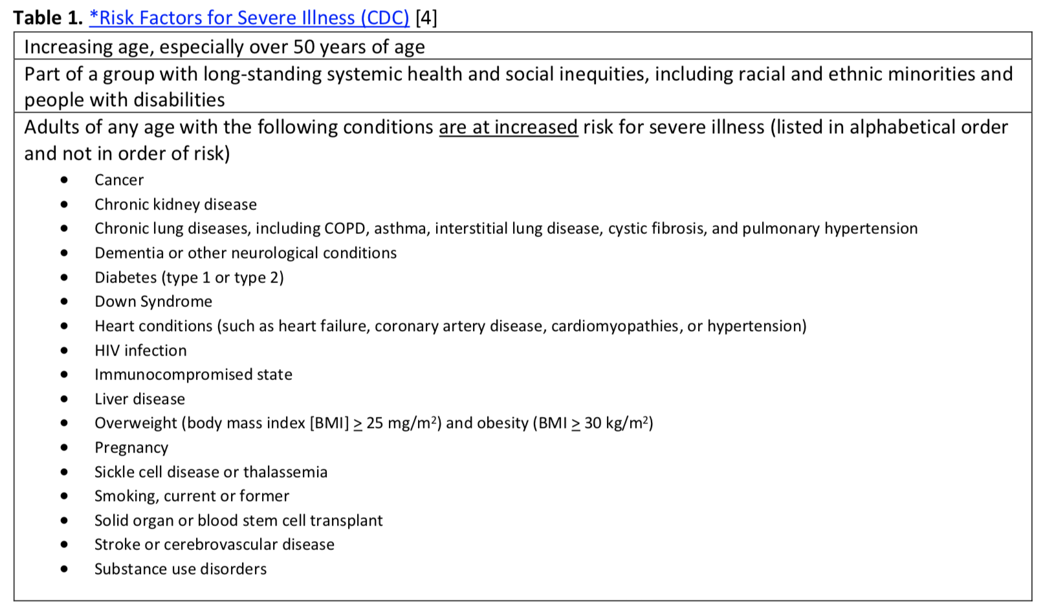

Slide 47
Monoclonal Antibody Protocol Supporting Documents examples
Advocate Lutheran General Hospital Monoclonal Antibody Infusion Protocol for Pregnant Patients Supporting Documents:
  Monoclonal Antibody Infusion Playbook
  Protocol REGEN-COV EUA Update
  Ordering COVID Meds
  Monoclonal Antibody Therapy for Pregnant Patients
  COVID: Monoclonal Antibody Administration

Slide 48
ACOG President Statement on CDC Health Warning Urging Vaccination for Pregnant People, J. Martin Tucker, MD, FACOG, September 29, 2021
“Despite recommendations from ACOG and the Society for Maternal-Fetal Medicine, as well as other organizations dedicated to maternal health and public health, vaccination rates among pregnant people remain alarmingly low. Unfortunately, obstetrician-gynecologists around the country are witnessing the crisis of unvaccinated pregnant people being hospitalized and dying due to COVID-19 infection. ACOG hopes that the urgent health advisory from the CDC, combined with the existing clear medical consensus in support of vaccination, will encourage pregnant people to choose vaccination.
“Our message cannot be stronger or clearer: please get vaccinated today. Whether you are pregnant, breastfeeding, trying to become pregnant, or plan to get pregnant in the future, vaccination is safe and effective, and is the best way to protect you from severe complications associated with COVID-19 infection. Further, I urge my fellow ACOG members and all maternal health colleagues to strongly, confidently, and clearly recommend COVID-19 vaccination to their pregnant patients.”

Slide 49
SMFM: Provider Considerations for Engaging in COVID-19 Vaccine Counseling With Pregnant and Lactating Patients (Updated 10.26.21)
SMFM and ACOG recommend that pregnant people, including health care workers, receive a COVID-19 booster shot at least 6 months after their primary series. As with the primary series, the booster dose should be given at any stage during pregnancy and postpartum.

Slide 50
Updated SMFM Patient Education Resources (on ILPQC Covid webpage)
SMFM: COVID-19 Vaccination if You Are
Pregnant or Breastfeeding English. (11.3.2021)
SMFM: COVID-19 Vaccination if You Are
Pregnant or Breastfeeding Spanish. (11.3.2021)
SMFM: Top 5 Reasons to Get the COVID-19 Vaccine (English and Spanish). (11.23.21)

Slide 51
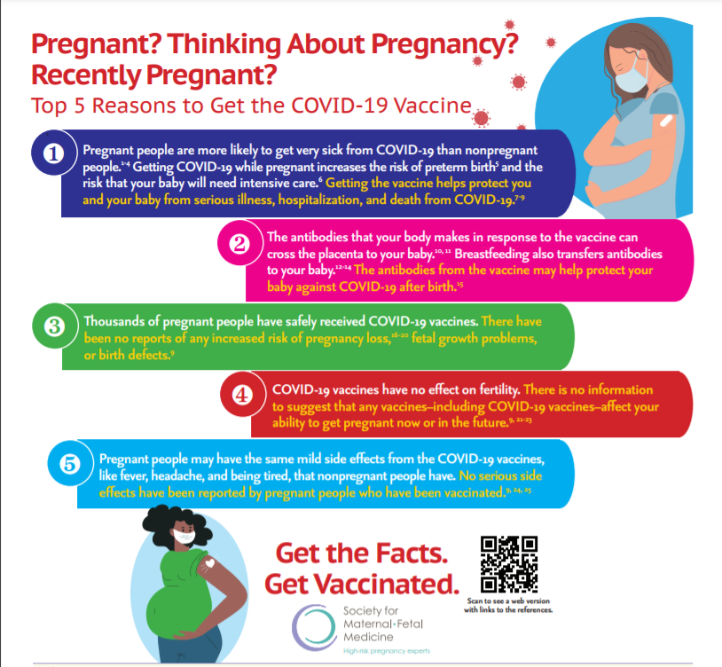
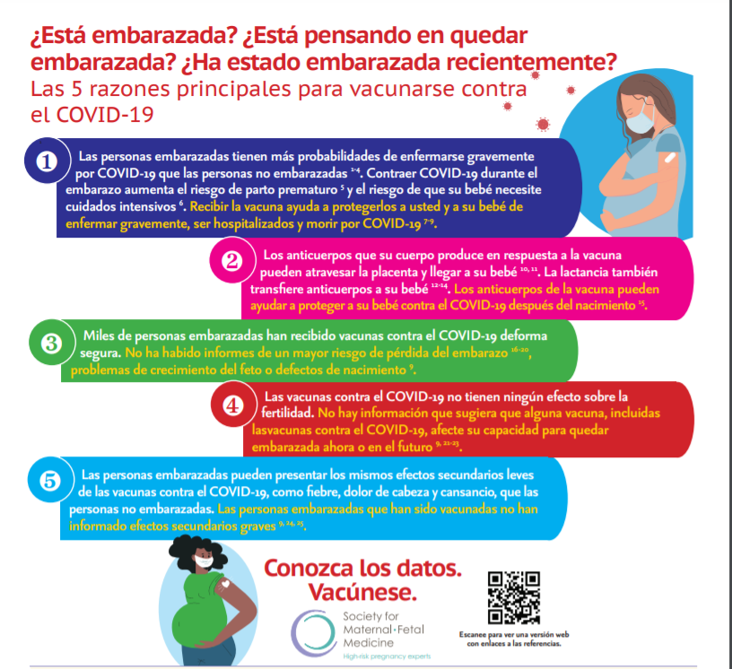
SMFM: NEW INFOGRAPHIC Top 5 Reasons to Get the COVID-19 Vaccine (English and Spanish)

Slide 52
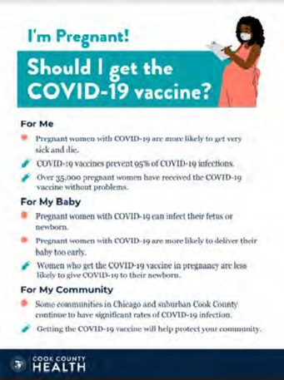
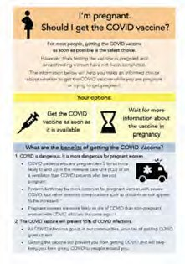

COVID Vaccine
Patient Education Examples
University of Massachusetts Medical School – Baystate: Covid Vaccine Info for Pregnant/Breastfeeding Patients English.
Available in:
Spanish, Nepali, Portuguese, Arabic, Turkish, Somali, Chinese, Vietnamese, Russian (3.17.21)
SMFM Patient Education (English/Spanish): COVID-19 Vaccines and Pregnancy. (3.4.21)
CDC: Safety of COVID-19 Vaccines. Video link. (Updated 6.8. 2021)
Cook County Health: Should I get the COVID-19 vaccine?
Flyer English and Spanish (6.11.21)
CDC: Information about COVID-19 Vaccines for People who Are Pregnant or Breastfeeding. (3.18.21)

Slide 53
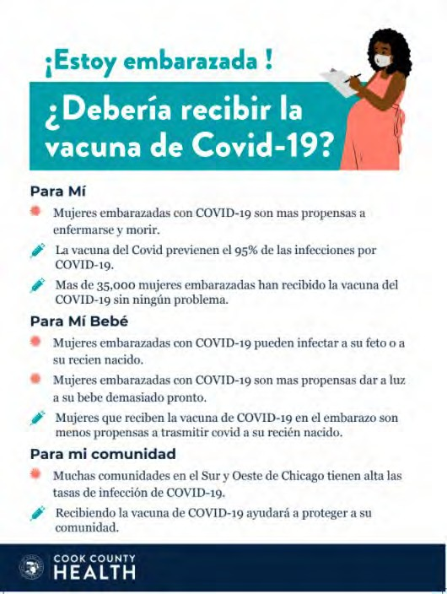

POSTERS

Slide 54
IDPH / HFS / CDC
CDC: New CDC Data: COVID-19 Vaccination Safe for Pregnant People. (8.11.21)
CDC: Receipt of mRNA COVID-19 vaccines preconception and during pregnancy and risk of self-reported spontaneous abortions. (8.9.21)
• CDC: Percent of Pregnant People aged 18-49 years receiving at least one dose of a COVID-19 vaccine during pregnancy. (9.4.21)
CDC: Monitoring Incidence of COVID-19 Cases, Hospitalizations, and Deaths, by Vaccination Status — 13 U.S. Jurisdictions. (9.17.21)
CDC Official Health Advisory : COVID-19 Vaccination for Pregnant People to Prevent Serious Illness, Deaths, and Adverse Pregnancy Outcomes from COVID-19. (9.29.21)
CDC: Recommends Pediatric COVID-19 Vaccine for Children 5 to 11 Years. (11.02.21)
CDC: Expands guidance for Covid-19 Booster shots for all over 18. (11.29.21)
37

Slide 55
CDC Expands Eligibility for Booster shots (11.29.21)
Everyone age 18 and older should receive a booster shot
Although COVID-19 vaccination remains effective in preventing severe disease/death, suggest vaccination becomes less effective over time, especially in people aged 65 and older and at preventing infection or milder illness with symptoms.
The recent emergence of the Omicron variant (B.1.1.529) further emphasizes the importance of vaccination, boosters, and prevention efforts needed to protect against COVID-19. Early data from South Africa suggest increased transmissibility of the Omicron variant and the potential for immune evasion.
Emerging evidence also shows that among healthcare and other frontline workers, vaccine effectiveness against COVID-19 infections is also decreasing over time.
This lower effectiveness is likely due to the combination of decreasing protection as time passes since getting vaccinated, as well as the greater infectiousness of the Delta variant.

Slide 56
CDC: Expands guidance for Covid-19 Booster shots for all over 18. (11.29.21)
For individuals who received a Pfizer-BioNTech or Moderna COVID-19 vaccine
  Everyone over age 18 is eligible for a booster shot at 6 months or more after their initial vaccine series
If you got the Johnson & Johnson COVID-19 vaccine
  Everyone over age 18 and older is eligible for a booster shot who were vaccinated two or more months ago.
Pregnant women should receive the booster
Individuals may choose which vaccine they receive as a booster. Some people may have a preference for the vaccine type that they originally received, and others may prefer to get a different booster.

Slide 57
CDC Recommends Pediatric COVID-19 Vaccine for Children 5 to 11 Years (November 2, 2021)
CDC endorsed the ACIP recommendation that children 5 to 11 years old be vaccinated against COVID-19 with the Pfizer pediatric vaccine. Extending vaccination to about 28 million children in the United States in this age group and allows providers to begin vaccinating them as soon as possible.
COVID-19 cases in children can result in hospitalizations, deaths, MIS-C (inflammatory syndromes) and long-term complications, such as “long COVID,” in which symptoms can linger for months.
The spread of the Delta variant resulted in a surge of COVID-19 cases in children throughout the summer. During a 6-week period in late June to mid-August, COVID-19 hospitalizations among children and adolescents increased fivefold.
Similar to what was seen in adult vaccine trials, vaccination was nearly 91 percent effective in preventing COVID-19 among children aged 5-11 years.
Vaccine side effects were mild, self-limiting, and similar to those seen in adults and other vaccines for children. The most common side effect was a sore arm.

Slide 58
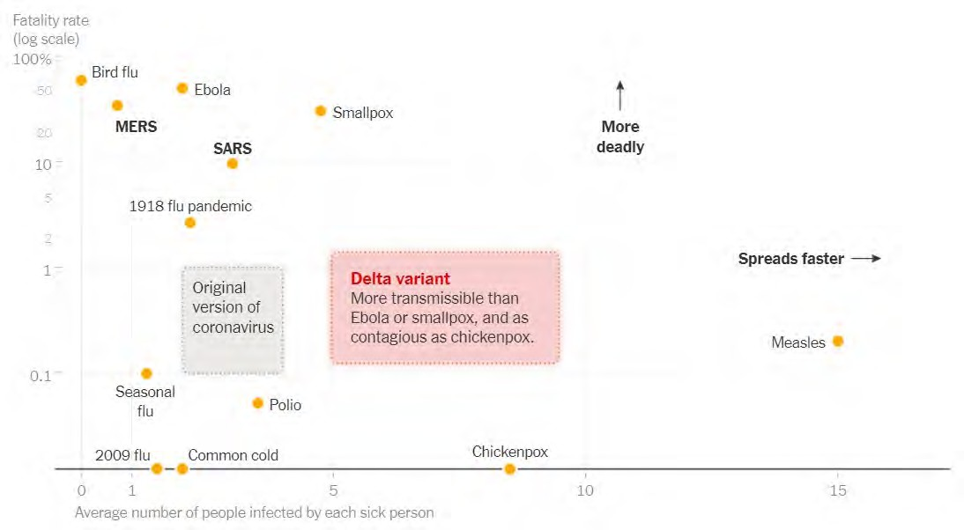

Delta Variant“ fatality rate by number infected by each sick person

Slide 59
Delta Variant Summary
Is more transmissible than prior variants – R0 close to 6-8 (similar to chicken pox)
Higher rates of hospitalization are seen
Can lead to breakthrough cases in fully vaccinated
  Those infected and vaccinated, given high viral loads 1000 x higher than alpha variant
  May cause more severe disease*
Vaccine effectiveness remains high against severe disease and hospitalization, but decreasing against infection
Need for increased vaccination/boosters and mask wearing indoors in public spaces
Omicron variant – more mutations on the spike protein, seems to be more highly contagious than Delta, prior infections not protective from early data, CDC encouraging Boosters, need additional data to determine transmissibility and vaccine efficacy
*The Lancet, June 14, 2021 https://www.thelancet.com/journals/lancet/article/PIIS0140-6736(21)01358-1/fulltext

Slide 60
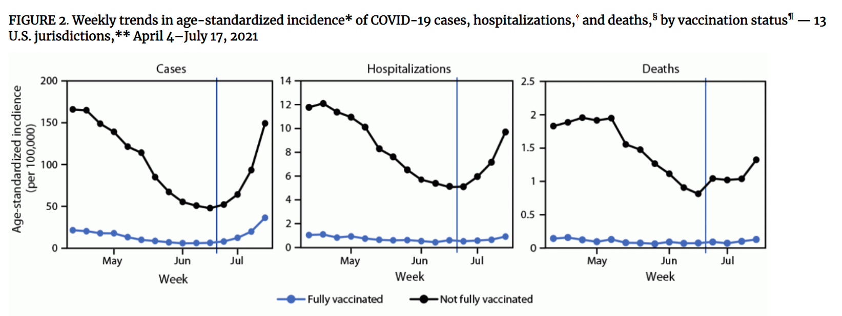
CDC MMWR: Incidence of cases, hospitalizations and deaths by vaccination status noting when > 50% cases Delta variant
CDC MMWR: Monitoring Incidence of COVID-19 Cases, Hospitalizations, and Deaths, by Vaccination Status — 13 U.S. Jurisdictions, April 4–July 17, 2021. (09.17.21)
Notes:
https://www.cdc.gov/mmwr/volumes/70/wr/mm7037e1.htm#F2_down

Slide 61
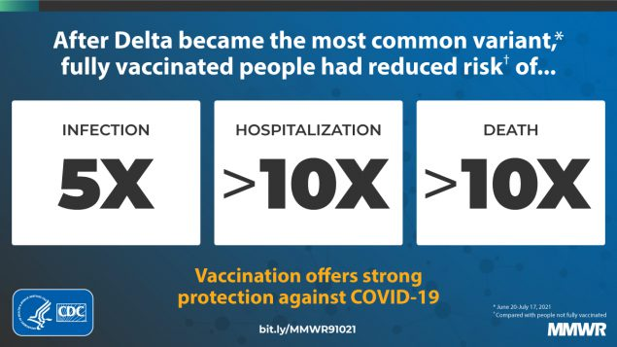

Slide 62
Updated Neonatal /AAP Resources
AAP: Supporting Emotional and Behavioral Health during the COVID19 Pandemic. (Updated 7.28.21)
AAP: Post Covid Conditions in Children and Adolescents. (Update 7.28.21)
AAP: Children and COVID-19: State-Level Data Report. (11.25.21)
31

Slide 63
AAP: Children and COVID-19: State-Level Data Report November 25, 2021
As of November 25, nearly 6.9 million children have tested positive for COVID-19 since the onset of the pandemic.
This week nearly 132,000 child cases were added. Child cases have declined since a peak of 252,000 the week of September 2nd, but COVID cases among children remain extremely high.
For the 16th week in a row child COVID-19 cases are above 100,000. Since the first week of September, there have been 1.85 million additional child cases.
Since the pandemic began, children represented 17.0% of total cumulated cases. For the week ending November 25, children were 24.6% of reported weekly COVID-19 cases (children, under age 18, make up 22.2% of the US population)
AAP: Children and COVID-19: State-Level Data Report. (11.25.21)
Illinois Perinatal Quality Collaborative
32
Notes:
Cumulative Number of Child COVID-19 Cases*
6,396,278 total child COVID-19 cases reported, and children represented 16.6% (6,396,278/38,496,700) of all cases
Overall rate: 8,498 cases per 100,000 children in the population
Change in Child COVID-19 Cases*
100,630 child COVID-19 cases were reported the past week from 10/21/21-10/28/21 (6,295,648 to 6,396,278) and children represented 24.2% (100,630/416,059) of the weekly reported cases
Over two weeks, 10/14/21-10/28/21, there was a 4% increase in the cumulated number of child COVID-19 cases since the beginning of the pandemic (218,332 cases added (6,177,946 to 6,396,278))

Slide 64
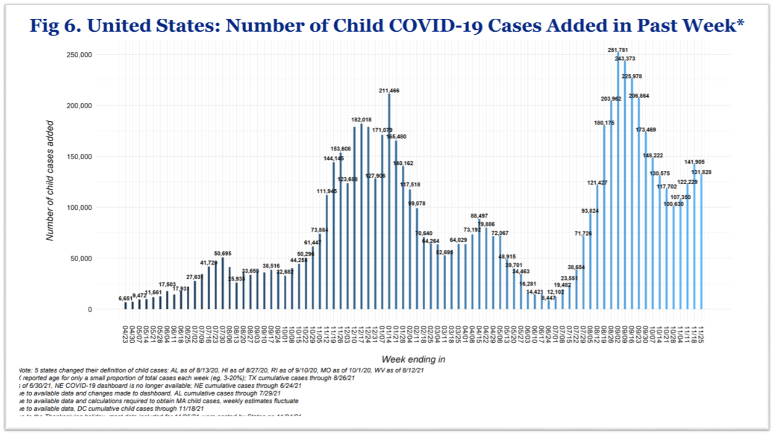
United States: Number of Child COVID- 19 Cases Added in Past Week
11.25.21
Notes:
https://urldefense.com/v3/__https://downloads.aap.org/AAP/PDF/AAP*20and*20CHA*20-*20Children*20and*20COVID-19*20State*20Data*20Report*2010.28*20FINAL.pdf__;JSUlJSUlJSUlJSU!!Dq0X2DkFhyF93HkjWTBQKhk!D-5cLBvIfiAilowD-9iaFSXEv05rxtamH43ejHiNr9camtO54UkH9Gg-63tHO9_EOFBqpED4TA$

Slide 65
OB Discussion Panel
Discussion of OB Unit Strategies
  Emily Miller, MD, MPH – Maternal Fetal Medicine, Northwestern University
  Angela Puric, MSN, APRN-FPA, CNM – Clinical Manager, Labor and Delivery/High Risk OB
  Advocate Lutheran General Hospital, Park Ridge
  Diana Kolettis, MD – Maternal Fetal Medicine, Advocate Lutheran General Hospital, Park Ridge

Slide 66
Monoclonal Antibody Infusions
Advocate Lutheran General Hospital
Angela Puric, APRN-FPA, CNM
Clinical Nurse Manager Labor and Delivery/3W HR OB
Dr. Diana Kolettis, MFM
December 3rd, 2021
Notes:
In an effort to make it as easy as possible to get Monoclonal antibody treatment to our pregnant patients who are COVID + (with mild to moderate symptoms), we have instituted a process to give them the monoclonal antibody therapy in our OB triage unit

Slide 67

Advocate Lutheran General Hospital
638 Bed Hospital – 6th largest hospital in Chicagoland area
Level I Trauma Center
Level III Perinatal Center
  2020 -3185 women delivered
  3271 babies delivered
Teaching Hospital with residents and fellows
Magnet Designation
ILPEX Gold Award

Slide 68
Pregnant patients are eligible for monoclonal antibody therapy if they have mild to moderate COVID symptoms for no more than 10 days and do not require oxygen therapy

Slide 69
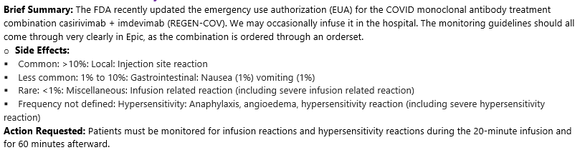
COVID Monoclonal Antibody Treatment

Slide 70
Getting Started
Set up a meeting with key stakeholders
  Pharmacy
  IV infusion center
  OB Leadership
  OB Providers
  Clinical Educators
Resource Binder was made and shared with staff
Providers were made aware of the process, how to order, and schedule their patients for the monoclonal antibody infusion.
Set times were established for appointments in OB Triage at Lutheran General Hospital
For the first pregnant patient, LGH L&D had a nurse go to the IV infusion center to obtain fetal heart tones and observe an infusion

Slide 71
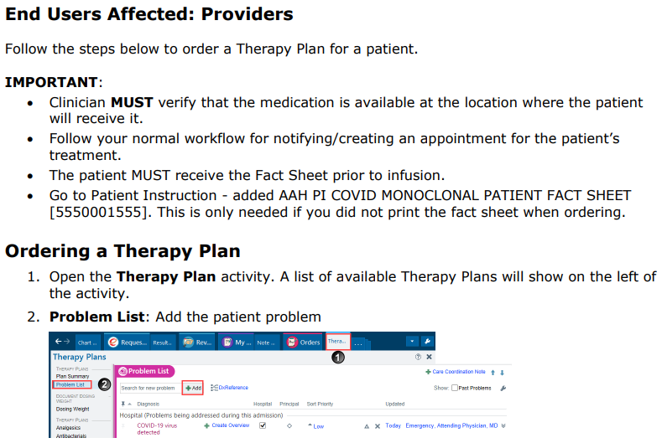
IV Therapy – Ordering COVID Meds
Notes:
Why was it done here instead of the infusion center.

Slide 72
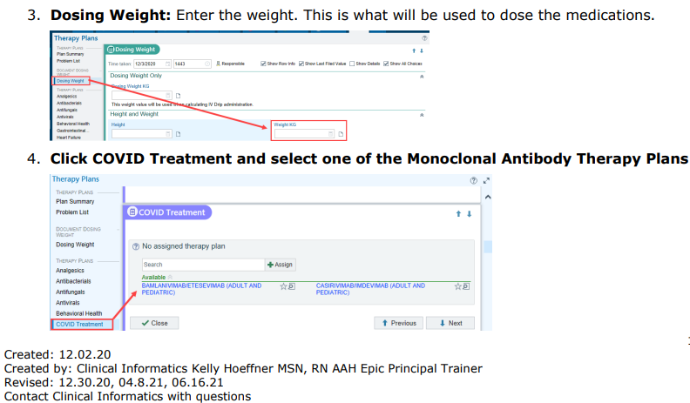

Slide 73
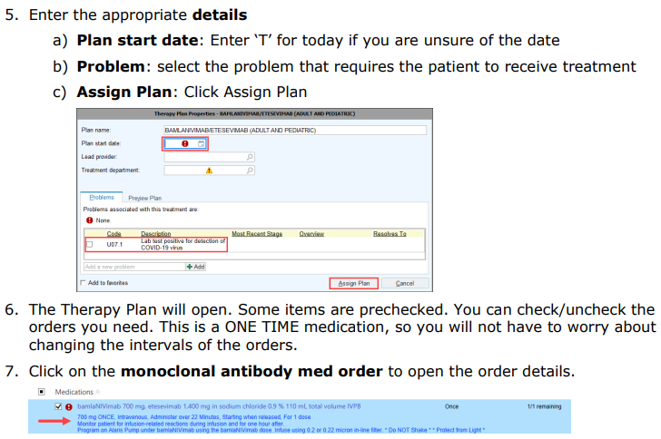

Slide 74
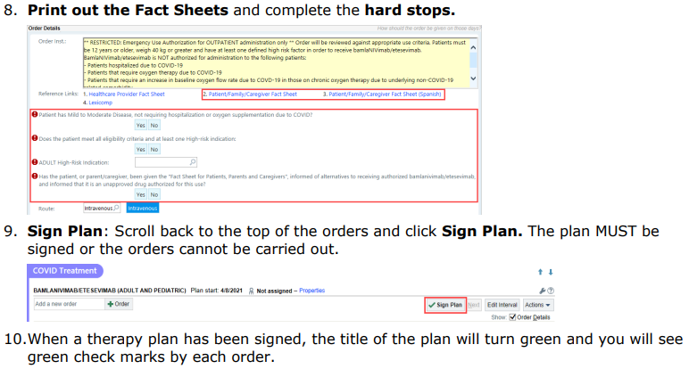

Slide 75
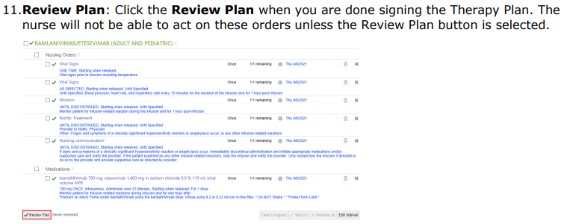


Slide 76
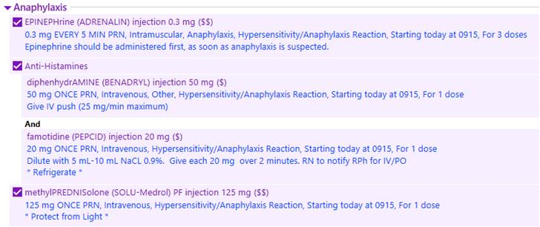
Treatment for possible reaction

Slide 77
How are we billing for this?
- Nurse Triage Visit
- IV Infusion billed from MAR
- No charge for actual medication, government funded
Is filter tubing required?
- Yes, per pharmacy and the order, IV filter tubing needed.
- LGH uses the SafeLine Filtered Extension Set
Fetal Monitoring?
- Since this patient can be at any gestation, it depends on how they are presenting. LGH typically does heart tones before and after the infusion. Continuous EFM or NST may be appropriate
Vitals?
- Patient vitals taken before the infusion
- Every 15 minutes for the duration of the infusion and 1 hour after
FAQ
Notes:
Barriers – provider putting in orders. Pharmacy – takes 30 minutes to thaw, has to be walked up. Bed placement – covid, using our procedure room. Pharmacy supply.

Slide 78
Case Review
Dr. Diana Kolettis, MFM

Slide 79
Open Discussion

Slide 80
Supporting Documents on ILPQC Covid webpage
Advocate Lutheran General Hospital Monoclonal Antibody Infusion Protocol for Pregnant Patients Supporting Documents:
Monoclonal Antibody Infusion Playbook
Protocol REGEN-COV EUA Update
Ordering COVID Meds
Monoclonal Antibody Therapy for Pregnant Patients
COVID: Monoclonal Antibody Administration

Slide 81












Thanks to our Funders
In kind support:

