Slide 1



COVID-19 Strategies for OB & Neonatal Units
August 6, 2021
12:00 – 1:15pm

Slide 2

Welcome
Please be certain you are on “mute” when not speaking to avoid background noise.
Whether you have joined by phone or computer audio, you can mute and unmute yourself by clicking on the microphone icon.
The following shortcuts can also be used
For PC: Alt + A : Mute or Unmute
For Mac: Shift + Command + A: Mute or Unmute
For telephone: *6 : Mute or Unmute
2

Slide 3
Housekeeping:
We Are Recording Now
3

Slide 4
ILPQC Covid 19 webinars
The strategies shared today are examples from individual institutions not IDPH or ILPQC recommendations.
This is our 23nd COVID-19 strategies for OB/Neonatal Units webinar in coordination
with IDPH, since April 2020. Please see https://ilpqc.org/covid-19-information/ for
future webinar registration, prior recorded webinars and written out Q/A’s from those webinars.
The next webinar will be Friday, September 3, noon to 1:15pm. We are moving to every other month and determining the needed frequency going forward
Please let us know if your hospital would like to share on an upcoming webinar, please put questions/comments into the chatbox or email directly to info@ilpqc.org
4

Slide 5
Overview
Introduction
Overview of updated data and recommendations: CDC, ACOG, SMFM
Discussion of OB Unit Strategies
Thaddeus Waters, MD - Director Maternal-Fetal Medicine, Rush University Medical Center, Chicago
Samantha De Los Reyes, MD – Maternal Fetal Medicine, Rush University Medical Center, Chicago
Open discussion
Discussion of NEO Unit Strategies
  Justin Josephsen, MD – Medical Director, St. Mary’s Hospital NICU, Neonatologist Cardinal Glennon Children’s Hospital, St. Louis
  Leslie Caldarelli, MD – NICU Director, Prentice Women's Hospital, Chicago
  Open Discussion
5

Slide 6
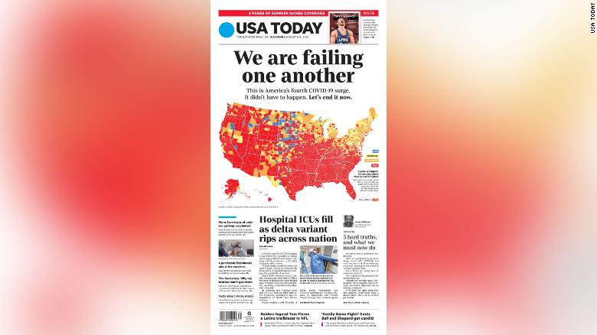
August 6, 2021

Slide 7
United States Covid Updates
Case details
The average number of new cases in the United States reached 100,199 yesterday, a 4 percent increase from the day before. Since January of last year, at least 1 in 9 people who live in the United States have been infected, and at least 1 in 539 people have died.
 | ON AUG. 5 | 7-DAY DAILY AVG. | PER 100,000 | 14-DAY CHANGE | TOTAL REPORTED
Cases | 127,108 | 100,199 | 30 | +119% | 35,565,532
Deaths | 574 | 439 | 0.13 | +74% | 615,408
Hospitalized | — | 52,636 | 16 | +82%

Slide 8

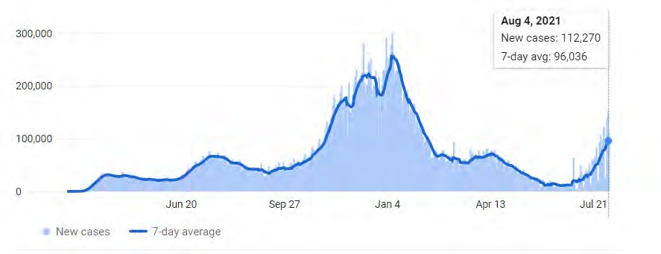
US COVID case trend
6

Slide 9
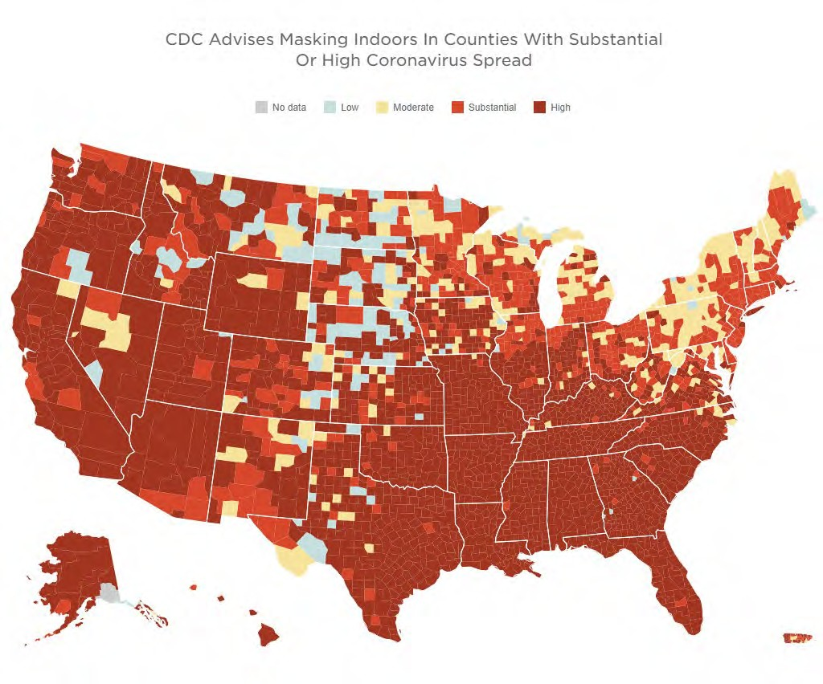

COVID spreads across the Country

Slide 10


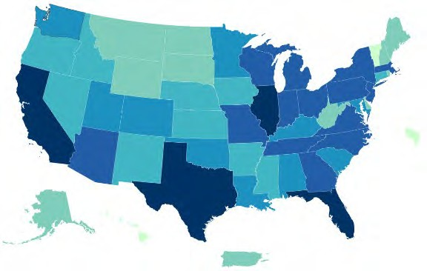
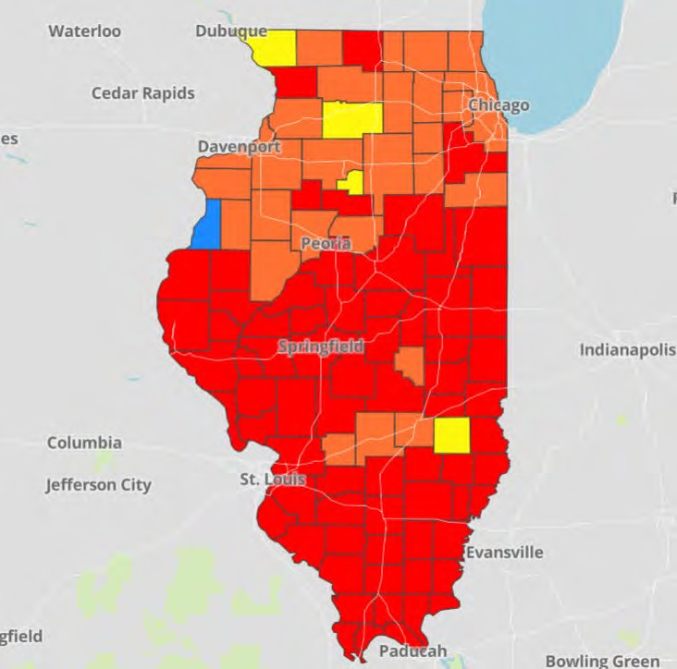

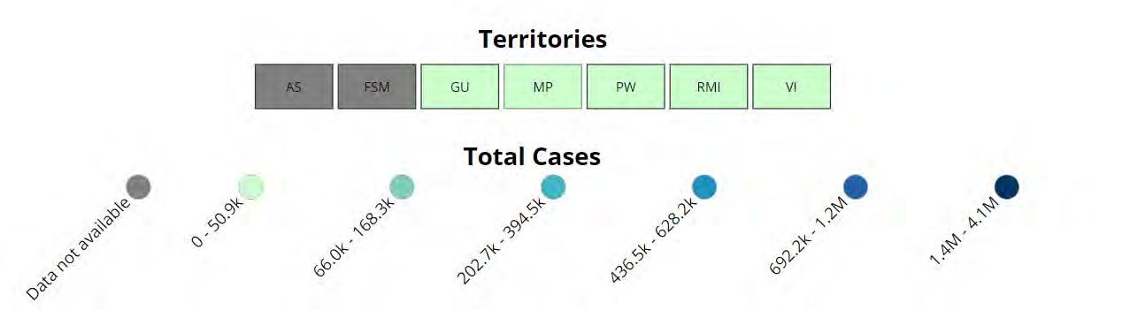
Data Update: August 5, 2021
CDC/IDPH: COVID-19 Outbreak
CDC https://covid.cdc.gov/covid-data-tracker/#cases_totalcases |  |  | IDPH https://www.dph.illinois.gov/covid19
Total cases: 35,392,284 confirmed Total deaths: 612,958 confirmed |  |  | 1,433,313 Confirmed Positive Cases 23,490 Deaths
 |  |  |  | 7

Slide 11
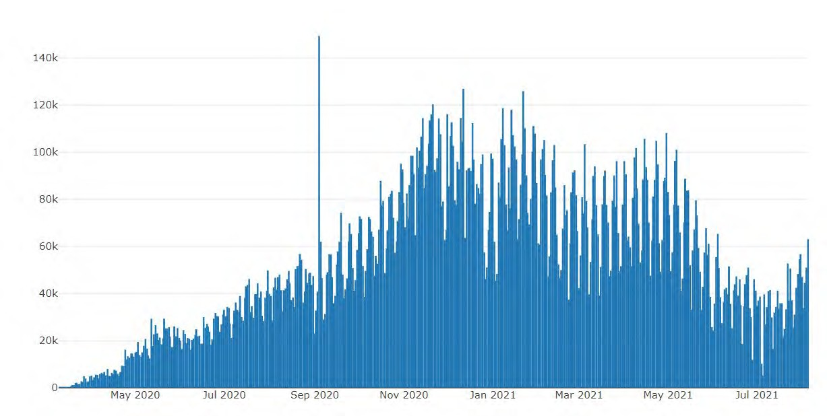
Illinois Daily Incidence
IDPH daily data summary
11

Slide 12
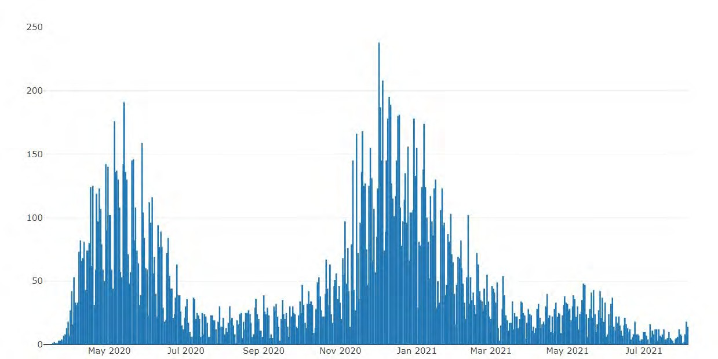
Illinois Covid Deaths
IDPH daily data summary
12

Slide 13

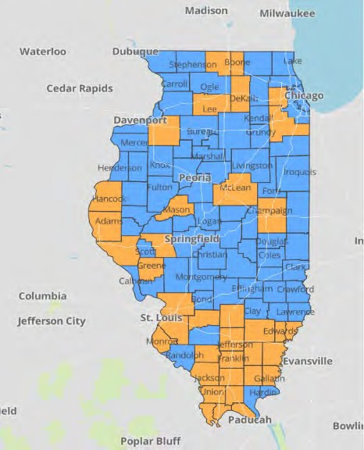
IDPH County Level COVID -19
Risk Metrics
Week 29: 7/18/2021 Through 7/24/2021 Blue indicates that the county is experiencing overall stable COVID-19 metrics.
Orange indicates there are warning signs of increased COVID-19 risk in the county.

Slide 14
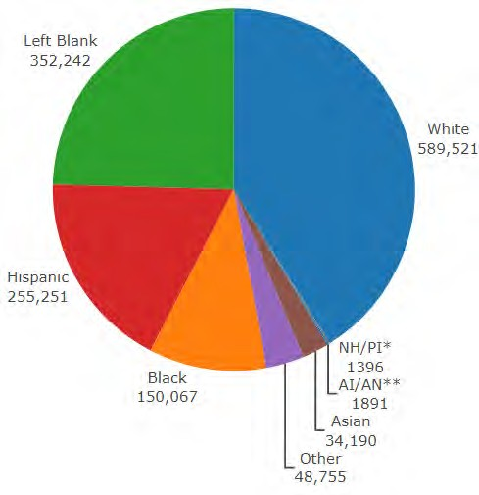
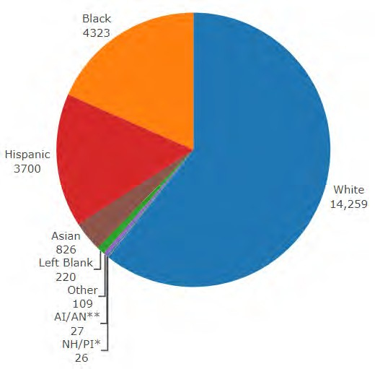
Data Update August 5, 2021 IDPH: COVID-19 Outbreak Race Demographics
https://www.dph.illinois.gov/covid19
Confirmed Cases
Deaths
13

Slide 15
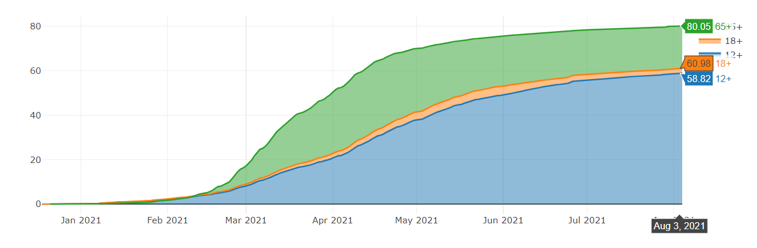
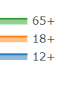
Illinois Population Vaccinated Fully
Notes:
Updated 6/10/2021
https://www.nytimes.com/interactive/2020/us/coronavirus-us-cases.html

Slide 16

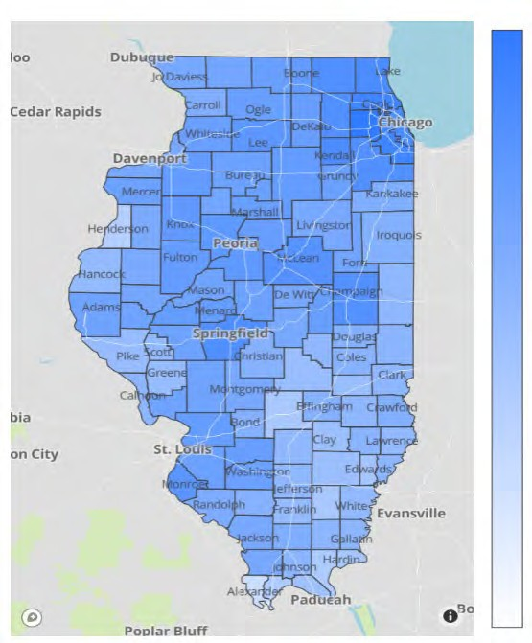
Illinois Daily Reported Administered Vaccine Doses
Last updated 8/4/2021
Illinois Perinatal Quality Collaborative
14

Slide 17

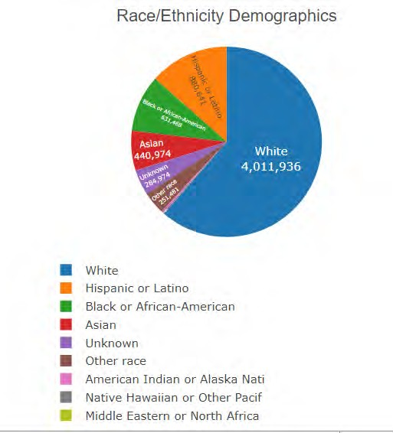
Vaccine by Race/Ethnicity Demographics
Updated 8/4/2021

Slide 18

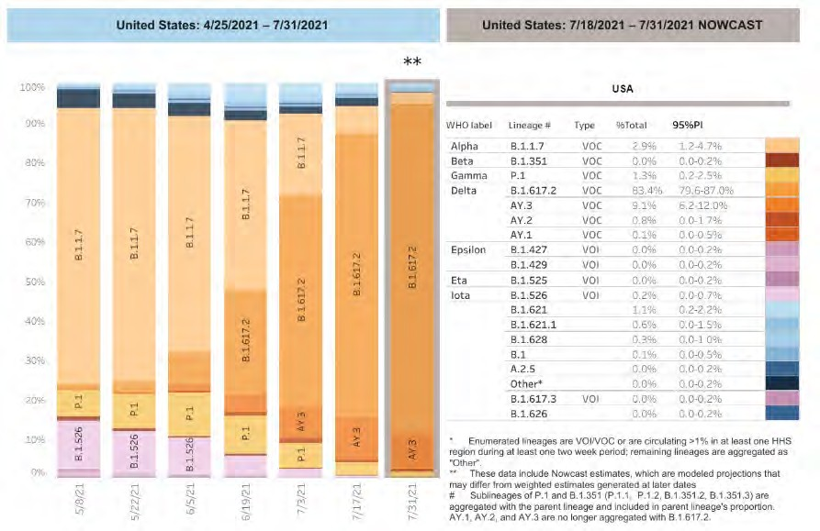
SARS-CoV-2 Variants Circulating in the United States
Delta Variant (B.1617.2)
Identified in India in December 2020
• More transmissible than prior variants
• First detected in the U.S. in March 2021
• U.S. Delta variant proportion:
• May: 0.1% of circulating strains
• July: 82% of circulating strains https://covid.cdc.gov/covid-data-tracker/#
CDC, through July 31, 2021

Slide 19
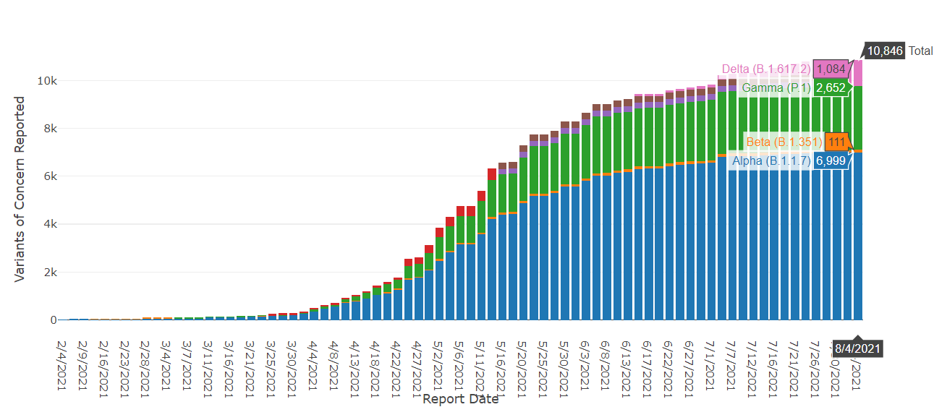
IL Delta variant (B.1617.2), IDPH data, last updated 8/4/21
In Illinois, Delta is 10%, but is rising,
alpha is still predominant
Notes:
Updated 6/10/2021
https://www.nytimes.com/interactive/2020/us/coronavirus-us-cases.html

Slide 20
CDC MMWR showing Delta breakthrough infections risk: 8/6/21
CDC MMWR: Outbreak of SARS-CoV-2 Infections, including Covid-19 vaccine breakthrough infections, associated with large public gatherings - Barnstable County, MA, July 2021 (released August 6, 2021)
Outbreak of 1000 cases from 4th of July parties on Cape Cod with high rates of vaccination
469 cases reviewed by the CDC, 346 (74%) vaccinated, 90% Delta variant,
274 (79%) were symptomatic, 4 (1.2%) fully vaccinated patients were hospitalized. No deaths reported
Similar levels of high viral load between vaccinated / unvaccinated patients
Delta variant is highly transmissible, 1000 x’s higher viral load, than alpha variant
Data behind updated guidelines recommending masks for indoor public spaces regardless of vaccination status

Slide 21
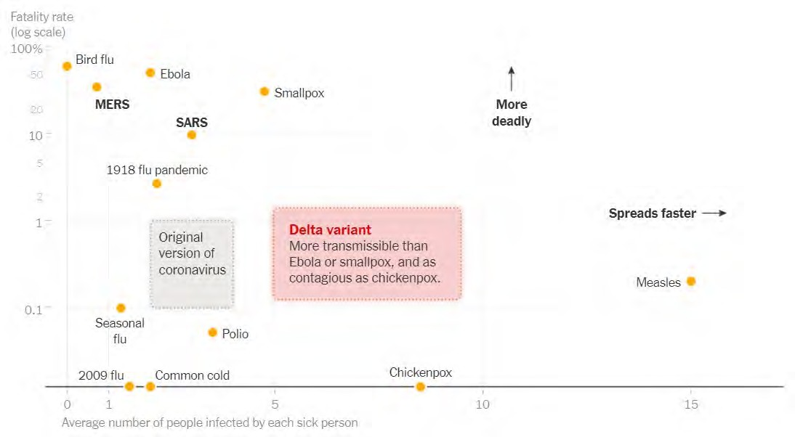
Delta Variant“ fatality rate by number infected by each sick person

Slide 22
Vaccine efficacy and Delta variant
Pfizer 2-dose vaccine available data
UK data:
  Viral effectiveness (VE) against symptomatic disease :
    93.7% among persons with the Alpha variant
    88.0% among those with the Delta variant
  VE against hospitalization:
    95% among persons with the Alpha variant
    96% among persons with the Delta variant
Israel:
  VE against infection and symptomatic disease: 64%
  VE against hospitalization and death: 93%
    Lopez Bernal J, Andrews N, Gower C, et al. Effectiveness of Covid-19 vaccines against the B.1.617.2 (delta) variant; https://www.thelancet.com/journals/lancet/article/PIIS0140- 6736(21)01358-1/fulltext
    Stowe et al. PHE preprint: https://khub.net/web/phe-national/public-library/-/document_library/v2WsRK3ZlEig/view/479607266; https://www.gov.il/en/departments/news/06072021-04
    NEJM: Effectiveness of Covid-19 Vaccines against the B.1.617.2 (Delta) Variant. (7.21.21)
UK data: Effectiveness after one dose of Pfizer vaccine was notably lower among persons with the delta variant (30.7%; 95% confidence interval [CI], 25.2 to 35.7) than among those with the alpha variant (48.7%; 95% CI, 45.5 to 51.7);

Slide 23
Delta Variant Sumary
Is more transmissible than prior variants – R0 close to 6-8 (similar to chicken pox)
Can lead to breakthrough cases in fully vaccinated
  Those infected and vaccinated, given high viral loads, and data from MMWR released today, may be able to transmit the virus
May cause more severe disease*
Vaccine effectiveness remains high against severe disease and hospitalization, but may be decreasing against infection
Need for increased vaccination and mask wearing indoors in public spaces
*The Lancet, June 14, 2021 https://www.thelancet.com/journals/lancet/article/PIIS0140-6736(21)01358-1/fulltext

Slide 24

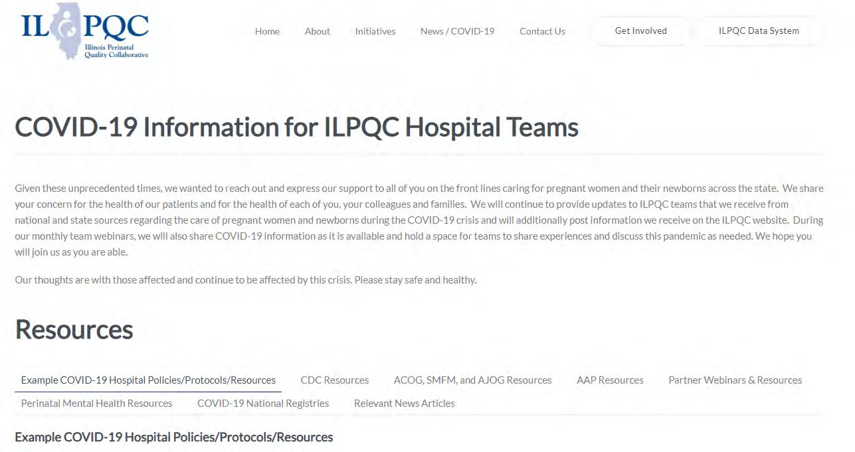
ILPQC COVID-19 Webpage www.ilpqc.org
ILPQC posts national guidelines and OB & Neonatal COVID-19 example hospital protocols & resources
please note dates as guidelines are changing rapidly
https://ilpqc.org/covid-19- information/

Slide 25
Updated OB (ACOG/SMFM) Resources
ACOG: Vaccinating Pregnant Individuals: Eight Key Recommendations for COVID-19 Vaccination Sites. (2.3.21)
ACOG: COVID-19 Vaccines Pregnancy - Conversation Guide for Clinicians. (3.5.21)
SMFM Pt Education (English/Spanish): COVID-19 Vaccines and Pregnancy. (3.4.21)
ACOG:COVID-19 FAQs for Obstetrician-Gynecologists, Obstetrics (Updated 7.1.21)
ACOG: Practice Advisory Novel Coronavirus 2019 (Updated 7.8.21)
ACOG: Practice Advisory: Vaccinating Pregnant and Lactating Patients Against COVID-19. (Updated 7.30.21)
SMFM: Provider Considerations for Engaging in COVID-19 Vaccine Counseling With Pregnant and Lactating Patients. (Updated 7.30.21)

Slide 26
Updated Neonatal /AAP Resources
AAP: Supporting Emotional and Behavioral Health during the COVID19 Pandemic. (Updated 7.28.21)
AAP: Post Covid Conditions in Children and Adolescents. (Update 7.28.21)

Slide 27
Updated OB/Neo Covid Publications
ACOG: Disease Severity and Perinatal Outcomes of Pregnant Patients With Coronavirus Disease 2019 (COVID- 19) (2.21.21)
AJOG: COVID-19 vaccine response in pregnant and lactating women: a cohort study. (3.21.21)
BMC Pediatrics: Newborn antibodies to SARS-CoV-2 detected in cord blood after maternal vaccination – a case report. (3.22.21)
U.S. News: Promising News for Pregnant People Who Want a COVID-19 Vaccine. (4.6.21)
NEJM: Preliminary Findings of mRNA Covid-19Vaccine Safety in Pregnant Persons. (4.21.21)
AJOG: Professionally responsible coronavirus disease 2019 vaccination counseling of obstetrical and gynecologic patients. (5.2021)
Obstetrics & Gynecology: Severe Acute Respiratory Syndrome Coronavirus 2 (SARS-CoV-2) Vaccination in Pregnancy: Measures of Immunity and Placental Histopathology. (5.11.21)
Obstetrics & Gynecology: Cord blood antibodies following maternal coronavirus disease 2019 vaccination during pregnancy (4.1.2021)
NEJM: Effectiveness of Covid-19 Vaccines against the B.1.617.2 (Delta) Variant. (7.21.21)
NEJM - Breakthrough infections in vaccinated healthcare workers. (7.28.21)
NY Times: Covid Updates: New C.D.C. Mask Guidelines Rest on Data Showing the Vaccinated May Transmit Virus. (7.29.21)

Slide 28
NEJM - Breakthrough infections in vaccinated healthcare workers. (7.28.21)
Largest medical center in Israel.
Among 1497 fully vaccinated health care workers for whom RT-PCR data were available, 39 SARS-CoV-2 breakthrough infections were documented.
Neutralizing antibody titers in case patients during the peri-infection period were lower than those in matched uninfected controls (case-to-control ratio, 0.361; 95% confidence interval, 0.165 to 0.787).
Most breakthrough cases were mild or asymptomatic, although 19% had persistent symptoms (>6 weeks).
The B.1.1.7 (alpha) variant was found in 85% of samples tested.
A total of 74% of case patients had a high viral load (Ct value<30) at some point during infection

Slide 29
IDPH / HFS / CDC
HFS: Provider Notice Issued Blood Pressure Monitoring Kit (7.2.2020) - Medicaid now covers home BP cuffs for all pregnant / postpartum patients
CDC: Information about COVID-19 Vaccines for People who Are Pregnant or Breastfeeding. (4.28.21)
CDC: Covid Data Tracker: Health Equity Data (June 2021)
CDC MMRC: Patterns in COVID-19 Vaccination Coverage, by Social Vulnerability and Urbanicity — United States. (6.4.21)
CDC: Safety of COVID-19 Vaccines. Video link. (Updated 6.8. 2021)
CDC: Myths and Facts on Covid-19 vaccines. (Updated 7.7.21)
CDC updated mask guidance: Interim Public Health Recommendations for Fully Vaccinated People. (7.27.21)
CDC MMWR: Outbreak of SARS-CoV-2 Infections, including Covid-19 vaccine breakthrough infections, associated with large public gatherings - Barnstable County, MA, July 2021. (8.6.2021)
•

Slide 30
Delta Variant“ fatality rate by number infected by each sick person

Slide 31
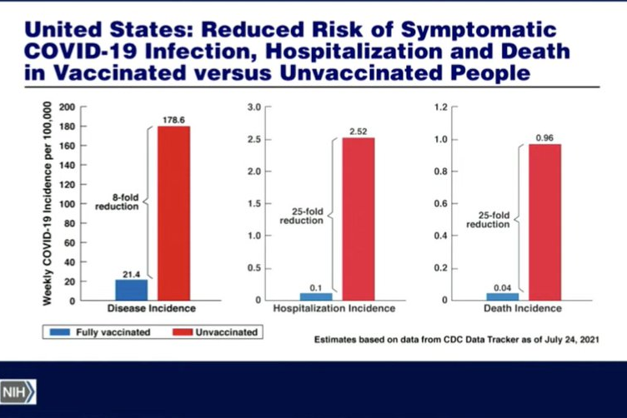
New CDC Data
7/24/21

Slide 32
CDC Updated Mask Recommendations
7/27/21 “the war has changed”
Updated information for fully vaccinated people given new evidence on the B.1.617.2 (Delta) variant currently circulating in the United States.
Added a recommendation for fully vaccinated people to wear a mask in public indoor settings in areas of substantial or high transmission (now 95% of the United States)
Added information that fully vaccinated people might choose to wear a mask regardless of the level of transmission, particularly if they are immunocompromised or at increased risk for severe disease from COVID-19, or if they have someone in their household who is immunocompromised, at increased risk of severe disease or not fully vaccinated.
Added a recommendation for fully vaccinated people who have come into close contact with someone with suspected or confirmed COVID-19 to be tested 3-5 days after exposure, and to wear a mask in public indoor settings for 14 days or until they receive a negative test result.
CDC recommends universal indoor masking for all teachers, staff, students, and visitors to schools, regardless of vaccination status.

Slide 33
Masks indoors where Substantial or High Spread
Substantial or High Spread > 95% of United States

Slide 34
CDC
CDC MMWR: Outbreak of SARS-CoV-2 Infections, including Covid-19 vaccine breakthrough infections, associated with large public gatherings - Barnstable County, MA, July 2021 (released August 6, 2021)
Outbreak of 1000 cases from 4th of July parties on Cape Cod with high rates of vaccination
469 cases reviewed by the CDC, 346 (74%) vaccinated, 90% Delta variant,
Similar levels of high viral load between vaccinated / unvaccinated patients means vaccinated persons can spread COVID19
Delta variant is highly transmissible, 1000 x’s higher viral load, than alpha variant
Data behind updated guidelines recommending masks for indoor public spaces regardless of vaccination status

Slide 35
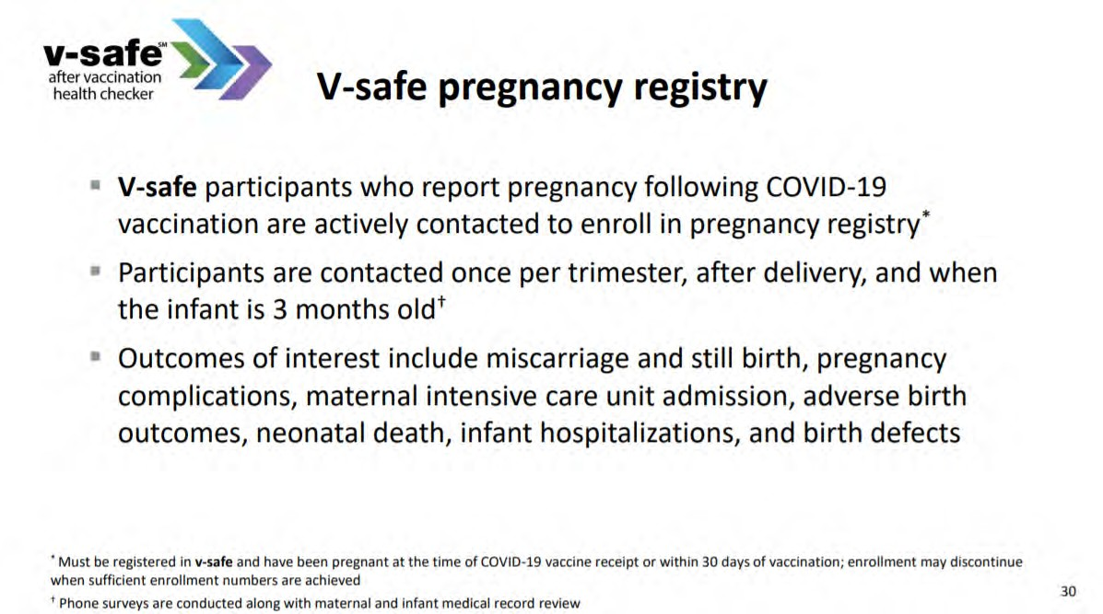
35

Slide 36
V-SAFE vaccine monitoring
– what data is being gathered pregnant patients
As of July 26, 2021, there have been over 139,562 pregnancies reported in CDC’s V-SAFE post-vaccination health checker
CDC is currently enrolling pregnant individuals in a pregnancy registry with over 5,1004 enrolled.
Evidence gathered through these system provide clinicians with critically needed data to inform future recommendations related to COVID-19 vaccination during pregnancy
https://www.cdc.gov/coronavirus/2019-ncov/vaccines/safety/vsafe.html

Slide 37
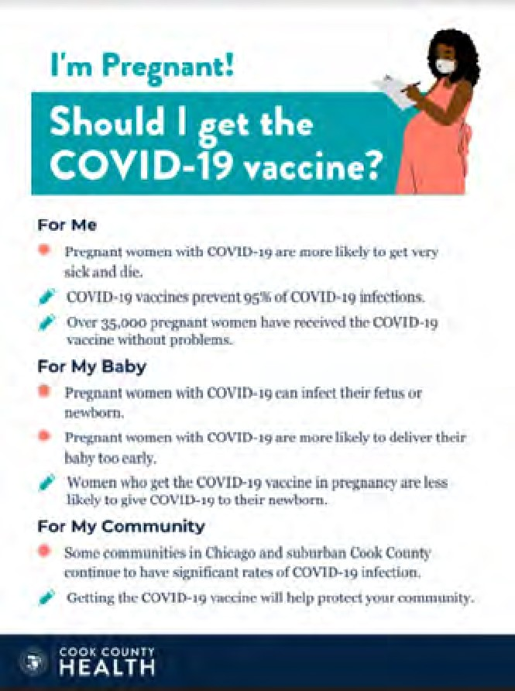
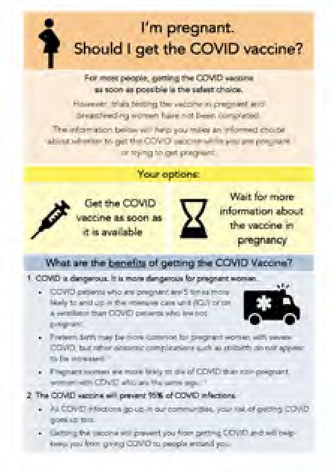

COVID Vaccine
Patient Education Examples
University of Massachusetts Medical School – Baystate: Covid Vaccine Info for Pregnant/Breastfeeding Patients English.
Available in:
Spanish, Nepali, Portuguese, Arabic, Turkish, Somali, Chinese, Vietnamese, Russian (3.17.21)
SMFM Patient Education (English/Spanish): COVID-19 Vaccines and Pregnancy. (3.4.21)
CDC: Safety of COVID-19 Vaccines. Video link. (Updated 6.8. 2021)
Cook County Health: Should I get the COVID-19 vaccine?
Flyer English and Spanish (6.11.21)
CDC: Information about COVID-19 Vaccines for People who Are Pregnant or Breastfeeding. (3.18.21)

Slide 38
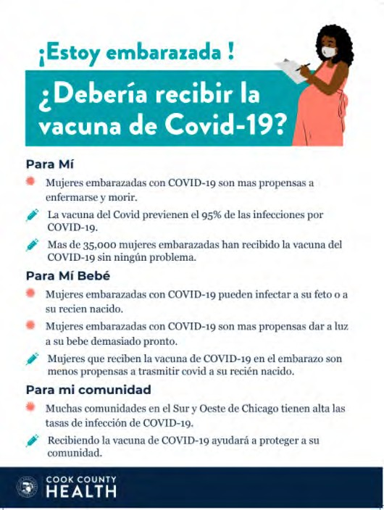
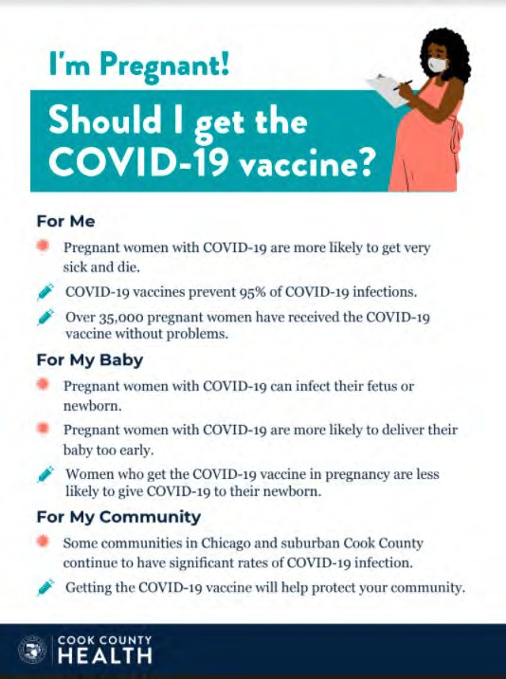
POSTERS

Slide 39
Summary ACOG Update
7.30.21
ACOG strongly recommends that all eligible persons, including pregnant and lactating individuals, receive a COVID-19 vaccine or vaccine series.
Obstetrician-gynecologists and other women’s health care practitioners should lead by example by being vaccinated and encouraging eligible patients to be vaccinated as well.
COG recommends that pregnant individuals be vaccinated against COVID-19.
ACOG recommends that lactating individuals be vaccinated against COVID-19.
While a conversation with a clinician may be helpful, it is not a requirement prior to vaccination, as this may cause unnecessary barriers to access.

Slide 40
ACOG Update 7.30.21
Claims linking COVID-19 vaccines to infertility are unfounded and have no scientific evidence supporting them. ACOG recommends vaccination for all eligible people who may consider future pregnancy.
For patients who do not receive the vaccine, the discussion should be documented in the patient’s medical record. During subsequent office visits, obstetrician–gynecologists should address ongoing questions and concerns and offer vaccination again. Clinicians should reinforce the importance of other prevention measures such as hand washing, physical distancing, and wearing a mask.

Slide 41
ACOG UPDATE 7.30.21
Obstetrician-gynecologists are encouraged to assess and document patients’ COVID-19 vaccination status.
COVID-19 vaccines may be administered simultaneously with other vaccines, including within 14 days of receipt of another vaccine. This includes vaccines routinely administered during pregnancy, such as influenza and Tdap.
A prospective cohort study from two academic centers found that vaccinated pregnant and lactating women produced comparable immune responses to non-pregnant controls, and generated higher antibody titers than those observed following SARS-CoV-2 infection in pregnancy.
Further, vaccine-generated antibodies were present in umbilical cord blood and breastmilk after maternal vaccination (Gray 2021, Prabhu 2021, Juncker 2021).

Slide 42
Pregnancy vaccine safety data
ACOG Updates, 7.30.21
CDC is currently enrolling pregnant individuals in a v-safe pregnancy registry.
Data collected from the v-safe pregnancy registry did not indicate any safety concerns based on the reactogenicity profile and adverse events observed among pregnant individuals.
Additionally, side effects were similar in pregnant and non-pregnant populations.
Further, no differences have been seen when comparing pregnant individuals participating in the v-safe pregnancy registry with the background rates of adverse pregnancy outcomes.

Slide 43
ACOG Updates 7.30.21 addressing Vaccine hesitancy
When discussing COVID-19 vaccines with an individual who expresses concerns, it is critical to:
  Be aware of historical and current injustices perpetuated on communities of color
  Actively listen to and validate expressed fears and concerns
  Be knowledgeable of the existing avenues for vaccine access in traditionally underserved communities
  Continue to support patients who decide not to be vaccinated, share resources, and encourage the continued use of prevention measures
If the patient is amenable to further discussion:
  Inform about the testing process, existing safety data and continued monitoring of safety and efficacy data on COVID-19 vaccines; there have not been shortcuts with the testing of this vaccine
  Discuss the increased incidence of infection and severe illness from COVID-19 in communities of color

Slide 44
Communicate Vaccine Confidence
ACOG Update 7.30.21
Vaccine hesitancy, particularly around COVID-19 vaccines, exists among all populations.
When communicating with patients it is extremely important to underscore the general safety of vaccines and emphasize the fact that no steps were skipped in the development and evaluation of COVID-19 vaccines.
This can be done by briefly highlighting the safety requirements of vaccines, and ongoing safety monitoring even after vaccines are made available.
The following are some messages to consider using when discussing COVID-19 vaccines with patients:
  Vaccines are one of the greatest public health achievements of the 20th century. Before the widespread use of vaccines, people routinely died from infectious diseases, several of which have since been eradicated thanks to robust immunization programs.
  All available COVID-19 vaccines are highly effective.
  Several vaccines have safely been given to pregnant and lactating individuals for decades.
  To date, safety data on COVID-19 vaccines administered during pregnancy do not reveal any safety concerns.
  The rigor of COVID-19 vaccine clinical trials with regards to monitoring safety and efficacy meet the same high standards and requirements as with a typical vaccine approval process.

Slide 45
SMFM Update 7/30/21
SMFM recommends that pregnant and lactating people be vaccinated against COVID19.
What should be considered when counseling a pregnant person regarding COVID-19 vaccination?
  SMFM recommends that pregnant, postpartum, and lactating people and those considering pregnancy receive the COVID-19 vaccination.
  Vaccination is the best method to reduce maternal and fetal complications of SARS-CoV-2 infection.
  Counseling to support the recommendation for vaccination should include available data on vaccine efficacy, as well as data on vaccine safety during pregnancy and lactation.
  Provider counseling has been shown to have a significant positive impact on patient vaccination.

Slide 46
Maternal and obstetrical risk of disease
Data indicate that pregnancy is an independent risk factor for severe COVID-19 disease.
  3-fold increased risk for ICU admission,
  2.4-fold increased risk for needing ECMO,
  1.7-fold increased risk of death due to COVID-19, compared with symptomatic nonpregnant patients.
  Pregnant patients with comorbidities (body mass index greater than 35 kg/m2, diabetes, and heart disorders) and those older than age 35 also appear to have a particularly elevated risk of adverse maternal outcomes.
  Other conditions the CDC has identified as increasing the risk for severe illness from SARS-CoV-2 infection include cancer, chronic kidney disease, chronic obstructive pulmonary disease, heart conditions, immunocompromised state from organ transplant, sickle cell disease, and smoking.
  Hispanic, Latinx, and Black patients are disproportionately affected by severe maternal morbidity and mortality and have a disproportionately higher incidence of COVID-19 infection and death. These disparities, caused by social determinants of health that act as barriers to health and well-being, have become more apparent and exaggerated during this crisis
  Data also indicate an increased rate of adverse obstetric outcomes, including cesarean delivery, preterm birth, and possibly stillbirth in pregnant patients with symptomatic SARS-CoV-2 infection.

Slide 47
Vaccine efficacy
SMFM Update 8.30.21
Pfizer - 95% after 2nd dose (3 weeks apart)
Moderna - 94.1% after 2nd dose (4 weeks apart)
Janssen (J&J) - 72% moderate; 85% severe; 100% COVIDrelated hospitalization and death
*Female individuals younger than age 50 years, including those who are pregnant, lactating, and postpartum individuals, can receive any FDA-authorized COVID-19 vaccine available to them. However, they should be aware of the rare risk of thrombosis with thrombocytopenia syndrome after receiving the Janssen (J&J) vaccine and be counseled that other FDA-authorized COVID-19 vaccines are available. (28 blood clots out of 8.7 million J&J vaccinations)

Slide 48
New CDC Data
7/24/21

Slide 49
What safety data are available about the vaccines and pregnancy?
To date, more than 139,000 pregnant people have self-reported within the CDC v-safe program, and the types and frequency of self-reported acute side effects do not appear to differ from those in the general population.
Moreover, more than 5,100 of these individuals have been followed longitudinally in a registry devoted specifically to pregnancy outcomes, such as miscarriage and stillbirth, pregnancy complications, maternal ICU admission, adverse birth complications, neonatal death, infant hospitalizations, and birth defects.
A recent study showed the transfer of vaccine-induced IgG to the neonate, with higher umbilical cord blood titers achieved with longer intervals from vaccination. Boosting following the second vaccine dose resulted in augmented IgG levels in the cord blood.
These findings point to the ability of maternal mRNA vaccination to induce immunologic protection to neonates through antibody transfer in utero and during lactation.

Slide 50
OB Discussion Panel
Thaddeus Waters, MD - Director Maternal-Fetal Medicine, Rush University Medical Center, Chicago
Samantha De Los Reyes, MD – Maternal Fetal Medicine, Rush University Medical Center, Chicago
Open Discussion

Slide 51
Neonatal Discussion Panel
Justin Josephsen, MD – Medical Director, St. Mary’s Hospital NICU, Neonatologist Cardinal Glennon Children’s Hospital, St. Louis
Leslie Caldarelli, MD – NICU Director, Prentice Women's Hospital, Chicago
Open Discussion

Slide 52
Thank You
We continue to give thanks to the nurses, doctors, health care workers, public health teams and others across our state at work confronting the COVID-19 pandemic.
Please send questions, comments and recommendations, cases / willingness to share for future COVID-19 OB/Neo discussion webinars to info@ilpqc.org
Recording of this webinar, Q/A and registration for the next webinar on Friday August 6, 12-1pm, will be available at www.ilpqc.org

Slide 53












Thanks to our Funders
In kind support:

