Slide 1
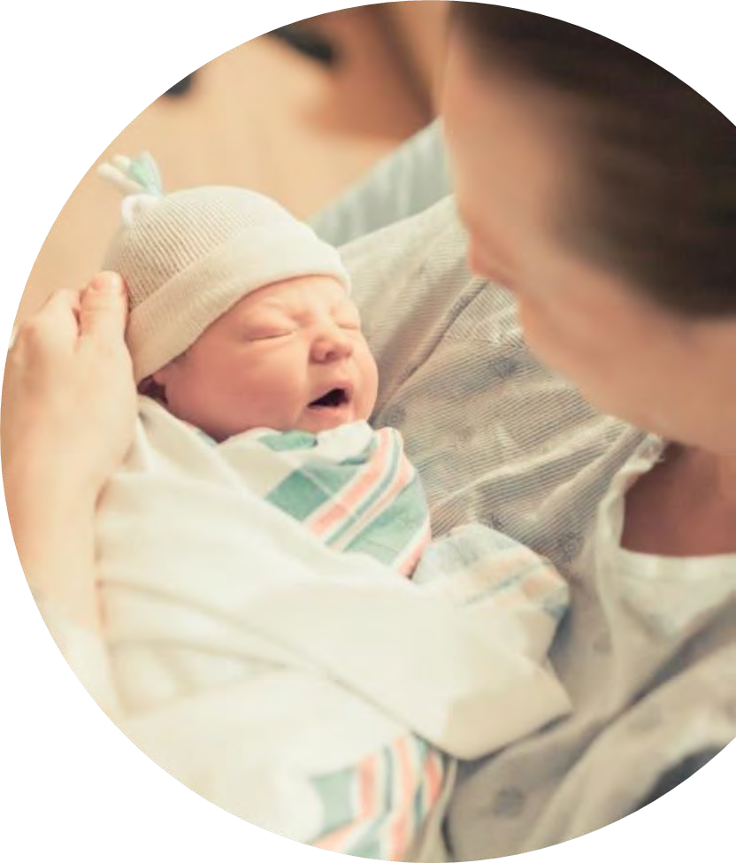
COVID-19 Strategies for OB & Neonatal Units
August 5, 2022
12:00 – 1:15pm

Slide 2
Welcome
Please be certain you are on “mute” when not speaking to avoid background noise.
Whether you have joined by phone or computer audio, you can mute and unmute yourself by clicking on the microphone icon.
The following shortcuts can also be used
For PC: Alt + A : Mute or Unmute
For Mac: Shift + Command + A: Mute or Unmute
For telephone: *6 : Mute or Unmute
2

Slide 3
Housekeeping:
We Are Recording Now
3

Slide 4
ILPQC Covid 19 webinars
The strategies shared today are examples from individual institutions not IDPH or ILPQC recommendations.
This is our 33rd COVID-19 strategies for OB/Neonatal Units webinar in coordination with IDPH, since April 2020. Please see https://ilpqc.org/covid-19-information/ for
future webinar registration, and prior recorded webinars.
The next webinar will be Friday, October 7, noon to 1:15pm. We have moved to every other month webinars. Please let us know if you agree with this spacing of webinars and continued helpfulness of having this time to share strategies and updates together.
Please let us know if your hospital would like to share on an upcoming webinar, please put questions/comments into the chatbox or email directly to info@ilpqc.org
4

Slide 5
Overview
Introduction
Overview of updated Covid data and recommendations
Monkey Pox and Pregnancy updates
Discussion of OB Unit Strategies:
Stephanie Fisher, MD - Northwestern Maternal-Fetal Medicine
Anna McCormick, MD - Director L&D, Rush University
Andie Baker -- Deputy Director of Strategy and Programs, EverThrive Illinois
Mary Darby – Burness consulting with ILPQC to create covid-19 education
5

Slide 6
US Trends
COVID cases are high
Plateau in cases in the northeast and Midwest
Hospitalizations increasing in some parts of the U.S.
Deaths remain low
Source: NYT COVID Tracker
Notes:
The World Health Organization has reported that BA.2, the highly contagious Omicron subvariant, is now driving most coronavirus cases around the world.
Hong Kong officials said that the city was running low on coffins amid its deadliest Covid wave.
A staggered lockdown in Shanghai is testing China’s “Covid zero” policy and the patience of the city’s 26 million residents.
Scientists said they were still searching for explanations for why African countries have reported low rates of Covid infections and deaths, despite earlier predictions that the virus would devastate the continent.
More than 11.2 billion vaccine doses have been administered worldwide, including over 1.6 billion boosters or additional doses. Track each country’s vaccination progress here.

Slide 7
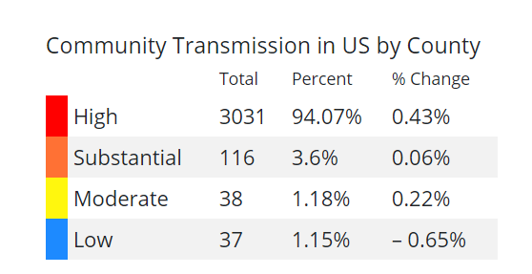
U.S. COVID-19 Community Transmission
CDC community transmission levels are provided to guide healthcare facilities and healthcare safety practices
https://covid.cdc.gov/covid-data-tracker/#county-view?list_select_state=all_states&list_select_county=all_counties&data-type=Risk&null=Risk

Slide 8
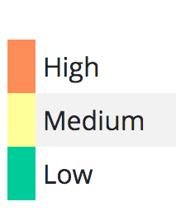
US Hotspots: CDC Community Metric
CDC COVID-19 Community Levels provided to guide community safety practices
As of 8/4/22: https://covid.cdc.gov/covid-data-tracker/#county-view?list_select_state=all_states&list_select_county=all_counties&data-type=CommunityLevels&null=CommunityLevels

Slide 9
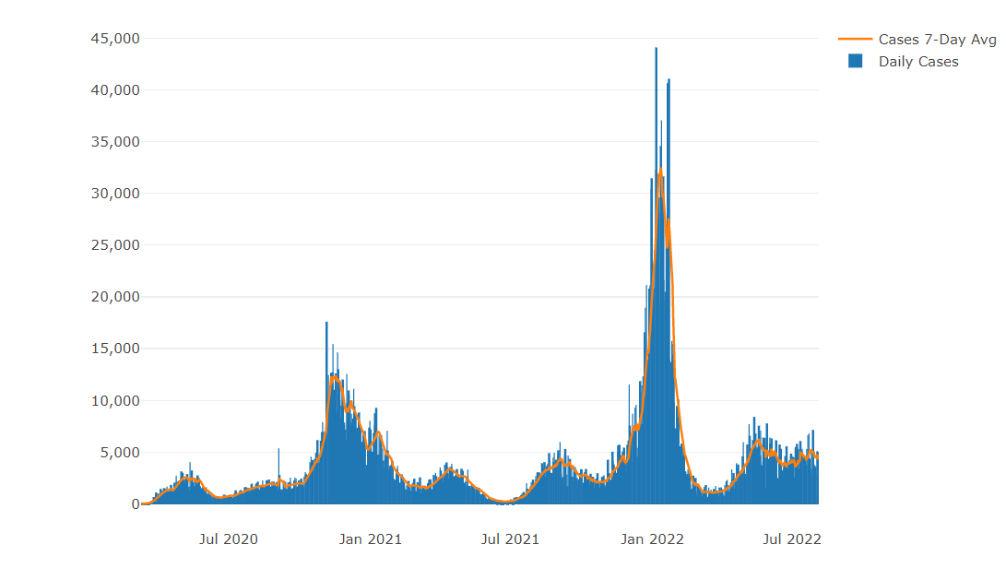
Illinois Daily Incidence
IDPH daily data summary
9

Slide 10
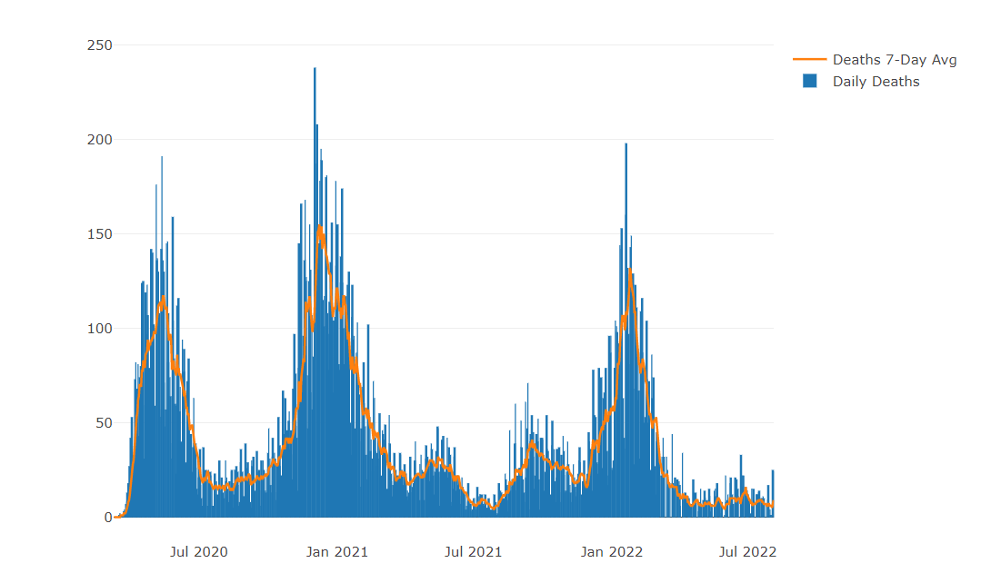
Illinois Covid Deaths
IDPH daily data summary
10

Slide 11
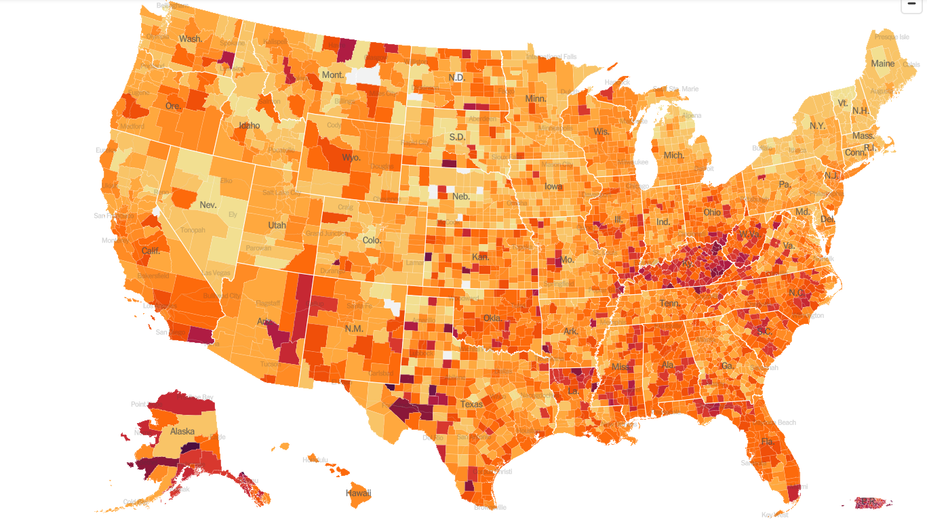
United States Hot Spots 8/4/22

Slide 12
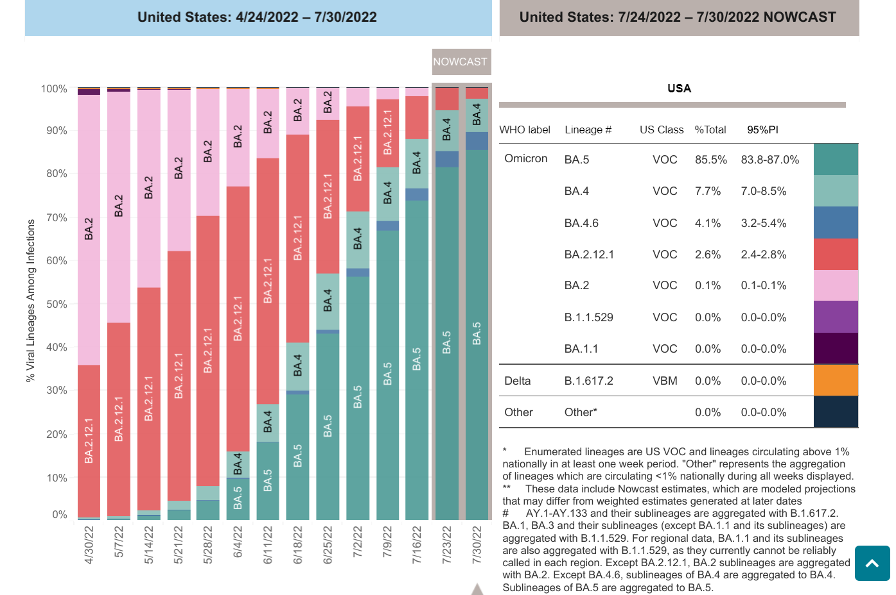
COVID-19 Variants
Omicron subvariants:
BA..5 is now the dominant variant in the U.S.
Does not seem to cause more severe disease than previous variants
BA.5 now represent ~ 85% of all circulating variants
Evidence suggests that unvaccinated people who were infected with the original version of Omicron, known as BA.1, might be easily reinfected by BA.5. (Vaccinated people are likely to fare somewhat better, the study suggests.)
Data on variants is evolving
- BA.5 is more transmissible than prior variants
-Possible enhanced immune escape
No change in current therapy recommendations:
Paxlovid
Bebtelovimab
Molnupiravir – not recommended for pregnant pts unless only option (per SMFM)
Remdesivir (inpatients)
* Evusheld

Slide 13
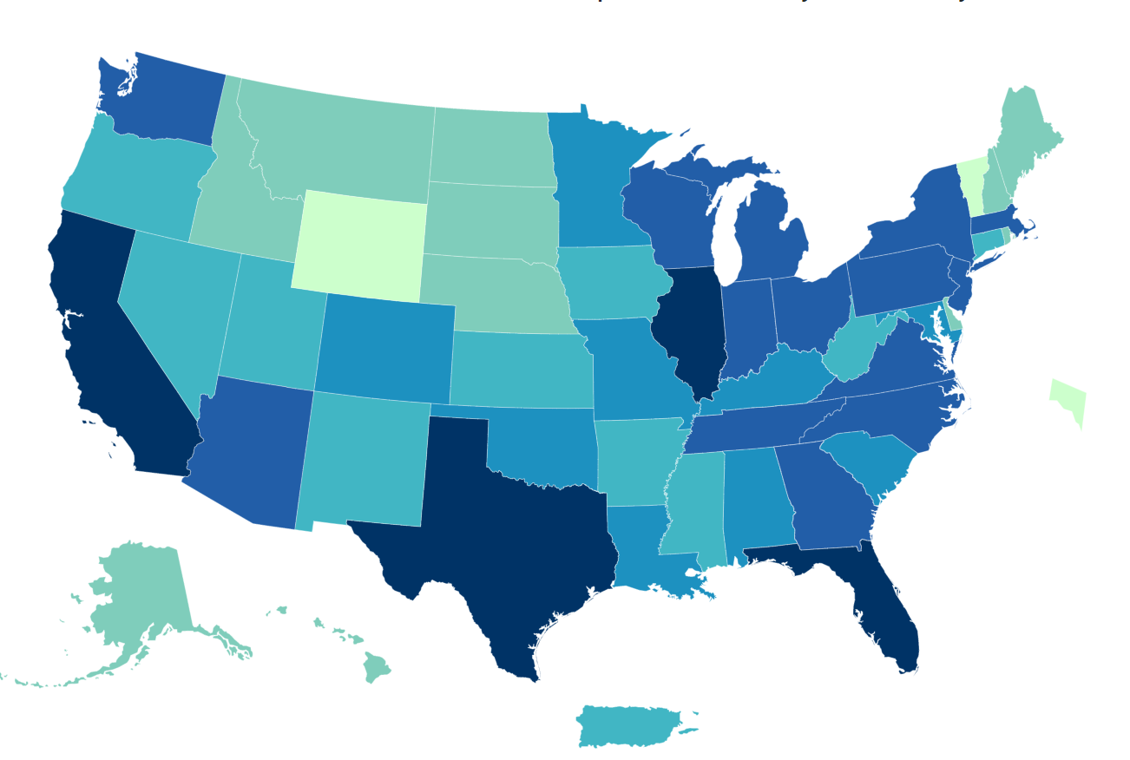
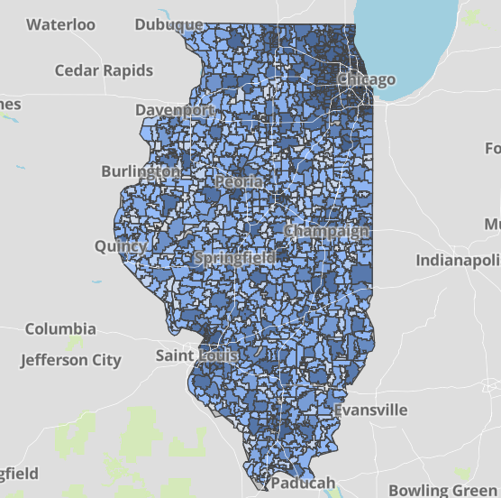
Data Update: August 4, 2022
CDC/IDPH: COVID-19 Outbreak
CDC
https://covid.cdc.gov/covid-data-tracker/#cases_totalcases
IDPH
https://www.dph.illinois.gov/covid19
Total cases: 91,676,264 confirmed
Total deaths: 1,027,370 confirmed
3,588,158 Confirmed Positive Cases
34,412 Deaths
8

Slide 14
Illinois Hospitalizations By Time through 8/4/2022
Sources: U.S. Department of Health and Human Services (daily confirmed and suspected Covid-19 hospital admissions); Census Bureau (population data). Data prior to October 2020 was unreliable. Data reported in the most recent seven days may be incomplete.

Slide 15
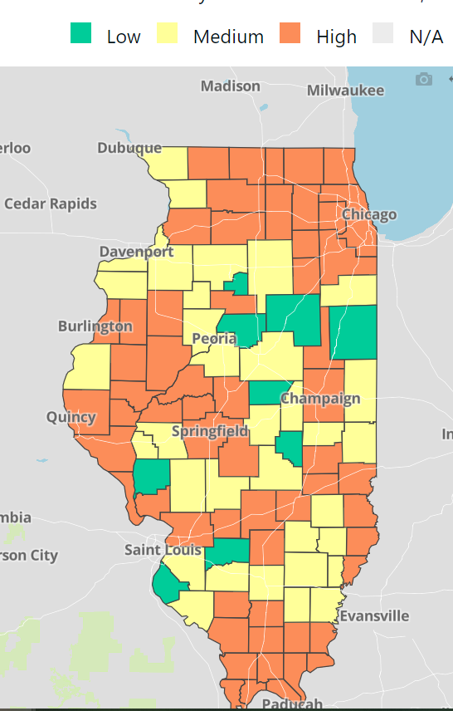
COVID-19 Community Levels Map Updated 8/4/2022
New CDC Guidance (3/4/2022):
Levels can be low, medium, or high and are determined by looking at % of hospital beds being used by pts with Covid, new Covid hospital admissions, and the total number of new COVID-19 cases in an area.
Notes:
determined by looking at hospital beds being used by patients with COVID-19, new hospital admissions among people with COVID-19, and the total number of new COVID-19 cases in your area.

Slide 16
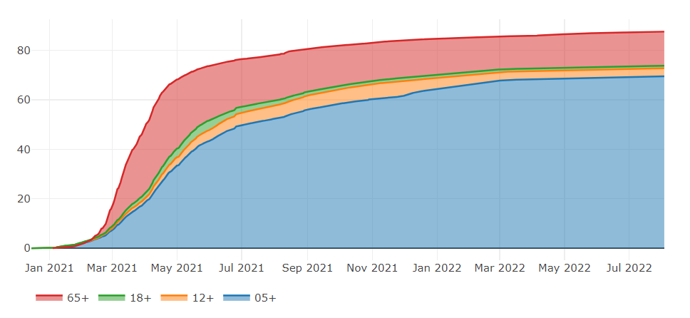
Illinois Population Vaccinated Fully
13

Slide 17
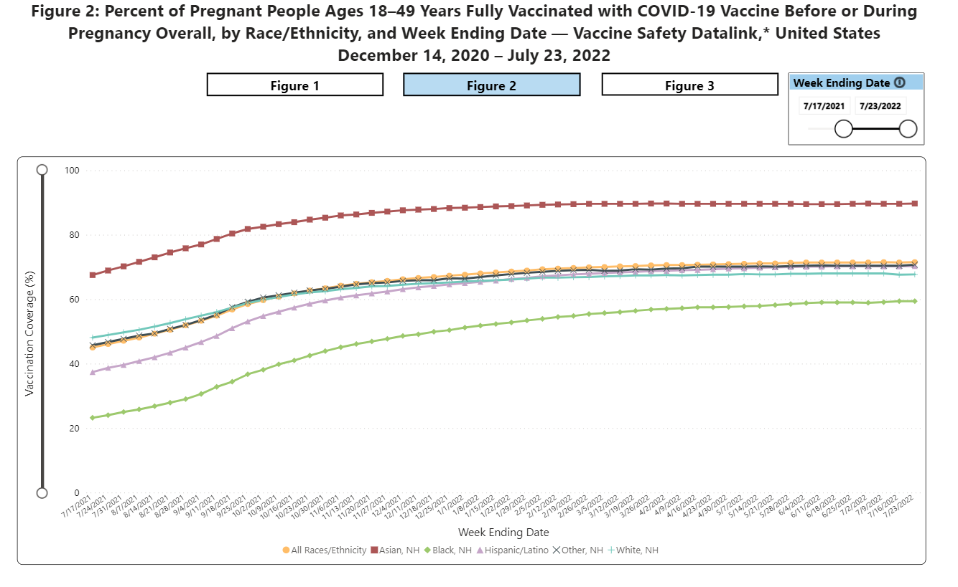
Notes:
https://urldefense.com/v3/__https://covid.cdc.gov/covid-data-tracker/*vaccinations-pregnant-women__;Iw!!Dq0X2DkFhyF93HkjWTBQKhk!BRT8JkbGHSHMqUvlHo57UsXRx3oQL6Au0KIaOe8oN7qp9yWGe1oyTAFdCw-PzSyj1gqEUOSiCw$

Slide 18
Covid-19 and Pregnancy
Pregnant Women with COVID-19, United States, January 22, 2020 – July 25, 2022
TOTAL CASES: 225,656
Hospitalized Cases: 34,693
TOTAL DEATHS: 306 (11 pregnancy deaths in last month)

Slide 19
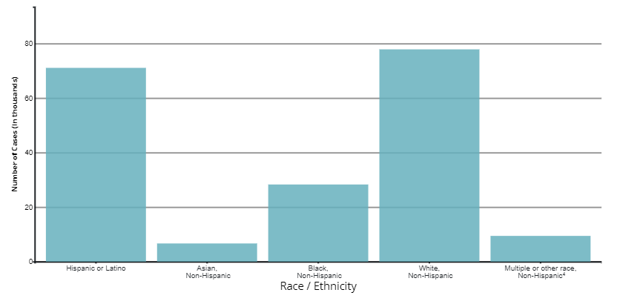

Slide 20
Nature Medicine: SARS-CoV-2 infection and COVID-19 vaccination rates in pregnant women in Scotland. (2.4.2022)
Using whole-population data from a national, prospective cohort, 25,917 COVID-19 vaccinations were given to 18,457 pregnant women in Scotland through October 2021.
Overall, 77.4% (3,833 out of 4,950; of SARS-CoV-2 infections, 90.9% (748 out of 823; of SARS-CoV-2 associated with hospital admission and 98% (102 out of 104;) of SARS-CoV-2 associated with critical care admission, as well as all baby deaths, occurred in pregnant women who were unvaccinated at the time of COVID-19 diagnosis.
Addressing low vaccine uptake rates in pregnant women is imperative to protect the health of women and babies in the ongoing pandemic.

Slide 21
JAMA editorial: COVID-19 mRNA Vaccines During Pregnancy New Evidence to Help Address Vaccine Hesitancy. (3.24.2022)
As of February 28,2022 68% of pregnant patients in the US are vaccinated.
Over the past 14 months a substantial body of evidence supporting the safety of the mRNA Covid 19 vaccines in pregnancy has accumulated.
Observational studies from Norway, Israel and the US have shown that mRNA vaccine in pregnancy are not associated with increase risk of miscarriage, preterm birth or other adverse birth outcomes.
JAMA 2 population based cohort studies evaluate outcomes in more than 250,000 pregnancies from 3 countries provide the strongest evidence to date regarding the safety of covid-19 vaccines in pregnancy

Slide 22
CDC Vaccine and Pregnancy Summary: what you need to know
People who are pregnant or recently pregnant are more likely to get severely ill with COVID-19 compared with people who are not pregnant.
Getting a COVID-19 vaccine can help protect you from severe illness from COVID-19.
COVID-19 vaccination is recommended for people who are pregnant, breastfeeding, trying to get pregnant now, or might become pregnant in the future.
People who are pregnant should receive a COVID-19 vaccine booster shot.
Evidence about the safety and effectiveness of COVID-19 vaccination during pregnancy has been significant. There is currently no evidence that any vaccines, including COVID-19 vaccines, cause fertility problems in women or men.
Pregnant women should be counseled to call when Covid + and should be offered Covid therapeutics to reduce risk of hospitalization and death

Slide 23
SMFM: Provider Considerations for Engaging in COVID-19 Vaccine Counseling With Pregnant and Lactating Patients (1.11.2022)
SMFM and ACOG recommend that pregnant people, including health care workers, receive a COVID-19 booster shot at least 5 months after their primary series. As with the primary series, the booster dose should be given at any stage during pregnancy and postpartum.
Everyone 5 and over is eligible for booster at least 5 months from primary series. Over age 50 or immunocompromised should have 2nd Booster.

Slide 24
COVID Therapeutics
For use in HIGH RISK individuals early in symptoms
Oral therapies (Paxlovid) to be given within 5 days
IV monoclonal antibody bebtelovimab to be given within 7 days
HIGH RISK generally refers to those > 65 years, immunocompromised, high-risk comorbid conditions (obesity, DM), pregnancy or under vaccinated
NIH Therapy Tier: https://www.covid19treatmentguidelines.nih.gov/therapies/statement-on-patient-prioritization-for-outpatient-therapies/
Washington University in St. Louis COVID-19 Outpatient Therapeutics Decision Guide. (4.14.22)

Slide 25
Outpatient Therapeutic Preferences
https://www.covid19treatmentguidelines.nih.gov/therapies/statement-on-therapies-for-high-risk-nonhospitalized-patients/
Paxlovid (nirmatrelvir/ritonavir)
PROS: oral and highly effective
CONS: needs to be given within 5 days of symptom onset, renal adjustment (can’t be given for GFR <30) and many drug-drug interactions (DDIs)
Bebtelovimab (monoclonal antibody)
PROS: highly effective, can be given up to 7 days of symptom onset
CONS: intravenous, limited access – need pathway for pregnant patients
Remdesivir – second line – typically used INPATIENT
PROS: highly effective in early illness, readily available, can be given outpatient up to 7 days of symptom onset
CONS: three consecutive days of IV therapy is extremely difficult in the outpatient world
Good use is for inpatients who are COVID+ but actually hospitalized for another reason

Slide 26
COVID-19 Outpatient Therapeutics Decision Guide updated 4/14/2022
START
Does patient meet all criteria?
Positive SARS-CoV-2 test
Mild to moderate COVID-19
High risk for severe illness (see box)
Washington University in St. Louis COVID-19 Outpatient Therapeutics Decision Guide. (4.14.22)
Supportive care
Monitor symptoms
NO
High Risk for Severe Illness
(see CDC website linked here for
other high-risk conditions)
Diabetes
Sickle cell disease
Cardiovascular disease or
hypertension
Pregnancy
Obese or overweight
Older age
< 1 year of age
Immunosuppressive disease or
treatment
Neurodevelopment disorder or other condition that confers medical complexity
Medical-related technological dependence
Chronic kidney disease
Chronic lung disease
Part of group with systemic health and social inequities, including racial and ethnic minorities, and people with disabilities
Other – see CDC website
YES
NO
Is the patient > 12 yrs of age and > 40 kg?
7 DAYS
Does patient meet ALL criteria?
< 12 years old OR > 12 years but
< 40 kg
> 3.5 kg
Symptom onset < 7 days
Unvaccinated with risk factor(s) for severe illness OR
Immunocompromised*
Recommended
Labs
BMP or POC
Creatinine
Urine HCG for women of childbearing age
Consider
remdesivir
YES
NO
YES
Consider Labs (see box)
Symptom onset 6-7 days?
NO
Symptom onset within < 5 days?
Monoclonal
antibody
YES
YES
YES
Is monoclonal
MUST meet all three
criteria:
Able to manage CYP3A
Paxlovid
Is monoclonal antibody therapy accessible?
18 yrs of
age?
NO
antibody therapy accessible?
NO
drug interactions
YES
eGFR > 30 mL/min
No severe liver impairment
18 yrs of
age?
NO
YES
Does patient agree to a contraception requirement? (see box)
Supportive
Care
NO
NO
YES
Contraception requirement for molnupiravir
Females of childbearing age during therapy and for 4 days following last dose
Males with partners of childbearing age during therapy and for 90 days following last dose
YES
NO
YES
Consider
Fluvoxamine if no SSRIs or MAOIs. Limit caffeine
Supportive
Care
Consider
Fluvoxamine if no SSRIs or MAOIs. Limit caffeine
Consider
Molnupiravir (confirm pregnancy ruled out)
Monoclonal
antibody

Slide 27
Access to medications
There are
639 therapeutics locations across the state
325 Drive-through Walgreens
136 Walmarts and 23 Sam’s Clubs
Cover 99.4% of state population
14 LTC pharmacies are involved in distributing therapy
Notes:
CIMPAR ( we are not a pharmacy but we survive LTC with vaccines and mABs ) BANDYS LONG TERM CARE PHARMACY
CARE ONE PHARMACY SERVICES
Forum Extended Care Services
GREEN TREE PHARMACY
HEALTHDIRECT PHARMACY #128
HEALTHDIRECT PHARMACY #129 MAC RX LLC MEDICATION MANAGEMENT PARTNERS MEDWIZ PHARMACY OF ILLINOIS OREGON HEALTHCARE PHARMACY SERVICES PHARMSCRIPT OF ILLINOIS SYMBRIA RX SERVICES THE MEDICINE SHOPPE #503

Slide 28
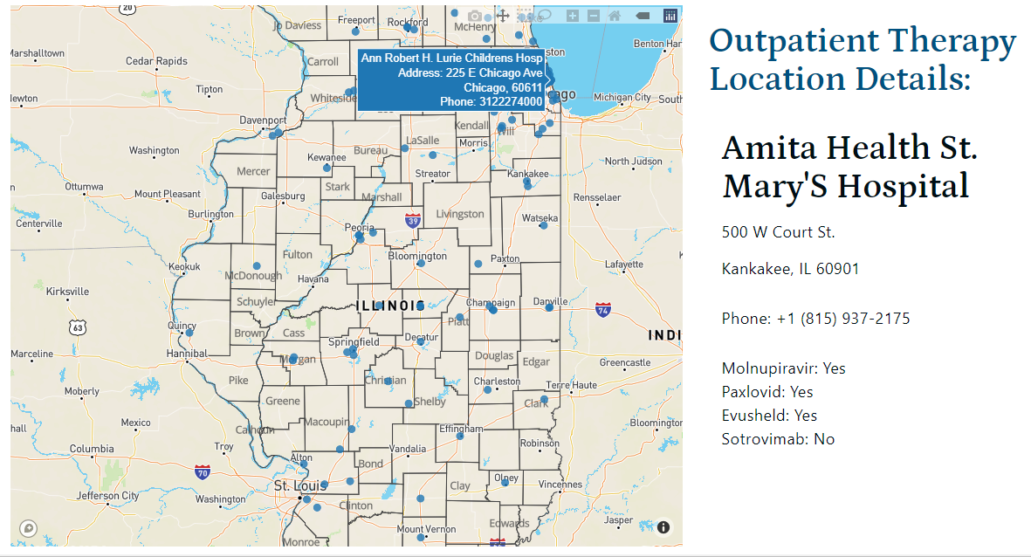
IDPH Covid Outpatient Therapy locator

Slide 29
Make it easier for OB providers / pregnant patients to access Therapeutics
Therapeutics can prevent hospitalizations and deaths (maternal and child) in pregnant with Covid
Oral agents are widely accessible and work against variants
Counsel all pregnant patients to call with symptoms and get tested so can start treatment with in 5 days of symptoms start.

Slide 30
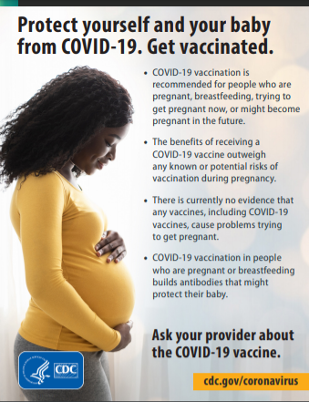
CDC
Protect yourself and your baby
from COVID-19

Slide 31
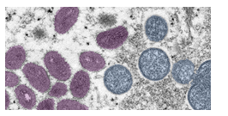
Updates on Monkey Pox and pregnancy

Slide 32
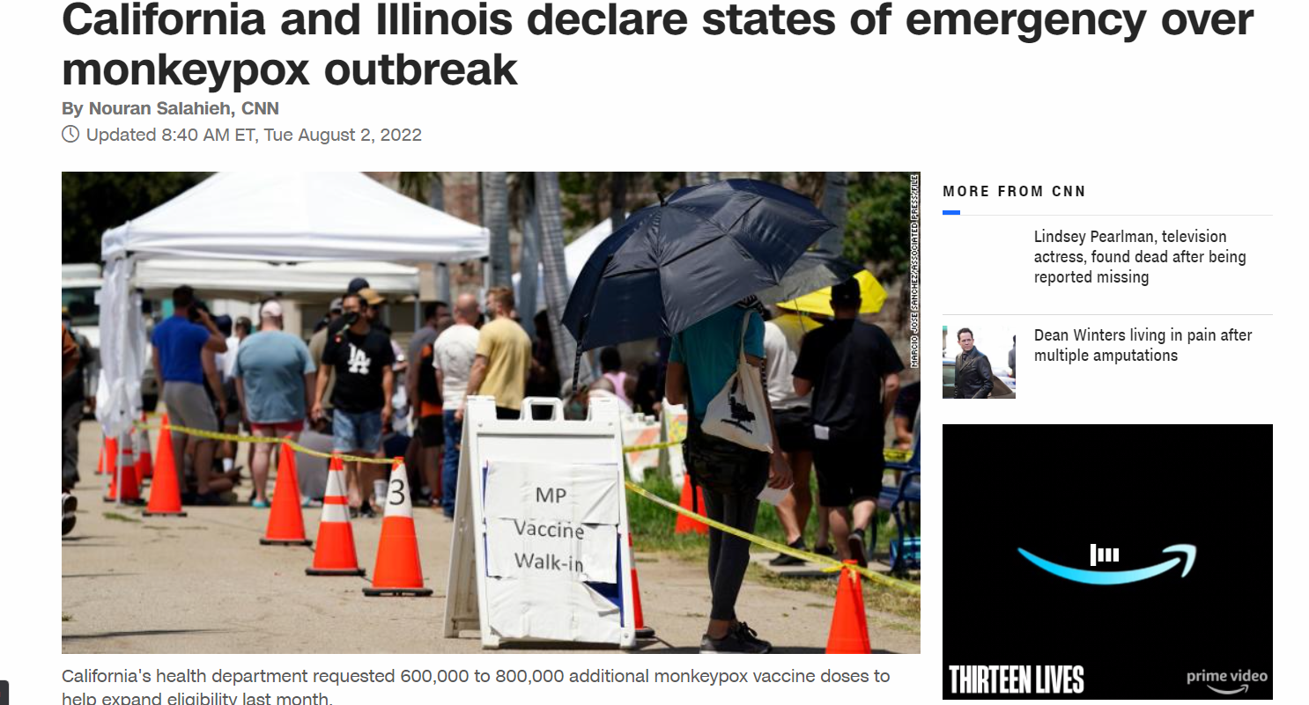

Slide 33
Monkeypox Health Emergency
Now 28,864 known cases worldwide
United States has 7,101 cases, the most cases worldwide
Illinois has >571 cases, the 4rd most cases across all states (behind NY 1,748 cases, CA 826 cases, FL 577 cases)

Slide 34
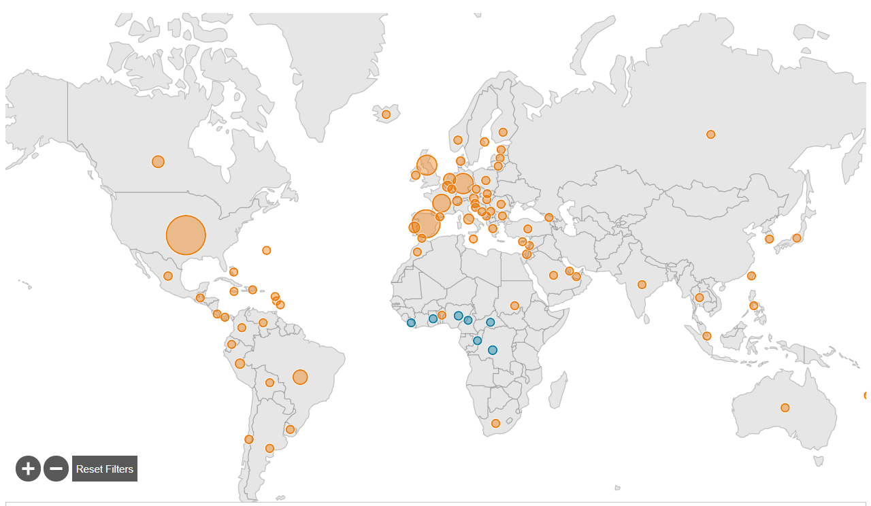
Updated August 4, 2022
26,864 cases worldwide
88 countries
US has the most cases worldwide with 7,101

Slide 35
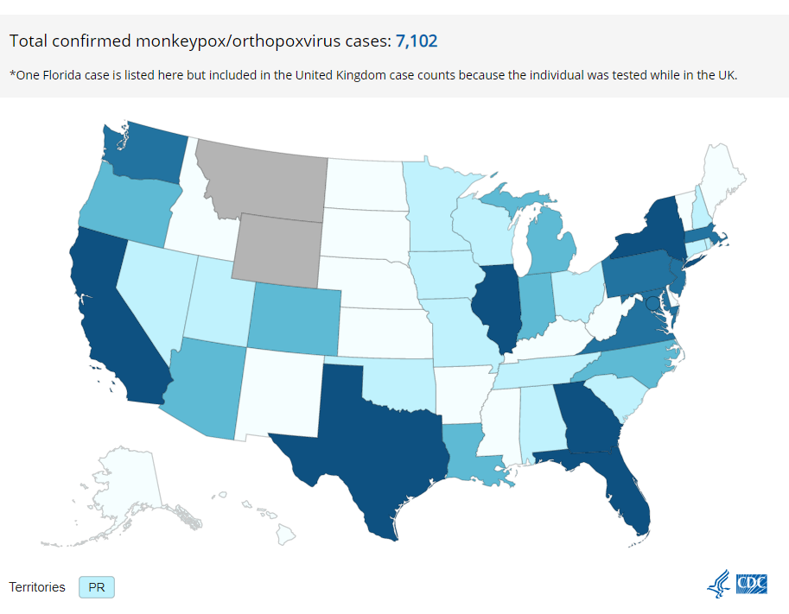
As of August 4, 2022 per CDC
New York — 1,748 California — 826 Florida — 577 Illinois — 571 Texas — 559 Georgia — 544 District of Columbia — 280 Pennsylvania — 192 New Jersey — 188 Washington — 174 Maryland — 162 Massachusetts — 157 Virginia — 122 Arizona — 90 North Carolina — 86 Oregon — 78 Colorado — 78 Louisiana — 69 Michigan — 65 Indiana — 63 Minnesota — 44

Slide 36
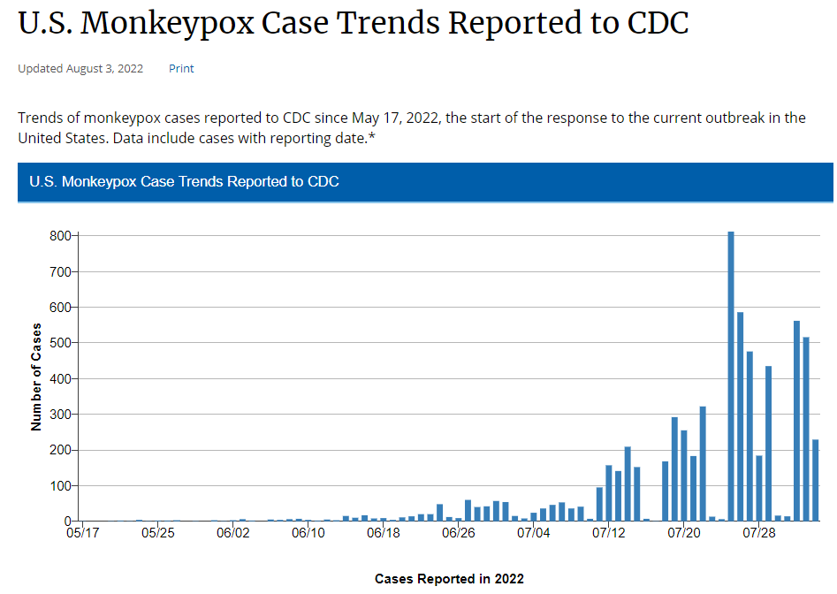

Slide 37
Updated info on Monkeypox and Pregnancy
SMFM Resources:
Monkeypox and Pregnancy - MFM FAQ's (7/19/22)
Partner Resources:
CDC Monkeypox guidance: https://www.cdc.gov/poxvirus/monkeypox/index.html (7/31/22)
CDC: Clinical Considerations for Monkeypox in People Who are Pregnant or Breastfeeding (7/18/22)
CDC Health Alert: Update for Clinicians on Monkeypox in People with HIV, Children and Adolescents, and People who are Pregnant or Breastfeeding(7.30.22)
Outside Resources (Green Journal, Jamieson et al):
A Primer on Monkeypox Virus for Obstetrician-Gynecologists
Last updated on: 7/19/2022

Slide 38
Monkeypox and Pregnancy
Spread by close skin-to-skin contact, respiratory secretions, fomites (bedding)
1-2 wks incubation (no sxs) followed by prodrome (fever, HA, sore throat, fatigue, lymphadenopathy, muscle aches), rash for 2 weeks (first on tongue/mouth, then flat rash on face but spreads to whole body in 24 hrs, then raised lesion, then vesicles, then pustules)
Can be transmitted to fetus and associated with IUFD, PTD, neonatal infection
There are two vaccines – JYNNEOS – live, but non replicating, ok to use in pregnancy; ACAM2000 live and replicating, not for use in pregnancy
Vaccines can be used as pre- and post-exposure prophylaxis
The first line antiviral agent tecovirmimat or TPOXX, can be used in pregnancy
Who to worry about: Fever with LAD preceding painful rash by about 1-2 days.

Slide 39
CDC Health Alert: Monkeypox and Pregnancy what do we know?
5 lab confirmed cases in the literature prior to this outbreak
3/5 cases resulted in fetal loss: 2 miscarriages and 1 IUFD
Fetal remains demonstrated:
Maculopapular rash, hepatomegaly, peritoneal effusions, and hydrops fetalis
High viral loads were detected in the placenta and fetal tissues
1/5 cases with mild Monkeypox delivered health baby at term
1/5 cases was infected 2nd trimester, baby was born preterm 6 weeks later with a generalized rash

Slide 40
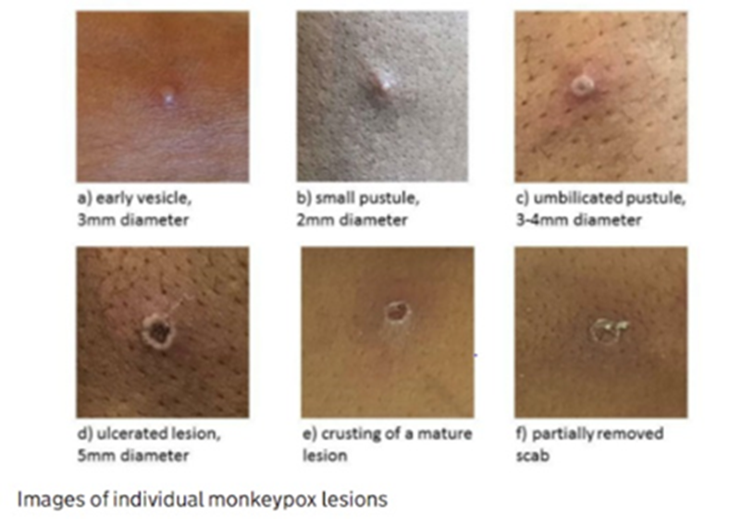
Monkeypox Rash

Slide 41
Monkeypox Rash

Slide 42
CDC Health Alert: Update for Clinicians on Monkeypox in People with HIV, Children, and Adolescents, and People who are pregnant or breastfeeding
People with HIV, individuals who are immunocompromised, children, adolescents, and people who are pregnant or breastfeeding may be at increased risk of disease severity and adverse health outcomes associated with Monkeypox infection.
Other pox viruses are more severe in pregnancy
Monkeypox can be transmitted to the fetus during pregnancy: leading to IUFD, PTD, neonatal monkeypox infection
Frequency of transmission is not known
Unknown if Monkeypox is transmitted in breastmilk, but may be transmitted through close contact during breastfeeding

Slide 43
CDC Health Alert: Prevention Measures for Pregnant /postpartum patients
Pre- and Post-exposure prophylaxis (vaccination) can be offered to pregnant and breastfeeding patients
JYNNEOS Monkeypox vaccine can be used in pregnancy
Live, non-replicating viral vaccine ok to use in pregnancy
Also known as Imvamune or Imvanex
Available human data is insufficient to determine pregnancy specific benefits / risks
Animal studies have not shown evidence of harm and the vaccine should not be withheld from pregnant individuals who are eligible in the context of shared decision making
ACAM2000 Monkeypox vaccine, a live, replicating viral vaccine, should not be used in pregnancy

Slide 44
CDC Health Alert: Identification
During pregnancy, the cause of fever may be difficult to differentiate from other infections (such as chorio) until the monkeypox rash appears.
Pregnant patients with rashes initially considered characteristic of dermatoses of pregnancy (PUPPS, varicella zoster etc) should be carefully evaluated for a monkeypox rash and submission of specimens of lesions for monkeypox diagnosis should be considered.
Especially if the person has any epidemiological risk factors / recent travel or exposures exist
Patients with unexplained fever, rash or significant Lymphadenopathy should be isolated and tested.

Slide 45
CDC Health Alert: Testing
Diagnosis of Monkeypox is a 2 step process
Initial identification of orthopoxvirus.
If confirmed, then specimens are sent for Monkeypox testing
Multiple samples should be collected, ideally from different lesions.
2-3 from different areas of the body or of different appearance to send for PCR testing
Lesion swabs or crusts from lesions are acceptable specimen types.
Given no other orthopox viruses circulating in US now, if + then start treatment options for Monkeypox.

Slide 46
CDC Health Alert: Treatment Pregnant patients
Most adults with Monkeypox self-limiting infection and recover in 2-4 weeks.
Pregnant and breastfeeding patients should be prioritized for medical treatment due to the probable increased risk of severe disease during pregnancy, risk of transmission to the fetus, risk of transmission to the newborn after birth, and risk of severe infections in newborns.
The first line antiviral agent tecovirmimat or TPOXX, can be used in pregnancy
For access to all treatment options contact state health department to request through the CDC / Strategic National Stockpile

Slide 47
CDC Health Alert: exposure
Remain infectious until lesions have resolved, scabs have fallen off and fresh layer of intact skin has formed
Close contacts should monitor symptoms for 21 days, do not need to quarantine
Post-exposure prophylaxis: JYNNEOS Monkeypox vaccine
If given within 4 days of exposure likely will prevent infection
If given within 4-14 days postexposure, reduces symptoms but doesn’t prevent disease

Slide 48
CDC Health Alert: Monkeypox Infection Control
Newborns born to persons with Monkeypox should be placed in isolation
Patients with Monkeypox should be counseled about measures to reduce risk of transmission to their newborn.
Patients with Monkeypox should be isolated, cover any lesions, use a well fitting mask, avoid close contact with others, and do not share clothing, towels, linens.
Healthcare providers should wear standard PPE: gown, gloves and NIOSH approved particulate respirator
Activities that can aerosolize particles (intubation/extubation) should occur in an airborne isolation room
Monkeypox can spread on surfaces/fomites: such as through exposed bandages, bedding or clothing

Slide 49
Overview
Introduction
Overview of updated Covid data and recommendations
Monkey Pox and Pregnancy updates
Discussion of OB Unit Strategies:
Stephanie Fisher, MD - Northwestern Maternal-Fetal Medicine
Anna McCormick, MD - Director L&D, Rush University
Andie Baker -- Deputy Director of Strategy and Programs, EverThrive Illinois
Mary Darby – Burness consulting with ILPQC to create covid-19 education
49

Slide 50
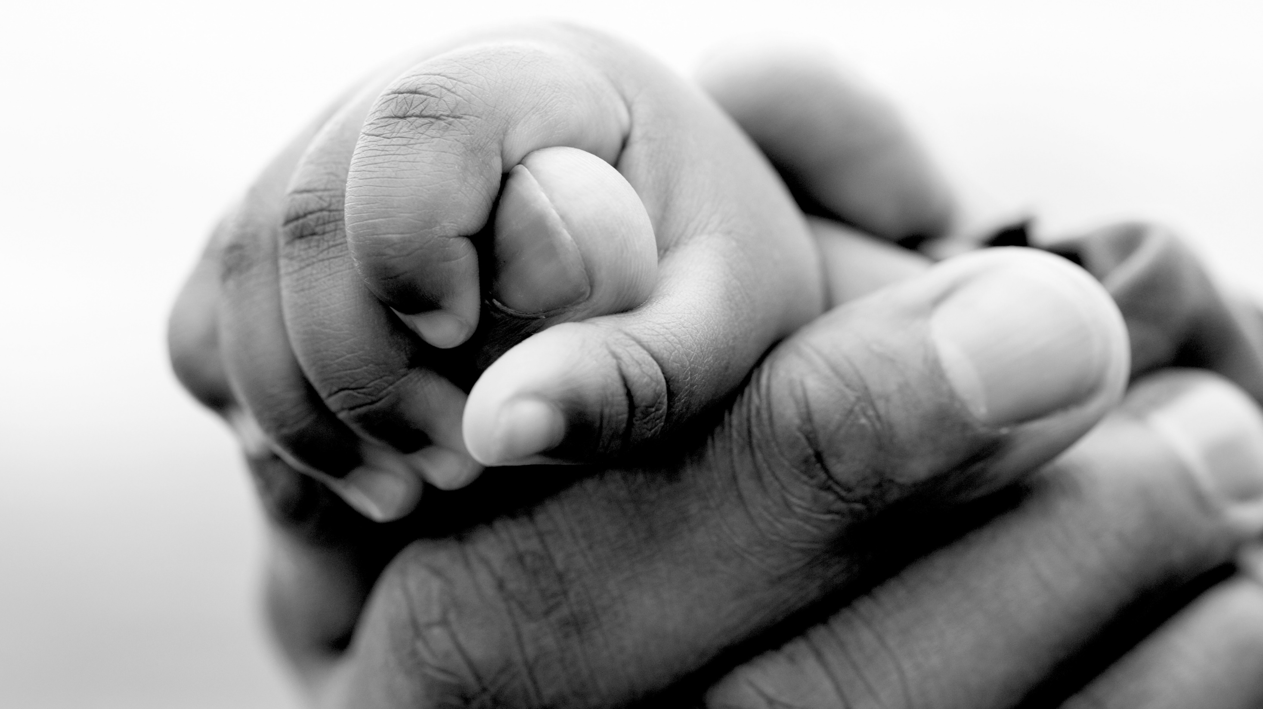
Increasing vaccination rates among Black Chicagoans
ILPQC COVID-19 Strategies for OB and Neonatal Units
Andie Baker, AM
Deputy Director of
Strategy and Programs

Slide 51
About EverThrive IL
OUR MISSION
EverThrive Illinois’ mission is to achieve reproductive justice in the health care ecosystem through community-driven partnership, policy action, and systems change.
OUR VISION
A just and affirming health care ecosystem where individuals, families, and communities can thrive.
OUR VALUES
Reproductive Justice
Anti-Racism
Centering the Most Impacted
Bold Action and Transformation
Notes:
Andie

Slide 52
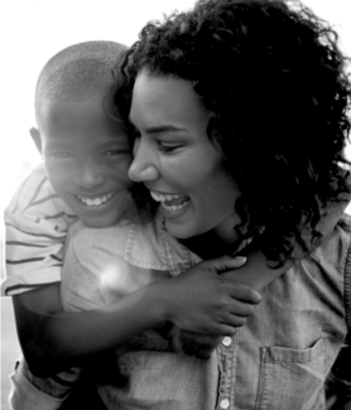
Background
In Chicago, 77.1% of city received at least one does of COVID-19 vaccines, compared to 62.1% among Black Chicagoans
In Chicago, 69.5% of the city completed their vaccine series, compared to 56% percent among Black Chicagoans
We see similar trends statewide with 70% of white Illinoisians receiving one dose of vaccine compared to 63% of Black Illinoisians
Now is the time to close this gap with FDA approval of 6mo to 4-year-olds and anticipated COVID-19 booster available in the fall
Chicago Department of Public Health COVID-19 Dashboard
https://www.chicago.gov/city/en/sites/covid-19/home/covid-dashboard.html
https://www.chicago.gov/city/en/sites/covid19-vaccine/home/covid-19-vaccine-coverage.html
Kaiser Family Foundation, Latest on COVID-19 vaccine by Rac/Ethnicity https://www.kff.org/coronavirus-covid-19/issue-brief/latest-data-on-covid-19-vaccinations-by-race-ethnicity/
Notes:
Andie

Slide 53
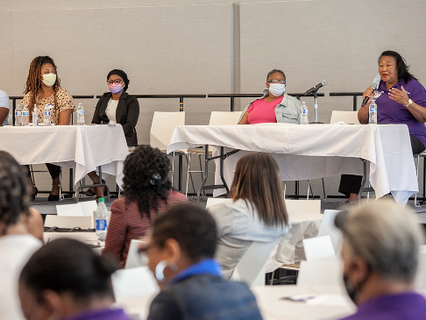
Convening to Identify Effective Solutions
Partnered with Chicago Department of Public Health to host a Roundtable Discussion at Malcolm X College on June 30th
Engaged over 75 attendees from healthcare and social service organizations, faith communities, schools and the health department to identify strategies to close the gap
Publishing a list of recommendations that emerged from the panel and table discussions
Notes:
Talibah
-

Slide 54
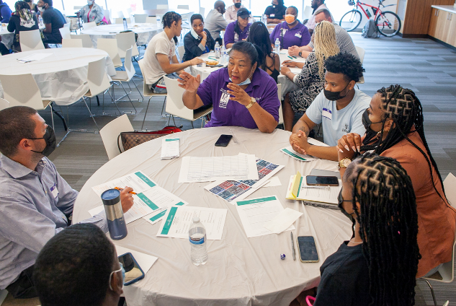
Key Recommendations
1) Strengthen partnerships with Chicago Public Schools and other stakeholders to better utilize schools as a hub for vaccine uptake
2) Increase alignment of COVID-19 messaging across sectors, ensuring materials center Black/African American communities and include testimonies from trusted community members
Notes:
Talibah
-

Slide 55
Key Recommendations
3) Expand events and tailored messaging toward specific communities and populations, including younger populations and interfaith groups.
4) Expand use of community members as vaccine ambassadors and educators to build trust in communities
5) Maintain practices that reduce access barriers for each appointment in the vaccine series.
Notes:
Talibah
-

Slide 56
THANK YOU!!
Andie Baker
Deputy Director of Strategy and Programs
abaker@everthriveil.org
Join our Mailing List:
https://everthriveil.org/contact-us/

Slide 57
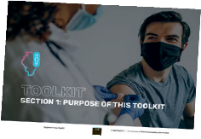
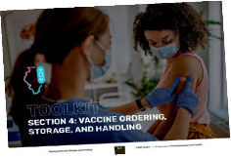
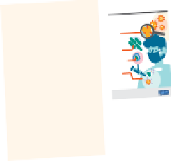
I-VAC NEWSLETTER
JUNE 2022
ILLINOIS VACCINATES AGAINST COVID-19 (I-VAC) DO-IT-YOURSELF TOOLKIT AND OUTREACH MATERIALS
We are happy to announce that the I-VAC do-it-yourself toolkit and outreach bundle are available digitally and can be mailed upon request.
This is a one-stop-shop with up-to-date information about how you can integrate the COVID-19 vaccines into regular clinical workflows from the ground up. It is broken down into self-guided modules that cover topics including:
Becoming a vaccinator
Vaccine ordering, storage, and handling
Vaccine administration
Clinical considerations
Increasing vaccine uptake
And much more – including charts, one page information sheets, etc..
Every source used to compile this toolkit (guidance, policies, and procedures, etc.) around vaccine administration is linked and organized by section to ensure any additional information you might need is easy to find. The toolkit will be updated on a regular basis.
Access the digital version of the toolkit at:
illinoisvaccinates.com/toolkit
ADDITIONAL RESOURCES
OUTREACH BUNDLE
RECOMMENDED
RESOURCES
RECOMENDACIONES
PARA QUE SUS HIJOS
RECOMENDACIONES
TO HELP YOU AND YOUR CHILD
PARA QUE SUS HIJOS
GET THROUGH THE NEEDLESTICK
TIPS & TRICKS
SUPEREN EL MIEDO A LA VACUNA
TIPS & TRICKS
1. Su mano sostiene
^{How}TO H^{m}ELP^{R}YO^{N}U A^{A}ND YCOUOR VCHIILDD -19
SUPEREN EL MIEDO A LA VACUNA
el brazo del exterior
Cómo funcionan las vacunas
1. Inside arm tucked
1. El brazo derecho del
cerca del cuerpo del
de pie enfrente de
2. Su mano sostiene
under adult’s armpit
el brazo del exterior
GET THROUGH THE NEEDLESTICK
1. Inside arm tucked
Vaccines Work
2. Su mano agarra el
cerca del cuerpo del
or stands in front of
the crown-like spikes on their
brazo externo cerca
del niño entre sus
contra el COVID-19 de
2. Adult’s hand restrains
Hable con sus hijos sobre la vacuna.
3. El niño se coloca de
I-VAC
Tenga un plan
lado en su regazo con
How mRNA COVID-19
niño debajo de la axila 1. El niño se sienta en su
usted con las piernas
Hable con sus hijos pequeños el mismo día de la vacunación.
las piernas del menor
izquierda del adulto regazo o permanece
Use these additional
Coronaviruses, like the one that
durante la inyección
the child’s body
su regazo y usted
usted al sentarse
ARNm (mRNA)
Tell younger children on the same day assurthefacveaccine., called spike proteins.
abrazando al niño en
niño
el COVID-19 reciben su nombre
under adult’s armpit 1. Child sits on your lap
Dé más tiempo a sus hijos mayores para hacer preguntas y forjar un plan para que se sientan mejor.
between adult’s legs
3. Abrace a su niño
Talk to your child about getting the vaccine.
3. Child positioned
del cuerpo del niño 2. Sostenga las piernas
Los coronavirus como el que causa
your thighs
cruzadas sobre
muslos
en medio
BEFORE ^{the virus that}
N ANTES
Vaccines Work
targets for vaccines.
3. El niño mira hacia
Decida qué llevar a la clínica para distraer a sus hijos mientras y durante la vacunación.
you as you sit 2. Adult’s hand restrains
niño
or las untas de corona que
over the adult’s lap
CÓMO SOSTENER A SU HIJO MIENTRAS ESTÁ EN SU RE^{GAZO}
with adult hugging the
These spike proteins are ideal
Un juguete o un juego nuevo, su juguete favorito para relajarse o algo para oír música o ver vídeos.
Understanding
OUTREACH
resources to help
the crown-like spikes on their
with legs straddled
^{Give older} children more time to ask questions. Talk with them about a plan for the vaccine so they feel in control.
su pecho
^{Pregunte} a su proveedor de servicios médicos acerca de aplicar alguna crema adormecedora,
causes COVID-19, are named for
HOW TO HOLD YOUR CHILD WHILE SITTING UP ON YOUR ^{LAP}
3. Child facing the adult child’s legs between
Decide what to bring to distract your child when waiting and during the vaccine:
outside arm close to outside arm close to
sin receta médica (lidocaína), en el brazo de su hijo antes de la vacuna.
Coronaviruses, like the one that
están sobre su su erficie, llamadas
3. Hug your child during sideways on lap
child on their chest
causes COVID-19.
the child’s body 2. Hold both of the
proteínas S. Estas proteínas S son
Bring a new toy or game, a favorite toy to squeeze or something to listen to music or watch videos on.
Si su hijo pregunta si la vacuna duele, dígale la verdad. Le puede decir: “Algunos niños sienten un pequeño
Make a plan. causes COVID-19, are named for
Entendamos el
Messenger RNA, or mRNA, is
These spike proteins are ideal
objetivos ideales ara las vacunas.
the injection with child’s legs held
Elógielos y hágales saber lo bien que lo han hecho. Puede decirles:
surface, called spike proteins.
virus que causa
DESPUÉS
Sea sincero
targets for vaccines.
Show them praise and let them know what they did well. You can say things like:
“Lo lograste”. Repita su validación junto con una felicitación. Diga: “Sé que estabas muy nervioso”.
Stay safe from COVID-19
If your child asks if the vaccine will hurt, bteolldthey homwtheto mtrauth.ke pYroouteincans. say, “Some kids say they feel a small pinch
el COVID-19.
“I’m so proud of you for telling us how you feel and for holding so still.”
piquete y algunos un poco de presión. Me puedes decir lo que sientes una vez que hayamos terminado.”
encourage COVID-19
Understanding
AFTER
and some pressure. You can tell me what you feel after it’s done.”
“Estoy muy orgulloso de que me hayas contado cómo te sentías y por no haberte movido”.
the virus that
El ARN mensajero, o ARNm, es
“You did it. I know you were really nervous about that.”
Si tienen miedo, tenga en cuenta sus sentimientos: “Algunas personas se ponen nerviosas antes de visitar
Dígales que es normal que el brazo esté adolorido y que pueden sentirse mal un par ^{de días más.}
preguntar cuando lleguemos”.
pia y fría sobre el brazo. Seguir moviendo o ejercitando el brazo.
BUNDLE
their body is making ways to protect itself.
al doctor. Es normal sentirse de esa manera. Yo estaré a aquí a tu lado. Lo pasaremos juntos”.
causes COVID-19.
Tell them it is normal to have a sore arm or not feel well for a day or two afterwards. ^{This means}
Colocar una toallita lim
you will get through it together.
El cuerpo está construyendo defensas para su protección.
Messenger RNA, or mRNA, is
material genético que le dice al
Cuando el cuerpo
If they are scared, let them know their feelings are okay. Let them know some people get nervous before
Su hijo podría hacer preguntas que quizá usted no pueda responder. Está bien decir: “No sé. Podemos
responde a la
seeing the doctor and it is normal to feel that way. Tell them you will be right there with them and
responds to the
genetic material that tells your
cuer o cómo roducir roteínas.
leve, escalofríos o
Place a clean, cool washcloth on their arm. Keep moving or exercise the arm.
hild can take these
Puede darles una medicina para el dolor que no requiere receta médica (acetaminofén o ibuprofeno)
vaccination uptake
vacuna, a veces
wrapped in a coating that makes
When your body
body how to make proteins.
You can give over-the-counter medicine for pain (acetaminophen or ibuprofen) only if your c
sometimes cause a
si su(s) hijo(s) pueden tomar esta clase de medicamentos.
^{How} I get my COVID-19 shot
puede causar fiebre
^{Ask your} provider about numbing medicWatihonastthatis mmaRNy beA?available to be used prior to the vaccination
The vaccine is made of mRNA
mild fever, headach
y es un signo de
Your child may ask you a question you are not sure how to answer. It is OK to say you don’t know
and can ask when you get there.
medications (check with your provider if not sure)
dolor de cabeza. Esto
Be honest. genetic material that tells your
Deje que sus hijos decidan lo más posible:
responds to the
La vacuna está com uesta or
URANTE
vaccine, it can
delivery easy and keeps the body
When your body
sometimes cause a
virus; por lo
Looking for more Information on vaccine management?
It cannot change
que la vacuna está
from damaging it.
your DNA in any way.
¿Busca información sobre cómo manejar los dolores asociado con la vacuna?
¿Qué es el ARNm?
La vacuna NO
Posiciones Cómodas para Procedimientos Pediátricos • Reducir el Dolor de las Vacunas en Niños y
tanto, no puede
cambiar su ADN de
virus, so it cannot and a sign that the
Estrategias para Lidiar con Inmunizaciones y Dolores
facilita su trans orte e im ide que
contiene NINGÚN es totalmente normal
Comfort Positioning for Pediatric Procedure • Reduce Vaccine Pain in Infants
The vaccine DOES or chills. This is
Infantiles: The Coping Toolbox, a Child Psych Podcast • No Tiene que Doler – Recursos para Padres
in your communities!
mild fever, headache
ARNm envuelto en una ca a que
Tampoco puede
rebrand.ly/ComfortingPositions rebrand.ly/InfantVaccinePain
rebrand.ly/VaccinePainKidsandTeens
wrapped in a coating that makes
DURING
Distracción en Acción para Ayudar a sus Hijos Durante • No Tiene que Doler – Video de YouTube
e,
^{NOT contain ANY} completely normal • ¿Quieren ver la vacunación o voltearse? • ¿Quieren escuchar música o v er un vídeo?
What is mRNA?
Anticuerpo
Coping Strategies for Childhood • Reduce Vaccine Pain in Kids and Teens
rebrand.ly/ComfortingPositions Adolecentes
The vaccine is made of mRNA
NOT contain ANY completely normal
rebrand.ly/VaccinePainKidsandTeens
rebrand.ly/CopingStrategies rebrand.ly/ItDoesntHaveToHurt
It cannot change
el cuer o lo dañe.
What is in the vaccine?
¿Quieren sentarse en su pierna o en la suya? usted esté en el cuarto con ellos?
Do they want to watch or look away? The mRNA in• Dothe thevacycinwante teactohlisesten to music or watch a video?
Cómo Puede Ayudar a Reducir el Dolor de la
We developed culturally and
Antibody
give you COVID-19. vaccine is working. • ¿Quieren que el proveedor cuente hasta tres? • Para niños mayores de 10 años: ¿Quieren que
virus, so it cannot and a sign that the
Immunizations and Pain: The Coping
your DNA in any way.
causarle COVID-19. funcionando.
Give them a choice.
The vaccine DOES or chills. This is
ninguna manera.
Toolbox, a Child Psych Podcast • It Doesn’t Have to Hurt Parent resource
delivery easy and keeps the body
give you COVID-19. vaccine is working.
Do they want the provider to count to 3? your cells h•owForto mkidakse10+:copieDos they want you to be in the room
Pregunte al proveedor si tiene algo para ayudar con el dolor de la jeringuilla.
rebrand.ly/CopingStrategies rebrand.ly/ItDoesntHaveToHurt
^{vaccine, it can} Deles una opción
from damaging it.
of the spike pwroittheinth.emIf you? are
rebrand.ly/Distrac tion
^{Download} these pre-
Distraction in Action Helping Your Child • It Doesn’t Have to Hurt YouTube video
Procedimientos Médicos rebrand.ly/ItDoesntHaveToHurt_Video
rebrand.ly/ReduceImmunizationPain para acceder a los enlaces
,
¿Qué contiene la vacuna?
rebrand.ly/ItDoesntHaveToHurt_Video
it down and get rid of it.
AYUDA Eliminar el Dolor en Niños y Adultos Inoculación de Sus Hijos
Reducir el Dolor de las Vacunas en Infantes
El ARNm de la vacuna le enseña a
células lo destruyen y eliminan.
During Medical Procedures
After the mRNA delivers the
piernas cuanto estén sentados en ellas.
Después de que el ARNm ha
Do they want to sit on your lap or by their seexlf?posed to the real virus later,
rebrand.ly/HELPkids
linguistically appropriate
las células cómo roducir co ias
transmitido las instrucciones, las
rebrand.ly/DistractionAction
reb and.ly/ReduceImmunizationPain
to access the links
Deje que sus hijos se sienten durante la vacunación. Para niños de 2 a 3 años, usted los puede sostener en sus
Immun
de la proteína S. Si usted se
or children ages 2 to 3,
What is in the vaccine?
Decrease pain and anxiety. your body will recognize it and
rebrand.ly/InfantVaccinePain
The mRNA in the vaccine teaches
it down and get rid of it.
How
After the mRNA delivers the
rebrand.ly/HELPkids
know how to fight it off.
instructions, your cells break • Hacer algo distinto puede. Enfocarse en otras cosas puede disminuir el dolor del piquete de la aguja:
your cells how to make copies
How does the
instructions, your cells break
su cuer o lo reconocerá y sabrá
HELP Eliminate Pain in Kids and Adults ization Pain
when they are sitting on your lap.
^{made posters,} videos, or
of the spike protein. If you are
ex one al virus real más adelante,
^{Allow your child} make as many choices asvpossiaccineble:work?
soplando burbujas, leer los libros de I-Spy o distraerse con un jugar juego del en el teléfono celular.
materials to go along with existing
exposed to the real virus later,
Let your child sit up during the vaccine. F you can hold them on your lap
^{Antibody} Disminuir el dolor y la ansiedad
Escanee el código
Doing something else can decrease your child’s pain during the needle stick: blowing bubbles,
Estosconsejosfueron desarrollados porunequipo multidisciplinariodeprofesionalesenelárea deasistenciamédicaconexperiencia La información que contiene este folleto se considera precisa. Sin embargo,
your body will recognize it and
cómo combatirlo.
I-spy books or playing a cellphone game.
en el manejo del dolor en niños a lo largo de múltiples organizaciones pediátricas y producido por el Rush Patient Education Planning preguntas y preocupaciones sobre su propia salud deberán ser consultadas
¿Cómo funciona
These tips were developed by a multidisciplinary team of health care professionals with expertise The information contained in this brochure is believed to be accurate;
and Development Oversight Committee. Readaptado por el Departamento de Salud Pública de Chicago, bajo permiso. con su proveedor de servicios médicos.
Try not to say things like “you are OK” or give false ideas like “you won’t feel a thing”.
Do not focus on the pain.
You Can Help Reduce Your Kids’ Scan the ^{Qr Code}
la vacuna?
in children’s pain management, from across multiple pediatric organizations, and was produced however, questions about your individual health concerns or treatments
For information about COVID-19 vaccine,
^{social} graphics to share
know how to fight it off.
by the Rush University Medical Center Patient Education Planning and Development Oversight should be referred to your health care provider.
outreach materials to create an
How does the
Committee. It was re-purposed by the Chicago Department of Public Health with permission.
vaccine work?
Para obtener información sobre la vacuna contra el COVID-19, visite
Evite decir frases como “estás bien” o dar falsos indMyicios cdomocto “noorsenstiraysás nadaI”.nNeedo se enftooquegeten el daoloCr. OVID-19 shot.
outreach bundle for your clinical
For information about COVID-19 vaccine,
https://espanol.cdc.gov/coronavirus/2019-ncov/vaccines/index.html
DOWNLOAD
^{with} your patients and
DOWNLOAD
GETTING VACCINATED?
The shot helps keep me from getting very sick from COVID-19.
spaces. These materials help
visit: cdc.gov/coronavirus/vaccines
DOWNLOAD
DOWNLOAD
Información relevante adicional en la parte de atrás
^{display} these resources
COVID Latino Video—
¿SE VA A VACUNAR?
More impvoisirtt:acndct.goinfv/cormoronatiaovirnus/von tachecineotsher side DOWNLOAD
DOWNLOAD
encourage COVID-19 vaccination
GETTING VACCINATED?
DOWNLOAD
CDP Poster—
in your clinical spaces,
^{“Does the COVID-19 vaccine} cause infertility?”
CDPH Poster—“Tips &
uptake in your community and
CDC Poster—“Cómo
^{CDC} Poster—“How mRNA
“Recomendaciones ^{Para}
^{on your} organization’s
^{“¿Causa Infertilidad} la Vacuna COVID-19?”
Tricks to Get Through ^{the}
CDP Vaccine Storybook—
CDC Poster—“How ^{mRNA}
Que Sus Hijos Superen ^{El}
will be mailed to your clinic
^{Format:} Video Download Only
Funcionan Las Vacunas
^{COVID-19 Vaccines Work” “Stay} Safe—How I get my
^{social} media pages, and
Vaccines Work”
Needlestick”
^{F}ormat: 8.5”x11” PDF
upon request OR you can
Languages: Spanish
Format: 8.5”x11” ^{PDF} Miedo ^{a la Vacuna”}
^{website.} Together, we
Format:
8.5”x11” PDF Contr^{a El COVID-19 de}
^{Languages:} English, Arabic,
COVID-19 shot”
simply download these posters,
Languages: English Format: ^{8.5”x11” PDF}
Languages: ^{English} ARNm (mRNA)”
Chinese, Korean, Tagalog,
^{Format:} 11”x8.5”, 13-page PDF
Format: 8.5”x11” ^{PDF}
Languages: Spanish
can vaccinate Illinois!
^{Spanish,} Vietnamese, Russian
Languages: English, Spanish
handouts, and activities to share
Languages: Spanish
with your patients. Together,
THE DO-IT-YOURSELF TOOLKIT
we can vaccinate Illinois!
I WANT TO
GETTING MY
GET BACK TO
COVID-19
MY FAVORITE
VACCINE MEANS
ACTIVITIES.
I CAN GET BACK
TO MY FAVORITE
ACTIVITIES.
A safe and effective vaccine to prevent
A safe and effective vaccine to prevent
COVID-19 is now available for everyone 12 years
and up. Get yours today!
COVID-19 is now available for everyone 12 years
and up. Get yours today!
Learn more: www.cdc.gov
DOWNLOAD
Learn more: www.cdc.gov
DOWNLOAD
DOWNLOAD
DOWNLOAD
DOWNLOAD
DOWNLOAD
DOWNLOAD
Protecting Immigrant Familes Coalition Video—“COVID
ICAAP Poster—“Are ^{You ICAAP Poster—“¿Está}
Vaccine: Safe, Free, and the Right Choice for Your Family”
^{CDC Poster—}“Get Back to
^{Format:} Video Download Only
Up To Date with Y^{our Actual Con la Vacuna de}
ICAAP Poster—“Dat^{os Sobre Las Vacunas}
My Favorite Activities”
^{CDPH} Poster—“Why Get
ICAAP Poster—“The ^{Facts About the}
Languages: English, Arabic, Chinese (Mandarin), Haitian Creole, French,
COVID-19 Vaccine” ^{COVID-19?”}
De COVID-19”
^{F}ormat: 8.5”x11” PDF
Vaccinated”
^{Korean, Spanish,} Tagalog, and Vietnamese
Format: 12”x18” ^{PDF Format: 12”x18” PDF}
COVID-19 Vaccines”
Format: 18”x12” ^{PDF}
Languages: English, Spanish
Format: 15”x15” PNG
Languages: English ^{Languages: Spanish}
Format:
18”x12” PDF
Languages: Spanish
Languages: English
Languages: English
Page 1 of 2 Additional resources at illinoisvaccinates.com
Page 1 of 2 Additional resources at illinoisvaccinates.com
THE I-VAC OUTREACH BUNDLE
This is a collection of patient-facing resources designed to help normalize COVID-19 vaccines. These posters, handouts, etc. convey medically accurate information about COVID-19 vaccines and were developed with diverse audiences and health literacy levels in mind.
Some resources are meant to be shared via social media or digitally, while others are printed out to hand directly to
patients or hang in your clinical spaces. The materials cover a diverse range of topics and are available in multiple languages.
Browse the outreach bundle at:
illinoisvaccinates.com/resources
Request hard copies of the toolkit or outreach materials at illinoisvaccinates.com/contact.
E-mail facts@ilvaccinates.com with questions.
illinoisvaccinates.com

Slide 58
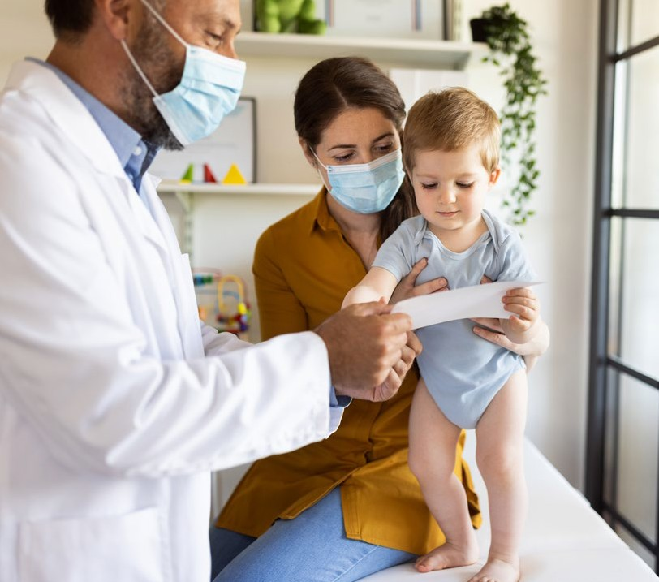
UPCOMING EVENTS:
JUNE 15, 5:30 PM
I-VAC & ECHO Learning Collaborative - Adult Populations
Register on Zoom
JUNE 17, 7:30 AM
I-VAC Vaccine Bootcamp
Register on Zoom
JUNE 21, 5:30 PM
I-VAC & ECHO Learning Collaborative - Pediatric Populations
Register on Zoom
JUNE 29, 5:30 PM
I-VAC & ECHO Learning Collaborative - Adult Populations
Register on Zoom
JULY 5, 5:30 PM
I-VAC & ECHO Learning Collaborative - Pediatric Populations
Register on Zoom
COVID-19 VACCINE FOR UNDER 5, WHAT WE KNOW NOW
In just a few weeks, it will be the littlest kids’ turn to receive a COVID-19 vaccine. This means infants, toddlers and preschoolers will finally be protected and parents and families will have some peace of mind after more than two years of navigating their safety. It is more important than ever that these younger age groups be vaccinated in their medical homes to ensure they are also getting their other routine vaccinations in a timely manner. We also know parents trust information about these vaccines coming from their child’s pediatrician the most. We are here to help you in preparing now.
According to the Centers for Disease Control and Prevention’s (CDC) Pediatric Planning Guide: The Vaccines and Related Biological Products Advisory Committee (VRBPAC) is tentatively scheduled to meet on June 14 and June 15 regarding Moderna and Pfizer’s EUA request. CDC’s Advisory Committee on Immunization Practices (ACIP) is anticipated to meet within several days of VRBPAC, assuming FDA authorization; the meeting(s) will be posted here once scheduled.
Pfizer-BioNTech and Moderna have conducted clinical trials and data collection for COVID-19 vaccines for children ages 6 months through 4 years and 6 months through 5 years, respectively. Either one or both vaccines may receive FDA Emergency Use Authorization (EUA) and CDC recommendation. Additional information will be released as it becomes available here.
While there are still questions and much anticipation as to what the next steps will be, it is important to start preparing and acting now.
JULY 13, 5:30 PM
I-VAC & ECHO Learning Collaborative - Adult Populations
Register on Zoom
JULY 19, 5:30 PM
I-VAC & ECHO Learning Collaborative - Pediatric Populations
Register on Zoom
JULY 27, 5:30 PM
I-VAC & ECHO Learning Collaborative - Adult Populations
Register on Zoom
illinoisvaccinates.com

Slide 59
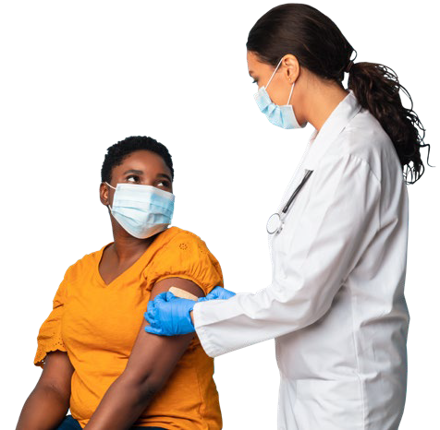
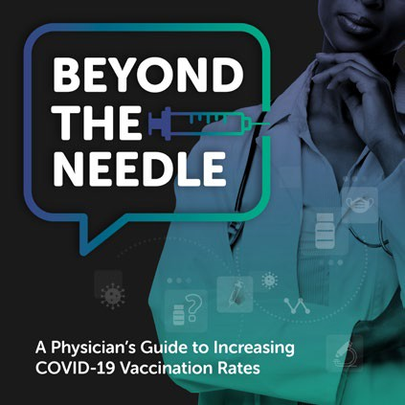
VACCINE UPDATES CORNER:
COVID-19 VACCINE UPDATES:
Summary of recent changes from the CDC Interim Clinical Considerations for Use of COVID-19 Vaccines Currently Approved or Authorized in the United States (last updated May 20, 2022):
New guidance for use of a Pfizer-BioNTech COVID-19 Vaccine booster dose in children ages 5–11 years
Updated guidance that the following people should receive a second COVID-19 booster dose:
People ages 12 years and older who are moderately or severely immunocompromised
People ages 50 years and older
Updated guidance for people who are moderately or severely immunocompromised and are treated with B-cell-depleting therapies
Clarification of COVID-19 vaccination guidance for multisystem inflammatory syndrome in children (MIS-C) and adults (MIS-A)
Updated guidance for primary series vaccination after SARS-CoV-2 infection
The Advisory Committee on Immunization Practices (ACIP) approved booster shots:
Would be the third dose available for most children ages 5–11
The fourth dose for immunocompromised children ages 5–11
I-VAC PODCAST: BEYOND THE NEEDLE
A PHYSICIAN’S GUIDE TO INCREASING COVID-19 VACCINATION RATES
Beyond the Needle is a podcast for and by physicians. You can sit down with primary care clinicians across the state as they tackle the real-world barriers to COVID-19 vaccination uptake and share experiences with implementation. Together, you’ll uncover practical solutions to help you and your team incorporate the COVID-19 vaccine into your practice and increase vaccination rates amongst your patients.
This podcast honors the struggles and traumas of the pandemic, empowers primary care clinicians to feel confident in implementing COVID-19 vaccinations so that your patients can receive a vaccine within their usual site of care.
Topics we’ll cover:
Implementation Barriers
Vaccine Hesitancy
Special Populations
Motivational Interviewing
LEARN MORE & LISTEN AT:
illinoisvaccinates.com/podcasts
View Episodes
Meet the Faculty
illinoisvaccinates.com

Slide 60
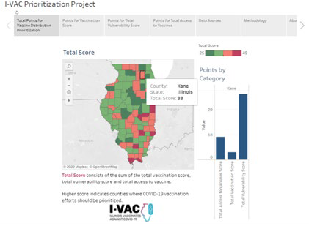
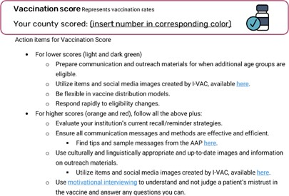
Tips for Pediatric
HELPING TEENS TALK WITH THEIR PARENTS ABOUT VACCINES
Supporting your teen/minor patients who want to be vaccinated, when their parents or guardians don’t want them to be vaccinated can be complicated. ICAAP created a handout for teens and for clinicians on how to approach these conversations between healthcare provider and teen and teen and parent/guardian. We hope you find them useful.
Download Handout for Teens Download Tips for Clinicians
Providers
Use this guide to help support your patients in
having productive conversations with their parents
or guardians about the benefits of vaccination.
Consider your patient’s Piaget’s Cognitive Developmental Stages on patient counseling when communicating with them
about their medical care and vac^{cinations}
Tips for Talking with Your Parents
Approximate Developmental General
Counseling
Example
Age (yrs) Stage Considerations
or Guardians about Vaccines
No counseling recommended
information given
It might be that your parents or guardians unsure about vaccines. Perhaps you would
0–2 Sensory Motor • Not able to process medication
like to be able to talk to them about this in a way that is helpful to both of you.
implications of the future
It tastes pretty good and I think you will like it.
^{Well, that} is what this handout is for.
Do you have any questions for me?
Cannot comprehend cause and effect or • This medicine will make you feel better.
Visual displays are effective
can affect their health
2–7 Preoperational • Unable to understand how their actions • Your mom or dad will give it to you when you wake up and before you go to sleep.
Begin to be able to understand diseases • This medicine will help get rid of the pain and infection in your ear
Concrete and different aspects of a situation • You will take it when you get up in the morning and before you go to bed.
Operations • Better understand concrete examples • It’s important to take it every day for 10 days so your infection doesn’t come back.
7–11
than hypothetical situations • Do you have any questions for me?
This amoxicillin will decrease the bacteria in your ear to get rid of your ear infection.
^{Find a time when ev}eryone is free, when there isn’t
Understand illness, how it occurs and • You will take it twice a day, in the morning and evening for 10 days.
^{anything stressful} going on, and no one is distracted
(e.g. not during a car ride).
^{Listen to your par}ents’ concerns and learn about
≥12 • Capable of logical reasoning you start feeling better so the infection doesn’t come back.
why they feel how they do.
at the same level as an adult • You can take amoxicillin with food to help decrease upset stomach.
Formal how they can control it • Your should start feeling better in 2 days, but it is important to keep taking it even if
What questions do you have for me?
^{Talk about how y}ou are feeling – your concerns,
^{Operations} • Typically able to receive a message • Be sure to talk to your parents if you still feel bad after 2 days or if you get a rash.
Source: Communication Strategies for Empowering and Protecting Children.
^{your h}opes, why this is important to you.
^{Don’t fight – if it} the conversation isn’t going well,
Present the facts:
try again another time.
^{There is medica}l and scientific evidence that show
Answer the patient’s questions about vaccines. Know the situations in which a minor may be able to
COVID-19 Vaccines
vaccines are safe and effective.
consent to care: Patients under ^{18 typically cannot consent}
Inform them of the expected immunization to medical care or vaccination wi^{thout a parent/guardian’s}
^{Vaccines and th}e possible short-term side effects
s include:
^{These vaccines are} proven to prevent severe illness,
schedule and required vaccinations and why approval. Exceptions to thi
death and long COVID-19.
these are mapped out (to protect ^{them when they}
^{(sore arm, headach}e, fever, etc.) from them are much
A minor who is 12 or older who ^{may have come into contact}
^{The studies on safet}y of COVID-19 vaccines were not
are most vulnerable or before the^{y are exposed to}
^{less dangerous than v}accine-preventable diseases and
with any STI may give consent to ^{the furnishing of medical}
vaccine preventable diseases.)
their potential long-term effects.
care or counseling related to the ^{diagnosis or treatment of,}
^{rushed; they were we}ll-funded (meaning they had a lot
Review the CDC’s Parents’ Co^{mmonly Asked}
^{The Human P}apillomavirus (HPV) vaccine can
or vaccination against, an STI (H^{PV or Hepatitis B vaccine)}
^{of money available qu}icker than other studies) so steps
Questions about Vaccines to h^{elp prepare}
^{prevent cancer! It is} important to be vaccinated before
^{could ha}ppen at the same time vs. waiting.
being exposed to HPV.
Minors who are married, pregna^{nt, or a parent}
the patient for conversations with ^{their parent or}
^{A p}erson who has been vaccinated:
guardian.
Patient is an unaccompanied m^{inor seeking care. This is}
^{Might still get s}ick, but is much less likely to get
^{All major religion}s support vaccines! You can visit
a person at least 14 years of age ^{but less than 18 years of}
^{severely} sick, become hospitalized, or die.
Encourage teens to:
^{whyimmunize.org}/religion-and-vaccines to learn
age who is living separate and ap^{art from his or her parents}
Listen to their parents’ perspect^{ive}
^{more ab}out what religions and vaccines.
or legal guardian, whether with o^{r without the consent of a}
^{May be} sick for a shorter amount of time.
parent or legal guardian who is u^{nable or unwilling to return}
^{Maybe not} have to quarantine, miss school or
Share their own personal persp^{ective/feelings}
^{Vaccines don’t just} help protect you, but they protect
other activities.
Give their parents the facts abo^{ut vaccines}
^{those around th}em (babies, immunocompromised
to the residence of a parent and m^{anaging his or her own}
^{Is pro}tecting themselves and loved ones
^{friends/family, th}ose who can’t get vaccines, older
personal affairs. “Minor seeking c^{are” does not include}
ctive custody, temporary
people/grandparents, etc.).
minors who are under the prote
^{from} COVID-19 (grandparents, infants,
immunocompromised)
Share ICAAP handout and/or fam^{ily resources}
custody, or guardianship of the D^{epartment of Children and}
^{webpage with them.} Family Services. Learn more abo^{ut minors seeking care in}
^{Visit the websites belo}w to learn more about COVID-19
the Consent by Minors to Healt^{h Care Services Act.}
^{and other va}ccines, so you are prepared for a
conversation with your parents.
Illinois Chapter, American Academy of Pediatrics | illinoisaap.org
Share your perspective:
^{How does not} having a COVID-19 vaccine make
you feel?
^{What areas of} your life will not being vaccinated
change or impact?
For additional resources and
^{inf}ormation about minor consent
^{l}aws, scan the QR code or visit:
^{illin}oisaap.org/family-immunization-resources
Illinois Chapter
COVID-19 PRIORITIZATION PROJECT
PROJECT BACKGROUND
A key initiative of I-VAC is to identify areas of the state with lower COVID-19 vaccine coverage and performing targeted outreach and education in those areas. This led us to the I-VAC COVID-19 Prioritization Project. This data can inform priority areas for clinicians and healthcare organizations.
Access the I-VAC Prioritization Project
VACCINE SCORES
For this project, we used several data sources and broke them into three distinct vaccine scores. These include a vaccination score, a vulnerability score, and an access score. The vaccination score measures vaccination rates in that county and includes % of the total population fully vaccinated,
% 5–11-year-olds fully vaccinated, and % 12-17-year-olds fully vaccinated. The vulnerability score measures characteristics of the patient population based on the CDC’s Social Vulnerability Index and COVID-19 Community Vulnerability Index. The access score measures how accessible the COVID-19 vaccines are and includes the rate of primary care physicians, rate of certified pediatricians, and rate of locations that are currently providing the COVID-19 vaccines.
Then each variable was broken down into quartiles and given a score. Scores for each variable within the category were totaled to create a Total COVID-19 Vaccine Prioritization Score. Counties with the highest scores should be prioritized for COVID-19 vaccine distribution and outreach efforts.
DATA SOURCES
The sources for these data include IDPH, CDC, census.gov, countyhealthranking.org, and apb.org. You can find a detailed list of the sources and how they were used on the dashboard under the ‘Data Sources’ tab. The dashboard is being updated monthly.
We hope you will find this information helpful for supporting your COVID-19 vaccination programs!
VISIT OUR WEBSITE
illinoisvaccinates.com
JOIN US ON SOCIAL MEDIA
@illinoisvaccinates @ILVaccinates
I-VAC Newsletter • June 2022
4

Slide 62
Sub-grantees
The Extension for Community Health Outcomes (ECHO)-Chicago at the University of Chicago
The Illinois Academy of Family Physicians
(IAFP)

Slide 63
Foundational Training
Learning
Collaboratives
Implementation Support
Toolkit & Outreach
Materials

Slide 64
Foundational Training
“Vaccine Bootcamps” provide foundational knowledge and skills related to
COVID-19 vaccine administration and distribution:
Operational issues (I-CARE, VFC, etc.)
Handling, storage and preparation
Clinical resources for adult and pediatric populations
Strategies for overcoming vaccine hesitancy
Web-based – free CME
Next one: Friday, September 23rd from 8AM-12:15PM. Register here

Slide 65
Learning Collaboratives
Forum for providers to engage with their peers around solving real-world
barriers to COVID-19 vaccine implementation
Available to any provider or provider organization in the state who is interested, regardless of bootcamp participation
Held bi-weekly – drop in as needed – web-based – free CME
August 10 (Adult Populations): Register here
August 16 (Pediatric Populations): Register here
August 24 (Adult Populations): Register here

Slide 66
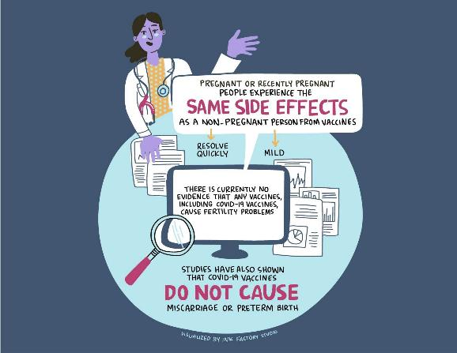
Implementation Support
Local providers in primary care and hospital networks serve as coaches
From each of the 11 COVID-19 regions in
the state
Support throughout the process
Upcoming drop-in office hours:
8/5
8/9
8/19
8/25
8/31

Slide 67
DIY Toolkit

Slide 68
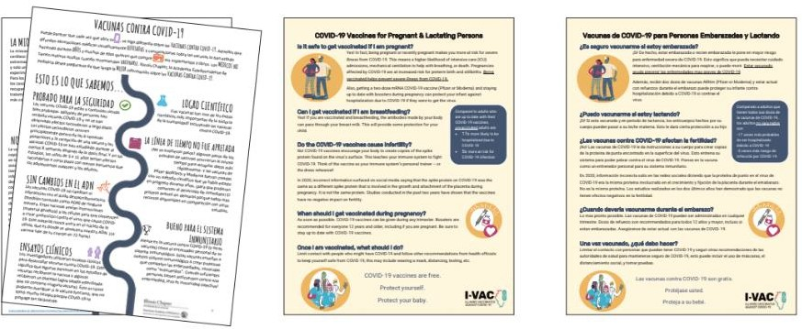
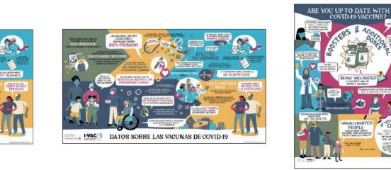
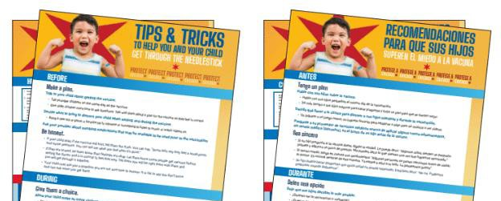
Outreach Materials

Slide 69
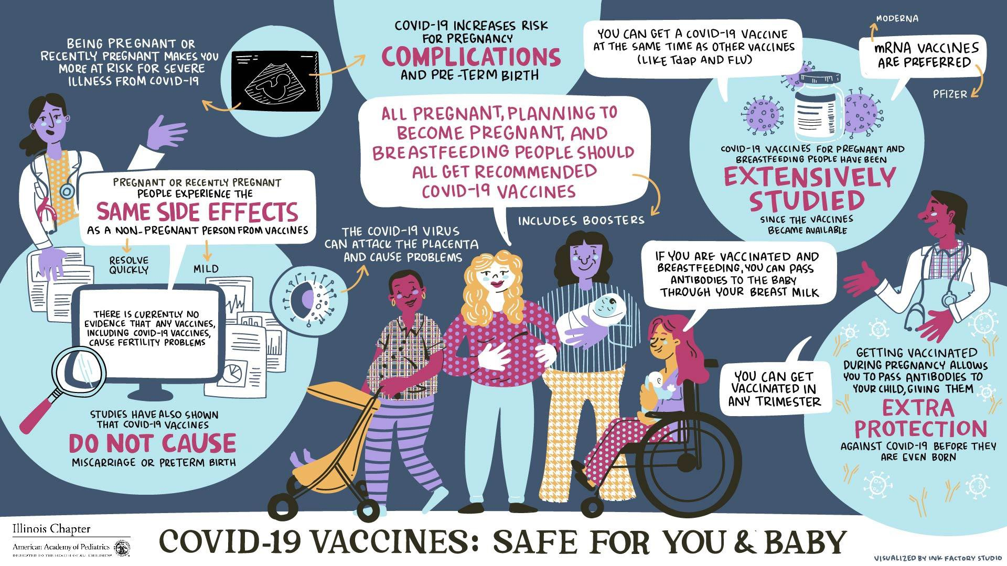
LINK TO REQUEST AN OUTREACH BUNDLE

Slide 70
BEYOND THE NEEDLE PODCAST
A Physician’s Guide to Increasing COVID-19 Vaccination Rates

Slide 71
ILPQC Vaccine Interviews & Focus Group Report
Summary of findings to promote COVID-19 vaccination among pregnant people
August 5, 2022

Slide 72
Table of Contents
Background and Methodology
Patient Materials
Provider Materials
Findings
Recommendations and Next Steps
Appendix
72

Slide 73
Background and Methodology

Slide 74
Research Objective
Learn how pregnant people, or those thinking of becoming pregnant, are making decisions regarding the COVID-19 vaccine.
Understand what patients view as the benefits of the vaccine for themselves and their babies and also the questions and concerns they have about the vaccine.
Gather feedback on content and messaging that is most powerful and persuasive to encourage vaccination.
74

Slide 75
Methodology
Two online focus groups and a one-on-one interview with vaccinated and unvaccinated
Four interviews with practitioners from across Illinois.
75

Slide 76
Materials Appendix
CDC Poster Protect Yourself and your Baby from COVID-19. Get Vaccinated
SMFM Poster Pregnant? Thinking about Pregnancy? Recently Pregnant?
Cook County Brochure I’m Pregnant! Should I get the COVID-19 Vaccine?
Ever Thrive guide quote: “COVID-19 Vaccines are safe and effective. Did you know that we have lived and fought back viruses through vaccines for more than 200 years? Fighting COVID-19 is not an exception. Curious to learn more about the strong scientific evidence for COVID-19 vaccines? Click www.understand. EverThriveIL.org.”
Ever Thrive guide quote: “COVID-19 vaccines are safe. Once the vaccine has been injected into your arm, it quickly dissolves while strengthening your immune system to defend you from the virus. The vaccine never reaches your reproductive organs; therefore, it does not affect your natural fertility. Access more information and resources at www.understand.EverThriveIL.org.”
ACOG flyer Your COVID Vaccination Choice
WH Maternal Health video Pregnant COVID ICU survivor
CDC: Talking with Patients about COVID-19
ACOG: COVID-19 Vaccines and Pregnancy: Conversation Guide
76

Slide 77
Patient Materials

Slide 78
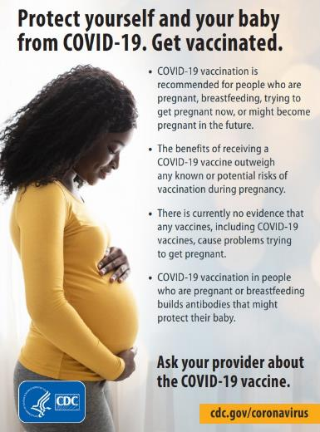
Materials and Resources
78

Slide 79
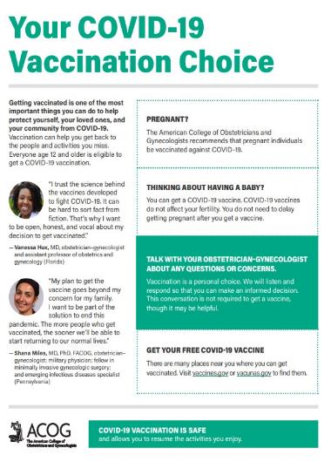
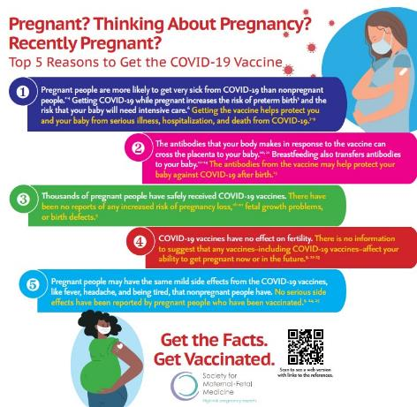
Materials and Resources
79

Slide 80
Materials and Resources
EverThrive guide quotes:
“COVID-19 Vaccines are safe and effective. Did you know that we have lived and fought back viruses through vaccines for more than 200 years? Fighting COVID-19 is not an exception. Curious to learn more about the strong scientific evidence for COVID-19 vaccines? Click www.understand. EverThriveIL.org.”
“COVID-19 vaccines are safe. Once the vaccine has been injected into your arm, it quickly dissolves while strengthening your immune system to defend you from the virus. The vaccine never reaches your reproductive organs; therefore, it does not affect your natural fertility. Access more information and resources at www.understand.EverThriveIL.org.”
80

Slide 81
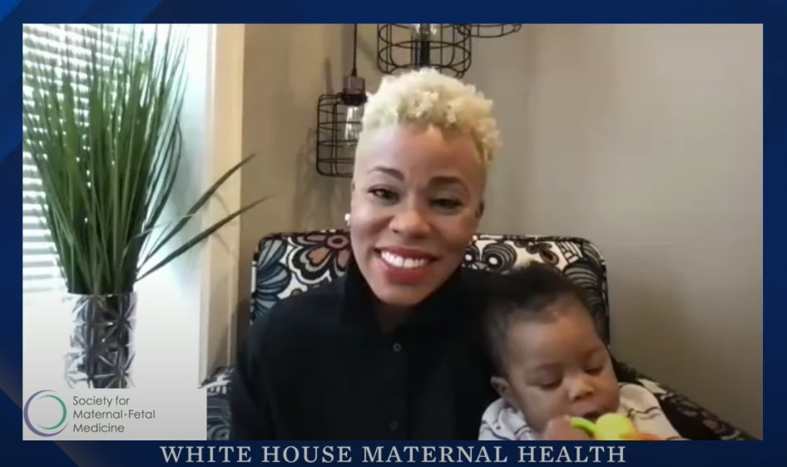
Materials and Resources
81
Notes:
https://www.youtube.com/watch?v=Tp99Xw89Yy8

Slide 82
Provider Materials

Slide 83
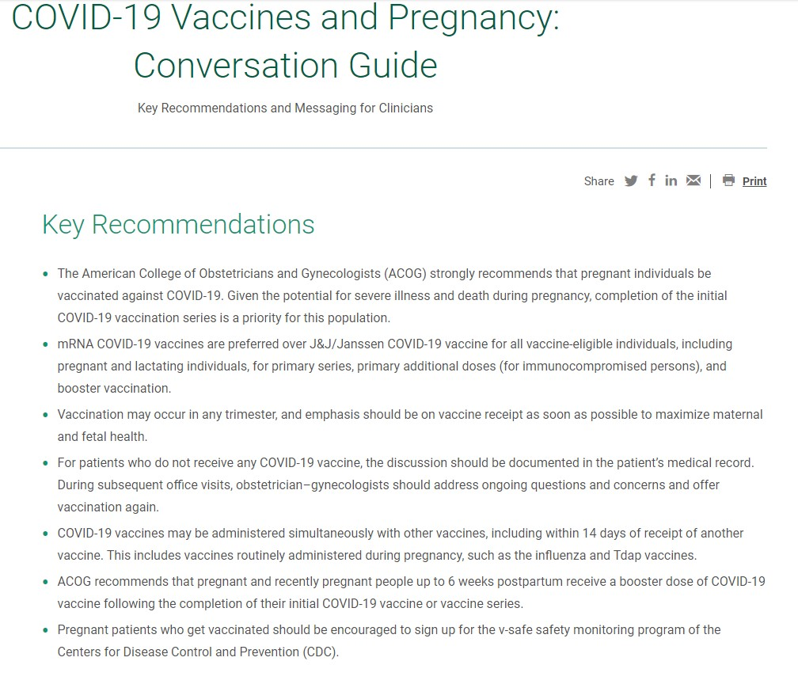
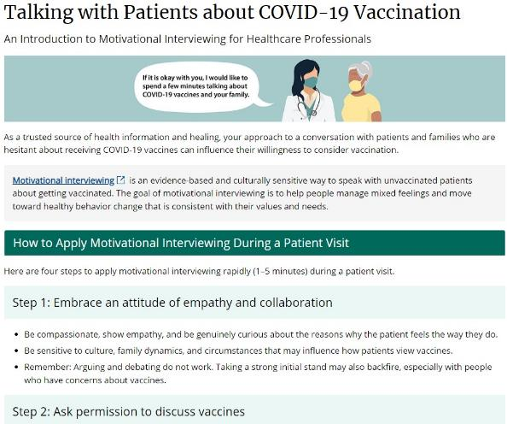
Materials and Resources
83

Slide 84
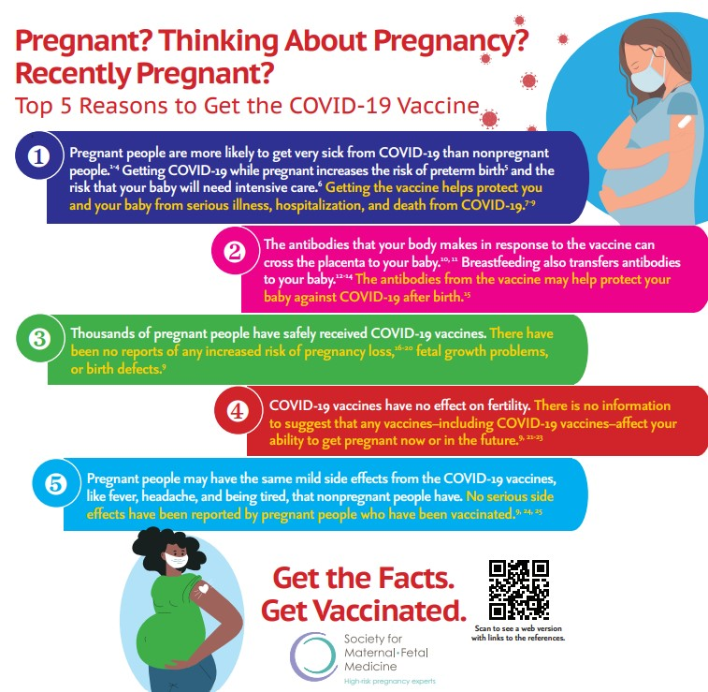
Materials and Resources
84

Slide 85
Materials and Resources
85
Notes:
https://www.youtube.com/watch?v=Tp99Xw89Yy8

Slide 86
Patient Focus Group Topics
During the focus groups and patient interviews, we asked questions to learn:
Patient concerns about COVID-19 and the vaccine.
Who patients trusted for information about the vaccines.
We also showed patients different materials to identify compelling messaging and content.

Slide 87
Physician Interview Topics
During the physician interviews, we asked questions to:
Learn more about the conversations physicians have with patients that have been most persuasive with regard to COVID-19 vaccination.
Identify persuasive messaging or gaps from the materials we shared with them.

Slide 88
Findings

Slide 89
Main Takeaways
There is a lot of entrenched distrust around the vaccine and reliance on misinformation, and politics is not the only reason.
Vaccine-resistant people are stuck on the fact that vaccines are not 100% effective and that people can still get sick after being vaccinated.
Over time, vaccine mandates can motivate people to get vaccinated as they tire of the inconvenience.
Pregnant patient/physician stories and quotes can be powerful (include no side effects to baby)
Physicians (and patients) emphasize not pressuring patients and suggest using reassuring language and folding COVID-19 vaccine discussion in with conversations around other vaccines.
Trusted messengers are critical; physicians could benefit from specific talking points on medical racism.
89

Slide 90
The Vaccinated Focus Group
Why they chose to get vaccinated:
Concern about getting COVID-19 and passing it on to their babies or being refused hospital admission for delivery.
Interest in passing on antibodies to their babies, either during pregnancy or afterward, through breastfeeding.
Conversations with their trusted doctors.
What they said:
“Moms that I talk to, they're not thinking about themselves. They're thinking about babies.”
“Part of that was that [the antibodies] would pass to the baby too. That would be doing double protection for myself and for her.”
“I did talk it over with my OB, but I was pretty decided. And he was able to say, ‘These people have gotten [the vaccine]. I haven't seen any negative reactions. It's like any other vaccine you're going to get.’”
90
Notes:
“A pregnant mom’s biggest concern is the safety of her baby.”

Slide 91
The Vaccinated Group
Reaction to the materials
CDC Poster Protect Yourself and your Baby from COVID-19. Get Vaccinated
“You are protecting yourself and your baby … And I think moms, when you're pregnant, that's what you're thinking about. ‘How do I get this baby the best that they can get?’ So in that way, I like it.”
SMFM Poster Pregnant? Thinking about Pregnancy? Recently Pregnant?
“It has a lot more words, which means it can share a lot more information, but if it's hanging in a hallway or somewhere, are people going to really read it? But that given, it's much more direct. It's like, ‘You are more likely to get really sick from COVID,’ the data is all there.”
“I mean, it took the sugar-coat off of it and just, ‘Yeah, let me rip the bandaid off. Here you go.’”
“I think this one has a better chance of convincing someone because it actually has some meat to it, whereas the other one (CDC poster) is just general.”
ACOG Brochure Your COVID-19 Vaccination Choice
“I love the diversity”
Cook County Brochure I’m Pregnant! Should I get the COVID-19 Vaccine?
“It's kind of inviting them (unvaccinated people) to have that discussion, to be okay having a question.”
“Why doesn't it just say, ‘Do you know, we have been fighting viruses with vaccines for more than’... I don't know. It's wordy”
WH Maternal Health video Pregnant COVID ICU survivor
“I think it's really helpful because it brings a realness to it.”
“I think if you were showing this in a rural white downstate area, they would be less powerful because they would be white, just racism. It would be like, well that's not going to happen. So, I think for the specific target audiences, yes. I think if you're trying to convince conservative white women, that that would not be as useful.”
91

Slide 92
The Non-Boosted Participant
Why one participant chose not to get boosted:
Physician didn’t stress the importance of the booster/felt that there wasn’t enough science to confidently recommend booster during pregnancy.
Already vaccinated and didn’t see it as an urgent matter.
Experienced side effects from the COVID vaccine so was concerned about fever and being sick while pregnant from a booster.
What they said:
“If I could have gone back in time, knowing that I was going to get COVID two weeks after I gave birth and expose my [newborn and 2-year-old] to it, I probably would have gotten boosted.”
“If a medical provider tells me do something I do it, and [my OB] was very not conclusive about her recommendation, and so I kind of just didn't do it (get boosted).”
92
Notes:
“A pregnant mom’s biggest concern is the safety of her baby.”

Slide 93
The Non-Boosted Participant
Reaction to the materials
CDC Poster Protect Yourself and your Baby from COVID-19. Get Vaccinated
“I think it's good that it touches on pregnancy, as well as breastfeeding, because that was my first question for my provider a week ago; ‘Can I continue to breastfeed?’”
SMFM Poster Pregnant? Thinking about Pregnancy? Recently Pregnant?
“I don't know that I would take that first bullet point super seriously because without numbers and knowing the science backs up that statement, it just seems really inconclusive.”
93

Slide 94
The Unvaccinated Group
Why they chose not to get vaccinated:
Fear for both the baby and themselves.
Mistrust of doctors and information being put out, compounded by misinformation.
Inconvenience of actually receiving the vaccine.
What they said:
“I was going to be forced to get it because I want to go out, I want to experience the nightlife, but since I saw that they are possibly thinking about lifting this mandate now, that just went out.”
“I know somebody who’s still sick and has been in the hospital for a couple of weeks and they've been vaccinated, fully vaccinated. I feel like it's a waste of time. It's different for everyone. What was the point of that person getting the vaccine if they’re still in the hospital? It’s just stupid to me.”
“There are different versions of the vaccine and a lot distrust in the healthcare system, If I did consider the shot, I would go outside of my neighborhood where they get better treatment.”
“I want to know more about the manufacturers, I want to know more about the history.”
94

Slide 95
The Unvaccinated Group
Reaction to the materials
CDC Poster Protect Yourself and your Baby from COVID-19. Get Vaccinated
“Tell me something that helps assure me that my baby safety is gonna be ensured.”
“This sounds like a person trying to sell something to me.”
SMFM Poster Pregnant? Thinking about Pregnancy? Recently Pregnant?
“I like this one because it's giving me more facts and information (than the CDC poster).”
ACOG Brochure Your COVID-19 Vaccination Choice
“The quotes are cool.”
“There should be a pregnant doctor. Then maybe I could listen.”
“Doctors aren’t always trustworthy. Just because you have the title doesn’t mean you’re trustworthy.”
Cook County Brochure I’m Pregnant! Should I get the COVID-19 Vaccine?
“I like that it asks if it’s right for me.”
“It makes me feel like I’m going to get some information, some facts.”
“I need to see or hear a story or a quote from a pregnant mom. I need something that I can connect to.”
WH Maternal Health video Pregnant COVID ICU survivor
“ After what she went through, it would make me want to get it and hope the shot won't affect the baby or anything.”
“It makes me want to double up on my vitamin C’s and my Zincs and stuff”
95

Slide 96
Practitioner Interviews
Dr. Chen: “When I say that nobody's going to force you to get a vaccine we're just going to talk and have a conversation it takes a lot of the pressure off for them [unvaccinated patients]. Just having a more open mind to everything, I think that's what I have found that to be very reassuring for patients”
Dr. Premkumar: “ One of the main reasons I hear people (patients) don’t get vaccinated is because the vaccine is not going to 100% protect me and they know people who have gotten sick or died… A lot of people also say they will get it after delivery.” &
“Part of my routine (when meeting with patients) is immunizations, so I talk about flu vaccine, COVID, TDAP–those are things I will always talk about.”
Dr. Nelson: “The video is a digital media that people can see. I think that if they can see a patient of ours who we had in the hospital for about two months with COVID… talking about what it was like to not get the vaccine, get sick, be oxygen-dependent, and then to have to stay in the hospital for weeks and weeks. She talked about the things that went through her mind and how guilty she felt that she hadn't done everything she could to protect her child. I think that was very powerful.” &
“As an African American physician, I can talk about the greater risks that pregnant Black women face and that we want to make sure that we're doing everything that we can, and I make it kind of like a partnership. I'm working with you, I have a vested interest in your health and I know where you're coming from.”.
Dr. Jones: “Even though we're not using social media in my practice, that's where we get information from. So, I think that jumping into that conversation having stuff circulating out there on social media probably is important because you have to fight fire with fire with the raw information on social media. It makes sure there’s good information going on social media as well.”
96

Slide 97
Practitioner Interviews
Main Takeaways
Experiences are somewhat mixed, depending on where they practice and their patient population.
Patients who are now pregnant and haven’t gotten vaccinated are pretty entrenched in their beliefs.
Patient resistance to vaccines is based in fear, misinformation and sometimes political reasons.
Some help with having difficult conversations—acknowledging medical racism, talking points for patients who say “no”—could be useful to doctors.
Rolling the COVID-19 vaccine into the same conversations about other vaccines can be helpful in reducing hesitancy.
La Tasha Nelson said that being a female African American doctor is helpful with her patients. Having a doctor who looks like you and having messengers who look like their target audiences is powerful.
Use language about working in partnership, OB and patient, to give birth to a healthy baby. Reassuring language like “I would never recommend anything that would harm you.”
Include friendly posters and video and stories; doctors felt they had up-to-date information from ACOG.
97

Slide 98
Recommendations and Next Steps
Provider Materials:
One-pager highlighting testimonials to remind physicians of their influence on patients’ openness to vaccines AND boosters, combined with tips for integrating COVID vaccine and booster recommendation into discussions on other vaccines recommended during pregnancy.
Patients Materials:
Produce a short video that shares story of Kntrice (featured in White House summit) or similar pregnant COVID survivor.
One-page patient poster that consolidates best parts of existing patient documents and stresses boosters.

Slide 99
Thank You
We continue to give thanks to the nurses, doctors, health care workers, public health teams and others across our state at work confronting the COVID-19 pandemic.
Please send questions, comments and recommendations, cases / willingness to share for future COVID-19 OB/Neo discussion webinars to info@ilpqc.org
Recording of this webinar, Q/A and registration for the next webinar on Friday, October 7, 12-1:15pm, will be available at www.ilpqc.org

Slide 100
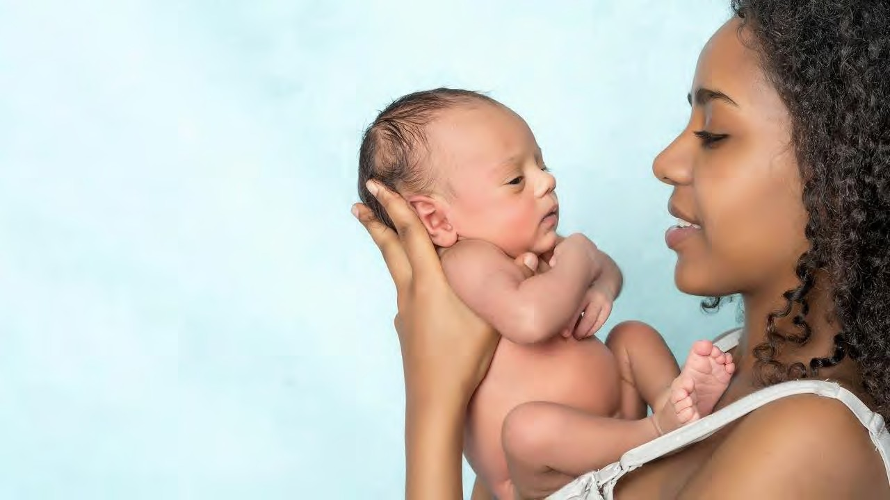
Thanks to our Funders
In kind support:

