Slide 1
COVID-19 Strategies for OB & Neonatal Units
April 1, 2022
12:00 – 1:15pm

Slide 2
Welcome
Please be certain you are on “mute” when not speaking to avoid background noise.
Whether you have joined by phone or computer audio, you can mute and unmute yourself by clicking on the microphone icon.
The following shortcuts can also be used
For PC: Alt + A : Mute or Unmute
For Mac: Shift + Command + A: Mute or Unmute
For telephone: *6 : Mute or Unmute
2

Slide 3
Housekeeping:
We Are Recording Now
3

Slide 4
ILPQC Covid 19 webinars
The strategies shared today are examples from individual institutions not IDPH or ILPQC recommendations.
This is our 31th COVID-19 strategies for OB/Neonatal Units webinar in coordination with IDPH, since April 2020. Please see https://ilpqc.org/covid-19-information/ for
future webinar registration, prior recorded webinars and written out Q/A’s from those webinars.
The next webinar will be Friday, May 6, noon to 1:15pm. We are continuing monthly for now, but determining the needed frequency going forward
Please let us know if your hospital would like to share on an upcoming webinar, please put questions/comments into the chatbox or email directly to info@ilpqc.org
4

Slide 5
Overview
Introduction
Overview of updated data and recommendations
Discussion of OB Unit Strategies:
Jeannie Kelly, MD, MS -- Director Maternal Fetal Transport, Maternal Fetal Medicine, Barnes Jewish Hospital, St. Louis
Ayesha Hasan, MD – Maternal-Fetal Medicine, University of Illinois Chicago Medical Center, Chicago
John Holden, MD – OB Hospitalist, UW Health SwedishAmerican Hospital, Rockford
5

Slide 6
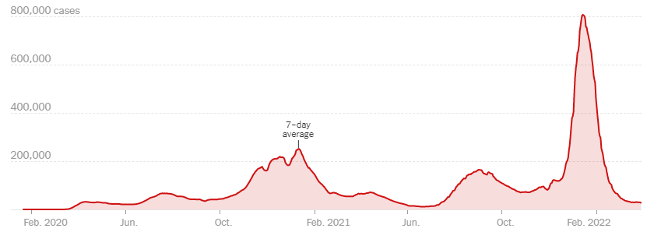
US COVID case trend
6

Slide 7
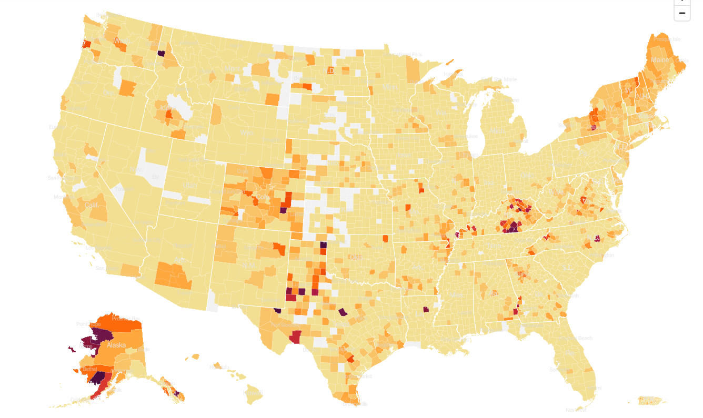
United States Hot Spots 4/1/22

Slide 8
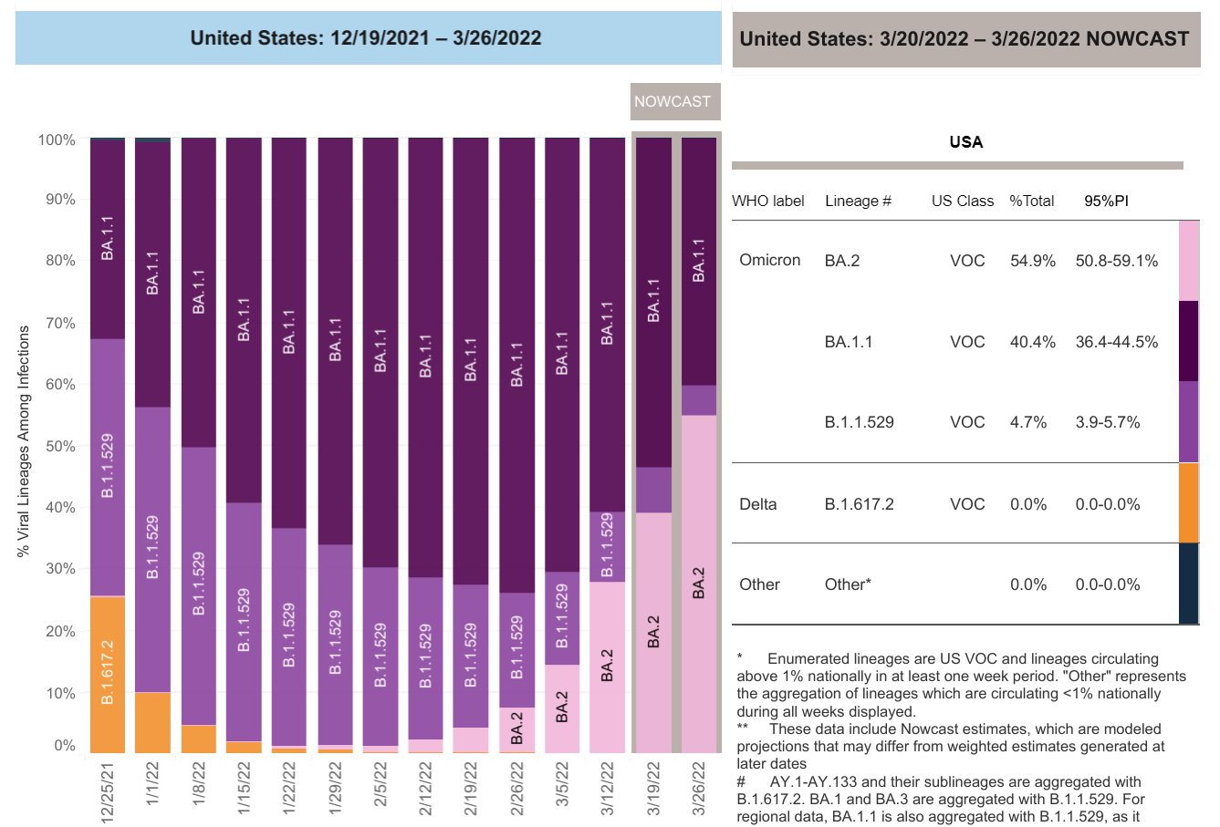
Increasing Omicron Cases
Updated 4/1/2022

Slide 9
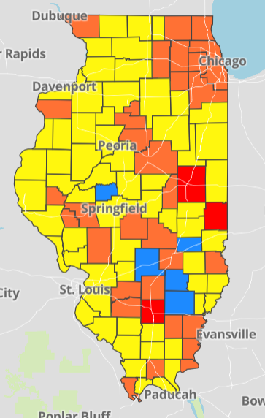
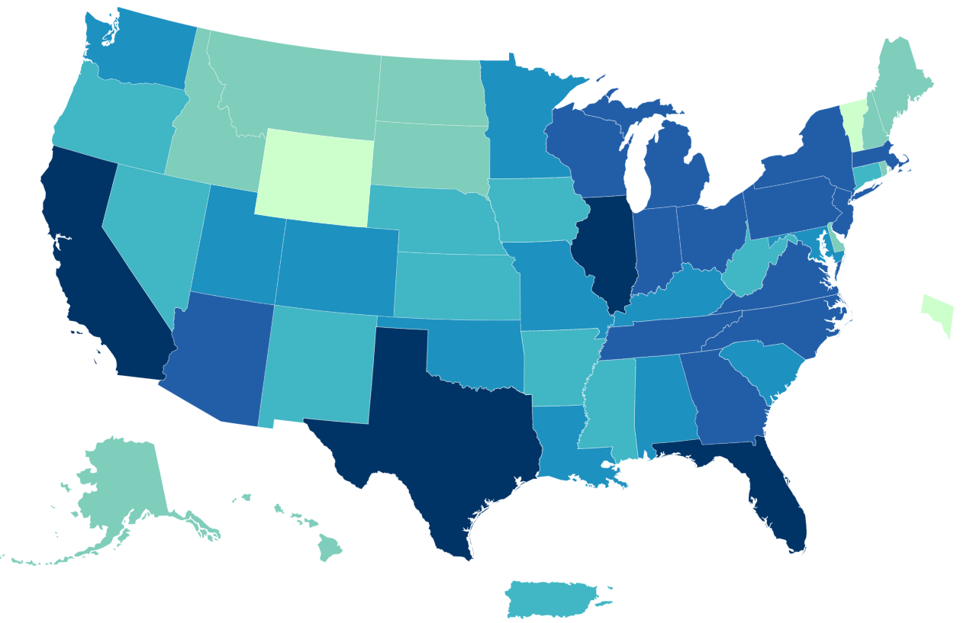
Data Update: April 1, 2022
CDC/IDPH: COVID-19 Outbreak
CDC
https://covid.cdc.gov/covid-data-tracker/#cases_totalcases
IDPH
https://www.dph.illinois.gov/covid19
Total cases: 79,853,683 confirmed
Total deaths: 976,229 confirmed
3,068,237 Confirmed Positive Cases
33,377 Deaths
8

Slide 10
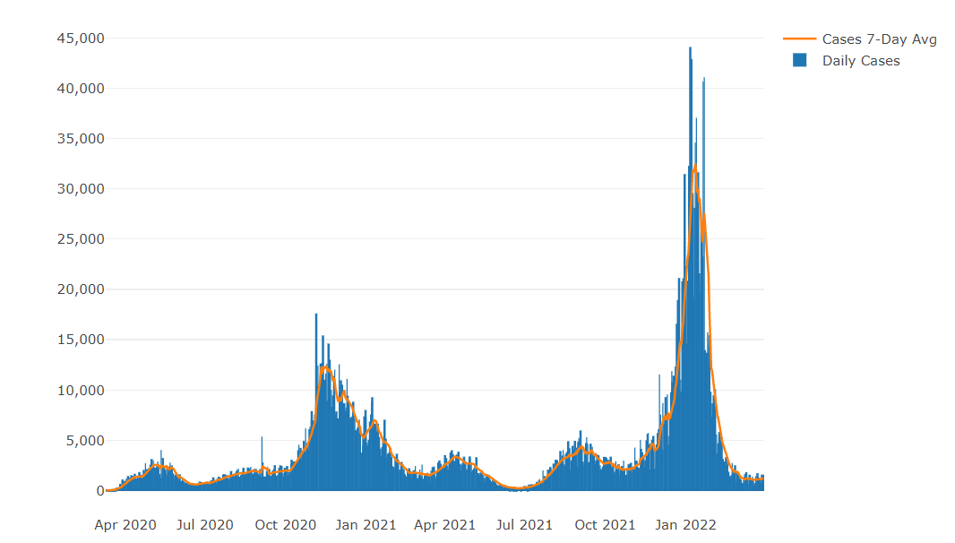
Illinois Daily Incidence
IDPH daily data summary
10

Slide 11
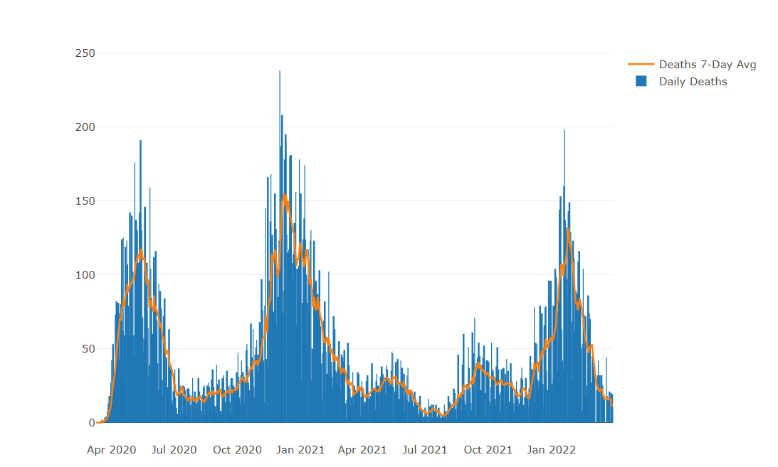
Illinois Covid Deaths
IDPH daily data summary
11

Slide 12
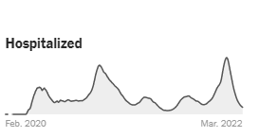
Illinois Hospitalizations By Time through 4/1/2022
Sources: U.S. Department of Health and Human Services (daily confirmed and suspected Covid-19 hospital admissions); Census Bureau (population data). Data prior to October 2020 was unreliable. Data reported in the most recent seven days may be incomplete.

Slide 13
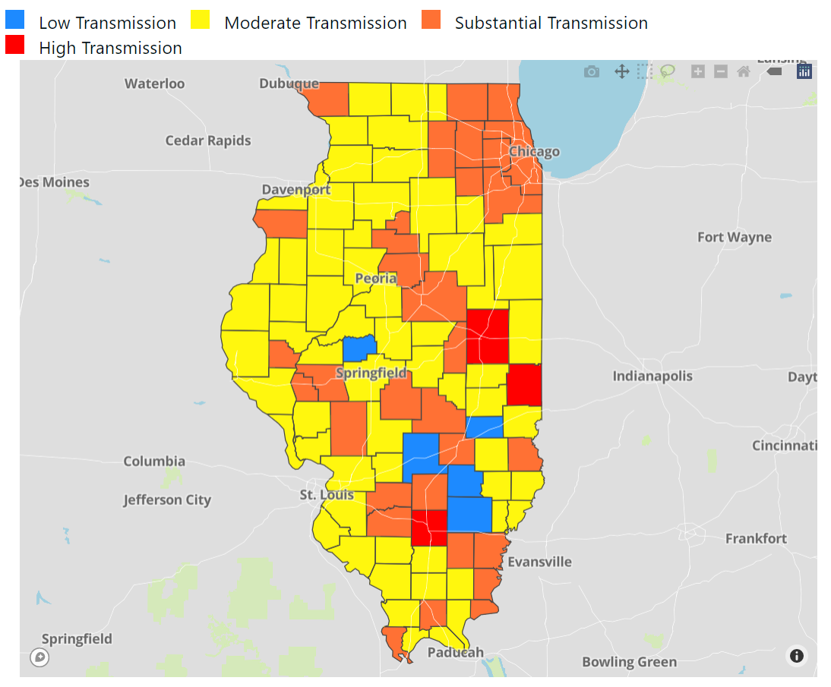
Illinois Covid Transmission
by County
Updated 4/1/2022
Based on:
Cases/100,000 (>100 red)
Test Positivity Avg (>10% red)

Slide 14
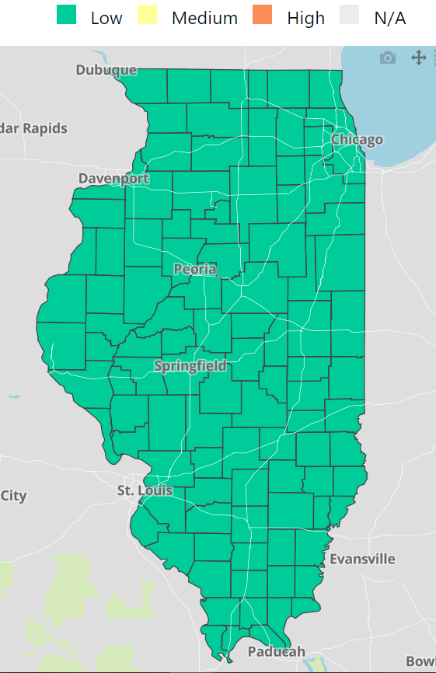
COVID-19 Community Levels Map Updated 4/1/2022
New CDC Guidance (3/4/2022):
Levels can be low, medium, or high and are determined by looking at % of hospital beds being used by pts with Covid, new Covid hospital admissions, and the total number of new COVID-19 cases in an area.
Notes:
determined by looking at hospital beds being used by patients with COVID-19, new hospital admissions among people with COVID-19, and the total number of new COVID-19 cases in your area.

Slide 15
CDC’s COVID-19 Community Levels and Indicators
New Cases (per 100,000 population in the last 7 days) | Indicators | Low | Medium | High
Fewer than 200 | New COVID-19 admissions per 100,000 population (7-day total) | <10.0 | 10.0-19.9 | ≥20.0
 | Percent of staffed inpatient beds occupied by COVID-19 patients (7-day average) | <10.0% | 10.0-14.9% | ≥15.0%
200 or more | New COVID-19 admissions per 100,000 population (7-day total) | NA | <10.0 | ≥10.0
 | Percent of staffed inpatient beds occupied by COVID-19 patients (7-day average) | NA | <10.0% | ≥10.0%
The COVID-19 community level is determined by the higher of the inpatient beds and new admissions indicators, based on the current level of new cases per 100,000 population in the past 7 days Check your county’s COVID-19 Community Level.

Slide 16
Low | Medium | High
Stay up to date with COVID-19 vaccines Get tested if you have symptoms | If you are at high risk for severe illness, talk to your healthcare provider about whether you need to wear a mask and take other precautions Stay up to date with COVID-19 vaccines Get tested if you have symptoms | Wear a mask indoors in public Stay up to date with COVID-19 vaccines Get tested if you have symptoms Additional precautions may be needed for people at high risk for severe illness
People may choose to mask at any time. People with symptoms, a positive test, or exposure to someone with COVID-19 should wear a mask.
The whole community can be safe only when we all take steps to protect each other, even when the COVID-19 Community Level is low or medium. No matter what your COVID-19 Community Level, layered prevention strategies can help limit severe disease and reduce the potential for strain on the healthcare system. Proven prevention steps include staying up to date on vaccines, getting tested if you have symptoms, and wearing a mask when you’re around someone at increased risk. – CDC 3/4/2022
New
Covid-19 Community Levels
3/4/2022
Does not apply to health care facilities

Slide 17
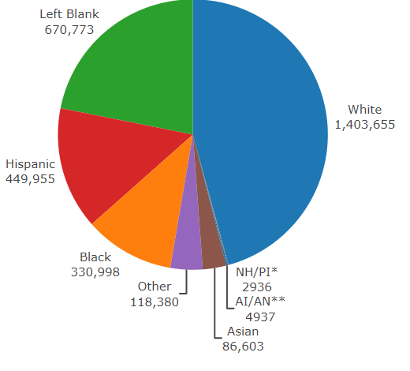
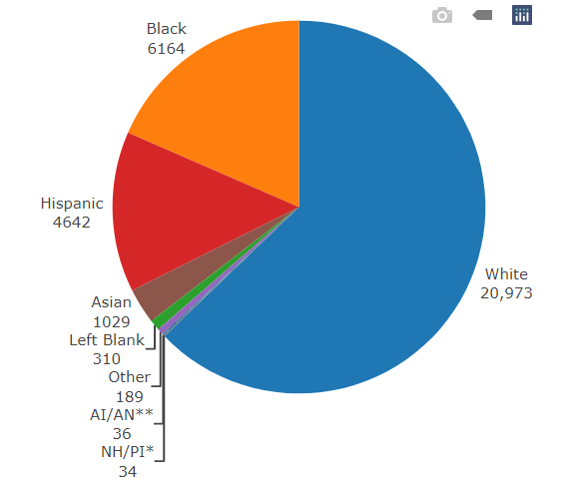
Data Update April 1, 2022 IDPH: COVID-19 Outbreak Race Demographics
https://www.dph.illinois.gov/covid19
Confirmed Cases
Deaths
13

Slide 18
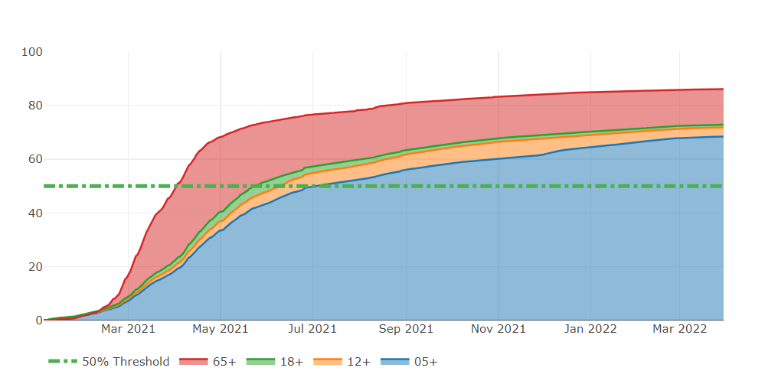
Illinois Population Vaccinated Fully
13

Slide 19
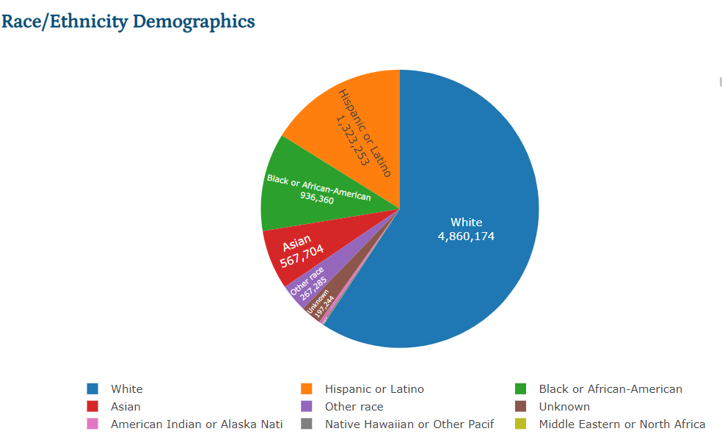
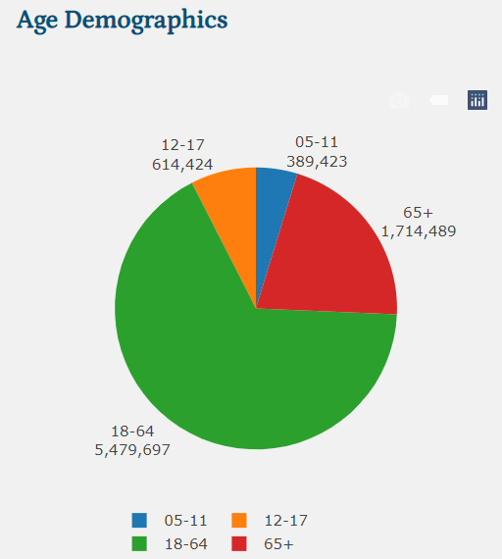
Illinois Population Administered Booster Doses
13

Slide 20
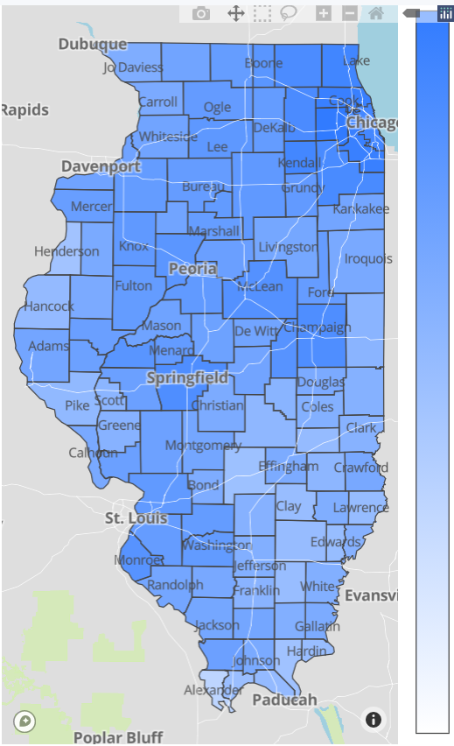
Illinois Daily Reported Administered Vaccine Doses
Last updated 4/1/2022
21,354,847
Administered Vaccine Doses
Illinois Perinatal Quality Collaborative
14

Slide 21
In January, compared to fully vaccinated persons in each group shown below, the monthly rates of COVID-19-associated hospitalizations were:
7X Higher in Unvaccinated Adults Ages 18 Years and Older
3x Higher in Unvaccinated Adolescents Ages 12-17 Years
5x Higher in Unvaccinated Adults Ages 18-49 years
7x Higher in Unvaccinated Adults Ages 50-64 years
8x Higher in Unvaccinated Adults Ages 65 Years and Older

Slide 22
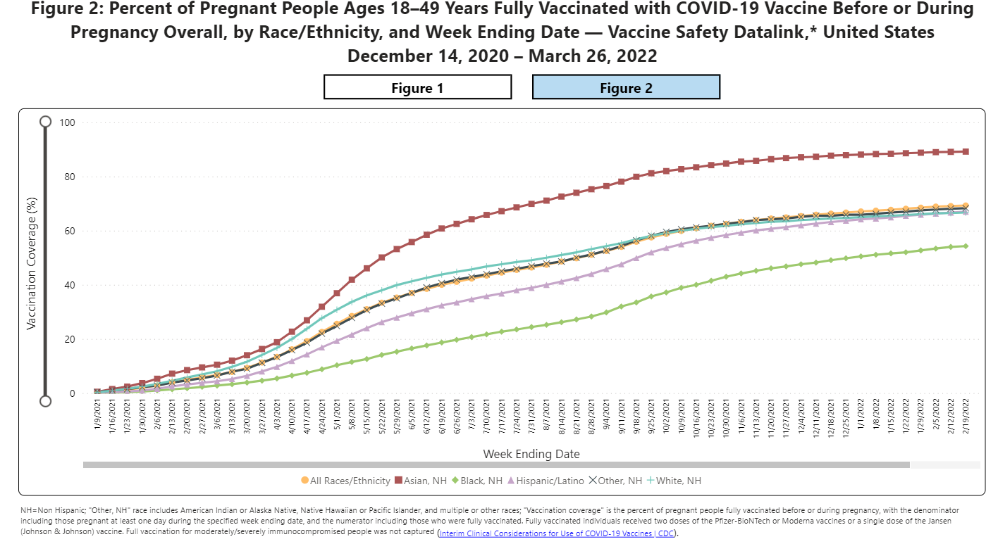
Notes:
https://urldefense.com/v3/__https://covid.cdc.gov/covid-data-tracker/*vaccinations-pregnant-women__;Iw!!Dq0X2DkFhyF93HkjWTBQKhk!BRT8JkbGHSHMqUvlHo57UsXRx3oQL6Au0KIaOe8oN7qp9yWGe1oyTAFdCw-PzSyj1gqEUOSiCw$

Slide 23
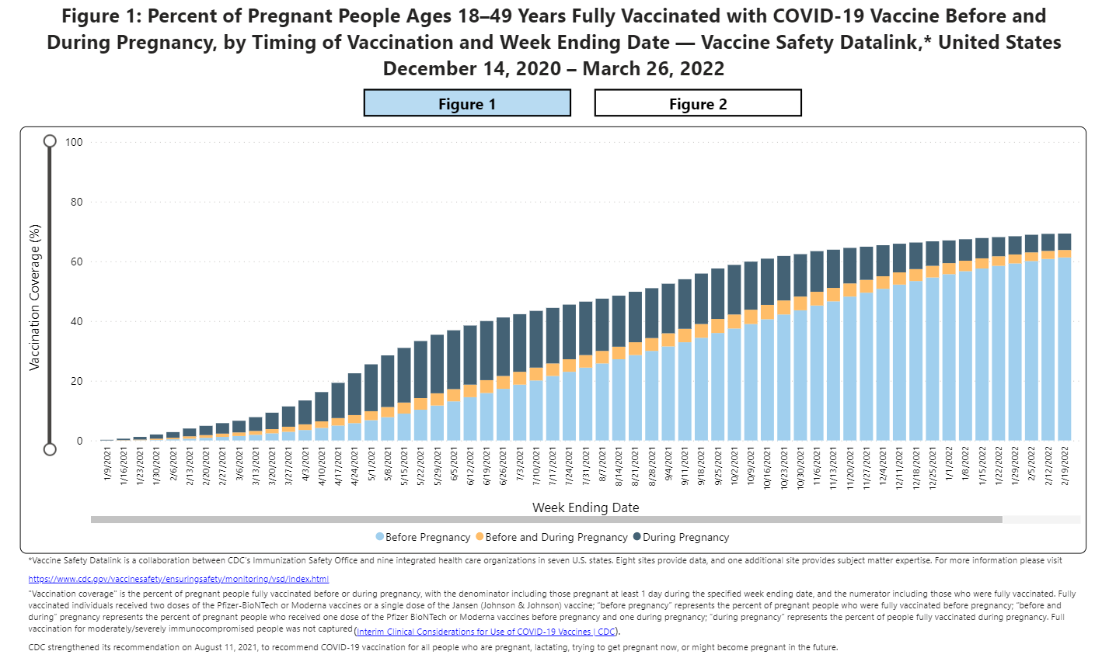
Notes:
https://urldefense.com/v3/__https://covid.cdc.gov/covid-data-tracker/*vaccinations-pregnant-women__;Iw!!Dq0X2DkFhyF93HkjWTBQKhk!AZLmkCzjPqbpDlw3HSvzpeV2yHLjASTwFArm1NOsQ1zqBmsgYQCTjWJcfL5ZsjyF2-lUxyxYPA$

Slide 24
Covid-19 and Pregnancy
Pregnant women with COVID-19, United States, January 22, 2020 - March 28, 2022
195,125 cases
31,404 hospitalizations
273 deaths

Slide 27
Nature Medicine: SARS-CoV-2 infection and COVID-19 vaccination rates in pregnant women in Scotland. (2.4.2022)
Using whole-population data from a national, prospective cohort, 25,917 COVID-19 vaccinations were given to 18,457 pregnant women in Scotland through October 2021.
Overall, 77.4% (3,833 out of 4,950; of SARS-CoV-2 infections, 90.9% (748 out of 823; of SARS-CoV-2 associated with hospital admission and 98% (102 out of 104;) of SARS-CoV-2 associated with critical care admission, as well as all baby deaths, occurred in pregnant women who were unvaccinated at the time of COVID-19 diagnosis.
Addressing low vaccine uptake rates in pregnant women is imperative to protect the health of women and babies in the ongoing pandemic.

Slide 28
JAMA: Association of SARS-CoV-2 Infection With Serious Maternal Morbidity and Mortality From Obstetric Complications. (2.7.2022)
In this retrospective cohort study that included 14 104 patients, a composite outcome of maternal death or serious morbidity related to hypertensive disorders of pregnancy, postpartum hemorrhage, or infection other than SARS-CoV-2 occurred significantly more frequently in individuals with SARS-CoV-2 infection compared with individuals without SARS-CoV-2 infection (13.4% vs 9.2%, respectively).
Compared with those without a positive SARS-CoV-2 test result, moderate or higher COVID-19 severity (n = 586) was significantly associated with the primary outcome (26.1% vs 9.2%; difference, 16.9% [95% CI, 13.3%-20.4%]; aRR, 2.06 [95% CI, 1.73-2.46]) and the major secondary outcome of cesarean birth (45.4% vs 32.4%; difference, 12.8% [95% CI, 8.7%-16.8%]; aRR, 1.17 [95% CI, 1.07-1.28])

Slide 29
MDPI: Stillbirth after COVID-19 in Unvaccinated Mothers Can Result from SARS-CoV-2 Placentitis, Placental Insufficiency, and Hypoxic. (2.15.2022)
Arch Pathol Lab Med: Placental Tissue Destruction and Insufficiency from COVID-19 Causes Stillbirth and Neonatal Death. (2.10.2022)
Stillbirth after COVID-19 in Unvaccinated Mothers Can Result from SARS-CoV-2 Placentitis, Placental Insufficiency, and Hypoxic Ischemic Fetal Demise, Not Direct Fetal Infection: Potential Role of Maternal Vaccination in Pregnancy
An MMWR released on September 16, 2020, reported an increased stillbirth rate of 3.2% among pregnant patients with symptomatic and asymptomatic SARS-CoV-2 infection.
An MMWR released on November 19, 2021, found that the adjusted risk of stillbirth in patients with a COVID-19 diagnosis documented at delivery hospitalization was 4 times higher than the risk in patients without COVID-19 infection.
In addition, case series of patients with COVID-19 who experienced stillbirth had evidence of fibrin deposition and trophoblast necrosis on placental pathology.

Slide 30
CDC: COVID-19 Vaccination for Pregnant People to Prevent Serious Illness, Deaths, and Adverse Pregnancy Outcomes from COVID-19. (9.29.21)
CDC recommends urgent action to help protect pregnant people and their fetuses/infants.
Healthcare providers should communicate the risks of COVID-19, the benefits of vaccination, and information on the safety and effectiveness of COVID-19 vaccination in pregnancy.
Compared with non-pregnant symptomatic people, symptomatic pregnant people have more than a two-fold increased risk of requiring ICU admission, invasive ventilation, and ECMO, and a 70% increased risk of death.⁶
Healthcare providers should strongly recommend that people who are pregnant, recently pregnant (including those who are lactating), who are trying to become pregnant now, or who might become pregnant in the future receive one of the authorized or approved COVID-19 vaccines as soon as possible.

Slide 31
VACCINE SAFETY DATA

Slide 32
JAMA editorial: COVID-19 mRNA Vaccines During Pregnancy New Evidence to Help Address Vaccine Hesitancy. (3.24.2022)
As of February 28,2022 68% of pregnant patients in the US are vaccinated.
Over the past 14 months a substantial body of evidence supporting the safety of the mRNA Covid 19 vaccines in pregnancy has accumulated.
Observational studies from Norway, Israel and the US have shown that mRNA vaccine in pregnancy are not associated with increase risk of miscarriage, preterm birth or other adverse birth outcomes.
JAMA this month 2 population based cohort studies evaluate outcomes in more than 250,000 pregnancies from 3 countries provide the strongest evidence to date regarding the safety of covid-19 vaccines in pregnancy

Slide 33
JAMA: No association of COVID-19 vaccination in pregnancy with adverse Peripartum Outcomes (March 24, 2022)
Population based cohort study of all pregnant patients using birth registry data, including 97,590 patients in Ontario Canada
Covid-19 vaccination in pregnancy compared to vaccination after pregnancy vs no vaccination was not associated with increased risk of adverse peripartum outcomes.
Including: postpartum hemorrhage, chorioamnionitis, cesarean delivery, admission to NICU, or low newborn Apgar score.
JAMA: No Association of COVID-19 Vaccination in Pregnancy With Adverse Peripartum Outcomes. (3.24.2022)

Slide 34
JAMA: Association of COVID-19 Vaccination in Pregnancy With Adverse Peripartum Outcomes. (3.24.2022)
Population-based cohort study of 157,521 deliveries in Sweden and Norway
Covid vaccination in pregnancy vs no vaccination no association with preterm birth, stillbirth, small for gestational age, low Apgar score or neonatal care admission
Covid vaccination not associated with adverse pregnancy outcomes

Slide 35
V-SAFE vaccine monitoring
– what data is being gathered pregnant patients
As of March 28, 2022, there have been over 212,850 pregnancies reported in CDC’s V-SAFE post-vaccination health checker
CDC is also enrolling pregnant individuals in a pregnancy registry for additional follow up with over 20,720 enrolled.
Evidence gathered through these system has provide clinicians with critically needed safety data on COVID-19 vaccination during pregnancy
No adverse pregnancy outcomes associated with Covid-19 vaccine and pregnancy
https://www.cdc.gov/coronavirus/2019-ncov/vaccines/safety/vsafe.html

Slide 36
Durability of Antibodies in Infants After Maternal COVID-19 Vaccination or Natural Infection (2/7/2022)
A JAMA study suggests that vaccinating women against SARS-CoV-2 in mid to late pregnancy could provide their infants some protection against COVID-19 through six months of age.
Compared to infants born to mothers who had COVID-19 during pregnancy, infants born to vaccinated mothers were much more likely to have antibodies against the virus.
Read the full NIH Science Update at https://bit.ly/33fsSPr
The JAMA article is open access and can be found here: Durability of Anti-Spike Antibodies in Infants After Maternal COVID-19 Vaccination or Natural Infection

Slide 37
CDC MMWR: Effectiveness of Maternal Vaccination with mRNA COVID-19 Vaccine During Pregnancy Against COVID-19–Associated Hospitalization in Infants Aged <6 Months — 17 States. (2.18.2022)
Completion of a 2-dose primary mRNA COVID-19 vaccination series during pregnancy was associated with reduced risk for COVID-19–associated hospitalization among infants aged <6 months, and protection was higher among infants whose mothers were vaccinated later in pregnancy
Among 176 infants aged <6 months hospitalized with COVID-19, 148 (84%) were born to mothers who were not vaccinated during pregnancy. Overall, these findings indicate that maternal vaccination during pregnancy might help protect against COVID-19 hospitalization among infants aged <6 months.

Slide 38
CDC Vaccine and Pregnancy Summary: what you need to know
People who are pregnant or recently pregnant are more likely to get severely ill with COVID-19 compared with people who are not pregnant.
Getting a COVID-19 vaccine can help protect you from severe illness from COVID-19.
COVID-19 vaccination is recommended for people who are pregnant, breastfeeding, trying to get pregnant now, or might become pregnant in the future.
People who are pregnant should receive a COVID-19 vaccine booster shot.
Evidence about the safety and effectiveness of COVID-19 vaccination during pregnancy has been significant and continues to grow. These data suggest that the benefits of receiving a COVID-19 vaccine outweigh any known or potential risks of vaccination during pregnancy.
There is currently no evidence that any vaccines, including COVID-19 vaccines, cause fertility problems in women or men.

Slide 39
SMFM: Provider Considerations for Engaging in COVID-19 Vaccine Counseling With Pregnant and Lactating Patients (1.11.2022)
SMFM and ACOG recommend that pregnant people, including health care workers, receive a COVID-19 booster shot at least 5 months after their primary series. As with the primary series, the booster dose should be given at any stage during pregnancy and postpartum.
Everyone 12 and over is eligible for booster at least 5 months from primary series.

Slide 40
Boosters needed to fight Omicron
Data from South Africa and the United Kingdom demonstrate that vaccine effectiveness against infection for two doses of an mRNA vaccine is approximately 35%.
A COVID-19 vaccine booster dose restores vaccine effectiveness against infection to 75%.
COVID-19 vaccination decreases the risk of severe disease, hospitalization, and death from COVID-19. CDC strongly encourages COVID-19 vaccination for everyone 5 and older and boosters for everyone 12 and older.

Slide 41
FDA: Coronavirus (COVID-19) Update: FDA Authorizes Second Booster Dose of Two COVID-19 Vaccines for Older and Immunocompromised Individuals. (3.29.2022)
A second booster dose of the Pfizer-BioNTech COVID-19 Vaccine or Moderna COVID-19 Vaccine may be administered to individuals 50 years of age and older at least 4 months after receipt of a first booster dose of any authorized or approved COVID-19 vaccine.
A second booster dose of the Pfizer-BioNTech COVID-19 Vaccine may be administered to individuals 12 years of age and older with certain kinds of immunocompromise at least 4 months after receipt of a first booster dose of any authorized or approved COVID-19 vaccine. These are people who have undergone solid organ transplantation, or who are living with conditions that are considered to have an equivalent level of immunocompromise.
A second booster dose of the Moderna COVID-19 Vaccine may be administered at least 4 months after the first booster dose of any authorized or approved COVID-19 vaccine to individuals 18 years of age and older with the same certain kinds of immunocompromise.
Research Square Israel Data: Second Booster Vaccine and Reduction in Covid-19 Mortality in Adults 60 to 100 Years Old. (3.24.2022)

Slide 42
FDA update 2nd booster for > age 50 and immunocompromised
“Current evidence suggests some waning of protection over time against serious outcomes from COVID-19 in older and immunocompromised individuals. Based on an analysis of emerging data, a second booster dose of either the Pfizer-BioNTech or Moderna COVID-19 vaccine could help increase protection levels for these higher-risk individuals,”.
“Additionally, the data show that an initial booster dose is critical in helping to protect all adults from the potentially severe outcomes of COVID-19. So, those who have not received their initial booster dose are strongly encouraged to do so.”

Slide 43
CDC Updates 2nd Booster for over age 50 (3/29/22)
“Today, CDC expanded eligibility for an additional booster dose for certain individuals who may be at higher risk of severe outcomes from COVID-19. Boosters are safe, and people over the age of 50 can now get an additional booster 4 months after their prior dose to increase their protection further.
CDC: CDC Recommends Additional Boosters for Certain Individuals. (3.29.2022)

Slide 44
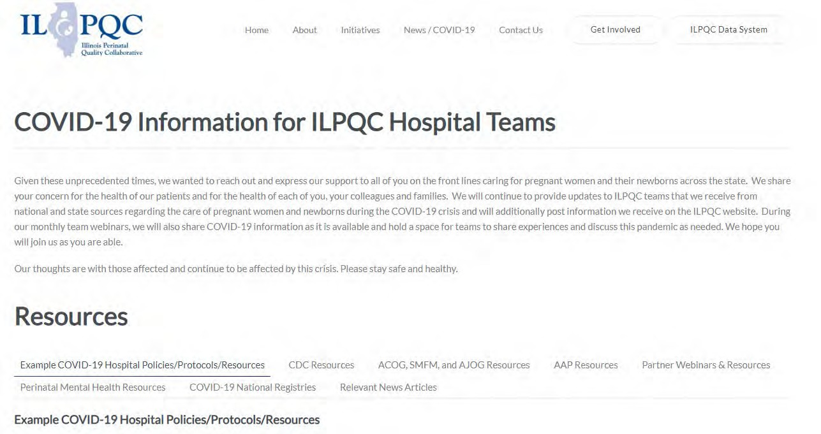
ILPQC COVID-19 Webpage www.ilpqc.org
ILPQC posts national guidelines and OB & Neonatal COVID-19 example hospital protocols & resources
please note dates as guidelines are changing rapidly
https://ilpqc.org/covid-19- information/

Slide 45
Updated OB (ACOG/SMFM) Resources
ACOG: Statement on the CDC’s Health Advisory on COVID-19 Vaccination. (9.29.21)
ACOG: COVID-19 Vaccination During Pregnancy Is Key to Saving Lives, Medical Experts Urge. (12.6.21)
SMFM: SMFM Supports the Use of Paxlovid in Pregnant Patients. (12.22.21)
ACOG: COVID-19 FAQs for Obstetrician-Gynecologists, Obstetric. (12.28.21)
SMFM: Provider Considerations for Engaging in COVID-19 Vaccine Counseling With Pregnant and Lactating Patients(1.11.2022)
ACOG new PSA: COVID-19 Vaccines in Pregnancy: Safe, Proven, Effective. (2.8.2022)
ACOG: COVID-19 Vaccines: Tools for Your Practice and Your Patients. (2.8.2022)
ACOG: COVID-19 FAQs for Obstetrician-Gynecologists, Obstetric. (2.8.22)
SMFM: Coronavirus (COVID-19) and Pregnancy: What Maternal-Fetal Medicine Subspecialists Need to Know (03.2.2022)
ACOG: COVID-19 Vaccination Considerations for Obstetric–Gynecologic Care. (3.2.2022)
Notes:
SMFM: Coronavirus (COVID-19) and Pregnancy: What Maternal-Fetal Medicine Subspecialists Need to Know (03.2.2022)

Slide 46
SMFM: Coronavirus (COVID-19) and Pregnancy: What Maternal-Fetal Medicine Subspecialists Need to Know (March 2, 2022)
The following pertains to outpatient treatment for pregnant patients:
• Paxlovid (nirmatrelvir [PF-07321332] tablets and ritonavir tablets) is an antiviral medication. There are no human pregnancy data available on nirmetrelvir, but ritonavir is used extensively in pregnancy with documented safety. Practitioners should consider drug-drug interactions.
• Sotrovimab is a monoclonal antibody. It is available as a single infusion and is effective against the Omicron variant. May be limited supply and may only be available to patients at the highest risk of progression to severe disease. No need to delay vaccination after receipt of monoclonal antibody Rx.
• Remdesivir (3-day outpatient regimen) is an antiviral medication. There has been documented use of remdesivir throughout the pandemic. This regimen requires multiple IV infusions, which can be logistically difficult. All of the above have similar efficacy at preventing hospitalization and death; however, no trials have specifically evaluated efficacy in a pregnant population.
• Molnupiravir is an antiviral medication with a reported 30% efficacy. Although the EUA recommends against its use in pregnancy due to mutagenicity concerns, this drug may be reasonably considered for use in pregnancy if there are no other therapies available and with documented counseling that the patient understands the risks and benefits.

Slide 47
COVID Therapeutics
For use in HIGH RISK individuals early in symptoms
Oral therapies (Paxlovid) to be given within 5 days
IV monoclonal antibody (Sotrovimab) bebtelovimab to be given within (updated 2/22/22) reduced from 10 to 7 days
HIGH RISK generally refers to those > 65 years, immunocompromised, high-risk comorbid conditions (obesity, DM), pregnancy or under vaccinated
NIH Therapy Tier: https://www.covid19treatmentguidelines.nih.gov/therapies/statement-on-patient-prioritization-for-outpatient-therapies/

Slide 48
Outpatient Therapeutic Preferences
https://www.covid19treatmentguidelines.nih.gov/therapies/statement-on-therapies-for-high-risk-nonhospitalized-patients/
Paxlovid (nirmatrelvir/ritonavir) – first line
PROS: oral and highly effective
CONS: needs to be given within 5 days of symptom onset, renal adjustment (can’t be given for GFR <30) and many drug-drug interactions (DDIs)
Sotrovimab - first line / bebtelovimab 2nd line
PROS: highly effective, can be given up to (updated 2/22/22) reduced from 10 to 7 days of symptom onset
CONS: intravenous, limited access – need pathway for pregnant patients
Remdesivir – second line – typically used INPATIENT
PROS: highly effective in early illness, readily available, can be given outpatient up to 7 days of symptom onset
CONS: three consecutive days of IV therapy is extremely difficult in the outpatient world
Good use is for inpatients who are COVID+ but actually hospitalized for another reason
Molnupiravir – only if above therapies unavailable NOT TO USE IN PREGNANCY
PROS: oral and more readily available than Paxlovid, no significant DDIs
CONS: less effective, concerns about mutagenesis, not recommended in pregnancy, requires contraception for patients of childbearing potential, only for age > 18

Slide 49
IDPH-NIH Clinical Decision Tree
IDPH: COVID-19 Outpatient Treatment. (2.22.2022)
MINNESOTA DEPARTMENT OF HEALTH. COVID-19 Monoclonal Antibody Use in Pregnancy. (1.22.2022
Notes:
90 days use 2 forms of protection

Slide 50
BA.2
First detected in IL mid Jan 2022
Now > 50% of cases
Sotrovimab with 27 fold reduction in activity
Bebtelovimab retains activity. Mixed data about Evusheld
Oral antivirals (Paxlovid) expected to retain activity
VACCINES RETAIN activity
NEJM: Efficacy of Antiviral Agents against the SARS-CoV-2 Omicron Subvariant BA.2. (3.9.2022)
Zhou et al, BioRxIV Pre-print Jan 2022
Iketani et al BioRxIV Pre-print Jan 2022
U.K. Health Security Agency Report Jan 2022
Notes:
Vaccines 70% efficacy symptomatic disease UK

Slide 51
FDA updates Sotrovimab emergency use authorization
The Centers for Disease Control and Prevention (CDC) Nowcast data from March 29, 2022 estimates that the proportion of COVID-19 cases caused by the Omicron BA.2 variant is above 50% in three additional Health and Human Services (HHS) regions (5, 9, and 10). Due to these data, FDA has added these regions to the list of states and territories where sotrovimab is not authorized at this time.
Sotrovimab is not authorized at this time in the following states and territories:
Connecticut, Maine, Massachusetts, New Hampshire, Rhode Island, and Vermont (Region 1) (as of 3/25/2022)
New Jersey, New York, Puerto Rico, and the Virgin Islands (Region 2) (as of 3/25/2022)
Illinois, Indiana, Michigan, Minnesota, Ohio, and Wisconsin (Region 5) (as of 3/30/2022)
Arizona, California, Hawaii, Nevada, American Samoa, Commonwealth of the Northern Mariana Islands, Federated States of Micronesia, Guam, Marshall Islands, and Republic of Palau (Region 9) (as of 3/30/2022)
Alaska, Idaho, Oregon, and Washington (Region 10) (as of 3/30/2022)
Sotrovimab remains authorized in U.S. regions where the CDC Nowcast point estimate for the proportion of the Omicron BA.2 variant remains below 50%. FDA will continue to monitor BA.2 in all U.S. regions and may revise the authorization further to ensure that patients with COVID-19 have effective treatments available. Health care providers in regions where sotrovimab remains authorized should strongly consider the use of other approved or authorized products, and monitor the frequency of BA.2 in their region as they choose appropriate treatment options for patients.
FDA: FDA limits use of Sotrovimab to treat COVID-19 in additional U.S. regions due to the BA.2 Omicron sub-variant. (3.30.2022)

Slide 52
Agents that remain effective against BA.2
There are several other therapies – Paxlovid, Veklury (remdesivir), bebtelovimab, and Lagevrio (molnupiravir) – that are expected to be effective against the BA.2 sub-variant, and that are authorized or approved to treat certain patients with mild-to-moderate COVID-19 who are at high risk for progression to severe disease, including hospitalization or death. Health care providers should assess whether these treatments are right for their patients.

Slide 53
NIH: The COVID-19 Treatment Guidelines Panel's Statement on the Role of Bebtelovimab for the Treatment of High-Risk. (3.24.2022)
If none of the preferred therapies (Paxlovid, Sotrovimab, Remdesivir) for high-risk, nonhospitalized patients are available, feasible to deliver, or clinically appropriate (e.g., due to drug-drug interactions, concerns related to renal or hepatic function), the Panel recommends using 1 of the following therapies (listed in alphabetical order):
Bebtelovimab 175 mg as a single IV infusion, administered as soon as possible and within 7 days of symptom onset in those aged ≥12 years and weighing ≥40 kg, ONLY if none of the preferred therapies are available, feasible to deliver, or clinically appropriate (CIII).

Slide 54
mAb Recommendation in Pregnancy
The FDA explicitly lists pregnancy as a condition that places patients at higher risk for progression to severe COVID-19 and states that mAb therapy should be used “during pregnancy if the potential benefit outweighs the potential risk for the mother and the fetus.”
The National Institutes of Health (NIH) Coronavirus Disease 2019 (COVID-19) Treatment Guidelines states that “The use of anti-SARS-CoV-2 mAbs can be considered for pregnant people with COVID-19, especially those who have additional risk factors for severe disease,” and goes on to recommend that “authorized anti-SARS-CoV-2 mAbs should not be withheld in the setting of pregnancy.”
The American College of Obstetricians and Gynecologists (ACOG) has issued a recommendation that obstetric providers "may consider the use of monoclonal antibodies for the treatment of nonhospitalized COVID-19-positive pregnant individuals” and, in addition, that “lactation is not a contraindication for the use of monoclonal antibodies.”
The use of mAb therapy may also be considered for post-exposure prophylaxis in pregnant persons who have had a recent exposure to an individual with SARSCoV-2 infection, if they are not fully vaccinated, or fully vaccinated but not expected to mount an adequate immune response.

Slide 55
Access to medications
There are
639 therapeutics locations across the state
325 Drive-through Walgreens
136 Walmarts and 23 Sam’s Clubs
Coverate 99.4% of state population
14 LTC pharmacies are involved in distributing therapy
Notes:
CIMPAR ( we are not a pharmacy but we survive LTC with vaccines and mABs ) BANDYS LONG TERM CARE PHARMACY
CARE ONE PHARMACY SERVICES
Forum Extended Care Services
GREEN TREE PHARMACY
HEALTHDIRECT PHARMACY #128
HEALTHDIRECT PHARMACY #129 MAC RX LLC MEDICATION MANAGEMENT PARTNERS MEDWIZ PHARMACY OF ILLINOIS OREGON HEALTHCARE PHARMACY SERVICES PHARMSCRIPT OF ILLINOIS SYMBRIA RX SERVICES THE MEDICINE SHOPPE #503

Slide 56
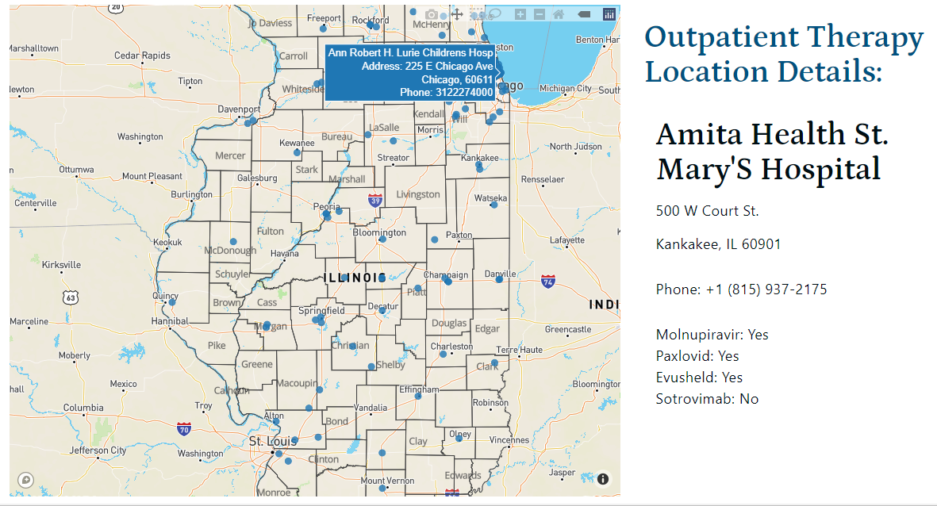
IDPH Covid Outpatient Therapy locator

Slide 57
Make it easier for OB providers / pregnant patients to access Therapeutics
Therapeutics can prevent hospitalizations and deaths (maternal and child) in pregnant with Covid
Oral agents are widely accessible and work against variants
The Need-to-Use gap should decrease especially in high risk pregnant women

Slide 58
Updated SMFM Patient Education Resources (on ILPQC Covid webpage)
SMFM: COVID-19 Vaccination if You Are Pregnant or Breastfeeding English. (11.3.2021)
SMFM: COVID-19 Vaccination if You Are Pregnant or Breastfeeding Spanish. (11.3.2021)
SMFM: Top 5 Reasons to Get the COVID-19 Vaccine (English and Spanish). (11.23.21)

Slide 59
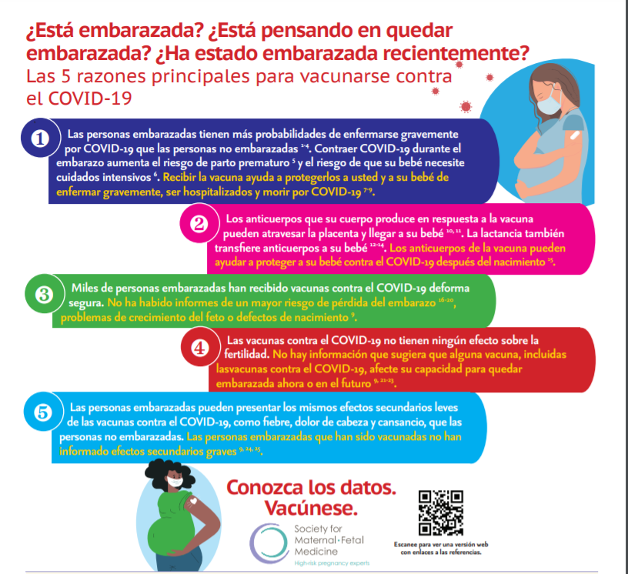
SMFM: NEW INFOGRAPHIC Top 5 Reasons to Get the COVID-19 Vaccine (English and Spanish)

Slide 60
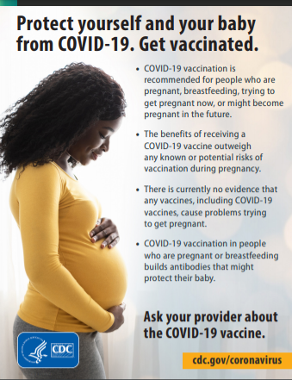
CDC

Slide 61
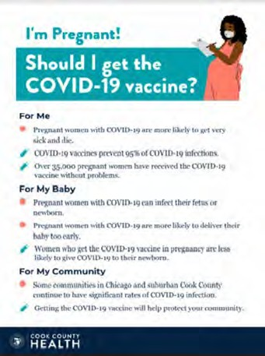
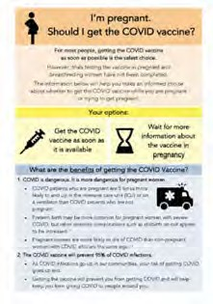
COVID Vaccine
Patient Education Examples
University of Massachusetts Medical School – Baystate: Covid Vaccine Info for Pregnant/Breastfeeding Patients English.
Available in:
Spanish, Nepali, Portuguese, Arabic, Turkish, Somali, Chinese, Vietnamese, Russian (3.17.21)
SMFM Patient Education (English/Spanish): COVID-19 Vaccines and Pregnancy. (3.4.21)
CDC: Safety of COVID-19 Vaccines. Video link. (Updated 6.8. 2021)
Cook County Health: Should I get the COVID-19 vaccine?
Flyer English and Spanish (6.11.21)
CDC: Information about COVID-19 Vaccines for People who Are Pregnant or Breastfeeding. (3.18.21)

Slide 62
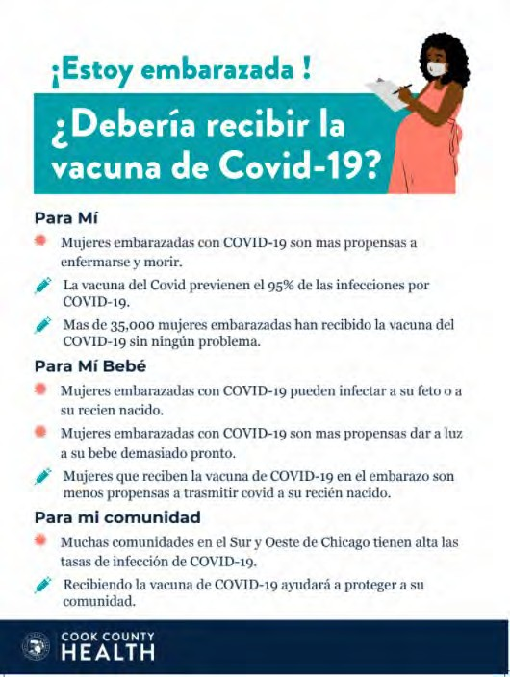
POSTERS

Slide 63
New ACOG / CDC PSA Covid Vaccination in Pregnancy
Please Share This Important PSA
In partnership with the CDC, ACOG has released our first-ever PSA! Please help us spread this important, life-saving message to get vaccinated during pregnancy by sharing: https://vimeo.com/674866776 https://vimeo.com/672469139
We know that a trusted obstetrician-gynecologist can play a large role in a patient’s decision about whether to get vaccinated, so use this PSA as a tool to share with your communities and spread the message.

Slide 64
Updated OB/Neo Covid Publications
NyTimes: U.S. Has Far Higher Covid Death Rate Than Other Wealthy Countries. (1.2.2022)
AJOG: COVID-19 vaccination during pregnancy: coverage and safety. (2.1.2022)
JAMA: Association of BNT162b2 COVID-19 Vaccination During Pregnancy With Neonatal and Early Infant Outcomes. (2.10.2022)
Arch Pathol Lab Med: Placental Tissue Destruction and Insufficiency from COVID-19 Causes Stillbirth and Neonatal Death. (2.10.2022)
Nature: SARS-CoV-2 is associated with changes in brain structure in UK Biobank. (08.19.21)
NyTimes: Covid May Cause Changes in the Brain, New Study Finds. (03.7.2022)
MDPI: Stillbirth after COVID-19 in Unvaccinated Mothers Can Result from SARS-CoV-2 Placentitis, Placental Insufficiency, and Hypoxic. (2.15.2022)
NEJM: Efficacy of Antiviral Agents against the SARS-CoV-2 Omicron Subvariant BA.2. (3.9.2022)
Epic Health Research Network: Which Comorbidities Increase the Risk of a COVID-19 Breakthrough Infection? (3.31.2022) 34

Slide 65
OB Discussion Panel
Discussion of OB Unit Strategies:
Jeannie Kelly, MD, MS -- Director Maternal Fetal Transport, Maternal Fetal Medicine, Barnes Jewish Hospital, St. Louis
Ayesha Hasan, MD – Maternal-Fetal Medicine, University of Illinois Chicago Medical Center, Chicago
John Holden, MD – OB Hospitalist, UW Health SwedishAmerican Hospital, Rockford

Slide 66
Thank You
We continue to give thanks to the nurses, doctors, health care workers, public health teams and others across our state at work confronting the COVID-19 pandemic.
Please send questions, comments and recommendations, cases / willingness to share for future COVID-19 OB/Neo discussion webinars to info@ilpqc.org
Recording of this webinar, Q/A and registration for the next webinar on Friday, May 6, 12-1:15pm, will be available at www.ilpqc.org

Slide 67
Thanks to our Funders
In kind support:

