Slide 1

COVID-19 Strategies for OB & Neonatal Units
April 9, 2021
12:00 – 1:15pm

Slide 2

Welcome
Please be certain you are on “mute” when not speaking to avoid background noise.
Whether you have joined by phone or computer audio, you can mute and unmute yourself by clicking on the microphone icon.
The following shortcuts can also be used
For PC: Alt + A : Mute or Unmute
For Mac: Shift + Command + A: Mute or Unmute
For telephone: *6 : Mute or Unmute

Slide 3
Housekeeping:
We Are Recording Now

Slide 4
ILPQC Covid 19 webinars
The strategies shared today are examples from individual institutions not IDPH or ILPQC recommendations.
This is our 20th COVID-19 strategies for OB/Neonatal Units webinar in coordination with IDPH, since April 3rd. Please see https://ilpqc.org/covid-19-information/ for future webinar registration, prior recorded webinars and written out Q/A’s from those webinars.
The next webinar will be Friday, May 7, noon to 1:15pm. We are continuing monthly webinars for now.
Please let us know if your hospital would like to share on an upcoming webinar, please put questions/comments into the chatbox or email directly to info@ilpqc.org

Slide 5
Overview
Introduction
IDPH Updates
    Amanda Bennett, PhD, MPH - CDC Field Assignee in Maternal and Child Health Epidemiology, Illinois Department of Public
Discussion of OB Unit Strategies
  Jeannie Kelly, MD, MS – Director Maternal Fetal Transport, Maternal Fetal Medicine, Barnes Jewish Hospital, Washington University, St. Louis
  Catalin Buhimschi, MD, MMS, MBA – Director Division of Maternal Fetal Medicine, University of Illinois Hospital, Chicago
Discussion of NEO Unit Strategies
  Lily J. Lou, MD, FAAP - Chair, AAP-Section on Neonatal-Perinatal Medicine,, Assistant Co-director for Neonatology, UIC-IDPH Administrative Perinatal Center, University of Illinois - Chicago

Slide 6
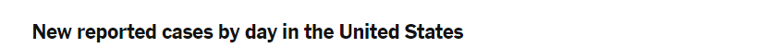
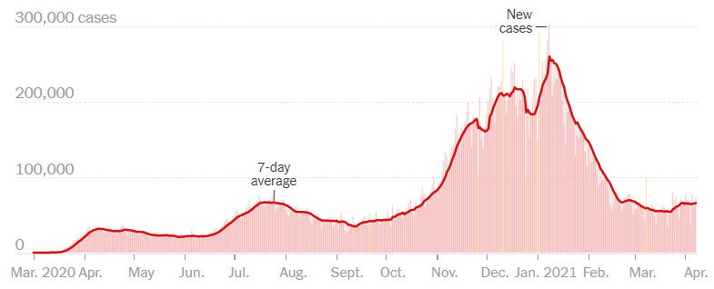
US COVID case trend
Notes:
Updated 4/8/2021
https://www.nytimes.com/interactive/2020/us/coronavirus-us-cases.html

Slide 7
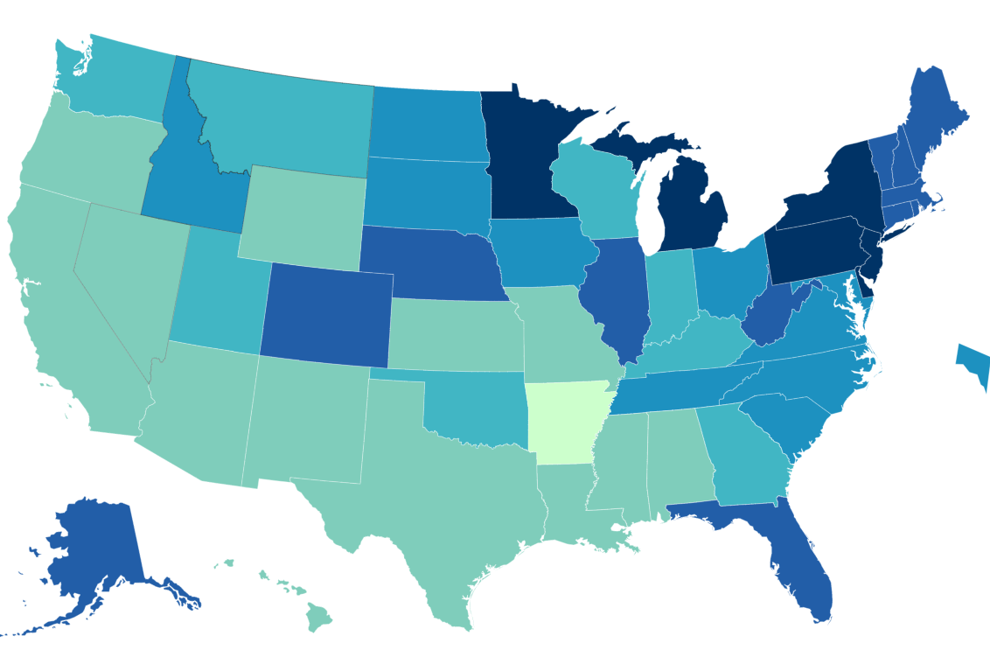
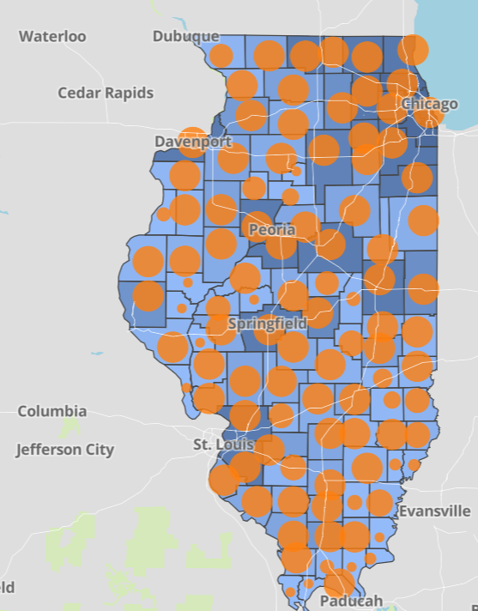
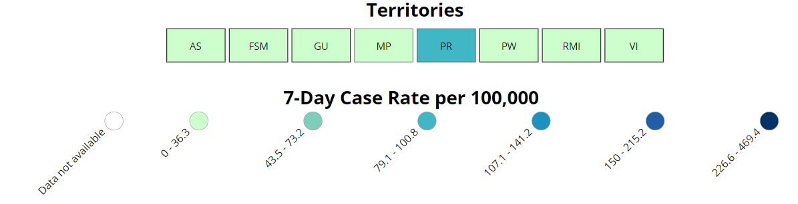
Data Update: April 8, 2021
CDC/IDPH: COVID-19 Outbreak
CDC https://www.cdc.gov/coronavirus/2019-ncov/cases-updates/cases-in-us.html | IDPH https://www.dph.illinois.gov/covid19
Total cases: 30,662,171 confirmed Total deaths: 555,231 confirmed | 1,265,457 Confirmed Positive Cases 21,423 Deaths
Notes:
Updated 4/8/2021

Slide 8
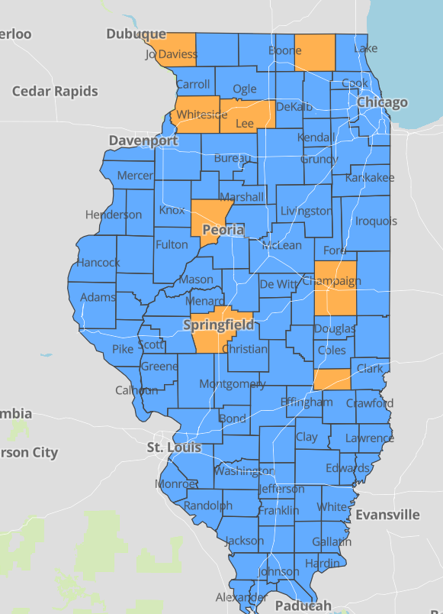
IDPH County Level COVID-19 Risk Metrics
Week 12: 3/21/2021 Through 3/27/2021
Blue indicates that the county is experiencing overall stable COVID-19 metrics.
Orange indicates there are warning signs of increased COVID-19 risk in the county.
Notes:
Updated 4/8/2021
https://www.dph.illinois.gov/countymetrics?county=Cook

Slide 9
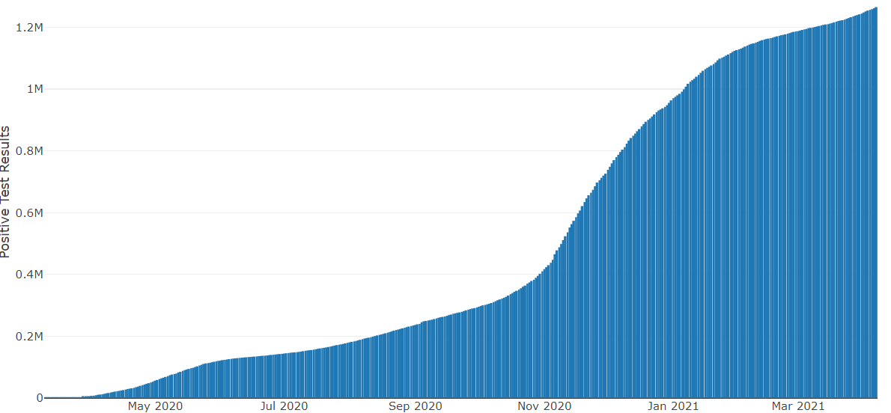
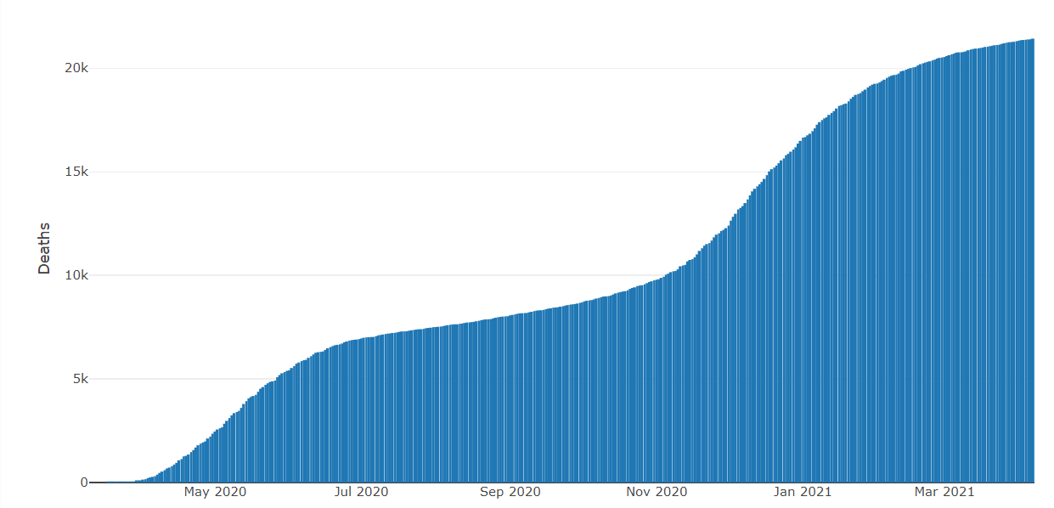
Data Update April 8, 2021
IDPH: COVID-19 Outbreak
https://www.dph.illinois.gov/covid19
IL Positive Cases Over Time
IL Deaths Over Time
Total: 1,265,457 Confirmed Positive Cases
Total: 21,423 Deaths
Notes:
Update 4/8/2021
http://www.dph.illinois.gov/covid19/covid19-statistics

Slide 10
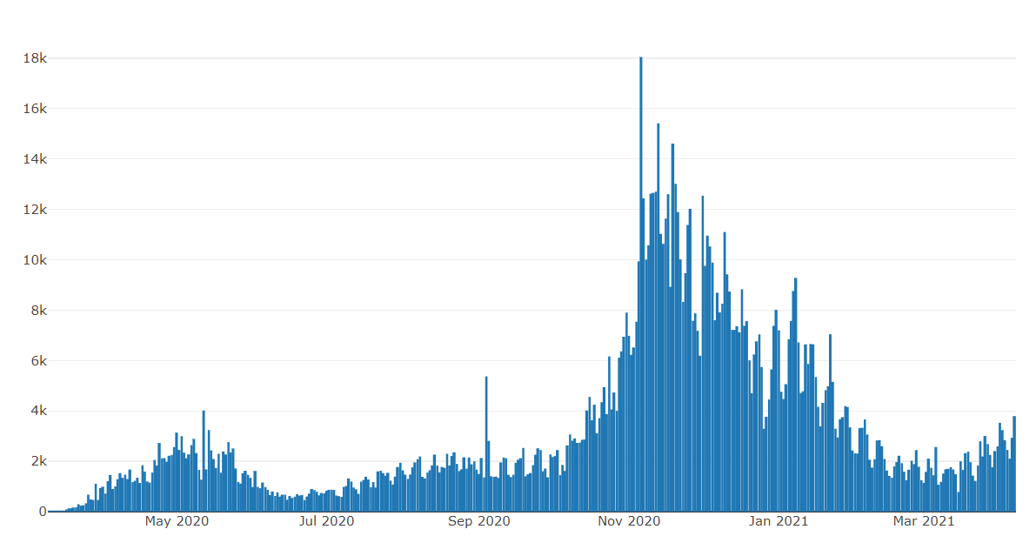
Illinois Daily Incidence
IDPH daily data summary
Notes:
Updated 4/8/2021
https://www.dph.illinois.gov/covid19/covid19-statistics

Slide 11
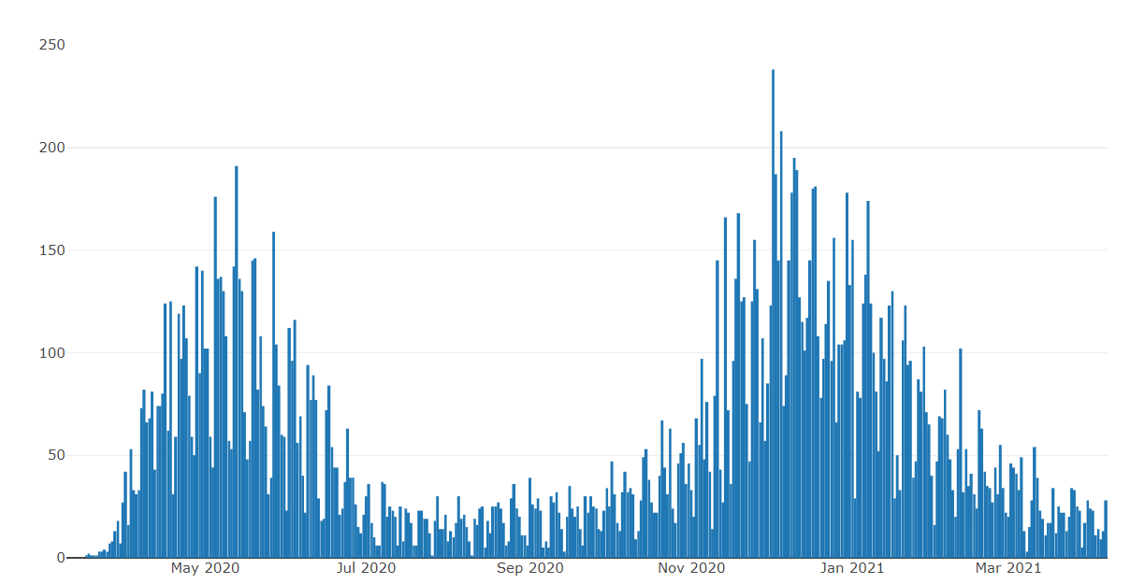
Illinois Covid Deaths
IDPH daily data summary
Notes:
Updated 4/8/2021
https://www.dph.illinois.gov/covid19/covid19-statistics

Slide 12
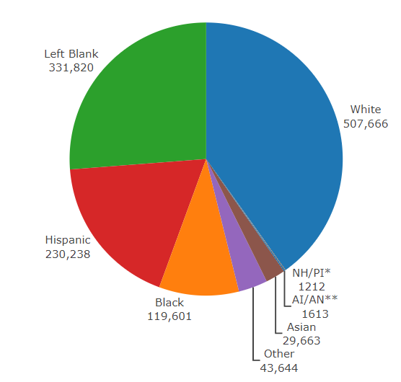
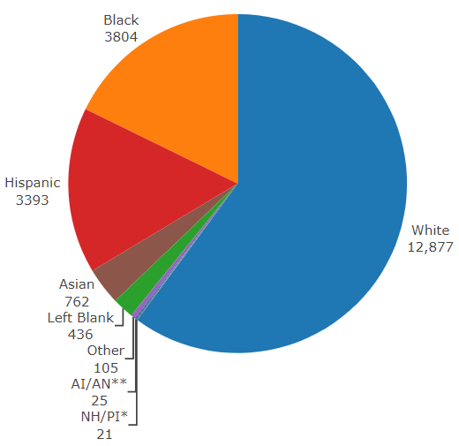
Data Update April 8, 2021
IDPH: COVID-19 Outbreak
Race Demographics
https://www.dph.illinois.gov/covid19
Confirmed Cases
Deaths
Notes:
Updated 4/8/2021
http://www.dph.illinois.gov/covid19/covid19-statistics

Slide 13
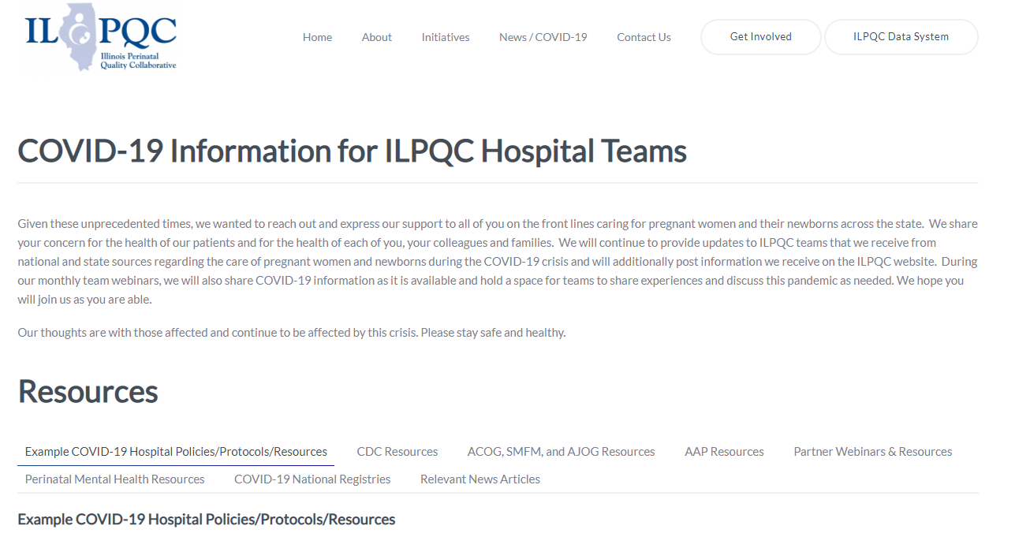
ILPQC COVID-19 Webpage www.ilpqc.org
ILPQC posts national guidelines and OB & Neonatal COVID-19 example hospital protocols & resources
please note dates as guidelines are changing rapidly
https://ilpqc.org/covid-19-information/

Slide 14
Updated OB (ACOG/SMFM) Resources
SMFM: Coronavirus (COVID-19) and Pregnancy: What Maternal-Fetal Medicine Subspecialists Need to Know (11.23.20)
ACOG: Vaccinating Pregnant Individuals: Eight Key Recommendations for COVID-19 Vaccination Sites. (2.3.21)
SMFM: Management Considerations for Pregnant Patients With COVID-19 (2.2.21)
ACOG: COVID-19 Vaccines Pregnancy - Conversation Guide for Clinicians. (3.5.21)
SMFM Pt Education (English/Spanish): COVID-19 Vaccines and Pregnancy. (3.4.21)
AGOG: My Vaccine Choice: A Pregnant Ob-Gyn Shares Why She Got a COVID-19 Vaccine (March 2021)
AGOG: My Vaccine Choice: 4 Questions I Asked Myself About the COVID-19 Vaccines (March 2021)
ACOG:COVID-19 FAQs for Obstetrician-Gynecologists, Obstetrics (Updated 3.30.2021)
ACOG: Practice Advisory: Vaccinating Pregnant and Lactating Patients Against COVID-19. (Updated 3.24.21)
SMFM: Provider Considerations for Engaging in COVID-19 Vaccine Counseling With Pregnant and Lactating Patients. (Updated 4.1.21)

Slide 15
Updated Neonatal /AAP Resources
AAP: COVID-19 Testing Guidance - Guidance developed to help pediatric practices determine when to test for severe acute respiratory syndrome-coronavirus 2 (SARS-CoV-2) infection in their patient population. (Updated 3.5.21)
FAQs: Management of Infants Born to Mothers with Suspected or Confirmed COVID-19: Includes precautions for birth attendants, rooming-in, breastfeeding, testing, neonatal intensive care, visitation and hospital discharge. (2/11/2021)
Breastfeeding Guidance Post Hospital Discharge for Mothers or Infants with Suspected or Confirmed SARS-Co V-2 Infection: Guidance developed to support pediatricians providing direct care for breastfeeding families after discharge from the newborn hospital stay. (2/11/2021)
Family Presence Policies for Pediatric Inpatient Settings During the COVID-19 Pandemic: (1/25/21)
Multisystem Inflammatory Syndrome in Children (MIS-C) Interim Guidance: Clinical guidance for pediatricians including signs, symptoms, diagnosis and management of this rare but serious complication associated with COVID-19. (Updated 2/10/2021)
AAP: Interim Guidance for COVID-19 Vaccination in Children and Adolescents. (2.2.21)

Slide 16
Updated OB/Neo Covid Publications
JAHA: Extracorporeal Life Support in Pregnancy: A Systematic Review. (9.2020)
JAMA: Pregnancy Outcomes Among Women With and Without Severe Acute Respiratory Syndrome Coronavirus 2 Infection. (11.19.2020)​
JAMA: Assessment of Maternal and Neonatal SARS-CoV-2 Viral Load, Transplacental Antibody Transfer, and Placental Pathology in Pregnancies During the COVID-19 Pandemic. (12.22.20)
AJOG: Disease Severity, Pregnancy Outcomes and Maternal Deaths among Pregnant Patients with SARS-CoV-2 Infection (12.30.20)
Neo Reviews: Perinatal SARS-CoV-2 Infection and Neonatal COVID-19: A 2021 Update (2.4.21)
ACOG: Disease Severity and Perinatal Outcomes of Pregnant Patients With Coronavirus Disease 2019 (COVID-19) (2.21.21)
WBEZ: YouTube recording of WBEZ Q&A: African Americans and the COVID 19 vaccine. (3.3.21)
MedRxiv: SARS-CoV-2 antibodies detected in human breast milk post-vaccination. (3.02.21)
AJOG: COVID-19 vaccine response in pregnant and lactating women: a cohort study. (3.21.21)
BMC Pediatrics: Newborn antibodies to SARS-CoV-2 detected in cord blood after maternal vaccination – a case report. (3.22.21)
U.S. News: Promising News for Pregnant People Who Want a COVID-19 Vaccine. (4.6.21)
​

Slide 17
IDPH / HFS / CDC
HFS: Provider Notice Issued Blood Pressure Monitoring Kit (7.2.2020)​ - Medicaid now covers home BP cuffs for all pregnant / postpartum patients
CDC: Birth and Infant Outcomes Following Laboratory-Confirmed SARS-CoV-2 Infection in Pregnancy. (MMWR 11.6.2020)
CDC: Interim Clinical Considerations for Use of mRNA COVID-19 Vaccines Currently Authorized in the United States. (MMWR 1.6.21)
Racial and Ethnic Disparities in the Prevalence of Stress and Worry, Mental Health Conditions, and Increased Substance Use Among Adults During the COVID-19 Pandemic (MMWR Feb 5, 2021)
CDC: The Advisory Committee on Immunization Practices’ Interim Recommendation for Use of Janssen COVID-19 Vaccine (MMWR 3.5.21)
CDC: Toolkit for Pregnant People and New Parents. (2.2621)
CDC: Information about COVID-19 Vaccines for People who Are Pregnant or Breastfeeding. (3.18.21)

Slide 18
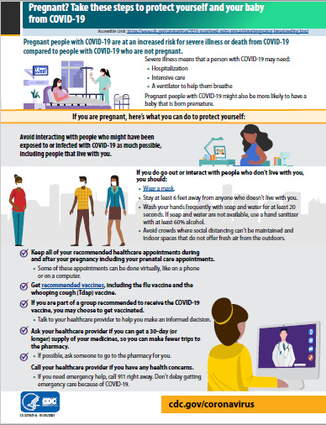
CDC: Pregnancy Factsheet
CDC Patient Education: Pregnant? Take these steps to protect yourself and your baby from COVID-19. (Jan. 2021)

Slide 19
Covid-19 Vaccines
Currently three vaccines are approved with an FDA Emergency Use Authorization
  Pfizer
  Moderna
  Jansen (Johnson and Johnson)
Pfizer and Moderna vaccines are mRNA vaccines Jansen vaccine is an adenovirus vaccine
Both Pfizer and Moderna vaccines require two doses Pfizer doses are 21 days apart Moderna doses are 28 days apart Jansen vaccine is a single IM injection

Slide 20
ACOG Practice Advisory:
Vaccinating Pregnant and Lactating Patients against Covid-19 (03/24/21)
ACOG recommends that COVID-19 vaccines should not be withheld from pregnant individuals who meet criteria for vaccination based on ACIP-recommended priority groups.
COVID-19 vaccines should be offered to lactating individuals similar to non-lactating individuals when they meet criteria for receipt of the vaccine based on prioritization groups outlined by the ACIP.
Individuals considering a COVID-19 vaccine should have access to available information about the safety and efficacy of the vaccine, including information about data that are not available. A conversation between the patient and their clinical team may assist with decisions regarding the use of vaccines approved under EUA for the prevention of COVID-19 by pregnant patients. Important considerations include:
  the level of activity of the virus in the community
  the potential efficacy of the vaccine
  the risk and potential severity of maternal disease, including the effects of disease on the fetus and newborn
  the safety of the vaccine for the pregnant patient and the fetus.

Slide 21
Risks of Covid-19 in pregnancy
Fever and cough most common, occurring in about 40% of pregnant people with COVID-19
Compared to non-pregnant people, pregnant people are at increased risk of severe illness from COVID-19 and death
COVID-19 associated with pregnancy complications and maternal death
  Admission to ICU (OR=2.85, 95% CI: 1.08-7.52)
  Preterm birth (OR=1.47, 95% CI: 1.14-1.91)
  Maternal death (OR=2.85, 95% CI: 1.08-7.52)
Effects on fetus and neonate
  Stillbirth (OR=2.84, 95% CI: 1.25-6.45)
  Neonatal intensive care unit (OR=4.89, 95% CI: 1.87 to 12.81)
Allotey J, Stallings E, Bonet M et al. Update to living systematic review on covid-19 in pregnancy. BMJ 2021; March 10 https://www.bmj.com/content/bmj/370/bmj.m3320.full.pdf
Zambrano LD, Ellington S, Strid P, et al. Update: Characteristics of Symptomatic Women of Reproductive Age with Laboratory-Confirmed SARS-CoV-2 Infection by Pregnancy Status — United States, January 22–October 3, 2020. MMWR Morb Mortal Wkly Rep 2020;69:1641–1647. DOI: http://dx.doi.org/10.15585/mmwr.mm6944e3

Slide 22
Limited Safety Data for Covid Vaccines in Pregnancy
No safety concerns in animal developmental and reproductive toxicity (DART) studies on Pfizer-BioNTech, Moderna, or Janssen COVID-19 vaccines
Pregnant persons excluded from Pfizer, Moderna, and Janssen COVID-19 vaccine clinical trials
  No safety concerns noted among those inadvertently
  vaccinated with Pfizer (23), Moderna (13), or Janssen (8)
  COVID-19 vaccines
mRNA and Adenovirus vaccines
  mRNA degrades quickly by normal cellular processes
  and doesn’t enter the nucleus of the cell
  Ebola adenovirus vaccine has demonstrated safety data during pregnancy
https://www.cdc.gov/coronavirus/2019-ncov/need-extra-precautions/pregnancy-breastfeeding.html

Slide 23
Vaccination of pregnant and breastfeeding women can confer maternal and neonatal immunity
Prospective cohort: 131 reproductive-age vaccine recipients
  Titers of SARS-CoV-2 Spike & RBD IgG, IgA, IgM quantified in sera (n=131) and
  breastmilk (n=31) at baseline, 2nd vaccine dose, 2-6 weeks post 2nd dose, and delivery
  Umbilical cord sera (N=10) titers assessed at delivery
  Titers compared to those of pregnant women 4-12 weeks from natural infection (N=37)
Key Findings
  Pregnant and lactating women elicited comparable vaccine-induced humoral immune responses to non-pregnant controls
  Vaccination generated higher antibody titers than those observed following SARS-CoV-2 infection in pregnancy
  Vaccine-generated antibodies were present in umbilical cord blood and breastmilk after maternal vaccination
Gray et al. COVID-19 vaccine response in pregnant and lactating women: a cohort study. American Journal of Obstetrics and Gynecology. March 2021. https://www.ajog.org/article/S0002-9378(21)00187-3/fulltext

Slide 24
V-SAFE vaccine monitoring
– what data is being gathered pregnant patients?
As of April 5, 2021, there have been over 77,960 pregnancies reported in CDC’s V-SAFE post-vaccination health checker and CDC is currently enrolling pregnant individuals in a pregnancy registry. Evidence gathered through these systems will provide clinicians with critically needed data to inform future recommendations related to COVID-19 vaccination during pregnancy
https://www.cdc.gov/coronavirus/2019-ncov/vaccines/safety/vsafe.html
Notes:
v-safe COVID-19 Vaccine Pregnancy Registry
Pregnant people enrolled, United States, as of April 5, 2021
4,218*

Slide 25
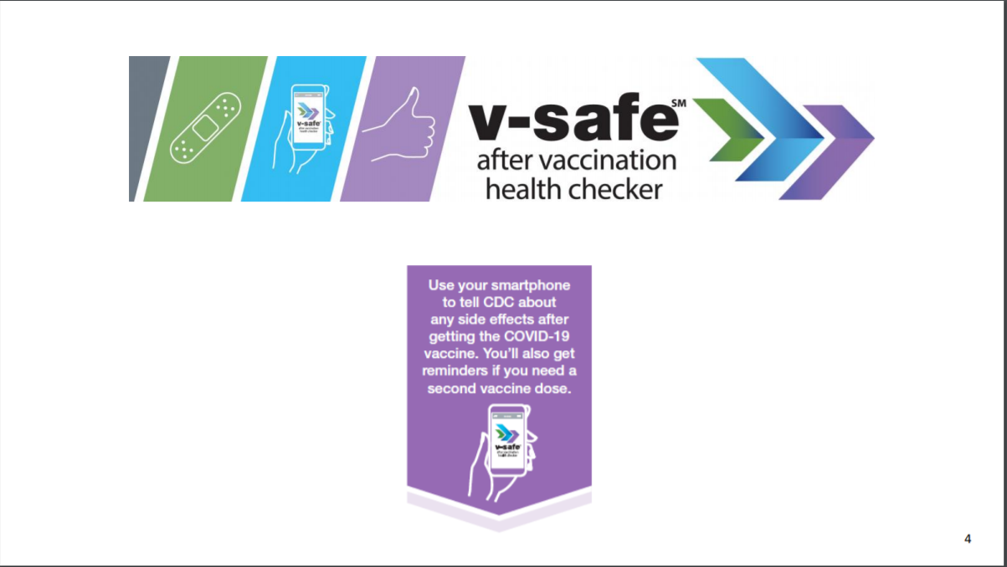

Slide 26
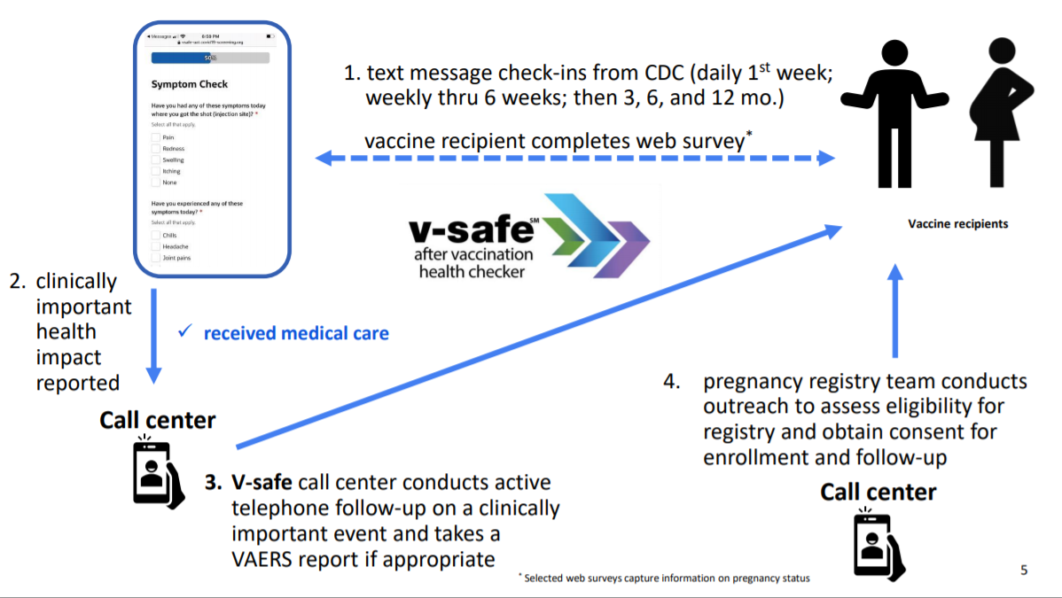

Slide 27
Preliminary Findings from v-safe:
Comparing Pregnant & Non-pregnant Persons
 | All Vaccines N | Pfizer-BioNTech N | Moderna N
Pregnancies reported to v-safe | 30,494 | 16,039 | 14,455
Preliminary v-safe data from Day 1 check-ins indicate similar rates of:
  Health impacts
  Local reactions
  Systemic reactions
UPDATE:
77,960 pregnant people
reported to v-safe
(as of April 5, 2021)
Publicly available analyses as of Feb 16, 2021

Slide 28
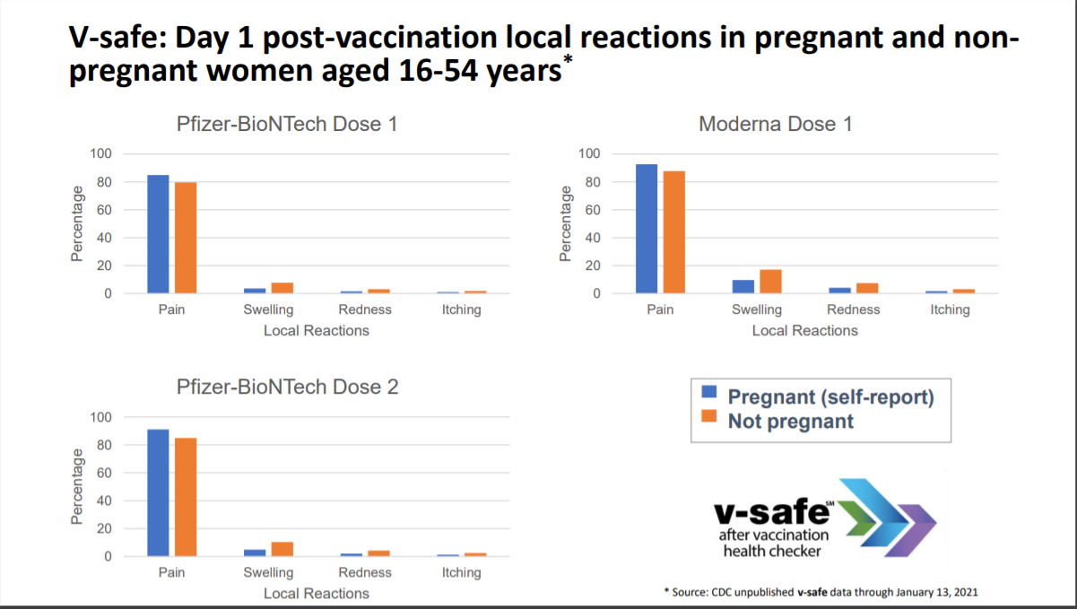

Slide 29
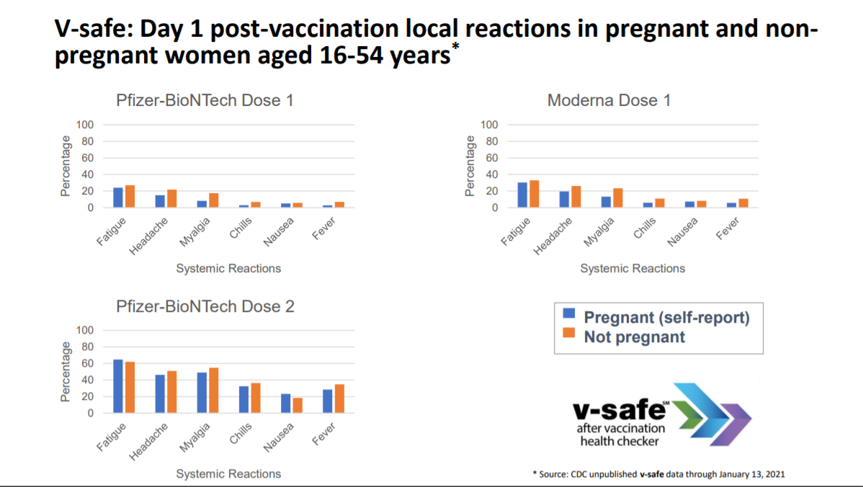

Slide 30
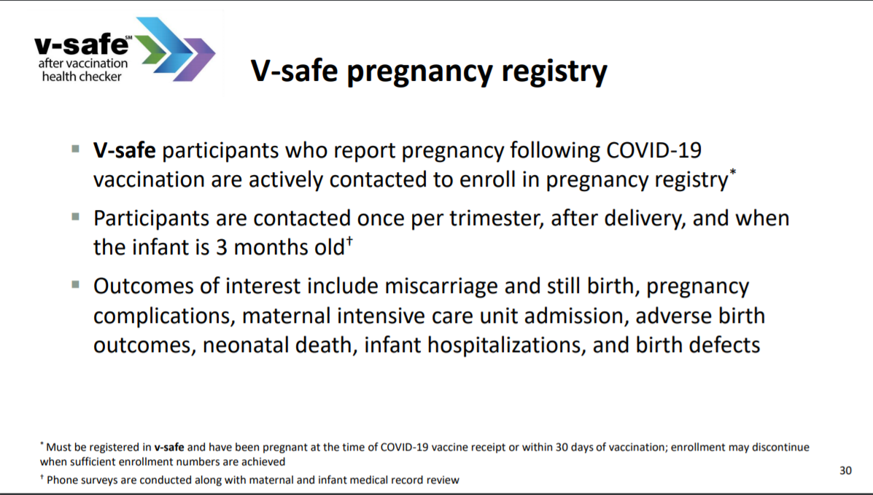

Slide 31
v-safe Pregnancy Registry: Preliminary reports
 | All Vaccines N
Enrolled | 1,815
Not Eligibleª | 103
Refused/Declined^{b} | 31
UPDATE:
4,218 pregnant people
enrolled in v-safe pregnancy registry
(as of April 5, 2021)
To date, about 275 completed pregnancies
  Most are live births, based on self-report data
  No pregnancy or neonatal outcomes above the background rate based on self-reported outcomes
Publicly available analyses as of Feb 19, 2021
ª Eligibility assessment determines whether vaccination was during pregnancy or within 30 days of last menstrual period
^{b} Refused indicates those for whom eligibility could not be fully assessed because participant chose not to engage with pregnancy registry team; declined indicates those who were eligible to participate but chose not to enroll

Slide 32
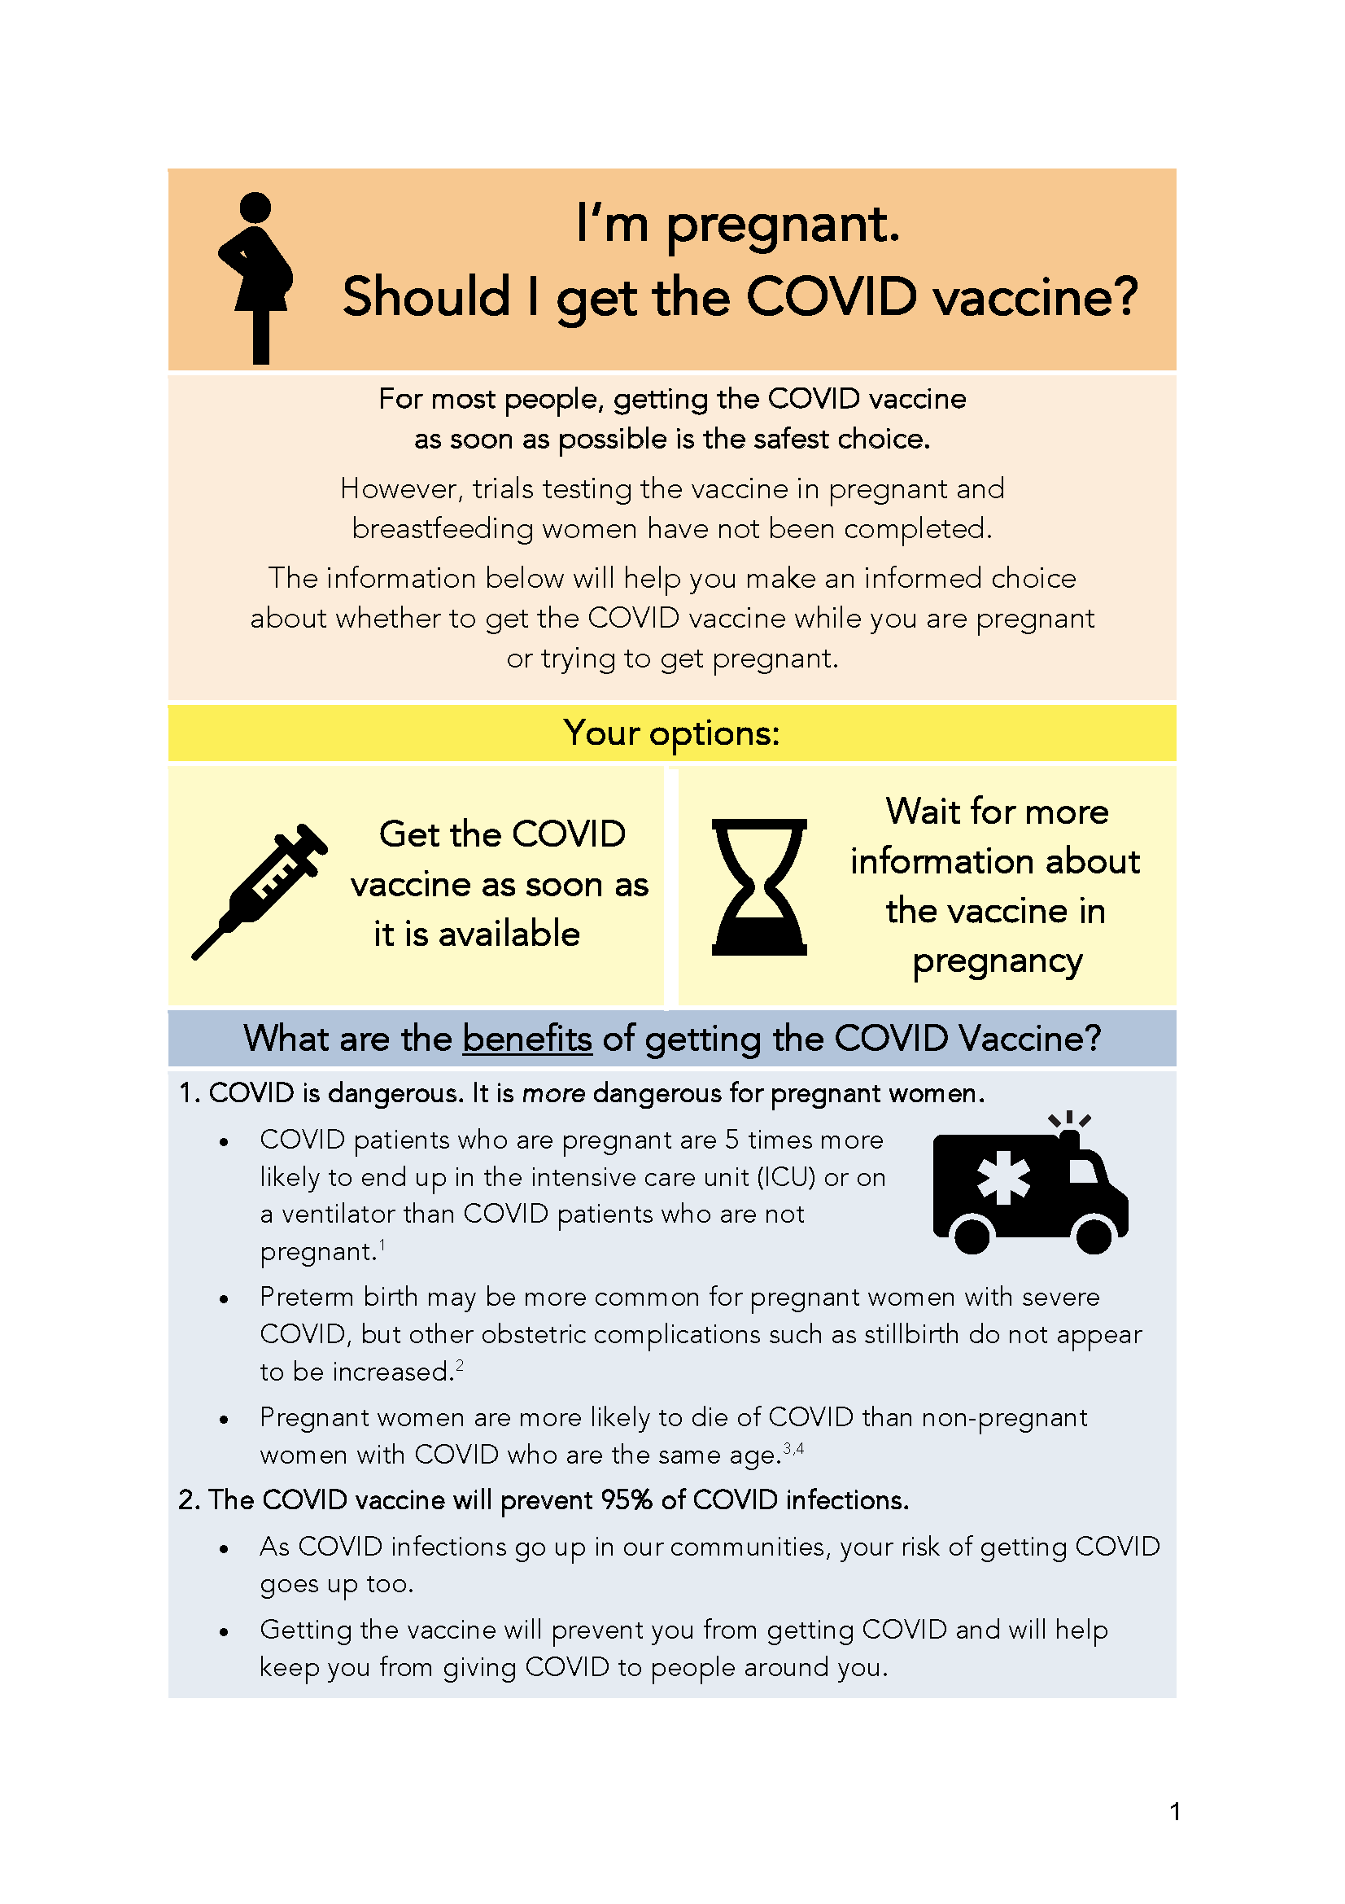
COVID Vaccine
Patient Education Examples
University of Massachusetts Medical School – Baystate: Covid Vaccine Info for Pregnant/Breastfeeding Patients English.
Available in:
Spanish, Nepali, Portuguese, Arabic,
Turkish, Somali, Chinese, Vietnamese,
Russian (3.17.21)
SMFM Patient Education (English/Spanish): COVID-19 Vaccines and Pregnancy. (3.4.21)
CDC: Information about COVID-19 Vaccines for People who Are Pregnant or Breastfeeding. (3.18.21)

Slide 33
Help Finding Vaccines
State of Illinois Coronavirus Response: Find IL Vaccine Distribution Locations by Zipcode or City
NPR: How to Sign Up for a COVID-19 Vaccine in Your State

Slide 34
  IDPH Updates
  Amanda Bennett, PhD, MPH
  CDC Field Assignee in Maternal and Child Health Epidemiology, Illinois Department of Public Health

Slide 35
Perinatal COVID-19
Surveillance in Illinois
Amanda Bennett, PhD, MPH
CDC Maternal and Child Health Epidemiology Field Assignee
Illinois Department of Public Health
April 8, 2021

Slide 36
Disclaimers
The findings and conclusions in this report are those of the author(s) and do not necessarily represent the official position of the Centers for Disease Control and Prevention.
I have no conflicts of interest to report.
This work is supported by the Epidemiology and Laboratory Capacity for Prevention and Control of Emerging Infectious Diseases (ELC) Cooperative Agreement (ELC CK19-1904)

Slide 37
Routine surveillance:
SARS-Cov-2 infection
During pregnancy

Slide 38
Background on COVID-19
Surveillance and Reporting
All cases of COVID-19 are reported to IDPH
  Local health departments
  Hospital electronic lab reporting
  Specimens tested by IDPH state lab
Case files are opened in the state’s infectious disease reporting database (I-NEDSS)
Local health department conduct contact tracing to gather additional information
  Patient demographics
  Potential source of infection
  Symptoms
  Pre-existing conditions
  Treatment
  Complications
  Lab results/test details

Slide 39
Identifying Pregnancy During Contact Tracing
The COVID-19 case reporting form has a field for “pregnancy”
  In Illinois, in “General Illness” section of case reporting form
  Completed during contact tracing interview
  Patient would need to know and disclose pregnancy
Most records for women of reproductive age have unknown or missing pregnancy status on the case reporting form
  Of 235,209 confirmed COVID-19 cases among women ages 15–44 during 2020, 84% had “unknown” pregnancy status
  Percent with unknown pregnancy status increased over time
    64% missing in March 2020 → 92% missing in November 2020

Slide 40
Improving Identification of COVID-19
During Pregnancy
IDPH is matching COVID-19 case reporting forms to birth and fetal death certificates to identify COVID-19 cases who had a delivery outcome since the start of the pandemic
Date of COVID-19 specimen is compared to date of delivery to identify cases occurring during pregnancy
  Cases with positive specimens up to the date of delivery = “pregnant”
IDPH has confirmed over 4,200 pregnant cases with deliveries through December 2020
  Only 45% of these confirmed pregnant cases had the pregnancy field marked as “yes” on the COVID-19 case reporting form

Slide 41
Percent of Illinois Live Births with Confirmed
Maternal COVID-19 Infection at Any Time During Pregnancy
(deliveries through 12/31/2020)
Of all live births in April–December 2020, 4.4% had confirmed maternal COVID-19 infection during pregnancy
Proportion increased in November-December 2020
  Women delivering in Nov/Dec had pregnancies that started in early stages of pandemic, so had opportunity throughout entire pregnancy to become infected
  Increase in transmission during those months could have led to higher infection rate in late stages of pregnancy and detected near delivery time
Notes:
Linkages to fetal deaths are excluded from this slide. There were only 23 COVID-19 cases during pregnancy that linked to a fetal death certificate, as opposed to approximately 4200 cases that linked to a birth certificate.
Proportion early in the pandemic might be influenced also by testing availability, variable implementation of universal screening by facility, and variable testing of patients based on symptom status.

Slide 42
Percent of Illinois Live Births with Confirmed
Maternal COVID-19 Infection at Any Time During Pregnancy
(deliveries through 12/31/2020)
Of all live births in 2020, the groups with the highest prevalence of maternal COVID-19 infection during pregnancy were:
  Hispanic women
  Young women (<25 years)
  Women on Medicaid
  Women residing in Chicago
*
* Racial/ethnic groups are mutually exclusive. Hispanic women are those with Hispanic ethnicity, regardless of race.

Slide 43
Collecting More Detailed Data on COVID-19 During Pregnancy
CDC developed a “pregnancy module” to augment the data collected on COVID-19 case reporting forms
  Obstetric information
  Pre-existing conditions
  COVID-19 symptoms, testing, and treatment
  Maternal complications
  Birth and infant outcomes
IDPH & Chicago DPH received CDC cooperative agreement to collect and report detailed data on pregnant women with confirmed COVID-19
  Identify all pregnant women with confirmed COVID+ specimen through December 31, 2020
  Abstract medical records for both the woman and her infant(s)

Slide 44
IDPH Pregnancy Module Data Collection
IDPH & Chicago DPH are coordinating to develop project plans and will submit data jointly to CDC
  Cases will be divided by location of delivery hospitalization
IDPH Adverse Pregnancy Outcomes Reporting System (APORS) started chart abstraction in January
  Process will be very similar to what is already done for birth defects
  No additional requirements from hospitals other than continuing to share records with APORS
Illinois will begin submitting data to CDC to contribute to multistate population-based studies of pregnancy within the next few months
Public reporting website for CDC SET-NET:
https://www.cdc.gov/coronavirus/2019-ncov/cases-updates/special-populations/birth-data-on-covid-19.html

Slide 45
Sentinel surveillance:
SARS-Cov-2 infection
At labor & delivery

Slide 46
Why Sentinel Surveillance?
Traditional surveillance measures have limitations for enabling timely estimation of changes in disease transmission
  Test positivity rate in general population can be biased because it is dependent on test seeking behaviors
  Changes in hospital admissions data “lag” behind transmission changes by several weeks
    Less biased, but also less timely for identifying rapid changes
Goal of sentinel surveillance is timely identification of changes in population disease occurrence to signal potential need for enhanced mitigation measures

Slide 47
Perinatal Sentinel Surveillance in Illinois
Pregnant women delivering at birthing hospitals conducting universal COVID-19 testing are ideal for sentinel surveillance
  Relatively stable and healthy population
  Continue to seek care and present to hospital even during pandemic
  Universal testing prevents bias due to patient testing behavior
  Universal testing identifies asymptomatic infected patients
IDPH developed a data collection process to obtain daily, aggregate data on deliveries, testing practices, positivity, and symptom status
  Piloted with 8 hospitals for 2 months
  Invited all birthing hospitals with universal testing at labor and delivery to voluntarily submit data starting in mid-August 2020
  By January 2021, 25 hospitals contributed data to the surveillance system
    Represent more than 40% of Illinois’ deliveries
    Over 26,000 deliveries in system over project period

Slide 48
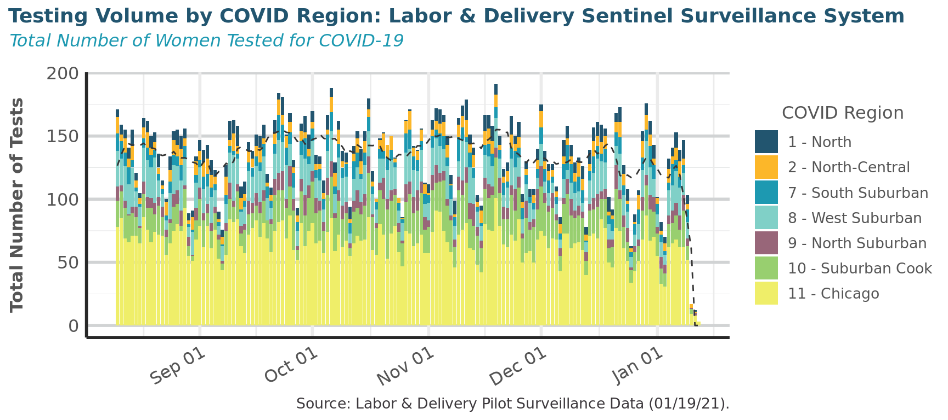
Perinatal Sentinel Surveillance:
Testing Volumes
Dashed line indicates 7-day rolling average in testing volume for all regions combined
100-150 deliveries per day reported to system
96.8% (n=25,772) were tested for COVID-19 at delivery

Slide 49
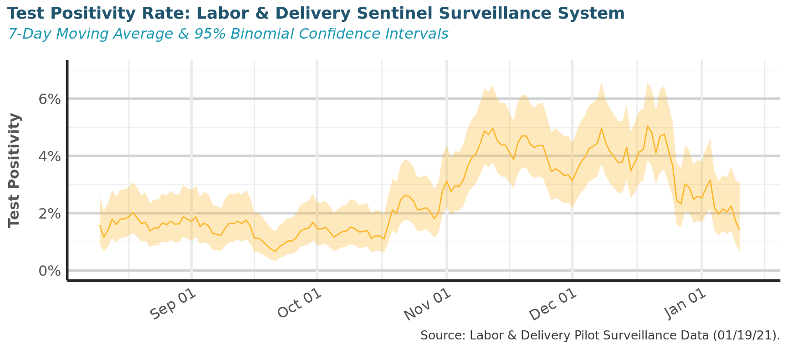
Perinatal Sentinel Surveillance:
Test Positivity & Asymptomatic Rates
Over full project period, 2.4% test positivity rate at delivery (n=615)
  Ranged from <1% to 5% over time period
Of persons with positive tests, 78% were asymptomatic at the time of testing (n=478)

Slide 50
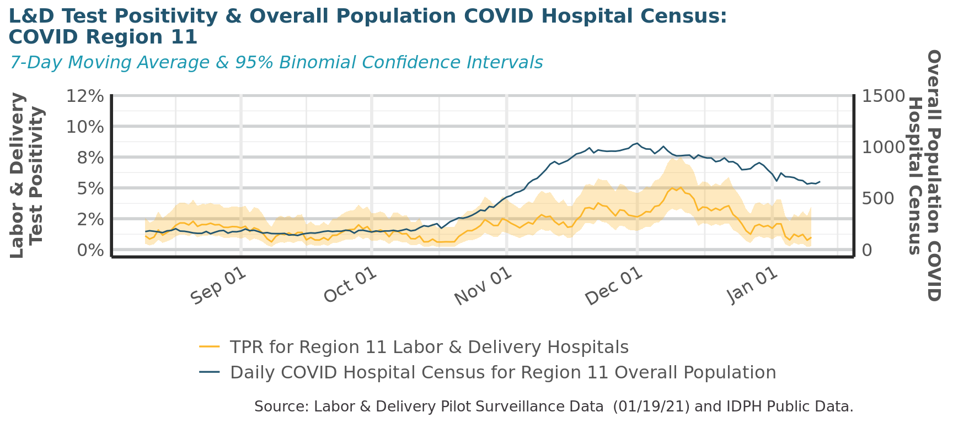
Perinatal Sentinel Surveillance:
Usefulness for Early Signals of Trends
Within Region 11 (Chicago), the test positivity rate among pregnant women at delivery did not provide an early signal of COVID-19 transmission in the overall population

Slide 51
Sentinel Surveillance: Lessons Learned
Test positivity rate among pregnant women at delivery was more stable and lower than the general population
Most women who were infected with COVID-19 at delivery were asymptomatic at testing
However, the test positivity rate among pregnant women at delivery did not provide an early warning of transmission in the general population
Pregnant women might take more precautions to protect themselves from COVID-19 than the general population
Universal testing valuable for identifying asymptomatic infections, informing clinical decision-making and patient education
Sentinel surveillance among labor & delivery hospitals was discontinued in January 2021.
Notes:
Despite sentinel surveillance at IDPH ending in January, many hospitals are continuing universal testing at labor & delivery. This is likely to continue until the pandemic reaches acceptably low community transmission and/or high vaccination rates among healthcare workers and pregnant women.

Slide 52
Contact Information:
Amanda.C.Bennett@illinois.gov

Slide 53
OB Discussion Panel
  Jeannie Kelly, MD, MS – Director Maternal Fetal Transport, Maternal Fetal Medicine, Barnes Jewish Hospital, Washington University, St. Louis
  Catalin Buhimschi, MD, MMS, MBA – Director Division of Maternal Fetal Medicine, University of Illinois Hospital, Chicago

Slide 54

Barnes-Jewish Hospital affiliated with Washington University Physicians
St. Louis, Missouri
10,125 employees
1,266 beds
Parkview Tower
Opened Feb. 2018
  Women and Infants
    18 Labor rooms
    12 Triage bed unit
    18 Antepartum bed unit
    34 Postpartum bed unit
    3 OR’s
      1 for Fetal Surgery
3,665 Deliveries
545 Inbound Maternal Transfers
150 Bed NICU St. Louis Children’s Hospital (August 2020)

Slide 55
Today’s Update
1 case
2 publications

Slide 56
Case
TF is a 34 yo G1 transferred at 36 weeks with worsening COVID-19 PNA
  Ruled in for preeclampsia, induction started at OSH
  To our Labor unit: 2L NC, bilateral patchy infiltrates on CXR
  Induction continued x24 hours without progress >5cm
    Worsening respiratory status requiring 4-6L NC
    Cat 2 tracing
    Cesarean delivery
    To COVID ICU

Slide 57
ICU course
Uptitrated quickly to Optiflow --> BiPAP → Intubation → ECMO HD#7 (POD#5)
  RV perforation → PEA HD#18 → RV patch repair
  Trach performed HD #28
  ECMO decannulated HD#31
  Course also c/b bilateral DVTs
  Discharged to rehab HD#58

Slide 58
Co-morbidites
BMI 35
Primary hyperparathyroidism
No prior HTN diagnosis

Slide 59
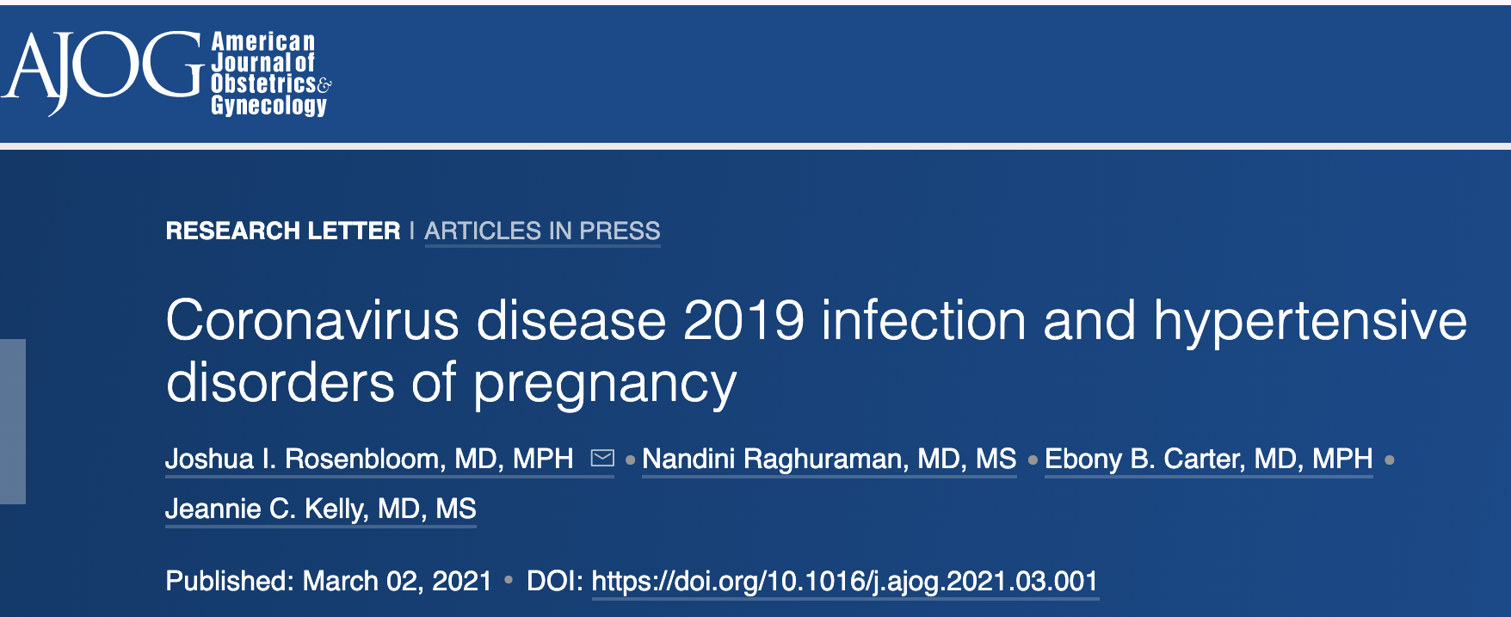
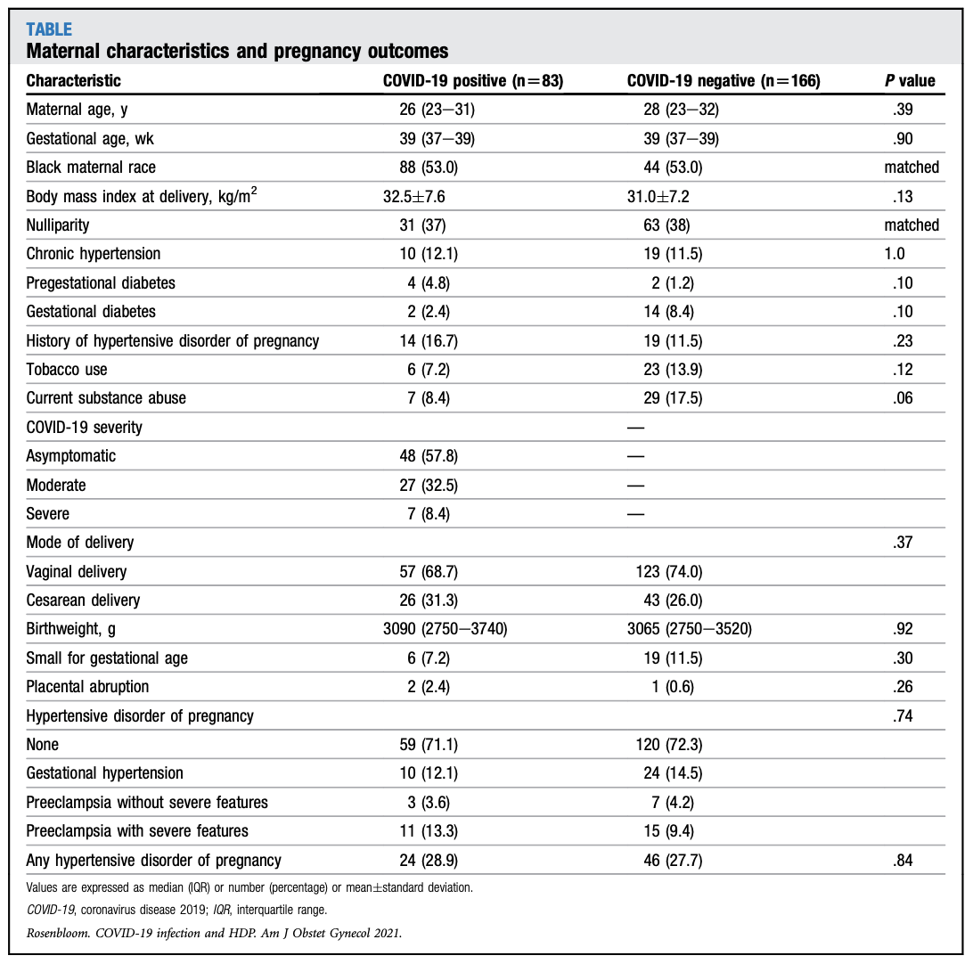

Patients with COVID-19 infection had almost a two-fold risk of HDP (HR 1.93 (95%CI 1.13, 3.31)
Early (<32 wks) COVID-19 infection higher risk (HR 2.17 95% CI, 1.11, 4.24) than late (HR 1.68 95% CI 0.79,3.57).
Notes:
Josh Rosenblum performed a retrospect.tive cohort study of 83 covid pos moms and 166 matched controls and found an increased risk of HDP in those with COVID-19

Slide 60
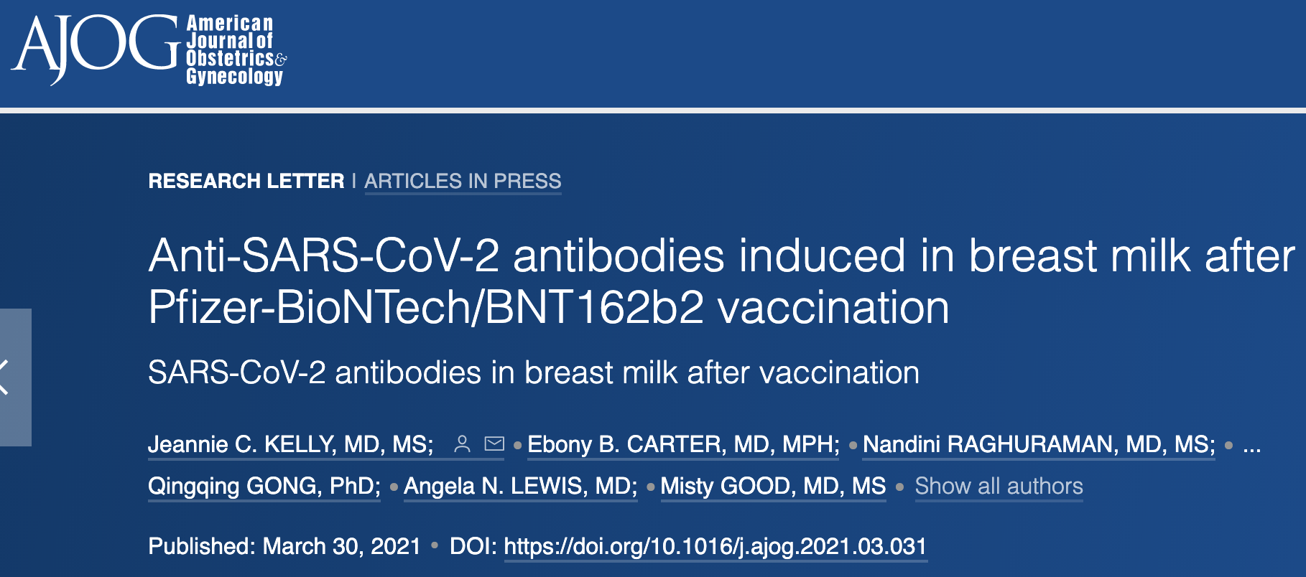

Human Milk SARS-CoV-2 Anti-Spike Protein IgG
Human Milk SARS-CoV-2 Anti-Spike Protein IgA

Slide 61
Neonatal Discussion Panel
  Lily J. Lou, MD, FAAP - Chair, AAP-Section on Neonatal-Perinatal Medicine,, Assistant Co-director for Neonatology, UIC-IDPH Administrative Perinatal Center, University of Illinois - Chicago

Slide 62


STATE-OF-THE-ART
PERINATAL CARE DURING THE
COVID-19 PANDEMIC sharing key takeaways
March 26, 2021
University of Illinois at Chicago
IDPH Administrative Perinatal Center

Slide 63
What was covered
Study strategies over the past year & how evidence has informed practice
  Perinatal COVID Registry (>8000, positive 14d prior to 3d after birth)
  CDC data (400K women of childbearing age; >30K pregnant women)
  VON Impact Audit (logistical & qualitative data)
  IL state data

Slide 64
Summary of the Evidence
Pregnant women are at increased risk of serious illness and mortality with COVID-19 compared to non-pregnant peers
COVID-19 may impact pregnant women with prolonged recovery and persistent side effects (cognition, chronic pulmonary and cardiovascular)
COVID-19 may increase the risk for stillbirth and infant mortality
Perinatal transmission is greatest for women who become COVID-19 positive near the time of delivery (<8 days prior to delivery)
Perinatal vertical transmission appears to be very low—horizontal transmission from mother to baby occurs largely via respiratory droplet exposure
Both mothers and children are at risk for long term complications of COVID-19
The pandemic poses non-infectious risks, especially to children

Slide 65
PRACTICE RECOMMENDATIONS - Obstetrics
Pregnant women with COVID-19 can be managed in the outpatient setting but should transition to inpatient expeditiously if they develop shortness of breath, altered mental status
Asymptomatic mothers who are COVID-19 positive do not need to be separated from their babies in the hospital. Visitation policies may depend on physical facilities limitations.
All mothers should be encouraged to establish lactation if they so choose.
Direct nursing by asymptomatic COVID-19 positive mothers should be supported.
Symptomatic COVID-19 positive mothers should be encouraged to pump breastmilk for their infants until they are well enough to nurse directly.
Symptomatic mothers should wear masks, practice good hand hygiene and try to maintain physical distancing until 10 days have passed since the onset of symptoms.
A low threshold for further evaluation should be maintained for delivered mothers who develop tachycardia, shortness of breath or other cardiac symptoms.
Pregnant women should get vaccinated against COVID-19.

Slide 66
PRACTICE RECOMMENDATIONS-Neonates
Neonates do not need to be isolated from asymptomatic COVID-19 positive mothers.
Testing (at 24 & 48 hours of age) of neonates born to COVID-19 positive mothers is still recommended because they may be at risk via horizontal transmission.
Breastfeeding and skin-to-skin care should be supported for newborns of asymptomatic COVID-19 positive mothers. Breastfeeding may confer protection through breast milk antibodies. Contact with healthy parents’ flora is important for development of a normal microbiome.
Duration of the birth hospitalization should not be curtailed due to COVID-19. The risk to the newborn is increased by early hospital discharge.
Symptomatic mothers should wear masks, practice good hand hygiene and try to maintain physical distancing until 10 days have passed since onset of symptoms. They should be encouraged to pump breastmilk for their infants until they are well enough to nurse directly.
It is safe for newborns to follow up in person with their pediatrician. Children should continue routine pediatric care—including routine immunizations—during the pandemic.
A low threshold for evaluation should be maintained for infants who contract COVID-19 as newborns. They may be at risk for MIS-C or other long-term cardiac complications.

Slide 67
Questions for Ongoing Studies
Better understand how COVID-19 impacts stillbirth and prematurity
Learn more about COVID-19 infection during various phases of pregnancy
Follow up on long term effects of COVID-19 acquired during pregnancy-for women & infants
Learn whether in utero exposure to SARS-CoV-2 has later impacts in infants who do not become ill in the immediate newborn period
Learn more about the natural history of COVID-19 infection in children
Gain a fuller understanding of vaccination safety and efficacy during pregnancy & in children
Understand epidemiology of SARS-CoV-2 in a vaccinated population
Understand how COVID-19 infection (or vaccination) during pregnancy might or might not confer immunity to infants – how long would that last?
Continue to monitor SARS-CoV-2 variants and vaccine effectiveness

Slide 68
What was covered
Study strategies over the past year & how evidence has informed practice
  Perinatal COVID Registry (>8000, positive 14d prior to 3d after birth)
  CDC data (400K women of childbearing age; >30K pregnant women)
  VON Impact Audit (logistical & qualitative data)
  IL state data
Mental health in the pandemic

Slide 69
Mental Health Resources – Jo Kim
Articles – including specific COVID-19 resources
Resources clearinghouses
Grief resources
Condition specific resources (anxiety, psychosis, OCD)
Resources for kids
Resources for patients
Resources for providers

Slide 70
What was covered
Study strategies over the past year & how evidence has informed practice
  Perinatal COVID Registry (>8000, positive 14d prior to 3d after birth)
  CDC data (400K women of childbearing age; >30K pregnant women)
  VON Impact Audit (logistical & qualitative data)
  IL state data
Mental health in the pandemic
Health disparities and the impact of the pandemic – concrete ways to address
Ethics of allocation of life support resources across the lifespan in a disaster
State university response: vaccine trials, vaccine distribution
CDC update on COVID vaccination in pregnancy
Breakouts: visitation – telehealth – lactation support – long term effects
ILPQC COVID-19 resources

Slide 71



Upcoming UIC Perinatal Center Courses and Conferences
https://calendars.Illinois.edu/list/5460

Slide 72
Burnout Conference Highlights
Story of Burnout & Recovery – Howard Hast
National Approach to Physician Burnout – Nisha Mehta
Stress as a Precursor to Burnout: Why One Size Does Not Fit All – Aarti Raghavan
Breakout Sessions:
  Preventing Burnout: Building your Personal Toolkit – Dena Hubbard
  Building Organizational Culture to Prevent & Overcome Burnout – Quint Studer
  Power of Writing – David Thoele
  Developing Peer Support Programs – Jo Shapiro

Slide 73


Slide 74
Thank You
We continue to give thanks to the nurses, doctors, health care workers, public health teams and others across our state at work confronting the COVID-19 pandemic.
Please send questions, comments and recommendations, cases / willingness to share for future COVID-19 OB/Neo discussion webinars to info@ilpqc.org
Recording of this webinar, Q/A and registration for the next webinar on Friday, 5/7/21 will be available at www.ilpqc.org

Slide 75










THANKS TO OUR
FUNDERS
In Kind Support

