Slide 1



Birth Equity (BE) Monthly Webinar
Making progress towards our goals together!
September 19th, 2022

Slide 2


Overview
ILPQC updates
Birth Equity data review
Postpartum Education
BE next steps
Team Talk
  JoAnn Dominick Meigs, RN BSN MBA - Nurse Manager at Ascension Resurrection Medical Center
  Jena Wallander Gemkow, MPH, BSN, RN - Clinical Research Manager at Alliance Chicago, Chicago Collaborative for Maternal Health

Slide 3
Annual Conference Updates

Slide 4
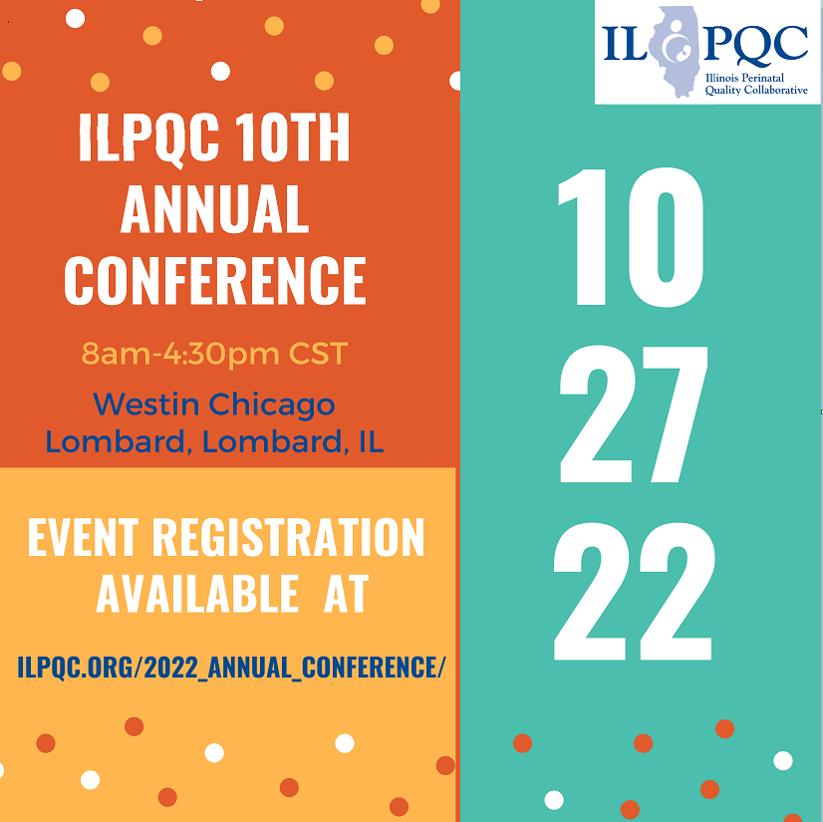

Registration Open!

Slide 5

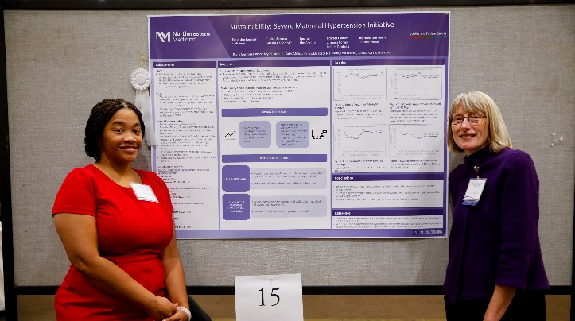

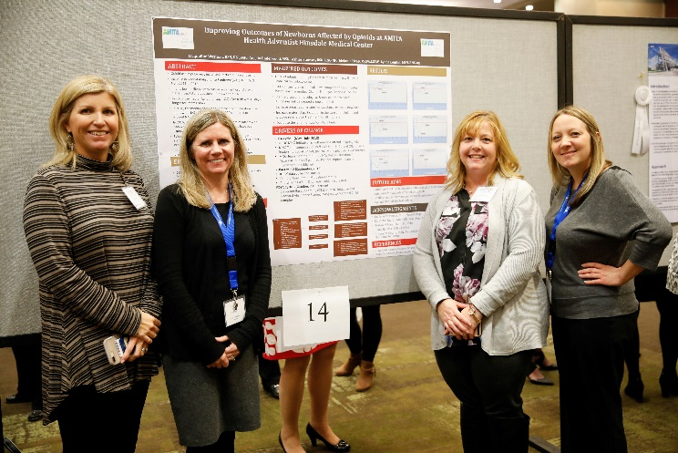



Join us
Collaborative magic.
Remember how great this was?
Make sure at least one provider champion and nursing champion from your hospital are there.
Don’t miss it.

Slide 6


ILPQC 10th Annual Conference Webpage
Register here // Reserve Hotel Room // AC Teams Survey // Poster Abstract

Slide 7
We want to hear from you
ILPQC sent out the 2022 Annual Conference Teams Survey September 1st
Can be found at www.ILPQC.org under “Annual Conference Teams Survey Link”
This is a great opportunity to share your teams' thoughts & insights reflecting on 2022 and planning for 2023!
Please coordinate with your colleagues working across all ILPQC initiative to have one person from your hospital submit the survey by October 3rd
We typically have almost 100% of teams complete the Annual Survey! Please plan with your team who will complete and submit this important survey to share your important input to make ILPQC the best it can be for every IL birthing hospital

Slide 8

Annual Conference Awards Ceremony
Get your data submitted for awards!
  MNO-OB
  MNO-Neo
  PVB
  BASIC
  BE
Submit data by TODAY, September 19 to be considered for Quality Improvement Recognition
Notes:
The deadline has past, so do we want to delete this slide…We are running the data tomorrow, are we giving any leeway? What about awards for getting all data submitted? Could we give additional time for teams if they got all data in to get a Data Champion Award certificate at AC? Would encourage teams to keep working on getting their data submitted. What is the latest we would need data to get certificates printed in time? Ok if we just say they had to have data in already and just delete this slide.

Slide 9


BE QI Leader
All data entered for Baseline-August 2022
Key Structure Measures "In Place“ or “Working on it”:
  At least 7 structure measure in place or working on it
Achievement of process and outcome level measures
  Implicit Bias Education for clinical teams overall (80%)
  SDoH screened and documented for quarter 3 (June, July, Sept.) (80%)
Due Friday, September 16th
Notes:
I think we should reserve QI Excellence Awards are when teams complete an initiative. We haven’t decided what the criteria will be for completing the BE initiative but I don’t think we are there yet and I don’t think ready to give out QI Excellence Awards for BE? That would mean giving the big plaques out? If we give some out and then we change the criteria that would get complicated….we should use the same name we used for Face to Face BE. I don’t think we want to use Race/ethnicity documented and completed…I think we dropped this measure as everyone pulled in the random sample has race/ethnicity documented if they were sampled (unless Medicaid)… where are teams with the SDOH measure can we include that? I think it is hard since we haven’t shared these measures with the teams and the data is due…we should make it simpler if possible. Also how are teams doing with 2 week postpartum visit?
We say ALL STRUCTURE measures entered for Baseline – August 2022, do we just care about the structure measues? Do we want to require all data submitted?

Slide 10

Call for Abstracts for AC Poster Session
All hospital teams are encouraged to submit an abstract on complete or in-progress perinatal quality improvement (QI) work.
Abstract briefly describes your QI work and is foundation for your poster you create to display and share at the ILPQC 10th Annual Conference Poster Session.
Abstract format (no more than 300 words overall), submit via RedCap link:
  Background
  Project Implementation
  Results
  Conclusions

Slide 11
Hospital Team Annual Conference Prep
Register
Data & Awards
Submit your Annual Conference Poster Abstract by October 3rd to be considered for an award.
2022 AC Survey
Abstracts
Make sure all data Baseline-August 2022 is entered in REDCap by Sept 19th 2022
Registration open on ILPQC webpage!
Attend Event
Meet together in-person for ILPQC 10th Annual Conference at the Westin 8:00am-4:30pm
Book your hotel at the Westin in Lombard, IL
Opportunity to share thoughts & insights reflecting on 2022 & 2023 planning
Submit the survey by October 3rd
Print and bring your poster to display!

Slide 12
Opportunities available for BE initiative

Slide 13


We are here for support: Schedule a Key Players Meetings to help overcome any barriers!
LAST CALL: Schedule a Key Players Meeting through September
Consultation for all BE teams with a BE champion
Strategize and map out your hospital’s next steps to address barriers and create a 30/60/90 plan.
18 teams have completed their KPM
Request your KPM meeting with this link: https://redcap.healthlnk.org/surveys/?s=C9TKXKJNMD
It was informative and helpful. Helped us eliminate barriers to moving forward! -- OSF HealthCare Saint Francis
It was extraordinarily helpful! Looking forward to getting back together with our team to start putting things into action!! – Barnes Jewish Hospital
SIGN your team up TODAY to get the support your hospital need!
Illinois Perinatal Quality Collaborative
Notes:
Additional support for your birth equity initiative! We want to help you succeed by:
Partnering with you to arrange your Key Players meeting.
Assist you with who to invite at each hospital for most effective meeting with representative from ILPQC
Provide you with a Birth Equity champion from the BE speakers bureau to partner with you to problem solve, overcome barriers, and move implementation forward

Slide 14


Upcoming Implicit Bias Training
Opportunity – all are welcome
Virtual Group Training:
  3.5 hour training session with
  March of Dimes facilitator
  Up to 100 participants
  3.5 Continuing Medical Education (CME) and Continuing Nursing Education (CNE) credit
  Interactive activities
September 29th 2022 at 10am –1:30pm
Click here to register for this training: https://marchofdimes.zoom.us/meeting/register/tJwlde6vqD4jHt3ufTFAX2O-Hsg1w3g3_gkB

Slide 15
Birth Equity initiative data review
Helping hospital teams move this important work forward together

Slide 16
BE Key QI Strategies
Optimize race/ethnicity data collection & review key maternal quality data by race, ethnicity & Medicaid status
Engage patients and community members for input on quality improvement efforts
Universal social determinants of health screening tool (prenatal/L&D) with system for linkage to appropriate resources
Share respectful care practices on L&D and survey patients before discharge on their care experience (using the PREM) for feedback
Standardize postpartum safety education and schedule early postpartum follow up prior to hospital discharge
Implicit Bias / Respectful Care training for providers, nurses and other staff
Notes:
Optimize race/ethnicity data collection and review key maternal quality data by race, ethnicity and Medicaid status
Universal social determinants of health screening tool (prenatal/L&D) with system for linkage to appropriate resources
Share respectful care practices on L&D and survey patients before discharge on their care experience (using the PREM tool) for feedback
Engage patients and community members for input on quality improvement efforts
Standardize postpartum safety education and schedule early postpartum follow up prior to hospital discharge
Implicit Bias / Respectful Care training for providers, nurses and other staff

Slide 17
Structure Measures:
Implementing Systems Changes
Notes:
Protocol for improving patient-reported race/ethnicity data
Stratified by race/ethnicity and Medicaid status
Standardized SDoH screening tools for delivery admission
SDoH community resources mapping tool

Slide 18
Structure Measures:
Implementing Systems Changes
Notes:
Sharing expected respectful care practices with delivery staff and patients (i.e. posting in L&D)
Patient Reported Experience Measure (PREM) patient survey
Engaged patients and/or community members on QI efforts
Standardized PP safety patient education, where to call, and early follow-up

Slide 19
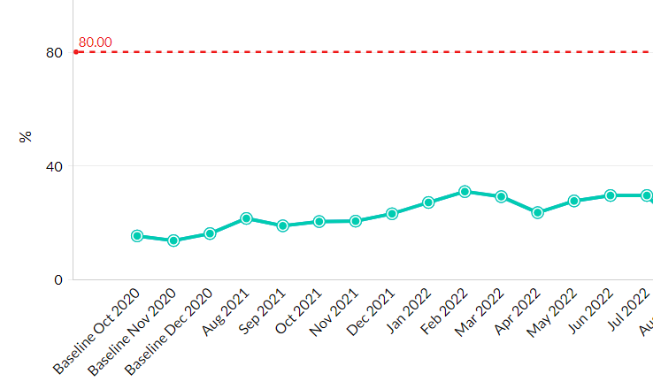
Outcome Measures:
SDoH Screening Tool Documented during L&D
Notes:
For AC let’s make a slide that shows the % for each hospital with bar charts in order like we do for PVB NTSV CS rate…that will show many hospitals have 80-100% of patients screened and many hospitals haven’t started screening… averages 40%, but it is the variability that is motivating.

Slide 20
Process Measures:
Implicit Bias Training
Notes:
Structure Measures- highlight/congratulate the success in place/working on measures: how to consolidate these
Implemented standardized social determinants of health screening tools for delivery admission
Implemented affiliated prenatal care sites standardized screening tools for universal social determinants of health screening
Completed ILPQC social determinants of health community resources mapping tool and shared with affiliated outpatient
Incorporating discussion of social determinants of health and discrimination as potential factors in hospital maternal morbidity reviews
Protocol for improving the collection and accuracy of patient-reported race/ethnicity data
Process to review maternal health quality data stratified by race/ethnicity and Medicaid status
Engaged patients and/or community members to provide input on quality improvement efforts
Sharing expected respectful care practices with delivery staff and patients
Implicit Bias Training (line graph)

Slide 21

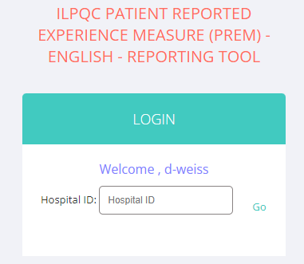
PREM Survey Reports Launched!
BE Team members have received access to view their PREM reports in REDCap
PREM Reports:
    % of all delivered patients completing the PREM survey per month
    Reports provided by month or quarter (must have >5 responses per category)
    Can view overall or stratified data
    Responses from patients with Public Insurance compared to Private Insurance
    Responses from BIPOC patients compared to Non-Hispanic White patients
    Stratified by Black, White, Asian, Hispanic, Other (will report only if sufficient numbers > 5 patients per category)
Use your hospital’s 3-digit ID!
Notes:
Number of birthing people discharged after delivery who received the Patient Reported Experience Measure (PREM) Survey either via QR Code or hospital iPad/tablet/laptop

Slide 22
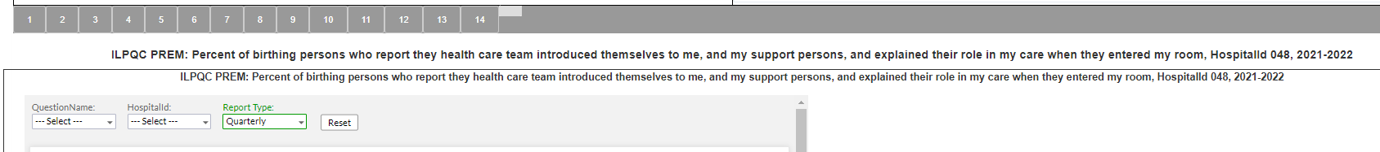
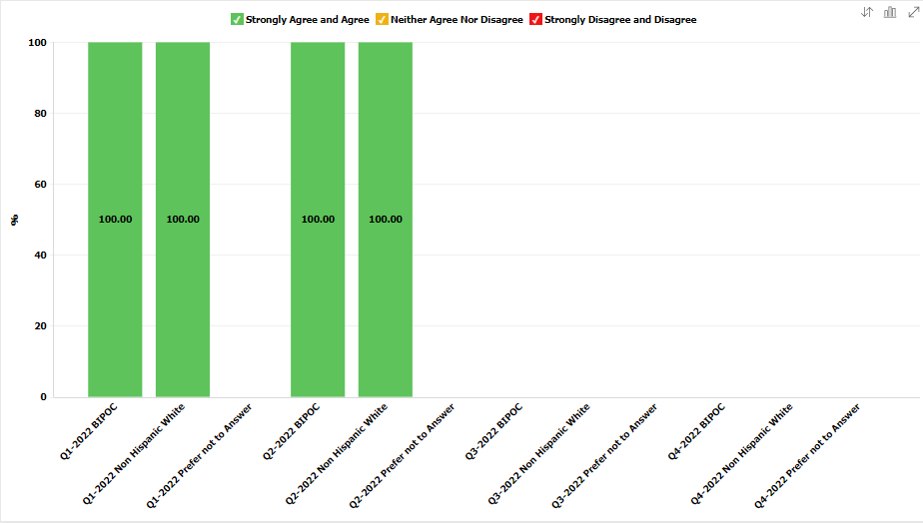
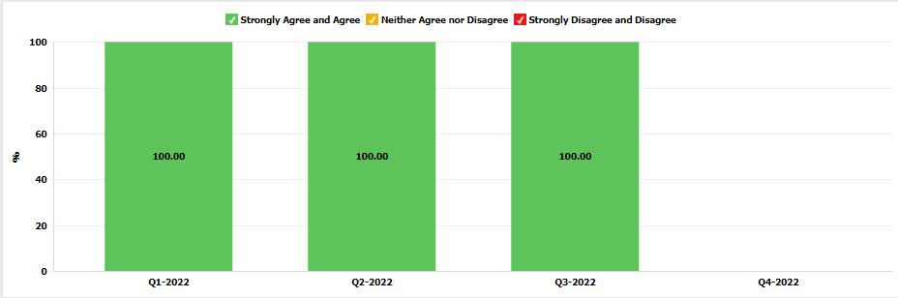
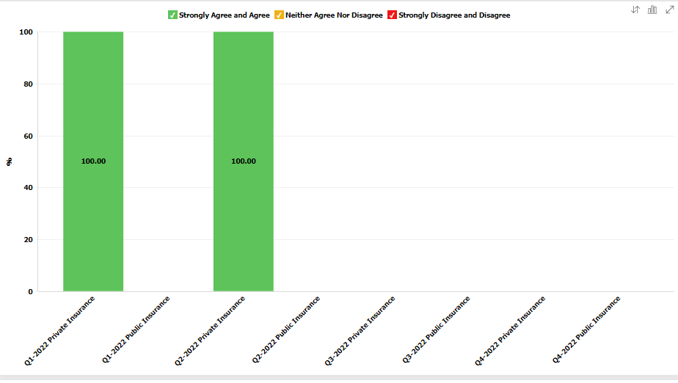
PREM Reports Launched!
Toggle between Reports 1-14
Toggle between Monthly & Quarterly
Race and Ethnicity
Insurance
Aggregate
Notes:
Number of birthing people discharged after delivery who received the Patient Reported Experience Measure (PREM) Survey either via QR Code or hospital iPad/tablet/laptop

Slide 23
Focusing on Postpartum Safety

Slide 24
Postpartum Safety
Birth Equity Key Strategy
  Standardize postpartum safety education and schedule early postpartum follow up prior to hospital discharge

Slide 25
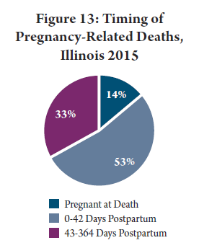
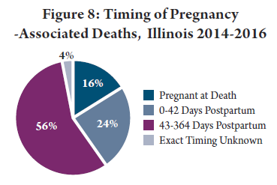
Maternal Mortality in the Early
Postpartum Period
24% of pregnancy associated deaths 0-42 days
53% of pregnancy related deaths 0-42 days
Before the 6 week visit
http://dph.illinois.gov/sites/default/files/publications/publicationsowhmaternalmorbiditymortalityreport112018.pdf
Notes:
Key recommendations from MMRC report
Providers should adopt the recommendation from the American College of Obstetricians and Gynecologists (ACOG) for early postpartum visit in addition to traditional 6 week visit
Birthing hospitals should ensure that women are connected with a primary care or obstetrical provider and scheduled for a postpartum visit prior to hospital discharge

Slide 26

Maternal Morbidity in the Early Postpartum Period
50% of postpartum strokes occur within 10 days of discharge (Too G et al, 2018)
20% of women discontinue breastfeeding before the first 6-weeks (Stuebe et al, 2014)
Up to 40% of women do not attend the 6-week postpartum visit (ACOG CO #736 2018)
As many as 1 in 5 women experience a postpartum mental health disorder and is a leading cause of pregnancy related death (Tully, 2018, IDPH Maternal Mortality Report)
Notes:
Suzanne to add citations
Stuebe AM, et. al. Prevalence and risk factors for early, undesired weaning attributed to lactation dysfunction. J Womens Health (Larchmt) 2014;23:404–12.
Martin A, et. al. Views of women and clinicians on postpartum preparation and recovery. Matern Child Health J 2014;18:707–13. 5.
Tully KP, et. al. The fourth trimester: a critical transition period with unmet maternal health needs. Am J Obstet Gynecol 2017;217:37–41.
Optimizing postpartum care. ACOG Committee Opinion No. 736. American College of Obstetricians and Gynecologists. Obstet Gynecol 2018;131:e140–50.
. Illinois Maternal Morbidity and Mortality Report. Illinois Department of Public Health. (October 2018)
Too G , Went T , Boehme AK , Miller EC , Leffert LR , Attenello FJ , et al. Timing and Risk Factors of Postpartum Stroke . Obstet Gynecol 2018

Slide 27
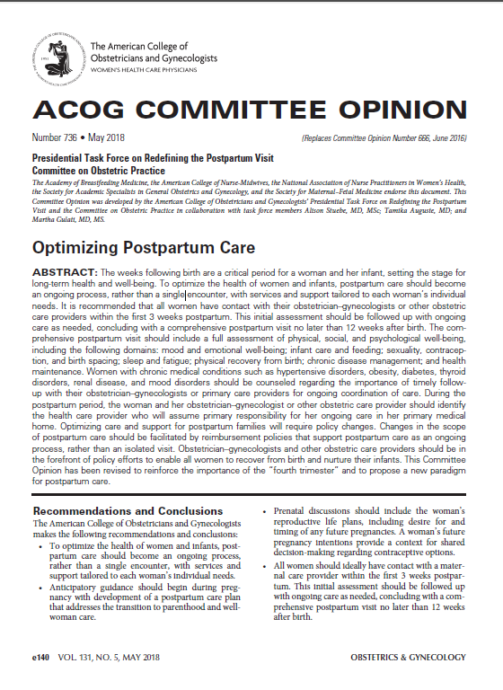
Redefining Postpartum Care:
ACOG CO #736
To optimize the health of women and infants, postpartum care should become an ongoing process, rather than a single encounter
All women should ideally have contact with maternal care provider within the first 3 weeks postpartum (2 week maternal safety check)
  Blood pressure checks
  Breastfeeding support
  Mental health well-being
  Contraception
Initial assessment should be followed up with ongoing care as needed
Conclude with a comprehensive postpartum visit approximately 6 weeks postpartum, NO LATER than 12 after birth

Slide 28


Components of the 2 week early
PP visit
Maternal Health
Safety Check
Blood pressure / preeclampsia symptoms check
Wound/ perineum check
Assess appropriate postpartum bleeding
Mood check/depression screening
Breastfeeding support
Family planning/contraception options
Linkage to health / community services
(ie. WIC, breastfeeding support, home visits)
Assess medical / pregnancy complications, including
SUD/OUD risks and link to needed follow up care
Review risk reduction strategies for future
pregnancies

Slide 29


AIM Bundle
Postpartum Discharge Transition Bundle: To address the postpartum period, specifically focusing on key transition periods, such as hospital discharge to outpatient obstetrical care and ongoing specialist care as needed.

Slide 30







IPAC Initiative: Improving Postpartum Safety
16 hospitals participated from May 2019 to May 2020
Implement universal 2 week postpartum Maternal Health Safety Check schedule before discharge
Provide postpartum safety education before delivery discharge for ALL patients
  Post birth warning signs
  Benefits of early postpartum follow-up
  Healthy pregnancy spacing
16 hospitals participated
https://ilpqc.org/improving-postpartum-acess-to-care-ipac/
Notes:
Add bullet on universal 2 week postpartum visit. Two things Saftey education # of participating. Insert a map of hospitals on where they are
Results
14 participating hospitals were diverse by geography, birth volume, and patient mix. All hospitals implemented scheduling universal early postpartum visits before delivery discharge by May 2020. Teams reported 90% of providers and nurses received education regarding maternal risk and improving access to care in the postpartum. A sample of 1,940 deliveries across participating hospitals showed an increase of patients with an early postpartum visit scheduled prior to discharge from 2% to 80%. Discharge education on postpartum early warning signs increased from 21% to 98% of patients. Hospitals achieved benchmarks on key measures regardless of hospital characteristics
Implementation of universal scheduling of early postpartum visits and postpartum safety patient education before delivery discharge is feasible and can be implemented across diverse hospitals. Future work should focus on the impact of early postpartum maternal health safety checks and improved postpartum education on maternal postpartum outcomes and disparities.
Postpartum safety

Slide 31
IPAC:
Making Change Happen
Key QI Strategies
Implement process flow to facilitate universal scheduling prior to hospital discharge, of early pp visits / maternal health safety check within 2 wks
Utilize provider outpatient packet to engage OB providers and outpatient care sites to help plan for early pp visit scheduling, obtain buy-in from providers, and
share options for billing and coding.
Implement provider and nurse education on risks of the postpartum period, benefits of early pp visit, and key components of maternal health safety check
Standardize system to provide patient education prior to hospital discharge
on the benefits of early pp visit, early pp warning signs and how to seek care (ie AWHONN resource), and benefits of healthy pregnancy spacing
Notes:
Here are the key QI strategies to making change happen. Some of you may have noticed that these strategies have been the focus of our call and also the 4 key drivers in our KDD. These strategies have included….

Slide 32
Percent of Provider Education on Postpartum Safety
Notes:
Ieshia updated 12/17/2020

Slide 33
Percent of Patients with Standardized Patient Education
Notes:
Ieshia updated 12/17/2020

Slide 34
Percent of Patients with Early Postpartum Visit Scheduled
Notes:
Ieshia updated 12/17/2020

Slide 35
Focusing on Postpartum Safety Patient Education

Slide 36
Process map current discharge
workflow
Test – work with patient to call the provider’s office to schedule postpartum visit during postpartum discharge education on early warning sign and importance of early postpartum visit
OB Provider to see patient and place d/c order
Prescription plan/orders complete in EMR or e-pharmacy
Complete AVS (d/c) instructions and signed off in EMR specific to patient
OB Provider
Verify OB Provider tasks are complete
Complete birth record activities or verify parental plan for birth record completion
Complete discharge education for mother and baby
Resolve care plan & complete d/c tasks (security system, infant transportation, tests, etc)
Complete discharge note
PP Nurse
Send admitting notification on patient’s discharge
Clear chart from EMR system
Order for pp room to be cleaned
Secretary
36

Slide 37
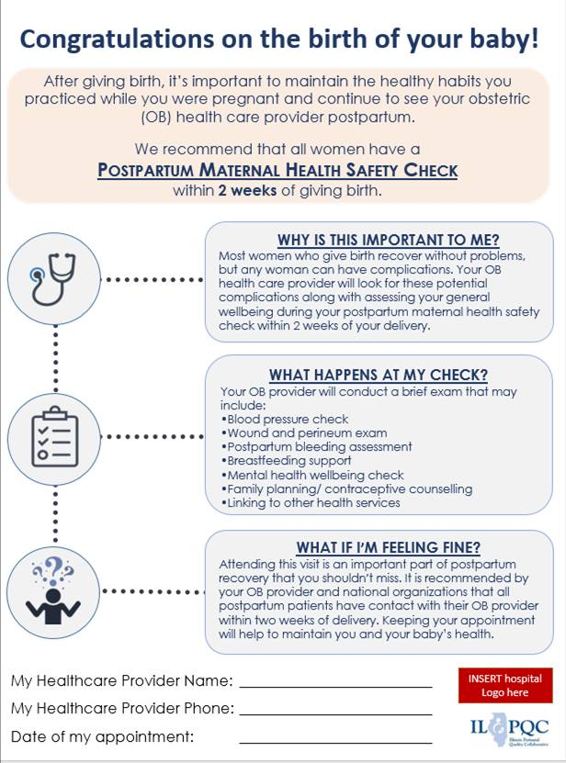
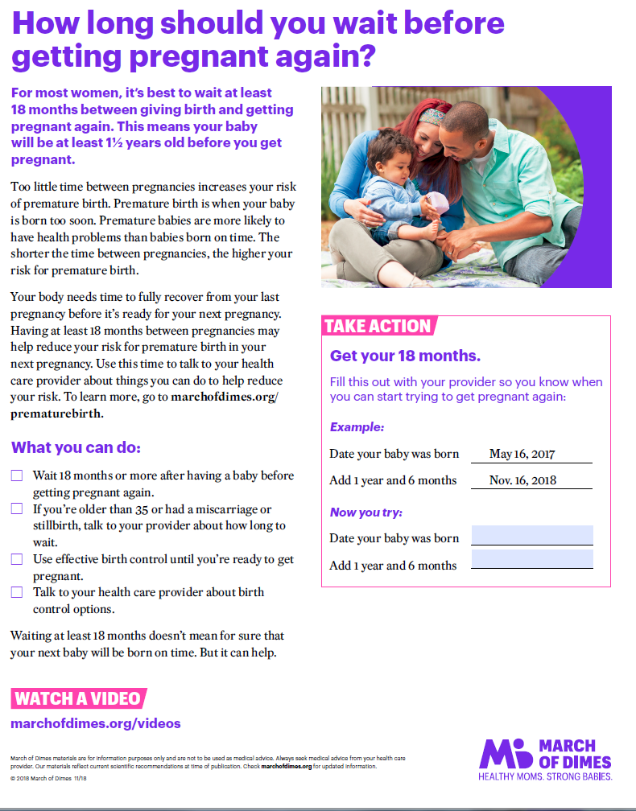

Example Postpartum Patient
Education Material
Healthy Pregnancy spacing
Post-birth warning signs
Importance of early postpartum visit

Slide 38

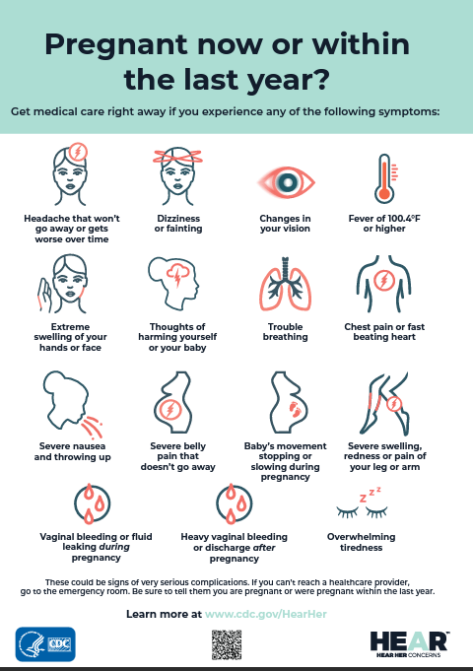

CDC: Hear HER
Conversation Guide for Partners, Friends, and Family of Pregnant or Postpartum Women
Conversation Guide with healthcare provider
Urgent Maternal Warning Signs

Slide 39
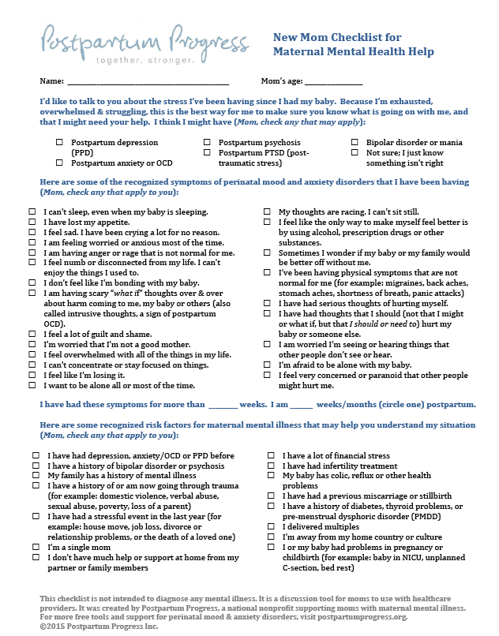
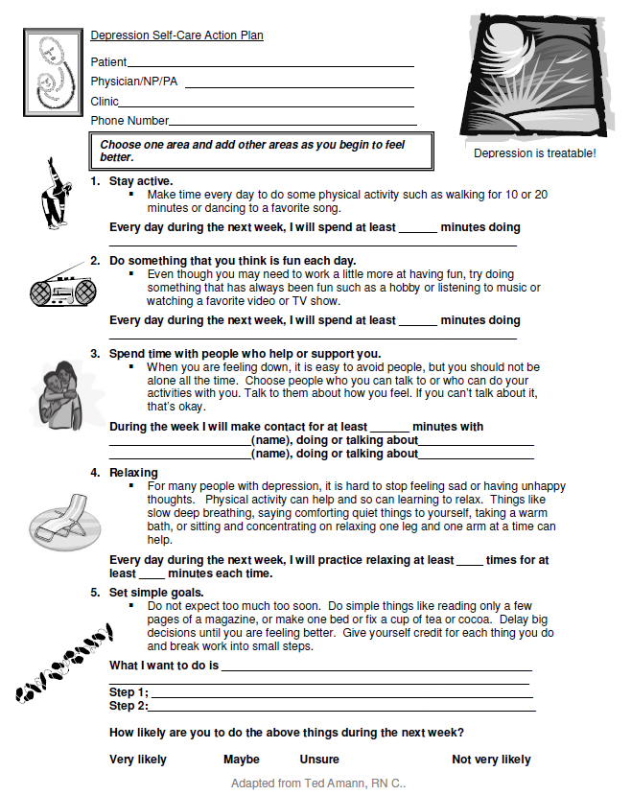
Additional Examples
Postpartum Patient Education Material
Mom checklist maternal health help
Depression self-care action plan

Slide 40
Focusing on Postpartum Safety Provider Education

Slide 41
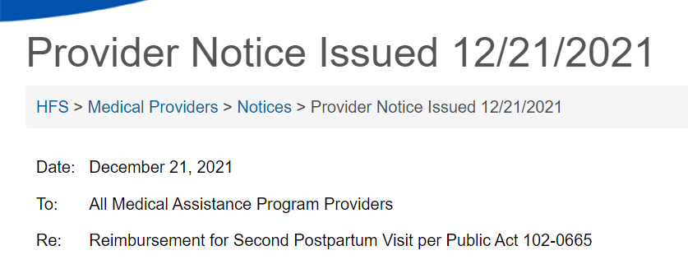

This notice confirms coverage for a second postpartum visit required by Public Act 102-0665. This policy applies to both Medicaid fee-for-service and the HealthChoice Illinois managed care plans.
The Act specifies coverage for a postpartum visit within the first 3 weeks after childbirth and a comprehensive visit within 4 to 12 weeks postpartum for persons who are otherwise eligible for Medical Assistance. Department policy already allows for one postpartum visit. Providers may bill the same procedure code, 0503F – Postpartum Care Visit, twice during the postpartum period and be reimbursed in accordance with the Act.
This policy is retroactive to dates of service beginning October 8, 2021. Questions may be directed to the Bureau of Professional and Ancillary Services at 877-782-5565 or the applicable managed care plan.
https://www2.illinois.gov/hfs/MedicalProviders/notices/Pages/prn211221b.aspx

Slide 42
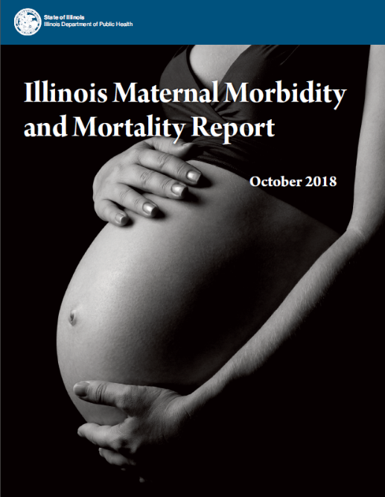
OB Provider Packet for Buy-In
What’s included
Initiative introductory letter signed by hospital OB Chair
Hospitals discharge process flow
IPAC Fact Sheet
National and State Guidance documents
  ACOG CO #736
  AIM Postpartum Care Safety Bundle
  IDPH Maternal Morbidity and Mortality Report
Medicaid provider notice (covers 2 wk pp visit)
Provider education resources
Office Flyer
https://ilpqc.org/improving-postpartum-acess-to-care-ipac/
Notes:
Has this all been updated since Medicaid now covers 2 preventative postpartum visits? That is the biggest issue now for buy in and all of the old IPAC materials discussed all of the billing work arounds we used to have to explain.

Slide 43
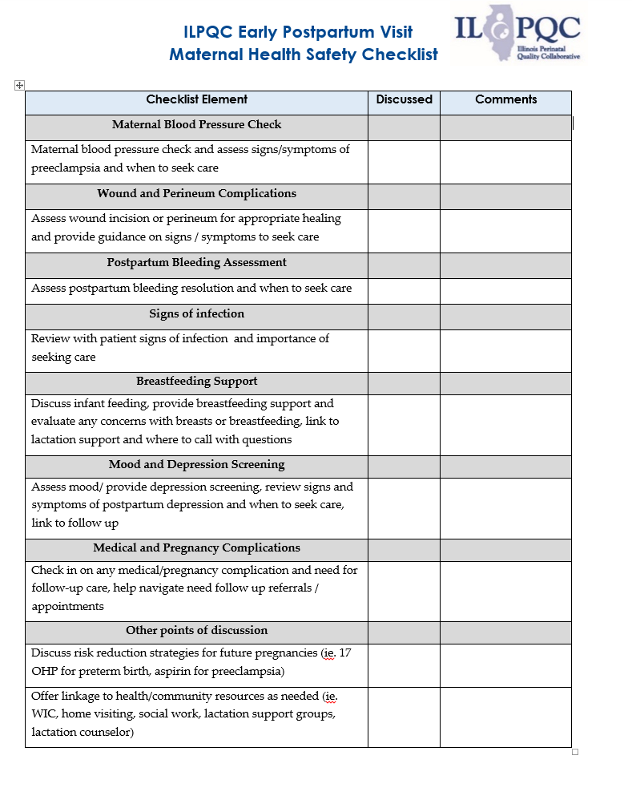
Early Postpartum
Visit/ Maternal Health Safety Checklist

Slide 44

Process Flow for Scheduling
Early Postpartum Visit
Patient meets all discharge criteria
Patient counseled on need for early postpartum visit at 2 weeks and will help make appointment before discharge
Provide patient education materials on the benefit of early postpartum visit, warning signs/symptoms to seek care (ie. AWHONN hand out), and information on benefits of pregnancy spacing/family planning options.)
Able to schedule early postpartum appointment before discharge
Arrange follow up with patient to schedule 2 week postpartum visit after discharge
No
Yes
Confirm patient has early pp visit scheduled and document in record
Appointment scheduled and appointment date and time added to patient’s discharge paperwork
Document counseling, education and postpartum care plan in discharge summary / instructions and ensure patient has follow up plan

Slide 45
What is the role of the
OB provider for postpartum safety?
Council all patients on the plan for early postpartum visit and why a maternal health safety check within 2 weeks is important (discuss key components of visit), document plan/discussion
Make sure patient receives pp education material before discharge:
  Benefit of early postpartum visit
  Postpartum early warning signs and how to seek care
  Benefits of pregnancy spacing, family planning options
Facilitate scheduling early postpartum visit (within 2 weeks) for all patients, document in chart
Confirm patients receive early pp visit within 2 weeks/ maternal health safety check and use check list for key components
Document and bill for early postpartum visit

Slide 46
What is the role of the OB Nurse for postpartum safety?
Understand maternal risks in the postpartum period and benefits of early postpartum visit / maternal health safety check
Make sure patient receives pp education material before discharge:
  Benefit of early postpartum visit
  Postpartum early warning signs and how to seek care
  Benefits of pregnancy spacing, (outpatient) family planning options
Facilitate and help ensure scheduling early postpartum visit (within 2 weeks) for all patients before hospital discharge, confirm documented in chart and discharge instructions
Discharge conversation ensure patient understands key pp education materials, understands plan for early postpartum visit, and has appointment scheduled.

Slide 47
Team Talk & Guest Speaker
  JoAnn Dominick Meigs, RN BSN MBA - Nurse Manager at Ascension Resurrection Medical Center
  Jena Wallander Gemkow, MPH, BSN, RN - Clinical Research Manager at Alliance Chicago,
  Chicago Collaborative for Maternal Health

Slide 48
Ascension Resurrection
Improving Access to Postpartum Care (IPAC)

Slide 49
Family Birthplace and Special Care Nursery
Template Guide
A reminder for content slides: Do not allow your text to descend below the line and overlap the Ascension logo.
If you need more room for text, use Title and Content Option 2 in the template.
Ascension Resurrection
~1,000 deliveries/year
24/7 in house coverage: Neonatology, OB, Anesthesia
17 ante/triage/LDRs
2 surgical suites with a recovery room
22 bed post-partum/gyne unit
8 Bed SCN (Level 2E)
ED, FP and OB Residency Program
  New Beginnings Clinic (resident clinic)
Perinatal Nurse Home Visit Program
  Program resumed in mid-February 2021-visited 355 families and logged over 5,600 miles in 2021.

Slide 50
Structure and Process Measures (June 2019)
Ascension Resurrection
Educated all providers and staff on optimizing early postpartum care including:
  maternal safety risks in the postpartum period
  benefits of early postpartum care/maternal health safety check
  protocol for facilitating scheduling early postpartum visit prior to discharge
  documentation and billing for early postpartum visit
  components of early postpartum visits/maternal health safety check
Communicated recommendation/strategy for early postpartum visit with OB providers
Implemented standard postpartum education prior to discharge after delivery

Slide 51
Role of the Nurse in IPAC
Ascension Resurrection
Make sure patient receives pp education material before discharge (included in the NB admission packet):
  Benefit of early postpartum visit
  Postpartum early warning signs and how to seek care
  Benefits of pregnancy spacing
  Breastfeeding resources
Facilitate and help ensure scheduling early postpartum visit (within 2 weeks) for all patients before hospital discharge, confirm that it is documented in the chart in the AVS. If patient has a Home Visit scheduled, document it in the AVS.
Discharge conversation: ensure patient understands key pp education materials, understands plan for early postpartum visit, and has appointment scheduled.

Slide 52
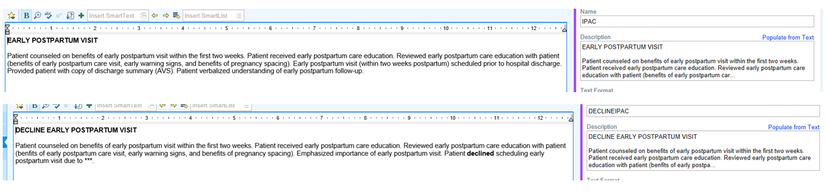
Documentation
Ascension Resurrection
Document using the smart phrase “IPAC” or “IPAC declined” on the AVS and include appointment date on AVS.

Slide 53
Outcomes
Ascension Resurrection
Increase % of women with documentation of an early postpartum visit/maternal health safety check encounter scheduled within the first 2 weeks of delivery
  24-72 hour discharge phone call done, visit appointment confirmed during call
  ~45% of patients opt-in to Home Visit Program-appointment confirmed during visit
  High-risk patients (HTN, surgical, etc.) already scheduled for 1-2 week visit prior to initiative
  On random quarterly audits we have had 100% compliance
Increase % of patients who receive standardized pp patient education prior to discharge
  All patients receive the postpartum education/discharge booklet with standardized education on admission to PP, and education provided by RN
  Attempt to schedule appointment prior to discharge

Slide 54


  Jena Wallander Gemkow, MPH, BSN, RN -Clinical Research Manager at Alliance Chicago

Slide 55

CCMH Overview
Mission: The Chicago Collaborative for Maternal Health seeks to combat the maternal mortality and morbidity crisis in Chicago by building awareness in communities and government, fostering collaboration among health and social service providers, and driving quality of care in ambulatory care settings.
Vision: The CCMH envisions a Chicago where all people and all communities thrive because healthcare providers, policymakers, community organizations, individuals, and families partner with intention to improve maternal health.
Aims
  Aim 1: Develop a QI collaborative for ambulatory care providers focused on best practices in maternal health for systems and culture change
  Aim 2: Implement a complementary community engagement effort that informs families and community, social service providers about maternal morbidity and mortality prevention
  Aim 3: Determine and advocate for policy recommendations based on the learnings from Aims 1 and 2

Slide 56
Aim 1

Slide 57
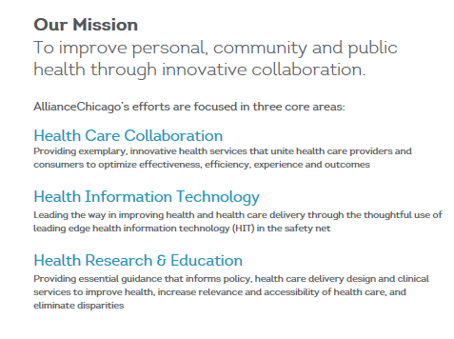

AllianceChicago Mission and Service Lines

Slide 58
Aim 1 Methods: QI Roadmap
Step | Deliverables
Identify Topic | Community Needs Assessment
Develop Stakeholder Committee | Engage and invite potential stakeholders Survey stakeholders
Inform Topic | Review literature Assess clinical guidelines/evidence-based practice Connect with quality collaboratives on resources and lessons learned
Develop Standardized Protocol | Select intervention to test Establish aim and measures for testing Develop key driver diagram Develop Toolkit & Resources Review Protocol and revise as needed Finalize Standardized protocol
Implement/Test Standardized Protocol | Data collection and reporting to track progress towards outcomes and monitor adherence to protocol PDSA Cycles/tests of change Protocol revision (as needed)
Wrap up Implementation Period | Review outcomes and acknowledge successes Continued site support
Sustainability | Determine timeline for sustainability Continue data collection as capacity allows

Slide 59
Aim 1 Methods: Key Driver Diagram
Aim | Driver | Strategy | Measure
Global Aim: Improve number of patients with pregnancies complicated by medical conditions who linked to PCP by 6 months. | Identify and follow high-risk pregnancies | Establish criteria for identifying high-risk/medically complex patients. | STRUCTURE: Are criteria for identifying high-risk patients defined?
 |  | Develop registry of high-risk/medically complex patients during pregnancy | STRUCTURE: Is a registry in place to identify high-risk patients in place?
 |  | Realign workflow to identify patients and coordinate care through postpartum follow up | STRUCTURE: Is a process in place to coordinate care for high risk patients?
 |  |  | PROCESS: # of cumulative locations of care to date implementing this process
 | Training on process | Train providers and staff on the importance of and process of care coordination for patients with high risk pregnancies | PROCESS: % of staff trained (by type)
 | Ensure delivery of prioritized health services (postpartum care) | Ensure postpartum visit scheduled and attended. | OUTCOME: % patients who attended a postpartum appointment
 |  | Create a process for establishing primary/well-person care following initial postpartum visit | OUTCOME: % patients linked to PCP at delivery discharge and completed appt within 6 months
Notes:
what is our goal and how are we going to measure that we are making progress towards it?

Slide 60
CHC High-Risk Criteria
diabetes & gestational diabetes
(history of and/or active dx)
hypertension & pre-eclampsia
(history of and/or active dx)
multiple (additional) high-risk conditions
depression
100%
66%
Resulting in transfer to high-risk OB provider
Multi-risk stratification and criteria
50%
33%

Slide 61
Aim 1 Results: Structure & Process Measures

Slide 62
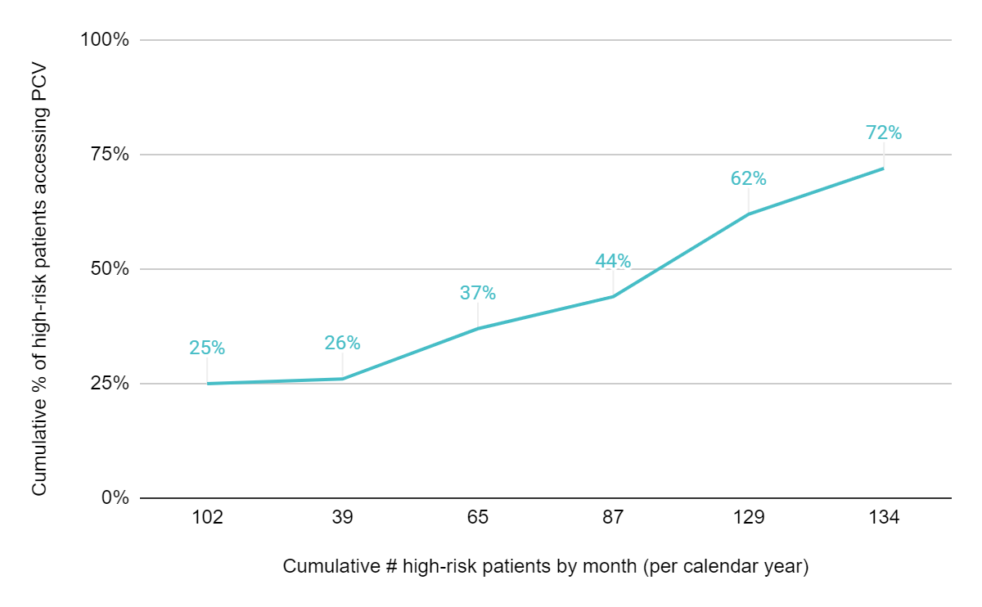
Aim 1 Results: High-Risk Patients Accessing Primary Care Visits (PCV)
Final
Baseline (2020)
Implementation (2021)

Slide 63
Additional Evaluations – Aim 1
Inclusion criteria: Patients in with documented pregnancy outcome date in 2018
Qualitative study –University of Illinois at Chicago
11 interviews across 6 CHC (November 2021 - January 2022)
Secondary data analysis: Postpartum care across network
Primary Outcome: Primary Care visit within 6 months postpartum(Y/N)
Main Predictors: High risk status, Insurance loss after 12 weeks postpartum, Engagement in care:
Analysis: Unadjusted (X²) and adjusted (logistic regression)
Results: Cohort 7,926 patients
Over 85% documented postpartum visit vs only 17% primary care visit
Risk status, insurance loss, engagement in care were independent predictors of primary care visit
Among high-risk cohort only (n=1,956) similar findings (25% w/ PCP visit)
Bottom line: Majority do NOT make transition to primary care, even among high-risk patients; insurance loss contributes, but is not only factor at play
Accepted for publication by the American Journal of Preventive Medicine.
Facilitators: Support, communication, and focus, yet flexible:
“…sometimes, when you do these sorts of things, they want things by a very specific time, very specific criteria. And they were really open to us making it work within our clinic structure, which I think is both relieving but also a smarter way of, actually, getting it done because we are all so different. We use different medical records. We do different things. We have different structures. My job doesn’t exist at all of these places…. And so, they’ve been really open to the variety of ways and trying to support people at those things but also really open to kind of anything”
Barriers: Resources, training, communication, data
“it's still kind of challenging to work when understaffed and know that you're putting something on someone's plate when their plate is already full.”

Slide 64
Aim 1 Conclusions
CHC-informed approach
  QI Topic and evaluation approach were selected and designed with QI Subcommittee
  Baseline data confirmed gaps identified
  CHCs designed QI workflows based on existing processes
Continued engagement/sustainability
  5 out of 6 CHC implementing sites continuing workflows implemented to connect patients to primary care
  Overall QI Subcommittee remains engaged and has continued to partner with us on pilots/proposals supporting this work

Slide 65
Aim 2

Slide 66


CHAMPIONS FOR HEALTH EQUITY
EverThrive Illinois’ mission is to achieve reproductive justice in the health care ecosystem through community-driven partnership, policy action, and systems change.
OUR VISION
A just and affirming health care ecosystem where individuals, families, and communities can thrive.
OUR VALUES
Reproductive Justice
Anti-Racism
Centering the Most Impacted
Bold Action and Transformation

Slide 67
Aim 2 Methods: Community Engagement
Community Needs Assessment
Engage Community Survey Collection
Focus Groups
Training Social Service Providers
Community Responsive Health Campaign
GOAL: Work with community members and partners to develop and implement and community education campaign to promote maternal health and improve trustworthiness of healthcare systems.
PROCESS:
GUIDING PRINCIPLE: People with lived experience are essential partners in identifying barriers to care and transforming the healthcare system to better support pregnant and postpartum people.

Slide 68

Aim 2 Methods: Community Engagement
Outreach to health fairs, community events, back to school events, and local businesses
330 completed surveys and four focus groups engaging pregnant and post partum people in East and West Garfield Park, Austin, Englewood, Greater Grand Crossing, and Chatham
12 social service organizations and more than 100 social service providers trained

Slide 69
Aim 2 Methods: Analysis Objective
To assess stakeholder perspectives of maternal morbidity and mortality.
  1. What type of support in the antenatal and postnatal period do women have access to?
  2. How do people who are pregnant access healthcare and health information?
  3. What are people's perceptions of maternal morbidity and mortality?
Notes:
Methods: Rapid Qualitative Analysis

Slide 70
Aim 2 Results: Survey Findings
66%
Reported not hearing about maternal mortality before
70%
Reported maternal mortality is not an issue in their community

Slide 71
Aim 2 Results: Focus Group Themes
Need for support outside of medical care
Sources of health information are varied and not singular
Need for strengthened connection with medical providers
Familiarity with the lived experience of the postpartum period and maternal morbidity and mortality, but lack the medical information
Differences in language and associated gaps in understanding
Notes:
Need for support outside of medical care
-- lack of interpersonal, community, social support
-- Not as much description of: hard to access medical care
-- Mental health conditions were overwhelmingly mentioned during focus groups
Sources of health information are varied, not singular
-- Multiple sources at one time
-- Are people referring to health provider and referring to social services they get from their doctor’s office?
Need for strengthened connection w/ medical providers
-- Disconnect with care providers
-- Feel like they’re not being listened too, like providers are not treating them as an individual and taking their individual circumstances into mind
-- Respondents didn’t trust doctors, the advice given by doctors
Familiarity with the lived experiences of postpartum period and maternal MM, but lack medical information
-- Respondents had been through childbirth, had family members who experienced pregnancy, postpartum period, and maternal morbidity and mortality
-- Don’t have the medical information they need to
- Define the pp period
- Identifying complications
- Explain complications they had
Differences in language and associated gaps in understanding
-- Respondents and care providers don’t use the same language
-- Respondents don’t have the medical language to describe postpartum care, maternal MM in the way the medical providers do
-- Doctors don’t use the terms “setback” that respondents would use

Slide 72
Aim 2 Results
Theme 1: Need for support outside of medical care
“One of the main problems within our community is we don’t necessarily… have a strong support system while we’re pregnant… we really don’t know who to talk to or who we could depend on because we really, most of the time we really only have ourselves.”
Notes:
Additional quote to read:
“So I think [postpartum care needs to be prioritized. And I think people need a lot more community based [care].”

Slide 73
Aim 2 Results
Theme 2: Sources of health information are varied and not singular
“I definitely don’t show trust the doctor, but my mom and all the women that had multiple kids and my family I do trust.”
“I would definitely say it’s a combination of the health providers and then like, um, well… like the elders of my family, but I’m big on research and stuff. So I’ll research everything.”
Notes:
Additional quote to read:
“If you’re having a rough pregnancy dealing, maybe housing issues or, um, just mental issues that you need support, you know, the doctor is there, they refer you and you always have a case manager, a case manager at the doctor’s office and they give you a referral

Slide 74
Aim 2 Results
Theme 3: Need for strengthened connection with medical providers
“They not really seeing what… what part our environment has to play in it. What our, you know, what our stress levels, what our life at home has to do with anything. They just basically, um, diagnosing us off of textbook definitions. And I feel like that is not, that’s not doing us no good.”
“But I think that our healthcare industry isn’t designed to care about people. And I think when it comes to Black mothers, that’s where the least care is given.”

Slide 75
Aim 2 Results
Theme 4: Familiarity with the lived experience of the postpartum period and maternal morbidity and mortality, but lack the medical information
“…we’ve seen perfectly healthy, um, parents or mothers just don’t make it out of childbirth… And I’m still clueless about that. I almost lost my sister and she was perfectly healthy. She had a C-section, they were able to bring her back, but like what happened? Like we just don’t know everything.”
Facilitator: “Okay. Um, when I say postpartum care, what was the first thing that popped in your mind?” Speaker: “Depression”

Slide 76
Aim 2 Results
Theme 5: Differences in language and associated gaps in understanding
“We had these adverse health outcomes… after we have our children, we liked dang, well, I had a setback because… they’re not putting the medical terms to it.”
Speaker 6: “I haven’t heard of maternal mortality. I dunno what that is. What is it?” Speaker 7: “That doesn’t happen often right? Or does it happen often?”

Slide 77
Social Service Provider Curriculum
Developed Train the Trainor curriculum to
  Build awareness of maternal mortality and morbidity and associated disparities
  Activate social service providers and community-based organizations as part of the solution
  Learn from social service providers about how to improve the system for women.
All participants surveyed (n=31*) reported significant (p < 0.05) increases in knowledge in the following areas:
Factors contributing to pregnant persons’ health
Factors that contribute to mothers dying/becoming severely sick from pregnancy-related complications
Postpartum birth warning signs
Discussing pregnancy and postpartum health with families served
How community organizations can contribute to addressing pregnancy complications and death
*some data loss due to file transfer issues

Slide 78


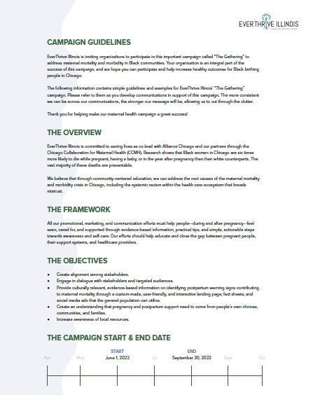

Notes:
Example of door hanger from our vaccination campaign which launched Monday

Slide 79

Join the Gathering!
A complete set of Campaign Guidelines summarizes how to use digital assets, the campaign timelines and sample messaging
This digital campaign includes the following:
The Gathering Landing Page
During Your Pregnancy Fact Sheet
After You Give Birth Fact Sheet
Family and Friends Fact Sheet
Glossary of Terms for Doctors and Clinics
Social Media Graphics
The Gathering Video
Notes:
We need your help to further amplify the campaign! The campaign guide which is available to download from this deck summarizes the digital assets linked below and provides information on our timeline, how to use the assets and sample community-centered messaging. The landing page provided here also has links to our three factsheets for download and glossary of terms for healthcare providers eager to learn about commonly misunderstood terms and suggested alternatives. We also included links to our social media graphics and video for promotion on social media.

Slide 80
Aim 3

Slide 81
Community-Informed Policy Agenda
Community, clinician and social service provider, and Steering Committee engagement presents an opportunity to develop a community-informed and responsive policy agenda addressing structural barriers to healthy pregnant and postpartum people and their families
Policy Agenda
FQHCs
Social Service Engagement
Community Engagement

Slide 82

Policy Brief
Objectives:
Educate policy makers and others interested in influencing policy about the issues faced by clinicians, social service providers and community members contributing to maternal mortality crisis on the south and west sides of Chicago
Identify policy solutions to address these issues
Planned release: Fall 2022

Slide 83

Acknowledgements
AllianceChicago Project Team: Dr. Lisa Masinter, Jena Wallander Gemkow, Roxane Padilla, Ta-Yun Yang, Dr. David Liss
EverThrive Illinois Project Team: Kirbi Range, Andie Baker, Talibah Johnson, April Thompson, Sheila Sanders, Tamela Milan-Alexander
Northwestern University Project Team: Dr. Marquita Lewis-Thames, Dr. Madeline Perry
University of Illinois At Chicago Project Team: Dr. Arden Handler, Ashlee Van Schyndel, Renee Odom, Ananya Stoller, Abigail Holicky, Dr. Nadine Peacock
Thank you to the Illinois Perinatal Quality Collaborative and people with lived experience who served as key advisors for this work.
Thank you also to the participating community health centers and social service organizations who participated in this project.

Slide 84
Thank you!

Slide 85
Birth Equity next steps

Slide 86

Next Steps for Birth Equity
Monthly data for August due into REDCap by September 15^{th (TODAY)!}
Schedule your team KPM before the end of the month
Get your all your team data in to qualify for an award!
Make a 30/60/90 day plan for next steps to implement early pp visit scheduling before discharge
Next Stop!
Illinois Perinatal Quality Collaborative

Slide 87

AIM TAP: PATIENT EDUCATION - IMPROVING POSTBIRTH EDUCATION ABOUT POTENTIAL COMPLICATIONS
  Faculty: LaShea Haynes M.Ed.,MSN, AGCNS-BC, APRN, RNC-OB/EFM
  Time & Date: October 20, 2022 – 3 PM ET
  Registration link: https://us02web.zoom.us/meeting/register/tZEqdOGprTwpE9CyV0A3Ynuqzrqwp2khWM07

Slide 88

Upcoming BE Webinars:
Event | Day/Time
NO Webinar (Annual Conference) | October 17th at 12:00pm
Register and Join here:
https://northwestern.zoom.us/meeting/register/tJMod-uoqDotGtzzJICE1O5TphPWT2-pZfmY

Slide 89










Thanks to our Funders
In kind support:

