Slide 1



Birth Equity (BE) Monthly Webinar
Making progress towards our goals together
July 18th, 2021

Slide 2


Overview
ILPQC updates
Birth Equity data review
Review of implementation tools and resources for key strategies
    Linking patients to SDoH resources and services
    Implementing Respectful Care Practices and PREM
BE next steps
Team Talk – Elena Jenkins, RN BSN | Nurse Manager - Labor & Delivery at SSM Health St. Mary’s Hospital - St. Louis

Slide 3
ILPQC updates

Slide 4

Save the Dates:
Calling all perinatal health care providers, nurses, allied health professionals, and public health/community partners!
ILPQC OB and Neonatal Face to Face Meetings:
  May 24 and 25, 2023 TBD

Slide 5


EXTENDED: Schedule a Key Players Meeting through August 2022
Consultation for all BE teams with a BE champion
Strategize and map out your hospital’s next steps to address barriers and create a 30/60/90 plan.
16 teams have completed their KPM
Request your KPM meeting with this link: https://redcap.healthlnk.org/surveys/?s=C9TKXKJNMD
It was informative and helpful. Helped us eliminate barriers to moving forward! -- OSF HealthCare Saint Francis
It was extraordinarily helpful! Looking forward to getting back together with our team to start putting things into action!! – Barnes Jewish Hospital
SIGN your team up TODAY to get the support your hospital need!
Illinois Perinatal Quality Collaborative
Notes:
Additional support for your birth equity initiative! We want to help you succeed by:
Partnering with you to arrange your Key Players meeting.
Assist you with who to invite at each hospital for most effective meeting with representative from ILPQC
Provide you with a Birth Equity champion from the BE speakers bureau to partner with you to problem solve, overcome barriers, and move implementation forward

Slide 6

Celebrating success:
Regional Community Meetings
The meeting went very well. The 3 community partners articulated their positive experiences related to the 4 key drivers of the BE initiative.
–Northwestern Network
9 out of 10 community regional meetings with 83% of hospital teams (last one coming in July)
Total of 26 community members /patient advisors participating throughout the state
This is such a great discussion! Hearing from the community panelists is powerful and very much needed. I appreciate all of the input. – Provider, Stroger Network
Notes:
34/44

Slide 7
Birth Equity initiative data review
Helping hospital teams move this important work forward together

Slide 8

What is the focus of Birth Equity (BE)?
BE AIM: By December 2023, more than 75% of Illinois birthing hospitals will be participating in the Birth Equity Initiative and more than 75% of participating hospitals will have the key strategies in place.
Promote patient- centered approach to engage patients and communities
Develop respectful care and bias education for providers, nurses, and staff
Addressing Social Determinants of Health
Review race/ethnicity medical record and quality data

Slide 9
Key QI Strategies
Optimize race/ethnicity data collection & review key maternal quality data by race, ethnicity & Medicaid status
Engage patients and community members for input on quality improvement efforts
Universal social determinants of health screening tool (prenatal/L&D) with system for linkage to appropriate resources
Share respectful care practices on L&D and survey patients before discharge on their care experience (using the PREM) for feedback
Standardize postpartum safety education and schedule early postpartum follow up prior to hospital discharge
Implicit Bias / Respectful Care training for providers, nurses and other staff
Notes:
Optimize race/ethnicity data collection and review key maternal quality data by race, ethnicity and Medicaid status
Universal social determinants of health screening tool (prenatal/L&D) with system for linkage to appropriate resources
Share respectful care practices on L&D and survey patients before discharge on their care experience (using the PREM tool) for feedback
Engage patients and community members for input on quality improvement efforts
Standardize postpartum safety education and schedule early postpartum follow up prior to hospital discharge
Implicit Bias / Respectful Care training for providers, nurses and other staff

Slide 10
ILPQC Hospital Team
Data Submission (86 Teams Total)
Month | Teams Reporting Hospital Data
Baseline (Q4 2020) | 47
August 2021 | 54
September 2021 | 51
October 2021 | 50
November 2021 | 46
December 2021 | 36
January 2022 | 40
February 2022 | 41
March 2022 | 59
April 2022 | 47
May 2022 | 46

Slide 11
Structure Measures:
Implementing Systems Changes

Slide 12
Structure Measures:
Implementing Systems Changes

Slide 13
Process Measures:
Implicit Bias Training
Notes:
Structure Measures- highlight/congratulate the success in place/working on measures: how to consolidate these
Implemented standardized social determinants of health screening tools for delivery admission
Implemented affiliated prenatal care sites standardized screening tools for universal social determinants of health screening
Completed ILPQC social determinants of health community resources mapping tool and shared with affiliated outpatient
Incorporating discussion of social determinants of health and discrimination as potential factors in hospital maternal morbidity reviews
Protocol for improving the collection and accuracy of patient-reported race/ethnicity data
Process to review maternal health quality data stratified by race/ethnicity and Medicaid status
Engaged patients and/or community members to provide input on quality improvement efforts
Sharing expected respectful care practices with delivery staff and patients
Implicit Bias Training (line graph)

Slide 14
Review implementation steps for SDoH and Respectful Care / PREM key strategies
Consider how your team can use these steps as you plan your work

Slide 15
Social Determinants of Health SDoH

Slide 16


What are Social Determinants of Health?
Social Determinants of Health
  Food
  Housing
  Transportation
  Utilities
  Exposure to Violence
  Financial Resources
  Community/ Social Support
  Education/Health Literacy
  Child Care
  Legal Status
  Stress
Factors in a persons environment that play an important role in shaping health outcomes (ACOG, CO#, 729).
Have historically prevented many people from racial and ethnic minority groups from having fair opportunities for economic, physical and mental health (CDC, 2021).
Illinois Perinatal Quality Collaborative
16
Notes:
Presenter
2021-06-16 00:38:03
--------------------------------------------
Need easier defnitions and list key areas

Slide 17
ACOG CO #729: Importance of Social Determinants of Health and Cultural Awareness in the Delivery of Reproductive Health Care
The American College of Obstetricians and Gynecologists makes the following recommendations for obstetrician–gynecologists and other health care providers to improve patient-centered care and decrease inequities in reproductive health care:
  Inquire about and document social and structural determinants of health that may influence a patient’s health and use of health care such as: access to stable housing, access to food and safe drinking water, utility needs, safety in the home and community, immigration status, and employment conditions.
  Maximize referrals to resources and social services to help improve patients’ abilities to fulfill these needs.
  Provide access to interpreter services for all patient interactions when patient language is not the clinician’s language.
  Acknowledge that race, institutionalized racism, and other forms of discrimination serve as social determinants of health.

Slide 18


Addressing Social Determinants of Health
Sample screening tools
Community resources and mapping tool
Folders with patient and provider resources for SDoH screen positive patients
SDoH Folder
SDoH Screening Tools
SDoH Resource Mapping Tool
NowPow Access Guide
Universal SDoH Resources
SDoH Tip Sheets by Topic
Local SDoH Resources
Patient handouts on SDoH resources (ILPQC Tip Sheets and or NowPow referral)
Create a Process Flow for patients who screen positive to confirm documentation & linked to resources
Review our online toolkit to find these resources linked on our BE website: https://ilpqc.org/birthequity/ !
Illinois Perinatal Quality Collaborative

Slide 19
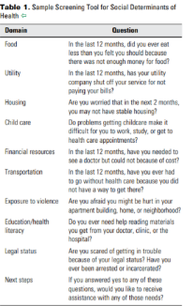
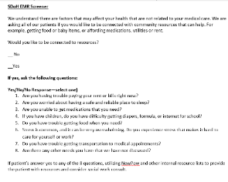
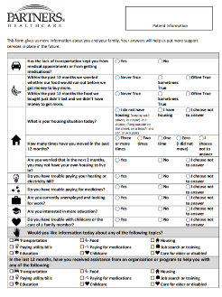
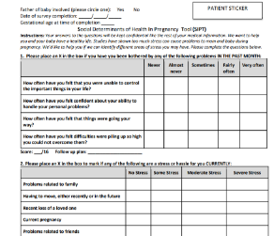
Social Determinants of Health
Screening Tools
SDoH EMR Screener (Developed by Erie Health Centers, Chicago)
ACOG Committee Opinion #729: Sample Screening Tool for Social Determinants of Health
Social Determinants of Health In Pregnancy Tool (SIPT) with 5Ps (Used by Chicago PCC Communities Wellness Centers) and Actionable Map and Scoring Sheet
Partner Healthcare SDoH Screening Tool shared by Massachusetts General Hospital Obstetrics & Gynecology

Slide 20
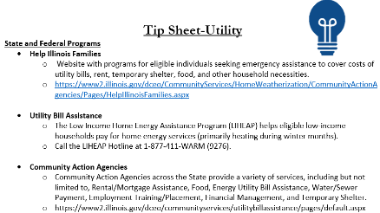

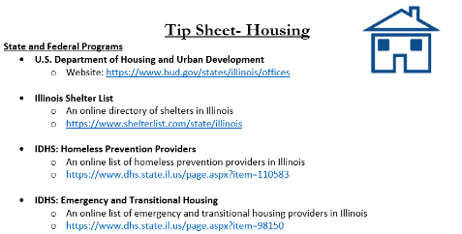

ILPQC SDoH Tip Sheets
ILPQC Tip Sheets (for patients) (click link)

Slide 21
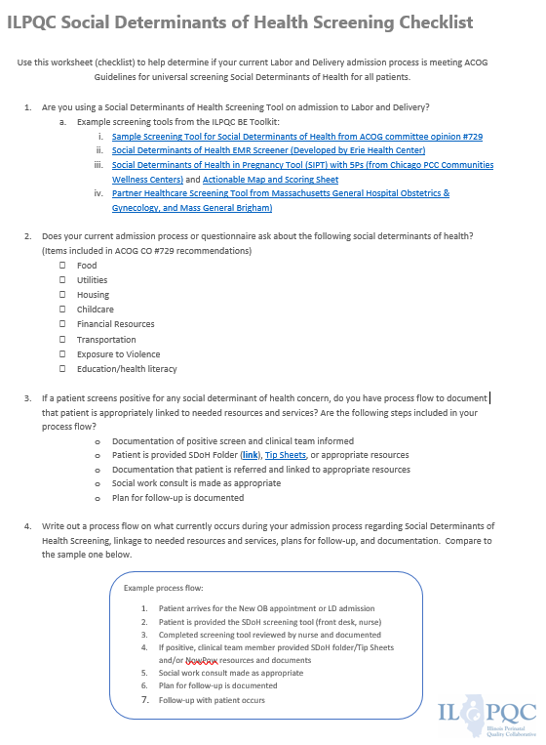
Social Determinants of Health Screening Checklist
ILPQC Social Determinants of Health Screening Checklist (*NEW) (Click link)

Slide 22
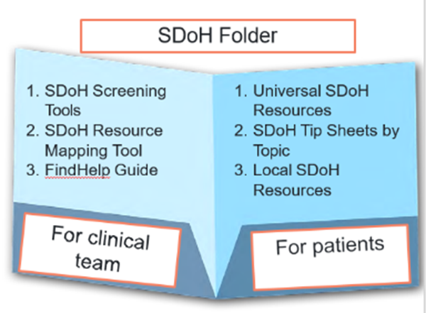
NowPow Update and NEW FINDHELP.ORG
ILPQC has provided hospitals teams free access to NowPow, an online SDOH database (June 2021-June 2022).
In June 2022, two options for online database of resources:
  FindHelp.org via ilpqc.org free tool to search for social determinants of health resources
  Or continue to use your hospital NowPow access or connect with NowPow for options for hospital access
Findhelp.org has more than 300,000 verified programs that provide help across Illinois and Missouri (and all 50 states).
Notes:
https://findrx.ilpqc.org/findrx/ilpqc

Slide 23
QI Strategies
PDSA cycle to test SDOH screening tools implementation on L&D
  Start with one nurse, one patient or one day on L&D to trial a screen
  Get feedback on process and determine best tool
  Share information with outpatient sites
Develop a Process Flow Diagram
  assist implementation of screening for all patients on L&D, with paper screening tool or through Epic
  linkage to appropriate resources / services for all screen + patients
  plan for follow up documented
Consider steps needed in 30/60/90 day planning process

Slide 24
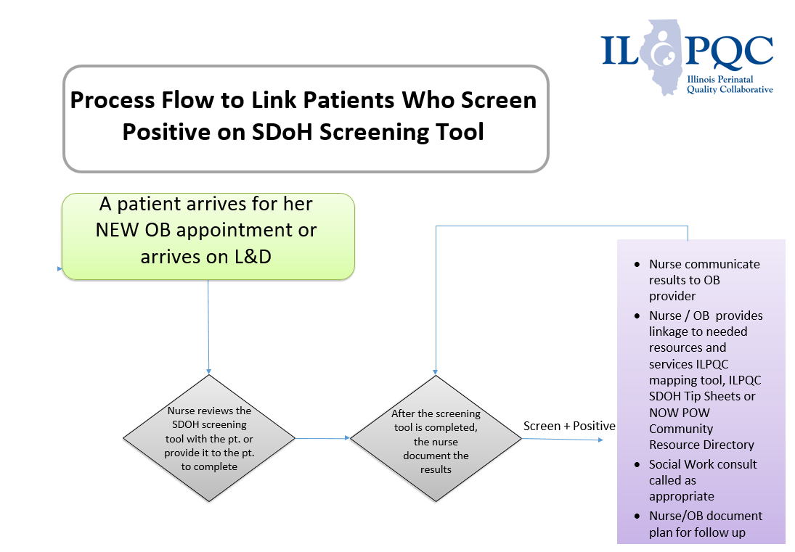
Process Flow to Link Patients Who Screen Positive on SDoH Screening Tool

Slide 25
NM: Example Social Determinants of Health
Workflow
SDOH Screen = Required Documentation
RN Screens Pt
Pt Admitted
NowPow List Auto generated
SW Consult not needed
Screen Positive
and
Yes
No
or
SW customizes lists
SW Consult queue populated
SW Consult by MD order
SW Consult & Resources given
Outpatient F/U =
Loss or Clinic based
Pt Discharged

Slide 26




Example of Mass General Hospital Workflow
A patient arrives for her NEW OB appointment or L&D
Front desk gives patient the SDOH screen
MA takes screen from the patient and gives it to the RN
RN / OB provider reviews screen with patient and offers resources
ILPQC SDOH Tip Sheets or NOW POW resource provided to patient based on resource need, Social Work consult called as appropriate and if > 2 positive items
RN / OB documents screen results, linkage to resources and plan for follow up
Notes:
To understand the patient’s experience with the survey; i.e. literacy, amount of time to complete
To determine if the survey would have an impact on the practice schedule; would it slow down through put

Slide 27
Implementing Respectful Care Practices and PREM

Slide 28
Steps for Implementing
Respectful Care Practices
Make sure your team has received the Respectful Posters ILPQC sent to your hospital
Provide all providers and nurses a copy of the Respectful Care Practices to read and sign off on to acknowledge they commit to these practices
Post Respectful Care Practices posters in patient facing areas where patients can read them: such as labor and delivery rooms, triage, check in
Create a process flow to
  Identify a team member responsible for providing patients the expected Respectful Care Practices on arrival to L&D and briefly reviewing to make sure patient has received
  At discharge, make sure all patients receive the PREM Survey QR Code and are asked to anonymously complete the PREM Survey on their phone before discharge to report back on their respectful care experience during their delivery admission.
Review PREM Survey Reports and provide feedback to clinical team

Slide 29
We commit to…
Treating you with dignity and respect throughout your hospital stay
Introducing ourselves and our role on your care team to you and your support persons upon entering the room
Learning your goals for delivery and postpartum: What is important to you for labor and birth? What are your concerns regarding your birth experience? How can we best support you?
Working to understand you, your background, your home life, and your health history so we can make sure you receive the care you need during your birth and recovery.
Communicating effectively across your health care team to ensure the best care for you
Partnering with you for all decisions so that you can make choices that are right for you
Practicing “active listening”—to ensure that you, and your support persons are heard
Valuing personal boundaries and respecting your dignity and modesty at all times, including asking your permission before entering a room or touching you
Recognizing your prior experiences with healthcare may affect how you feel during your birth, we will strive at all times to provide safe, equitable and respectful care
Making sure you are discharged after delivery with an understanding of postpartum warning signs, where to call with concerns, and with postpartum follow-up care visits arranged
Ensuring you are discharged with the skills, support and resources to care for yourself and your baby
Protecting your privacy and keeping your medical information confidential
Being ready to hear any concerns or ways that we can improve your care
Notes:
Communicating
eff ectively across your
health care team to ensure
the best care for you
. Partnering with you for all
decisions so that you can
make choices that are right
for you
. Practicing “active
listening”—to ensure
that you, and your support
persons are heard
. Valuing personal
boundaries and
respecting your dignity
and modesty at all times,
including asking your
permission before entering a
room or touching you
. Recognizing your
prior experiences with
healthcare may aff ect
how you feel during your
birth, we will strive at
all times to provide safe,
equitable and respectful
care
. Making sure you are
discharged a er delivery
with an understanding of
postpartum warning signs,
where to call with concerns,
and with postpartum
follow-up care visits
arranged
. Ensuring you are
discharged with the skills,
support and resources to
care for yourself and your
baby
. Protecting your privacy
and keeping your medical
information confi dential
. Being ready to hear any
concerns or ways that we
can improve your care

Slide 30
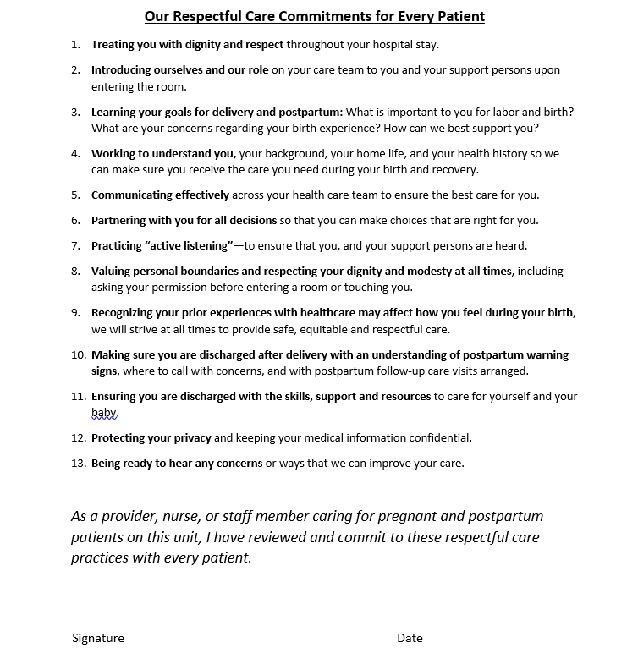
Respectful Care Sign off form

Slide 31



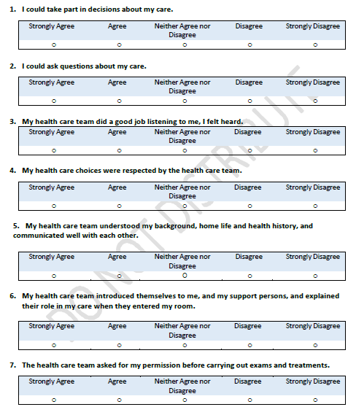

Labor & Delivery
PREM
Respectful Care Practices
Notes:
Teams will receive patient handout with QR code reports on patient feedback will be available in the ILPQC Data System
Available in English and Spanish
Additional 7 languages coming soon

Slide 32
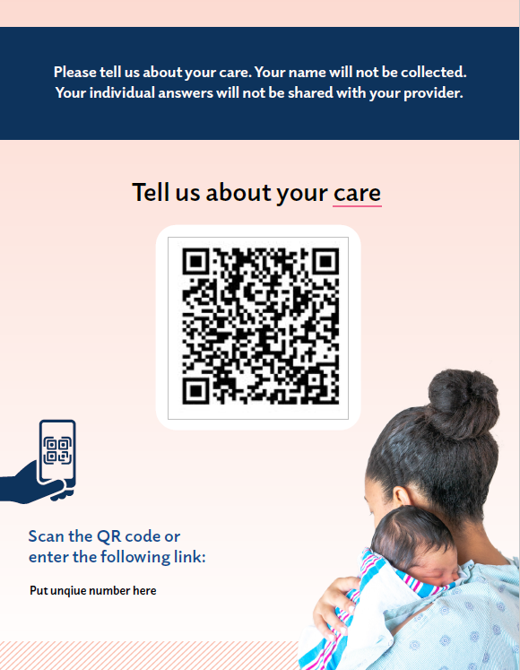
PREM Implementation
QI code form is customizable - Hospitals will have an unique number to put on their QR code paper for patients to identify the correct hospital name. Please use the English PREM survey to receive your hospital #. It is located in front of your hospital name on the survey!
Provider instructions
Sample survey
Currently available in 5 languages
  English and Spanish
  8 more languages coming soon!
Surveys completed by patients on smart phone, tablet or computer before discharge:
  Laminate QR code with your hospital number
  Create script for your hospital (example scripts in toolkit)
  PREM QR Code

Slide 33
Example of Introduction of PREM to Patients from NYSPQC
This survey is an opportunity for birthing people to provide feedback on their experience of care during labor and delivery and postpartum.
XXX Hospital in partnership with New York State both aim to improve the care of birthing people.
This survey is anonymous and takes only a few minutes to complete.
We encourage ALL our birthing people to participate
Please scan the QR code. I will give you your privacy while you complete the survey and will return in a few minutes.
Thank you
Confidential Education Law 6527: Public Health Law 2805, J, K, L, M

Slide 34



Albany Medical Center NYSPQC Team Example
Flyer for PREM promotion to patients

Slide 35
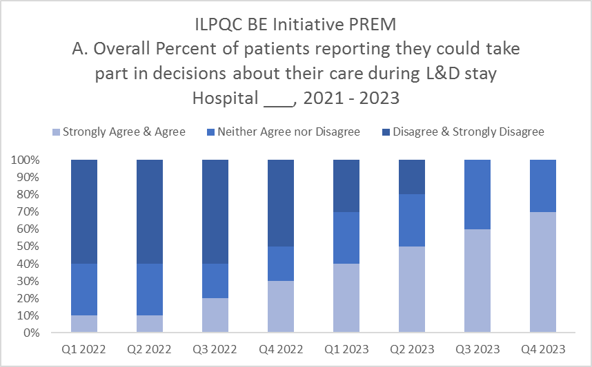
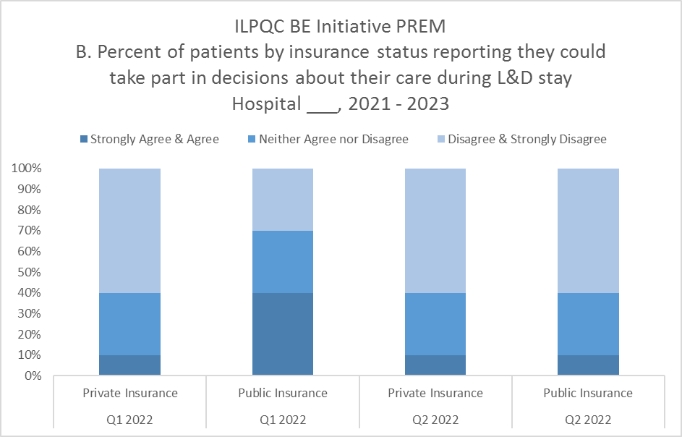
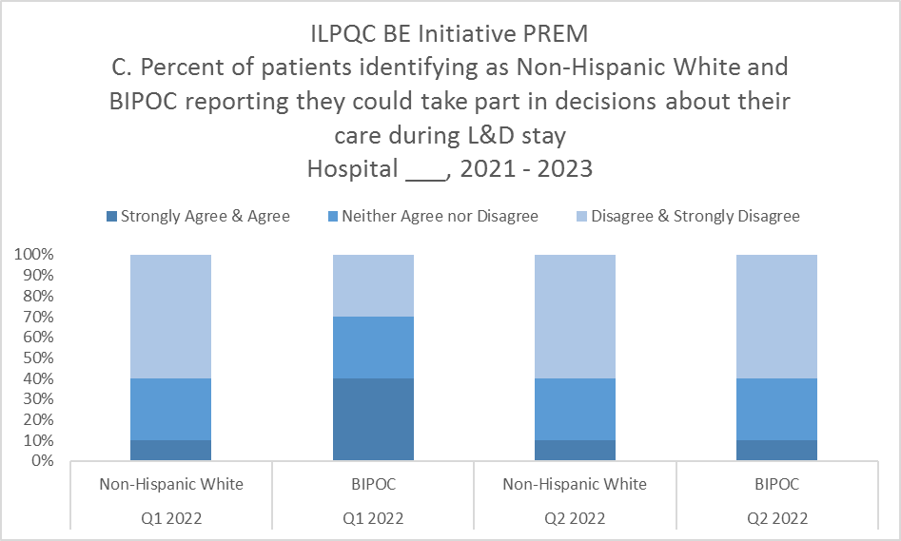
PREM Reports Updates
Proposed PREM Timeline:
  PREM reports to launch July 2022
  ILPQC very close to validating the reports
  Once reports are finish with validation teams will be granted access
PREM Reports:
  Will stratify responses by:
    Overall respondents
    Report will be available for overall % completed per month by total deliveries per month
    Reports will be available monthly and quarterly at five 5 response per month
    Public Insurance compared to Private Insurance responses
    Non-Hispanic White compared to BIPOC responses
    Black, White, Asian, Hispanic, Other (will report only if sufficient numbers > 5 patients per category)
Notes:
Number of birthing people discharged after delivery who received the Patient Reported Experience Measure (PREM) Survey either via QR Code or hospital iPad/tablet/laptop

Slide 36


Helpful resources to start working on implementing patient-centered respectful care
Respectful Care Practices poster and handout:
  Developed with IL patients
  All providers and nurses should read and sign off on the Respectful Care Commitments
  Post Respectful Care Practices in labor and delivery rooms, triage and check in
Patient Reported Experience Measure (PREM) – approved by HCAHPS for use with OB patients
  Provider/staff script and instructions
  Process to distribute the PREM survey QR Code to all birthing patients
PREM

Slide 37

QI Topic Call
We plan to schedule a QI Topic Call in August to provide additional support to teams working on Respectful Care / PREM implementation
We would like to help teams make progress on this work over the summer / fall before Annual meeting
  implementing Respectful Care posters in L&D rooms
  getting sign off on Respectful Care practices with delivery clinical team and staff
  implementing PREM Surveys before discharge with ALL patients.

Slide 38
Team Talks

Slide 39
Approaches and Strategies for implementation of SDoH screening, Linkage to Resources, and Respectful Care Practices

Slide 40
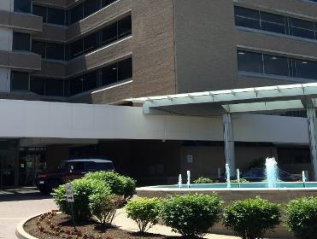
St Mary’s Hospital
2600 Deliveries/yr – 66% POC
Labor and Delivery Unit
13 LDR rooms, 6 Triage rooms, 2 ORs
Antepartum Unit
28 Antepartum rooms, 10 Perinatal Special Care Unit rooms
Mother/Baby Unit
30 Postpartum rooms
Level III NICU
42 beds
Designated Administrative Perinatal Center for the Southern Illinois Perinatal Network.

Slide 41
SDoH
Challenges: No consistent screening, ability to document for SDOH, or easily accessible resources. No way to flag needs identified prenatally to alert the inpatient team.
Initial work:
Developed a SDoH survey tool on paper
  challenges re:
    transcription into record,
    visibility to other providers,
    staffing/time resource

Slide 42
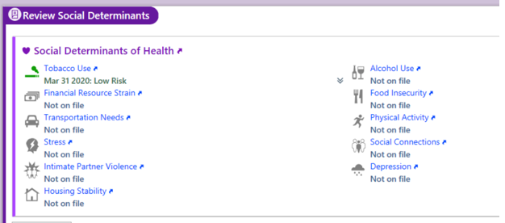

SDoH
Accomplishments within the last year:
EPIC work group implemented an EPIC based SDoH screening for in-hospital and out-patient clinic with tailored questions
  4 areas:
    Financial Resource Strain
    Transportation Needs
    Housing Stability
    Food Security

Slide 43
SDoH
Accomplishments within the last year:
  SDOH questions are integrated as part of admission workflow and provide a visible flag to inform providers of identified needs/when linkage to resources completed
    Screening placed on admission navigator as required documentation – Go Live 7/15/22

Slide 44
Linkage to Resources
Accomplishments within last year:
Identification of resources to allow for linkage to patients in Missouri local area
‘Easily accessible resources’ (project by grad student) completed, mapping resources in our area
Resources listed on website; flyers created with QR code to provide to patients
If a patient screens positive on SDoH questions, a social work consult is placed to ensure linkage to resources OR patient given resource guide if unable to be seen by SW

Slide 45
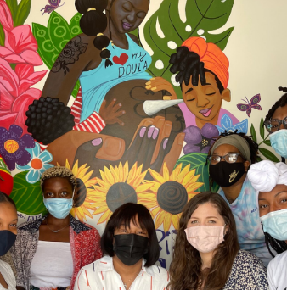


Linkage to Resources
In progress and looking forward:
Connections to resources:
    Increasing Community Partnerships between SSM and organizations that support Black Women’s maternal health
    Doula Collaboration Program
    Program focused on enhancing Perinatal Behavioral Health
    Creation of OB Nurse Navigator program to address continuity of resources for patients.

Slide 46
Respectful Care Practices
Accomplishments within last year:
Respectful Care Practices Posters re-branded with permission from ILPQC
Large Posters posted in all Women’s Services inpatient units and in all SSM outpatient clinics in St Louis area
Smaller posters hung in each inpatient room in Antepartum, Labor and Delivery, and Postpartum
Pamphlets added to admission materials for Antepartum and L&D

Slide 47
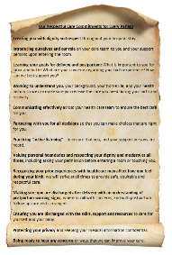
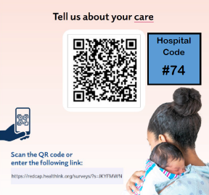
Respectful Care Practices
In Progress Work:
Badge buddies created and distributed with RCP elements
PREM Survey Implemented
    PREM Survey discussed in Leader rounding on L&D
    Staff on Postpartum unit go over information on PREM on admission to PP unit
    QR code posted on Whiteboards in front of patients
    small survey QR codes placed in patient folders

Slide 48
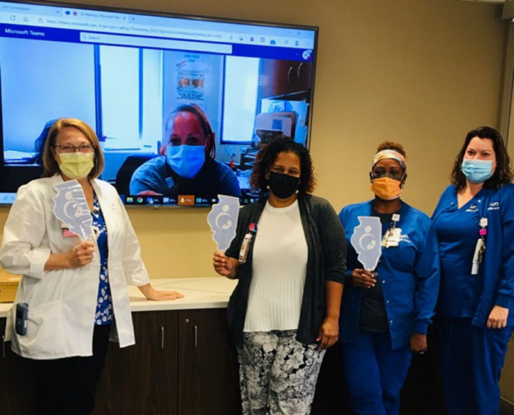

Thank you!

Slide 49
Birth Equity next steps

Slide 50

Next Steps for Birth Equity
Monthly data for June due into REDCap by July 15^{th (now)!}
Schedule your team KPM meeting to receive help to get started
Make a 30 60 90 day plan for next steps with SDoH, Respectful Care, and/or PREM implementation
Next Stop!
Illinois Perinatal Quality Collaborative

Slide 51

Upcoming BE Webinars:
Event | Day/Time
Implementing postpartum early schedule two-weeks (AIM PP bundle) | August 15th at 12:00pm
Implementing postpartum education | September 19th at 12:00pm
Register and Join here:
https://northwestern.zoom.us/meeting/register/tJMod-uoqDotGtzzJICE1O5TphPWT2-pZfmY

Slide 52










Thanks to our Funders
In kind support:

