Slide 1



Birth Equity (BE) Monthly Webinar
December 20th, 2021

Slide 2


Overview
ILPQC Updates
Birth Equity Data Review
Implementing Respectful Care Practices and PREM
Guest Speakers:
  Terri Nikoletich MSN, MPH, RN, CNS - Program Director Memorial Care Miller Children’s and Women’s Hospital, Long Beach, CA
  Angela A. Antonikowski, PhD, MA - Chief Health Equity, Diversity & Inclusion Officer, Albany Med Health System, Albany, NY
Team Talk – Stroger Hospital Team

Slide 3

ILPQC Updates
14

Slide 4



2022 OB & Neonatal Face-to-Face Meetings
Obstetric May 25, 2022
Neonatal May 26, 2022
2022 ILPQC 10th Annual Conference
Thursday, October 27, 2022
More information coming soon!

Slide 5
Birth Equity Initiative
Helping hospital teams move this important work forward together

Slide 6


What is the focus of Birth Equity (BE)?
BE AIM: By December 2023,
more than 75% of Illinois birthing hospitals will be participating in the Birth Equity Initiative and
more than 75% of participating hospitals will have the key strategies in place.
Promote patient- centered approach to engage patients and communities
Develop respectful care and bias education for providers, nurses, and staff
Addressing Social Determinants of Health
Review race/ethnicity medical record and quality data

Slide 7

BE Key Drivers Diagram
Strategies
Drivers
1. Utilize ILPQC social determinants of health (SDoH) community resources mapping
tool to assist linking patients to resources based on the social determinants of health
screening and share with affiliated prenatal care sites and hospital OB units
1. Address social determinants of health during prenatal, delivery,
and postpartum care to improve birth equity
2. Screen patients for social determinants of health during prenatal care and delivery admission and appropriately link to resources
AIM
3. Implement strategy for incorporating discussion of social determinants of health and discrimination as factors in potential hospital maternal morbidity reviews
By December 2023, more than 75% of Illinois birthing hospitals will be participating in the Birth Equity Initiative and more than 75% of participating hospitals will have all key strategies in place
4. Implement processes and protocols for improving the collection and accuracy of patient- reported race/ethnicity data
2. Utilize race/ethnicity medical record &
quality data to improve
birth equity
5. Develop and implement a process to review and share maternal health quality data stratified by race/ethnicity and Medicaid status
6. Identify a patient advisor for hospital perinatal quality improvement team or other opportunities to engage patient / community members
3. Engage patients, support partners
including doulas, and
communities to improve birth equity
7. Implement a strategy for sharing expected respectful care practices with delivery staff & patient (i.e. posting in LD) including appropriately engaging support partners and/or doulas
8. Implement a Patient Reported Experience Measure (PREM) patient survey to obtain feedback from postpartum patients and a process to review & share results with providers,
nurses, and staff
9. Provide patients the recommended postpartum safety patient education materials prior to hospital discharge including education on urgent maternal warning signs, postpartum
safety, communication with healthcare providers and importance of early follow up
4. Engage and educate providers, nurses, & staff to improve birth
equity
10. Educating providers, nurses, and staff on the importance of listening to patients, providing respectful care and addressing implicit bias

Slide 8
Key QI Strategies
Optimize race/ethnicity data collection & review key maternal quality data by race, ethnicity & Medicaid status
Engage patients and community members for input on quality improvement efforts
Universal social determinants of health screening tool (prenatal/L&D) with system for linkage to appropriate resources
Share respectful care practices on L&D and survey patients before discharge on their care experience (using the PREM) for feedback
Standardize postpartum safety education and schedule early postpartum follow up prior to hospital discharge
Implicit Bias / Respectful Care training for providers, nurses and other staff
Notes:
Optimize race/ethnicity data collection and review key maternal quality data by race, ethnicity and Medicaid status
Universal social determinants of health screening tool (prenatal/L&D) with system for linkage to appropriate resources
Share respectful care practices on L&D and survey patients before discharge on their care experience (using the PREM tool) for feedback
Engage patients and community members for input on quality improvement efforts
Standardize postpartum safety education and schedule early postpartum follow up prior to hospital discharge
Implicit Bias / Respectful Care training for providers, nurses and other staff

Slide 9
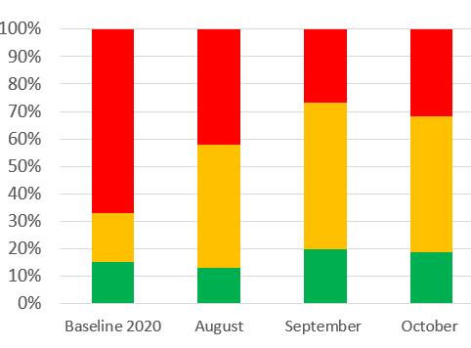
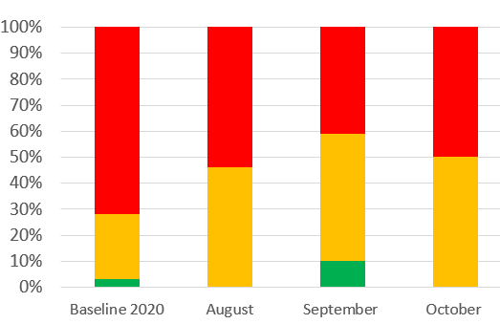
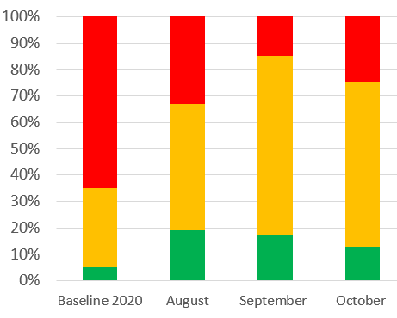
Structure Measures:
Implementing Systems Changes
Implemented standardized social determinants of health screening tools for delivery admission
Completed and shared social determinants of health community resources mapping tool
Protocol for improving the collection and accuracy of patient-reported race/ethnicity data

Slide 10

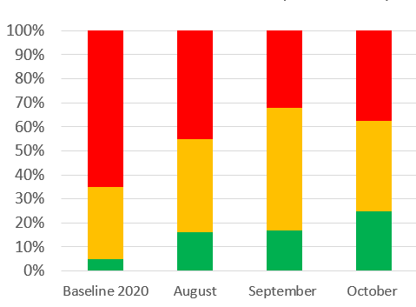
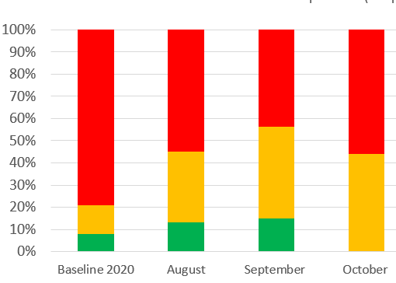
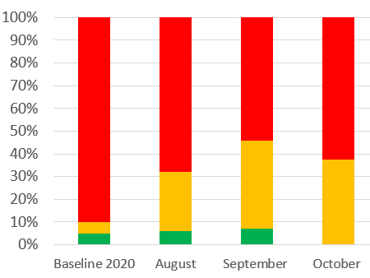
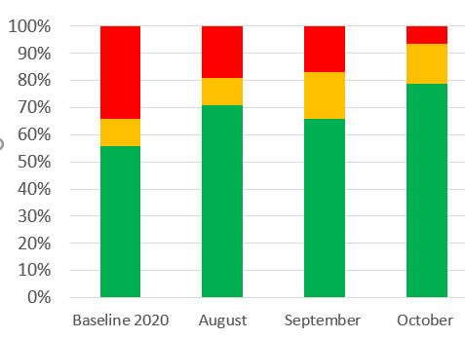
Structure Measures:
Implementing Systems Changes
Process to review maternal health quality data stratified by race/ethnicity and Medicaid status
Sharing expected respectful care practices with delivery staff and patients
Engaged patients and/or community
System to provide patients postpartum safety education, where to call, and early follow-up

Slide 11
Process Measures:
Social Determinants of Health Screening

Slide 12
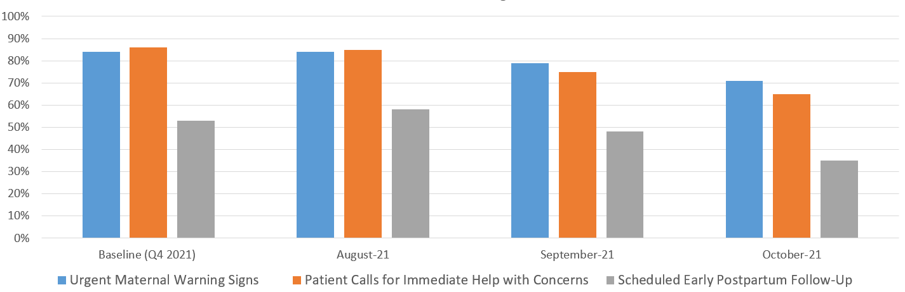
Process Measures:
Postpartum Safety
Patients receiving postpartum safety education prior to hospital discharge including urgent maternal warning signs, where to call with concerns, and scheduling early postpartum follow-up

Slide 13
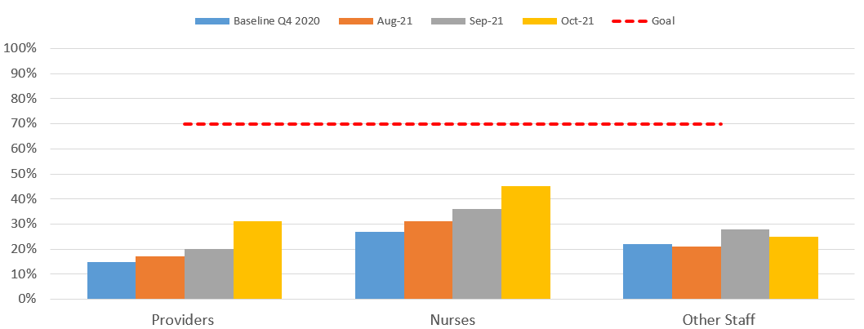
Process Measures:
Staff Training
Providers, nurses, and other staff completing education addressing implicit bias and respectful care

Slide 14
ILPQC Hospital Team
Data Submission (86 Teams Total)
Month | Teams Reporting Hospital Data
Baseline (Q4 2020) | 47
August 2021 | 48
September 2021 | 47
October 2021 | 43
Use your hospital data form as a QI team meeting roadmap to guide your efforts. Please contact us if you need help getting started with reviewing and entering your data!
Please submit monthly data into REDCap by the 15th of each month!

Slide 15
Respectful Care Practices

Slide 16

Why Respectful Care Practices and
Patient Reported Experience matters?
Patients of color, particularly Black and Latine patients, as well as those enrolled in Medicaid at the time of delivery more often report that:
  Members of their care team did not engage them in care,
  Did not respond to their concerns and requests
  Did not treat them with respect compared to White and privately insured patients
Patient experience matters:
  Individuals with poorer experience of healthcare are more likely to have poorer health outcomes;
  Demonstrate lower adherence to recommended treatments;
  Forego preventative care; and have poorer technical care delivery and higher likelihood of adverse event
Hoyert DL, Miniño AM. Maternal Mortality in the United States: Changes in Coding, Publication, and Data Release, 2018. Natl Vital Stat Rep. 2020 Jan;69(2):1–18. PMID: 32510319
2. Vedam S, Stoll K, Taiwo TK, Rubashkin N, Cheyney M, Strauss N, McLemore M, Cadena M, Nethery E, Rushton E, Schummers L, Declercq E, GVtM-US Steering Council. The Giving Voice to Mothers study: inequity and mistreatment during pregnancy and childbirth in the United States. Reprod Health. 2019 Jun 11;16(1):77. PMCID: PMC6558766
3. Doyle C, Lennox L, Bell D. A systematic review of evidence on the links between patient experience and clinical safety and effectiveness. BMJ Open. 2013 Jan 3;3(1):e001570. PMCID: PMC3549241
Notes:
Add references from grant for these articles at the bottom in italics

Slide 17
Why Respectful Care Practices and
Patient Reported Experience matters?
A review of 39 intervention studies identified that the implementation of universal screening for SDOH among patients, including housing, food, and safety needs, and subsequent linkage to care was associated with significant improvement in health and/or cost outcomes for patients in 87% of cases.
The role of bias in clinical outcomes was evaluated in another review of 15 publications, which identified that implicit bias among healthcare practitioners was significantly associated with more negative patient–provider interactions, less appropriate treatment decisions, reduced treatment adherence, and poorer mental health outcomes
Hoyert DL, Miniño AM. Maternal Mortality in the United States: Changes in Coding, Publication, and Data Release, 2018. Natl Vital Stat Rep. 2020 Jan;69(2):1–18. PMID: 32510319
2. Vedam S, Stoll K, Taiwo TK, Rubashkin N, Cheyney M, Strauss N, McLemore M, Cadena M, Nethery E, Rushton E, Schummers L, Declercq E, GVtM-US Steering Council. The Giving Voice to Mothers study: inequity and mistreatment during pregnancy and childbirth in the United States. Reprod Health. 2019 Jun 11;16(1):77. PMCID: PMC6558766
3. Doyle C, Lennox L, Bell D. A systematic review of evidence on the links between patient experience and clinical safety and effectiveness. BMJ Open. 2013 Jan 3;3(1):e001570. PMCID: PMC3549241

Slide 18


CDC: HEAR Her Campaign
Active listening, making sure patients and their support persons feel heard
Confirm all patients have postpartum education on warning signs and close follow up
“A woman knows her body. Listening and acting upon her concerns during or after pregnancy could save her life.” — Dr. Wanda Barfield, Director of CDC’s Division of Reproductive Health
HEAR Her Campaign Goal: CDC’s Hear Her campaign seeks to raise awareness of potentially life-threatening warning signs during and after pregnancy and improve communication between patients and their healthcare providers.
https://youtu.be/nxGz3naF_JQ
Notes:
Click on the video to play it and I have provided the link for back up!

Slide 19
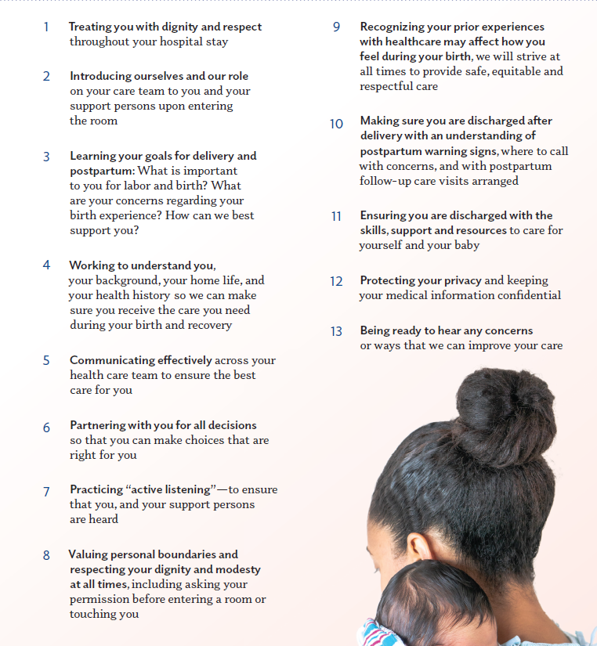
Respectful Care Practices Resources
Available in:
  Tear pads
  Posters
  Bi-Fold

Slide 20
We commit to…
Treating you with dignity and respect throughout your hospital stay
Introducing ourselves and our role on your care team to you and your support persons upon entering the room
Learning your goals for delivery and postpartum: What is important to you for labor and birth? What are your concerns regarding your birth experience? How can we best support you?
Working to understand you, your background, your home life, and your health history so we can make sure you receive the care you need during your birth and recovery.
Communicating effectively across your health care team to ensure the best care for you
Partnering with you for all decisions so that you can make choices that are right for you
Practicing “active listening”—to ensure that you, and your support persons are heard
Valuing personal boundaries and respecting your dignity and modesty at all times, including asking your permission before entering a room or touching you
Recognizing your prior experiences with healthcare may affect how you feel during your birth, we will strive at all times to provide safe, equitable and respectful care
Making sure you are discharged after delivery with an understanding of postpartum warning signs, where to call with concerns, and with postpartum follow-up care visits arranged
Ensuring you are discharged with the skills, support and resources to care for yourself and your baby
Protecting your privacy and keeping your medical information confidential
Being ready to hear any concerns or ways that we can improve your care
Notes:
Communicating
eff ectively across your
health care team to ensure
the best care for you
. Partnering with you for all
decisions so that you can
make choices that are right
for you
. Practicing “active
listening”—to ensure
that you, and your support
persons are heard
. Valuing personal
boundaries and
respecting your dignity
and modesty at all times,
including asking your
permission before entering a
room or touching you
. Recognizing your
prior experiences with
healthcare may aff ect
how you feel during your
birth, we will strive at
all times to provide safe,
equitable and respectful
care
. Making sure you are
discharged a er delivery
with an understanding of
postpartum warning signs,
where to call with concerns,
and with postpartum
follow-up care visits
arranged
. Ensuring you are
discharged with the skills,
support and resources to
care for yourself and your
baby
. Protecting your privacy
and keeping your medical
information confi dential
. Being ready to hear any
concerns or ways that we
can improve your care

Slide 21
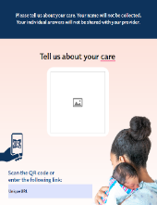


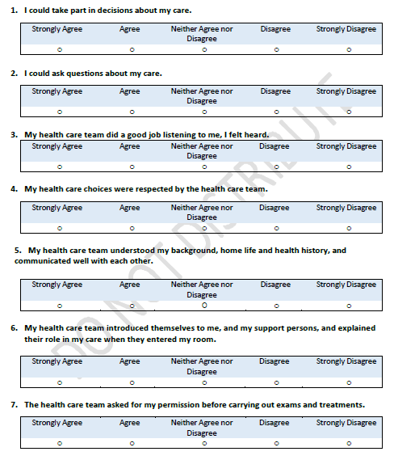
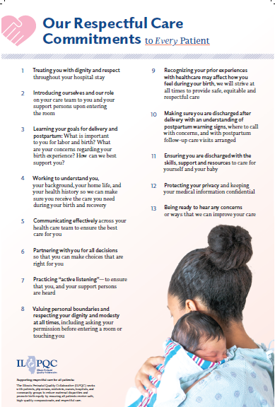
Labor & Delivery
PREM
Respectful Care Practices
Notes:
Teams will receive patient handout with QR code reports on patient feedback will be available in the ILPQC Data System
Available in English and Spanish
Additional 7 languages coming soon

Slide 22

We are shipping out Respectful Care Practices Materials for teams
ILPQC shipped each BE QI teams a sample package of Respectful Care Resources:
  10 Posters (English)
  5 Posters (Spanish)
  1 Tear pad of 50 sheets (English and Spanish)
  10 Bi-folds Brochure
We will be shipping the materials to the hospital addresses we have on file for your BE team
The materials was shipped out by the printing company 12/14/21, so please expect to receive the materials soon

Slide 23
Implementing Respectful Care Practices
Provide all providers and nurses a copy of the Respectful Care Practices to read and sign off on to acknowledge they commit to these practices
Post Respectful Care Practices posters in patient facing areas where patients can read them: such as labor and delivery rooms, triage, check in
Create a process flow to
  Identify a team member responsible for providing patients the expected Respectful Care Practices on arrival to L&D and briefly reviewing to make sure patient has received
  At discharge, make sure all patients receive the PREM Survey QR Code and are asked to anonymously complete the PREM Survey on their phone before discharge to report back on their respectful care experience during their delivery admission.
Review PREM Survey Reports and provide feedback to clinical team

Slide 24
Guest Speaker:
Terri Nikoletich MSN, MPH, RN, CNS
Program Director
BirthCare Center
Memorial Care Miller Children’s and Women’s Hospital
Long Beach, CA
CMQCC Team

Slide 25

Illinois Perinatal Quality Collaborative
Terri Nikoletich MSN, MPH, RN, CNS
Program Director
BirthCare Center
tnikoletich@memorialcare.org
12.20.21

Slide 26
Overview of Miller Children’s & Women’s
BirthCare Center
Level IV maternity care, Level III NICU
BFUSA Designated in 2018
101 bed unit (between MBU and Labor), 95 bed NICU
5708 total deliveries
NTSV C/S rate of 23.7%
Average a 60% monthly Medi-Cal delivery rate.
Affiliated OB clinic; 590 total deliveries (UCI residents)
Over 300 nurses, over 200 community Peds, OB’s, Fam. Practice physicians.
Notes:
Data from 2019;
Level IV maternity care, Level III NICU
101 bed unit (between MBU and Labor), 95 bed NICU
5708 total deliveries
NTSV C/S rate of 23.7%
Average a 60% monthly Medi-Cal delivery rate.
Affiliated OB clinic; 590 total deliveries (UCI residents)
Over 300 nurses, over 200 community Peds, OB’s, Fam. Practice physicians.

Slide 27
Birth Equity Project
(began as a CMQCC quality improvement initiative
Patient Reported Experience Metrics (PREM)
Staff education
Anti-Bias Strategies
Commitment for Safe and Equitable Birth (our Promise Statement)
MemorialCare Values: the iABC’s
  Integrity
  Accountability
  Best Practices
  Compassion
  Synergy
Notes:
Began in 2018 w/ more than a years worth of time and effort learning everything we could to help inform the effort
The California Birth Equity Collaborative is a CMQCC quality improvement initiative to improve birth care, experiences and outcomes for Black mothers and birthing people in California. Our team is comprised of partnerships among:
CMQCC - Elliott Main MD, Terri Deeds RN
Participating hospitals and their local communities
2 in Northern CA (Bay area) 3 Southern CA
State/national and local experts
including California Health Care Foundation (Hospital Quality Institute).

Slide 28


Slide 29


Patient Reported Experience Metric (PREM)
As part of the CMQCC Birth Equity (BE) Collaborative, our Birth Equity team was tasked with selecting questions from a large list that we felt would best provide information about how they perceived their care and birth experience.
Doctors, nurses or other staff at the hospital asked my permission before carrying out procedures and examinations.
The health care team helped create a comfortable, caring environment.
I trusted my doctors, nurses and other staff at the hospital to take the best care of me.
The doctors, nurses, and midwives listened to and respected my wishes.
I was treated differently based on my race/ethnicity during my hospital birthing experience.
I was treated differently based on my insurance status during my hospital birthing experience.
I was treated differently based on my sexual orientation or gender identity during my hospital birthing experience.
When the health care team could not meet my wishes, they explained why.
Overall, during my labor and birth I felt my personal preferences were respected.
The staff made me feel cared for as an individual.
Notes:
The prem questions …over 730 responses so far.

Slide 30

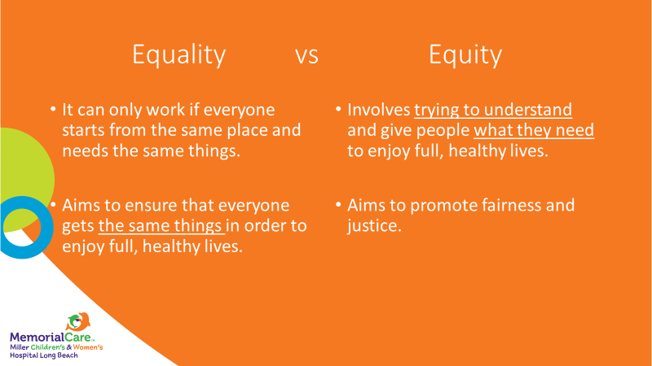
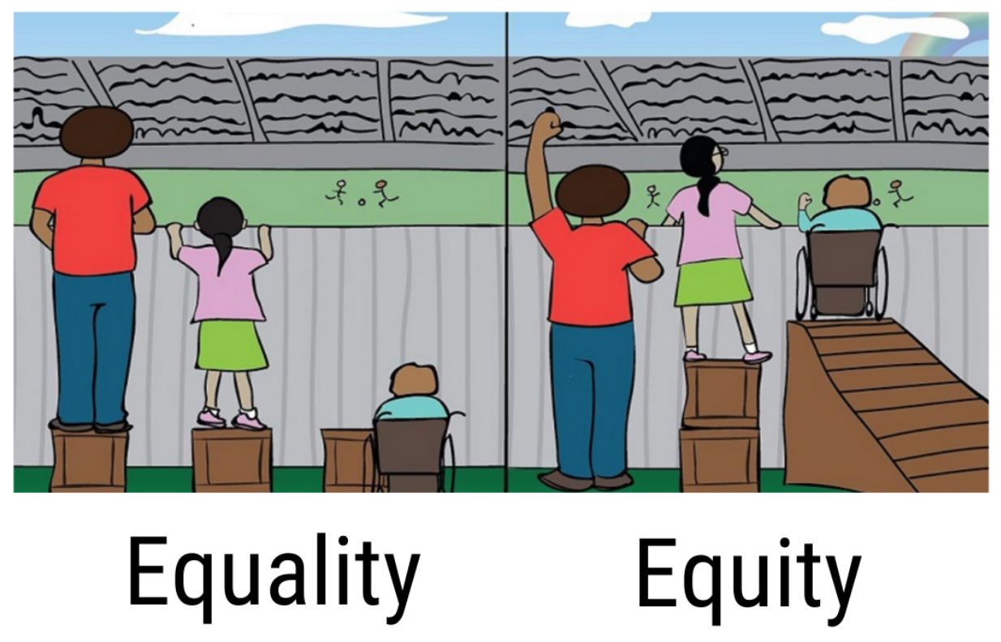
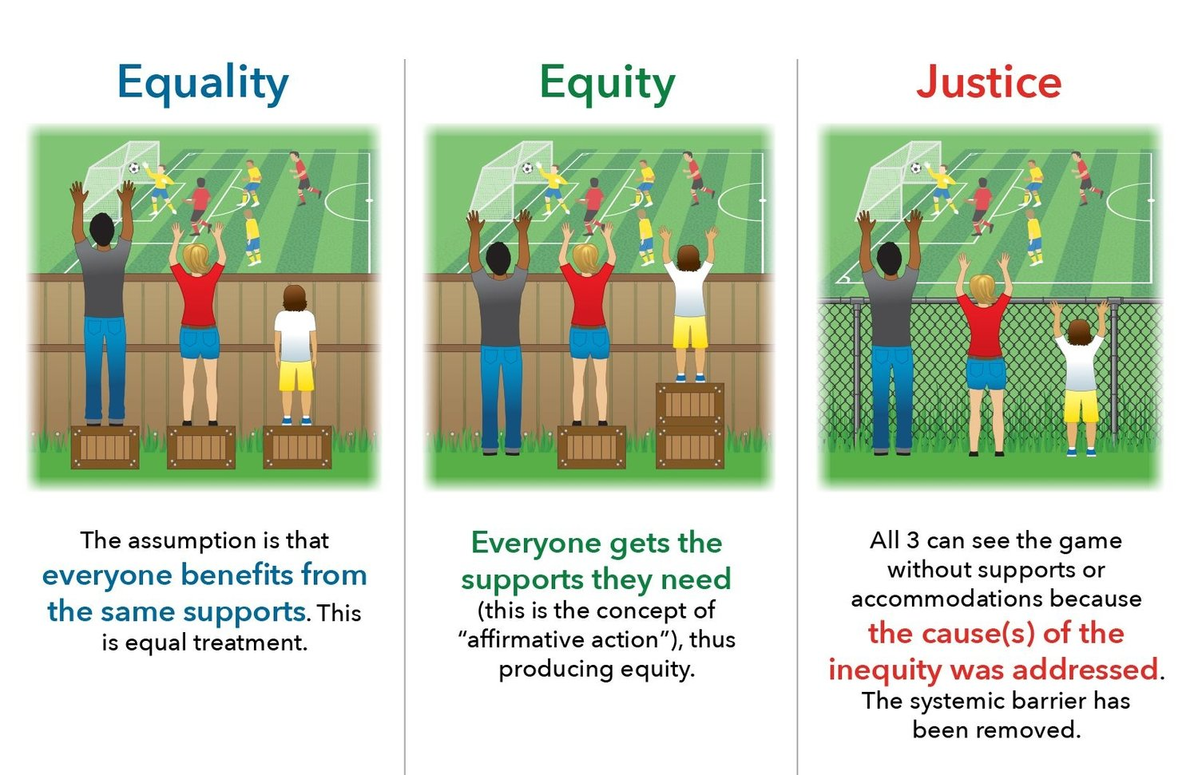
STAFF EDUCATION
ALLY / ALLYSHIP
A = Avoid Assumptions
Avoid assumptions and stereotypes by relying on objective
information and evidence.
Focus on the information that the patient provides
L = Listen
Listen more than you talk
L = Learn
Learn about the patient
Y = Yield
Yield to the person by involving them in their care.
Notes:
Three series of short presentation via the electronic messaging boards over the course of 3-4 months. Then launch of the three Diversity Science Modules over the course of 6 months including physicians.
Examples of some staff responses to the initial 3 EMB’s :
“I am not sure why we are doing this. Where did this come from? I treat all of my patients the same.”
“It’s about time that we are looking at this issue,” it’s long overdue.”
“How can we select Equity Champions to represent this really important topic on our units?”
“This is really hard work. I hope we stick to it and it is not phased out.”

Slide 31

What we do:
How we do it:
Commitment for Safe and Equitable Birth
We promise to ask permission before carrying out procedures and examinations, and always protect your personal boundaries.
YOUR BODY, YOUR RULES
MemorialCare Values: iABCs
Integrity
Accountability
Best Practices
Compassion
Synergy
8
25
90
254
54
56
487 Patients Responded
Notes:
Example of connecting our iABC’s to the promise statement.

Slide 32
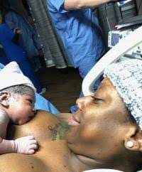
What we do:
How we do it:
Commitment for Safe and Equitable Birth
We promise to provide explanations and information in the language of your choice so we can make an informed decision that is right for you
MemorialCare Values: iABCs
Integrity
Accountability
Best Practices
Compassion
Synergy
5
26
87
249
26
57
450 Patients Responded
Notes:
Example of connecting our iABC’s to the promise statement.

Slide 33

What we do:
How we do it:
Commitment for Safe and Equitable Birth
We promise to care for you with dignity and respect and provide you safe and equitable care, in a non-discriminatory way
MemorialCare Values: iABCs
Integrity
Accountability
Best Practices
Compassion
Synergy
5
23
89
255
52
52
476 Patients Responded
Notes:
Touches all 5 values

Slide 34

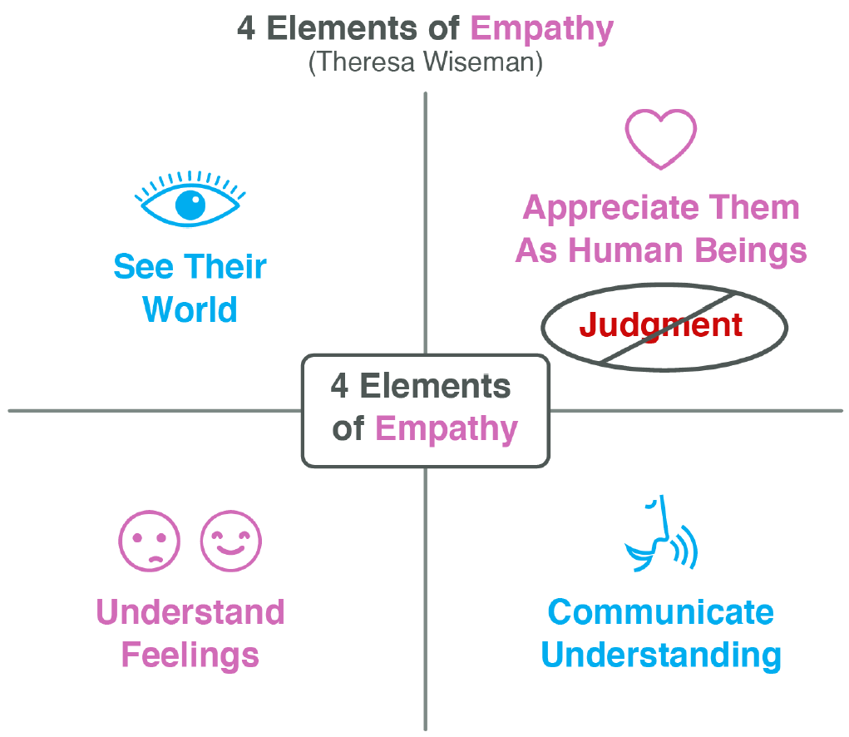
What we do:
How we do it:
Anti-bias Strategy:
Practice perspective-taking
“I am wondering how I might see it if I were looking through your eyes…”
“I was imagining being in your shoes, and it occurred to me that I would feel this way..”
Check your accuracy by asking the patient.
6
26
88
257
55
57
489 Patients Responded
Notes:
Connecting to anti-bias strategies

Slide 35


What we do:
How we do it:
Commitment for Safe and Equitable Birth
We promise to recognize the importance of your support persons and value their role in your birth experience
MemorialCare Values: iABCs
Integrity
Accountability
Best Practices
Compassion
Synergy
7
25
83
259
53
57
484 Patients Responded

Slide 36

What we do:
How we do it:
Anti-bias Strategy:
Build Partnerships
The sense of working together towards a common goal has been shown to reduce bias.
Focus on common goals
Discover what you have in common
Use words like “we, us, and our” instead of “I, you, or them”
6
23
82
254
52
57
474 Patients Responded
Notes:
Commit to Sit
Words matter!
Connecting to anti-bias strategies
Examples of partnership on next slide.

Slide 37

Partnership and Feedback
Patient Family Advisory Councils (from our multiple hospitals)
Quality Team
Best Practice Teams
Institute for Hospital Improvement (equity team)
The City of Long Beach DHHS Black Infant Health Program
The Center (serving our LGBTQ population in our community)
The CMQCC Birth Equity other pilot project hospitals
Notes:
Before I share the promise document I want to tell you how important it is to get feedback not just from your own group but outside teams and organizations as well.

Slide 38
Our baseline data and current data demonstrates our care teams’ commitment to Birth Equity.
Are we ready to declare and display our promise to our patients and families?
MCWH BIRTHCARE CENTER
Commitment for Safe and Equitable Birth
We Promise;
  To care for you with dignity and respect and provide you safe and equitable care, in a non-discriminatory way;
  To partner with you to understand any social and emotional concerns you may have, and assist you with community resources you may find helpful;
  To provide explanations and information in the language of your choice so we can make an informed decision that is right for you;
  To ask permission before carrying out procedures and examinations, and always protect your personal boundaries;
  To recognize the importance of your support persons and value their role in your birth experience.
If at any time we fall short of our promise, please contact our Executive Director, Shari Kelly at 562) 933-2777 or email her at skelly@memorialcare.org.

Slide 39
Next Steps
We plan to post the Promise Statement and welcome further feedback from staff and patients as we transition the document into our new vision statement.
Review all policies and procedures with an equity lens
Expand our Commit to Sit action item onto our Mother Baby Unit
Review other educational offerings (besides Diversity Science) such as the training from The Office of Minority Health to incorporate into our educational system for 2022 staff assignment
Integrate our birthcare center efforts into the larger system wide DEI efforts coming in 2022.
Notes:
There are also system wide DEI initiative efforts. Coming up shortly we are reviewing a potential presentation for all our employees throughout system.

Slide 40
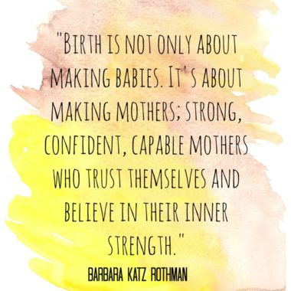


Slide 41
PREM

Slide 42
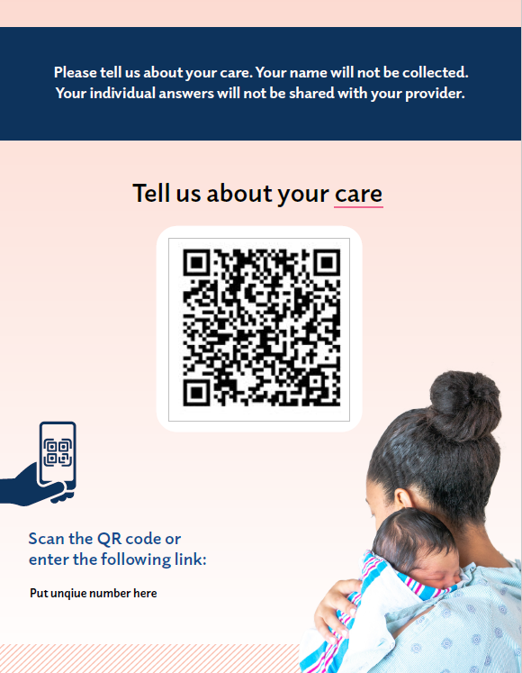
PREM Implementation
QI code form is customizable - Hospitals will have an unique number to put on their QR code paper for patients to identify the correct hospital name
Provider instructions
Sample survey
Currently available in 2 languages
  English and Spanish
  8 more languages coming soon!
Data collection starts now
Surveys completed by patients on smart phone, tablet or computer before discharge
  Laminate QR code
  Create script for your hospital (example scripts in toolkit)
  PREM QR Code
  PREM questions (for provider/nursing reference)

Slide 43
PREM Survey Questions
I could take part in decisions about my care.
I could ask questions about my care.
My health care team did a good job listening to me, I felt heard.
My health care choices were respected by the health care team.
My health care team understood my background, home life and health history, and communicated well with each other.
My health care team introduced themselves to me, and my support persons, and explained their role in my care when they entered my room.
The health care team asked for my permission before carrying out exams and treatments.

Slide 44
PREM Survey Questions cont.
I felt pressured by the health care team into accepting care I did not want or did not understand.
When the health care team could not meet my wishes, they explained why.
I trusted the health care team to take the best care of me.
I was treated differently by the health care team because of:
  My race or skin color
  My ethnicity or culture
  My sexual orientation or gender identity
  The type of health insurance I have
  The language I speak

Slide 45
PREM Survey Questions cont.
I was treated with respect and compassion:
  During my check-in
  During my labor and delivery
  During my care after delivery
  During discharge
I was treated with respect and compassion:
  By the obstetric doctors/midwives that took care of me
  By the nurses that took care of me
  By other staff at the hospital
The care I received was: Excellent, Good, Average, Fair, Poor
Please share any additional thoughts or comments about your experience with your delivery and hospital stay

Slide 46
PREM Demographics Questions
1. Ethnicity:
  O Hispanic
  O Non-Hispanic
  O Prefer not to answer
2. Race (select all that apply):
  O Asian
  O Black
  O Native American/American Indian
  O Native Hawaiian/Pacific Islander
  O White
  O Other:
  O Prefer not to answer
3. Health insurance type
  O Private insurance
  O Public insurance (Medicaid or Medical Card)
  O Self-pay
  O Uninsured
  O Prefer not to answer
6. Age:
  O <18
  O 18-24
  O 25-29
  O 30-34
  O 35-39
  O 40 +
  O Prefer not to answer
7.Type of Delivery:
  O Vaginal
  O Cesarean section
  O Prefer not to answer
4. Sexual Orientation:
  O Straight/Heterosexual
  O Bisexual
  O Gay
  O Lesbian
  O Queer
  O Other
  O Prefer not to answer
5. Gender Identity (select all that apply):
  O Agender
  O Female
  O Gender-neutral
  O Male
  O Non-binary/Gender non-conforming
  O TransMale
  O Other
  O Prefer not to answer

Slide 47
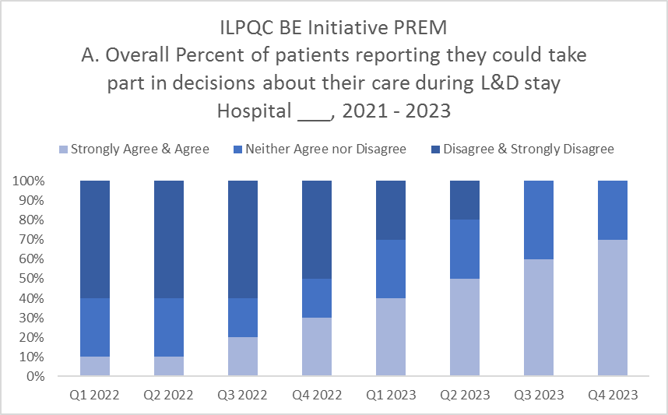
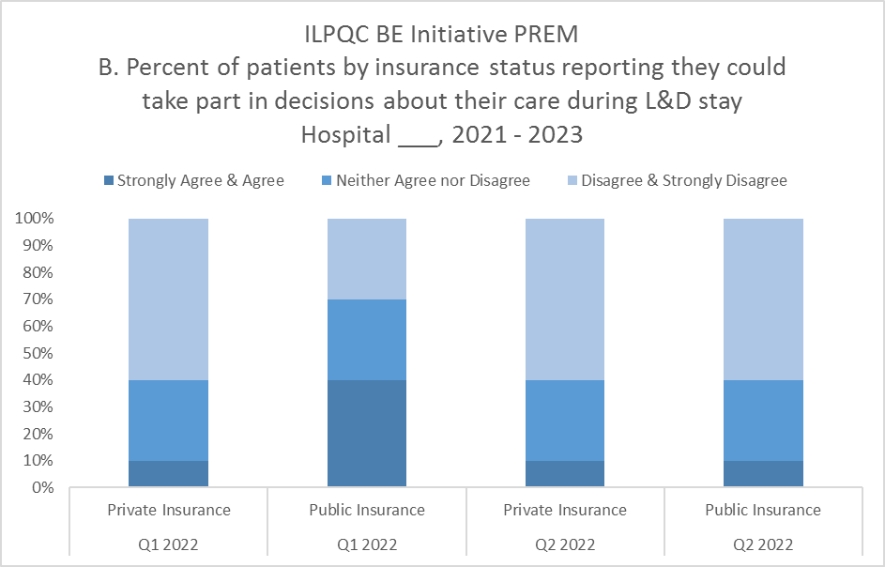
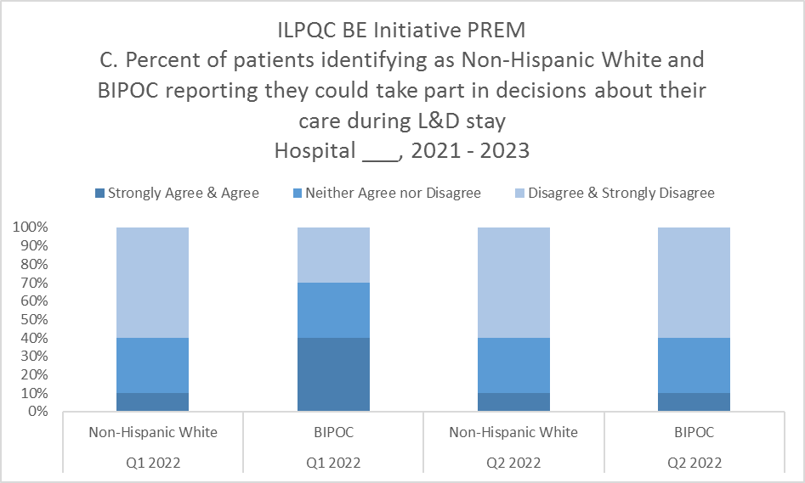
PREM Reports Updates
Proposed PREM Timeline:
  PREM reports to launch in early 2022
PREM Reports:
  Will stratify responses by:
    Overall respondents
    Public Insurance compared to Private Insurance responses
    Non-Hispanic White compared to BIPOC responses
    Black, White, Asian, Hispanic, Other (will report only if sufficient numbers > 5 patients per category)

Slide 48
Example of Introduction of PREM to Patients from NYSPQC
This survey is an opportunity for birthing people to provide feedback on their experience of care during labor and delivery and postpartum period.
North Shore University Hospital in partnership with New York State both aim to improve the care of birthing people.
This survey is anonymous and takes only a few minutes to complete.
We encourage ALL our birthing people to participate
Confidential Education Law 6527: Public Health Law 2805, J, K, L, M

Slide 49
NYSPQC PREM Recruitment Script Example
North Shore University Hospital has partnered with New York State in an effort to improve the care of all our birthing people. If you have a few minutes to spare, I would like to invite you to complete a quick survey.
  (If yes, then continue – if no, then thank the patient for their time).
This survey is an opportunity to provide feedback on your experience of labor & delivery and postpartum care at North Shore University hospital.
This survey is anonymous and should take you only a few minutes to complete. It would be very helpful to us to complete all the questions.
Please scan the QR code. I will give you your privacy while you complete the survey and will return in a few minutes.
Thank you
  When you return to the room
Thank you so much for completing the survey!
You will also receive a “NSUH” patient experience survey in the mail with questions regarding all aspects of your care here.
Confidential Education Law 6527: Public Health Law 2805, J, K, L, M

Slide 50
Guest Speaker:
Angela A. Antonikowski, PhD, MA
Chief Health Equity, Diversity & Inclusion Officer
Albany Medical Center
Albany, NY
NYSPQC Team

Slide 51


PREM Implementation Albany Medical Center
Angela A. Antonikowski, PhD, MA
Chief Health Equity, Diversity & Inclusion Officer
Albany, NY

Slide 52



Process
Engaged with the NY Birth Equity Improvement Project January 2021
Institution-wide initiative as a collaboration with Office of Health Equity, Diversity & Inclusion and clinical departments
Strong Community Engagement Institutional /Structural Engagement

Slide 53
Albany Med - NYBEIP Team
Rebecca Adler, MD Assistant Professor Obstetrics and Gynecology Albany Med | Brigid Mack, MD Clinical Assistant Professor Family & Community Medicine Community Care Physicians
Angela Antonikowski, PhD MA Associate Professor Chief Health Equity, D&I Officer Albany Med | Erin McKee BSN, RNC-OB, C-EFM Regional Perinatal Quality Specialist Perinatal Outreach Program Albany Med
Maryalice Cullen, DNP, MSN, RNC-NIC, NEA-BC AVP, Women’s and Children’s Services Pediatrics Albany Med | Evelyn Pedralvez, RN, MSN Nurse Manager Postpartum/ Term Nursery and Lactation Albany Med
Ishbel Correa Narvaez, Med Program Coordinator Office of Health Equity, Diversity & Inclusion Albany Med | Kelly Miles, NP Neonatology Albany Med
Sara Garcia, MD Assistant Professor Pediatrics Albany Med | Rebecca Rogers, MD Professor Chair – Obstetrics and Gynecology Albany Med
Jaime Gifford Data Coordinator Perinatal Outreach Albany Med | Steve Ross Manager Perinatal Outreach Albany Med
Kathleen Lucia, RN Nurse Clinician, Women’s and Children’s Services Pediatrics Albany Med | Megan Zysick, MD Associate Professor Obstetrics and Gynecology Albany Med

Slide 54
Workplan

Slide 55
Process
Identify PREM procedures
Examine current process
Develop script for uniformity
Contingency planning
Develop tracking for non completeness
Monthly reporting of results

Slide 56
Progress

Slide 57
Progress

Slide 58


Slide 59
Questions?
Angela Antonikowski, PhD, MA
Antonia@amc.edu

Slide 60
Team Talk
Stroger Hospital Team

Slide 61
ILPQC Birth Equity Team Talk John H. Stroger Hospital
Monday, December 20, 2021

Slide 62
Community Serviced
John H. Stroger Hospital is a safety net hospital which mainly serves a culturally and ethnically diverse population. Mostly an undeserved population in which most of the patients come from disadvantaged, lower social-economic status, limited access to health care and unfortunately, most are at risk for maternal and infant mortality and pregnancy related health outcomes.
2

Slide 63
Getting Started
Initial Steps:
Held an initial meeting with OB Leadership on the best way to implement and roll-out BE project
Selected Multidisciplinary Providers and submitted roster
Held first meeting – Discussion included: Defining Birth Equity, importance for taking part in this initiative and completed the readiness survey
We discussed and completed responses for Structure and Process Measures
Developed a mechanism for collecting baseline data and continuous data
Identified Data Specialists from OB
Submitted request for Redcap
Created a BE team on Microsoft Teams to maintain data, meetings, forms and other BE information

Slide 64
Baseline Chart Review
We completed an initial chart review on 30 records of patients who delivered between October – December 2020. SDOH screening included questions for:
Housing insecurity
Childcare
Food insecurity
Intimate partner violence
Transportation to appointments
Education level
Ability to pay for prescriptions

Slide 65
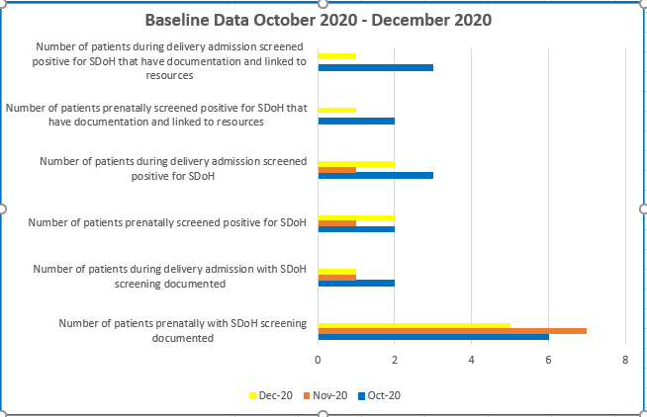
Baseline Chart Results:

Slide 66
Baseline Chart Results cont.
Initial chart reviews found:
Some charts had unknown race/ethnicity not documented
Most patients were screened upon entrance to prenatal care, if prenatal care was established at Stroger
Patients who were transferred-in were not screened
Majority of patients were not screened during their admission for delivery
Patients who screened positive for SDOH and documented in EMR were not always linked to appropriate services

Slide 67











GOAL PROJECT #1
7

Slide 68

BE Project #1
Improve the screening process for SDOH at all entrance points including prenatally (considering screening per trimester) and admission to labor and delivery and ensure that all patients who screen positive will be referred to appropriate Social Service Providers.
68

Slide 69

Thank you!
69

Slide 70
Birth Equity Additional Resources & Tools
14

Slide 71

*NEW Perinatal Quality Improvement
SPEAK-UP Training
ILPQC will host another Speak Up Training January 19th & 26th.
The SPEAK UP Champions™ Implicit and Explicit Racial Bias education is a total of 8 hours over two days January 19th and 26th at 8:30AM-12:30PM both days are required.
  Agenda Flyer here (click link)
  Registration link here (click link)
BE Teams who did NOT sign up for the November 2021 training have the opportunity to attend the January 2022 training, along with teams who would like to send additional team member to be trained.
  If interested in sending an additional team member, please contact Ieshia Johnson at Ieshia.Johnson@northwestern.edu to make sure we have space available.
92 people attended November’s training!
Illinois Perinatal Quality Collaborative

Slide 72

Tiered Approach for Birth Equity Implicit
Bias Training
Diversity Science: Dignity in Pregnancy and Childbirth Course training
  FREE e-module trainings available for all staff
  Can integrate into the hospitals e-learning systems to track completion
Perinatal Quality Improvement SPEAKUp Training
  1 team member per hospital to attend over 2 days (total 8 hours) anti-racism training
  Train the trainer model to amplify local trainings
Laboring with Hope video and discussion guide
  Working with developer (Dr. Nakeitra Burse) to make the 30 min video and discussion guide available for free for all BE teams for group viewing and discussion
Make sure someone from your BE QI team is signed up for the January PQI Speak Up training by 12/29/21!
Illinois Perinatal Quality Collaborative

Slide 73



Develop respectful care and bias education for providers, nurses, and staff
ILPQC has partnered with Diversity Science to provide simplified online access to the Dignity in Pregnancy and Childbirth online e-module training
3-module free program for perinatal providers, nurses and staff
  With resources to promote health equity in clinical practice and organizations also available
Free access to the resources and support to add e-modules to online hospital learning systems will be provided
Webpage link: NEW*
https://www.diversityscience.org/ilpqc-2/!
Illinois Perinatal Quality Collaborative
49

Slide 74

Birth Equity Toolkit Outline
Introduction
National Guidance ACOG/SMFM
ACOG Committee Opinions/Statements
SMFM Guidance
Birth Equity Toolkit now available online: https://ilpqc.org/birthequity/
National Guidance Alliance for Innovation on Maternal Health (AIM):
Initiative Resources *10 Steps to Getting Started with BE*
Address Social Determinants of Health (SDoH)
Utilize Race and Ethnicity Medical Record and Quality Data
Engage patients, support partners, and communities in patient- centered, respectful care
Engage and educate providers, nurses, and staff to improve birth
equity
41

Slide 75
Resources and Education for RCP & PREM
Resources to review for sharing expected respectful care practices with providers, nurses, staff, and patients:
ILPQC Respectful Care Practices English
  Poster
  Patient and Provider Handout
  Bi-Fold (Brochure)
ILPQC Respectful Care Practices Spanish
    Poster
    Patient and Provider Handout
    Bi-Fold (Brochure)
CDC: HEAR Her
  Listen Campaign from Her Birth Right
  CDC: Hear Her Campaign
  Institute for Perinatal Quality Collaborative SPEAK UP Flyer
Patient Reported Experience Measure (PREM) patient survey
ILPQC PREM Survey English Link
  PREM information for hospital teams
  QR Code for teams to post within L&D rooms
ILPQC PREM Survey Spanish Link
  QR Code for teams to post within L&D rooms
*(customize this page with your unique number)

Slide 76
Birth Equity next steps

Slide 77

Key Players Meetings to help support you get started
Opportunity for each BE team to receive consultation with a BE champion to strategize and map out your hospital’s next steps for making progress with BE by helping your team address barriers and create 30/60/90 plans.
  Teams can start scheduling KPM meeting in November
  Request your KPM meeting with this link: https://redcap.healthlnk.org/surveys/?s=C9TKXKJNMD
Illinois Perinatal Quality Collaborative
Notes:
Additional support for your birth equity initiative! We want to help you succeed by:
Partnering with you to arrange your Key Players meeting.
Assist you with who to invite at each hospital for most effective meeting with representative from ILPQC
Provide you with a Birth Equity champion from the BE speakers bureau to partner with you to problem solve, overcome barriers and move implementation forward

Slide 78
Upcoming Monthly Webinars:
Date | Topic
Monday, January 17th 12:00-1:00pm | Discussion of implementation strategies for topics covered so far… SDoH Screening Tool Respectful Care & PREM
Monday, February 21th 12:00-1:00pm | Implementing a comprehensive implicit bias training for provider / nurse education
Monday, March 21st 12:00-1:00pm | Engaging patients and community in QI / Birth Equity work
Register and Join here:
https://northwestern.zoom.us/meeting/register/tJMod-uoqDotGtzzJICE1O5TphPWT2-pZfmY

Slide 79

Next Steps for Birth Equity
Monthly data for November due into REDCap by December 15th
Schedule your team KPM meeting to receive help to get started
Make a 30 60 90 day plan for next steps with respectful care and PREM implementation
Review the BE toolkit for great resources and materials to help move things forward!
Next Stop!
Illinois Perinatal Quality Collaborative

Slide 80


QI Champions
Obtain a Certificate in
Quality Improvement Science Sponsored by ILPQC
ILPQC is offering hospital teams access to IHI Open School, a free opportunity to asynchronously complete over 13 continuing education hours
Access starting June 2021 but can complete the certificate over two years.
Please complete the IHI Open School inquiry form to designate a specific number of members across OB & Neonatal QI initiatives at your hospital.
40 hospitals have team members receiving this FREE QI training
Fill out this link with your team TODAY!
https://redcap.healthlnk.org/surveys/?s=RN9D4H9AMD
Pump up your Quality Improvement skills!

Slide 81










Thanks to our Funders
In kind support:

Slide 82
PREM vs Press Ganey
PREM
ILPQC centering patient reported experience as a reflection of the Respectful Care Practices
Anonymous survey for every birth discharge measuring patient experience during labor and delivery
Patients use a QR code to access survey and select hospital they delivered at
Answers go directly to ILPQC for analysis from RedCap
Aggregate results reported back quarterly to BE hospital teams
Press Ganey
40 million patients and 3 million healthcare workers fused with safety and quality data
Done after patient leaves the hospital typically completed via phone
Hospitals use for improving their score, rather than improving the actual patient experience
Randomly selected not given to every patient
Own scoring system for determining how hospitals are dedicated to enhancing a patient's experience
Does not represents only labor and delivery experiences

