Slide 1

ILPQC Community Advisory Board (CAB)
August 3, 2022

Slide 2
Call Overview
Introductions & Round Robin
ILPQC Updates
2022 Initiative Discussions
  PVB
  Birth Equity
  MNO-OB
Discussion & Next Steps

Slide 3

Round Robin
Name and where you are from
Ice Breaker: What is your favorite summer food?
What is one thing you want to gain from these community meetings?

Slide 4
What is the Community Advisory
Board (CAB)?
ILPQC is a collaborative of health care providers, nurses, allied health professionals, patients, public health/community partners who care for birthing people and babies during pregnancy, labor, and delivery – we value your input!
The CAB provides a regular, ongoing space for ILPQC to hear your (our patient and community partners) input and feedback on statewide quality initiatives and projects
We plan to meet about quarterly (4 times / year) with occasional outreach via email
You will receive a $25 Visa gift card per meeting for your participation via email address we have on file

Slide 5
ILPQC Updates

Slide 6
Working on Shared Decision Making Initiative
Team Birth: A care process innovation involving a series of team huddles between the patient and their care team, to improve shared decision making and support the patient to participate in all health care decision during their labor.
Patient’s reports feeling engaged in shared decision making, feeling heard and listened to, feel engaged in their care, improved communication across team members
We are applying for funding to offer TeamBirth as an initiative for 22 hospital teams
The ILPQC CAB would provide input on the TeamBirth initiative in quarterly meetings

Slide 7
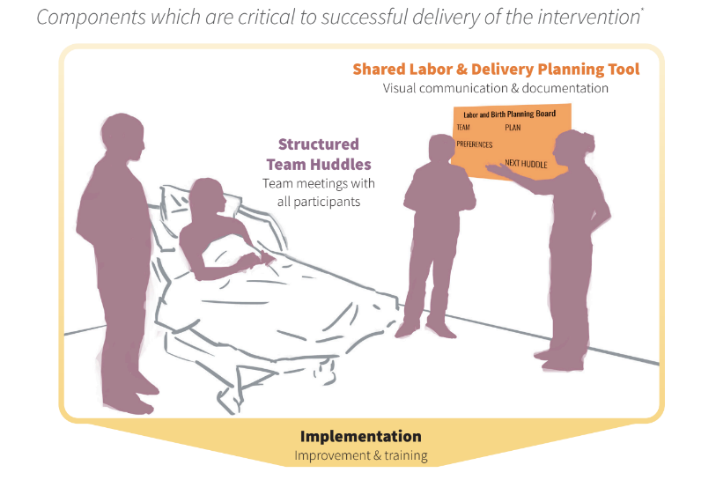
TeamBirth Core Components
Shared Planning Board

Slide 8
Working on Shared Decision Making Initiative
Next Steps:
  A letter of support from each interested CAB member is requested (Ieshia sent template)
  These letters will go in with the grant to PCORI (patient centered outcomes research institute) to fund the initiative
  Sign and return by August 3, 2022 to info@ilpqc.org
  If funded project would start in LATE 2023-2024
  THANK YOU!!!

Slide 9

Save the Dates:
Calling all perinatal health care providers, nurses, allied health professionals, patients and public health/community partners!
ILPQC OB and Neonatal Face to Face Meetings:
  May 24 and 25, 2023 TBD

Slide 10
Promoting Vaginal Birth

Slide 11
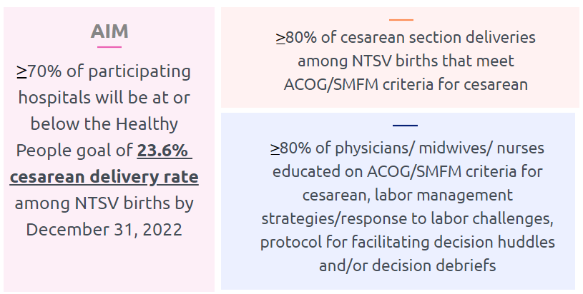
PVB Aims and Measures

Slide 12
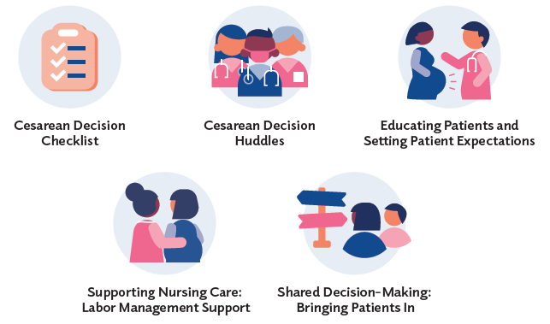


PVB Key Strategies for
Creating Clinical Culture Change
Sharing Unblinded Provider-level NTSV C-Section Rates
Review of NTSV C-Section Cases Not Meeting ACOG/SMFM Guidelines

Slide 13



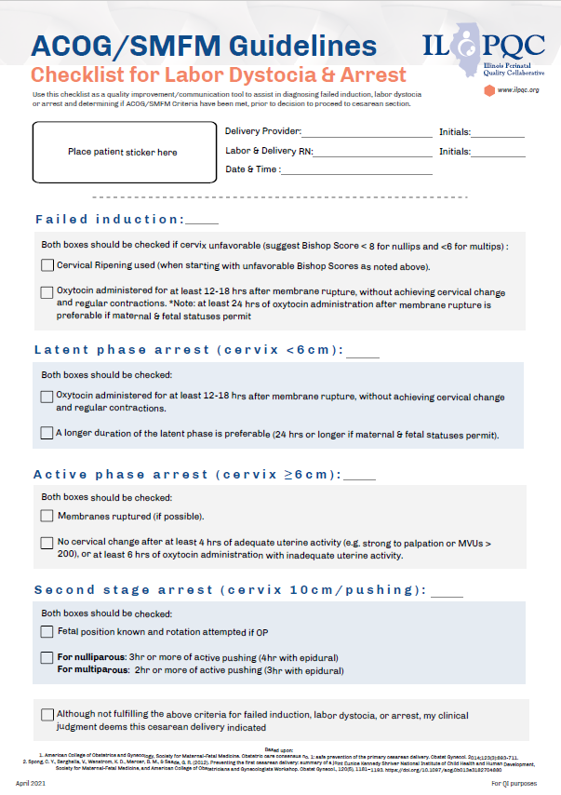


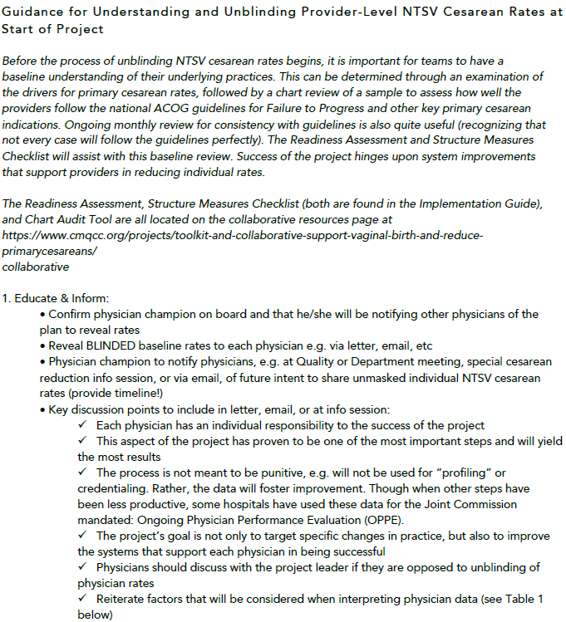
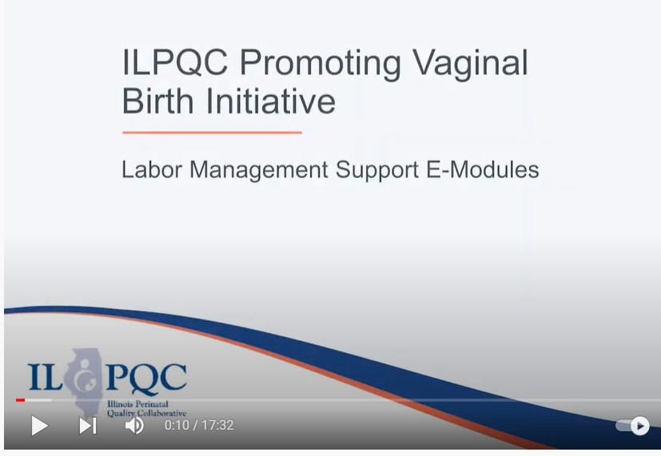
PVB Key Resources
Provider Education Posters
CMQCC Un-blinding Provider Data
Missed Opportunity Review
Cesarean Decision Checklist
Labor Management E-modules

Slide 14
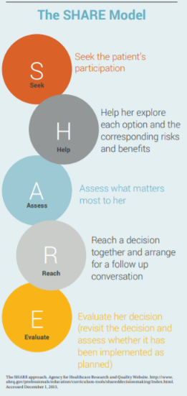


Key Resources and strategies for Shared Decision Making and Patient Education
Know Your Options poster
SHARE model infographic
My Birth Matters from California Health Care Foundation
Notes:
Resources for Standardized Patient Education materials, SHARE Model (for providers/clinical team)

Slide 15
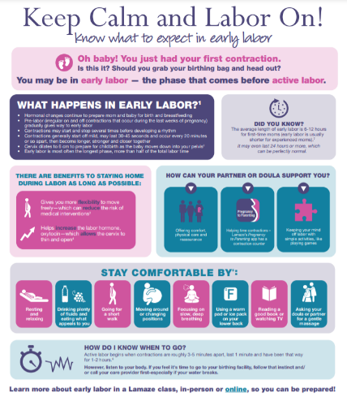
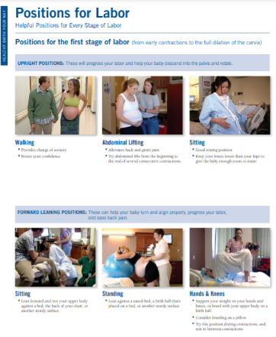
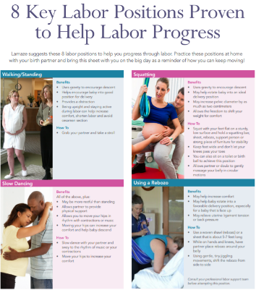
Key Resources and strategies for Shared Decision Making and Patient Education
Keep Calm and Labor On
Positions for Labor
Positions for Labor Progress
Notes:
Standardized Patient Education Materials to support vaginal birth

Slide 16
PVB Teams Progress on Key Structure Measures
Notes:
I am leaving this is may because june data looks like we have a lot less teams with all 6 SM in place or working on it because we only have 33 teams

Slide 17
ILPQC teams NTSV C-Section Rate

Slide 18
NTSV C-Section Rates, by hospital
Goal: < 23.6%
All ILPQC Average: 23%

Slide 19
NTSV C-Section Rate by Race and
Ethnicity: 2020 IDPH birth certificate data
NTSV C-Section Race and Ethnicity Data Collection:
Goal: Provide data reports to all teams with their NTSV CS rates stratified by race, ethnicity and insurance status
Bridging PVB and BE initiatives to stratify key measures to identify disparities and address them
"There is no quality without equity"

Slide 20
Discussion Questions for PVB?
How can we ensure patients are empowered to advocate for themselves in decision regarding their delivery?
What strategies are most effective to engage patients in shared decision making during labor and when deciding about cesarean deliveries with their clinical team?
What strategies are most important for hospital teams to address to reduce disparities in cesarean rates?

Slide 21
Birth Equity

Slide 22

Birth Equity
Initiative
6/2021 – 12/2023 or as needed
86/101 birthing hospitals
Foundational initiative that builds on existing hospital efforts and lays the groundwork for ongoing equity work to address maternal disparities and promote birth equity
Notes:
Foundation initiative for ALL Illinois birthing hospital that will build on existing hospital efforts and lay the groundwork for ongoing equity work in all statewide quality improvement initiatives to address maternal disparities and promote birth equity.

Slide 23
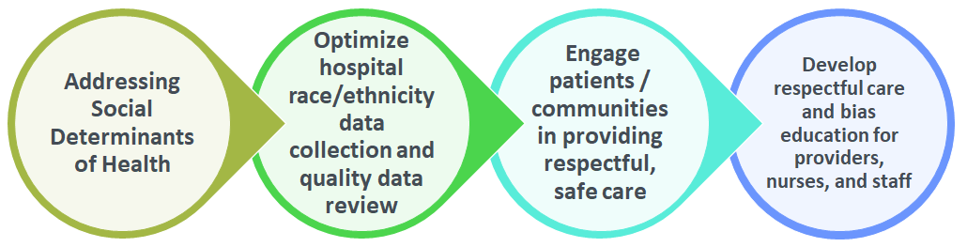
Birth Equity Initiative Aims & Drivers
AIMS
By December 2023:
≥ 75% of IL birthing hospitals will be participating in the Birth Equity Initiative
≥ 75% of hospitals participating will have all key strategies in place
KEY DRIVERS
Notes:
*New picture

Slide 24
Key QI Strategies
Optimize race/ethnicity data collection & review key maternal quality data by race, ethnicity & Medicaid status
Engage patients and community members for input on quality improvement efforts
Universal social determinants of health screening tool (prenatal/L&D) with system for linkage to appropriate resources
Share respectful care practices on L&D and survey patients before discharge on their care experience (using the PREM) for feedback
Standardize postpartum safety education and schedule early postpartum follow up prior to hospital discharge
Implicit Bias / Respectful Care training for providers, nurses and other staff
Notes:
Optimize race/ethnicity data collection and review key maternal quality data by race, ethnicity and Medicaid status
Universal social determinants of health screening tool (prenatal/L&D) with system for linkage to appropriate resources
Share respectful care practices on L&D and survey patients before discharge on their care experience (using the PREM tool) for feedback
Engage patients and community members for input on quality improvement efforts
Standardize postpartum safety education and schedule early postpartum follow up prior to hospital discharge
Implicit Bias / Respectful Care training for providers, nurses and other staff

Slide 25


Optimizing race/ethnicity data collection
Sample language to request patient race and ethnicity data
Resources to develop a process to stratify and review hospital maternal health quality data by race, ethnicity, and Medicaid status
Hospital Guide to Stratifying Data by Patient Demographics:
Assemble workgroup
Validate patient data
Identify priority metrics
Determine if stratification is possible
Stratify the data

Slide 26





SDoH screening and linkage to resources
Folders with patient and provider resources for SDoH screen positive patients
Sample screening tools
Community resources and mapping tool
Patient Tip Sheets
Documenting positive patients for SDoH
SDoH folders for patients
Universal Screening for SDoH

Slide 27



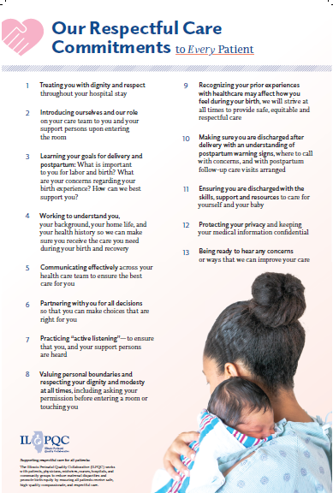
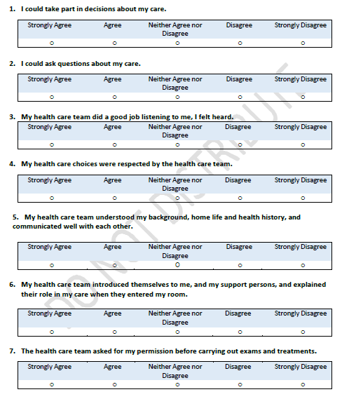
RCP and PREM
Labor & Delivery
PREM
Respectful Care Practices

Slide 28
We commit to…
Treating you with dignity and respect throughout your hospital stay
Introducing ourselves and our role on your care team to you and your support persons upon entering the room
Learning your goals for delivery and postpartum: What is important to you for labor and birth? What are your concerns regarding your birth experience? How can we best support you?
Working to understand you, your background, your home life, and your health history so we can make sure you receive the care you need during your birth and recovery.
Communicating effectively across your health care team to ensure the best care for you
Partnering with you for all decisions so that you can make choices that are right for you
Practicing “active listening”—to ensure that you, and your support persons are heard
Valuing personal boundaries and respecting your dignity and modesty at all times, including asking your permission before entering a room or touching you
Recognizing your prior experiences with healthcare may affect how you feel during your birth, we will strive at all times to provide safe, equitable and respectful care
Making sure you are discharged after delivery with an understanding of postpartum warning signs, where to call with concerns, and with postpartum follow-up care visits arranged
Ensuring you are discharged with the skills, support and resources to care for yourself and your baby
Protecting your privacy and keeping your medical information confidential
Being ready to hear any concerns or ways that we can improve your care
Notes:
Communicating
eff ectively across your
health care team to ensure
the best care for you
. Partnering with you for all
decisions so that you can
make choices that are right
for you
. Practicing “active
listening”—to ensure
that you, and your support
persons are heard
. Valuing personal
boundaries and
respecting your dignity
and modesty at all times,
including asking your
permission before entering a
room or touching you
. Recognizing your
prior experiences with
healthcare may aff ect
how you feel during your
birth, we will strive at
all times to provide safe,
equitable and respectful
care
. Making sure you are
discharged a er delivery
with an understanding of
postpartum warning signs,
where to call with concerns,
and with postpartum
follow-up care visits
arranged
. Ensuring you are
discharged with the skills,
support and resources to
care for yourself and your
baby
. Protecting your privacy
and keeping your medical
information confi dential
. Being ready to hear any
concerns or ways that we
can improve your care

Slide 29
PREM Survey Questions
I could take part in decisions about my care.
I could ask questions about my care.
My health care team did a good job listening to me, I felt heard.
My health care choices were respected by the health care team.
My health care team understood my background, home life and health history, and communicated well with each other.
My health care team introduced themselves to me, and my support persons, and explained their role in my care when they entered my room.
The health care team asked for my permission before carrying out exams and treatments.

Slide 30
PREM Survey Questions cont.
I felt pressured by the health care team into accepting care I did not want or did not understand.
When the health care team could not meet my wishes, they explained why.
I trusted the health care team to take the best care of me.
I was treated differently by the health care team because of:
  My race or skin color
  My ethnicity or culture
  My sexual orientation or gender identity
  The type of health insurance I have
  The language I speak

Slide 31
PREM Survey Questions cont.
I was treated with respect and compassion:
  During my check-in
  During my labor and delivery
  During my care after delivery
  During discharge
I was treated with respect and compassion:
  By the obstetric doctors/midwives that took care of me
  By the nurses that took care of me
  By other staff at the hospital
The care I received was: Excellent, Good, Average, Fair, Poor
Please share any additional thoughts or comments about your experience with your delivery and hospital stay

Slide 32
Structure Measures:
Implementing Systems Changes

Slide 33
Structure Measures:
Implementing Systems Changes

Slide 34
Process Measures:
Implicit Bias Training
Notes:
Structure Measures- highlight/congratulate the success in place/working on measures: how to consolidate these
Implemented standardized social determinants of health screening tools for delivery admission
Implemented affiliated prenatal care sites standardized screening tools for universal social determinants of health screening
Completed ILPQC social determinants of health community resources mapping tool and shared with affiliated outpatient
Incorporating discussion of social determinants of health and discrimination as potential factors in hospital maternal morbidity reviews
Protocol for improving the collection and accuracy of patient-reported race/ethnicity data
Process to review maternal health quality data stratified by race/ethnicity and Medicaid status
Engaged patients and/or community members to provide input on quality improvement efforts
Sharing expected respectful care practices with delivery staff and patients
Implicit Bias Training (line graph)

Slide 35

Celebrating success: Speak-UP trainings and
Regional Community Meetings
The meeting went very well. The 3 community partners articulated their positive experiences related to the 4 key drivers of the BE initiative.
–Northwestern Network
3 PQI SpeakUp Trainings here in Illinois with 71 teams with 1 or more person attending
10 out of 10 community regional meetings within six different networks with 77% of hospital teams
This is such a great discussion! Hearing from the community panelists is powerful and very much needed. I appreciate all of the input. – Provider, Stroger Network
Notes:
34/44

Slide 36
Discussion Questions for BE?
What strategy do feel is most important regarding Birth Equity?
After reviewing the respectful care practices, What practices feel most important to you and how can nurses and doctors best practice these strategies?
What do you think we could say to doctors and nurses on L&D to help them understand that these respectful care practices really matter to patients and are needed to provide safe, equitable and quality care?
What approach do you think will work best to encourage patients to scan the survey QR code for the PREM survey on their phone or a hospital provided IPAD and complete the PREM survey before delivery discharge?
What is the best way to connect patients who need help to resources and services for their social determinants of health needs?

Slide 37
MNO-OB

Slide 38
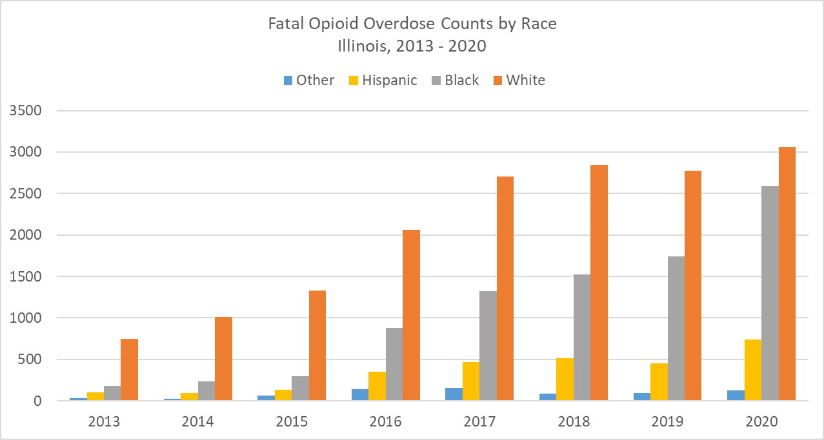
The Opioid Epidemic- Illinois Impact
Opioid overdoses in Illinois increased 33% from 2019 to 2020
In 2020, there were 2,944 opioid overdose fatalities
Opioid overdose deaths increased among racial and ethnic minority groups
https://dph.illinois.gov/topics-services/opioids/idph-data-dashboard.html

Slide 39
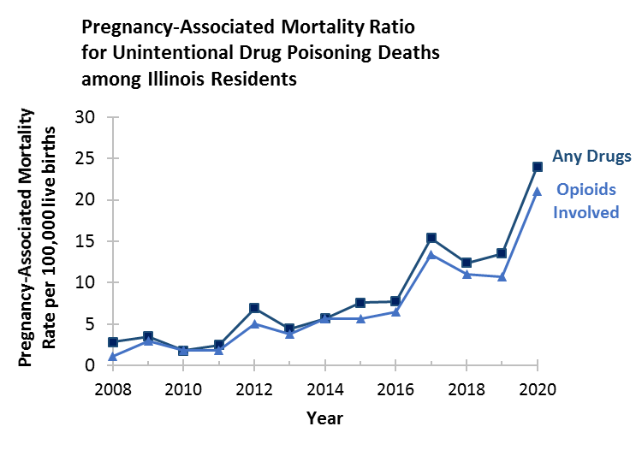
Maternal deaths due to opioids in IL
In Illinois between 2019 – 2020:
The rate of pregnancy associated mortality ratio for unintentional drug poisonings involving opioids increased from 10.7 to 21.0 per 100,000 live births
Mental health conditions, including substance use disorder, were the leading cause of pregnancy-related deaths​
IDPH Maternal Morbidity and Mortality report on 2016-2017 deaths, 2021; IDPH Death Certificates, 2021
Notes:
How to show increase in oud cases in 2020

Slide 40






Our Goal:
Optimal OUD care every time
Screen every pregnant patient with OUD with a validated screening tool
Assess readiness for Medication Assisted Treatment (MAT)
Start MAT and link to recovery treatment services (RTS)
Provide patient education on OUD, NAS, and reduce stigma, promote respectful care across clinical team
Provide Naloxone (Narcan) counseling and medication
Warm hand-offs for community-based MAT, RTS, OB follow up

Slide 41
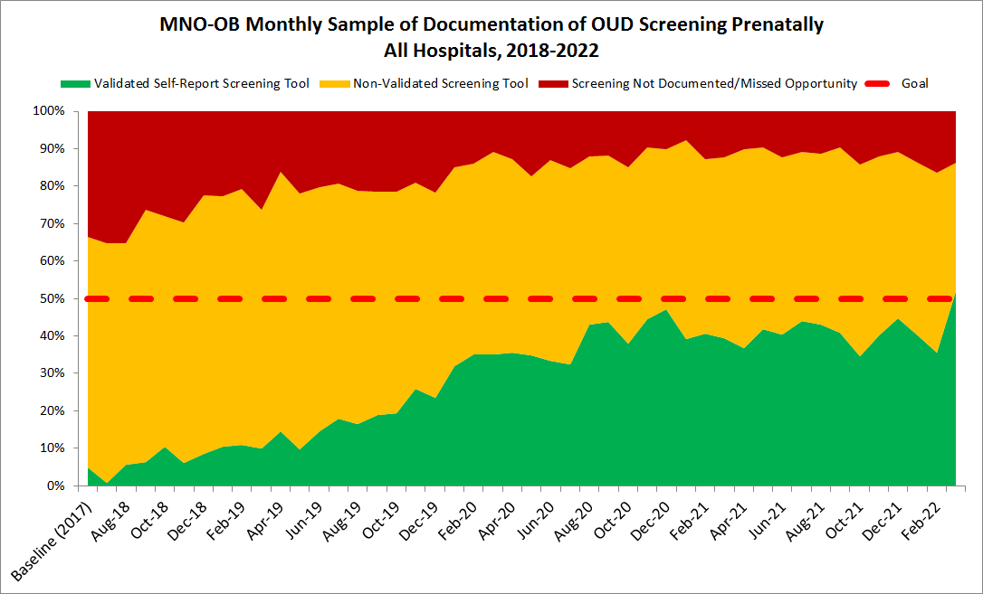
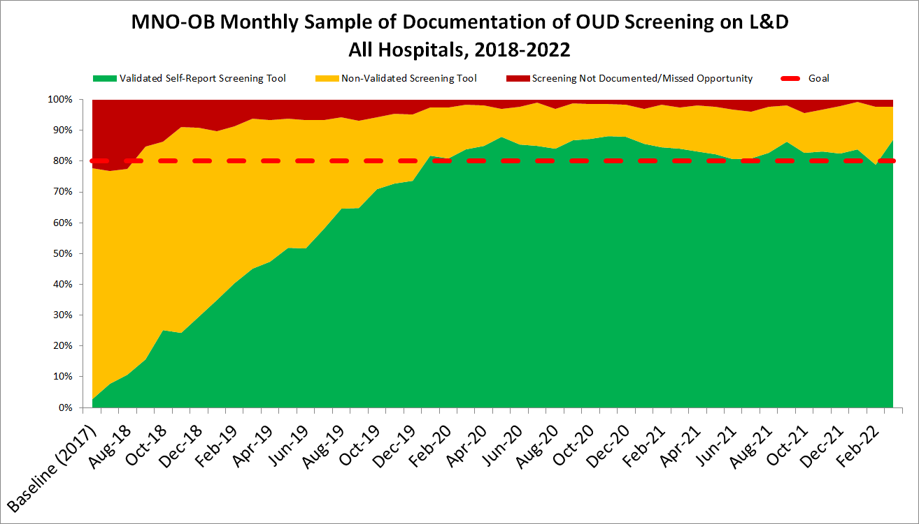
4 Years of MNO: Screening
Prenatal Screening
L&D Screening
52%
87%
2%
2%
Sustainability data
Sustainability data
28,440 charts sampled since 2018

Slide 42
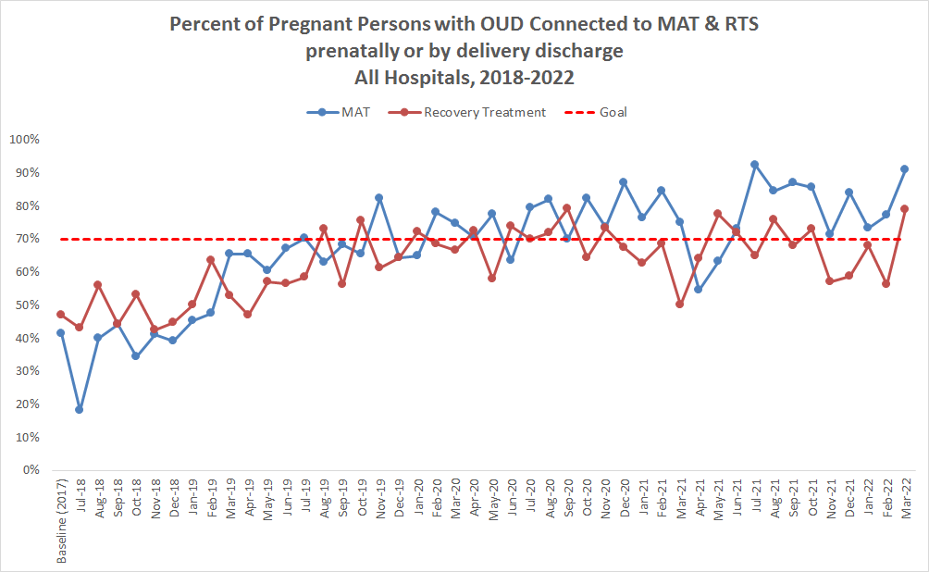
4 Years of MNO:
MAT and Recovery Treatment Services
Teams have cared for over 2,556 birthing persons with OUD across the initiative
Teams have connected over 1,500 birthing persons to MAT and Recovery Treatment services across the initiative
Sustainability data

Slide 43

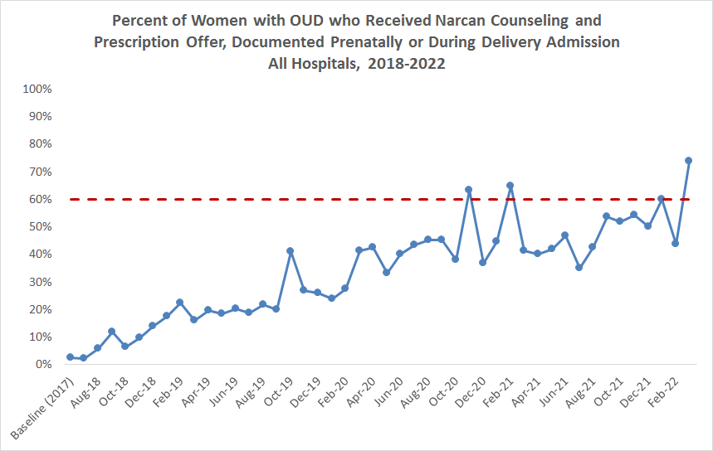
4 Years of MNO: Narcan
Teams provided Narcan counseling to over 683 pregnant persons with OUD since the start of the initiative
74%
2%
Sustainability data
Notes:
Stop at 2020?

Slide 44
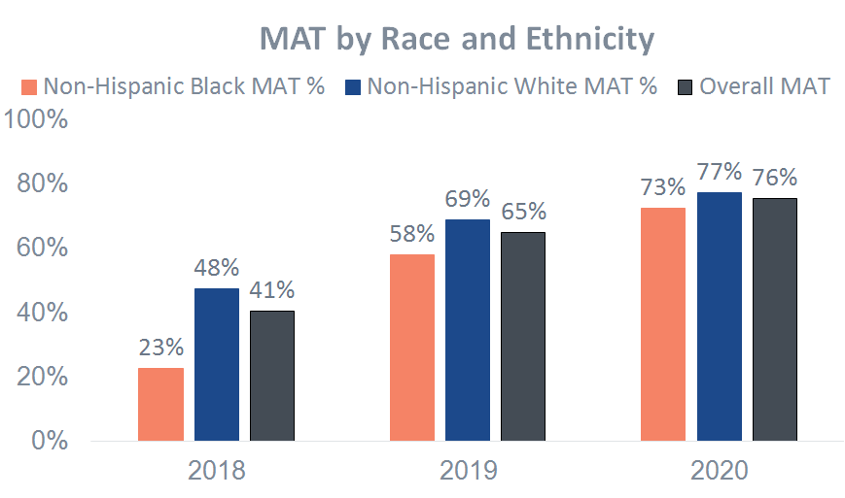
Optimal OUD Care- Reducing Disparities
Start of Initiative
Non-Hispanic Black persons with OUD were connected to MAT at lower rates compared to non-Hispanic White persons.
End of Initiative
The disparity in connecting patients to MAT closed, with the greatest achievement seen among non-Hispanic Black persons

Slide 45
Discussion

Slide 46
ILPQC Community Advisory Board how do we make it work best for you?
What information is most helpful to discuss each meeting?
How can we make sure everyone gets to provide input?
Any thing else?

Slide 47










Thanks to our Funders
In kind support:

