Slide 1
The Value of Data to Advance Equity-Based QI: Introducing the New MDC Equity Dashboard
Terri Deeds, RN, MSN, NE-BC
Anne Castles, MA, MPH
September 27, 2019, 12-1pm

Slide 2
Housekeeping
All lines have been muted to eliminate background noise
Questions will be addressed at the end of the webinar via the chat box or Q&A
The webinar recording will be available on the CMQCC website
Other questions: contact vcape@Stanford.edu

Slide 3
Utilizing Data to Establish the Need for Equity Based Quality Improvement
Terri Deeds, RN, MSN, NE-BC
Clinical Lead, CMQCC
Notes:
Title Slide layout

Slide 4
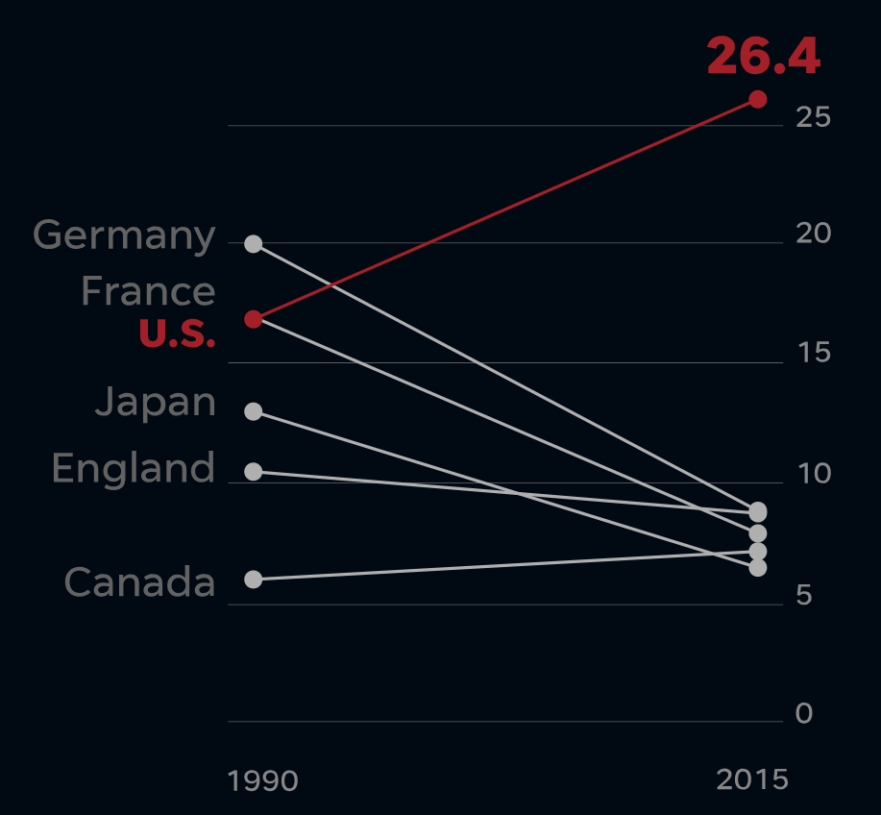
In the last 15 years, US has seen rises in:
Maternal Mortality: Up 50-70%
Severe Maternal Morbidity:
Up 100 %
Cesarean Births:
Up 50%
17.3
CDC
Notes:
When we look at the national landscape with regards to the current state of maternal outcomes, we see a stark and concerning upward trend in maternal mortality, severe maternal morbidity and cesarean births. Some of the agencies who calculate these outcome statistics utilize different parameters, regardless the trend should concern all maternal health care providers.

Slide 5

Maternal Mortality Rate,
California and United States; 1999-2013
California: ~500,000 annual births, 1/8 of all US births
Maternal Deaths per 100,000 Live Births
CMQCC
HP 2020 Objective – 11.4 Deaths per 100,000 Live Births
Toolkits and Collaboratives
CA Mortality Review Committee
SOURCE: State of California, Department of Public Health, California Birth and Death Statistical Master Files, 1999-2013. Maternal mortality for California (deaths ≤ 42 days postpartum) was calculated using ICD-10 cause of death classification (codes A34, O00-O95,O98-O99). United States data and HP2020 Objective use the same codes. U.S. maternal mortality data is published by the National Center for Health Statistics (NCHS) through 2007 only. U.S. maternal mortality rates from 2008 through-2013 were calculated using CDC Wonder Online Database, accessed at http://wonder.cdc.govon March 11, 2015. Produced by California Department of Public Health, Center for Family Health, Maternal, Child and Adolescent Health Division, March, 2015.
Notes:
So what does the maternal mortality picture look like closer to home. Many of you may have seen this slide but this depicts the history of maternal mortality in CA.

Slide 6
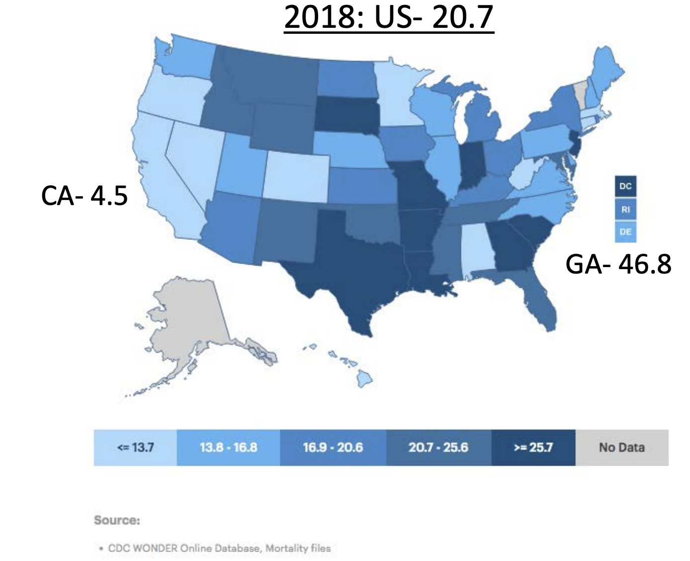
Maternal Mortality by State (NCHS)
Notes:
In 2018 The National Center for Health Statistics at the CDC presented this data of maternal mortality by state, and you can see the vast difference in outcomes by state. You can also see that all of the collaborative work of the hospitals in California has resulted in one of the lowest maternal mortality rates in the country. This is the strongest argument that data utilized to drive clinical quality improvement can result in positive outcomes and, in fact, save lives.

Slide 7
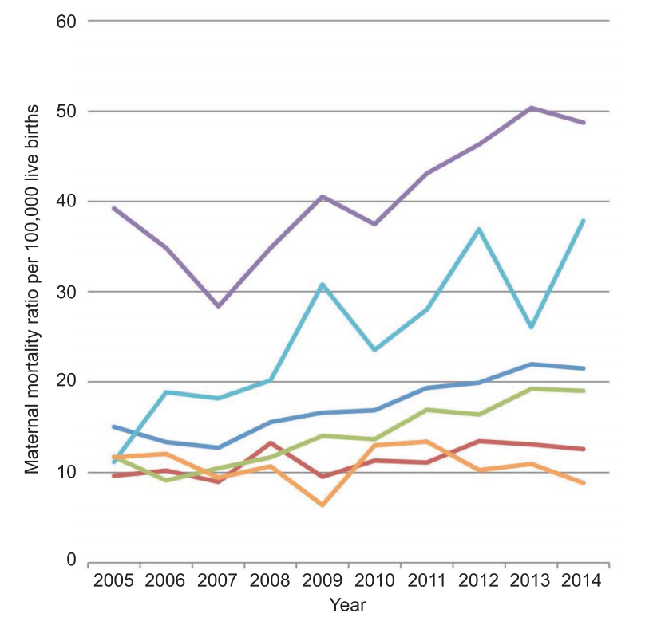
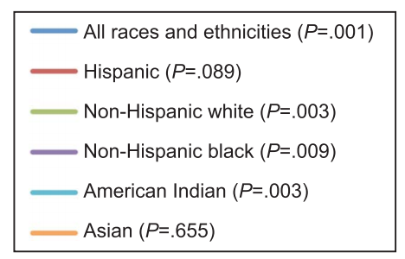
U.S. Maternal Mortality by Race/Ethnicity
Maternal mortality is defined by WHO as a death during or within 42 days of a delivery and related to the pregnancy (captured from the Death Certificate with a cause of death code from the Obstetric chapter)
Moaddab A et al. Obstet Gynecol 2018;131:707-12.
Notes:
So where does the data drive us now to refocus our quality improvement efforts….Maternal Mortality is defined by the World Health Organization as a death during or within 42 days of a delivery and related to the pregnancy. If we take a step back and look at national maternal mortality outcomes by Race/Ethnicity, the picture becomes bleaker. Although there is a rise in maternal mortality for most all racial ethnic groups with the exception of the Asian community, there is a significant rise in the Non-Hispanic Black and American Indian communities.

Slide 8
Maternal Mortality Rate, By Race/Ethnicity
Three–Year Moving Averages; 1999-2013
California Only Data
Maternal Mortality Ratio
(per 100,000 live births)
Mortality Disparity Ratio
Notes:
So let’s look back at California and see how the race/ethnicity outcomes are presented here. How is maternal mortality rate by race/ethnicity calculated? This is data produced by the California Department of Public Health using race and Hispanic ethnicity from the birth certificate when available (~85% of the time, otherwise from hospital data). Because of small numbers for many races, the rates are calculated by 3-year moving averages.
Every race and ethnicity rose 2001-2009 and then started to fall particularly after 2010.
The Mortality Disparity ratio is calculated by dividing the rate of maternal mortality of African American mothers into the rate of White, non-Hispanic women. In other words, how many times high is the black outcome compared to whites. In the US as a whole, the rate has varied between 3-4 times higher for African American women. We see the same ratio, 3-4 times higher, for African American women in California. When the rates of African American women and and White women fell in the period 2010 -2013, it fell equally for both races, so that the disparity ratio remained at 3 times higher.

Slide 9

That must be happening someplace else right?
Notes:
One column layout

Slide 10

Equality vs. Equity?
But I (we) treat everyone the same!
Notes:
My guess if we asked everyone on the call we would hear from all of you that you have said this or heard it said by your co-workers at least once and I am not excluding myself. But I have had the opportunity to learn and internalize the difference between equality (treating everyone the same) and equity (which is meeting each person of their level of need). So if we have a giveaway opportunity drawing and we offer all of these winners the same bicycle, we might be treating all of the winners the same, however, would each of those individuals feel that they had received a gift that would benefit them? However, if we provide the individuals with the means of transportation that meets their individual needs, then it becomes a win/win for both parties. This is a crucial component as we consider the opportunities ahead of us in the use of data to drive birth equity quality improvement efforts.

Slide 11
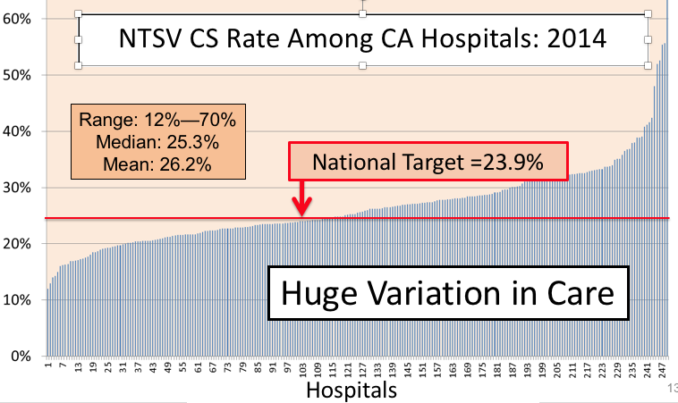
Variation in Care is Endemic
Notes:
Just like the data that we first saw in 2014, care varies from hospital to hospital in CA, especially in a state as large as ours. This was especially true when looking at NTSV C sections when we first started the Supporting Vaginal Birth Collaboratives in 2015. Where there is variation there is opportunity to learn from each other and to improve care.

Slide 12
Low-Risk First-Birth Cesarean (NTSV)
Black to White Ratios by Hospital
2015-2016
Statewide rates:
Total: 25.3%
White: 24.8%
Black: 30.0%
Notes:
This is also true in the NTSV rates by race across the hospitals in CA.
Not all hospitals are the same—Variation in care is common for all aspects of health care. We have studied the variation in hospital cesarean rates extensively—California hospitals vary in their risk adjusted cesarean rates form 14% to 60%... Here we are examining whether at the same hospital black women have higher rates than white women. The ratio is simply the black rate divided by the white rate. If the hospital has the same rate of NTSV Cesarean deliveries for blacks and whites, the ratio will be 1.0 (see the red line). If black women have a lower risk, the relative risk will be <1. If the relative risk is 2 then that group has twice the chance of an NTSV C/S.
Black births are concentrated in one third of California hospitals. 90 hospitals (out of 240) account for 86% of all black births. Because the proportion of black births is statistically low (5.5%) of the total birth rate, we restricted this analysis to hospitals with at least 150 black births over two years.

Slide 13
Severe Maternal Morbidity (SMM)
Black to White Ratios by Hospital
2015-2016
Statewide rates:
Total: 1.6%
White: 1.2%
Black: 2.4%
Notes:
The same story exists when looking at Severe Maternal Morbidity. The variation amongst those same hospitals remains.

Slide 14

So is this happening at my hospital?
A close look at the data from your hospital should provide opportunities to focus your quality improvement efforts on the issues affecting your hospital.
Notes:
So the baseline question is this happening at my hospital? I would now like to turn the remainder of this presentation over to Anne Castles, Director of the California Maternal Data Center to preview the newest additions to the MDC that will allow you to quickly identify birth equity quality improvement opportunities in your facility.

Slide 15
Birth Equity Reports in the Maternal Data Center
Notes:
Title Slide layout

Slide 16
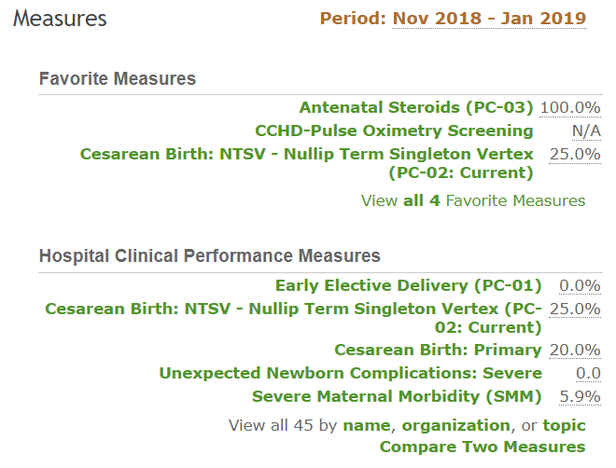
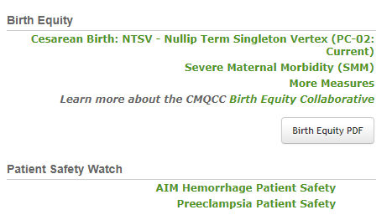
Birth Equity Features on Home Page
On Home Page
2 Key Outcome Measures
  NTSV C/S rate
  SMM rate
More Measures
  Links to additional highlighted metrics
Link to Additional Resources
Link to Birth Equity PDF
Notes:
Two column layout

Slide 17
Birth Equity PDF Report
“One-Click” PDF Report
For sharing outcomes directly with staff, physicians or hospital leadership.
Notes:
Two column layout

Slide 18
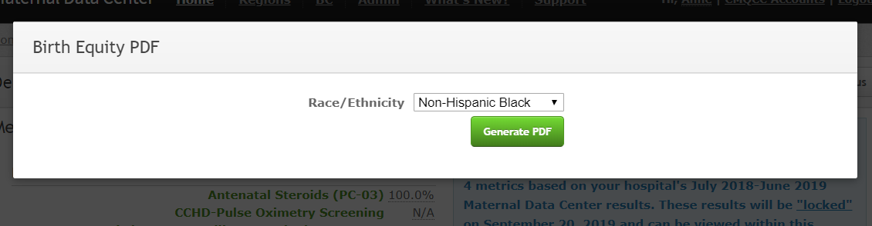
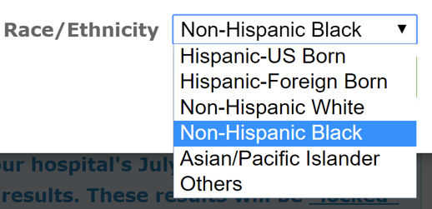
Birth Equity PDF Report
Select the Race/Ethnicity group from the dropdown box
The default is Non-Hispanic Black
Click the Generate PDF button

Slide 19

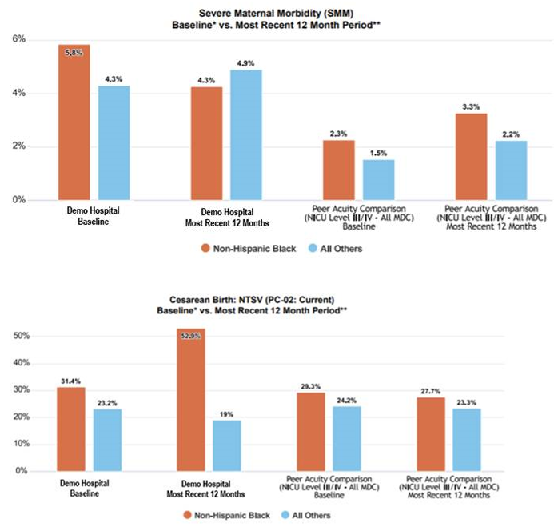
One-Page Report with:
2 Key Measures
  Severe Maternal Morbidity (SMM)
  NTSV Cesarean Delivery Rate
3 Types of Comparisons
  Selected R/E Category vs. All Others
  Baseline vs. Current
  Own Hospital vs. Peer Acuity Comparison
Let’s unpack it!

Slide 20
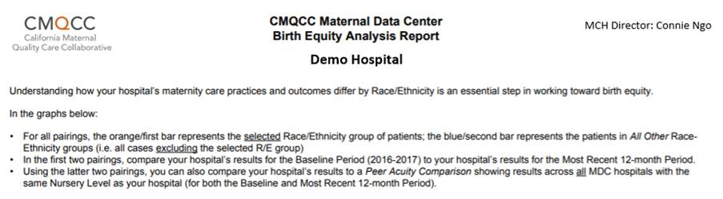
Birth Equity PDF
Interpretive Guidance at top!

Slide 21
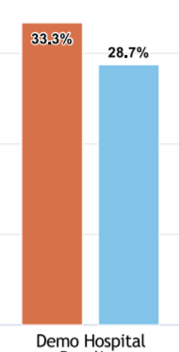

Birth Equity PDF
NTSV Cesarean Delivery Rates
Comparison I
Selected R/E Category
(per your prior selection)
compared to
All Others
(all cases excluding the selected R/E group)
Key Questions:
*Is there a disparity in hospital outcomes between different groups?
*Are we willing to make a concerted effort to address?

Slide 22
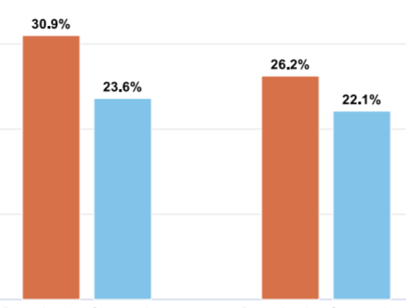

Birth Equity PDF
NTSV Cesarean Delivery Rates
Comparison II
Baseline
(prior 2 year period: currently using 2016-17)
compared to
Most Recent 12 Months
(based on your MDC data submissions)
Key Questions:
* Are we improving outcomes in our target community?
* What more can we do?

Slide 23
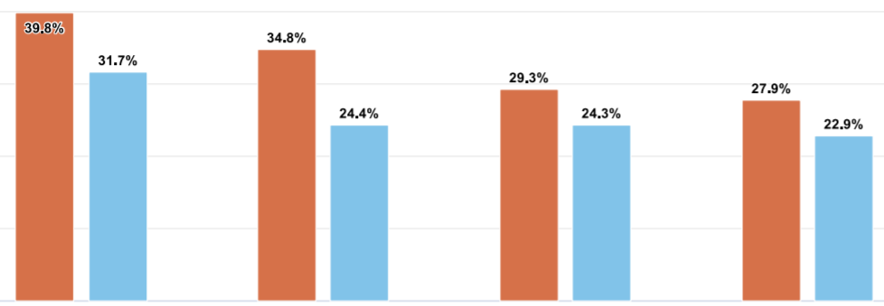

Birth Equity PDF
Comparison III
Own Hospital
compared to
Peer Acuity Average
(average across all MDC hospitals with same Nursery Level)
Key Question:
How do we compare to other hospitals that serve same acuity of patients?
What are we doing differently from our peers?
NTSV Cesarean Delivery Rates

Slide 24
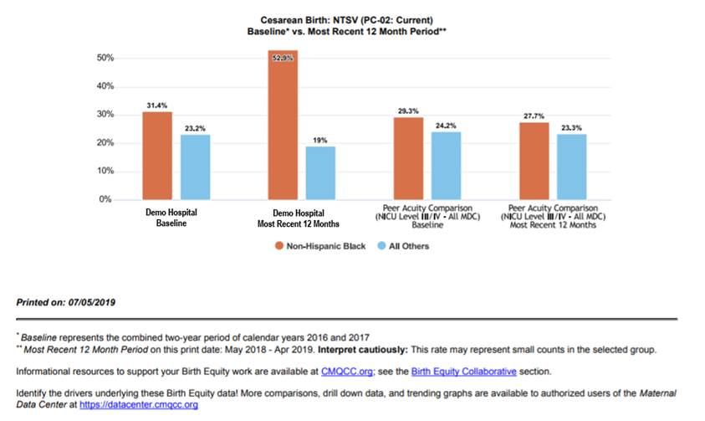
Birth Equity PDF
Additional information at bottom
  Definition of Time Periods
  Small Count Warning
  Recommendation:
  Review the denominator counts in the MDC for the R/E category; do not use PDF if target R/E category has < 20 denominator cases

Slide 25
Key Measures for Evaluating Birth Equity
On Home Page
2 Key Outcome Measures
  NTSV C/S rate
  SMM rate
More Measures
  Links to additional highlighted metrics
Notes:
Two column layout

Slide 26
Birth Equity Features on Home Page
Click on More Measures to see additional Birth Equity Measures available for review.
Notes:
Two column layout

Slide 27
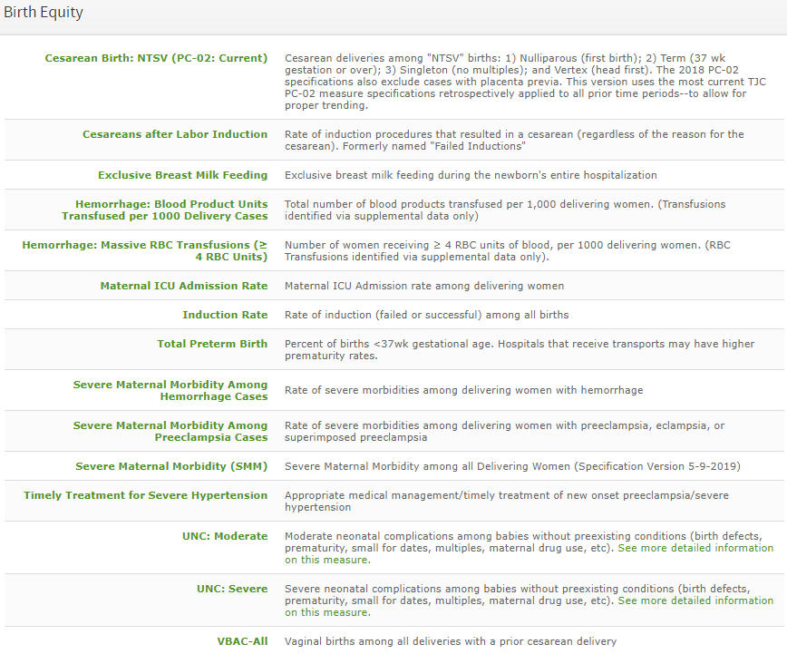
More Measures
Section
Click into any measure
Notes:
Two column layout

Slide 28
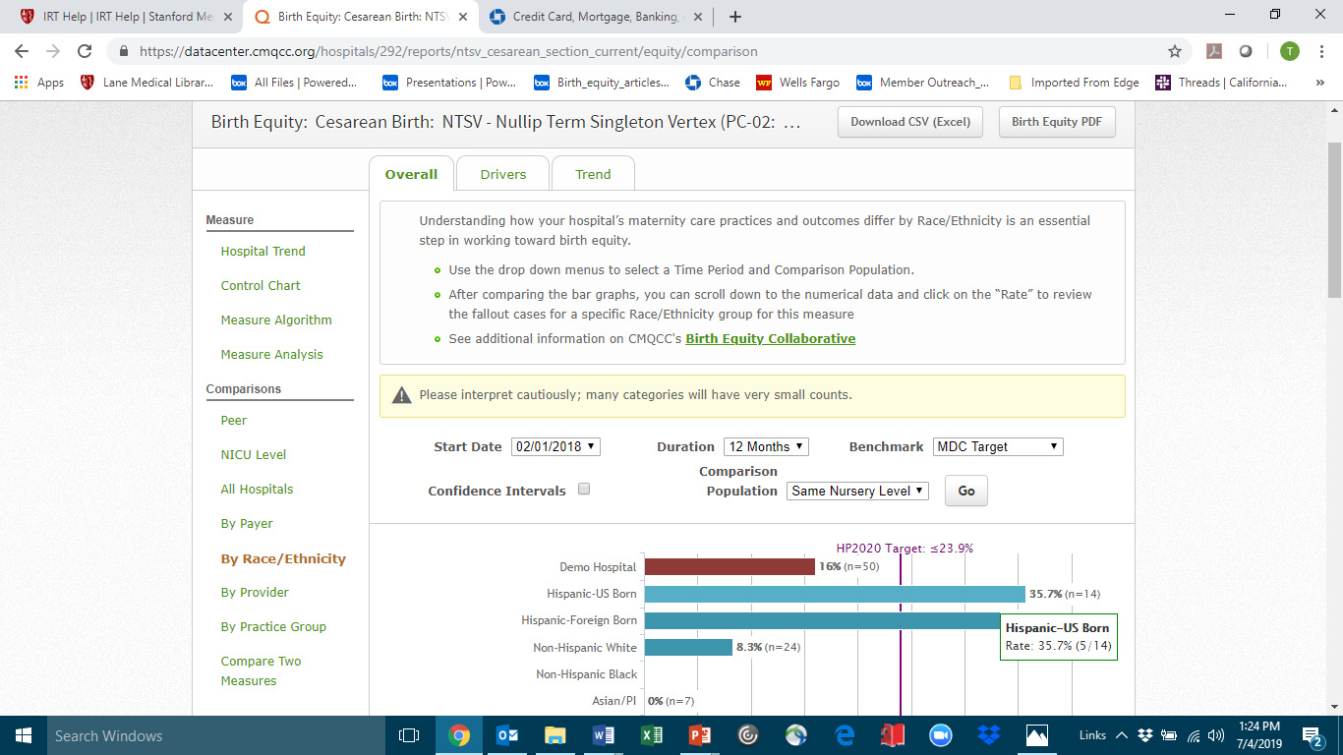

Navigation
Top buttons enable:
PNG screen shots
Data downloads into Excel
3 Tabs at top of screen
Overall
Drivers
Trend
Notes:
Two column / long logo layout
*NOTE – if your content is going to be longer than the text box, switch to the standard “two column” layout. There should always be one inch between the long logo and the end of each slide’s content*

Slide 29
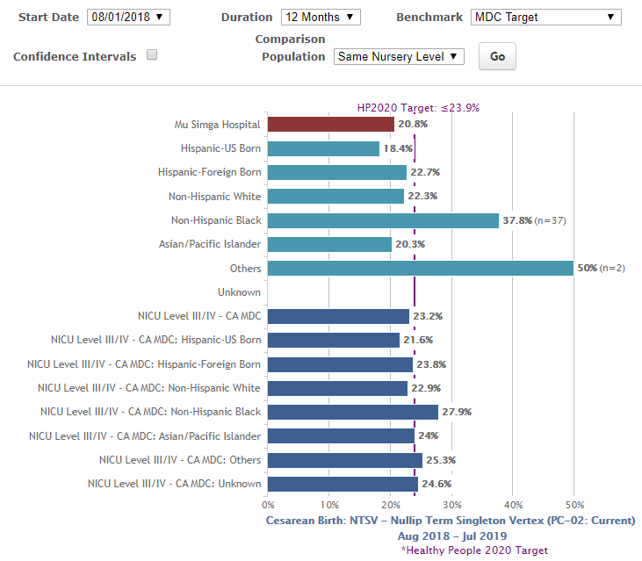
Overall Tab
3
Parse your hospital’s rate by Race/Ethnicity categories (categories differ some by state)
Compare to “Peer Acuity” average
Customize the report and Click “Go”!
  Change the Time Period
  Add Benchmarks
  Comparison Populations
    Nursery Level (Peer Acuity)
    System
    State MDC
    All MDC
1
2
Notes:
Two column / long logo layout
*NOTE – if your content is going to be longer than the text box, switch to the standard “two column” layout. There should always be one inch between the long logo and the end of each slide’s content*

Slide 30
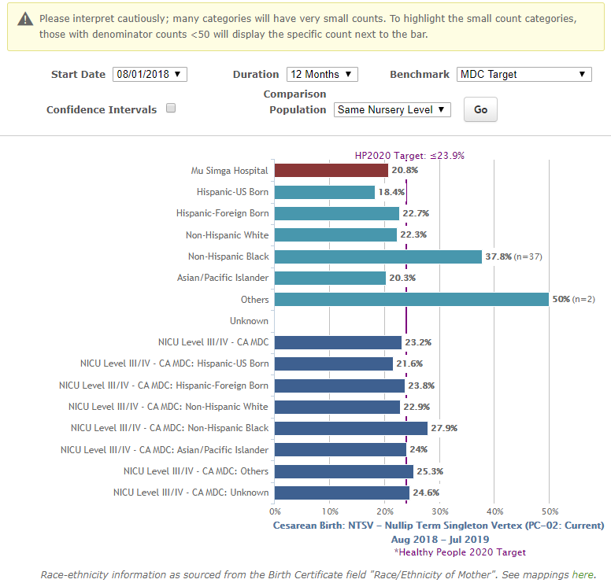
Overall Tab
4
Note “Small Count” warning
If denominator count <50, will display next to bar
See definitions for each R/E Category in “Mappings” document
NOTE on Data Source:
CA: Birth Certificate
WA/OR: Discharge Data
5
6
Notes:
Two column / long logo layout
*NOTE – if your content is going to be longer than the text box, switch to the standard “two column” layout. There should always be one inch between the long logo and the end of each slide’s content*

Slide 31
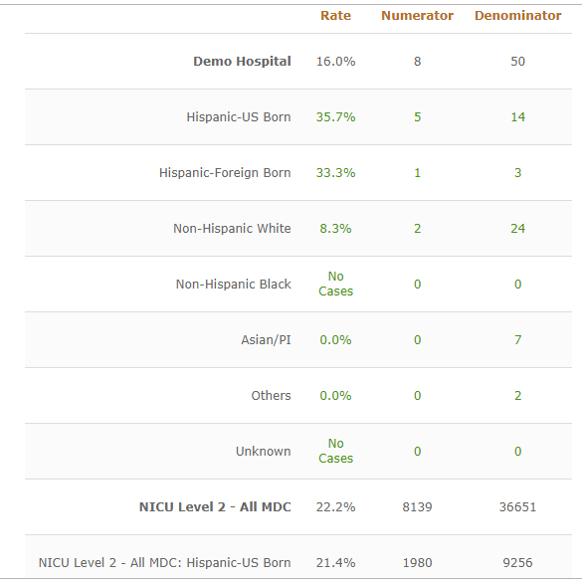
Overall Tab: Fallout Drill Down Capability
Bottom half of “Overall Tab” displays:
Numerical data, including numerators and denominators
Clicking into any of the green numbers leads to “patient drill down screen”

Slide 32
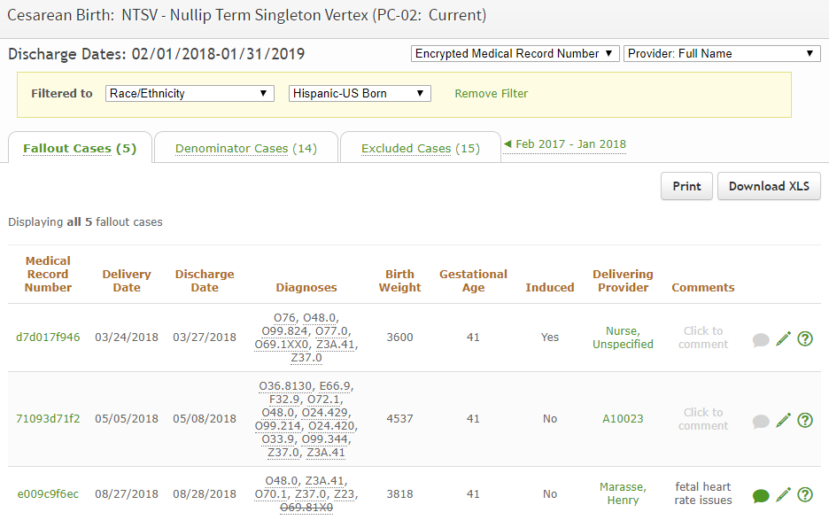
Overall Tab: Fallout Drill Down Capability
Drill Down Screen auto-filtered based on the prior selection
Can change the selection from this screen using the “Filter” drop down menus

Slide 33

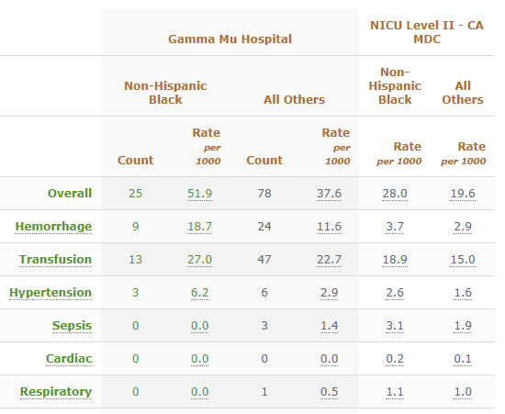
Drivers Tab
Drivers tab provides a breakdown of the indicators driving the measure results.
Intent: Focus your QI activities!
Compare the selected R/E group to:
  “All Others”
  Selected Peer Group

Slide 34
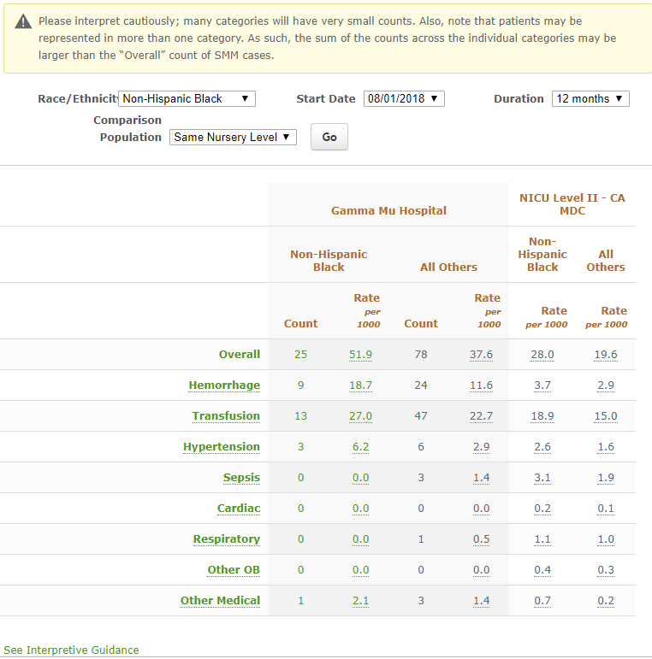
Driver Tab Review
1
Note the caution regarding small volumes.
Use the dropdown boxes to customize selections for race/ethnicity, comparison population and start date.
Note Duration button is restricted to 12 and 24 months to minimize “small count” issues.
Patient level drill down is available by clicking on any green numbers.
See “Interpretive Guidance”
3
2
4
5

Slide 35
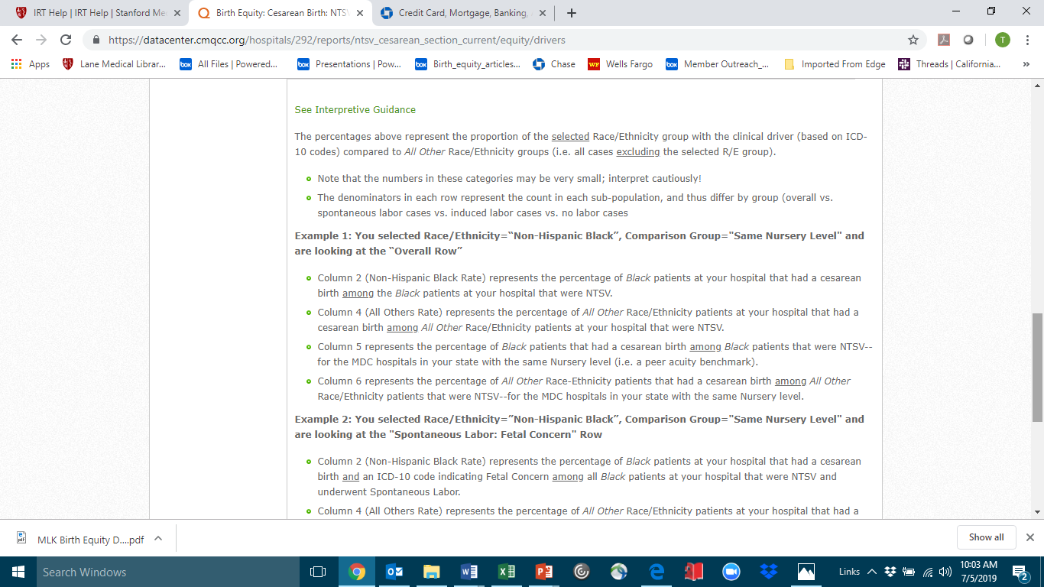
Interpretive Guidance
Clicking on Interpretive Guidance button provides support for analyzing the tables

Slide 36

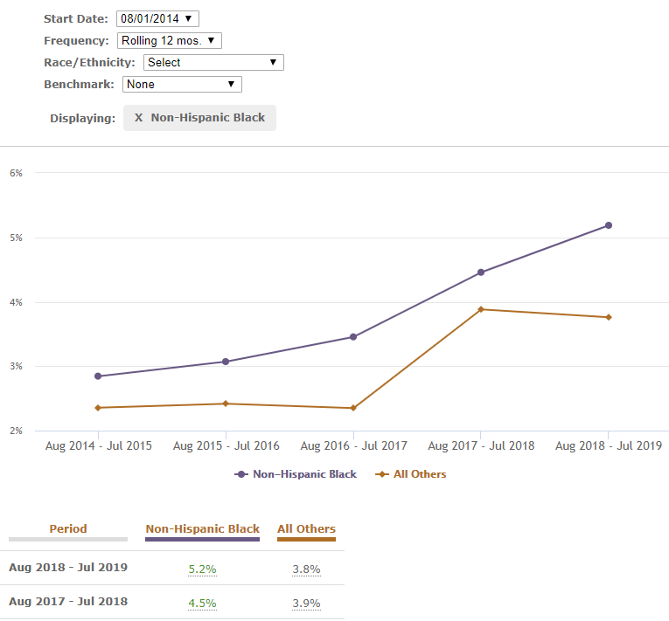
Trend Tab
Birth Equity section allows for trending of Race/Ethnicity results for each selected measure
Answers question: Are we making progress toward our birth equity goal?

Slide 37
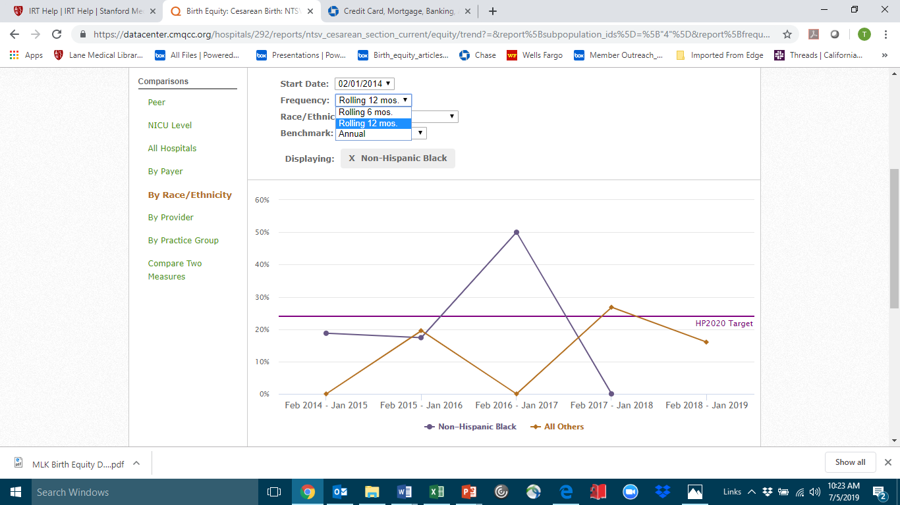
Trend Tab Review
Recommendation: Restrict reviews to 12 months unless you are a large volume hospital
Rolling 6 month option is available—but use with care and only at large-volume hospitals!

Slide 38
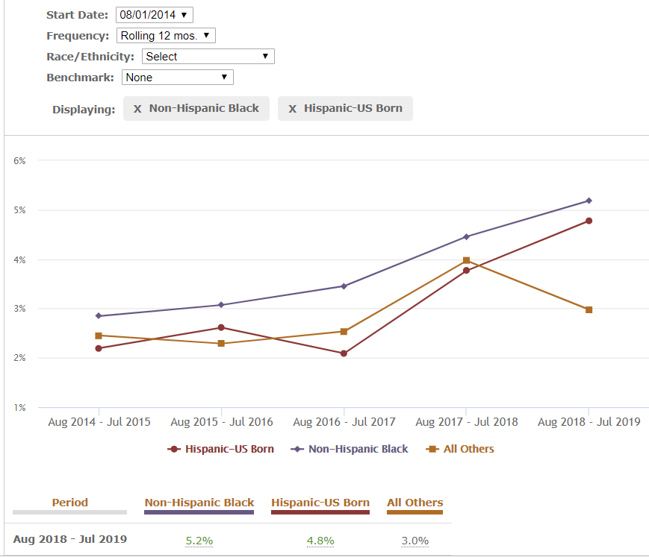
Trend Tab Review
Use drop down menus to add different benchmarks and Race/Ethnicity groups

Slide 39
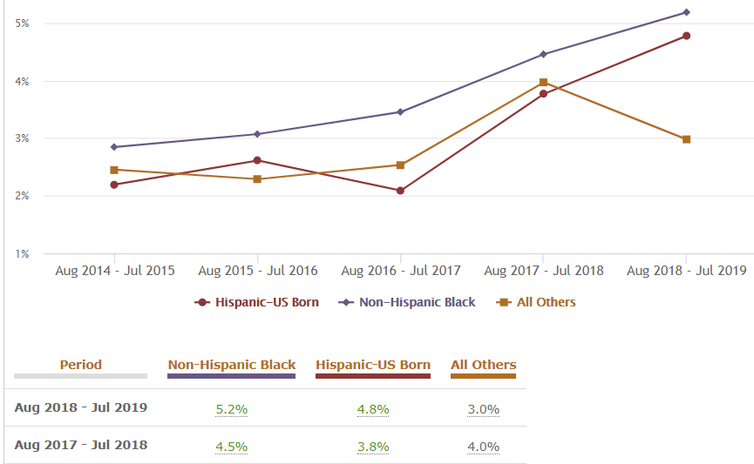
Trend Tab Review
Patient level drill down also available on this screen by clicking on any of the data points in graph or any of the green numbers

Slide 40
Birth Equity Features on Home Page
A link on the home page will send the viewer directly to the Birth Equity section of the CMQCC website for additional resources on Birth Equity
Notes:
Two column layout

Slide 41
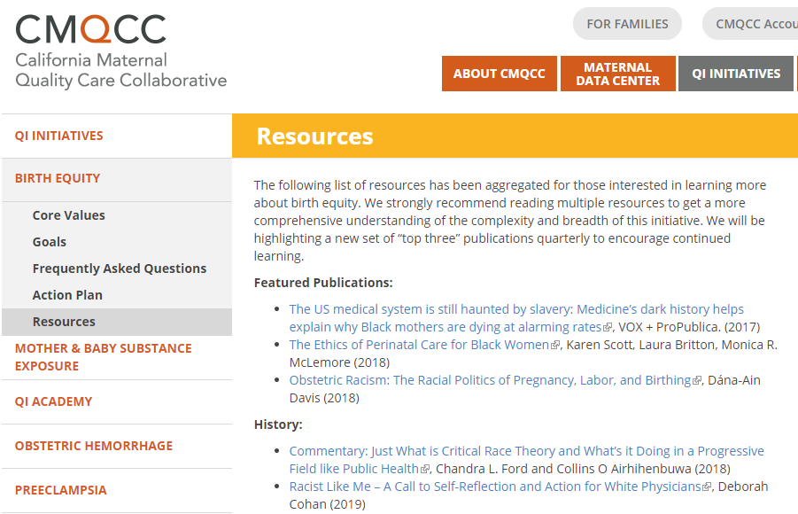
Resource List on CMQCC.org

Slide 42

Next Steps
Use the Data Center to identify, and build awareness of, inequities
Access the CMQCC Resource List to educate yourself and your team
Engage your leadership and clinical teams to identify your equity opportunities
Build relationships with community groups in your area
Notes:
So the baseline question is this happening at my hospital? I would now like to turn the remainder of this presentation over to Anne Castles, Director of the California Maternal Data Center to preview the newest additions to the MDC that will allow you to quickly identify birth equity quality improvement opportunities in your facility.

Slide 43

Notes:
So the baseline question is this happening at my hospital? I would now like to turn the remainder of this presentation over to Anne Castles, Director of the California Maternal Data Center to preview the newest additions to the MDC that will allow you to quickly identify birth equity quality improvement opportunities in your facility.

Slide 44
Notes:
Backdrop slide. Can also put this as the very first slide (before title slide) to be displayed on screen before you start talking.

