Slide 1
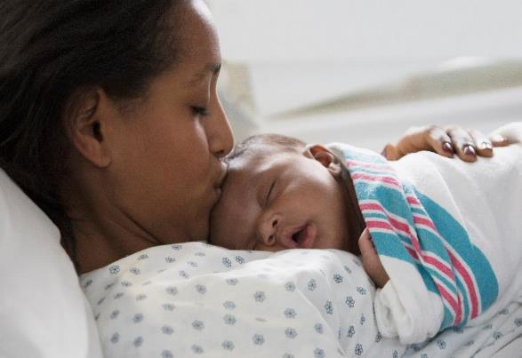
BE QI Summer Series Call #3: Linking Patients to Community Resources
Thursday, August 24th, 2023

Slide 2
Thank you to our QI Leaders for sharing today!
SSM St. Mary's Hospital – St. Louis
FHN Memorial Hospital

Slide 3
Linking patients to community resources
FHN Memorial Hospital Birth Equity Team
Robin Ortman BSN, RNC-MNN, C-EFM
Keri Schubert BSN, RNC-MNN
Theresa Wilson, PCT, Obstetrics unit secretary

Slide 4
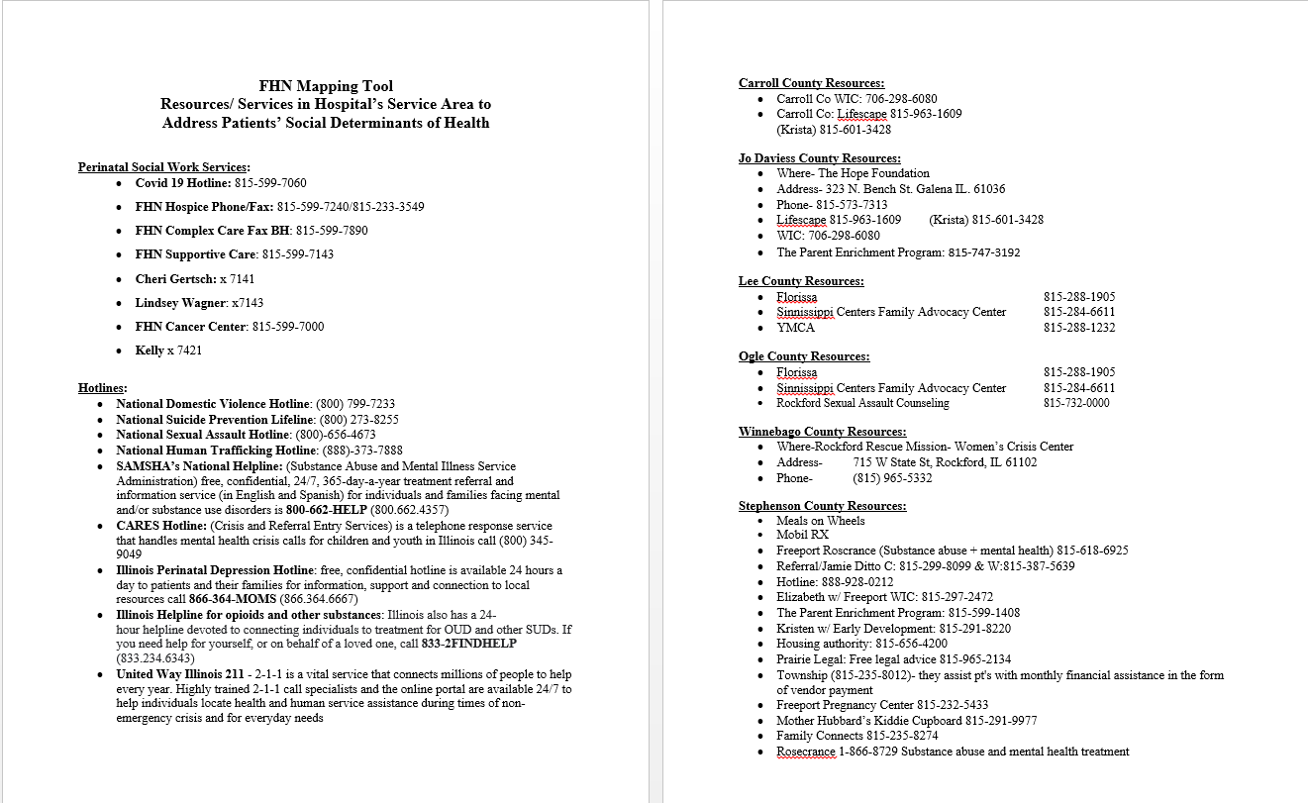

Slide 7
Discussion – SDoH Screening
What are the barriers to implementing SDoH screening for all patients?
Is your SDoH screening embedded into the EMR or is it a paper form?
How can ILPQC support your team to move SDoH screening forward on your unit?

Slide 8
Discussion – Linkage to Resources
Please share any successes with linking patients to community resources!
What are some of your identified challenges/barriers to linking patients to community resources?
What is one step you can take in the next week to move this strategy forward?
What is your process to help connect patients to resources? Who does it? When is it done?
Do you have a local community partner that you currently work with to assist/connect birthing people to their needs?

Slide 9
Discussion – Staff
How is the bedside nurse being educated on the local resources that are available to their patients to help them connect to resources?
Does your unit have a maternal nurse navigator who assists in the linkage to resources?

Slide 10
Social Determinants of Health resources shared in August BE Call
IDHS Office Locator
IGrow coordinated referral system to local accredited home visiting programs in Illinois
Healthy Families of America accredited programs
Parents as Teachers accredited programs
UIC Office of Community Engagement
National Healthy Start Association

Slide 11
Our ILPQC Goal for Patient Engagement

Slide 12
Our ILPQC goal for Patient Engagement
Every team to hold a Respectful Care Breakfast
Ask doulas or lactation counselor, midwives/docs to consider patients to invite or ask NICU moms…
Celebrate and talk about Respectful Care and strategies to increase Respectful Care Practices (how can we improve shared decision making, active listening)
Make sure to also invite OB providers / nurses to attend and use name tags
Every team to engage a Patient Partner to work with their QI team by 11/2
You may identify patients to ask if they want to work with your QI team as a Patient Partner through Respectful Care Breakfasts

Slide 13
Patient Engagement Leader Recognition at Annual Conference
You will be recognized as a patient engagement leader if:
You hosted a respectful care breakfast
You have identified a patient partner for your QI team
Reach out to ILPQC with the name of your patient partner
ILPQC will organize a patient partner training!
Post-event survey submitted by attendees

Slide 14
Once you have identified a patient partner for your BE QI team
Inform ILPQC
We will plan a training for all patient partners (ie. Momma’s Voices)
Invite your patient partner to the ILPQC Annual Conference, 11/2/23
ILPQC will cover the conference fee for your team's patient partner
Will be a Patient / Community Breakout Session for patient partners
All patient partners at Annual Conference will be recognized

Slide 15
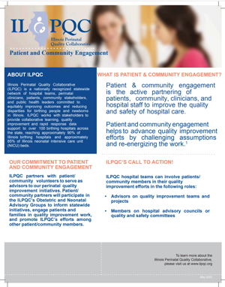
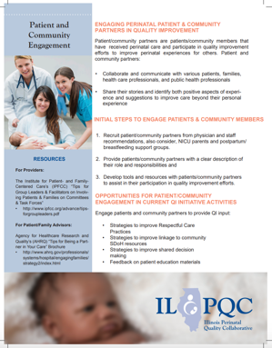
How can you get started?
Utilize the ILPQC Patient / Community Engagement Fact Sheet for tips on how to identify and engage with a patient partner!
Visit https://ilpqc.org/family-engagement/ to utilize our Patient and Family Engagement Toolkit!

Slide 16
Upcoming BE Calls
Event | Day/Time
BE September Webinar | Monday, September 18th at 12pm
ILPQC 2023 Annual Conference The Westin Lombard, IL | Thursday, November 2nd 8:00am-4:30pm

