Slide 1
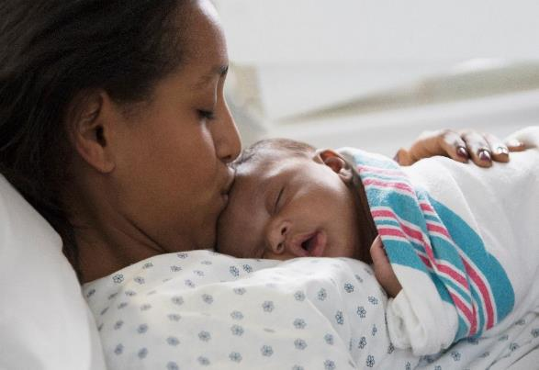
BE QI Summer Series Call #2:
Patient Partners on QI Teams
Thursday, July 20th, 2023

Slide 2
Parent Partners in the NICU

Slide 3
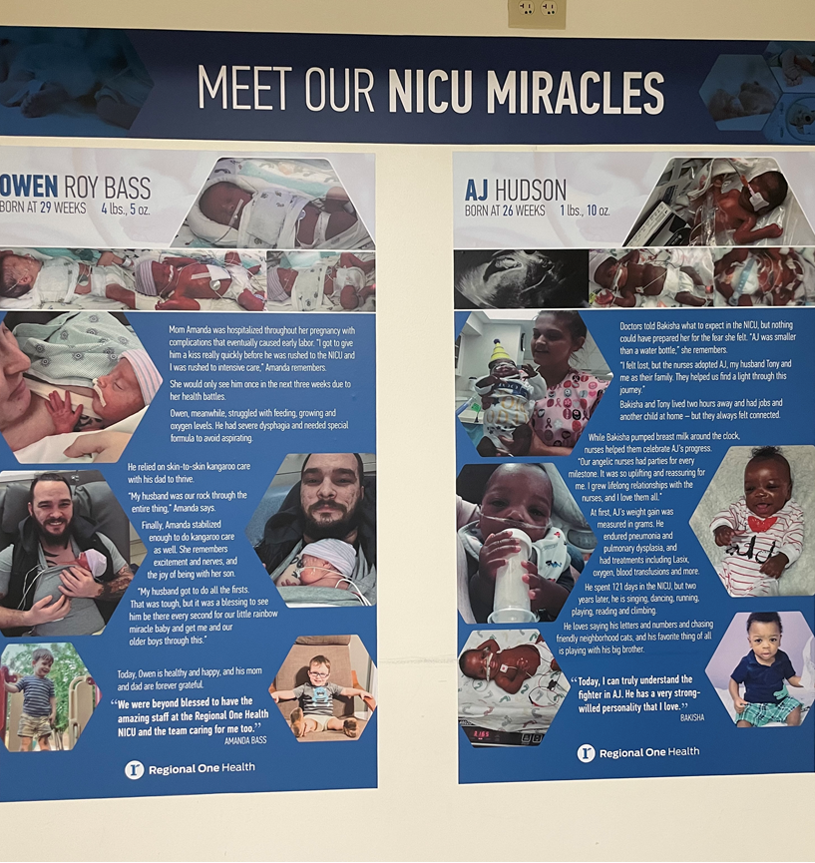
Meet our Families

Slide 4
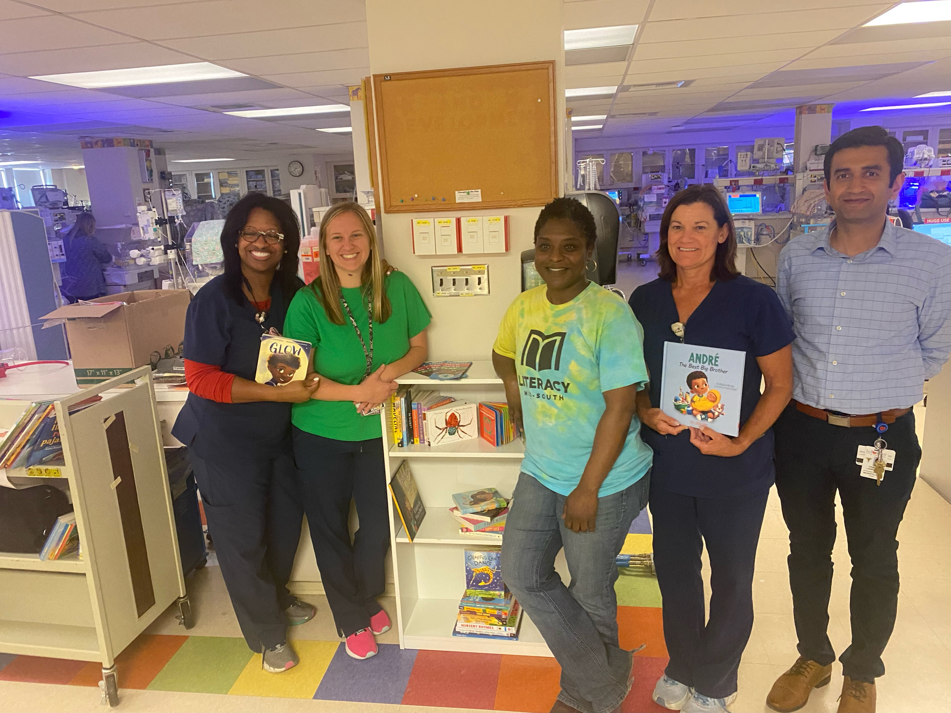
NICU Library

Slide 6
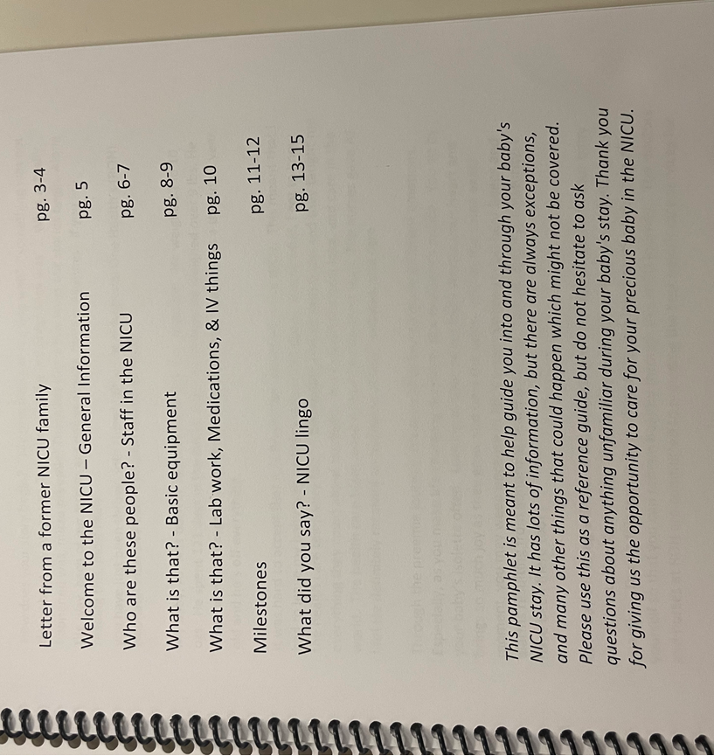
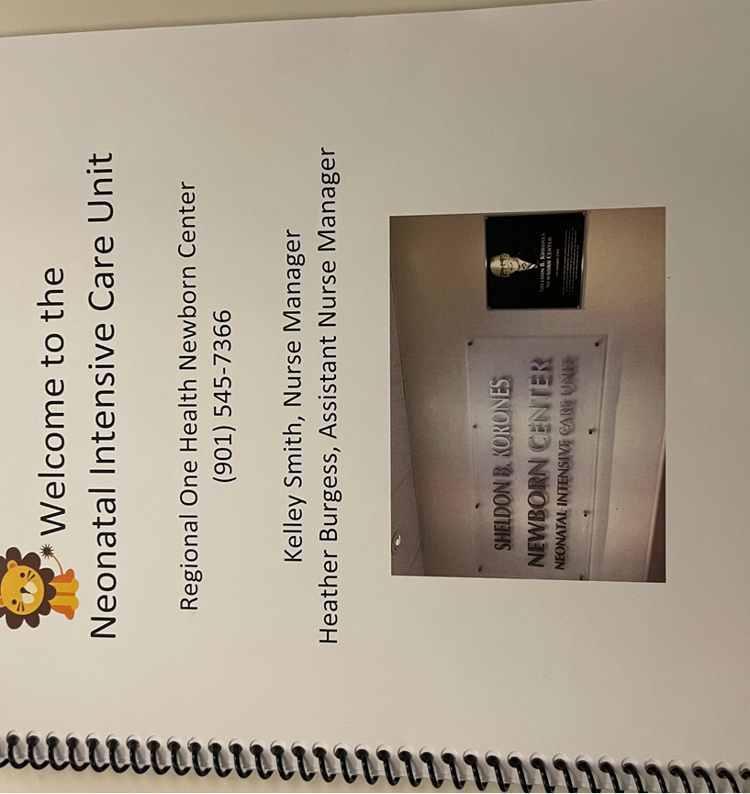
NICU Booklet

Slide 7
Discussion
Have you identified a patient partner yet?
What are some of your identified challenges/barriers to engaging a patient partner?
What is one step you can take in the next week to move this strategy forward?

Slide 8
Our ILPQC Goal for Patient Engagement

Slide 9

Our ILPQC goal for Patient Engagement
Every team to hold a Respectful Care Breakfast
Ask doulas or lactation counselor, midwives/docs to consider patients to invite or ask NICU moms…
Celebrate and talk about Respectful Care and strategies to increase Respectful Care Practices (how can we improve shared decision making, active listening)
Make sure to also invite OB providers / nurses to attend and use name tags
Every team to engage a Patient Partner to work with their QI team by 11/2
You may identify patients to ask if they want to work with your QI team as a Patient Partner through Respectful Care Breakfasts

Slide 10

Patient Engagement Leader
Recognition at Annual Conference
You will be recognized as a patient engagement leader if:
You hosted a respectful care breakfast
You have identified a patient partner for your QI team
Reach out to ILPQC with the name of your patient partner
ILPQC will organize a patient partner training!
Post-event survey submitted by attendees

Slide 11
Once you have identified a patient partner for your BE QI team
Inform ILPQC
We will plan a training for all patient partners (ie. Mamma’s Voices)
Invite your patient partner to the ILPQC Annual Conference, 11/2/23
ILPQC will cover the conference fee for your teams patient partner
Will be a Patient / Community Breakout Session for patient partners
All patients partners at Annual Conference will be recognized

Slide 12


How can you get started?
Utilize the ILPQC Patient / Community Engagement Fact Sheet for tips on how to identify and engage with a patient partner!
Visit https://ilpqc.org/family-engagement/ to utilize our Patient and Family Engagement Toolkit!

Slide 13
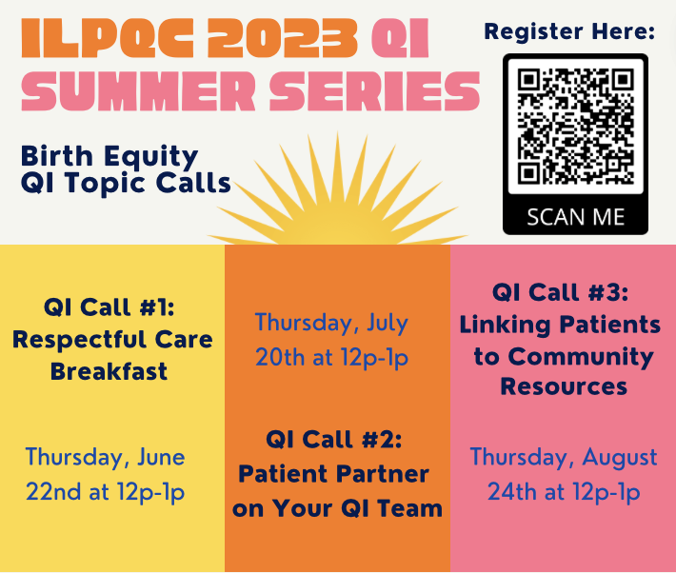

Slide 14

Upcoming BE Calls
Event | Day/Time
BE August Webinar – Meaningful Connections for SDoH Linkages | Monday, August 21st at 12pm
BE QI Summer Series: Linking Patients to Community Resources | Thursday, August 24th at 12pm

