Slide 1
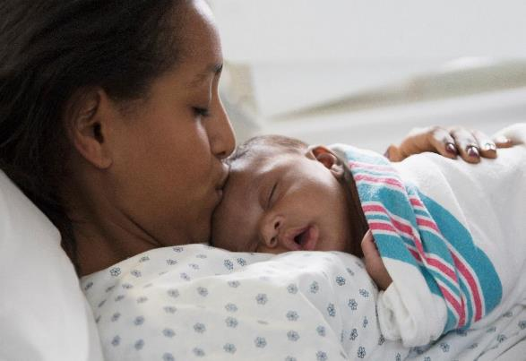
BE QI Summer Series Call #1:
Respectful Care Breakfasts
Thursday, June 22nd, 2023

Slide 2

Engage Patients and Community in QI Work
4% --> 41%
Host a Respectful Care Breakfast Celebration with clinical team members, patients, and community partners
Engage a patient/community partner on QI team
Implement a Community Advisory Board for ongoing QI input

Slide 3
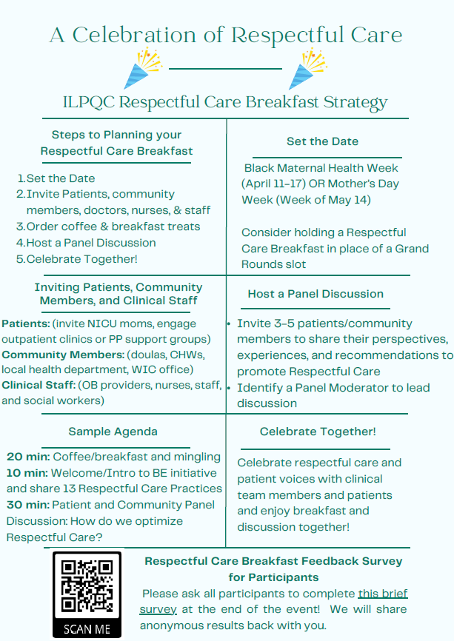
Respectful Care Breakfast Planning Resource

Slide 4

Planning your Respectful Care Breakfast
Gather your planning group
Connect/ Invite Patients
Ask OB offices / clinics to each invite 2-3 postpartum pts, invite NICU moms.
Set the Date
Unit leadership
Educator
Provider and RN Champion
PP Leader Rounds
Community Outreach (invite doulas, community health worker, home visit program, community health clinic etc.)
Celebration of Respectful Care and Patient Voices Breakfast with clinical team members and patients!
Consider using a Grand Rounds time slot
Social work
(YOUR BE TEAM!)
June, July, and August- Summer focus

Slide 5
Respectful Care Breakfast:
Sample Agenda & Discussion Questions
20 min: Coffee / Breakfast and Mingling (Name tags help!)
10 min: Welcome / Introduction to ILPQC Birth Equity / Share Respectful Care Practices
30 min: Patient/Community Panel Discussion (3-5 patients/community stakeholder)
  Moderator/Facilitator (could be DEI officer at facility, BE Champion, OB leader etc.)
  Guided Discussions around how clinical teams can best provide Respectful Care
  Sample Discussion Questions:
    What does respectful care mean? What does it look like/feel like for each patient on panel? Any examples where they have experienced Respectful Care in a clinical setting.
    How can clinical team members best take action on the Respectful Care Practices? How do we make sure patients feel listened to? How do we best practice shared decision making?
    Any PREM Survey elements you are seeing a disparity, or use overall ILPQC data. Ask for input on how to do better.

Slide 6
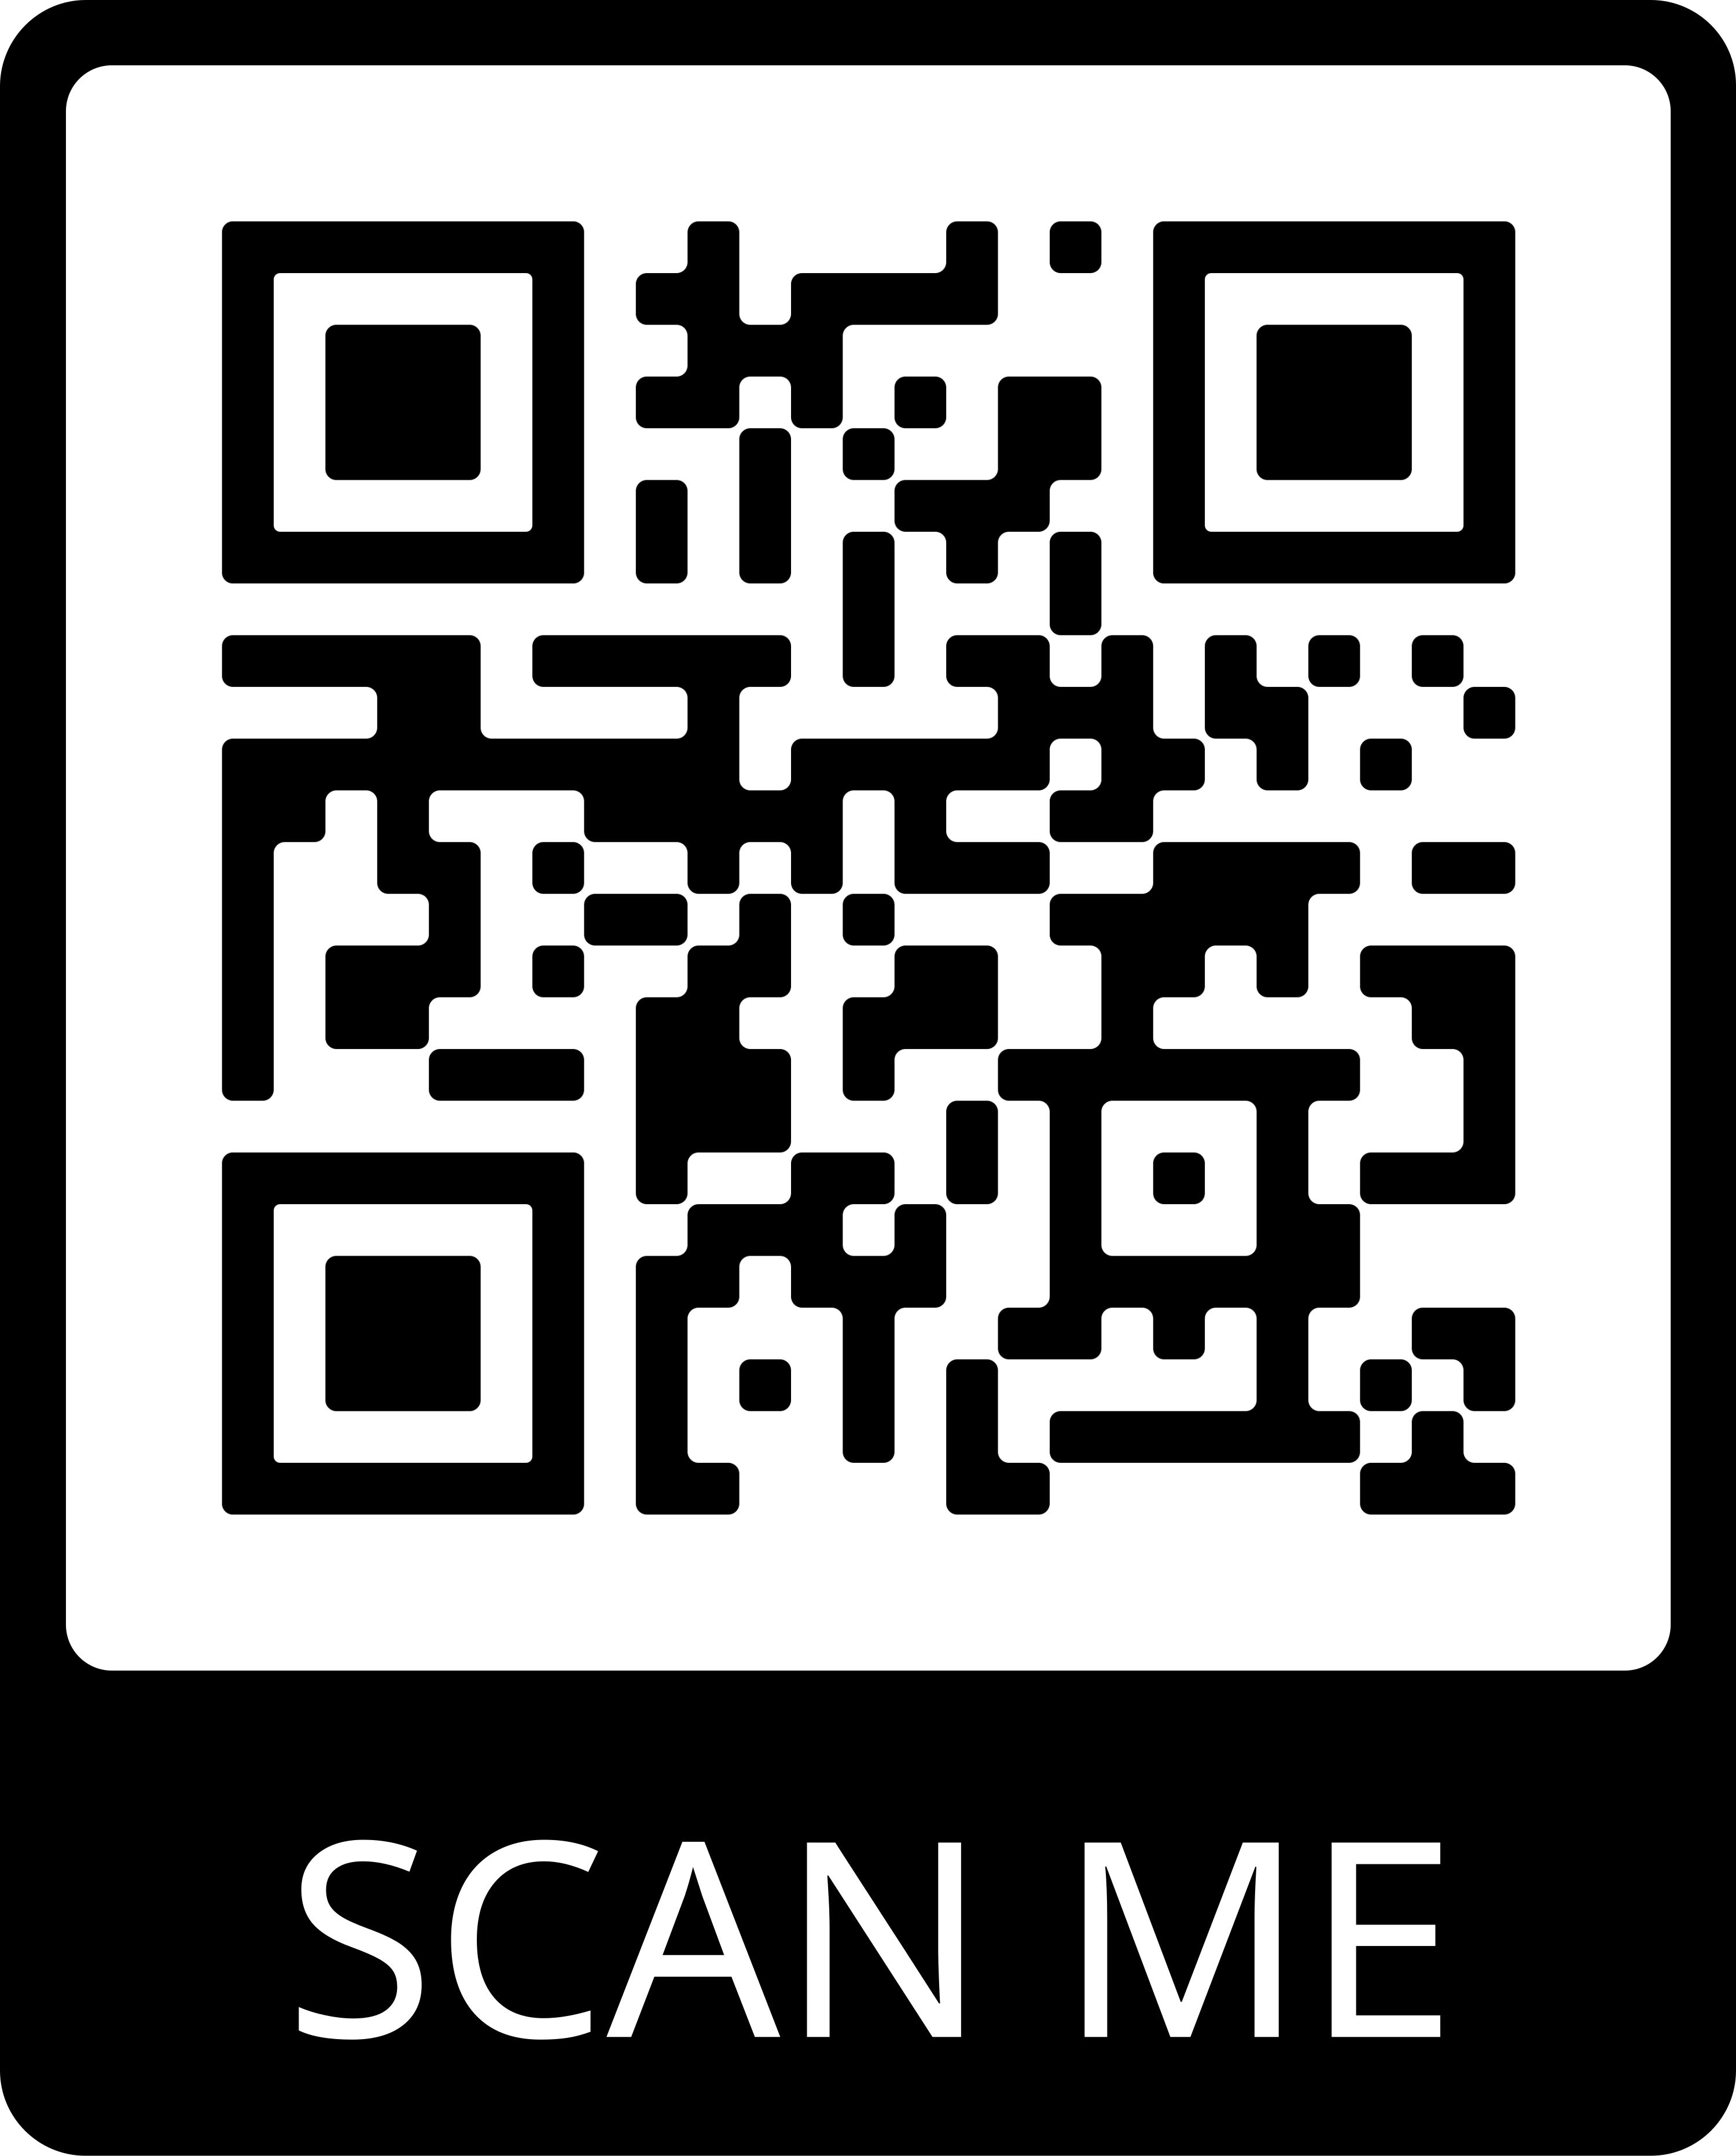
Post-Event Survey
Key tool in evaluating this effectiveness and acceptability of this strategy for clinical team and community members/ patient partners
Please ask all participants to complete this survey at the end of the event!

Slide 7

Our ILPQC goal for Patient Engagement
Every team to hold a Respectful Care Breakfast
Ask doulas or lactation counselor, midwives/docs to consider patients to invite or ask NICU moms…
Celebrate and talk about Respectful Care and strategies to increase Respectful Care Practices (how can we improve shared decision making, active listening)
Make sure to also invite OB providers / nurses to attend and use name tags
Every team to engage a Patient Partner to work with their QI team by 11/2
You may identify patients to ask if they want to work with your QI team as a Patient Partner through Respectful Care Breakfasts

Slide 8

UIH Birth Equity Luncheon
How’d we do that?

Slide 9


Recruitment
Be Our Guest
The UI Health Women’s Health Team is hosting a tea, and we want YOU to be the main attraction!
UI Health, as members of the Illinois Perinatal Quality Collaborative (ILPQC), is interested in knowing about you. Particularly, we want to know, “What does respectful care look like to you”?
We are seeking those who have recently delivered with us to come and have light refreshments with our team, share your birth experience (good, bad or indifferent), and let us know what we can possibly do in the future to make those experiences better for birthing persons. So, if you’re comfortable being a part of a 30-minute panel discussion to enlighten our OB providers, nurses, and staff on how you expect to be cared for while delivering a baby, we want to hear from you!
If you’re interested, please let your nurse, physician, or midwife know and we will reach out to you. You can also reach out to us on your own by emailing or calling the individual below. Thanks! And we look forward to seeing you!

Slide 10

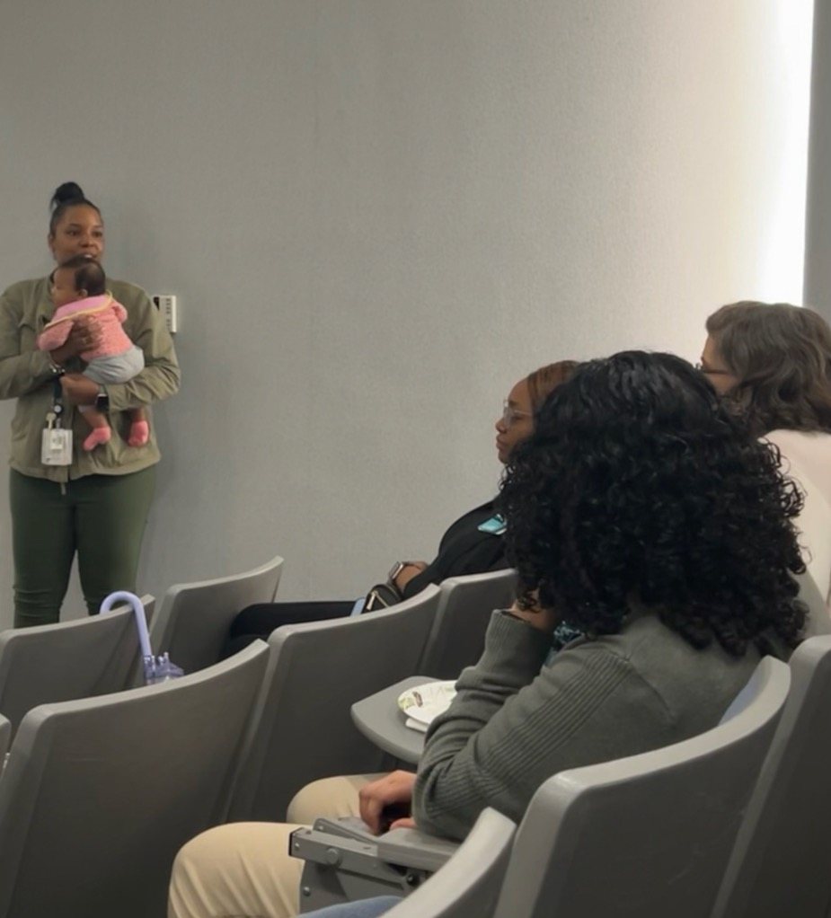
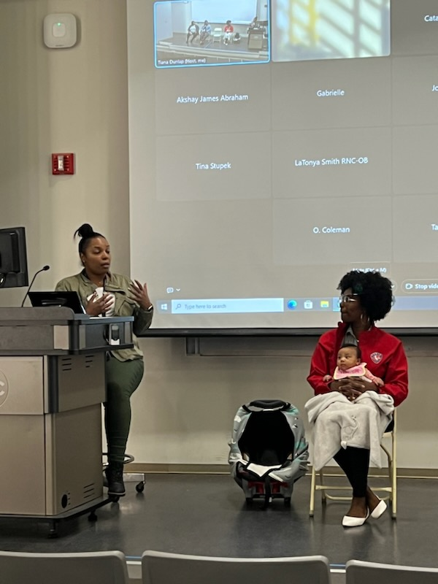
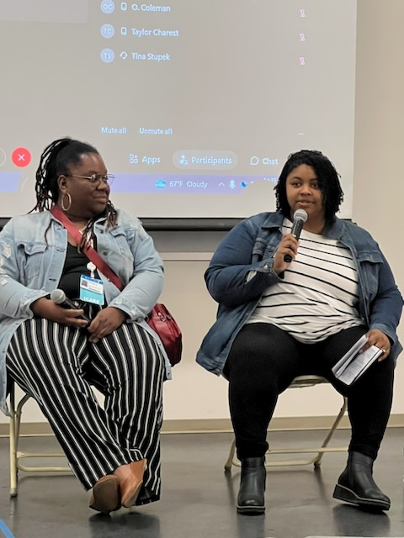
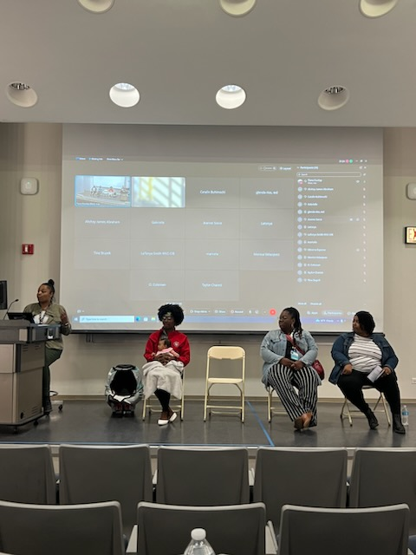
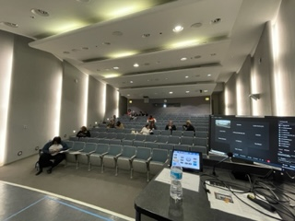
Luncheon Day

Slide 11
Things I learned
Going forward, build this into the budget
Provide name tags
Bigger is not always better
It’s ok to do hybrid

Slide 12
Memorial Hospital of Carbondale
Birth Equity
Respectful Care Breakfast
Team Members:
Jessica Duncan, BSN, RN
Mary Jarvis, MSN, RN, CLC
Dr. Sherry Jones

Slide 13

Memorial Hospital of Carbondale
Memorial Hospital of Carbondale is the flagship hospital for SIH and regional referral center for the 16 county southern Illinois region. Memorial paves the way to bring big city medicine home. Physicians in over 45 different specialties practice here, bringing expertise and new procedures, but successfully tailoring them to the particular needs of a rural setting.
154-bed tertiary care hospital
The core hospital for SIH’s comprehensive, regional heart program, Prairie Heart Institute.
High level surgical capabilities including daVinci technology
Affiliated with SIU School of Medicine through its Family Practice Residency Program
Neuroscience program including neurosurgery and a designated Primary Stroke Center
Accredited by the Commission on Cancer for comprehensive cancer treatment
Recently added Level II Trauma Center Designation

Slide 14
Women and Children
Designated Level II+, SIH Women and Children center delivers around 2200 births per year. And with a local birthing center closing their doors we have increased our deliveries by 30%. Baby Friendly Designated since 2015.
7 LDR, 2 C-section ORs, 13 SCN beds, 8 Antepartum beds, 6 Triage rooms, 21 Mother Baby beds, 13 Pediatric beds
Southern Illinois’ largest and most spacious birthing center with Level II+ Special Care Nursery
Only dedicated pediatric unit in the region
Dedicated Anesthesia 24/7
24/7 Lactation support

Slide 15

Steps in planning your Respectful Care Breakfast:
Gather your planning group
  Your Birth Equity group works great for this and even now the NICU Equity group! Combine forces
Set the date and Reserve the venue/conference room/restaurant
  When thinking of a venue - think of places that public transportations can get to
  When setting the time – think times that when schools are in session. (9:00-10:30am for instance)
Time to invite
  From the Hospital: Your BE team, Providers, Nurses, Social Workers, Leadership, educators, Lactation
  From the Community: Anyone who has had a Baby in the last 2 years, including Moms and Dads, NICU/SCU parents, Doulas
  How to invite: Community outreach: ask doulas, WIC, La leche groups, provide flyers to providers to hand out to patients, speak to current NICU/SCN moms in the nursery to come to breakfast!

Slide 16


Slide 17
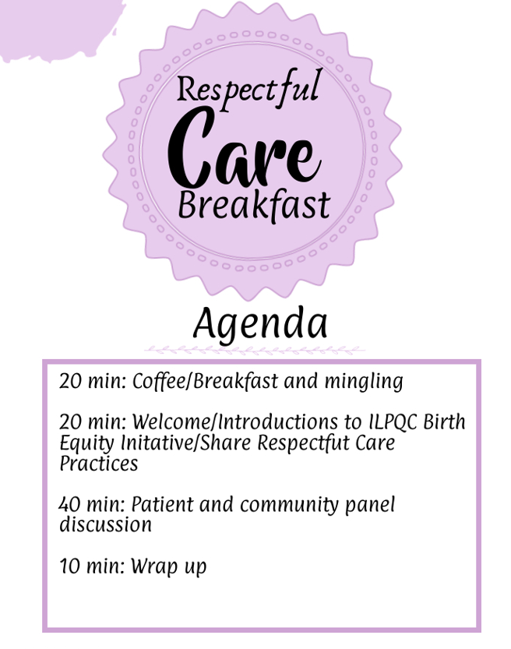
Create an Agenda
Have them at the printed out at the breakfast
Helps you keep you stay on track

Slide 18

Sample Panel Discussion Questions
What does respectful care mean to you?
My healthcare team did a good job listening to me, I felt heard? (PREM question)
How does this question make you feel - I trusted the health care team to take the best care of me and my child (PREM question)
I could take part in decision about my care (PREM question)
My health care choices were respected by the health care team (PREM question)
Thoughts on how you feel we can get patients to fill out the Birth Equity Initiative Patient Reported Experience Measure (PREM) Survey while in the hospital?
Goal is to create a Women & Children Birth Equity Committee – would anyone like to be involved to serve as a link between administration, medical staff, patients and our community by identifying the needs and priorities of our patient's population and offering recommendation to leadership as SIH plans future patient programs, services and polices that promote the system’s values.

Slide 19
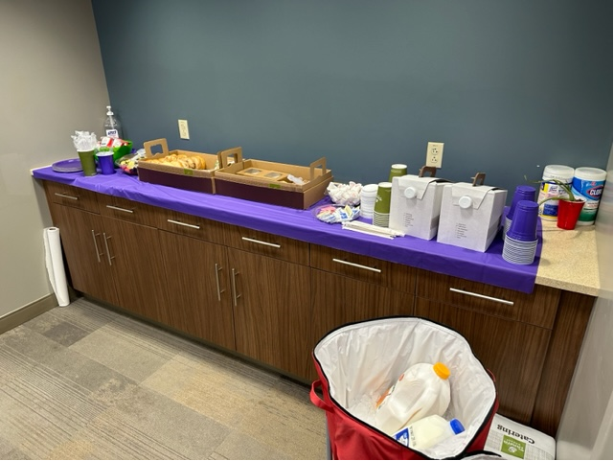

Slide 20
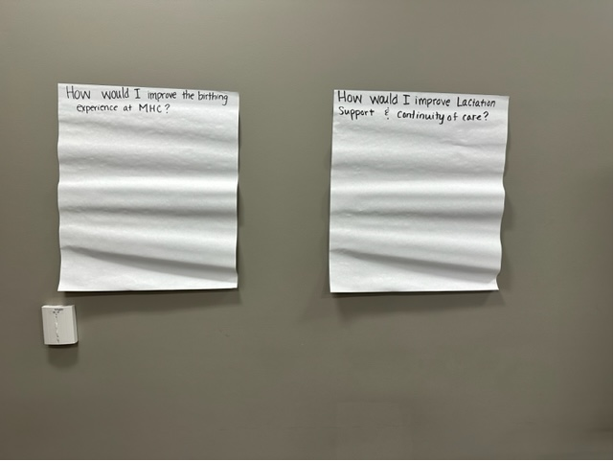

Slide 21
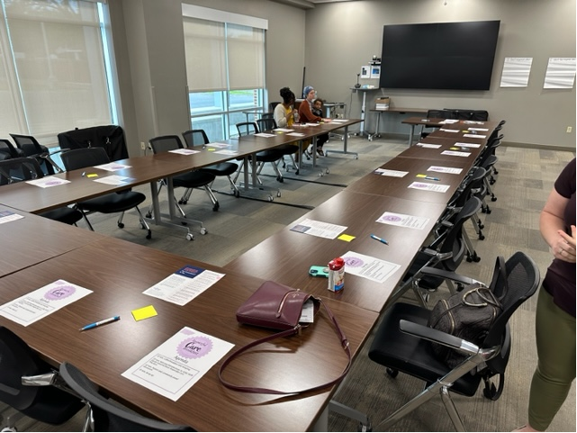

Slide 22
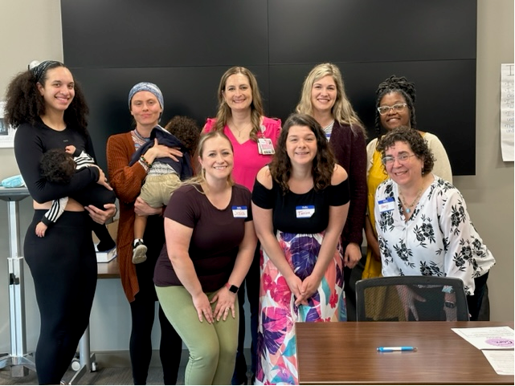

Slide 23


Post-Event Feedback
Follow up with your Birth Equity Team members who were not able to join and share with the team the feedback you received from the Respectful Care Breakfast
Share the feedback with the department
Breakdown the feedback and find out how you will work on best practices, respectful care, and disparities

Slide 24
Thank you!
Mary Jarvis, MSN, RN, CLC
Mary.Jarvis@sih.net

Slide 25
Discussion
Have you held a Respectful Care Breakfast yet? How did it go?
What are some of your identified challenges/barriers to hosting the breakfast?
What is one step you can take in the next week to move planning forward?

Slide 26
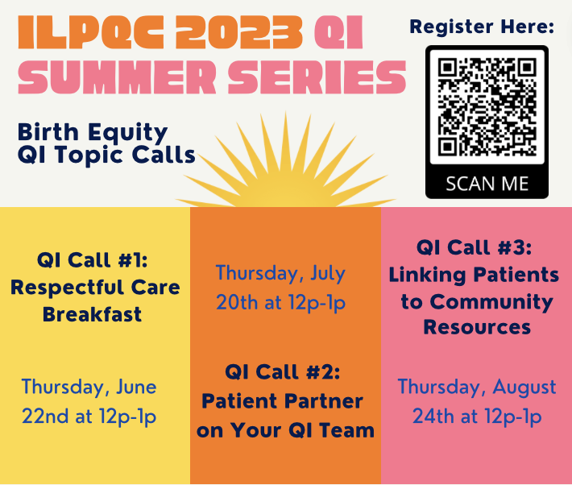

Slide 27

Upcoming BE Calls
Event | Day/Time
BE July Webinar - The Importance of Patient Voices: Engaging Patient Partners on QI Teams | Monday, July 17th at 12pm
BE August Webinar – Meaningful Connections for SDoH Linkages | Monday, August 21st at 12pm
BE QI Summer Series: Patient Partner on Your QI Team Linking Patients to Community Resources | Thursday, July 20th at 12pm Thursday, August 24th at 12pm

