Slide 1

BE Teams Call: Strategies to Increase PREM Survey Completion
Monday, March 20th, 2023

Slide 2
Call Overview
ILPQC Updates
BE Data Review
Respectful Care Breakfast Strategy Check-In
Respectful Care Practices and PREM Overview
Strategies to Increase PREM Survey Completion
Team Talk: Mercyhealth Javon Bea Hospital
NYSPQC Presentation

Slide 3


ILPQC-Sponsored – FREE AWHONN Resource for your Respectful Care work:
Respectful Maternity Care Guideline (RMC-EBG) &
Implementation Toolkit (RMC-IT)
ILPQC is providing access to
(1) AWHONN Respectful Maternity Care Framework and Evidence-Based Guideline & Toolkit for each BE Team.
A $74.95 value.
Team leads – check your email to learn more information!
Notes:
The Respectful Maternity Care Framework and Evidence-Based Clinical Practice Guideline provides evidence-based approaches to accomplish the following:
Identify the essential aspects of respectful care
Enhance awareness regarding the need for RMC
Encourage reflection to identify opportunities for personal and organizational improvement to provide RMC
Participate in improving the birth experience for people obtaining health care in maternity settings
Support the implementation of RMC processes
Description
Respectful Maternity Care (RMC) is an approach to care that emphasizes the fundamental rights of women, newborn, and families, promoting equitable access to evidence-based care while recognizing unique needs and preferencerods (Shakibazadeh et al., 2018). Attitudes and behaviors of healthcare providers are entrenched in cultural norms and implicit and explicit bias may cause unintended harm during patient interactions (Howell et al., 2018). These factors may lead to harmful consequences and place patients at greater risk for not receiving appropriate attention to address individual concerns or quality care, specifically in the intrapartum and postpartum periods (Levine & Lowe, 2015; Miller et al., 2016; Saluja & Bryant, 2021).
The Respectful Maternity Care Framework and Evidence-Based Clinical Practice Guideline provides evidence-based approaches to accomplish the following:
Identify the essential aspects of respectful care
Enhance awareness regarding the need for RMC
Encourage reflection to identify opportunities for personal and organizational improvement to provide RMC
Participate in improving the birth experience for people obtaining health care in maternity settings
Support the implementation of RMC processes
Respectful Maternity Care Implementation Toolkit provides you the tools and resources you need to implement the 10 Step “C.A.R.E. P.A.A.T.T.H.” in your organization to provide Respectful Maternity Care to every patient, every interaction, every time.

Slide 4
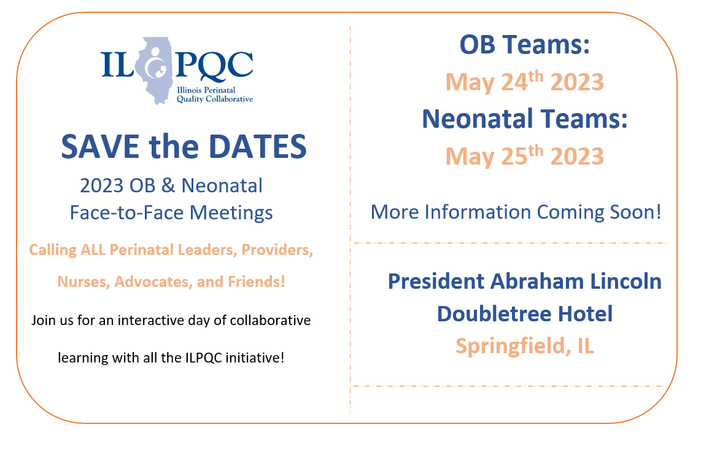

Slide 5
2023 Face to Face: Let's Get Ready!
Save the Dates!
Submit your Data!
Submit all your 2022 data plus January, February, March 2023
OB- May 24th, Wednesday
Neonatal- May 25th, Thursday
Storyboard Submissions!
Share your successes, opportunities, and specific strategies implemented!
Share your DATA, graphs, PDSA cycles, process flow or 30/60/90 plans
Review the award criteria for PVB, BE, and BASIC to achieve QI Excellence!
Start brainstorming your storyboard ideas!
ILPQC Room Block TBA
President Abraham Lincoln Hotel, Springfield, IL
Share your teams past year QI story
All Data due
April 21st!
Registration opens soon!
Templates coming soon!

Slide 6
OB Story Board Template
Hospital Name
PVB
Birth Equity
PVB Success
Including Data
BE Success
Including Data
Hospital Demographics
PVB Barriers and plans to address
PVB QI Team Members
BE Barriers and plans to address
BE QI Team Members
PVB Next Steps
BE Next Steps

Slide 7
BE Award Criteria for F2F
QI Leader Award
  All data submitted through March by April 21, 2023
  5 of 7 structure measures In Place / Green
  Achieving goal for 3 of 6 of the following outcome & process measures:
    Provider, Nurse, & Other Staff Bias education – 75%
    Scheduled early postpartum follow up – 75%
    Postpartum Safety Patient education - 75%
    SDoH delivery admission screening – 75%
    SDoH screen positive linked to resources – 75%
    PREM completion rate – 40%

Slide 8
Goal for every team to achieve BE QI Excellence by end of 2023
Submit all of your BE data through March by April 21
Move your structure measures to green / in place
Move your process/outcome measures to goal
    Provider, Nurse, & Other Staff Bias education – 75%
    Scheduled early postpartum follow up before discharge – 75%
    Postpartum Safety Patient education - 75%
    SDoH delivery admission screening – 75%
    SDoH screen positive linked to resources – 75%
    PREM completion rate – 40%
Call ILPQC info@ilpqc.org for help achieving your QI excellence award!

Slide 9
Respectful Care Practices/PREM Kickoff Photo Winner!

Slide 10

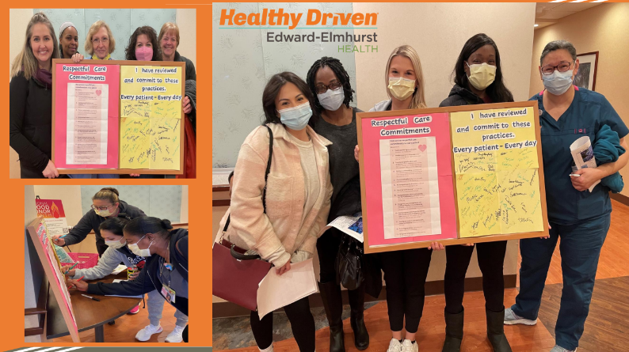


Congrats to Edward Hospital!!!
Enjoy the coffee and donuts for your team!!

Slide 11

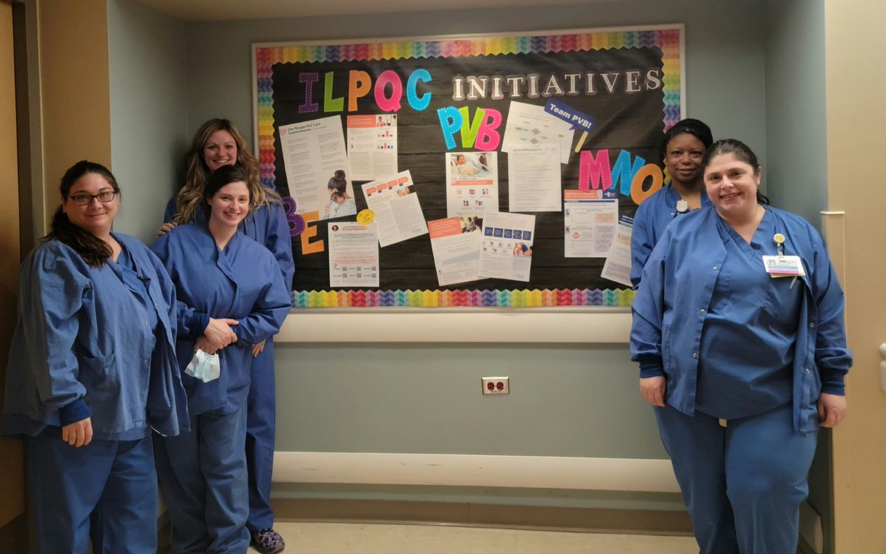
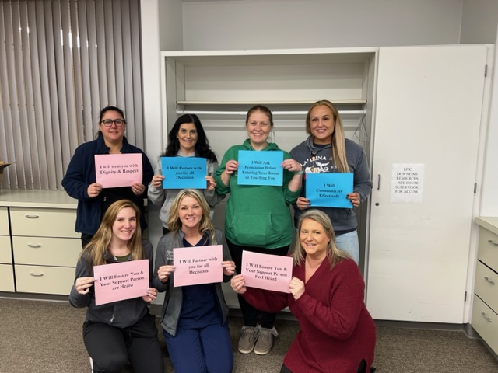
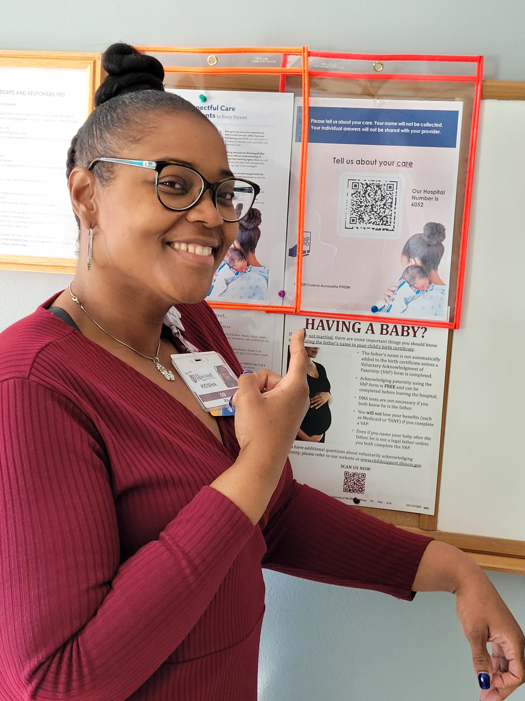
Keep submitting photos!
Your team will be featured at Face-to-Face!

Slide 12
Birth Equity Data Review

Slide 13







BE Aim: By December 2023, ≥75% will have all key strategies in place
Screen all patients for social determinants of health and link to needed services
Optimize race and ethnicity data collection and review stratified data
Standardize postpartum safety education and schedule early postpartum visit
Share respectful care practices and survey patients on their care experience
Engage patients and community members for input
Implicit bias, respectful care training for providers, nurses, other staff
Notes:
Shortened in this breakout version. Original in YIR
Guide slide/

Slide 14
Structure Measures:
Implementing Systems Changes
SDOH Screening
Linkage to Community Resources
17%
80%
3%
54%

Slide 15
Structure Measures:
Implementing Systems Changes
Stratify Maternal Health QI Data
Patient / Community Engagement
7%
74%
4%
30%

Slide 16
Structure Measures:
Implementing Systems Changes
Promote Respectful Care Practices
Implement PREM Survey
9%
64%
9%
60%

Slide 17
Structure Measures:
Implementing Systems Changes
Postpartum Safety Education
54%
88%

Slide 18
ILPQC Hospital Team Data Submission
(86 Teams Total)
Structure Measures​ | Baseline (% In Place)​ | January 2023 (% In Place)​
SDOH Screening (L&D)​ | 17%​ | 80%​
Identifying local SDOH Resources​ | 3%​ | 54%​
Optimize Self-Reported ​ Race and Ethnicity Collection​ | 7%​ | 74%​
Engage Patients and Community ​ in QI Work​ | 4%​ | 30%​
Sharing Respectful Care Strategies with Healthcare Team and Patients​ | 9%​ | 64%​
PREM Implementation​ | 9%​ | 60%​
Postpartum Safety Patient Education​ | 54%​ | 88%​

Slide 19
PREM Data Breakdown

Slide 20
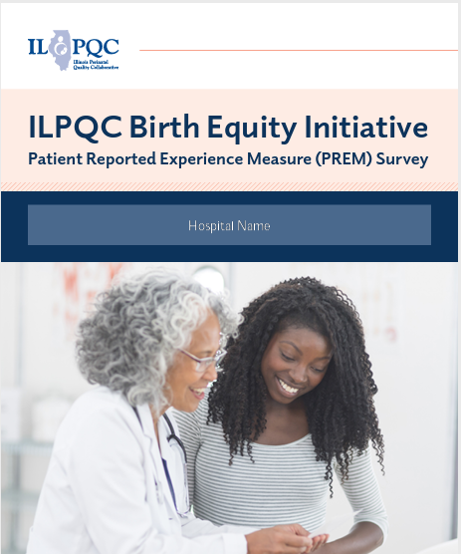
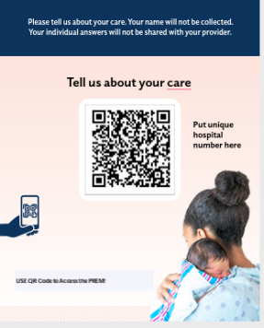
PREM Survey Completion
To date,
1,948 PREM surveys submitted across 49 hospitals
As of January 2023, the statewide average PREM completion rate is 11.5%
A few hospitals have completion rates ranging from 30-90%. Great work!!

Slide 21
PREM Survey Completion
 | # PREM Surveys Submitted | # Hospitals | % Completion Rate
February 2022 | 3 | 1 | 10.71%
March 2022 | 14 | 1 | 33.33%
April 2022 | 53 | 5 | 9.1%
May 2022 | 47 | 8 | 6.98%
June 2022 | 54 | 11 | 5.49%
July 2022 | 85 | 18 | 4.25%
August 2022 | 109 | 18 | 4.16%
September 2022 | 127 | 18 | 7.05%
October 2022 | 175 | 25 | 4.21%
November 2022 | 217 | 23 | 9.71%
December 2022 | 290 | 23 | 11.07%
January 2023 | 284 | 27 | 11.56%

Slide 22

Summary of PREM Survey Completion: Demographic Breakdown
Race / Ethnicity
  18% of survey respondents reported as Hispanic
  20% of survey respondents reported as Black
  52% of survey respondents reported as White
Insurance
  52% of survey respondents have private insurance
  41% of survey respondents have public insurance
Total PREM surveys:
n =1,948
Notes:
Can we add # of PREM completed with these numbers

Slide 23
Summary of PREM data: by Race/Ethnicity
93% of patients of color felt they were treated with respect during L&D stay vs 97% of white patients (5% of BIPOC patients felt not treated with respect).
Only 79% of BIPOC patients and 77% of white patients felt that when clinical team couldn’t meet patient's wishes they explained why (over 20% of pts across all racial groups did not feel that decision making was explained to them)
15% of BIPOC patients and 11% of white patients felt they were pressured into care they didn’t want
97% of Black patients, compared to 100% of white patients felt their health care team did a good job of listening to me

Slide 24
Summary of PREM data: Insurance status
Only 77% of private patients and 83% of public insurance patients felt that When my clinical team couldn’t meet my wishes they explained why
10% of private insurance patients and 17% of public insurance patients felt pressured into accepting care they didn’t want
GOAL is to improve RESPECTFUL CARE and focus on improved communication with patients!
Shared decision making and active listening
How do we make progress? → Get patient input!

Slide 25
Respectful Care Breakfast Check-In

Slide 26
Respectful Care Breakfast Celebration
Goal is for every team to hold their breakfast before Face-To-Face Meeting on Wednesday, May 24th
Invite your OB providers, nurses, staff and some patients and community members for breakfast and celebrate Respectful Care!
Share information on Birth Equity & Respectful Care Practices and have a panel discussion with patients/community members for input on Respectful Care strategies
Opportunity for Patient / Community Engagement and input on Birth Equity work!
Please check in with ILPQC for any questions or for support
Respectful Care Breakfast Planning Resource

Slide 27

Planning your Respectful Care Breakfast
Gather your planning group
Connect/ Invite Patients
Ask OB offices / clinics to each invite 2-3 postpartum pts, invite NICU moms.
Set the Date
Unit leadership
Educator
Provider and RN Champion
Black Maternal Health Week (April 11-17) and/or
Mother’s Day Week (week of May 14)
PP Leader Rounds
Community Outreach (invite doulas, community health worker, home visit program, community health clinic etc)
Celebration of Respectful Care and Patient Voices Breakfast with clinical team members and patients!
Consider using a Grand Rounds time slot?
Social work
(YOUR BE TEAM!)
Reflection: What is one step you can take before in the next week to move this forward?

Slide 28
Respectful Care Breakfast:
Sample Agenda & Discussion Questions
20 min: Coffee / Breakfast and Mingling (Name tags help!)
10 min: Welcome / Introduction to ILPQC Birth Equity / Share Respectful Care Practices
30 min: Patient/Community Panel Discussion (3-5 patients/community stakeholder)
  Moderator/Facilitator (could be DEI officer at facility, BE Champion, OB leader etc.)
  Guided Discussions around how clinical teams can best provide Respectful Care
  Sample Discussion Questions:
    What does respectful care mean? What does it look like/feel like for each patient on panel? Any examples where they have experienced Respectful Care in a clinical setting.
    How can clinical team members best take action on the Respectful Care Practices? How do we make sure patients feel listened to? How do we best practice shared decision making?
    Any PREM Survey elements you are seeing a disparity, or use overall ILPQC data. Ask for input on how to do better.

Slide 29
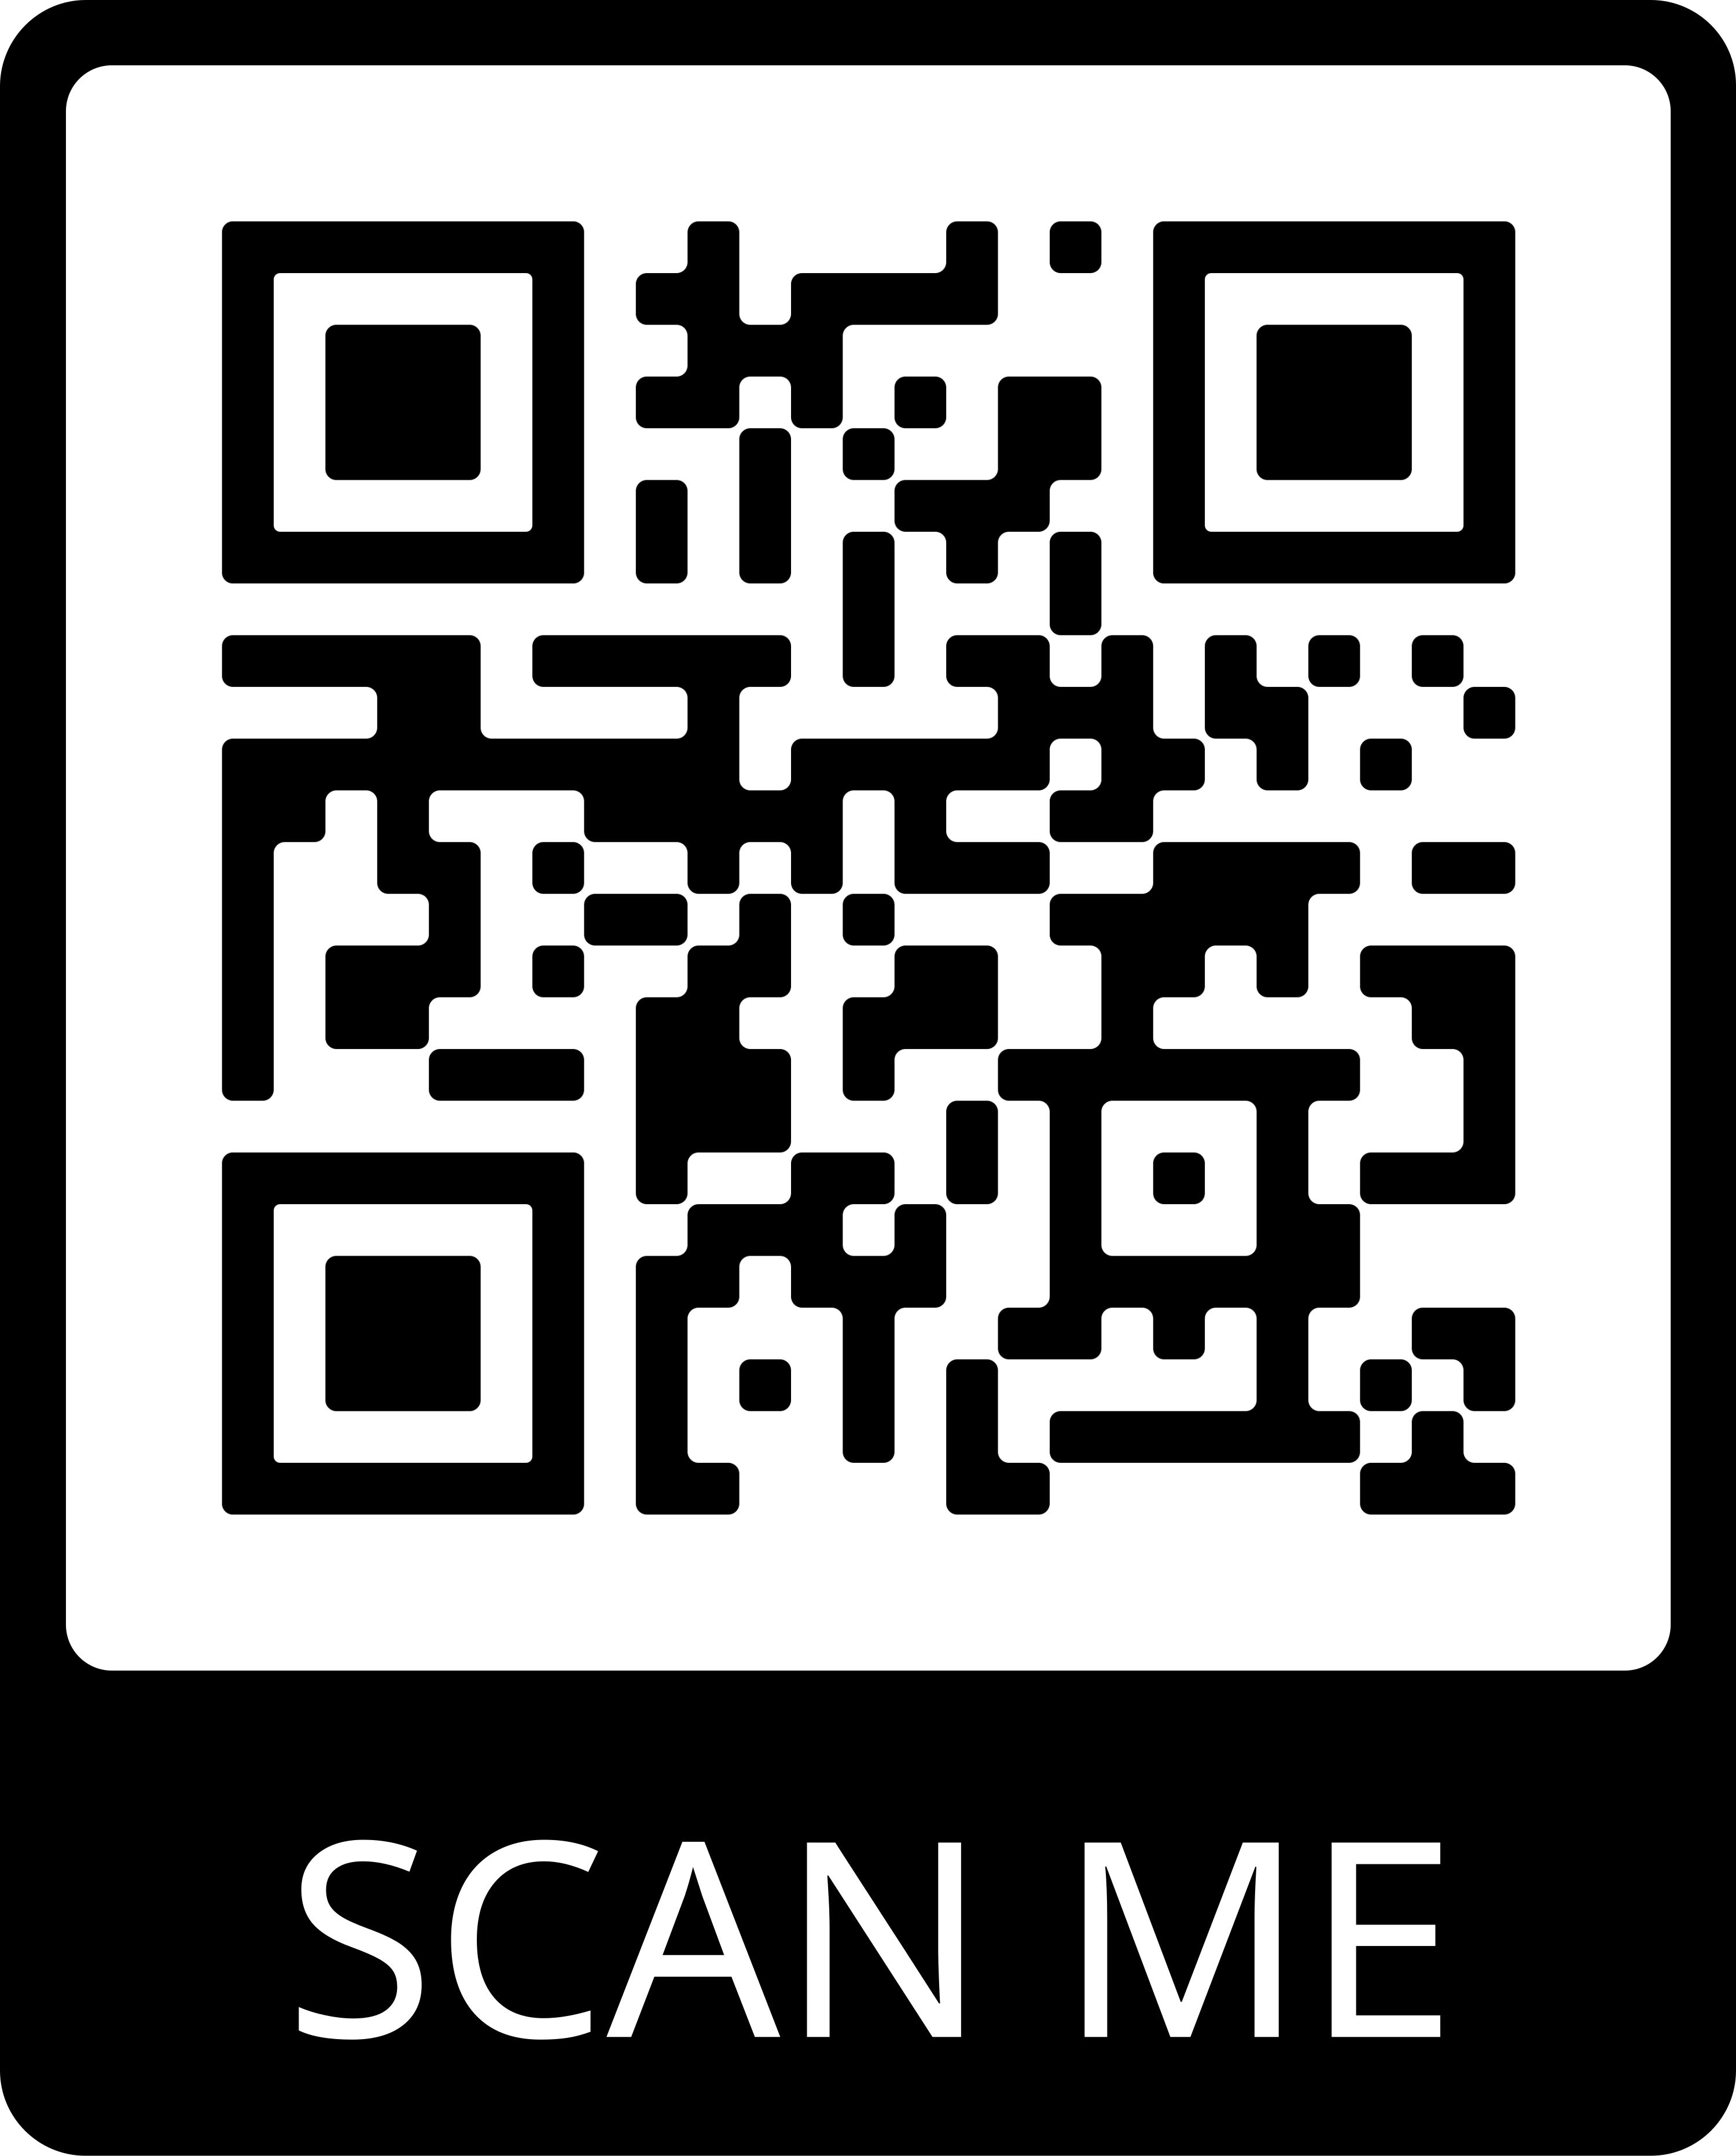
Post-Event Survey
Key tool in evaluating this effectiveness and acceptability of this strategy for clinical team and community members/ patient partners
Please ask all participants to complete this survey at the end of the event!
We will share the compiled responses with your team!

Slide 30
Respectful Care Practices and PREM
Connecting the dots

Slide 31



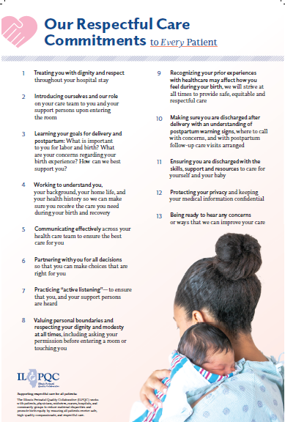
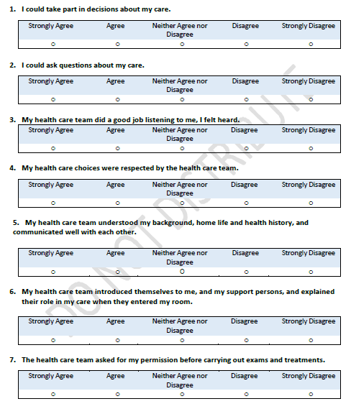
Labor & Delivery
PREM
Respectful Care Practices

Slide 32
Respectful Care Practices
We commit to…
Treating you with dignity and respect throughout your hospital stay
Introducing ourselves and our role on your care team to you and your support persons upon entering the room
Learning your goals for delivery and postpartum: What is important to you for labor and birth? What are your concerns regarding your birth experience? How can we best support you?
Working to understand you, your background, your home life, and your health history so we can make sure you receive the care you need during your birth and recovery.
Communicating effectively across your health care team to ensure the best care for you
Partnering with you for all decisions so that you can make choices that are right for you
Practicing “active listening”—to ensure that you, and your support persons are heard
Valuing personal boundaries and respecting your dignity and modesty at all times, including asking your permission before entering a room or touching you
Recognizing your prior experiences with healthcare may affect how you feel during your birth, we will strive at all times to provide safe, equitable and respectful care
Making sure you are discharged after delivery with an understanding of postpartum warning signs, where to call with concerns, and with postpartum follow-up care visits arranged
Ensuring you are discharged with the skills, support and resources to care for yourself and your baby
Protecting your privacy and keeping your medical information confidential
Being ready to hear any concerns or ways that we can improve your care
Notes:
Communicating
eff ectively across your
health care team to ensure
the best care for you
. Partnering with you for all
decisions so that you can
make choices that are right
for you
. Practicing “active
listening”—to ensure
that you, and your support
persons are heard
. Valuing personal
boundaries and
respecting your dignity
and modesty at all times,
including asking your
permission before entering a
room or touching you
. Recognizing your
prior experiences with
healthcare may aff ect
how you feel during your
birth, we will strive at
all times to provide safe,
equitable and respectful
care
. Making sure you are
discharged a er delivery
with an understanding of
postpartum warning signs,
where to call with concerns,
and with postpartum
follow-up care visits
arranged
. Ensuring you are
discharged with the skills,
support and resources to
care for yourself and your
baby
. Protecting your privacy
and keeping your medical
information confi dential
. Being ready to hear any
concerns or ways that we
can improve your care

Slide 33
Strategies to Increase PREM Survey Completion

Slide 34
How to actively implement Respectful Care and PREM with your clinical teams....
Provide all providers and nurses a copy of the Respectful Care Practices to read and sign off to acknowledge they commit to these practices.
Discuss activation of Respectful Care Practices with clinical care teams: how do we improve “Commit to Sit”, active listening, shared decision making...
Post Respectful Care Practices posters in patient facing areas where patients can read them: such as admission area, triage, labor and delivery rooms and postpartum!
Create a process flow to:
  Provide and Review with all patients the expected Respectful Care Practices on arrival to L&D and inform patients they will be asked for feedback on their respectful care experience
  Opportunity to review expected Respectful Care Practices after delivery on postpartum
  During postpartum, ensure all patients receive PREM Survey QR code and are asked to anonymously complete the PREM Survey on their phone/or IPAD before discharge to give their feedback
Notes:
Review PREM Survey Reports and provide feedback to clinical team
Do it during newborn hearing screen
Provide patients with an ipad that has the survey already loaded on it

Slide 35
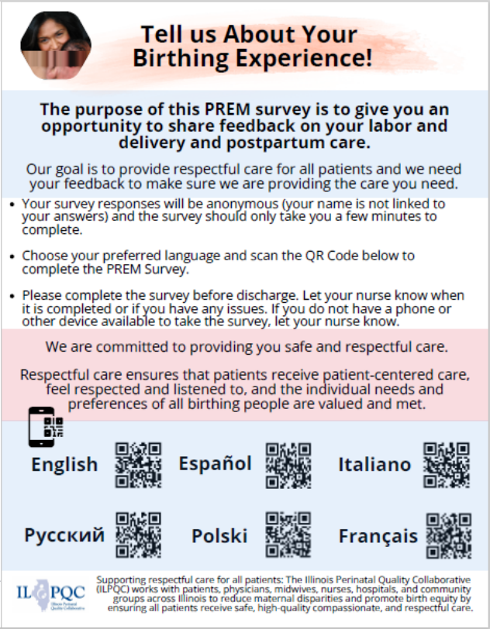
Strategies to Integrate PREM Survey into Hospital Workflow
Post PREM Survey Patient Handout with QR Codes throughout OB unit & distribute to patients
  Available online in ILPQC BE Toolkit!
  Customize with your hospital ID and logo
Utilize unit iPads
  Post PREM script on the top of the iPad
Introduce PREM survey while birthing person has some downtime
  During newborn hearing screening
  Before discharge, while waiting for instructions

Slide 36
Engage your clinical team with PREM
We need our clinical team members to be talking to patients about Respectful Care Practices to expect during delivery admission and that before discharge we will ask all patients to complete a survey to give us feedback on how we did providing respectful care!
Nurses talking about the PREM survey on postpartum and asking patients to complete it before discharge will increase % completed – use the ILPQC PREM Handout for nurses to provide to patients
Track what patients have completed the PREM survey on postpartum
Data Dashboard: track % PREM completed, share with clinical team, and work on reaching your goal!

Slide 37
Team Talk:
Mercyhealth Javon Bea Hospital, Rockford, IL
Laura Smith
OB Educator

Slide 38

Birth Equity
Laura Smith, OB educator
Mercyhealth Javon Bea Hospital
Rockford

Slide 39

Buy-In
  Staff Education – multiple approaches
    Case reviews
    Monthly newsletter
    Staff meetings
    Sharing patient feedback
    Safety huddles
    Survey results

Slide 40
Sharing
Respectful
Care
Practices
  Respectful Care Practices Posters
  Patient Folders
  Nursing Education
  Commitments
  Nursing Validations
  Prenatal classes
Notes:
RCP Posters were hung in all of our OB clinics and in all of our L&D and postpartum rooms. We put posters on the outside of the bathroom door to make them visible from the patients bed.
We added a handout of the RCPs in the patient folders. Patients receive a copy of the practices at their first prenatal appointment and on admission to L&D.
Monthly respectful care education was implemented.
Nurses and physicians in the hospital and outpatient clinics signed commitments to treat every patient with respectful care.
Staff peer reviews were performed to review each other on educating patients on the paperwork inside their folders.

Slide 41
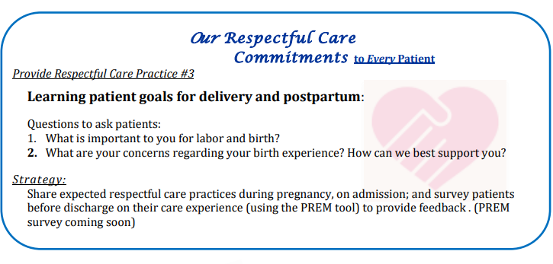
RCP Monthly Education
RCP of the month
  Strategies presented in our monthly unit newsletter

Slide 42


BE Apparel to promote RCP

Slide 43
PREM Survey (Patient Reported Experience Measure)
Rate how strongly you agree or disagree with the following statements about your care.
  I could take part in decisions about my care
          “I want you to feel included in your care.”
  I could ask questions about my care.
        "I want you to feel comfortable asking questions about your care throughout your stay; please feel free to ask any questions as they come up“
  My healthcare team did a good job listening to me; I felt heard.
  My healthcare choices were respected by the healthcare team.
        "I want to ensure that you feel your choices are respected while we care for you. What things are important to you during your birth experience and hospital stay?'
  My healthcare team understood my background, home life, and health history, and communicated well with each other.
        "Your care team wants to ensure we understand your background, home life, and health history. This is one way we can provide better care for you and communicate effectively with each other"
  My team introduced themselves to me, and my support persons, and explained their role in my care.
  The team asked for my permission before carrying out exams and treatments
  I felt pressured by the team into accepting care I did not want or did not understand.
        “ I want to ensure you understand the plan and agree to proceed.”
  When the health care team could not meet my wishes, they explained why.
        “ I know this goes against your wishes, but I want to explain why the treatment plan has changed.”
  I trusted the healthcare team to take the best care of me.

Slide 44
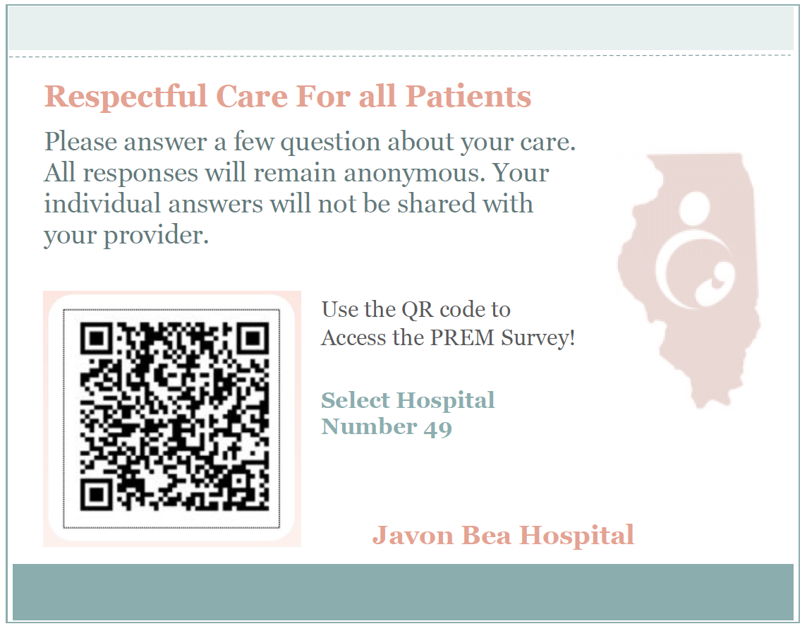
PREM
Survey
Laminated Cards
Scripting for Nurses
Discharge Checklist

Slide 45


PREM Scripting
PREM Survey Drop-Off
We are working to ensure all of our patients are treated with respect and dignity.
This survey, focused on Respectful Care, is completely anonymous and individual responses will not be shared with the team.
Scan this QR code, select hospital #49 at the top, and answer a few questions to let us know if we exceeded your expectations.
I am going to step-out out of the room to gather your discharge gifts, and allow you a few minutes to complete the questionnaire.

Slide 46
NYSPQC: NYSBEIP Presentation
Kristen Lawless
Program Director, NYSPQC, New York State Department of Health
Jacqueline Kellachan, MPH
Project Director, NYSBEIP

Slide 47
New York State Birth Equity Improvement Project (NYSBEIP)
Collecting and Using Data From Birthing People
Kristen Lawless
Program Director, NYSPQC, New York State Department of Health
Jacqueline Kellachan, MPH
Project Director, NYSBEIP

Slide 48

NYSBEIP Project Goal
All New York State birthing hospitals and centers will identify how individual and systemic racism impacts birth outcomes at their facility and will take actions to improve both the experience of care and perinatal outcomes of Black birthing people in the communities they serve.
January 2021 Project Launch
73 NYS birthing facilities participating

Slide 49
Patient Reported Experience Measure (PREM)
NYSBEIP outcome centered on birthing experience.
Anonymous 17-question survey for every person discharged with a live birth measuring patient experience during the project period:
  Birthing people use a facility-specific QR code to access the survey.
Answers go directly to NYSDOH for analysis from Momentive.
Each facility receives a PREM Implementation Packet

Slide 50
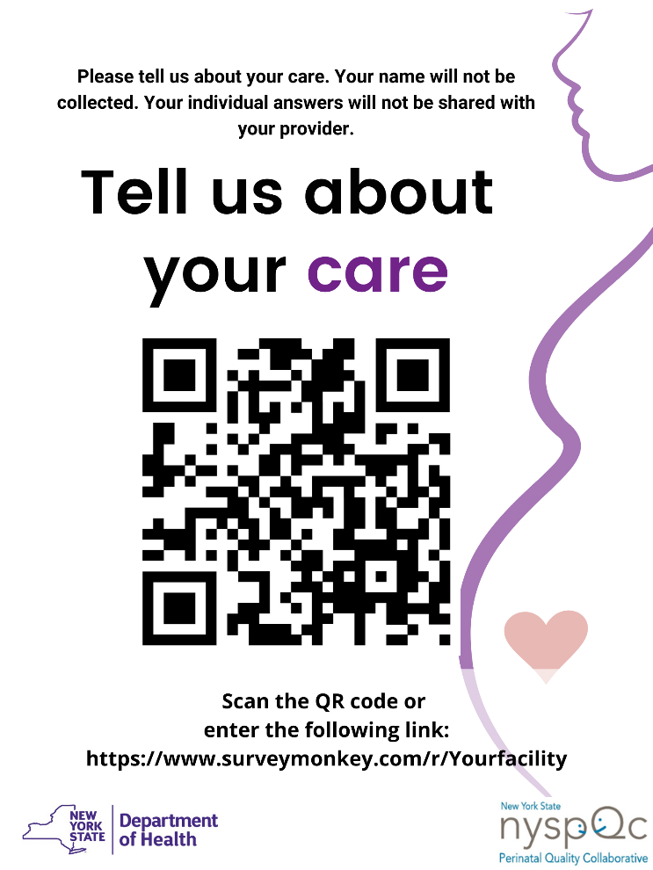
Patient Reported Experience Measure (PREM)
Discharge sheet and survey is available in 12 languages.
Facility-specific QR Code shared with each patient.
Wednesday, May 5, 2021

Slide 51
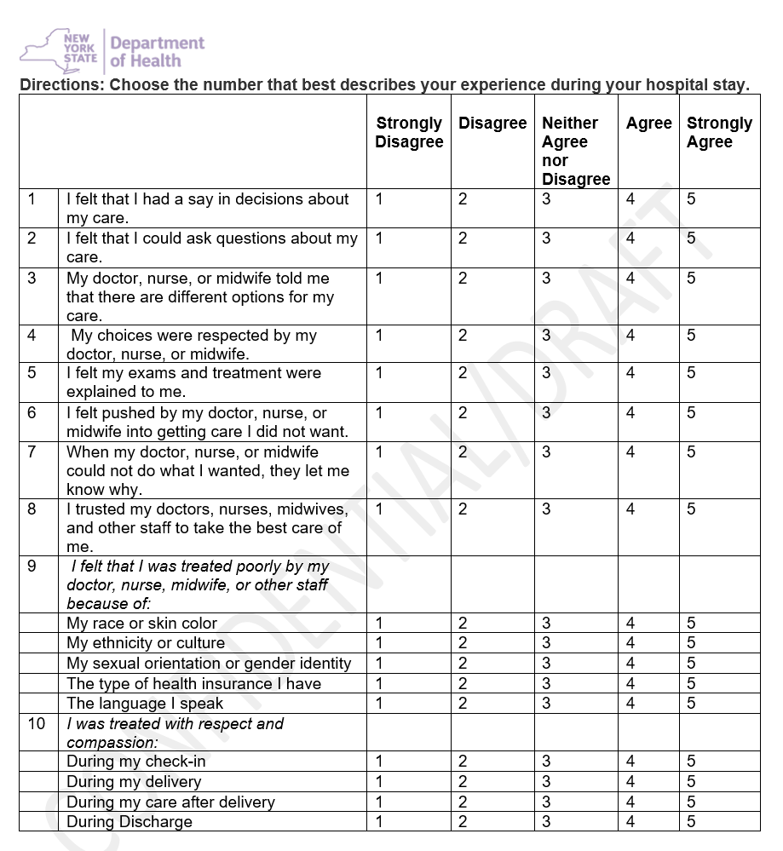
Patient Reported Experience Measure (PREM)
Post scan sheet in rooms, discharge folders
Facility staff or volunteers help birthing people access surveys via a tablet at the time of discharge.
Survey can also be accessed via a smartphone.
Survey takes less than 5 minutes to complete

Slide 52

Patient Information Sheet
Can be customized with facilities name
Distributed to birthing people on admission

Slide 53
Number of PREMs Completed
 | July-Aug-21 | Sep-21 | Oct-21 | Nov-21 | Dec-21 | Jan-22 | Feb-22 | Mar-22 | Apr-22 | May-22 | Jun-22 | Jul-22 | Aug-22 | Sep-22 | Oct-22 | Nov-22 | Dec-22
Surveys Included in Analysis** | 1355 | 1006 | 1026 | 1066 | 1008 | 846 | 1157 | 1485 | 1364 | 1391 | 1445 | 1714 | 1982 | 1854 | 1979 | 1866 | 1780
Total Surveys Submitted | 1790 | 1413 | 1437 | 1462 | 1439 | 1233 | 1640 | 2002 | 1827 | 1863 | 1987 | 2224 | 2598 | 2400 | 2661 | 2419 | 2287
**A PREM Survey is included in analysis if it has answers to at least 2 of the 17 core PREM
questions, including questions 2-8, 9a-9e, 10a-10d, and 11.

Slide 54
PREM Implementation Best Practices
Volunteers
Patient Information Sheet
Registrar
Nurses in Clinical Ladder
Electronic Messages
My Chart
After Visit Summary

Slide 55
NYSDOH Technical Support
Weekly emails to facilities with the number of PREM surveys submitted the previous week
Aggregate results reported back monthly to facilities stratified by race and ethnicity
Coaching Calls to review best practices for implementation and how to understand and use PREM data
Ongoing office hours for small group discussion and support

Slide 56
Question 6
I felt pressured by the health care team into accepting care I did not want or understand

Slide 57
Q6. % of Birthing people who selected Strongly Agree, Agree, Neutral to the Statement “I felt pressured by the health care team into accepting care I did not want or did not understand. “
Aggregate Data, July 2021-December 2022
Direction of Improvement
 | July-Aug-21 | Sep-21 | Oct-21 | Nov-21 | Dec-21 | Jan-22 | Feb-22 | Mar-22 | Apr-22 | May-22 | Jun-22 | Jul-22 | Aug-22 | Sep-22 | Oct-22 | Nov-22 | Dec-22
Strongly Agree, Agree, Neutral | 296 | 234 | 253 | 208 | 235 | 185 | 238 | 302 | 298 | 261 | 297 | 332 | 437 | 371 | 425 | 359 | 358
NYS Average % S.Agree, Agree, Neutral | 22% | 23% | 25% | 20% | 23% | 22% | 21% | 21% | 22% | 19% | 21% | 20% | 22% | 20% | 22% | 19% | 20%

Slide 58
Q6. % of Birthing people who selected Strongly Agree, Agree, Neutral to the Statement “I felt pressured by the health care team into accepting care I did not want or did not understand. “ By Race/Ethnicity
Direction of Improvement

Slide 59

What are some of the best team practices(team actions and responses) that we have discussed that could help relieve pressure on birthing people?
Faith Ringgold

Slide 60

Upstate Hospital - Syracuse

Slide 61
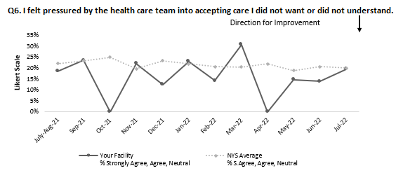

Q6- Pressure
Increased by 53%
Average=16.25%
Shared Decision Making- Birth Pref Plan PDSA, Preferred name
Labor comfort techniques, coping tools PDSA
Top 10 Labor Positions Video
Ask permission PDSA
Spinning Babies PDSA
Notes:
Including data

Slide 62
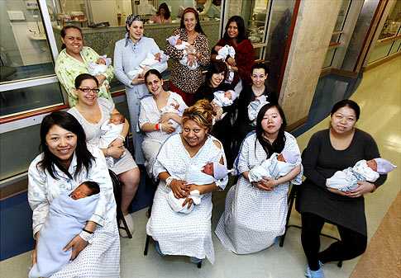
Maimonides Medical Center
Brooklyn, NY

Slide 63
Patient experience rounding
Daily rounding about patient’s experience
  Environment
  Food
  Nursing
  Engineering
  Clinical experience
Real time service recovery depending on feedback
Depending on feedback, escalation is done to respective department

Slide 64

NYCHHC Queens

Slide 65

Respectful Patient Partnerships:
Lived Experience of Birthing People
Participation in the pilot HOPE Doula program in conjunction with Elmhurst Hospital, Mt Sinai Physicians, Caribbean Women’s Health Association, NYC DOH, and Ancient Song Doula Services
  Monthly Community Advisory Board Meetings where patients and community members can gather to share their experiences with doula care, nursing leaders, and community resources

Slide 66

NYU Brooklyn

Slide 67


Respectful Patient Partnerships:
Lived Experience of Birthing People
Patient receive post-discharge phone calls and have the opportunity to share their experience
Patient comments (+/-) are shared at a weekly patient experience meeting with all team members

Slide 68

NYU Langone Manhattan

Slide 69

Holistic Care Partner
NYU's Black Mothers Matter Committee members have created a navigator program designed to provide culturally congruent support for Black childbearing families, centering the voices of Black birthing people, and empowering them to make informed decisions for their care.
Care coordination
Monthly Safe Spaces Support Groups
Intrapartum support
One year of postpartum follow-up
Project Team:
Antoinette Grant, BSN, RNC-OB, C-EFM, CBC, CCE
Georgette Paulycarpe, MSN, CNM, RN, LCCE
Aisha Rab, BSN, RNC-OB, c-EFM
Leticia Rios, PhD(C), RN, NPD-BC, IBCLC, RNC-NIC

Slide 70

Consider the impact of your facility’s system on even one Black birthing person.
Black birthing people are experts on the accountability, empathy and humanity of your system.

Slide 71


Slide 72
New York State Birth Equity Project Team
Camie Berardi, MPA Associate Project Director (NICHQ) | Kristen Lawless, MS Program Director, NYSPQC Office of the Medical Director (NYSDOH) | Stacy Scott, PhD, MPA Senior Project Director and Equity Lead (NICHQ)
Marilyn Kacica, MD, MPH Medical Director, Division of Family Health (NYSDOH) | Rinka Murakami, MPH Data Analyst (NICHQ) | Eileen Shields Director, Data, Research & Surveillance Unit Bureau of Women, Infant, & Adolescent Health (NYSDOH)
Jacqueline Kellachan, MPH Project Director (NICHQ) | Amanda Roy, MPH Research Scientist, Office of the Medical Director (NYSDOH) | Jane Taylor, Ed.D, MBA Improvement Advisor (NICHQ)

Slide 73

Thank you!

Slide 74

https://www.sarahprall.com/newborns-babies-and-toddlers/children-family-newborn-infant/vgl1op9khqdev95cy9e6rxdiuvtyfw
#BlackBirthingMatters!
#BlackMothersMatter!
#BlackFamilysMatter!
#BlackBreastfeedingMatters!
#BlackFathersMatter!

Slide 75

Contact
New York State Birth Equity
Improvement Project
NYSBEIP@health.ny.gov
www.nyspqc.org

Slide 76
Upcoming ILPQC BE calls

Slide 77

Upcoming BE Calls
Event | Day/Time
BE Teams Call (3rd Monday of the Month) | April 17th, at 12:00pm TOPIC: Using PREM survey data feedback to improve Respectful Care
 | May 24-25, See you at Face-to-Face in Springfield, IL

Slide 78



