Slide 1



Birth Equity Data Discussion Webinar
July 30, 2021 12:00pm – 1:00pm

Slide 2
Call Overview
What is the ILPQC/Data System (REDCap)?
Accessing REDCap
Overview of ILPQC BE Data Collection Strategies
Live REDCap demo
Data Collection Timelines (Baseline & Prospective Data)
Questions Anyone?

Slide 3


ILPQC Data System
23

Slide 4

ILPQC: Three Pillars Support
Quality Improvement Success

Slide 5
REDCap
REDCap is the platform for data entry
Currently hosted on a site called “healthink”
Rapid-response data
    –A dashboard will be available in early 2022 for teams to quickly review real-time data
    - Upgraded format and tools for hospitals to better use their data

Slide 6
Data is yours!
ILPQC manages the rapid-response data sytem (REDCap), but data collection is really a benefit to teams
Share success with others at your hospital
Review areas that you still need to work on and use data to compel others on your team to work for change
Compare your hospital progress over time with aggregate data of all ILPQC BE teams

Slide 7
Accessing RedCap
23

Slide 8

RedCap Access
REDCap access will be granted by those identified when you submitted your BE team roster
If you have edits to those who need access, please email Ieshia.Johnson@northwestern.edu

Slide 9

Key Steps to Access REDCap
Add https://redcap.healthlnk.org to your bookmarks bar on your computer or available on the ILPQC home page via website
Use your username & password to log in. You should have received an email with your username. Please email info@ilpqc.org if you have trouble logging in

Slide 10
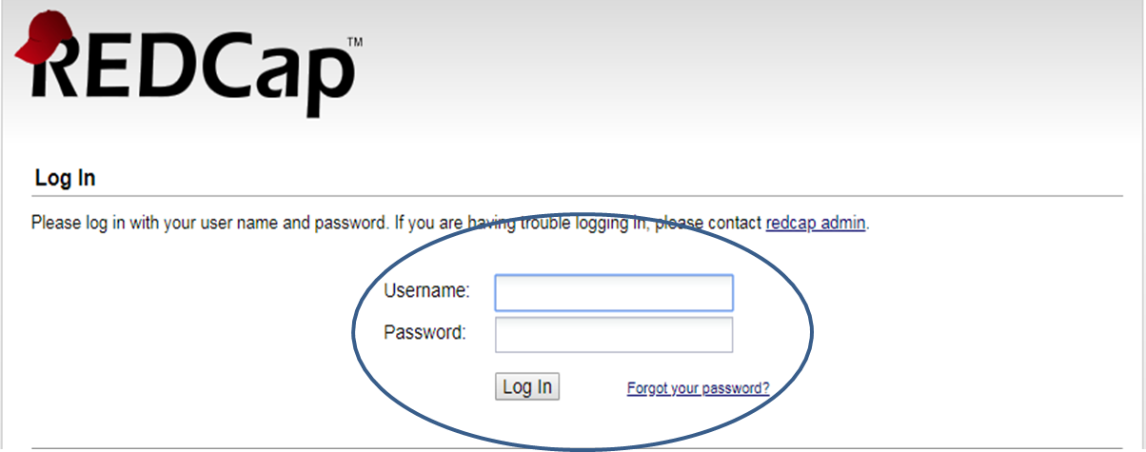
REDCap Interface Overview
REDCap Log In Page https://redcap.healthlnk.org

Slide 11
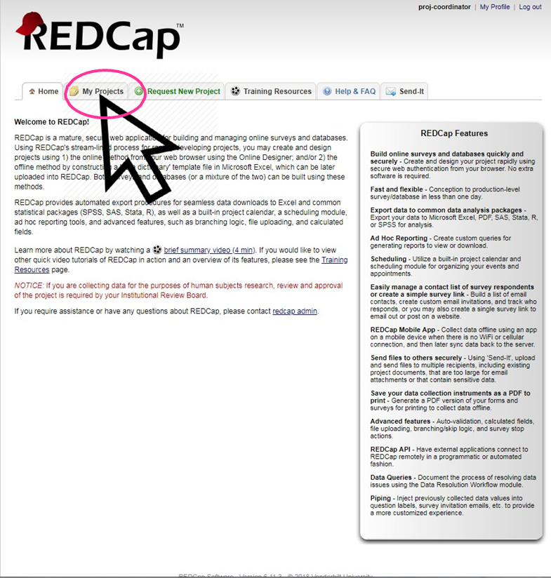
REDCap Interface Overview
REDCap Landing Page After Logging in
REDCap “My Projects” Landing Page

Slide 12
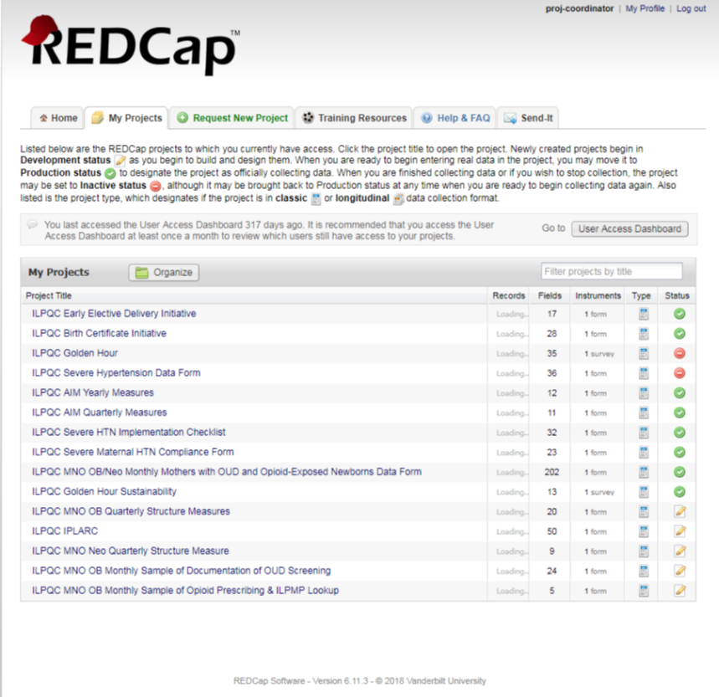
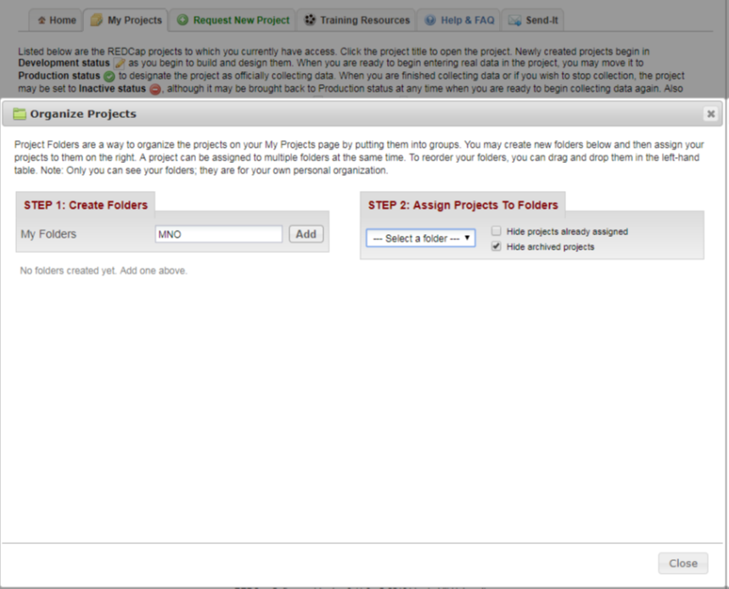


Participating in multiple ILPQC Initiatives?

Slide 13
BE DATA COLLECTION & DATA FORM
23

Slide 14





How will we show improvement?
Tracking system changes → Structure Measures
  Not started - working on it - in place
Tracking clinical culture change → Process and Outcome Measures
  Random sample of 10 delivery records per month from Black patients /patients of color or patients with public insurance to track progress on key strategies
  Report progress on educating providers, nurses, and staff
Illinois Perinatal Quality Collaborative
24

Slide 15
Structure Measures to track progress on key system changes at your hospital:
Implement universal social determinants of health screening
Map community resources to assist linking patients to resources/services
Protocol to optimize patient-reported race/ethnicity data collection
Process to review maternal health quality data by race/ethnicity and Medicaid status
Take steps to engage patient and/or community members on quality improvement efforts
Strategy for sharing expected respectful care practices with delivery staff and patients
Patient Reported Experience Measure (PREM) survey to obtain feedback from patients
System to provide patients postpartum safety education prior to hospital discharge
25
Notes:
Presenter
2021-06-16 00:38:06
--------------------------------------------
Implement standardized social determinants of health screening tool for screening all pregnant women during delivery admission and linking to needed resources services
Provide affiliated prenatal care sites options for standardized social determinants of health screening in order to screen pregnant patients and link to needed resources and services
Complete ILPQC social determinants of health community resources mapping tool to assist linking patients to resources and services and shared tool with affiliated outpatient prenatal care sites and hospital OB units Strategy for incorporating discussion of social determinants of health and discrimination as potential factors in hospital maternal morbidity reviews
Implemented a protocol for improving the collection and accuracy of patient-reported race/ethnicity data Developed a process to review maternal health quality data stratified by race/ethnicity and Medicaid status Engaged patients and/or community members to provide input on quality improvement efforts
Strategy for sharing expected respectful care practices with delivery staff and patients (i.e. posting in L&D) including appropriately engaging support partners and/or doulas Hospital has implemented a Patient Reported Experience Measure (PREM) patient survey to obtain feedback from postpartum patients and a process to review and share results
Hospital has standardized system to provide all patients the recommended postpartum patient education materials prior to hospital discharge including education on urgent maternal warning signs, postpartum safety and tools to improve communication between patients and their healthcare providers

Slide 16
Process and outcome measures to track clinical culture change:
% providers, nurses and staff completing education on providing respectful care and addressing implicit bias
% patients in 10 chart sample per month with documentation of:
  patient education on postpartum safety
  social determinants of health (SDoH) screening prenatal and delivery admission
  % patients who screen positive for SDoH with documented linkage to needed services/resources
% patients completing patient-reported experience measure who reported always or often feeling heard on PREM

Slide 17
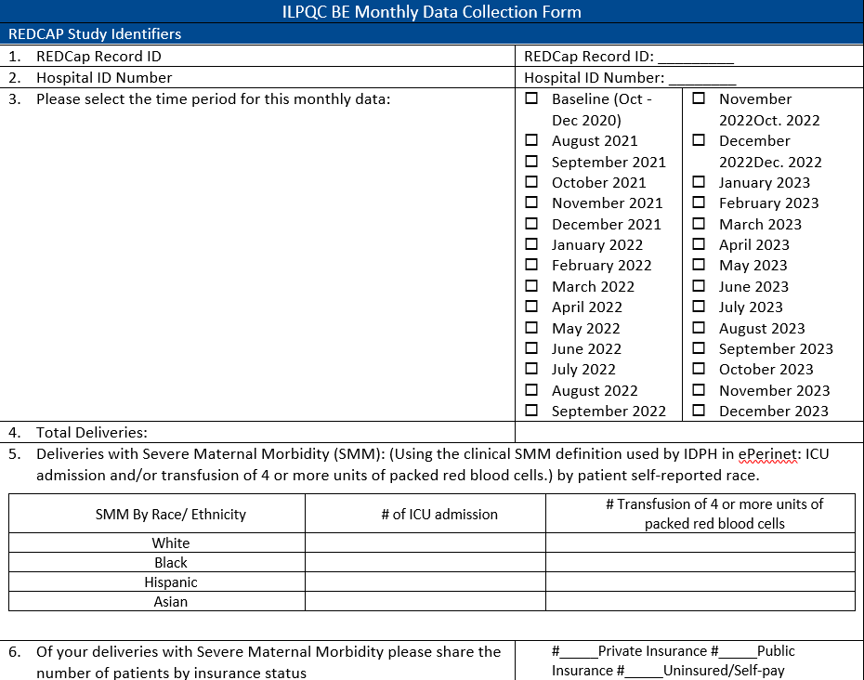
BE Monthly Data Form
One form for:
  Structure Measures
  Process Measures
  Outcome Measure

Slide 18
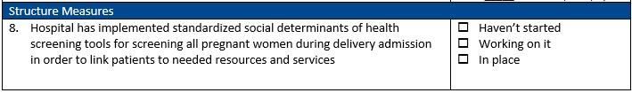
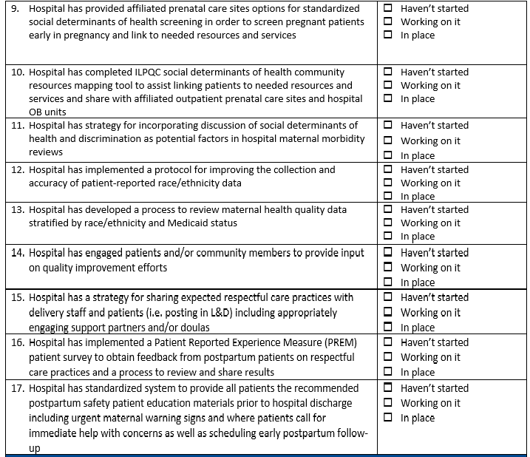
Data Form - Structure Measures
Notes:
Presenter
2021-06-14 14:36:51
--------------------------------------------
Ieshia can we take item off of slide 29 and add item 8 into this structure measure slide.

Slide 19

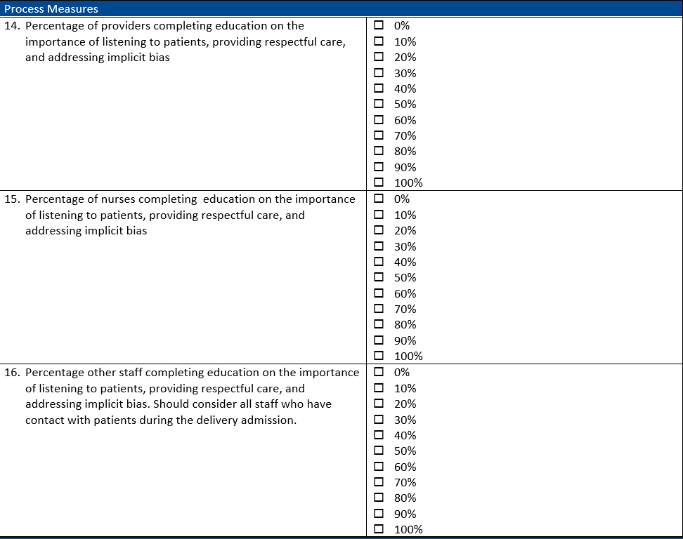
Data Form - process measures

Slide 20
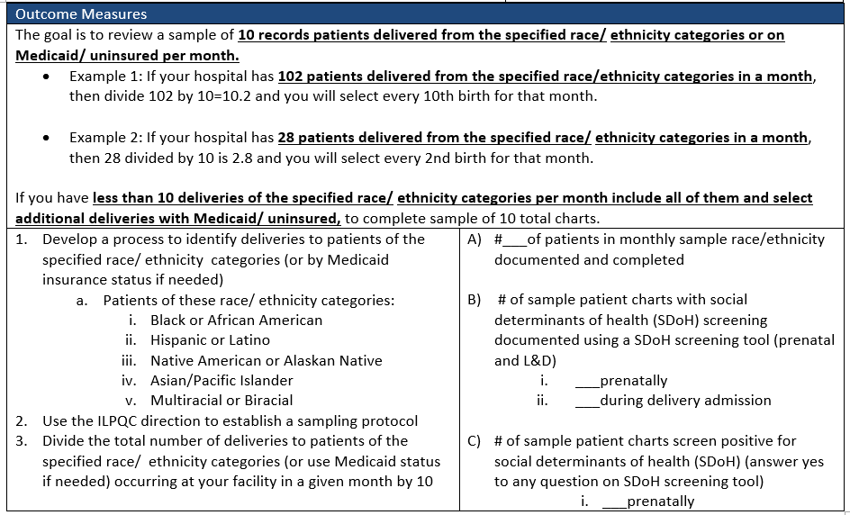
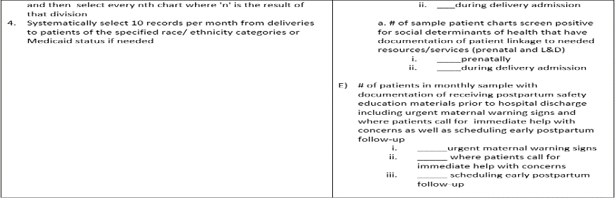
Data Form – Outcome Measures

Slide 21
Proposed Process & Outcome Measures based on monthly sample:
10 records patients delivered from the specified race/ ethnicity categories or on Medicaid/ uninsured per month
Develop a process to identify deliveries to patients of the specified race/ ethnicity categories (or by Medicaid insurance status if needed)
Use the ILPQC direction to establish a sampling protocol
  Divide the total number of deliveries to patients of the specified race/ ethnicity categories (or use Medicaid status if needed) occurring at your facility in a given month by 10 and then select every nth chart where 'n' is the result of that division
Systematically select 10 records per month from deliveries to patients of the specified race/ ethnicity categories or Medicaid status if needed
Once a sampling protocol is determined you can use every month

Slide 22
Proposed Process & Outcome Measures based on monthly sample:
Patients of these race/ ethnicity categories:
Black or African American
Hispanic or Latino
Native American or Alaskan Native
Asian/Pacific Islander
Multiracial or Biracial
38

Slide 23
Sampling Examples
The goal is to review a sample of 10 records patients delivered from the specified race/ ethnicity categories or on Medicaid/ uninsured per month.
Example 1: If your hospital has 102 patients delivered from the specified race/ethnicity categories in a month, then divide 102 by 10=10.2 and you will select every 10th birth for that month.
Example 2: If your hospital has 28 patients delivered from the specified race/ ethnicity categories in a month, then 28 divided by 10 is 2.8 and you will select every 2nd birth for that month.
If you have less than 10 deliveries of the specified race/ ethnicity categories per month include all of them and select additional deliveries with Medicaid/ uninsured, to complete sample of 10 total charts.
Illinois Perinatal Quality Collaborative
39

Slide 24
Live DEMO
23

Slide 25


Step by Step live enter data
Let’s walk through the data form in REDCap

Slide 26
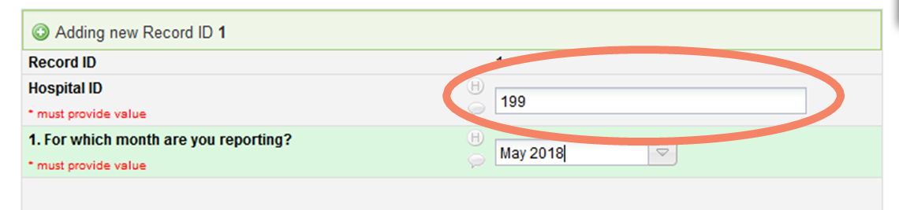
Avoid Common Data Entry Mistakes
Make sure you enter the correct hospital ID
Do not enter a patient’s medical record number
If you do not know your hospital ID, please email Ieshia.Johnson@northwestern.edu

Slide 27
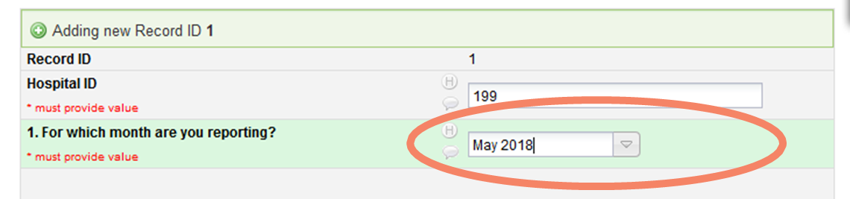
Avoid Common Data Entry Mistakes
Make sure to select the appropriate month (double check the year)!

Slide 28
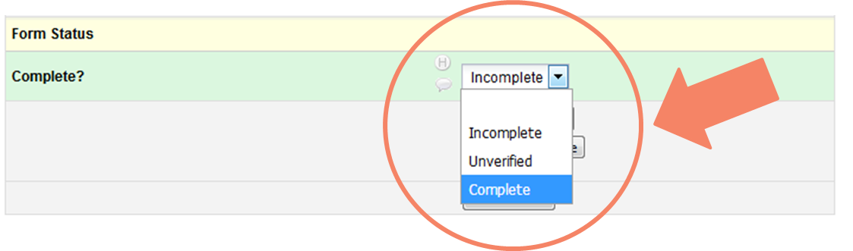
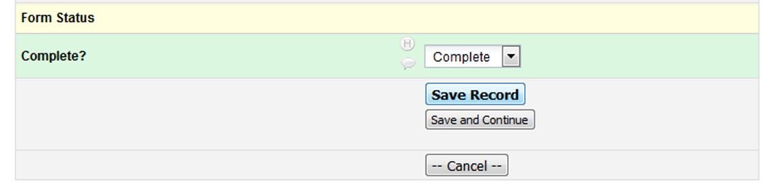
Close Out and Save the Form
Select the appropriate status for your form. Most forms will be marked as “complete”
Don’t forget to save!

Slide 29
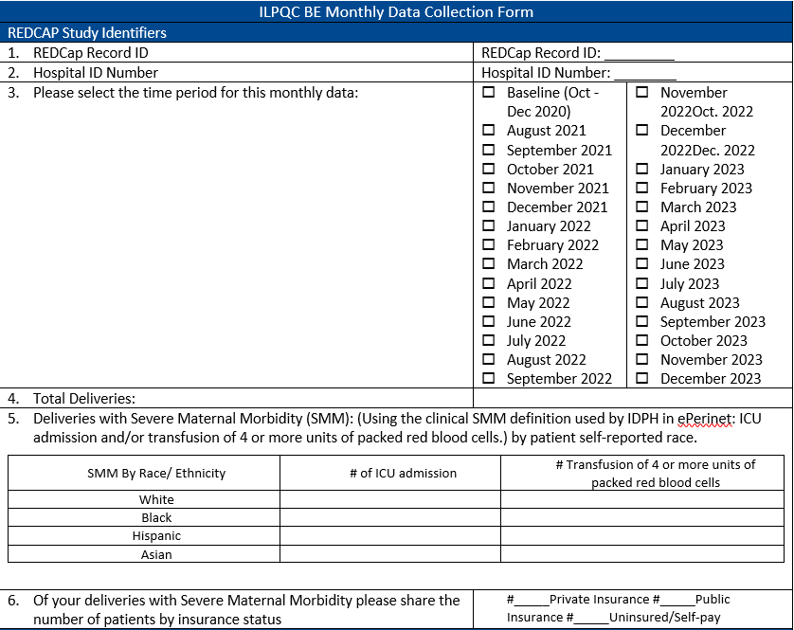
Paper Data Form
Hospital-Level Form

Slide 30


PREM – Patient Data
PREM survey
Patient Reported Experience Measure (PREM) patient survey with QR code (coming soon)!

Slide 31
When and how often to submit the data?
 | Birth Equity Data
Data Collection Form(s) Name | Birth Equity Hospital Level Measures
Data Collection Start | Baseline Q4: Oct – Dec 2020 to REDCap by September 15th Monthly data: August and September due into REDCap by October 15th
Data Due Date | Baseline data: August 15th All other data: The 15th of the following month (i.e. Aug data due Sept 15)
Who/what are we collecting data on? | Patients of these race/ ethnicity categories: Black or African American Hispanic or Latino Native American or Alaskan Native Asian/Pacific Islander Multiracial or Biracial

Slide 32
Next Steps
23

Slide 33


10 Steps to Getting Started with BE
Submit your BE Roster and complete the ILPQC BE Teams Readiness Survey to identify team opportunities for improvement.
Schedule regular, at least monthly, BE QI team meetings to review your data and make improvement plans and identify PDSAs cycles for the coming month.
Review the ILPQC BE Data Collection Form with your team and discuss strategies for data collection and attend one of the BE Data Calls in July.
Review your hospital’s baseline data and identify opportunities for improvement. Reference the BE Key Driver Diagram and BE Key Strategies to identify possible interventions.
Review the ILPQC Birth Equity Toolkit for nationally vetted resources to support your improvement goals.
33
Notes:
Presenter
2021-06-16 00:38:10
--------------------------------------------
Ieshia, here we want to go through the 10 steps so would not present as a screenshot but bring text into numbered bullets with no more than 4-5 per slide.

Slide 34


10 Steps to Getting Started with BE
Meet with your QI team to create a draft 30-60-90 day plan. This plan helps your team decide where to start and identify what you want to accomplish in the first 3 months.
Plan your first PDSA cycle with your team to address your 30-60-90-day plan. These small tests of change help your hospital test process/system changes to reach initiative goals.
Consider scheduling a BE kick-off meeting and /or grand rounds to officially announce the launch of your hospital BE initiative work.
Review implicit bias training resources and create a plan for implementation and completion of implicit bias training by L&D OB providers, nursing, and all staff that interact with pregnant/postpartum patients, plan for QI team member to participate in SPEAK UP Training, for train the trainer, to provide additional engagement and follow up training for providers and staff.
Reach out to ILPQC with any questions or for clarification – we are here to help!
33

Slide 35

Next Steps for Birth Equity
Complete Birth Equity Readiness Survey by July 25 .
Register for and attend one of the Data Discussion Calls July 15th or 30th at 12:00pm
Mark you calendar for the BE monthly webinars starting August 16th 12-1:00pm
Submit baseline data collection (Oct – Dec 2020) to REDCap by September 15th
Monthly data starting August with August and September due into REDCap by October 15th
Next Stop!
Illinois Perinatal Quality Collaborative
Notes:
Presenter
2021-06-16 00:38:11
--------------------------------------------
I think we can keep this header red to discuss dates with Ann for data collection.

Slide 36
Birth Equity Timeline
July | August
Data Discussion Calls Review measures / data form and resources July 15th or 30th , 2021 | Monthly Teams Webinars Begin August 16th: 12-1:00pm Every 3rd Monday of the month at 12:00 pm

Slide 37
Questions?
23

