Slide 1



Birth Equity (BE) Monthly Webinar
Making progress towards our goals together!
August 15th, 2021

Slide 2


Overview
ILPQC updates
Birth Equity data review
Postpartum Safety: Implementing early postpartum visits
BE next steps
Team Talk
  Mary Jarvis, MSN, RN, CLC at Memorial Hospital of Carbondale
  Trish Kovacs at Franciscan St. James, Olympia Fields

Slide 3
ILPQC updates

Slide 4

Save the Date:
Calling all perinatal health care providers, nurses, allied health professionals, and public health/community partners!

Slide 5


Slide 6
Steps to prepare for
2022 Annual Conference
Email arivera@northshore.org if interested in joining the 2022 10th Annual Conference Planning Committee!
Register for conference when registration opens September 5th
Book hotel room (room block link to come)
BASIC QI Excellence Award Criteria: Data submission due date – September 16
Coordinate with your team to submit your Annual Conference Survey between September 1st and October 3rd
Submit your Abstract by October 3rd to be considered for an award (Opening September 1st)

Slide 7


EXTENDED: Schedule a Key Players Meeting through August 2022
Consultation for all BE teams with a BE champion
Strategize and map out your hospital’s next steps to address barriers and create a 30/60/90 plan.
17 teams have completed their KPM
Request your KPM meeting with this link: https://redcap.healthlnk.org/surveys/?s=C9TKXKJNMD
It was informative and helpful. Helped us eliminate barriers to moving forward! -- OSF HealthCare Saint Francis
It was extraordinarily helpful! Looking forward to getting back together with our team to start putting things into action!! – Barnes Jewish Hospital
SIGN your team up TODAY to get the support your hospital need!
Illinois Perinatal Quality Collaborative
Notes:
Additional support for your birth equity initiative! We want to help you succeed by:
Partnering with you to arrange your Key Players meeting.
Assist you with who to invite at each hospital for most effective meeting with representative from ILPQC
Provide you with a Birth Equity champion from the BE speakers bureau to partner with you to problem solve, overcome barriers, and move implementation forward

Slide 8

Upcoming Implicit Bias Training
Opportunity
Virtual Group Training:
  3-4 hour training session with
  March of Dimes facilitator
  Up to 100 participants
  3.5 Continuing Medical Education (CME) and Continuing Nursing Education (CNE) credit
  Interactive activities
TDB – September 2022

Slide 9
Birth Equity initiative data review
Helping hospital teams move this important work forward together

Slide 10

What is the focus of Birth Equity (BE)?
BE AIM: By December 2023, more than 75% of Illinois birthing hospitals will be participating in the Birth Equity Initiative and more than 75% of participating hospitals will have the key strategies in place.
Promote patient- centered approach to engage patients and communities
Develop respectful care and bias education for providers, nurses, and staff
Addressing Social Determinants of Health
Review race/ethnicity medical record and quality data

Slide 11
Key QI Strategies
Optimize race/ethnicity data collection & review key maternal quality data by race, ethnicity & Medicaid status
Engage patients and community members for input on quality improvement efforts
Universal social determinants of health screening tool (prenatal/L&D) with system for linkage to appropriate resources
Share respectful care practices on L&D and survey patients before discharge on their care experience (using the PREM) for feedback
Standardize postpartum safety education and schedule early postpartum follow up prior to hospital discharge
Implicit Bias / Respectful Care training for providers, nurses and other staff
Notes:
Optimize race/ethnicity data collection and review key maternal quality data by race, ethnicity and Medicaid status
Universal social determinants of health screening tool (prenatal/L&D) with system for linkage to appropriate resources
Share respectful care practices on L&D and survey patients before discharge on their care experience (using the PREM tool) for feedback
Engage patients and community members for input on quality improvement efforts
Standardize postpartum safety education and schedule early postpartum follow up prior to hospital discharge
Implicit Bias / Respectful Care training for providers, nurses and other staff

Slide 12
ILPQC Hospital Team
Data Submission (86 Teams Total)
Month | Teams Reporting Hospital Data
Baseline (Q4 2020) | 47
August 2021 | 54
September 2021 | 51
October 2021 | 50
November 2021 | 46
December 2021 | 36
January 2022 | 40
February 2022 | 41
March 2022 | 59
April 2022 | 47
May 2022 | 46
June 2022 | 41

Slide 13
Structure Measures:
Implementing Systems Changes

Slide 14
Structure Measures:
Implementing Systems Changes

Slide 15
Process Measures:
Implicit Bias Training
Notes:
Structure Measures- highlight/congratulate the success in place/working on measures: how to consolidate these
Implemented standardized social determinants of health screening tools for delivery admission
Implemented affiliated prenatal care sites standardized screening tools for universal social determinants of health screening
Completed ILPQC social determinants of health community resources mapping tool and shared with affiliated outpatient
Incorporating discussion of social determinants of health and discrimination as potential factors in hospital maternal morbidity reviews
Protocol for improving the collection and accuracy of patient-reported race/ethnicity data
Process to review maternal health quality data stratified by race/ethnicity and Medicaid status
Engaged patients and/or community members to provide input on quality improvement efforts
Sharing expected respectful care practices with delivery staff and patients
Implicit Bias Training (line graph)

Slide 16

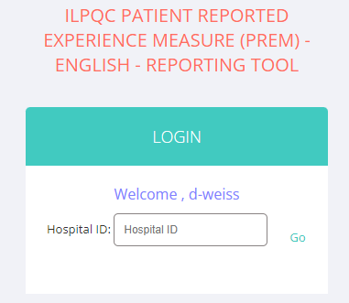
PREM Reports Launched!
BE Team members have received access to view PREM reports for their hospital in REDCap
You can view PREM Reports by:
    Overall respondents
    Report will be available for overall % completed per month by total deliveries per month
    Reports will be available monthly and quarterly at five 5 response per month
    Public Insurance compared to Private Insurance responses
    Non-Hispanic White compared to BIPOC responses
    Black, White, Asian, Hispanic, Other (will report only if sufficient numbers > 5 patients per category)
Use your hospital’s 3-digit ID!
Notes:
Number of birthing people discharged after delivery who received the Patient Reported Experience Measure (PREM) Survey either via QR Code or hospital iPad/tablet/laptop

Slide 17
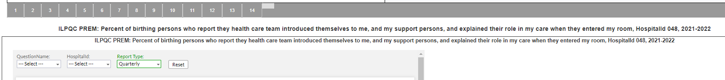
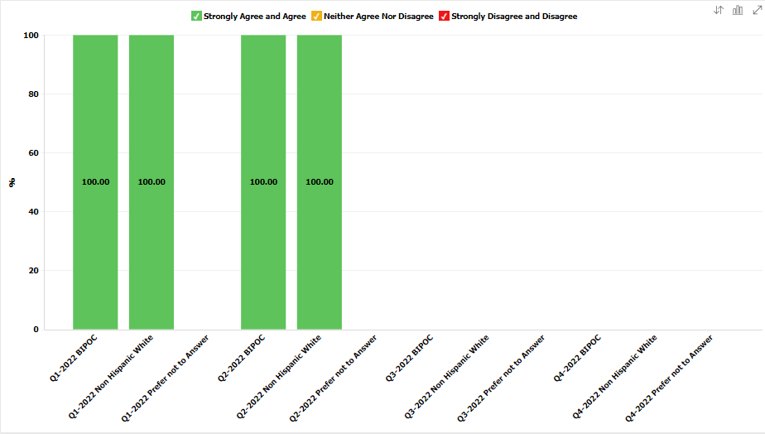
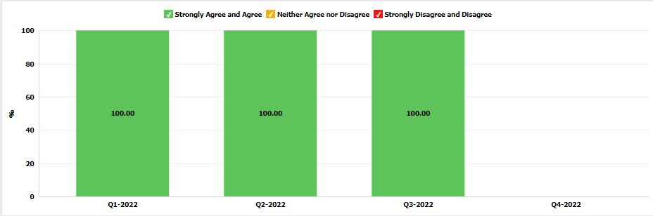
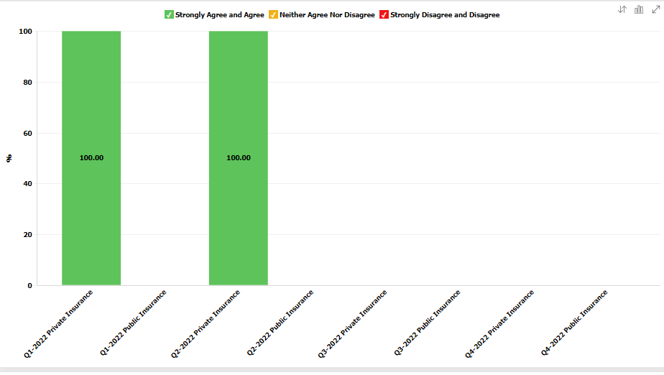
PREM Reports Launched!
Toggle between Reports 1-14
Toggle between Monthly & Quarterly
Race and Ethnicity
Insurance
Aggregate
Notes:
Number of birthing people discharged after delivery who received the Patient Reported Experience Measure (PREM) Survey either via QR Code or hospital iPad/tablet/laptop

Slide 18
Focusing on Postpartum Safety

Slide 19

Postpartum Safety
Birth Equity Key Strategy
  Standardize postpartum safety education and schedule early postpartum follow up prior to hospital discharge

Slide 20
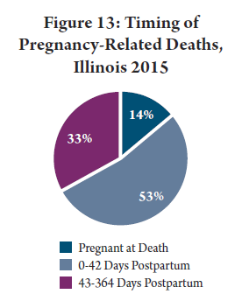
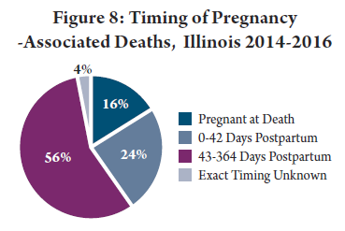
Maternal Mortality in the Early
Postpartum Period
24% of pregnancy associated deaths 0-42 days
53% of pregnancy related deaths 0-42 days
Before the 6 week visit
http://dph.illinois.gov/sites/default/files/publications/publicationsowhmaternalmorbiditymortalityreport112018.pdf
Notes:
Key recommendations from MMRC report
Providers should adopt the recommendation from the American College of Obstetricians and Gynecologists (ACOG) for early postpartum visit in addition to traditional 6 week visit
Birthing hospitals should ensure that women are connected with a primary care or obstetrical provider and scheduled for a postpartum visit prior to hospital discharge

Slide 21
Key Recommendations from the IL MMRC report, 2018
For Providers:
  Providers should adopt the recommendation from the American College of Obstetricians and Gynecologists (ACOG) for early postpartum visit in addition to traditional 6 week visit
For Hospitals:
  Birthing hospitals should ensure that women are connected with a primary care or obstetrical provider and scheduled for a postpartum visit prior to hospital discharge
For Health Plans:
  Illinois should expand Medicaid eligibility for the postpartum period from 60 days to one year after delivery and health insurance plans should cover case management and outreach for postpartum high-risk women for up to one year after delivery
  Health insurance plans should separate payment for visits in the postpartum period from labor and delivery (unbundle postpartum visit services from labor and delivery)
http://dph.illinois.gov/sites/default/files/publications/publicationsowhmaternalmorbiditymortalityreport112018.pdf
Notes:
https://www.riverbender.com/articles/details/illinois-releases-first-maternal-morbidity-and-mortality-report-31421.cfm
CAN WE ADD THE % OF PREVENTABLE DEATHS FOR OB CAUSES
Also can we add a slide on top causes of death? If there is a slide.

Slide 22

Maternal Morbidity in the Early Postpartum Period
50% of postpartum strokes occur within 10 days of discharge (Too G et al, 2018)
20% of women discontinue breastfeeding before the first 6-weeks (Stuebe et al, 2014)
Up to 40% of women do not attend the 6-week postpartum visit (ACOG CO #736 2018)
As many as 1 in 5 women experience a postpartum mental health disorder and is a leading cause of pregnancy related death (Tully, 2018, IDPH Maternal Mortality Report)
Notes:
Suzanne to add citations
Stuebe AM, et. al. Prevalence and risk factors for early, undesired weaning attributed to lactation dysfunction. J Womens Health (Larchmt) 2014;23:404–12.
Martin A, et. al. Views of women and clinicians on postpartum preparation and recovery. Matern Child Health J 2014;18:707–13. 5.
Tully KP, et. al. The fourth trimester: a critical transition period with unmet maternal health needs. Am J Obstet Gynecol 2017;217:37–41.
Optimizing postpartum care. ACOG Committee Opinion No. 736. American College of Obstetricians and Gynecologists. Obstet Gynecol 2018;131:e140–50.
. Illinois Maternal Morbidity and Mortality Report. Illinois Department of Public Health. (October 2018)
Too G , Went T , Boehme AK , Miller EC , Leffert LR , Attenello FJ , et al. Timing and Risk Factors of Postpartum Stroke . Obstet Gynecol 2018

Slide 23

Women desire improved postpartum care
Qualitative studies point to women’s lack of satisfaction with postpartum care compared to maternal care
With women noting a steep drop off in care in the early postpartum period
Women reported wanting additional, early postpartum care
Martin A, et. al. Views of women and clinicians on postpartum preparation and recovery. Matern Child Health J 2014.
Tully KP, et. al. The fourth trimester: a critical transition period with unmet maternal health needs. Am J Obstet Gynecol 2017

Slide 24
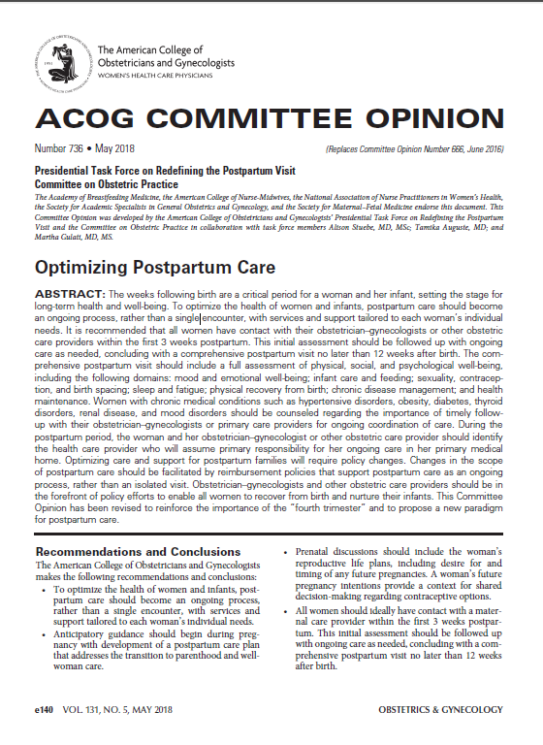
Redefining Postpartum Care:
ACOG CO #736
To optimize the health of women and infants, postpartum care should become an ongoing process, rather than a single encounter
All women should ideally have contact with maternal care provider within the first 3 weeks postpartum
  Blood pressure checks
  Breastfeeding support
  Mental health well-being
  Contraception
Initial assessment should be followed up with ongoing care as needed
Conclude with a comprehensive postpartum visit NO LATER than 12 after birth

Slide 25
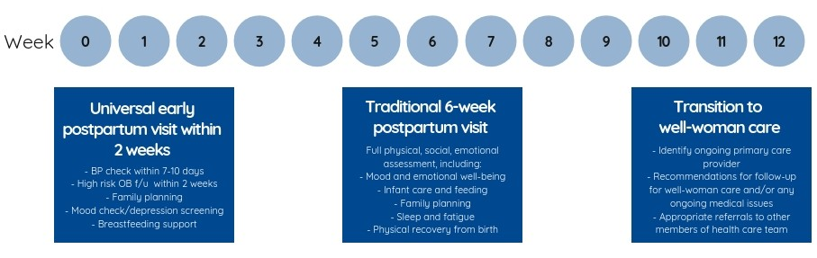
New Postpartum Care Continuum
An early postpartum visit (within 2 weeks of delivery) provides women with essential maternal safety checks such as blood pressure evaluation, wound/perineum evaluation, breastfeeding support, mental health well-being, and family planning, among other essential health services.

Slide 26


Components of the 2 week early
PP visit
Maternal Health
Safety Check
Blood pressure / preeclampsia symptoms check
Wound/ perineum check
Assess appropriate postpartum bleeding
Mood check/depression screening
Breastfeeding support
Family planning/contraception options
Linkage to health / community services
(ie. WIC, breastfeeding support, home visits)
Assess medical / pregnancy complications, including
SUD/OUD risks and link to needed follow up care
Review risk reduction strategies for future
pregnancies

Slide 27
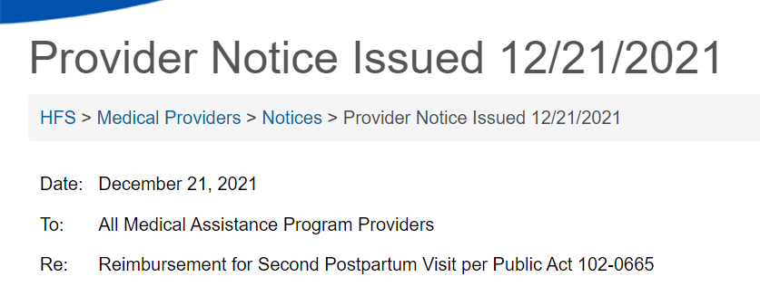

This notice confirms coverage for a second postpartum visit required by Public Act 102-0665. This policy applies to both Medicaid fee-for-service and the HealthChoice Illinois managed care plans.
The Act specifies coverage for a postpartum visit within the first 3 weeks after childbirth and a comprehensive visit within 4 to 12 weeks postpartum for persons who are otherwise eligible for Medical Assistance. Department policy already allows for one postpartum visit. Providers may bill the same procedure code, 0503F – Postpartum Care Visit, twice during the postpartum period and be reimbursed in accordance with the Act.
This policy is retroactive to dates of service beginning October 8, 2021. Questions may be directed to the Bureau of Professional and Ancillary Services at 877-782-5565 or the applicable managed care plan.
https://www2.illinois.gov/hfs/MedicalProviders/notices/Pages/prn211221b.aspx

Slide 28

AIM Bundle
Postpartum Discharge Transition Bundle: To address the postpartum period, specifically focusing on key transition periods, such as hospital discharge to outpatient obstetrical care and ongoing specialist care as needed.

Slide 29

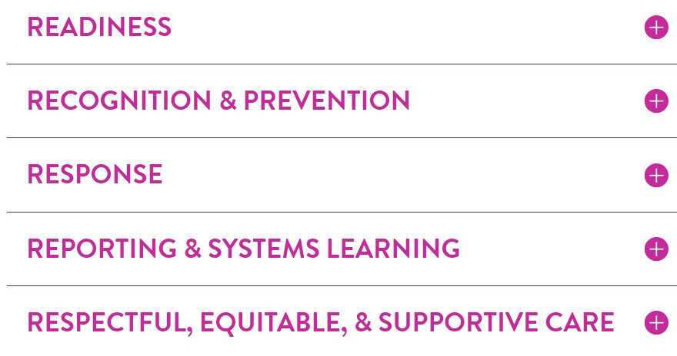
AIM Bundle Resources (clink links)
Postpartum Discharge Transition Printable Bundle (PDF)
Postpartum Discharge Transition Element Implementation Details (PDF)
Postpartum Discharge Transition Core Data Collection Plan (PDF)
Postpartum Discharge Transition Bundle Implementation Resources (PDF)
Postpartum Discharge Transition Implementation Webinar

Slide 30
ILPQC IPAC Initiative

Slide 31







Improving postpartum safety through improved access to postpartum care
16 hospitals participated from May 2019 to May 2020
Implement universal 2 week postpartum Maternal Health Safety Check schedule before discharge
Provide postpartum safety education before delivery discharge for ALL patients
  Post birth warning signs
  Benefits of early postpartum follow-up
  Healthy pregnancy spacing
16 hospitals participated
https://ilpqc.org/improving-postpartum-acess-to-care-ipac/
Notes:
Add bullet on universal 2 week postpartum visit. Two things Saftey education # of participating. Insert a map of hospitals on where they are
Results
14 participating hospitals were diverse by geography, birth volume, and patient mix. All hospitals implemented scheduling universal early postpartum visits before delivery discharge by May 2020. Teams reported 90% of providers and nurses received education regarding maternal risk and improving access to care in the postpartum. A sample of 1,940 deliveries across participating hospitals showed an increase of patients with an early postpartum visit scheduled prior to discharge from 2% to 80%. Discharge education on postpartum early warning signs increased from 21% to 98% of patients. Hospitals achieved benchmarks on key measures regardless of hospital characteristics
Implementation of universal scheduling of early postpartum visits and postpartum safety patient education before delivery discharge is feasible and can be implemented across diverse hospitals. Future work should focus on the impact of early postpartum maternal health safety checks and improved postpartum education on maternal postpartum outcomes and disparities.
Postpartum safety

Slide 32
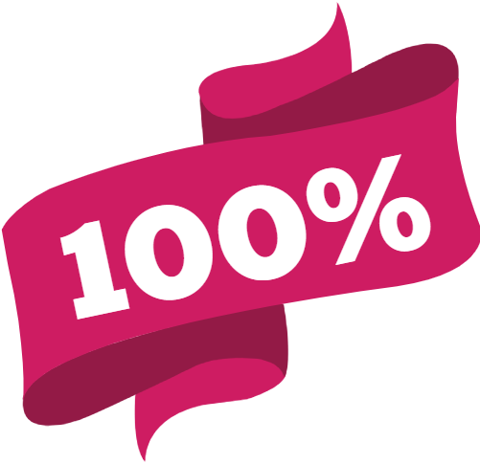
Achieving sustainable change
Of hospital teams went live with IPAC within 11 months
Compliance Monitoring
Monitor patient postpartum safety education
Monitor % of patients with early pp visit scheduled prior to d/c
New Hire & Ongoing Education
Plan for training residents, new providers on maternal health safety check
Educate new nursing hires on the scheduling process
Monitor Scheduling & Provider billing
Identify potential issues early
Inform ILPQC for help with troubleshooting

Slide 33
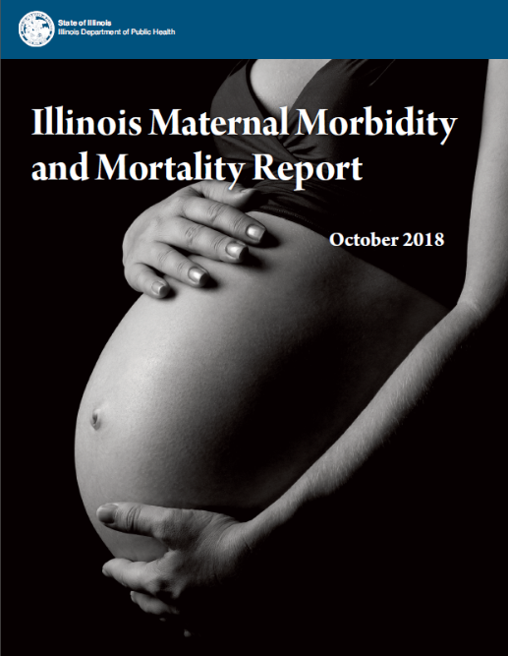
IPAC Toolkit Resources:
OB Provider Packet for Buy-In
What’s included
Initiative introductory letter signed by hospital OB Chair
Hospitals discharge process flow
IPAC Fact Sheet
National and State Guidance documents
  ACOG CO #736
  AIM Postpartum Care Safety Bundle
  IDPH Maternal Morbidity and Mortality Report
Billing and coding resources
Provider education resources
Office Flyer
https://ilpqc.org/improving-postpartum-acess-to-care-ipac/

Slide 34
Implementing: Early 2 week PP visits
Consider how your team can use these steps as you plan your work

Slide 35
Recognition & Prevention – Every Patient – Key Themes
Establish a system for scheduling the postpartum care visit and any needed specialty care visit follow up (virtual or in-person visit) prior to discharge or within 24 hours of discharge.
Screen each patient for postpartum risk factors and provide linkage to community services/ resources prior to discharge.*

Slide 36

Process Flow for Scheduling
Early Postpartum Visit
Patient meets all discharge criteria
Patient counseled on need for early postpartum visit at 2 weeks and will help make appointment before discharge
Provide patient education materials on the benefit of early postpartum visit, warning signs/symptoms to seek care (ie. AWHONN hand out), and information on benefits of pregnancy spacing/family planning options.)
Able to schedule early postpartum appointment before discharge
No
Arrange follow up with patient to schedule 2 week postpartum visit after discharge
Yes
Appointment scheduled and appointment date and time added to patient’s discharge paperwork
Confirm patient has early pp visit scheduled and document in record
Document counseling, education and postpartum care plan in discharge summary / instructions and ensure patient has follow up plan

Slide 37
Process map current discharge
workflow
Test – work with patient to call the provider’s office to schedule postpartum visit during postpartum discharge education on early warning sign and importance of early postpartum visit
OB Provider to see patient and place d/c order
Prescription plan/orders complete in EMR or e-pharmacy
Complete AVS (d/c) instructions and signed off in EMR specific to patient
OB Provider
Verify OB Provider tasks are complete
Complete birth record activities or verify parental plan for birth record completion
Complete discharge education for mother and baby
Resolve care plan & complete d/c tasks (security system, infant transportation, tests, etc)
Complete discharge note
PP Nurse
Send admitting notification on patient’s discharge
Clear chart from EMR system
Order for pp room to be cleaned
Secretary
37

Slide 38

Sample PDSA
Asked one OB resident from the large clinic along with one nurse to try the new workflow for one patient during discharge process.
Identified patient was unclear on who they should schedule an appointment with. Resident realized opportunity to discuss at discharge visit.
Team will ADAPT implementation approach and add to the OB provider’s role in identifying place of pp follow-up visit.
Team met and developed a process flow on current discharge workflow. Identified opportunity to schedule postpartum visit during discharge education.
Act
Plan
Study
Do

Slide 39
Adapted process map of discharge workflow
Adapt Identified that patients were able to schedule visit during discharged education but need to know where to follow-up if issues/ early warning signs. Incorporate in provider discussion and discharge instructions.
OB Provider to see patient and place d/c order
Prescription plan/orders complete in EMR or e-pharmacy
Complete AVS (d/c) instructions and signed off in EMR specific to patient
OB Provider
Verify OB Provider tasks are complete
Complete birth record activities or verify parental plan for birth record completion
Complete discharge education for mother and baby and schedule pp visit
Resolve care plan & complete d/c tasks (security system, infant transportation, tests, etc)
Complete discharge note
PP Nurse
Send admitting notification on patient’s discharge
Clear chart from EMR system
Order for pp room to be cleaned
Secretary
39

Slide 40
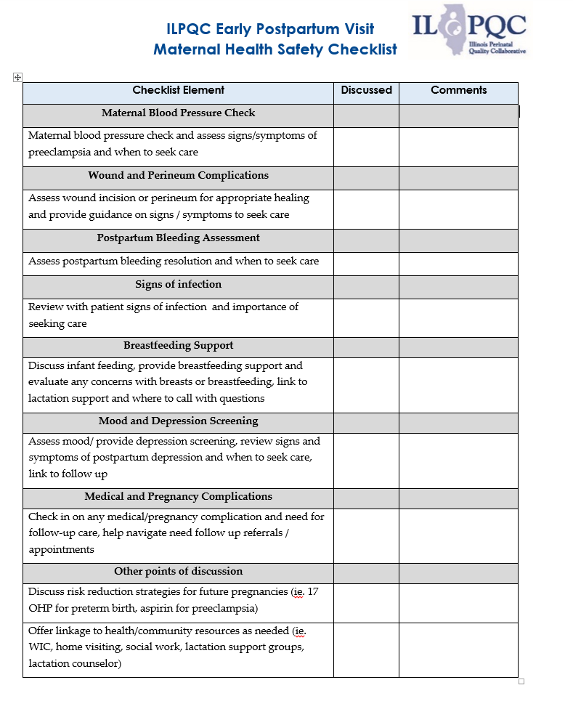
Early Postpartum
Visit/ Maternal Health Safety Checklist

Slide 41
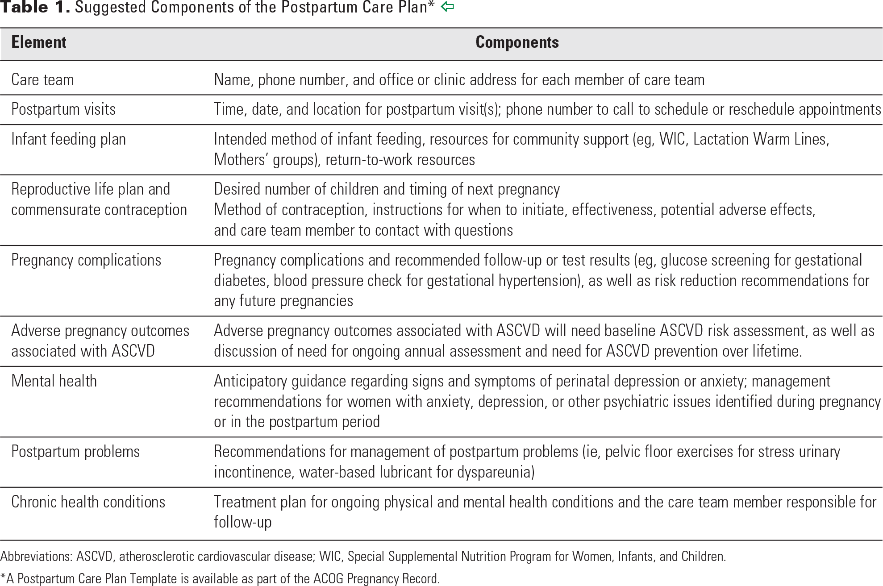
https://www.acog.org/clinical/clinical-guidance/committee-opinion/articles/2018/05/optimizing-postpartum-care

Slide 42
Using QI Strategies to update
discharge / scheduling process
Team meets to brainstorm what process/workflow might work best for their hospital, providers, and staff:
Create a Process Map for current discharge workflow
Review their current process to determine ideas on what might work best to address scheduling postpartum / specialist visits
QI work: Perform PDSA cycle to test with one patient, one nurse and one OB provider
Consider steps needed in 30/60/90 day planning process

Slide 43
Team Talk

Slide 44
Memorial Hospital of Carbondale IPAC
Team Members:
Mary Jarvis, MSN, RN, CLC
Angi Ellis, RN
Dr. Sherry Jones

Slide 45

Memorial Hospital of Carbondale
Memorial Hospital of Carbondale is the flagship hospital for SIH and regional referral center for the 16 county southern Illinois region. Memorial paves the way to bring big city medicine home. Physicians in over 45 different specialties practice here, bringing expertise and new procedures, but successfully tailoring them to the particular needs of a rural setting.
154-bed tertiary care hospital
The core hospital for SIH’s comprehensive, regional heart program, Prairie Heart Institute.
High level surgical capabilities including daVinci technology
Affiliated with SIU School of Medicine through its Family Practice Residency Program
Neuroscience program including neurosurgery and a designated Primary Stroke Center
Accredited by the Commission on Cancer for comprehensive cancer treatment
Recently added Level II Trauma Center Designation

Slide 46
Women and Children
Designated Level II+, SIH Women and Children center delivers 2000 births per year. And with a local birthing center closing their doors we have increased our deliveries by 30%. Baby Friendly Designated since 2015.
85 Total Beds (7 LDR, 2 C-section ORs, 13 SCN, 21 Normal Newborn, 8 Antepartum, 6 Triage , 20 Mother Baby, 14 Pediatric)
Southern Illinois’ largest and most spacious birthing center with Level II+ Special Care Nursery
Only dedicated pediatric unit in the region
Dedicated Anesthesia 24/7
Nearly covering 24/7 Lactation support

Slide 47

Overall Initiative Aim:
Implement universal early postpartum visits (within 2 weeks) and be able to facilitate scheduling prior to discharge
Communicate recommendations/ strategy for early postpartum visit with OB providers
Provided ILPQC OB provider/outpatient care site packet
Worked with discharge patient navigator to facilitate scheduling of early postpartum visits & universal patient education prior to discharge
Implement standard postpartum education prior to discharge after delivery
Educate all providers and staff on optimizing early postpartum care
Outcome:
Increase the % of women with early postpartum visits within first 2 weeks of delivery
Increase PP education prior to discharge
Notes:
Our discharge navigator calls the office for the moms appoint to be followed up in 2 weeks. She is here Tues-Friday. On the other days we notify the patients to call on Monday for a follow up appointment within 2 weeks.

Slide 48
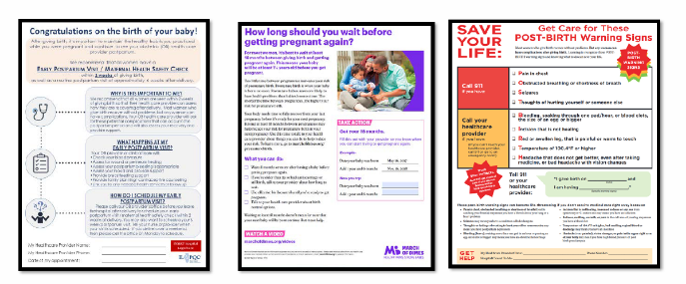
Goals:
Implement standard postpartum education prior to discharge after delivery
Implement provider and nurse education on risks of the postpartum period, benefits of early pp visit, and needs of the maternal health safety check.
Implement above process with patient discharge navigator to review education with patient prior to going home and has 2 week (7-10days if HTN) pp follow up appointment.

Slide 49
Thank you!

Slide 50
Birth Equity
Franciscan Health
St. James Hospital,
Olympia Fields
Trish Kovacs
Raquel Lewis
Ann Mitchell

Slide 51

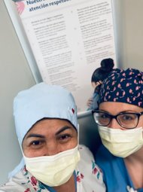
Family Birth Center Info
Level II E
About 80-100 births/month
7 labor suites; 8 postpartum beds; 7 special care nursery beds;
2 triage rooms;
4 NST rooms; ultrasound; MFM clinic
Majority of patients from Aunt Martha's Chicago Heights Women's Health Center

Slide 52

Birth Equity Successes
Coming up:
Cornerstone CDC Health & Wellness Fair Saturday, 8/27; Ford Heights
Speak Up Training (January)
Diversity Science Modules in Learning Compass (April)
Respectful Care Practices Visible Around Unit (May)
SDOH Resource Packets (July)
Key Players Meeting for PREM Survey Roll Out (August)

Slide 53


Focus on IPAC
--Improving Access to Care
Schedule EARLY Postpartum Visits Prior to Discharge
Why See Patients Within 2 weeks?
  In IL, 24% of pregnancy-associated deaths occurred 0-42 days postpartum
  50% of postpartum strokes occur within 10 days of discharge
  20& of women discontinued breastfeeding before the first 6 weeks
  Up to 40% of women do not attend the 6-week postpartum visit
  As many as 1/5 women experience a postpartum mental health disorder
  IL Maternity Morbidity and Mortality recommended ACOG standard of...

Slide 54
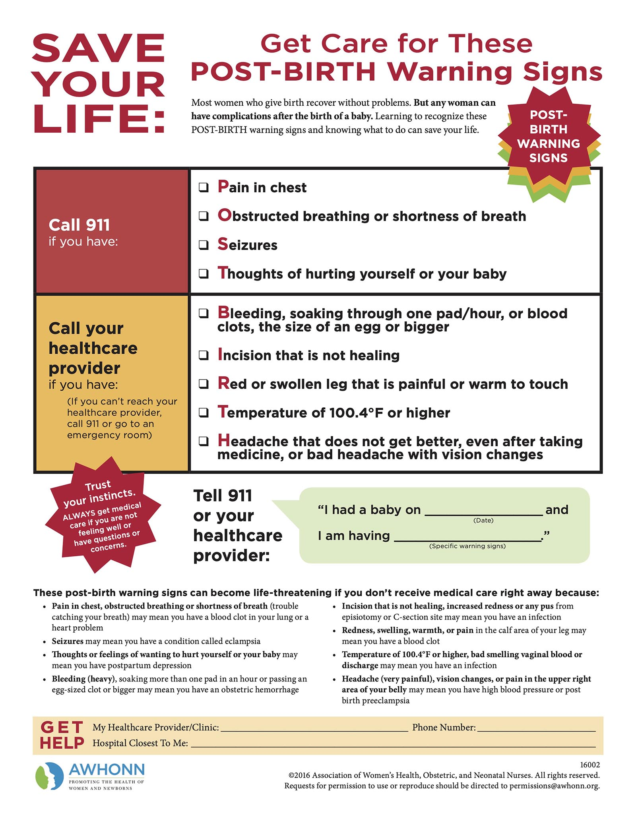
Franciscan St. James Methods since at least 2017...
Expectation: Postpartum visit is scheduled before d/c home
  ("Routine"- patient seen within 2 weeks of discharge)
If blood pressure disorder, patient should be seen within 3 days of discharge
If blood pressure controlled on medications, patient should be seen within one week of discharge
Buy in From Aunt Martha's clinic- office personnel come every 2-3 days to schedule appointments for postpartum women and infants (greatly increases our success rate with this movement)

Slide 55

Challenges
This Photo by Unknown author is licensed under CC BY.
Getting away from "She's fine"; "Six weeks is okay to see her" thinking
As we know, most issues come up the first few weeks someone is home after discharge
It's important to know the statistics to have educational conversations with providers to keep women safe and help the Birth Equity movement
80% of pregnancy-associated deaths in IL occurred in the postpartum period
72% of pregnancy-associated deaths were preventable
In IL- Black women are 6 times more likely to experience pregnancy-associated death then white women and experience morbidity at 3 times the rate

Slide 56

Goal for all providers/hospitals
Reframing the Postpartum Period:
At 2 weeks:
  BP check, Wound/perineum check, Mood check, depression screening, Family planning, Breastfeeding support then traditional visit at 6 weeks
  Scan QR code for full chart

Slide 57
References
ILPQC Improving Access to Care (IPAC) Toolkit. (May 2019-May 2020).

Slide 58
Birth Equity next steps

Slide 59

Next Steps for Birth Equity
Monthly data for July due into REDCap by August 15^{th (TODAY)!}
Schedule your team KPM meeting to receive help to get started
Make a 30 60 90 day plan for next steps to implement early pp visit scheduling before discharge
Next Stop!
Illinois Perinatal Quality Collaborative

Slide 60

Upcoming BE Webinars:
Event | Day/Time
Implementing postpartum education | September 19th at 12:00pm
NO Webinar (Annual Conference) | October 17th at 12:00pm
Register and Join here:
https://northwestern.zoom.us/meeting/register/tJMod-uoqDotGtzzJICE1O5TphPWT2-pZfmY

Slide 61










Thanks to our Funders
In kind support:

