Slide 1
Perinatal-Neonatal Quality Improvement Network of Massachusetts (PNQIN) Our PQC’s Approach & Commitment to Equity
Audra Meadows, MD, MPH
PNQIN
Notes:
Improving Maternal Health in Region 5:
Amplifying Effective Strategies to Address Substance Use Disorder and Birth Equity
September 16, 2020

Slide 2
Disclosure
I have no financial relationships with a commercial entity producing health care related products or services related to this presentation.

Slide 3
PNQIN Mission Statement (August 2016)
Through open sharing of data and promotion of best practices, PNQIN will achieve measurable improvements in perinatal health outcomes while eliminating health disparities and improving health equity among Massachusetts mothers, newborns, and their families.
quality improvement initiatives
collaborative learning
open sharing of data
promotion of best practices

Slide 4
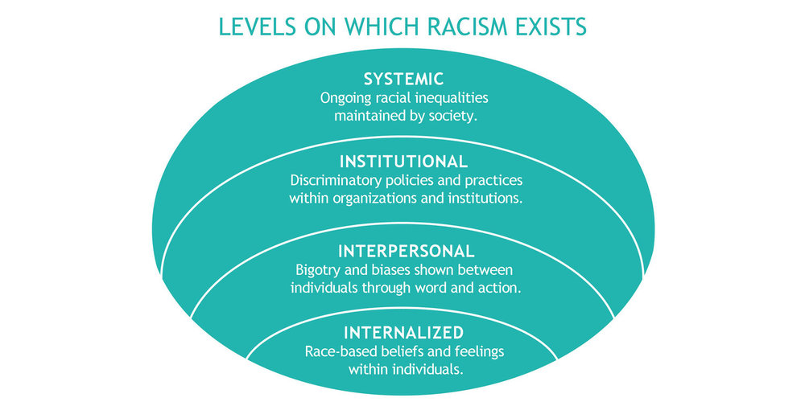
Raise Awareness
Raise Awareness
Raise Awareness
Collect and Stratify Data by Race/Ethnicity
Implement Programs and Trainings
Implement AIM Equity Bundle Components

Slide 5
Moving the Conversation: Equality to Equity to Liberation
Assumption: Everyone benefits from the same (equal) support
Everyone gets the support they need
Systemic Barriers Removed

Slide 6
Moving the Conversation: Equality to Equity

Slide 7
Raised Equity Awareness at our AIM Kick-Off Meeting May 2019
Timoria McQueen Saba
Maternal Health Advocate
Candice Belanoff, ScD, MPH
Clinical Associate Professor
Department of Community Health Sciences
Boston University School of Public Health
Allison Bryant, MD MPH
Vice Chair, Quality, Equity and Safety
Associate Professor of Ob/Gyn, Harvard
Massachusetts General Hospital
Joia Crear-Perry, MD
National Birth Equity Collaborative
Hafsatou Fifi Diop, MD, MPH
Massachusetts Department of Public Health
Notes:
STORY: I wish we had taped this

Slide 8
Our Massachusetts Partners

Slide 9
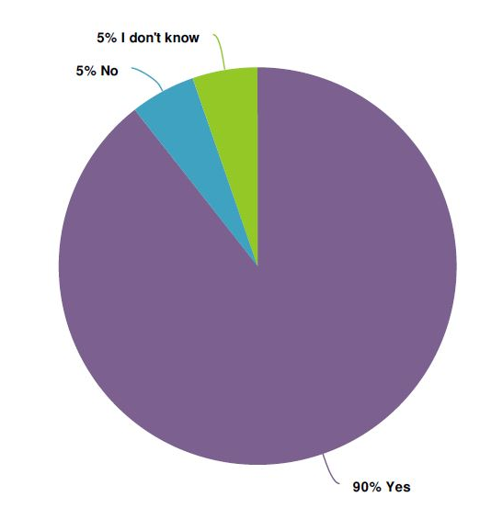
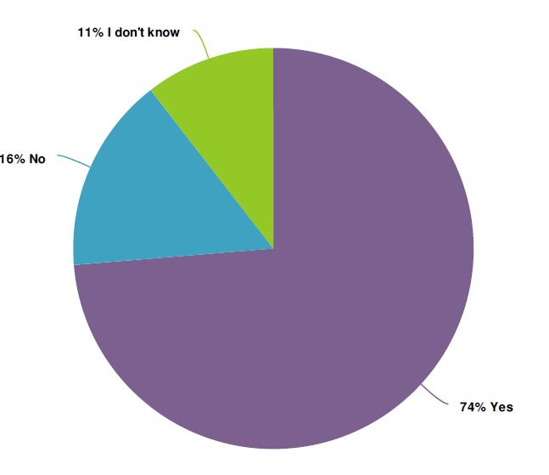
AIM Baseline Survey
Does your site collect data on race, ethnicity, language, gender in your EHR/EMR?
Race Language Gender

Slide 10
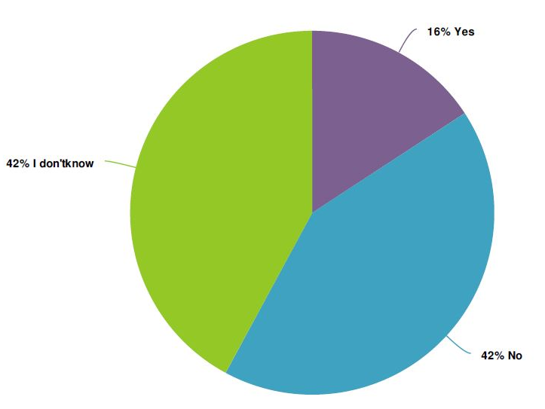
AIM Baseline Survey
Does your site have an equity dashboard?
A healthcare dashboard is defined as a modern analytics tool to monitor healthcare Key Performance Indicators in a dynamic and interactive way, including patient statistics in real-time. Health equity dashboards include REAL (race, ethnicity, and language) data.

Slide 11
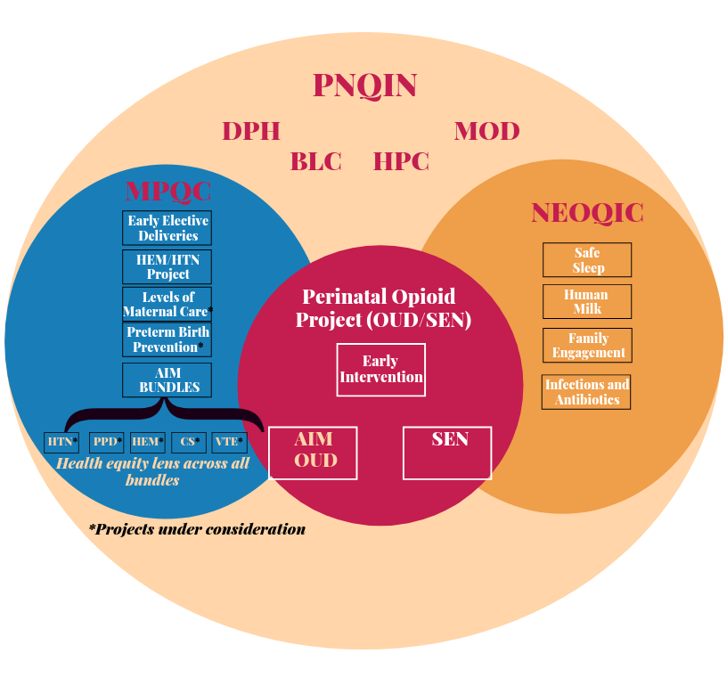
Hospital Engagement in AIM OUD -> SMM Data Project
AIM OUD Bundle enhancement of PNQIN Opioid Project
Tool used to increase obstetrical involvement in current efforts
Wave 1: June 2019- 22 hospitals
Wave 2: June 2020- 17 hospitals

Slide 12
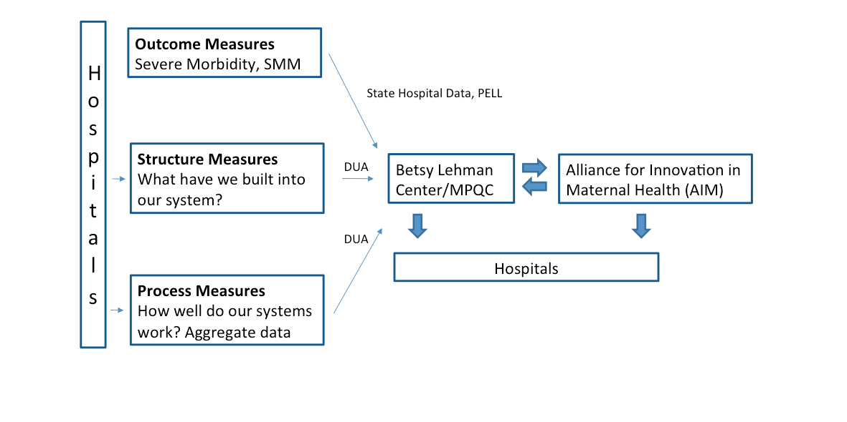
AIM Data Flow

Slide 13
PNQIN AIM Initiative and SMM Reports
MA AIM Mission: AIM launched in 2018-19 to reduce maternal morbidity, prevent mortality, and eliminate associated disparities in MA.
About AIM and SMM: MPQC began the MA Data Project in 2014. With the SMM requirement related to joining AIM and our partnership with BLC, PNQIN invigorated our SMM work (MA Data Project 2.0). With our mission to address disparities, we enhanced this project to include race/ethnicity stratification.
Our Goals Include:
Generate reports from HDD to reflect hospital performance in maternal outcomes bi-annually
Support hospitals with (1) reviewing their SMM data including disparities, (2) obtaining timely and accurate hospital discharge data and (3) measure AIM bundle performance

Slide 14
What is SMM?
Severe maternal morbidity (SMM) includes unexpected outcomes of labor and delivery that result in significant short- or long-term consequences to a woman’s health.
Using the most recent list of indicators, SMM has been steadily increasing in recent years. Our goal is to change that in MA. We started with OUD and plan to move to hemorrhage and hypertension.
American College of Obstetricians and Gynecologists and the Society for Maternal–Fetal Medicine, Kilpatrick SK, Ecker JL. Severe maternal morbidity: screening and review external icon. Am J Obstet Gynecol. external icon2016;215(3):B17–B22.
Callaghan WM, Creanga AA, Kuklina EV. Severe maternal morbidity among delivery and postpartum hospitalizations in the United States.external icon Obstet Gynecol. 2012;120(5):1029–1036.

Slide 15
CDC Severe Maternal Morbidity (SMM) List
Acute myocardial infarction
Aneurysm
Acute renal failure
Adult respiratory distress syndrome
Amniotic fluid embolism
Cardiac arrest/ventricular fibrillation
Conversion of cardiac rhythm
Disseminated intravascular coagulation
Eclampsia
Heart failure/arrest during surgery or procedure
Puerperal cerebrovascular disorders
Pulmonary edema / Acute heart failure
Severe anesthesia complications
Sepsis
Shock
Sickle cell disease with crisis
Air and thrombotic embolism
Blood transfusion
Hysterectomy
Temporary tracheostomy
Ventilation
https://www.cdc.gov/reproductivehealth/maternalinfanthealth/smm/severe-morbidity-ICD.htm

Slide 16
SMM20 and SMM21 Rates in Massachusetts: 2016-2018

Slide 17
SMM20 Rates by Race/Ethnicity: MA 2016-2018

Slide 18
Apply Equity Lens to Severe Maternal Morbidity Data
SMM Pilot Project
8 pilot sites receiving feedback on report sharing and understanding SMM outcomes by race/ethnicity to highlight inequities
Collaboration with the Betsy Lehman Center (BLC) since 2018 to access and analyze HDD from the MA Center for Health Information and Analysis, known as CHIA.
Plan with 33 remaining sites
Key Takeaways
Trends continue to increase in SMM, especially in more recent years
Racial disparities exist in Massachusetts’ SMM rates:
Black women are 2 times more likely to have SMM compared to White women
Hispanic women are nearly 1.5 times as likely to have SMM compared to White women
Black women are nearly 1.5 times more likely to experience SMM compared to their Hispanic counterparts

Slide 19
Apply Equity Lens to Severe Maternal Morbidity Data
Challenges
Quality of existing data
Missing data points (e.g., race/ethnicity)
Lack of data from women about their experience (e.g., not being respected, not being heard, being discriminated against, etc.)
Concern about reported data “over capturing” SMM indicators, possibly due to coding errors
Higher SMM attributed to transports of high risk mothers out of community hospitals
Desire to apply a research lens to quality improvement data
Medical record data not accurately transmitted to HD data

Slide 20
Massachusetts SMM for OUD

Slide 21
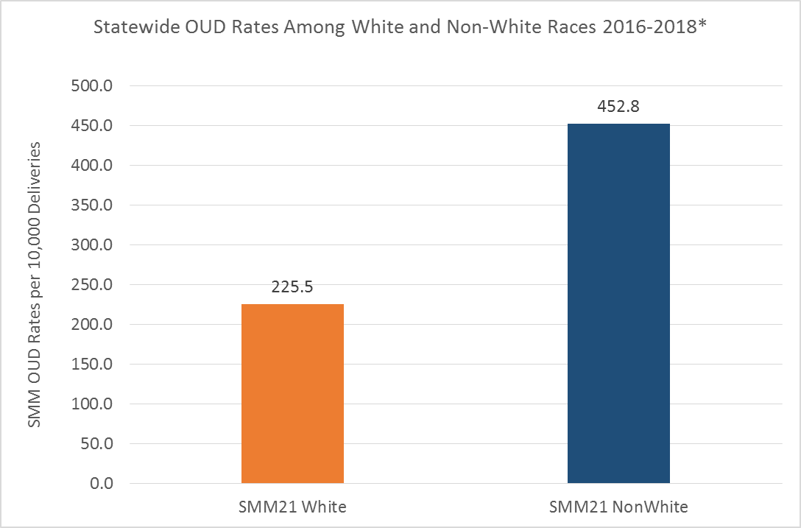
Massachusetts SMM21 OUD by Non-white/white*
Notes:
SMM rate for the state runs around 180
Nonwhite twice as high as white

Slide 22
Collaboration with Boston University School of Public Health
MC802 Student Consulting Team (BUSPH)
Fall 2019
Notes:
Project RESPECT (Recovery, Empowerment, Social Services, Prenatal care, Education, Community and Treatment) is a high risk obstetrical care and addiction recovery medical home at Boston Medical Center and Boston University School of Medicine. Established in 2006, the Project RESPECT clinic provides a unique service of comprehensive obstetric and substance use disorder treatment for pregnant women and their newborns.

Slide 23
BUSPH Pregnant Women of Color project

Slide 24
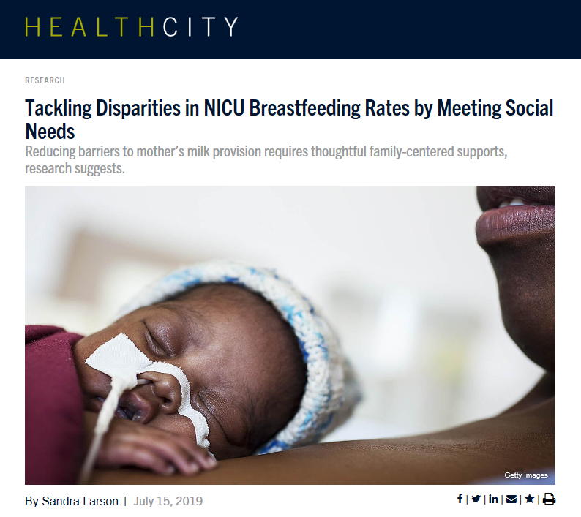
Breastfeeding and Racial Disparities
Notes:
Scholarship

Slide 25
Education on racial bias in care and creating a culture or equity
Notes:
Debra Bingham
Renée Byfield, MS, RN, FNP, C-EFM
Clinical Leader
Specializing in obstetric and newborn care

Slide 26
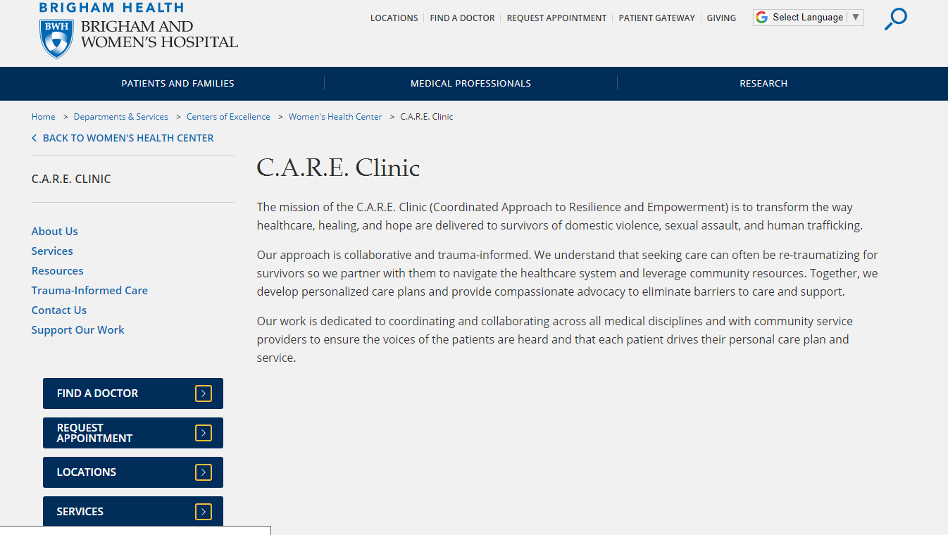
Trauma Informed Care, Stigma and Bias Trainings
Brigham & Womens Hospital CARE Program
Coordinated Approach to Resilience and Empowerment (CARE)
Led by Dr Annie Lewis-O’Connor
PNQIN POP Summit Trainings
Team TIC Trainings
June to September 2020
2 hours
Team focused
Interactive

Slide 27
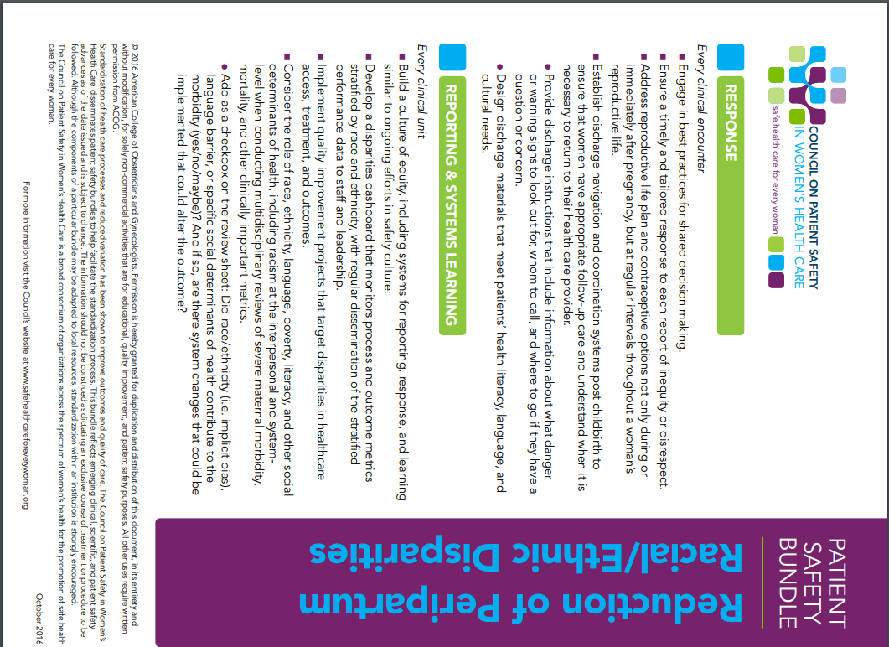
Commitment to Equity Bundle Implementation
AIM Bundle to Reduce (eliminate) Racial/Ethnic Disparities
https://safehealthcareforeverywoman.org/patient-safety-bundles/#tab-maternal

Slide 28
Thank you Now to Patti and then questions…

