Slide 1

Getting the Reports you need from REDCap
BASIC Monthly Teams Call
June 20th, 2022
Notes:
Using Data to tell your Story

Slide 2
Call Overview
Face-to-Face Recap
BASIC Data Review
Data Definitions
  36 is the new 48
Logging in to REDCap
Accessing your REDCap Reports
QI Corner
Notes:
Data Definitions
36/48 hours
NM has a BASIC specific dashboard, going out to all the partners
Picked out specific data to share on
Listing of Reports: so people know what each report is
Highlight Key reports

Slide 3


Face-to-Face Conference Recap
93 hospitals attended
OB Day: 356
Neonatal Day: 272
5 National Speakers
Breakout Sessions:
  15 OB Breakout Sessions
  10 Neonatal Breakout Sessions
Storyboards:
  36 OB Storyboards
  26 Neonatal Storyboards

Slide 4
Face-to-Face Recordings Available Soon
If you were unable to attend the ILPQC 2022 Face-to-Face meeting, the recordings will be available soon on the webpage.
Be sure to check out the awesome sessions we had including….
  Recovering from the Pandemic: The Role of Civility and Community with Gaurava Agarwal, MD
  Continuing our MNO-Neonatal Work amidst Increasing Maternal OUD Rates in Illinois
  Partnering with Parents on our QI Journey with LaToshia Rouse, CD(DONA)
  The Right Antibiotics, Right Babies, Right Amount of Time: Going for Gold in 2022
  BASIC Hospital Teams Panel Share Real-World Approaches

Slide 5
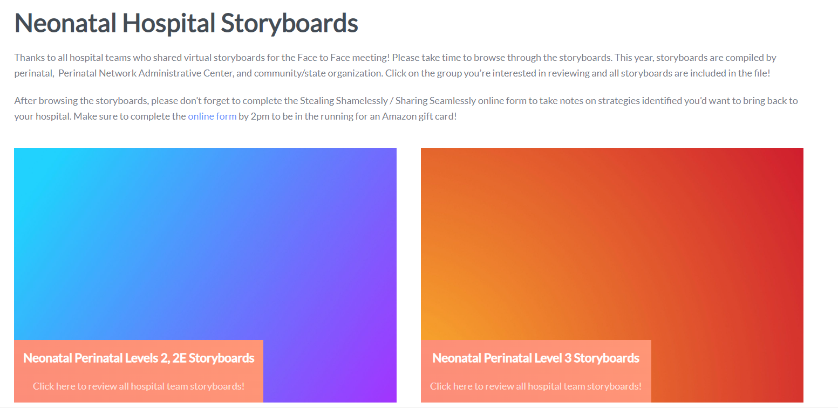
Storyboards are still available on the F2F webpage

Slide 6



BASIC QI Awards
QI Excellence Award:
6 key structure measures in place
Achieved all process and outcome measures
QI Leader Award:
6 key structure measures in place
Achieved at least three process and outcome measures
QI Recognition Award:
Have 4-5 key structure measures in place
Achieved at least two process and outcome measures
10 winners
7 winners
13 winners

Slide 7
BASIC QI Award Winners
QI Excellence Award
Advocate Aurora Sherman Hospital
Advocate Children's Hospital- Oak Lawn
Advocate Good Samaritan Hospital
Edward Hospital
Loyola University Medical Center
Memorial Hospital East
NorthShore University HealthSystem Evanston
Northwestern Lake Forest Hospital
OSF St. Francis Medical Center
QI Leader Award
Advocate Illinois Masonic Medical Center
Alton Memorial Hospital
Ascension Resurrection
Ascension Saint Alexius
Elmhurst Memorial Hospital
HSHS St. John's Hospital
West Suburban Medical Center
QI Recognition Award
AdventHealth Hinsdale
Advocate Condell Medical Center
Blessing Hospital
FHN Memorial Hospital
John Stroger Hospital of Cook County
Memorial Hospital of Carbondale
Morris Hospital
NM Delnor Hospital
NM Huntley Hospital
OSF St. Anthony Medical Center
Riverside Medical Center
Rush Copley Medical Center
SSM Health Good Samaritan Hospital

Slide 8
MNO-Neonatal Achievement Awards
Submitted all monthly patient data
Have all key structure measures in place
Completed and submitted a sustainability plan
Achieved key goals in the care for patients with opioid use disorder between October 2021 and March 2022, including:
  ≥70% of newborns breastfeeding at infant discharge
  20% reduction in pharmacologic treatment
  ≥ 95% of newborns with a coordinated discharge plan
38 winners

Slide 9
MNO-Neonatal QI Achievement Awards
Breastfeeding at Infant Discharge
Carle BroMenn Medical Center
HSHS St. Mary's Hospital
Little Company of Mary Medical Center
Memorial Hospital Carbondale
Morris Hospital
NM Kishwaukee Hospital
Northwestern Memorial Hospital
Riverside Medical Center
Coordinated Discharge
Elmhurst Memorial Hospital
Little Company of Mary Medical Center
Memorial Hospital Carbondale
Morris Hospital
Riverside Medical Center
Silver Cross Hospital
SSM Health St. Mary's – St. Louis
West Suburban Medical Center
Pharmacologic Treatment Reduction
Carle BroMenn Medical Center
Elmhurst Memorial Hospital
HSHS St. Mary's Hospital
Little Company of Mary Medical Center
Memorial Hospital Carbondale
Morris Hospital
Northwestern Memorial Hospital
Rush Copley Hospital
Silver Cross Hospital
SSM Health St. Mary's – St. Louis
Notes:
MAT & RTS, Narcan, Prenatal Screening

Slide 10



QI Data Champions Recognition
Recognizing team's hard work in submitting monthly QI data to drive change at your hospital
All teams who submitted complete data, baseline through March 2022, will receive a $50 gift card per initiative for a QI team celebration within the next 2 weeks

Slide 11
QI Data Champions to Date:
BASIC
Advocate Aurora Sherman Hospital
Advocate Children's Hospital- Oak Lawn
Advocate Condell Medical Center
Advocate Good Samaritan Hospital
Advocate Illinois Masonic Medical Center
Alton Memorial Hospital
Ascension Alexian Brothers Medical Center
AdventHealth Hinsdale
Ascension Resurrection Medical Center
Ascension St. Mary’s Hospital- Chicago
Ascension St. Mary’s Hospital- Kankakee
Ascension St. Alexius Medical Center
Blessing Hospital
Edward Hospital
Elmhurst Memorial Hospital
FHN Memorial Hospital
HSHS St. John's Hospital
John Stroger Hospital of Cook County
Loyola University Medical Center
Memorial Hospital East
Memorial Hospital of Carbondale
Morris Hospital
NM Delnor Hospital
NM Huntley Hospital

Slide 12
QI Data Champions to Date:
BASIC
NorthShore University HealthSystem Evanston
Northwestern Lake Forest Hospital
Northwestern Medicine Central DuPage Hospital
Northwestern Memorial Hospital
OSF Little Company Mary Medical Center
OSF St. Anthony Medical Center
OSF St. Francis Medical Center
Palos Hospital
Riverside Medical Center
Rush Copley Medical Center
Rush University Medical Center
SSM Health Good Samaritan Hospital
UI Health & Hospital System
West Suburban Medical Center

Slide 13
Evaluations
Thank you for sharing your feedback via the evaluation link!
Here are some key takeaways:
“Continue meetings show us how to interpret results in RedCap”
“Continue sharing tools and tips on data gathering”
“Continue monthly team webinars”
50+ evaluations requested “in-person”
“Can't wait for these to be in person!”
“Smaller group sessions... both of mine had 20+ people in them!”

Slide 14
BASIC Data Review

Slide 15
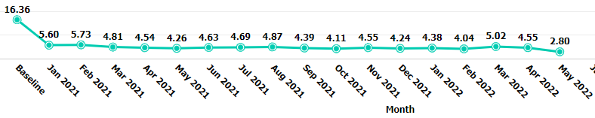
≥35 Week ABX Prescribing Rate

Slide 16
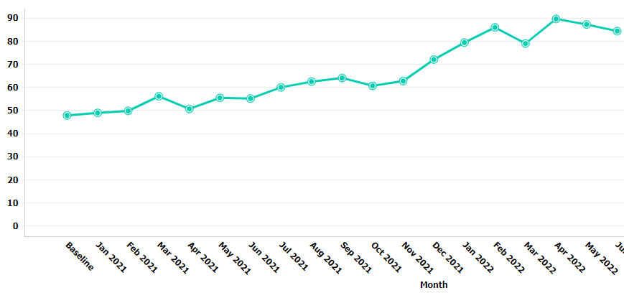
Automatic Stop Orders

Slide 17
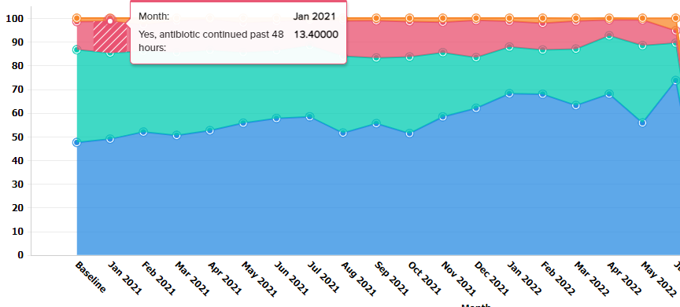
≥35 Week ABX Stopped at 48 Hrs

Slide 18
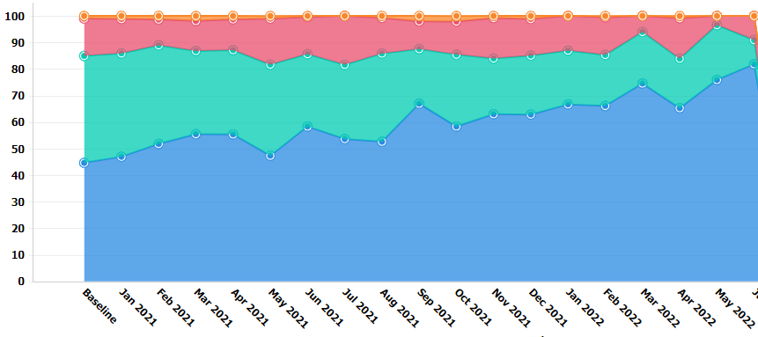
<35 Week ABX Stopped at 48 Hrs

Slide 19
Data Definition: 36 is the new 48
What does it mean to move from 48 to 36 hours to antibiotics?
  Your last dose of antibiotics covers until the 36 hour mark
  Example 1: Gentamicin Q24, Ampicillin Q8
    Old Practice:
      Gent: 2 doses at 0, 24 hours
      Amp: 6 doses at 0, 8, 16, 24, 32, 40 hours
    New Practice
      Gent: 2 doses at 0, 24 hours
      Amp: 5 doses at 0, 8, 16, 24, 32 hours
  Example 2: Gentamicin Q24, Ampicillin Q12
    Old Practice:
      Gent: 3 doses at 0, 24 and 48 hours
      Amp: 4 doses at 0, 12, 24, 36 hours
    New Practice
      Gent: 2 doses at 0, 24 hours
      Amp: 3 doses at 0, 12, 24 hours
Notes:
Justin or Leslie please make sure this is correct!

Slide 20
Logging in to REDCap and
Accessing your BASIC Reports

Slide 21
What are BASIC reports?
A report is a visual depiction of the data that you enter into REDCap
You can see your data compared to the rest of the collaborative
You can use these reports to make sure you have your structures in place, what successes you have had and what you still need to work on
  Structure Measures Reports: show whether you have not started working on a structure measure (red), are working on it (yellow) or have it in place (green)
  Process Measure and Outcome Measure Reports: show whether you have made progress towards goals and helps to determine what to work on next

Slide 22
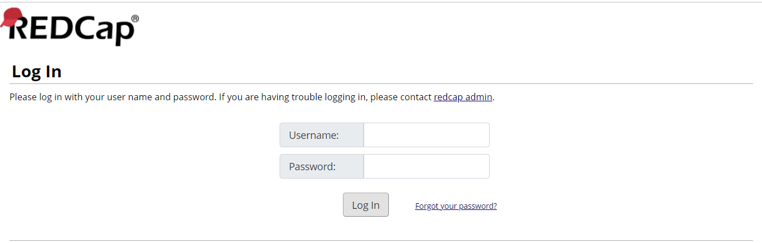
Logging in to REDCap to enter BASIC data
Go to https://redcap.healthlnk.org and log in with your username and password.
Usernames were assigned to individuals who requested access on your BASIC Roster, but if you would like more of your team to have REDCap access, contact us to create an account.
Contact ellie.suse@northwestern.edu if you need an account created or do not know your username or password

Slide 23
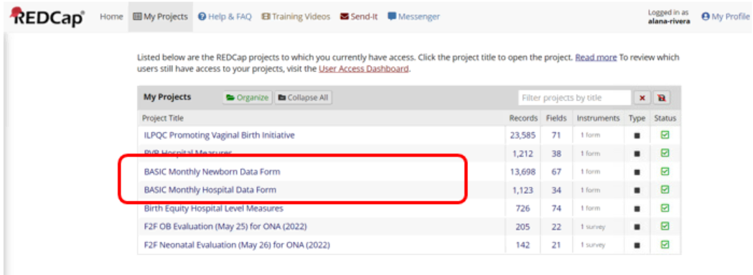
Logging in to REDCap
2. Go to your BASIC Patient or Hospital Data form.
Pro Tip: You can organize your REDCap Data forms by initiative

Slide 24
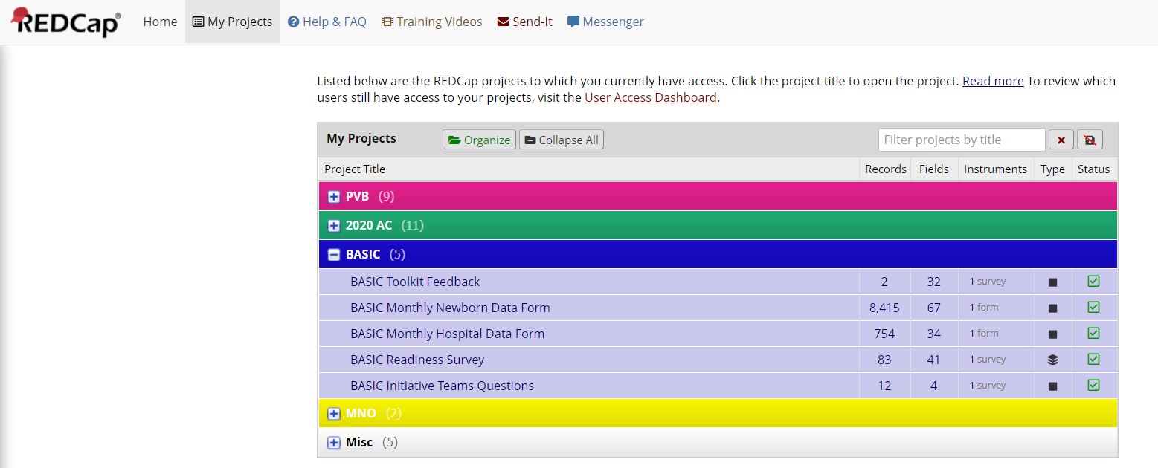
Logging in to REDCap
2. Organizing by ILPQC Initiative (BASIC Patient or Hospital Data form)
Pro Tip: You can organize your REDCap Data forms by initiative

Slide 25
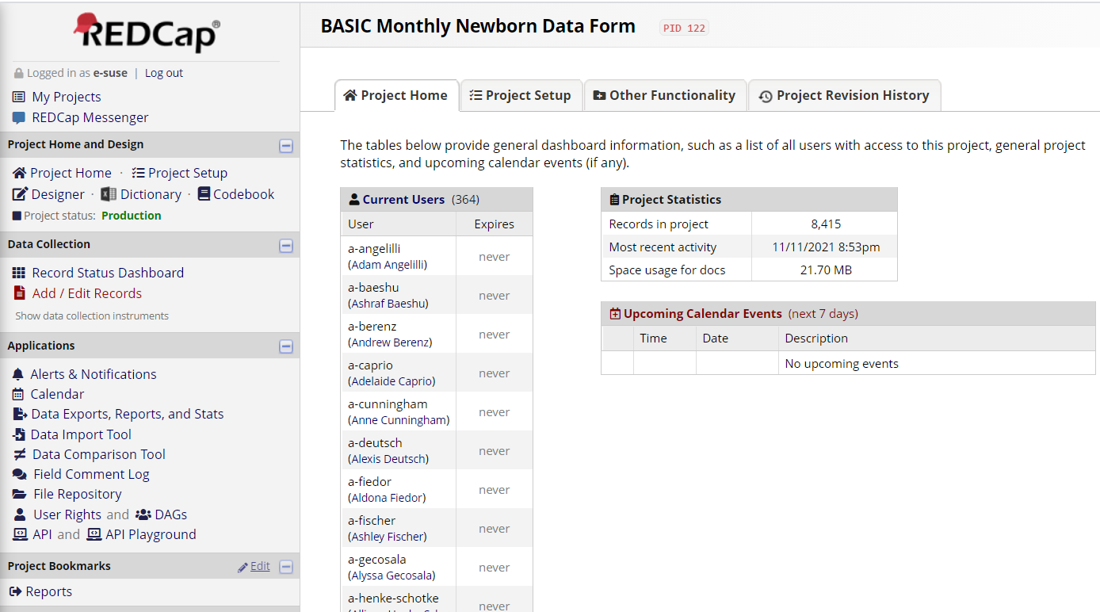
Entering REDCap Data
3. Click Add/Edit Records

Slide 26
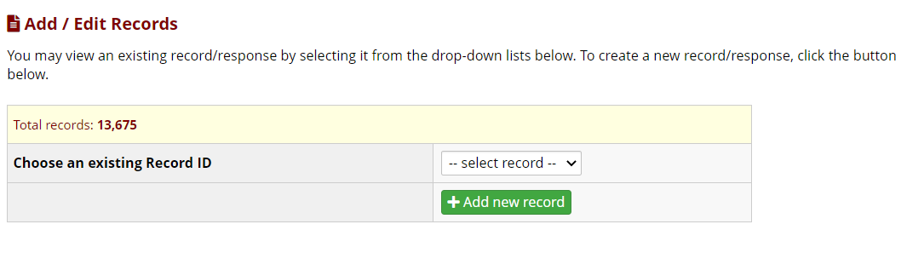
Entering REDCap Data
4. Click + Add New Record to open a new data form

Slide 27
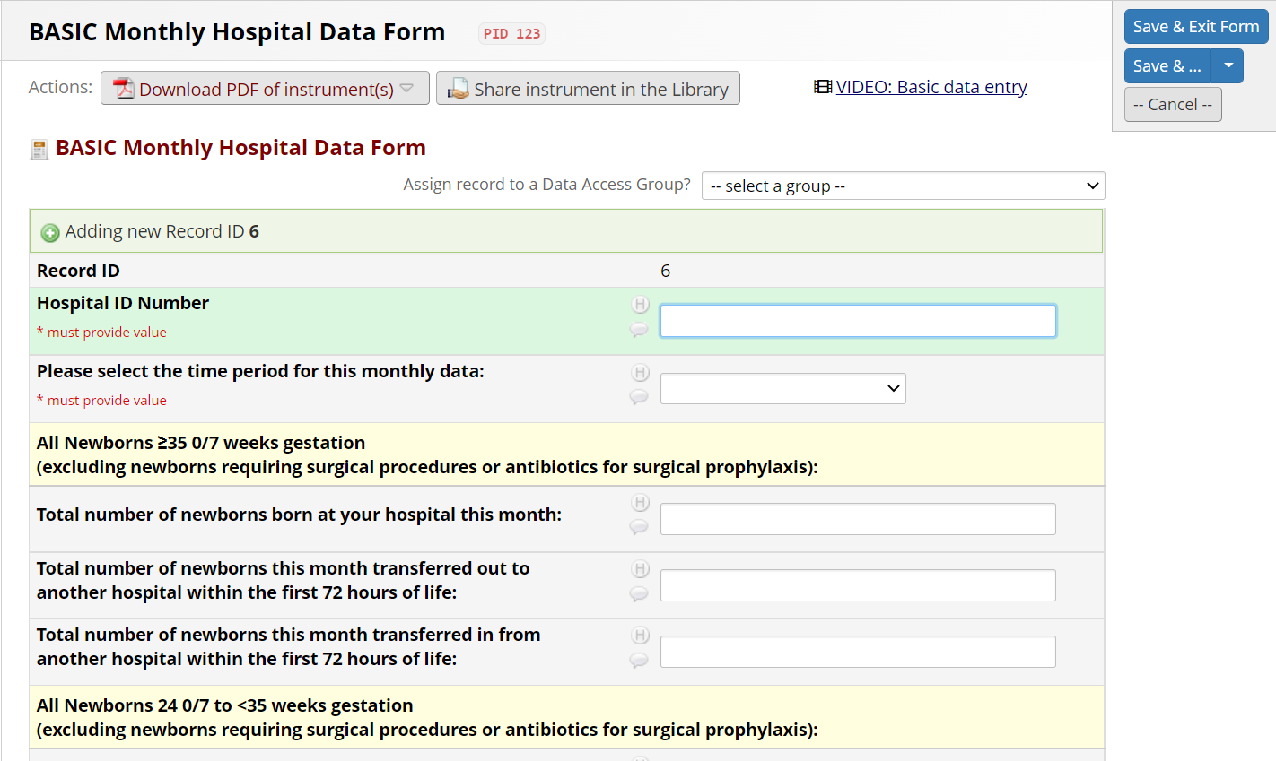
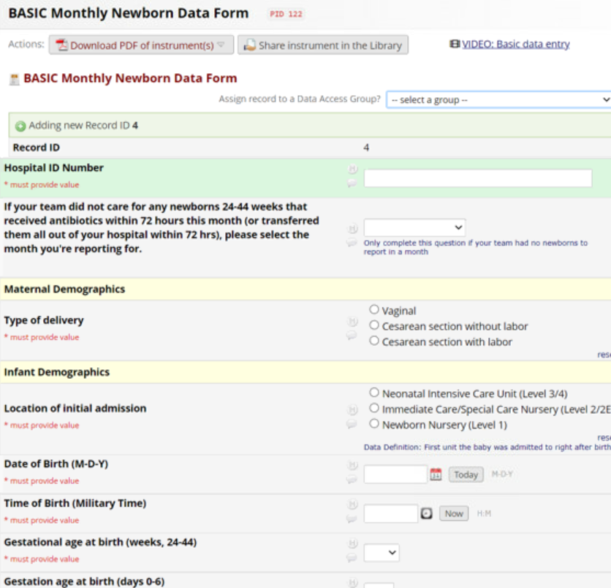
Entering REDCap Data: Forms
Hospital Data Form
Newborn Data Form
Notes:
--Hospital Level Reports: Show progress on changes that you have made at your hospital
--Newborn Level Reports: For babies receiving antibiotics show progress towards achieving process and outcome measures on data you report on individual

Slide 28
Viewing your Reports
Log in to REDCap the same way you did to enter data
Click Reports on the left hand side

Slide 29
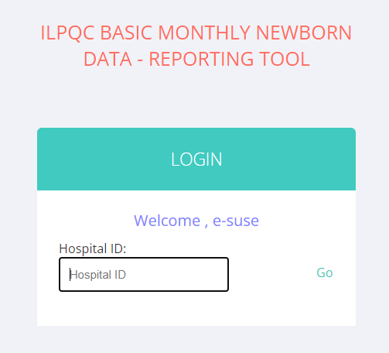
Viewing your Reports
4. A new webpage will open to view your reports
5. Enter your 3-digit Hospital ID (and email us if you do not know it!)
Note: if your ID is single or double digits, place 0’s in front to make 3 digits

Slide 30
REDCap BASIC Reports
6. Review the 11 Patient level and 19 Hospital Level reports.
  Newborn (Patient) Level Reports: For babies receiving antibiotics show progress towards achieving process and outcome measures on data you report on individual
    For the patient level reports you can toggle between gestational weeks as well as compare yourself to the collaborative average for each measure.
  Hospital Level Reports: Show progress on changes that you have made at your hospital
    Stacked bar charts show what percent of the collaborative has not started working on the structure measure (red), is working on getting the structure measure in place (yellow), or has structure measure in place (green).

Slide 31
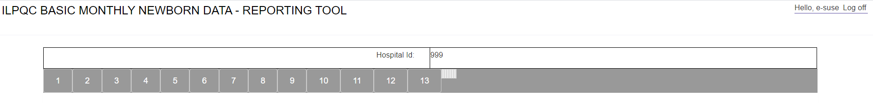
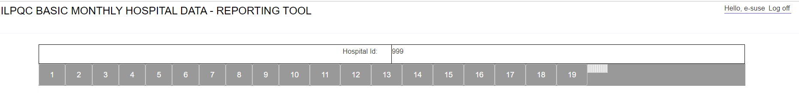
How to get to different reports
Patient Level Reports
Hospital Level Reports
You can view the different reports by clicking on the different numbers a the top of the screen

Slide 32
BASIC Patient Level Reports

Slide 33
BASIC Patient Level Reports
BASIC DATA Dashboard
2-3
Percent of newborns ≥35 and <35 weeks who received antibiotics within 72 hours of life
4-5
6-7
Percent of newborns ≥35 and <35 weeks with a risk assessment tool used and documented
Parent and Family Education
1
8
Maternal risk factor for neonatal EOS documentation
9
Antibiotic Timeout
10
11-12
Automatic Stop Time
Percent of Newborns ≥35 and <35 weeks with any antibiotic continued past 48 hours from a negative blood culture result

Slide 34
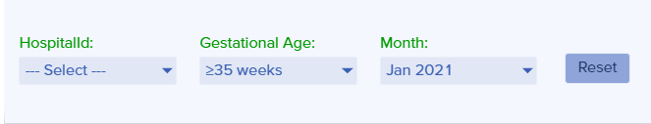
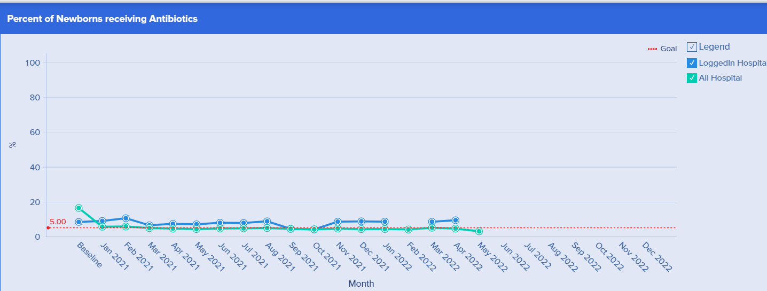
BASIC Dashboard
Ability to toggle between gestational age and Month
Percent of Newborns Receiving Antibiotics

Slide 35
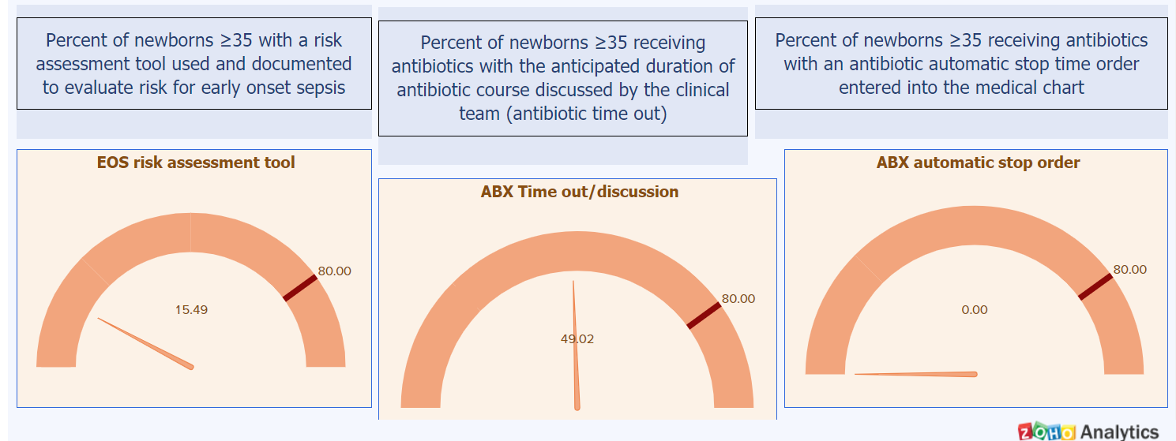
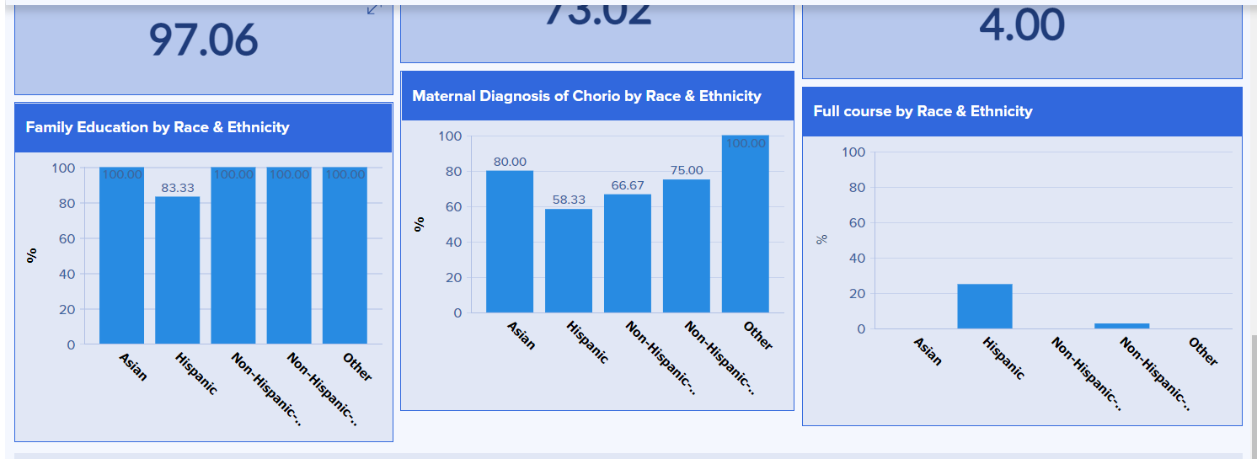

BASIC Dashboard
EOS Risk Assessment Tool,
ABX timeout and
Automatic Stop Order
Key Measures by Race and Ethnicity:
Family Education, Chorio Diagnosis and full ABX course

Slide 36
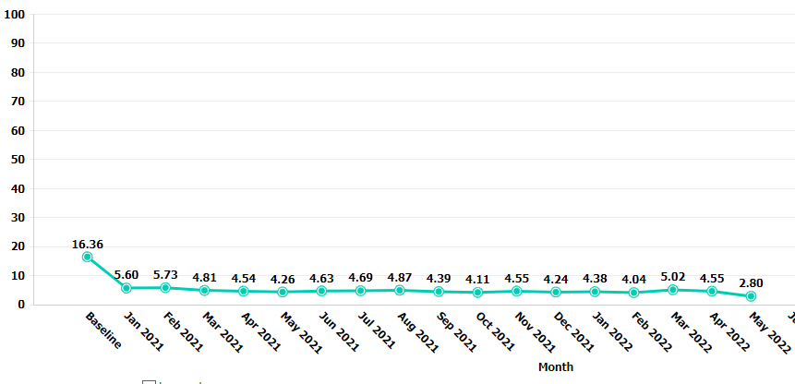
BASIC Key Outcome Measures: Reports
  Report 2 and Report 3:
    Antibiotic Prescribing Rate
Notes:
Find hospital that has a downward trend: stroger,
Add in report 11
Add in 9 or 10

Slide 37
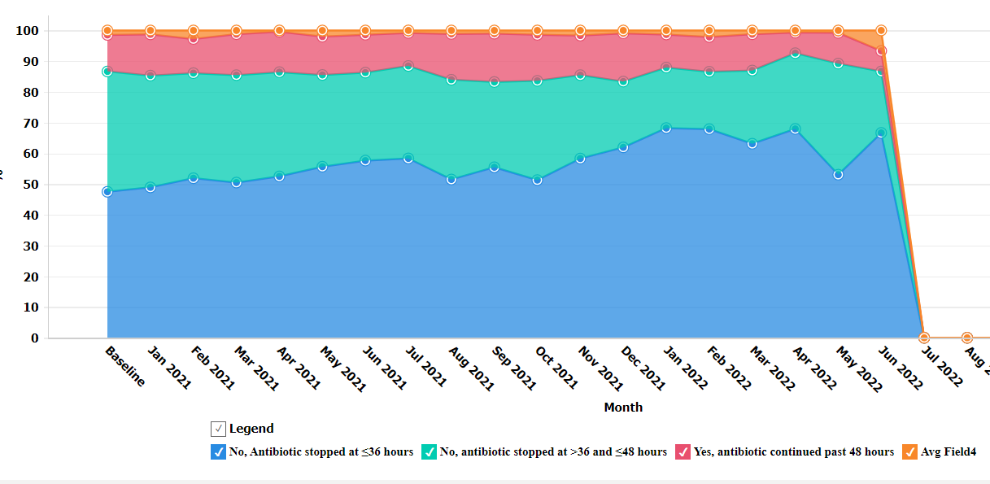
BASIC Key Outcome Measures: Reports
  Report 11 and Report 12
    Newborns with a negative blood culture who receive antibiotics for >48 hours
Notes:
Find hospital that has a downward trend: stroger,
Add in report 11
Add in 9 or 10

Slide 38
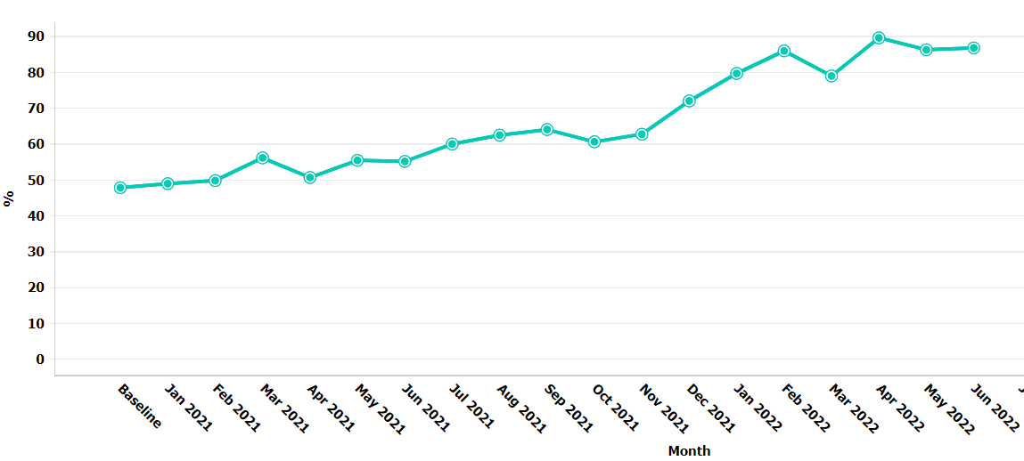
BASIC Key Outcome Measures: Reports
  Report 9
    Newborns with anticipated duration of antibiotic course discussed by clinical team (antibiotic time out)
  Report 10
    Newborns with an automatic stop order entered into the medical chart

Slide 39
BASIC Hosptial Level Reports

Slide 40
BASIC Hospital Level Reports
Provider and Nurse education Structure and Process Measures
4
Parent Education Structure measure
5-6
7-9
QI partnerships Structure Measures
EOS Risk Assessment Structure Measures
1-3
10
OB to Peds Communication Structure Measure
11-12
Neo serial Assessment and Response
13-14
15-17
Blood Culture Structure Measures
Antibiotic Prescribing and discontinuation
17
18
Antibiotic Timeout Structure Measure
19
Stratifying BASIC Data by race and ethnicity Structure Measure
Automatic Stop Order Structure Measure

Slide 41
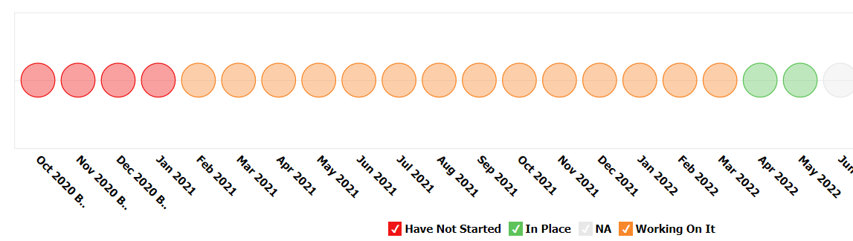
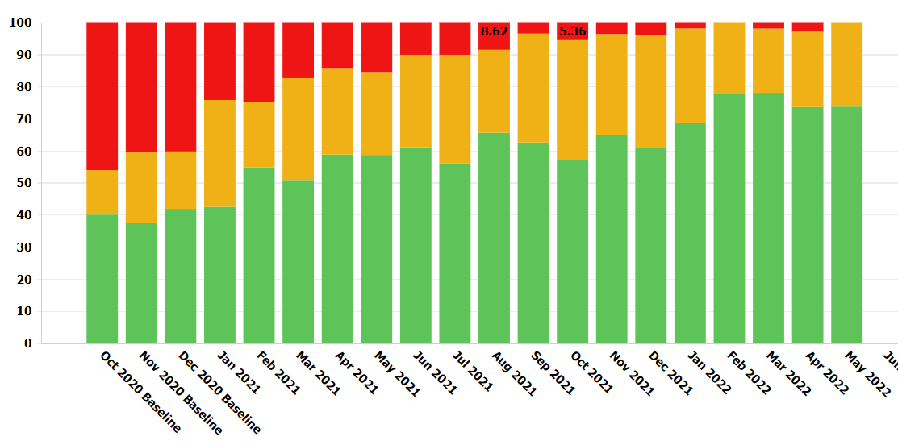
BASIC Key Structure Measures: Reports
  Report 4:
    Standardized Family Education Process
  Report 7 and Report 9:
    EOS Risk Assessment Protocols for ≥35 and <35 Newborns
  Report 16:
    Standardized Dosing Guidelines
  Report 17:
    Antibiotic Discussions/Time Outs Protocol
  Report 18:
    Standardized Automatic Stop Order Process
Notes:
Redo screenshot

Slide 42
BASIC QI Corner
Mock QI Team Meeting

Slide 43
BASIC QI Corner
Scenario: the BASIC QI team at ILPQC Hospital is hosting their BASIC monthly meeting and we get to be a part of it! Let’s listen in to hear how we to use REDCap data and reports at monthly QI team meetings to tell your team’s BASIC story.

Slide 44
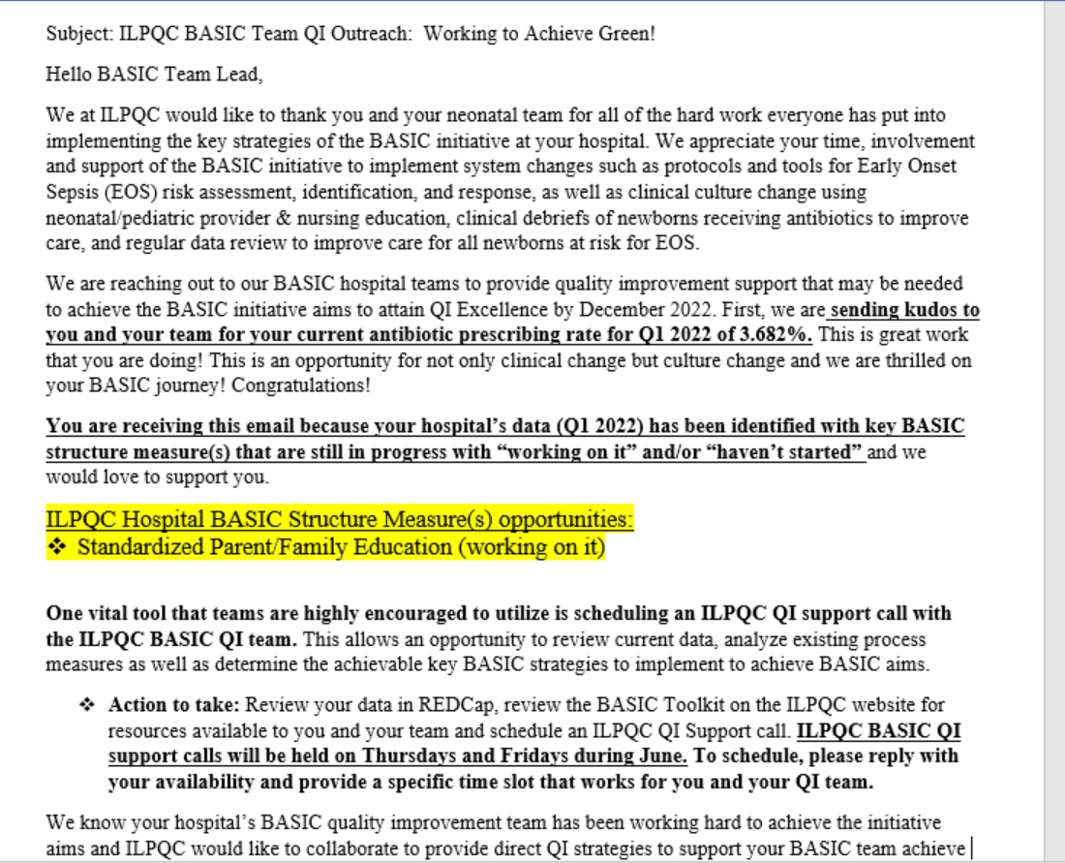
BASIC QI Corner:
QI Outreach

Slide 45
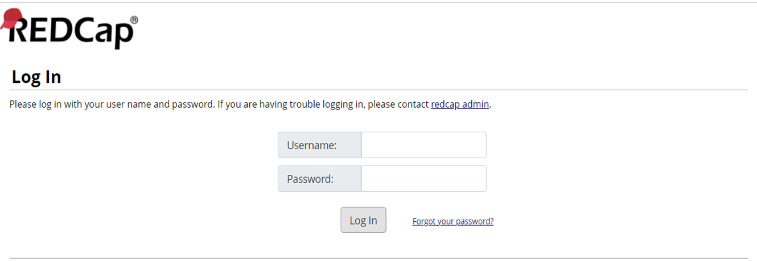
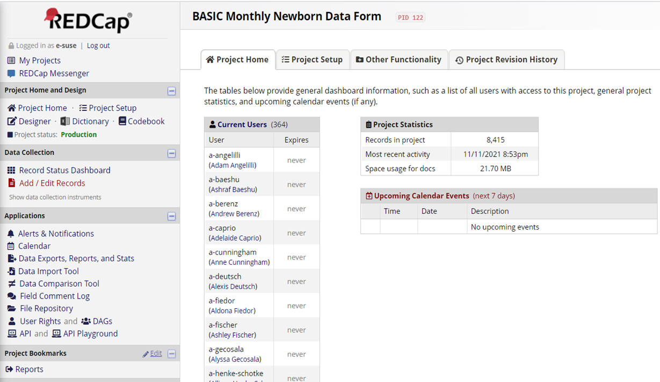

BASIC QI Corner
1)
3)
2)

Slide 46
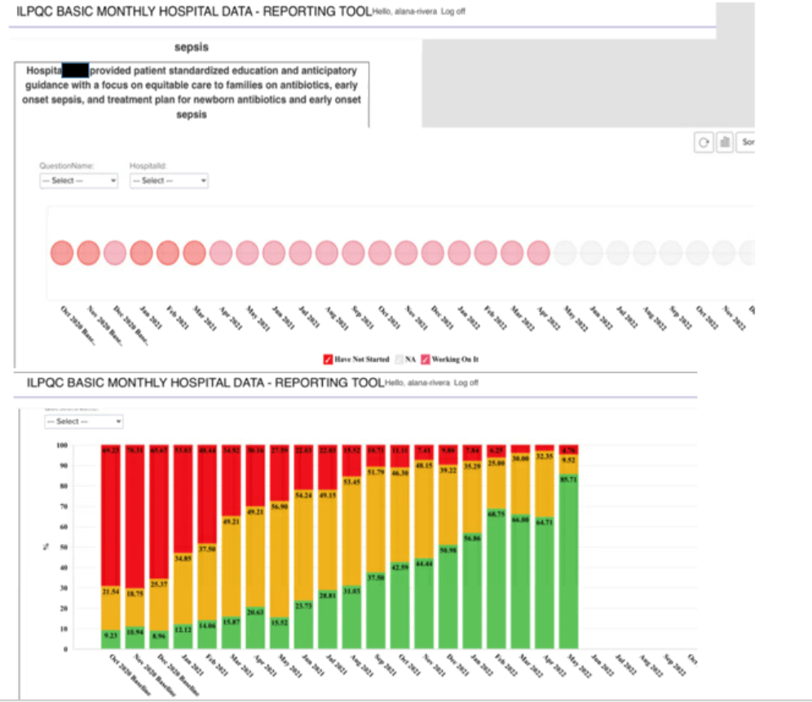
BASIC QI Corner:
Monthly Hospital Data,
Structure Measures

Slide 47
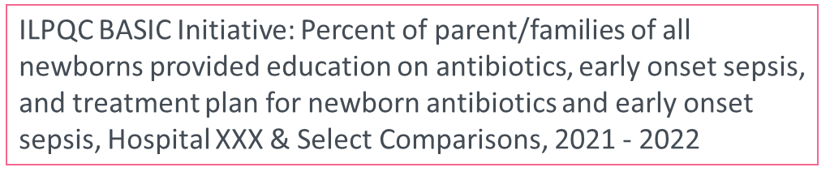
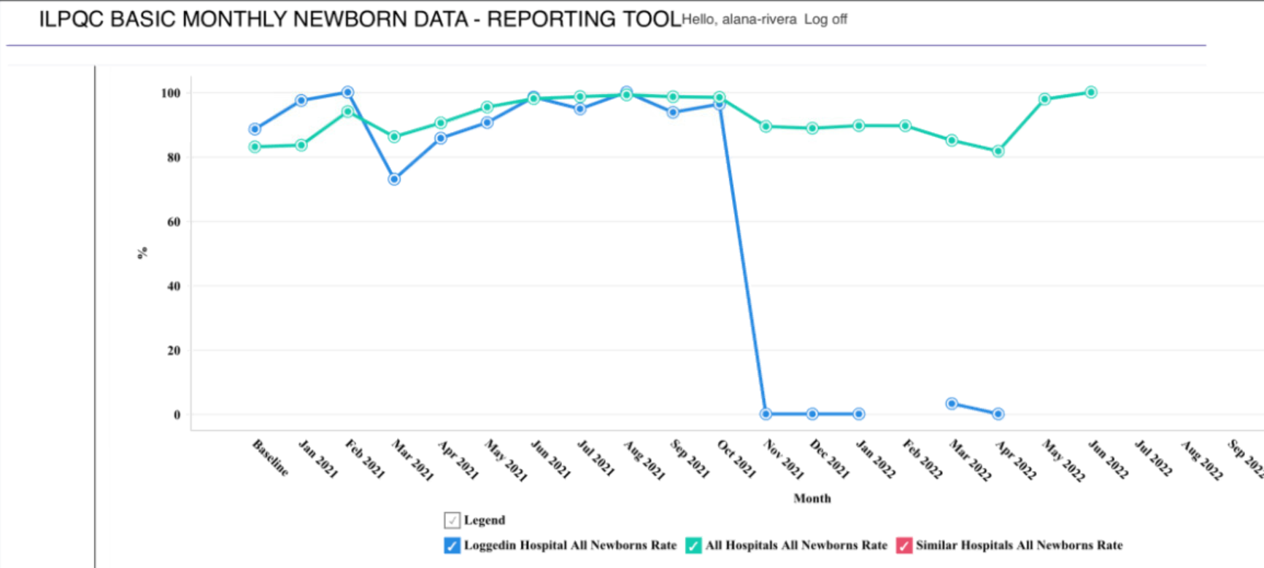
BASIC QI Corner: Monthly Newborn Data

Slide 48
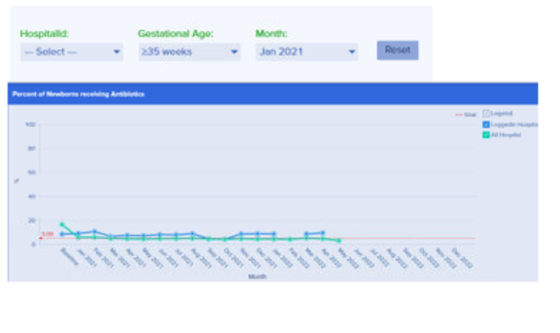
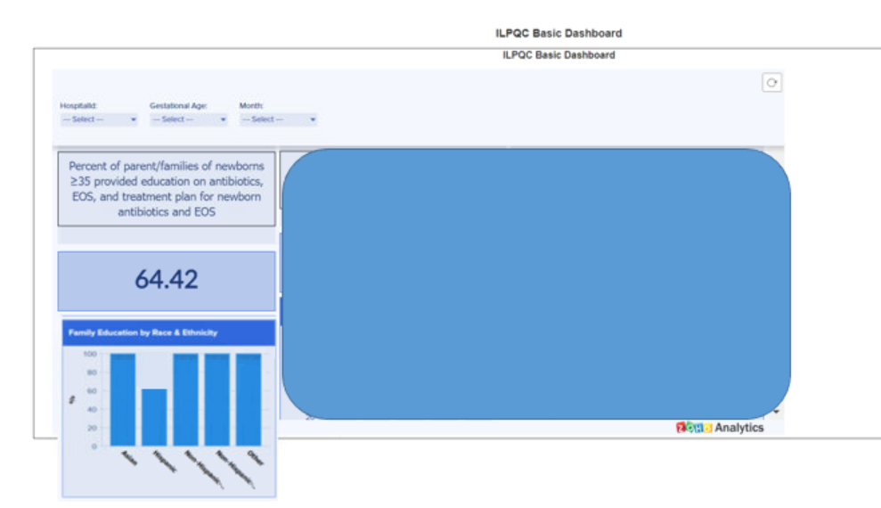
BASIC QI Corner: Dashboard Data
Scroll
Down and explore the Dashboard

Slide 49
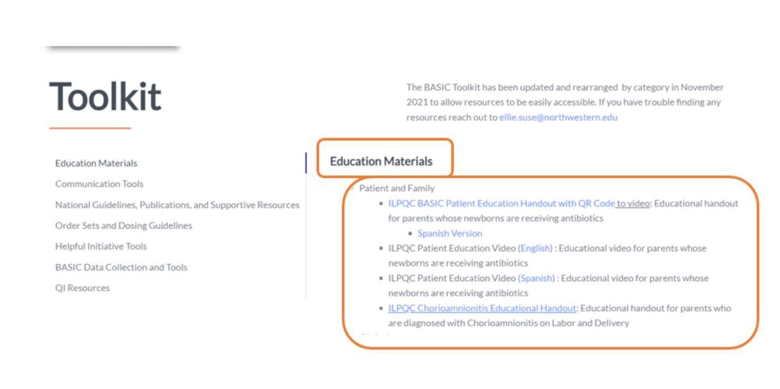
BASIC QI Corner: BASIC Toolkit

Slide 50
Wrap-up and Next Steps

Slide 51
Upcoming Call Schedule
Month | Topic
July | Using your BASIC data to tell a story
August | Preparing to Accept your Award at Annual Conference
September | TBD
October | 10th Annual Conference
What topics would be helpful to get your BASIC Team across the finish line?

Slide 52
Next Steps for BASIC
Celebrate your QI team BASIC Data Champions with gift card or QI award!
  Take a QI Celebration Pictures and send to info@ilpqc.org to show how your celebrations!
Determine which Structure Measures are still in progress and, think next steps!
Continue with QI Team meetings and data sharing!
Review REDCap reports!
Contact info@ilpqc to set up a 1:1 call to review your reports with ILPQC staff!

Slide 53










Thanks to our Funders
In kind support:

