Slide 1
BASIC Teams Call: Leveraging The EMR
April 19th, 2021
1:00 – 2:00pm

Slide 2
Objectives from Today’s Call
Summarize EMR utility in BASIC
Review EMR data structure and reporting
Showcase examples of EMR builds that will contribute to achieving BASIC AIMS

Slide 3
ILPQC BASIC
Vision: ILPQC hospitals, regardless of perinatal level or past experience with implementing newborn antibiotics initiatives, will implement best practices to provide: the right antibiotics for the right babies for the right duration
AIMs:
Decrease by 20% (or absolute rate of 4%) the number of newborns, born at ≥35 weeks who receive antibiotics
Decrease by 20% the number of newborns with a negative blood culture who receive antibiotics for longer than 36 hours

Slide 4
Data Entry & Reporting
Clinical Decision Support

Slide 5
BASIC Key Driver Diagram
AIMS
Primary Drivers
Change Ideas
Create multidisciplinary antibiotic stewardship QI team
Educate healthcare team on best practices
Provide standardized education and anticipatory guidance with focus on equitable care to families on EOS and treatment plan
By June 2022, ILPQC Hospitals will:
Implement QI infrastructure
Monitor & share transparent antibiotic data
A. Decrease by 20% (or absolute rate of 4%) the number of newborns, born at ≥35 weeks who receive antibiotics
B. Decrease by 20% the number of newborns with a negative blood culture who receive antibiotics for longer than 36 hours
Coordinate with IT to implement reporting system from EMR
Review transparent data and debrief with providers
Initiate timely and appropriate antibiotics
Standardize risk assessment for early onset sepsis (EOS)
Communicate with OBs to share maternal risk for EOS
Implement protocols for serial assessment with response to worsening status
Consistently obtain blood cultures
Partner with inpatient lab to process blood culture results
De-escalate therapy based on culture and sensitivity results
Implement pharmacy protocols to assure appropriate use
Standardize dosing guidelines and order sets
Implement process to discuss antibiotic duration and course
Implement automatic stop order processes
Administer and de-escalate antibiotics
Deliver equitable care
Review health quality data stratified by race, ethnicity, and Medicaid status to identify disparities and address opportunities for improvement
Version 2.12.2021

Slide 6
BASIC Key Driver Diagram
AIMS
Primary Drivers
Change Ideas
Create multidisciplinary antibiotic stewardship QI team
Educate healthcare team on best practices
Provide standardized education and anticipatory guidance with focus on equitable care to families on EOS and treatment plan
By June 2022, ILPQC Hospitals will:
Implement QI infrastructure
Monitor & share transparent antibiotic data
A. Decrease by 20% (or absolute rate of 4%) the number of newborns, born at ≥35 weeks who receive antibiotics
B. Decrease by 20% the number of newborns with a negative blood culture who receive antibiotics for longer than 36 hours
Coordinate with IT to implement reporting system from EMR
Review transparent data and debrief with providers
Initiate timely and appropriate antibiotics
Standardize risk assessment for early onset sepsis (EOS)
Communicate with OBs to share maternal risk for EOS
Implement protocols for serial assessment with response to worsening status
Consistently obtain blood cultures
Partner with inpatient lab to process blood culture results
De-escalate therapy based on culture and sensitivity results
Implement pharmacy protocols to assure appropriate use
Standardize dosing guidelines and order sets
Implement process to discuss antibiotic duration and course
Implement automatic stop order processes
Administer and de-escalate antibiotics
Deliver equitable care
Review health quality data stratified by race, ethnicity, and Medicaid status to identify disparities and address opportunities for improvement
Version 2.12.2021

Slide 7
Partnering with IT
Anticipating Challenges
Opaque change management process
How to even get started?
Limited resources (and competing priorities) within IT
IT jargon
Analyst = your friend in IT who will be doing the building
“Validate build”
IT Environments:
“PRD” or “Production” = the EMR system that you use every day
“Dev” or “POC” = the part of the system where changes are built
“TST” or “TEST”= the part of the system where changes are tested

Slide 8
Data Entry And Reporting

Slide 9
BASIC Reporting
Monthly Hospital Data Form (Structure Measure)
Hospital-Level Newborn Data
Monthly Newborn Data Forms (Process Measure)
Patient-Level: Data collection is resource intensive, especially with high volume hospitals.
Identify Eligible Patients (Newborn Form Data Collection Instructions)
Audit Patient-Level Data
Identify EMR Gaps
Organize Notes for Data
Generate Reports!

Slide 10
BASIC Reporting
Monthly Hospital Data Form (Structure Measure)
Hospital-Level Newborn Data
Monthly Newborn Data Forms (Process Measure)
Patient-Level: Data collection is resource intensive, especially with high volume hospitals.
Identify Eligible Patients (Newborn Form Data Collection Instructions)
Audit Patient-Level Data
Identify EMR Gaps
Organize Notes for Data
Generate Reports!

Slide 11
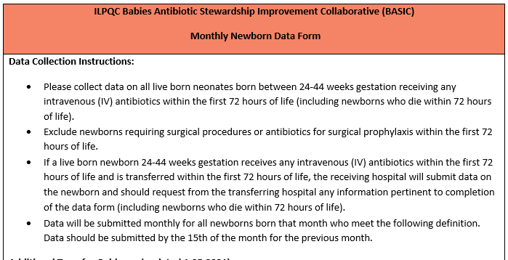
1 - Identify Eligible Patients

Slide 12
2 - Audit Patient-Level Data
Match data form questions to data source
On Paper (SBAR, signout sheets)
In the EMR
For example:
In nursing flowsheets
In lab results
??? Not in the chart

Slide 13
2 - Audit Patient-Level Data
(Fill in Data Gaps)
Modify the EMR to capture any missing data
Flowsheet for RN documentation
Note template for MD documentation

Slide 14
2 - Audit Patient-Level Data
(A Note on Note Templates)
Free Text = Manual Chart Review
Discreet = Reportable
Free Text
Discreet: Selection matches data form and is saved in a discreet form for reporting

Slide 15
3 - Generate Reports!
All EMRs have capability of generating reports; the process of building reports varies by institution
Most hospital systems have a dedicated team responsible for data reporting that might be separate from the IT team (Data Analytics, Enterprise Data Warehouse)
Key takeaways
Ensure the answer to every data form question exists in your EMR
Make data discreet to the extent possible to enable reporting
Work with your hospital’s data analytics team to create reports

Slide 16
Clinical Decision Support

Slide 17
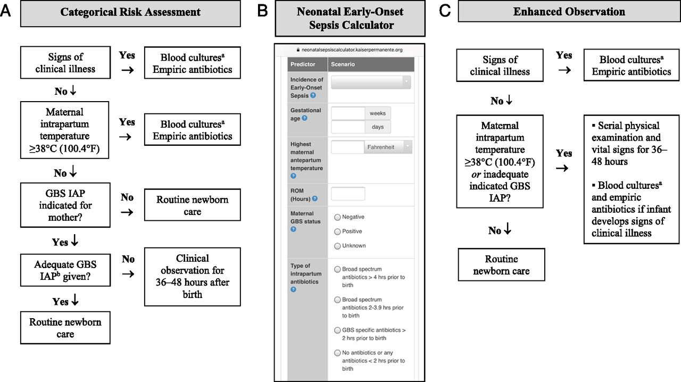
Adopt A Risk Assessment Tool
Our Example

Slide 18
Make Your Risk Assessment Tool Easy To Find
Add a link to a protocol or to the Kaiser EOS website into admission or antibiotic order sets
Using Epic & Using NEOSC? Turn on the built-in NEOSC based on the Kaiser EOS calculator!
Auto-populates risk factors from data in the maternal chart.
Recommendations can be displayed in patient lists and within the patient’s chart

Slide 19
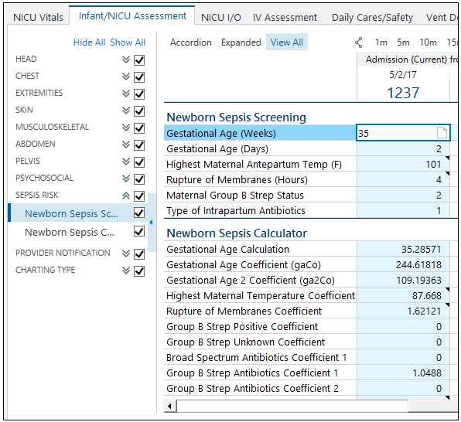
Epic Early-Onset Sepsis Calculator (Based on Kaiser NEOSC)

Slide 20
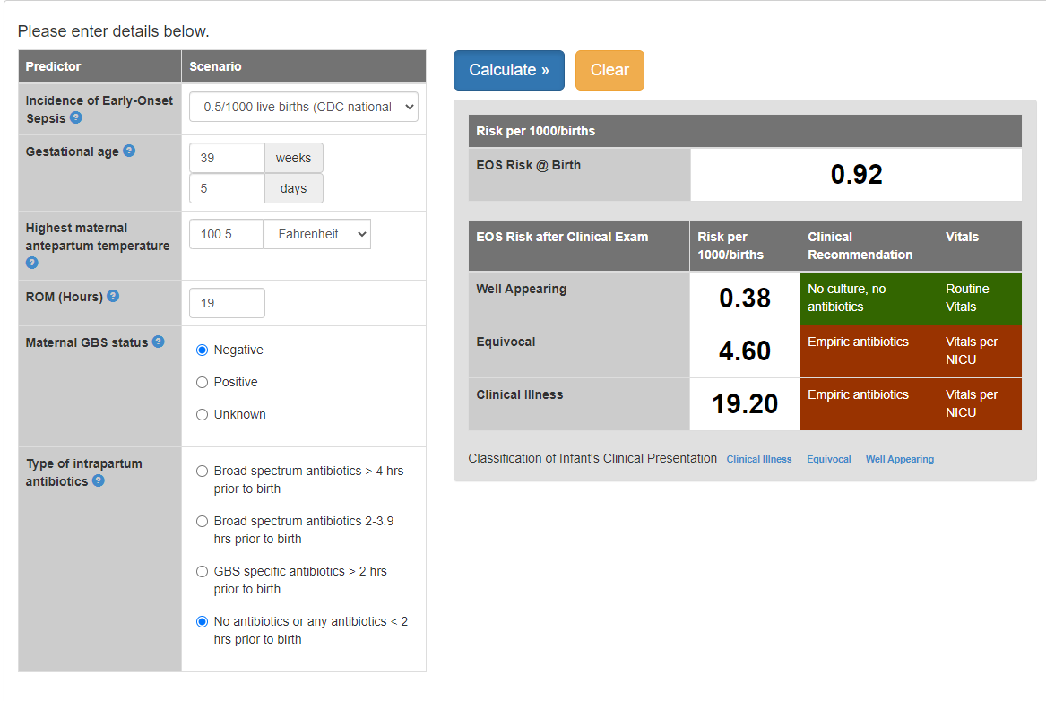
Order Sets With Kaiser NEOSC
Use order sets to translate recommendations into clinical practice

Slide 21
Order Sets
A group of orders that standardizes & expedites the ordering process for a common clinical scenario
Reduce variation in care
Align clinical practice with BASIC AIMS
Educate healthcare team on best practices

Slide 22
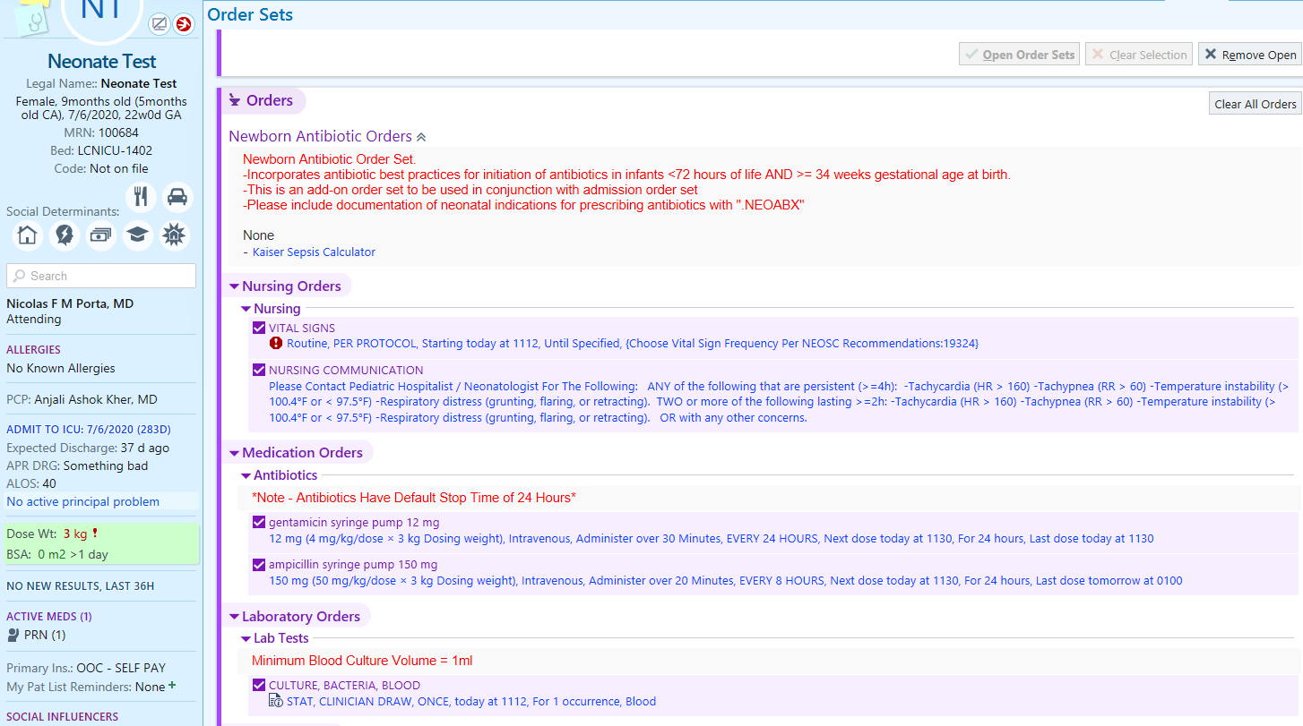
Order Sets With NEOSC

Slide 23
Order Sets With NEOSC
Link to Kaiser calculator

Slide 24
Order Sets With NEOSC
Vital Sign Frequency
Based on Kaiser EOS

Slide 25
Order Sets With NEOSC
Serial Assessment Protocols

Slide 26
Order Sets With NEOSC
Standardized Antibiotic Dosing

Slide 27
Order Sets With NEOSC
Default Stop Times

Slide 28
Order Sets With NEOSC
Blood Culture Best Practices

Slide 29
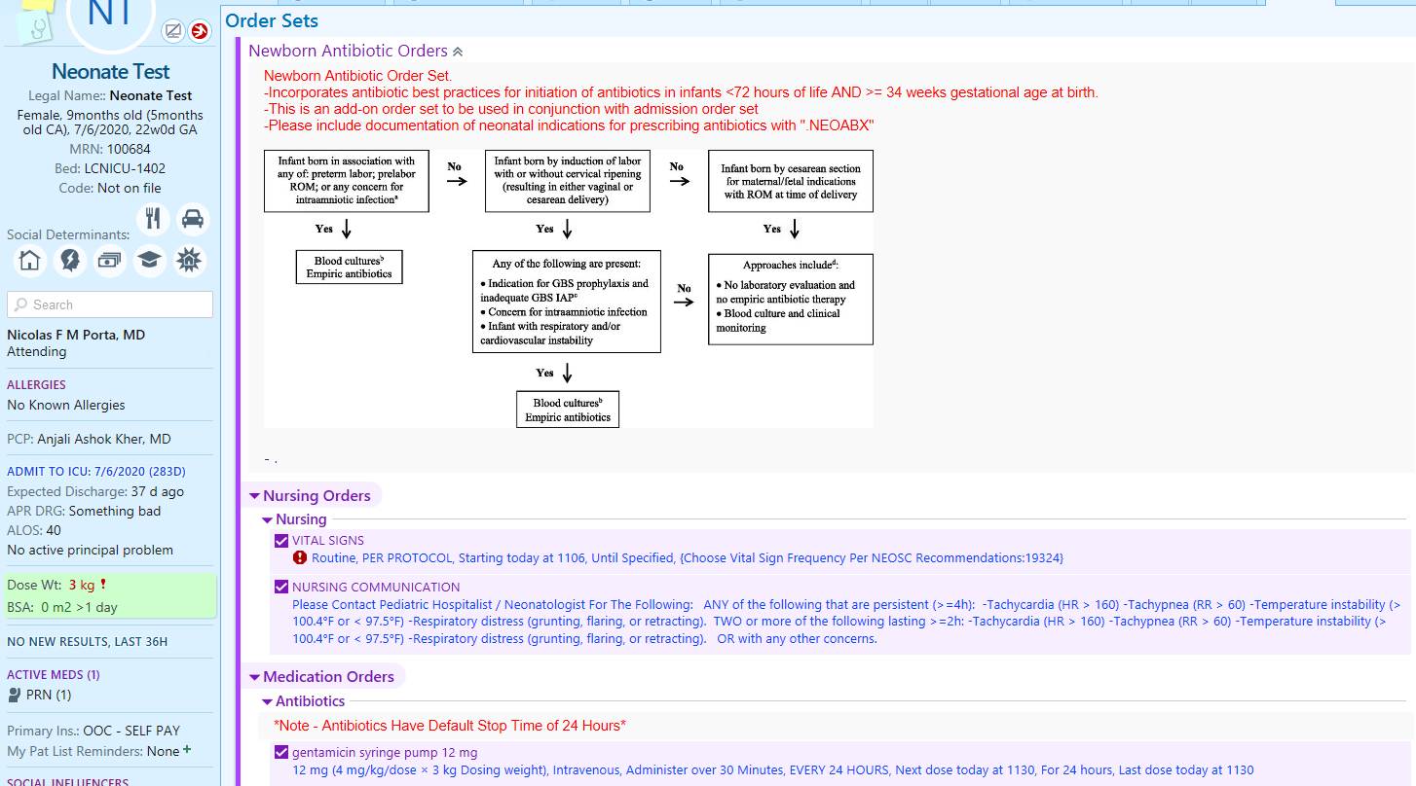
Order Sets With Risk Assessment Tools
Risk Categorization Tool for Infants <35 weeks GA

Slide 30
RECAP- EMR Process
Discovery phase
Brainstorming phase
Partnership phase

Slide 31
RECAP- EMR Partnership Process
Identify IT person for partnership
Share project plan and create assignments for departments
QI team continues with BASIC work
IT and analytics team builds EMR changes
QI team reviews draft/proposed changes
Feedback loop
QI teams and clinical staff provide feedback
Feedback incorporated and final review provided
EMR changes rolled out and staff education

