Slide 1
Order Sets
A group of orders that standardizes & expedites the ordering process for a common clinical scenario
Reduce variation in care
Align clinical practice with BASIC AIMS
Educate healthcare team on best practices

Slide 2
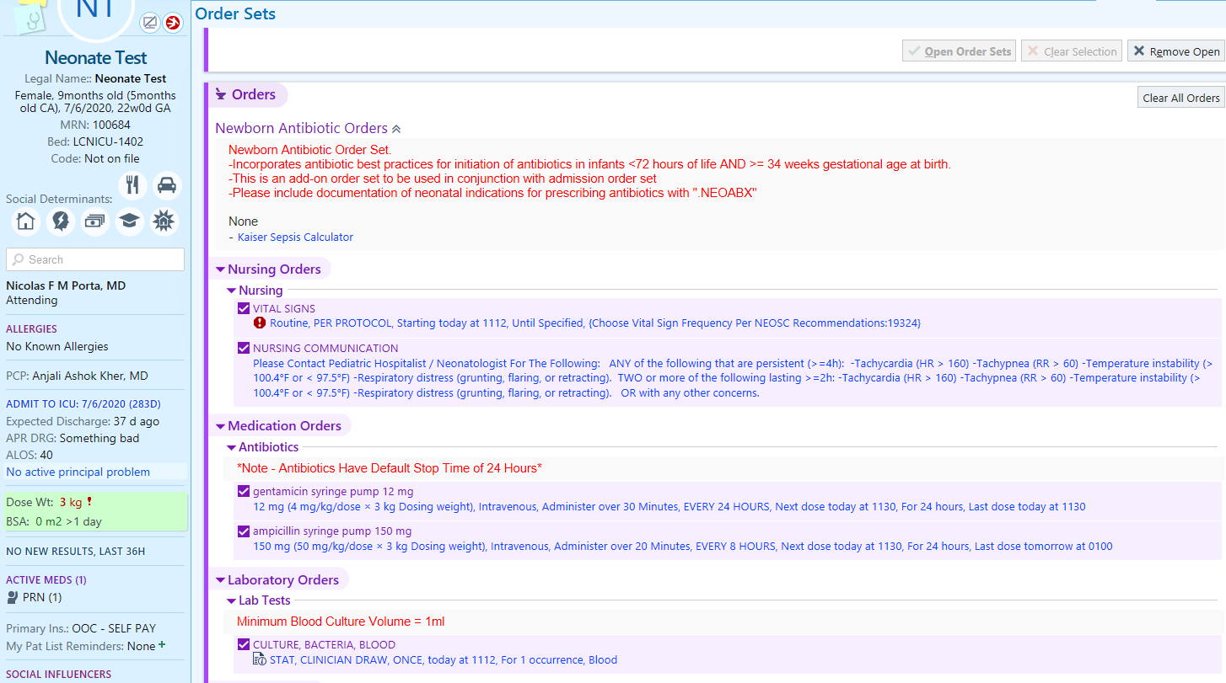
Order Sets With NEOSC

Slide 3
Order Sets With NEOSC
Link to Kaiser calculator

Slide 4
Order Sets With NEOSC
Vital Sign Frequency
Based on Kaiser EOS

Slide 5
Order Sets With NEOSC
Serial Assessment Protocols

Slide 6
Order Sets With NEOSC
Standardized Antibiotic Dosing

Slide 7
Order Sets With NEOSC
Default Stop Times

Slide 8
Order Sets With NEOSC
Blood Culture Best Practices

Slide 9
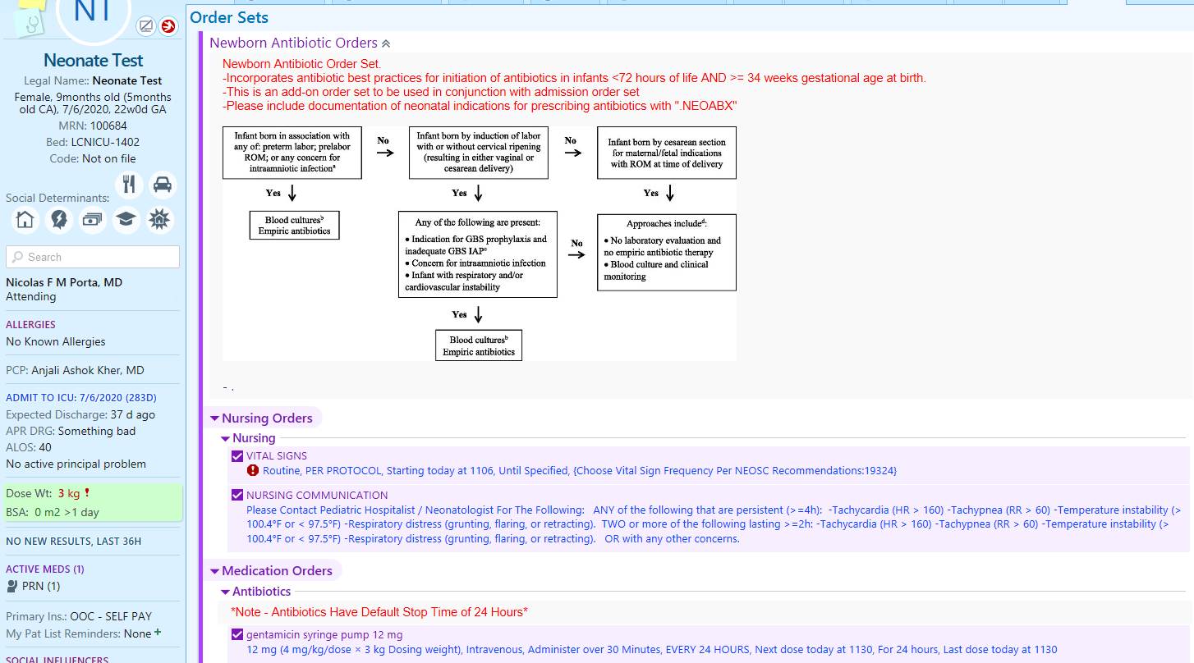
Order Sets With Risk Assessment Tools
Risk Categorization Tool for Infants <35 weeks GA

Slide 10
RECAP- EMR Process
Discovery phase
Brainstorming phase
Partnership phase

Slide 11
RECAP- EMR Partnership Process
Identify IT person for partnership
Share project plan and create assignments for departments
QI team continues with BASIC work
IT and analytics team builds EMR changes
QI team reviews draft/proposed changes
Feedback loop
QI teams and clinical staff provide feedback
Feedback incorporated and final review provided
EMR changes rolled out and staff education

