Slide 1
BASIC Aims and Measures

Slide 2


ILPQC BASIC
Vision: ILPQC hospitals, regardless of perinatal level or past experience with implementing newborn antibiotics initiatives, will implement best practices to provide: the right antibiotics for the right babies for the right duration
AIMs:
Decrease by 20% (or absolute rate of 4%) the number of newborns, born at ≥35 weeks who receive antibiotics
Decrease by 20% the number of newborns with a negative blood culture who receive antibiotics for longer than 36 hours
Notes:
Convert Aims into infographic form

Slide 3
Data to Drive Change

Slide 4
Structure Measures - lead to lasting changes
Gives a sense of a health care provider’s capacity, systems, and processes to provide high-quality care.
For example:
Whether the health care organization uses electronic medical records or medication order entry systems
The number or proportion of board-certified physicians
The ratio of providers to patients

Slide 5
Structure Measures
Identifying Hospital-Level Measures: Hospital policies, protocols, and educational curriculum for providers, staff, and patients
Building a foundation with hospital-level (structure) measures to standardize systems & drive optimal care
Planning for sustainability at the onset

Slide 6
Structure Measures
  Are the policies and practices in place that are needed to make systems improvements and facilitate culture change improvements?
  Hospital-level measures tracked monthly on the systems changes a hospital is making on an initiative
  Report Type: Stacked bar charts

Slide 7
Structure Measures
Data Monitoring, Transparency, and Stewardship Infrastructure
Provider and nurse education on abx stewardship & equitable care
Patient education
Electronic reporting system in EMR
Quality Improvement Strategies to ensure feedback is provided to clinical team

Slide 8
Structure Measures
Timely and Appropriate Initiation of Antibiotics
Standardized risk assessment for early onset sepsis
Partnership with obstetric team to standardize communication about maternal risk factors for early onset sepsis
Standardized serial assessment of neonates
Standardized identification and response to neonates with worsening clinical status

Slide 9
Structure Measures
Appropriate Administration and De-escalation
Standardized protocols to properly and consistently obtain blood cultures
Partnership with inpatient lab to optimize timely processing of blood culture results and communication with care team
Protocols to assist staff to stop or de-escalate therapy based on culture and sensitivity results
Standardized dosing guidelines
Standardized team approach to discuss anticipated duration of abx course at initiation of abx
Standardized automatic stop order process

Slide 10
Structure Measures
Equitable Care Delivery
Standardized process to review antibiotic data by race/ethnicity and share with providers and staff
Implementation of social determinants of health tool and facilitate coordinated connection to community resources and follow up
Provide information at the appropriate health literacy level
Provide communication in preferred language

Slide 11
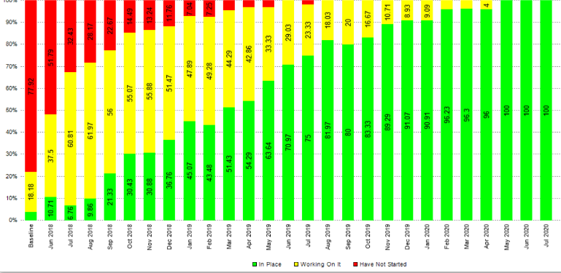
Measuring Progress – Structure Measures

Slide 12
Process Measures:
Process measures indicate what a provider does to maintain or improve health, either for healthy people or for those diagnosed with a health care condition. These measures typically reflect generally accepted recommendations for clinical practice.
For example:
The percentage of people receiving preventive services (such as mammograms or immunizations).
The percentage of people with diabetes who had their blood sugar tested and controlled.
The majority of health care quality measures used for public reporting are process measures

Slide 13
Process Measures
  Are the parts/steps in the system performing as planned? Are we on track in our efforts to improve the system?
  Patient-level measures tracked monthly on the clinical culture changes being implemented
  Report Type: Run Charts

Slide 14
Process Measures
% of parents/families with newborns who received antibiotics who were provided education on antibiotics, early onset sepsis, and treatment plan for newborn antibiotics and early onset sepsis
% of newborns <35 weeks gestation who received antibiotics with a risk assessment algorithm used and documented to evaluate risk of EOS
% of newborns ≥35 weeks gestation who received antibiotics with a risk assessment tool used and documented to evaluate risk for early onset sepsis (EOS)

Slide 15
Process Measures
% of all newborns who received antibiotics with documentation of maternal risk factors for neonatal EOS in the pediatric medical chart
% of all newborns with anticipated duration of antibiotic course discussed by the clinical team at the initiation of antibiotics
% of all newborns with an antibiotic automatic stop time order entered into the medical chart
Notes:
Consider removing

Slide 16
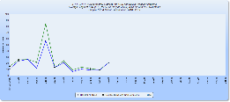
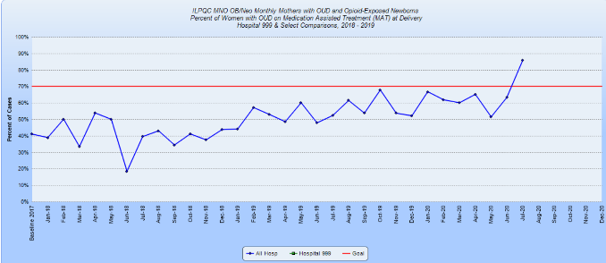
Types of Measures ILPQC Uses to Measure Progress – Process

Slide 17
Balancing Measures
  Ensuring there are no unintended consequences of the quality improvement initiatives

