Slide 1
Launching BASIC

Slide 2
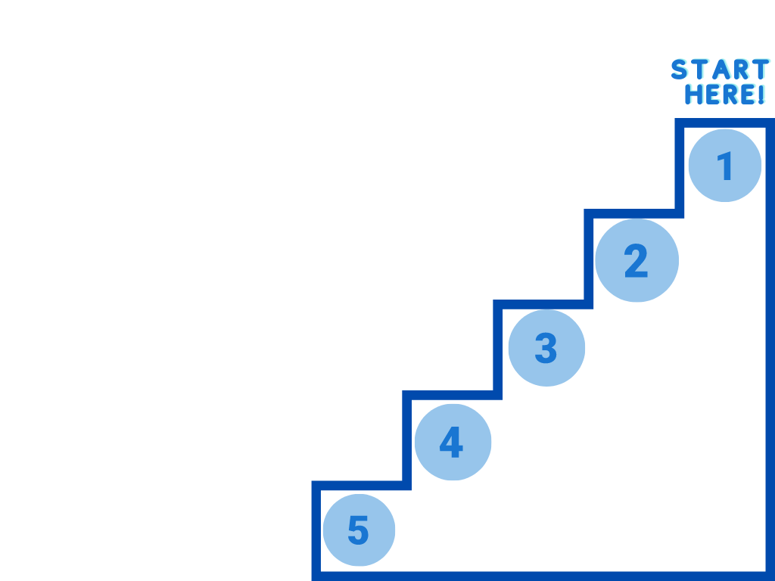
10 Steps to Prepare for BASIC
Schedule regular BASIC QI team meetings
Attend QI Team Lead Support Call - Provider & RN Champions
Review the ILPQC BASIC Data Collection Form and discuss strategies for data collection
Work with your QI team to complete the BASIC Teams Readiness Survey
Create a process flow diagram to reflect your current process for antibiotic decision making
Notes:
Successful launch

Slide 3
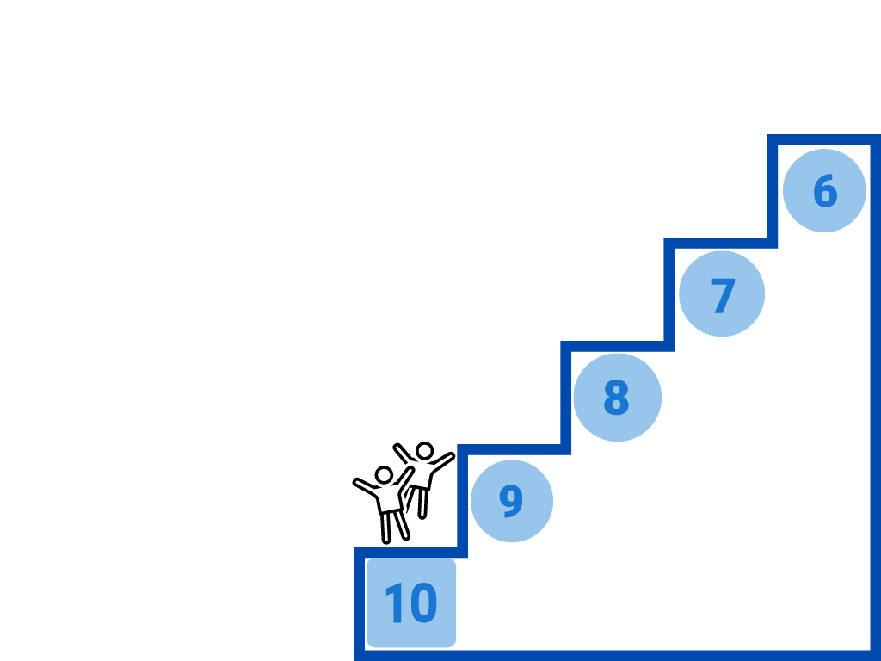
10 Steps for Teams to Prepare for BASIC
Identify opportunities for improvement and possible interventions by reviewing BASIC Key Driver Diagram
Review the ILPQC BASIC Online Toolkit for nationally vetted resources to support your improvement goals
Create a 30/60/90 day plan to identify what you want to accomplish in the first 3 months.
Plan your first PDSA cycle with your team to address your 30/60/90-day plan
Reach out to ILPQC for help and celebrate your successes early and often.

