Slide 1
Mississippi Perinatal Quality Collaborative
Charlene Collier MD, MPH, MHS, FACOG
Director

Slide 2
MSPQC BACKGROUND
Launched November of 2014
3 Divisions
Maternal
Neonatal
Family & Community
2016 joined Alliance for Innovation on Maternal Health ( AIM)
2018 CDC funding

Slide 3
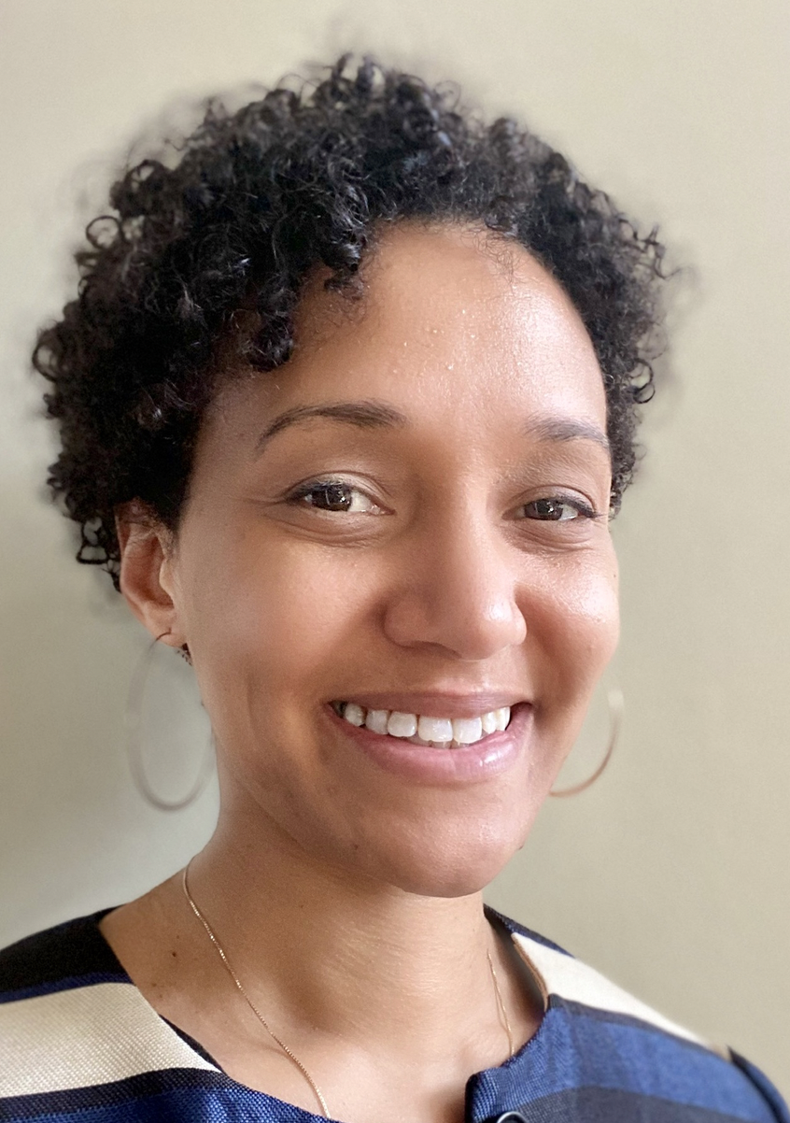
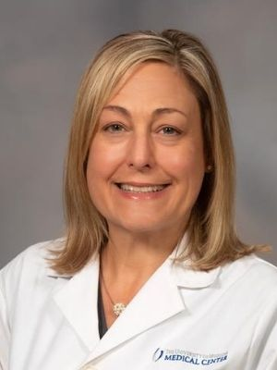
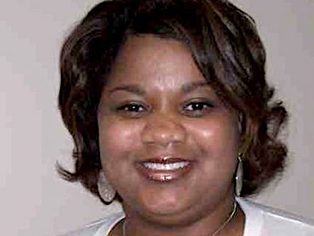
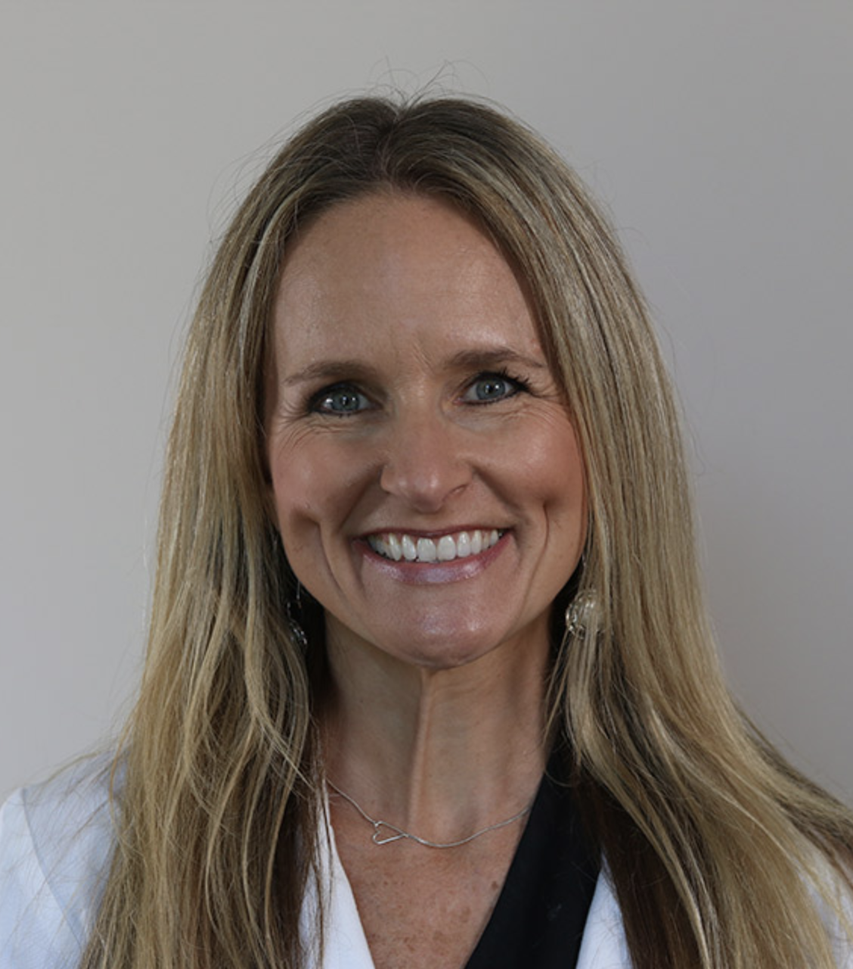
Our Team
Our Team
C. Collier MD, MPH
Monica Stinson, MS
Jasmine Williams MPH,LPN
Constance Bourne, MPH
Janice Scaggs, DNP, CNM
Director/ OB Lead
Program Manager
Project Manager
Data Analyst
OB Lead
Vaginal Birth
Kara Driver MD, MPH
Kim Sheffield, NP
Mobolaji Famuyide, MD
Lakisha Crigler, MD, MBA
Jim Martin, MD
Stephanie Swiley, RNC-OB
Neonatal Lead
Neonatal Lead
Neonatal Lead
OB Lead
Hypertension
OB Lead
Hypertension
Simulation Trainer

Slide 4
Partners

Slide 5
Racial Equity
Evaluating all practices
Data by race, geography, payer with focused goals to achieve equity
2021 Goal: Racial equity training for all birthing facilities in partnership with National Birth Equity Collaborative
3 Mississippi Hospitals/MSPQC partner with SACRED Birth Study to evaluate measures of Obstetric Racism

Slide 6
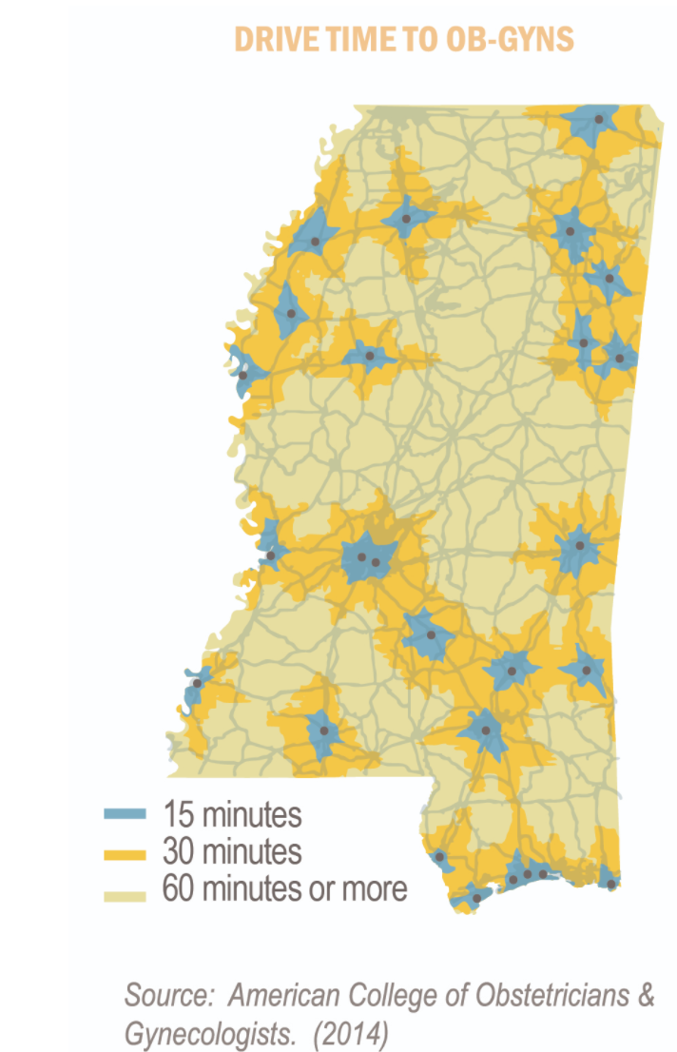
Landscape
42 Birthing Facilities in Mississippi
~37,000 births per year
65% Medicaid
1 Level IV NICU Level/Academic Medical Center
10 III NICUs
No Birthing Centers
429 ob/gyns in 36 of 82 counties
~10 MFMs

Slide 7
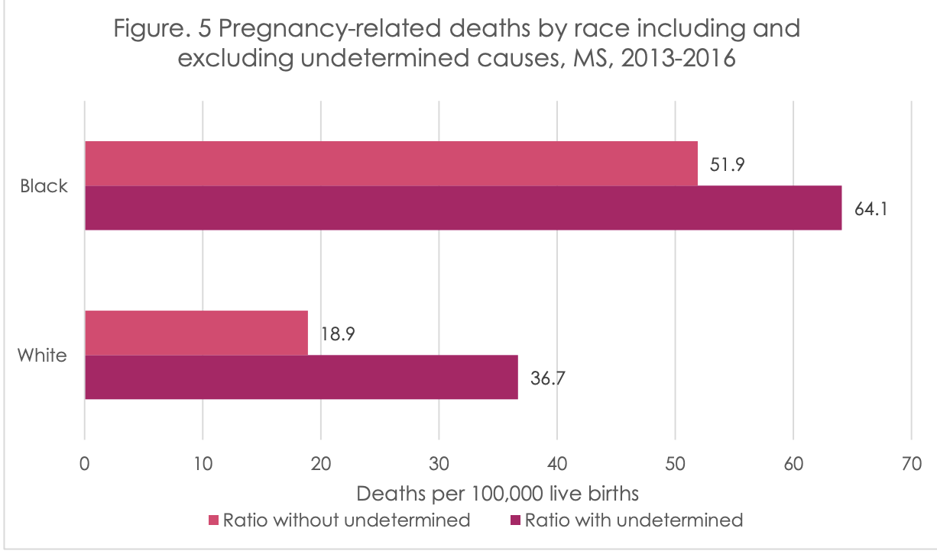
Maternal Outcomes

Slide 8
Past Initiatives
Early Elective Deliveries
Severe Maternal Hypertension 1.0
Obstetric Hemorrhage Initiative ( AIM)
Neonatal Golden Hour
Partner- Baby Friendly Hospital Initiative ( CHAMPS/Boston University)

Slide 9
Current Initiatives
Maternal
Hypertension & Heart
Initiative to Support Vaginal Birth ( I-Support)
Neonatal
Neonatal Abstinence Syndrome
Express Yourself- Human Milk in NICU

Slide 10
Hypertension & Heart Project Aims & Goals
By November of 2021, for mothers with confirmed severe maternal hypertension:
Increase proportion treated for severe HTN in <60 minutes to >80%
Increase proportion receiving preeclampsia education at discharge to >80%
Increase proportion with follow-up appointments within 10 days to >80%
Increase proportion of cases with provider/nurse debriefs to >80%
Reduce hypertension related mortality in Mississippi by 20% by 2021
All facilities conducting at least one annual drill on maternal cardiac arrest annually.

Slide 11
Hypertension & Heart Activities
Documented hypertension management protocol ( JCAHO)
Provider and nurse education on severe maternal hypertension
Debriefs
Multidisciplinary case reviews
Patient education materials
Electronic Health Record integration of order sets
Drills twice per year

Slide 12
Process
Toolkit development and materials dissemination
Annual Kick Off
Monthly Coaching Team Calls
Quarterly Individual Calls
AIM Database Entry & Tracking
Advanced Life Support in Obstetrics Simulation Training (ALSO)
Celebrations/Recognitions

Slide 13
Progress
 | 2016 | 2018 | 2020
Debriefs | 10% | 20% | 67%
Case Reviews | 10% | 25% | 76%
Patient Support | 15% | 25% | 67%
Written HTN Policy | 7% | 7% | 46%
EHR Integration | 7% | 7% | 56%
Drills (quarterly avg) | <1 | <1 | 1.6

Slide 14
Changing Culture & Convention
WHY AREN’T SEVERE BLOOD PRESSURES TREATED?
“We have just one doctor who still wants to start with Magnesium”
“We wait for the epidural to be in place”
“The main concern is bottoming the mother and baby out”
“ We only call the doctor about ‘emergencies’’
“ We tolerate higher pressures in postpartum period”
“If the patient has chronic hypertension, we don’t usually treat”
“ Our OB champion is the most junior person in the group”

Slide 15
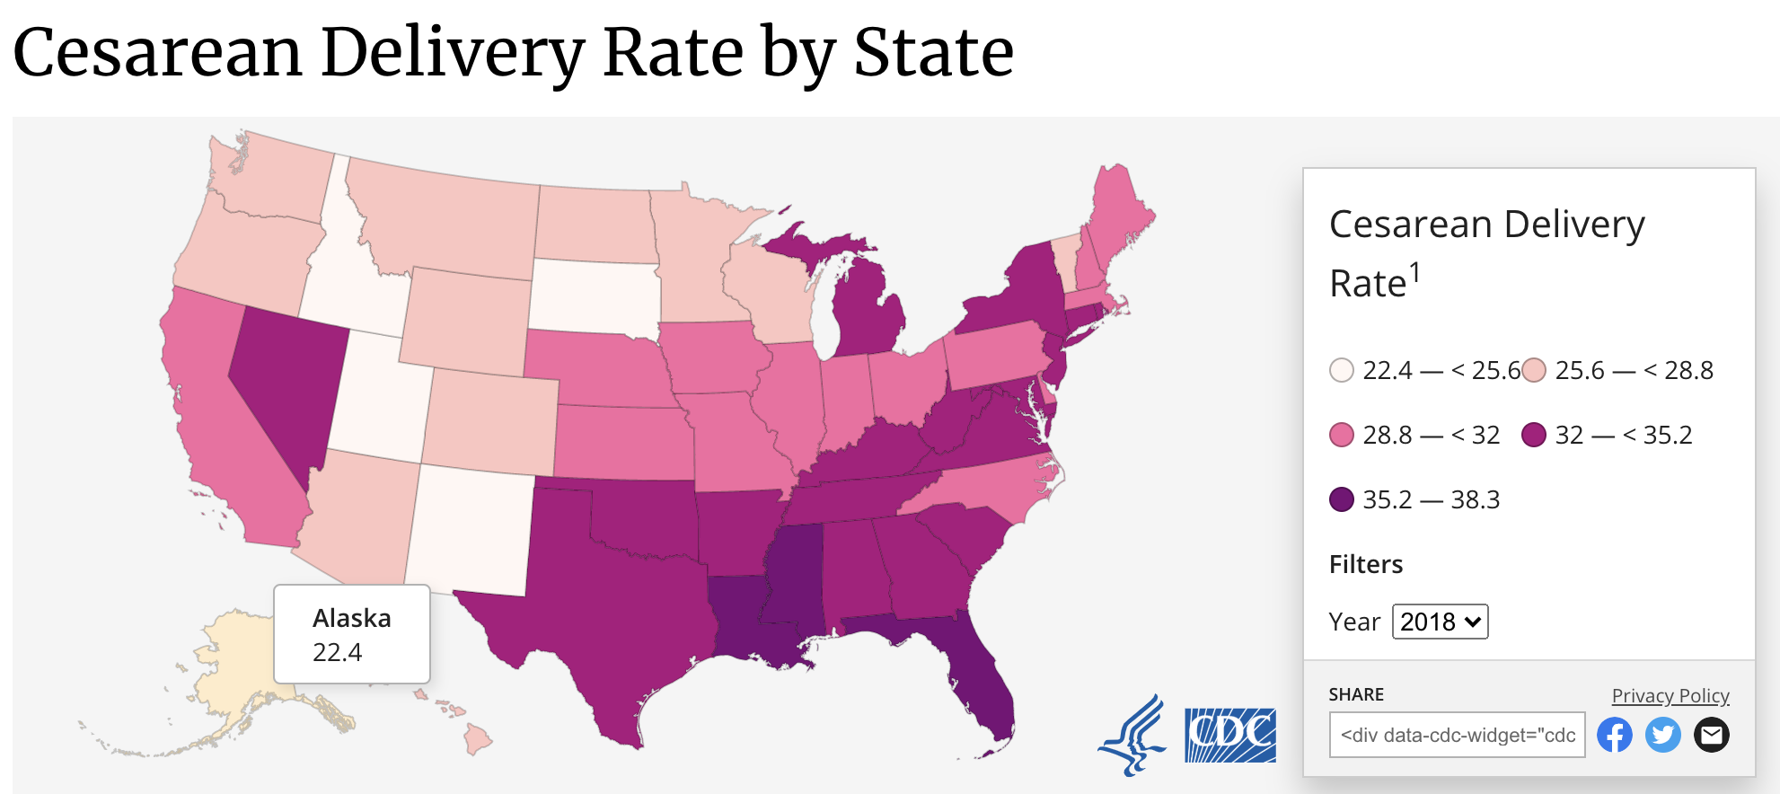
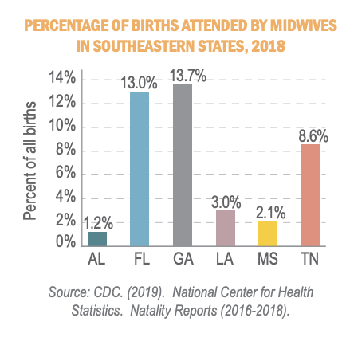
Cesarean Delivery in Mississippi

Slide 16
Initiative to Support Vaginal Birth (I-Support) Pilot
Pilot of 5 hospitals to test process & data
Goal: By 6/2021 reduce of primary cesarean due to failure to progress and failed induction of labor by 10%

Slide 17
Initiative to Support Vaginal Birth (I-Support) Pilot
Phase 1: Education & Training
1
Phase 2:
Data sharing & Case Review
2
Phase 3:
Policy Development
3

Slide 18
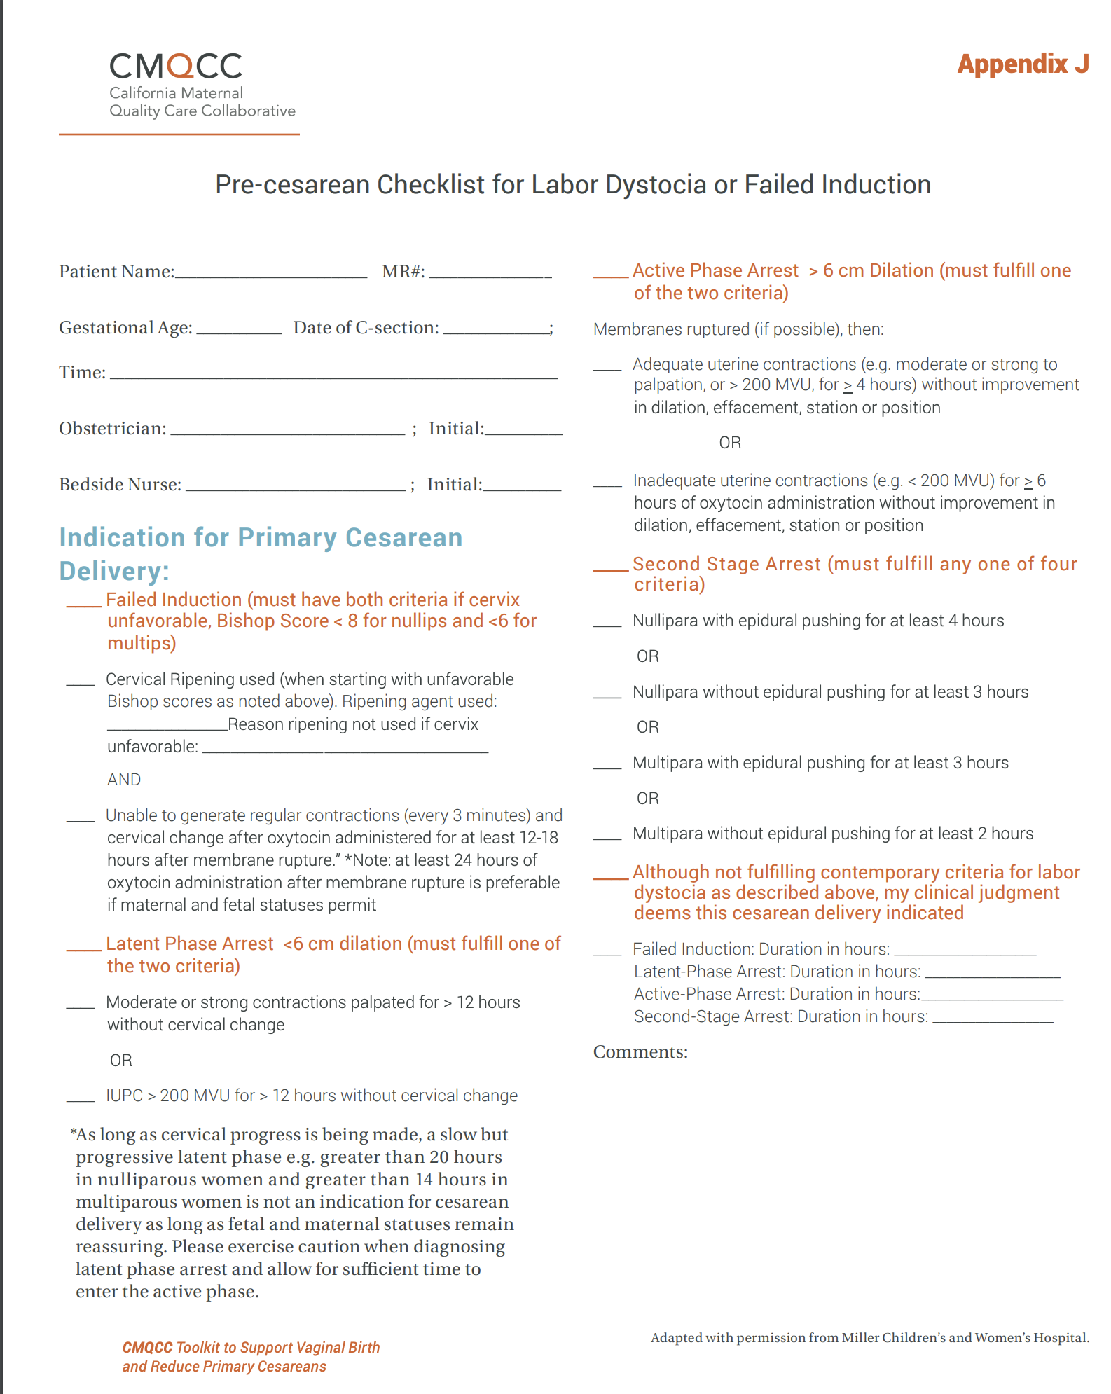
Initiative to Support Vaginal Birth (I-Support)
Phase 1- Education/Training
AIM eModules
Physiologic Birth Education
Hands-on /Virtual Training in Labor Support
ACOG/SMFM Safe Prevention of Primary Cesarean
Use of bedside checklist/review tool

Slide 19
Initiative to Support Vaginal Birth (I-Support)
Phase 2- Data Sharing & Case Reviews
Monthly sharing of unblinded or blinded NTSV with providers, aggregate with OB Unit
Proportion of primary cesareans performed for failure to progress or failed induction of labor that do not meet ACOG/SMFM Criteria
Monthly team case presentation
- A case that met criteria
- A case that did not meet criteria
 | Criteria to meet ACOG/SMFM Indication
Dystocia/Failure to Progress | Cervix 6cm or greater at time of CS Membranes ruptured and NO cervical change x 4 hours with adequate contractions (or 6hrs w/ oxytocin)
Failed Induction | Bishop score at or above 6cm before elective induction Oxytocin used for a minimum of 12 hrs after membrane rupture

Slide 20
Details from Case Presentations Highlight Challenges
Lack of in-house OB coverage drives 5pm cesareans
Lack of in-house Anesthesiology coverage slows overnight inductions
Small practices and solo providers balancing long labors and work schedules
Variable use of induction strategies: foley balloons, combined balloons with medications, IUPCs
Variable maternal support: Doulas, solid food, ambulation, showers

Slide 21
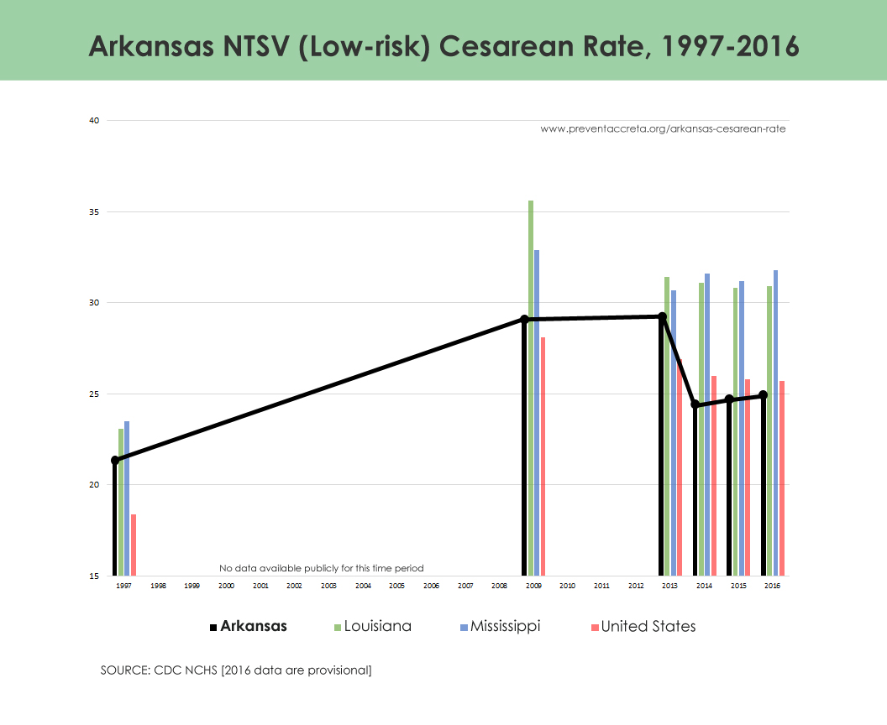
Initiative to Support Vaginal Birth (I-Support)
Phase 3- Policy Development
State Level
State/Payer level incentives
Staffing shortages
Hospital Level
In-house coverage
Standardized education
Standardized data sharing
Maternal support policies

Slide 22
Next Steps
Monthly data reporting to MSPQC
Enrolling 5 additional teams, keeping small cohorts
Patient/Family input- Local Cesarean Awareness Network
Statewide kick-off November 2021

Slide 23
Thank You
If you want to go fast, go alone;
if you want to go far, go together.
--Kenyan Proverb
Charlene.Collier@msdh.ms.gov

