Slide 1

Colorado Perinatal Care Quality Collaborative
October 29, 2020

Slide 2
Colorado Births
2019
Total Live Births: 62,875

Slide 3
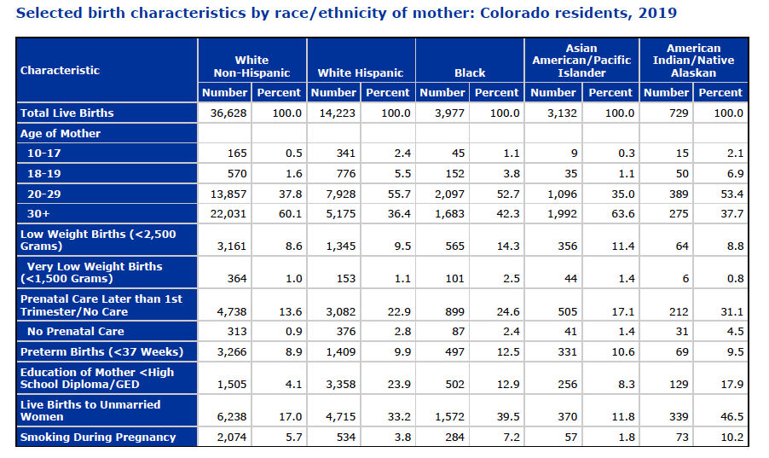

Slide 4

SOAR
SuppOrting vAginal delivery for low-Risk mothers

Slide 5

Overview
High degree of variability in NTSV cesarean birth rate across CO
While lifesaving in many cases, unnecessary cesarean births:
  Increase maternal morbidity and mortality
  Increase risks for infants
NTSV c-section by birthing hospital, Colorado, 2018
2018 Vital Statistics Program, CDPHE
Notes:
The SOAR initiative aims to create consistency among Colorado hospitals and birth centers to help them reach the Healthy People 2020 cesarean target rate of 23.9%. Though Colorado’s overall cesarean delivery rate is below the national average, rates vary greatly among providers.

Slide 6
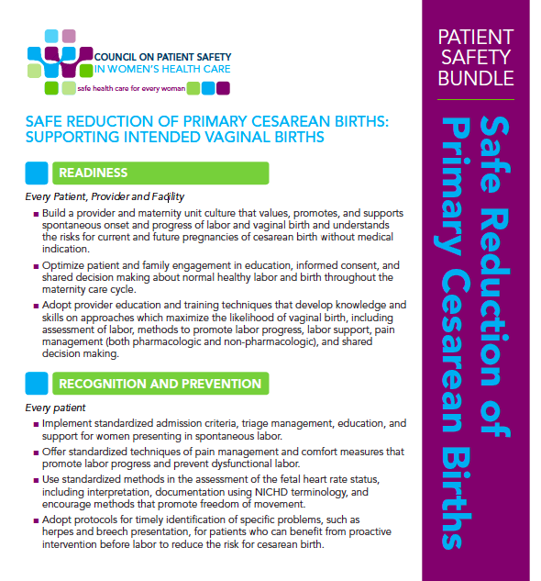

Approach
Intervention aligned with ACOG/SMFM
Consensus Statement & the AIM Patient
Safety Bundle
  Readiness
  Recognition & Prevention
  Response to Every Labor Challenge
  Reporting

Slide 7
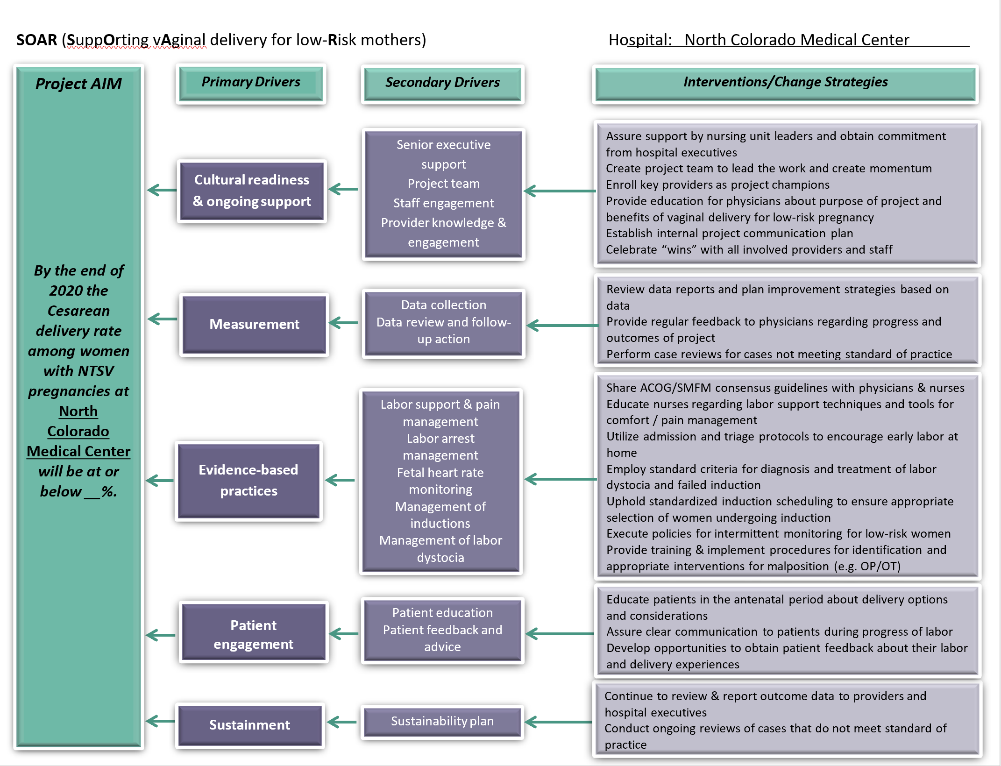
Key Drivers
Notes:
The SOAR key driver diagram outlines the elements required to drive success in this initiative. These range from educating providers in best practices, to evaluating baseline data, identifying secondary tests of change, and evaluating outcomes. Hospitals are encouraged to adopt policies that integrate these changes within common practice, such as patient education and shared decision-making, as well as regular case reviews.

Slide 8

1st Test of Change
2nd Test of Change
Use of labor dystocia checklist
*Adopted & adapted from CMQCC Toolkit
Individualized by hospital
  Pitocin protocol
  Scheduling of inductions
  Deep dive into cases not meeting dystocia criteria
  Use of intermittent auscultation
  Outpatient cervical ripening protocol
Notes:
The primary intervention is implementation of a Labor Dystocia checklist. This is designed as a best practice guide for 2 of the 3 leading causes of NTSV cesarean birth in our state: failed induction and labor dystocia (fetal distress is the 3rd). Implementation of this checklist standardizes clinical decision-making for these drivers, and reduces variability in the cesarean birth rate. As this “noise” (variability) decreases, hospitals can evaluate cases and identify secondary interventions and begin to implement sustainable changes to reduce their rates.

Slide 9
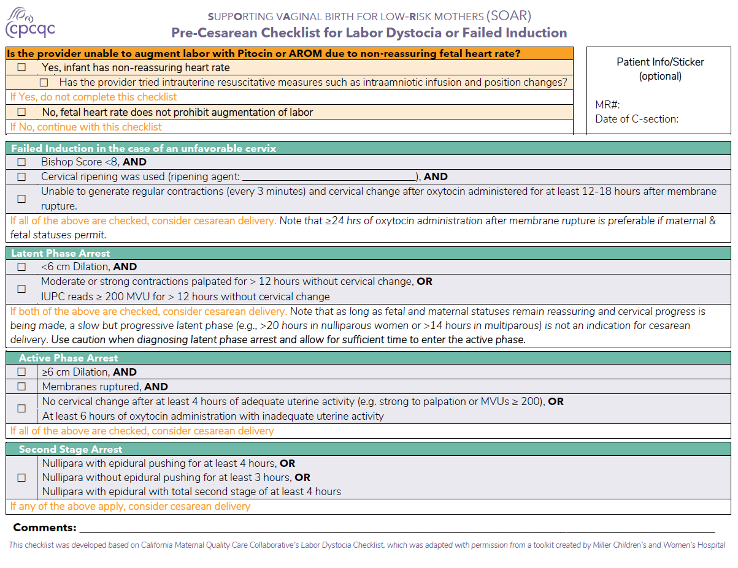
Labor Dystocia Checklist
Notes:
Current iteration of the LD checklist (revised June 2020 with input from SOAR teams)

Slide 10
Outcomes
Participating hospital teams recorded 52% (1,272/2,448) of NTSV cesarean births in REDCap
SOAR hospitals started with more variability and a higher average NTSV cesarean rate than the rest of CO

Slide 11
Outcomes
Control charts demonstrate a decrease in the NTSV cesarean birth rate
  Baseline = 25.4%, current = 22.9%
Enrollment
Notes:
A decrease in the average quarterly NTSV cesarean birth rate can be seen around 1 year post-implementation (based on special cause variation). The new average is below the HP 2020 goal of 23.9% (and the HP 2030 goal of 23.6%).
The pre-post change in the average rate was not statistically significant (p-value=0.156)

Slide 12
Outcomes
The CO average NTSV cesarean birth rate increased over the same time period
First hospital joins SOAR
Notes:
The green line is the CO average over time (excluding SOAR hospitals). Purple is the SOAR average.

Slide 13
Outcomes
10% of NTSV cesareans were for Failed Induction
  Nearly ¼ of inductions are elective
Labor Dystocia, Fetal Distress and Failed Induction remain the leading indications
Lack of adherence to best practice criteria indicates further opportunities for improvement
Indication | # Indicated | # Criteria Met | % Criteria Met
Failed Induction | 129 | 62 | 48%
Advanced Maternal Age | 74 | 15 | 20%
LD: Latent Arrest | 78 | 29 | 37%
LD: Active Arrest | 180 | 155 | 86%
LD: Arrest of Descent | 274 | 80 | 63%
Notes:
Teams submitted patient-level data to assess whether best practice criteria are met for the stated NTSV cesarean indication. The outcomes suggest a need for further training related to failed induction and Latent Phase Arrest of Descent. There is also opportunity with respect to advanced maternal age, however this is not a major contributor to the overall NTSV cesarean birth rate and is therefore of less concern.

Slide 14


Slide 15
Age-adjusted drug overdose rates from opioids: Colorado residents, 1999-2017
CDPHE HealthWatch No 106; December 2018

Slide 16
Colorado Department of Public Health and Environment (2020). Colorado Maternal Mortality Prevention Program Legislative Report 2014–2016.
Notes:
While as neonatologists, we tend of focus on the baby, we can’t forget that the health of mothers. Infant health is inextricably linked to the health of their mothers. In the recently released report from the Colorado Maternal Mortality Prevention Program, we learned that suicide and drug overdose were the leading causes of pregnancy-associated deaths in our state.
Nearly 2/3 of maternal deaths were related to substance use and mental health disorders – with the majority deemed preventable by the maternal mortality review committee.

Slide 17
Variability Across Colorado Hospitals in Care of Opioid-Exposed Newborns
Maternal and infant drug screening
Infant assessment for withdrawal
Location of care for opioid exposed newborns
Degree of engagement of mothers
Pharmacologic treatment modalities
    Initiation and weaning protocols
Criteria for discharge
On and on and on……
Notes:
Thus we had observational data and signals of adverse outcomes. We then sought to understand how opioid exposed newborns were cared for in Colorado.

Slide 18

Initiative Goal
To develop a collaborative quality improvement initiative of Colorado hospitals that uses structured quality improvement methods and sharing of data and practices to further support hospital-based improvement efforts to achieve measurable improvements in the care of substance-exposed newborns and their families.

Slide 19
September 2017
Hospital | Team Lead Identified | Team Roster Completed | IRB Review Completed | Data Audit Begun | Interventions Implemented | Data Sharing Begun
Denver Health | Y
Lutheran | Y
Parker | Y
Platte Valley | Y
Poudre Valley | Y
University Hospital | Y
Notes:
When we first convened in Fall of 2017, the hospitals that were staffed by our section’s faculty were represented and beyond identifying a team lead, very little had yet been done.

Slide 20
COLLABORATION

Slide 21
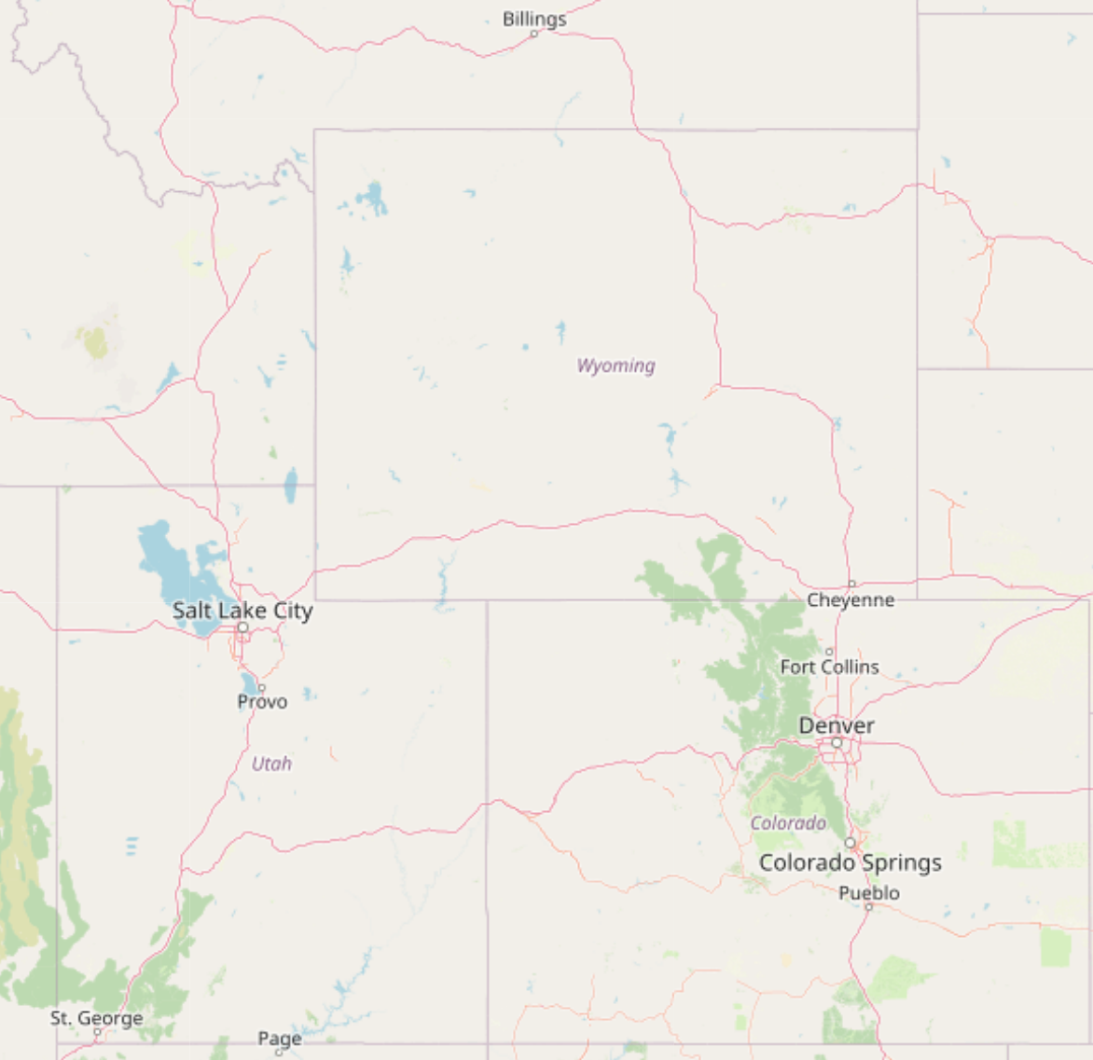
Timeline
Q1 2018
Q2 2018
Q3 2018
Q4 2018
Q1 2019
Q2 2019
Q3 2019
Q4 2019
Q1 2020
Q2 2020
Notes:
Such that by the second quarter of this year, we have nearly 30 hospitals in Colorado, Wyoming, and Montana engaged in CHOSEN QIC and more than half contribute data to our central database.

Slide 22

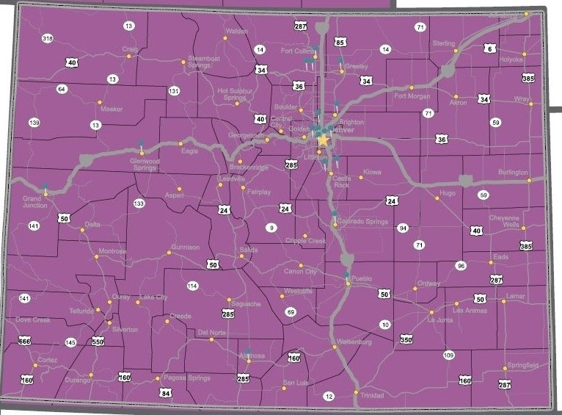
Over 50 percent of Colorado births occur in a hospital participating in CHoSEN QIC.
Notes:
Here in Colorado, nearly 50 percent of all births now occur in a hospital participating in CHOSEN QIC.

Slide 23

Hwang SS, Weikel B, Adams J, Bourque SL et al. Hosp Pediatrics 2020.

Slide 24


Slide 25

Total SEN: 1,234
Total OEN: 1,023

Slide 26
Maternal Substance Use
Maternal Substance Exposures | N (%)
MAT | 581 (57%)
MAT Only | 143 (25%)
MAT + Rx/Legal Substances | 35 (6%)
MAT + Illicit Substances | 403 (69%)
No MAT | 442 (43%)
Rx Opiates Only | 54 (12%)
Rx Opiates + Rx/Legal Substances | 37 (8%)
Illicit Opiates Only | 46 (10%)
Illicit Opiates + Other Substances | 305 (69%)
*MAT = Prescribed Buprenorphine/Methadone Rx = SSRI, Benzodiazepines Legal = Marijuana, Alcohol, Nicotine Illicit Substances = Meth/amphetamines, cocaine, MDMA

Slide 27
Co-Exposures
Frequency of Non-Opiate Co-Exposures
Meth/amphetamines | 359 (35%)
Nicotine | 285 (28%)
Marijuana | 266 (26%)
Cocaine | 76 (7%)
Benzodiazepines | 73 (7%)
Other | 40 (4%)
Alcohol | 33 (3%)
SSRIs | 32 (3%)
Frequency of Opiate Exposures (not mutually exclusive)
Heroin | 417 (41%)
Prescription Methadone | 298 (29%)
Prescription Buprenorphine | 287 (28%)
Illicit Opioids | 157 (15%)
Rx Opioids | 149 (15%)
Opioids, Unknown Source | 90 (9%)

Slide 36
Next Steps
Resume site visits
Moving beyond OEN care to care of SENs and their families
Key-Driver focused efforts
Engagement with MAT centers and providers
Engagement and education of outpatient pediatric providers
Data linkage project
Qualitative study: Lived experience of birthing individuals with SUD

Slide 37
Family Integration into
Neonatal Care
Data-driven Engagement of Families to Improve the NICU Experience in Colorado
(DEFINE Colorado)
Notes:
While the language of family centered care or parental experience is not new to us in the NICU, we know that families are not consistently and equitably integrated into the care of their preterm infants during prolonged birth hospitalization. Hence, we formed DEFINE Colorado – which stands for …..

Slide 38
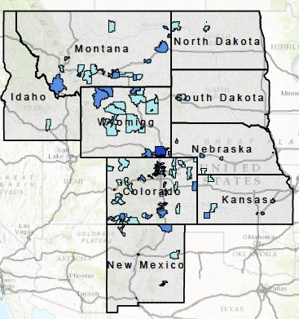
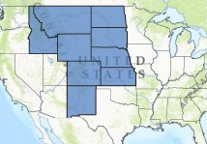
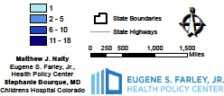
CHCO NICU Admissions by Zip Code
c/o Stephanie Bourque
Bourque SL, Levek C, Melara DL, Grover TR, Hwang SS . MCHJ 2018
Notes:
What might be some of the barriers to parental engagement in our NICUs in Colorado? I wanted to share two studies that highlight some of these barriers.
First, In the Children’s NICU, our infants come from a large catchment area and families tell us repeatedly how hard it can be to travel these long distances to be at their baby’s bedside. After infants recover from their acute illnesses and are convalescing, shouldn’t they be sent back to the referring hospital that is close to where the family lives? Does this happen in our unit? Stephanie Bourque, one of our faculty, undertook at study answer this question. She determined the prevalence and predictors of back-transport of infants ≤ 32 weeks
gestational age in our level IV NICU. Shown here is the vast region from which our NICU infants came during this study period.

Slide 39
Length of stay beyond
clinical stability
Median LOS in Level IV NICU for infants not back-transported was 28.5 days beyond being on LFNC and full enteral feedings
Bourque et al. Submitted. MCHJ 2018
Bourque SL, Levek C, Melara DL, Grover TR, Hwang SS . MCHJ 2018
Notes:
Notably, only 26% of our cohort were back transported and for those who were NOT sent closer to home, the median LOS in our NICU after reaching LNFC and full feeds was 28.5 days. Now what we don’t know is the quality of care at the level 2 units that are closer to maternal residence and we also don’t know what the outcomes of preterm infants across special care nurseries and NICUs are like in our catchment area. But we can say that 1 month of convalescence for these infants could be a valuable time of parental engagement and education about preterm infant health and development.

Slide 40
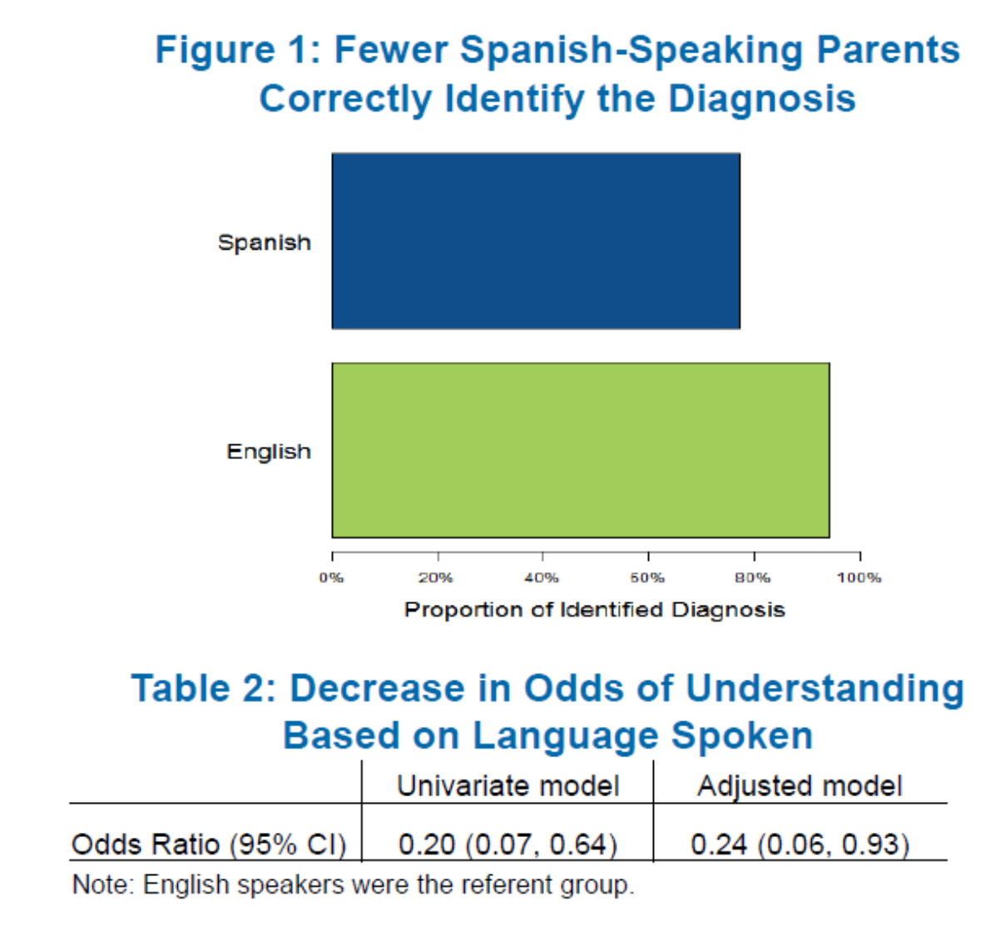
Palau MA, Meier MR, Brinton JT,
Hwang SS, Roosevelt GE, Parker TP.
J Perinatol 2018.
Mauricio Palau et al. Presented at PAS 2017.
Notes:
Another one of our faculty, Mauricio Palau, who now attends primarily at Denver Health sought to investigate the impact of primary language on communication in the NICU. Mauricio undertook primary data collection at the NICUs at Children’s and University by interviewing caregivers of hospitalized infants. He assessed their understanding of their infants’ conditions and the various diagnostics tests and therapeutic interventions undertaken. For clinical diagnosis, he found that Spanish speaking parents were less likely to correctly identify their child’s diagnosis and even after controlling for parental education, Spanish speaking families had far less understanding of their child’s clinical course than English speaking families.

Slide 41
Palau MA, Meier MR, Brinton JT,
Hwang SS, Roosevelt GE, Parker TP.
J Perinatol 2018.
Mauricio Palau et al. Presented at PAS 2017.
Notes:
When Spanish speaking parents were asked how they were communicated with, the majority reported being updated in English by both nurses and doctors

Slide 42
DEFINE Colorado QIC Key Driver Diagram
Aim Statement
Primary Drivers
Secondary Drivers
Potential Change Concepts
By December 2022, hospitals will improve family engagement in NICUs by:
Improving parental report of engagement in infant health and development during NICU hospitalization by 20%
Reduce disparities in parental report of engagement by race/ethnicity, primary language, and distance from hospital by 20%
1) Increase use of interpreter services often and early
Language barrier between providers and parents
Communication between NICU staff and families; among NICU providers
1) Standardize timing and content of first family meeting after admission
Measure: 1) Parental report of timely and consistent communication from providers; 2) Timing of first family meeting; 3) Frequency of family updates/meetings
Lack of timely and frequent family updates
1) Reduce parking cost; 2) Provide public transportation vouchers; 3) Minimize restriction of sibling visitation; 4) On site childcare for siblings; 5) Overnight accommodations for families; 6) Provide meals as needed
Inadequate family presence (during rounds, for infant cares)
By December 2022, hospitals will improve family engagement in NICUs by:
Improving parental report of engagement in infant health and development during NICU hospitalization by 20%
Reduce disparities in parental report of engagement by race/ethnicity, primary language, and distance from hospital by 20%
Inconsistency in understanding of infant care plans among providers
1) Improve communication among medical consultants and primary team; 2) improve communication among primary team and nurses
Current social services not comprehensive to address all needs
1) Social determinants screening tool; 2) establish referral service
Social and financial supports for families
1) Utilize parent peer support groups
Measure: 1) date of first social worker contact; 2) parental report of social and financial needs being met
Social workers bandwidth; timely availability
Inadequate family support in primary language
1) Increase use of interpreter services often and early
Inadequate mental health support
1) Introduce universal screening for parental depression/anxiety; 2) Provide mental health support during NICU hospitalization
Inadequate family presence
1) Reduce parking cost; 2) Provide public transportation vouchers; 3) Minimize restriction of sibling visitation; 4) On site childcare for siblings; 5) Overnight accommodations for families; 6) Provide meals as needed
Family engagement in Hands-On NICU care
Families and NICU staff have unclear expectations about parental role in the NICU; lack of parental empowerment
Measure: Skin to skin and breastfeeding continuation (through day 7, 28, and discharge)
1) Educate family on all aspects of care they can participate in; 2) Development of peer-support groups; 3) Standardize family participation in infant’s care (FICare)
Language barriers
1) Increase use of interpreter services often and early
Mother’s own milk (MOM) protocols, policies, and supports
1) Introduce MOM education and support during prenatal period; 2) Early pumping initiation; 3) Early and frequent skin to skin; 4) Address lactation issues by phone/telehealth
Lack of shared decision making in discharge planning
1) Educate family on all aspects of care they can participate in; 2) Development of peer-support groups; 3) Standardize family participation in infant’s care (FICare)
Family participation in discharge planning
Measure: 1) parental report of discharge readiness; safe sleep adherence post-discharge; 2) Timing of initiation and completion of discharge checklist
Language barrier
1) Increase use of interpreter services often and early
Inadequate family presence
1) Reduce parking cost; 2) Provide public transportation vouchers; 3) Minimize restriction of sibling visitation; 4) On site childcare for siblings; 5) Overnight accommodations for families; 6) Provide meals as needed
Compliance with safe sleep practices in NICU
1) Standardize infant sleep practices and environment for all NICU infants
Notes:
These are just two examples of the barriers to parental engagement in the NICU. There are many more and thus we have launched DEFINE Colorado – our data driven effort to improve the parental engagement experience in NICUs through Colorado. Shown here is our key driver diagram. The 4 primary drivers that we will focus on are communication between NICU staff and families as well as among NICU providers, addressing social determinants of health, family engagement in hands on NICU care, and family participation in the discharge planning process. What’s most notable about this initiative is that from the beginning equity is the focus. Our primary aims are . . .

Slide 43
Discontinuation of Pulse Oximetry Checks (DPOC)
c/o Meg Kirkley MD MPH
Notes:
I wanted to highlight 2 interventions of several which will be part of the DEFINE toolkit. Participating hospitals will be able to choose interventions most salient for their NICU population. Shown here is the key driver diagram for DPOC – Discontinuation of Pulse Oximetry Checks. Developed by Meg Kirkley, our faculty at DH, the global aim of this intervention is to……

Slide 44
PARTICIPATION IS GROWING
46% of Colorado birthing hospitals are participating in at least one QI initiative
60% of Colorado births take place in a collaborative member hospital
22% of participating hospitals are rural
78% of participating hospitals are urban

Slide 45


T H A N K Y O U
www.cpcqc.org
info@cpcqc.org

