Slide 1


Antibiotic Stewardship for the Newborn Population: Ample Opportunities for Improvement
October 29, 2020
ILPQC Annual Conference
Dmitry Dukhovny, MD MPH
Associate Professor of Pediatrics, Oregon Health & Science University
Co-leader, Northwest Neonatal Improvement Priority Alliance

Slide 2
Disclosures
Dr. Dukhovny served as faculty and consultant for Vermont Oxford Network
Most antibiotics are not FDA approved for neonates

Slide 3
Objectives
To define what antibiotic stewardship means in the NICU
To assess your NICU/hospital current practices with respect to antibiotic stewardship
To identify and apply key resources available to build/enhance antibiotic stewardship programs

Slide 6
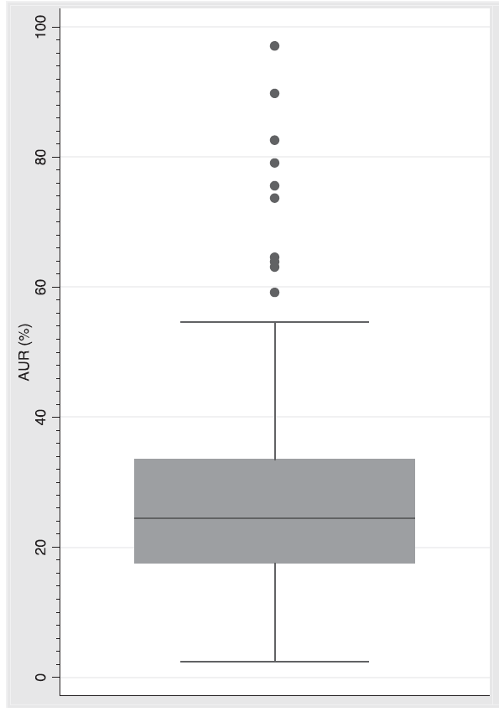
Variation in antibiotic use in NICU
Figure 1 from Schulman et al. Pediatrics 2015.

Slide 7
Antibiotic Stewardship
“coordinated interventions designed to improve and measure the appropriate use of [antibiotic] agents by promoting the selection of the optimal [antibiotic] drug regimen, including dosing, duration of therapy, and route of administration” (PIDS, SHEA, IDSA)
Many components to an Antibiotic Stewardship Program (ASP):
  Right antibiotic
  Right dose
  Right duration
  Right patient
Some (many) patients are getting unnecessary exposure to antibiotics in the NICU
  But…“Babies are sick and vulnerable to infection”

Slide 8
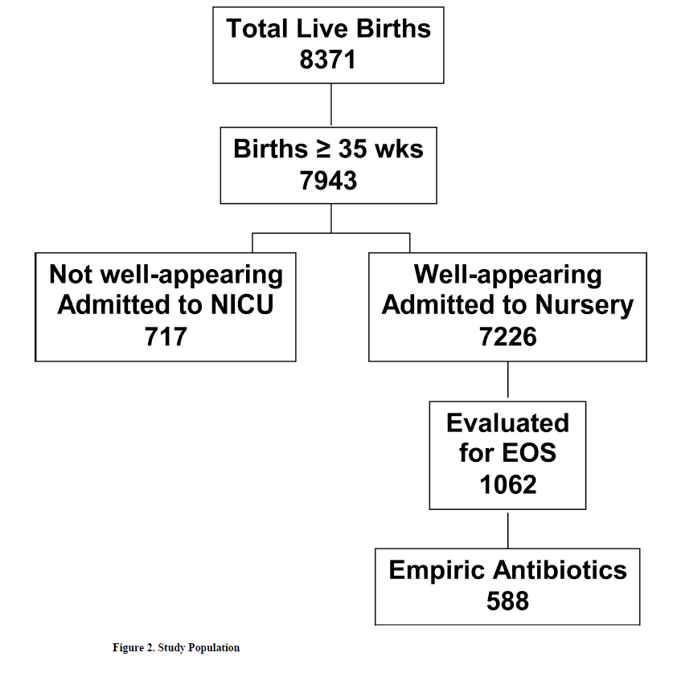
Antibiotic Exposure in Well Appearing Newborns
14.7% of well appearing infants
12.7% of total live births
Figure 2 from Mukhopadhyay et al. J. Perionatology 2013

Slide 9
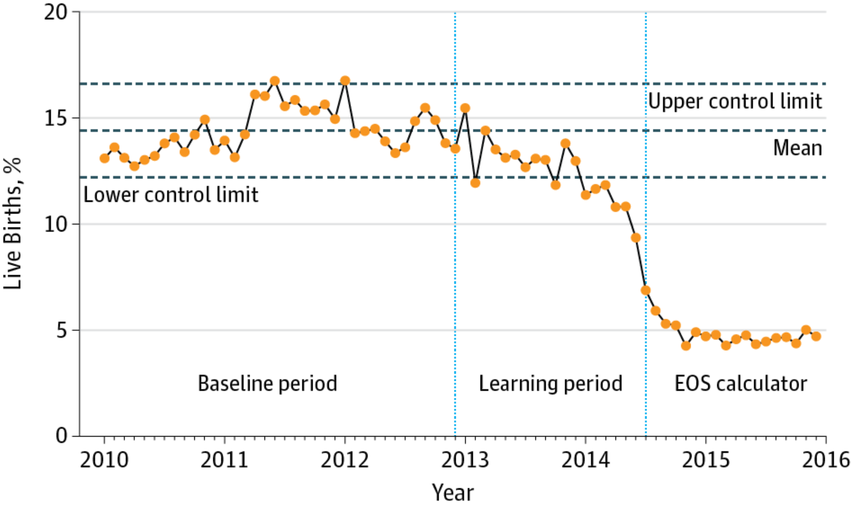
Introduction of Early Onset Sepsis
Risk Calculator (Kaiser) – Blood Cultures
Figure 1 from Kuzniewicz et al. JAMA Pediatrics. 2017
Notes:
Monthly Early-Onset Sepsis (EOS) Evaluation Rate onthly percentage of infants born at 35 weeks’ gestation or later undergoing EOS evaluation with a blood culture performed in the first 24 hours of life.

Slide 10
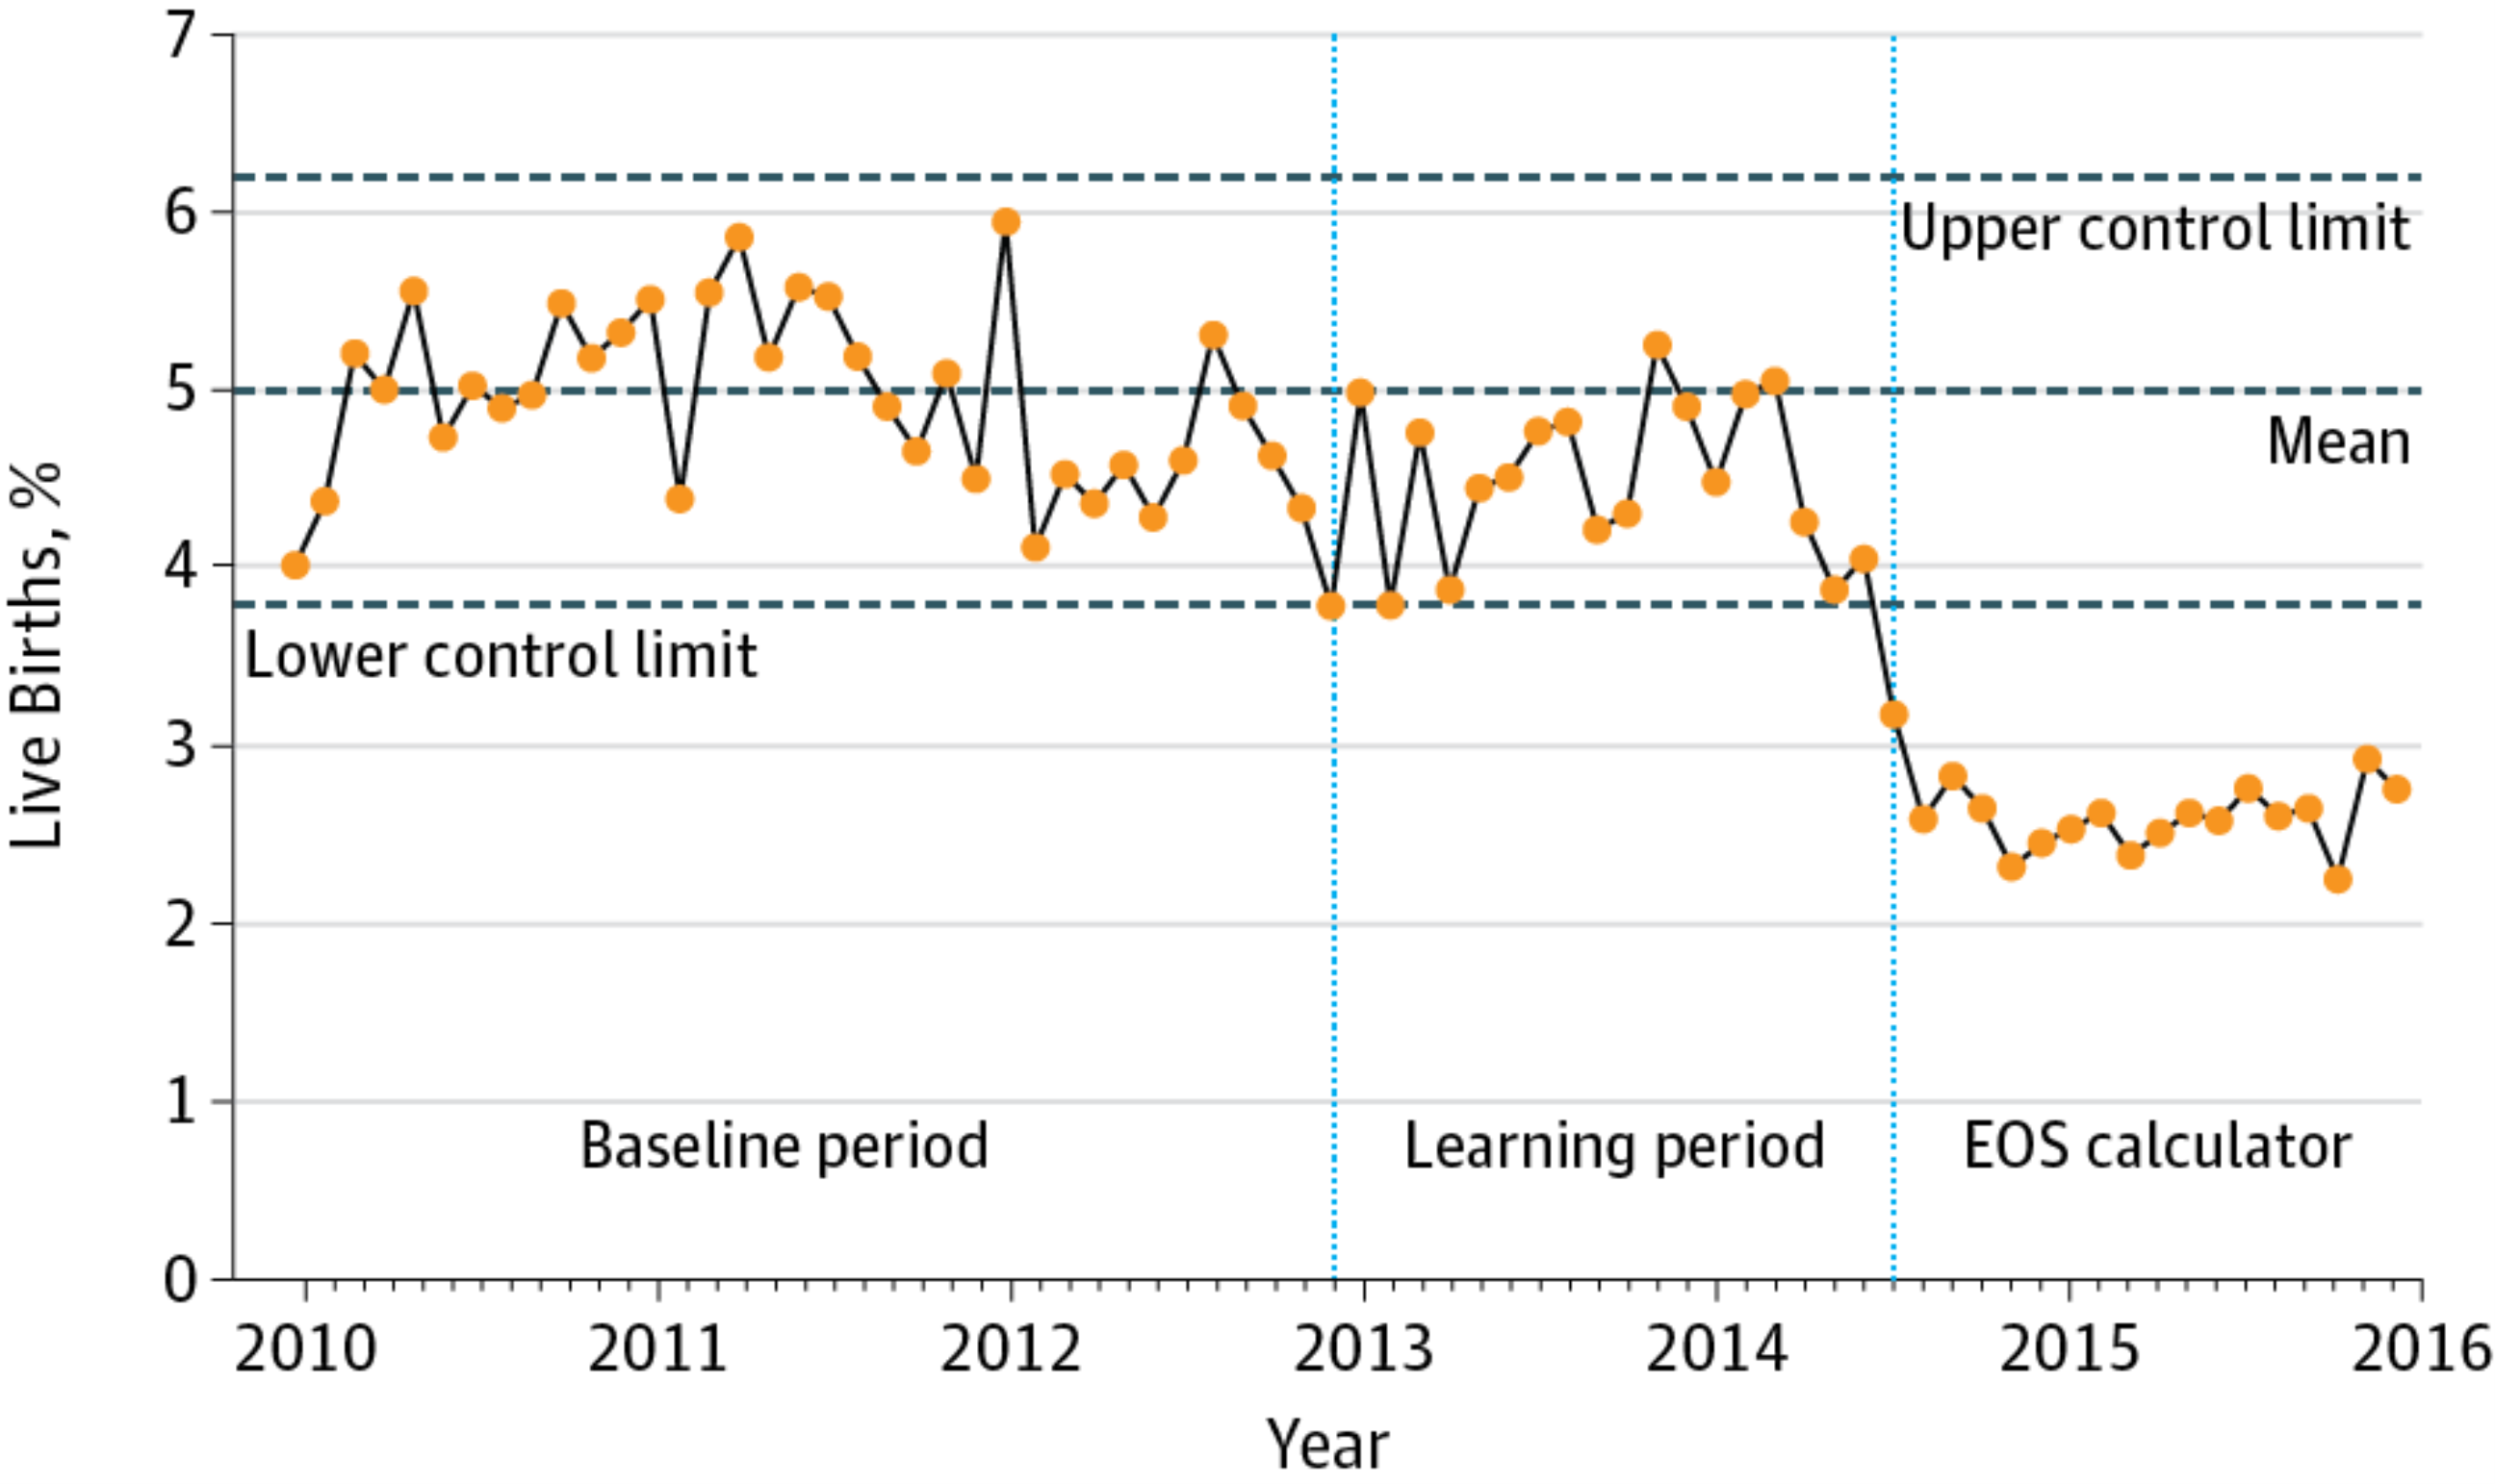
Introduction of Early Onset Sepsis
Risk Calculator (Kaiser) – Antibiotics
Figure 2 from Kuzniewicz et al. JAMA Pediatrics. 2017
Notes:
Monthly Antibiotic Treatment RateMonthly percentage of infants born at 35 weeks’ gestation or later receiving intravenous antibiotic therapy in the first 24 hours of life. EOS indicates early-onset sepsis.

Slide 11
We Are Over-treating preemies:
22-28 weeks, NRN Study
Early Onset Sepsis Incidence: 0.5% 2.5%
Table 5 from Puopolo et al. Pediatrics. 2017
Notes:
Prolonged antibiotics defined as >/= 5days

Slide 12
Variation Persists
Low Risk Group (0.5% EOS)
High Risk Group (2.5% EOS)
Figure 1 from Puopolo et al. Pediatrics. 2017
Notes:
Y-axis - % of centers with prolonged

Slide 13
What are the downsides to Antibiotics?
Increasing resistant organisms - can be helped by modified use of antibiotics Marston et al. JAMA 2016
NICU Problems:
  NEC from prolonged empiric antibiotics Cotten et al. Pediatrics 2009

Slide 14
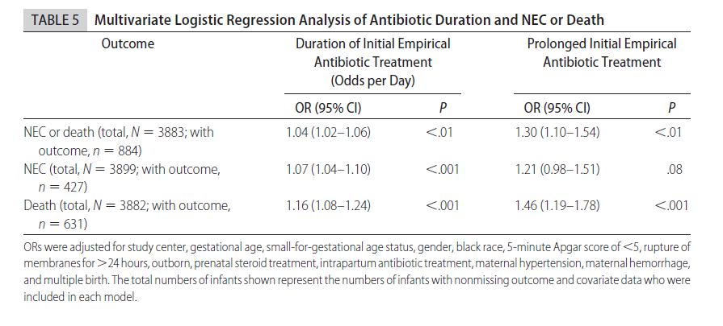
Antibiotics and NEC in ELBWs
  Table 5 from Cotten et al. Pediatrics 2009

Slide 15
Microbiome and Neurodevelopment
  Figure 3 from Roze et al JAMA OPEN Network 3 (9); 2020

Slide 16
What’s the downside to Antibiotics?
Increasing resistant organisms - can be helped by modified use of antibiotics Marston et al. JAMA 2016
NICU Problems:
  NEC from prolonged empiric antibiotics Cotten et al. Pediatrics 2009
  Change individual AND NICU flora (resistance)
  Long term effects?
  COSTS!!!

Slide 17
$2.2 Billion Dollars (2014) attribute to infections with antibiotic resistance
Thorpe et al. Health Affairs 2018
Notes:
Medical Expenditure Panel Survey (MEPS)

Slide 19
What’s the downside to Antibiotics?
Increasing resistant organisms - can be helped by modified use of antibiotics Marston et al. JAMA 2016
NICU Problems:
  NEC from prolonged empiric antibiotics Cotten et al. Pediatrics 2009
  Change individual AND NICU flora (resistance)
  Long term effects?
  COSTS!!!
Asthma risk with exposure in the 1st year of life Mara et al. Pediatrics 2009
Mitigate benefits of breastfeeding Korpela et al JAMA Peds 2016
90% of adult patients with cancer receive antibiotics in last week of life Juthani-Mehta et al JAMA (viewpoint) 2016

Slide 20
Reducing Unnecessary Antibiotic Exposure Works!
Vancomycin reduction strategy in the NICU Chiu et al PIDJ 2011
Inpatient pediatrics ASP programs Smith et al. JPIDS 2015
  Reduce antibiotic utilization
  Decrease costs
  Reduce prescribing errors
ASP implementation using different components Nguyen-Ha et al Pediatrics 2016
  Education
  Restriction on prescribing antibiotics
  Audits
  Clinical practice guidelines
No increased safety concerns noted

Slide 21

CDC Core Elements for ASP
Leadership support
Accountability
Drug expertise (i.e. pharmacy/physician leaders)
Policies to support optimal antibiotic use (i.e. clinical consensus)
Tracking
Reporting/Sharing
Education
Family Engagement
Equity

Slide 22

VON Initiative:
Choosing Antibiotics Wisely
Avoid routine continuation of antibiotic therapy beyond 48 hours for initially asymptomatic infants without evidence of bacterial infection.
Avoid routine screening term-equivalent or discharge brain MRIs in preterm infants.
Avoid routine daily chest radiographs without an indication for intubated infants.
Avoid routine use of pneumograms for pre-discharge assessment of ongoing and/or prolonged apnea of prematurity.
Avoid routine use of anti-reflux medications for treatment of symptomatic gastroesophageal reflux disease (GERD) or for treatment of apnea and desaturation in preterm infants.
Figure 1 from Schulman et al. Pediatrics 2015
Ho et al. Pediatrics 2015
Notes:
150 plus centers, CDC as a partner

Slide 23
Austria
Belgium
Brazil
Canada
Chile
China
Colombia
England
Ethiopia
Finland
Germany
Ireland
Israel
Italy
Kuwait
Malaysia
Mexico
Namibia
Netherlands
Northern Ireland
Portugal
Qatar
Romania
Saudi Arabia
Scotland
Singapore
Slovenia
South Africa
Spain
Switzerland
Taiwan
Turkey
United Arab Emirates
Wales
Over 1300 members
Slide modified and shared with permission from VON
Notes:
VON Mission: “To build a worldwide community of practice dedicated to providing every newborn infant and family with the best possible and ever improving medical care.”

Slide 24
iNICQ Choosing Antibiotics Wisely
2016, 2017, 2018
Webinars (6-9/year)
  Topic content
  QI content
  Coaching
Antibiotic Stewardship Toolkit
  Potentially better practices
Day audits of policies/stewardship/practice (2/year)
On the ground team work
Network of learning
  Web based
  Discussion list-serve

Slide 25
Goals of being part of iNICQ
Different for every center
Follow the Institute for Health Care Improvement (IHI) Model for Improvement to do on the ground, multi-disciplinary work
Participating centers have a range of expertise doing QI work

Slide 26
VON iNICQ Key Driver Diagram
Notes:
4 Potentially better practices (Primary Drivers)

Slide 27
Starting Point
Ho et al. Pediatrics 142 (6) Dec 2018

Slide 28
iNICQ Collaborative Progress
Dukhovny et al. Pediatrics 144 (6) Dec 2019

Slide 29
VON Day Audit
Dukhovny et al. Pediatrics 144 (6) Dec 2019

Slide 30
PBP: Policies and Protocols for specific Neonatal Conditions
Dukhovny et al. Pediatrics 144 (6) Dec 2019

Slide 31
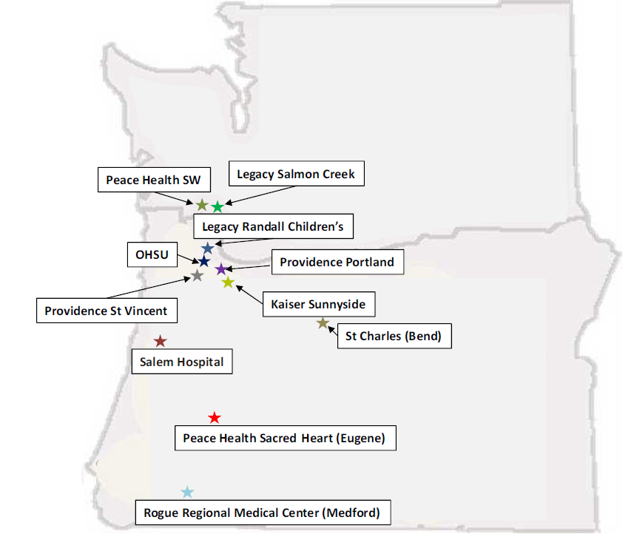
Northwest Improvement Priority:
Antibiotic Stewardship (NW IPAs)
Kaiser Sunnyside Portland, OR
Legacy Randall Children’s Hospital Portland, OR
Legacy Salmon Creek Salmon Creek, WA
Oregon Health & Science University Portland, OR
Peace Health Southwest Vancouver, WA
Peace Health Sacred Heart Eugene, OR
Providence Portland Portland, OR
Providence St. Vincent Portland, OR
Asante Rogue Regional Medical Center Medford, OR
Salem Hospital Salem, OR
St. Charles Bend, OR
Washington
Oregon

Slide 33
Who are the NW IPAs?
ALL 11 NICUs in Oregon and Southwest Washington
  the remaining hospitals/birthing centers in the region provide care to well newborns, as well as triage and stabilize newborns with issues
~50,000 live births/year regionally
All hospitals are members of VON

Slide 34
Overall Aims
Build an ongoing regional collaboration among the 11 NICUs in the region in order to help reduce morbidity and mortality in our patient population
Develop a partnership with the Oregon Health Authority (OHA), March of Dimes, Oregon Perinatal Collaborative (OPC) and other local/regional organizations to help optimize neonatal care and outcomes

Slide 35
Antibiotic Stewardship
SMART AIM
Decrease the number of antibiotic doses per newborn per NICU per month by 10% (from baseline) by December 2016

Slide 36
Key Drivers
Continue to work together and share ideas as 11 NICUs
Set up a venue for communication
Set up additional teleconferences focused on regional antibiotic stewardship work
Collaboration
SMART AIM:
To decrease the median antibiotic utilization rate (antibiotics/newborn/participating hospital/month) by 10% (from baseline year of 2016) in 2017
Enroll in iNICQ 2016 as a region
Begin on the ground antibiotic stewardship work at each individual center
Determine AND share AUR
Stewardship
Partner with other state and regional organization involved in perinatal health and antibiotic stewardship
  Oregon Health Authority (OHA)
  March of Dimes
  Oregon Perinatal Collaborative (OPC)
  Oregon Pediatric Improvement Partnership (OPIP)
Partnership

Slide 37
Practically Speaking…
Every NICU in the NW IPAs were tasked with:
  Joining the VON Collaborative
  Putting together a local multi-disciplinary antibiotic stewardship team
  Developing a SMART Aim
  Starting PDSA cycles to decrease their unnecessary antibiotic utilization
  Participate in NW IPAs activities
  Determine/share their Antibiotic Utilization Rate (AUR)* with NW IPAs
NW IPA Leadership:
  Organization and structure for collaborative QI
  Coaching to the teams
*CDC definition of antibiotic days per 1,000 patient days

Slide 38
Results

Slide 39
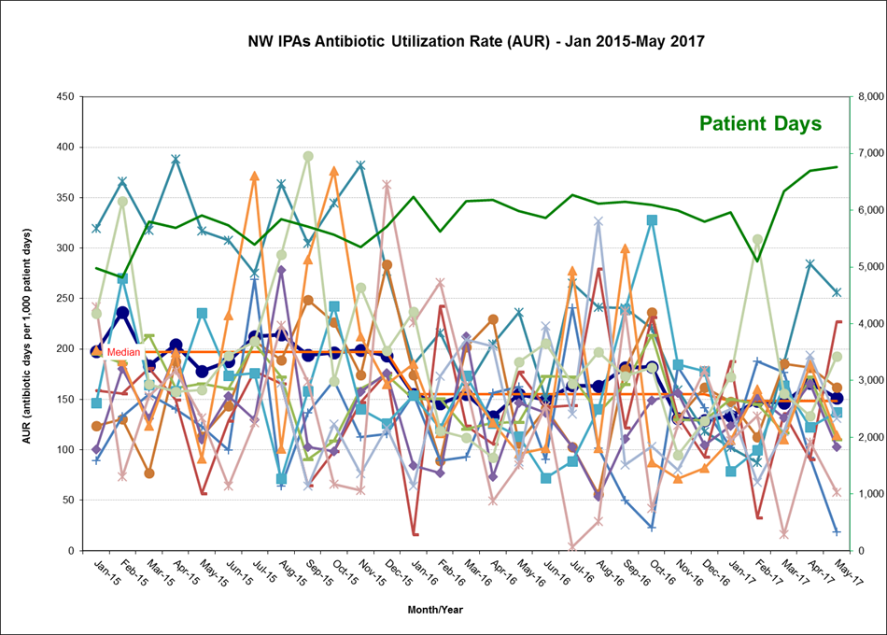
Individual AURs for NW IPA Centers:
Jan 2015 – May 2017
Y-axis (left) – AUR
Y-axis (right) – total patient days for NW IPAs
X-axis – month/year
Thick dark blue line- combined AUR of participating centers in NW IPAs
Individual lines – NW IPAs individual centers monthly AUR

Slide 40
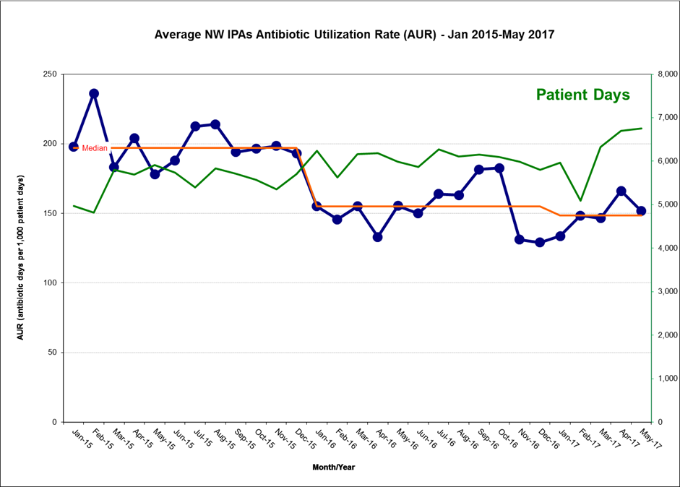
Combined AUR for NW IPAs:
Jan 2015 – May 2017
Y-axis (left) – AUR
Y-axis (right) – total patient days for NW IPAs
X-axis – month/year
Thick dark blue line – combined AUR for NW IPAs
~25% reduction from baseline in antibiotic utilization

Slide 41
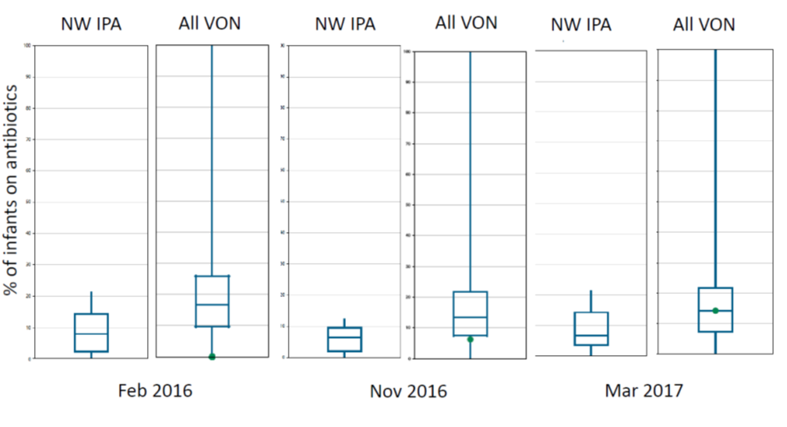
VON Day Audit
NW IPA All VON
Nov 2017
Notes:
This figure represents the NW IPAs antibiotic utilization using the VON Day Audits from February 2016 (Median-8.3%), November 2016 (Median-6.2%), March 2017 (Median-8.6%), Nov 2017 (Median-4.4%) compared to the rest of VON. The box and whiskers plot represents the median, 25th and 75th %iles, and the extreme data points. The green dot on the “All VON” plot represents the NW IPAs. The Y axis is the % of infants on antibiotics on that particular day of the audit.

Slide 42
Sample Report Sent to Each Center
(along with excel template) :
NW IPAs AUR Report
Oregon Health & Science University
January 2015-December 2016

Slide 43
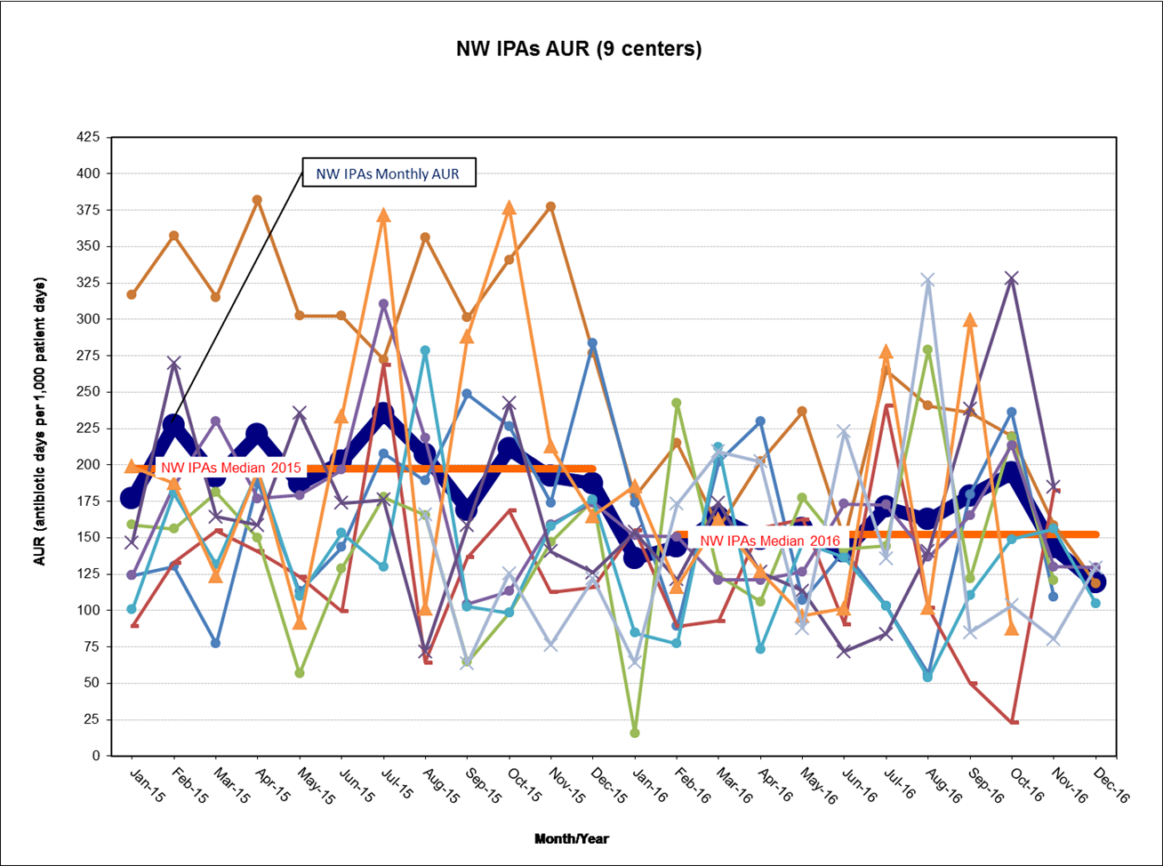
AUR of 9 out of the 11 centers in the NW IPAs from January 2015-December 2016
Notes: (a) 1 center only started data collection in August 2015; (b) only 4 centers have data through December 2016
The thick dark blue line represents the overall AUR for all the centers reporting (NW IPAs Monthly AUR)

Slide 44
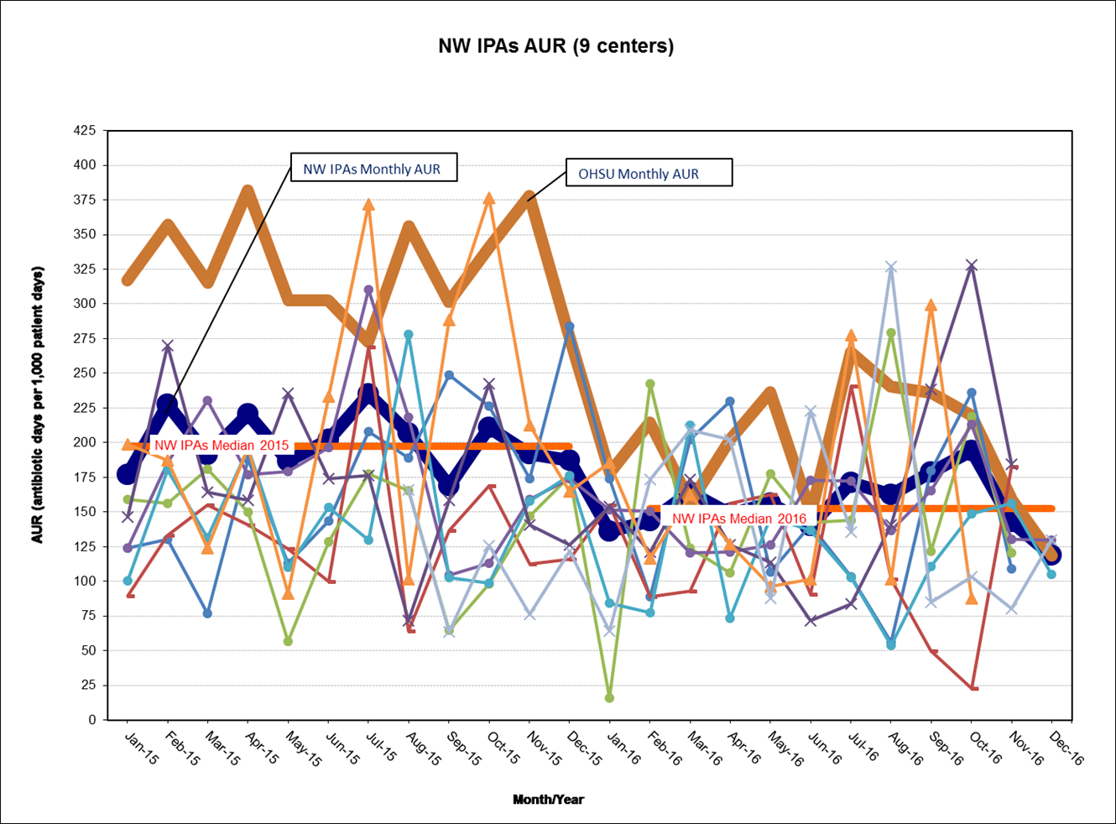
The thick dark blue line represents the overall AUR for all the centers reporting.
The other dark thick line represents the AUR for your center (OHSU)

Slide 45
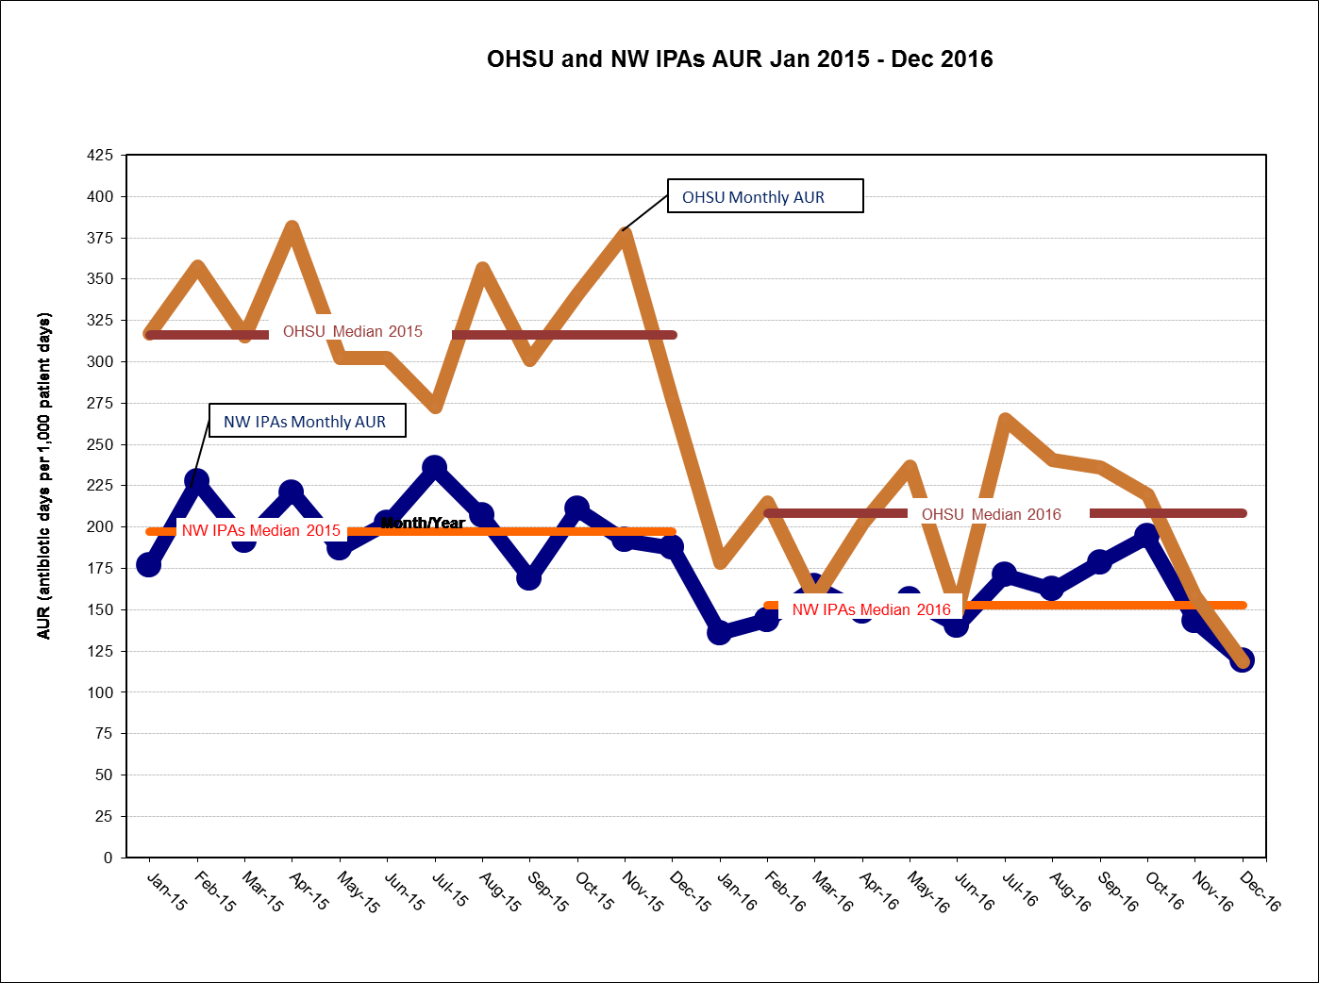
Please note that this is not a risk adjusted graph. If your center median is above the NW IPAs, then you are utilizing more antibiotics then the other 9 centers represented. If it is below the NW IPAs, than you are averaging less.

Slide 46
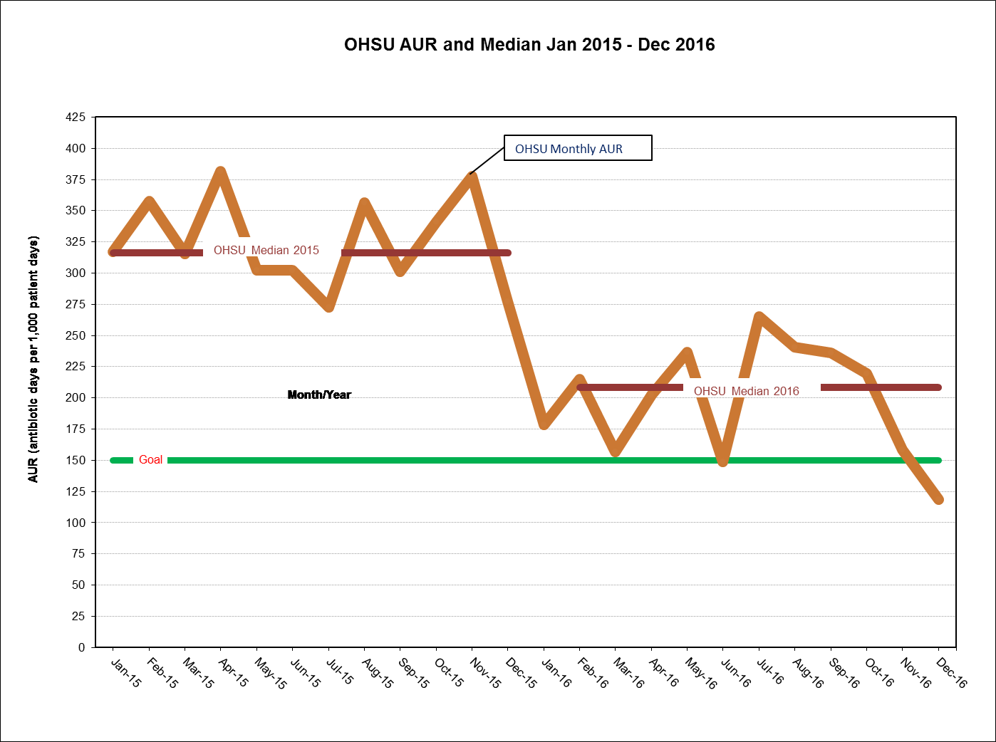
Each center should set it’s own goal line (that should be realistic and attainable –
150 was set arbitrarily for purposes of demonstration)

Slide 47
Summary
NW IPAs have successfully engaged all 11 NICUs in the region in collaboration and participation around antibiotic stewardship
All 11 centers have been able to determine their AUR*
  Labor intensive (getting better)
  Not risk adjusted
  2017 iNICQ participation for NW IPA centers was supported in part by the Healthcare Associated Infections Program of the Oregon Public Health Division with funding from the CDC Epidemiology and Laboratory Capacity Grant
First collaborative QI project in region that includes all NICU participation
*CDC definition of antibiotic days per 1,000 patient days

Slide 48
Our Local Improvement Story:
OHSU

Slide 49
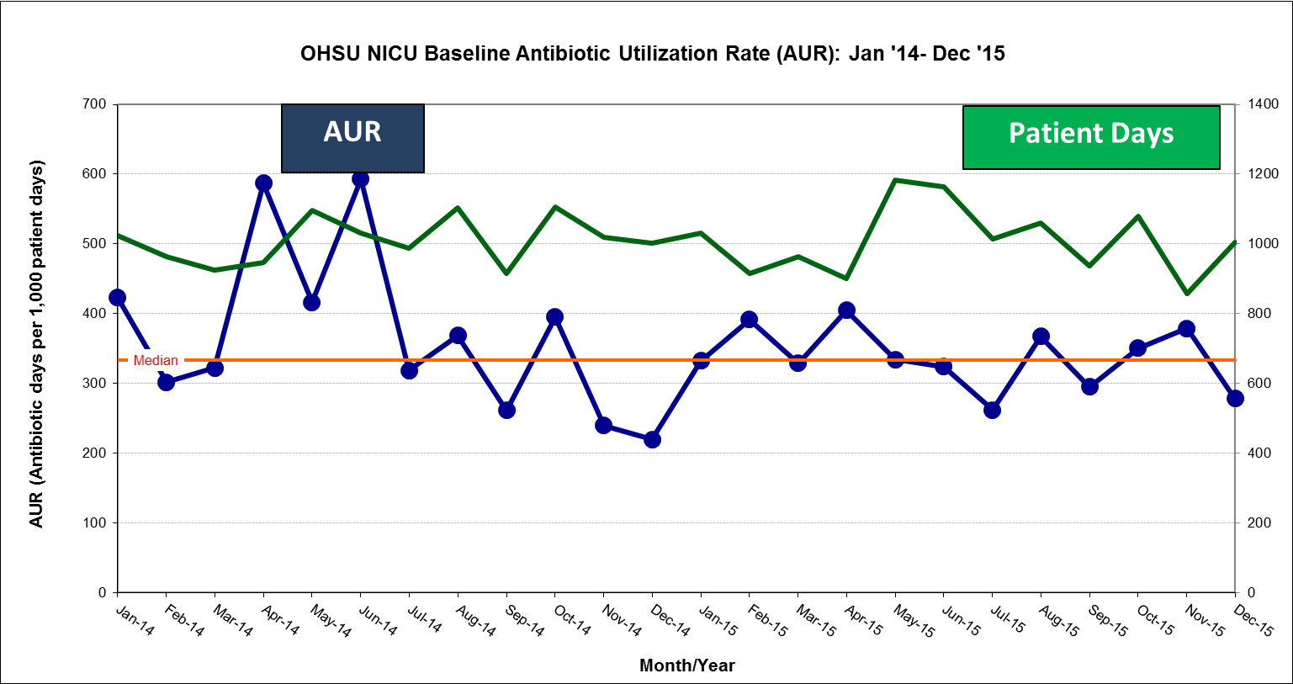
OHSU NICU Baseline Data

Slide 50
SMART Aim
To decrease Antibiotic Utilization Rate (AUR) (defined as antibiotic days/1,000 patients days per CDC) from 333 antibiotic days/1,000 patient days to 283 antibiotic days/1,000 patient days (15%) by December 31, 2016

Slide 51
Key Drivers
Establish a culture of Antibiotic Stewardship
Enroll in VON Collaborative 2016
Join regional collaborative
Form an antibiotic stewardship team
Determine AND share AUR
SMART AIM:
To decrease Antibiotic Utilization Rate (AUR) (defined as antibiotic days/1,000 patients days per CDC) from 333 antibiotic days/1,000 patient days to 283 antibiotic days/1,000 patient days (15%) by December 31, 2016
Identify areas for improvement
Vancomycin reduction strategies
Clarification/updates of clinical consensus guidelines
Initiation of antibiotics
Duration of antibiotics
Pharmacy/IT Driven Interventions
Communication with families
Help engage parents in conversations around antibiotic use

Slide 52
Interventions
Interventions | Time | Description
Pre-NICU ASP | July 2015 | Introduction of Kaiser Sepsis Calculator
1 | December 2015 | NICU ASP Team Formed
2 | March 2016 | Clinical Consensus Guidelines Changes: -48 to 36 hour rule out -Vancomycin reduction
3 | January 2017 | Monthly OHSU ASP Meetings
4 | February/March 2017 | “Hard Stops” for rule out sepsis for early and late onset sepsis
5 – DCH Wide | October 2017 | Pediatric ASP Team Rounds M-F
6 | November 2017 | Parent Information Cards

Slide 53
Results

Slide 54
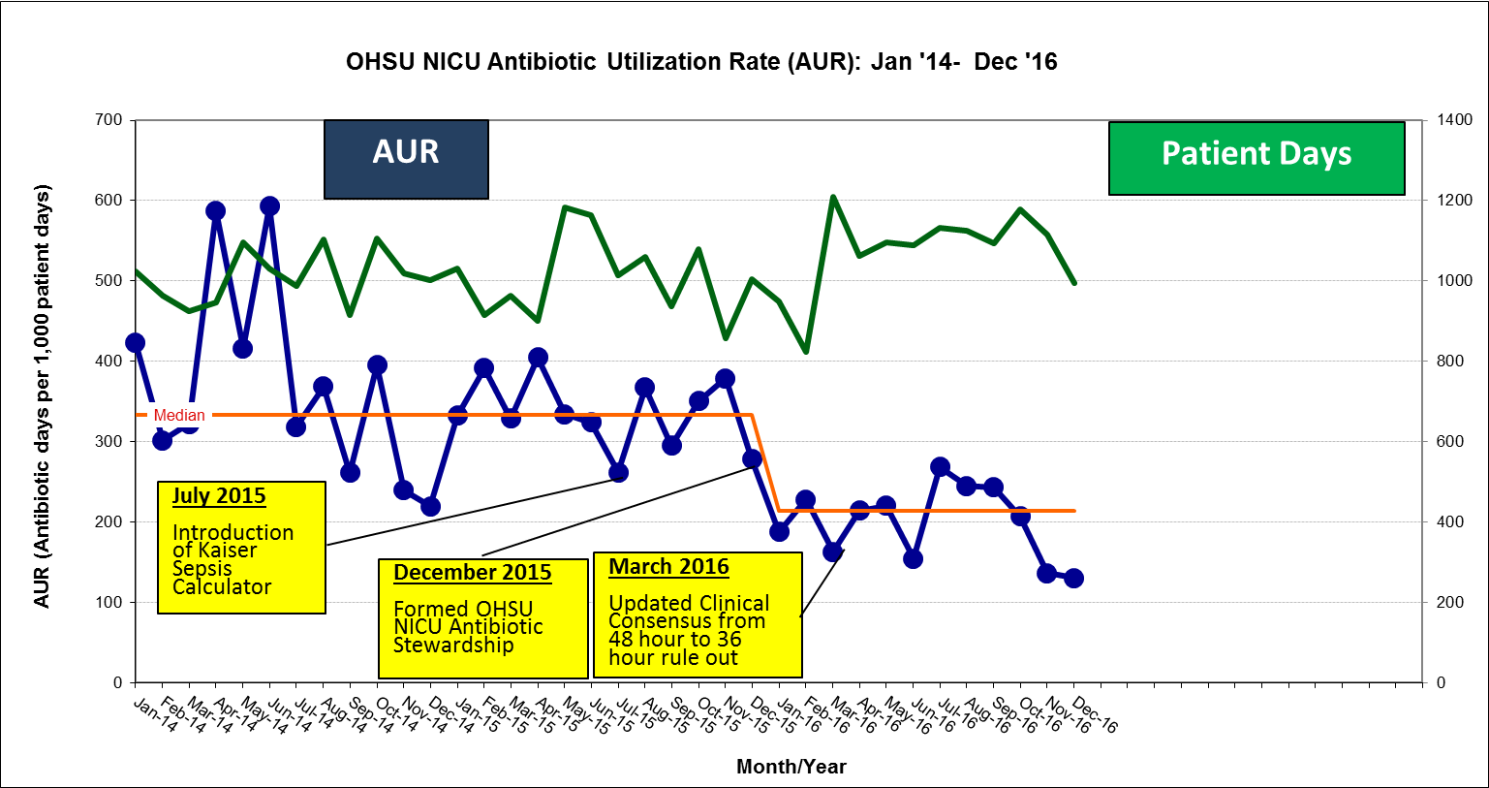
OHSU NICU AUR – Year 1
In 1 year, our median AUR decreased from baseline of 333 to 214 antibiotic
days per patient days (35.7% reduction)

Slide 55
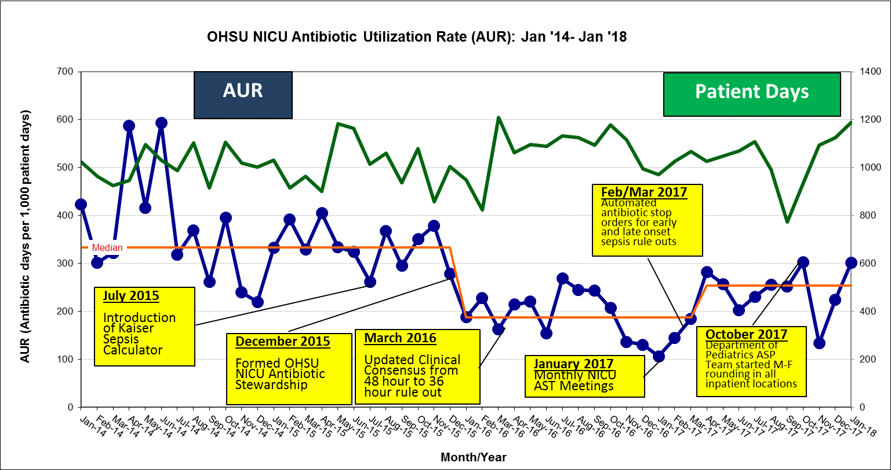
OHSU NICU AUR – Year 2
In 2 year, our median AUR increased (May 2017) from baseline of 188 to 253
antibiotic days per patient days (34.6% increase)
Remains 24% below the baseline data pre-intervention

Slide 56
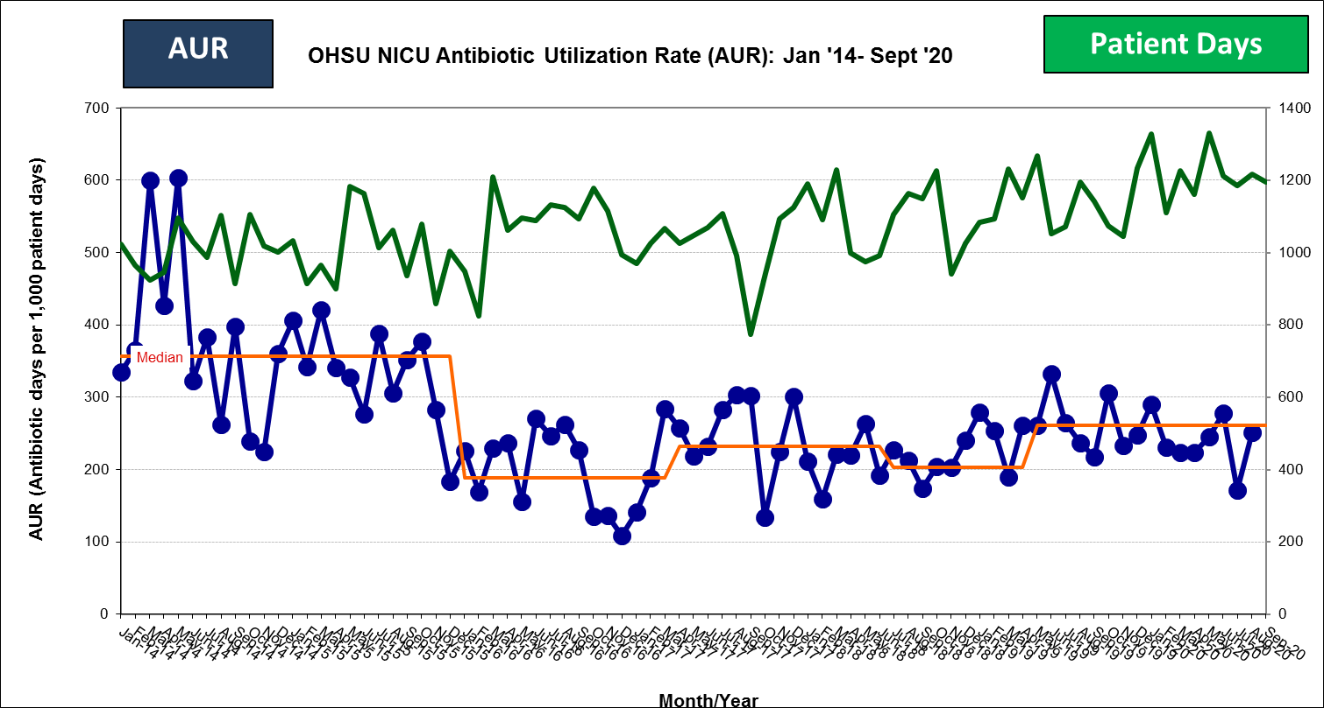
OHSU NICU AUR – Year 5

Slide 57
Keys to Our Success
We have successfully reduced unnecessary antibiotic utilization
Keys to our success:
  Easy topic for staff to buy into (subtracting rather than adding care)
  Pharmacy Engagement
  IT Support
  Infectious Disease/Control (Adult ASP Team)
  Just getting started
  Collaboration - first collaborative QI project in region that includes all NICU participation

Slide 58
Opportunities for Improvement
Understanding variation in AUR
  Antibiotics by indications
  Mapping to infections/NEC
  Getting to the provider level/feedback
Improving the timing of antibiotic administration on initiation
Family engagement
Measuring impact on disparity
Standardization of guidelines
  Low hanging fruit (early and late onset sepsis)
  Culture negative sepsis, VAP, etc
Balancing Measures

Slide 59
Balancing Measures
Meyers et al. Pediatrics 146 (5) Nov 2020

Slide 60
Balancing Measures
Impact on family
Disparity gap
Process measures
  Delay in initiation of antibiotics
  Antibiotics stopped too early
Outcomes
  Mortality, Sepsis, NEC
  Long term outcomes (beyond scope?)

Slide 61
Newborn ASP Strategies
Implementation of Early Onset Sepsis Calculator
  Engagement of the Mother-Baby Units
Shortening the time of rule out from 48 to 36 hours (some to 24 hours)
IT interventions – hard stops
Engaging the families in conversation
Education of staff
Multidisciplinary
  Pharmacy
  Microbiology lab
  ID

Slide 62
What Can You Do?
NICU/Newborn Level
  What are your antibiotic prescribing practices?
  How does your microbiology lab work?
  Do you track them?
Hospital Level
  Is there an antibiotic stewardship program?
    Adult vs. Pediatric
    Data (NHSN AU/AR Modules)
System/State
  What are other centers doing?
  Does your state department of public health have funding and support?

Slide 63
Antibiotic Stewardship
“coordinated interventions designed to improve and measure the appropriate use of [antibiotic] agents by promoting the selection of the optimal [antibiotic] drug regimen, including dosing, duration of therapy, and route of administration” (PIDS, SHEA, IDSA)
Many components to an Antibiotic Stewardship Program (ASP):
  Right antibiotic
  Right dose
  Right duration
  Right patient

Slide 64
Stewardship Opportunities

Slide 65
Meyers et al. Pediatrics 146 (5) Nov 2020

Slide 66
Figure 1 from American Nurses Association White Paper & CDC “Redefining the Antibiotic Stewardship Team” 2017
www.nursingworld.org

Slide 67
Acknowledgements
The work of the NW IPAs is on behalf of the Antibiotic Stewardship Teams in the 11 individual sites
NW IPAs Leadership
  Wannasiri “Awe” Lapcharoensap, MD (OHSU)
  Howard Cohen, MD (Salem Hospital)
  Stefanie Rogers, MD (Providence St. Vincent)
Infectious Disease/Control Support
  Judith Guzman-Cottrill, DO (OHSU)
  Dawn Nolt, MD MPH (OHSU)
Support
  Oregon Health Authority with funding from the CDC Epidemiology and Laboratory Capacity Grant
  March of Dimes (Joanne Rogovoy)
Collaborators:
  Vermont Oxford Network
  Oregon Pediatric Improvement Partnership (Colleen Reuland, MS)
  Oregon Perinatal Collaborative (Rachel Pilliod, MD MPH)

Slide 68
NW IPAs Team and Collaborators
Just the team leaders are listed here, although there are over 90 participants between the 11 sites (including physicians, nurses, nurse practitioners, pharmacists, parents, fellows and medical students)
Kaiser Sunnyside (Portland, OR)
    Tonia Berberich, RN, Hillsty Nicholson, MD, Milette Oliveros, MD
Legacy Randall Children’s Hospital (Portland, OR)
    Sean Sweeney, DO
Legacy Salmon Creek (Salmon Creek, WA)
    Bret Freitag, MD
Oregon Health & Science University (Portland, OR)
    Dmitry Dukhovny, MD MPH, Robert Schelonka, MD
Peace Health SW (Vancouver, WA)
    John Evered, MD, Wadnnasiri Lapcharoensap, MD, Tiffany Wright, NNP
Peace Health Sacred Heart (Eugene, OR)
    Mike Colasurdo, MD
Providence Portland (Portland, OR)
    Fred Baker, MD, Michael Garcia, PharmD, Tiffany Transue, RN, AnneMarie West, RN
Providence St. Vincent (Portland, OR)
    Stefanie Rogers, MD
Asante Rogue Regional Medical Center (Medford, OR)
    Katie Towns, DO, Tiffany Price, RN, Barbera Herzog Taft, RN
Salem Hospital (Salem, OR)
    Howard Cohen, MD, Cindy Davis, NNP, Ryan Lam, MD
St. Charles (Bend, OR)
    Robert Pfister, MD

Slide 69
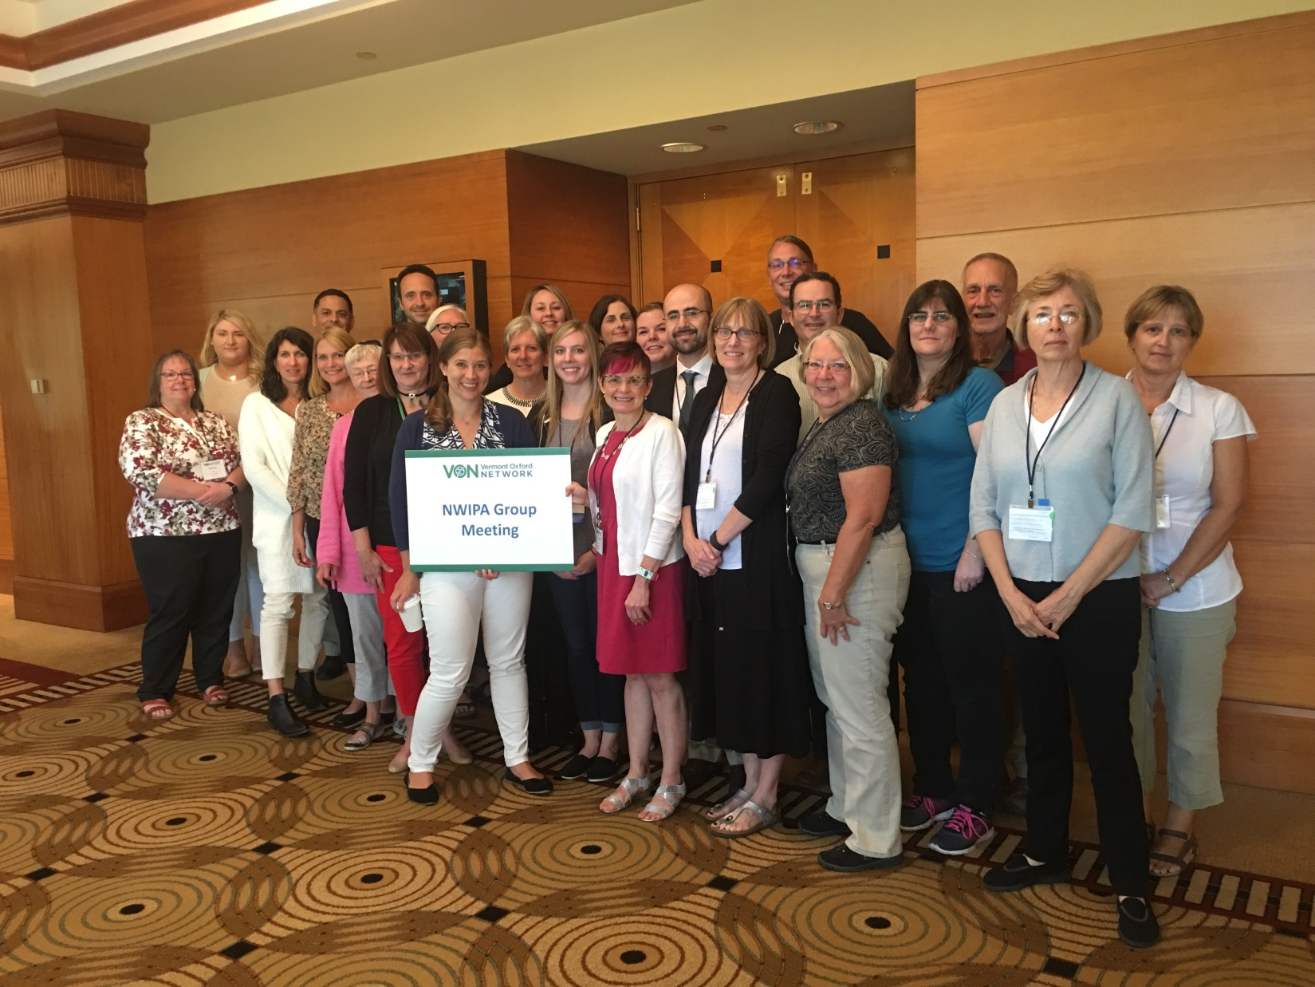
2016 VON Annual Quality Congress
Chicago, IL, September 2016

Slide 70

Thank You!
Questions/Comments
dukhovny@ohsu.edu

