Slide 1
Lowering NTSV CSR: Lessons from the West Coast 2020
David Lagrew MD
Medical Director
Women’s and Children’s Institute Providence St. Joseph Health-Southern California
Clinical Professor
UC Irvine, Dept. OBGYN
Notes:
1

Slide 2
Disclosure
The presenter has no financial disclosures to report

Slide 3
Lesson 1: NTSV CSRs Vary by Hospital but Success is Possible

Slide 4
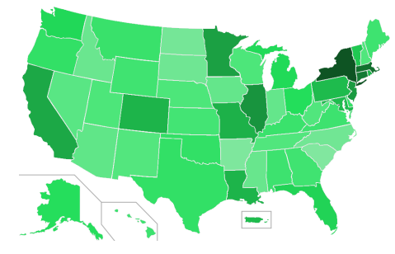
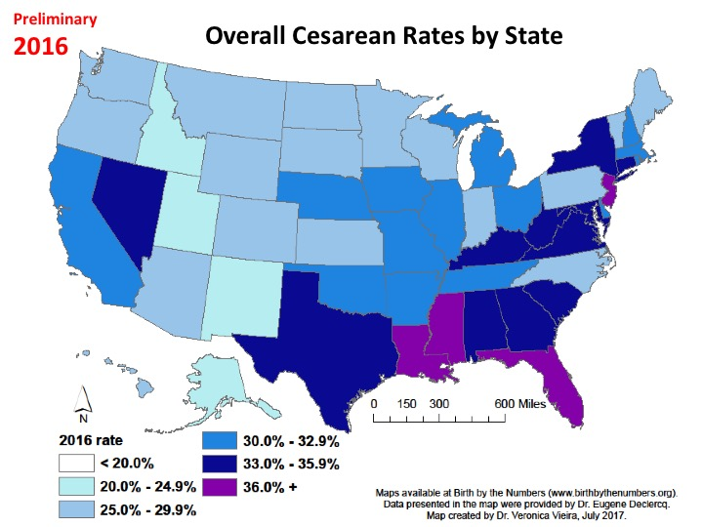
Lawyers versus CS per Capita
But you need to check your zip code!

Slide 5
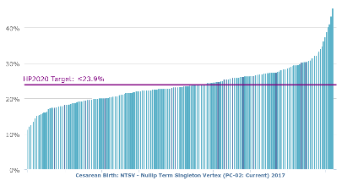
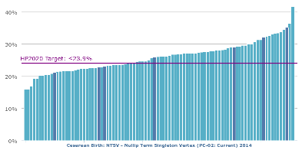
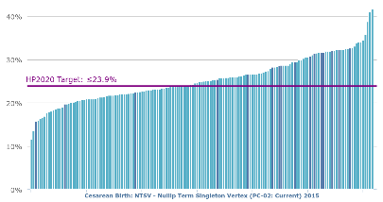
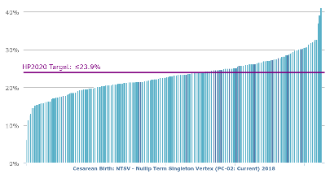
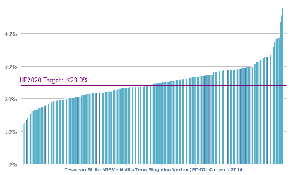
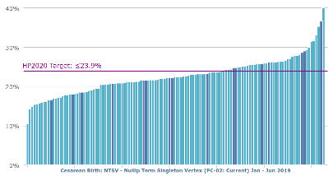
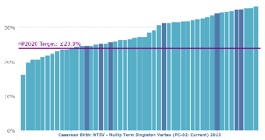
2014
2017
The California Journey
2015
2018
2013
2016
2019

Slide 6
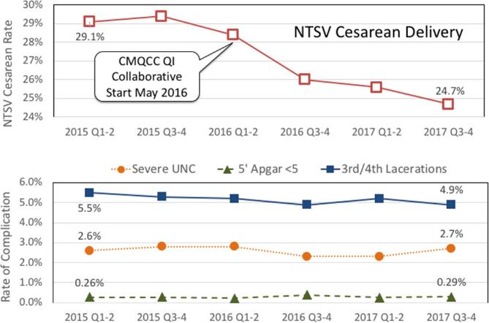
Main et al SMFM 2019, 46 hospitals met inclusion criteria with a mix of hospital types:
university, community, and integrated health system; and high, medium and small delivery volume.
They included an annual average of 115,000 births (of which 35% were NTSV).
American Journal of Obstetrics & Gynecology 2019 220, S183-S184DOI: (10.1016/j.ajog.2018.11.275)

Slide 7
Lesson 2: Individual Providers have as much variation as individual hospitals

Slide 8
Lowering the cesarean section rate in a private hospital: comparison of individual physicians' rates, risk factors, and outcomes.
STUDY DESIGN:
We retrospectively reviewed detailed computerized delivery records (n = 16,230) collected from May 16, 1988, to July 30, 1995. We excluded physicians who had <100 deliveries at our institution during the study period. The physicians were divided into two groups depending on whether their individual cesarean section rates were greater than (control group) or less than 15% (target group). Various cesarean section rates, risk factors for abdominal delivery, labor management techniques, and neonatal outcome parameters were calculated for each group. The cesarean section rates of the two groups were analyzed by year to assess changes.
RESULTS:
As expected by study design, the overall cesarean section rate was markedly different between the two groups (13.8% vs 23.8%). In addition, the primary, repeat, primigravid, and multiparous cesarean section rates were all lower for the target group. The rates of cesarean section for fetal distress (1.5% vs 3.3%) and cephalopelvic disproportion (5.3% vs 8.5%) were also significantly less in the target group. The rates of breech presentation, third-trimester bleeding, and active herpes cesarean sections were not lower. The control group had more postterm (8.6% vs 14.7%) and >4000 gm infants (12.0% vs 13.7%) but similar numbers of low birth weight, multiple gestation, and preterm infants. The target group used more epidural anesthesia, oxytocin induction, and trial vaginal births after cesarean delivery and more successful trial vaginal births after cesarean sections. Over the study period the cesarean section rate in the target group remained unchanged, whereas it steadily declined in the control group.
CONCLUSIONS:
Individual physician's lower cesarean sections are primarily obtained by labor management and attempting vaginal birth after cesarean delivery. These practice patterns did not appear to lead to any increase in perinatal morbidity or mortality.
To the point: “Individual physician's lower cesarean sections are primarily obtained by
labor management and attempting vaginal birth after cesarean delivery. These practice patterns
did not appear to lead to any increase in perinatal morbidity or mortality.”
Lagrew and Adashek. Am J Obstet Gynecol. 1998 Jun;178(6):1207-14.

Slide 9
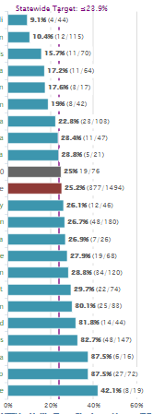
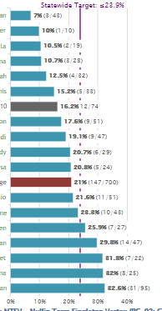
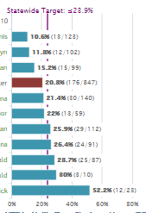
Physicians Variation is Also Present

Slide 10
Breaking Down Hospital Rates by Physician Rates
Hospital Rate
Individual Provider Rate
11 Hospitals, 1st 7 months of 2019

Slide 11
How Do They Get Lower Rates?
More Likely to:
Choose Inductions Wisely and Carefully
Lower number of failed inductions
Less Latent Phase Admission
More present during labor and pushing
Perform manual OP to OA
Aggressively ripen cervix
More Likely to:
More inductions
Higher number of failed inductions
More Latent Phase Admissions
Have more primary elective cesareans
Shorter Second Stages/higher CSR in 2nd stage
LOW RATES
HIGH RATES
11 Hospitals, 1st 7 months of 2019

Slide 12
Lesson 3: Following Guidelines Helps: Why reinvent when others have had success

Slide 13
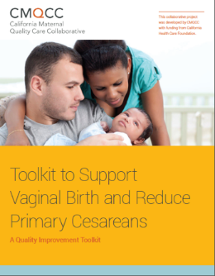
The CMQCC Toolkit
Comprehensive, evidence-based “How-to Guide” to reduce primary cesarean delivery in the NTSV population
Will be the resource foundation for the CA QI collaborative project
The principles are generalizable to all women giving birth
Released on the CMQCC website April 28, 2016
Has a companion Implementation Guide
13
Notes:
. As a keystone for QI implementation efforts, the toolkit offers a menu of various evidence-based strategies for the reduction of primary cesarean birth, corresponding tools that can be implemented within facilities, slide decks for professional education, and lessons learned from California hospitals that have achieved and sustained a low NTSV cesarean birth rate. While the majority of the toolkit is meant to guide individual hospital and provider-level change, it also includes guidance to inform state, county and hospital system-level change.

Slide 14
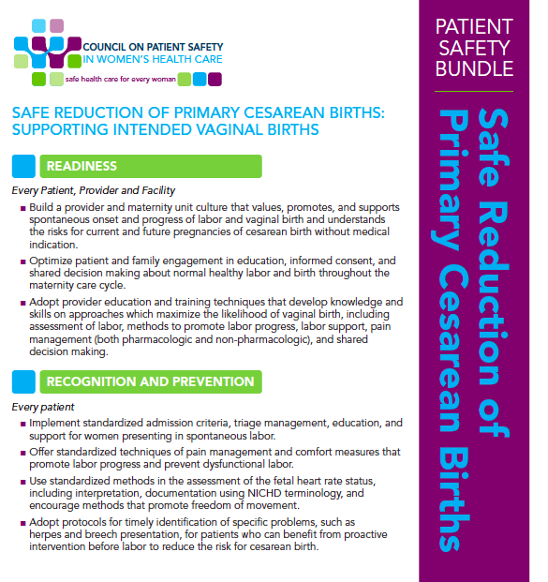
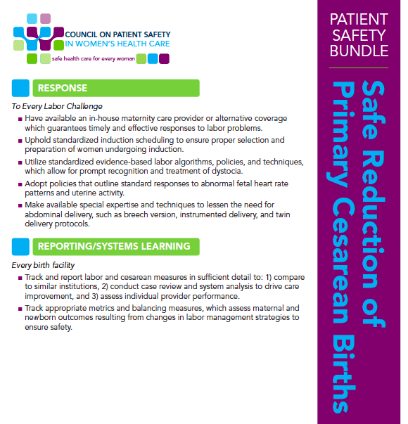
National Cesarean Reduction Bundle
Used as model for the CMQCC toolkit
Notes:
The contents of the toolkit are arranged to reflect the four major domains of the AIM bundle: Understandablly, QI programs for cesarean reduction will differ between facilities. The expectation is not that each facility will implement every tool or concept introduced in the toolkit. Rather, each facility should implement and/or adapt the tools and concepts that will best improve NTSV cesarean rates according to the unique needs of the organization.

Slide 15
Which are “a walk in the park”, “rolling hills” or “climbing mountains”?

Slide 16
Walk in the Park
Adopt provider education
Standardized pain management
Track outcomes and balancing measures (for many on electronic systems)

Slide 17
Rolling Hills
Provider and unit culture which values and promotes vaginal birth
Optimizing patient and family engagement in education, informed consent and shared decision making
Standardized response to FHR abnormalities
Timely identifications of specific problems such as herpes, breech, etc.
Available in-house maternity care
Special expertise for special conditions, e.g. breech version
Track and report labor and cesarean in specific detail, assess individual performance

Slide 18
Mountains to Climb
Implement standard admission criteria, triage management for spontaneous labor
Uphold standardized induction scheduling, proper selection and preparation
Utilize evidence-based labor and induction algorithms
Adopt policies standard responses to FHR patterns
Reducing elective cesareans

Slide 19
LESSON 4: Leadership - All Hands-on Deck
Fallouts from weekly review discussed one-on-one with surgeon.
Review weekly NTSV CSR by all senior leaders/ELT.
Monthly MEC updates from Quality Council.
Monthly meetings with Regional WC team to review/revise action planning.
CE/CMO Hallway conversations with fallout physicians.
OB Director daily walk through discussion with staff.
CNO weekly walkthrough/touch base with labor and delivery staff.
Making LAIP goals.
Begin planning for Natural Labor Program.

Slide 20
Opinion Leaders vs. Audit/Feedback
76 physicians in 16 community hospitals
Looked at trial of labor
After 24 months no difference between control and groups in audit and feedback group
Opinion leader groups were 85% higher than controls and 46% higher than audit groups
No adverse outcome differences
Lomas et al, JAMA 1991;265:2202

Slide 21
Sharing in decision making
Readiness
21

Slide 22
Birth Preferences Worksheet
Readiness
Collaborate with healthcare provider to determine birth preferences
Tailor choices to what is available at each facility
22

Slide 23
Key Strategies for Using Data to Reduce Cesareans
Make data compelling to Providers
Assist organizations to understand data associated with their hospital
Assist providers to understand their CS rates
Engage women, employers, and the general public in the improvement process
Reporting
23

Slide 24
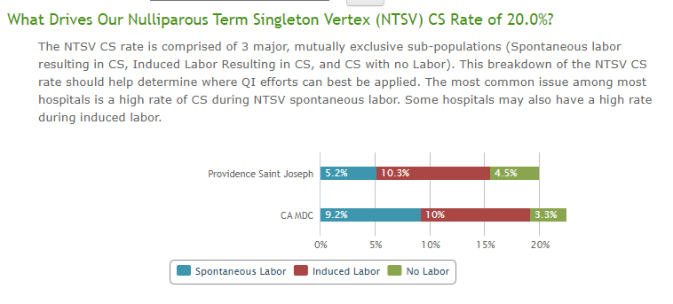
5 months Pre/Post 2/1/2020

Slide 25
Weekly NTSV CSR Review (sent to all Ministry Leaders)

Slide 26
Response
26

Slide 27
Most Important?
A Culture that values vaginal delivery

Slide 28
LESSON 5: Nursing has a Critical Role
Refresh labor techniques training/Spinning Baby/2nd Stage
Strip review at shift change
Review oxytocin policies and procedures for timely advancement of oxytocin and restarting after tachysystole/decelerations.
Work with medical leadership to invoke hard stop labor admissions before 4 cm without medical indications.
Scripted discussions from labor evaluation area

Slide 29
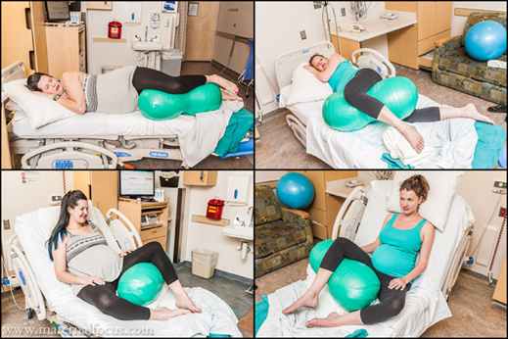
Peanut Ball
Recognition
Decrease length of labor
Decreasing CS rate in patients with epidurals
Tussey, C. M., Botsios, E., Gerkin, R. D., Kelly, L. A., Gamez, J., & Mensik, J. (2015). Reducing length of labor and cesarean surgery rate using a peanut ball for women laboring with an epidural. The Journal of Perinatal Education, 24(1), 16-24. http://dx.doi.org/10.1891/1058-1243.24.L16
29

Slide 30
LESSON 6: Elective Cesarean Reduction – Just enough to prevent success
Signed consent by patient acknowledging the unique risks and benefits to future health and pregnancies.
Attendance at Free Elective Cesarean Section Class prior to case being scheduled. (Tarzana Class is available until course created at Burbank). Registration Link
https://psjhcrmwebsites.microsoftcrmportals.com/home?region=CALA&ministry=%7BB2583C4A-9DA6-479C-8FA8-D2FBD5A0F849%7D
Mandatory second opinion by MFM prior to case being scheduled.
Approval for CS Macrosomia only if meets ACOG criteria, otherwise consider elective.

Slide 31
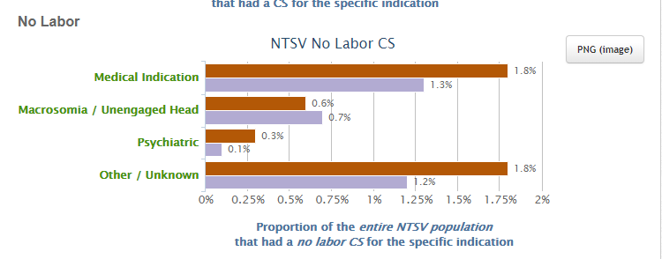
No Labor: 5 months Pre/Post 2/1/2020

Slide 32
Informed Consent prior to Scheduling

Slide 33
LESSON 7: Rates of Fetal Intolerance to Labor/Failure to Progress/Descent Account for a Large Amount of Variability
Mandatory raining on NICHD categories/5 Tier FHR Analysis with management planning.
Strip review by hospitalists and nursing on all changes of shift.
All FIL cesareans have medical director review for appropriateness.
Cord gases for FIL cesareans.
Hard stop for labor admissions prior to 4 cm unless medical indication.
Timely augmentation following appropriate policy procedure review.
Avoidance of laboring down and varying pushing techniques.
Operative Vaginal Delivery training.
Manual Rotation of Occiput Posterior/Transverse (define hospitalist role).

Slide 34
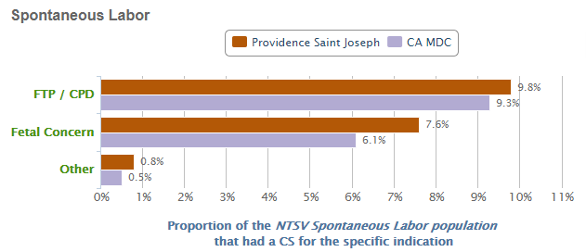
Spontaneous Labor: 5 months Pre/Post 2/1/2020

Slide 35
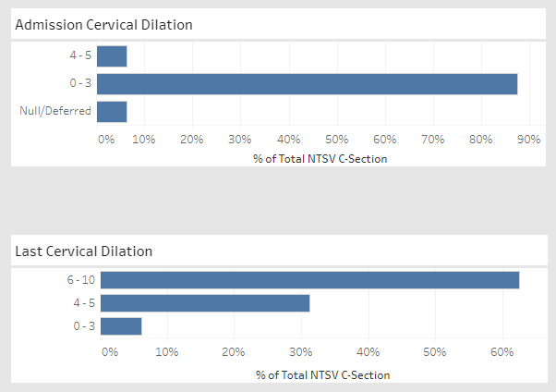
Cervix Data: 5 months Before and After 2/1/2020
(Note more admissions prior to 4 cm and more CS done before 6 cm)

Slide 36
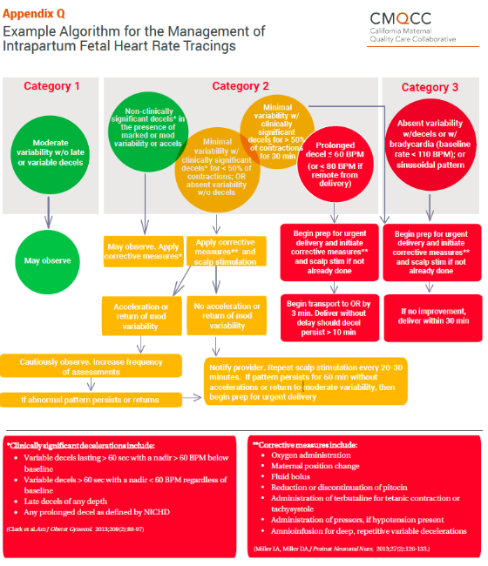
Example Algorithm: Management of Intrapartum FHR Tracings

Slide 37
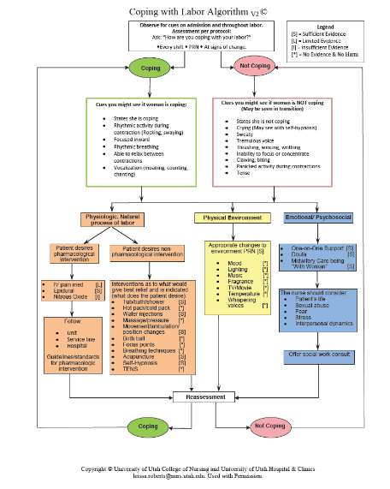
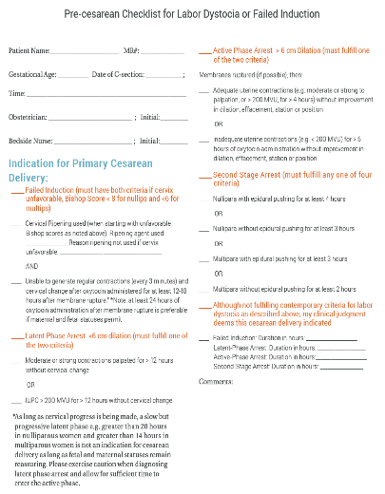
Notes:
Pre-cesarean checklist for Labor Dystocia/failed induction and Coping with Labor algorithm

Slide 38
Active Labor Partogram
Response
38

Slide 39
LESSON 7: It’s How You Conduct Induction of Labor
Hard stop for oxytocin or ROM prior to achieving ripe cervix.
Outpatient cervical ripening unless medically indicated.
Follow standard recommendations for medical inductions.
Combination cervical ripening for all inpatients.
Allowing elective inductions at 39 0/7ths weeks for patients with ripe cervices and physicians who have nulliparous CSR after induction of <25%.
Elective induction with aggressive cervical ripening at 40 3/7th for all other patients and physicians.
Induction progress reports at all hand off huddles.

Slide 40
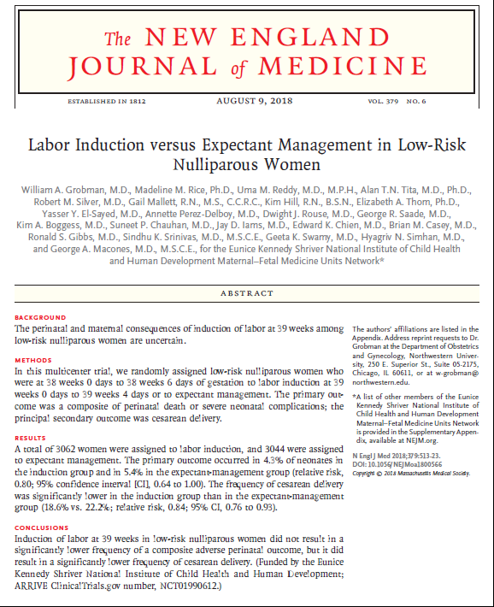
The ARRIVE TRIAL
Can everyone universally adopt and get the same results?

Slide 41
Non-Randomized vs. Randomized Results
Favors Induction

Slide 42
Mixed Response: Some Increased Induction/Some Not
Result: Increasing CSR in most
* Internal PSJH data

Slide 43
Summary of the ARRIVE trial
This was a well executed randomized control trial
Important findings: elective induction at 39 in nulliparous can reduce cesarean section rates by 3.6% and not harm mothers and babies
Well chosen group of young patients (evidence strict protocol)
Well chosen group of providers (evidence control group CSR)
Standardized protocols for failed induction
Average “cost” to labor units for additional 6 hours

Slide 44
The ARRIVE trial raised several questions:
Are the results generalizable to local patient population and to our providers?
What were the protocols for induction and labor management, and can we duplicate them in other settings?
Given the impact on length of labor (+6 hours), could the typical US hospital achieve the same results without significantly over burdening their staffing and room constraints?
Why were certain complications so frequent (preeclampsia and chorioamnionitis)?
Is the main effect seen from letting patients go past 41 0/7, should the routine induction be adjusted?

Slide 45
NTSV: Hours in Labor and CSR
Ind/Cx Ripening
Ind/No ripening
Spont/Augmented
Spontaneous
* Source internal PSJH data

Slide 46
Admission Dilation has Greatest Impact
* Source internal PSJH data

Slide 47
Critiquing a Failed Induction
Induction in the face of unripe cervix (Bishop score < 8 primip and < 6 multip)
Inadequate documentation of cervical ripening procedure and timing
Adequate trial defined by latent phase at least 12-18 hours of oxytocin and ruptured membranes

Slide 48
Defining Failed Induction
Nulliparous women remaining in the latent phase for 12 hours compared with women who had exited the latent phase had significantly increased rates of chorioamnionitis (12.1% compared with 4.1%) and endometritis (3.6% compared with 1.3%) and increased rates of neonatal intensive care unit admission (8.7% compared with 6.3%).
Similar patterns were present for multiparous women at 15 hours.
With ruptured membranes a latent phase (obtaining 6 cm) after initiation of oxytocin of at least 12 hours for nulliparous women and 15 hours in multiparous women is a reasonable criterion for diagnosing a failed induction
Kawakita T et al. . Obstet Gynecol. 2016 Aug;128(2):373-80.
Notes:
In this recent study, the authors found an increase in complication rates with minimal improvement of cesarean section chances

Slide 49
Rationale of Outpatient Cervical Ripening
Mechanical methods as effective with respect to achieving ripeness and cesarean delivery rates in controlled studies
Balloon ripening can be used outpatient since tachysystole is not associated
Better experience comes from patients having less cramping and not spending the night in the hospital
Less cost since monitoring and nursing care not used for 8-12 hours while awaiting ripening of the cervix

Slide 50
What if outpatient?
Outpatient only=>

Slide 51
Adverse Event Frequency Balloon Cervical Ripening
Event
Pain | 1:185
Bleeding | 1:364
Rupture of Membrane | 1:157
NRFHR | 1:365
Uterine Hypertonus | 1:3,707
Tachysystole | 1:4,812
Fetal Death | 0:8189
Diederen,M., et al BJOG 2018; 125:1086-95.

Slide 52
Keys for Induction Success
Who you choose (parity and cervical ripeness)
How you perform the induction
How you define failed induction
Follow your success rates!

Slide 53
Last Thoughts

Slide 54
Take-home Lessons from Our Experience
Rates vary by hospital, but success is possible
Rates vary by individuals, they practice differently
Following guidelines help
You needs leadership at every level
RNs have a critical role
Elective CS cause small but important role
FIL/FTP make up a significant amount of variability
How you do inductions is the most important thing
Oh, one more very, very important thing…
54

Slide 55
Avoid the Success Bump!
Your initial efforts by using data transparency, fun new laboring techniques, heightened awareness, etc. often lead to success over 9-12 months. Then complacency sets in and you take your eye off the ball…
Long term success and changing the culture likely to take 24 months or greater.
Building in natural labor techniques, hard wired data feedback, etc. will be needed to cement the gains and maintain NTSV cesarean section rates under 23.9%.

Slide 56
Thank You!
Visit: CMQCC.org
Notes:
On behalf of my partners in crime: Holly smith and David LaGrew and the countless other member of the Taskforce…Thank you so much.

