Slide 1

Listening to patients: The importance of integrating patients in quality improvement
LaToshia Rouse
Mom of 4,
PFE Consultant,
Birth and Postpartum Doula

Slide 2
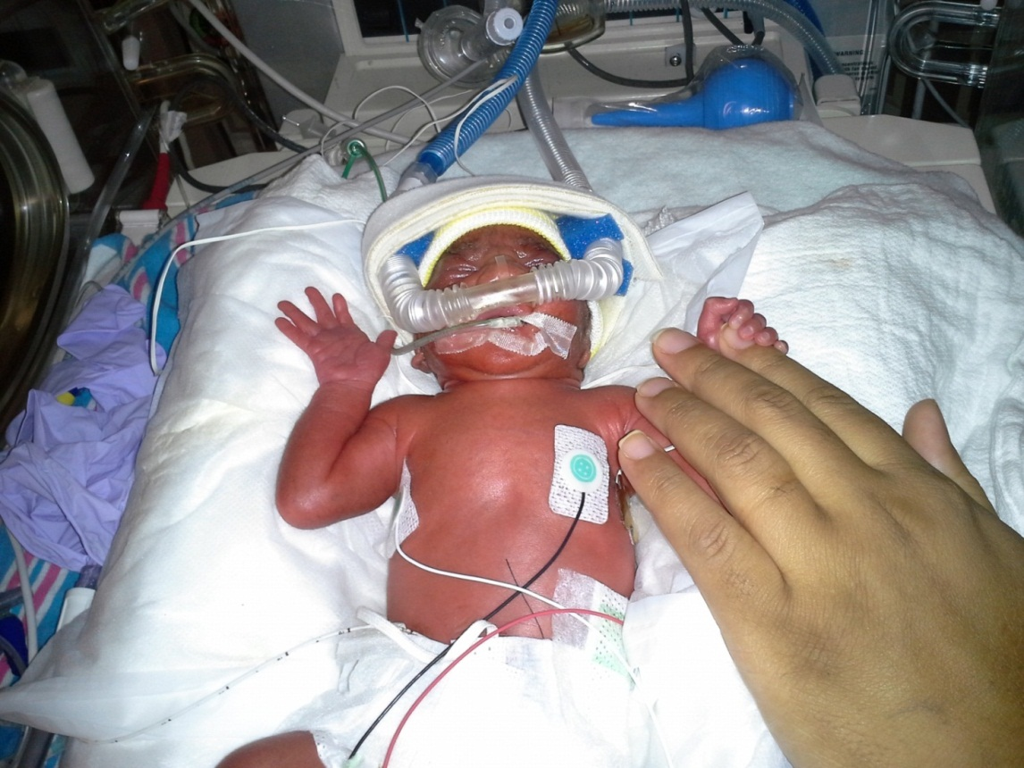
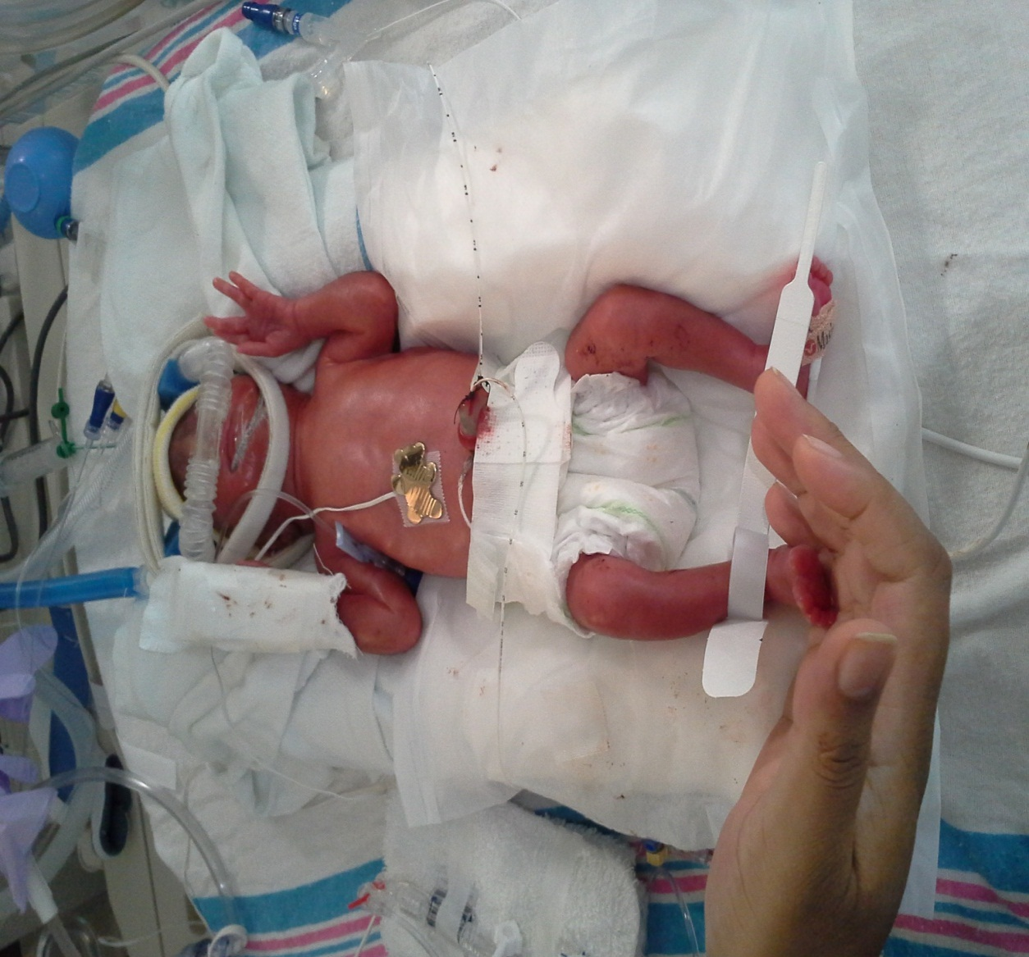


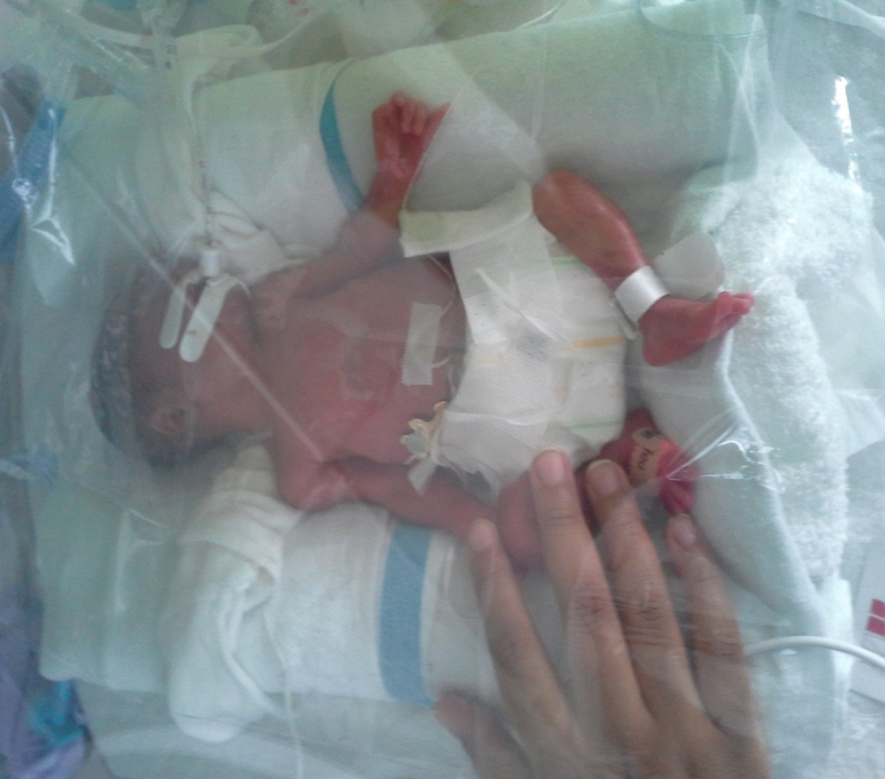



Slide 3
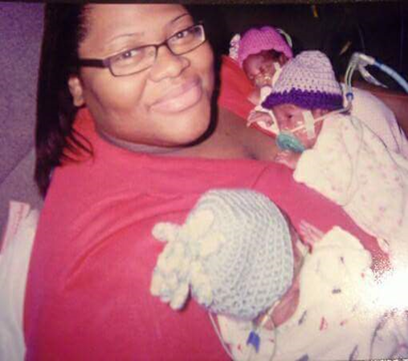

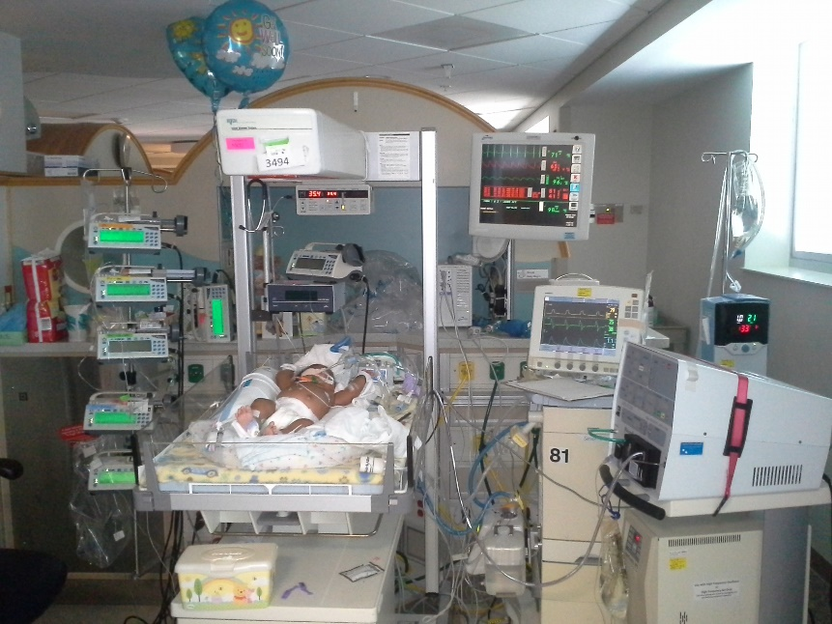




Slide 4

The Mask
Emotionally available to bond with my baby
Capable of caring for my kids
Capable of understanding
Not wanting to be a burden on staff’s time
Able to be a part of decisions

Slide 5




















Slide 6
Driver Diagram
Secondary Drivers
Develop a supportive structure
Appoint a staff liaison who has the knowledge and skills to effectively engage with PFP
Primary Drivers
Develop a measurement strategy for accountability
Aim:
All PQCS will have two or more designated patient/family partner leader(s) (PFP) who are core members of the PQC leadership team by January 2021
Engage Multidisciplinary Advisory Committee (MAC) Leaders
Assessment of PQC structure, financial structure and level of involvement of PFP
Identification, Recruitment and Orientation of Prepared and Activated PFP(s)
Readiness assessment to be done prior to PFP engaging in a committee that lacked PFE
Develop standardized role description, recruitment, and orientation materials
Levels of Partnership/ Leadership
PFP ensures that diverse populations are represented in the PQC work
PFP works to ensure alignment and advancement of improvement projects/ acts as PQC liaison between P/F state teams, Ad Hoc group, etc.
PFP acts as community liaison with existing, diverse P/F community leaders, volunteer groups, advocacy groups and individual P/F with unique healthcare experiences.
Collaboration: PFP are regarded as valuable as all other members of the PQC and they are engaged in every phase of the work of the PQC in a continuous collaboration to model a project that is patient and family-centered

Slide 7


Thank you!
See you in the Break Out Session on Patient Engagement!
LaToshia Rouse
PFEngage@gmail.com
www.PFEConsultant.com

