Slide 1
The Million Dollar Cesarean
Kristen Terlizzi
@kristenterlizzi

Slide 2
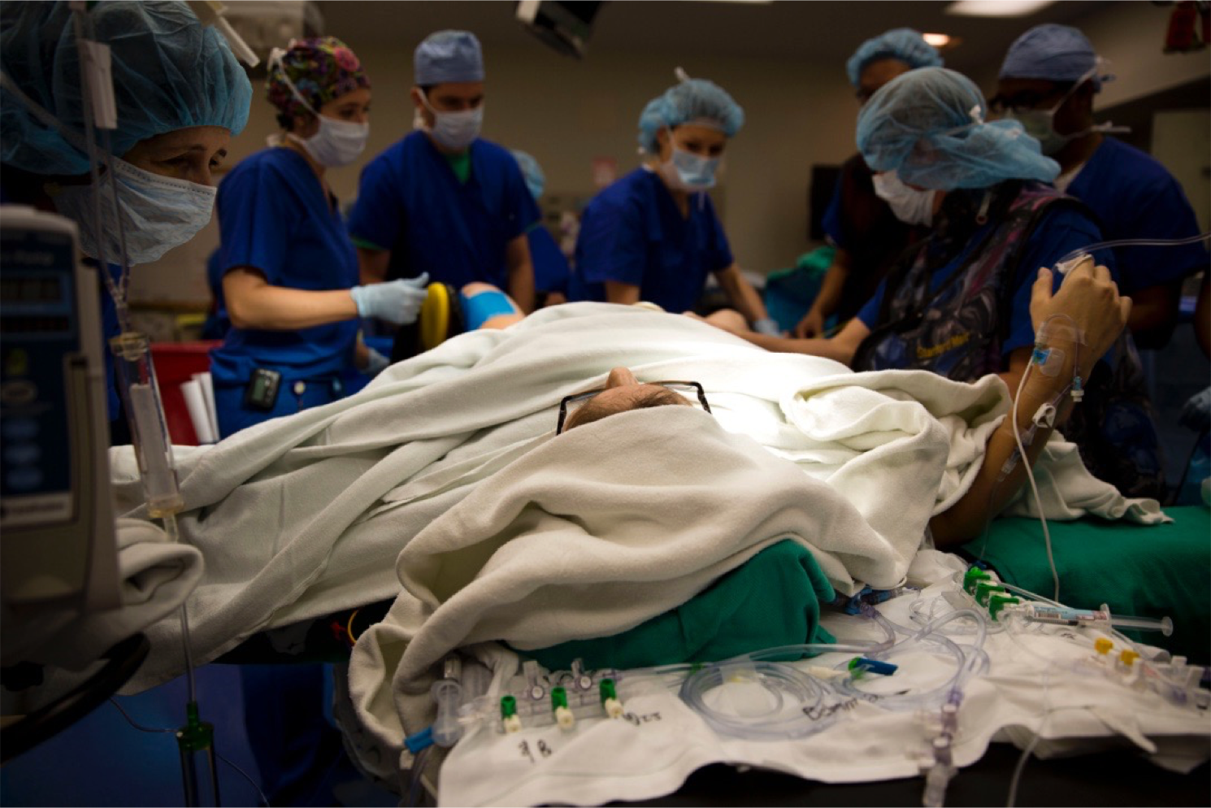

Slide 6
Cesareans are Common
Patients are already familiar with the term and know people who have had them
A baby is involved, patients may not consider a cesarean as they would any other major surgery

Slide 8
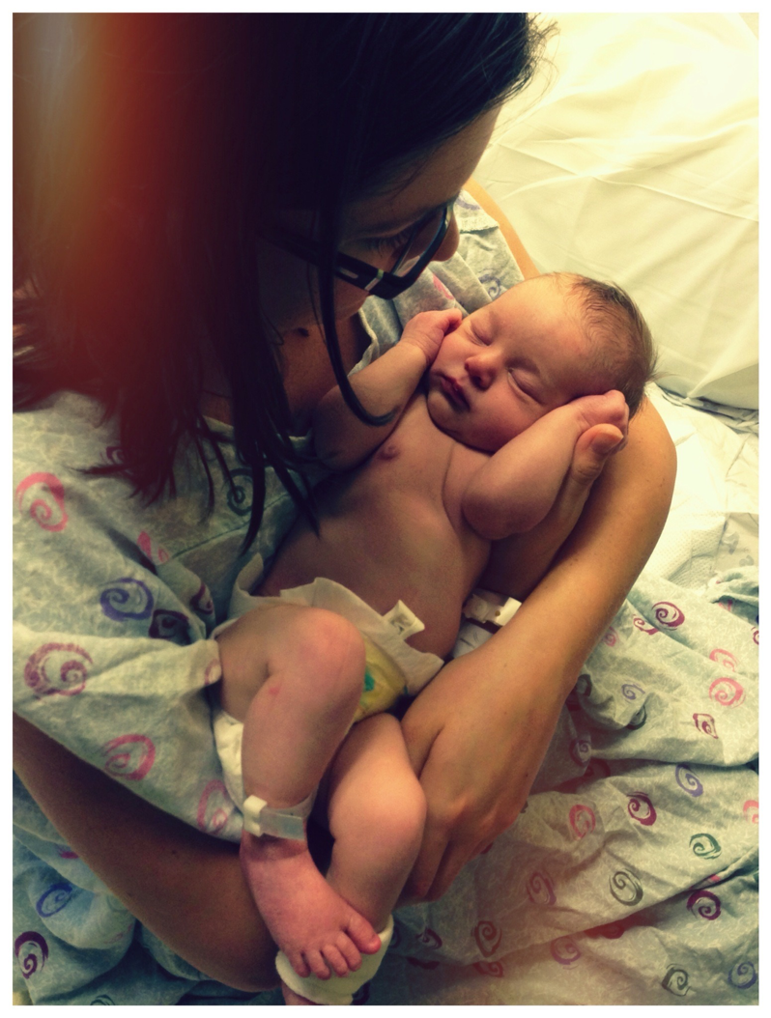

Slide 9
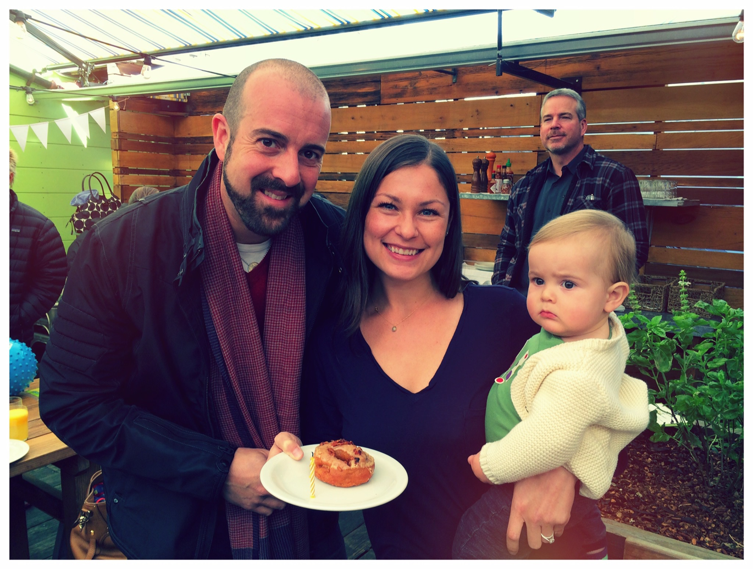

Slide 10
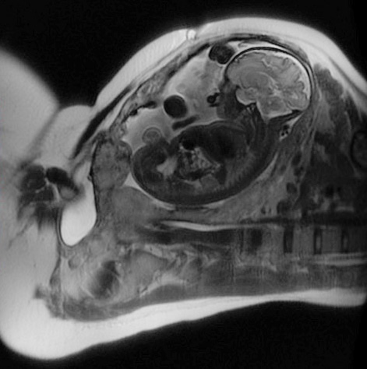

Slide 11
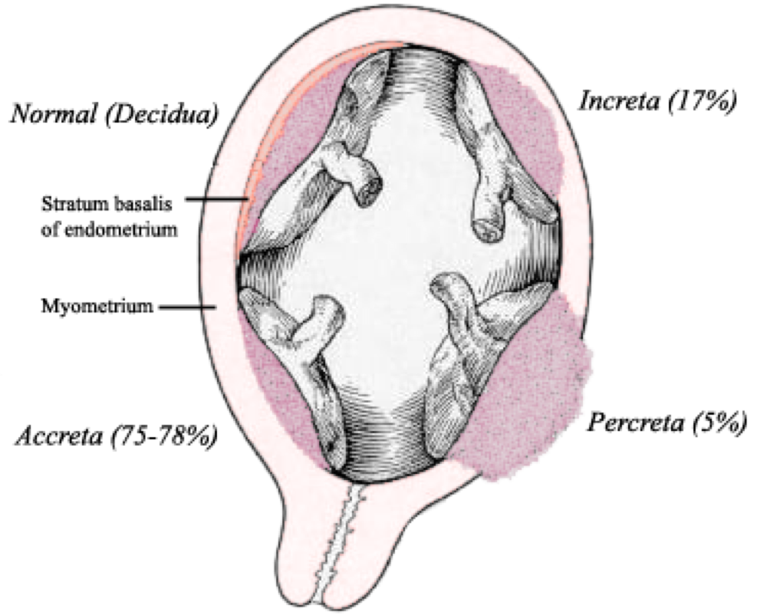
Placenta Accreta Spectrum
Maternal death may occur despite optimal planning, transfusion management, and surgical care (ACOG)

Slide 12
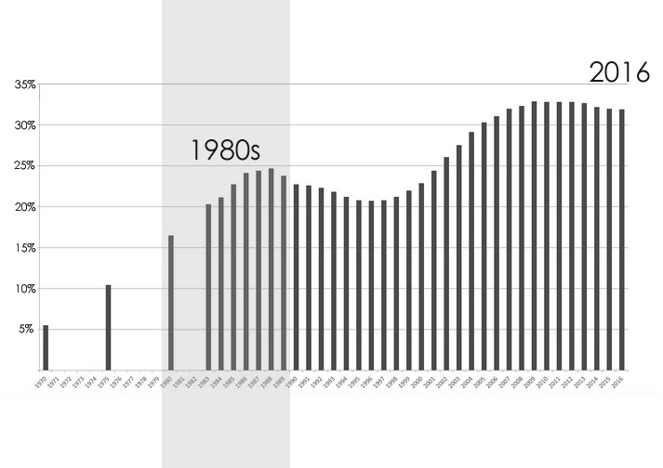
United States Cesarean Rates
32%
of births
6%
of births

Slide 13
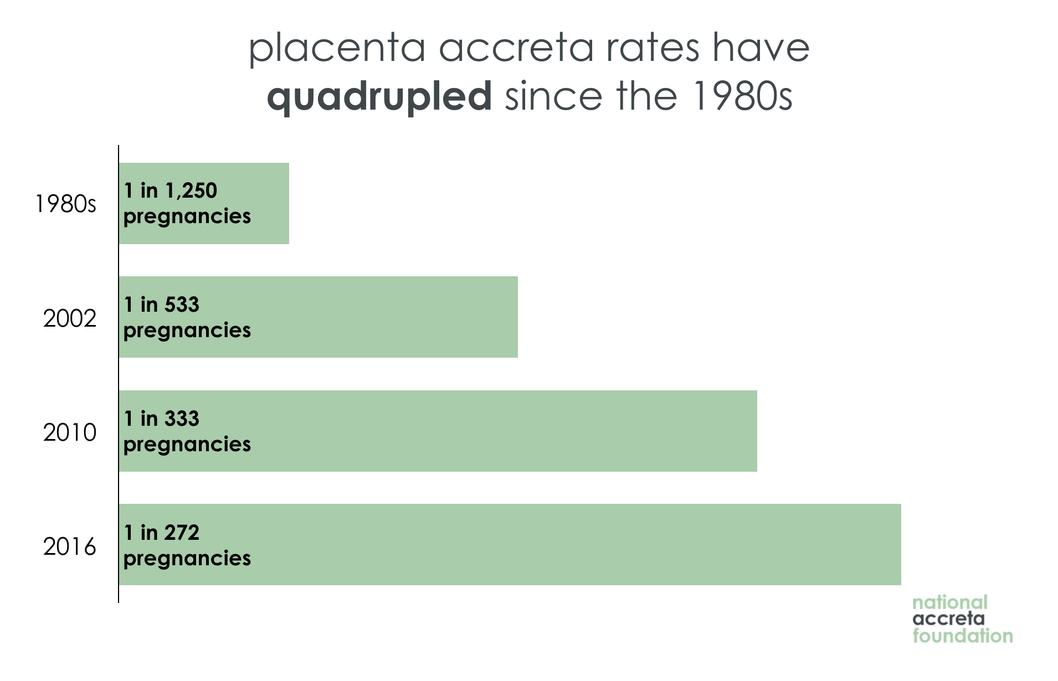
Data Source: SMFM & ACOG Obstetric Care Consenses #7 (2018) & SMFM Placenta Accreta Opinion in AJOG (2010)

Slide 14
Placenta accreta now affects 1 in 272 pregnancies

Slide 16
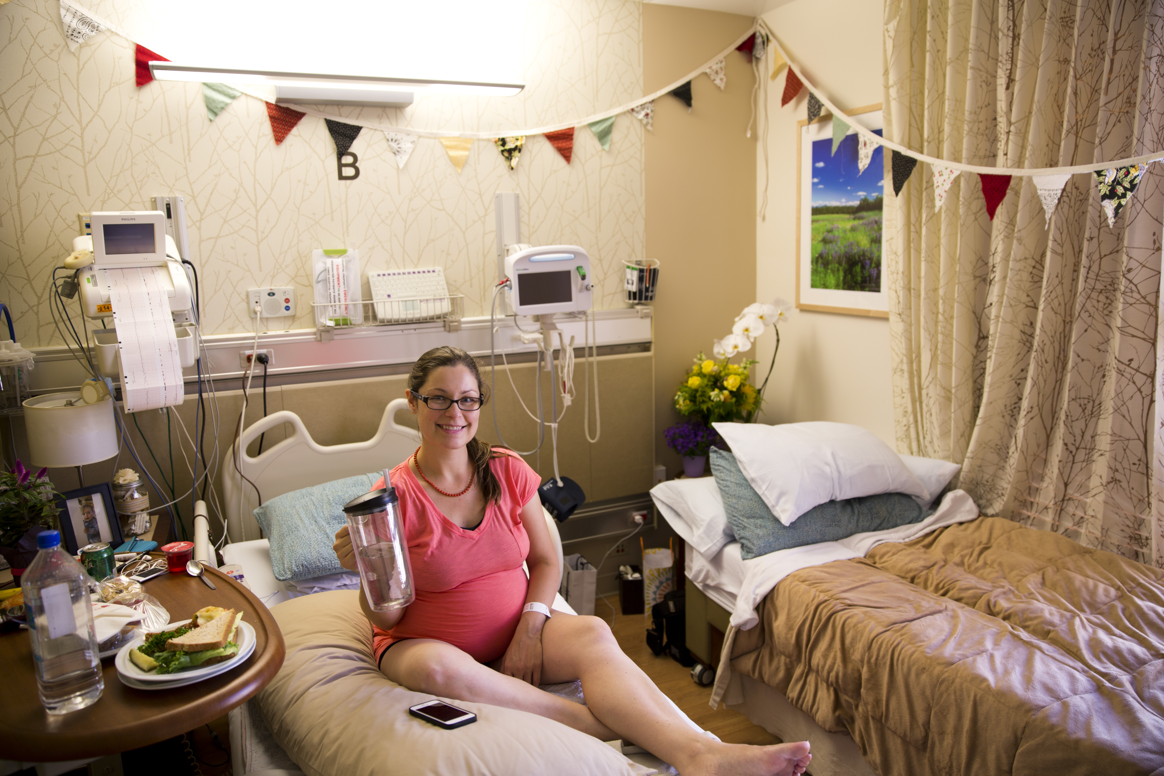

Slide 17
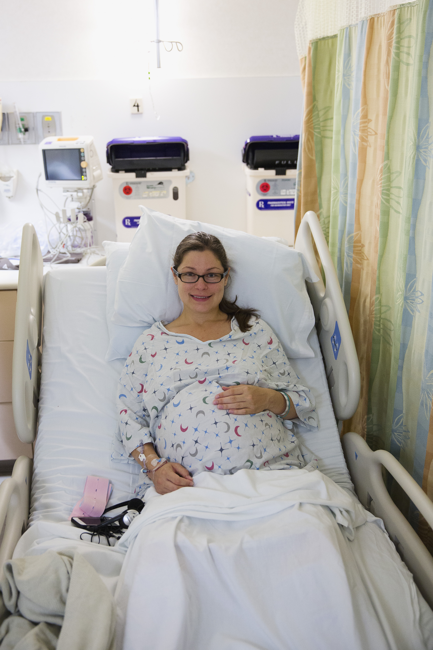

Slide 18
Complex Delivery Planning
Gynecological Oncologists
Interventional Radiologists
Maternal-Fetal Medicine Specialists
Neonatologists
Obstetric Anesthesiologists
Urologists

Slide 20
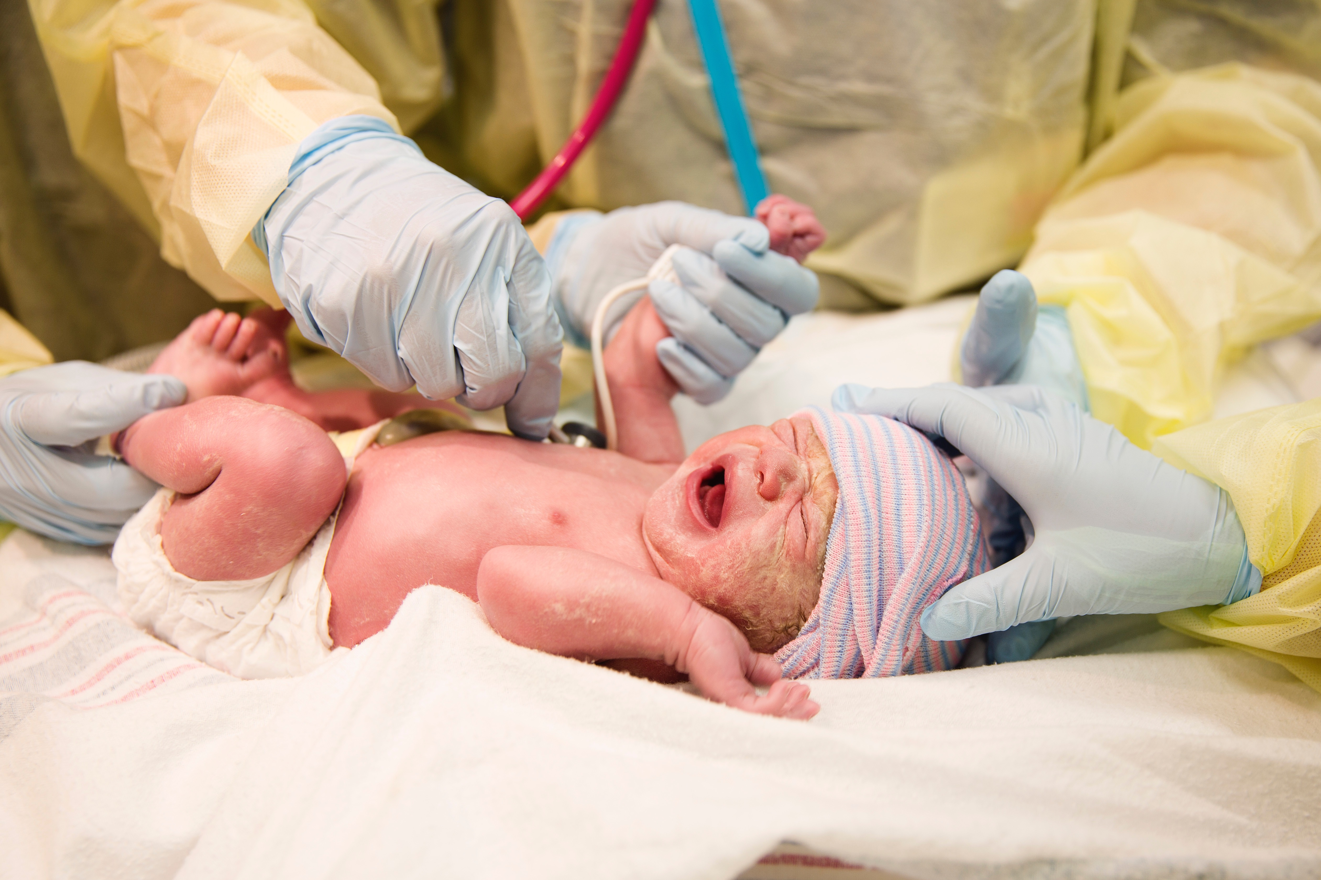

Slide 21
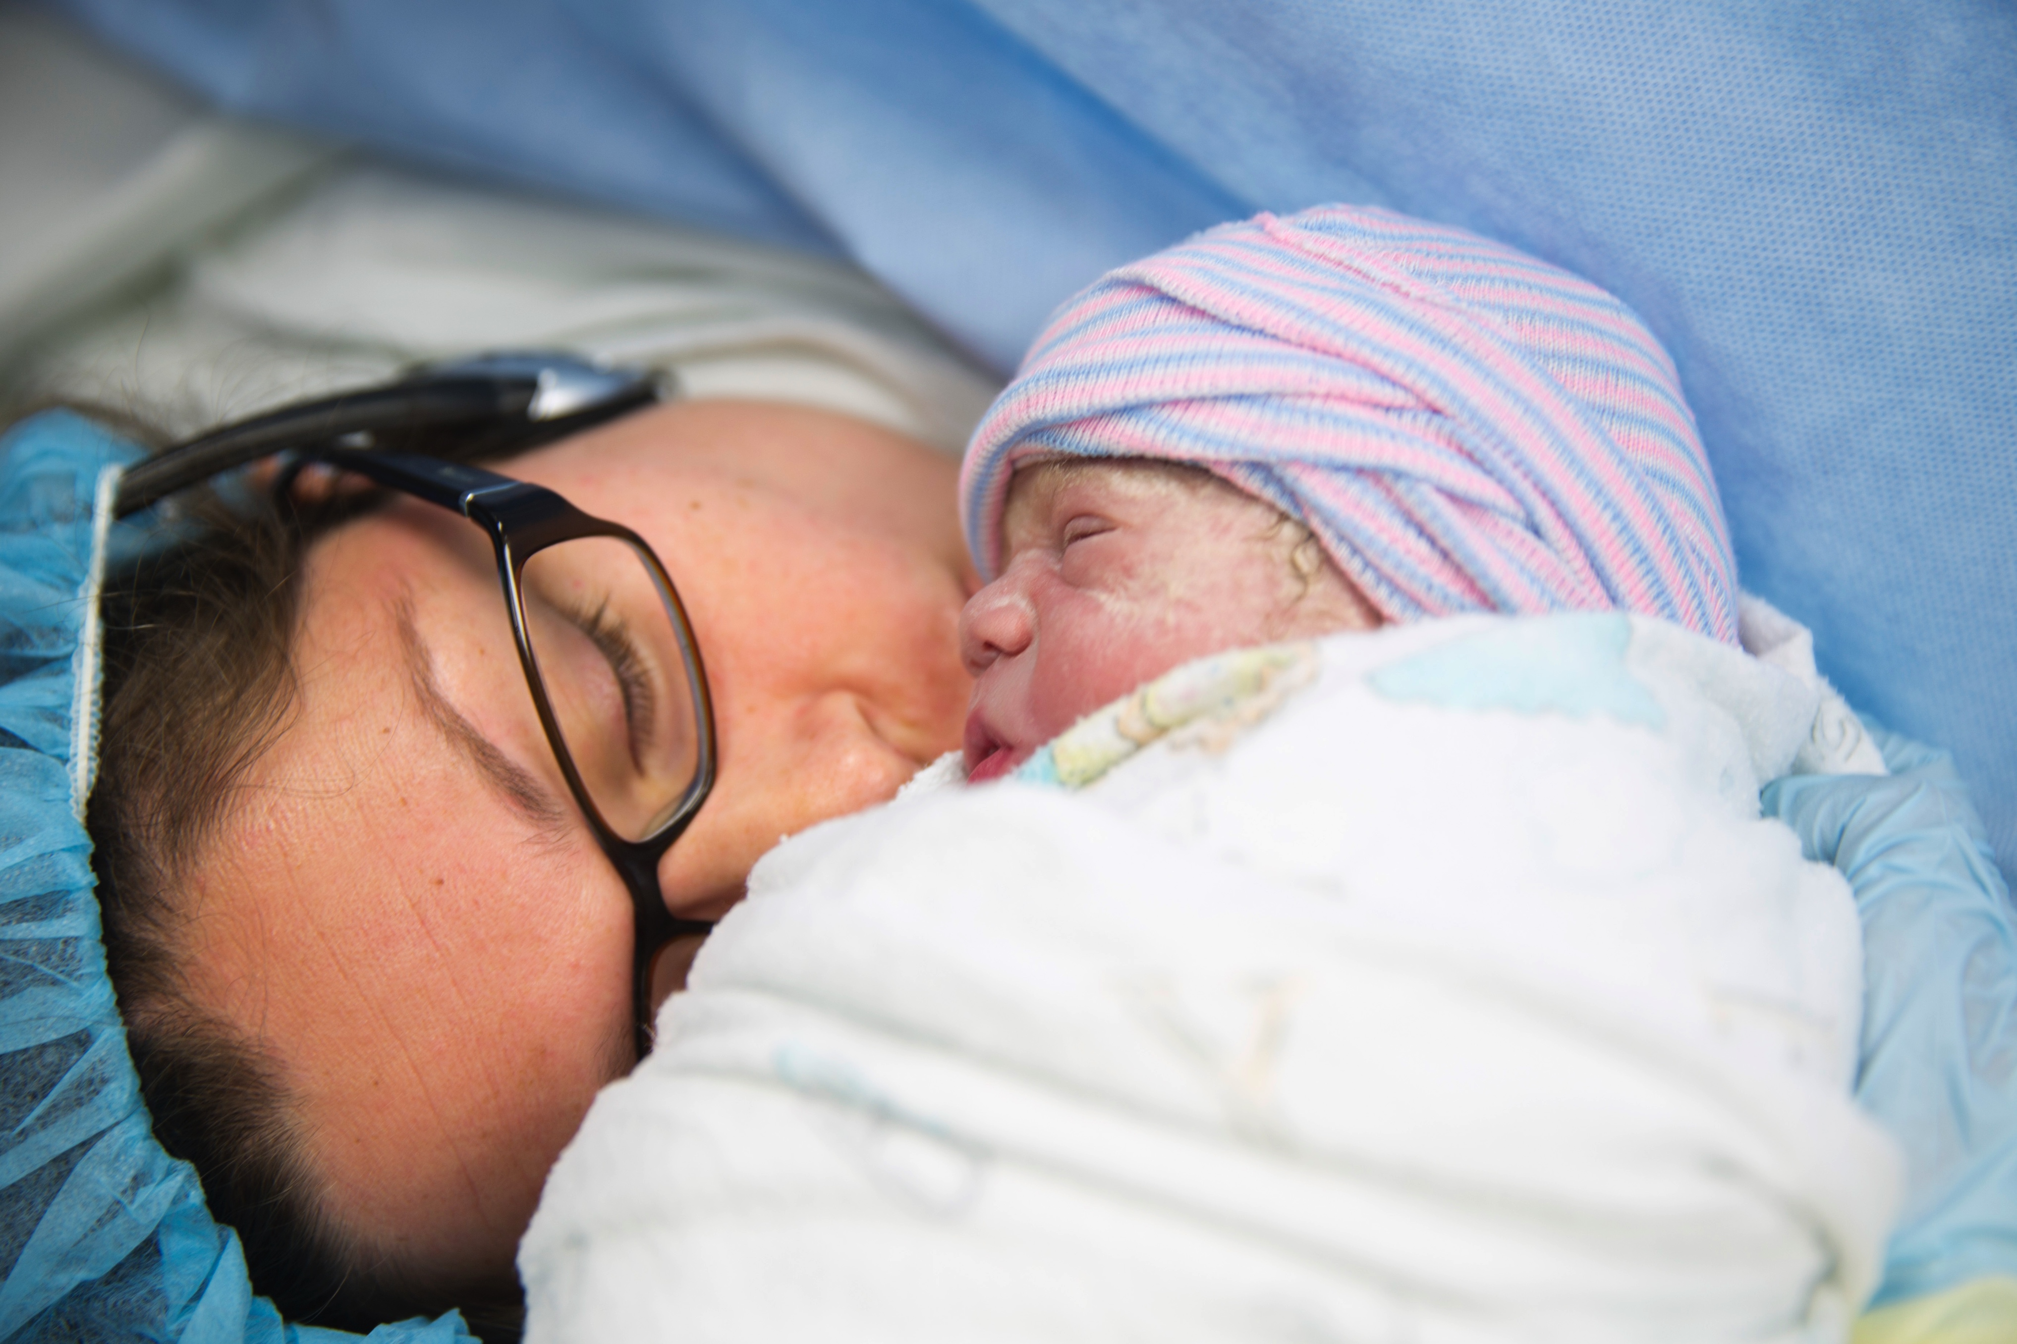

Slide 22
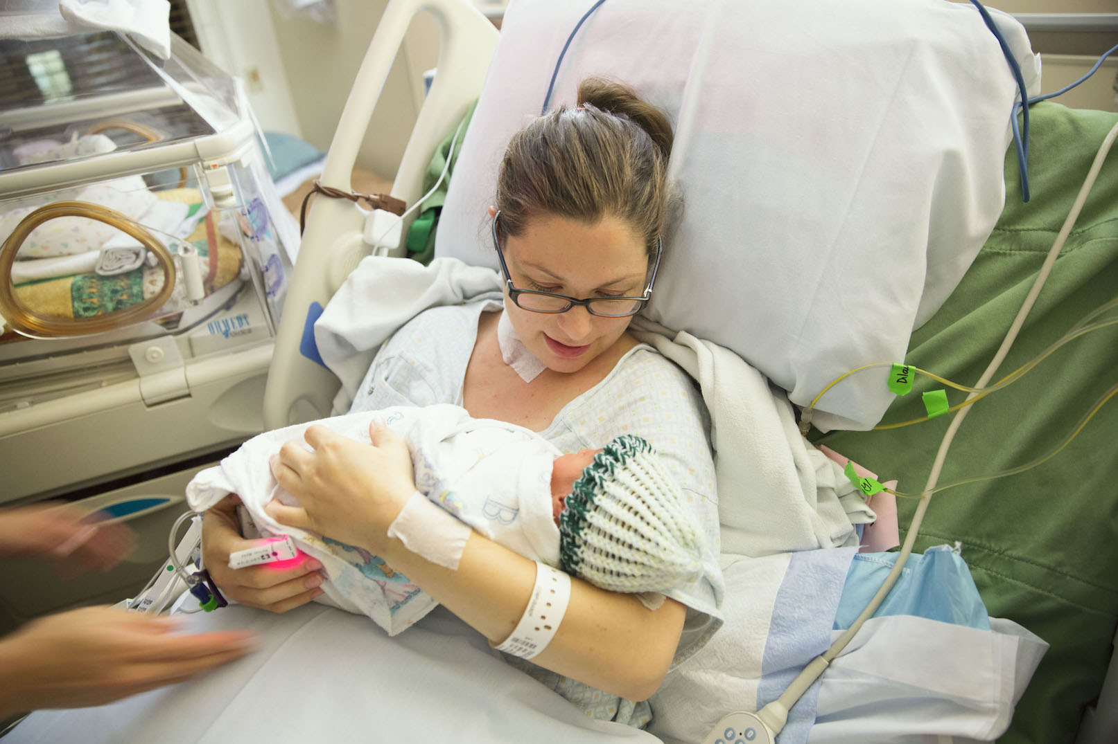

Slide 23
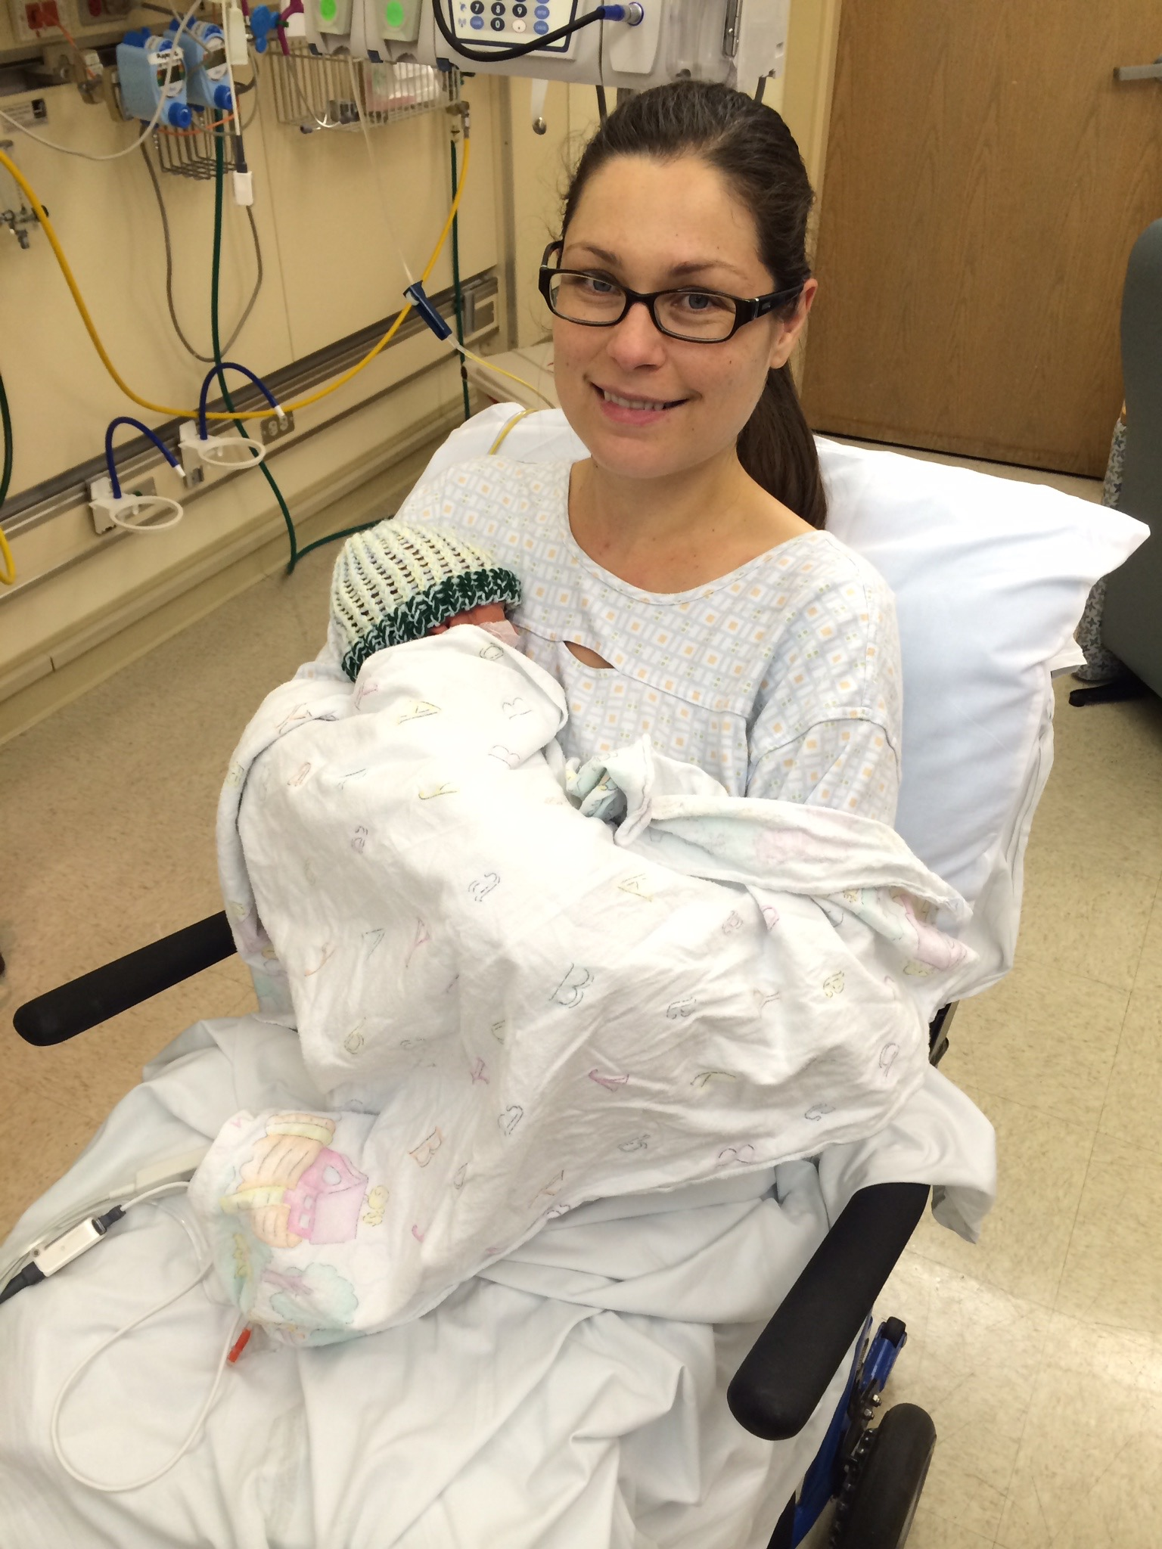
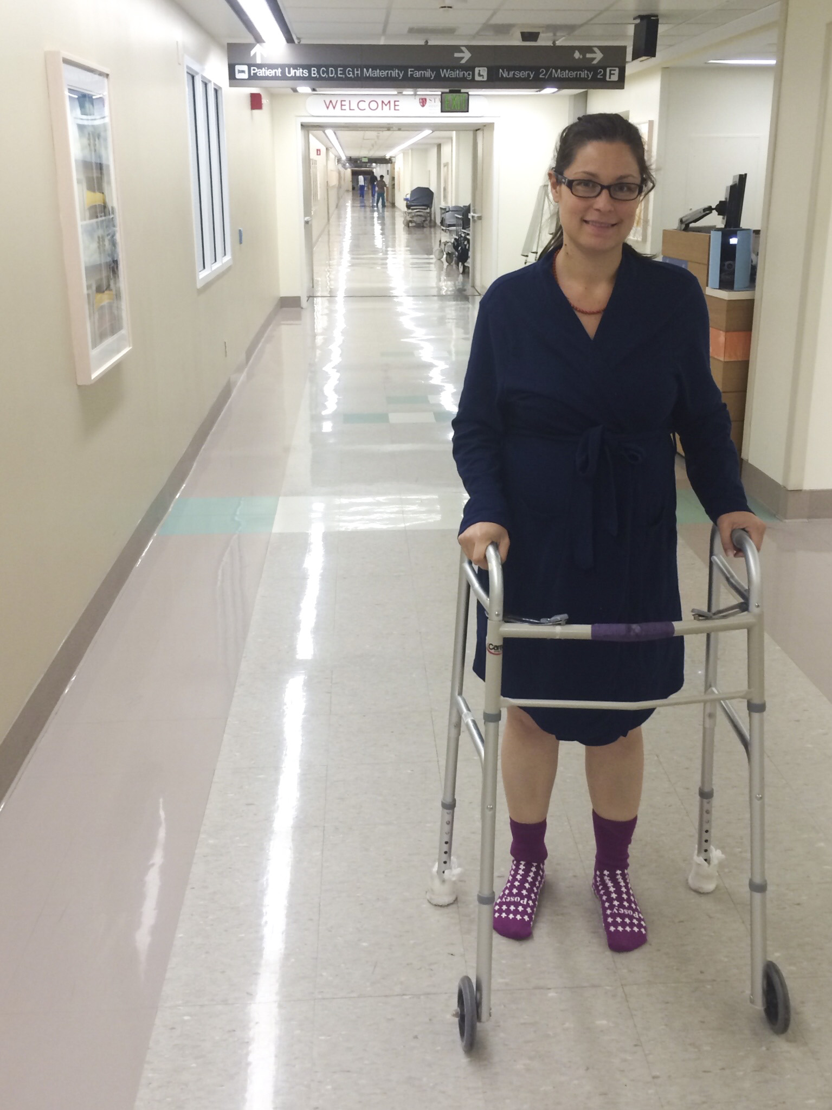

Slide 24
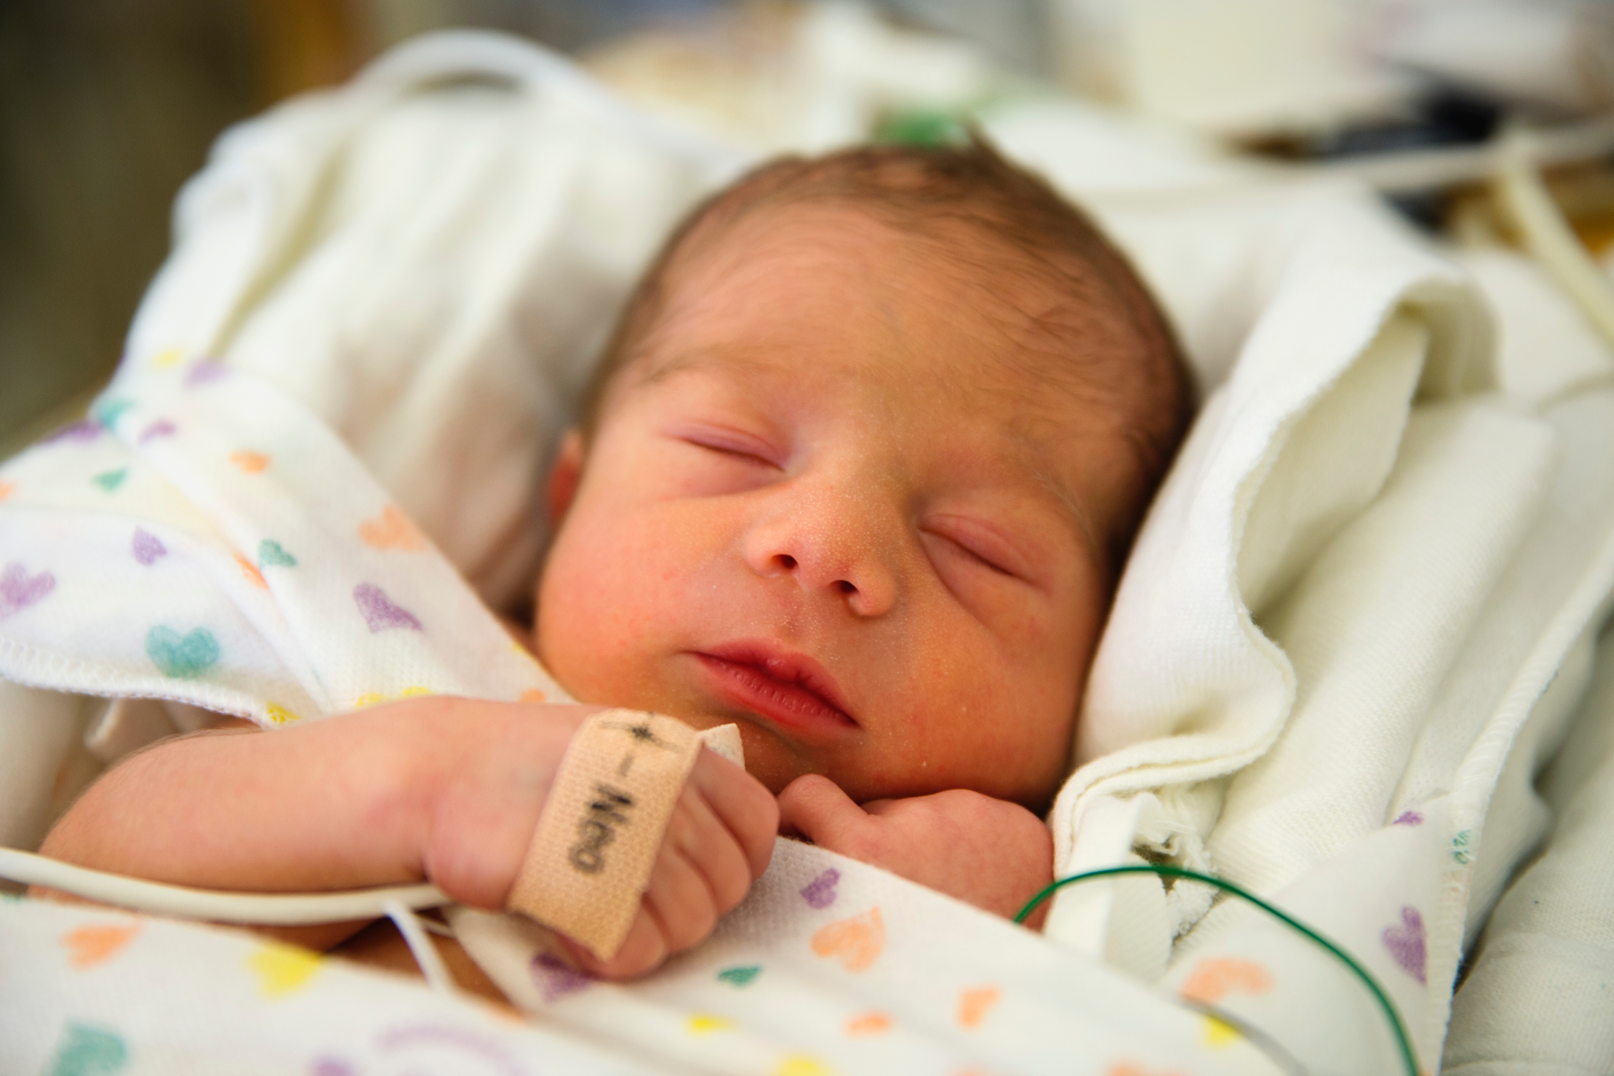

Slide 25
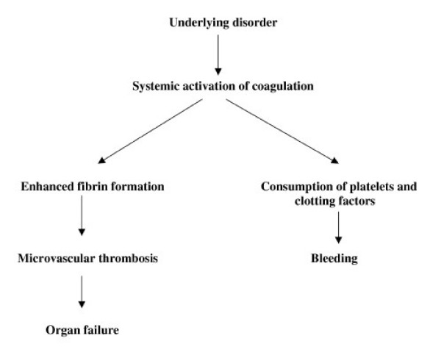
Disseminated Intravascular Coagulation (DIC)

Slide 27
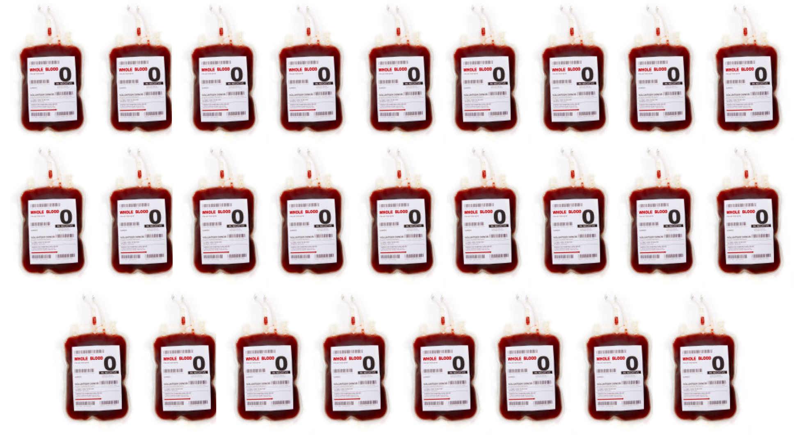

Slide 28
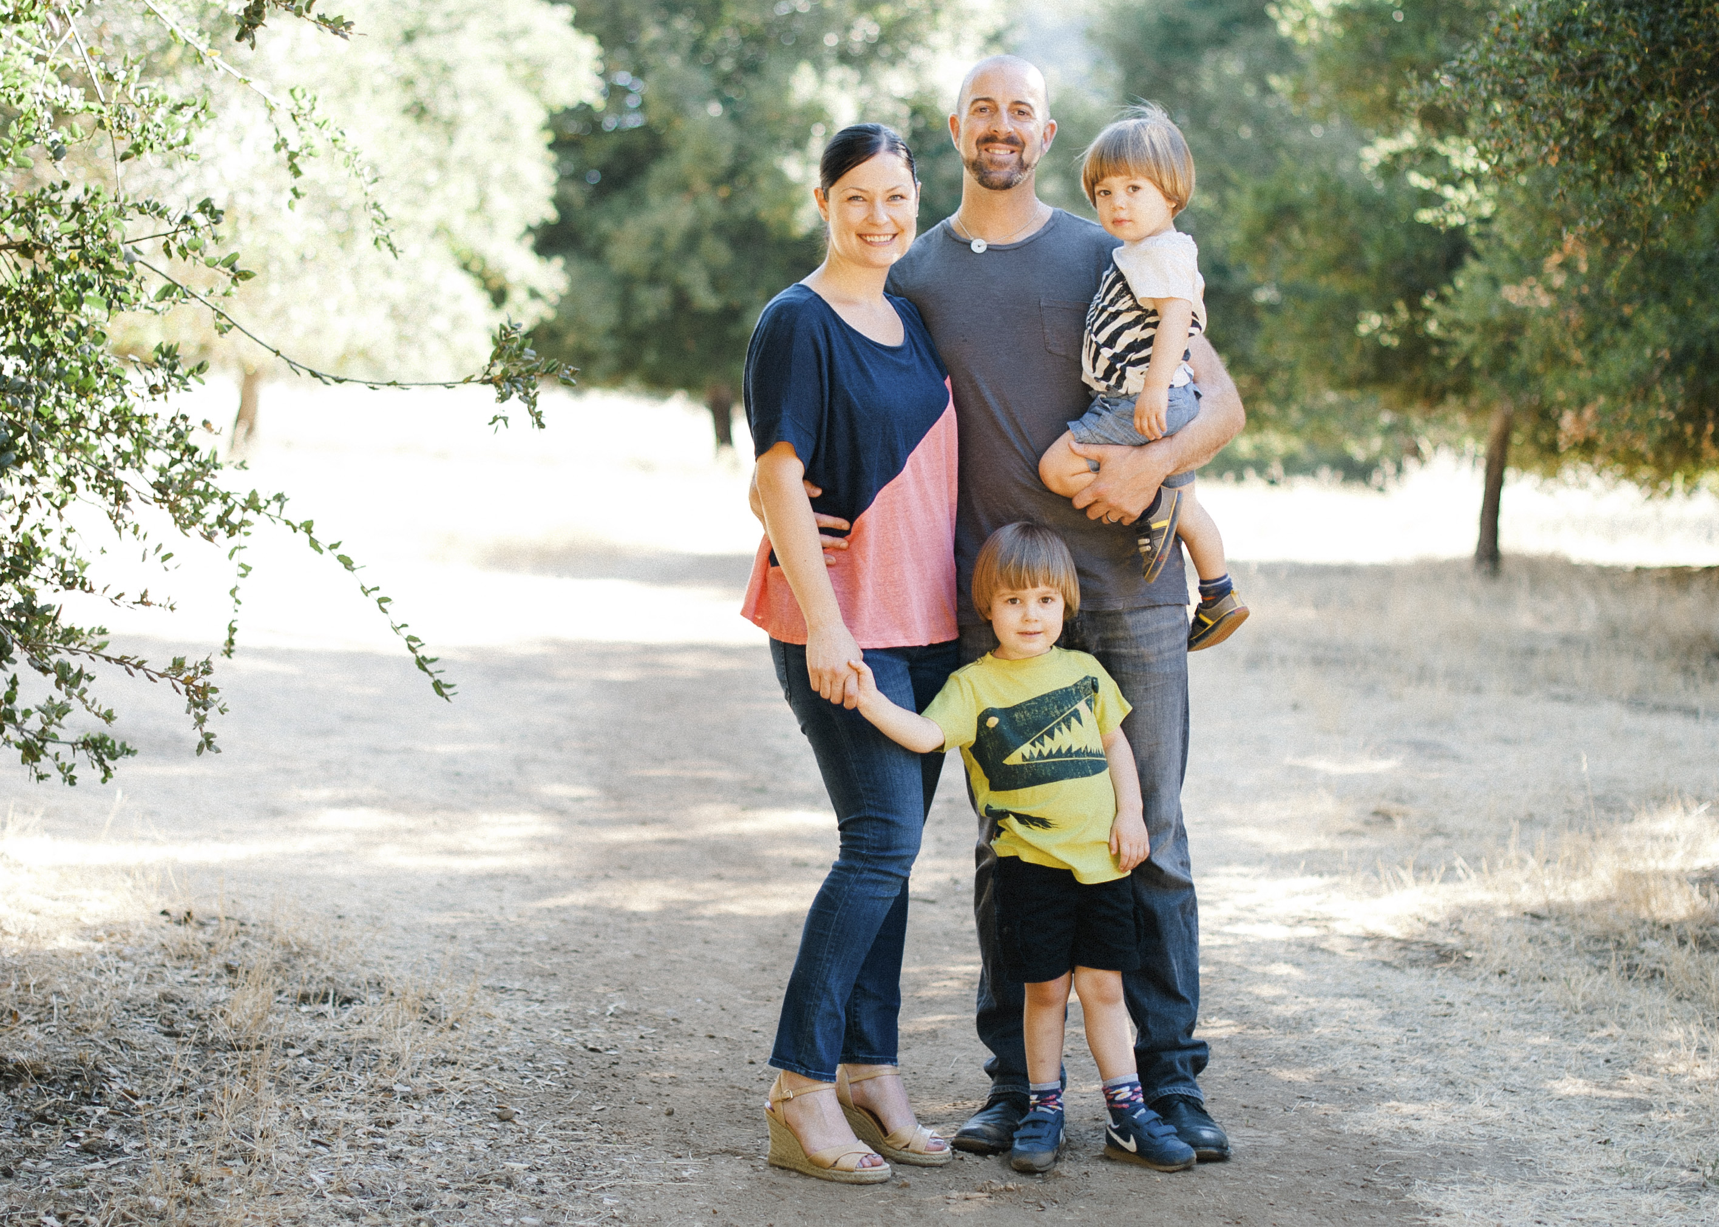

Slide 31
What was the future cost of my primary cesarean?
Accreta Diagnosis $8,101.00
office visit, ultrasound, MRI – 6/26/14 – 6/30/14
Mom’s Hospitalization #1 $805,372.30
cesarean delivery, exploratory laparotomy, uterine artery embolization, 11 days antepartum, 3 days ICU, 34 days gynecological oncology - 7/5/14 – 8/20/14
Infant Hospitalization $376,997.50
born electively due to mother’s condition at 33w6d; 1 day NICU, 25 days Intermediate Care Nursery - 7/16/14 – 8/10/14
Mom’s Hospitalization #2 $347,881.35
emergent readmittance for DIC, hysterectomy with cervix, bladder resection, appendectomy, ureter re-implantation, 26 units of blood products, post op CT scan, 2 days ICU, 6 days gynecological oncology unit - 9/4/14 – 9/12/14
2014 Recovery $22,493.96
1 ER visit for post op bladder infection, 4 in home nursing visits, multiple urology and gyn oncology follow up visits, stent removal, 14 pharmacy claims - 9/12/14 – 12/30/14

Slide 32
The Future Cost of my Cesarean
In 2012, my cesarean was billed at $38,384.77
In 2014, my resulting placenta accreta delivery was billed at
$1,560,846.11

Slide 34
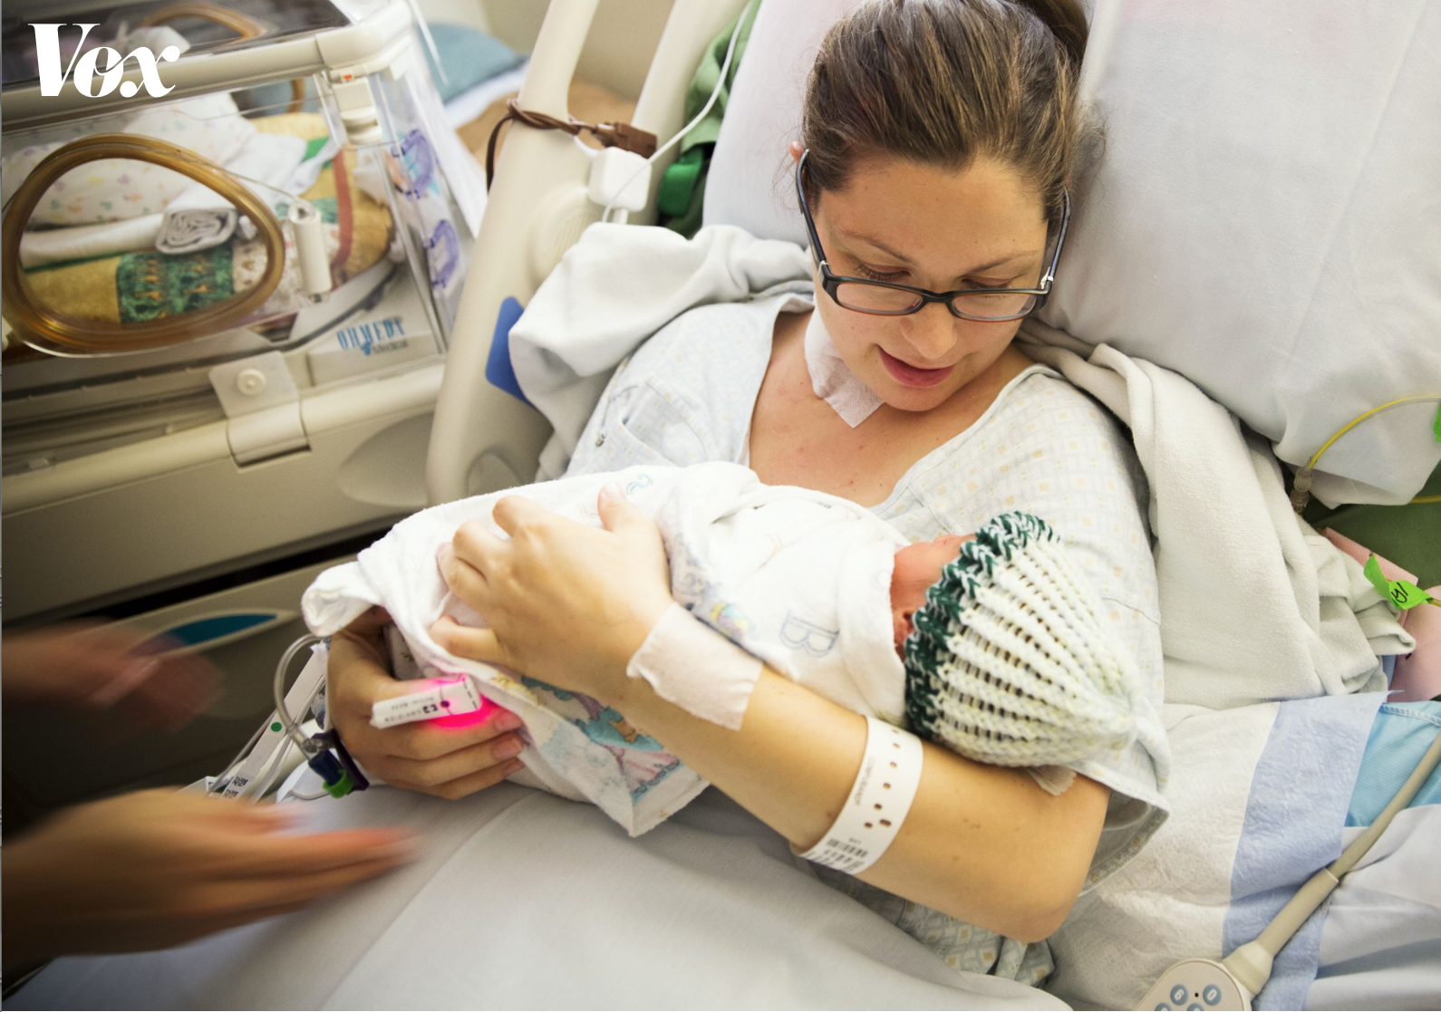
@kristenterlizzi
www.preventaccreta.org/kristen

