Slide 1
Looking Ahead to 2025: Introducing the AIM Perinatal Mental Health Bundle
Susan Kendig, JD, WHNP-BC, FAANP
Women's Health Integration Specialist
SSM Health Maternal Services - St. Louis
Director of WHNP Practice and Policy
National Association of Nurse Practitioners in Women's Health

Slide 2
Looking Ahead to 2025: Introducing the AIM Perinatal Mental Health Bundle
Susan Kendig, JD, WHNP-BC, FAANP
Women’s Health Integration Specialist, SSM Health-St. Louis
Director of WHNP-Practice and Policy
National Association of Nurse Practitioners in Women’s Health

Slide 3
Objectives
Introduce the AIM Maternal Mental Health bundle elements.
Discuss strategies to support element application in practice
Highlight available AIM TA center resources

Slide 4
Why focus on Maternal Mental Health?
Perinatal mental health conditions affect more than one in five people and are among the most common complications of pregnancy and postpartum.(Wisner et al., JAMA Psychiatry, 2013;70:409 -8; Fawcett et al., J Clin Psych.2019; 80:18r1257; Masters et al., J Clin Psych. 2022:8321r12527)
Suicide and overdose/poisoning are the most common causes of pregnancy associated maternal mortality.(Trost et al. Preventing pregnancy-related mental health deaths: insights from 14 MMRCs. Available at: https://pubmed.ncbi.nlm.nih.gov/34606354/)
Maternal mortality secondary to mental health conditions is preventable.
Perinatal depression affects approximately 1 in 7 women. (Wisner et al., JAMA Psychiatry, 2013;70:409 -8)
Perinatal anxiety strongly predictors perinatal depression.(Robertson et al. Gen Hosp Psych;2004; 26:289-295)
Bipolar disorder affects approximately 2% - 8% of the perinatal population. (Menkangas, et al. Arch Gen Psych; 2011:68:241-251)
Maternal mental health conditions are associated with adverse obstetric, fetal, neonatal and infant outcomes, including stillbirth, preterm birth, SGA, and other concerns. (Jahan et al, Cureus 2021; 13:e17251; Simonovich et al. Health Aff. 2021; 40:1560-1565.)
As cited in ACOG Clinical Practice Guideline No.4. (2023) Screening and Diagnosis of Mental Health Conditions During Pregnancy and Postpartum.

Slide 5
Many state PQCs are already working on mental health initiatives
Colorado Perinatal Care Quality Collaborative
Kentucky Perinatal Quality Collaborative
Louisiana Perinatal Quality Collaborative
Missouri Perinatal Quality Collaborative
Nebraska Perinatal Quality Improvement Collaborative
Northern New England Perinatal Quality Improvement Network
New Jersey Perinatal Quality Collaborative
Oklahoma Perinatal Quality Improvement Collaborative
Utah Women and Newborns Quality Collaborative
Virginia Neonatal Perinatal Collaborative
Perinatal Quality Collaborative - Vermont
Washington State Perinatal Collaborative

Slide 6
ILPQC Perinatal Mental Health (PMH) initiative coming in 2025
Understanding the AIM bundle as a resource in the development of your ILPQC PMH initiative
Learning more about this important work launching next year

Slide 7
Defining Perinatal Mental Health Conditions
For the purpose of this Bundle, Perinatal Mental Health conditions refer to mood, anxiety and anxiety-related disorders that occur during pregnancy or within one year of delivery and are inclusive of mental health conditions that predate pregnancy. These conditions include and are not limited to depression, anxiety, and anxiety-related disorders like post-traumatic stress disorder and obsessive-compulsive disorder, bipolar disorder, and postpartum psychosis.

Slide 8
Readiness
Note: * on any element refers the participant to the relevant implementation details document for more information.
https://saferbirth.org/wp-content/uploads/R1_AIM_Bundle_PMHC-EID.pdf

Slide 9
Readiness – Every Unit/Team
Develop workflows for integrating mental health care into preconception and obstetric care before pregnancy through the postpartum period, including provision of pharmacotherapy when indicated, including:*
Identify mental health screening tools to be integrated universally in every clinical setting where patients may present.*
Establish a response protocol based on what is feasible for each area of practice and local mental health resources.
Educate clinicians, office staff, patients, and patients’ designated support networks on optimal care across the preconception and perinatal mental health pathway including prevention, detection, assessment, treatment, monitoring and follow-up best practices.*

Slide 10
Identify Standardized Screening Tools
Even when women know something is wrong, over 80% are reluctant to report symptoms
Common perinatal mood and anxiety disorder symptoms often attributed to physical/psychosocial adjustments to pregnancy and postpartum. (Whitton, 1996)
Patients identified as having a positive screen are more likely to have treatment recommended/provided. (Miller et al. Obstet Gynecol 2019; 134:303-309)

Slide 11
How Do I Find an Appropriate Screening Tool?
Readily available
Inexpensive
Easy and efficient to administer
Validated in and acceptable to the population
Increases likelihood of detection
See AIM Perinatal Mental Health Conditions Bundle resources. https://saferbirth.org/psbs/perinatal-mental-health-conditions/

Slide 12
Readiness – Every Unit/Team
Facilitate trauma-informed trainings and education to address health care team member biases and stigma related to perinatal mental health conditions, including anti-racism considerations.
Develop and maintain a set of referral resources and communication pathways between obstetric providers, community-based organizations, and state and public health agencies to address patient needs, including social drivers of mental and physical health.

Slide 13
Finding and Utilizing Community Resources
Identify existing community-based resources
Maternal mental health providers
Home visiting services
Support groups
Wrap-around services
Maintain updated information about resources
Key staff contacts
Contact/access information
Requirements
Consider distance mediated resources

Slide 14
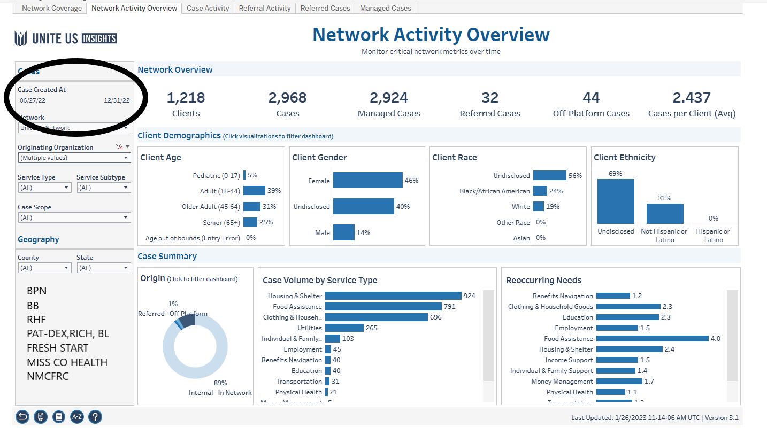
BoRN Q2 Data
Thank you to the Bootheel Perinatal Network Team for sharing their slide and information.

Slide 15
Recognition & Prevention
Note: * on any element refers the participant to the relevant implementation details document for more information.
https://saferbirth.org/wp-content/uploads/R1_AIM_Bundle_PMHC-EID.pdf

Slide 16
Recognition & prevention – Every Patient
Screen for perinatal mental health conditions consistently throughout the perinatal period, including, but not limited to:
Obtain individual and family mental health history at intake, with review and update as needed.*
Screen for depression and anxiety at the initial prenatal visit, later in pregnancy, and at the postpartum visits, ideally including pediatric well-child visits.
Screen for bi-polar disorder before initiating pharmacotherapy for anxiety and depression.*

Slide 17
Current Recommendations
American Academy of Pediatrics guideline (2019)
Pediatricians to screen mothers for depressive symptoms at well child visits at 1, 2 , 4 and 6 month well child visits.
ACOG Clinical Practice Guideline (June 2023)
Everyone receiving well woman, prepregnancy, prenatal and postpartum care be screened for depression and anxiety using standardized, validated tools.
Screen for perinatal depression and anxiety at the initial prenatal visit, later in pregnancy, and at postpartum visits.
Screen for bipolar disorder before initiating pharmacotherapy for anxiety or depression
USPSTF Recommendation Statement (Feb. 2019; June 2023)
Depression screening for adults, including pregnant and postpartum women.
Anxiety screening in adults 64 years or younger, including pregnant and postpartum persons, regardless of risk
Women’s Preventive Services Initiative (WPSI – 2020)
Anxiety in adolescent and adult women, including those who are pregnant or postpartum.

Slide 18
Recognition & Prevention – Every Patient
Screen for structural and social drivers of health that may impact clinical recommendations or treatment plans and provide linkage to resources.

Slide 19
Screening for Social Determinants of Health: CMS IPPS Rule 2023
SDOH-1 – Screening for social drivers of health
SDOH-2 – Screen positive rate for social drivers of health
Food insecurity
Unstable housing
Transportation
Utility difficulties
Interpersonal safety
https://www.federalregister.gov/documents/2022/08/10/2022-16472/medicare-program-hospital-inpatient-prospective-payment-systems-for-acute-care-hospitals-and-the

Slide 20
Does Screening for the “Big 5” SDoH Tell the Whole Story?
Experience of living with low income and material hardship influences parental stress and mental illness. (Gershoff et al., 2007, Child Development)
Food insufficiency was shown to increase risk for depression in poor Black women, even after adjusting for unemployment, unstable housing, childcare availability, transportation and discrimination.(Seifert, et al., 2007, Am J Orthopsychiatry)
Mothers experiencing diaper need exhibited higher depression scores than those with food insecurity. (Austin, A & Smith, 2017, Health Equity; Smith, MV et al, 2013, Pediatrics.)

Slide 21
Response
Note: * on any element refers the participant to the relevant implementation details document for more information.
https://saferbirth.org/wp-content/uploads/R1_AIM_Bundle_PMHC-EID.pdf

Slide 22
Response – Every Event
Initiate an evidence-based, patient-centered response protocol that is tailored to condition severity, and is strength-based, culturally relevant*, and is responsive to the patient’s values and needs.
Activate an immediate suicide risk assessment and response protocol as indicated for patients with identified suicidal ideation, significant risk of harm to self/others.

Slide 23
Mortality Risk: Suicide
Ten-year pregnancy-associated mortality rates for deaths by violence and injury compared with the leading obstetric causes in Illinois, 2002-2011.
Higher Risk of Homicide Among Pregnant and Postpartum Females Aged 10-29 Years in Illinois, 2002-2011.
Koch, Abigail; Rosenberg, Deborah; Geller, Stacie
Obstetrics & Gynecology. 128(3):440-446, September 2016.
DOI: 10.1097/AOG.00000000000015590
Ten-year pregnancy-associated mortality rates for deaths by violence and injury compared with the leading obstetric causes in Illinois, 2002-2011. Fig. 1. Koch. Pregnancy-Associated Homicide in Illinois. Obstet Gynecol 2016.

Slide 24
Stage-Based Response to Screening
“Screening alone is insufficient to improve clinical outcomes and must be coupled with appropriate follow-up and treatment” (ACOG,2015)
Determine maternal, infant and other children’s safety
Initiate treatment as indicated
Refer to appropriate mental health services

Slide 25
Manage Suicidal Ideation
Screen patient’s with depression for:
Suicidal thoughts
Suicidal intent/plan
Availability/lethality of method
Activate emergency referral protocol for birthing people with suicidal/homicidal ideation
Consultation, transportation, admission
Maintain open communication among team members
Post event planning for care coordination and follow-up

Slide 26
Seek Consultation
Failed response to medication
Persistent psychosocial problems
Complicated psychological problems
Actively suicidal
Discomfort in managing the problem
“Gut feeling”

Slide 28
Response – Every Event
Establish care pathways that facilitate coordination and follow-up among multiple providers throughout the perinatal period for pregnant and postpartum people referred to mental health treatment.*

Slide 29
Get Everyone on the Same Page
Coordinate care between maternity care, mental health, and primary care providers during the prenatal and postpartal period
Establish a plan for care beyond the postpartum period
Women’s Health Care Provider
Mental Health Care Provider
Primary Care Provider
Assure release of information
forms are in place.

Slide 30
Continuum of Care: The Warm Handoff
Screen
Assess
Engage
Triage
Treat
Improved Outcomes
Gilbody, S, Sheldon, T, & House, A. (2008). CMAJ, 178(8), 997-1003; Yonkers, K, Smith, M, Lin, H. Howell, H, Shao, L, & Rosenhack, R. (2009). Psychiatric Services, 60 (3), 322-328

Slide 31
The Warm Handoff
Create a successful referral process
Patient engagement - recognition that problem exists
Shared decision-making – agreement referral is needed
Remove barriers to care
Discuss referral logistics
Name for first appointment contact
Follow up – schedule contact for shortly after the referral appointment takes place

Slide 32
Reporting & Systems Learning
Note: * on any element refers the participant to the relevant implementation details document for more information.
https://saferbirth.org/wp-content/uploads/R1_AIM_Bundle_PMHC-EID.pdf

Slide 33
Reporting & Systems Learning – Every Unit
Incorporate mental health into multidisciplinary rounding to establish a non-judgmental culture of safety.

Slide 34
Create a Culture of Safety
A culture of safety - one where people are encouraged to work toward change and take action to make change happen
Non-judgmental
Emphasizes teamwork
Considers processes

Slide 35
Reporting & Systems Learning – Every Unit
Convene inpatient and outpatient providers in an ongoing way to share successful strategies and identify opportunities for prevention and evaluation of undesired outcomes related to perinatal mental health.*

Slide 36
The Interdisciplinary Review as a Patient Safety Tool
Debrief after severe maternal event/mental health crisis with the entire team
Review patients “lost to care or follow up”
Review protocols to identify, treat, refer and follow-up maternal mental health issues
Identify actionable items for improvement
Document actionable steps
Evaluate quality improvement processes

Slide 37
Follow-Up to a Severe Maternal Event
Women experiencing a severe maternal medical event during pregnancy or delivery are at increased risk for developing a Perinatal Mood and Anxiety Disorder (PMAD)
Post partum screening
Interconception screening
Antenatal screening in subsequent pregnancies
PMADs time to resolution may be longer as compared to other types of severe maternal events.
Women experiencing an obstetrical emergency and PMAD may require longer outpatient care and treatment with psychotherapy and pharmacotherapy.

Slide 38
Reporting & Systems Learning – Every Unit
Identify and monitor data related to perinatal mental health care, with disaggregation by race and ethnicity at a minimum, to evaluate disparities in processes of care.*
Data Collection Plan available at
saferbirth.org

Slide 39
Respectful, Equitable, & Supportive Care
Note: * on any element refers the participant to the relevant implementation details document for more information.
https://saferbirth.org/wp-content/uploads/R1_AIM_Bundle_PMHC-EID.pdf

Slide 40
Respectful, Equitable, and Supportive Care -Every Unit/Provider/Team Member
Include each pregnant and postpartum person and their identified support network as respected members of and contributors to the multidisciplinary care team.*

Slide 41
Respectful, Equitable, and Supportive Care -Every Unit/Provider/Team Member
Engage in open, transparent, empathetic, and trauma-informed communication with pregnant and postpartum people and their identified support network to understand diagnoses, options, and treatment plans.

Slide 42
Patient and Family Education
Include information about perinatal mental health with other prenatal and postpartum education
Provide education about warning signs, “red flags”, recognition of risk and signs of recurrence
Provide resource information and discuss where to go for help
Who to call
How to access services
Assess reports from family members and support person

Slide 43
The Racial Equity Learning Series: Our Journey & Evolution https://youtu.be/_GDkc-rN1Ss
https://maternalhealthlearning.org/resources/nhsa-aim-cci-racial-equity-learning-series-rels

Slide 44
Implementation Tools

Slide 45
Perinatal Mental Health Bundle Package
Patient safety bundle
Element implementation details
Implementation resources
Data Collection Plan
Change Package
Implementation webinar video
Bundle element context and references
www.saferbirth.org

Slide 46
Implementation Complexities
Inpatient vs outpatient implementation
Measurement challenges
Non-prescriptive QI program
State-level differences (rural/urban, policies, population)

Slide 47
State-Level Opportunities
Need for consultation
PQCs interested in Perinatal Psychiatry Access Programs
Local resource connections
Dissemination to broad range of health care team members that engage in PQCs or in AIM (ob-gyn, pediatrics, SUD treatment)

Slide 48
How Can I Get Connected?
Email
For direct connection requests, email aim@acog.org
Visit
Visit saferbirth.org
Follow
Follow AIM’s social media channels (Instagram, Facebook, LinkedIn, Vimeo)

Slide 49
Coming in 2025...
The ILPQC Perinatal Mental Health (PMH) Initiative
Clinician Education
Link to Mental Health Services
Education on screening & treating patients with PMH conditions.
Enhance linkage to mental health services for improved care coordination.
Key
Systems
Change
Screening
Engage Stakeholders
Enhance screening of PMH & SDoH in perinatal period.
Collaborate with patients & communities
and identify community-based resources.
Optimizing Treatment
Ongoing SUD Work
Establish processes for assessing
& treating PMH conditions.
Continue optimizing care of people with SUD through assessment & linkage to resources.
Wave 1: January - March 2025
PMH Initiative Launch: Face to Face 2025
Notes:
provides an opportunity to address perinatal mental health conditions across the full perinatal pathway in order to optimize perinatal care and reduce associated maternal mortality.

Slide 50
Questions?
Susan Kendig, JD, WHNP-BC
suekendig@gmail.com
314-629-2372

