Slide 1
Doula and Home Visting Services Panel:
Building Bridges to Community Partners to Improve Care
Notes:
Ann to introduce Corliss

Slide 2
Doula and Home Visiting Services Panelists
Community-based Doula Services
  Brenda Reyes: HealthConnect One
  Marvella Ying: M-Brace Birthing LLC & The Doula Lab
Home Visiting Services
  Jennifer Rosseau & Kathryn Kaintz Bender: Family Connects Chicago at Rush
  Damaris Montano: Lake County Health Department and Community Health Center, Family Case Management
Notes:
Corliss introduce panelists ☺

Slide 3
Brenda Reyes, RN, CLC
VP of Training and Curriculum
HealthConnect One

Slide 4




ROLE OF A COMMUNITY-BASED DOULA
  Non-clinical Do NOT Diagnose
  Work as part of a team
  Emotional & physical support
  Education & Information
  Link to referral
  Bridge to systems & resources
  Cultural relevant support in their language
  Listen, Affirm, Non-judgemental support
  Facilitate classes & Support Groups
  Offer support via home visits, clinic, or virtual
  Support during pregnancy, delivery & postpartum

Slide 5
BENEFITS OF COMMUNITY-BASED DOULA PROGRAMS
  Peer to Peer Support
  Parenting & baby bond strengthened
  Increased breastfeeding intention/initiation and duration rates
  Fewer medical interventions
  Fewer c-section deliveries
  More positive birth experiences
  Increased parenting skills
  Mentorship & community building
  Workforce development

Slide 6
How can hospitals, FQHC & Institutions Support CBD Programs?
  Become familiar with role of a CBD
  Have the tools available for CBD to use e.g. birth ball, warm/cold packs etc.
  Provide orientation to CBD
  Become familiar with referrals to CBD programs
  Provide lunch and learn / meet & greet opportunities with CBD program staff
  Racial Equity Training
  Celebrate Community Doula Week in March
  Support the investment in CBD programs and advocacy

Slide 7
Marvella Ying, BSBA, CD, CBE
Doula and Founder, M-Brace Birthing LLC
Co-facilitator, The Doula Lab

Slide 8
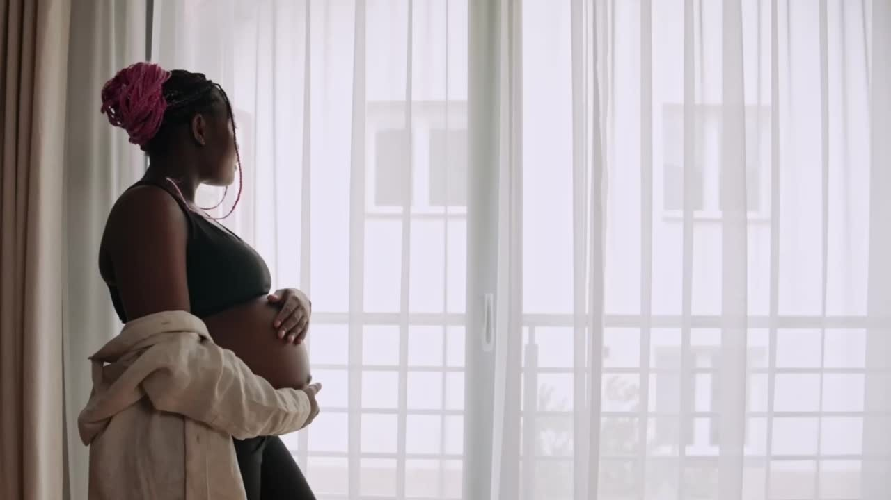
THE DOULA LAB
Help us to make the “Birth Experience Better” for all people, one family at a time.
PRESENTED BY: MARVELLA YING; BS, CFSD, CBE (CHARITY ORGANIZER & LEAD FACILITATOR )

Slide 9
About The Doula Lab
THE DOULA LAB
OVERVIEW
The Doula Lab is a non-profit organization that was created to help educate, advocate, and empower every birth no matter race, gender, or financial class.
By providing detailed pregnancy, labor, postpartum, lactation, newborn care, nutrition, CPR, and more classes that include the entire support system. We are here to truly explain the process the body goes through during pregnancy, childbirth, and postpartum, as well as complications that can arise. We also focus on the mental health aspect of maternal health.

Slide 10
Vision & Mission
THE DOULA LAB
Share And Send Smiles.
Vision
Our vision is to put an end to the maternal health crisis in our communities due to the lack of maternal health resources. St. Clair County, IL, and many other surrounding countries are in a maternal health desert. We want to provide resources for birthing families especially those of color to thrive and not just survive.
Mission
The mission of The Doula Lab pregnancy resource center is to significantly improve the mental, physical and emotional health and well-being of all members of the community through counseling, education, support, and advocacy.

Slide 11
Our Goal
THE DOULA LAB
Empower Birthing Families
The goal is to reduce maternal mortality and morbidity by improving care for the underserved population with the following access to resources such as:
Reduction in infant mortality rates
Reduction in maternal complications and mortality Reduction of unnecessary induction of labor
Reduction of elective deliveries that can lead to an increase in admission rates
to the neonatal intensive care unit Reduction of complications during deliveries
Reduction of prematurity rates that can lead to infant mortality
Reduction in costs associated with lengthy hospital stays due to pregnancy related complications
Reduction in anxiety, depression, substance addiction and suicide among
birthing families
Reduction in birthing experiences plagued by trauma & disrespect

Slide 12

Doula Lab Services
Community Health Workers (Doulas)
Community Health Workers will be in office to provide assistance and
Better Birth Start Community Room
(Filled with Baby diapers, wipes,
Essentials toiletries,
such as etc. free
giveaways for participating in classes)
resources to families/ individuals to meet their SDOH needs. EX: Medicaid enrollment, snap,, food pantry’s and other community resources.

Slide 13
Doula Lab Services
Perinatal/ Postpartum Peer Support Groups
Monthly expecting familes
groups will be held for families and postpartum to discuss varies topics
surrounding pregnancy, childbirth, postpartum and more.
Education
Pregnancy, Postpartum,
Childbirth (Natural/Medical), Newborn Care, Lactation,
nutrition, Comfort Measures Classes and more offered Monthly

Slide 14


Doula Training/ Birth Associate Training
Led by LaKisha Redditt , Owner and Operator of Virtuously B'Earthed Doula Services
LaKisha Redditt, B.S., CHW-C, Doula
Owner of Virtuously B'Earthed Doula Services Virtuous Doula Training
My 12-week hybrid course is a comprehensive Doula Training with hands-on learning incorporated into the curriculum. We talk about all of the traditional doula topics such as comfort measures, places of birth, etc. In addition, we discuss elements of public/community health, cultural competency, health awareness, capacity building, mental health, and more.

Slide 15
What is a Doula?
THE DOULA LAB
The doula's goal and role is to help the client feel safe and comfortable, complementing the role of the healthcare professionals who provide the client's medical care. Unlike a physician, midwife, or nurse, a doula cannot administer medication or other medical treatment or give medical advice.

Slide 16
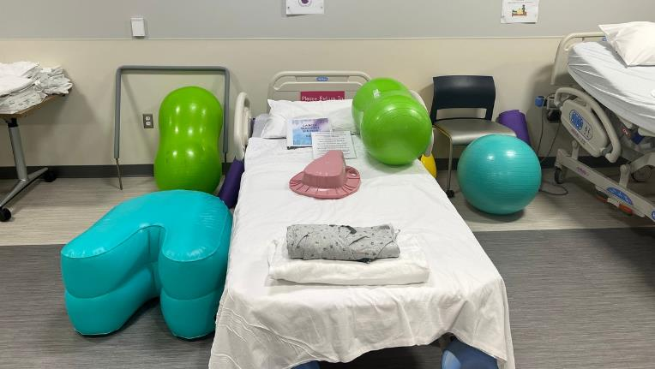
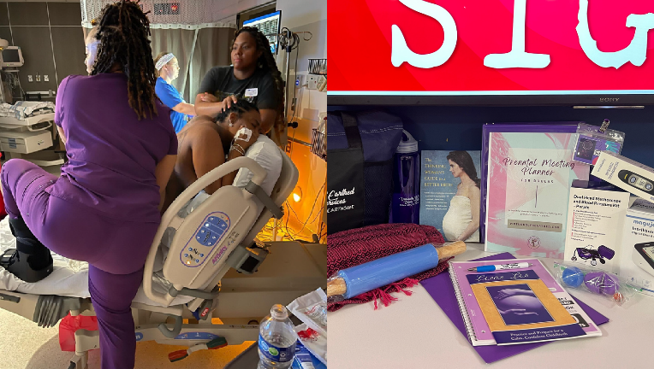

Training
Community-based doulas, integrated within communities they serve, can provide culturally and linguistically congruent care that supports communication between mothers and their health care team. This is a factor identified by Black women's health organizations as an essential aspect of the birthing experience
The Doula Lab

Slide 17
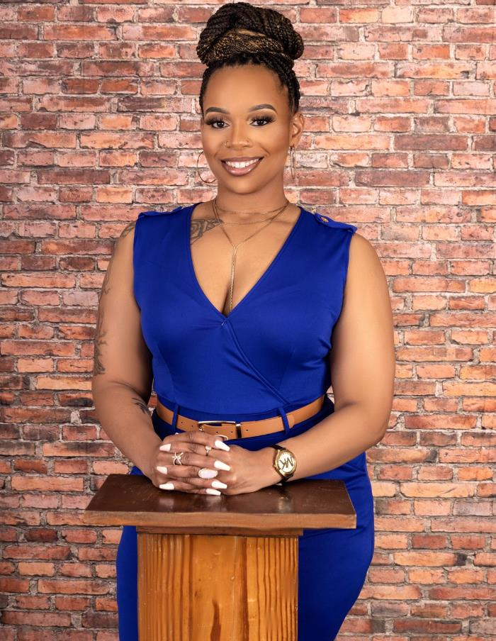
Our Founder
Charity S. Bean,CMA, CFSD, CLC, CHW, SRN
I AM A CERTIFIED PREGNANCY, LABOR, CHILDBIRTH, AND POSTPARTUM DOULA WHO SPECIALIZES IN HOSPITAL BIRTH. I HOLD MANY CERTIFICATIONS INCLUDING MEDICAL
ASSISTANT, LACTATION CONSULTANT, BIRTH ASSISTANT AND SOON TO BE CERTIFIED PERINATAL MOOD DISORDER COUNSELOR. I BEGAN MY JOURNEY INTO MIDWIFERY JANUARY 8TH, 2024, WITH THE MIDWIVES COLLEGE OF UTAH, WHERE I WILL BE PURSUING A BACHELOR’S IN THE
SCIENCE OF MIDWIFERY. I’VE HAS WORKED IN THE MEDICAL FIELD FOR 13 YEARS (PRIMARY CARE, TRAUMA, PSYCH, ER AND BIRTHING UNIT). I SERVE AS A BI STATE MATERNAL AND INFANT HEALTH ADVOCATE WITH EMPHASIS ON BLACK MATERNAL HEALTH. I AM THE FOUNDER OF THE DOULA LAB PREGNANCY RESOURCE CENTER LOCATED IN BELLEVILLE, ILLINOIS. AS WELL AS OWNER OF DOULA BEAN MATERNAL CARE, LLC. MY GOAL IS TO BECOME A MIDWIFE AND OPEN A FREE- STANDING BIRTHING CENTER IN EAST ST. LOUIS, ILLINOIS. MY PASSION FOR BIRTH WORK STEMS FROM BEING A TEEN MOM AND WORKING IN THE MEDICAL FIELD. OVER THE YEARS WITNESSING THE TREATMENT OF BIPOC FAMILIES INSPIRED ME TO NOT ONLY TALK ABOUT WHAT NEEDED TO BE DONE BUT TO BE THE CHANGE THAT MATERNAL HEALTH NEEDS
THE DOULA LAB

Slide 18

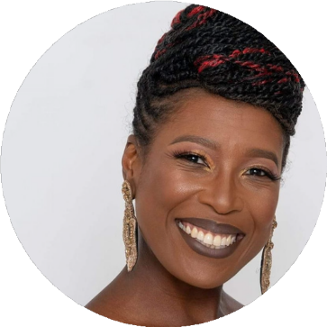
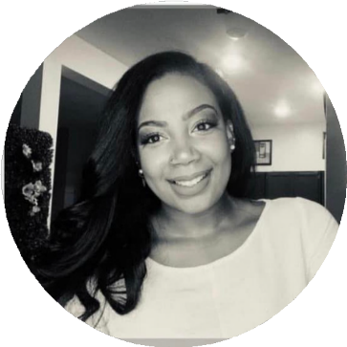
Meet Our Team
THE DOULA LAB
Marvella Ying- Clayburne, BS, CD, CBE
Lead Facilator
Together we can do so much.
We are a team of BIPOC who have united with our particular skill sets
Kyra L. Betts, CBE,ICS, BS(SOC), MHS
Advocacy Manager
Charisse Montgomery, BS, CLC, CIMI, CCPS, CHW
CO-FACALITATOR.
COMMMUNITY HEALTH WORKER
and passion to serve birthing families in our communities' and of all ages stages and phases of life with education, advocacy, empowerment, support and provide
resources to all in the MetroEast IL area and the surrounding metropolitan St. Louis, MO area.

Slide 19
Help Us Save Lives
THE DOULA LAB
Let's start sharing happiness and inspire people.
By collaborating with The Doula Lab, we hope to create a supportive relationship between your program and ours that not only provides research but will also lead to policy changes in maternal care based on data. As well as funding to make this a full time career for those in the organization as well as more access to resources to have a sustainable program and decrease mortality and morbidity in the many times forgotten Southwestern Illinois area. (East St. Louis, Cahokia, Granite City, Alton, and more)
For more information :
618-381-1716
618-570-3169 office line
cbean@doulabean.com

Slide 20
“GET YOU A DOULA SIS”
THANK YOU

Slide 21
Damaris Montano, MPH, BSN, RN
Program Coordinator, Maternal Child Health
Lake County Health Department and Community Health Center

Slide 22
Family Case Management
Damaris Montano, MPH, BSN, RN
Program Coordinator – Maternal Child Health Services
Notes:
Standard title slide.

Slide 23
Family Case Management
Statewide program for low-income families with pregnant persons and infants up to one year of age.

Slide 24
Purpose
To Provide Comprehensive Service Coordination
To Improve
  Health
  Social Needs
  Educational Needs
  Developmental Needs

Slide 25
Assessments
Home Assessment
Barriers to Services Assessment
Risk Assessment

Slide 26
Barriers to Services
Child-care
Work or School Schedule
Distance/Transportation
Language
Folk/Cultural Practices
Providers’ Attitudes
Cost/Insurance

Slide 27
Interventions
Screenings
Assessments and Interpretation
Education
Referrals
Advocacy
Support
Culturally Relevant
Care Coordination

Slide 28
Education
Nutrition
S/S of Complications
S/S of Labor
Making a Labor Plan
Getting Ready for Baby
Breastfeeding
Relaxation Techniques

Slide 29
Referrals
Doctor
Insurance
Transportation
Day Care
Food Pantries
Housing
Mental Health Care
GED
ESL
Referrals for Family Members

Slide 30
HRFCM
SFY25
New Program
Nurse Case Management
Home Visits
Monthly Nurse Visits

Slide 31
Meeting Our Goal

Slide 33
Kathryn Kaintz Bender, BSN, RN
Jennifer B. Rosseau, DNP, WHNP-BC, CNE
Nursing Director, Family Connects Chicago at Rush
RN Manager, Family Connects Chicago at Rush
Improving Health Equity in the Early Postpartum
One Family at a Time

Slide 34
Private – Public Partnership
Rush University Medical Center
Rush University College of Nursing
Chicago Department of Public Health

Slide 35
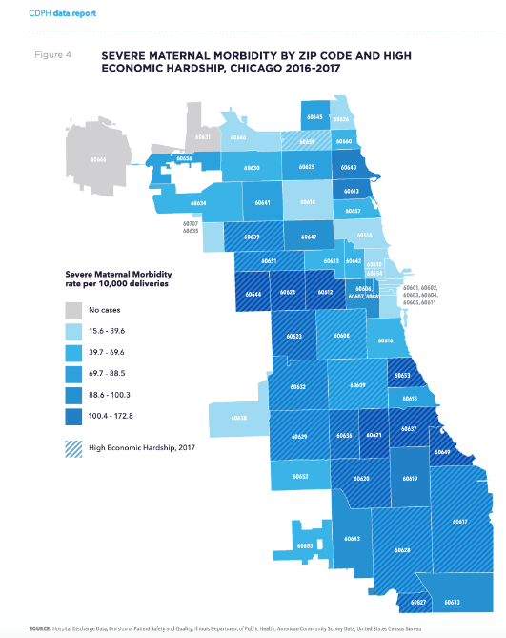
Notes:
Women experiencing severe maternal morbidity were more likely to have been living in areas with high economic hardship

Slide 36















Siloed Care Contributes to Compounding Needs
L&D care focuses on birthing parent
Well child care heavily focuses on infant health, with high visit completion rates
Postpartum care focuses on mom and baby separately
Patient Navigation and/or Care Management exists for only some families
Postpartum OB care focuses on maternal health, with low visit completion rates
Links to support for healthcare, mental health needs, longer term home visiting, and social needs are challenged by issues of availability, accessibility, policy and trust
Family support
fluctuates
Social needs compound
Notes:
The so-called “medical model” focuses on individuals and pathology. What is the disease and how can we fix it.
We have been working to embrace a lifecourse view, and this requires a shift in our perspective – from the problem to the person.
So what does a person’s perinatal journey look like in our system? This is how we broke it down.
Our system wasn’t meeting needs – it was exacerbating them.
Systemic problems that worsen outcomes: 1) Historical bias, 2) Competing interests, 3) Structural racism, 4) Zero-sum mentality, 5) A pandemic

Slide 37
Program Goals
  Advance maternal-infant health equity
  Standardize social needs screening and referral
  Standardize maternal and family well-being screening and referral
  Align with Medical Center and College of Nursing mission, vision, and values to meet the needs of and strengthen surrounding communities, increase multidisciplinary collaboration, and expose health professions students to innovative care delivery models

Slide 38
The Family Connects Model
FOR ALL
Helping all families regardless of income or background
THREE WEEKS
One visit is scheduled around 3 weeks after a baby’s birth
NO COST TO RECIPIENTS
As an eligible recipient, patients are not charged
REGISTERED NURSE
All visits are made by highly trained nurses
Notes:
The Family Connects model is an evidence-based approach to supporting newborns and their families.
The program is available to all families in a given community regardless of income or background. This approach reduces stigma and focuses on infants, families, and communities to address unmet needs and to identify critical gaps in the early childhood system to create population-level impact.
The program is voluntary and is no cost to recipients. The goal is for Family Connects to become part of a community’s system of care for children and families.
Visits are scheduled around three weeks after a baby’s birth. The visit takes place in the family’s home and is made by a highly trained registered nurse. Nurses are trusted professionals whose skillset is necessary for the medical component of the home visit such as taking mother and child vitals and examining the infant.

Slide 39
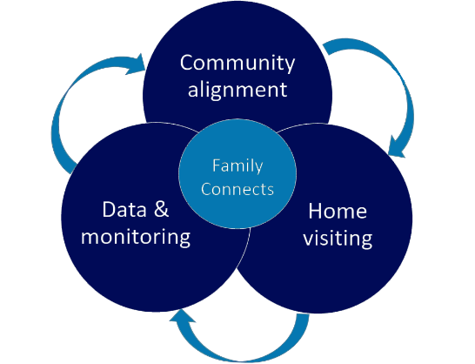
Family Connects Chicago: A Systems Solution
Home visit:
  Respond to immediate needs through brief interventions, education and support
  Respond to longer term needs via referrals with warm hand off
Data is tracked for both process and outcome measures at the city level through a web-based platform (Salesforce) and at Rush
Identify gaps in community services and supports to improve resource allocation and inform policy
Notes:
But Family Connects is more than a home visit.
It is designed to provide individual family support AND build a comprehensive system of support for all families.
Data from the home visits is compiled (keeping all families’ individual information private and protected) to better understand:
the needs of families
what services are available to meet those needs
whether families can access those services
Where the gaps are - attending to the inequities
This data is shared with a network of community alignment boards (in other cities, one board: Chicago innovation is 6 regionals):
People with lived experience
Health care providers
Social and human service providers (like housing orgs, workforce, intensive home visiting, WIC and other orgs addressing food insecurity – support for the social determinants of health)
Early childhood
Who do the work of reviewing the data, identifying additional community services, building shared knowledge about these services, advocating to fill gaps,
By offering the service to all families and doing the work of community alignment – we are able to address health at a population level

Slide 40



At Rush: How Does a Family Experience the Model?
Needed interventions
Pre-natal
Birth
Home Visit
Warm Hand Off
Flyers in prenatal clinics
Family Connects staff member visits patients at bedside to introduce the program and schedule a visit.
Flyers in all patient rooms; included in the Welcome Booklet.
Assigned nurse confirms the visit on the day of and sends screeners (EPDS, ACEs, CAGE) via Redcap.
Completes the 2-hour visit (in home or virtual)
For most families, telephone contact 1-2 weeks following visit is enough – but second and third visits are offered as needed
Post-visit telephone call 1 month later to check on use of and satisfaction with community referrals
Notes:
Make font larger

Slide 41
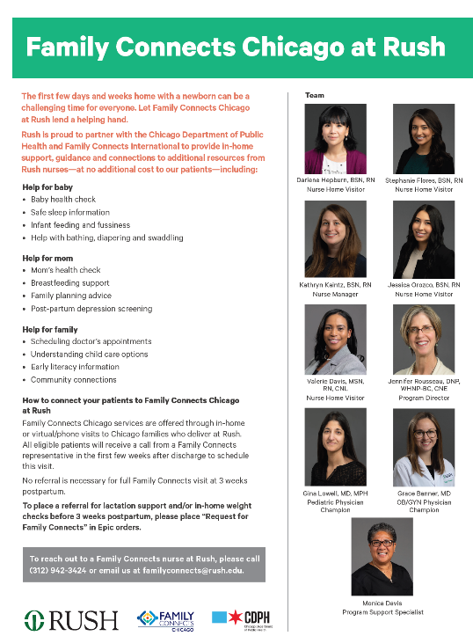

Slide 42
Components of Planning
Evaluate Current System Strengths/Gaps
Identify Stakeholders
Create a Budget
Legal Team for Consents and Data Sharing
Hire and Orient Community Health Nurses
Develop Documentation
Develop Workflows
Marketing
System for Referrals
Ensure Nurse Safety at Visits
Evaluation
Inform and Educate Providers and Inpatient Staff

Slide 43

What is Assessed During a 2-hour Visit: 12 Factors Empirically Linked to Family Risk
Support for Health Care
4. Child Care Plans
5. Parent-Child Relationship
Support for a
Safe Home
7. Household Safety/Material Supports
9. History with Parenting Difficulties (ACEs)
Support for Parent(s)
11. Substance Abuse in Household
12. Parent Emotional Support
Support for
Infant Care
1. Maternal Health
2. Infant Health
3. Health Care Plans
6. Management of Infant Crying
8. Family and Community Safety
10. Parent Well Being
Each factor is rated as:
1 = No family needs
2 = Needs addressed during visit
3 = Community resources needed
4 = Emergency intervention needed
Notes:
FC- Krysta
The IHV follows a detailed protocol: The Family Support Matrix to assess 12 factors predictive of child and family well-being.

Slide 44
Examples of how Family Connects Positively Impacts Morbidity and Mortality
Infant
Poor weight gain
Heart murmur
Difficulty breathing
Unsafe sleep situations
In-home/virtual lactation support
Maternal
Blood pressure checks
Education on symptoms of preeclampsia
Domestic violence
Depression
Increase trust in the healthcare system
Incision checks
Most common referrals:
  Mental health
  Follow-up care with PCP, OB, Pediatrician
  WIC referrals
  Legal/housing aid
  Case Management/Social Worker for complex needs requiring longer term follow-up
  Household/newborn material goods such as diapers, crib

Slide 45
Patient Stories
“I had a home visit with a mom that seemed perfectly healthy. It was her second child, and after providing lactation help, I started our routine vital checks. Her blood pressure was dangerously high — a sign of pre-eclampsia, which can cause seizure, stroke and organ failure in women. The mom repeatedly said she felt fine and had no other risk factors like diabetes, but when I checked it again, her blood pressure was even higher.
After alerting her obstetrician, the mother was hospitalized for three days to lower her blood pressure. Without this in-home intervention, it could have been weeks before a health professional would check the mother’s vital signs.” – Stephanie Flores, BSN, RN ​​

Slide 46
Patient Stories
I had the privilege of providing care to a young mother who was new to Chicago. When I explained the Family Connects program to her she was excited to schedule an appointment. During the visit, several needs were identified for both physical and emotional health, as well as social support. The patient disclosed that she had survived abuse in her childhood and still struggled with processing the events. I expressed empathy and allowed the patient time to share her experience. I offered to connect her to a Therapist or Counselor, and she agreed. She also wanted assistance with food, education, parenting classes, and tangible needs for her infant.
During my follow up with the patient, I was thrilled to learn that she has been receiving therapy consistently, has been enrolled in food assistance programs, and has had infant diapers ,clothing, and supplies delivered to her home. The patient is thriving and continues to build her support system to reach her personal and parenting goals.

Slide 47
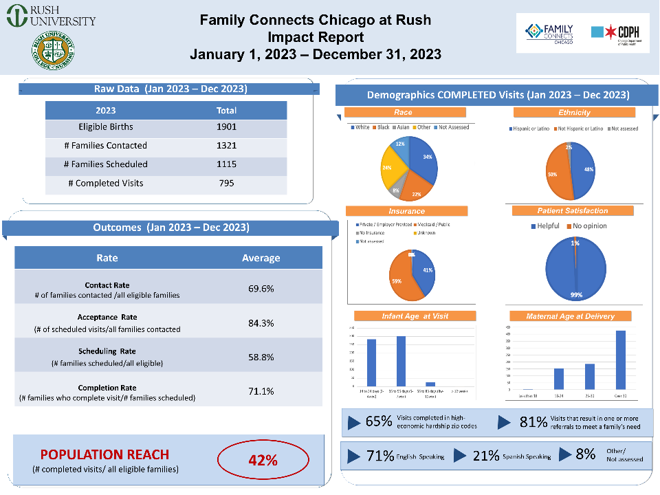

Slide 48

Panel Discussion
Q & A

