Slide 1
Birth Equity ​Teams Panel:
Sharing Strategies that make a difference

Slide 2
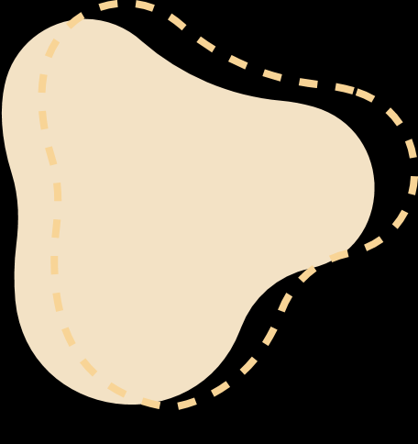



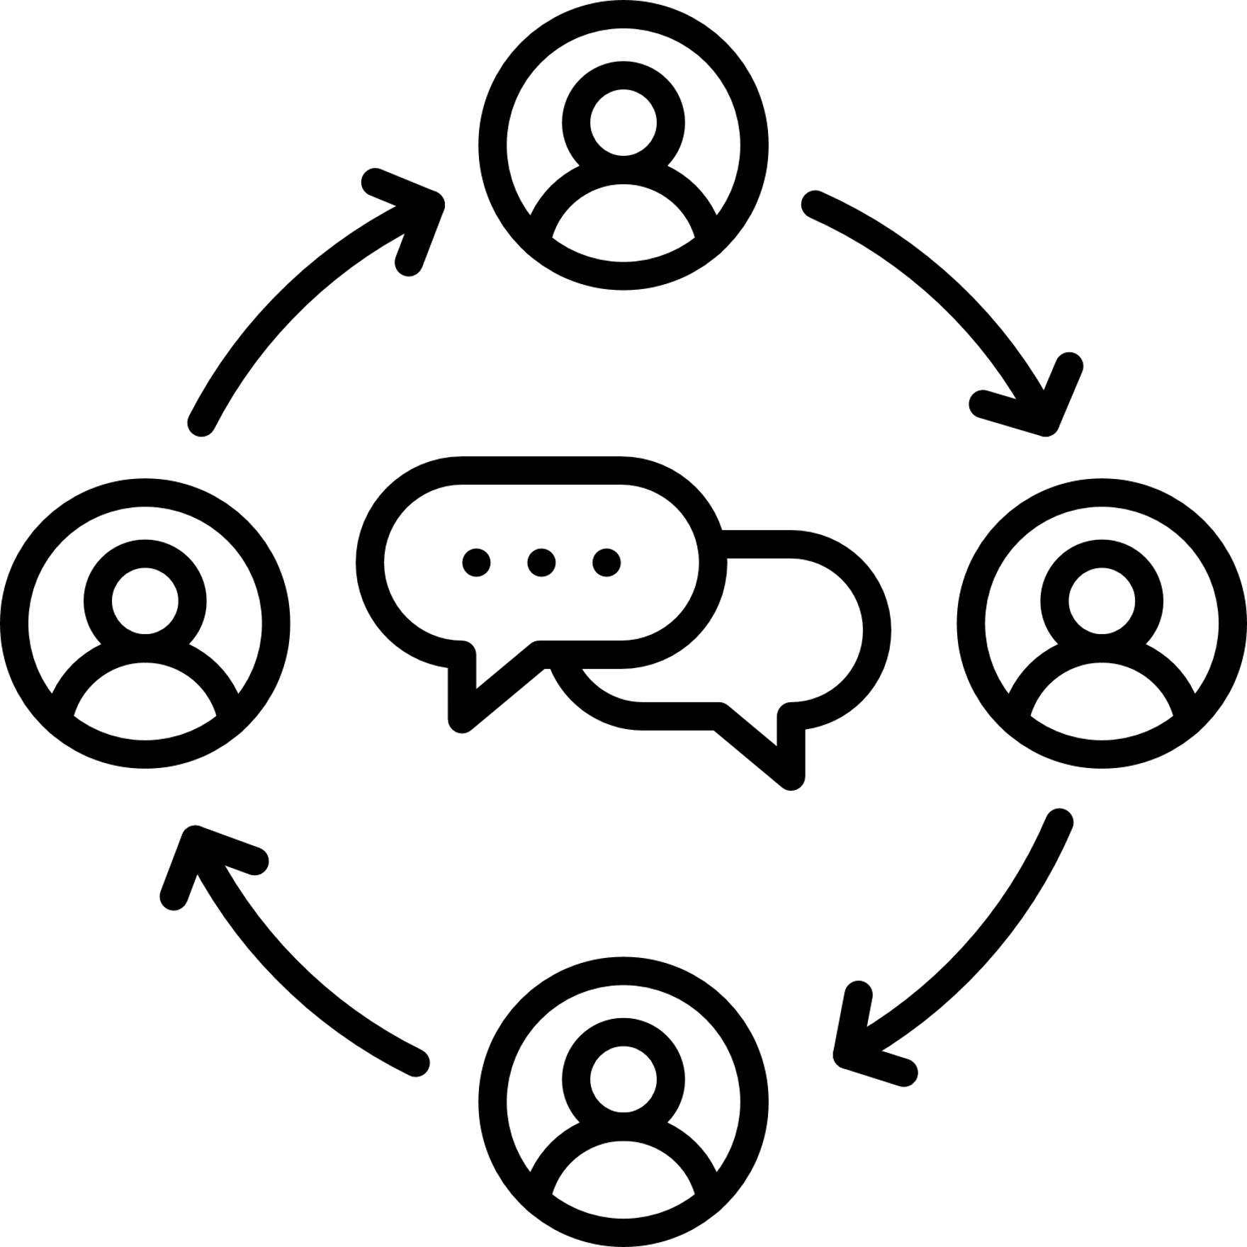




Birth Equity Initiative Aim: By May 2024, > 70% of participating hospitals will have implemented all key strategies
Birth Equity Key Strategies
Optimize race and ethnicity data collection and review stratified data
Screen all patients for social determinants of health and link to community resources
Standardize postpartum safety education and schedule early postpartum visit
Engage patients and community members for quality improvement input
Implement implicit bias and respectful care training for providers, nurses, other staff
Share respectful care practices and survey patients (PREM) on their care experience

Slide 3
Integrating Focused Birth Equity
Patient & Community Engagement Strategies
Hosting Respectful Care Breakfasts
Identifying Patient Partners
Connecting with Community-Based Doulas
Collaborating with Home-Visiting Programs

Slide 4
BE Teams Panel:
Patient and Community Engagement in QI
Lori Stevenson, Barnes Jewish Hospital Women & Infants Center
  Connecting with Community-based Doulas
Ashley Polnitz & Kyeshia Lewis, Carle Foundation Hospital
  Engaging a Patient Partner in QI Work
Beth Plunkett & Dina Kapogiannis, Endeavor Health Evanston Hospital
  Sharing Lessons Learned from Hosting a Respectful Care Breakfast
Shelly Shallat & Erin Miller, OSF Saint Francis Medical Center
  Collaborating with Local Home Visting Programs
Notes:
Aleena to introduce BE team panel

Slide 5
Lori Stevenson, MSN, RNC-OB, C-ONQS, CNML, ASQ-SSBB
Senior Performance Improvement Consultant
Barnes Jewish Hospital
St. Louis, MO

Slide 6
About us
Barnes Jewish and St. Louis Children’s Hospitals serve Southern Illinois and Eastern Missouri.
Care is provided for both low and high-risk obstetric patients and well newborn to critically ill newborns needing high level intensive care.
We average 3500 births per year.
These hospitals are in an urban area on the campus of an academic medical center and are connected by an enclosed bridge.
Notes:
Good morning. Thank you for having me. I am here to speak about our birth equity work at Barnes Jewish Hospital located in downtown St. Louis, MO. We are a high risk academic medical center working in partnership with Washington University. We offer maternal and neonatal care, including a maternal and neonatal transport team and fetal surgeries through our Fetal Care Center and we average 3500 births per year.

Slide 7
Our BIRTH EQUITY team
Lori Stevenson MSN, RN Sr. Performance Improvement Consultant, W&I
Jennifer Hudson, MSN, APRN, FNP-C
Clinical Programs Manager
Brittaney Vaughn, MSN-Nurse Navigator CARE Clinic
Sue Dersch, RN-AWARE Program
LaShanda Jackson, MSN, RN
Women’s Health Educator and Outreach Coordinator
Lauren Nacke, MSW, LCSW
Social Work
Notes:
Our Team is comprised of multidisciplinary members representing nursing, leadership, social work, performance improvement and community outreach
We meet monthly and include guests from our DEI and Community Health Initiatives teams to provide insight and feedback
We collaborate with community agencies to demonstrate our commitment to meeting our patients and families where they feel most comfortable
The team is led by Lashanda Jackson, MSN, RN who is our Outreach Nurse Coordinator.
In her role, she focuses on efforts to improve infant and maternal health outcomes by connecting with community in meaningful ways.
CARE is Clinic for Acceptance, Recovery & Empowerment We provide comprehensive, compassionate maternity care and postpartum support up to one year for pregnant women with opioid and other substance use disorders. AWARE is our domestic violence support program.
We purposely selected team members who understand the variety of patients that we serve. The insight from this team is phenomenal.

Slide 8
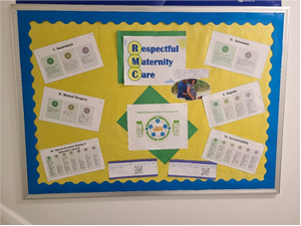
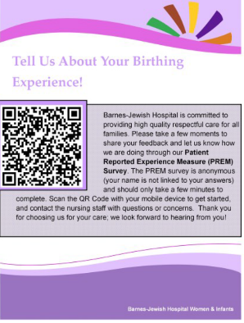
TEAM SUCCESSES
Introduced our staff to AWHONN’s Respectful Maternity Care Practices
Implemented the PREM survey…..FINALLY!
We faced a lot of challenges when implementing the survey, but we were finally able to go live in December 2023.
Notes:
We provided education during staff meetings, put up boards throughout the unit and shared information during huddles. We have also incorporated the respectful maternity care practices education into our new nurse fellowship training.
PREM Implementation Challenges:
Our legal team required validation that the survey was approved by CMS and did not conflict with CMS rules
Needed to combine Baby Friendly experience survey with PREM survey to prevent patient survey overload

Slide 9
Team successes
Implemented Social Determinants of Health screenings on all patients
Social work visits and collaborates with every delivered patient to address SDOH and other needs
Hosted our first and second respectful care luncheons.
The first was in collaboration with SSM St. Mary’s and the second was on our campus
Notes:
Our social work team visits with every delivered patient at least once during the post partum stay. Social work attends discharge rounds to help guide planning and discussion of patient needs. Our social work team is invaluable to the care team and supports the entire familial unit.
We invited all patients presenting for delivery or for prenatal care to attend the luncheons, regardless of where prenatal care was received. All maternal and neonatal providers and staff were invited as well.
Key takeaways from both sessions:
LISTEN to our patients-let them guide their care as much as possible
COMMUNICATE with patient and families about their care and their desires; keep the patient informed
KNOWLEDGE is power: teach our patients to speak up and create environments where they are empowered to do so without fear of repercussions

Slide 10
Team successes
Offered many opportunities for our front-line staff to volunteer in the community and hosted events to connect with our community members
Goal is to help our teams better understand the challenges our patients and families face and build relationships
Notes:
Staff volunteer opportunities included volunteering at our Community Baby Shower, the St. Louis Diaper Bank Warehouse, at the Urban League Community Empowerment Expo, our Respectful Care Breakfasts/Luncheons plus many others.
Our Community Baby Shower is held biannually in Spring and Fall and are staffed by W&I and community outreach. There is food, music, education and fun for the entire family. The event is held in the community for the community’s benefit.

Slide 11
Team successes: L&D Clinical Staff Doula Training
Collaborated with a community-based doula training organization to co-design a two-hour interactive session for clinical staff focused on:
  Defining the scope and role of a doula
  Defining where the role of a doula begins and ends
  Understanding and resetting provider perceptions of doula and working to integrate doulas into the hospital system
  Discussing behaviors and actions clinical care staff can implement to support doulas
  Reviewing types of doulas and how to access doula services
Notes:
One of our most exciting birth equity team projects was related to doulas. We identified that there was a gap of knowledge for our nursing staff related to what the role of a doula is, so the idea was born to do workshops to close that gap. A community-based doula organization and Barnes then started working with March of Dimes in their doula friendly collaborative to identify additional gaps. These gaps resulted in implementation of doula workshops with a focus on the items noted here:
Defining the scope and role of a doula
Defining where the role of a doula begins and ends
Understanding and resetting provider perceptions of doula and working to integrate doulas into the hospital system
Discussing behaviors and actions clinical care staff can implement to support doulas
Reviewing types of doulas and how to access doula services

Slide 12
Team successes: L&D Clinical Team Doula Training
Workshops were held in 2023 and all team members were strongly encouraged to attend.
The trainings were mandatory for L&D nurses.
The workshops were interactive and engaging.
Notes:
The workshops were held throughout the year on our campus and were facilitated by the community-based doula organization. These workshops were mandatory for all L&D nurses and open to all staff members, including providers. More than 200 staff members attended the workshops throughout the year.

Slide 13
Team Successes
Team members’ understanding of the role of the doula was measured pre and post workshop attendance.
Knowledge for those in attendance doubled!
Notes:
We conducted pre and post workshop surveys. Knowledge surrounding doulas and their value to the care team doubled for those who attended the workshops. Our team gained a deeper respect for doulas and the important role doulas play as part of the care team. One of our nurses even commented that she wants to use a doula for her next child.

Slide 14
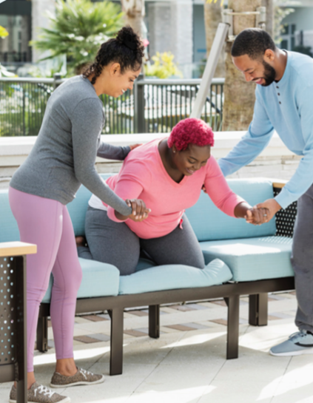
Team successes
Workshop Reflection Session Take-a-ways:
Doulas have felt more 'apart of the team' during births and feel increasingly welcomed within BJC hospitals.
Integrating doulas into a break rooms and access to hospital spaces could facilitate more natural interaction with team members
Expanding audience for the doula workshop
Include more education on how doulas help clients make decisions.
Notes:
At the end of the year, we hosted workshop reflection sessions and invited anyone who had attended a workshop to come and share their feedback and thoughts. We received valuable feedback on ways to make the workshops better but, most importantly, insight into how the workshops have affected the relationships between doulas and other members of the care team on our units. As noted, doulas have felt more “a part of the team” during births and report being increasingly welcomed to our facilities.

Slide 15
Team successes: Doula Meet and Greet Receptions
We hosted doula receptions to further enhance the relationships with the clinical care team
Feedback from the receptions has been overwhelmingly positive from doulas who have supported families at our hospital in the last year!
Notes:
In addition to training our staff, doula receptions are hosted quarterly. Local doulas and other community partners working in the Women and Infant’s realm (health department employees, mental health providers, lactation professionals as examples) are invited. We offer refreshments and tours of the units (if desired). There is a brief discussion about BJH community initiatives followed by an open forum for community members to guide the conversation.
One of the items developed out of this meeting include a Doula Welcome Packet. Doulas helped us understand what items would be important for a doula to know/have when arriving to the unit. Attendance at these receptions varies but no matter how many or how few attend, we gather honest feedback which is imperative to continually improving the hospital experience for our community partners.

Slide 16
Team challenges
Doula availability for all
  Working to find ways to provide doula access to every patient regardless of ability to pay
  Collaborating with community doulas to understand what approach is best
Notes:
Should hospitals hire doulas? Or should hospitals partner with community doulas? There is much debate and discussion about the best way to provide doula services to all. We are working with community doulas to determine what is the most respectful and patient focused option.

Slide 17
Next steps
Continue to host respectful care luncheons quarterly
Add a patient advisor to our team (ALMOST DONE!)
Continue to improve PREM participation
Maintain and expand upon creating a doula friendly hospital environment
Continue to host doula receptions to increase collaboration and trust
Host fall Community Baby Shower
Focus on DEI when revising/writing policies and procedures
Notes:
Our patient partner has agreed to participate. Currently working with her to allow her to help develop the role and expectations.
We are continuing to become more doula friendly by implementing welcome packets, continuing staff training, providing doula badges to better identify the doula as a member of the care team, including doulas in shared decision making at the bedside with the patient and family, providing snacks and parking validation
Welcome packets to include: information on family lounge, cafeteria; emergency procedures; supply availability and location (peanut ball, mirrors, snacks, ice, etc)

Slide 18
Keys to our success
Collaborate with community-based doulas to provide education and support
Host doula and community worker receptions to continue meaningful conversations and build partnerships
Schedule respectful care breakfasts/luncheons at a regular cadence to allow for patient and provider participation
Respect social work is a vital member of the care team
Participate in and/or host community events to build trust, respect and relationships within the communities served
Take advantage of every opportunity to listen to patients, their families and other community members-even when their feedback is tough to hear
Notes:
This is a list of the interventions/initiatives that have helped us along our journey. We have learned to practice humble inquiry, to listen more, and to respect our differences. We are hopeful our community relationships continue to grow and thrive and that we are creating a collaborative space where everyone feels empowered to participate as a valued member of the care team.

Slide 19
“Women often are the keepers of their family’s health; when they’re healthy it makes a difference to those in their lives and to their communities as a whole.”
Dineo Khabele, MD, FACOG, FACS
WUSM Department Chair of OB/GYN
Notes:
I will leave you with a quote from Dr. Khabele, the Wash U Department Chair of OB/GYN. (QUOTE)
Providing care to those we serve is an honor and we need to remain focused on providing care that meets the needs of the individual-culturally appropriate and patient centered. Listen, communicate, collaborate.

Slide 20
Beth A. Plunkett , MD
Department of Obstetrics and Gynecology
Division of Maternal-Fetal Medicine
Director of Research
Endeavor Health Evanston Hospital
Constandina (Dina) Kapogiannis, MS, RN, RNC-OB
SAVE MOMS Research Nurse Department of Obstetrics and Gynecology Endeavor Health Evanston Hospital

Slide 21
Hospital Demographics
Evanston is a Chicago suburb located on
the North shore of Lake Michigan
Perinatal Level: 3
Perinatal Network: Northwestern
Birth Volume: 3,243 deliveries (CY 2023)

Slide 22
Delivery Demographics (CY 2023)

Slide 23
BE QI Team Members
Barrett Robinson, MD, OB Chair
Suzanne Guy, MS, RN, Clinical Lead
Beth A. Plunkett, MD, MPH, OB Provider
Lauren Keenan-Devlin, PhD, MPH, Project Team Lead
Constandina Kapogiannis, MS, RN Champion
Sara Polonsky, RN, MPH
Shelly Ann Hope, MD, Vice Chair Perinatal Safety and Quality, Division Director Obstetrics, Vice Chair Health Equity

Slide 24
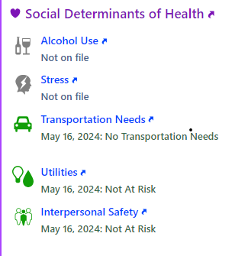
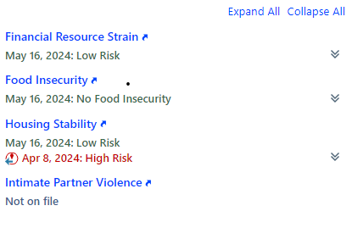
Birth Equity Journey
Successes
  Worked with system-wide task force to improve patient self-identification of race/ethnicity
  Embedded SDOH screening tool into L&D Nurse admission flowsheet
  Implemented the PREM survey permanently into discharge checklist
  Postpartum safety education implemented
  All RN and MD staff educated on respectful care practices and completed a mandated training module
  Obstetric and pediatric leadership completed longitudinal workshop-based anti-racism training
  Grant funding obtained to create a perinatal patient-engagement committee
  Respectful Care Breakfast held 2/22/2024

Slide 25
Respectful Care Breakfast
Getting ready
Patients were personally invited by a MD or CNM
  MFM group identified patients who delivered in the past year to invite, admitted PP patients, and patients who were visiting their infant(s) in ISCU invited
Staff (RN, MD/DO, CNM) were invited to attend breakfast via flyers posted on inpatient units (L&D, PP, ISCU) and in MFM office and an email invite was sent
Social work (perinatal family support team), Diversity and Inclusion staff were invited to attend via emails
Day of event
  Breakfast set up and decorations
  Check in, name tags, small group discussion at each table, panel discussion, patients not on the panel invited to also share their experiences
  Respectful care practices placed on each table in a stand
  Additional copies of respectful care practices placed on each table for attendees to take
  All attendees were thanked for their participation and asked to complete the feedback survey at the conclusion of the event

Slide 26
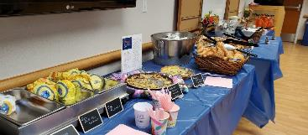
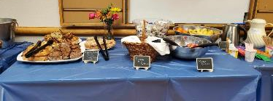
Respectful Care Breakfast 2/22/2024 @ 0745-0915
There were over 70 attendees including patients and care team providers. Patients shared honest feedback about their care.

Slide 27
Respectful Care Breakfast Survey Comments
Using translators to making sure we’re giving respectful care to our non-English speaking patients
Find a way in EPIC to identify what is the top priority to the patient so that all team members have access to that information easily
Listening to patients wishes more closely and finding ways to respect those wishes.
I felt terrible that a patient stated we didn’t listen and we didn’t follow through with her wishes. I never want that to happen again!
We can never listen too much, but we can listen too little if we don't actively listen and in the process, we may fail to accommodate for or validate patient experiences.

Slide 28
Respectful Care Breakfast Debrief
All feedback survey responses were compiled and sent via email to BE team for review
Team reviewed the responses and highlighted areas where improvements in respectful care could be made
All patient attendees were thanked for their participation via email follow-up, key takeaways from feedback and next steps were shared
Respectful care patient feedback and survey responses shared with all clinical staff
Staff reinvigorated to continue to strive for respectful care in every patient interaction!
  Respectful care practices reviewed at staff meetings

Slide 29
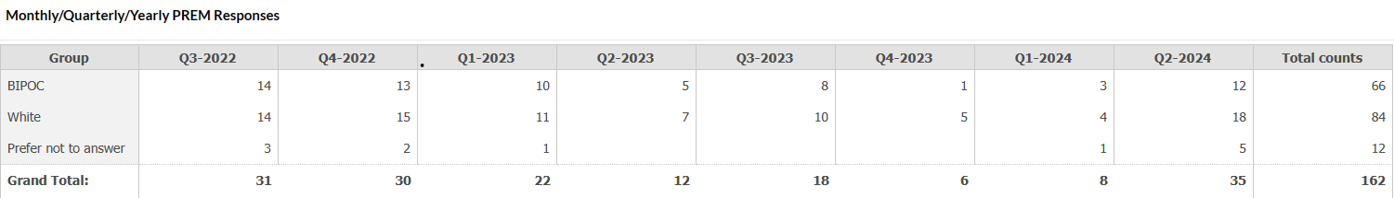
Birth Equity Journey
Challenges
  Completion of monthly audit data has been a challenge
  Low rates of patient completion of PREM surveys

Slide 30
Birth Equity Sustainability
Patient Partners
  Patient Partner identified in April 2024
  She will be invited to the Perinatal Advisory Council meetings moving forward.
  Innovation Grant funding obtained to compensate patient partners for their time.
  Initially challenging to find patients partners
Respectful Care Breakfast
  Events will be held twice yearly

Slide 31
Kyeshia Lewis
Ashley Polnitz, MSN, NE-BC, CLC
Nurse Supervisor, Carle Community Health Initiatives​
Carle Health, Urbana IL
Patient Partner
Carle Health, Urbana, IL

Slide 32


Birth Equities: Bridging the Gap
Innovative Approaches through Patient Advocacy
and Home Visiting Services
Ashley Polnitz
RN Nurse Supervisor, Co-Chair, Birth Equity Initiative

Slide 33


Carle Foundation Hospital
Urbana, IL

Slide 34
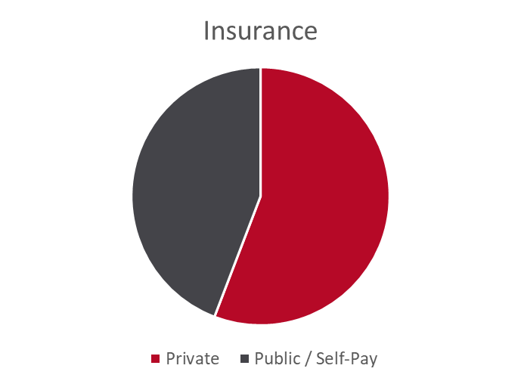
About Us
Level III Perinatal Center in Urbana, IL
  Antepartum, Labor/Delivery, LDRP, Postpartum, NICU Units
  2900 deliveries per year
Patient Demographics

Slide 35
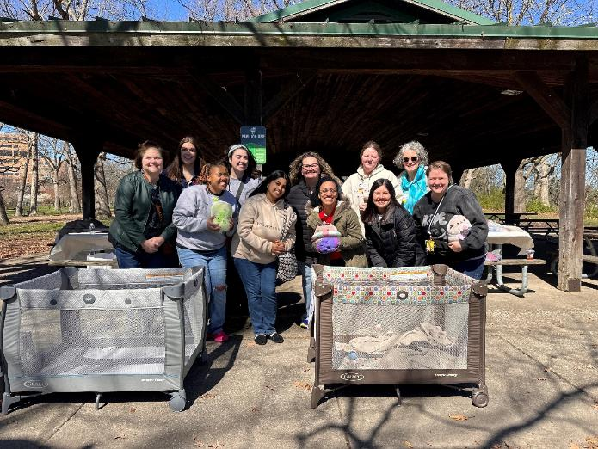
Our BE Team!
Interdisciplinary team members with a passion for improved experience and better outcomes: nursing staff and leaders in the inpatient, ambulatory, and community health setting for maternal-child health; social workers; midwives; MFM/OB providers; QI and outreach staff; educators; and more

Slide 36
What do we have?
Ambulatory / Inpatient OB Services
Integrated Home Visiting Services
ACCESS!
Notes:
Connecting ambulatory and inpatient services ensures continuity of care, integrated care teams, and streamlined referrals. With the addition of an integrated nurse home visiting service, we can gather additional information, sometimes even before it is captured in the clinic or inpatient setting. Moreover, we maintain long-term access to our clients with numerous opportunities for engagement, creating an ideal platform for successfully addressing and improving inequities within this population.

Slide 37
How Do We Use It?
Prenatal care
Home visiting services
Social work consults
Initiate Relationship
Offer support & education
Gather information
Link to necessary services
Communicate
Streamlined information sharing
Appointments/Admissions
Home Visits
Classes
Linkage to services
Data collection
PREM Survey
Client report
605 clients served
6,507 referrals
Notes:
Our system setup allows us to initiate relationships and engage with patients through various channels, whether they connect with their healthcare provider or our nurse home visiting service. Through these avenues, we provide comprehensive support and education about their care during visits and appointments, home visits, in-person and online classes. When additional support is needed, we link patients to necessary resources with the help of our social work and nurse home visiting team, leveraging strong community partnerships.
With all these services in place, we can gather a significant amount of information. Data metrics captured across all settings enable us to identify both successes and gaps in care.
Through SDoH screening, social work support, and engagement with patients in their unique settings, we can comprehensively identify the services needed. When implementing our SDoH tool, we were able to use the data captured to justify the need for a more detailed and comprehensive screening based on referrals we have made.

Slide 38
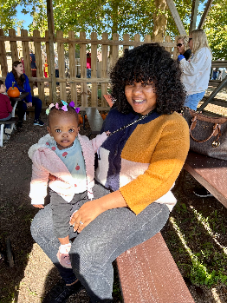
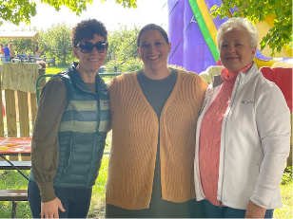
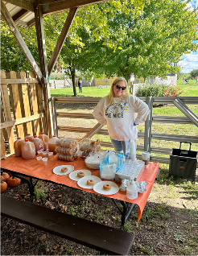
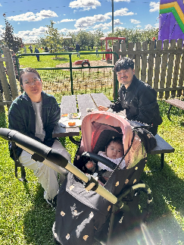
Respectful Care Event
Fall Family Engagement Event
  10/7/23 @ Curtis Orchard
Staff / Team Representation:
  Home Visiting Team
  Early Childhood Team
  Carle CNMs
  Carle Ambulatory Nurse
  Carle Inpatient L&D Educator
Families attended: 23 (87 total)
Feedback:
  3 electronic survey responses
  0 paper responses
2nd Attempt: 4/6/2024 @ Crystal Lake Park

Slide 39
What Have We Seen?
Improved communication across settings
  SDoH Screening
  EMR Access
Increased linkage to services
  Nursing and social work staff with strong community-based partnerships
Opportunity for a unique use of a Patient Advocate (Patient Partner)….
Notes:
SDoH screening between ambulatory and inpatient. Implementation in community setting is currently not live. While we have the capability to share information through various channels, there is still work to be done to make this process more efficient and streamlined. Although we have access to the EMR, policies and protocols for communication between departments and providers are still being refined."
Biggest Challenge: the platforms for sharing client experiences are limited, with minimal reporting through our patient relations department, hospital surveys, and even our PREM survey, despite an increase in completion rates. And as evident by our two events, there are better ways to elicit client feedback through in-person conversations and forums.

Slide 40
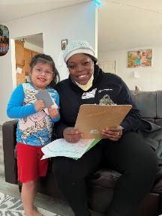
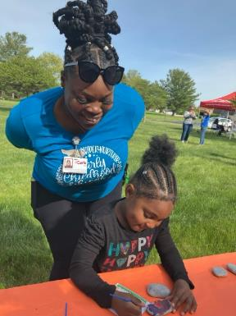
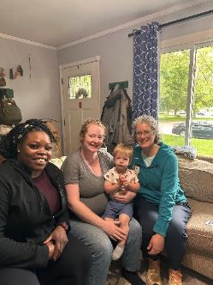
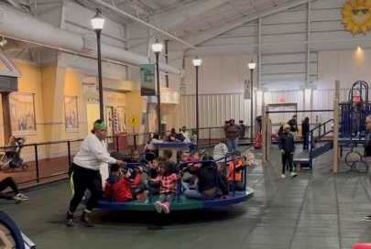
Where Do We Go?
Meet Kyeshia
Mother
Community Ambassador / Educator
Patient Advocate
Notes:
Talk about who she is and how she became an Advocate:
Employee of CHI home visiting
Previous client and graduate
Brief explanation of role (involvement in the home and relationship built with clients/families)
What do you hope to accomplish:
What you got from MommasVoice training
How your role can help in gathering more information by empowering clients to self-report, or by being a safe space alongside nurses to receive the information
Share stories with BE team to develop actions for change
Will plan to identify the best way to hold a successful event based on her success in running current CHI events

Slide 41
Future: What Do We Hope
Increased presence at future events
Increased PREM survey completion and experience sharing
Improved experiences = improved outcomes
"Patient advocacy is the cornerstone of compassionate healthcare, ensuring that every voice is heard, every need is met, and every patient receives equitable care."

Slide 42
Thank you!
  Ashley Polnitz, Nurse Supervisor, Home Visiting Services
  ashley.polnitz@carle.com
  Katie Southworth, Nurse Manager, Labor & Delivery
  katie.Southworth@carle.com

Slide 43
Shelly Shallat, MD, FAAP, CLS
Medical Director of Newborn Nursery, Newborn Hospitalist,
OSF Healthcare Children’s Hospital of Illinois, Peoria, IL
Erin Miller, BSN, RNC-MNN, PMH-C, CLS
Nursing Supervisor
Family Connects, Peoria County

Slide 44

OSF Saint Francis Medical Center Birth Equity Team and Family Connects Peoria County
5/22/24
Shelly Shallat MD FAAP CLS
Medical Director OSF SFMC Newborn Nursery
Erin Miller BSN RNC-MNN PMH-C CLS
Nursing Supervisor
Family Connects-Peoria County
Children’s Home Association of Illinois
Notes:
Good morning. We are tasked with discussing the impact of home visiting on Birth Equity work.

Slide 45
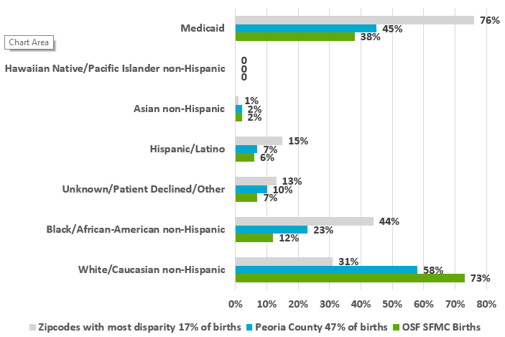
Will it Play in Peoria?
North Central Level III Perinatal Network Referral Center
  Serve over 25 counties
  65 bed Level 3 NICU
  Maternal Fetal Medicine
2,200 births a year
2 Birthing Hospitals in Peoria
Notes:
We are from Central Illinois, Peoria specifically. The population of peoria is about 100.000 people and our greater peoria area is 400,000 people. We are the north central perinatal network referral center with a 65 bed lvl3 nicu and 2200 births/year. Peoria is known from the vaudeville circuit as being representative of America – smaller scale. Our demographics reflect that. Our total births are primarily insured and white/Caucasian non Hispanic – but when you drill down to peoria county and a cluster of zipcodes surrounding the hospital – population shifts to primarily Medicaid and black/African American non- Hispanic. We are a very diverse community.

Slide 46
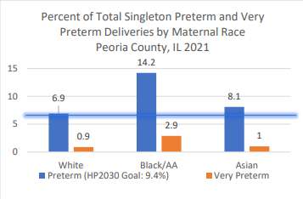

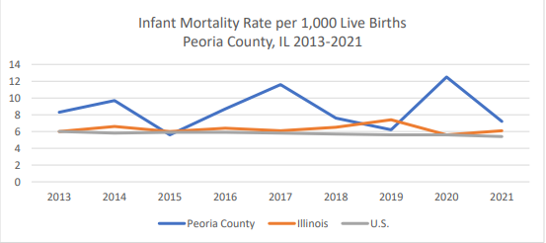
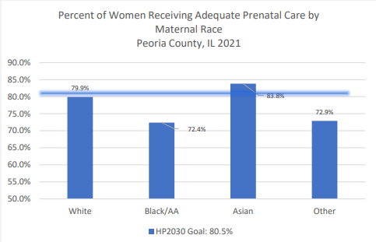
Notes:
Also similar to everywhere – we see the impact of disparity. The latest data available from Peoria county HD reveals a tragicly high rate of infant mortality and also reveals disparity in preterm births and access to adequate prenatal care when stratified by race and ethnicity with black families being disproportionately and negatively affected.

Slide 47
OSF SFMC Birth Equity Team
Chair and co-chair: Marie Lehman, Director of Women’s Services & Dr. Shelly Shallat, Medical Director of Newborn Nursery
Lisa Smith, Manager of Labor & Delivery
Amelia Lund & Ashley Long, Quality Safety Coordinators
Shelly Weaver & Macee Mills, Patient Experience Specialists
Ryan Sehring, Case Manager Supervisor
Linda Blackert, Data Analytics RN
Dr. Gretchen Kopec, Neonatologist
Desi Walker, Manager of Obstetrics Acute
Dr. Mary Stapel, Community Health Physician
Erin Miller, Manager of Family Connects
Lisa Richardson, RN Lactation Consultant
Heather Song, Faith Community Nurse
Universal SDoH Screening
PREM Survey
Equity Modules/Equity small group discussions
Respectful Care posters
Family Birthing Center Patient Advisory Council
Doula Connection
Provision of BP cuffs and virtual RN/APN follow up via OSF OB OnCall
Notes:
So – similar to everyone here – we have a birth equity team. Our team is led by Marie Lehman – Director of Women’s Services – we are lucky to have her. Here is our list of team members. Our activities are listed in the box on the right. Our focus today is to highlight the impact of incorporating home visiting on to your Birth Equity team. You see Erin Miller – Nurse manager of Family Connects Peoria County highlighted in red – and also sitting next to me.

Slide 48
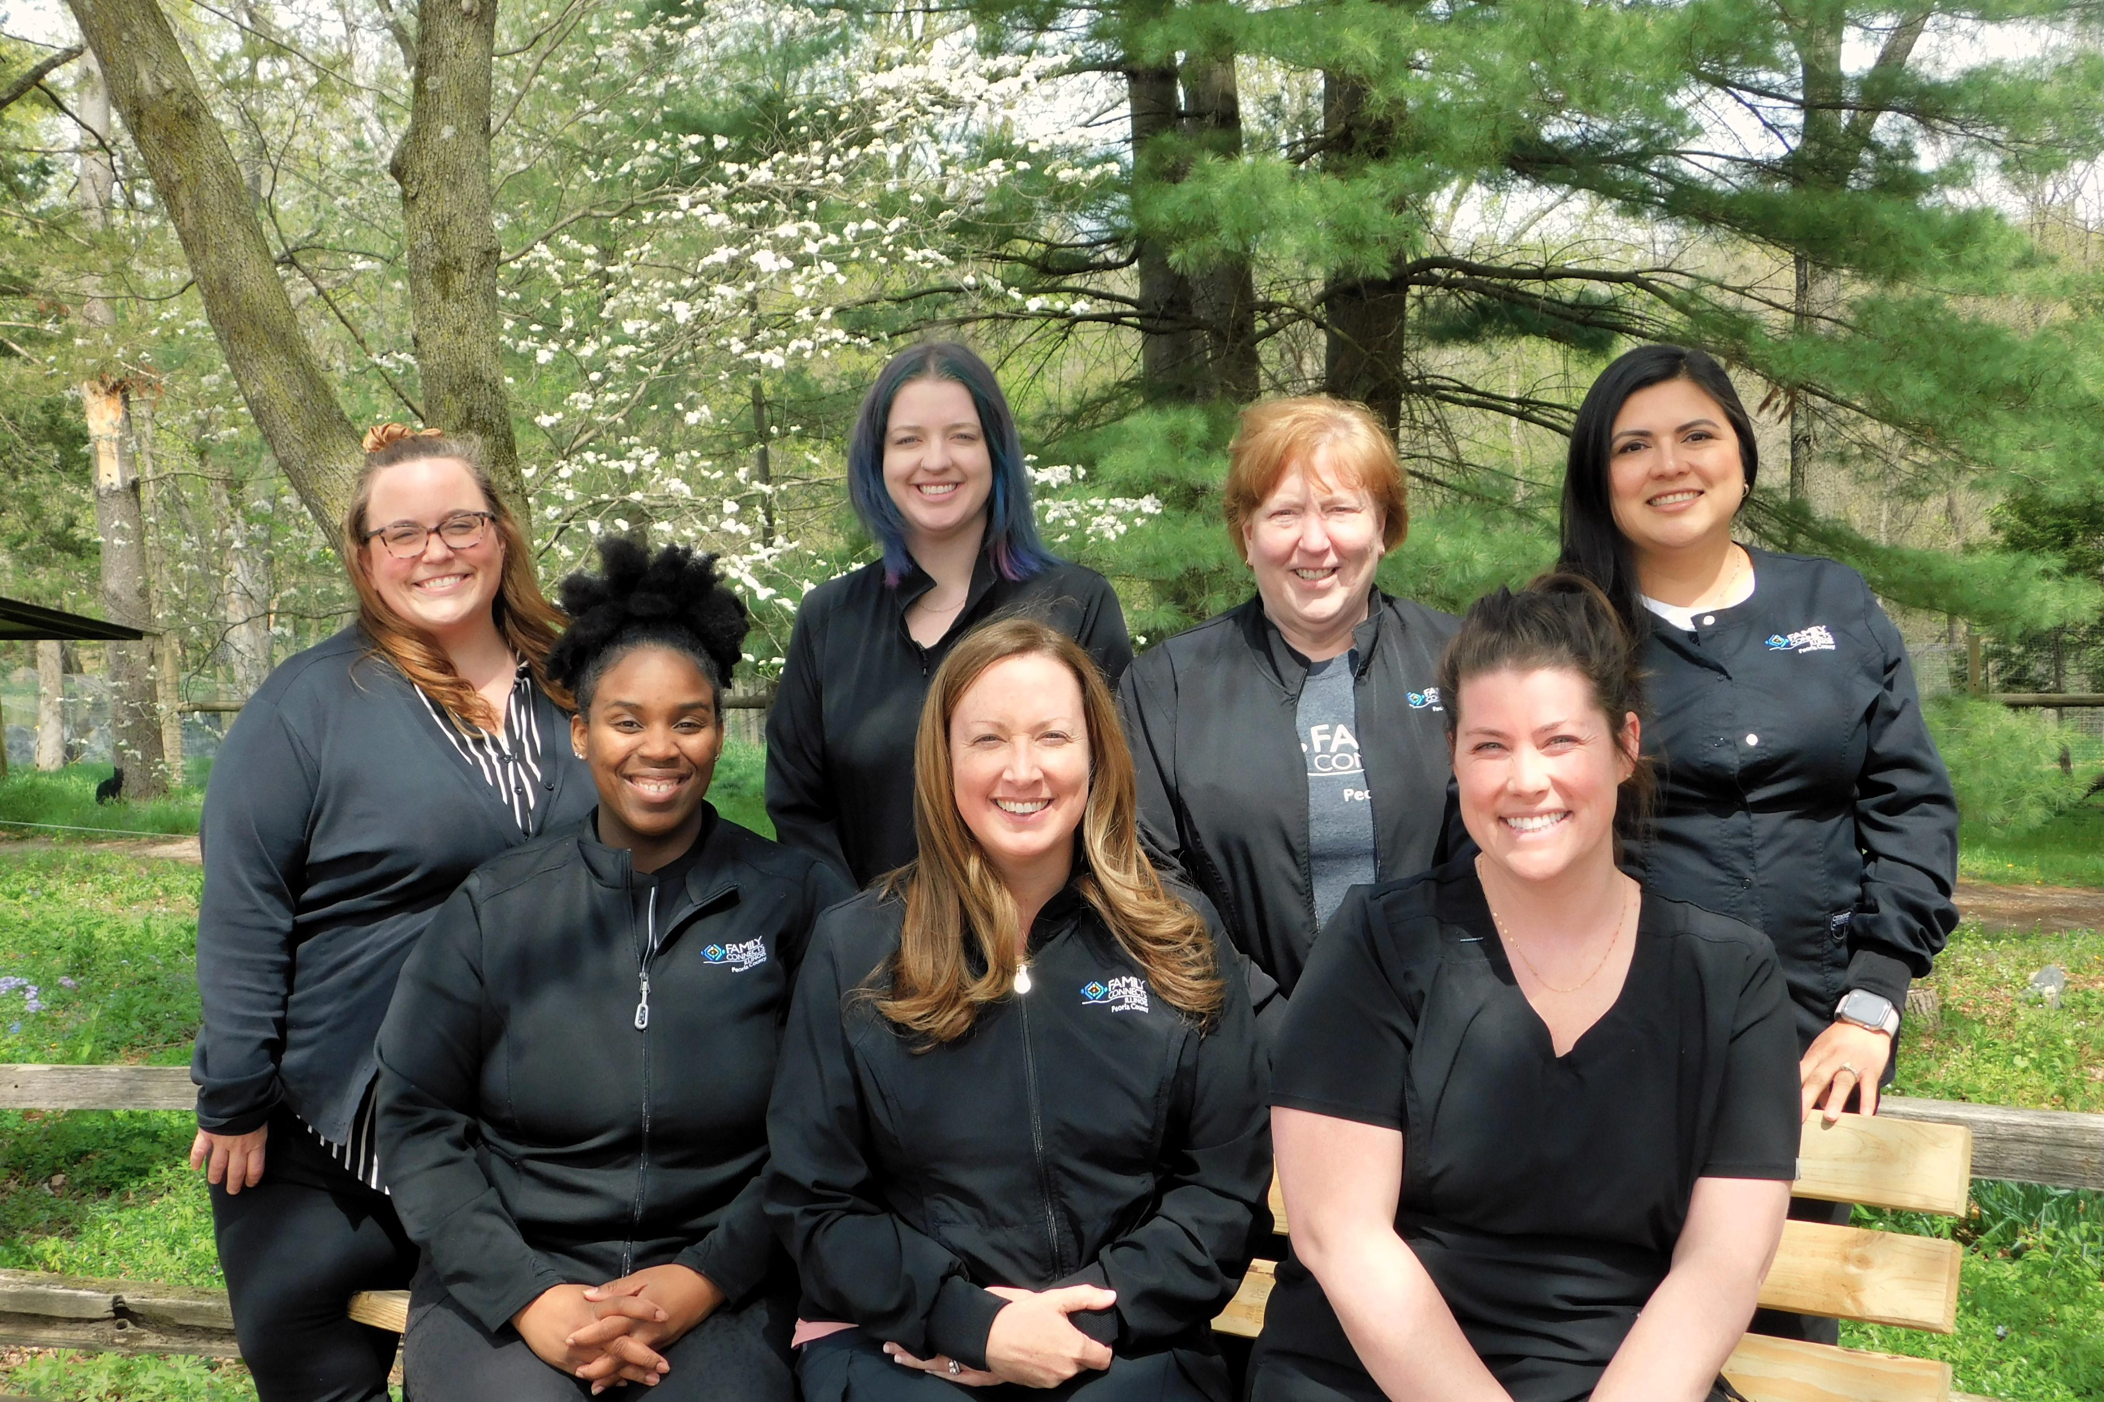
Family Connects Peoria County
Housed at the Children’s Home Association of Illinois since 2017
Funded by Start Early
Partners with both local birthing hospitals
Serves ALL Peoria County Births
  In 40% of Peoria County homes
Serves over 800 families/year with 400 visits in the zip codes with the most disparity
Meet families during birth stay to schedule their postpartum visit and complete home visit around 3 weeks postpartum
Notes:
Erin

Slide 49
Medical Impact
Comprehensive nurse home visits
Lactation visits
Blood pressure checks
Screen for Perinatal Mood Disorders
Connect to services for families with substance use disorders
Recognition of newborn pathology
Communicate with medical providers and assist in connections to medical homes
Notes:
Erin

Slide 50
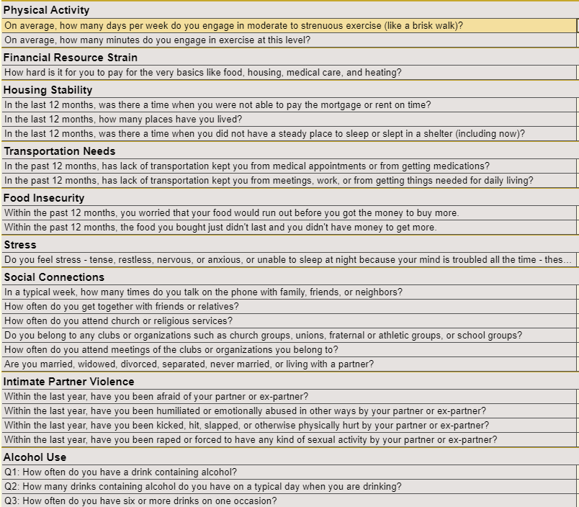
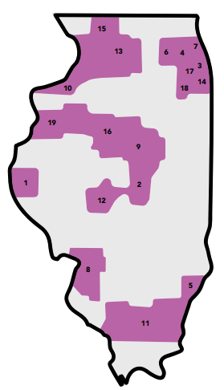


SDoH
Add to Case Management Support
  Extensive knowledge
  Connection to IRIS
  Go to homes post discharge
Notes:
Erin

Slide 51
Family Connects Referral Snapshot
Most Common Referrals
WIC
Long-term home visiting
Community health workers at FQHC
Child Care Resources & Referral team
Medical home (peds & OB)
Notes:
Erin

Slide 52
Projects
Birth Equity Team
Equity and Safe Sleep in Infants
Peoria County Infant Death Task Force
Peoria Pregnancy Connections – OSF, Carle, Peoria City County Health Dept, Family Connects Home Visiting, Heartland Health Services Federally Qualified Health Center
  Grant funded projects in collaboration with Illinois Public Health Institute and Illinois Chapter of the American Academy of Pediatrics
  >140 person list serve
  57 Central Illinois Home visitors in prenatal Ready, Set, Baby Curriculum
  Intensive prenatal support for 30 moms with focus on lactation education, connection to resources, outcomes. Federally Qualified Health Center Collaboration.
  74% engaged in a home visiting program when offered in-person at their prenatal visit by an embedded community outreach specialist
Notes:
in addition to medical and SDoH support discussed, the Family Connects team are active partners on our workgroups – ILPQC ones and others. Birht Equity, ESSI, we have a Peoria Co Infant Death Task Force. We collaborated across multiple entities to form Peoria Pregnancy Connections – of which Erin is a key leader of all activities. With grant funding from the Illinois Public health institute, We worked within the FQHC to embed home visitors, offer prenatal education, connect to home visiting programs and support. Of note – we found people were much more likely to engage in services when offered support relationally and in person versus telephonically.

Slide 53
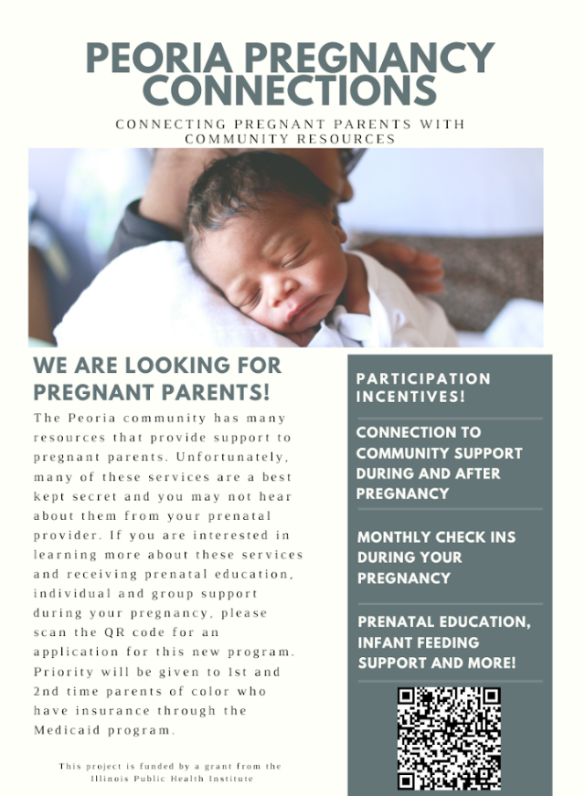
Notes:
This was the menu we developed and the sign up sheet. We started with one prenatal FQHC site within Heartland Health systems. They have spread the model and connection to 3 sites now. None of this would have been possible without family connects

Slide 54
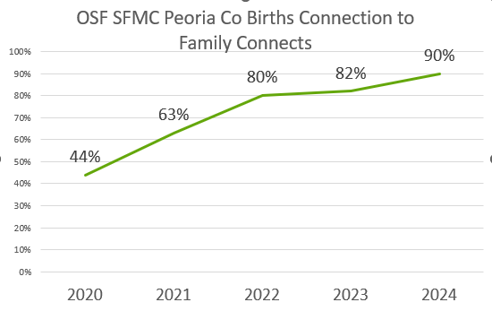
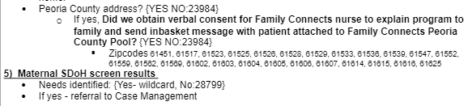
Logistics
Family Connects daily rounds (including weekends)
Limited EPIC access for receipt of referrals
Verbal consent obtained from families for Family Connects hospital visit
Hospital Visit
  Small gift
  Explain program/provide flyer
  Schedule 3 week visit
Connection with patients
  Pediatric Residents
    Send EPIC inbasket messages
    H and P documentation
    Rotate with Family Connects on Advocacy month
  Lactation Team
    EPIC inbasket messages
    Facesheets in a folder
Notes:
In regards to logistics – how do we connect FC to our birthing dyads? FC comes to our hospital everyday to meet with Peoria co families. Our pediatric and lactation team identify Peoria county families, obtain verbal consent for Family Connects to talk to them, document that, place an EPIC inbasket message referral. We have a back up system where lactation team prints facesheets as well. If it sounds complex and challenging – it is. We have made headway as you can see from the box in the upper right. Last month we actually connected 100% of our Peoria county births to talk to Family connects for the first time ever. Family Connects then meets the referred families during their hospital stay, provides a small gift. Explains program, schedules a visit for 3 weeks PP. If the family is discharged prior to the in-hospital meeting– they follow up telephonically.

Slide 55
Hospital and Staff Engagement
Family Connects Presentations
  Pediatric Department, Pediatric Resident Noon conference, OB Department, OB resident noon conference, Heartland Health Services, Case management team, OSF Medical Group
Agenda item/Quality Improvement Project
  Newborn Committee, Unit report out to hospital leadership
  Show connectivity rates, referrals, and stories
Posters hanging in breakrooms
Trifolds on the unit
Employed Family Connects Champions
Outpatient clinic referrals and relationship
Notes:
As Family Connects is a community agency – not employed by the hospital. Barriers to knowledge and connection. We have worked to inform hospital personnel about the program and build relationship. They present or are presented regularly at our pediatric meetings, OB meetings, FQHC meetings, and our outpatient providers have been educated as well. We have a QI project about our connectivity rates that we work on through our newborn committee. Our mom baby unit reports out FC successes, stories and activities to hospital leadership. We have posters, educational flyers and magnets. As time has passed, “home visiting” champions have emerged in different settings that connect and educate. Generally these are medical providers that have seen first hand the benefits of the program.

Slide 56
Impact
Universal SDoH Screening
  Offer additional support beyond hospital case management
  Post discharge - brings supplies, coordinates transportation, facilitates appointments, much more.
PREM Survey
Equity Modules/Equity small group discussions
Respectful Care posters
  Bilingual program navigator advocated for revisions to L and D Spanish signage
Family Birthing Center Patient Advisory Council
  Provided over half members
  One member presented impact of Home visiting to State of Illinois Women’s and Children’s Caucus
  Facilitates a monthly mom’s group at Peoria Playhouse invited OSF to gather voice of moms
Doula Connection
  Connected Doula’s with hospital and created slide deck for conversation
Provision of BP cuffs and virtual RN/APN follow up via OSF OB OnCall
  Perform medical assessments at 3 weeks postpartum- BPs, depression screens, lactation, weights
Bidirectional Wins
Notes:
The facts shared are important. I have so many stories of impact. Our FQHC called and asked them to go to home of client to make sure the patient had meds and was giving correctly, Family from East Moline – not Peoria, just moved from Chicago, had transportation needs and other children – FC coordinated referral to home visiting in their county. Family non English speaking being discharged with transportation and supply needs. Family connects person spoke Spanish, went to their house later that day – dropped off clothes, Pack and play, supplies. My stories go on and on. Very thankful for all they do -
Overall – in relation to headway made at OSF SFMC with the ILPQC Birth Equity project, this slide illustrates the same list shown initially – with direct impact of having Family Connects on the actual team. We screen for SDoH – consult case management FC offers additional supplies, transportation, appt help, go to homes. In regards to posters - this was not specifically the respectful care poster – poster in L and D. FC bilingual outreach worker brought to our attention sign did not make sense – it had been hanging there for some time. So- we changed it. we started a patient advisory council – over half of the members were referred from FC – one of them presented on home visiting to the Ill women;s and Childrens caucus here in Springfield. They have invited us to gather voice at a mom’s group they host. They provided us with a list of doulas, created a slide deck for OSF’s first formal meeting with the doulas. Similar to an OSF virtual program – they are in homes gathering BPS, screening for depression, gathering baby weights – connecting to the virtual program as well. Erin says the wins are bidirectional.

Slide 57
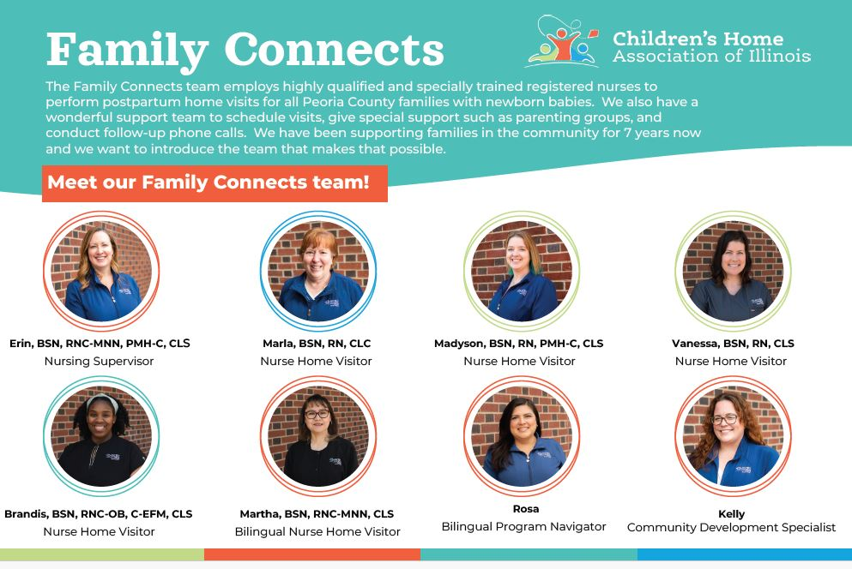
Lessons Learned
Only one county served – creates barriers for recognizing referrals and patient understanding/acceptance
Difficult to keep up with new staff/hires/cross coverage
Opportunity to improve predelivery discussion of program
Misunderstanding with Home Health
Working with home visiting has been overwhelmingly positive
The medical team learns about community resources
Ultimately – VERY comforting discharging families home with a warm handoff and to know someone is checking on them
Family Connects Peoria County
  Community resource experts
  Medical experts
  Committee experts
  CONNECTION experts
Notes:
Only one county served – creates barriers for recognizing referrals and patient understanding/acceptance
Difficult to keep up with new staff/hires/cross coverage
Opportunity to improve predelivery discussion of program
Misunderstanding with Home Health
Working with home visiting has been overwhelmingly positive
The medical team learns about community resources
Ultimately – VERY comforting discharging families home with a warm handoff and to know someone is checking on them
Family Connects Peoria County - Erin Miller leader
Community resource experts
Medical experts
Committee experts
CONNECTION experts
They are truly the connection between hospital and home.

