Slide 1



















Thanks to our Funders
CME Provider:
Supporters:
Notes:
Team, let's us this slide for sponsors

Slide 2
ILPQC
Neonatal Face-to-Face 2023
May 25, 2023

Slide 3



Welcome Back to Springfield, IL
1st in-person Face-to-Face Meeting since 2019!

Slide 4

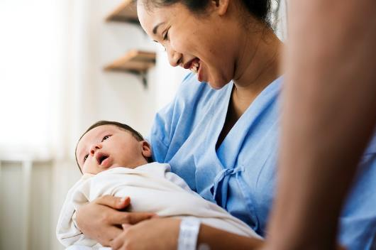
Illinois Perinatal Quality Collaborative
Neonatal Face-to-Face Meeting
Thursday, May 25th, 2023

Slide 5


Disclosures & Joint Accreditation Statement & eeds™ Information
In support of improving patient care, this activity has been planned and implemented by the Illinois Perinatal Quality Collaborative (ILPQC) and SSM Health. SSM Health is jointly accredited by the Accreditation Council for Continuing Medical Education (ACCME), the Accreditation Council for Pharmacy Education (ACPE), and the American Nurses Credentialing Center (ANCC), to provide continuing education for the healthcare team.
As a Jointly Accredited Organization, SSM Health is approved to offer social work continuing education by the Association of Social Work Boards (ASWB) Approved Continuing Education (ACE) program. Organizations, not individual courses, are approved under this program. Regulatory boards are the final authority on courses accepted for continuing education credit.
The speakers and planning team members report no relevant financial relationships.
Dr. Joseph Hageman’s disclosed financial relationship has been mitigated and will have no impact on the content being delivered during this conference.
Joseph Hageman, MD has disclosed a financial relationship with one or more ineligible companies whose primary business is producing, marketing, selling,
re-selling, or distributing healthcare products used by or on patients:
Owlet, Inc - Advisory Committee Member - Relationship Has Not Ended
5.00 education credits available for nurses, physicians, providers,
and social workers. Continuing education credits available for physician, nurse and social work attendees. *NOTE* CE credits must be claimed by no later than Monday, June 26th by 9AM CDT.

Slide 6


Obtain your Continuing Education Hours:
Must stay to the end of the event
QR codes to be distributed during wrap-up session at 3:15-3:30pm
Must complete evaluation online to receive your credits
*NOTE* Credits must be claimed by
June 26, 2023
5.00 education credits available for nurses, physicians, providers,
and social workers
Education credits sponsored by:

Slide 7
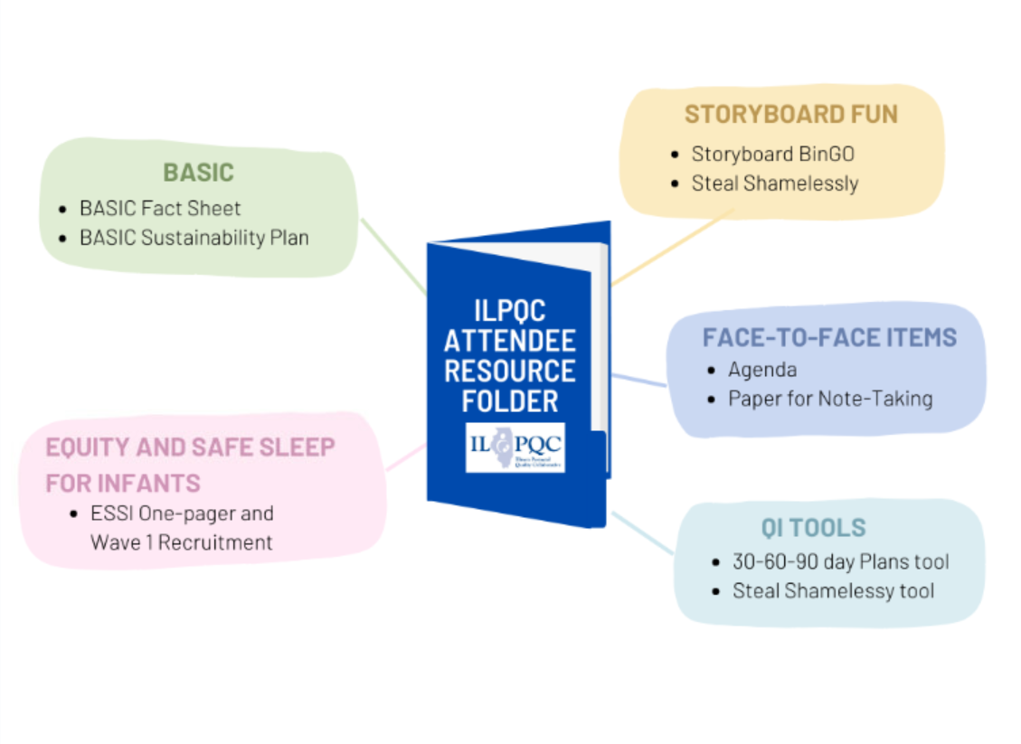
Face-to-Face
Resources
Resources also available at ilpqc.org

Slide 8
9:00-9:15am | Welcome and Overview of Day VIP Welcome: Dr. Sameer Vohra, Director of the Illinois Department of Public Health Leslie Caldarelli, MD and Justin Josephsen, MD Neonatal Co-Leads, ILPQC
9:15-9:45am | Celebration of a Successful BASIC Initiative Leslie Caldarelli, MD and Justin Josephsen, MD Neonatal Co-Leads, ILPQC
9:45-10:25 am | Team Storyboard Session: Opportunity to Share and Learn
10:25-11:10am | Health Equity for Infants: Start Where You Are Stacy D. Scott, Ph.D., MPA, GCSJ VP, Health Equity Innovation of National Institute for Children's Health Quality (NICHQ)
11:10-11:55am | Data Driven Approaches to SUID Prevention: from Surveillance to Safe Sleep Gina Lowell, MD, MPH Associate Professor, Department of Pediatrics, RUSH Medical College Co-Investigator for the CDC SUID Case Registry for Cook County Kyran Quinlan, MD, MPH Professor, Department of Pediatrics, RUSH Medical College Principal Investigator for the CDC SUID Case Registry for Cook County

Slide 9
11:55-12:30p | Networking Lunch
12:30-1:20p | Setting the Stage for the Equity and Safe Sleep in Infants (ESSI) Initiative Ashley Horne, MSPH Maternal and Child Health Epidemiologist at Illinois Department of Public Health Leslie Caldarelli, MD and Justin Josephsen, MD Neonatal Co-Leads, ILPQC
1:20-1:30p | Transition to Breakout Sessions
1:30-2:15pm | Breakout Session: Small Group Key Topic Discussions on Building Sleep Safety for Infants in Illinois Newborn Equity in a Quality Improvement Framework Facilitated by IL perinatal network administrators, educators, providers and nurses
2:15-2:30pm | Break/Transition to Breakout Sessions
2:30-3:15pm | Breakout Session: Small Group Key Topic Discussions on Building Sleep Safety for Infants in Illinois Newborn Equity in a Quality Improvement Framework Facilitated by IL perinatal network administrators, educators, providers and nurses
3:15-3:30 pm | Wrap-up and Next Steps in 2023 Leslie Caldarelli, MD and Justin Josephsen, MD Neonatal Clinical Co-Leads, ILPQC

Slide 10

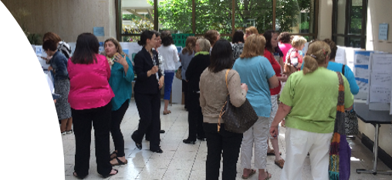
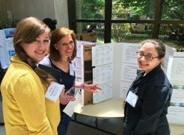
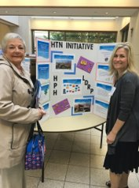
Located in your ILPQC F2F Folder

Slide 11
Breakout Sessions
1:30- 2:15pm
2:30-3:15pm
Building Sleep Safety for Infants in Illinois
Newborn Equity in a Quality Improvement Framework
Neonatal Breakout Sessions

Slide 12

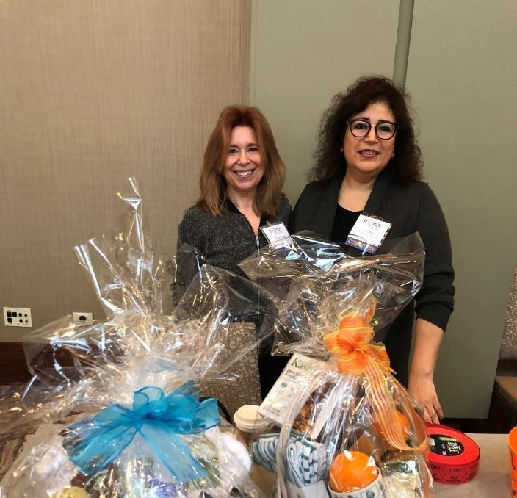
ILPQC 2023
Face-to-Face Raffle
Raffle will be held at the end of the day during Wrap-up session at 3:15-3:30pm
Every attendee received one raffle ticket during registration today
3 raffle baskets = chances to win
Must be present to win
This Photo by Unknown author is licensed under CC BY-SA.

Slide 13


But wait there's more....
Extra Raffle Ticket Fun!
Visit teams Storyboards and complete your BinGo card for another chance to win one of the amazing raffle baskets!
Located in your ILPQC F2F Folder
Opportunity to Get up and Storyboard BinGO ​

Slide 14
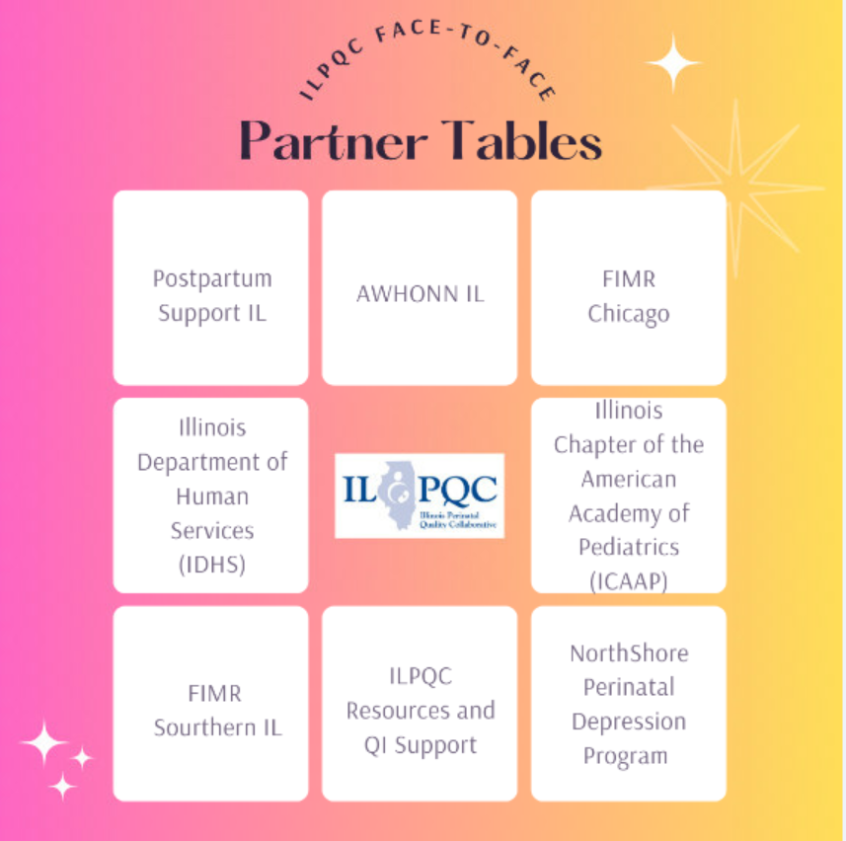
Make Sure
to Come & Visit
ILPQC's
Partner Tables
Open during Storyboard & Lunch Sessions
Located outside of the ballroom

Slide 15
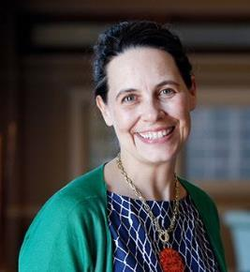
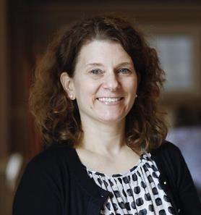
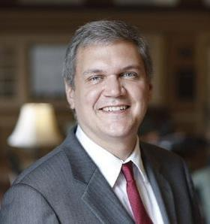
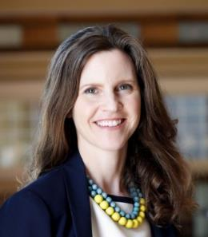
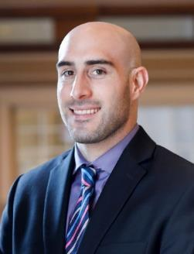
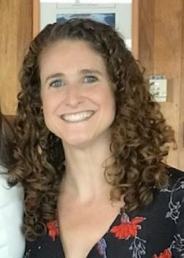
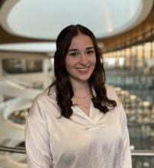
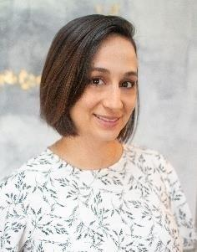
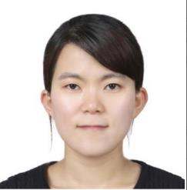
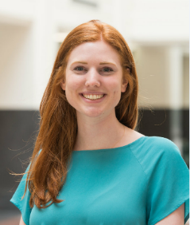
ILPQC Central Team
Ann Borders, MD, MSc, MPH: Executive Director, OB Lead
Leslie Caldarelli, MD : Neonatal Co-Lead
Justin Josephsen, MD: Neonatal Co-Lead
Patricia Lee King, PhD, MSW: State Project Director, Quality Lead
Daniel Weiss, MPH
Director of Data & Operations
Alana Rivera, MSN,
RNC-OB, C-EFM, CLC:
Nurse Quality Manager
Ellie Suse, MPH, MSN, RN: Project Coordinator
Aleena Surenan, MPH: Project Coordinator
Su Lee, PhD:
Postdoctoral Scholar
Emma Hegemiller, MS:
ILPQC Data System Team

Slide 16
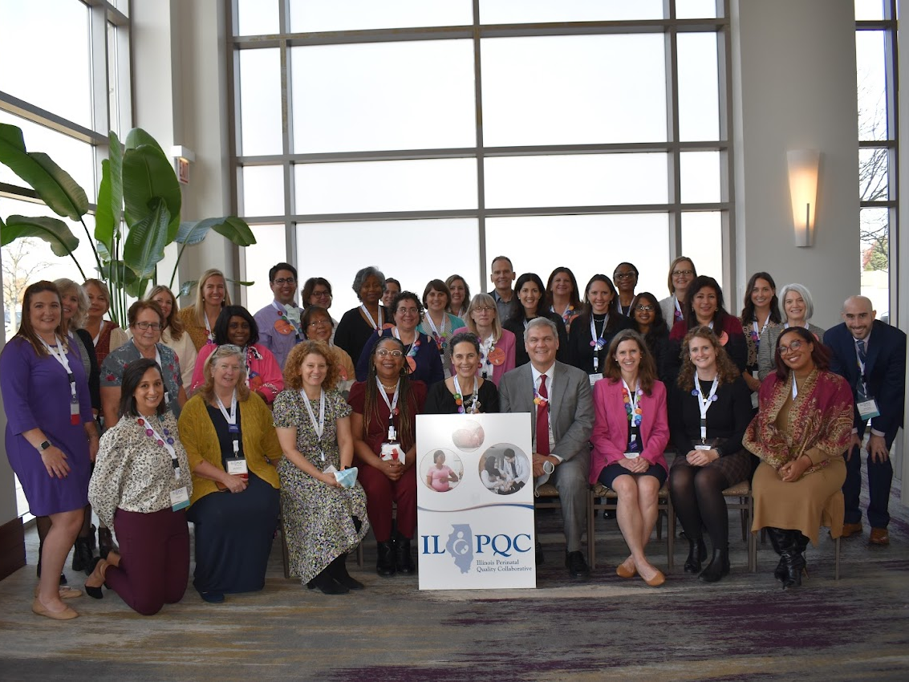
ILPQC
Statewide network of hospital teams, perinatal clinicians, patients, community partners, and public health leaders.
Committed to equitably improving outcomes and reducing disparities for birthing people and babies in Illinois.

Slide 17
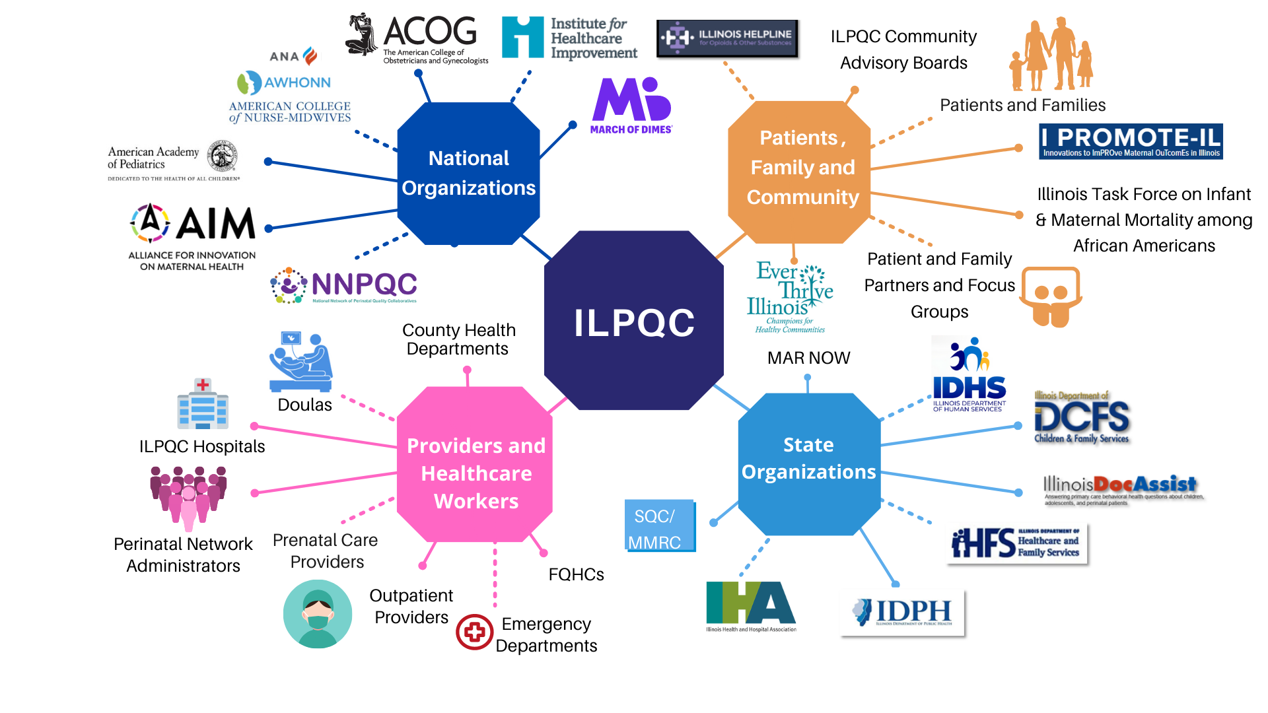
Together, WE ARE ILPQC!

Slide 19
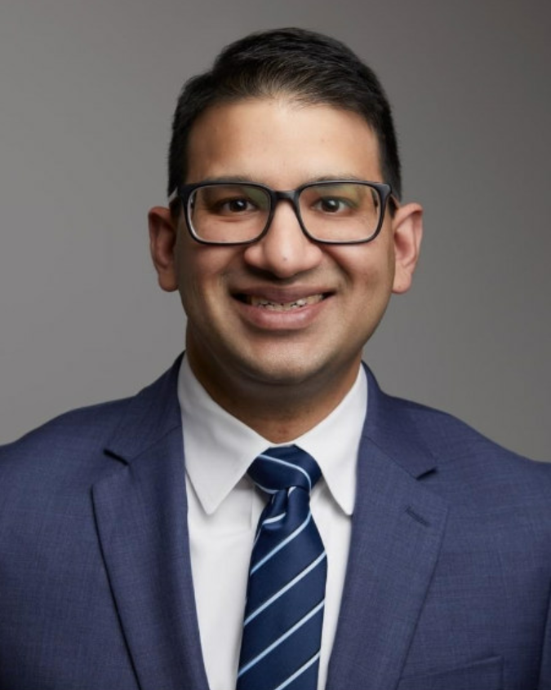
Welcome Address
Sameer Vohra, MD, JD, MA
Director of the Illinois Department of Public Health

