Slide 1
Setting the Stage for the Equity and Safe Sleep in Infants (ESSI) Initiative
Ashley Horne, MSPH
Maternal and Child Health Epidemiologist at Illinois Department of Public Health
Leslie Caldarelli, MD and Justin Josephsen, MD
Neonatal Co-Leads, ILPQC

Slide 2
Safe Sleep Prevention and Health Equity: Putting it All Together
Ashley Horne, MSPH
IDPH Office of Women’s Health and Family Services
ILPQC Neonatal Face-to-Face Meeting
May 25, 2023
Notes:
Today we are going to take you through what is going on in Illinois and how social determinants of health play a part in the disparities in sleep related death

Slide 3
Definitions
Infant Death
any live-born infant who dies within the first year of life
Neonatal Death: any live-born infant who dies during days 0-27 of life
Post-Neonatal Death: any live-born infant who dies during days 28-364 of life
Sudden Unexpected Infant Death (SUID)
Determined using death certificate cause of death
sudden infant death syndrome (SIDS) (ICD*-10* R95), ill-defined deaths (ICD-10 R99), and accidental suffocation and strangulation in bed (ICD-10 W75)
*International Classification of Diseases, 10th Revision

Slide 4
Definitions
Infant Mortality Ratio (IMR) | SUID Mortality Ratio (IMR-SUID)
The number of all infant deaths for every 1,000 live births | The number of infant deaths due to SUID for every 1,000 live births
$$\frac{\# deaths}{\# births}∗1,000=IMR$$ | $\frac{\# deathswith COD SUID}{\# births}∗1,000=IMR$-SUID

Slide 5
Data Sources: Vital Records
Birth Certificates
Any live born infant
Total live births = denominator in rates
Death Certificates
Deaths to live born infants
Cause of death listed based on ICD-10 codes
Fetal Death Certificates (Stillbirths)
Not used in Infant Mortality Rate calculation

Slide 6
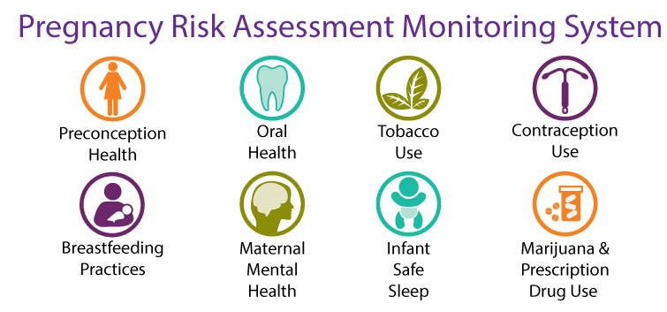
Data Sources: PRAMS
Pregnancy Risk Assessment Monitoring System (PRAMS)
Annual population-based survey
women who have recently delivered a live born infant in Illinois
Includes questions about safe sleep practices and risk factors

Slide 7
Infant Mortality by Cause of Death, 2017-2021

Slide 8
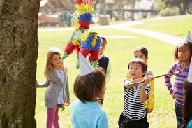
Breaking Down Disparities: Perinatal Periods of Risk

Slide 9
Illinois Infant Mortality Rate by Maternal and Infant Characteristics, 2017-2018 Birth Cohorts

Slide 10
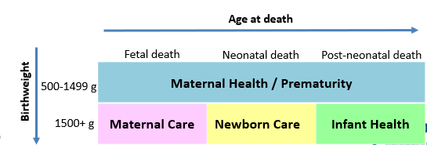
Reference Population
(Best Outcomes)
Target Population
(Worst Outcomes)
Non-Hispanic White , Age ≥ 20 years old,
Education ≥ 13 years
Non-Hispanic Black
4 Periods of Risk
Notes:
Example of PPOR with Racial disparities

Slide 11
Illinois Perinatal Periods of Risk Analysis
Mortality Rates for Low-Risk White Fetuses/Infants
1.2
1.0
0.7
0.6
Excess Deaths among Black Fetuses/Infants:9 deaths
per 1,000
Mortality Rates for Black Fetuses/Infants
4.7
3.0
1.4
3.5
Note: All rates expressed per 1,000 live births + fetal deaths
Data Source: Illinois Death, Birth, and Fetal Death Certificates, 2019-2020
* Some numbers may not exactly add up due to rounding errors
Notes:
This translates to an EXCESS mortality rate of 8.6 deaths per 1,000 among Black fetuses/infants.

Slide 12
Illinois Perinatal Periods of Risk Analysis
Mortality Rates for Low-Risk White Fetuses/Infants
1.2
3.6
deaths per 1,000
1.0
0.7
0.6
Excess Deaths among Black Fetuses/Infants:9 deaths
per 1,000
Mortality Rates for Black Fetuses/Infants
4.7
12.6 deaths per 1,000
3.0
1.4
3.5
Note: All rates expressed per 1,000 live births + fetal deaths
Data Source: Illinois Death, Birth, and Fetal Death Certificates, 2019-2020
* Some numbers may not exactly add up due to rounding errors
Notes:
This translates to an EXCESS mortality rate of 8.6 deaths per 1,000 among Black fetuses/infants.

Slide 13
Illinois Perinatal Periods of Risk Analysis
Mortality Rates for Low-Risk White Fetuses/Infants
1.2
3.6
deaths per 1,000
1.0
0.7
0.6
Excess Deaths among Black Fetuses/Infants:9 deaths
per 1,000
Mortality Rates for Black Fetuses/Infants
4.7
12.6 deaths per 1,000
3.0
1.4
3.5
Note: All rates expressed per 1,000 live births + fetal deaths
Data Source: Illinois Death, Birth, and Fetal Death Certificates, 2019-2020
* Some numbers may not exactly add up due to rounding errors
Notes:
This translates to an EXCESS mortality rate of 8.6 deaths per 1,000 among Black fetuses/infants.

Slide 14
If Black infants had the same mortality rates as low-risk White infants, 203 deaths would have been prevented each year
Period of Risk | Maternal Health & Prematurity | Maternal Care | Newborn Care | Infant Health
Excess Death Rate for Black Infants | 3.5 per 1,000 | 1.9 per 1,000 | 0.7 per 1,000 | 2.8 per 1,000
# Excess Deaths for Black Infants per Year | 79 | 44 | 16 | 64
Targets for Action | Pre-conception health Prenatal smoking Risk-appropriate care | Prenatal care High risk referral Obstetric care | Neonatal care NICU quality Pediatric surgery | Safe Sleep Breastfeeding Injury prevention
Data Source: Illinois Death, Birth, and Fetal Death Certificates, 2017-2018
Notes:
In total, this translates to a total of 212 EXCESS black fetal and infant deaths per year. This means that if the infants of black women had the same mortality rate as low-risk white women, 212 deaths would have been prevented each year.
Two red boxes account for nearly 70% of excess deaths among Black infants

Slide 15
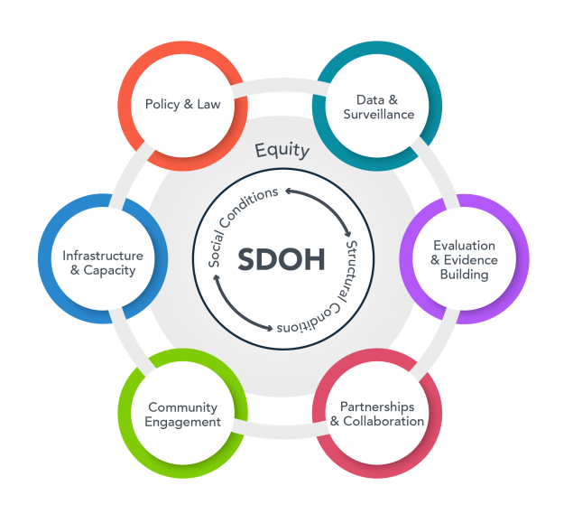
Safe Sleep + Health Equity Lens: Shifting the Narrative
Notes:
Thinking about de-stigmatizing safe sleep practies like de-stigmatizing SUD – there are structural factors and social determinnts of health driving population levelk disparities

Slide 16
SUID Prevention in Action
Notes:
Not inclusive of all activities!
Combination of state, local and national focys on safe sleep

Slide 17
SUID Prevention in Action
Notes:
Not inclusive of all activities!
Combination of state, local and national focys on safe sleep

Slide 18
SUID Prevention in Action
Notes:
Not inclusive of all activities!
Combination of state, local and national focys on safe sleep

Slide 19
SUID Prevention in Action
Notes:
Not inclusive of all activities!
Combination of state, local and national focys on safe sleep

Slide 20
SUID Prevention in Action
Notes:
Not inclusive of all activities!
Combination of state, local and national focys on safe sleep

Slide 21
SUID Prevention in Action
Notes:
Not inclusive of all activities!
Combination of state, local and national focys on safe sleep

Slide 22
SUID Prevention in Action
Notes:
Not inclusive of all activities!
Combination of state, local and national focys on safe sleep

Slide 23
SUID Prevention in Action
Notes:
Not inclusive of all activities!
Combination of state, local and national focys on safe sleep

Slide 24
Questions? ashley.horne@illinois.gov

Slide 25
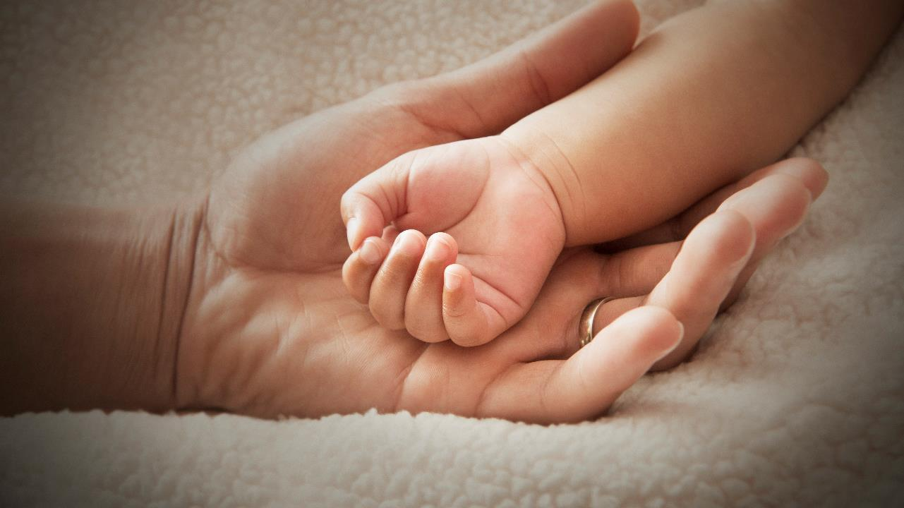
Looking to the Future The Foundation of the Next Neonatal QI Initiative
ILPQC is committed to continuing to equitably improve outcomes and reduce disparities for birthing people and newborns in Illinois.

Slide 26
Introducing our Next Neonatal Initiative

Slide 27
Next Neonatal Initiative
Equity and Safe Sleep in Infants

Slide 28
ESSI Initiative Vision
ILPQC has an opportunity to prevent infant deaths and reduce racial disparities through a quality framework. Our next initiative will address infant safe sleep environment, racial equity, social determinants of health, and other contributing factors. ​
The goal of the next ILPQC neonatal initiative is to better equip hospitals to address the issues that contribute to these disparities.

Slide 29
Putting it Together
Equitable Care Delivery
Neonatal Equity with a focus on a Safe Sleep Environment
Safe Sleep
Environment

Slide 30
Advancing a QI Initiative Together
ILPQC internal team
ILPQC hospital teams
Neonatal Community
Advisory Board
ESSI
Planning Group
Neonatal Advisory Workgroup

Slide 31
Neonatal Community Advisory Board
We are excited to have formed our first Neonatal Community Advisory Board to prioritize community input during the development of the initiative

Slide 32
Neonatal Community Advisory Board
Community partners representing diverse perspectives from around the state who meet regularly with ILPQC to collaborate on current and future quality improvement projects

Slide 33
Neonatal Community Advisory Board
Name | Organization
Timika Anderson and Keyonna Tompkins | Access Westside Healthy Start
Tia Britton | Outreach/Education Coordinator for ESL Healthy Start
Jennifer Graham and Erin Miller | Family Connects Peoria
Ashley Horne | IDPH
Nancy Maruyama | SIDS Illinois
Charisse Montgomery | Black Butterfly Doula and Grandmother
Jose Ortiz | FIMR Chicago
Bridget Patrick | FIMR East St. Louis, Program Manager
Kakuna Smith | Community Member, Bereaved Parent
Shanice Williams | Community Coordinator, Ingalls Memorial

Slide 34
ESSI Planning Group
A group made up of neonatologists, pediatricians, family practice providers, nurses, doulas, public health, and quality improvement professionals representing diverse perspectives from around the state who collaborate on the development and planning with the ILPQC Central team on the ESSI initiative

Slide 35
ESSI Planning Workgroup
Name | Institution
Stephanie Atella | ICAAP
Kyra Betts | Divine Flower Child Doula
Tonia Branche | Northwestern University
Paula Brodie | FIMR ESL
Andrea Cross | Stroger Hospital
Donna Lemmenes | UChicago
Cecilia Lopez | Carle & Carbondale
Jennie Pinkwater | ICAAP
Kyran Quinlan | Rush University Medical Center
Shelly Shallat | OSF St. Francis Medical Center
Jan Southard | Swedish American

Slide 36
ESSI will build on the foundation of the OB Birth Equity Initiative

Slide 37
ILPQC Birth Equity Initiative
Prioritized because of identified disparities in maternal health outcomes including:
Black women are about 3x more likely than white women to die during or within a year of pregnancy from a related complication
Compared to white women, all other racial and ethnic groups have higher rates of severe complications during pregnancy and in the year postpartum

Slide 38
ILPQC Birth Equity Engagement
81 OB teams have been participating in the Birth Equity Initiative since 2021
Aim: By December 2023, 75% of Illinois hospitals will have actively participated in the Birth Equity Initiative to address maternal disparities and promote birth equity

Slide 39
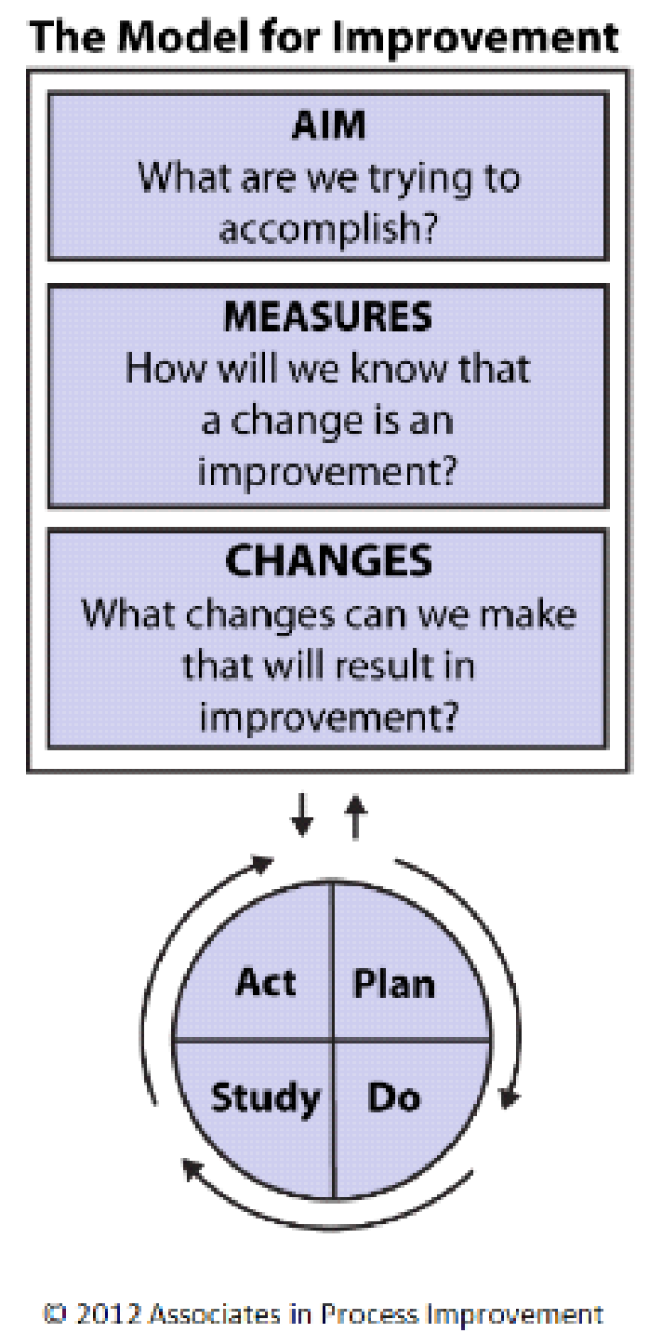
QI and SMART Aim for ESSI
SMART Aim
Specific
Measurable
Achievable
Relevant
Timebound
Langley GL MR, Nolan TW, Norman CL, Provost LP,. 2009
Notes:
Patti has slide for this

Slide 40
Draft ESSI Aims
By 2025, 80% of eligible infants will have an ESSI bundle completed.
ESSI Bundle:
Safe Sleep Awareness: Parents or caregivers reporting an understanding of a safe sleep environment prior to discharge
Safe Sleep Readiness: Completed Social Determinants of Health screening and linkage to appropriate resources
Safe Sleep Transfer of Care: Home safe sleep plan documented in the discharge summary
By 2025, 70% of Illinois birthing and children’s hospitals will have actively participated in the ESSI initiative to address disparities and promote neonatal equity.
Notes:
`

Slide 41
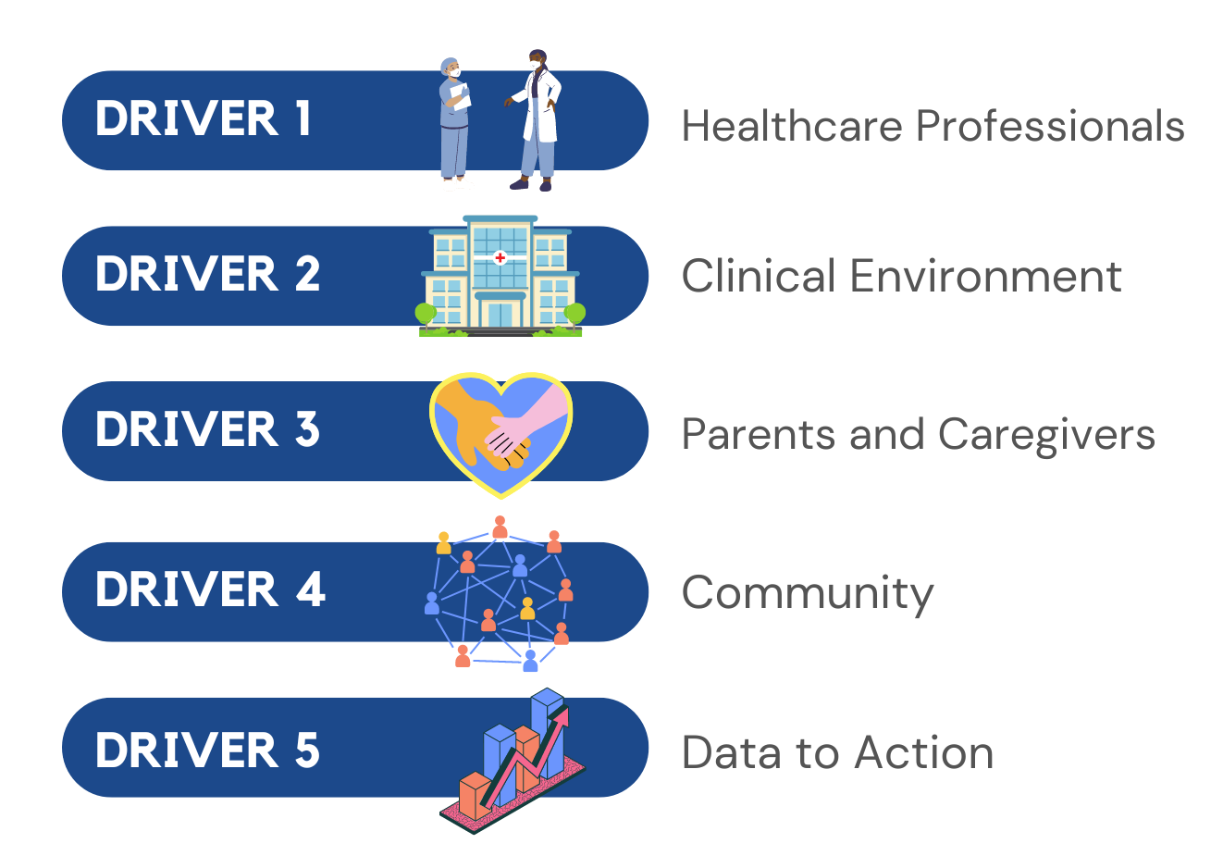
ESSI Key Drivers
Healthcare Data

Slide 42
Driver 1: Healthcare Professionals
Listening to parents and families
Providing respectful care and building trust
Addressing implicit bias and engaging in anti-racism
Promoting open discussions about equitable and respectful care
Having meaningful, culturally appropriate, respectful, nonjudgmental conversations about a safe sleep environment

Slide 43
Driver 2:
Clinical Environment
Obtain organizational leadership commitment to equitable and respectful healthcare delivery

Slide 44
Driver 3: Parents and Caregivers
Engage parents and caregivers in conversations to understand challenges and barriers to providing a safe sleep environment
Collect parent and caregiver feedback on their hospital experience
Review, share, and discuss feedback with providers nurses and other staff

Slide 45
Driver 4: Community
Partner with local community agencies, organizations, and champions to:
Understand challenges and barriers to a safe sleep environment
Support and endorse consistent safe sleep environment messaging and education

Slide 46
Driver 4: Community
Screen for social determinants of health
Connect parents and caregivers to needed resources
Coordinate family care plan to community provider if needed

Slide 47
Driver 5: Healthcare Data
Standardize processes for improving the collection and accuracy of reported race and ethnicity data
Standardize the processes to review, analyze, and share data stratified by race, ethnicity and insurance status
Develop strategies to address identified bias, inequities, and disparities

Slide 48
Draft ESSI Measures
Structure Measure: Standardize process to complete the ESSI Bundle
Process Measure: Percent of parents or caregivers reporting an understanding of a safe sleep environment prior to discharge
Process Measure: Percent of completed SDoH screening and linkage to appropriate resources
Process Measure: Percent of infants with a home safe sleep plan documented in the discharge summary

Slide 49
Draft ESSI Measures
Structure Measure: Standardized healthcare professional education about:
listening to patients, providing respectful care, addressing implicit bias and engaging in anti-racism
the importance of a safe sleep environment and engaging in meaningful, culturally appropriate, respectful, nonjudgmental conversations with parents or care givers about safe sleep

Slide 50
ILPQC ESSI Initiative Development
Winter 2023
Spring 2023
Collaboration with:
Neonatal Advisory
Neonatal CAB
ESSI Planning group
Driver Diagram development
Measure identification
Initiative strategy development
Summer 2023
Fall 2023
Toolkit development
Wave 1 data form testing
Recruitment of hospital teams
Initiative launch at Annual Conference

Slide 51
ESSI Launch Timeline

Slide 52
Wave 1 Teams needed!
What happens during Wave 1?
3-5 Monthly Webinars to review the data forms and measures
Testing data form with the QI Team at your hospital
Sharing and discussing you feedback on the data forms

Slide 53
Next Steps for Equity and Safe Sleep in Infants
Breakout Sessions
Wave 1
Neonatal Advisory
Birth Equity
Get ready to learn and share
Join to help test and improve the data forms
Join to help with initiative planning
Connect and collaborate with your BE Team
Notes:
Summary of Ashley. Lets go an conquer.
We have a problem.
ILPQC has an opportunity
You are part of the solution.
We CAN make a difference!
Start where we are. Here is what we can do today!
Go to your breakouts.
Breakout session;
Objectives here is what we hope youll achieve
Tell them about the logistics.

Slide 54
ILPQC Initiative Vision
ILPQC is planning our next neonatal initiative to better equip hospitals to address the issues that contribute to these disparities.
ILPQC has an opportunity to prevent infant deaths and reduce racial disparities through a quality framework. Our next initiative will address infant safe sleep environment, racial equity, social determinants of health, and other contributing factors.
Notes:
Also for breakout

Slide 55
The Birth of ESSI
You are part of the solution!
Using our ILPQC Collaborative QI methods we CAN make a difference!

Slide 56
Welcome ESSI
Arriving Late 2023

Slide 57
We look forward to continuing this great work together in 2023 and thank you for your continued support and dedication to make Illinois the best place to give birth and be born!

