Slide 1
ILPQC: Wrap-up & Next steps for 2023
2023 OB Face to Face Meeting

Slide 2
PVB 2023 Focus
Helping all PVB Teams Get Across the Finish Line
PVB monthly Webinars 4th Monday of the month
1-1 QI Support Calls with Ellie and Alana
Fallout reviews of all CS not meeting critiera
23.6%
All PVB teams to bring their NTSV C-Section Rates below 23.6% and sustain
70%
Increasing the % of NTSV C-Sections Meeting ACOG/ SMFM Criteria to >70%
23.6%
Identifying and addressing disparities in NTSV C-Section rates

Slide 3
Thinking ahead… What is next for BE teams?
Find the right path for your team on your Birth Equity journey
Create a 30/60/90 plan that works for you
Implement all key strategies by December 2023
Remainder of 2023 we will focus on:
SDOH screening/linkage to resources
Actionable Respectful Care Practices
Increase % PREM Survey Completion
Patient/Community Engagement, including a patient partner on your QI team
Notes:
Bring back in slide with 2023 priorities?

Slide 4
What’s Next for MNO: Sustainability
Sign up for DOPP to get FREE NARCAN KITS at your hospital
Develop a protocol to ensure patients with OUD are connected to MAR-NOW
Review your sustainability plan and make updates
Implement ideas from MNO-OB Breakout Session and Storyboard review
Notes:
Work with your team to sign up for DOPP to get FREE NARCAN at your hospital
Develop a protocol with your team to ensure pts with OUD are connected to MAR-NOW
Work with your team to review your sustainability plan and make any updates on protocol changes since 2022
Take notes from the MNO-OB Breakout Session and Storyboard review to bring strategies back to your team to implement!

Slide 5
What Can I Do Tomorrow?
Take a minute to reflect on today's general sessions, team panel, storyboards, and breakout sessions.
Write down one thing that you are going to do to work towards BE, PVB, and MNO-OB Sustainability improvement tomorrow/next week.

Slide 6
Thank You to our Speakers & Panelists!
Dr. Veronica Gillispie-Bell
Laura Smith
Elena Jenkins
Dr. Abbe Kordik
Anna Marzano
Danielle Wittig
Keri Schubert
Dr. Ebony Carter
Cheron Philips
Richelle Smith

Slide 7
Thank You Breakout Facilitators & Discussants!
Abbe Kordik​
Andrew Fisher​
Barrett Robinson​
Cheron Phillips​
Courtney Pemberton ​
Daniell Ashford​
Danielle Wittig
Deb Miller
Dina Kapogiannis
Ebony Carter
Elena Jenkins
Emily White VanGompel
John Holden
Julie Dervishoski
Kai Tao
Keri Schubert
LaShanda Jackson
Laura Smith
Linda Anderson
Mary Jarvis
Molly Cardwell
Nicole Gastala
Richelle Smith
Sandee Hayes
Sara Polonsky
Sherry Jones
Sogi Skariah
Tamara Smith
Veronica Gillispie-Bell
Facilitators and Discussants: Join us in the front of the ballroom after the meeting ends for a quick debrief on the breakout sessions

Slide 8
Thank You Planning Committee!!!
Ana Flores
Andrea Cross
Autumn Mels
Daniell Ashford
Deborah Miller
Donna Lemmenes
Joanne Sorce
Joseph Hageman
Keri Benbrook
Kshama Shah
Laura Peters
Mary Jarvis
Myra Sabini
Nenette Cacal
Sherry Jones
Sogi Skariah

Slide 10
Upcoming ILPQC Events
Event | Day/Time
BE Webinar: Key Takeaways from F2F Breakouts and Next Steps for Getting to Green on Key Strategies | Monday, June 5th at 12pm *moved earlier to honor Juneteenth*
PVB Webinar: Improving Failed Inductions Meeting ACOG/SMFM Criteria | Monday, June 26th at 12:30pm
BE QI Summer Series: Respectful Care Breakfasts Patient Partner on Your QI Team Linking Patients to Community Resources | Thursday, June 22nd Thursday, July 20th Thursday, August 24th

Slide 11
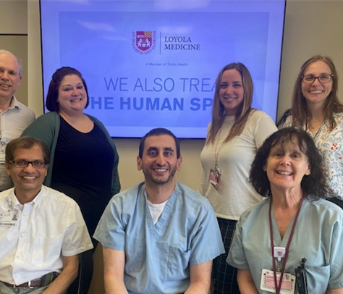
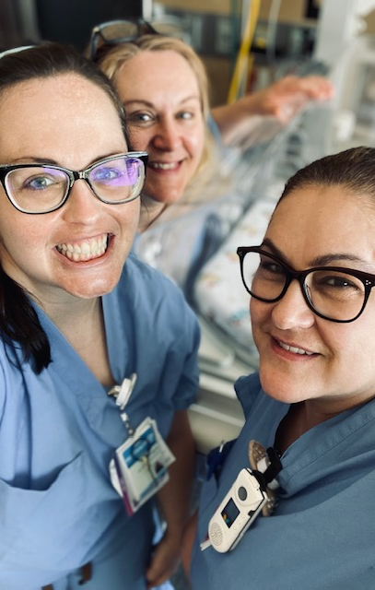
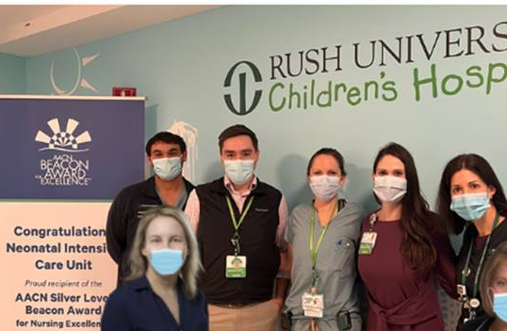
Join Us Tomorrow at 9am for the ILPQC Neonatal Face-to-Face Meeting
We have amazing speakers and a packed agenda including...
Celebration of a Successful BASIC Initiative
Health Equity for Infants: Start Where You Are
Data Driven Approaches to SUID Prevention: from Surveillance to Safe Sleep
Setting the Stage for the Equity and Safe Sleep in Infants (ESSI) Initiative
Breakout Sessions:
Building Sleep Safety for Infants in Illinois
Newborn Equity in a Quality Improvement Framework
We hope to see you there!

Slide 13
Thanks to our Funders
CME Provider:
Supporters:
Notes:
Team, let's us this slide for sponsors

