Slide 1
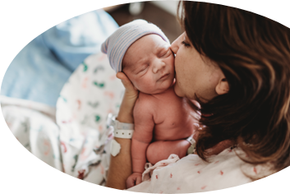
ILPQC: Wrap-up & Next Steps for 2023
2023 Neonatal Face-to-Face Meeting

Slide 2
What’s Next for BASIC: Sustainability
Work with your hospital team to complete your BASIC Sustainability Plan and submit it to ILPQC and your network administrator by June 30, 2023
Continue monitoring your achievements for changes
Take notes from the Storyboard Session back to your team to implement

Slide 3
What Can I Do Tomorrow?
Take a minute to reflect on today's general sessions, team storyboards, and breakout sessions.
Write down one thing that you are going to do to work towards BASIC sustainability and the next neonatal initiative, ESSI, tomorrow or next week.

Slide 4
Wave 1 Teams needed!
What happens during Wave 1?
3-5 Monthly Webinars to review the data forms and measures
Testing data form with the QI Team at your hospital
Sharing and discussing you feedback on the data forms

Slide 5
Thank You to our Amazing Speakers!
Ashley Horne
Dr. Gina Lowell
Dr. Kyran Quinlan
Dr. Stacy Scott

Slide 6
Thank You Breakout Facilitators & Discussants!
Dr. Kyran Quinlan
Dr. Joseph Hageman
Dr. Gina Lowell
Natosha McEvers
Adelaide Caprio
Donna Lemmenes
Dr. Ann Borders ​
Dr. Patti Lee King​
Ashley Horne
Aleena Surenian
Dr. Stacy Scott

Slide 7
Thank You Planning Committee!!!
Ana Flores
Andrea Cross
Autumn Mels
Daniell Ashford
Deborah Miller
Donna Lemmenes
Joanne Sorce
Dr. Joseph Hageman
Keri Benbrook
Kshama Shah
Laura Peters
Mary Jarvis
Myra Sabini
Nenette Cacal
Dr. Sherry Jones
Sogi Skariah

Slide 8
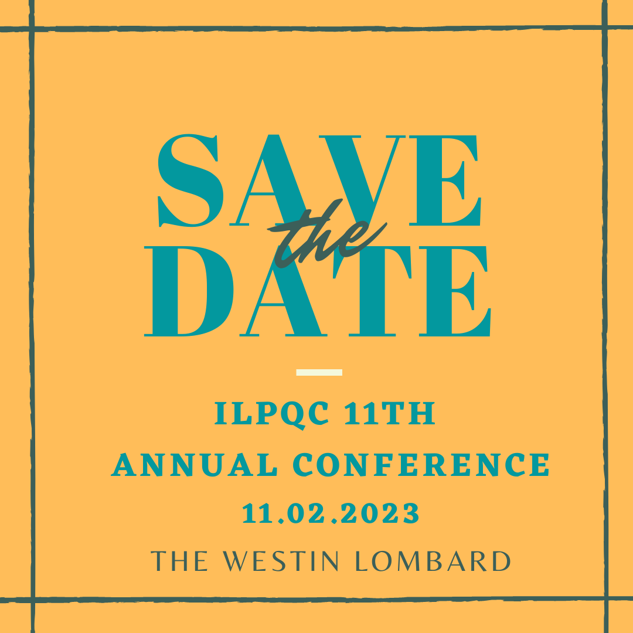

Slide 10
Thanks to our Funders
CME Provider:
Supporters:
Notes:
Team, let's us this slide for sponsors

