Slide 1
Louisiana Perinatal Quality Collaborative (LaPQC): Achieving Safe, Equitable, and Dignified Births
Veronica Gillispie-Bell, MD, MAS, FACOG
Medical Director, Louisiana Perinatal Quality Collaborative and Pregnancy Associated Mortality Review

Slide 2
LaPQC: Achieving Safe, Dignified Equitable Births
Veronica Gillispie-Bell, MD, MAS, FACOG
Medical Director, Louisiana Perinatal Quality Collaborative and Pregnancy Associated Mortality Review

Slide 3
Disclosures
AbbVie, Inc – consultant and speaker’s bureau
Bloomlife, Inc - consultant

Slide 4
LaPQC Equity Journey
How It Started
How It’s Going

Slide 5
What is the LaPQC?
The LaPQC is a network of perinatal care providers, public health professionals, and advocates who work to improve outcomes for birthing persons, families, and newborns in Louisiana

Slide 6
Safe Births Initiative
What is a safe, equitable, dignified birth?
A safe birth is one where evidence-based best practices are employed by health care providers at all levels in an effort to increase readiness, decrease response time, and ensure high quality communication across a care team
An equitable birth is one where best practices are not only employed with every patient, every time, but that birthing persons of color – particularly Black and African American birthing persons – are given access to the life-saving and sustaining resources they need throughout the birthing process
A dignified birth is one where, throughout the birth process, birthing persons experience timely and accurate communication with their health care providers, are acknowledged as informed health care consumers, and are included in decision-making about their health care.

Slide 7
Why should state Perinatal Quality Collaboratives focus on equity?

Slide 8
You Cannot Have Quality Without Equity
The Institute of Medicine defines quality as “the degree to which health services for individuals and populations increase the likelihood of desired health outcomes and are consistent with current professional knowledge”
Equity
Safe
Effectiveness
Patient-Centered
Timely
Efficient
Notes:
The IOM has identified six domains to achieve quality. Initially, equity was a separate domain. They have since revised the domains as they understand equity has to be woven into all domains to achieve quality care

Slide 9
Quality Improvement Science
It takes 17 years for translational research to go into practice at the bedside WITHOUT improvement science. WITH improvement science, it takes 3 years
Evidence based medicine tells us the “what and why” and Improvement science tell us the “how”
Source How to Improve. Science of Improvement: Test Changes. http://www.ihi.org/resources/Pages/HowtoImprove/ScienceofImprovementTestingChanges.aspx.

Slide 10
What is equity?

Slide 11
Equity
“Health equity is the state at which everyone has a fair and just opportunity to attain their highest level of health”
Achieving equity means having the same quality of care
Health disparities are the measure of health equity

Slide 12
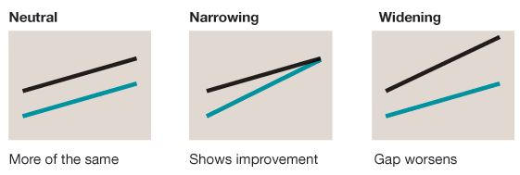
Equitable Care = same QUALITY of care
35.0
*Finding Answers: Solving Disparities through Payment and Delivery System Reform; solvingdisparities.org
Notes:
Equitable care does not mean providing the same care for everyone. Equitable care means providing the same QUALITY of care. Sometimes, it means providing different care

Slide 13
How do you achieve equity?

Slide 14
Many Steps, Not Just One Action
Awareness
Understanding own bias
Developing skills and interventions
Disrupting systems

Slide 15
Awareness
Rely on the data
Stratify process and outcome measures to show disparities in care and outcomes

Slide 16
Increase Awareness by Creating a Culture of Equity
Talk about it!
Bake it into everything you do!
RACE Framework
Reduce anxiety by talking about race
Accept that race is either visible or invisible
Call on internal and external allies
Expect that you will need to provide answers or plans
Ref

Slide 17
Use the Data for Awareness
Looking through a lens of equity, identify causes of disparities and prioritize how to address them
Must stratify data to identify the disparity

Slide 18
Understanding own bias
Implicit Association Test
Education on implicit bias
Addressing bias
See people as individuals
Recognize your belief as a stereotype
Increase opportunities to have contact with individuals from different groups
Empathy
Notes:
For Birth Ready Designation:
Identification of disparities in care and how disparity impacts maternal and
infant health outcomes;
• How to decrease health disparities at the interpersonal and facility levels;
• Historical sources of health disparities;
• How to effectively communicate and establish transparency across identities,
including racial, ethnic, religious, geographic, and gender identities;
• Community perspectives and resources from diverse, local constituency groups
and experts;
• Case studies that highlight the impact of health disparities and how they might
be addressed.

Slide 19
Implicit Bias Training: Key Components
How to decrease health disparities at the interpersonal and facility levels
Historical sources of health disparities
How to effectively communicate and establish transparency across identities, including racial, ethnic, religious, geographic and gender identities
Community perspectives and recourse from diverse, local constituency groups and experts
Case studies that highlight the impact of health disparities and how they might be addressed

Slide 20
Developing Skills and Interventions
Mechanism for Patients/Family to Provide Feedback that Leads to Tests of Change
Implement a Validated Tool to Measure Respect
Staff Training in Family-Centered Care

Slide 21
Validated Tools for Measuring Respect
Mothers Autonomy in Decision Making Scale
Mothers on Respect Index
Mistreatment Index

Slide 22
Family Centered Care Training
Patients are partners in their decision-making with healthcare providers and staff;
Reliable, evidenced-based patient education;
Transparency between the pregnant woman and her family/partner;
Mothers and babies should stay together (rooming in);
Labor support encouraged (doula, freedom of movement, birthing plan);
Birthing persons are primary care providers for newborn;
Routine interventions that are unsupported by scientific evidence should be avoided;
Physiologic birth and nonpharmacologic methods of pain management;
Skin-to-skin contact immediately after birth;
Exclusive breastfeeding should be standards of practice.

Slide 23
Disrupting Systems
Systems produce exactly what they are designed to produce
Disruption of the hierarchy

Slide 24
Disrupting Systems
Patient or Family Partner on the Improvement Team
Optimize Unit and Organization for Health Disparity and Patient Partnership
Implement Universal Screening for Social Determinants of Health*

Slide 25
What does that look like in practice?

Slide 26
Awareness
Louisiana Maternal Mortality Review Report
Leading causes of pregnancy-related maternal mortality: hypertension and hemorrhage
4 Black women die at a rate of every 1 white woman
RMMI Aims
achieve a 20% reduction in severe maternal morbidity in patients who experience a hemorrhage and/or severe hypertension in participating birth facilities between August 2018 and May 2020.
narrow the Black-white disparity in these outcomes in the same time period.
Notes:
In Louisiana, our disparities data was first highlighted in our maternal mortality report. In August 2018, the Louisiana Maternal Mortality Review Report was released. This report reviewed maternal deaths from 2011-2016. It was an expedited reviewed so only included pregnancy-related and only up to 42 days after delivery. However, this review revealed hypertension and hemorrhage as the leading clinical causes of maternal mortality, and 45% of those deaths were seen to be preventable. Additionally, this review revealed 4 Black women die at a rate of every 1 white woman. As a result, the RMMI was formed with the aim of reducing SMM in women who experience a hemorrhage and/or hypertension. Because our PAMR and PQC are both programs under the Bureau of Family Health in the Louisiana Department of Health, we work, collaboratively, to guide each other’s initiatives and areas of focus

Slide 27
Awareness
Getting on the same page and speaking the same language
Learning Session on Health Equity
CEO discussion on addressing equity
Understanding drivers of inequities
Implicit bias
Structural racism and SDoH
Notes:
Made equity a priority. Equity is part of our AIM, it is part of our fabric, it is part of who we are.

Slide 28
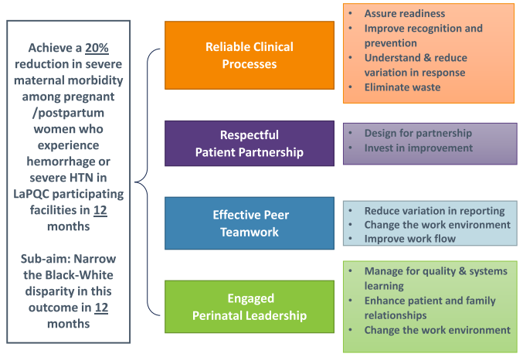
Developing Skills and Interventions
Reliable Clinical Process
Must stratify data to determine if a disparity exists
Respectful patient partnership
Design for partnership in care delivery and transparent communication for trust
Effective Peer Teamwork
Addressing microaggressions and creating a culture of respect
Engaged Perinatal Leadership
Investing resources for change
Notes:
A Driver Diagram is a visual display of a team’s theory of what “drives”, or contributes to, the achievement of a project aim
From the Driver Diagram, we build “change ideas”. Transparent communication is one we have focused on with our teams. We have encouraged and assisted them in ways to debrief with patients, especially in severe hemorrhage and severe hypertensive cases. In May, we had a topic call given by a risk attorney to help our teams.

Slide 29
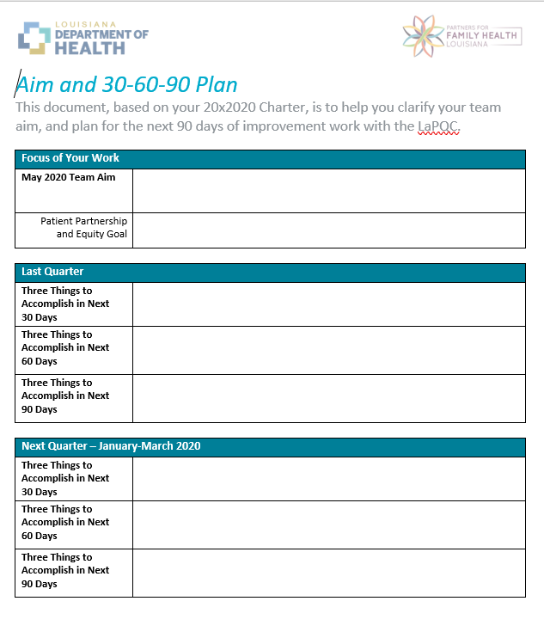
Designing Skills and Interventions
Charter Chats
30-60-90 Day Plan
Patient Partnership and Equity Goal
Notes:
Patient Partnership and Equity Goals range from having a patient review and critique discharge instructions to establishing a patient partnership

Slide 30
Louisiana Birth Ready Designation
Participation
Equity and Patient Partnership
Policy and Procedure
Structure Measures and Education
Outcome and Process Measures
Notes:
Implicit bias training for nurses and providers
Mechanism for patients/family to provide feedback that leads to tests of change
Patient or Family Partner on Improvement teams
Staff training in family-centered care

Slide 31
Reducing Maternal Morbidity Initiative
Hemorrhage
SMM overall: Decreased by 35%
SMM among non-Hispanic Black persons: Decreased by 49%
SMM among non-Hispanic white: Decreased by 16%
Hypertension
SMM overall: Decreased by 12%*
SMM among non-Hispanic Black: Increased by 8%
SMM among non-Hispanic white: Decreased by 31%
*prior to COVID-19, the reduction was 22%

Slide 32
Reducing Maternal Morbidity Initiative
Risk assessment on admission
Increased by 78.3%
Quantification of blood loss at delivery
Increased by 171.8%
Patients receiving timely treatment of hypertension
Increased by 210.8%

Slide 33
Quicksand
Don’t move too fast
Make the vision clear and communicate it often
Meet people where they are
Anticipate resistance, it’s part of the change process
Notes:
70% of organizational change efforts fail b/c the level of resistance was underestimated, pace of change was too fast or people felt the change was forced on them

Slide 34
Summary
Equity must be at the forefront
State perinatal quality collaboratives can lead the charge
It takes many steps, not just one action to address equity

Slide 35
References
Braveman, P. A. et al (2011). Health disparities and health equity: the issue is justice. American journal of public health, 101 Suppl 1(Suppl 1), S149–S155. https://doi.org/10.2105/AJPH.2010.300062
Pregnancy Mortality Surveillance System. Division of Reproductive Health, National Center for Chronic Disease Prevention and Health Promotion. https://www.cdc.gov/reproductivehealth/maternal-mortality/pregnancy-mortality-surveillance-system.htm. Last accessed on November 12, 2022.
Laurie Zephyrin, M.D., and Eugene Declercq, Ph.D., "Measuring Maternal Mortality," To the Point (blog), Commonwealth Fund, Feb. 6, 2020. https://doi.org/10.26099/c14w-nq52. Last accessed on November 12, 2022.
Peterson EE, Davis NL, Goodman D, Cox S, Syverson C, Seed K, Shapiro-Mendoz C, Callaghan W, Barfield W. (2019) Racial/Ethnic Disparities in Pregnancy-Related Deaths – United States, 2007-2016. MMR Morb Mortal Wkly Rep; 68:762765. DOI: http://dx.doi.org/10.15585/mmwr.mm6835a3
Creary S. How to Begin Talking About Race in the Workplace. Knowledge at Wharton. https://knowledge.wharton.upenn.edu/article/begin-talking-race-workplace/
Understanding Quality Measurement. Content last reviewed June 2020. Agency for Healthcare Research and Quality, Rockville, MD. https://www.ahrq.gov/patient-safety/quality-resources/tools/chtoolbx/understand/index.html. Retrieved November 18, 2022.
Morris, Z. S., Wooding, S., & Grant, J. (2011). The answer is 17 years, what is the question: understanding time lags in translational research. Journal of the Royal Society of Medicine, 104(12), 510–520. https://doi.org/10.1258/jrsm.2011.110180
QI Essentials Toolkit: Driver Diagram. Institute for Healthcare Improvement. 2017.
The Breakthrough Series: IHI’s Collaborative Model for Achieving Breakthrough Improvement. Innovation Series. Institute for Healthcare Improvement. 2003.

Slide 36
Thank you!
Veronica Gillispie-Bell, MD, MAS, FACOG
Veronica.gillispie@la.gov

