Slide 1
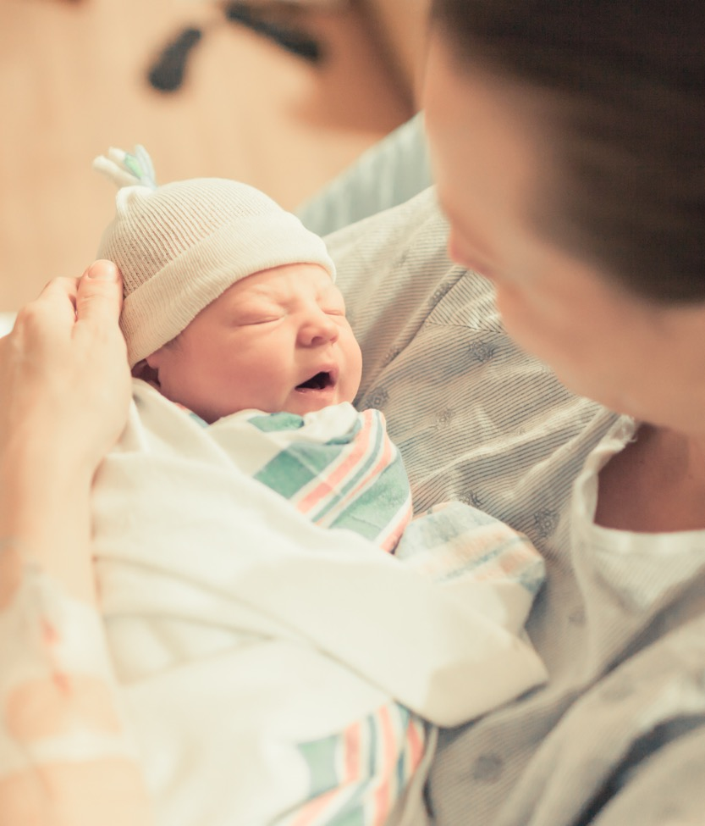
Teams QI Awards Ceremony
2023 OB Face to Face Meeting

Slide 2

Awards and Recognitions
11:25am – 11:35am
Complete Data Submission Recognitions
Promoting Vaginal Birth QI Excellence Awards
Birth Equity QI Leader Awards

Slide 3


QI Award Instructions
Data Submission Recognition, please stand to be recognized
PVB QI Excellence Award (Plaque), come to the table to the left of the stage and then walk across the main stage to be recognized.
BE QI Leader Award (Certificate), please stand when your hospital is called. Collect your certificates during lunch at the ILPQC QI Support Table.
Please connect with Ellie (PVB) or Aleena (BE) if you have any questions regarding your award status.

Slide 4
Promoting Vaginal Birth QI Recognition

Slide 5

Complete Data Submission: PVB
Advocate Christ Hospital
Adventist Hinsdale Hospital
Advocate Aurora Good Shepherd Hospital
Advocate Condell
Advocate Good Samaritan
Advocate Illinois Masonic Hospital
Advocate Lutheran General Hospital
Advocate Sherman Hospital
Alexian Brothers Medical Center
Alton Memorial
AdventHealth Adventist Medical Center – Bolingbrook
AdventHealth Glen Oaks Hospital
Ascension Mercy
Ascension Resurrection
Ascension Saint Alexius
Ascension Saint Mary- Chicago
Anderson Hospital
Barnes Jewish Hospital
Carle BroMenn Medical Center
Carle Richland Memorial Hospital
CGH Medical Center
Crawford Memorial
Edward Hospital
Elmhurst Hospital
FHN Memorial Hospital
Franciscan Health Olympia Fields
Genesis Medical Center- Silvis
Gibson Hospital
HSHS St. Francis Hospital
HSHS St. John's Hospital
HSHS St. Joseph's Breese
Javon Bea Hospital
KSB Hospital
Loyola University
MacNeal Hospital
Memorial Hospital East
Memorial Hospital of Carbondale
Memorial Medical Center
Morris Hospital & Healthcare Center
NM Delnor
NM Huntley Hospital
NM Kishwaukee Hospital
NM Lake Forest Hospital
NorthShore University HealthSystem Evanston Hospital
Northwest Community Hospital
Northwestern Memorial Hospital
OSF HealthCare Saint Anthony Medical Center
OSF HealthCare St. Elizabeth Medical Center
OSF HealthCare St. Mary Medical Center
OSF Heart of Mary Medical Center
OSF Little Company of Mary hospital
Palos Hospital
Riverside Medical Center
Rush Copley Medical Center
Rush University Medical Center
Silver Cross Hospital
SSM Good Samaritan
SSM Health St. Mary's Hospital- St. Louis
St. Elizabeth's Hospital
Stroger
Swedish American
Swedish Hospital
Unity Point Methodist
University of Chicago Medicine
Vista Medical Center East
Notes:
For all hospitals who completed their data submissions, please stand to be recognized and receive a round of applause
65 hospitals!
CLAP

Slide 6

PVB AWARD CRITERIA
QI Excellence Award:
All data submitted through March 2023
6 key structure measures in place
Achieved all 3 process and outcome measures
  ≥ 80% of Providers and Nurses educated on ACOG/SMFM guidelines
  ≥ 70% of all NTSV C-Sections meeting ACOG/SMFM guidelines
  NTSV C-Section Rate ≤23.6%
Your Hospital's Name Here!
Your H
Notes:
QI Excellence Awards signify that you have achieved the initiative aims.

Slide 7
Celebrating Previous PVB
QI Excellence Awards
Abraham Lincoln Memorial Hospital
Advocate Sherman Hospital
Edward Hospital
Elmhurst Memorial Hospital
Gibson Area Hospital
Javon Bea Hospital - Riverside
NM Kishwaukee Hospital
NorthShore University HealthSystem - Evanston Hospital
Northwestern Memorial Hospital
OSF Little Company of Mary Hospital
OSF St. Anthony Medical Center- Rockford
Riverside Medical Center
Notes:
Congratulations for already achieving PVB Initiative Aims!
You've received QI Excellence Awards at annual conference, and we'll be sharing the new awardees next who'll receive their awards today

Slide 8
New
PVB QI Excellence Awards
Advocate Christ Hospital
Advocate Sherman Hospital
Alton Memorial
Amita Health Glen Oaks Hospital
Carle BroMenn Medical Center
Carle Richland Memorial Hospital
Franciscan Health Olympia Fields
HSHS St. Francis Hospital
HSHS St. Joseph's Breese
Memorial Hospital of Carbondale
OSF Heart of Mary Medical Center
Rush University Medical Center
NM Lake Forest Hospital
Notes:
HUSTLE HUSTLE

Slide 9
Birth Equity QI Recognition

Slide 10
Complete Data Submission: BE
Advocate Aurora Sherman Hospital
Advocate Christ Medical Center
Advocate Condell Medical Center
Advocate Good Samaritan Hospital
Advocate Good Shepherd Hospital
Advocate Illinois Masonic Medical Center
Advocate Lutheran General Hospital
Advocate Trinity Hospital
Alton Memorial Hospital
St. Alexius Medical Center
AdventHealth Bolingbrook
AdventHealth Hindsdale
AdventHealth Saints Mary and Elizabeth
Anderson Hospital
Barnes-Jewish Hospital
Blessing Hospital
Carle BroMenn Medical Center
CGH Medical Center
Decatur Memorial Hospital
Edward Hospital
Elmhurst Memorial Hospital
FHN Memorial Hospital
Franciscan Health Olympia Fields
Gibson Area Hospital
HSHS St. Elizabeth's Hospital
HSHS St. Francis Hospital – Litchfield
HSHS St. John's Hospital
Ingalls Memorial Hospital
Katherine Shaw Bethea (KSB) Hospital
Loyola University Medical Center
MacNeal Hospital
Memorial Hospital East
Memorial Hospital of Carbondale
Memorial Medical Center
Mercyhealth Javon Bea Hospital
NM Delnor Hospital
NM Kishwaukee Hospital
NM Lake Forest Hospital
Northwest Community Hospital
Northwestern Memorial Hospital
OSF Little Company of Mary Hospital
OSF St. Anthony Medical Center- Rockford
OSF St. Francis Medical Center
Palos Community Hospital
Riverside Medical Center
Rush University Medical Center
Rush-Copley Medical Center
Silver Cross Hospital
SSM Health Good Samaritan
SSM St. Mary's Hospital - St.Louis
St. Joseph Hospital – Breese
Stroger Hospital of Cook County
Swedish American Hospital
UI Health
UnityPoint Health Methodist Medical Center
University of Chicago Medical Center
Notes:
Celebrate the data- how many hospitals got their data in
56 Teams

Slide 11
Face-to-Face BE AWARD CRITERIA
QI Leader Award:
All data submitted through March 2023
5 of 7 key strategies In Place (Green)
Achieved at least 3 of 6 process and outcome measures:
≥ 75% Provider, Nurse, & Other Staff Bias education
  ≥ 75% Scheduled early postpartum follow up
  ≥ 75% Postpartum Safety Patient education
  ≥ 75% SDoH delivery admission screening
  ≥ 75% SDoH screen positive linked to resources
  ≥ 40% PREM completion rate

Slide 12
Celebrating Past BE QI Leader Awards
AdventHealth Hinsdale
OSF Little Company of Mary Hospital
Ascension Alexian Brothers Womens and Childrens Hospital at St. Alexius
Gibson Area Hospital
MacNeal Hospital
Rush-Copley Medical Center
Advocate Condell Medical Center
Palos Community Hospital
NM Kishwaukee Hospital
Barnes-Jewish Hospital
Carle BroMenn Medical Center
AdventHealth Glen Oaks

Slide 13
Face-to-Face 2023
BE QI Leader Award Winners
CGH Medical Center
Edward Hospital
Elmhurst Memorial Hospital
FHN Memorial Hospital
Franciscan Health Olympia Fields
HSHS St. Elizabeth's Hospital
HSHS St. Francis Hospital – Litchfield
Ingalls Memorial Hospital
Loyola University Medical Center
MacNeal Hospital
Memorial Hospital East
Memorial Hospital of Carbondale
Mercyhealth Javon Bea Hospital
NM Delnor Hospital
Northwestern Memorial Hospital
OSF Little Company of Mary Hospital
OSF St. Anthony Medical Center- Rockford
Riverside Medical Center
SSM Health Good Samaritan
SSM St. Mary's Hospital - St. Louis
St. Joseph Hospital - Breese
Swedish American Hospital
UI Health
UnityPoint Health Methodist Medical Center
Advocate Aurora Sherman Hospital
Advocate Christ Medical Center
Advocate Condell Medical Center
Advocate Good Samaritan Hospital
Advocate Lutheran General Hospital
Advocate Trinity Hospital
Alton Memorial Hospital
AdventHealth Bolingbrook
Anderson Hospital
Carle BroMenn Medical Center

Slide 14
Achieving Birth Equity QI Excellence Award
Will start awarding for ILPQC Annual Meeting 11/2/2023
QI Excellence Award:
All data submitted
7 of 7 key strategies In Place (Green)
Achieving ALL goals for the following outcome & process measures:
  Provider, Nurse, & Other Staff Bias Education ≥70%
  SDoH Delivery Admission Screening Documented ≥70%
  SDoH Screen Positive Linkage to Resources Documented ≥70%
  PREM Completion Rate at least 25% (goal ≥40%)
Your Hospital's Name Here!
Your H
Notes:
Start awarding QI excellence for the 2023 Annual Conference
Showing you've completed the key aims and measures of the initiative.

Slide 15


Slide 16



















Thanks to our Funders
CME Provider:
Supporters:
Notes:
Team, let's us this slide for sponsors

