Slide 1
Health Equity for Infants: Start Where You Are
Stacy D. Scott, Ph.D., MPA, GCSJ
VP, Health Equity Innovation of National Institute for Children's Health Quality (NICHQ)

Slide 2

Are We On the Right Track?
Destination:
Equity Empowered System

Slide 3
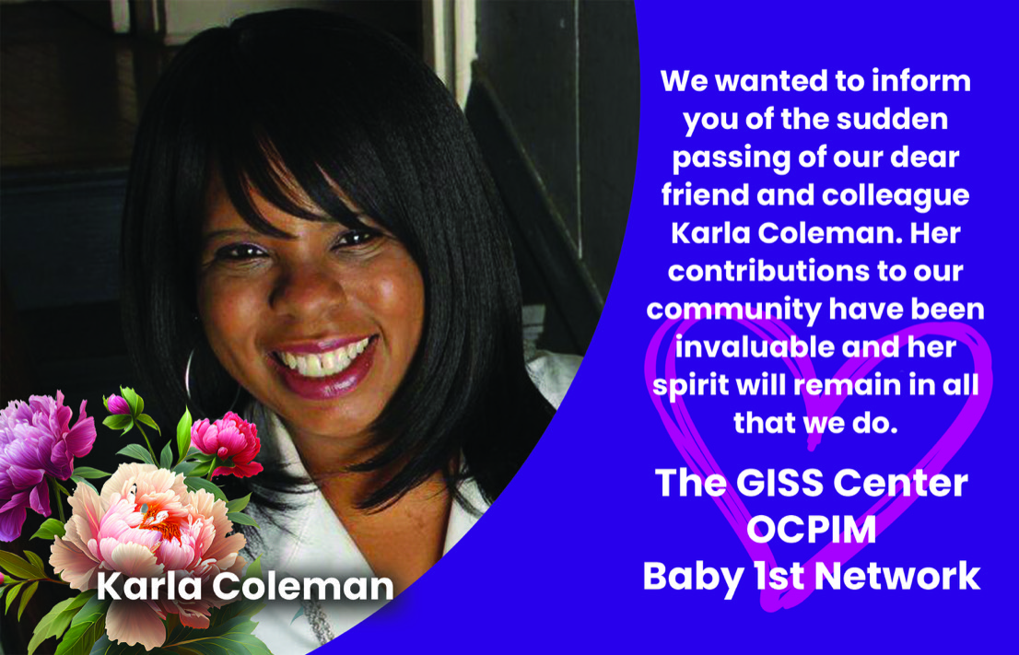
March 10, 1964 – May 4, 2023
Stacy D. Scott, Ph.D., MPA, GCSJ
VP, Department of Health Equity Innovation
Founder, Global Infant Safe Sleep Center

Slide 4
ILPQC is working to prevent infant deaths and reduce racial disparities through a quality framework.
By addressing infant safe sleep environment, racial equity, social determinants of health, and other contributing factors.
Equipping hospitals to address the issues that contribute to these disparities
Thank you for inviting me to join you today.

Slide 5
Equitable Care in Illinois
Supporting
Supporting a Safe Sleep Environment
Identifying
Identifying Social Determinants of Health
Partnering
Partnering with Families and Communities
Delivering
Delivering Respectful Care/Equitable Care
Evaluating
Evaluating Data with an Equitable Lens

Slide 6

Driver 1:Healthcare Professional Education
  Secondary Driver 1:Equitable and Respectful Care
Driver 1:Healthcare Professional Education
  Secondary Driver 2: Safe Sleep Environment
Driver 2: Clinical Environment
Driver 3: Parents, Circles of Support, and Community -Equitable and Respectful Safe Sleep Care
Driver 4: Social Determinants of Health
Driver 5: Healthcare Data

Slide 7
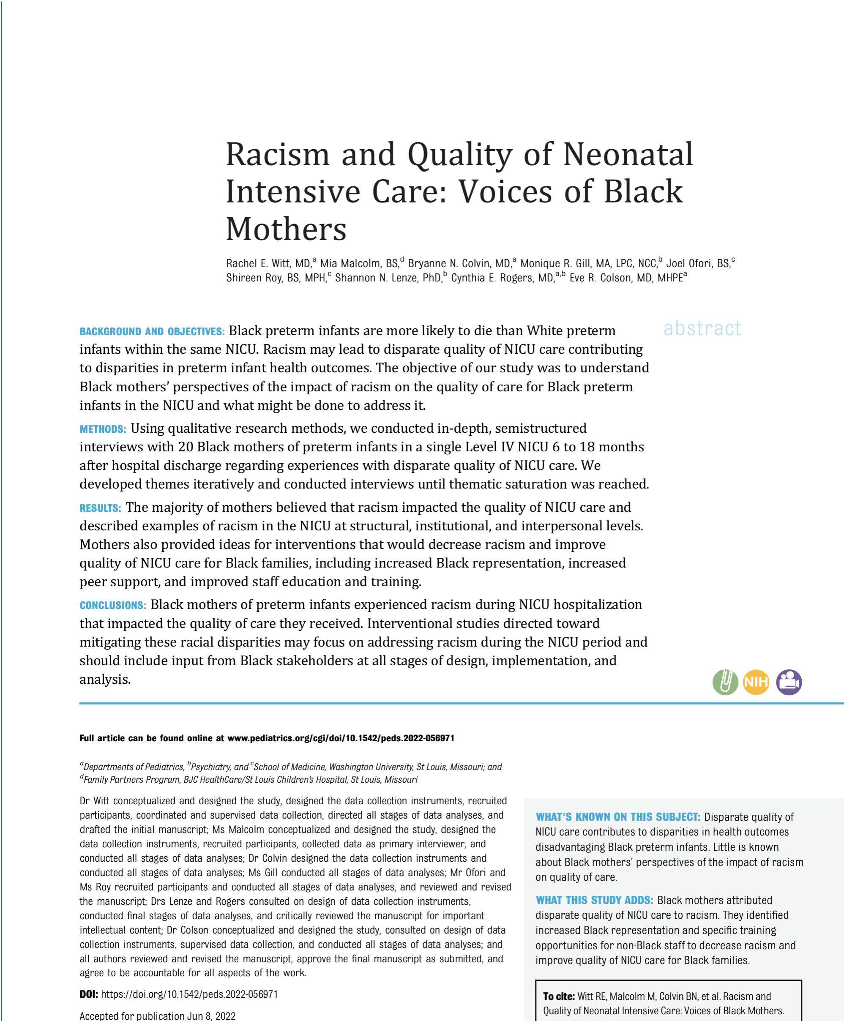
The objective of the study was to understand Black mothers’ perspectives of the impact of racism on quality of care for Black preterm infants in the NICU and what might be done to address it
Witt RE, Malcolm M, Colvin BN, Gill MR, Ofori J, Roy S, Lenze SN, Rogers CE, Colson ER. Racism and Quality of Neonatal Intensive Care: Voices of Black Mothers. Pediatrics. 2022 Sep 1;150(3):e2022056971. doi: 10.1542/peds.2022-056971. PMID: 35965288.
Notes:
The majority of studies investigating racial disparities in the NICU setting have relied on quantitative methodology, which limits the exploration of lived experiences that might identify the causes of these disparities, including experiences of racism..
The few qualitative studies in the NICU setting to date found that clinicians, family advocates, and parents observed disparities in quality of care and identified gaps in patient- and family-centered care among those who identified as non-White and of low socioeconomic status.^{15,16}

Slide 8
Participants Characteristics
Characteristics | N (%)
Time of interview after infant discharge
6–11 mo | 11 (55)
12–18 mo | 9 (45)
Age range, y
18–24 | 6 (30)
25–34 | 11 (55)
35–44 | 3 (15)
Characteristics | N (%)
Education level
High school degree or equivalent (eg, GED) | 6 (30)
Some college, no degree | 6 (30)
Associate degree (eg, AA, AS) | 2 (10)
Bachelor's degree (eg, BA, BS) | 5 (25)
Master’s degree (eg, MA, MS, MEd) | 1 (5)

Slide 9
Participants Characteristics
Characteristics | N (%)
Marital status
Single | 11 (55)
Married | 7 (35)
Separated | 2 (10)
Employment Status
Employed part or full time | 11 (55)
Student | 2 (10)
Unemployed or unable to work | 7 (35)
Characteristics | N (%)
Insurance type
Private | 5 (25)
Public (eg, Medicare, Medicaid) | 14 (70)
No coverage or self pay | 1 (5)
Household income level
$0 to $9999 | 6 (30)
$10 000 to $24 999 | 3 (15)
$25 000 to $49 999 | 1 (5)
$50 000 to $74 999 | 4 (20)
$75 000 to $99 999 | 1 (5)
Prefer not to answer | 5 (25)
Witt RE, Malcolm M, Colvin BN, Gill MR, Ofori J, Roy S, Lenze SN, Rogers CE, Colson ER. Racism and Quality of Neonatal Intensive Care: Voices of Black Mothers. Pediatrics. 2022 Sep 1;150(3):e2022056971. doi: 10.1542/peds.2022-056971. PMID: 35965288.

Slide 10
Results
The majority of mothers believed that racism impacted the quality of NICU care and described examples of racism in the NICU at structural, institutional, and interpersonal levels. Mothers also provided ideas for interventions that would decrease racism and improve quality of NICU care for Black families, including increased Black representation, increased peer support, and improved staff education and training.
Witt RE, Malcolm M, Colvin BN, Gill MR, Ofori J, Roy S, Lenze SN, Rogers CE, Colson ER. Racism and Quality of Neonatal Intensive Care: Voices of Black Mothers. Pediatrics. 2022 Sep 1;150(3):e2022056971. doi: 10.1542/peds.2022-056971. PMID: 35965288.

Slide 11
Structural
Being a Black person in America | “It’s just something—and this has nothing to do with the NICU—this is just being a Black woman in America… the first thing I think people insinuate is uneducated, especially in situations of being in doctor’s offices.” (Participant A)
Inequitable systemic barriers | “I didn’t see Black parents that should’ve been up there with their babies… They also out here tryin’ to take care of their other babies that no one will watch for them … I feel some White babies, their parents’ insurance are better than the Black community because we are the lower income.” (Participant B)
General mistrust of health care system | “I don’t remember the man’s name, but he was a doctor. He used to use women, Black women slaves, to figure out the process of how to do childbirth. And instead of him usin’ White people, he used Black people because we don’t feel pain… knowing that their medical textbooks tell them that Black people don’t feel the same pain that White people feel, it’s nerve-wracking for a parent.” (Participant C)
Witt RE, Malcolm M, Colvin BN, Gill MR, Ofori J, Roy S, Lenze SN, Rogers CE, Colson ER. Racism and Quality of Neonatal Intensive Care: Voices of Black Mothers. Pediatrics. 2022 Sep 1;150(3):e2022056971. doi: 10.1542/peds.2022-056971. PMID: 35965288.

Slide 12
Institutional
Lack of Black representation | “I mean, I feel like [the hospital system] is in the hood. So, I think that you would see a lot of folks of color and… you don’t see them as doctors and nurses or patient care techs. You see them doing stuff like picking up trash.” (Participant D)
Poor reputation of NICU or hospital system | “[Black friends] said that they will never take their child there [the children’s hospital]… They just kept saying that it wasn’t the best hospital to take your kid… They don’t think [my infant] was getting the best care… So maybe they would took it as racism.” (Participant E)
Differences in resource or assistance allocation and rule enforcement | “It was like a BP [gas] card… that they would give to people that is reloadable. And I was talking to some of the other [White] moms. That’s how I knew about it… I was never offered it… [The same person] was also my case worker, and she hasn’t mentioned anything to me… I asked about it with another Black mom, and she didn’t know nothing about it.” (Participant F)
Witt RE, Malcolm M, Colvin BN, Gill MR, Ofori J, Roy S, Lenze SN, Rogers CE, Colson ER. Racism and Quality of Neonatal Intensive Care: Voices of Black Mothers. Pediatrics. 2022 Sep 1;150(3):e2022056971. doi: 10.1542/peds.2022-056971. PMID: 35965288.

Slide 13
Interpersonal
Neglectful and/or judgmental treatment | “How long does my son have to really wait to eat when you not around 'cause you tending to White families more than you tend to my son? Now you starting to make me question… I'ma watch you. Now I gotta be on ya.” (Participant G)
Hierarchical flow of information | “I try to express to them that I want to be involved as much as I can, don’t round without me… But there was there was times where those requests were ignored… It was more of if I didn't stay on top of it, I was going to get lost. I wasn't gonna be informed about what happened… They just assumed that I was just a single Black mother.” (Participant H)
Power imbalance | “Two of the nurses I complained on went through my personal belongings… and then the charge nurse came in and asked me about the medication. And clearly, I just had a baby, my name is on all the pills, but they're like, ‘Well, someone can go in there and take your pills by mistake, like housekeeping or the food people.’… Because those drugs are street drugs…Because most of the food workers are Black.” (Participant I)
Witt RE, Malcolm M, Colvin BN, Gill MR, Ofori J, Roy S, Lenze SN, Rogers CE, Colson ER. Racism and Quality of Neonatal Intensive Care: Voices of Black Mothers. Pediatrics. 2022 Sep 1;150(3):e2022056971. doi: 10.1542/peds.2022-056971. PMID: 35965288.

Slide 14
Increased Black Representation
Shared experience of being Black | “I just feel like they're [Black health care providers] able to relate more ‘cause they see what we go through or they’ve probably experienced or seen it before… It would made me more comfortable because it would have just felt like they understood me more versus the different race.” (Participant J)
Bidirectional communication | “The only difference will be the nurse that I was telling you about… she was Black and she was a little bit more friendly, a little more talkative, provided a little bit more information without me having to ask or ask about her answers to the question.” (Participant K)
Personalized care | “I feel like with the Black nurses, it was almost as if they treated the twins as if they were theirs, like they were their family, so it was like they gave them a little bit more extra care and love almost.” (Participant L)
Witt RE, Malcolm M, Colvin BN, Gill MR, Ofori J, Roy S, Lenze SN, Rogers CE, Colson ER. Racism and Quality of Neonatal Intensive Care: Voices of Black Mothers. Pediatrics. 2022 Sep 1;150(3):e2022056971. doi: 10.1542/peds.2022-056971. PMID: 35965288.

Slide 15
Increased peer support
Shared experience of being NICU parents | “These were actually mothers who were going through what I was going through, feeling what I was feeling… I felt that was really, really a great moment to encourage one another or to help one another get past it.” (Participant M)
Support from family advocates | “They [Family Partners] came in… and everybody like dancing and singing about holding the baby. And I was like, ‘No. I ain’t hold this baby. This baby is tiny!’ [laughter] And they’re like, ‘Yup! You’re gonna hold her!’ [laughter]… They definitely helped.” (Participant N)
Strengthened connection with Black families | “I did meet… 3 Black moms through that [luncheons], and the connection was different than talking to the White moms… It’s kind of like the understanding that comes with being Black…” (Participant O)
Witt RE, Malcolm M, Colvin BN, Gill MR, Ofori J, Roy S, Lenze SN, Rogers CE, Colson ER. Racism and Quality of Neonatal Intensive Care: Voices of Black Mothers. Pediatrics. 2022 Sep 1;150(3):e2022056971. doi: 10.1542/peds.2022-056971. PMID: 35965288.

Slide 16
Improved staff education and training
Communication and engagement strategies | “Yes, they did very good with everything, anything I didn’t know about. I was always askin’ questions… I was like, ‘Am I talkin’ too much?’ They was like, ‘No, it’s okay. It’s okay.’… every time I got there, with the NICU… they’re like, ‘Oh, we’re gonna call the doctor down and let him know that you’re here so you can talk to him.” (Participant P)
Empathetic care | “Why should it be a color? That White baby is the same as that Black baby. The parents' color should not matter on the care and the level of respect….” (Participant G)
Responsiveness to specific needs of Black families | “I would definitely say that I think a doctor should spend a little extra time with the Black families, and assure them that you’re not pokin’ and proddin’ on my child—that you don’t believe what we’ve all heard because that’s reality… So that they know how to approach the situation and how to basically tell us, ‘That’s not the case.’” (Participant C)
Witt RE, Malcolm M, Colvin BN, Gill MR, Ofori J, Roy S, Lenze SN, Rogers CE, Colson ER. Racism and Quality of Neonatal Intensive Care: Voices of Black Mothers. Pediatrics. 2022 Sep 1;150(3):e2022056971. doi: 10.1542/peds.2022-056971. PMID: 35965288.

Slide 17
Conclusion
Black mothers of preterm infants experienced racism during NICU hospitalization that impacted the quality of care they received. Interventional studies directed toward mitigating these racial disparities may focus on addressing racism during the NICU period and should include input from Black stakeholders at all stages of design, implementation, and analysis.
Witt RE, Malcolm M, Colvin BN, Gill MR, Ofori J, Roy S, Lenze SN, Rogers CE, Colson ER. Racism and Quality of Neonatal Intensive Care: Voices of Black Mothers. Pediatrics. 2022 Sep 1;150(3):e2022056971. doi: 10.1542/peds.2022-056971. PMID: 35965288.

Slide 18




The Problem
“Institutional racism is comparable to a runaway vine. Often it is difficult to find its roots. And as with the vine, you can kill as many branches as you choose, but if you fail to destroy the root, the vine continues to grow.”
Terry Jones, Institutional racism in the United States, 1974
Notes:
Over the course of hundreds of years, racism has been institutionalized into U.S. health care systems, propagating organizational practices and policies that marginalize and discriminate against people of color. Today, institutional racism continues to plague the health of children and families across the country, leading to inequitable outcomes. To address racism and other forms of oppression, many organizations have embarked on implicit bias training as a solution.

Slide 19
The Equity Systems Continuum Project
Notes:
Stacy

Slide 20

What is the Equity Systems Continuum (ESC)?
“In an effort to achieve an equitable system of healthcare, we need to be able to describe and differentiate the type of systems that exist and that are needed to ensure equity for all. By mapping this continuum—by giving each system a name and definition—we can consider where our current approaches have succeeded and failed, and what we need to do to address racism and other forms of oppression.”
Notes:
Stacy

Slide 21
We theorize the Equity Systems Continuum is made up of four systems: Supremist-designed, Savior-designed, Ally-designed, and Equity-empowered
By giving each system a name and definition, an organization may
Identify where they are along this continuum,
Consider where their current approaches have succeeded and failed, and
Determine what actions need to be taken to improve along the continuum
Notes:
Stacy
Based off of lived experience but not validated/confirmed.

Slide 22
Development of the ESC
ESC developed by Dr. Stacy Scott and GISS Center
Concept entails three systems: Savior-designed, Ally-designed, Equity-empowered
Partnership with NICHQ; funding from W.K. Kellogg Foundation
Developed ESAT
Added fourth system informed by ESAT responses: Supremist-designed
Funding from Yield Giving Foundation
Addition of fourth system highlighted need for formal validation
2018
2021
2023
Notes:
Stacy
2018
Developed by Dr. Stacy Scott and GISS Center
Informed by literature review and lived experience
Theorized three systems
Savior-designed
Ally-designed
Equity-empowered
2021
Partnership with NICHQ; W. K. Kellogg Foundation funding
Developed and fielded the Equity Systems Audit Tool (ESAT)
To assess where an organization lands on the ESC
Added a fourth system (supremist-designed) informed by ESAT responses in late 2021
2023
Addition of fourth system highlighted need for formal validation
ESC is the foundation for the ESAT
Therefore, ESC validation must inform eventual ESAT validation

Slide 23

Equity System Continuum
Supremist
Savior
Ally
Equity Empowered
Social Justice
New system identified in 2021
Original Three-System Continuum, developed in 2018
Ultimate Equitable State

Slide 24
Supremist-designed Systems
Defined | Systems Construct | Residual Impact
Supremist-designed systems regardless of intent, maintain inherent structural biases, reinforcing and perpetuating inequities that have long been entrenched in institutions, policies, and community relations. | Operates in indifference Driven by factors that impede equity and perpetuate longstanding beliefs, practices, and structures that benefit one group and harm others Fails to address implicit/explicit bias and discrimination appropriately Fails to develop new or uphold existing policies intended to protect staff Lacks effective recruitment/retention strategies and resources to implement equity-based approaches | Supremacist: Imposes and maintains cultural, social, political, historical, and/or institutional domination by white people. Denotes structural or societal racism that privileges white people over others, regardless of racial hatred’s presence or absence. Patriarchal: Gender roles and gender inequity are instruments of power establishing social norms that support systems where men dominate over others resulting in exploitation or oppression. Explicitly: Biases and prejudices are intentional and controllable and are expressed or shown clearly and openly, without any attempt to hide

Slide 25
Savior-designed Systems
Defined | Systems Construct | Residual Impact
Savior-designed systems are originally designed to rescue a “vulnerable” community by delivering services that espouse quality defined by the less vulnerable. | Overlooks root causes and the role of the institution in the vulnerabilities of a community Entrenches values, policies, and practices unaware of institutional power dynamics, although not explicitly to discriminate Preserves values, policies, and practices that treat disenfranchised groups as less important Impedes navigation by or on behalf of disenfranchised groups | Top-down expertise: In many cases, individuals’ lived experiences are less valued than professional opinions when it comes to their care Victim-blaming: Disregarding the contexts that contribute to what has impacted the decisions and survival mechanisms of the person seeking care Gate-keeping: Criticizing and instructing an individual in what to do, without taking their lived experience into account Labeling: Seeing an individual as non-compliant, difficult, or rude rather than empathizing with the struggle of seeking care in systems not designed for them to succeed

Slide 26
Ally-designed System
Defined | Systems Construct | Residual Impact
Ally-designed Systems are focused on building self-awareness among those controlling the institution and its care while partnering with disenfranchised communities to spark change. | Recognizes that unique circumstances and social conditions affect overall health and must be factored into decisions Reflects on lived experience, points of privilege, and oppression to inform decisions and initiatives Attempts to nurture institutional awareness and practices that address deep structural issues Engages disenfranchised groups to create a system dedicated to dignity, respect, and equality | Paternalism: Those with power might take input from but are not accountable to those who are affected by the decisions being made Monological (one-sided) approaches: Relying on experts despite being well-intentioned results in a failure to include voices of disparity groups. Work is not reciprocal, reflective, or truly participatory. Tokenism: Creating a perfunctory or symbolic effort to be inclusive of members of disparity groups, especially by recruiting and/or objectifying smaller numbers in order to give the appearance of diversity and inclusion

Slide 27
Equity-empowered System
Defined | Systems Construct | Residual Impact
Equity-empowered systems are purposefully reconstructed to value diversity of experience at all levels and actively work to change structures, governance, and ideas of excellence to promote enfranchisement. | Accepts racism and other forms of oppression adversely impact systems of care.​ Addresses unique needs and root causes of inequitable outcomes. Embraces diversity, equity, and inclusion coaching and mentorship to establish, maintain, and enhance equity at all levels. Values power-sharing that ensures diverse representation and redistributes resources to establish equitable processes.​ | Divisiveness: The impact of conflicting ideas about equality, fairness, and the allocation of limited resources Disrupting: Challenging the status quo and advancing equality often which can be a threat to those people or groups who are in power Resistance: Balancing the need for social change with the realities of political and economic structures Powershifting: Racial inequity, in terms of power dynamics, means addressing racism and the impact it has on establishing and maintaining power structures that are centered around whiteness

Slide 28
Poll Question: Please select the category that best describes the organization where you work.
Go to www.menti.com and use the code 8624 8885
Supremist-designed | Savior-designed | Ally-designed | Equity-empowered
Operate in indifference, which is harmful. May be driven by motivating factors that impede equity. Perpetuate longstanding cultural beliefs, practices, organization structures that benefit the oppressor. | Do not consider the root causes and institutions that make the population vulnerable in the first place. Have policies and practices that harm specific racial groups while benefiting others. Are impacted by segregation and division, which often results in habits, policies, and institutions that are not explicitly designed to discriminate. | Recognize that individuals’ unique circumstances and social conditions affect their health and need to be factored into healthcare decisions. Reflect on lived experience, points of privilege, and oppression to inform additional perspectives needed “at the table.” Unite with disparity groups who are treated unjustly to create a system dedicated to dignity, respect, and equality. | Are built and governed to center on the experiences of disparity groups. Accept racism and other forms of oppression that adversely impact systems of care. Share power by not only ensuring diverse representation, but also redistributing resources to establish equitable decision-making, design, and implementation processes

Slide 29

Results
https://www.mentimeter.com/app/presentation/alk7fdqpspswkeho6zhnpusr2ytyvj9b

Slide 30
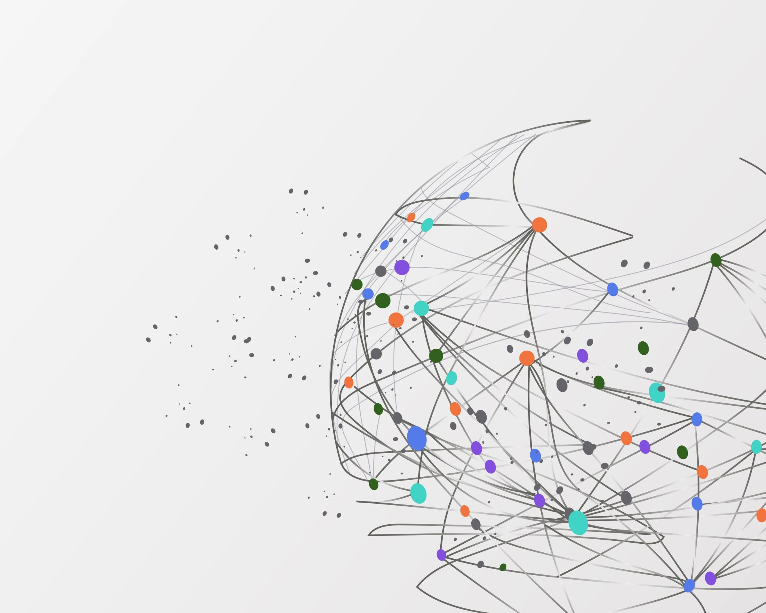
The ESC is an emerging framework that will assist healthcare systems in assessing and quantifying how racism and discrimination operate in the health, medicine, and patient care spaces.
The ESC is working to address internal workplace bias and how these biases can contribute to inequitable external outcomes.

Slide 31
Equity Systems Audit Tool (ESAT)
Audit long standing policies and practices that contribute to systemic racism and other forms of oppression
Measure experience and perception of systemic racism in organization
  Eight domains: treatment, access, tools/resources, knowledge management, diversity, human resources, culture, lived experience
Long-term vision:
  ESAT results may aid organizations/health systems to identify how their workers perceive the institution’s approach to equity
  Provide guidance on how to progress along the ESC to promote equitable workplaces
Notes:
Stacy

Slide 32
ESC Validation:
Preliminary Results
Notes:
Meera

Slide 33
Accessing professional development
"Sometimes [we ask] our techs…[would you] consider taking on extra [responsibility]? That's how I was taught, you help people and you guide them and if it works for them, that's fine. If their family situation is difficult, they can't do it. But we've had quite a few people who've gone on from cleaning the floors to be techs, from being administrators to doing other things."
Notes:
Meera
Informant describes their perceptions of availability and support for professional development. This could include resources available to all staff, or resources only available to certain staff. Informants described barriers to professional development access, such as family responsibilities. A common discussion was how PD opportunities were offered passively and the informants observed or experienced that strong self-advocacy was required to receive professional development.

Slide 34
Assessing others’ motivations or intentions
"I think people think, ‘As long as you're doing your scope of work, you're not killing anybody, you're not offending anybody, keep working.’ And I want to say there's more to our work than that. I'm a believer in purpose and passion."
Notes:
Rebecca
Informant speculates about others’ alternative reasons or motivations to engage or not engage in DEI work

Slide 35

Checking off boxes
"I worry we are just checking off a box [with DEI training] and we're not going into depth. So my [colleague] is trying bring some [external consultants] on board. Sometimes somebody from outside might just stir you a little differently."
Notes:
Meera
In vivo code. Informant expresses meeting certain DEI expectations to meet requirements without going into depth on the topic at hand

Slide 36
Code switching
"I've had two promotions in those five and a half years. Someone said to me the other day that I've had a meteoric rise. And I thought that was a very weird and strange thing to say. But I also think that I'm, unfortunately, a palatable Black person, and I'm very aware of how people perceive me. But that doesn't represent or reflect who I am inside."
Notes:
Rebecca
Informant describes needing to alter demeanour or communication approach based on who they are interacting with

Slide 37
Expressing salient identity
"[My] heart, purpose, and passion, it's really about saving Black people. Because I'm a Black person and my family’s Black. My personal mission is aligned with my professional work."
Notes:
Meera
Demographic and related characteristics of the informant that may play a role in perceptions of organizational and BIPOC issues

Slide 38
Feeling like there are no safe spaces
"They don't value me because I can't bring my full identity to work. I have to be intentional not to be too emotional, I have to keep my tone monotone. I have to try to have a straight face in order to even have conversations [about discrimination incidents]. But once the conversation is over, there is no follow up, no change…But then, when COVID came, they valued me enough to have me out testing folks…in my Black community [and engaging] vaccine conversations…So in those terms, they see that my work has value, but outside of whatever the goals of management team are, then [I] don’t matter."
Notes:
Rebecca
In vivo code. Informant expresses they feel there is no area within their workplace that they can bring their full self

Slide 39
Feeling unsupported
"I think there are individuals within the organization that have a passion for bringing attention to [workplace diversity]. And so I think there's effort that you can see, but it's not because the organization has provided anything, it's just because of people want to try to figure out how to make it happen."
Notes:
Meera
Informant reports lacking feelings of mutual confidence, strength, acceptance, and/or encouragement at work. This could be in both day-to-day job requirements, or specifically within DEI work.

Slide 40

I am not so sure
"[HR posts] a job, you apply for it, you go for interviews…and that it is all on the strength of who you are. Is everybody who’s [applying to jobs] as diverse as perhaps we could employ here? That I don't know. Maybe they just don’t [apply] here. Maybe they apply somewhere else."
Notes:
Rebecca
In vivo code. Informant is not sure the answer to the question. This could be because the informants’ hierarchy in the organization means they are unsure of how logistical matters are executed, or because of opacity in decision making among leadership.

Slide 41
Observing diversity practices in HR
"I feel our organization is great at hiring people at that entry-level position. And if you're a White staff, you can elevate very quickly up that ladder…But our BIPOC staff…are not given those same opportunities. Oftentimes, supervisors for our White counterparts will encourage [career ladders] where I've had several of my Black people [attempt the same career ladders] and be discouraged. I think those subtleties are a huge part of the culture…and prevent advancement for folks that look like me"
Notes:
Meera
Informant perception of organizational approach to DEI in talent recruitment and retainment. This could include hiring from outside of the organization, or hiring from within the organization, and contained both positive and negative sentiments.

Slide 42
Observing or exerting efforts to understand needs
"When I'm sending a person home from labor and delivery triage, [I ask,] does she know how she's going to get home? How is she going to get out from here at 11 o'clock at night in the city that's pouring with rain? Those are things that [not all] people [consider]."
Notes:
Rebecca
Informant summarizes and expresses different approaches and activities undertaken to understand perspectives of other individuals, including those working in the organization, or those being served by the organization. These approaches or activities could occur on the individual or organizational level.

Slide 43
Pick your battles
"I think I've built relationships where I can feel comfortable saying the things that I need to say. But [when hurtful comments occur I] have to really [weigh the reporting options] because I want to make sure that I…get the point across. I think [the organization is] slow to act…I think it's political."
Notes:
Meera
In vivo code. Informant describes decision-making around when to “rock the boat” related to DEI matters

Slide 44
Seeing organization with rosy glasses
"We have a lot of online trainings…every year [the trainings are] mandated. [My organization is] trying. They're trying. They really are."
"Personally, I have not [experienced discrimination]. Age [discrimination] might be something, but I don't think so. But my glasses are a little different. They're a little rosy."
Notes:
Rebecca
In vivo code. General qualifying comments summarizing potentially overly positive or justifying perspectives on the organization's intentions and/or promotion of DEI.

Slide 45
Code Title | Description
Accessing professional development | Informant describes their perceptions of availability and support for professional development
Assessing others' motivations and intentions | Informant speculates about others’ alternative reasons to engage in DEI
Checking off boxes | Informant expresses meeting certain DEI expectations to meet requirements without going into depth on the topic at hand
Code switching | Informant describes altering demeanor or communication approach based on who they are interacting with
Expressing salient identity | Demographic and related characteristics of the informant that may play a role in perceptions of DEI
Feeling like there are no safe spaces | Informant expresses they feel there is no area in their workplace where they can bring full self
Feeling unsupported | Informant reports lacking feelings of confidence, strength, acceptance, and/or encouragement from others at work
I am not so sure | Informant is not sure the answer to the question
Observing diversity practices in HR-hiring | Informant perception of organizational approach to DEI in talent recruitment and retainment
Observing or exerting effort to understand needs | Informant summarizes and expresses different approaches and activities undertaken to understand perspectives of other individuals or groups
Pick your battles | Informant describes decision-making around when to “rock the boat” related to DEI
Seeing organization with rosy glasses | General qualifying comments summarizing positive perspectives on the organization's intentions and/or promotion of DEI
Notes:
Meera

Slide 46
Tools and Resources

Slide 47
Self-Assessment for Maternal and Child Health Practitioners
National MCH Workforce Development Center Spring 2023
This instrument provides maternal and child health (MCH) practitioners with a point-in-time assessment of the degree to which their current practice incorporates the principles and methods for conducting work using a culturally responsive and racial equity lens.
National MCH Workforce Development Center Sprint 2023

Slide 48
Self-Assessment for Maternal and Child Health Practitioners
This instrument provides maternal and child health (MCH) practitioners with a point-in-time assessment of the degree to which their current practice incorporates the principles and methods for conducting work using a culturally responsive and racial equity lens.
  Section 1: Cultural Responsiveness of MCH Practitioner
  Section 2: Cultural Responsiveness of Team Practice
  Section 3: Applying the Lens to Process Evaluation
  Section 4: Applying the Lens to Outcome Evaluation
  Section 5: Implications and Action Planning
National MCH Workforce Development Center Sprint 2023

Slide 49
Cultural Responsiveness of MCH Practitioner
At all stages of implementation, I examine the potential impact of cultural stereotypes and my own personal biases around race, ethnicity, gender, socioeconomic status, and other individual differences.
I pay attention to the similarities and differences of life experiences between the implementation team and members of the target population and consider how those dynamics might impact practice.
I deliberately include time in the implementation planning and support activities to discuss cultural and racial issues that might occur in the work.
National MCH Workforce Development Center Sprint 2023

Slide 50
Cultural Responsiveness of Team Practice
Our team engages community members, consumers, and stakeholders in…
…creating and/or tailoring culturally responsive interventions and activities (i.e., programs, practices, and supports) focused on equity.
Data-collection instruments (i.e., surveys, interview protocols, etc.) are selected and adapted to ensure appropriateness for the culture(s) of the people of whom the questions are being asked.
Needs assessment and implementation planning activities that require interaction with community members, consumers, and stakeholders are led by the team members who are best suited to understand the specific cultural context, based on factors such as shared experiences with the target population, knowledge of the target population, and awareness of biases.
National MCH Workforce Development Center Sprint 2023

Slide 51
Applying the Lens to Process Evaluation
In designing ongoing improvement plans for answering questions about how the program/project/initiative/service was implemented, our team pays attention to…
…the extent of shared experiences between members of the governing board and recipients of the program’s services.
…the organization’s historical stance and/or practice related to issues of equity.
Where differences in service delivery are required, we seek to understand the nature of the differences, the policies and practices causing the differences, and the steps taken by the program to address the differences.
National MCH Workforce Development Center Sprint 2023

Slide 52
Applying the Lens to Outcome Evaluation
In analyzing and interpreting outcome data, our team disaggregates data along demographic lines to identify and assess the extent of differential impacts of the program.
In assessing program outcomes, we look for:
…disparities in access to program services among different groups represented in the target population.
…any unintended consequences of program activities due to cultural or racial/ethnic issues/context
…whether the most “in need” community group was served equitably.
National MCH Workforce Development Center Sprint 2023

Slide 53
Maternity Care Clinicians' Experiences Promoting Infant Safe Sleep and Breastfeeding During the COVID-19 Pandemic
Objective: To explore the phenomenon of clinicians' perceptions and experiences of promoting infant-safe sleep (ISS) and breastfeeding during the COVID-19 pandemic.
Design: Descriptive qualitative hermeneutical phenomenology of key informant interviews conducted as part of a quality improvement initiative.
Setting: Maternity care services of 10 U.S. hospitals from April through September 2020.
Participants: Ten hospital teams, including 29 clinicians.
Intervention: Participants were part of a national quality improvement intervention focused on promoting ISS and breastfeeding. Participants were asked about challenges and opportunities promoting ISS and breastfeeding during the pandemic.
Results: We identified four themes summarizing the experiences and perceptions of clinicians promoting ISS and breastfeeding in the COVID-19 pandemic: Strain on Clinicians Related to Hospital Policies, Coordination, and Capacity; Effects of Isolation for Parents in Labor and Delivery; Reevaluating Outpatient Follow-Up Care and support; and Adopting Shared Decision-Making around ISS and breastfeeding.
Conclusions: Our results support the need for physical and psychosocial care to reduce crisis-related burnout for clinicians to encourage the continued provision of ISS and breastfeeding education, particularly while navigating capacity constraints. Our findings also suggest that clinicians perceived that parents may require additional support to enhance potentially limited ISS and breastfeeding education. These findings may be used to inform approaches to parental and clinician maternity care support in future public health crises.
Keywords: COVID-19; breastfeeding; burnout; infant safe sleep; maternity care systems; pandemic; perinatal education.
Menon, M., Huber, R., Russell, R. B., Feldman-Winter, L., Goodstein, M. H., Scott, S., & Berns, S. D. (2023). Maternity care clinicians’ experiences promoting infant safe sleep and breastfeeding during the COVID-19 pandemic. Nursing for Women’s Health, 27(2). https://doi.org/10.1016/j.nwh.2023.01.004.

Slide 54
Community-based approaches to infant safe sleep and breastfeeding promotion: a qualitative study
Background
In the U.S., sudden unexpected infant deaths (SUID) due to accidental suffocation and strangulation in bed (ASSB) are increasing, with disparities by race/ethnicity. While breastfeeding is a protective factor against infant mortality, racial/ethnic disparities are present in its uptake, and motivations to breastfeed are also often coupled with non-recommended infant sleep practices that are associated with infant sleep deaths. Combining infant safe sleep (ISS) and breastfeeding promotion on the community level presents opportunities to address racial/ethnic disparities and associated socioeconomic, cultural, and psychosocial influences.
Methods
We completed a descriptive qualitative hermeneutical phenomenology using thematic analysis of focus group data. We examined the phenomenon of community-level providers promoting ISS and breastfeeding in communities vulnerable to ISS and breastfeeding disparities. We asked eighteen informants participating in a national quality improvement collaborative about i.) areas requiring additional support to meet community needs around ISS and breastfeeding, and ii.) recommendations on tools to improve their work promoting ISS and breastfeeding.
Results
We identified four themes: i.) education and dissemination, ii.) relationship building and social support, iii.) working with clients’ personal circumstances and considerations, and iv.) tools and systems.
Conclusions
Our findings support embedding risk-mitigation approaches in ISS education; relationship building between providers, clients, and peers; and the provision of ISS and breastfeeding supportive material resources with educational opportunities. These findings may be used to inform community-level provider approaches to ISS and breastfeeding promotion.
Menon, M., Huber, R., West, D. D., Scott, S., Russell, R. B., & Berns, S. D. (2023). Community-based approaches to infant safe sleep and breastfeeding promotion: A qualitative study. BMC Public Health, 23(437). https://doi.org/10.1186/s12889-023-15227-4.

Slide 55

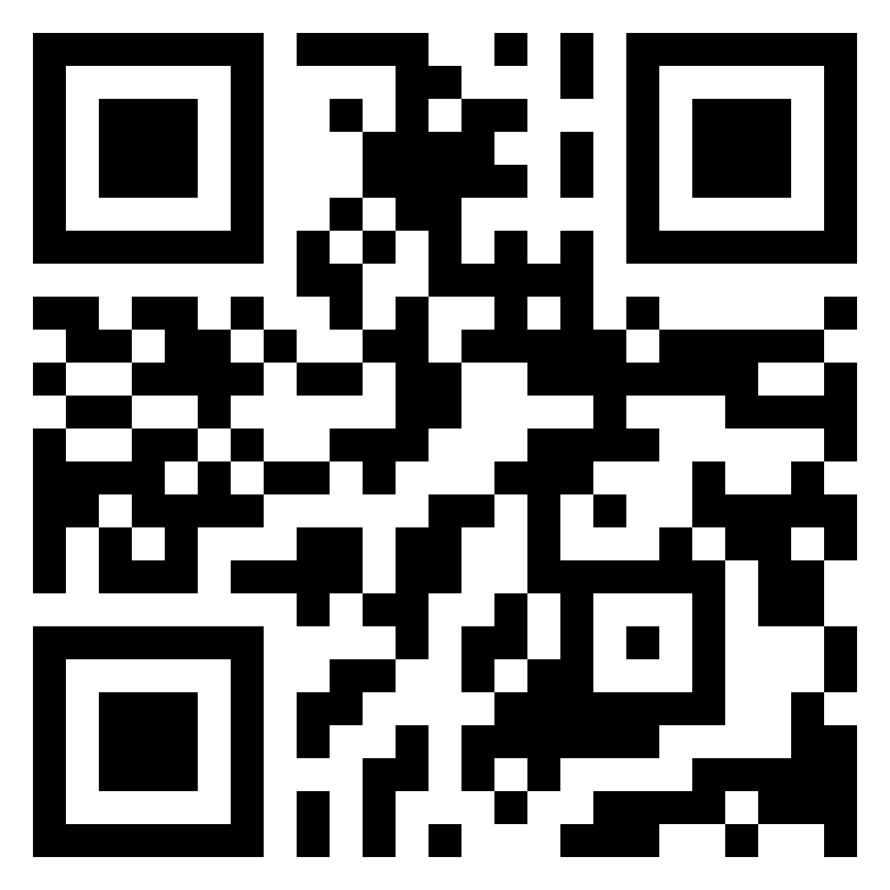
Social Determinants of Grief: The Impact of Black Infant Loss Webinar, June 30th @1:30
1.0 Contact Hours Registration Fee: $50.00
Understanding Black grief requires taking a long look at the historical and contemporary experiences around the issues of death. But troublingly, there is very little research conducted on Black grief and its connection to racism and the social injustices connected to it. Understanding the impact of systemic racism and its influence on how a person reacts to loss sets the stage for addressing how best to support communities that are disproportionately affected by infant death. This webinar will offer insight into how some women of color deal with compound loss and trauma. Participants will walk away with an opportunity to gain additional knowledge on how to best serve communities of color affected by infant loss.
Registration Information: www.gisscenter.org
www.baby1stnetwork.org
This nursing continuing professional development activity was approved by the Ohio Nurses Association, an accredited approver by the American Nurses Credentialing Center’s Commission on Accreditation. (OBN-001-91)

Slide 56

SSCOTT@NICHQ.ORG
THANK YOU!!!

