Slide 1
Team Recognition, Networking Lunch, Poster Session, and Initiative Tables
ILPQC 11th Annual Conference
November 2nd, 2023

Slide 2
Awards and Recognitions
11:45am – 12:00pm
Quality Improvement Awards for BE, PVB, and BASIC
Data Champion Recognition for BE, PVB, and BASIC
Abstracts Awards of Excellence
Stay tuned for Patient Engagement Awards this Afternoon

Slide 3
Award Instructions
If your hospital QI team is receiving a QI Excellence Award (Plaque) for PVB, BE or BASIC, when your hospital name is read, please come to the table to the right of the stage to receive your QI Excellence Award Plaque and then walk across the main stage to be recognized.
If your hospital is receiving Data Champion awards for PVB, BE, or BASIC, please come to the table to the left of the stage to receive your award.
Please connect with Aleena or Ellie if you have any questions regarding your award status.
Notes:
Will want a list of who to see for which award, maybe in internal agenda so can be edited?

Slide 4
PVB Quality Improvement Awards
Notes:
Dan could we add a brief summary slide of # of abstracts submitted for each category?
Thanks, patti

Slide 5
PROMOTING VAGINAL BIRTH
QUALITY IMPROVEMENT AWARDS
QI Excellence Award: ​
All data submitted
6 key structure measures in place​
NTSV C-Section Rate <23.6%​
>70% of NTSV C-Sections Meeting ACOG/SMFM Criteria​
> 80% of providers and nurses education on ACOG/SMSM Criteria​
Data Champion Award:​​
Complete data submitted ​​

Slide 6
PROMOTING VAGINAL BIRTH
Fall 2023 QI Excellence Award Winners
Advocate Good Samaritan
Anderson Hospital
Barnes Jewish Hospital
Loyola University Medical Center
MacNeal Hospital
Memorial Hospital East
NM Huntley Hospital
NM Kishwaukee Hospital​
NM Palos Hospital​
Silver Cross Hospital​
SSM Health St. Mary's - St. Louis​
Unity Point Methodist​
University of Chicago Medicine​
Gibson Area Hospital

Slide 7
PROMOTING VAGINAL BIRTH
Past QI Excellence Award Winners
Abraham Lincoln Memorial Hospital
Advocate Sherman Hospital
Edward Hospital
Elmhurst Memorial Hospital
Javon Bea Hospital - Riverside
NM Kishwaukee Hospital
NorthShore University HealthSystem - Evanston Hospital
Northwestern Memorial Hospital
OSF Little Company of Mary Hospital
OSF St. Anthony Medical Center- Rockford
Riverside Medical Center
Advocate Christ Hospital​
Advocate Sherman Hospital​
Alton Memorial​
Amita Health Glen Oaks Hospital​
Carle BroMenn Medical Center​
Carle Richland Memorial Hospital​
Franciscan Health Olympia Fields
HSHS St. Francis Hospital
HSHS St. Joseph's Breese
Memorial Hospital of Carbondale
OSF Heart of Mary Medical Center
Rush University Medical Center
NM Lake Forest Hospital

Slide 8
PROMOTING VAGINAL BIRTH
Data Champions
Adventist Hinsdale Hospital
Advocate Aurora Good Shepherd Hospital
Advocate Christ Hospital
Advocate Condell
Advocate Good Samaritan
Advocate Illinois Masonic Hospital
Advocate Lutheran General Hospital
Advocate Sherman Hospital
Alton Memorial
Advent Health Bolingbrook
Ascension Mercy Medical Center
Ascension Resurrection Medical Center
Ascension Saint Alexius Medical Center
Ascension St. Mary & Elizabeth Hospital
Anderson Hospital
Barnes Jewish Hospital
Carle BroMenn Medical Center
Carle Health Methodist
Carle Richland Memorial Hospital
CGH Medical Center​
Crawford Memorial​
Edward Hospital​
Elmhurst Hospital​
FHN Memorial Hospital​
Franciscan Health Olympia Fields​
Gibson Hospital​
HSHS St. Francis Hospital​
HSHS St. John's Hospital​
HSHS St. Joseph's Breese​
Javon Bea Hospital
KSB Hospital
Loyola University
MacNeal Hospital
McDonough District Hospital
Memorial Hospital East
Memorial Hospital of Carbondale
Memorial Medical Center
Morris Hospital & Healthcare Center
NM Delnor
NM Huntley Hospital
​
NM Kishwaukee Hospital
NorthShore University HealthSystem Evanston Hospital
Northwest Community Hospital
NM Lake Forest Hospital
Northwestern Memorial Hospital
OSF HealthCare Saint Anthony Medical Center
OSF Healthcare Saint Francis Medical Center
OSF HealthCare St. Elizabeth Medical Center
OSF Little Company of Mary hospital
Palos Hospital
Riverside Medical Center
Rush Copley Medical Center
Rush University Medical Center
Silver Cross Hospital
SSM Good Samaritan
SSM Health St. Mary's Hospital- St. Louis
St. Elizabeth's Hospital
Swedish American
University of Chicago Medicine

Slide 9
Birth Equity Quality Improvement Awards
Notes:
Dan could we add a brief summary slide of # of abstracts submitted for each category?
Thanks, patti

Slide 10
BIRTH EQUITY
QUALITY IMPROVEMENT AWARDS
QI Excellence Award: ​
All data submitted
7/7 key structure measures in place
Achieve all goals for the following process and outcome measures:
Provider, nurse, and staff education > 70%
SDoH delivery admission screening > 70%
SDoH screen positive linkage to resources > 70%
PREM completion rate > 10%
Data Champion Award:​​
Complete data submitted ​​

Slide 11
BIRTH EQUITY
2023 QI Excellence Award Winners
Alton Memorial Hospital
CGH Medical Center
Edward Hospital
FHN Memorial Hospital
MacNeal Hospital
Memorial Hospital East
OSF St. Anthony Medical Center - Rockford
Riverside Medical Center
SSM St. Mary's Hospital - St. Louis
Swedish American Hospital

Slide 12
BIRTH EQUITY
Teams Near QI Excellence
Advocate Lutheran General Hospital
HSHS St. Francis Hospital – Litchfield
Loyola University Medical Center
Memorial Hospital of Carbondale
Mercyhealth Javon Bea Hospital
Northwest Community Hospital
Northwestern Memorial Hospital
Fulfill 1 more award criteria to receive QI excellence award!

Slide 13
BIRTH EQUITY
Data Champions
Advocate Aurora Sherman Hospital
Advocate Christ Medical Center
Advocate Condell Medical Center
Advocate Good Samaritan Hospital
Advocate Good Shepherd Hospital
Advocate Illinois Masonic Medical Center
Advocate Lutheran General Hospital
Advocate Trinity Hospital
Alton Memorial Hospital
Ascension St Alexius
UChicago Medicine AdventHealth Bolingbrook
UChicago Medicine AdventHealth Hinsdale
Ascension St Mary – Chicago
Ascension Resurrection
Anderson Hospital
Barnes-Jewish Hospital
Blessing Hospital
Carle BroMenn Medical Center
Carle Foundation Hospital
Carle Health Methodist Hospital
CGH Medical Center
Decatur Memorial Hospital
Edward Hospital
Elmhurst Memorial Hospital
FHN Memorial Hospital
Gibson Area Hospital
HSHS St. Elizabeth's Hospital
HSHS St. Francis Hospital – Litchfield
Katherine Shaw Bea (KSB) Hospital
Loyola University Medical Center
MacNeal Hospital
Memorial Hospital East
Memorial Hospital of Carbondale
Memorial Medical Center
Mercyhealth Javon Bea Hospital
Morris Hospital and Healthcare Centers
NM Delnor Hospital
NM Kishwaukee Hospital
NM Lake Forest Hospital
Northwest Community Hospital
Northwestern Memorial Hospital
OSF Little Company of Mary Hospital
OSF St. Anthony Medical Center – Rockford
OSF St. Francis Medical Center
OSF St. Joseph Medical Center
Palos Community Hospital
Riverside Medical Center
Roseland Community Hospital
Rush University Medical Center
Rush-Copley Medical Center
Silver Cross Hospital
SSM Health Good Samaritan Hospital
SSM St. Mary's Hospital – St. Louis
Swedish American Hospital
Swedish Hospital
University of Chicago Medical Center
UI Health
Vista Medical Center East

Slide 14
BASIC Quality Improvement Awards
Notes:
Dan could we add a brief summary slide of # of abstracts submitted for each category?
Thanks, patti

Slide 15
BABIES ANTIBIOTIC STEWARDSHIP IMPROVEMENT COLLABORATIVE
QUALITY IMPROVEMENT AWARDS
QI Excellence Award: ​
All data submitted
6 key structure measures in place​
Data Champion Award:​​
Complete data submitted ​​

Slide 16
BASIC
Fall 2023 QI Excellence Award Winners
Ascension Saint Mary- Chicago
Carle BroMenn Medical Center
Memorial Hospital of Carbondale
NM Huntley Hospital
West Suburban Medical Center

Slide 17
BASIC
Past QI Excellence Award Winners
AdventHealth Bolingbrook
AdventHealth Hinsdale
Advocate Aurora Sherman Hospital
Advocate Children's Hospital- Oak Lawn
Advocate Condell Medical Center
Advocate Good Samaritan Hospital
Advocate Illinois Masonic Medical Center
Advocate Lutheran General & Advocate Children's Hospital- Park Ridge
Ascension St. Alexius Medical Center
Ascension Alexian Brothers
Ascension Resurrection
Blessing Hospital
Edward Hospital
Elmhurst Memorial Hospital
FHN Memorial Hospital
HSHS St. John's Hospital
HSHS St. Joseph's Hospital Breese​
Loyola University Medical Center​
MacNeal Hospital​
Memorial Hospital East​
NM Delnor ​
NM Lake Forest Hospital​
NorthShore University HealthSystem Evanston​
Northwest Community Healthcare​
Northwestern Memorial Hospital​
OSF Little Company Mary Medical Center​
OSF St. Anthony Medical Center​
OSF St. Francis Medical Center​
Palos Hospital​
Riverside Medical Center​
Rush University Medical Center​
Silver Cross Hospital

Slide 18
BASIC
Data Champions
Advocate Aurora Sherman Hospital
Advocate Children's Hospital- Oak Lawn
Advocate Condell Medical Center
Advocate Illinois Masonic Medical Center
Advocate Lutheran General Hospital
Alton Memorial Hospital
Advent Health Bolingbrook Hospital
Advent Health Adventist Medical Center Hinsdale
Ascension Resurrection Medical Center
Ascension Saint Joseph Hospital
Ascension St. Mary and Elizabeth Medical Center
Ascension St. Alexius Medical Center
Ascension St. Marys Hospital
Anderson Hospital
Blessing Hospital
Carle BroMenn Medical Center​
Edward Hospital​
Elmhurst Memorial Hospital​
FHN Memorial Hospital​
Franciscan Health Olympia Fields​
HSHS St. John's Hospital
HSHS St. Joseph's Hospital Breese
KSB Hospital
Loyola University Medical Center
MacNeal Hospital
Memorial Hospital East
Memorial Hospital of Carbondale
Morris Hospital
NM Delnor Hospital
NM Huntley Hospital
​
NorthShore University HealthSystem Evanston
Northwest Community Healthcare
Northwestern Lake Forest Hospital
Northwestern Medicine Central DuPage Hospital
Northwestern Memorial Hospital
OSF Little Company Mary Medical Center
OSF St. Anthony Medical Center
Palos Hospital
Riverside Medical Center
Rush Copley Medical Center
Rush University Medical Center
Silver Cross
SSM Health Good Samaritan Hospital
West Suburban Medical Center

Slide 19
Abstract Awards of Excellence
Notes:
Dan could we add a brief summary slide of # of abstracts submitted for each category?
Thanks, patti

Slide 20
ABSTRACT AWARDS OF EXCELLENCE
Thank you to the 30 Hospitals who submitted abstracts
Obstetric
Neonatal
Patient, Family and Community Engagement
35
Abstracts
13
Abstracts
3
Abstracts

Slide 21
OB Abstracts of Excellence
Postpartum Readmission After Implementation of a Remote Patient Monitoring Program for Hypertension – Colleen Duncan and team (U of C Medical Center)
Patient Perceptions Regarding Remote Patient Monitoring for Postpartum Hypertension – Arin Everett and team (U of C Medical Center)
Six-Week Blood Pressure Trends in Postpartum Patients Utilizing Remote Patient Monitoring Program – Sanela Andelija and team (U of C Medical Center)
Increasing Social Determinants of Health Screening – Anna Marzano and team (U of C Medical Center)
Screening for Social Determinants of Health on Admission to Labor and Delivery – Joy Ungaretti and team (Stroger)

Slide 22
Neonatal Abstracts of Excellence
PROJECT LIGHT: Learning and Implementing Guidelines for Hyperbilirubinemia Treatment - Kelly Harre and team (Memorial Hospital East)
Serious Harm Reduction of Respiratory Support-related Pressure Injuries using Innovative Technology - Lydia Goodyear and team (St. Louis Children's Hospital)​
Antibiotic Stewardship QI: Thirty-Six is the New Forty-Eight and don't forget the Sepsis Calculator - Walid Hussain and team (U of C Medical Center)​
Notes:
Patient Perceptions Regarding Remote Patient Monitoring for Postpartum Hypertension – A. Everett, MPH (U of C) -implementaiton plan excellence
Six-Week Blood Pressure Trends in Postpartum Patients Utilizing Remote Patient Monitoring Program – S. Andelija, DO (U of C) data excellence
Postpartum Readmission After Implementation of a Remote Patient Monitoring Program for Hypertension – C. Duncan, RN (U of C)
Increasing Social Determinants of Health Screening – A. Marzano, RN (U of C) - Data excellence
Screening for Social Determinants of Health on Admission to Labor and Delivery – J. Ungaretti, MD (Stroger)
PROJECT LIGHT: Learning and Implementing Guidelines for Hyperbilirubinemia Treatment (LIGHT) -K. Harre BSN, RNC-EFM (Memorial Hospital East) implementation plan excellence
Serious Harm Reduction of Respiratory Support-related Pressure Injuries using Innovative Technology - L. Goodyear, RN-WCC (St Louis Childrens)
Antibiotic Stewardship QI: Thirty-Six is the New Forty-Eight and don't forget the Sepsis Calculator - W. Hussain, MD (U of C)
Quality Improvement Initiative to Improve Newborn Safe Sleep Practices in a Pediatric Resident Continuity Clinic – K Selmec, MD (UI Health)

Slide 23
Best Implementation
Patient Perceptions Regarding Remote Patient Monitoring for Postpartum Hypertension – A. Everett, MPH et. al (U of C)
PROJECT LIGHT: Learning and Implementing Guidelines for Hyperbilirubinemia Treatment (LIGHT) -K. Harre BSN, RNC-EFM, et. al (Memorial Hospital East)
Best use of Data
Increasing Social Determinants of Health Screening – A. Marzano, RN, et. al (U of C)
Six-Week Blood Pressure Trends Postpartum Patients Utilizing Remote Patient Monitoring Program – S. Andelija, DO et. al (U of C)

Slide 24
Networking Lunch and Poster Session

Slide 25
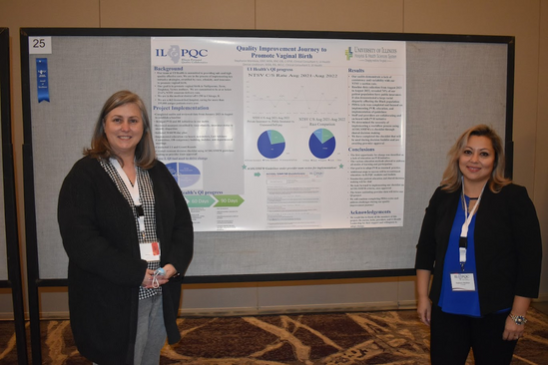
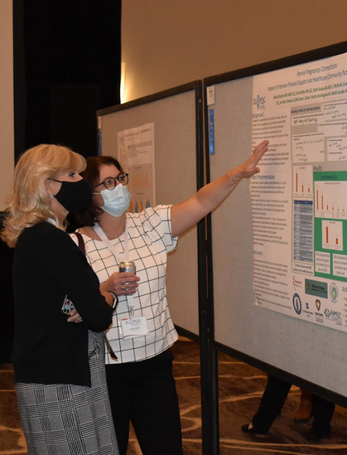
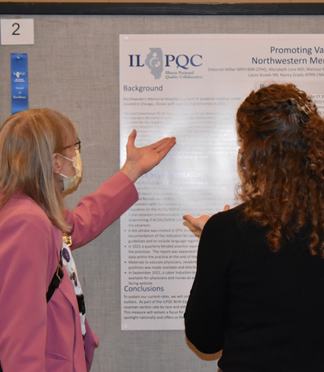
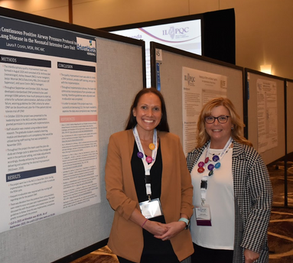
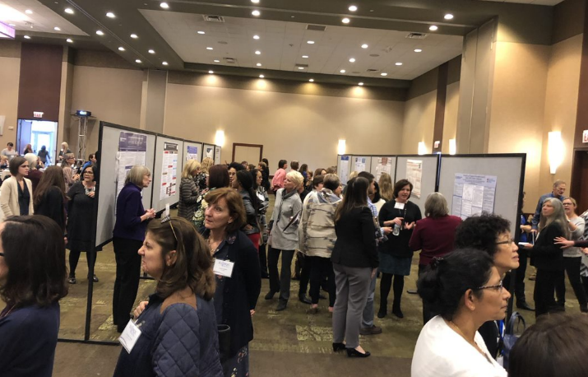
ILPQC Poster Session
Collaborative Learning
Opportunity
12:00-1:15pm

Slide 26
Networking Lunch & Poster Session
12:00pm – 12:30pm
Pick up your lunch box and drink outside the Grand Ballroom
12:30pm – 1:15pm
Presenters at their posters from 12:30 – 1:15pm
Posters with blue ribbons received Awards of Excellence

Slide 27
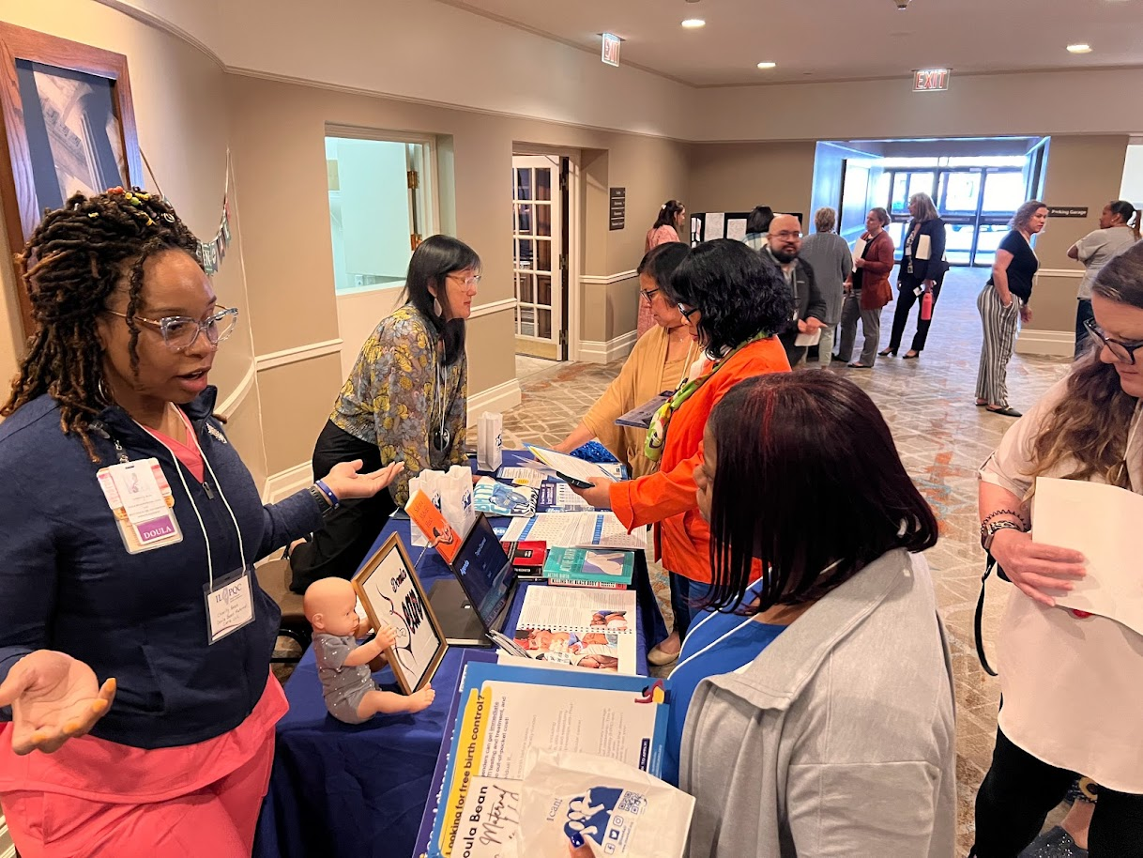
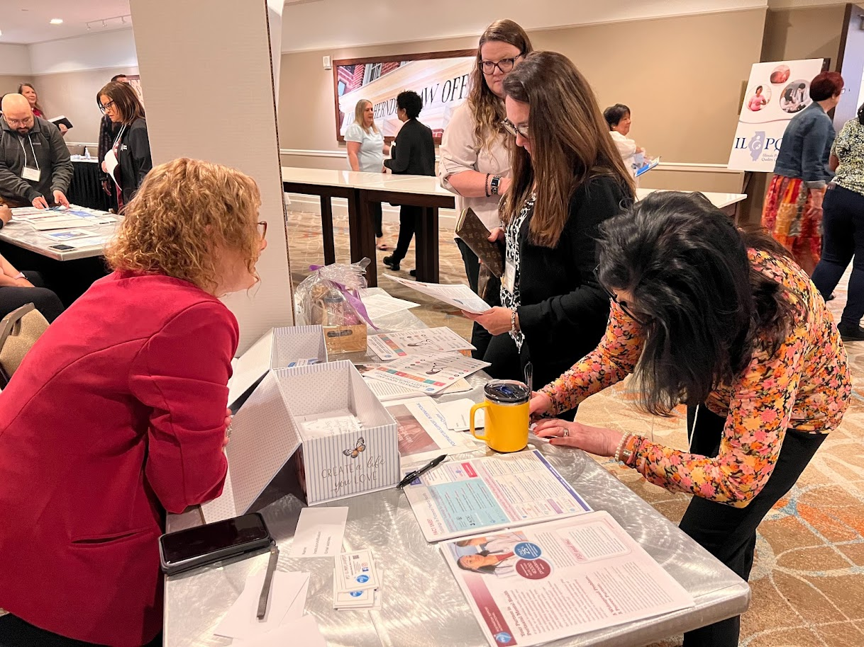
ILPQC PARTNER TABLES
Visit and E.N.G.A.G.E.
The Star Legacy Foundation (Stillbirth Awareness)
IDPH: Illinois Maternal Morbidity and Mortality Report
DHS: Illinois Safe Sleep Support
Open during Lunch/Poster Session
DHS:
MAR NOW
(OUD Resources)
Postpartum Support International-IL Chapter
ILPQC Resources
Located at the Back of the Room
I PROMOTE-IL
Innovations to ImPROve Maternal OuTcomEs in Illinois
Home Visiting Connections
Doula Bean
Connect, Find Resources and Build Community

Slide 28
Speakers & ILPQC Committees Photos
All Speakers and ILPQC Committees: Please meet outside the Grand Ballroom for a group photograph at 12:00pm by the windows
Speakers
Leadership Committee
Perinatal Network Administrators and Educators
OB Advisory Workgroup
Neonatal Advisory Workgroup
OB and Neonatal Community Advisory Boards
Planning Committee
State Quality Council
ILPQC Central

