Slide 1
Equity-focused Approaches to Improving Safe Infant Sleep during Birth Hospitalization
Sunah Susan Hwang, MD, MPH, PhD
The Lula O. Lubchenco Chair in Neonatal-Perinatal Medicine
Associate Professor of Pediatrics
Director, Perinatal Health Services Research
Section of Neonatology, Department of Pediatrics
University of Colorado School of Medicine

Slide 2
Sunah Susan Hwang, MD, MPH, PhD
November 2, 2023
Equity-focused Approaches to Improving
Safe Infant Sleep during Birth Hospitalization

Slide 3
Conflicts of Interest
None

Slide 4
Outline
Epidemiology of sudden unexpected infant death (SUID) and safe infant sleep practices in the U.S.
Principles of equity-focused QI to improve safe sleep practices
Family engagement and family centered care to improve safe sleep practices

Slide 5
Sudden Unexpected Infant Death

Slide 6
Sudden Unexpected Infant Death
Death in an infant less than 1 year of age that occur suddenly and unexpectedly, and whose cause of death is not immediately obvious prior to investigation.
Sudden Infant Death Syndrome
Death of an infant less than 1 year of age that cannot be explained after a thorough investigation is conducted, including a complete autopsy, examination of the death scene, and review of the clinical history.

Slide 7
SUID/SIDS
Annually in the US, about 3500 infants die suddenly of no immediately, obvious cause (SUID).
In 2020, most frequent causes of SUID:
~1400 deaths were reported as SIDS
~1100 as cause unknown
~900 as accidental suffocation and strangulation in bed.
SOURCE: CDC/NCHS, National Vital Statistics System, Compressed Mortality File. 2020

Slide 8
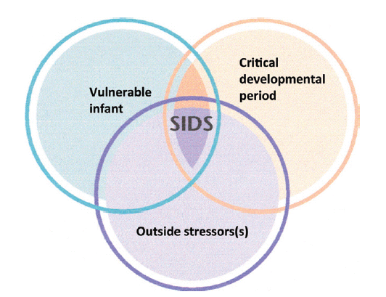
SIDS: Triple Risk Model
Intrinsic Factors
Prenatal exposures
Medullary serotonin system
Genetic background
Prematurity, IUGR
Extrinsic/ Modifiable Risk Factors
Breastfeeding
Smoking
Temperature regulation
Sleep practices
Moon et al. Pediatrics 2016

Slide 9
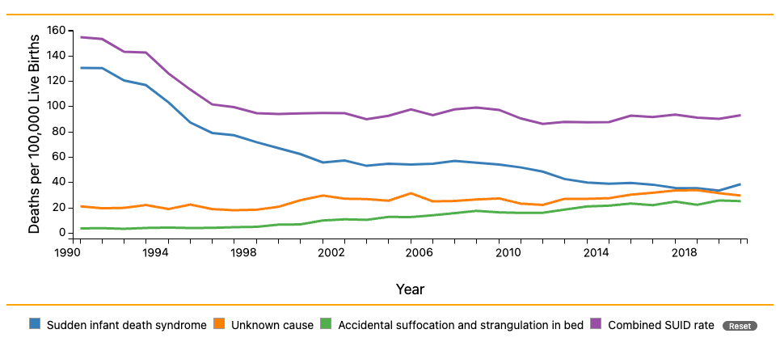
Trends in SUID by Cause, 1990-2020
Data Source: http://www.cdc.gov/sids/data.htm
SOURCE: CDC/NCHS, National Vital Statistics System, Compressed Mortality File.

Slide 10
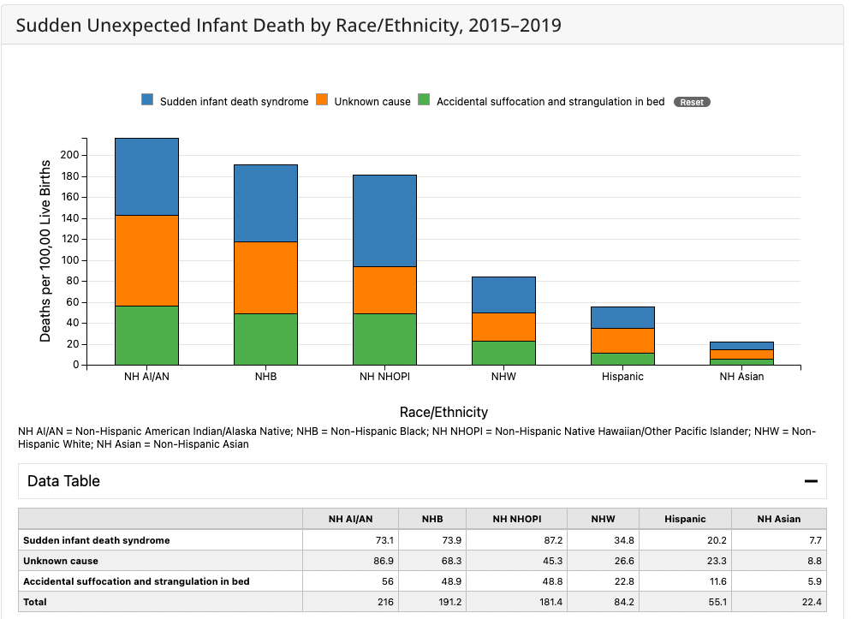
SOURCE: CDC/NCHS, National Vital Statistics System, Compressed Mortality File.
Notes:
Significant racial/ethnic disparities exist in SUID rates with the highest being in our American Indian/Alaska Native and Black populations and native Hawaiian/Pacific islander groups. For example, SIDS rates are nearly 3x higher among our indigenous infants compared to white infants. And indigenous and black infants are more than twice as likely to die from accidental suffocation and strangulation in bed compared to white infants.

Slide 11
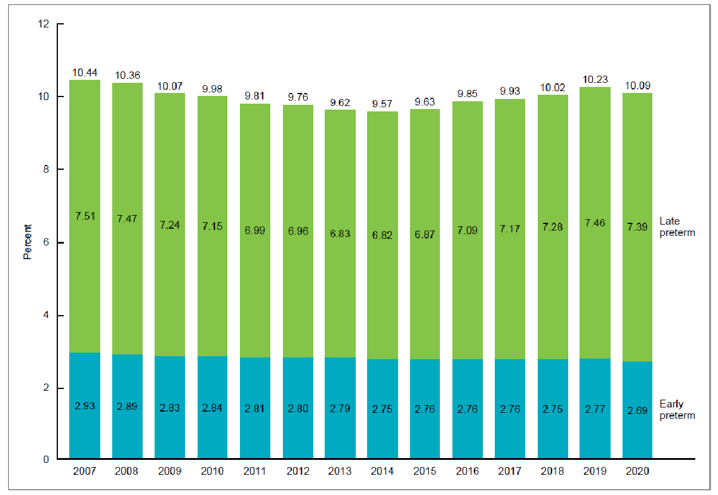
U.S. Preterm Birth Rates, 2007-2020
Hamilton BE, et al. Births: Provisional data for 2020. National Center for Health Statistics. May 2021.

Slide 12
Prematurity and SUID
Malloy MH. J Perinatol 2013.
Between 2007 and 2020, nearly 12,000 preterm infants
experienced SUID beyond the first month of life.
Notes:
2005-2007

Slide 13
Safe Infant Sleep Practices

Slide 14
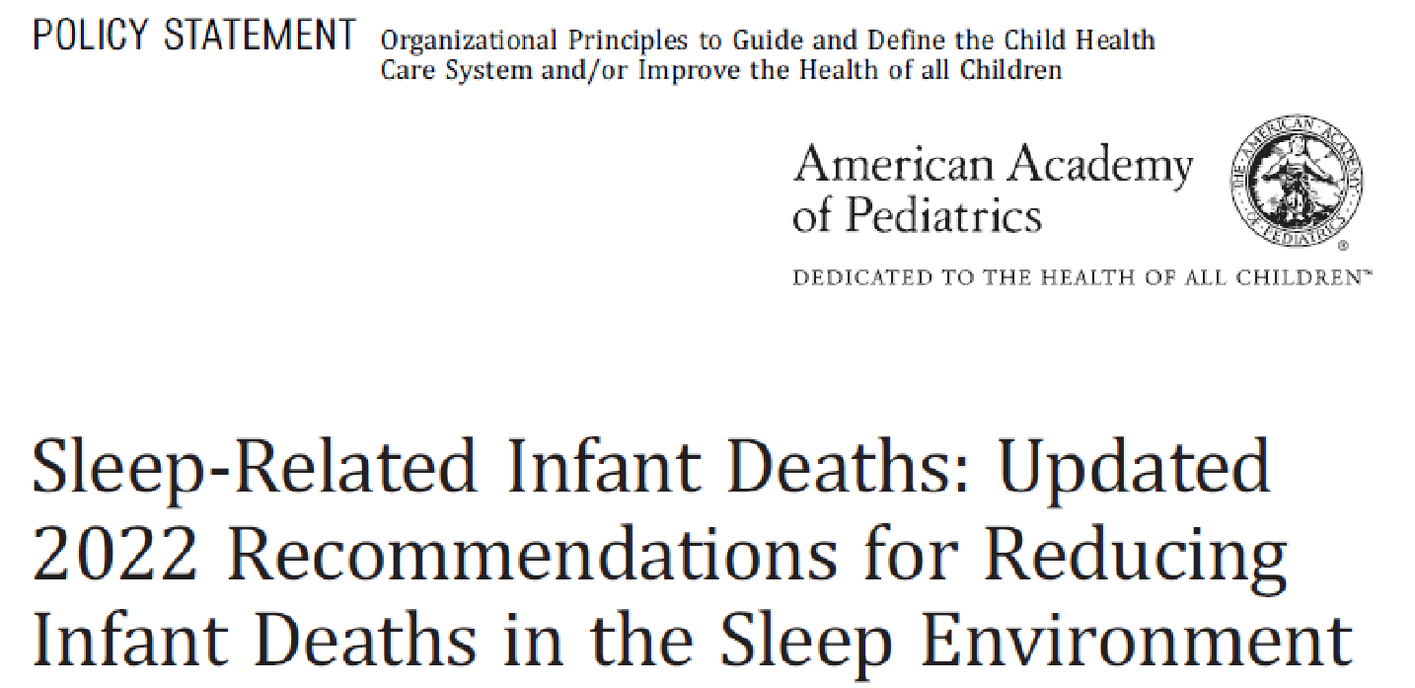
Moon et al. Pediatrics 2022.
Notes:
Disconnect between well known recommendations from the AAP and actual practice.

Slide 15
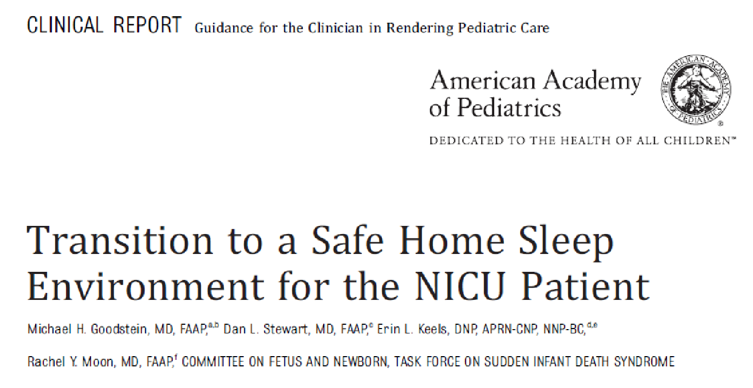
Goodstein et al. Pediatrics 2021

Slide 16
Data Source
Pregnancy Risk Assessment Monitoring System (PRAMS)
Ongoing state-based surveillance system, funded by the Centers for Disease Control and Prevention (CDC).
Monitors selected self-reported maternal behaviors and experiences among women who recently delivered a live-born infant in a hospital in the prior 2-4 months, with a maximum allowable recall period of 9 months postpartum.

Slide 17
Home Care of Late Preterm and Early Term Infants
Hwang, Barfield, Smith, Morrow, Shapiro-Mendoza, Prince, Smith, and McCormick. Pediatrics 2013

Slide 18
Notes:
We assessed PRAMS data from 35 states - maternal report of adherence to supine sleep positioning stratified by GA categories. There were several notable results – first, is that despite preterm infants being at greater risk for SUID, they have lower adherence to supine sleep positioning compared to term infants. Second, even the highest compliance rates are still far from optimal. And third, for every gestational age group, less than 50% of all black infants were positioned supine to sleep.

Slide 19
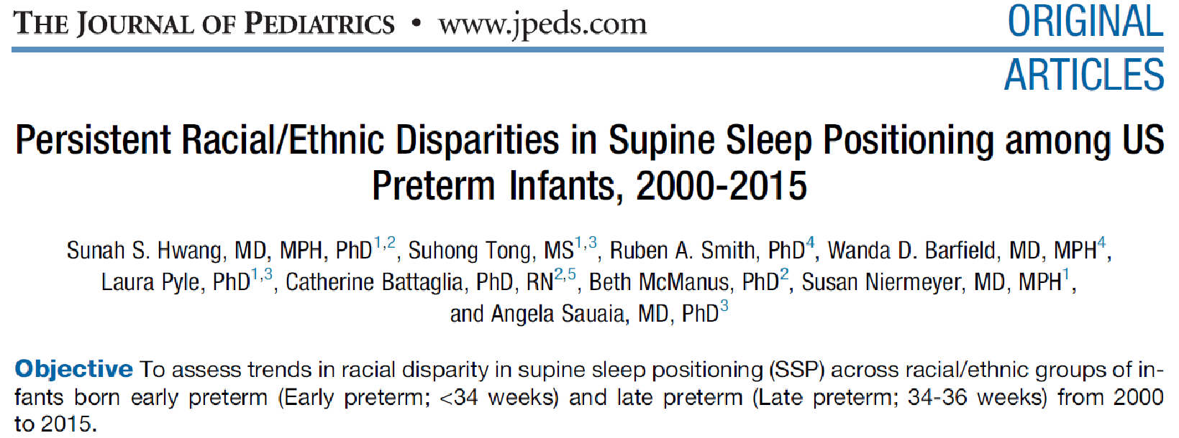
NHB-NHW racial disparity in SSP persisted during study period
For early preterm infants, NHB mothers had a slower SSP improvement rate than NHW mothers.
For late preterm infants, there was no difference in SSP improvement rates for NHB and NHW mothers.

Slide 20
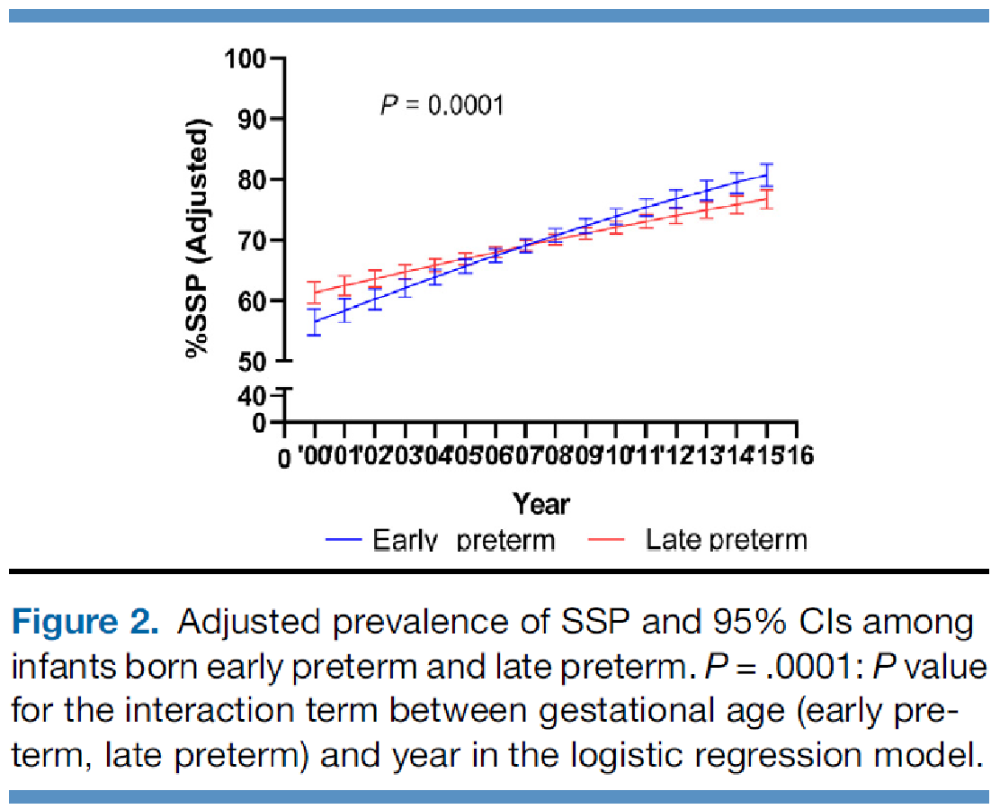

Slide 21
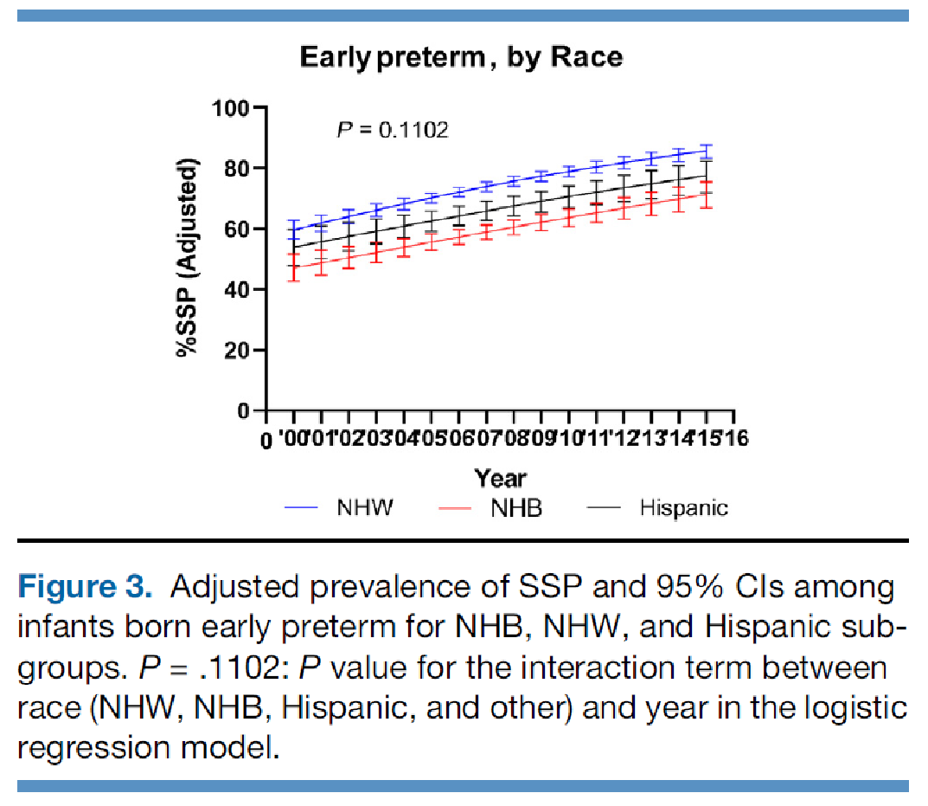

Slide 22
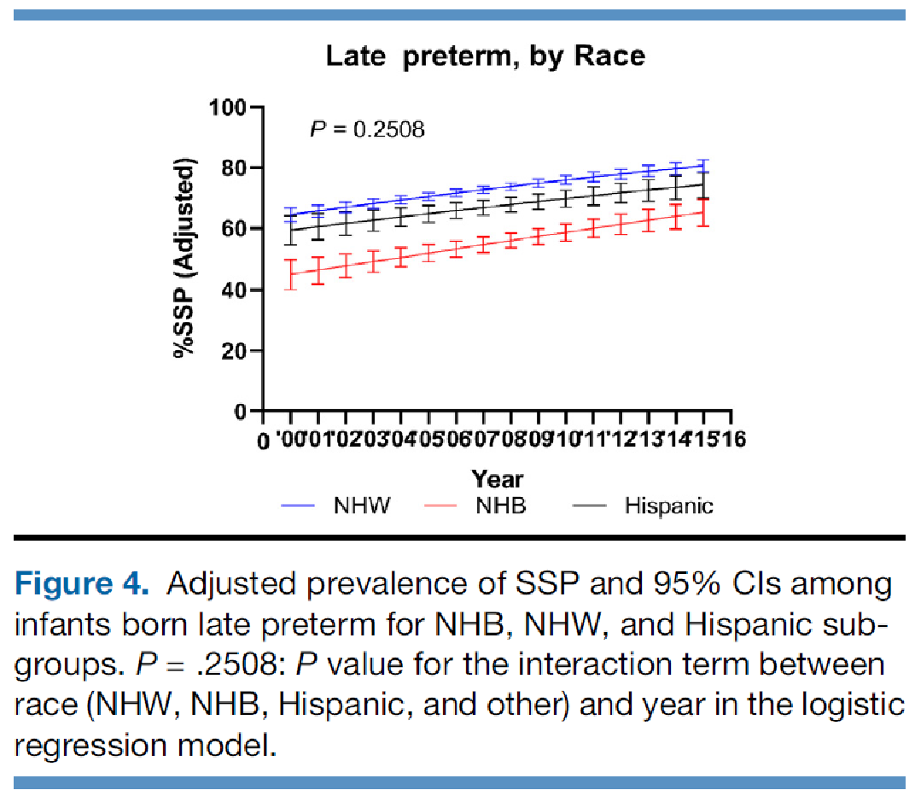

Slide 23
Study of Attitudes and Factors Effecting PREterm infant care Practices
NICHD 1R01HD095060
PIs: Margaret Parker/ Sunah Hwang
Notes:
What became apparent in the safe sleep quality improvement effort was that we didn’t quite understand the barriers and facilitators to parental adherence to SUID risk reducing practices for the preterm population. We knew a lot about the healthy full term group but we hypothesized that these factors were not the same for our NICU population given infants’ medical complexity as well as the tremendous psychosocial stress that parents of preterm infants experience. Hence we applied for and received funding for Safe Prep – short for study of attitudes and factors effecting Preterm infant care practices.

Slide 24
Rationale for SAFE PREP Study
Preterm infants have a higher risk of SUID
Lack of data on factors associated with adherence to AAP recommendations
Preterm infants are medically complex/vulnerable
Parents of preterm infants experience psychosocial distress
Need to characterize barriers and facilitators of adherence

Slide 25
SAFE PREP Study Objectives
Determine national prevalence of adherence to AAP-recommended infant care practices and reasons for parental adherence among mothers of preterm infants
Findings will inform the development of intervention strategies to improve parental adherence which can be effectively delivered in the NICU and post-discharge

Slide 26
Study population
Nationally representative sample of preterm infants
1500 mother-infant dyads (weighted to reflect the US population of preterm infants)
30 hospital sites in U.S./5 regions
20 NICUs
10 Special Care/Level II Nurseries
Notes:
While COVID has delayed our hospital recruitment, we are close to bringing on board 30 sites across the US. I look forward to sharing results in the next few years.

Slide 27
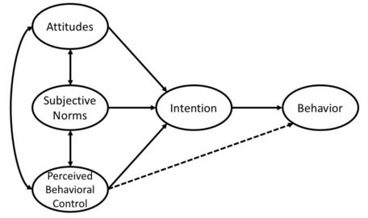
Mothers' fear about their infants' vulnerable preterm state related to suffocation, apnea of prematurity, and reflux influenced infant sleep practices.
Theory of Planned Behavior
23 in-depth interviews
In English or Spanish with mothers of preterm infants
Recently discharged from 4 NICUs
Education received in the NICU and advice from other health care providers, family, friends, and media impacted their choices.
Mothers adapted infant sleep practices to meet their own needs and address the perceived safety and comfort of infants.
Hwang SS, Parker MG, Colvin BN, Forbes ES, Brown K, Colson ER. J Perinatol. 2021
Notes:
23 in-depth interviews in English or Spanish with mothers of preterm infants who were recently discharged from four hospitals, utilizing a grounded-theory approach and framework of the Theory of Planned Behavior (attitudes, perceived control, social norms).

Slide 28
SAFE PREP Preliminary Quantitative Findings
Recruited >1000 mothers (of 1500) of preterm infants across 30 US hospitals
4-8 weeks post-discharge:
Non-supine sleep rate 50%
Bedsharing rate 23%
Final week of NICU hospitalization:
35% of mothers observed their infants in an exclusively supine position
62% observed loose objects in cribs.
>20% of mothers reported that providers supported non-supine positioning.
Identified modifiable factors that contribute to parental decision-making about sleep practices.

Slide 29
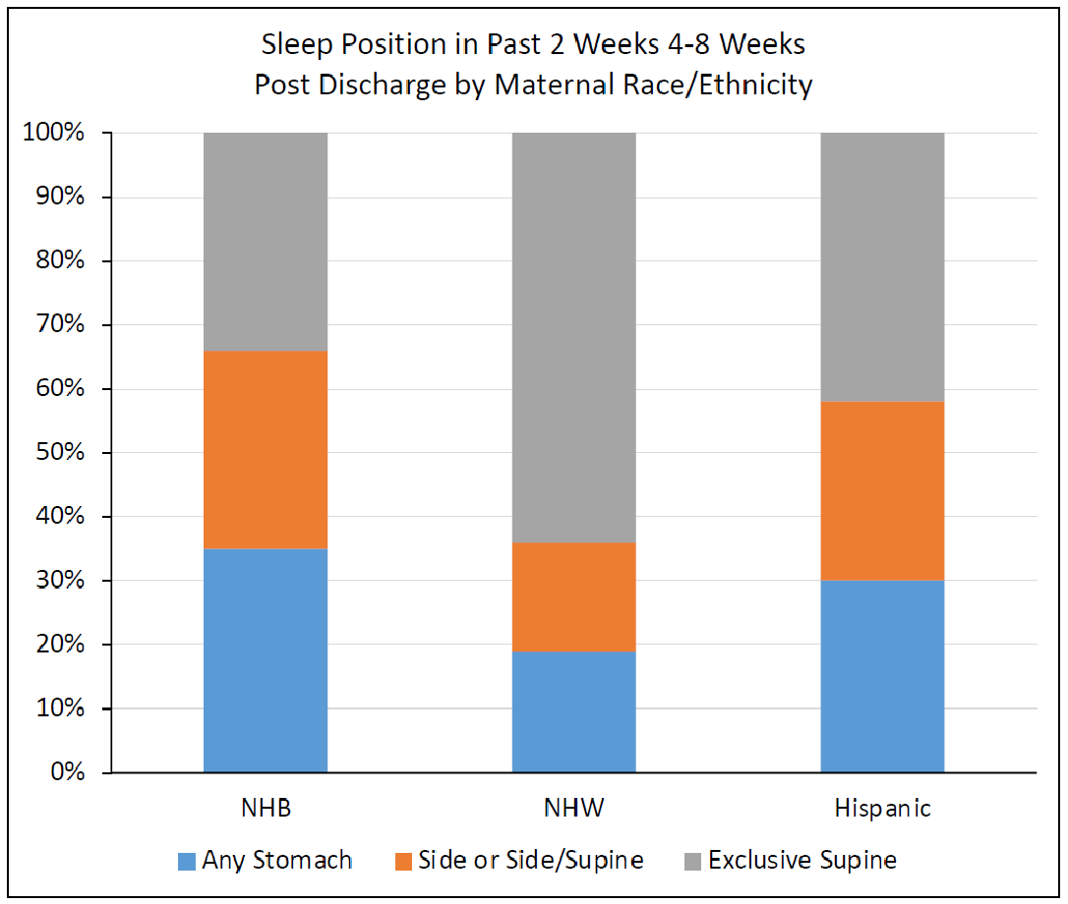
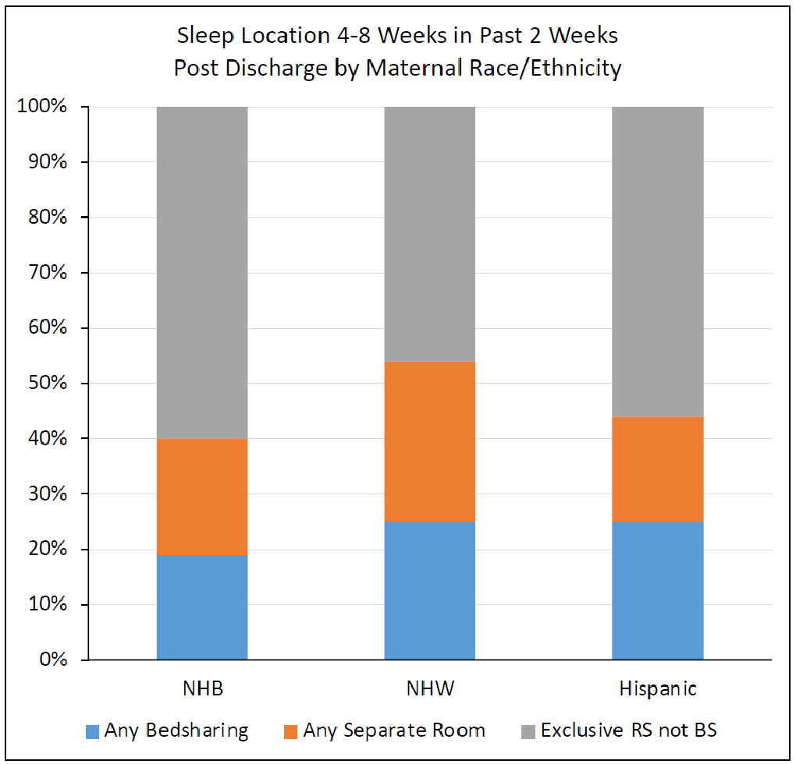

Slide 30
Persistent Disparities
Preterm Birth
Complications of Prematurity
Black infants are 1.5x more likely to be born preterm than NHW infants.
Preterm infants are 2-3x more likely to suffer SUID.
SUID
Black infants are over-represented in the population of infants who suffer the complications of prematurity.
Preterm NH-Black infants are 2x more likely to die from SUID than NH-White infants.

Slide 31
Improving Safe Infant Sleep Practices in Massachusetts NICUs

Slide 32
Implementation of Safe Sleep Practices in the NICU
Hwang SS, O'Sullivan A, Fitzgerald E, Melvin P. J Perinatol 2015

Slide 33
Hwang SS, O'Sullivan A, Fitzgerald E, Melvin P. J Perinatol 2015

Slide 34
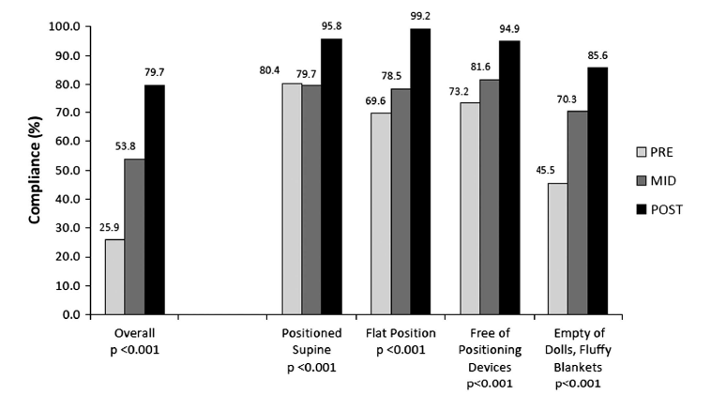
Results
PRE
Hwang, Sullivan, Fitzgerald, Melvin et al.
J Perinatology 2015.

Slide 35
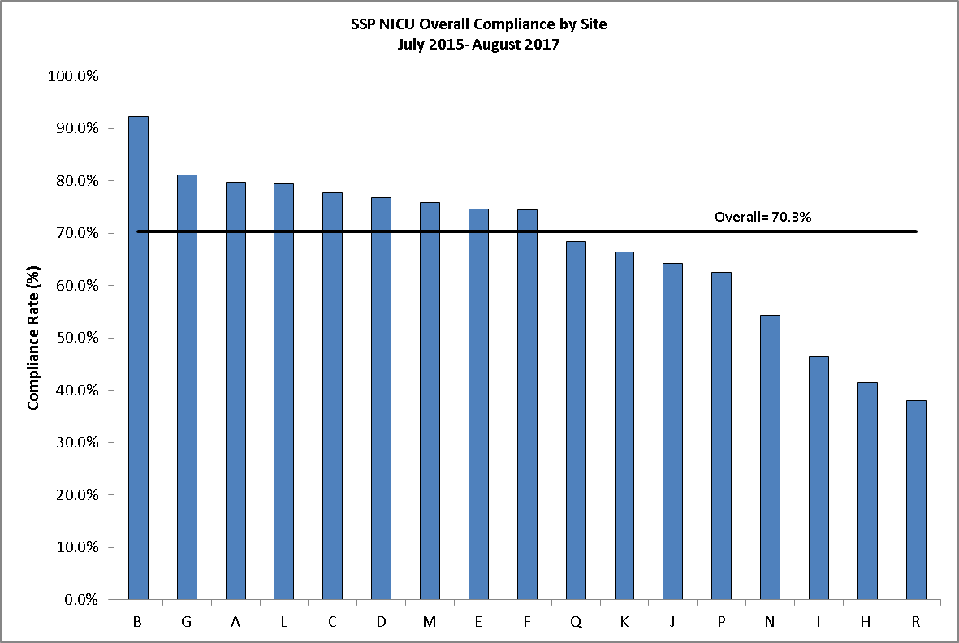
Expansion to and Comparison Across MA Birthing Hospitals

Slide 36
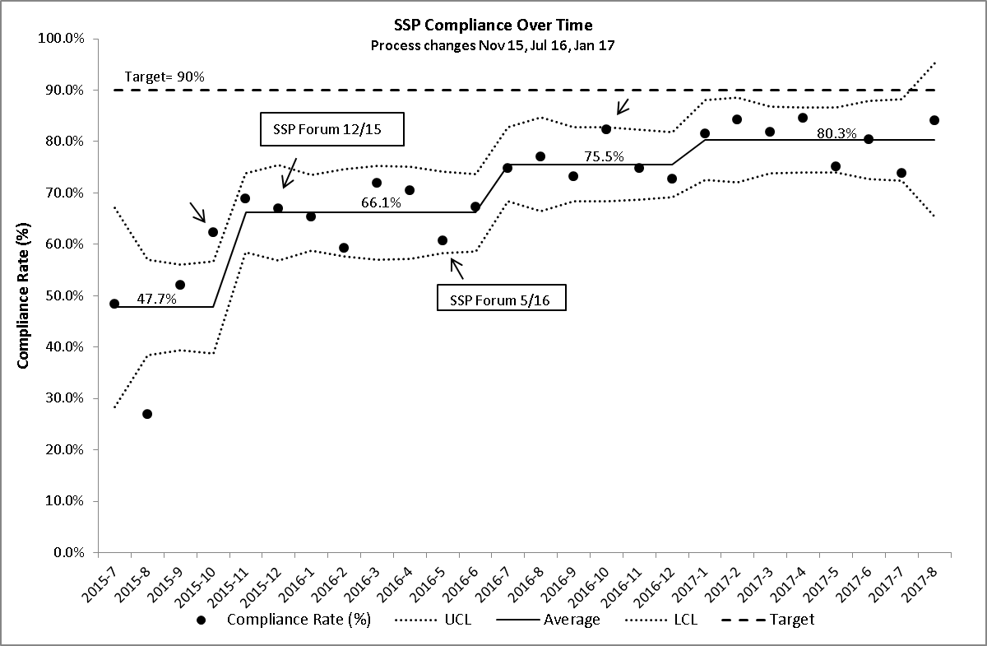
NICU SSP Compliance over Time
N=7261
SSP Webinar 10/16
SSP Webinar 10/15
SSP Forum 12/16
Project Launch 4/15
Hwang SS, Melvin P, Diop H, Settle M, Gupta M. J Perinatol 2018.

Slide 37
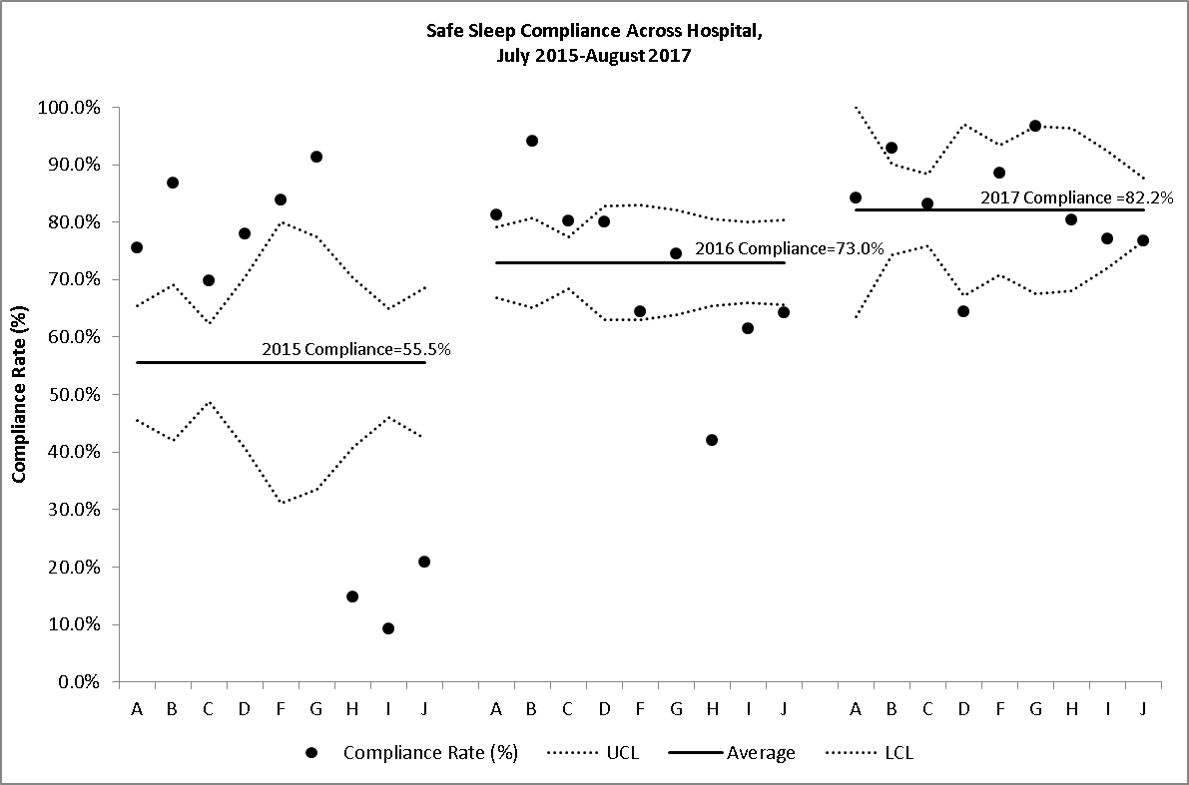
Hospital SSP Compliance Variation by Year
Hwang SS, Melvin P, Diop H, Settle M, Gupta M. J Perinatol 2018.
Notes:
Also encouraging was the reduction in various across hospitals that we demonstrated. Each dot here represents a NICU and you can see that at the start of the collaborative, all units were outside of the confidence bounds, evidence of the wide variation in safe sleep compliance across centers. By 2017, near all units are centered around the mean.

Slide 38
Did we reduce racial/ethnic disparities in
safe sleep compliance?

Slide 39
Equity-focused QI Questions We’re Learning to Ask
Are we embedding equity from the very beginning and into all stages of this QI project?
Are we collecting aggregate or stratified data?
Where is our race/ethnicity data coming from and how accurate are the data?
How might broader social determinants of health impact your intervention implementation and your outcomes?
Are we actively seeking and listening to the voices of our NICU parents?

Slide 40
Centering the Family in NICU Care
Data-driven Engagement of Families to Improve the NICU Experience in Colorado
(DEFINE Colorado)

Slide 41
SMART Aim
SPECIFIC
MEASURABLE
ATTAINABLE
REALISTIC
TIMEBOUND
Notes:
So for example, in QI, we typically talk about SMART aims to ensure that your goal is…

Slide 42
SMART Aim
SMARTIE Aim
SPECIFIC
MEASURABLE
ATTAINABLE
REALISTIC
TIMEBOUND
INCLUSIVE
EQUITABLE
Notes:
So for example, in QI, we typically talk about SMART aims to ensure that your goal is…

Slide 43
DEFINE Colorado QIC Key Driver Diagram
Aim Statement
Primary Drivers
Secondary Drivers
Potential Change Concepts
By December 2023, hospitals will improve family engagement in NICUs by:
Improving parental report of engagement in infant health and development during NICU hospitalization by 20%
Reduce disparities in parental report of engagement by race/ethnicity, primary language, and distance from hospital by 20%
Language barrier between providers and parents
1) Increase use of interpreter services often and early
Communication between NICU staff and families; among NICU providers
1) Standardize timing and content of first family meeting after admission
Measure: 1) Parental report of timely and consistent communication from providers; 2) Timing of first family meeting; 3) Frequency of family updates/meetings
Lack of timely and frequent family updates
1) Reduce parking cost; 2) Provide public transportation vouchers; 3) Minimize restriction of sibling visitation; 4) On site childcare for siblings; 5) Overnight accommodations for families; 6) Provide meals as needed
Inadequate family presence (during rounds, for infant cares)
By December 2023, hospitals will improve family engagement in NICUs by:
Improving parental report of engagement in infant health and development during NICU hospitalization by 20%
Reduce disparities in parental report of engagement by race/ethnicity, primary language, and distance from hospital by 20%
Inconsistency in understanding of infant care plans among providers
1) Improve communication among medical consultants and primary team; 2) improve communication among primary team and nurses
Current social services not comprehensive to address all needs
1) Social determinants screening tool; 2) establish referral service
Social and financial supports for families
1) Utilize parent peer support groups
Measure: 1) date of first social worker contact; 2) parental report of social and financial needs being met
Social workers bandwidth; timely availability
Inadequate family support in primary language
1) Increase use of interpreter services often and early
Inadequate mental health support
1) Introduce universal screening for parental depression/anxiety; 2) Provide mental health support during NICU hospitalization
Inadequate family presence
1) Reduce parking cost; 2) Provide public transportation vouchers; 3) Minimize restriction of sibling visitation; 4) On site childcare for siblings; 5) Overnight accommodations for families; 6) Provide meals as needed
Family engagement in Hands-On NICU care
Families and NICU staff have unclear expectations about parental role in the NICU; lack of parental empowerment
Measure: Skin to skin and breastfeeding continuation (through day 7, 28, and discharge)
1) Educate family on all aspects of care they can participate in; 2) Development of peer-support groups; 3) Standardize family participation in infant’s care (FICare)
Language barriers
1) Increase use of interpreter services often and early
Mother’s own milk (MOM) protocols, policies, and supports
1) Introduce MOM education and support during prenatal period; 2) Early pumping initiation; 3) Early and frequent skin to skin; 4) Address lactation issues by phone/telehealth
Lack of shared decision making in discharge planning
1) Educate family on all aspects of care they can participate in; 2) Development of peer-support groups; 3) Standardize family participation in infant’s care (FICare)
Family participation in discharge planning
Measure: 1) parental report of discharge readiness; safe sleep adherence post-discharge; 2) Timing of initiation and completion of discharge checklist
Language barrier
1) Increase use of interpreter services often and early
Inadequate family presence
1) Reduce parking cost; 2) Provide public transportation vouchers; 3) Minimize restriction of sibling visitation; 4) On site childcare for siblings; 5) Overnight accommodations for families; 6) Provide meals as needed
Compliance with safe sleep practices in NICU
1) Standardize infant sleep practices and environment for all NICU infants

Slide 44
Equity-Focused Quality Improvement (EF-QI)
Stratified sociodemographic data & intentional comparator groups
Families & community partners as compensated stakeholders
Identifies & names root causes of inequities
Focuses on systems NOT individuals
Incorporates EQUITY into every step of a QI initiative
Reichman, V., Brachio, S. S., Madu, C. R., Montoya-Williams, D., & Peña, M.-M. (2021). Using rising tides to lift all boats:
Equity-focused quality improvement as a tool to reduce neonatal health disparities. Seminars in Fetal and Neonatal Medicine.

Slide 49
Overall Safe Sleep: White vs Non-White

Slide 50
Equity-Focused Quality Improvement (EF-QI)
Stratified sociodemographic data & intentional comparator groups
Families & community partners as compensated stakeholders
Identifies & names root causes of inequities
Focuses on systems NOT individuals
Incorporates EQUITY into every step of a QI initiative
Reichman, V., Brachio, S. S., Madu, C. R., Montoya-Williams, D., & Peña, M.-M. (2021). Using rising tides to lift all boats:
Equity-focused quality improvement as a tool to reduce neonatal health disparities. Seminars in Fetal and Neonatal Medicine.

Slide 53
Qualitative Data
Particularly helpful for QI projects focused on disparities
Incorporate qualitative/experiential data into some or all stages of your PDSA cycles
Engage family members, staff members, and other partners
Report results of qualitative data to your partners, clinical teams, and other influencers

Slide 54
“We’re told all the things that we can’t do about infant sleep. When it’s 2am and we’re exhausted and literally can’t think straight, tell us what we CAN do?”
“In the NICU, my one twin was sleeping on his belly the day before he was discharged home. That’s just how he always slept because he oxygenated better on his belly. My other twin had horrible reflux and so his head of the bed was raised up. That’s how they always slept. Then on the day of discharge, the nurses said we couldn’t do any of that and they had to sleep on the backs, totally flat.”

Slide 55
Equity-Focused Quality Improvement (EF-QI)
Stratified sociodemographic data & intentional comparator groups
Families & community partners as compensated stakeholders
Identifies & names root causes of inequities
Focuses on systems NOT individuals
Incorporates EQUITY into every step of a QI initiative
Reichman, V., Brachio, S. S., Madu, C. R., Montoya-Williams, D., & Peña, M.-M. (2021). Using rising tides to lift all boats:
Equity-focused quality improvement as a tool to reduce neonatal health disparities. Seminars in Fetal and Neonatal Medicine.

Slide 56
Witt et al. Pediatrics 2023.

Slide 57
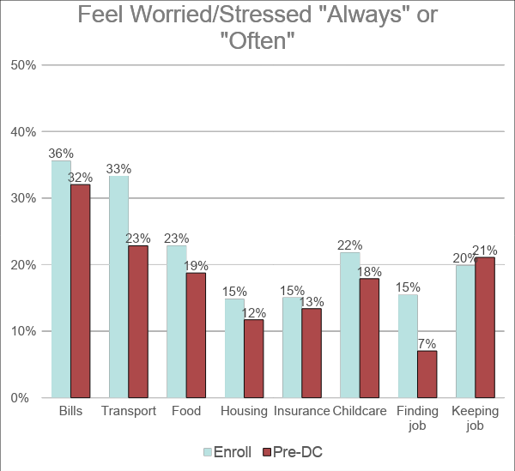
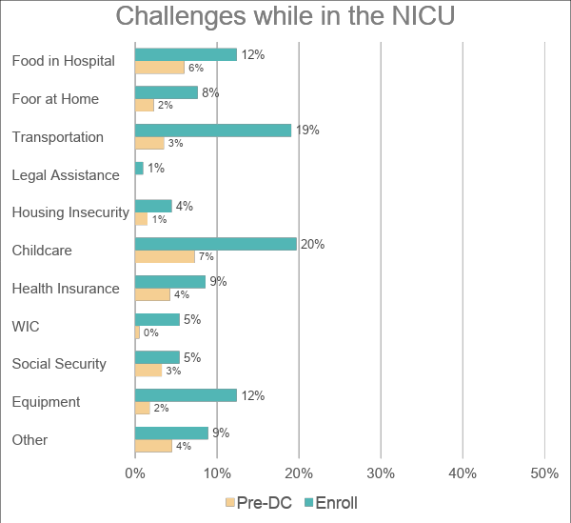
Parental Burdens

Slide 58
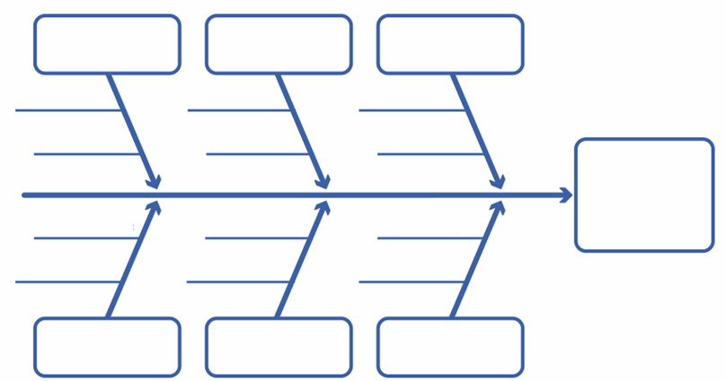
Fishbone diagram
Consider Sociodemographic barriers for each factor:
Communication barriers: language, general literacy, and health literacy.
Difficulty accessing and navigating the system.
Patient-centered, culturally competent care.
Conscious and unconscious biases
Policies & Procedures
Place: Culture, Environment
Process
Problem
Statement
People: Patient & Family Factors
Community & Historical Context
Product: Equipment/ Resources
Adapted from Michelle-Marie Peña with permission. Please do not reproduce without permission

Slide 59
PLACE/CULTURE
PRODUCT/ RESOURCES
Privacy for parents in the units
Implicit and explicit bias of staff
Assumption an individual from a group will or will support SSP
Societal: Minimal modeling, representation with Black parents and healthcare workers
Access to safe sleep supplies such as sleep sacks, tight-fitting sheets, cribs
Access to education about SSP and SUID
Representation in education about SSP in social circles, media, etc
Visitor restriction, family constraints
Breast Pump Supplies availability
Lack of availability of breast pumps in the hospital
Community support/services, discharge lactation plan
Culture of all or nothing
Cumbersome and long process for parent
Malfunctioning of personal beast pumps
Lack of availability of breast pumps out of the hospital- Ronald McDonald house and home
SMARTIE AIM:
Reduce the Black-White disparity in safe sleep practices (SSP) after hospital discharge by 20% by Dec 2024.
SMART AIM:
Increase percentage of infants receiving Human milk at discharge from NICU by a target of 10% from baseline by December 31, 2024
Support of lactating parent to return to work
Potential Transportation issues
Lack of paid parental leave
Lack of knowledge of about state policies related to paid parental leave
Hostile, judgmental environment; health care site may be source of trauma want to avoid
Other personal/outside responsibilities keep families from visiting and engaging in the NICU
Maternity Leave, Lack of paid time off from work
Access to breast pump
Insurance
Parent advisor (hospital volunteers)- significant hour commitment). Lack of representation
Communication in the primary language
Multidisciplinary emphasis on importance
Reduced access to baby due to NICU admission
Inadequate knowledge of limitations associated with Donor Milk
Historical: Distrust in healthcare due to past experiences
Implicit and explicit bias of staff
Health conditions (e.g. physical and emotional)
Familial: Lack of family support due to lack of knowledge on the SUID risk
Prenatal education on importance of Human Milk- the why, the how, the time sensitive nature
Separation of mother-baby dyad
(Mom in birth hospital, baby in main campus)
Culture of promoting continued pumping vs permissive weaning in the setting of stressors
Assessment of parental lactation goals
Inconsistent messaging amongst team members
Lactation specialist availability after delivery
Birth Hospitals: No policy towards pumping within first 6 hours
Mother not pumping regularly- trouble shoot pumping schedule strategies
Cumbersome and long process for staff
Lack of knowledge of lactation physiology- early initiation, frequency of stimulation, modes of stimulation (NNBF, SSC), expression
Support/education of lactating parent by other family members
No policy towards lactation interventions in the first 6 hours- SSC, Oral care
Reduced access to lactation support
Assessment of infant readiness for DBF
PEOPLE
PROCESS
POLICIES

Slide 60
Equity-Focused Quality Improvement (EF-QI)
Stratified sociodemographic data & intentional comparator groups
Families & community partners as compensated stakeholders
Identifies & names root causes of inequities
Focuses on systems NOT individuals
Incorporates EQUITY into every step of a QI initiative
Reichman, V., Brachio, S. S., Madu, C. R., Montoya-Williams, D., & Peña, M.-M. (2021). Using rising tides to lift all boats:
Equity-focused quality improvement as a tool to reduce neonatal health disparities. Seminars in Fetal and Neonatal Medicine.

Slide 61
SLEEP WELL: IMPROVING SAFE INFANT SLEEP PRACTICES IN THE NICU TO REDUCE INFANT DEATH AFTER DISCHARGE
Data Collection and Analysis
EPIC Order Sets, Crib Cards
- Crib Audits
- DEFINE Surveys
SSP videos and other materials
- EPIC order set for all admitted infants
- Crib card creation and implementation for all admitted infants
- Qualitative interviews with parents and staff to inform development of educational materials
- Creation of materials
- Integration of materials into SSP and discharge teaching
Sept 2023- Feb 2024
Mar 2024 – Aug 2024

Slide 62
Initiatives
Anschutz + Colorado Springs Partnership
Policy Update & Alignment
Nursing Education
Epic Order
Family Facing Materials

Slide 63
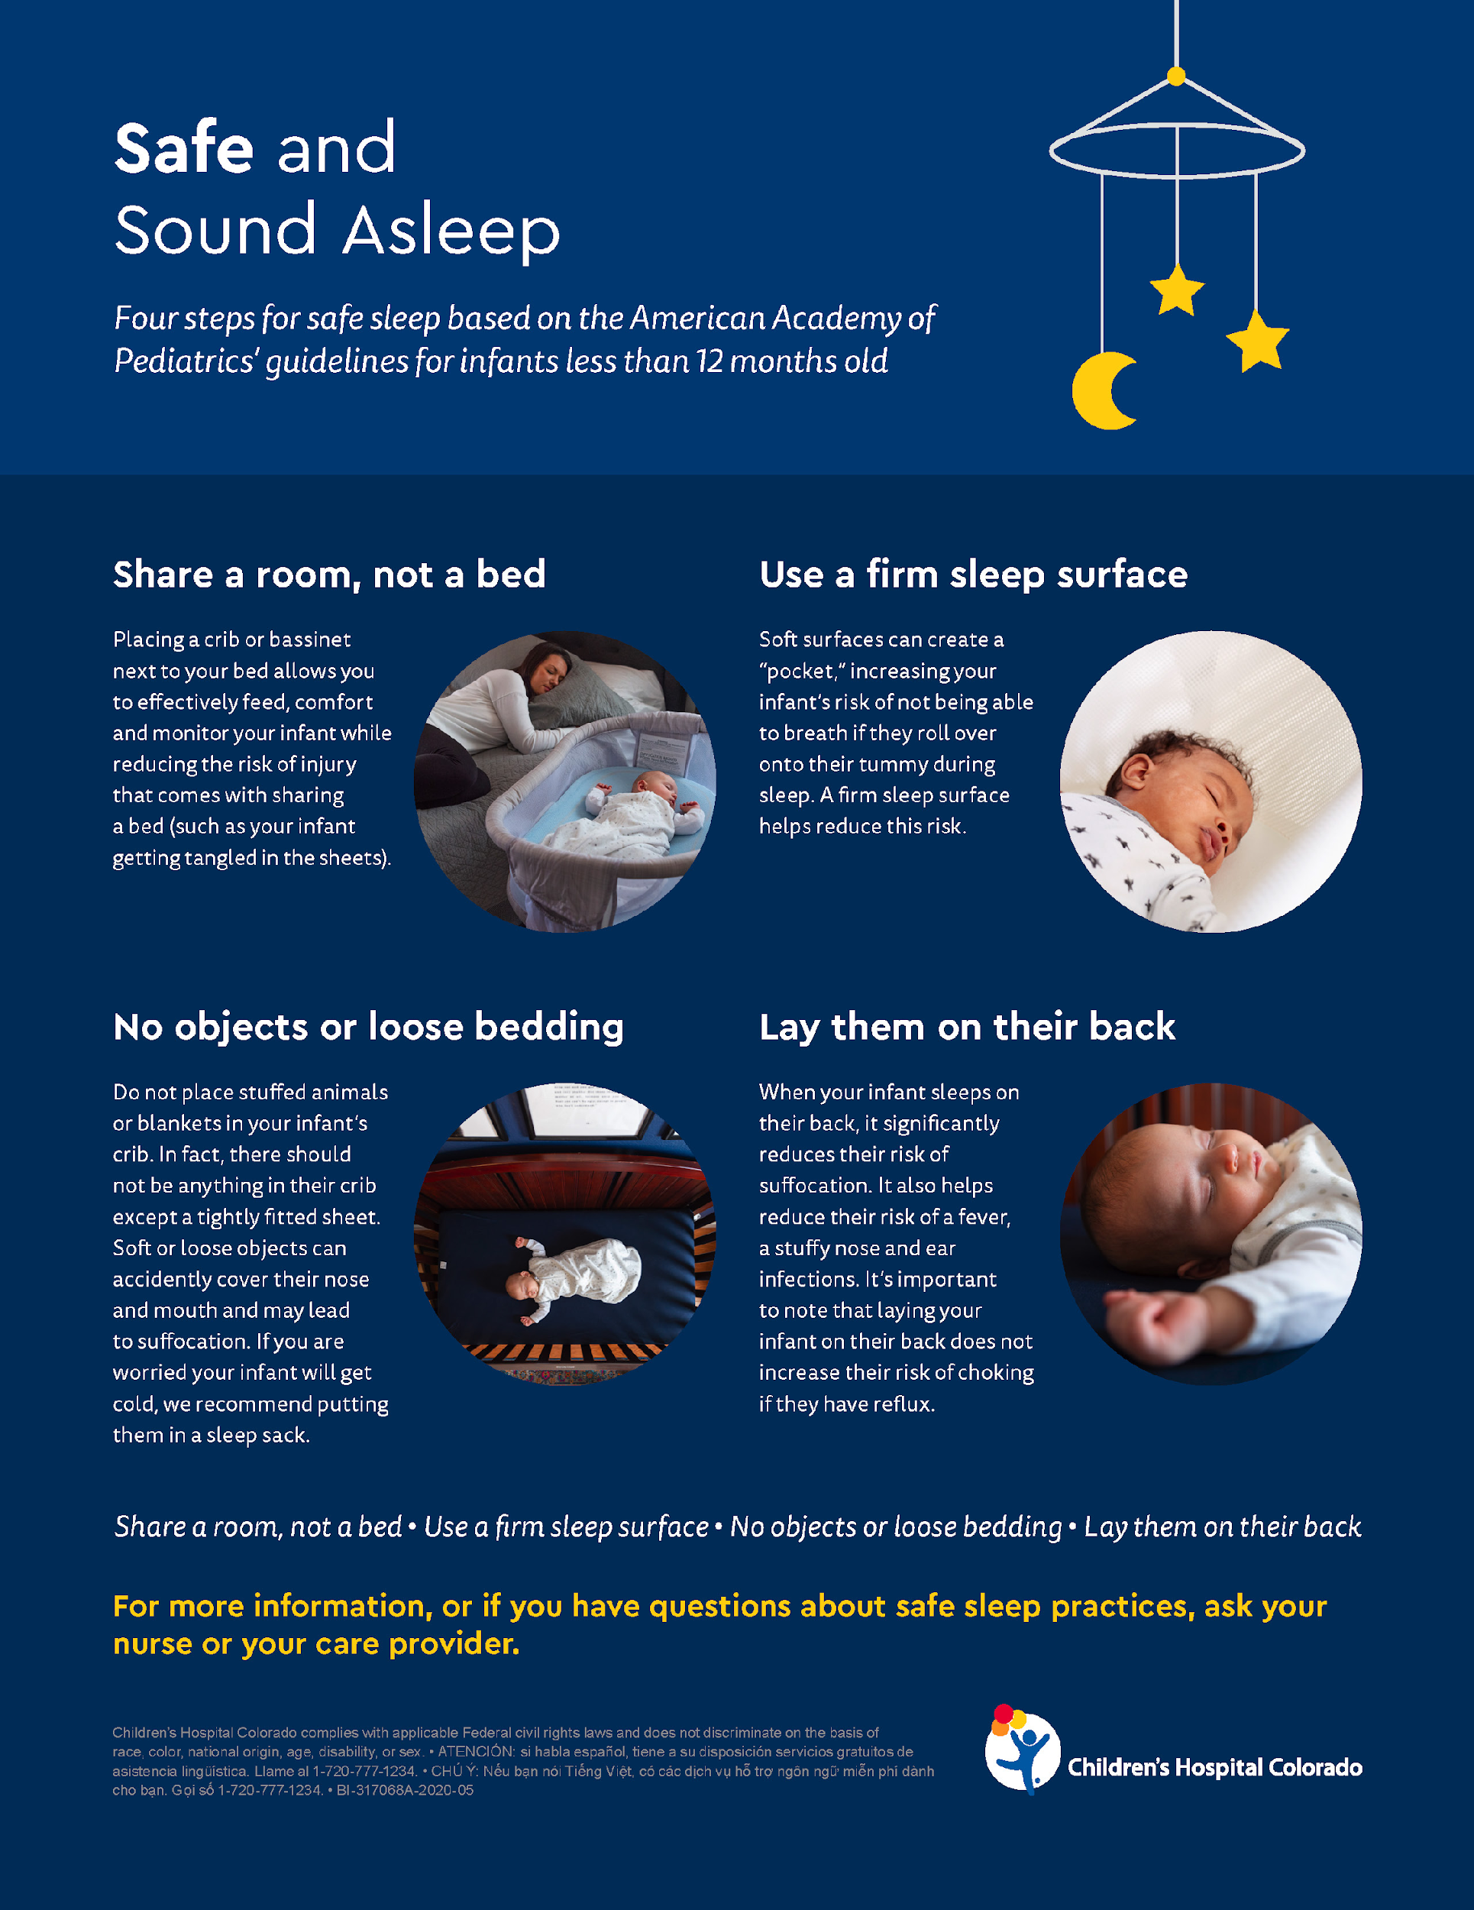
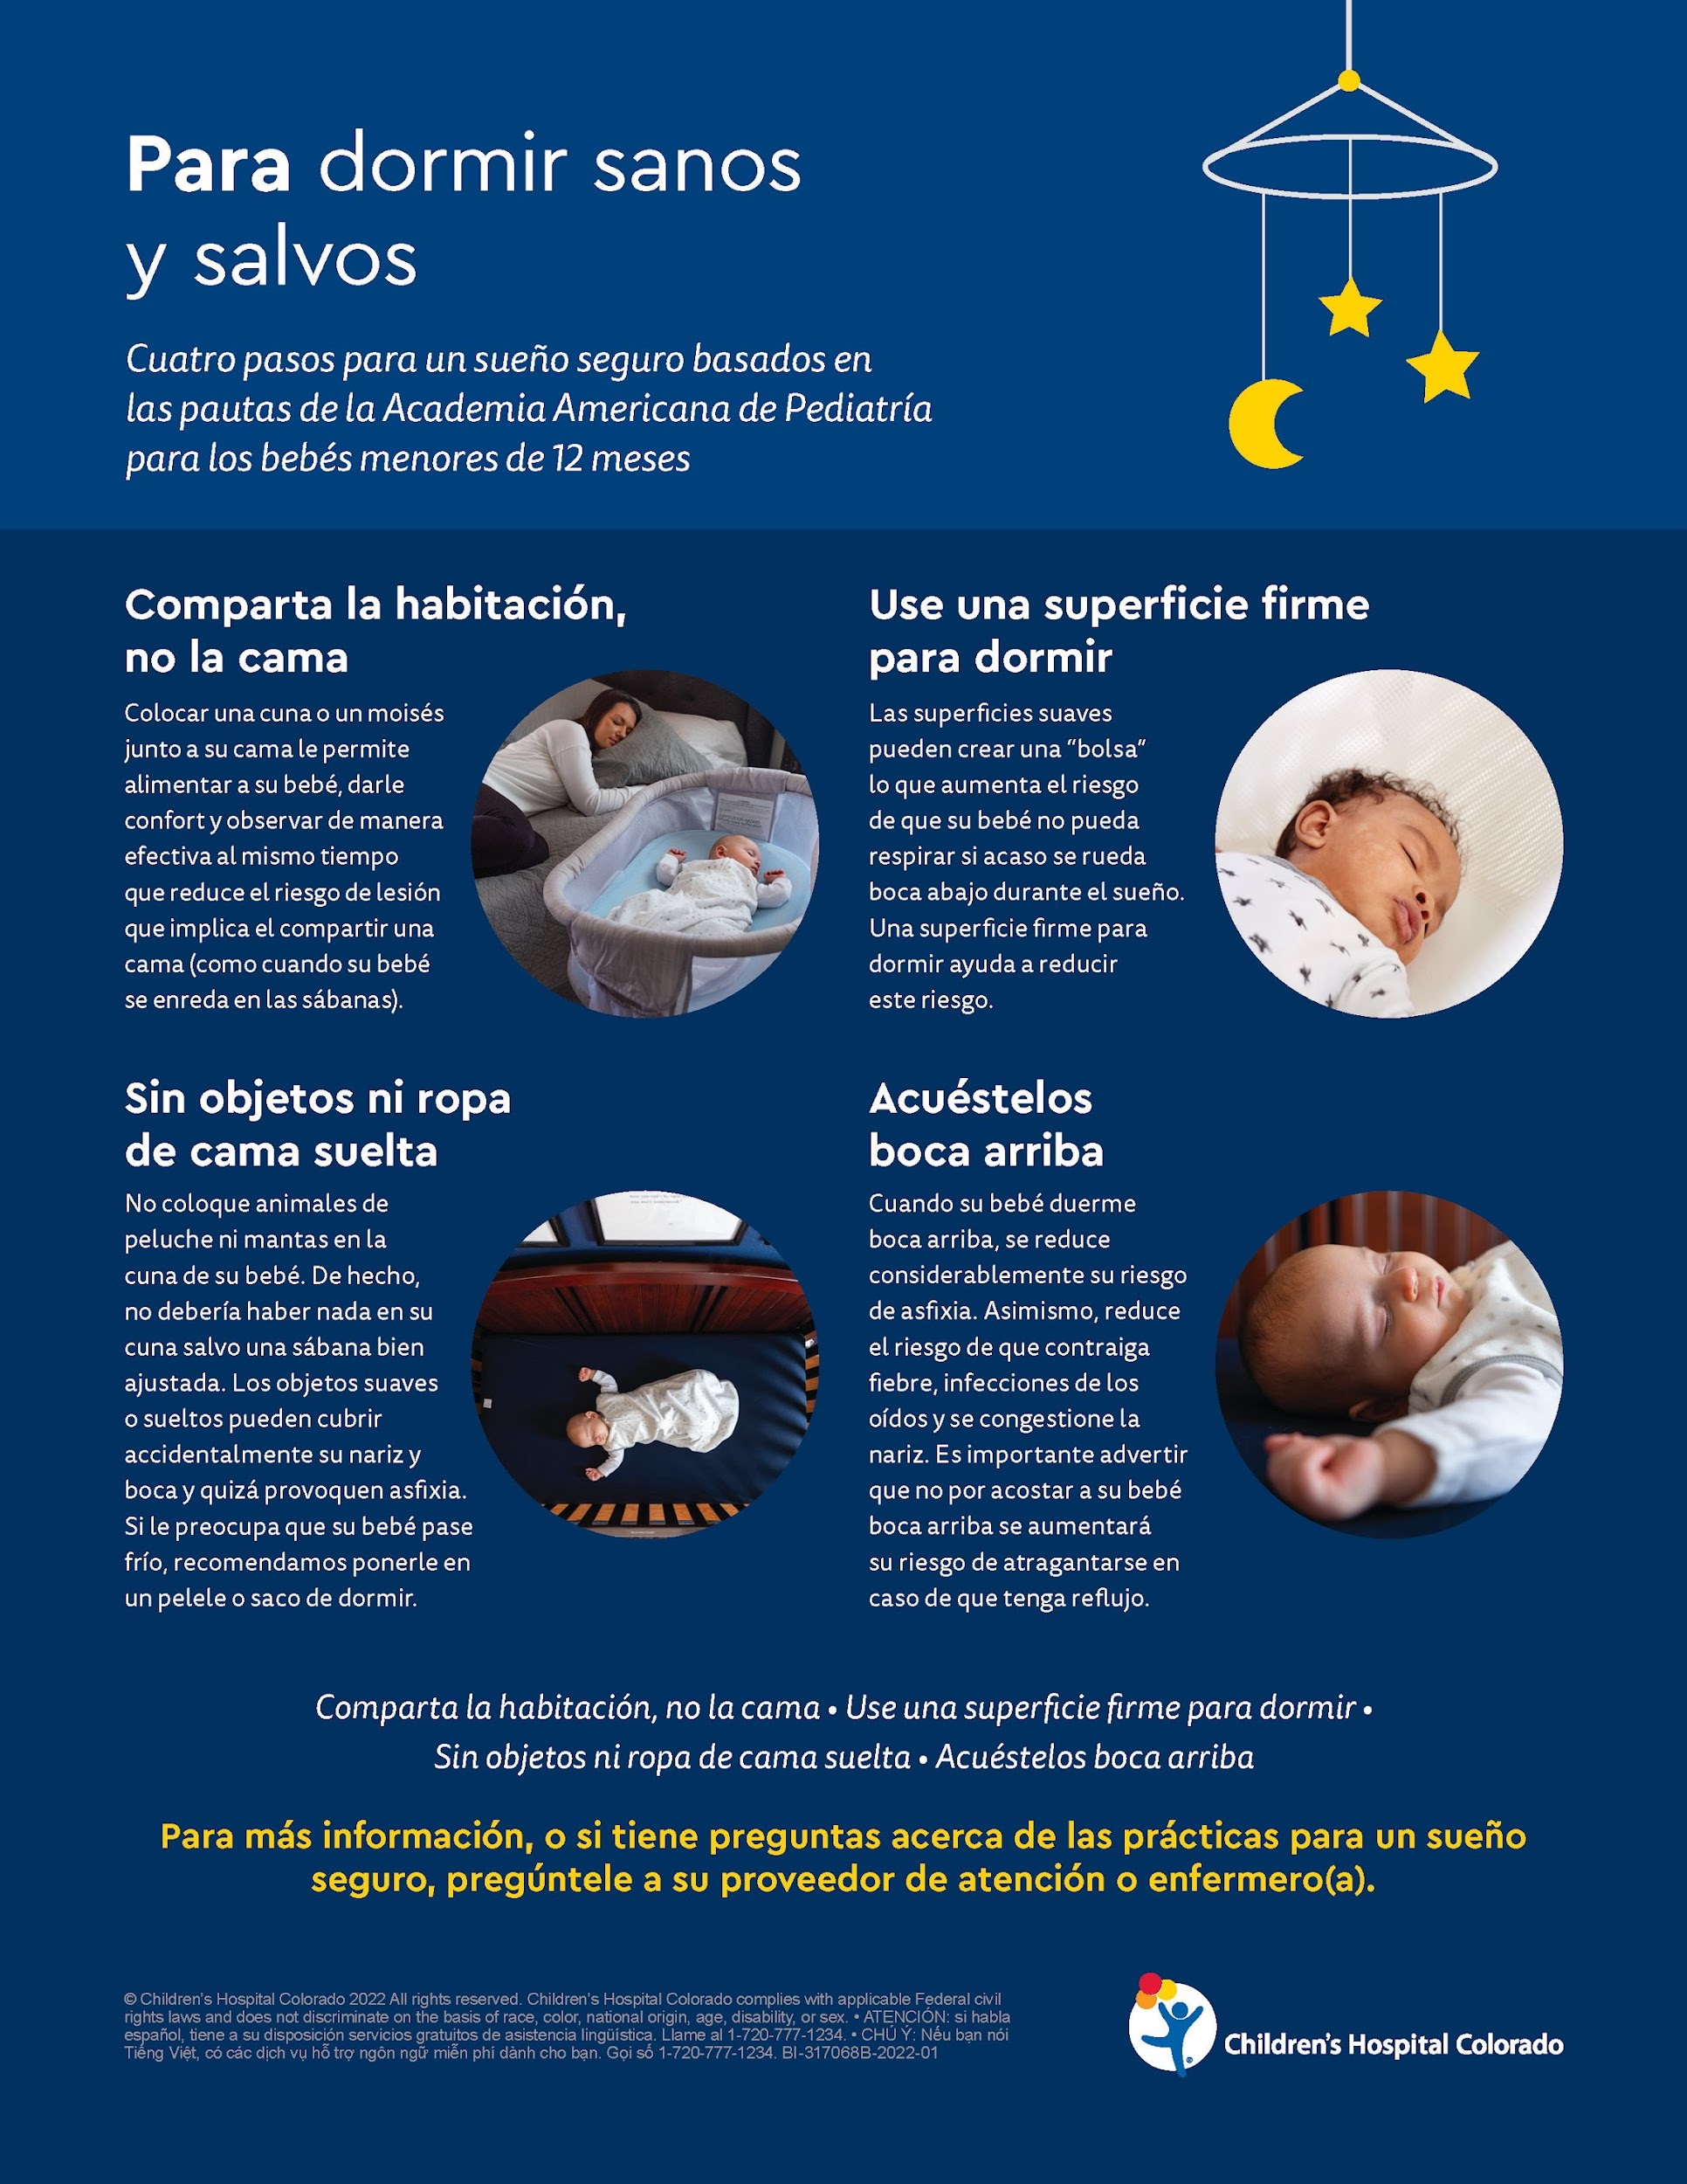

Slide 64
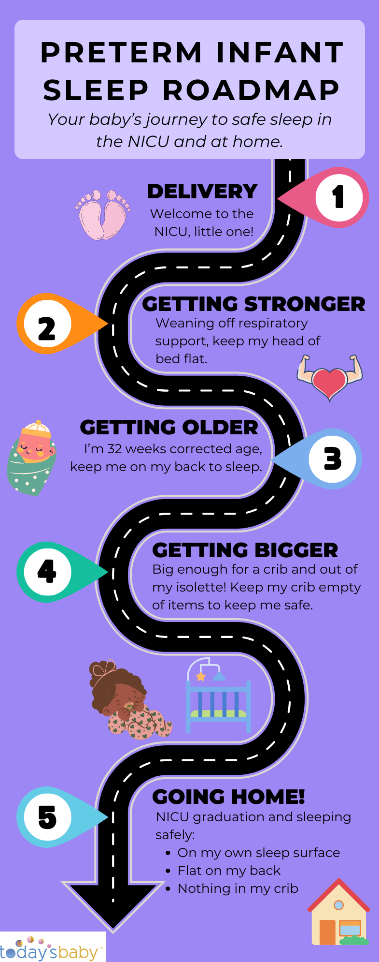

Slide 65
“Me, personally, I feel like the first video was almost unrealistically because it just like it was staged. It just felt staged. I’m just bein’ honest.”
“I think that was really sugarcoated. I think when people ask me questions about birth or after birth and things like that, I’m like, “I’m gonna be completely honest with you. This is my experience, though. Everybody’s different, but I’m gonna be completely honest with you.” I think, like they said, the videos are unrealistic and sugarcoated.”
“The other thing I didn’t see that there was single parents. Everybody expect that fairy tale ending until reality once again hits and people change and yeah.”
“Even in the second video, I think, we heard, “Oh. If I was frustrated, I’d pass ‘em off.” Not everybody has
that as an option. It’s the Pack ‘n Play or me.”

Slide 66
Acknowledgements
R01 NIH Research Grant (HD095060-01)
“Study of Attitudes and Factors Effecting PREterm infant care Practices (SAFE PREP)”
(PI: Parker/Hwang)
Colorado Medicaid Upper Payment Limit Program (530012)
“Colorado Hospitals Substance Exposed Newborn Quality Improvement Collaborative (CHoSEN QIC)”
(PI: Hwang)
American SIDS Institute
“Population-based Study of Prevalence and Predictors of SUID among Preterm Infants”
(PI: Hwang)
R01 NIH Research Grant (HD064595)
“Child Health after Assisted Reproductive Technology (ART): A Population-Based Study”
(PI: Stern/Diop)
CHOSEN QIC
Stephanie Bourque
Lauren Bruns
Rebecca Guigli
Laurie Halmo
Danielle Smith
Blair Weikel
Colleen Wheeler
Erica Wymore
DEFINE Colorado
Stephanie Bourque
Shannon Brinker
Victoria Del Valle
Emily Fawaz
Kathleen Hannan
Madoka Hayashi
Meg Kirkley
Mary Laird
Tina Fisher
Elizabeth Schierholz
Blair Weikel
CPCQC
Katie Breen
Brace Gibson
Rebecca Alderfer
Illuminate Colorado
Jillian Fabricius
Jade Woodard
CUSOM, Neonatology
Randy Wilkening
Susan Niermeyer

Slide 67
Thank You

