Slide 1
Incorporating Health Equity into Quality Improvement Initiatives in Perinatal Healthcare
Christina Davidson, MD
Associate Professor | Division of Maternal Fetal Medicine
Vice Chair of Quality, Patient Safety & Health Equity | Department of Obstetrics & Gynecology| Baylor College of Medicine
System Chief Health Equity Officer
Chief Quality Officer, Obstetrics & Gynecology
Texas Children’s Hospital

Slide 2


Incorporating Health Equity into Quality Improvement Initiatives in Perinatal Health Care
Christina Davidson, MD
Associate Professor | Division of Maternal Fetal Medicine
Vice Chair of Quality, Patient Safety & Health Equity | Department of Obstetrics & Gynecology | Baylor College of Medicine
System Chief Health Equity Officer & Chief Quality Officer for Obstetrics & Gynecology | Texas Children’s Hospital

Slide 3
Equality vs Equity
Health Equity:
-Opportunity for everyone to attain his/her full health potential
-Removing economic and social obstacles to health such as poverty and discrimination
www.smfm.org/covid19
Notes:
Health Equity: When every person has the opportunity to attain their full health potential. When no one is disadvantaged from achieving this potential because of social position or other socially determined circumstances.
Screen for and document social determinants that may influence health and use of health care:
Access to stable and safe housing
Access to clean water, food, other supplies
Access to translation services
Employment status
Screen positive → refer to institutional and community support services
Deliver clinical and public health messaging in the preferred language of each patient; use trained medical interpreters for any clinical encounters with patients of limited English proficiency

Slide 4


Health Disparities vs Inequities
Health disparities
Difference in health outcomes between groups within a population
Related to social or demographic factors
Health inequities
Differences in health outcomes that are systematic, avoidable, and unjust
Created when barriers prevent individuals and communities from accessing conditions that allow them to reach their full potential
IHI Improving Health Equity: Make Health Equity a Strategic Priority; SMFM Special Report. Am J Obstet Gynecol. 2018 Feb;218(2):B9-B17; Greenwood B, et al. Proc Natl Acad Sci U S A. 2020 Sep 1;117(35):21194-21200; Pregnancy Mortality Surveillance System, 2011-2015. MMWR 2019;68:423-9; Howell, E et al. Clin Obstet Gynecol. 2018 Jun;61(2):387-399
Notes:
Health Disparities are the differences between the health of one population and another in measures of who gets disease, who dies from disease, and other adverse health conditions that exist among specific population groups in the US. Healthy People 2030 defines a health disparity as a particular type of health difference that is closely linked with social, economic, and/or environmental disadvantage. Health disparities adversely affect groups of people who have systematically experienced greater obstacles to health based on factors such as their racial or ethnic group or any other characteristics historically linked to discrimination or exclusion
As an example, non-Hispanic black women are 3-4 times more likely to die from pregnancy related causes than Non-Hispanic white women. But why is that…
While the terms “health disparity” and “health inequity” may seem interchangeable, they are different. Health disparity denotes differences, whether unjust or not. Health inequity, on the other hand, denotes differences in health outcomes that are systematic, avoidable, and unjust. Inequities are created when barriers prevent individuals and communities from accessing conditions that allow them to reach their full potential. Examples of such barriers include unstable housing, lack of access to clean water, and lack of neighborhood safety.
Health disparities are one way we can measure our progress toward achieving health equity.
Health Disparity = difference in a health outcome between populations
Health Inequity = difference in a health outcome by a social construct (such as race) that are avoidable, unfair, unjust, and rooted in social and structural inequities.
(Understanding the difference between health disparity and health inequity (columbia.edu)).
Black women have higher case-fatality rates from a range of conditions though the leading causes of maternal death for black and white women are similar. For example, Black women experience higher mortality from cardiomyopathy, hypertensive disorders of pregnancy, and hemorrhage while Hispanic women have an increased risk of death due to hypertensive disorders.
Health care disparity: Defined by the Institute of Medicine as “racial or ethnic differences in the quality of health care that are not due to access-related factors or clinical needs, preferences, and appropriateness of intervention.” Ref = IHI Improving Health Equity: Make Health Equity a Strategic Priority
Health Equity: The opportunity for everyone to attain his or her full health potential. No one is disadvantaged from achieving this potential because of his or her social position (e.g., class, socioeconomic status) or socially assigned circumstance (e.g., race, gender, ethnicity, religion, sexual orientation, geography). Health equity means that everyone has a fair and just opportunity to be as healthy as possible. This requires removing obstacles to health such as poverty, discrimination, and their consequences, including powerlessness and lack of access to good jobs with fair pay, quality education and housing, safe environments, and health care. For the purposes of measurement, health equity means reducing and ultimately eliminating disparities in health and its determinants that adversely affect excluded or marginalized groups. health disparities—worse health in excluded or marginalized groups—are how we measure progress toward health equity.(what is health equity_robert wood johnson foundation.pdf)
https://www.acog.org/clinical-information/policy-and-position-statements/position-statements/2020/addressing-health-equity-during-the-covid-19-pandemic
Healthy People 2030 Questions & Answers | health.gov

Slide 5
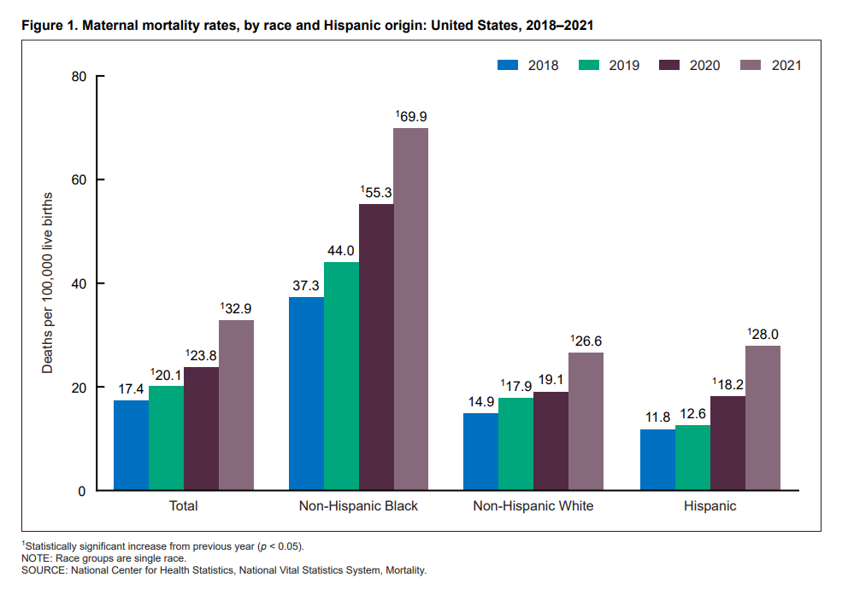
Racial & Ethnic Disparities in Pregnancy-Related Deaths:
United States, 2018–2021
https://www.cdc.gov/nchs/data/hestat/maternal-mortality/2021/maternal-mortality-rates-2021.htm
Notes:
https://www.cdc.gov/reproductivehealth/maternal-mortality/disparities-pregnancy-related-deaths/infographic.html
About 700 women die each year in the U.S. as a result of pregnancy or its complications.
American Indian/Alaska Native and Black women are 2 to 3 times as likely to die from a pregnancy-related cause than white women. Black women are 3–4 times more likely to die a pregnancy-related death as compared with white women, and this is independent of education, income, and comorbidities.
The PRMR (which is an estimate of the number of pregnancy-related deaths for every 100,000 live births) for black women with at least a college degree was 5 times as high as white women with a similar education. Non-Hispanic Black women with graduate degrees have higher rates of severe maternal morbidity than non-Hispanic White women who never graduated from high school.
Inequities increase by age, with the disparity for black and AI/AN women older than 30 years four to five times that of their white counterparts. For example, the disparity ratio for black women compared to white women ranged from 1.5 among the <20 years age group to 4.3 for the 30–34 years age group.
2018-2021: In 2021, 1,205 women died of maternal causes in the United States compared with 861 in 2020 and 754 in 2019. The maternal mortality rate for 2021 was 32.9 deaths per 100,000 live births, compared with a rate of 23.8 in 2020 and 20.1 in 2019. In 2021, the maternal mortality rate for non-Hispanic Black women was 69.9 deaths per 100,000 live births, 2.6 times the rate for non-Hispanic White women (26.6). Rates for Black women were significantly higher than rates for White and Hispanic women. The increases from 2020 to 2021 for all race and Hispanic-origin groups were significant
State Pregnancy-Related Mortality Ratios (PRMR) were placed equally into three groups (high, medium, low) and the PRMR was further calculated by race/ethnicity for each group. Even in states with the lowest PRMR, the PRMR for black women was about 3 times as high as the PRMR for white women.
CDC: Pregnancy-related death is defined as “the death of a woman while pregnant or within 1 year of pregnancy termination—regardless of the duration or site of the pregnancy—from any cause related to or aggravated by the pregnancy or its management, but not from accidental or incidental causes.” This definition relies on the connected causality of the WHO definition, but extends the time frame to one year, with a subclassification of late pregnancy related death for those beyond 42 days. Pregnancy-associated death is defined as “all deaths during pregnancy or within 1 year of pregnancy regardless of cause,” which forms a collection of cases from which to find pregnancy-related death.
The WHO uses the term “maternal death” to identify maternal mortality defined as “the death of a woman while pregnant or within 42 days of termination of pregnancy, irrespective of the duration and site of the pregnancy, from any cause related to or aggravated by the pregnancy or its management but not from accidental or incidental causes.”

Slide 6

MATERNAL MORTALITY
Heart failure/arrest during surgery/procedure
Ventilation
Hysterectomy
Puerperal cerebrovascular disorders
Pulmonary edema / Acute heart failure
Sepsis
Severe anesthesia complications
Shock
Sickle cell disease with crisis
Temporary tracheostomy
Acute myocardial infarction
Acute renal failure
Adult respiratory distress syndrome
Air and thrombotic embolism
Amniotic fluid embolism
Aneurysm
Blood transfusion
Cardiac arrest/ventricular fibrillation or flutter
Conversion of cardiac rhythm
Disseminated intravascular coagulation
Eclampsia
SEVERE MATERNAL MORBIDITY
Notes:
Mortality is the “tip of the iceberg”, and for every 1 death there are 100 cases of severe maternal morbidity (SMM)
SMM: unintended outcomes of the process of L&D that result in significant short-term or long-term consequences to a woman’s health
List of 18 indicators by CDC

Slide 7
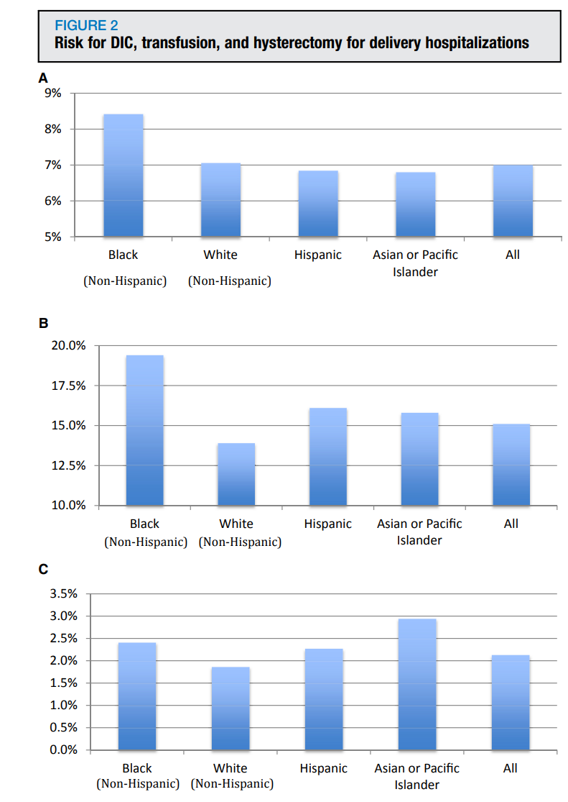
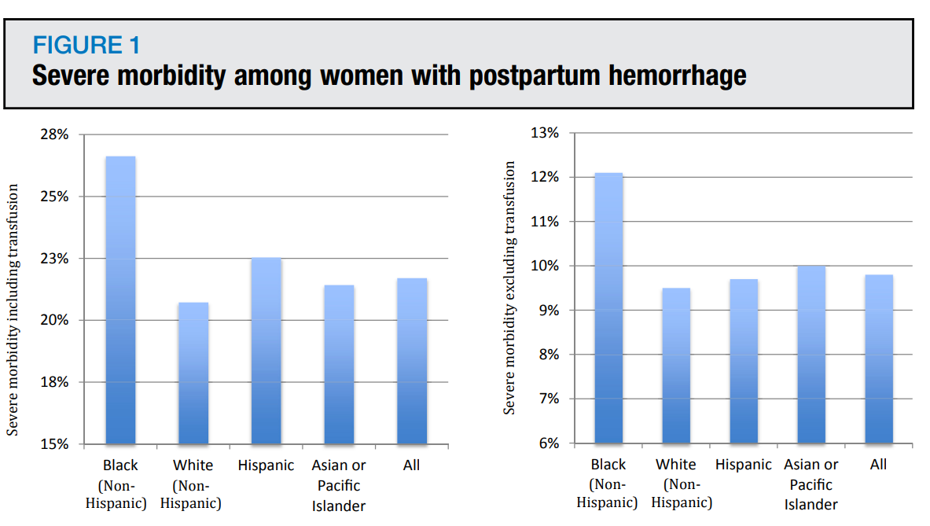
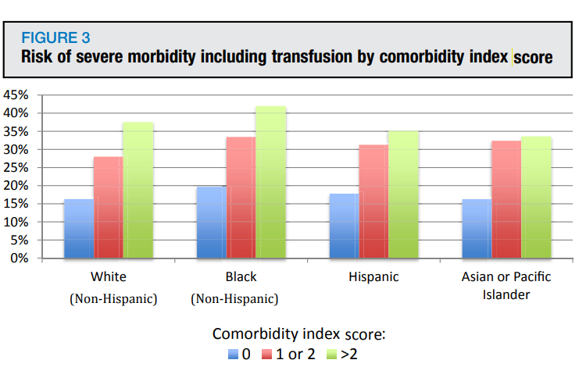
Postpartum Hemorrhage: Outcomes and Race
Gyamfi-Bannerman C, Srinivas SK, Wright JD, et al. Postpartum hemorrhage outcomes and race. Am J Obstet Gynecol 2018;219:185.e1-10.
Notes:
Figure 1: The figure demonstrates the risk for severe morbidity with and without transfusion by race based on CDC criteria for delivery hospitalizations complicated by postpartum hemorrhage in the Nationwide Inpatient Sample from 2012 to 2014. Black women were significantly more likely than white women to experience severe morbidity with and without transfusion (P < .01). Hispanic women, regardless of race, are categorized as Hispanic ethnicity; white and black categories include only non-Hispanic women.
Figure 2: A, B, and C demonstrate the risk for DIC, transfusion, and hysterectomy for delivery hospitalizations complicated by postpartum hemorrhage in the Nationwide Inpatient Sample from 2012 to 2014. Black women were significantly more likely than white women to experience each of these conditions (P < .01). Hispanic women, regardless of race, are categorized as Hispanic ethnicity; white and black categories include only non-Hispanic women.
Figure 3: risk for severe morbidity by comorbidity index score by race. Women with higher comorbidity scores were at increased risk for morbidity in the setting of postpartum hemorrhage. NonHispanic black women had a significantly higher risk for severe morbidity than non-Hispanic white women across comorbidity index score.
5X higher risk for death
Risk for severe morbidity was significantly higher among non-Hispanic black women (26.6%) than nonHispanic white, Hispanic, or Asian or Pacific Islander women (20.7%, 22.5%, and 21.4%, respectively, P < .01). For non-Hispanic black compared with non-Hispanic white, Hispanic, and Asian or Pacific Islander women risk was higher for disseminated intravascular coagulation (8.4% vs 7.1%, 6.8%, and 6.8%, respectively, P < .01) and transfusion (19.4% vs 13.9%, 16.1%, and 15.8%, respectively, P < .01). Black women were also more likely than non-Hispanic white women to undergo hysterectomy (2.4% vs 1.9%, P < .01), although Asian or Pacific Islander women were at highest risk (2.9%). Adjusting for comorbidity, black women remained at higher risk for severe morbidity (P < .01). Risk for death for non-Hispanic black women was significantly higher than for nonblack women (121.8 per 100,000 deliveries, 95% confidence interval, 94.7e156.8 vs 24.1 per 100,000 deliveries, 95% confidence interval, 19.2e30.2, respectively, P < .01)

Slide 8
Maternal Health Disparities
Black women 3-4 times more likely to die from pregnancy-related causes and have more than twofold greater risk of severe maternal morbidity than White women
Black-White maternal mortality disparity is largest among all conventional perinatal health disparities
Most mortality preventable, especially in Black women
Notes:
Health Disparities: differences between the health of one population and another in measures of who gets disease, who dies from disease, and other adverse health conditions that exist among specific population groups in the US
Health Equity: The opportunity for everyone to attain his or her full health potential. No one is disadvantaged from achieving this potential because of his or her social position (e.g., class, socioeconomic status) or socially assigned circumstance (e.g., race, gender, ethnicity, religion, sexual orientation, geography).
Black women are 3-4 times more likely to die a pregnancy related death compared to White women. This is the largest racial disparity in outcomes among all conventional population perinatal health measures. Black women are more likely to have a preventable death

Slide 9
What is a Root Cause(s) Analysis?
A structured method used to analyze serious adverse events
A process for identifying the basic or causal factors that underlie variation in performance
Focuses primarily on systems and processes, not individual performance
There may be multiple root causes of a problem; different people who see different parts of the system may answer the questions differently
Notes:
RCA: used for Sentinel events as defined by Joint Commission, All serious safety events at TCH

Slide 10

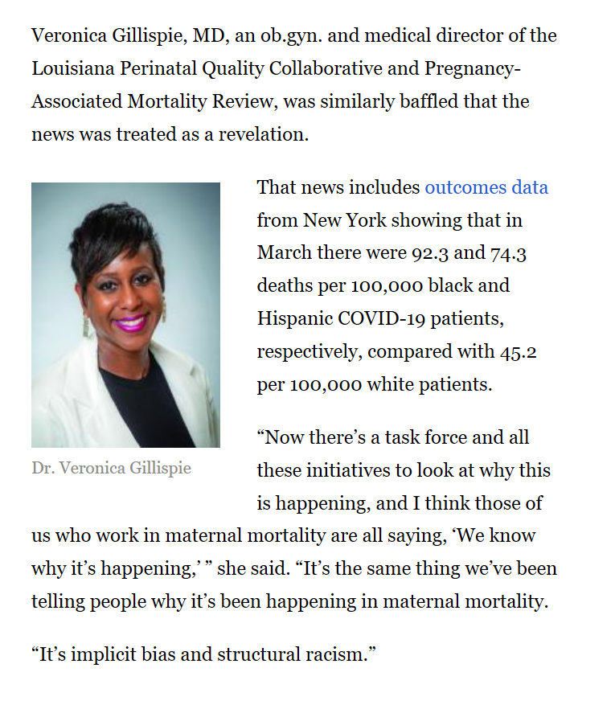
The disparities seen over the past year were not a result of COVID-19. Instead, the pandemic illuminated inequities that have existed for generations and revealed for all of America a known, but often unaddressed, epidemic impacting public health: racism.
- Dr. Rochelle Walensky, CDC Director
Notes:
https://www.mdedge.com/obgyn/article/221705/obstetrics/american-maternal-mortality-crisis-role-racism-and-bias

Slide 11
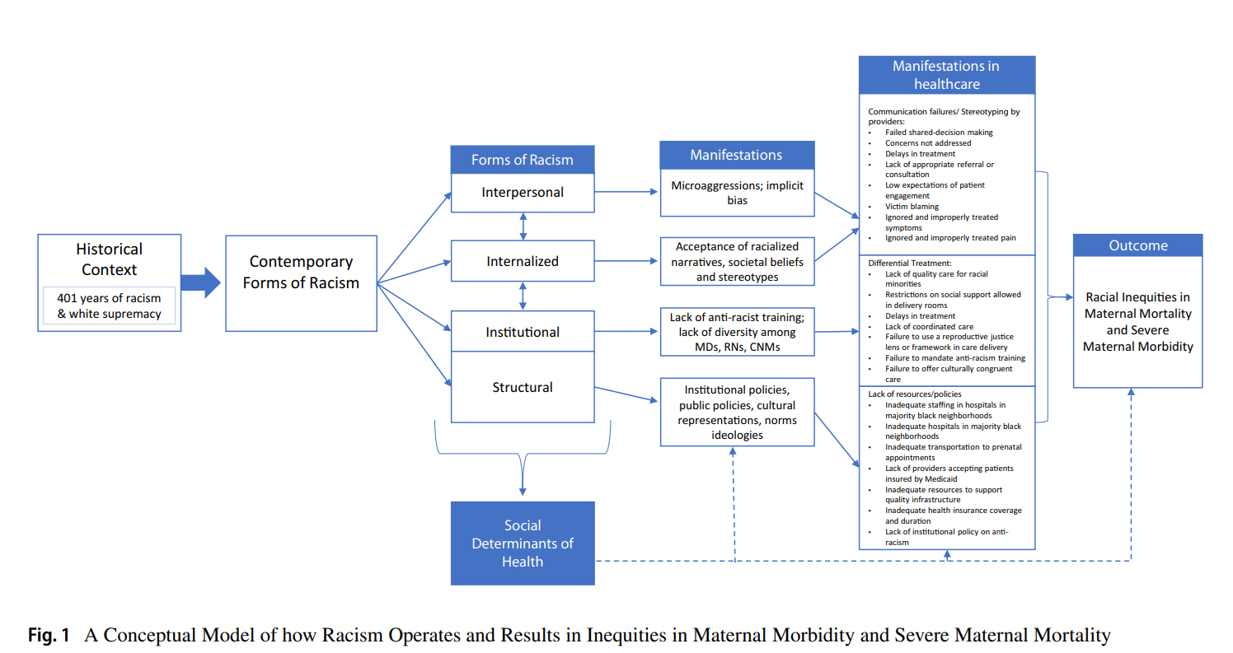
“Race Is Not a Risk Factor, Racism Is.”
Joia Crear-Perry, MD Founder and President of National Birth Equity Collaborative
Hardeman R, et al. Developing Tools to Report Racism in Maternal Health for the CDC Maternal Mortality Review Information Application (MMRIA). Child Health J . 2022 Apr;26(4):661-669.
Notes:
Our conceptual model depicts the complex ways in which racism creates racial inequities in maternal mortality and morbidity. In the model we depict how the historical context of racism in the U.S. precipitated contemporary forms of racism that can be described as interpersonal, internal, institutional, and structural. These forms of racism do not operate in isolation; they are interconnected and feed of one another. The authors include a box to illustrate how structural racism is situated as the root cause of the social determinants of health. Structural racism has manifested in the social determinants of health through the historical impact of legalized racial residential and healthcare segregation, which led to underdeveloped neighborhoods with food deserts that still struggle economically today and hospitals and clinics once reserved for minority families that remained under-resourced
These forms of racism manifest in many ways; the model offers some examples. Interpersonal racism often reveals itself as microaggressions and implicit racial bias (unconscious or automatic bias). Internalized racism often results in those who are oppressed accepting or embodying a negative stereotype about their racial group.

Slide 12
Corrective Action Plan
Using Quality Improvement to Eliminate Preventable Maternal Morbidity and Mortality and Achieve Health Equity

Slide 13


System Factors

Slide 14
Improving Delivery and Hospital Care
Most important factor in preventable morbidity and mortality: improved quality of care
  Safety bundles
  Protocols
  Checklists
  Triggers (such as maternal early warning criteria)
  Simulation trainings
  Team/staff training
  Care coordination
  Promotion of a safety culture
Quality initiatives aimed at standardizing delivery care → improved care at all hospitals
Howell, E et al. Clin Obstet Gynecol. 2018 Jun;61(2):387-399
Notes:
A significant proportion of severe maternal morbidity and mortality events are preventable. Provider factors such as inappropriate or delay in diagnosis or treatment and system factors such as communication failures and policies/procedures not in place or not followed are common preventability factors. Preventability of these events may be higher among black than white women. In a study of maternal deaths, 46% of black and 33% of white maternal deaths were considered potentially preventable. Improved quality of care is often considered the most important factor in preventing these events.
A number of quality initiatives aimed at standardizing delivery care will likely improve care at all hospitals and especially the lowest performing hospitals, which serve a disproportionate number of racial and ethnic minority women. The implementation of safety bundles (e.g. hemorrhage, venous thrombolic disease, hypertension) are important steps to improving care to women at all hospitals. Protocols, checklists, triggers (such as maternal early warning criteria), simulation trainings, the provision of coordinated care and crew resource management, team training, staff training, credentialing, and the promotion of a safety culture have all been recommended in recent reviews.

Slide 15
TexasAIM
Texas Department of State Health Services (DSHS) launched statewide initiative in 2018 to implement AIM Obstetric Hemorrhage patient safety bundle
Goal: reduce SMM from hemorrhage by 25% by January 1, 2020
Obstetric Hemorrhage AIM Patient Safety Bundle | AIM Program (Previously Council on Patient Safety) (safehealthcareforeverywoman.org)
Notes:
The Alliance for Innovation on Maternal Health (AIM) is a national data-driven maternal safety and quality improvement initiative. Based on proven safety and quality implementation strategies, AIM works to reduce preventable maternal mortality and severe morbidity across the United States. AIM works through state and community-based teams to align national, state, and hospital level quality improvement efforts to improve overall maternal health outcomes.

Slide 16

Texas Children’s Hospital Pavilion for Women
Level IV Maternal and Neonatal hospital located in Texas Medical Center
~6500 deliveries/year
24/7 coverage by Ob/Gyn Hospitalists, Critical Care Medicine, and BCM Residents
Patient demographics:
  38% Hispanic
  34% Non-Hispanic White
  20% Non-Hispanic Black
  7% Asian
  1% Other
  40% Medicaid
  10% non-English preferred language

Slide 17
Texas Children’s Pavilion for Women Quality Improvement Initiative
Ob Hemorrhage bundle gap analysis
Formation of Hemorrhage Committee and workgroups
Hospital quality data converted to SMM

Slide 18
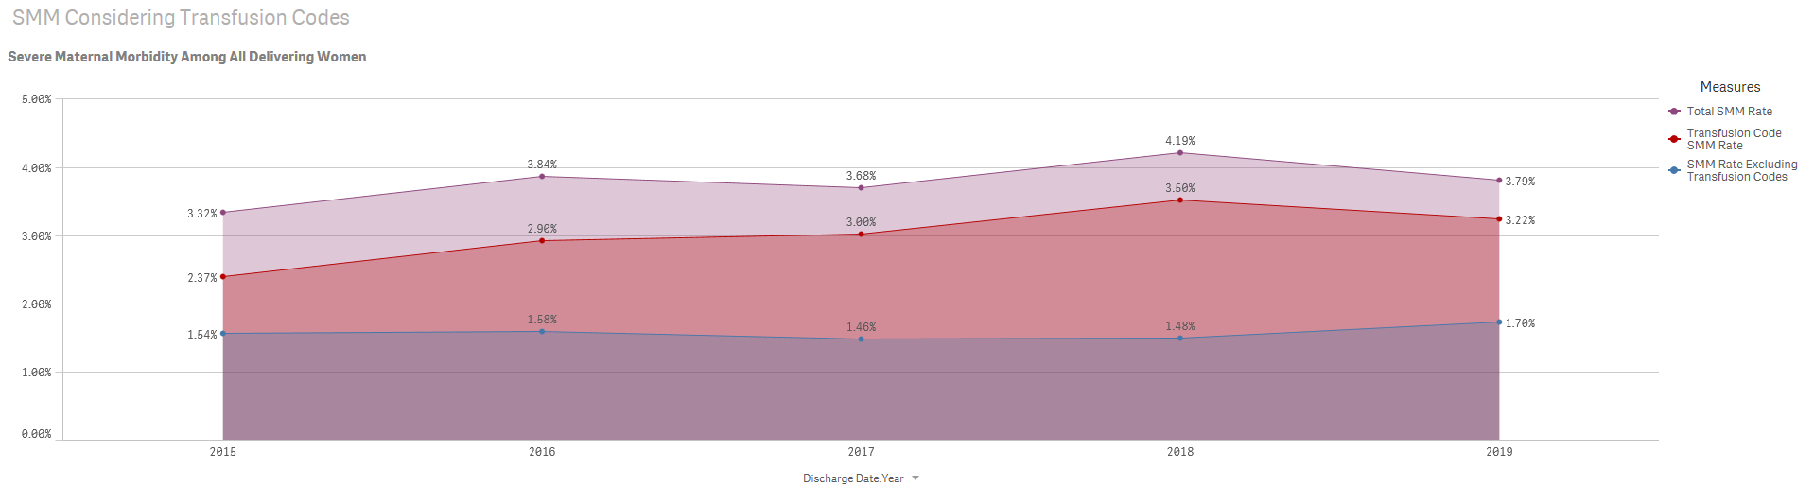
Data Presented at Texas Children’s Pavilion for Women Department Meeting: January 2019
SMM Rates October 2015 – January 2019

Slide 19


Patient Safety Bundles - Improving Maternal Health | Council on Patient Safety (safehealthcareforeverywoman.org)

Slide 20
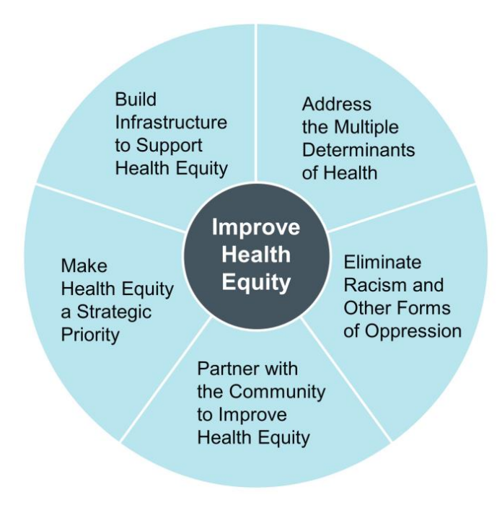
Institute for Healthcare Improvement’s Health Equity Framework
Strategy 1: Create the Data Infrastructure to Improve Health Equity
Strategy 2: Display and Use Stratified Data
Improving Health Equity: Build Infrastructure to Support Health Equity. Guidance for Health Care
Organizations. Boston, Massachusetts: Institute for Healthcare Improvement; 2019. (Available at www.ihi.org)
Notes:
There are 5 core elements to the IHI’s Health Equity Framework
The IHI also has the Improving Health Equity Assessment tool available on their website; that tool helps hospitals evaluate their current health equity efforts to identify areas for improvement. It is to be completed by senior leadership responsible for health equity within the organization. They each complete it individually and then meet to compare and discuss. The leadership can then identify goals and incorporate them into the strategic plan for the organization. Each department then aligns their goals with the organization’s strategic plan.
Make Health Equity a Strategic Priority
Organizational leaders commit to improving health equity by including equity in the organization’s strategy and goals. Equity is viewed as mission critical — that is, the mission, vision, and business cannot thrive without a focus on equity.
• Build Infrastructure to Support Health Equity
Operationalizing a health equity strategy requires dedicated resources, including human resources and data resources, as well as an organizational infrastructure.
• Address the Multiple Determinants of Health
Health care organizations must develop strategies to address the multiple determinants of health, including health care services, organizational policies, the organization’s physical environment, the community’s socioeconomic status, and encouraging healthy behaviors.
• Eliminate Racism and Other Forms of Oppression
Health care organizations must look at their systems, practices, and policies to assess where inequities are produced and where equity can be proactively created.
• Partner with the Community to Improve Health Equity
To support communities to reach their full health potential, health care organizations must work in partnership with community members and community-based organizations that are highly engaged with community members

Slide 21

Race, Ethnicity & Language
REaL Data

Slide 22
REaL Data: OMB Standard Categories
Ethnicity | Race | Combined Race/Ethnicity
Hispanic or Latino | American Indian or Alaska Native | American Indian or Alaska Native
Not Hispanic or Latino | Asian | Asian
 | Black or African American | Black, not of Hispanic origin
 | Native Hawaiian or Other Pacific Islander | Native Hawaiian or Other Pacific Islander
 | White | White, not of Hispanic origin
Office of Management & Budget (OMB) DIRECTIVE 15: RACE AND ETHNIC STANDARDS FOR FEDERAL STATISTICS AND ADMINISTRATIVE REPORTING (cdc.gov)
Notes:
The OMB developed standardized categories for race and ethnicity and as a result many health care organizations adopted the OMB categories. Additionally, the OMB categories for race and ethnicity are included in all electronic health records. OMB standards also enable individuals to select multiple racial categories. (ref = IHI)
Office of Management and Budget (OMB)
Office of Management and Budget (OMB) Standards | Office of Research on Women's Health (nih.gov)
OMB DIRECTIVE 15: RACE AND ETHNIC STANDARDS FOR FEDERAL STATISTICS AND ADMINISTRATIVE REPORTING (cdc.gov)

Slide 23
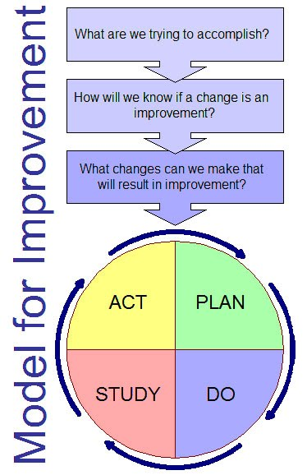
Using Data Stratification to Improve Health Equity
What are we trying to accomplish?
  Provide organizational leaders with strategic measures stratified by race, ethnicity, language to reveal disparities that can be reduced/eliminated to improve care
How will we know that a change is an improvement?
  Stratified data helps organizations identify inequities, inform action, improve overall performance
What change can we make that will result in improvement?
  Identify one strategic measure the organization wants to improve and provide stratified data for that measure to identify opportunities for improvement
IHI Improving Health Equity: Build Infrastructure to Support Health Equity
Notes:
An approach proposed by the IHI is to use REaL data to stratify one strategic measure to build will and interest among leaders and clinicians. Fast deployment of stratified data for one strategic measure versus waiting for development of an entire dashboard allows the organization to learn and understand aspects of equity in practice. This approach supports IHI’s current recommendation that organizations should gain experience in improving equity by first applying an “equity lens” to existing improvement projects aligned with strategic priorities rather than chartering new projects with the specific focus to improve equity.
There are two distinct approaches in using QI to address disparities, both of which emphasize the tailoring of interventions to meet the cultural and linguistic needs of the populations of focus. The difference lies in the use of data in the identification of disparities and monitoring of improvement. One approach, commonly used in research and practice, is to focus on improving care for a population that has historically experienced disparities in care or is an underserved population. With this approach, the use of REAL data to monitor differences among and between groups is not emphasized. Improved equity is determined by assessing if interventions lead to improvements in baseline measures. The second and ideal approach is to use REAL data to demonstrate gaps in care by comparing a quality measure among two (or more) groups. For example, colon cancer screening rates for English speaking patients are compared with screening rates for nonEnglish speakers. Improved equity is evaluated by looking for better quality of care and a decrease in the gap between groups. This approach is impossible to do without high quality REAL data. Using this approach, QI can result in three possible effects on equity. First, it can improve care for both groups but have no effect on the gap. Or, QI can improve quality of care and reduce the gap. Lastly, improvement efforts can widen the gap by improving care for one group while worsening it for the second group. Stratifying quality measures improves accuracy and quality of data and therefore allows more efficient and cost effective use of QI resources. This approach also provides a way to demonstrate which practices result in improved equity and can be spread to other systems and settings. Quality improvement may not benefit all populations equally. Careful measurement is vital to improving equity. Focused analysis of data can help uncover disparities between and within populations. These data should be monitored as improvements © 2012 Center for the Health Professions at the University of California, San Francisco Bringing Equity into Quality Improvement: An Overview of the Field and Opportunities Ahead 13 are made to confirm that the changes resulting in the intended goal of diminishing gaps in the quality of care.(Ref=Bringing Equity into Quality Improvement: An Overview and Opportunities Ahead)
IHI Improving Health Equity: Build Infrastructure to Support Health Equity
http://www.ihi.org/Engage/Initiatives/Pursuing-Equity/Pages/default.aspx

Slide 24
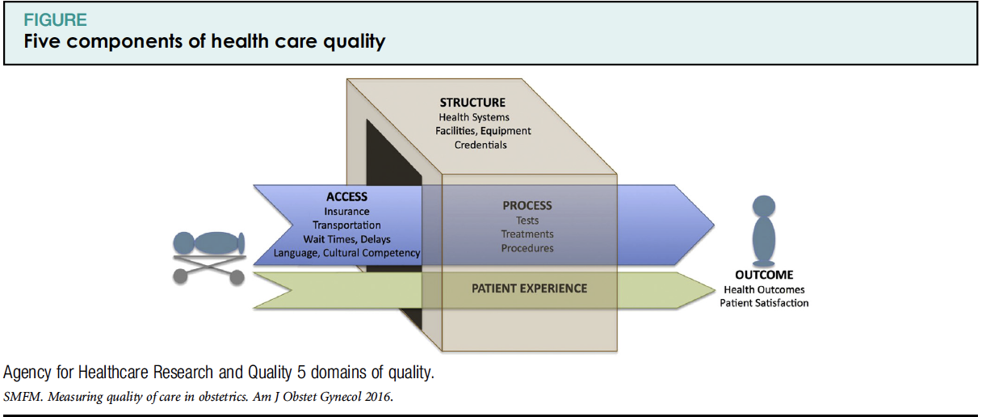
Quality Measures
Notes:
Structure measures: the organization’s infrastructure, capacity, systems, and processes; Used to assess if standardized, evidence-based systems, protocols, and materials have been established to improve patient care
Process measures: the way services are delivered; the activities done to provide care; Used to monitor the adoption and implementation of evidence-based practices
Outcome measures: the overall impact or results of the care provided; used to examine changes that occur in the health of an individual, group of people, or population that can be attributed to the adoption of clinical best practices
Balancing measures: check for unintended outcomes
Structural Measures
Structural measures give consumers a sense of a health care provider’s capacity, systems, and processes to provide high-quality care. For example:
Whether the health care organization uses electronic medical records or medication order entry systems.
The number or proportion of board-certified physicians.
The ratio of providers to patients.
Process Measures
Process measures indicate what a provider does to maintain or improve health, either for healthy people or for those diagnosed with a health care condition. These measures typically reflect generally accepted recommendations for clinical practice. For example:
The percentage of people receiving preventive services (such as mammograms or immunizations).
The percentage of people with diabetes who had their blood sugar tested and controlled.
Process measures can inform consumers about medical care they may expect to receive for a given condition or disease, and can contribute toward improving health outcomes. The majority of health care quality measures used for public reporting are process measures.
Outcome Measures
Outcome measures reflect the impact of the health care service or intervention on the health status of patients. For example:
The percentage of patients who died as a result of surgery (surgical mortality rates).
The rate of surgical complications or hospital-acquired infections.
Outcome measures may seem to represent the “gold standard” in measuring quality, but an outcome is the result of numerous factors, many beyond providers’ contro
AHRQ: Types of Health Care Quality Measures | Agency for Healthcare Research and Quality (ahrq.gov)

Slide 25
Numerator = delivery admissions in Black women with any SMM
Denominator = delivery admissions in Black women

Slide 26
Numerator = delivery admissions in Black women with any SMM
Denominator = delivery admissions in Black women with a hemorrhage diagnosis

Slide 27
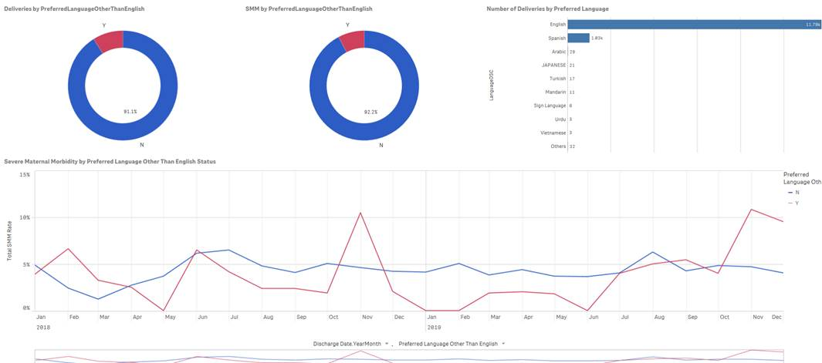
Severe Maternal Morbidity and Preferred Language

Slide 28
Kotter's 8 Step Change Model
Implementing & sustaining for change
0
Step 8
Engaging & enabling the organization
0
Make it stick
Step 7
0
Build on the change
Step 6
0
Create quick wins
Creating the climate for change
Step 5
0
Empower action
Step 4
Step 3
Communicate the vision
Step 2
Create a vision for change
Step 1
Form a powerful coalition
Create urgency

Slide 29
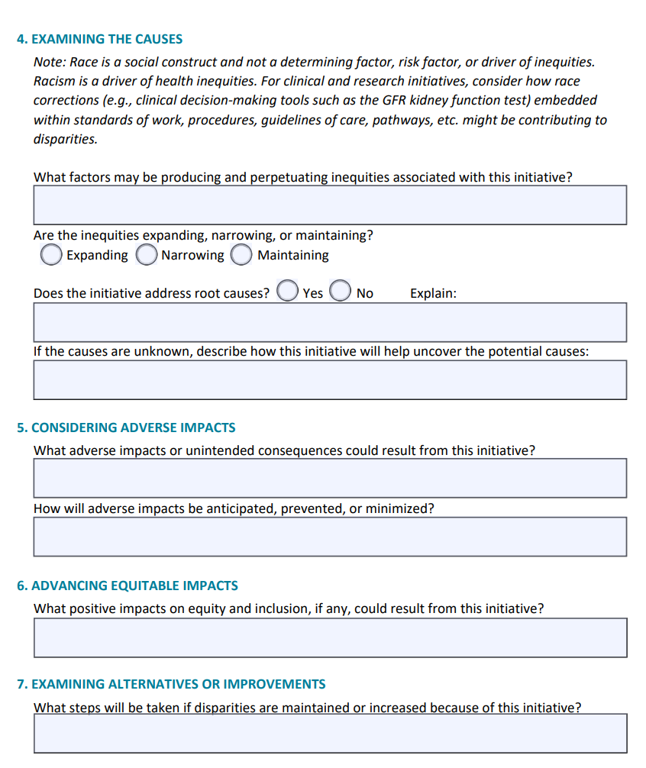
Equity Impact Assessment Tool
lack of preparation & standardized management, dismissal of signs/symptoms, delay in response
Tool to systematically examine how groups will be affected by a proposed action or decision
Used to anticipate, eliminate, and prevent adverse consequences and discrimination/inequities in access and care
Best conducted during decision-making process, prior to enacting new proposals, programs, or policies; used to inform decisions
https://www.seattlechildrens.org/clinics/diversity-health-equity

Slide 30
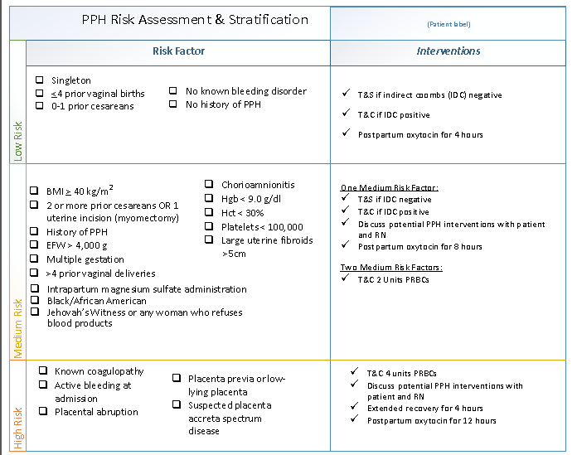
due to health disparities from unconscious bias
does not accept blood products
Notes:
Readiness – every unit
Is your team ready for an emergency?
Recognition – every patient
How does your team recognize patients at risk or experiencing deterioration?
Response – every emergency
What is your team’s response to an emergency?
Reporting – every unit
How does your team improve and learn?

Slide 31
Davidson C, et al. Examining the effect of quality improvement initiatives on decreasing racial disparities in maternal morbidity. BMJ Qual Saf. 2022 Apr 15

Slide 32
Severe Maternal Morbidity from Hemorrhage (SMM-H) Rate decreased from 45.5% during the Pre-Intervention Phase to 31.6% during the Post-Intervention Phase (p=.011)
Davidson C, et al. Examining the effect of quality improvement initiatives on decreasing racial disparities in maternal morbidity. BMJ Qual Saf. 2022 Apr 15

Slide 33
Severe Maternal Morbidity from Hemorrhage Rate (%)
Davidson C, et al. Examining the effect of quality improvement initiatives on decreasing racial disparities in maternal morbidity. BMJ Qual Saf. 2022 Apr 15

Slide 34
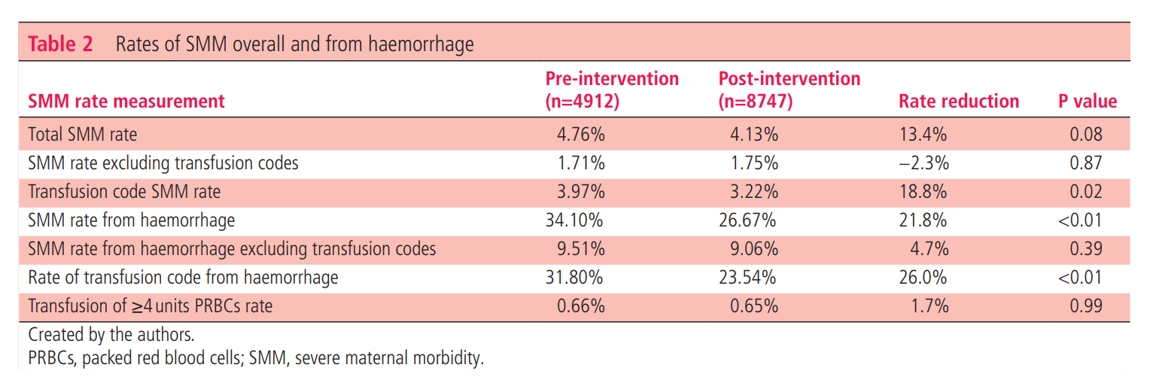
Davidson C, et al. Examining the effect of quality improvement initiatives on decreasing racial disparities in maternal morbidity. BMJ Qual Saf. 2022 Apr 15

Slide 35

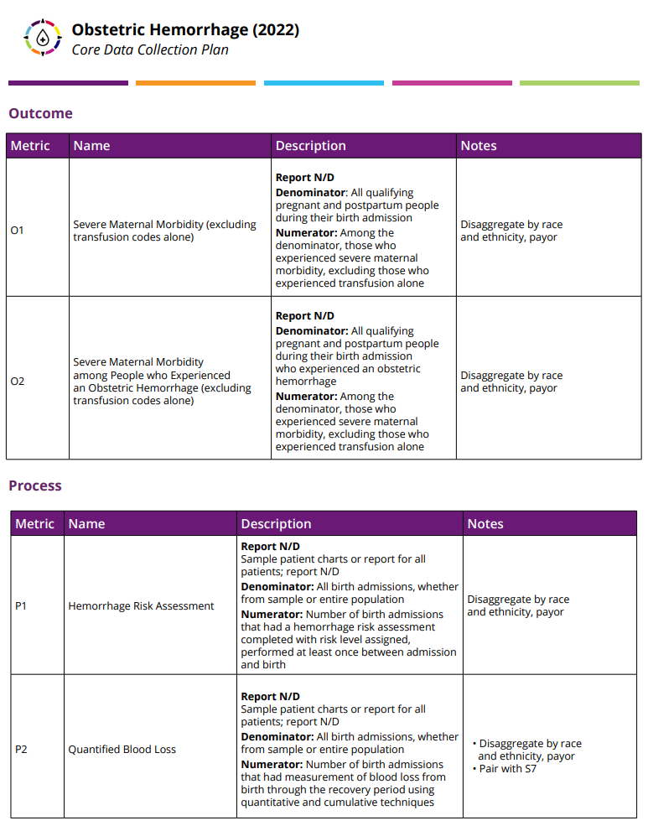

https://saferbirth.org/psbs/obstetric-hemorrhage/

Slide 36
US News and World Report: NTSV Cesarean Births
Survey Question (CY2020 Data) | Total | White | Black | American Indian or Alaska Native | Asian or Pacific Islander | Hispanic | Other | Unknown
A4 (Numerator) NTSV C-sections performed with eligible patients | 639 | 179 | 158 | 2 | 67 | 227 | 3 | 3
A3 (Denominator) NTSV C-section eligible patients | 2241 | 728 | 453 | 2 | 184 | 853 | 14 | 7
Rate % | 28.51% | 24.59% | 34.88% | 100% | 36.41% | 26.61% | 21.43% | 42.86%
Notes:
National Vital Statistics System - Natality (NVSS-N), CDC/NCHS
January 2022 Feedback to US News:
With respect to complications in Cesarean births, the survey relies on the Joint Commission definition for NTSV. However, the Society for Maternal Fetal Medicine (SMFM) has developed a new definition for low risk cesarean delivery rate which excludes patients with a prior cesarean and excludes additional clinically relevant risk factors. This metric more accurately reflects what is low risk and gives a more clinically accurate definition. Some hospitals may not be able to safely reduce their NTSV rate using the Joint Commission definition if they are performing cesareans for indications such as HIV with a high viral load, prior history of myomectomy, umbilical cord prolapse during labor, or placenta previa in the index pregnancy. While these are all acceptable medical indications to perform a primary cesarean delivery, they would be part of the numerator in the Joint Commission definition but excluded from the SMFM definition. See “Comparing variation in hospital rates of cesarean delivery among low-risk women using 3 different measures” (article attached to feedback email).

Slide 37
SMARTIE Objective/Aim
Specific: Does this objective state the outcome that you aim to accomplish? Among what population, by when, and by how much?
Measurable: How will you track your progress and know when milestones have been reached and the objective achieved?
Attainable/Achievable: Is the objective challenging but achievable within the capabilities of your program and the priority population(s) being served? Do you have enough resources?
Relevant: Is the objective aligned with the priorities of your program? Is it meaningful to the priority population(s)?
Time-Based: Is there a deadline to achieve the objective? Are there review points to assess progress?
Inclusive: Have you invited, considered, and incorporated input from the priority population(s) and your community partners where appropriate?
Equitable: Does the objective address the unique needs and circumstances of your priority population(s) and seek to address condition-specific disparities?

Slide 38
Achieving Health Equity through Quality Improvement
What are we trying to accomplish?
  Reduce the rate of non-medically indicated NTSV cesarean deliveries and the Black/White and Asian/White disparity
How will we know that a change is an improvement?
  Monitor NTSV rates, overall and stratified by race and ethnicity
  Monitor indications for NTSV cesareans, overall and stratified by race and ethnicity
What change can we make that will result in improvement?
  Implement labor dystocia checklist
  Track evidence-based indications for cesarean delivery, overall and by race and ethnicity
  Engage the Patient Advisory Council
  Share data with department
IHI Improving Health Equity: Build Infrastructure to Support Health Equity
Notes:
An approach proposed by the IHI is to use REaL data to stratify one strategic measure to build will and interest among leaders and clinicians. Fast deployment of stratified data for one strategic measure versus waiting for development of an entire dashboard allows the organization to learn and understand aspects of equity in practice. This approach supports IHI’s current recommendation that organizations should gain experience in improving equity by first applying an “equity lens” to existing improvement projects aligned with strategic priorities rather than chartering new projects with the specific focus to improve equity.
There are two distinct approaches in using QI to address disparities, both of which emphasize the tailoring of interventions to meet the cultural and linguistic needs of the populations of focus. The difference lies in the use of data in the identification of disparities and monitoring of improvement. One approach, commonly used in research and practice, is to focus on improving care for a population that has historically experienced disparities in care or is an underserved population. With this approach, the use of REAL data to monitor differences among and between groups is not emphasized. Improved equity is determined by assessing if interventions lead to improvements in baseline measures. The second and ideal approach is to use REAL data to demonstrate gaps in care by comparing a quality measure among two (or more) groups. For example, colon cancer screening rates for English speaking patients are compared with screening rates for nonEnglish speakers. Improved equity is evaluated by looking for better quality of care and a decrease in the gap between groups. This approach is impossible to do without high quality REAL data. Using this approach, QI can result in three possible effects on equity. First, it can improve care for both groups but have no effect on the gap. Or, QI can improve quality of care and reduce the gap. Lastly, improvement efforts can widen the gap by improving care for one group while worsening it for the second group. Stratifying quality measures improves accuracy and quality of data and therefore allows more efficient and cost effective use of QI resources. This approach also provides a way to demonstrate which practices result in improved equity and can be spread to other systems and settings. Quality improvement may not benefit all populations equally. Careful measurement is vital to improving equity. Focused analysis of data can help uncover disparities between and within populations. These data should be monitored as improvements © 2012 Center for the Health Professions at the University of California, San Francisco Bringing Equity into Quality Improvement: An Overview of the Field and Opportunities Ahead 13 are made to confirm that the changes resulting in the intended goal of diminishing gaps in the quality of care.(Ref=Bringing Equity into Quality Improvement: An Overview and Opportunities Ahead)
IHI Improving Health Equity: Build Infrastructure to Support Health Equity
http://www.ihi.org/Engage/Initiatives/Pursuing-Equity/Pages/default.aspx

Slide 39

Applying a Health Equity Lens to Quality Case Reviews

Slide 40

https://saferbirth.org

Slide 41


Standardized Case Review
Notes:
Determine which factors, if any, could have altered outcome
The goal is not to place blame on an individual, but to use the findings to assist in identification of quality of care or systems issues and practice improvement opportunities

Slide 42
Case Reviews: Opportunities for Improvement
 | Problem | Solution
Blood Pressure Cuffs | Delays in patients obtaining BP cuff after discharge Not covered by some insurance, cost can be access barrier DME vendor at hospital did not offer BP cuffs | Partnership with hospital Care Coordination Added BP cuff to hospital DME vendor list Charity opportunity
Postpartum discharge with new anti-hypertensive medication(s) | Meds not immediately available at local pharmacy→ readmission for worsening HTN | Partnered with pharmacy and educated providers and nurses on use of on-site pharmacy for discharge prescriptions (pick-up prior to discharge)

Slide 43
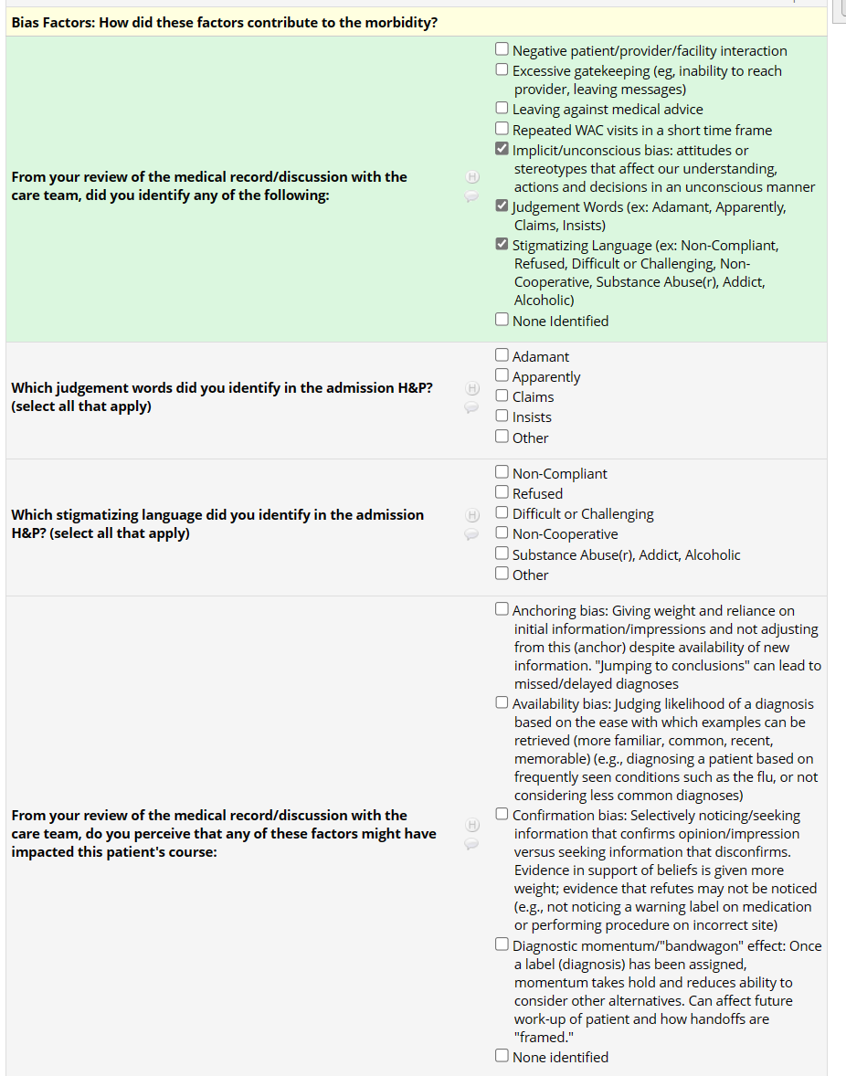
Cognitive and Linguistic Bias in Case Reviews
References
Quick Safety 28: Cognitive biases in health care, The Joint Commission: https://www.jointcommission.org/resources/news-and-multimedia/newsletters/newsletters/quick-safety/quick-safety-28/cognitive-biases-in-health-care/#.Y9FnacnMLtU (accessed 1/25/23)
Beach MC, et al. Testimonial Injustice: Linguistic Bias in the Medical Records of Black Patients and Women. J Gen Intern Med. 2021 Jun;36(6):1708-1714.
P Goddu A, et al. Do Words Matter? Stigmatizing Language and the Transmission of Bias in the Medical Record. J Gen Intern Med. 2018 May;33(5):685-691.
Himmelstein G, et al. Examination of Stigmatizing Language in the Electronic Health Record. JAMA Netw Open. 2022 Jan 4;5(1):e2144967.
Enhancing Reviews and Surveillance to Eliminate Maternal Mortality (ERASE MM): https://www.cdc.gov/reproductivehealth/maternal-mortality/erase-mm/index.html (accessed 1/25/23)

Slide 44
Case Review #1
Ms. A is a 20 y/o G2 P0010 at 37w4d who presented for fever.
  Patient triggered MEWS for maternal tachycardia (125-150) and temperature of 101.1 F
  Per provider note, “Tachycardia appears secondary to anxiety or just is reflective of her baseline.”
  Urine culture positive for E. Coli
  Patient admitted for suspected pyelonephritis and started on antibiotics → required transfer to ICU with severe sepsis with metabolic acidosis

Slide 45

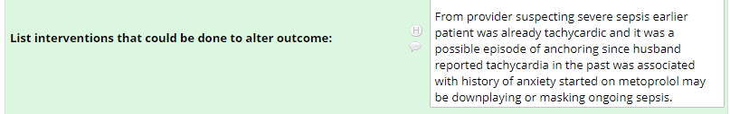




Anchoring Bias identified:
Tachycardia explanation was attributed to anxiety rather than sepsis

Slide 46
Case Review #2
Ms. D is a 41 y/o G5 P3114 at 34w0d with CHTN who presented with worsening dyspnea and chest pain and BPs 200s/100s.
Work-up significant for elevated troponin and BNP, echocardiogram with pericardial effusion and concern for cardiomyopathy
Diagnosed with superimposed pre-E with severe features → underwent uncomplicated SVD at 34w2d and was transferred to ICU postpartum
Postpartum course complicated by pulmonary edema and severe HTN requiring escalating doses of Lasix and antihypertensive medication
On PPD5, patient had signs and symptoms concerning for stroke and was transferred to OSH after stabilization by Neurology and Critical Care Medicine
Notes:
963919714

Slide 47
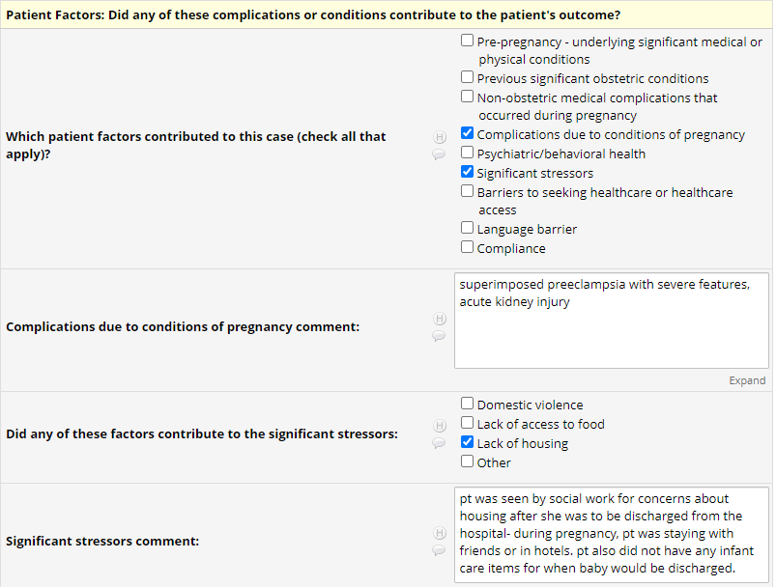

Slide 48
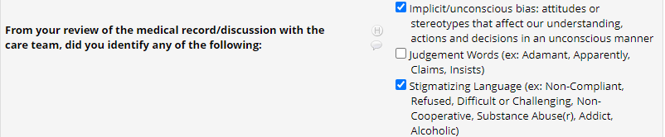
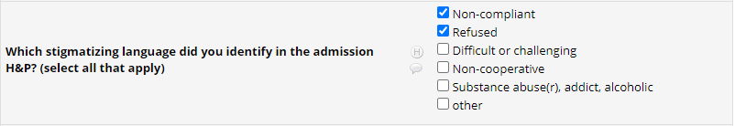
Stigmatizing language noted throughout chart (Non-complaint, Refused)
“Refusing blood work”
“Refusing weights”
“Refusing medications”
“Refusing BIPAP”
“Non-compliance with lactation plan”
“Non-compliance with medications”

Slide 49
What word should I use instead?
A patient with substance use and mental health disorders was presented at L&D board sign-out and was described as “uncooperative” with vaginal exams.
  Presenting resident: patient presented with leakage of fluid and resident unable to perform adequate SSE because patient would move away from speculum upon insertion
  Another resident: provided additional history that patient has history of sexual abuse
  Team:
    Agreed it would be better to describe patient as having poor tolerance to vaginal exams, possibly secondary to her history of sexual abuse, as opposed to labeling her uncooperative
    Acknowledged that describing patient as “uncooperative” could lead to bias in how we interact with her and the care we provide vs. seeking to understand the clinically relevant history that may have led to the behavior, which could result in more compassionate and trauma-informed care
Notes:
I asked in what way the patient was being “uncooperative:”
I found it to be a great teaching/learning opportunity and I hope this helps illustrate what I am hoping we accomplish by having more awareness and education around how the language we use to describe patients (verbally and in the EMR) can make a difference.

Slide 50
Achieving Health Equity: Key Points
Stratify quality measures by REaL and implement disparities dashboard
Ensure optimal use of translation services, including printed material
Standardize clinical management
Performed enhanced reviews of adverse events
Approach every quality improvement effort with a health equity lens
Address implicit and cognitive bias and ensure delivery of respectful care

Slide 51
THANK YOU cmdavids@bcm.edu

