Slide 1
Illinois Perinatal Quality Collaborative
11th Annual Conference
Thursday, November 2nd, 2023
Notes:
Change photo to mom with baby

Slide 2
What can I do tomorrow?
Take a few minutes to reflect on today's sessions, poster session, & breakout sessions.
Write down 1 thing that you are going to
do to work towards an ILPQC initiative
goal tomorrow/next week.​

Slide 3
Thank You to our Speakers & Breakout Panelists!
Charity S. Bean, CMA, CFSD, CLC, CBA, CHW, SRN
Christina Davidson, MD
Sunah Susan Hwang, MD, MPH, PhD
Brenda Barker, M Ed, MBA
Kylie Hibshman, LCSW, PMH-C
Sydnie Carraher, DNP, APRN-NP, NNP-BC
Nancy Maruyama, RN, BSN, NCBF
Kakuna Smith
Bekah Bischoff
Tamela Milan-Alexander, MPPA

Slide 4
Thank You Planning Committee!!!
Thank you to the 2023 Annual Conference Planning Committee!
Daniell Ashford, DNP, MBA, NE-BC, RNC-OB, C-EFM, C-ONQS, FNP-BC, LNC
Keri Benbrook, BSN, RN, RNC-NIC, CBC, CPN
Felicitas Cacal, DNP, MSN, RN, CNML, RNC-OB, C-EFM
Ana Flores, RNC-OB, MSN, CLC
Mary Jarvis, MSN, RN, CLC
Donna Lemmenes, MSN, CPNP, RNC-NIC
Cecilia Lopez, MSN, RN
Autumn Mels, DNP, MSN-Ed, RNC-OB, C-EFM, CNE
Deborah Miller, MPH, BSN, RN, CPHQ
Vivian Moreno, MPH
Shawn O’Connor, MD
Laura Peters, MSN, RN, NE-BC
Myra Sabini, BSN, RNC-OB, C-EFM
Joanne Sorce, MSN, RNC-OB, C-EFM
Tina Stupek, MSN, RNC-OB, C-EFM, C-ONQS
Mara Ulin, MD

Slide 5
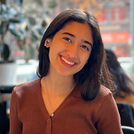
Thank You Planning Committee!!!
Thank you to the 2023 ILPQC
Summer and Fall Interns!
Laiqa Mazhar
Northwestern University Intern
Isabel Gippo
Northwestern University Intern

Slide 6
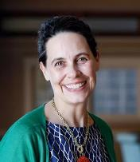
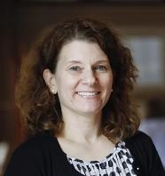
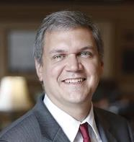
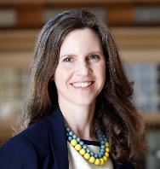
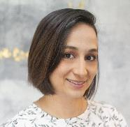
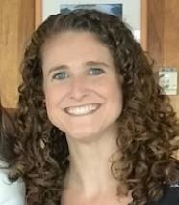
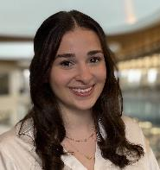
Ann Borders, MD, MSc, MPH: Executive Director, OB Lead
Leslie Caldarelli, MD: Neonatal Co-Lead
Justin Josephsen, MD: Neonatal Co-Lead
Patricia Lee King, PhD, MSW: State Project Director, Quality Lead
Alana Rivera, MSN, RNC-OB, C-EFM, CLC:
Nurse Quality Manager
Ellie Suse, MPH, BSN, RN: Project Manager
Aleena Surenian, MPH : Project Coordinator

Slide 7
2023 Annual Conference Raffle
And the Winner is...

Slide 8
save the date
2024 OB & Neonatal
Face-to-Face Meetings
OB TEAMS:
MAY 22ND, 2024
at the President Abraham Lincoln Doubletree Hotel
in Springfield, IL
Calling ALL Perinatal Leaders, Providers, Nurses, Advocates, & Friends!
NEONATAL
TEAMS:
MAY 23RD, 2024
Join us for an interactive day of collaborative learning with the ILPQC initiative!

